Slide 1
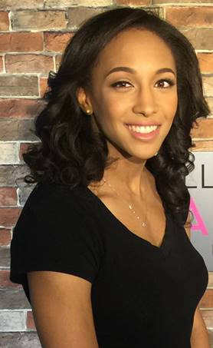
Brooke Russell
In 2014, Brooke began her doctoral research at Yale University under the supervision of Prof. Bonnie Fleming on the MicroBooNE experiment. She came to the Lab in fall of 2016 to work under the tutelage of Xin Qian through a DOE Office of Science Graduate Student Research Award. Since then she has been working with physicists in Brookhaven’s Electronics Detector Group on MicroBooNE physics analyses. Upon receipt of her doctorate, she will go to Lawrence Berkeley National Laboratory to work on 3D pixelated charge readout devices to enable the single phase LArTPC DUNE Near Detector physics program as an Owen Chamberlain Postdoctoral Fellow.

