Slide 1
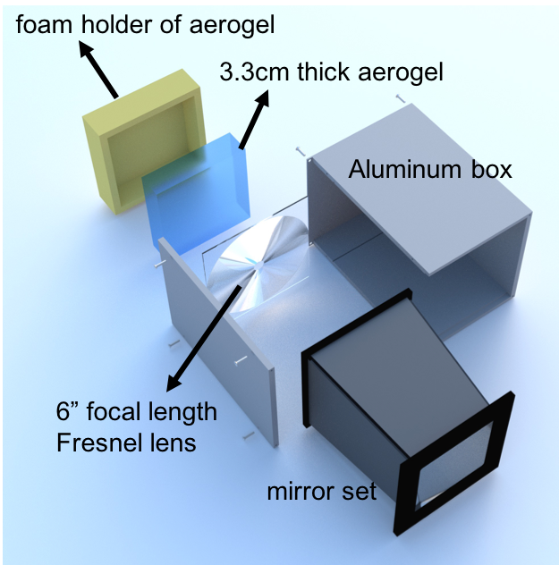
Modular Aerogel RICH (mRICH)
Goal:
Compact PID device with momentum coverage up to 10 GeV/c for π/K and e/π up to 2 GeV/c.
First aerogel RICH with lens-based focusing (for performance and cost).
FY20 Activities:
Data analysis of the second mRICH beam test (ongoing effort).
Study of radiation hardness of Fresnel lens.
Simulation study of mRICH performance in the electron endcap of JLEIC and in the Forward sPHENIX experiments at BNL (ongoing effort).
Organize a joint dRICH/mRICH beam test. Plan for an electron beam (~2 GeV/c) test.
Optical characterization of Fresnel lens and aerogel block properties.

Slide 2
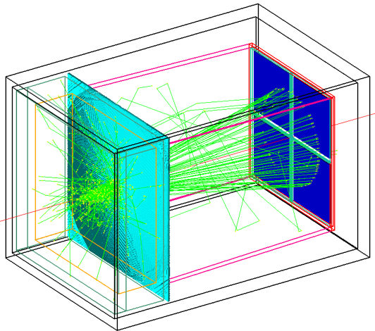
mRICH – lens-based focusing aerogel detector design
Smaller, but thinner ring improves PID performance and reduces length
Fresnel lens
Lens-Based mRICH Design |  | 9GeV/c pion beam launched at the center of xy plane in simulation Smaller and thinner ring image
Two-Layer Proximity Focusing Design (BELLE-2 ARICH) |  | EIC mRICH designed for K/pi ID up to 10 GeV/c BELLE-2 ARICH aims to separate pion and kaon up to 4 GeV/c
Aerogel
Sensor plane
9 GeV/c pion beam launched at the center of xy plane in simulation
Notes:
The modular RICH detector consists of a block of aerogel, Fresnel lens, mirror set and sensor plane.

Slide 3
mRICH – lens-based focusing aerogel detector design
Smaller, but thinner ring improves PID performance and reduces length
Lens-Based mRICH Design |  | 9 GeV/c pion beam launched at the center of xy plane in simulation Smaller and thinner ring image
Two-Layer Proximity Focusing Design (BELLE-2 ARICH) |  | EIC mRICH designed for K/pi ID up to 10 GeV/c BELLE-2 ARICH aims to separate pion and kaon up to 4 GeV/c
9 GeV/c pion beam launched at the center of xy plane in simulation
Notes:
This lens-based design generates smaller and sharper ring image compare to the state of art proximity focusing deisng.

Slide 4
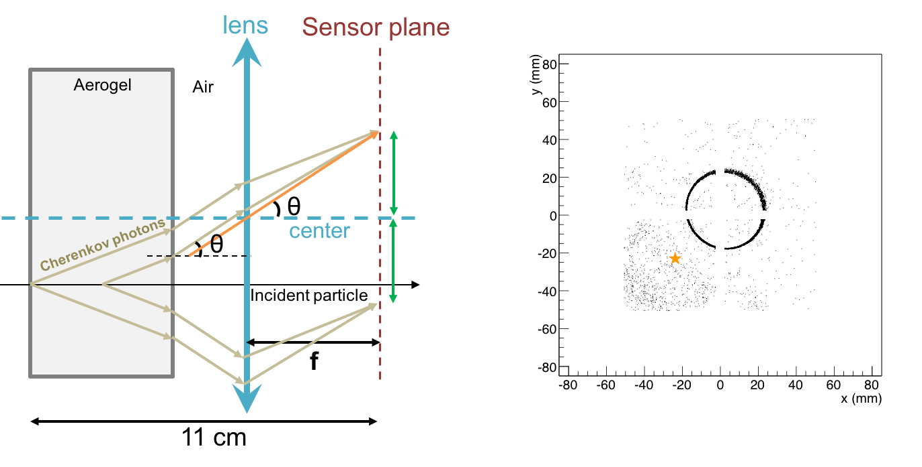
mRICH – lens-based focusing shifts image to center
Ring centering of lens-based optics reduces sensor area (main cost driver)
Lens-Based mRICH Design |  | 9 GeV/c pion beam incident at third quadrant (star) in simulation Ring image is center on the middle of the sensor plane
Two-Layer Proximity Focusing Design (BELLE-2 ARICH) |  | 9 GeV/c pion beam incident at third quadrant (star) in simulation Ring is centered at point of incidence
Notes:
Furthermore, the Cherenkove photons generated at off the optical principle can be shifted to the middle of sensor plane by the lens. These results to less required sensor plane area.

Slide 5
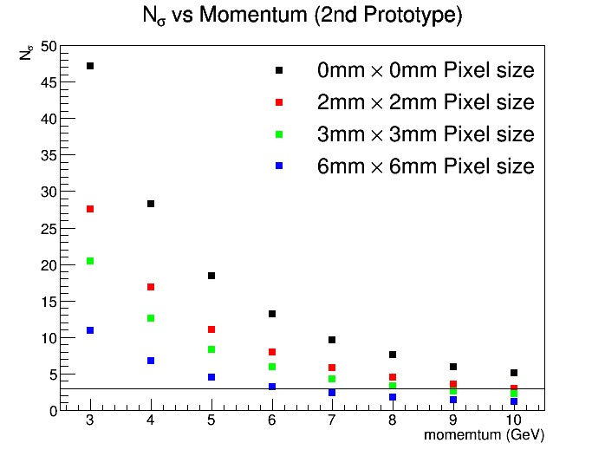
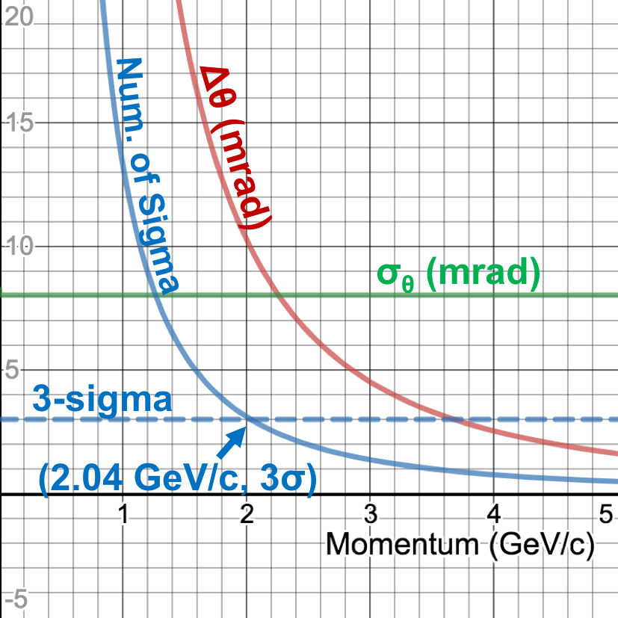
Projected mRICH Performance
Projected K/pi separation of mRICH 2nd prototype detector (Green dots)
2nd prototype detector can achieve 3-sigma K/pi separation up to 8 GeV/c
Projected e/pi separation of mRICH 2nd prototype detector (blue solid line)
2nd prototype detector can achieve 3-sigma e/pi separation up to 2 GeV/c
Data sets taken during the second mRICH beam test at Fermilab in June/July 2018
The major goal of the 2nd mRICH beam test data analysis is to verify the PID performance at 2, 5 and 8 GeV/c

Slide 6
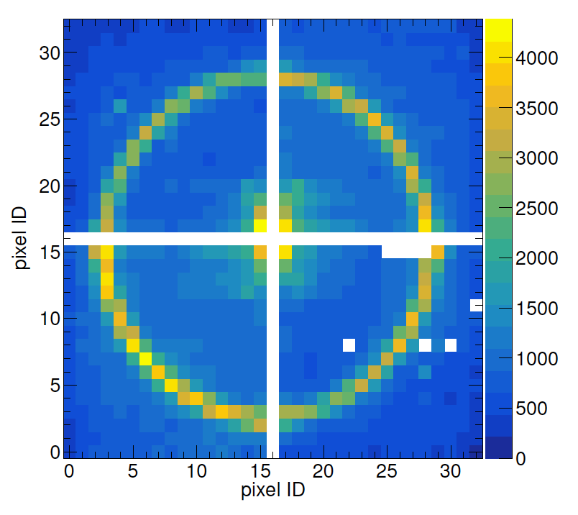
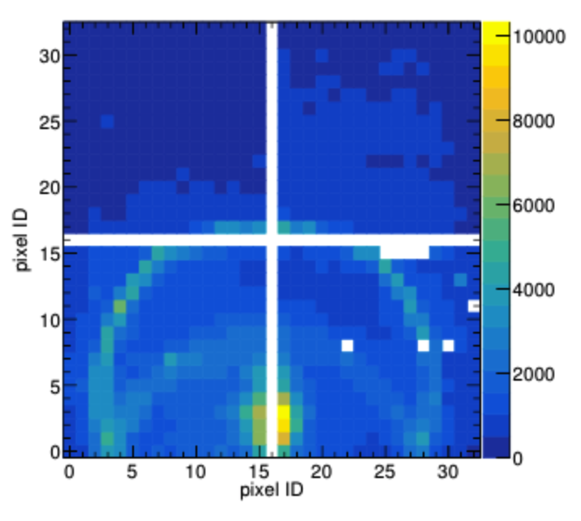
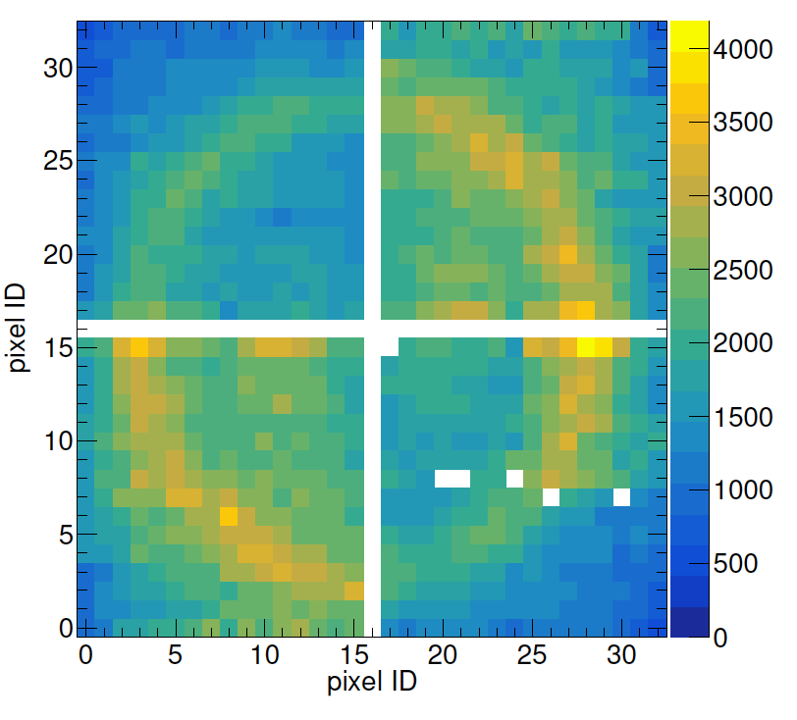
Completed Data QA Analysis for the 2nd Beam Test
Examples of cumulative ring images from the second mRICH prototype beam test
Left: ring images formed by 120-GeV primary proton beam incident on the center of mRICH. White gaps are the PMT frames.
Middle: ring images from 120-GeV primary proton beam incident at an angle of 11° toward the lower section of mRICH.
Right: images from an 8-GeV meson run. The challenge of this analysis is to determine the beam position since the beam hodoscope readout was not ready for this test.
Four Hamamatsu H13700 PMTs (3mm x 3mm pixel size; 16x16 channels) were used in these test runs. Each costs ~$5k. These sensors will NOT work in high magnetic field!!!

Slide 7
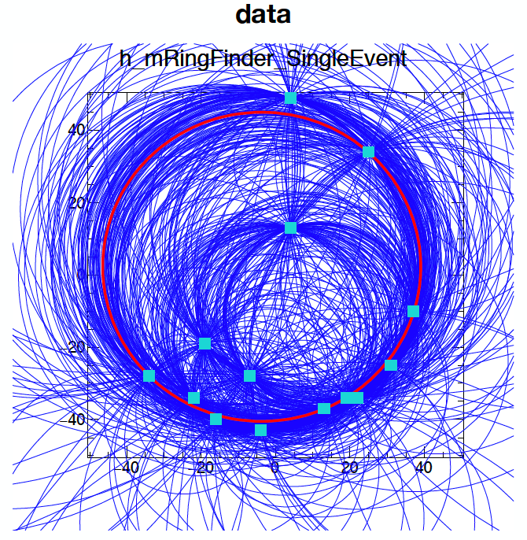
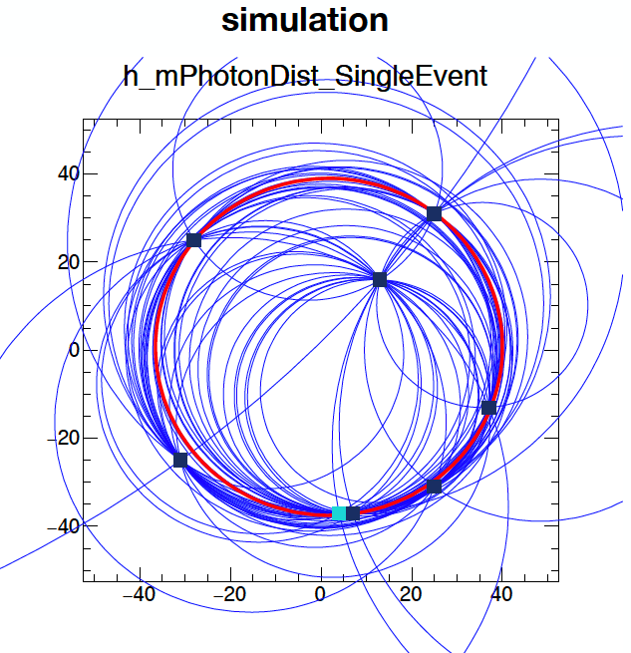
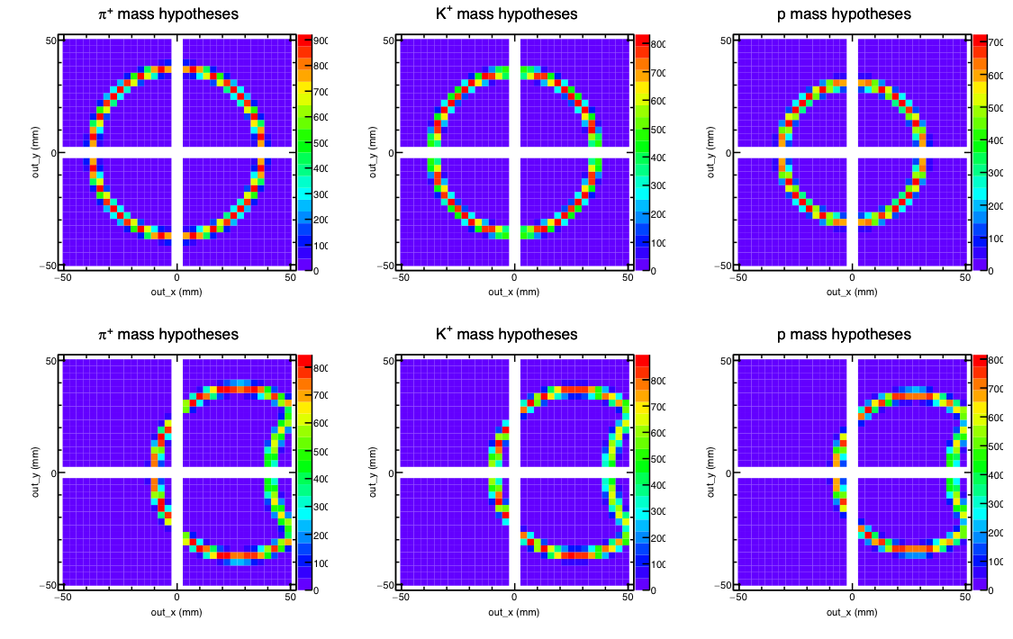
Ring Finding Algorithm Development
1. Perfect circle image exists only when beam hit at the center. Used Hough transformation to find the ring image and provided the baseline for consistency checks on GEANT4 simulation and analytical results.
2. For other ring image forms (i.e., particles entering at off-center positions and angles), one needs to use log-likelihood method for determining ring image formation. Extensive simulation is required for generating image template database.

Slide 8
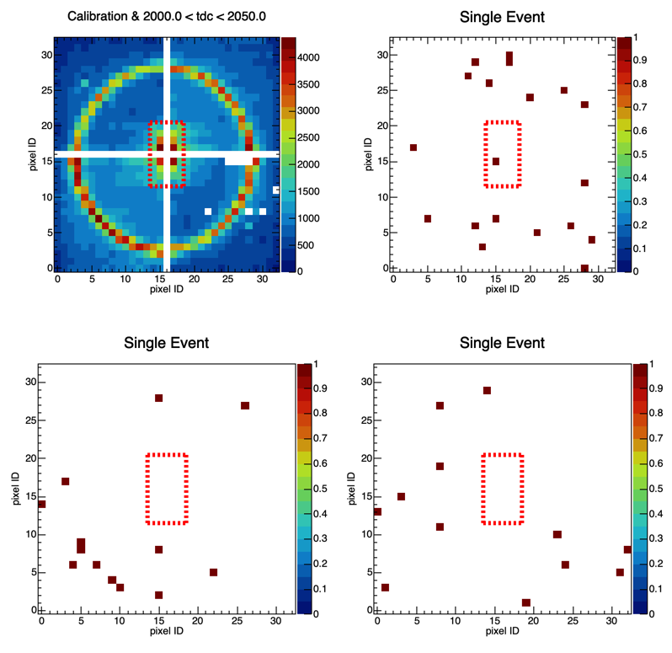
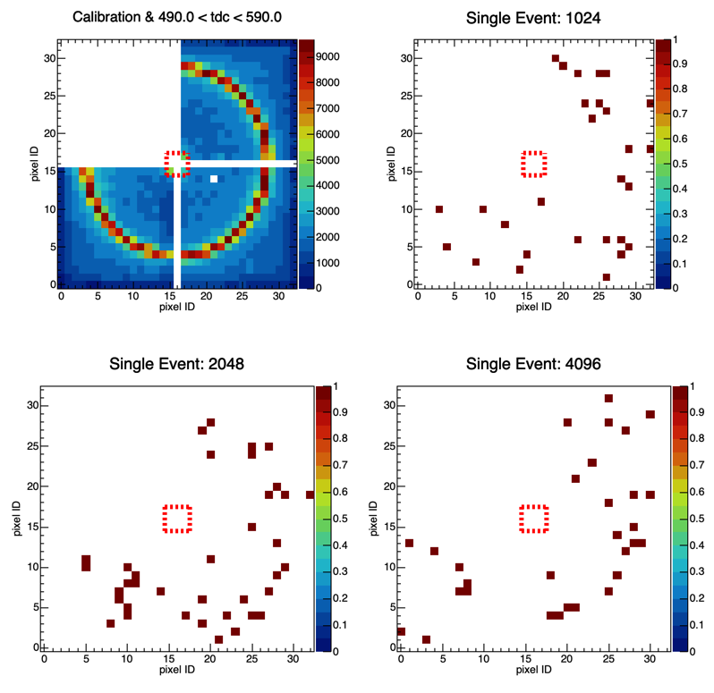
Event-by-Event Analysis (example)
With 4 H13700 – PMT’s
With 3 Hamamatsu SiPM matrices (-30⁰C)
120 GeV/c proton beam incident at the center of mRICH - baseline analysis

Slide 9
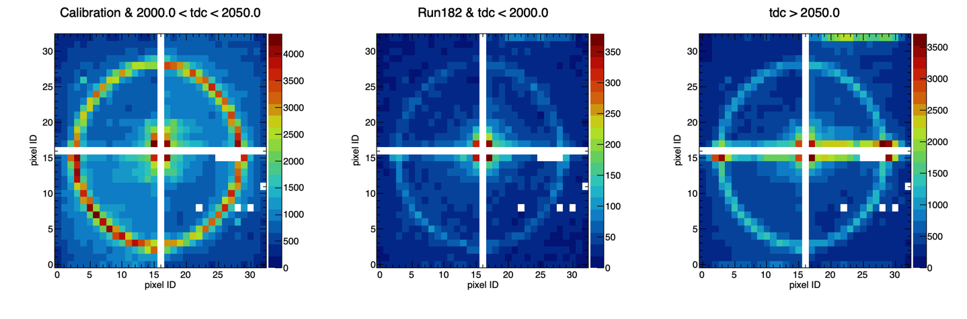
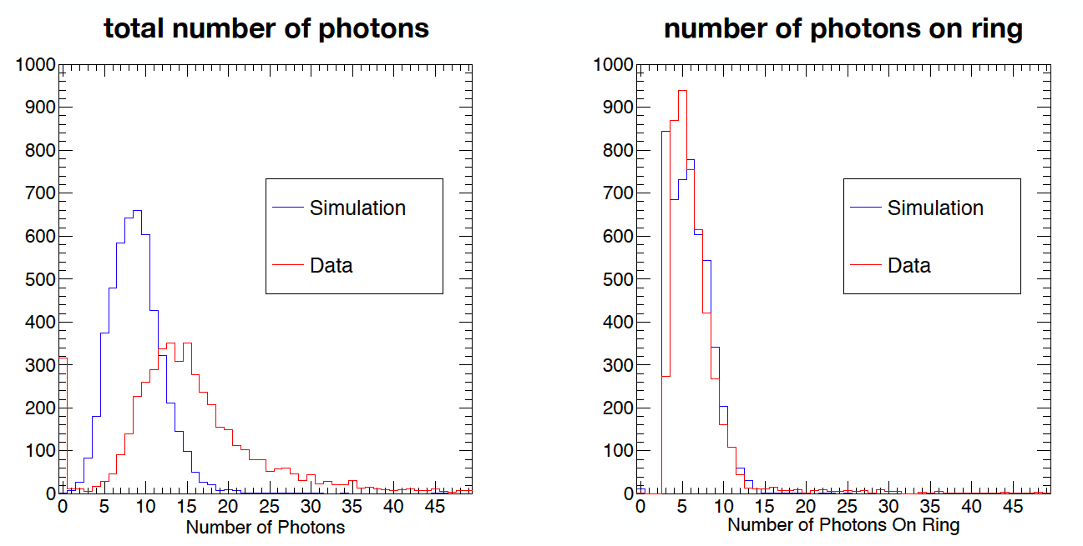
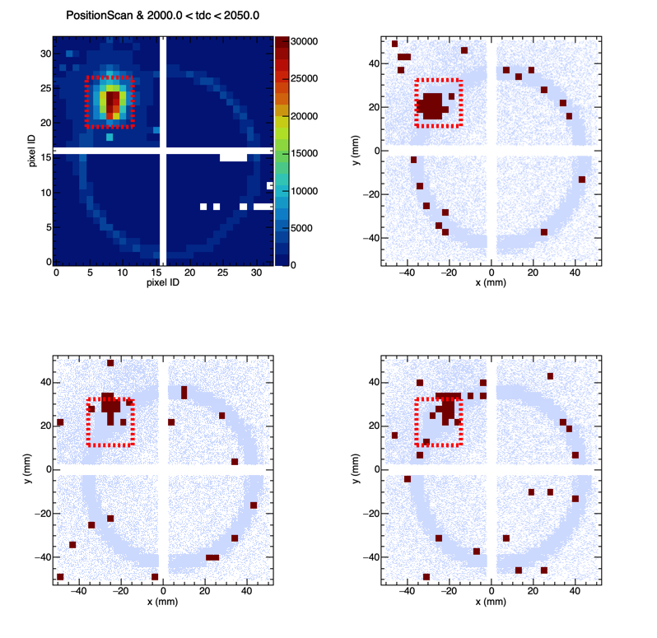
Baseline Performance as Expected
120 GeV/c proton beam spot
Confirm ring centering feature of mRICH
Cumulative image
Single event samples (shaded ring images are from simulation)

Slide 10
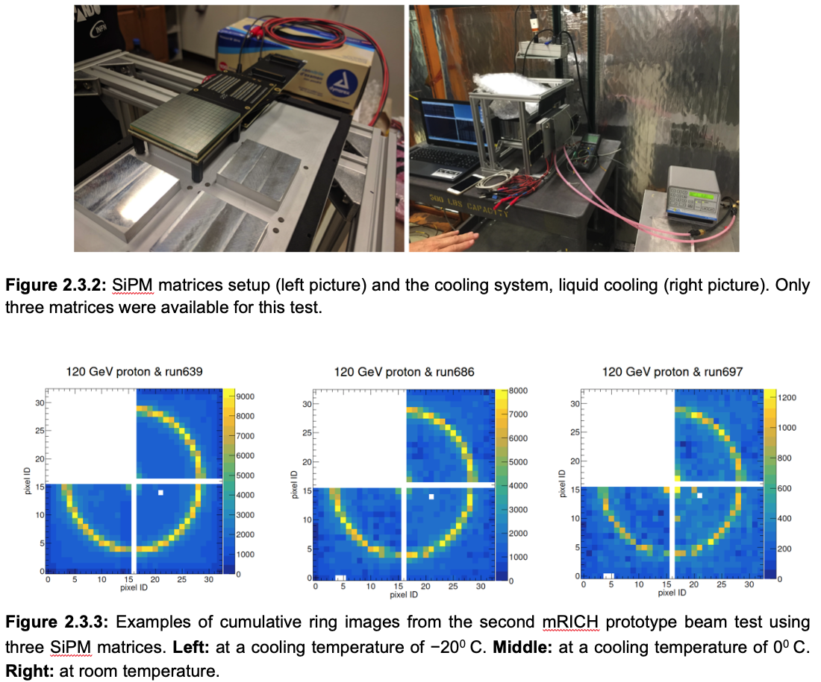
mRICH Ring Images from SiPM Sensors (a FIRST!)
To meet the requirement of operating photosensors in high magnetic field in EIC experiment, we successfully demonstrated ring imaging construction using mRICH in the 2nd beam test. There were only three Hamamatsu SiPM matrices available at the time of this test. Given the limited beam time, we only took data with the primary proton beam at 120 GeV with cooling temperature settings at
-30ºC, -20ºC, -10ºC, 0ºC and room temperature.
SiPM matrix: 16 x 16 channels, 3mm x 3mm pixel size
SiPM
SiPM matrix assembly and Cooling setup
Room
temp
-20ºC
0ºC
Cumulative ring images from 120 GeV/c proton beam at center
Ongoing effort: (a) photon hit timing structure; (b) noise level study; and (c) event-by-event ring image construction and fine tuning simulation.

Slide 11
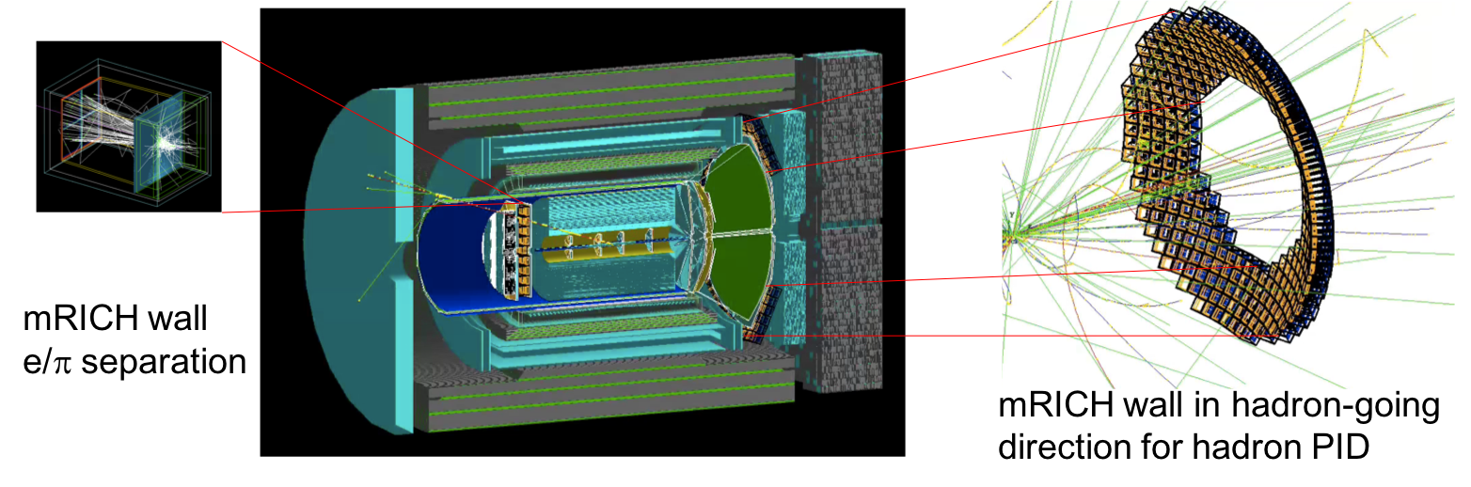
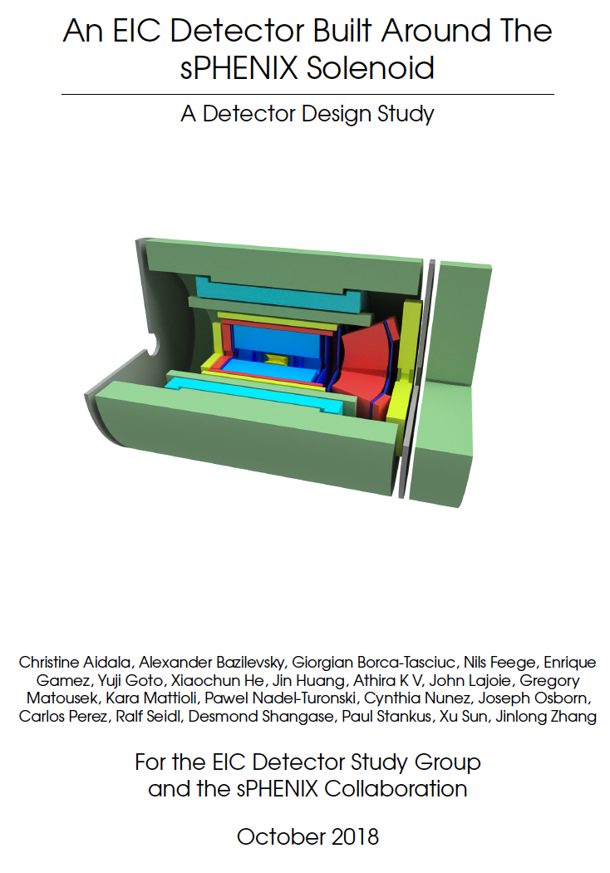
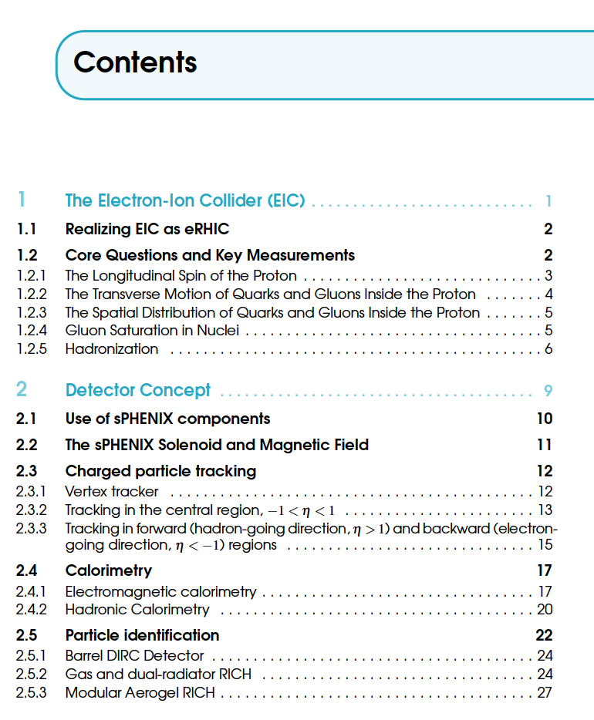
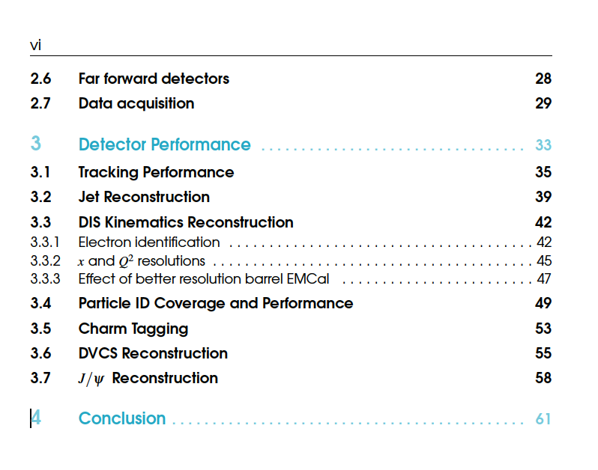
mRICH in an EIC Detector Built Around the sPHENIX Solenoid

Slide 12
Backup Slides
mRICH

Slide 13
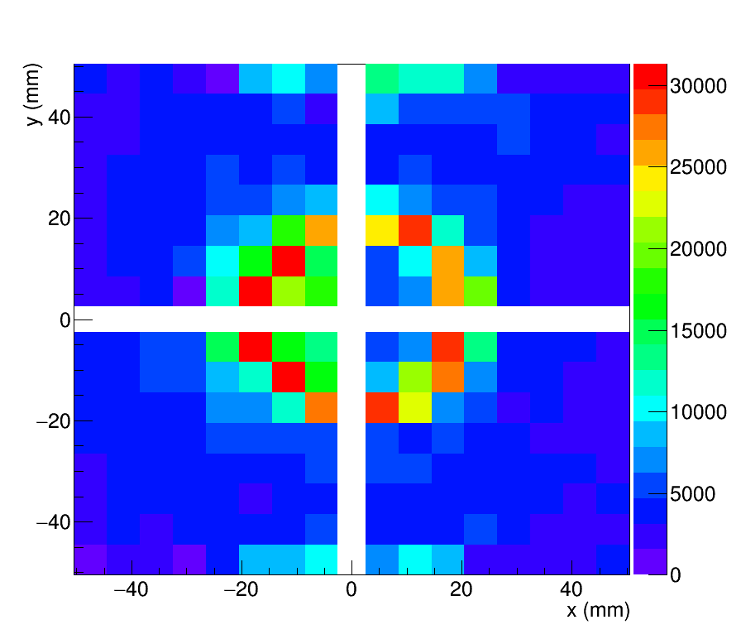
1st and 2nd Beam Test Comparison (120 GeV Proton Beam)
The 1st test beam result verified mRICH working principle and validated simulation
1st mRICH prototype was tested at Fermilab Test Beam Facility in April 2016
Images from 120 GeV
Proton beam
Simulated Images
Using GEANT4
New features: a) separation of optical and electronic components; b) longer focal length (6”); c) 3mm x 3mm photosensors.
2nd mRICH prototype was tested at Fermilab Test Beam Facility in June/July 2018

Slide 14
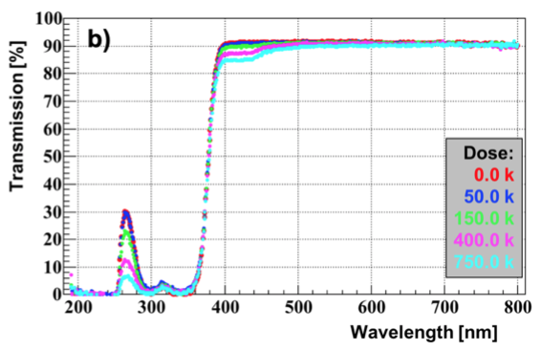
mRICH – FY19 activity (part two)
Study of the radiation hardness of Fresnel lens (i.e., address the committee concern!) in spring 2019 at BNL using ⁶⁰Co source together with DIRC team to confirm the earlier test result shown below. Have purchased more lens samples from Edmund for this test.
Simulation study of mRICH performance in the Forward sPHENIX experiment at BNL (ongoing effort).
Simulation study of mRICH performance in the electron endcap in JLEIC (ongoing effort).
Work with dRICH group to develop a plan for a join dRICH/mRICH beam test.
Tested by Greg Kalicy. 2 mm-thick acylic mRICH lens sample. A small drop of transmission was observed below 500 nm. This material seems surprisingly radiation hard even after a dose of 750 krad.

