Slide 1
MCP-PMT / LAPPDTM
Goal:
Adapt LAPPDTM to the EIC requirements:
Highly pixelated LAPPDTM working at 2~3 Tesla, to be used as photosensors
for mRICH, dRICH, and DIRC detectors, as well as TOF applications.
FY 19 Report:
Magnetic field tolerance, fast timing improvement
Pixel MCP-PMT readout with glass/fused silica anode plate
MCP-PMT simulation
FY 20 Proposed tasks:
Integrate magnetic field tolerant design with glass pixelated readout
Advantage/disadvantage comparison of glass pixel vs. ceramic pixel
MCP-PMT simulation with magnetic field
Effort enhancement with electronics, DIRC, dRICH and mRICH sub-systems

Slide 2
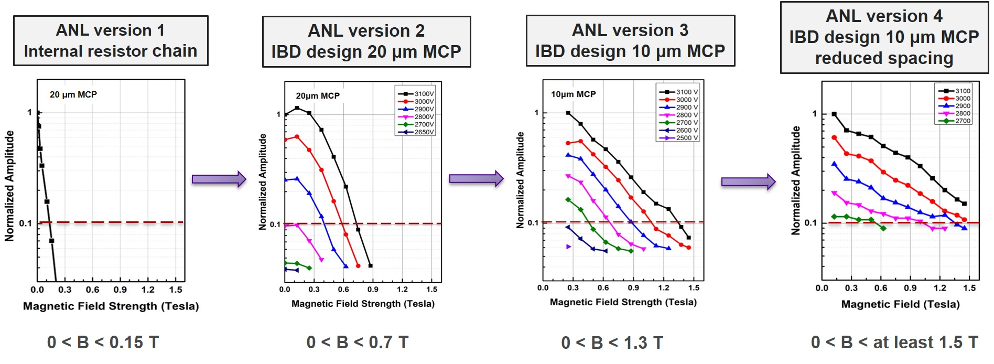
Improvement of Argonne MCP-PMT Performance in Magnetic field
CLEO-II or BaBar Magnet: 1.5T
Optimization of biased voltages for both MCPs: version 1 -> 2
Smaller pore size MCPs: version 2 -> 3
Reduced spacing: version 3 -> 4
Further improvement if needed:
Smaller pore size is planned: 6 μm, version 4 -> 5 (future)

Slide 3
Argonne MCP-PMT Performance comparison
 |  | ANL Version 2 Standard 20 μm MCP-PMT | ANL Version 3 10 μm MCP-PMT without reduced spacing | ANL Version 4 10 μm MCP-PMT with reduced spacing
MCP | Pore size | 20 μm | 10 μm | 10 μm
 | Length to diameter ratio (L/d) | 60:1 | 60:1 | 60:1
 | Thickness | 1.2 mm | 0.6 mm | 0.6 mm
 | Open area ratio | 60 % | 70 % | 70 %
 | Bias angle | 8º | 13º | 13º
Detector geometry | Window thickness | 2.75 mm | 2.75 mm | 2.75 mm
 | Spacing 1 | 3.25 mm | 2.25 mm | 2.25 mm
 | Spacing 2 | 1.75 mm | 2.0 mm | 0.7 mm
 | Spacing 3 | 2.0 mm | 4.0 mm | 1.1 mm
 | Shims | 0.3 mm | 0.3 mm | 0.3 mm
 | Tile base thickness | 2.75 mm | 2.75 mm | 2.75 mm
MCP-PMT stack | Internal stack height | 9.70 mm | 9.75 mm | 5.55 mm
 | Total stack height | 15.20 mm | 15.25 mm | 11.05 mm
Gain Characteristic | Gain | 1.35 × 10⁷ | 3.05 × 10⁶ | 2.0 × 10⁷
Time Characteristic | Rise time | 536 ps | 439 ps | 390 ps
 | Timing distribution RMS | 204 ps | 106 ps | 190 ps
 | System resolution | 70.0 ps | 37.2 ps | 43 ps
 | Time resolution | 63 ps | 20 ps | 30 ps
 | Differential time spread | 11 ps | 7 ps | 5 ps
 | Spatial resolution | 0.83 mm | 0.53 mm | 0.38 mm
Magnetic Field | Magnetic field tolerance | 0.7 Tesla | 1.3 Tesla | Over 1.5 T

Slide 4
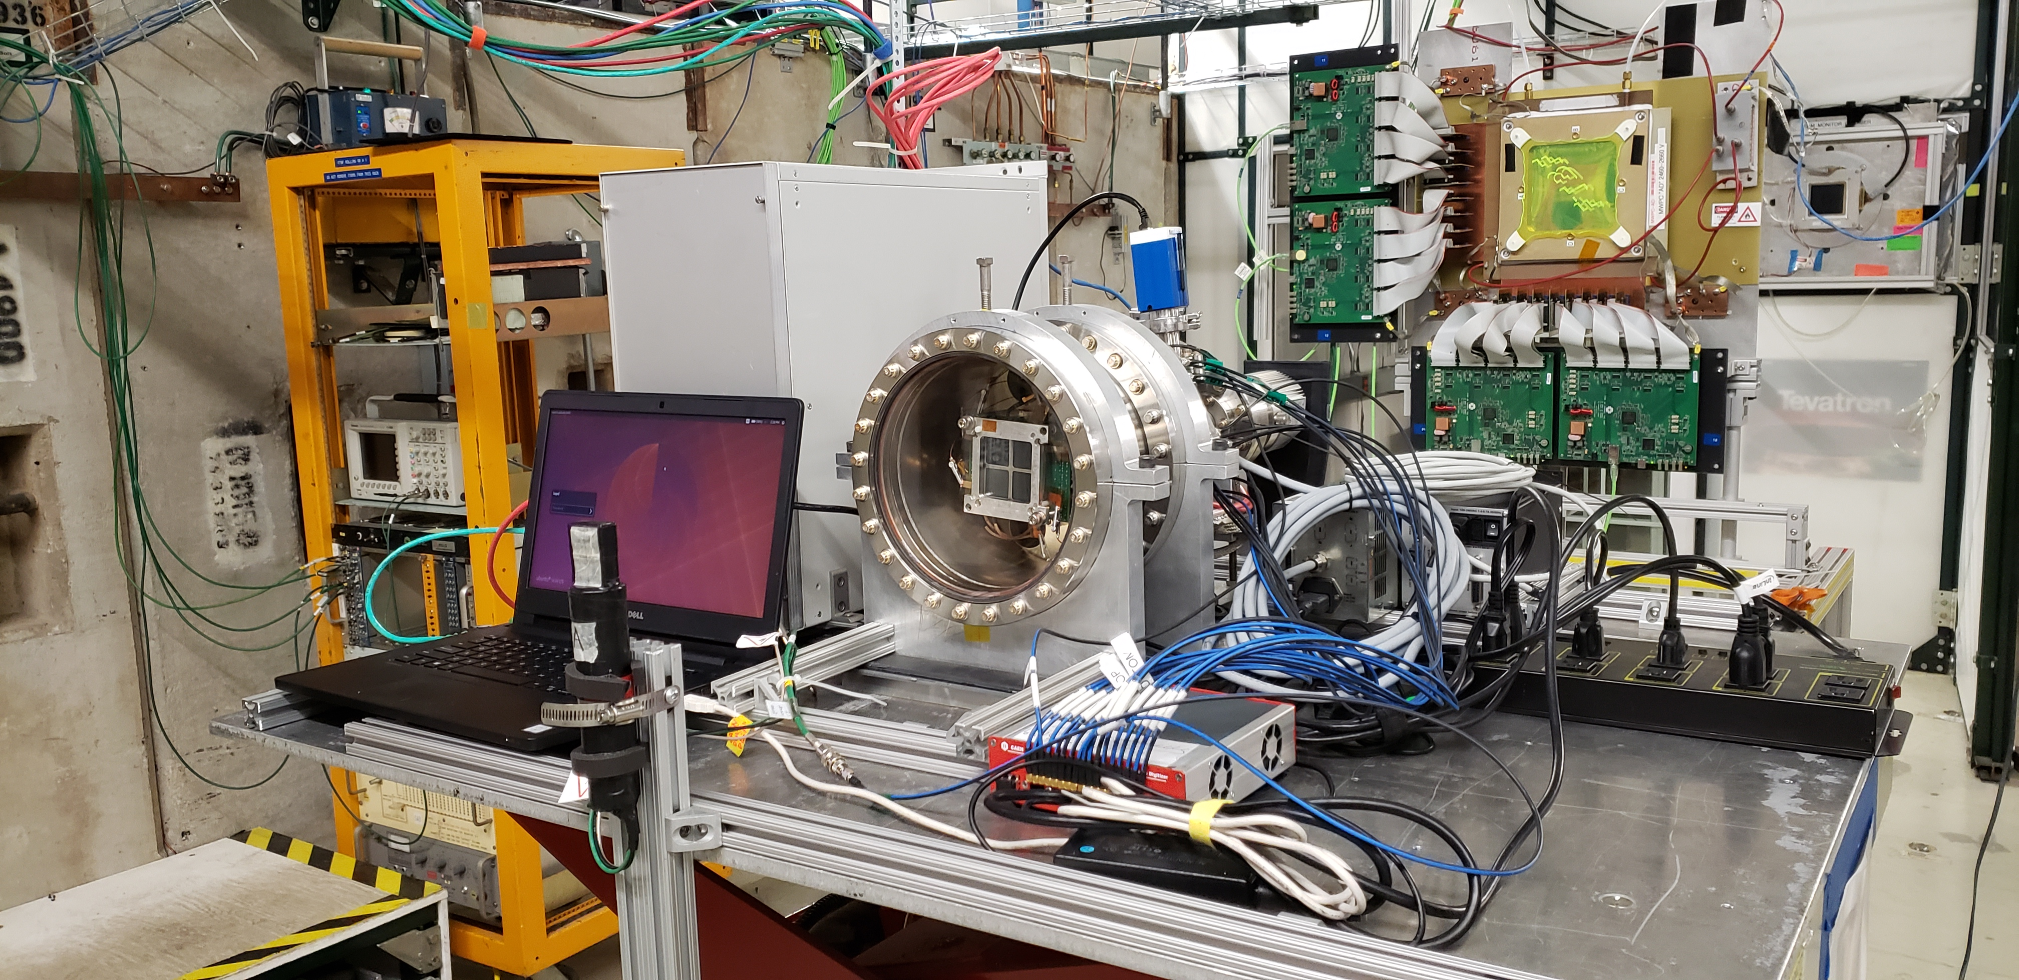
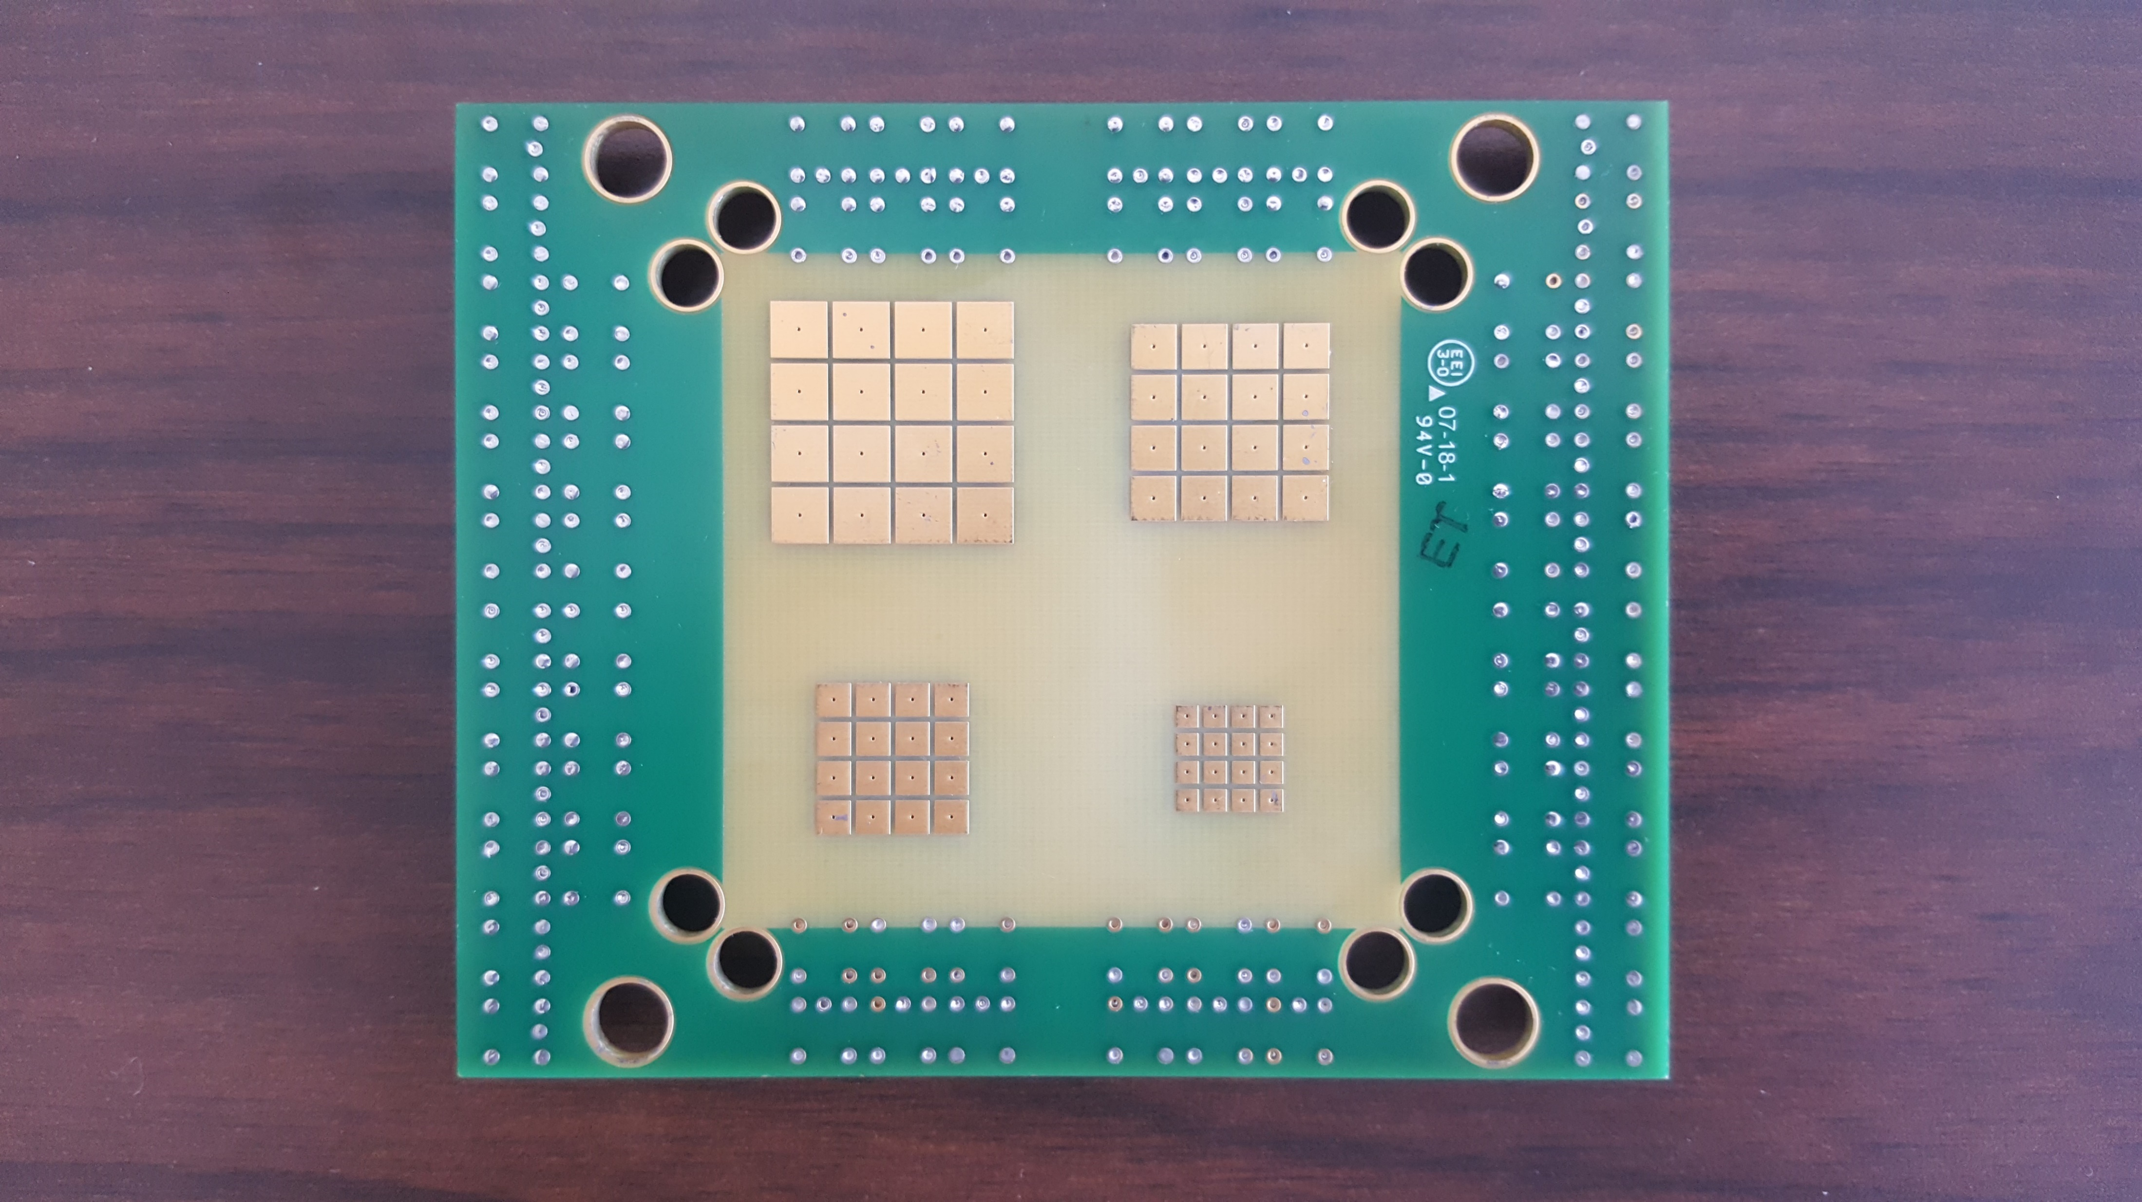
Fine pixelated readout through glass/fused silica anode
Argonne MCP stack (glass anode) in Fermilab test beam
MWPC tracking used
4 different
pixel sizes (2x2,3x3,4x4and 5x5mm²)
implemented for testing

Slide 5
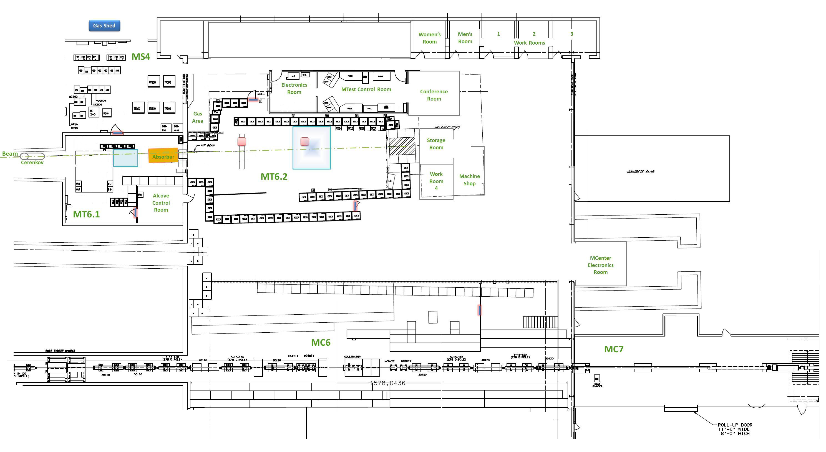
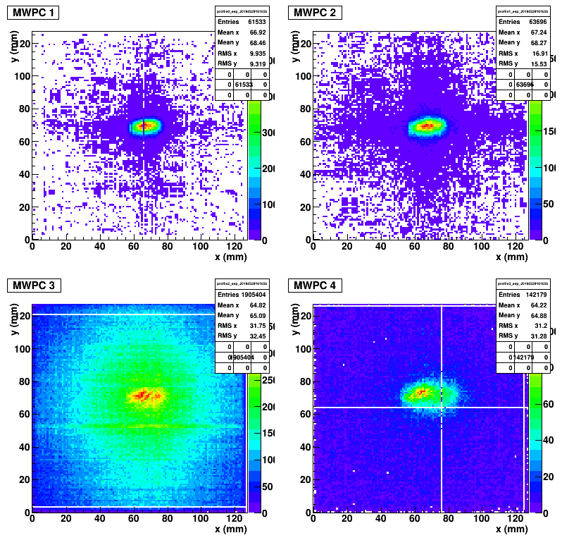
Tracking system
Location of MCP-PMT vacuum chamber
MWPCs
4 MWPC’s for tracking, MWPC 1 and 2 upstream, and 3 and 4 downstream
In MWPC 3 we got a lot of spray from hadronic interactions in the vacuum chamber

Slide 6
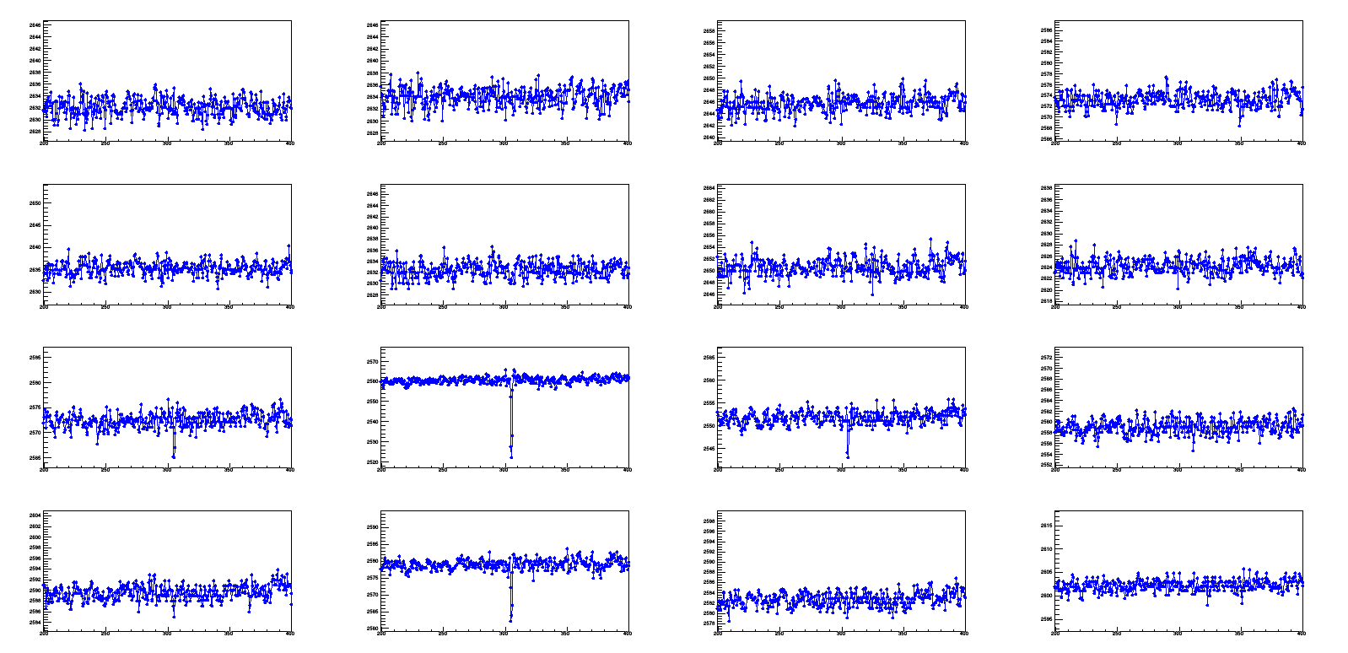
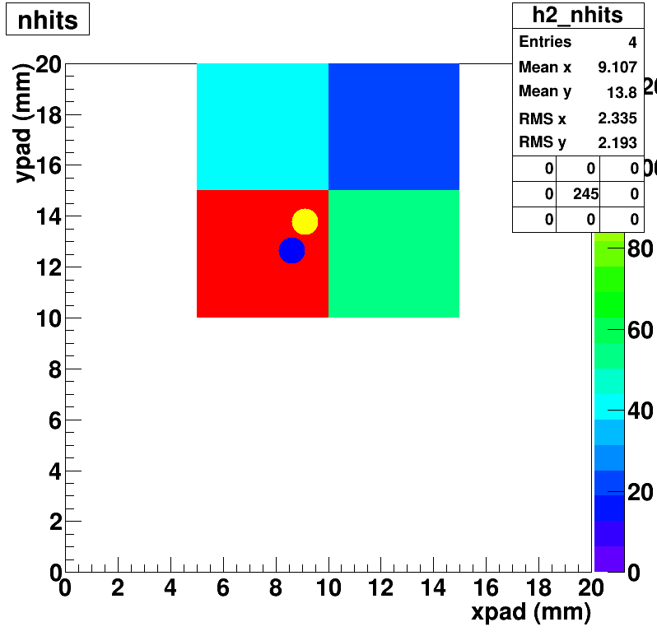
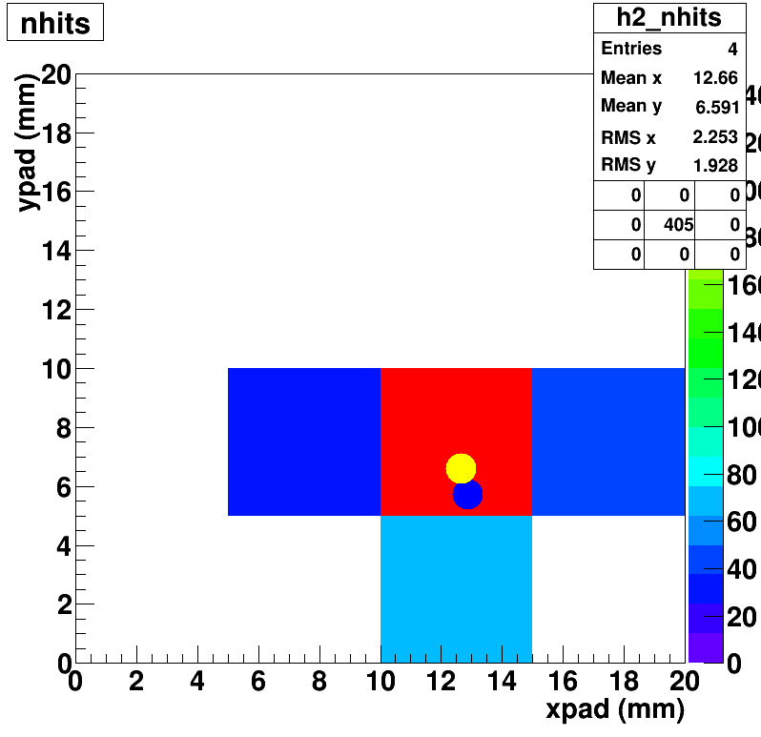
Event Display
2x2 mm² pixels
4x4 mm² pixels
2x2 mm² pixel size is too small, signals spread onto several pixels.
Larger pixel size, signals are more confined, mainly on one pixel.
Center of mass calculation for hit position
5x5 mm² as example
Yellow dot is the center of mass of pad hits; Blue dot is projection from MWPC tracking

Slide 7
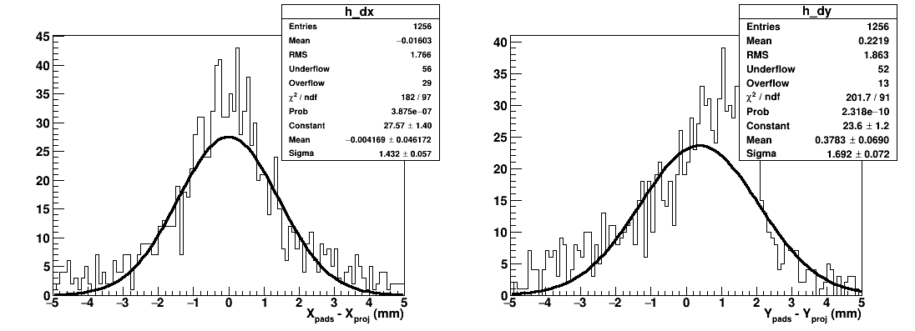
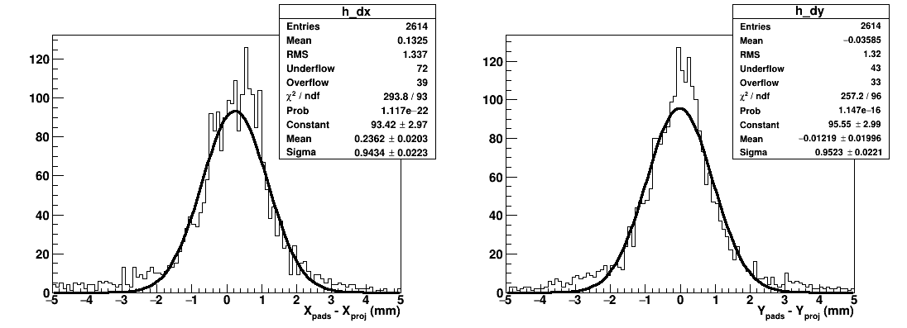
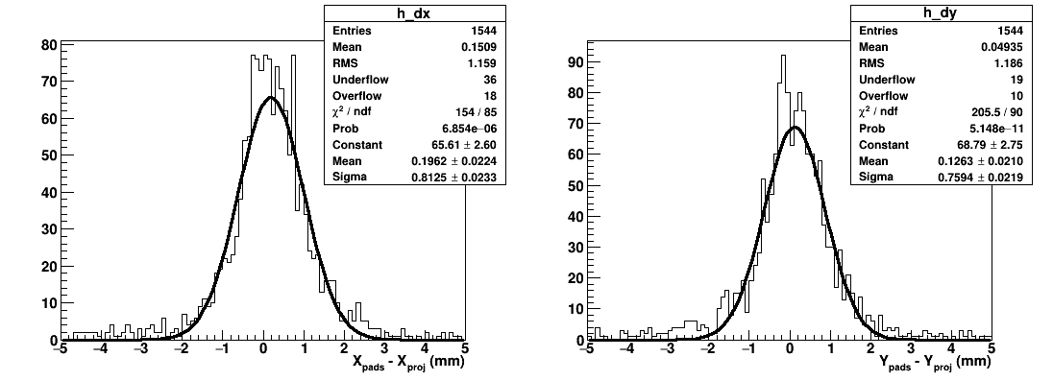
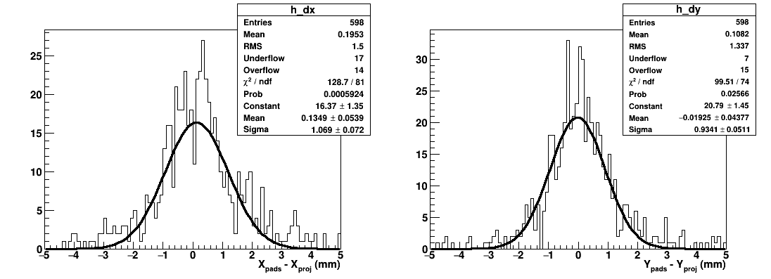
Position resolution
Difference between the pad mean position (CG) and the track pointing
2x2 mm
3x3 mm
4x4 mm
5x5 mm
 | X res (mm) | Y res (mm)
2x2 mm | 1.4 | 1.7
3x3 mm | 0.94 | 0.95
4x4 mm | 0.81 | 0.76
5x5 mm | 1.1 | 0.97
All resolutions ~1 mm, satisfy the requirement for the EIC.
Potentially limited by track pointing resolution capability of MWPCs (1 mm pitch)
2x2 may be worse due to leakage of signals (poor containment since it is a smaller area)

Slide 8
MCP-PMT simulation
(a)
(b)
(c)
# electrons
time(ps)
Single MCP simulation with SIMION software, effort launched at ANL:
Side view of the secondary electron emission process in a single pore with multiple electrons
3-D view of the secondary electron emission process in a single pore at the beginning of the pore;
Dependence of a series of simulated detection pulses on the time relative to the initial electron time: times are consistent pulse to pulse.

Slide 9
MCP-PMT / LAPPD – Conclusion
MCP-PMT / LAPPD achieved magnetic field tolerance of over 1.5 Tesla and time resolution RMS of ~100 ps
MCP-PMT readout with 3x3 mm² pixel size and position resolution of <1 mm was demonstrated.
MCP-PMT simulation with SIMION software effort was launched.

