Slide 1
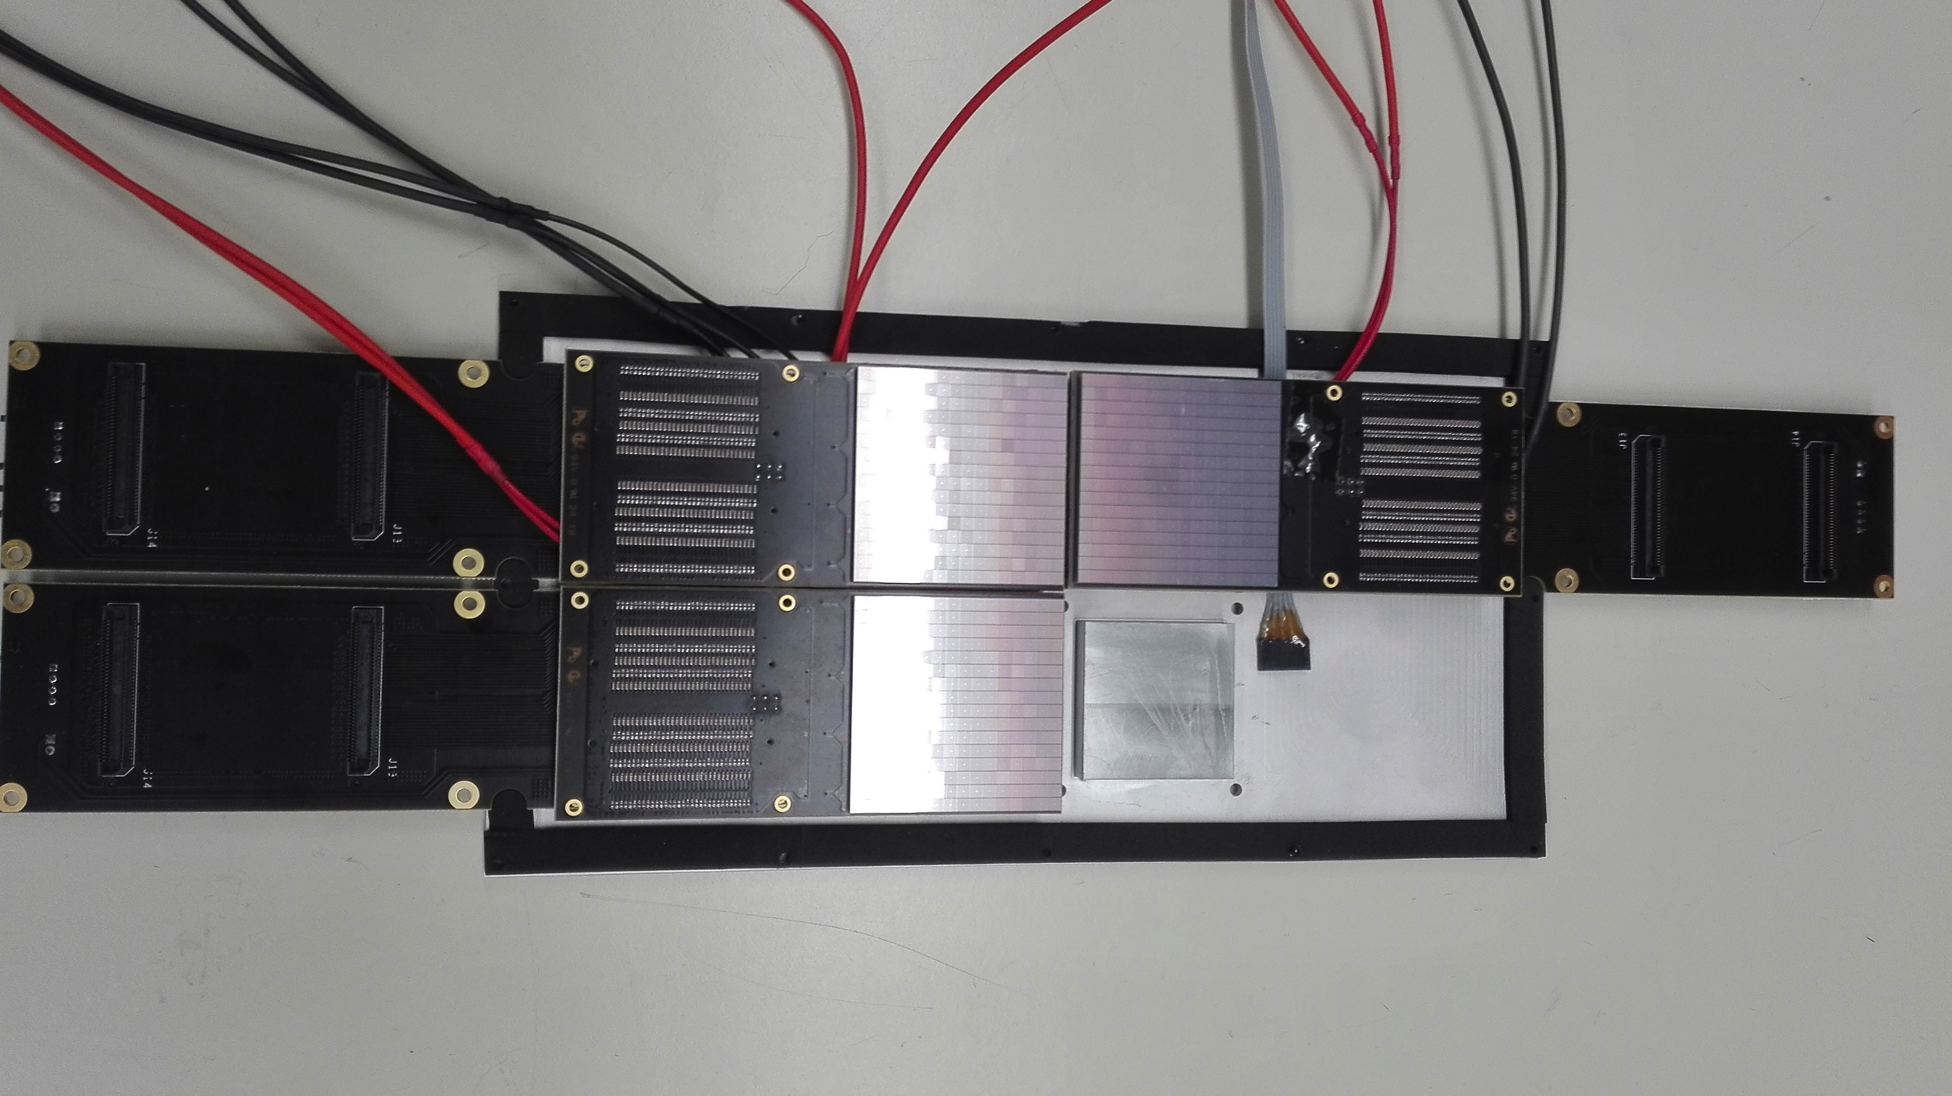
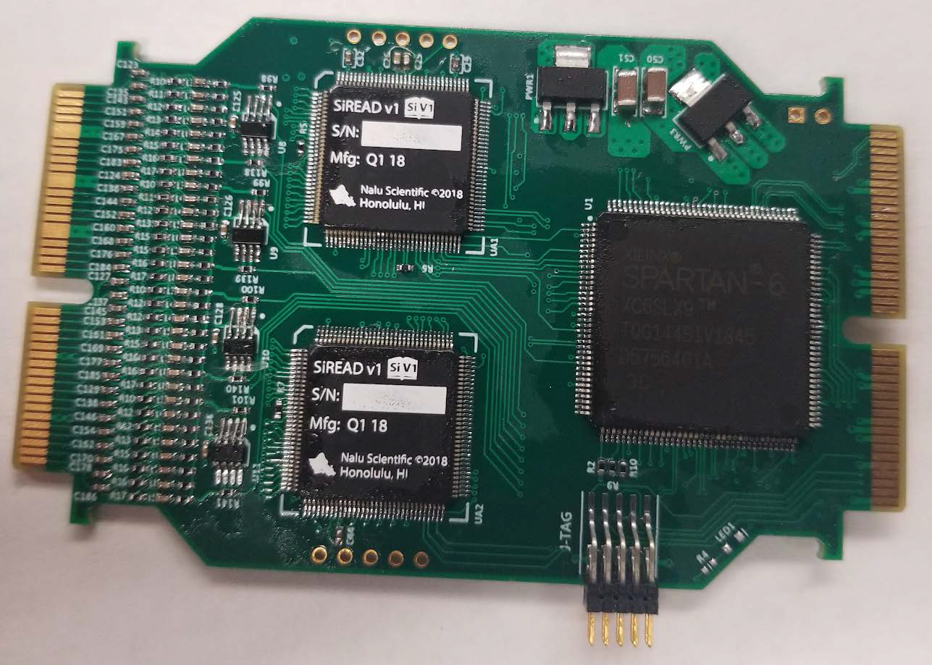
Readout Electronics
Goal:
Develop an integrated suite of readout electronics for the different photosensors used for all the Cherenkov detectors and prototypes.
Provide a reference readout system for prototypes performance assessment
Developed a generic DAQ system compatible with the Consortium needs
Test applications with innovative sensors (SiPM)
FY 19:
Moving from the TARGETX (Belle-II) to the new SiREAD chip
Development of pulsed laser test benches for detailed characterization
Radiation tolerance study for SiPM

Slide 2
Electronics – overview
Requirements
Need to read out several photosensors (MaPMTs, MCP-PMTs, and SiPMs) with similar sensor and pixel size (16x16 array of 3 mm pixels)
DIRC also requires good timing (<100 ps)
Goal is to have common front end electronics with good timing that can be used for all sensors and detectors (mRICH, dRICH, DIRC)
Implementation
The Maroc-based CLAS12 front end has been used for the first two mRICH beam tests and will remain available in the future
Maroc is not a long-term solution due to its poor timing
A new front end based on TARGETX (used in Belle II) has been developed by U. Hawaii and has already been used for the beam hodoscope
Excellent timing, can be a fallback solution also for the DIRC
Ultimately, a front end based on the new SiREAD chip from Hawaii will be used for all EIC PID detectors and sensors.

Slide 3
Next Generation Photosensor Readout
Building upon lessons learned from the development of photosensor readout for the Belle II upgrade (picosecond timing, low-cost, large muon system) and CTA SCT cameras ($1.40/channel)
ASIC development important, but firmware and support have been the most critical issues
UH has partnered with Nalu Scientific team to develop commercial variants (with functional extensions), to provide engineering support
UH can then focus on strengths of an academic institution for innovation, testing and data analysis

Slide 4
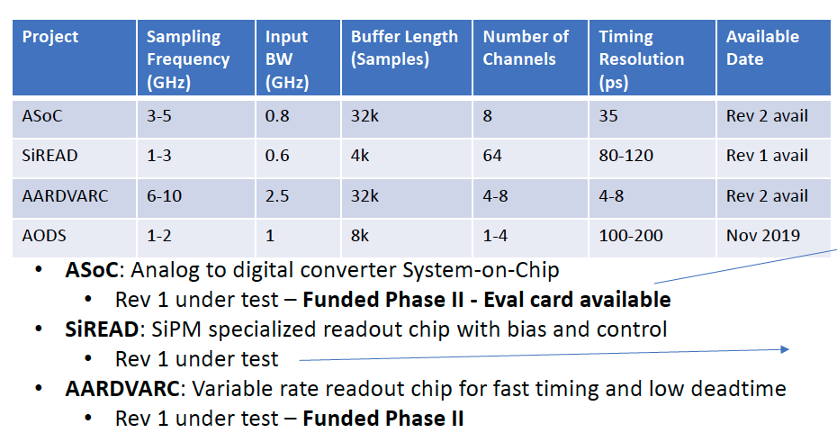
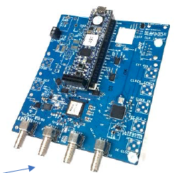
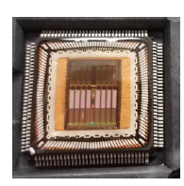
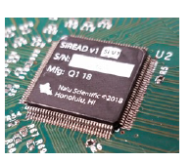
Current Nalu’s SoC-ASIC Projects
All chips, are designed with commercial grade tools
and licenses and can be sold once commercialized.

Slide 5
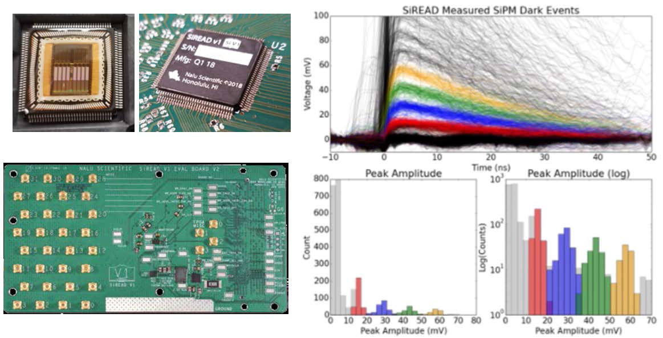
SiREAD Electronics Evaluation
Micrograph of the fabricated prototype SiREAD (top left). Prototype SiREAD on the evaluation PCB (top middle). Superimposed dark count waveforms recorded from a SiPM using the SiREAD operating at 1 Gsa/s (right). High channel count evaluation PCB for SiREAD with 32 dedicated MMCX connectors (bottom left).

Slide 6
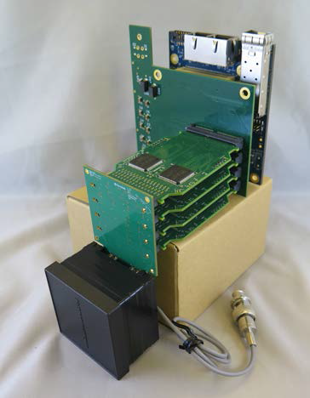
MaPMT Readout
Photograph of the 64 channel SiREAD based (2x SiREAD rev.1) readout card as a building block for the 256 MA-PMT readout.
Photograph of the first generation of 256-anode 2" PMT readout for use with mRICH prototype in the Fermilab beam test facility.

Slide 7
HW/FW Development
Need for robust firmware development
Nalu Scientific team provides in-house FW development, with institutional memory
UH provides comprehensive bench, environment and picosecond laser/photosensor testing
UH hiring new EE post doc on July 3rd (pending hiring paperwork)
Immediate push is to get SiREAD version of 256 anode PMT readout working; evaluate performance; design more compact version

Slide 8
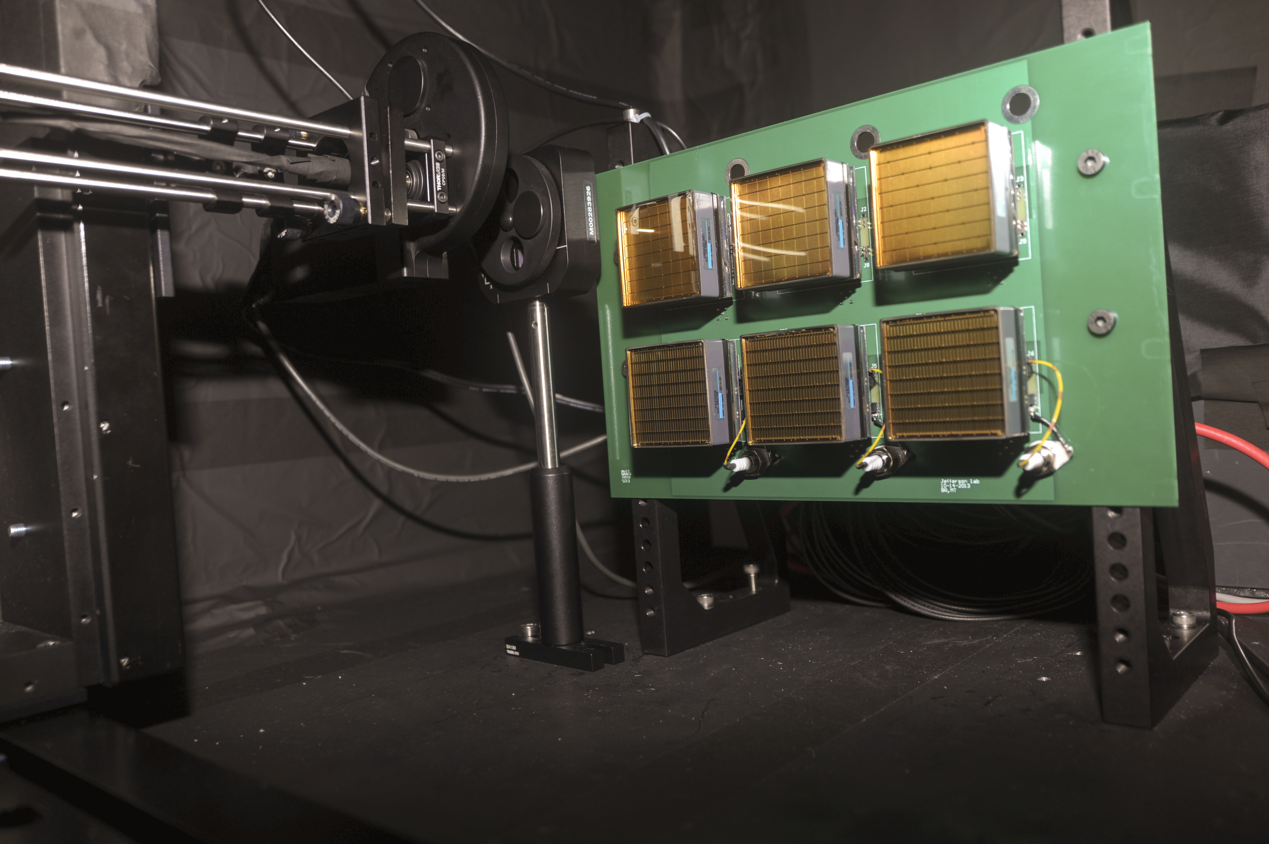
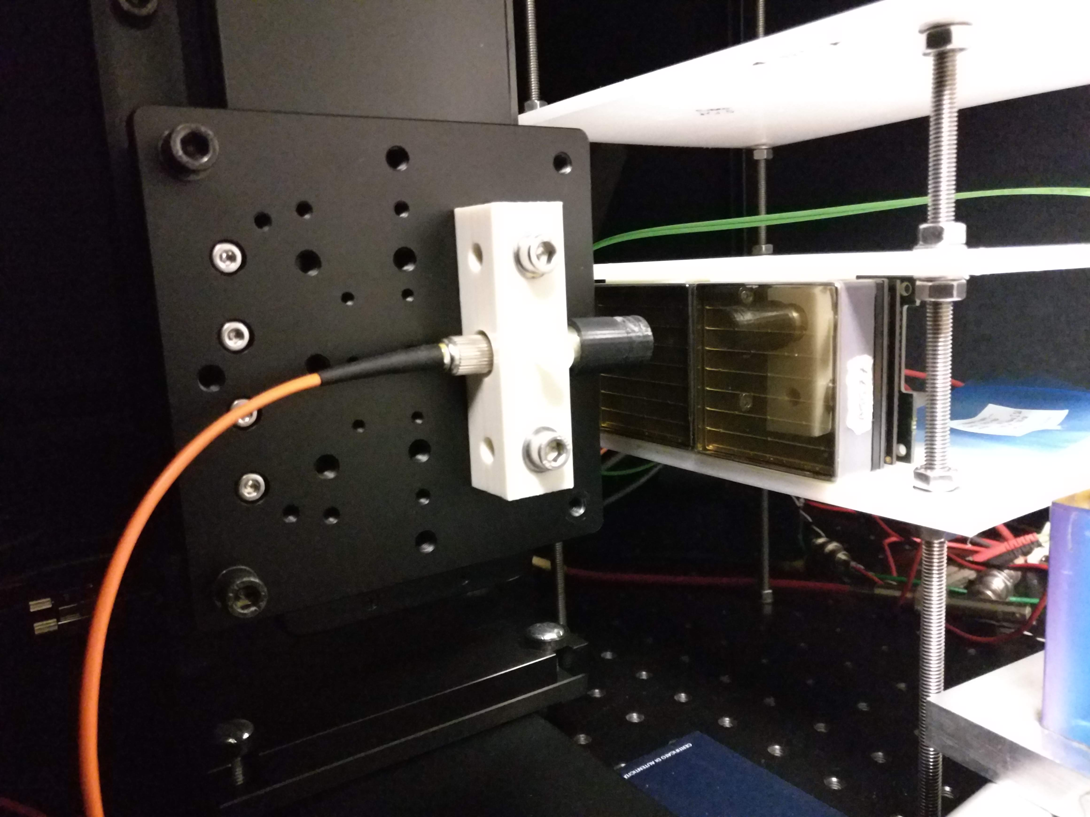
Pulsed Laser Test Benches
Detailed characterization
Sensors: gain, efficiency, cross-talk, radiation tolerance
Electronics: gain, cross-talk, thresholds, time resolution
JLab
632 nm picosecond pulsed laser light
Light diffuser to illuminate the whole MAPMT surface Standardized system with CLAS12 electronics
H8500 6x6 mm² pixel sensor so far
Laser head +
diffuser
MAPMT holder
INFN
632 nm and 407 nm picosecond pulsed laser light
Light concentrator to scan the pensor surface
Flexible layout supporting various sensors and
Front-End electronics
Laser head +
collimator
MAPMT holder

Slide 9
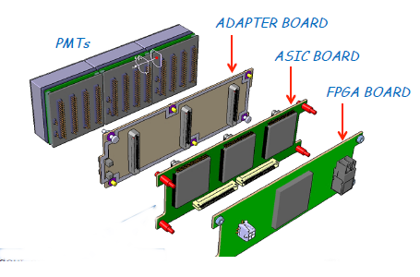
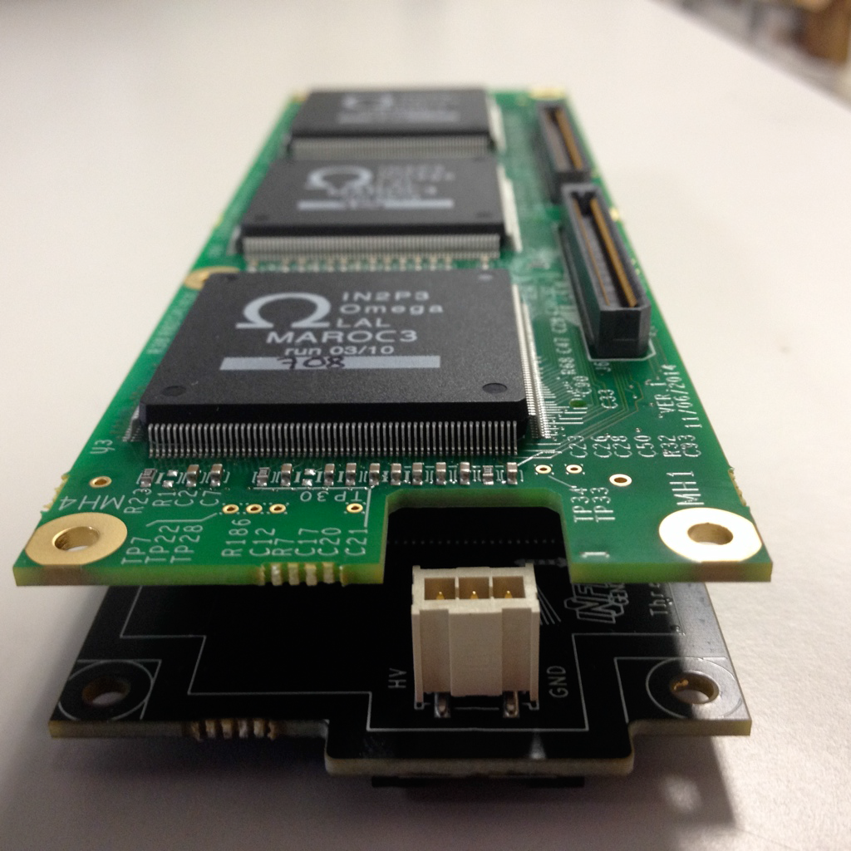
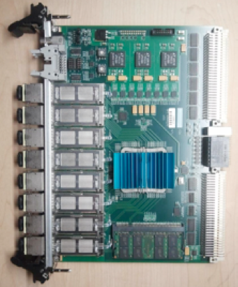
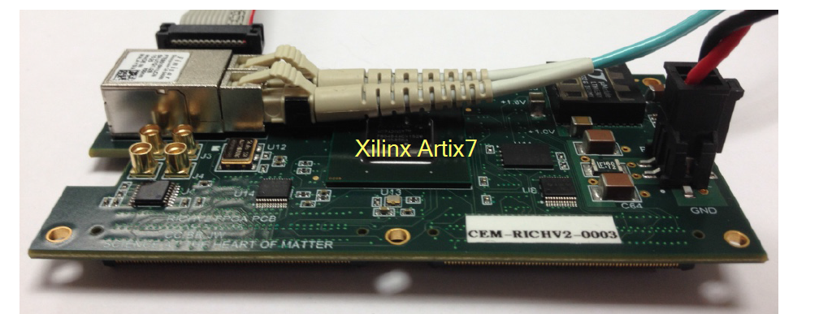
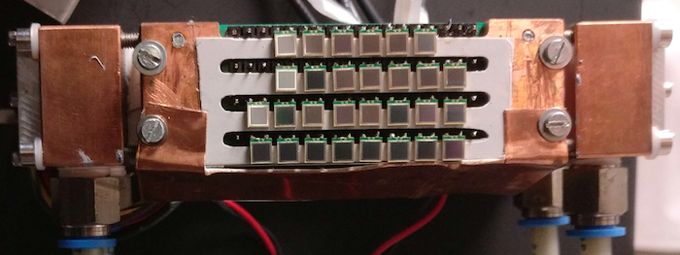
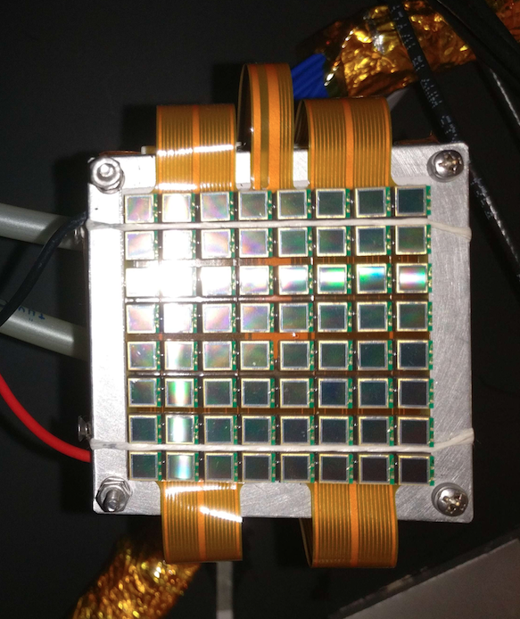
Electronics – Maroc (used for FY17-18 mRICH beam tests)
CLAS12 RICH electronics
SSP Fiber-Optic DAQ
Adapter
& Asics
Boards
FPGA
Board
SiPMs
✓ Mass production technology
✓ Photon counting
✓ Excellent time resolution
✓ Compatible with magnetic field
✓ High dark rate
✓ Low radiation tolerance
Work at low temperature

Slide 10
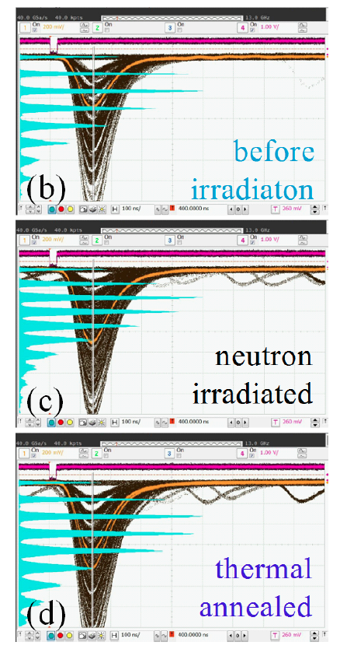
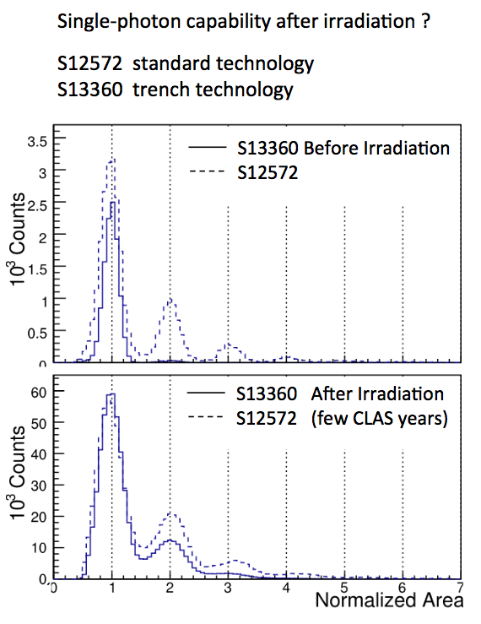
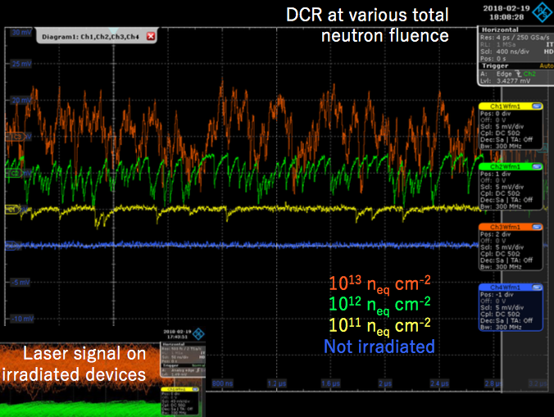
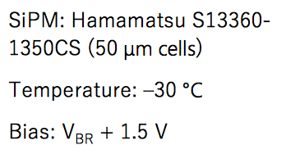
SiPM Radiation Tolerance
T. Tsang et al.
JINST 11 (2016) P12002
I. Balossino et al.
NIMA 876 (2017) 89
Paolo Carniti
@ RICH 2018
T= 84 K
10⁹ n_{eq} cm²
Annealing at 250 ºC
T= 0 C
few 10⁹ n_{eq} cm²

Slide 11
Electronics Status and Plans
F19 Progress:
First generation firmware for front-end to back-end communication
Development of pulsed laser test benches for detailed characterization
Radiation tolerance study for SiPM
FY 20 proposed activity:
Integration of the SSP DAQ protocol with the SiREAD front-end chips
Readout adaptation for the dRICH prototype
Development of a portable DAQ system derived from the CLAS12 RICH readout
Study SiPM single-photon detection performance in the EIC environment
in collaboration with other eRD Consortia and experiments

