Slide 1
BO #1: What are the projections and recorded luminosity for Run-19 for the 4.59 and 3.85 GeV/n
Achieved events
582M 2/24/19-4/3/19
201M 6/28/19-6/30/19
324M 4/3/19-6/3/19
53M 6/18/19
51M 7/8/19-7/9/19
PAC Comment (10-11 June, 2019): “The highest priority for C-AD at RHIC is LEReC, which allows execution of the lower energy BES-II runs. This is essential to realize the significant discovery potential of the BES-II physics program.”
J.H. Lee, RHIC Retreat 2019
+ LEReC commissioning: 3.85 GeV/n, 2 shifts/weekday, 168 days total, 4.59 GeV/n, 2 shifts/weekday, 18 days total

Slide 2
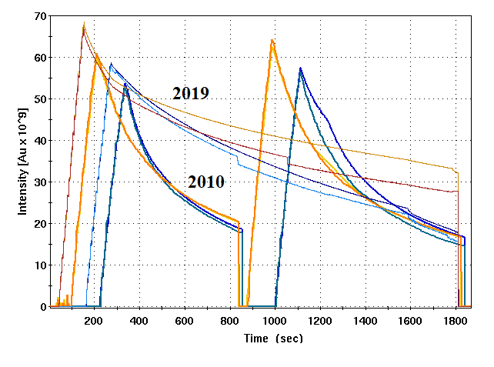
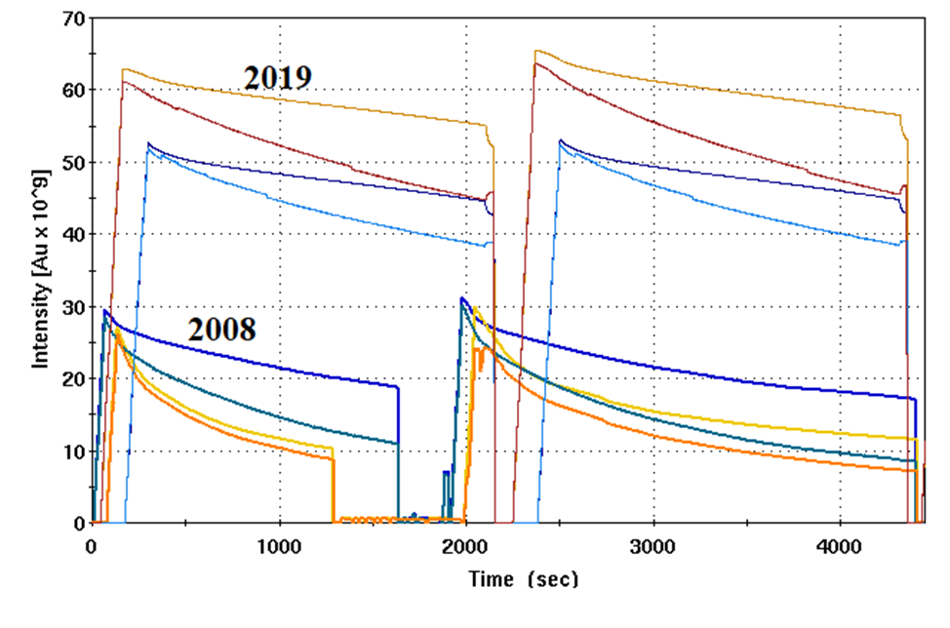
LEReC commissioning: 3.85 GeV/n
3.85 GeV/n
Mostly without collisions (concentration on beam cooling).
slightly higher bunch intensities
longer lifetimes (new 9 MHz rf cavities)
reduced beta* (6 m)
average luminosity
~ 2 times that of 2010
STAR “good” events in +/- 70 cm vertex
average “good event” rate in 2019 similar to 2010
(without cooling)
LEReC commissioning: 4.59 GeV/n
Mostly without collisions (concentration on beam cooling).
higher bunch intensities (3→1 vs 2→1 bunch merge in AGS) and longer lifetimes (both due to higher energy and use of both 9 MHz and 28 MHz rf cavities)
→ 55% increase in – uncorrected - good event rate
in 2019 compared to 2008 (without cooling)
4.59 GeV/n

Slide 3
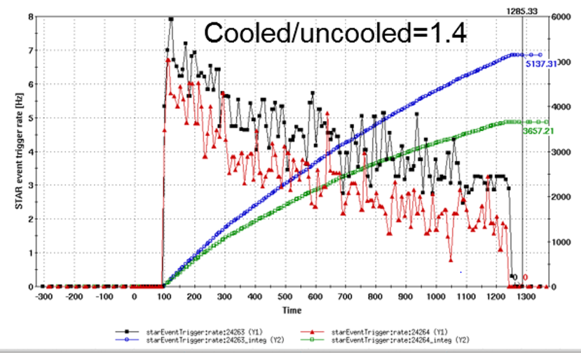
BO #2: In Michiko slide 12 Highlights: quantify (where appropriate) outcome of highlights.
Highlights (Run-19)
Low Energy RHIC Electron Cooling (LEReC) to mitigate IBS
new 9 MHz cavities to reduce space charge effects (longer bunches)
new lattice to accommodate larger tune shifts
new magnet demagnetization cycle to reduce persistent current effects
Low Energy RHIC Electron Cooling (LEReC) to mitigate IBS … see slides 16-20 of A. Fedotov’s presentation
cooling of 111x111 ion bunches at 3.85GeV (1.6MeV 9MHz CW electrons)

Slide 4
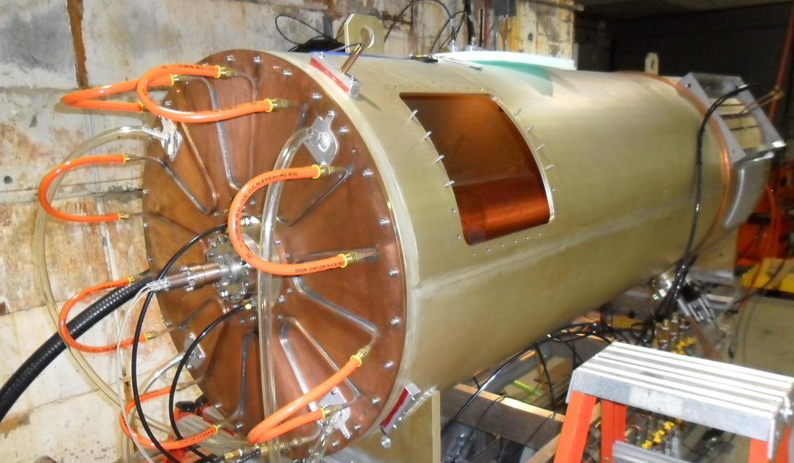
new 9 MHz cavities:
3 cavities / ring (60 kV/cavity)
anticipated benefits:
1) larger bucket and ramp speed for protons (avoids squeeze out on early part of ramp, faster crossing of
spin resonances) … not yet tested
2) lower peak current for transition crossing (increase in bunch intensity) … negligible losses to date
3) operation with long bunches for low energy ions (reduced space charge) … ~ 5 times longer beam lifetime
at 3.85 GeV/n (see plots on previous slide)

Slide 5
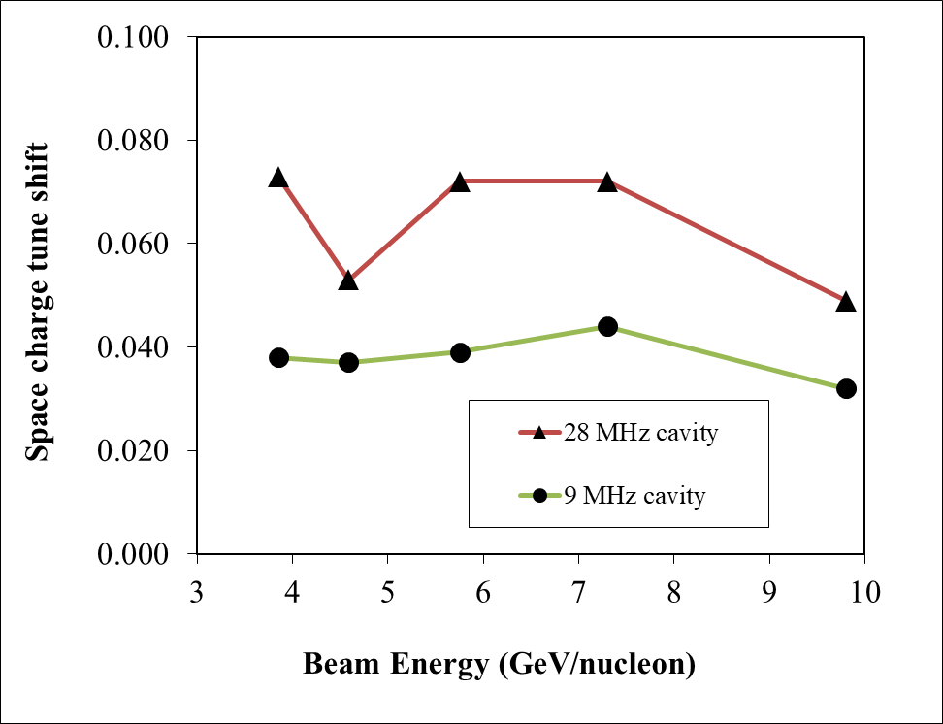
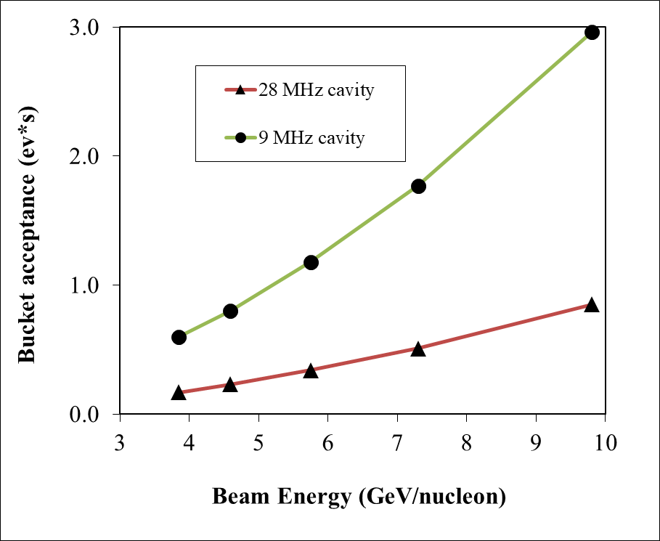
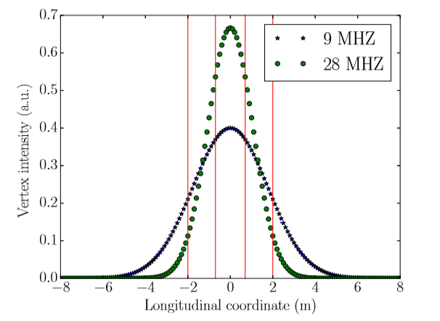
Space charge
C. Liu et al, NAPAC2019
At the BES-I/II beam energies, the ions in the beam experience a strong direct space charge force. The space charge force introduces incoherent and coherent tune shifts.
The space charge effects are significantly reduced by using the new 9 MHz cavities due to reduced peak beam intensity.
The 9 MHz cavities provide a larger bucket area than the 28 MHz cavities.

Slide 6
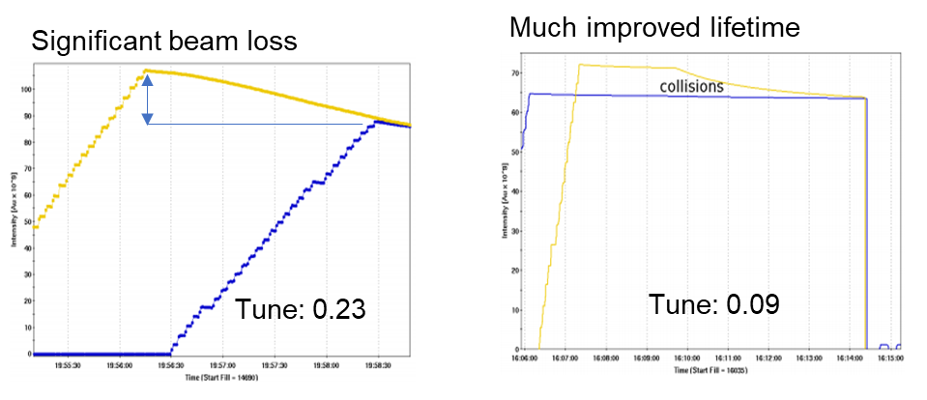
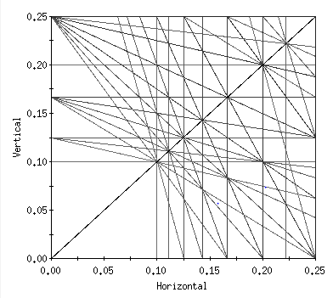
new lattice to accommodate larger tune shifts
beam-beam is relative weak however beam-beam + space charge hurts lifetime
ref: A.V. Fedotov et al, ‘Beam lifetime and limitations during low-energy RHIC operation’, Proc. PAC’11, THP081
working point below 0.1 provides large tune space and mitigates beam loss
resonance diagram
old working point
new working point
OLD
NEW
Working points during 9.8 GeV/n and 7.3 GeV/n colliding beam runs: Q_{x} = 0.093, Q_{y} = 0.085
(at higher beam energies, historically used tunes are ~ 0.22 and ~0.23)

Slide 7
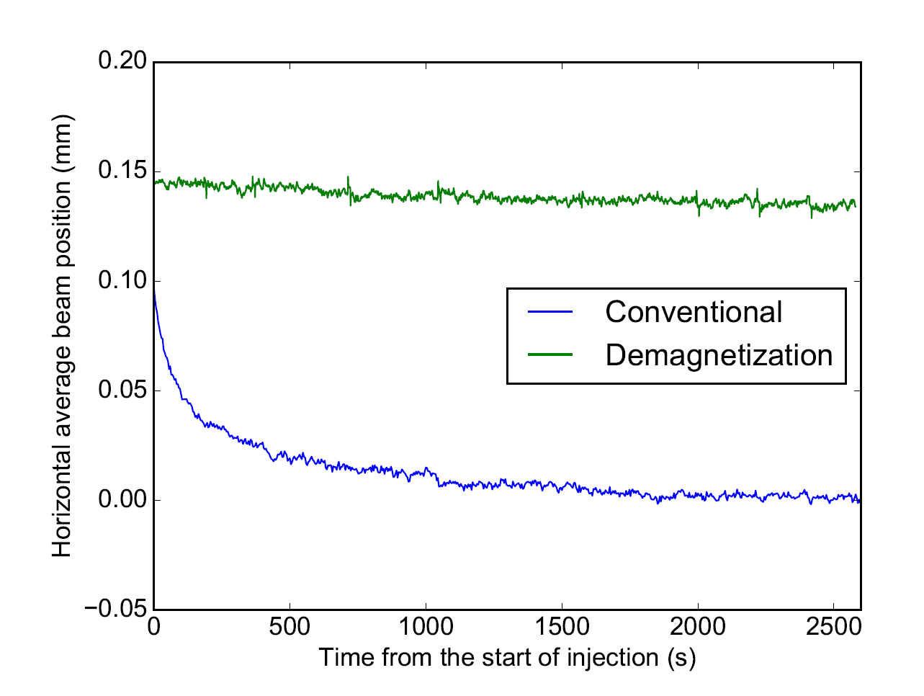
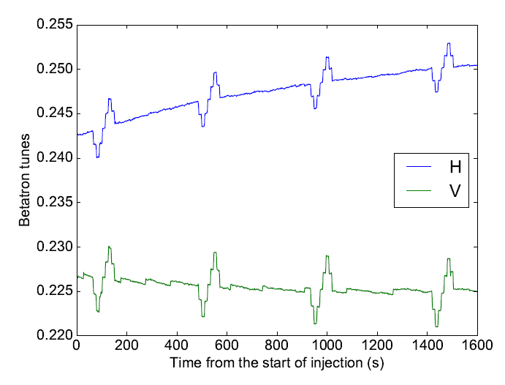
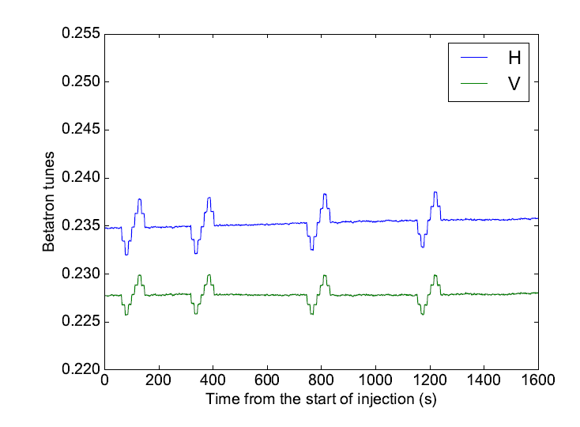
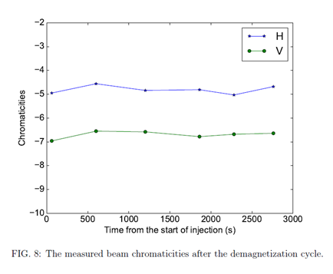
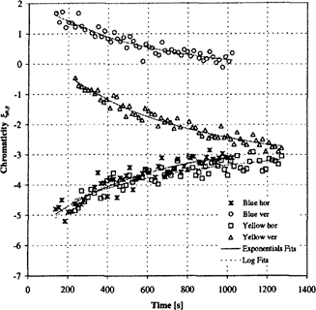
new magnet demagnetization cycle to reduce persistent current effects
beam position vs time
after
before
betatron tunes vs time
chromaticities vs time
after
before
before
after
orbits, tunes and chromaticities constant with new demagnetization cycle
demagnetization cycle provided stable and reproducible conditions and enabled frequent energy changes needed for
operations and LEReC commissioning

Slide 8
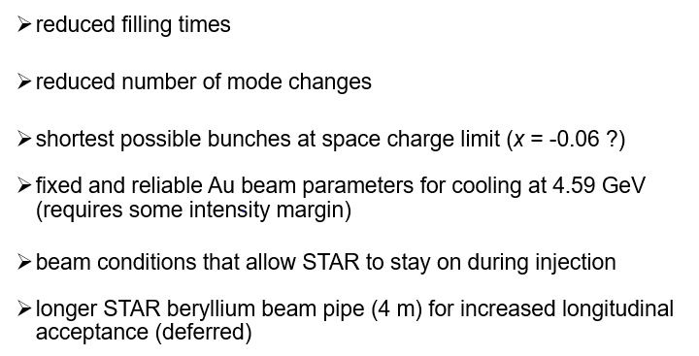
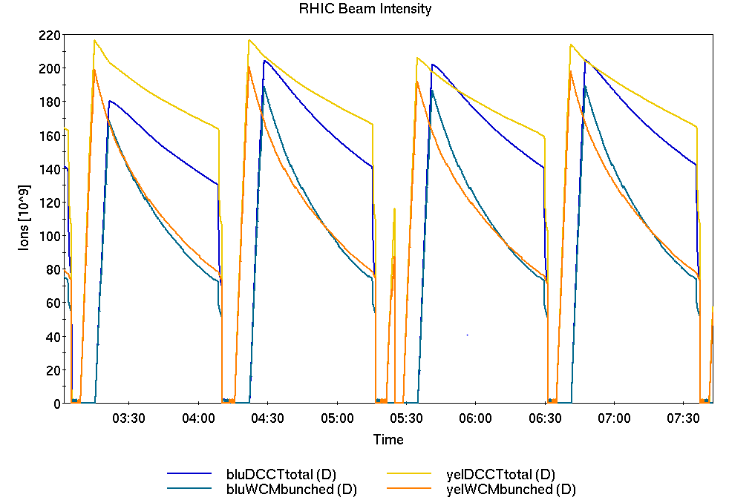
BO 3: In Michiko slide 21: quantify (where appropriate) expected improvements for RHIC Run 2020
(see below)
beam delivery scheduling
continued lattice optimization
multiple ~ 10% improvements
operator tuning with constant conditions
TBD
50%
30% improvement (for RHIC Run 2020) – increased longitudinal acceptance with existing beam pipe
fill times:
(fewer mode changes)
AGS main magnet power supply (Siemens rather than Westinghouse)
fewer bunch merges in the AGS
minimization of detector off time

Slide 9
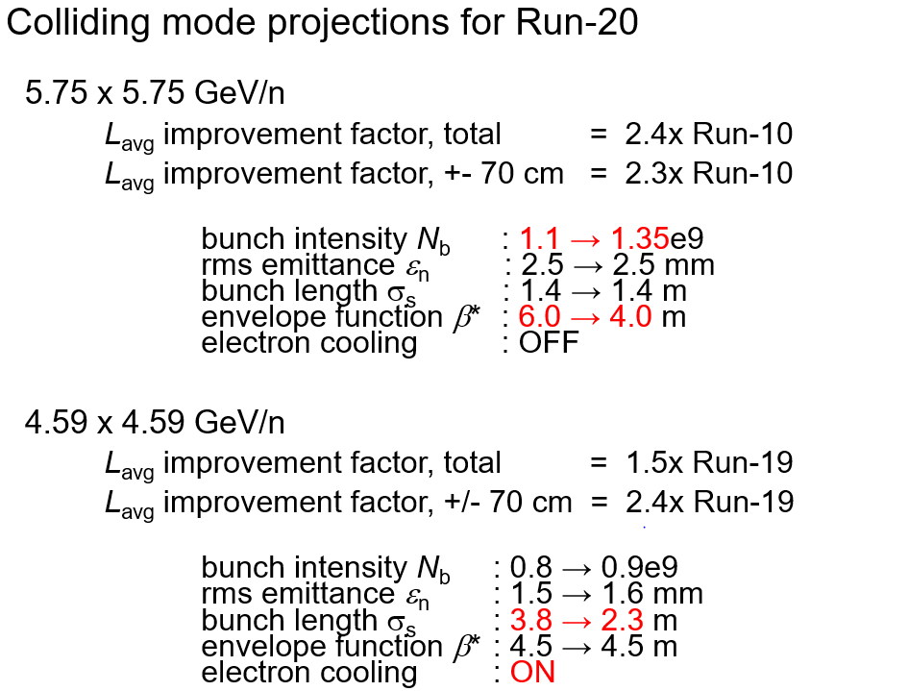
In presentation or BO #4: How will BNL go from 20% luminosity increase (mostly intensity?) to the factor of 3-4 needed for lowest energy BES-II collider-mode collisions with LEReC? This was claimed to be achievable, but we did not get details.
inject using Tandem with lower longitudinal emittance
Run-19: β* = 2m at 9.8 GeV/n
demonstrated in Run-10
Cooling (and possibly reduced number of bunch merges in the AGS)
demonstrated in Run-19
Not included: (1) additional 30% from expanded vertex cut on good events in run-20, 50% in run-21 with new STAR beam pipe, (2) multiple 10% enhancements from improved efficiency, (3) reduced β* with improved transverse cooling

