Slide 1

Status of EIC Developments
F. Willeke, BNL EIC R&D Team Leader
DOE NP Science and Technology Review
Sep 17-19, 2019
Electron Ion Collider – EIC at BNL

Slide 2
Outline
Pre-conceptual design of the BNL EIC
Design Reviews
Ongoing R&D Efforts
Summary

Slide 3
Fundamental Physics Questions which will be answered by EIC Experiments
How does the proton get its spin?
What is the nature of dense gluon matter?
How does the proton get its mass?
➔
How do quarks and gluons form nucleons and nuclei?

Slide 4
Requirements for EIC Performance
The U.S. Nuclear Physics community collaboratively developed the requirements for the Electron-Ion Collider:
  Highly polarized (70%) electron and light ion beams
  Ion beams from deuteron to the heaviest nuclei (Uranium, Lead)
  Variable center of mass energies from 20 to 100 GeV, upgradable to 140 GeV
  High luminosity of 10³³-10³⁴ cm⁻²s⁻¹
  Possibility of having more than one interaction region.
  The BNL proposal for the EIC is designed and planned be constructed to meet, and in polarization exceed, these requirements without needs for further upgrades

Slide 5
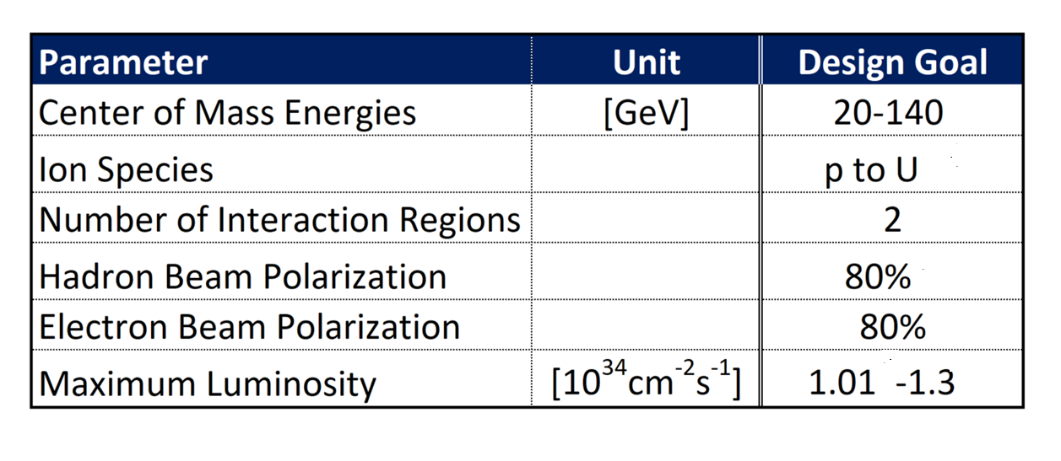
BNL EIC Design Machine Parameters
The full range of the required E_{cm} of (20-140) GeV is part of the base design there is no need for an upgrade
The full range of required ion species is already provided by the existing RHIC hadron complex
The present complex contains two large, fully equipped detector halls
Proton polarization already exists and will, with small improved exceed the requirement
Electron polarization design to exceed the requirement
Maximum luminosity exceeds the required range of L= (10³³-10³⁴) cm⁻²s⁻¹
b) c)
f)

Slide 6
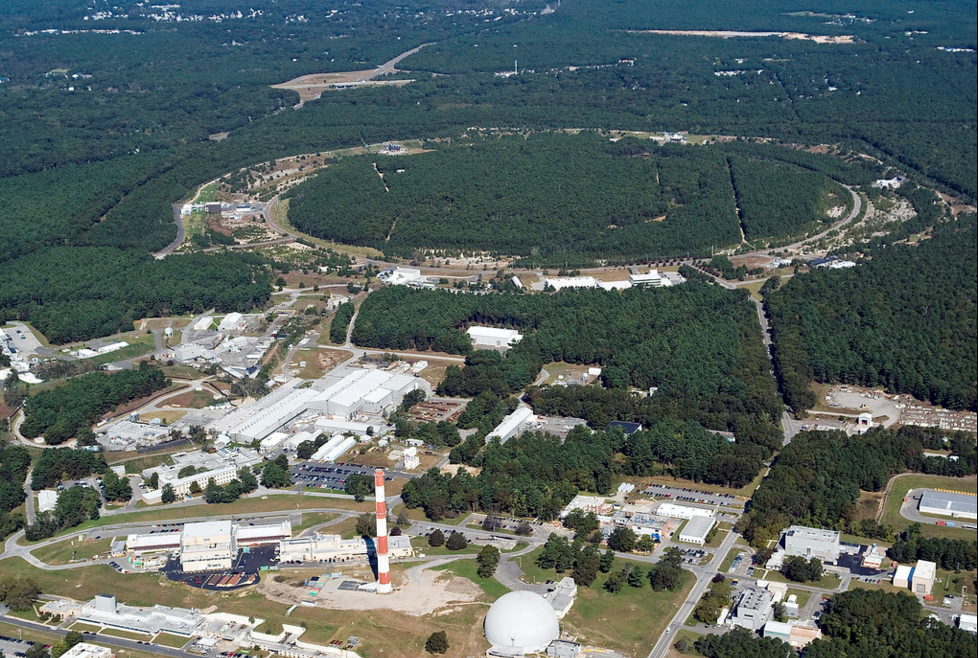

How BNL’s EIC is implemented?
Design based on existing RHIC,
well maintained, operating at its peak
Hadron storage ring (existing)
  Operated between 41 GeV and 275 GeV
  many bunches (1160)
  bright beam emittance ε_{norm} = 0.5 μm
  need strong cooling or frequent injections
Electron storage ring (new)
  Operated between 2.5 GeV and 18 GeV
  many bunches
  large beam current I_{e} = 2.5 A
BNL-EIC
Peak luminosity of L > 10³⁴ cm⁻²s⁻¹
Center of mass energy range 20-140 GeV

Slide 7
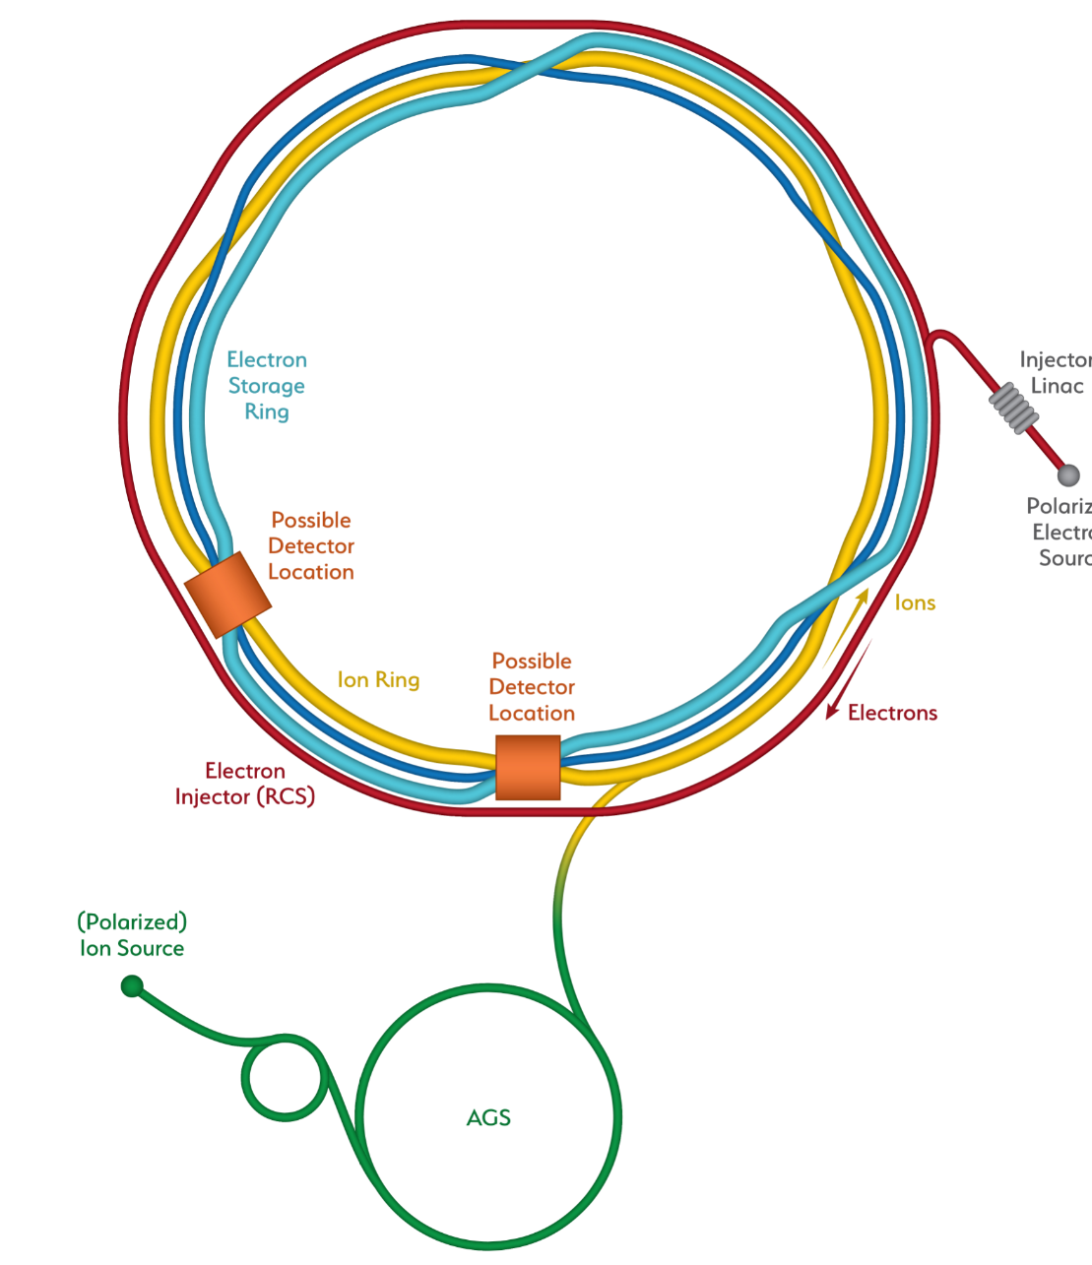

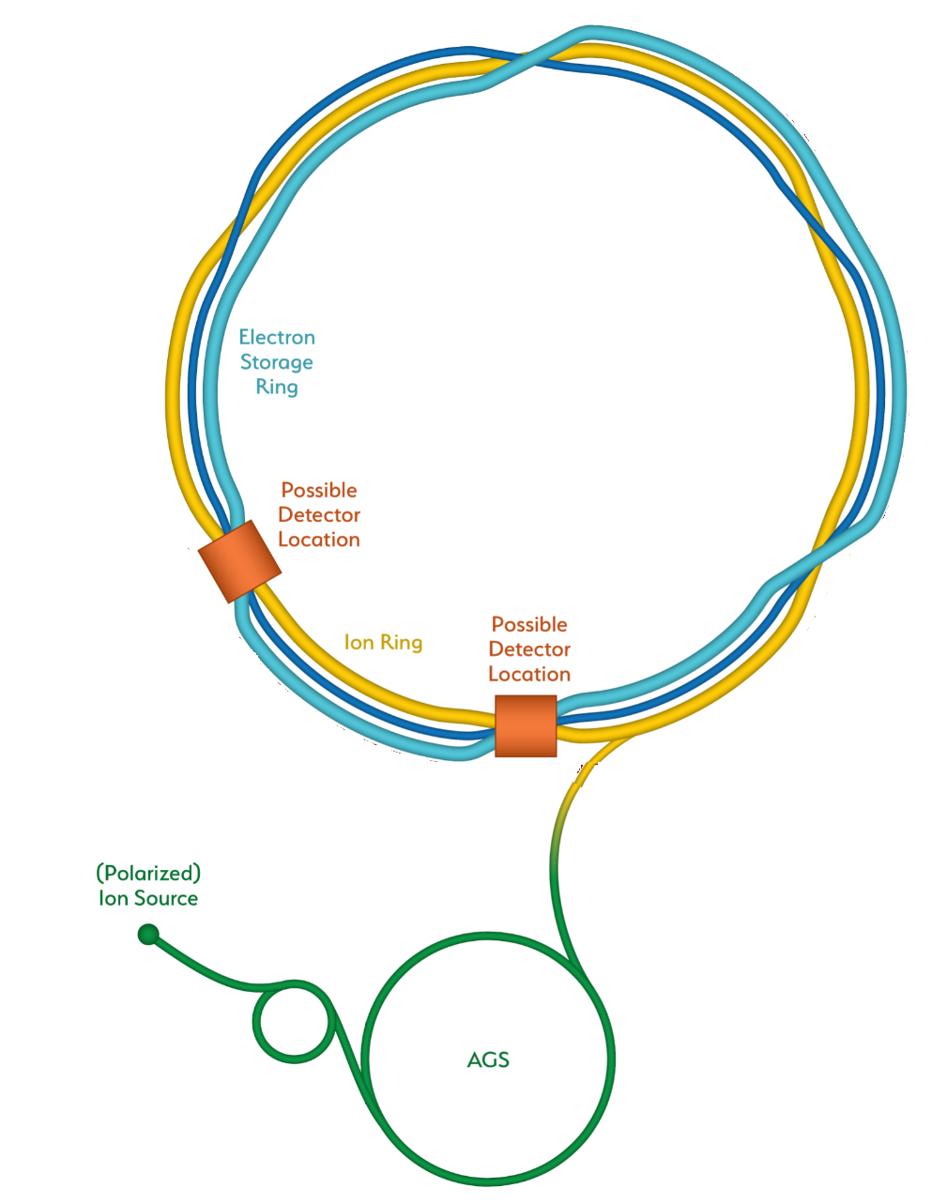
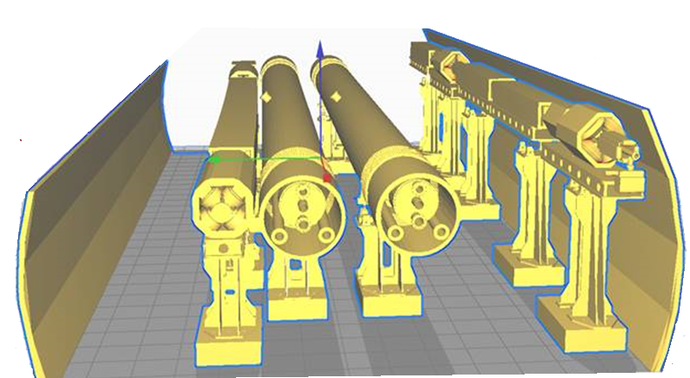
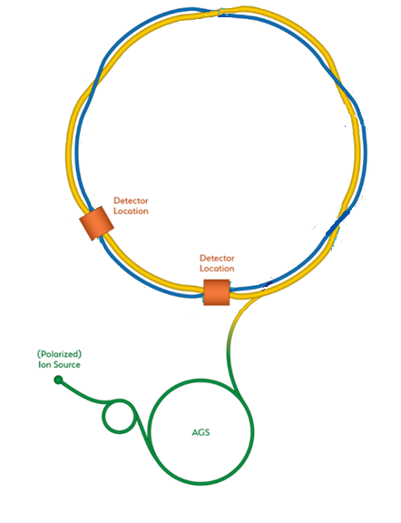
How RHIC is transformed into an EIC
BNL-EIC
Existing RHIC with
Blue and Yellow ring
Add electron storage ring
Which holds the electrons which collide with hadrons
add electron Injector complex delivering full energy electrons to storage ring
The strong hadron cooling facility completes the facility
Hadron Storage Ring
Electron Storage Ring
Electron Injector Synchrotron
Possible on-energy Hadron
injector ring
Hadron injector complex

Slide 8
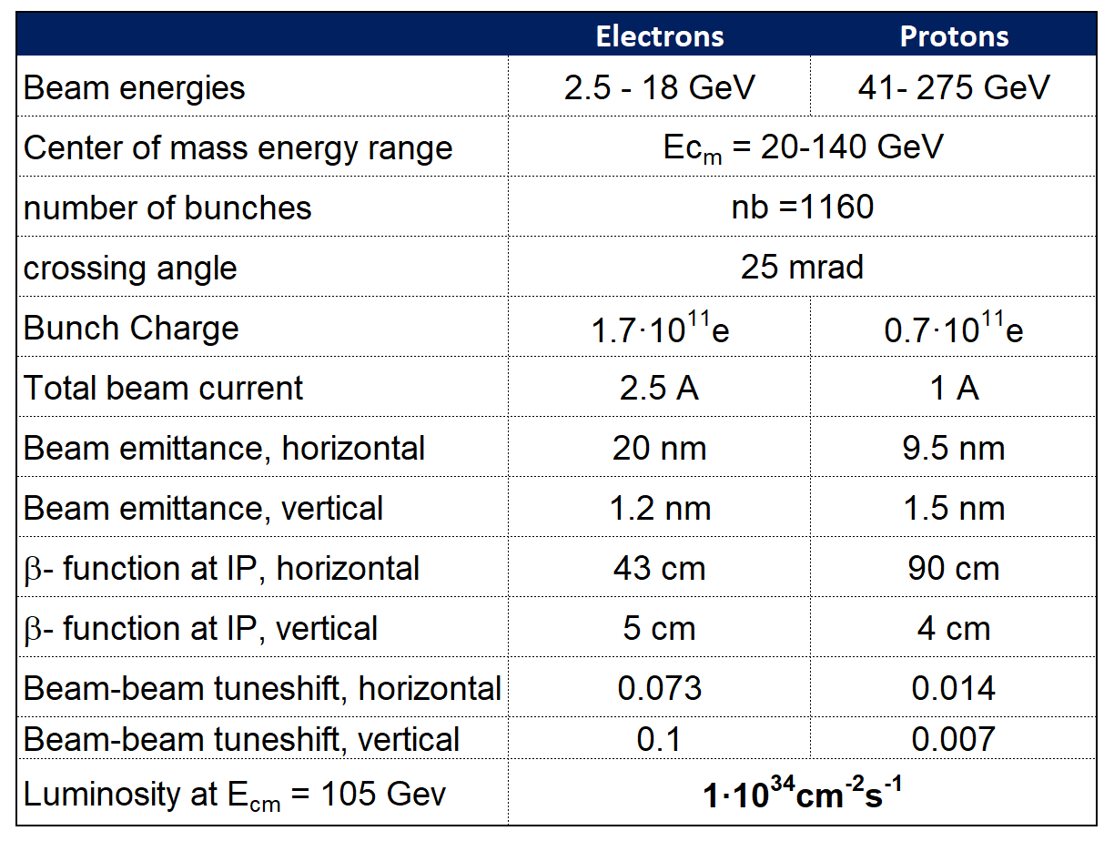
Parameters for E_{cm} and Luminosity

Slide 9
Main Parameter Implications
Implies a 25 mrad crossing angle
collision geometry with crab
crossing and crab cavities
➔ implies IBS growth times of
2 h (H) and 3.4 h (L)
  Requires strong hadron cooling
  or
  frequent on-energy injections
implies RF power of 10 MW
design choice, defines maximum
beam current
Implies to use sextant 2-12 of the
Blue ring for 41 GeV operation
1160 bunches
High Hadron beam density
  Hadron bunch charge of 0.7·10¹¹e
  Hadron emittance 9.6/1.2 nm
  Small β∗ = 4 cm, bunch length σ = 6 cm
Electron current 2.5 A at 10 GeV
Proton lowest Energy of 41 GeV

Slide 10
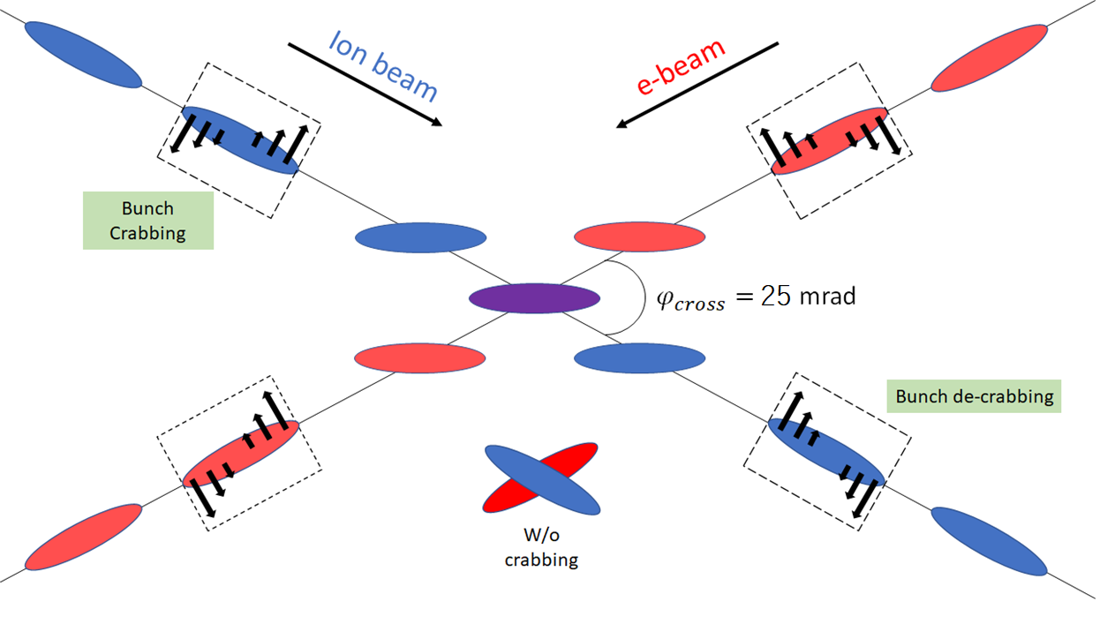
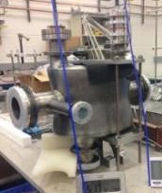
EIC High Luminosity with a Crossing Angle
crossing angle is necessary to avoid parasitic collisions due to short bunch spacing, make space for machine elements, improve detection and reduce detector background, 25 mrad
However, crossing angle causes
Low luminosity
Beam dynamics issues
Crab Crossing
Effective head-on collision
restored and most severe beam dynamic issue resolved
BNL developed prototypes which has been tested with beam in the Cern-SpS
Courtesy V. Morozov and Andrei Seryi
BNL crab-cavity prototype.

Slide 11
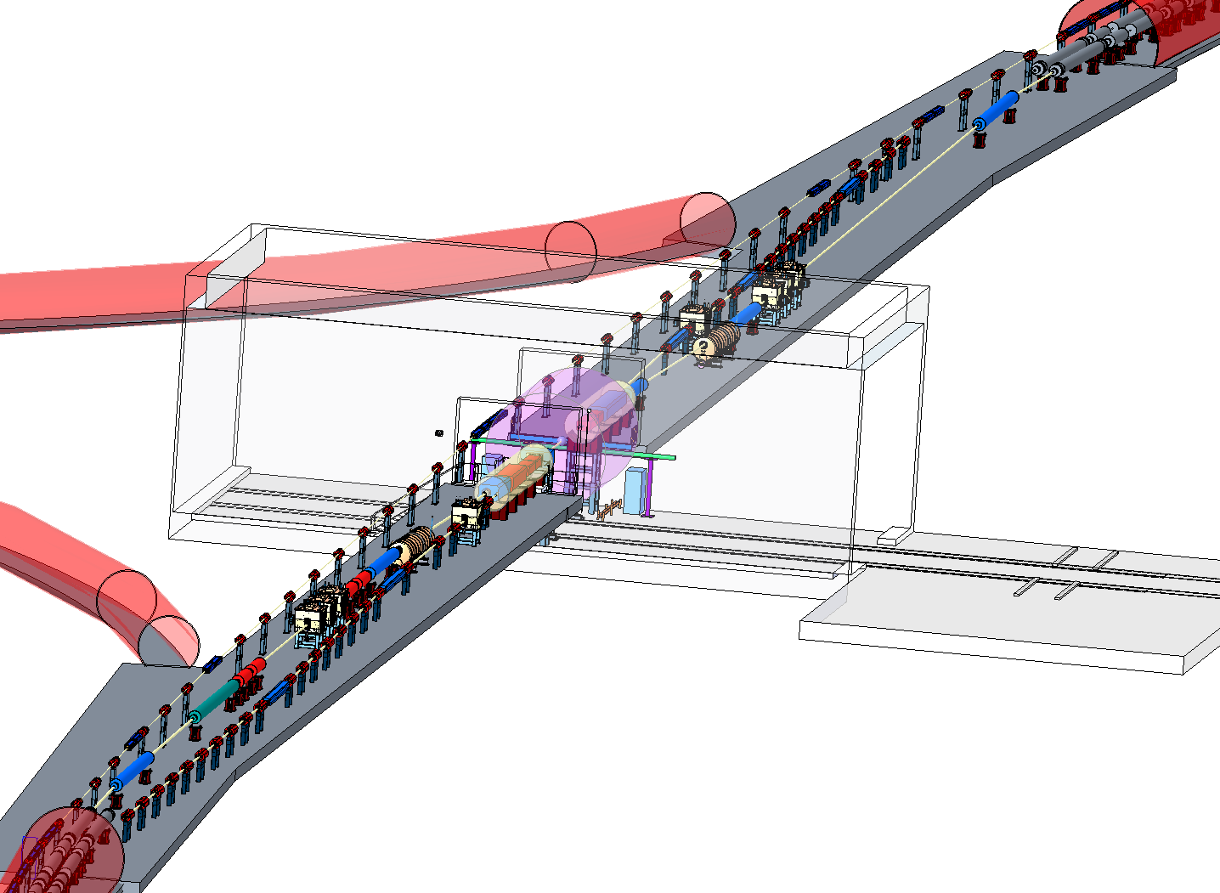
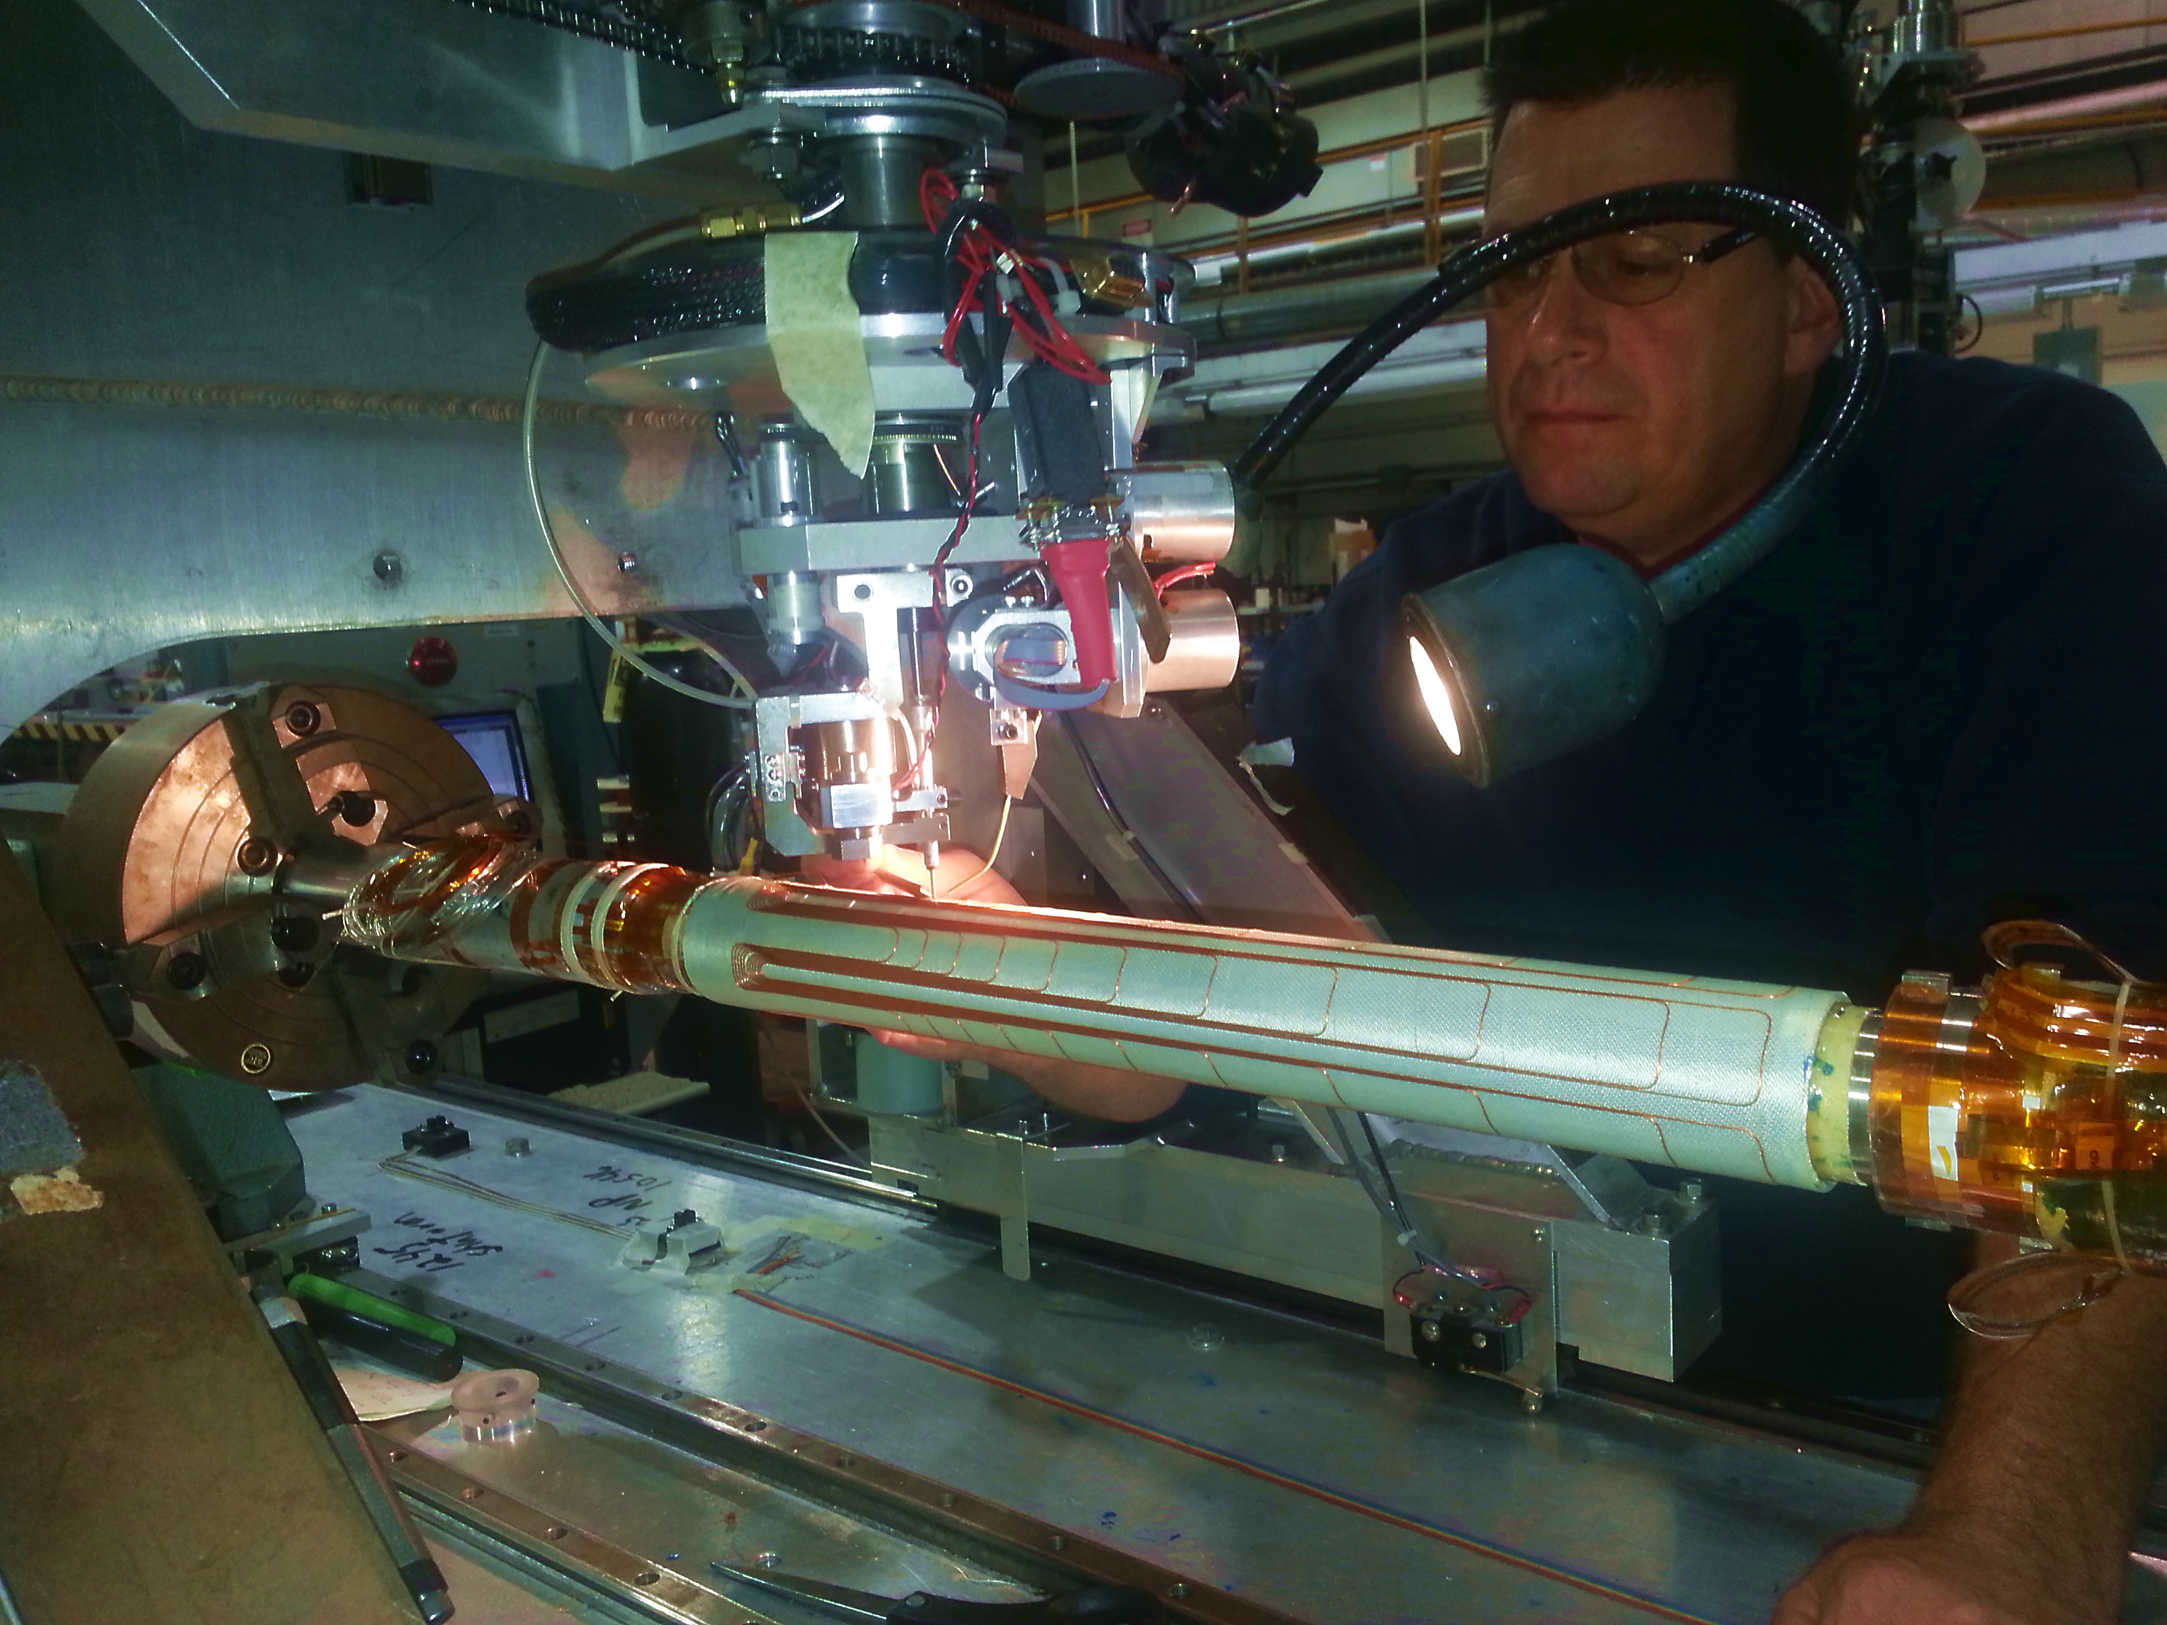
BNL-EIC Interaction Region
Luminosity
25 mrad crossing angle
Focusing the beam down to β_{yp} = 4 cm @ beam size 7 μm gives L=10³⁴cm⁻²s-¹
provides full acceptance for the colliding beam detector
Crab cavity and spin rotators for e and h accommodated
Full acceptance for forward and near beam detectors
Acceptable IR chromaticities and sufficient dynamic aperture
Acceptable beam induced backgrounds
Achieved with NbTi sc. IR magnets and in many cases by using effecicent and versatile direct wind technique
Detector hall
Direct wind s.c. coil production in progress

Slide 12
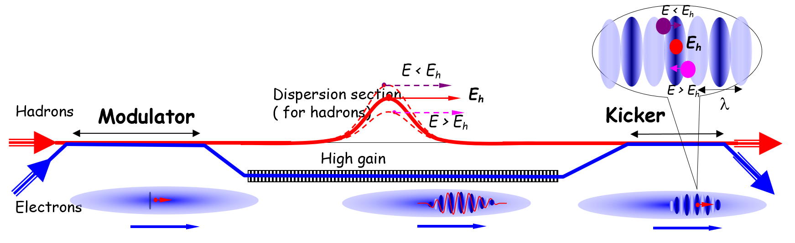
How to maintain high luminosity during a fill?
Luminosity
Issue: Dense hadron beam leads to emittance growth due to IBS causes luminosity decay, would imply reduced average luminosity
eA collisions: existing stochastic cooling system preserves emittance and e-ion maintains luminosity, thus for Ions, no issue
ep collisions: need to prevent actively p emittance growth with cooling scheme
BNL-EIC Strong Hadron Cooling: extension of established stochastic cooling to higher bandwidth: replacing cables @ amplifiers with electron beam and beam dynamical effects: Coherent Electron Cooling (CeC)
Establishing CeC desirable:
  long interrupted luminosity runs,
  advance in accelerator science
But: CeC not yet demonstrated (Risk), therefore:
BNL-EIC alternative: frequent on-energy injections using existing Blue Ring
restores average luminosity up to ~ the peak luminosity.

Slide 13
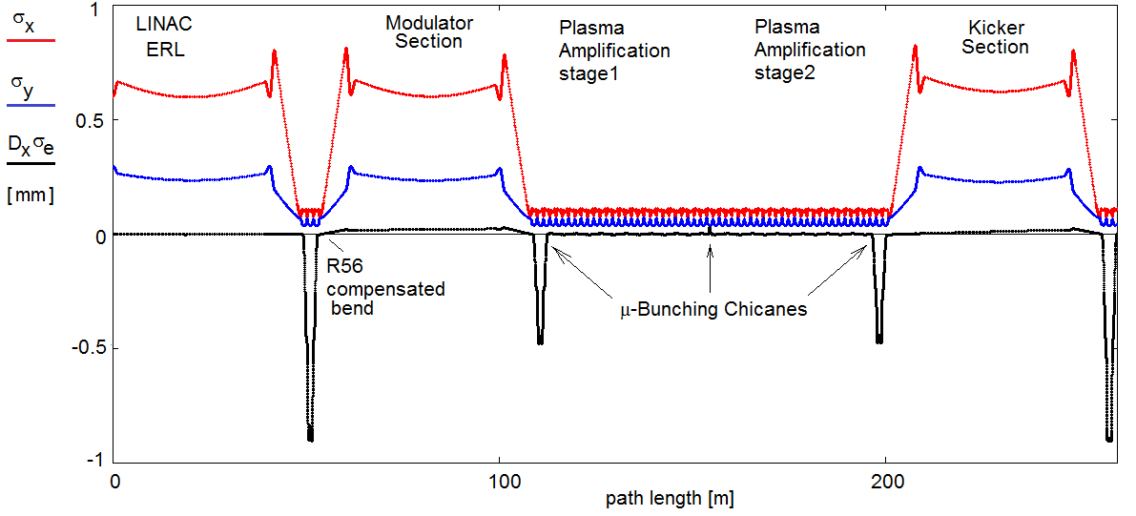
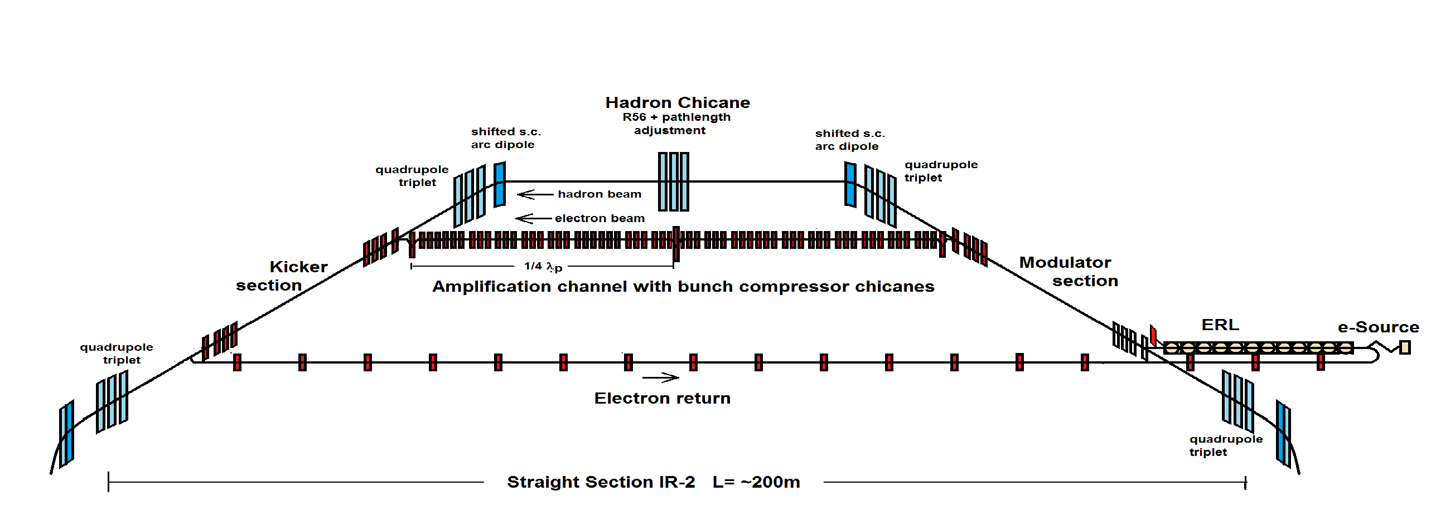
BNL-EIC Strong Hadron Cooling
Luminosity
Coherent Electron Cooling with μ-bunching amplification
will provide cooling rates of R_{cool} < 1 h⁻¹
Electron beam parameters reasonable:
E = 150 MeV, I = 100 mA, Q = 1nC ε_{N} = 1μm
Electron Beam Optics

Slide 14
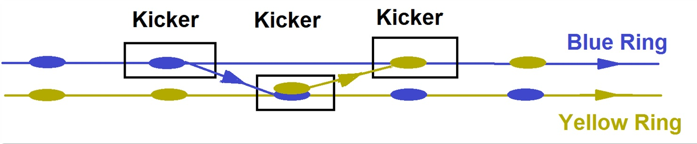
Alternative to Strong Hadron Cooling
Luminosity
maximum luminosity of 1·10³⁴ cm⁻²s⁻¹ does not depend on the feasibility of strong hadron cooling.
Since present RHIC has a second superconducting ring, the Blue Ring, on-energy injections into the collider ring, the Yellow Ring will replace the hadron bunches after one hour of storage.
Transfer takes 13 μs and will preserve the total charge in both machines, no transient injection effect.
The emittance growth between injections is so small that an average luminosity of 0.9·10³⁴ cm⁻²s⁻¹ will be achieved.
The required small vertical emittance ε_{Ny} = 0.5 μm will be achieved with standard DC electron beam cooling in the AGS.
No new hardware for spin transparency is required

Slide 15
Luminosity versus E_{CM} center of mass energy
Larger crossing angle 50 mrad ➔ more crab voltage
Stronger cooling required
Dynamic aperture more critical
Easier to optimize for lower E_{cm}
Modest crossing angle 25 mrad
robust solution, parameters previously demonstrated
Easier to optimize for higher E_{cm}
BNL EIC
Optimization for low E_{cm}
Annual Integrated Luminosity [fb⁻¹]
Peak Luminosity [cm⁻²s⁻¹]
10³⁴
10³³
10³²
BNL EIC
Optimization for high E_{cm}
100
10
1
Tomography (p/A)
Spin and Flavor Structure of
the Nucleon and Nuclei
Internal
Landscape of the Nucleus
QCD at Extreme Parton Densities-
Saturation
150
Center of Mass Energy E_{cm} [GeV]

Slide 16
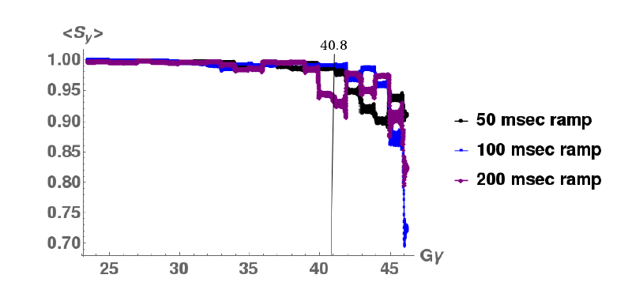
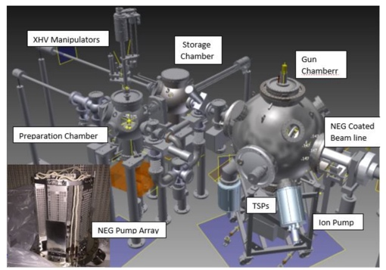
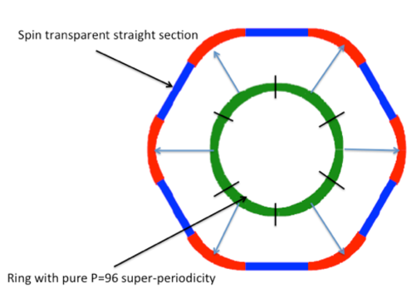
18 GeV Rapid Cycling Synchrotron enables high electron polarization in the electron storage ring
Ingenious optical design: High periodicity arcs and unity transformation in the straights suppresses all systematic depolarizing resonances up to E >18 GeV
resonance free acceleration up >18 GeV
no loss of polarization on the entire ramp up to 18 GeV (100 ms ramp time, 2 Hz)
Polarized Electron Source
(R&D Prototype)
RCS Design
RCS Polarization Performance
Requires well aligned quadrupoles @ rms orbit ≤ 0.5 mm @ good reproducibility
well within the present state of the art of orbit control and
achieved today by NSLS-II Booster synchrotron.

Slide 17
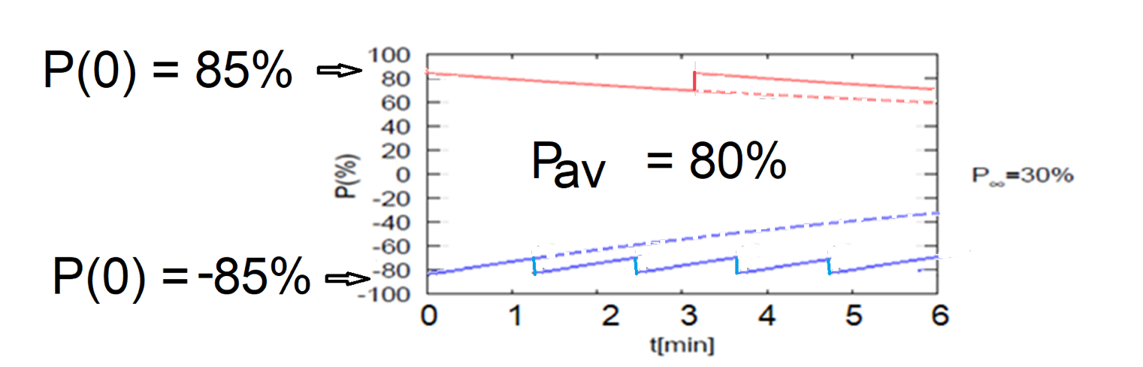
High average polarization at electron storage ring of 80% by
Frequent injection of bunches with high initial polarization of 85%
Initial polarization decays towards P∞ < ~50%
At 18 GeV, every bunch is refreshed in 2.2 min with RCS cycling rate of 2Hz.
B P
B P
Refilled every 1.2 minutes
Refilled every 3.2 minutes
Re-injection
P_{av}=80%
P∞= 30%
(conservative)
P_{av}=80%
Re-injections
Exceeds key parameter requirement!

Slide 18
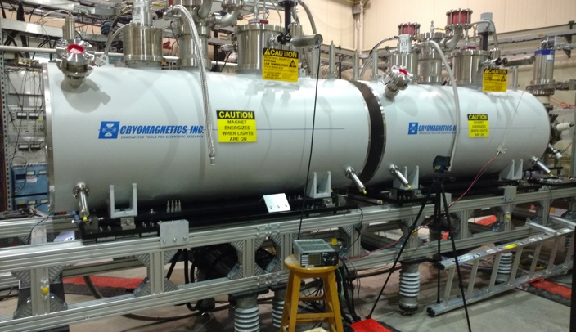
BNL-EIC Hadron Polarization
Existing p Polarization in RHIC achieved with “Siberian snakes”.
Near term improvements will increase proton polarization in RHIC from 60% to 80%.
³He polarization of >80% measured in source
80% polarized ³He in BNL-EIC will be achieved with six “snakes”,
Acceleration of polarized Deuterons in BNL-EIC 100% spin transparent
Need tune jumps in the hadron booster synchrotron
Exceeds key parameter requirement!
Electron beam ion source EBIS with polarized ³He extension

Slide 19
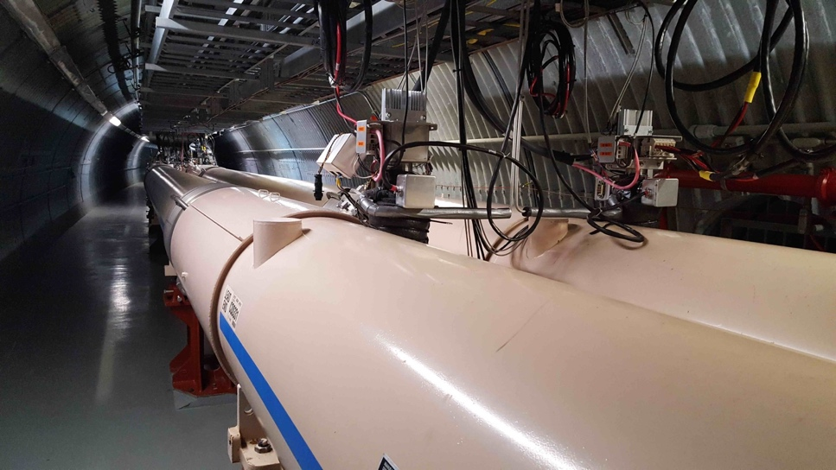
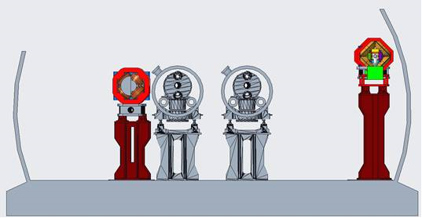
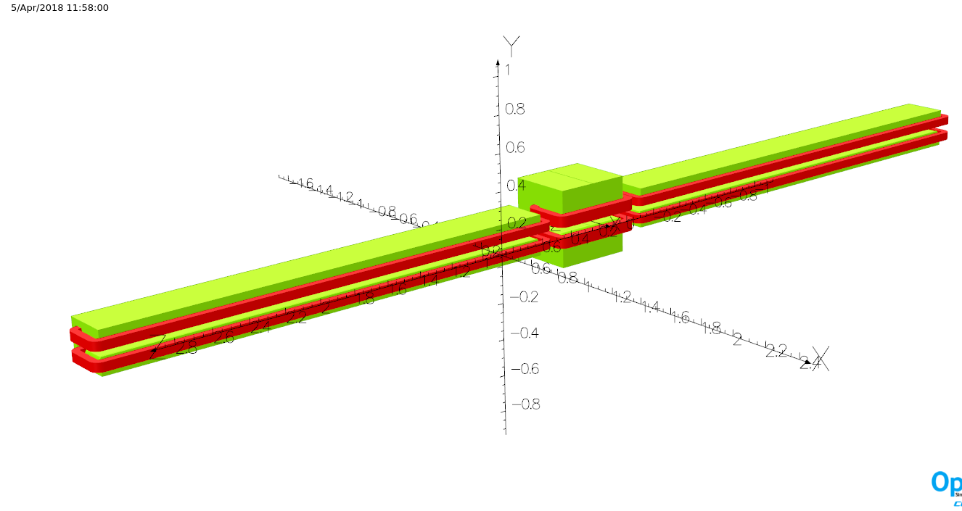
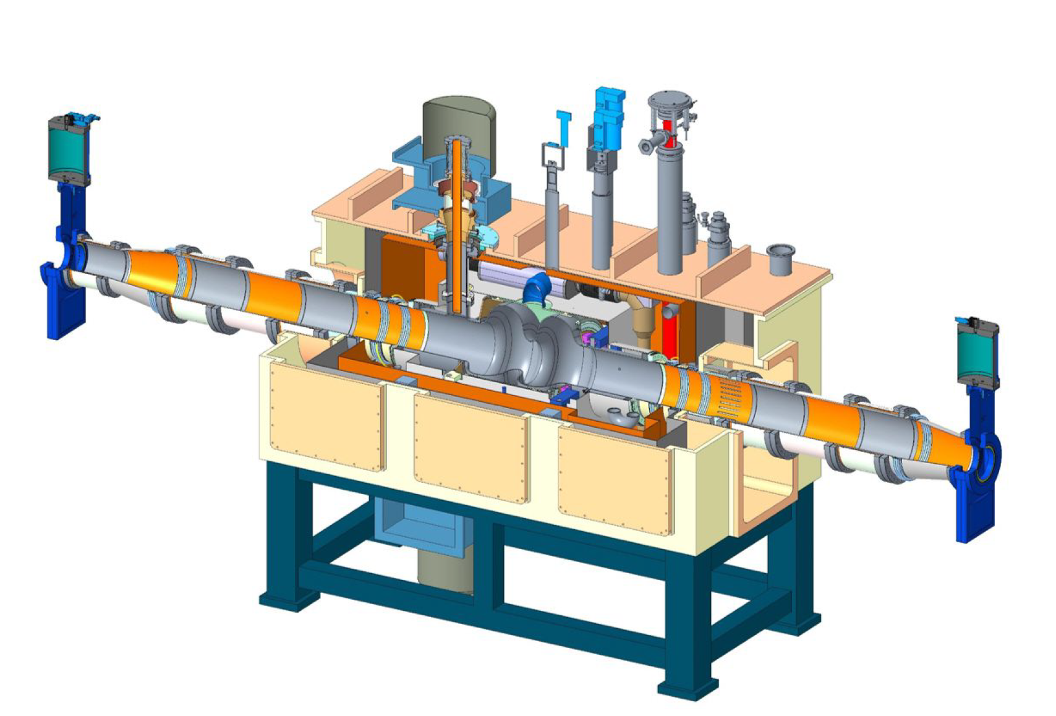
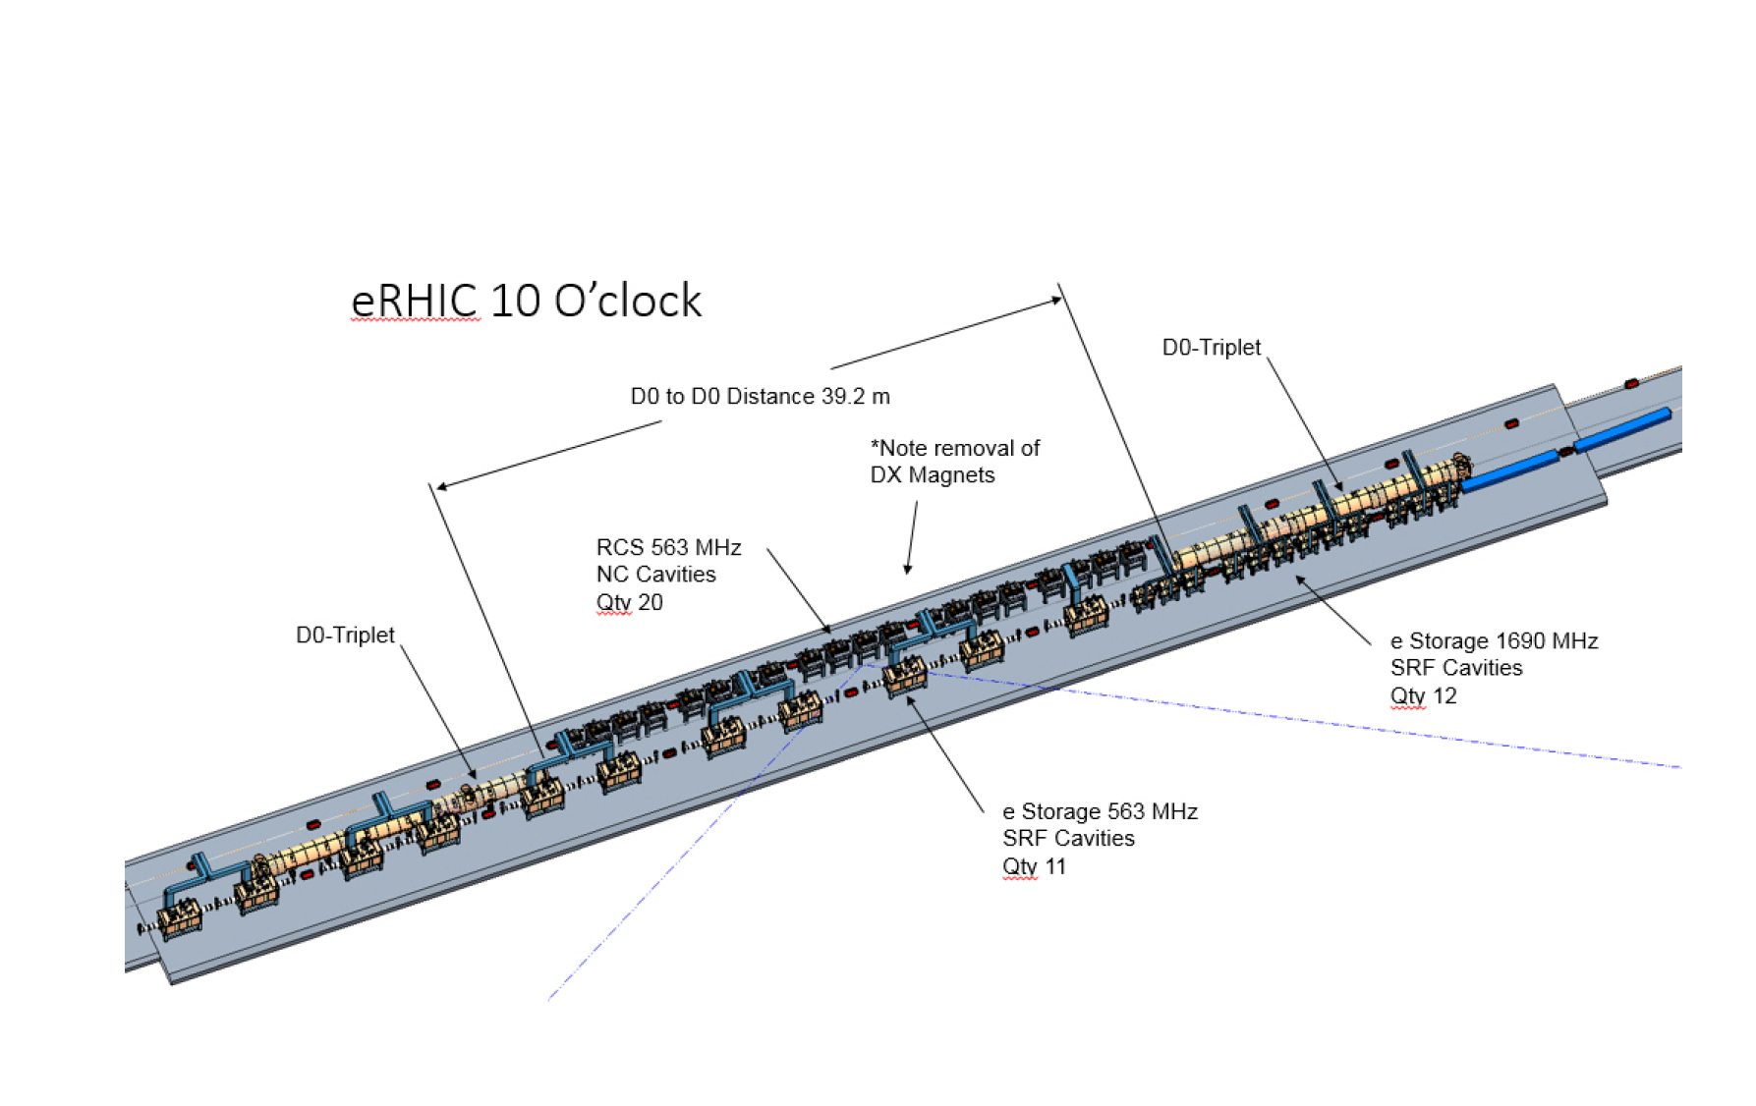
Summary of Technical Scope
The technical scope thus consists of
3 accelerator rings:
  RHIC yellow ring 275 GeV
  Rapid Cycling Synchrotron (400 MeV – 18 GeV)
  Electron Storage Ring (2.5-18 GeV),
2 Injector complexes:
  Hadron injectors (existing)
  Electron Injectors: Electron source, injector LINAC,
Hadron Cooling Facility
Common systems
Infrastructure

Slide 20
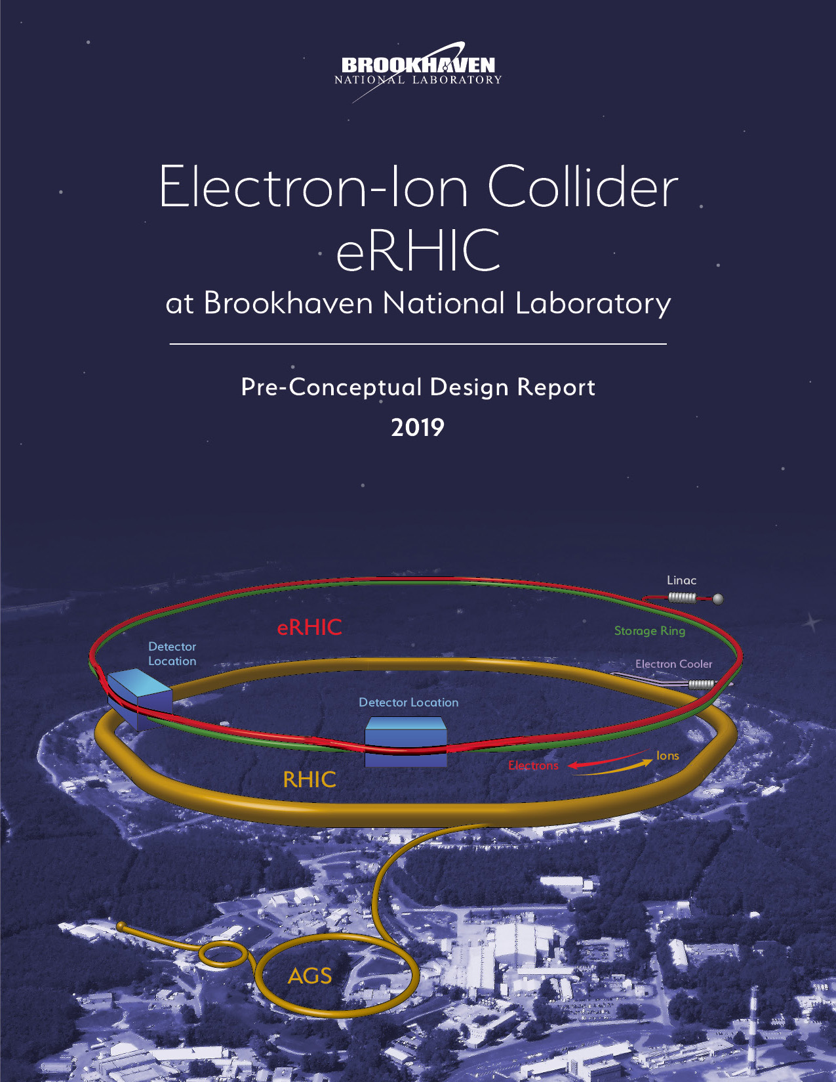
BNL EIC Pre-Conceptual Design Report
Updated
August 2nd
2019

Slide 21
R&D Overview
A rich R&D program supports the BNL-EIC (eRHIC) pre-conceptual Development:
Development of preconceptual Design
Development of beam dynamics models and simulation codes for EIC
Development of reliable electron sources
  High charge polarized photo-cathode gun
  High current unpolarized photo-cathode gun for cooling ERL
Superconducting RF R&D for EIC
  591 MHz 2-cell superconducting cavity for high current electron storage ring operation
  591 MHz Five cell s.c. cavity development for cooling ERL and RCS
  High power (500kW) main forward coupler with variable coupling development
  Test of Si-C HOM absorber
  Crab-Cavity prototype beam test at CERN SPS, evaluation of results
Strong Hadron Cooling
  Development of 3-D μ−bunched electron beam cooling theory @ simulation, strawman design of cooling facility
  Experimental tests ➔ next talk
  Explore bunched beam electron cooling using a storage ring for electrons
³He Source and polarimetry development
SC-IR quadrupole development
  Prototyping of Nb-Sn IR quadrupole
  Exploring high-field limit of direct wind s.c. IR magnets
Experimental tests of proton polarization in mockup figure-8 geometry in RHIC

Slide 22
R&D - Overview
eRHIC Development and Design Studies
Goal: Develop low risk Ring-Ring based BNL EIC which demonstrates EIC design goals, resolves beam dynamics questions and issues, and remains within cost expectations
Result: Comprehensive pre-conceptual design report completed in July 2018, updated August 2019, Preconceptual Design Review by top authorities of the field April 2018/2019
Funding: Base Funding FY17-19
eRHIC Beam Dynamic Studies and Development of Simulation codes
Goal: Develop/adapt computer code for critical EIC beam dynamics issues, benchmark codes by comparing different codes and by comparing simulations with experimental results
Result: Computer codes for all critical beam dynamics issues made available (beam-beam effects, dynamic aperture, polarization, fast ion instability, electron cloud effects, collective effects, Intrabeam-Scattering …) compared to each other, whenever possible compared with experiments. Critical simulations carried out in support of eRHIC design study
Ongoing: Continue on critical beam dynamics questions (crab crossing, fast ion instability, electron cloud instability (plus specific R&D topics discussed below)
Funding: Base Funding FY17-18, LDRD FY16-17, Additional NP funding KB020105-2, FOA FY18-19 (beam-beam centered)
Collaborations: with NSLS-II, LBNL, MSU, FNAL (support from KEK)

Slide 23
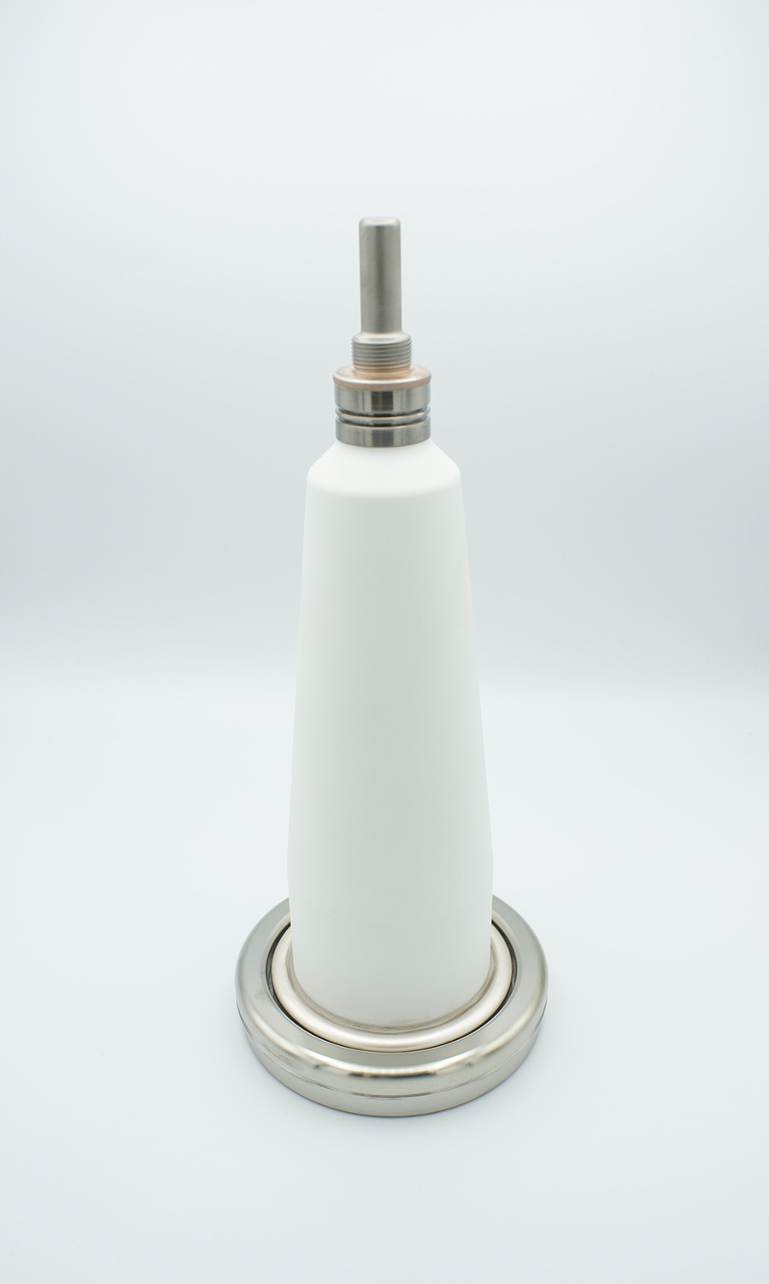
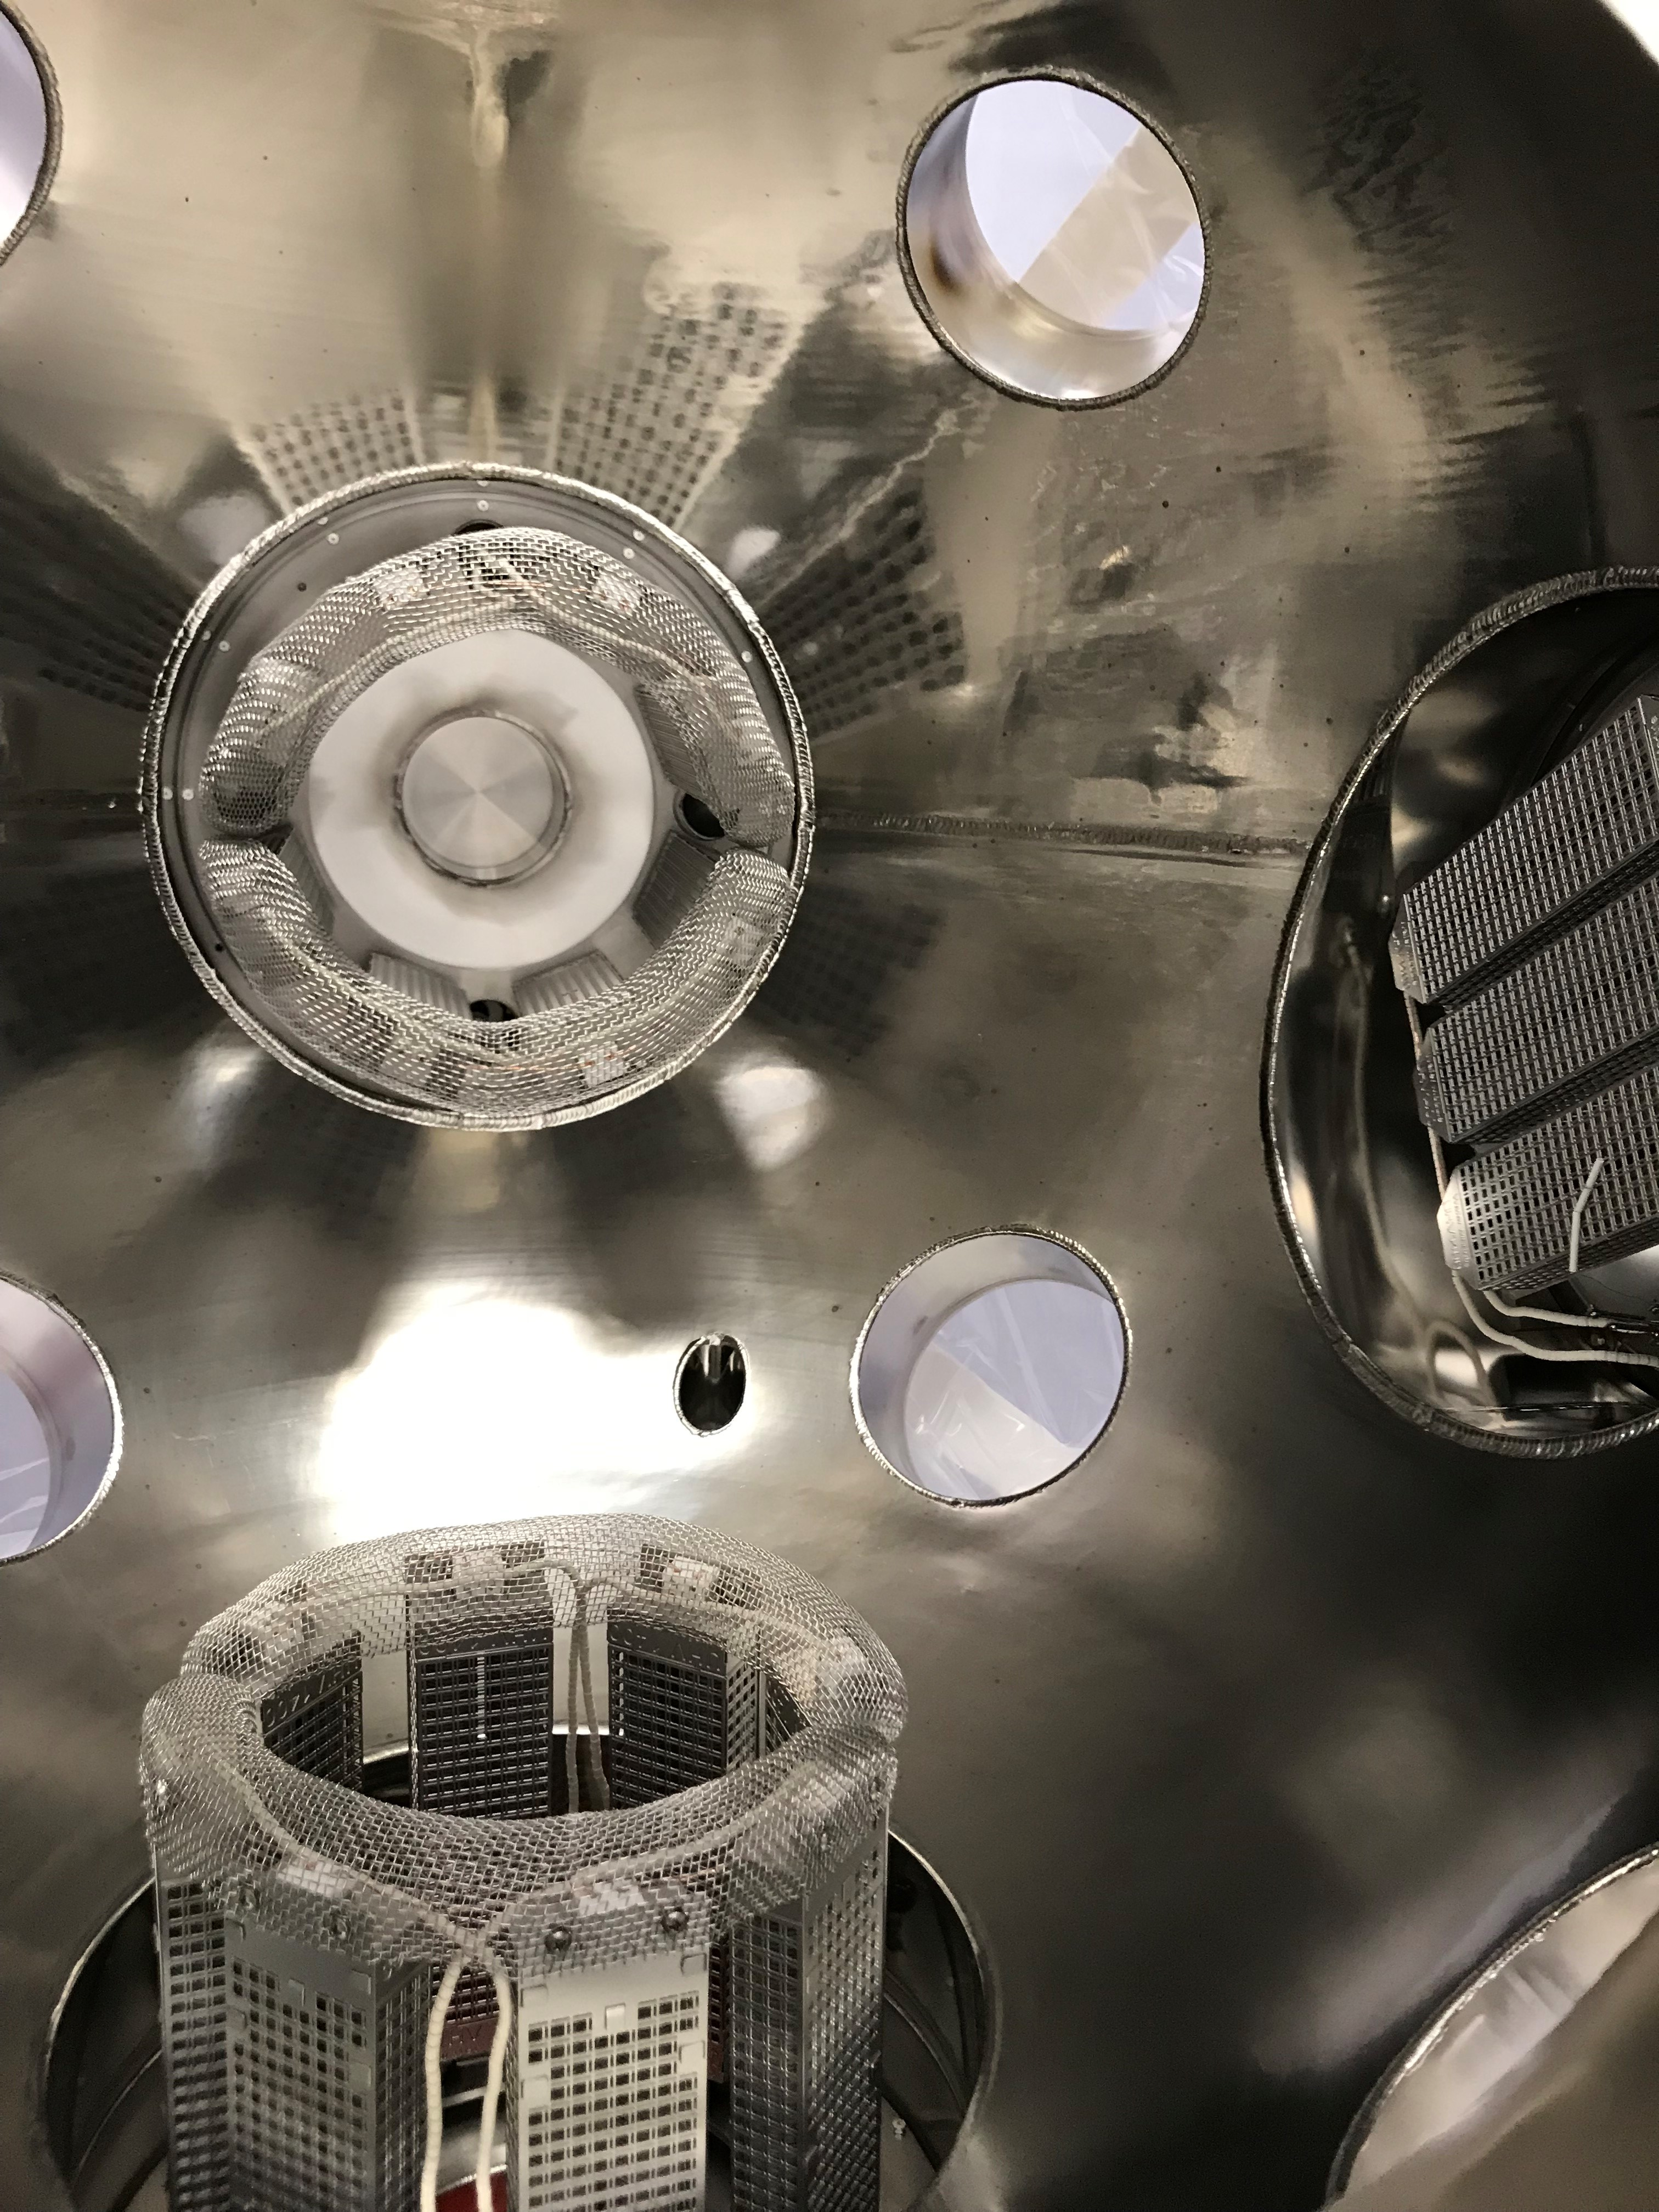
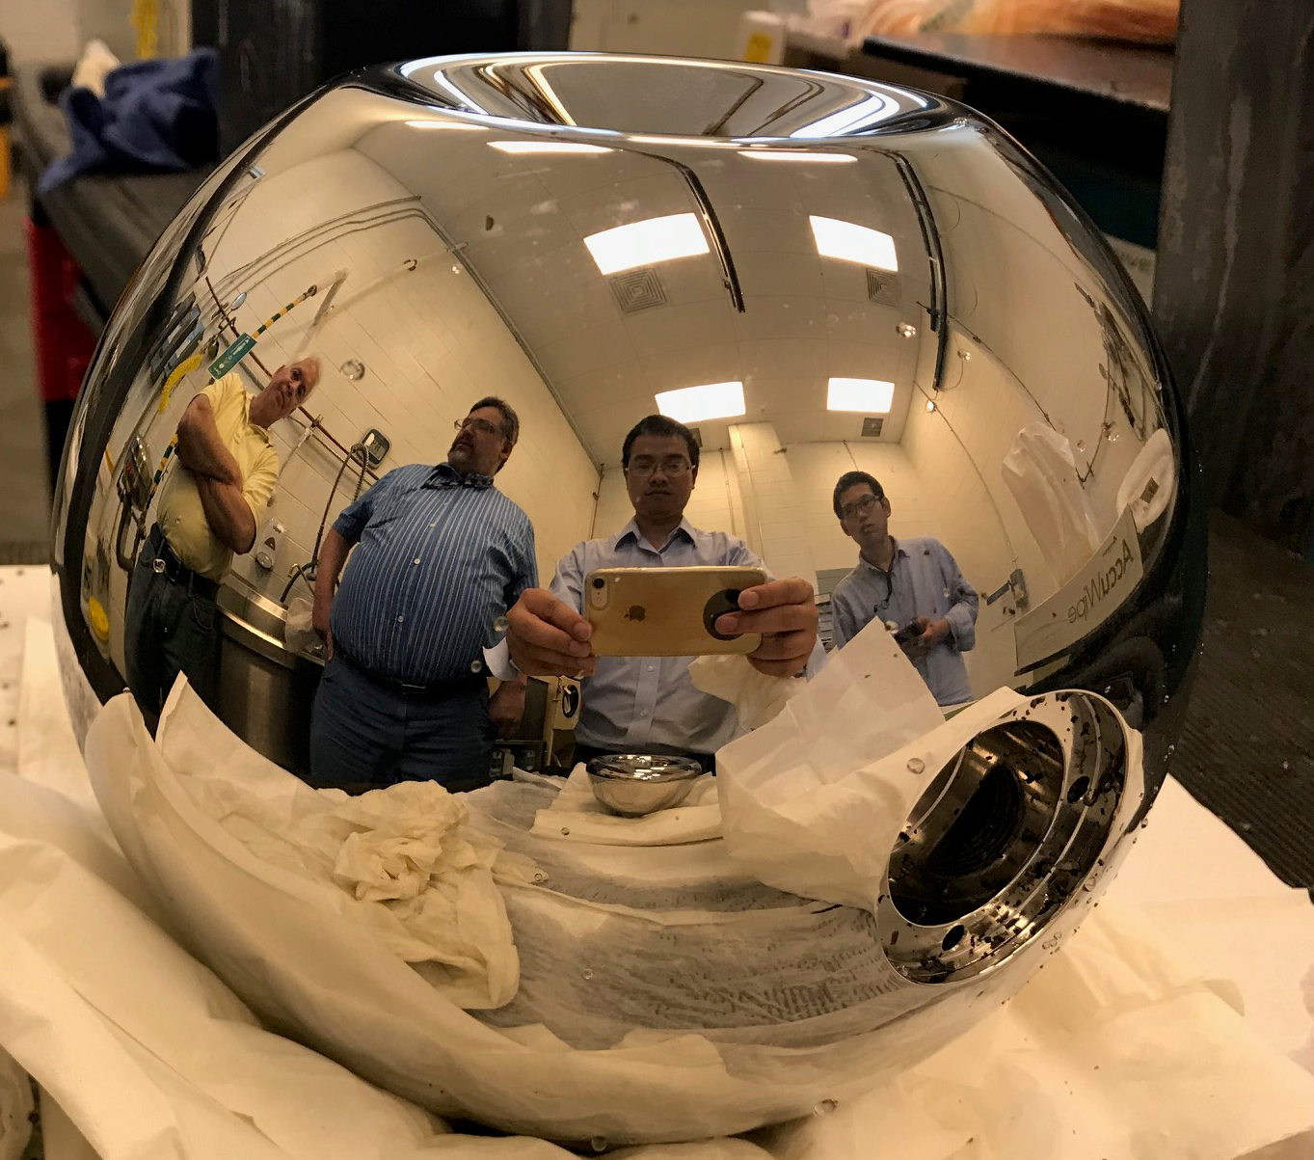
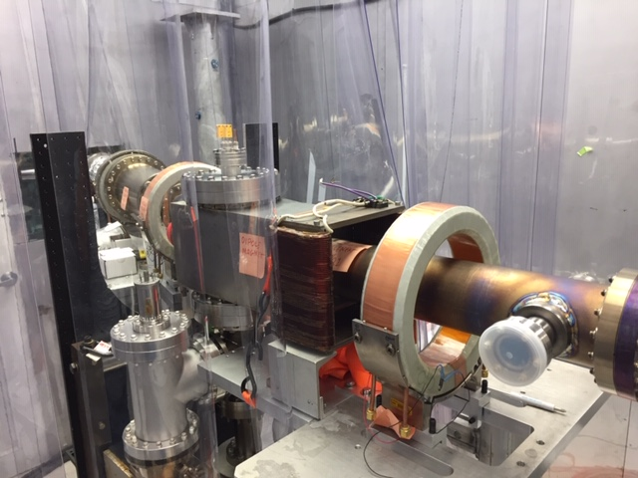
R&D- Overview continued
eRHIC Development of polarized Electron Guns
Goal: - Develop polarized electron gun for high bunch charge (>15 nC), high average ……...current (>50 mA@ 5nC), high reliability, and long cathode lifetime
Results: -XUV scale vacuum (10⁻¹³ torr) demonstrated with existing Gatling gun
-Diagnostic beamline designed, assembled, vacuum tested
-New inverted gun design with minimum ion back-bombardment
-Parts for new gun procured, prepared, assembly started
- High voltage tests up to 400 kV successful
Next steps: complete assembly of new gun and start beam tests in 2019, prepare e-source lab
Funding: Base Funding FY17-18, Additional NP funding FY17/18 KB020105-2, HEP-DD funds, BNL Program Development Funds (PDF).
Collaborations: MIT, TJNAF

Slide 24
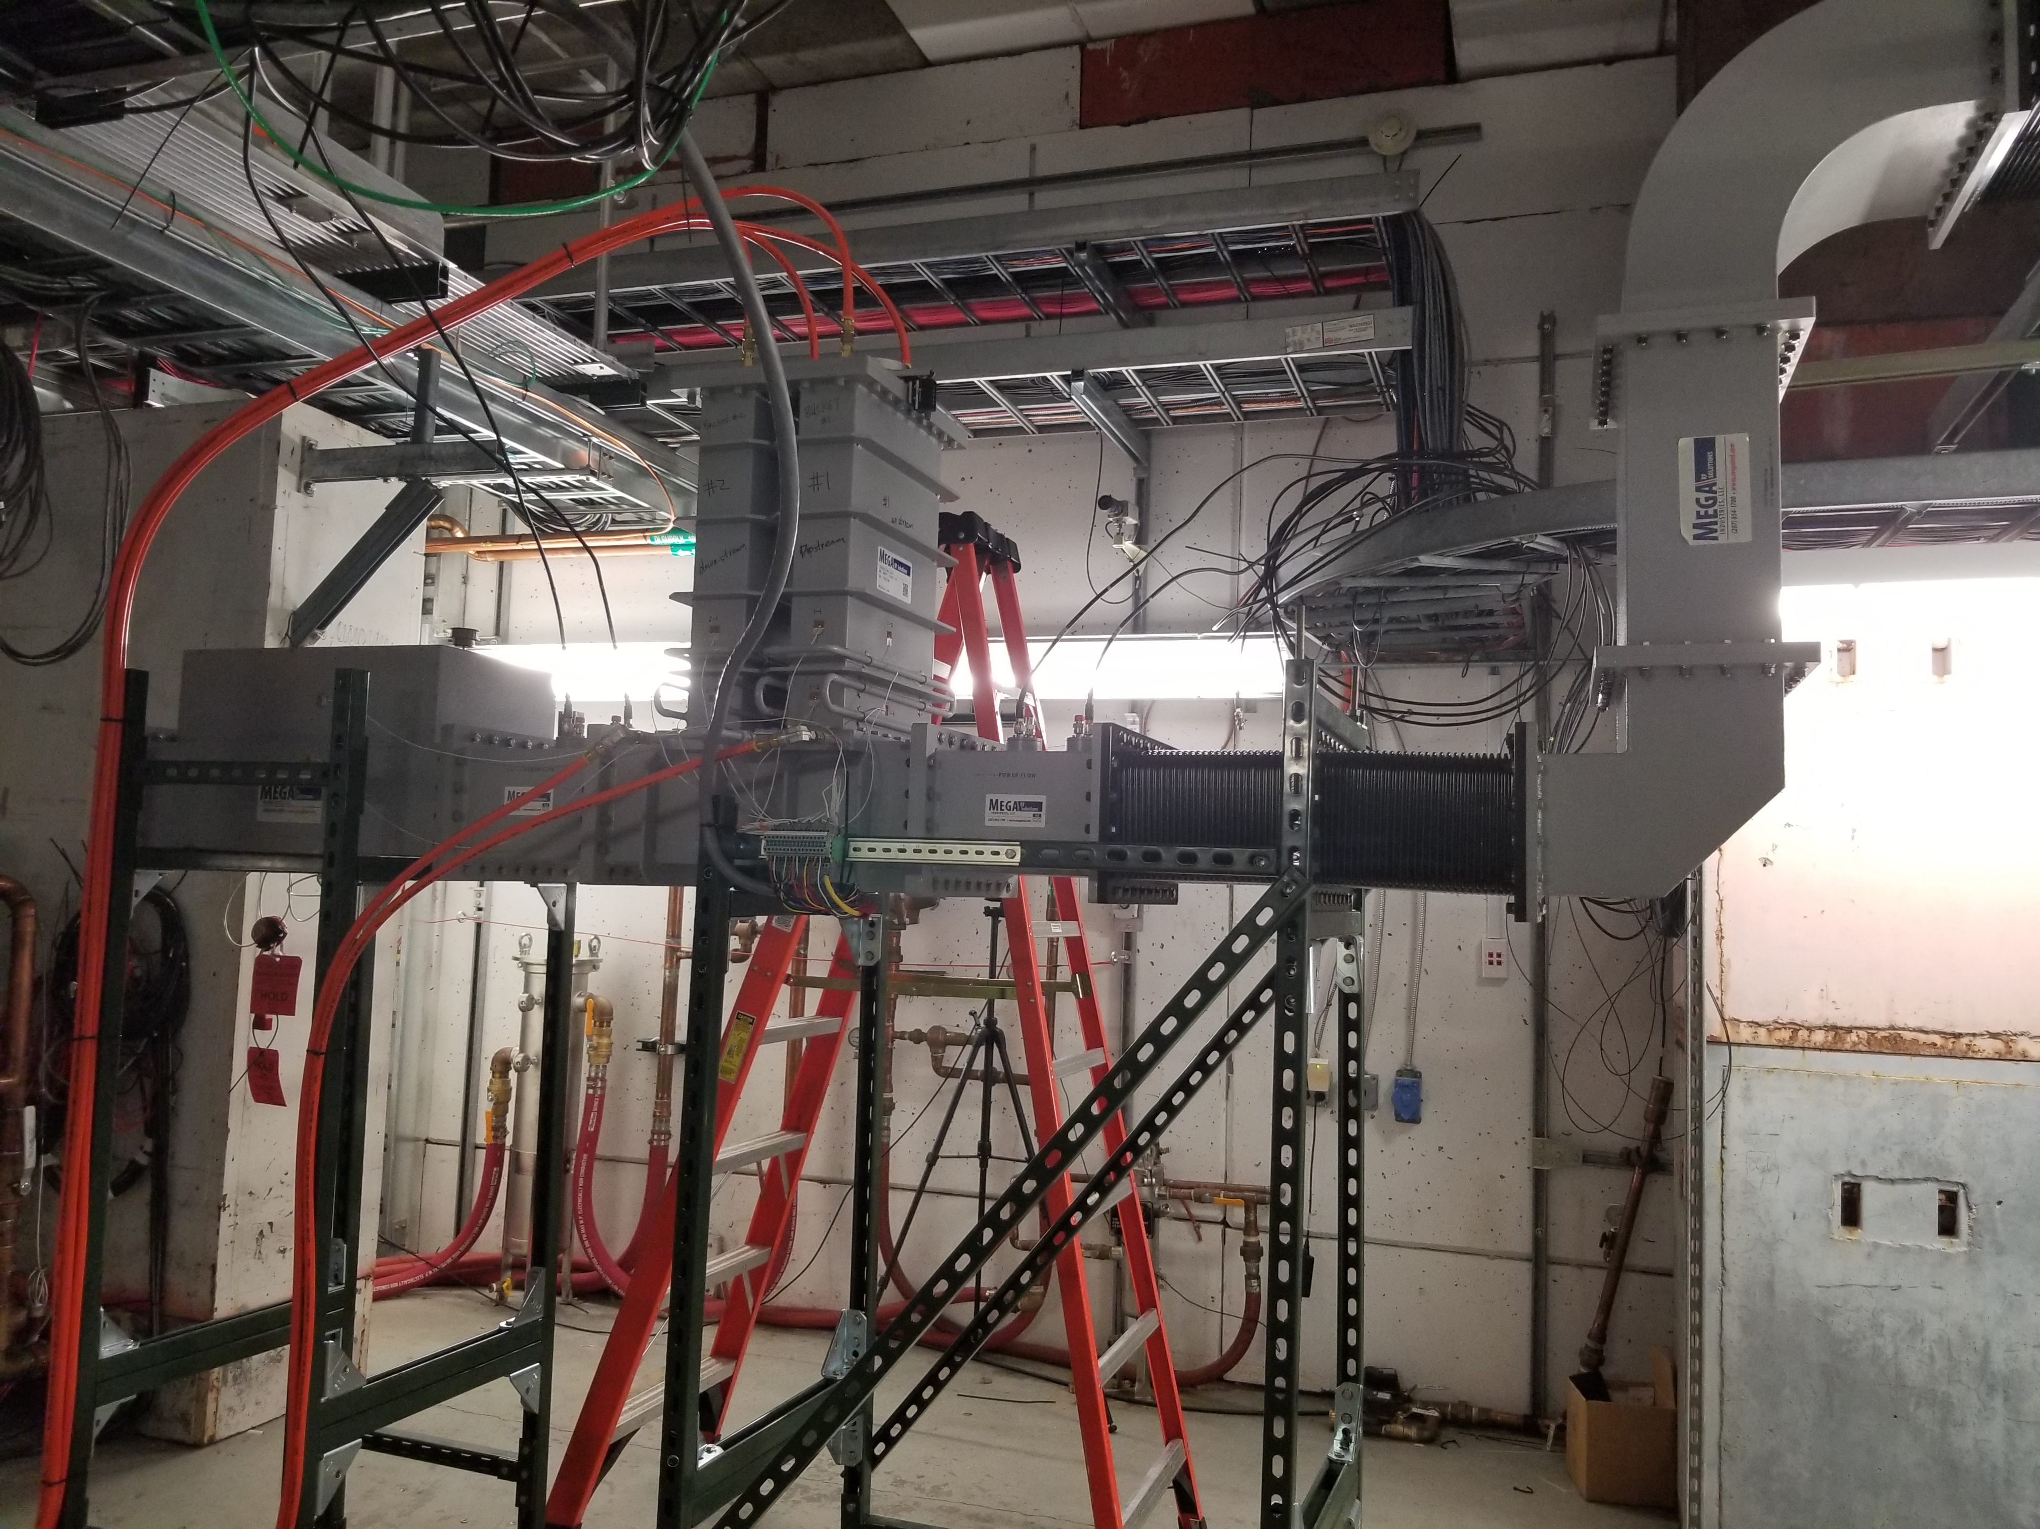
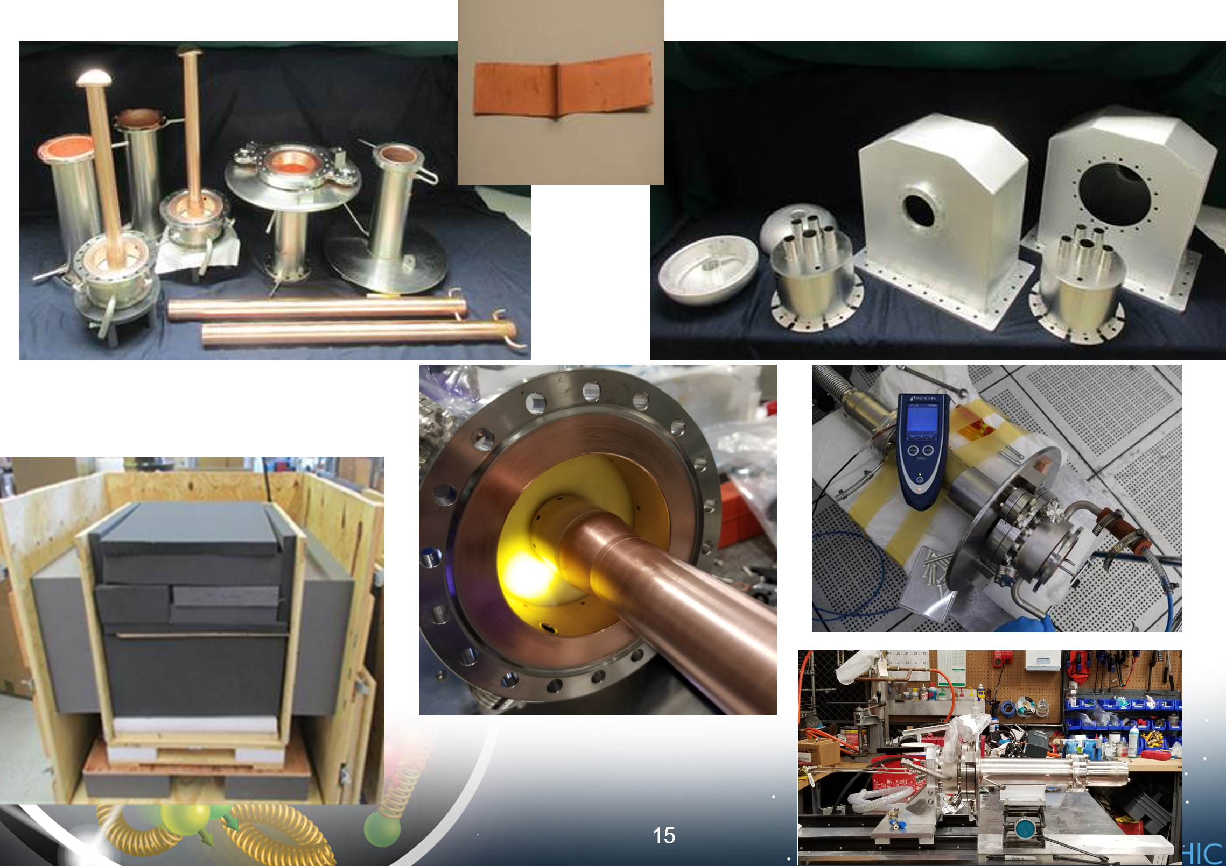
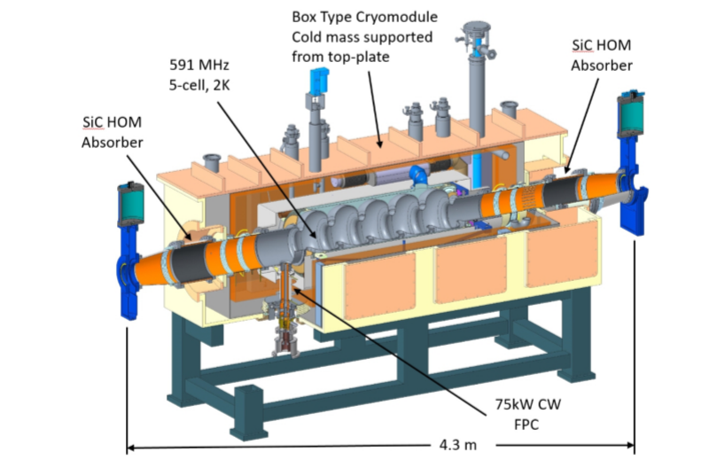
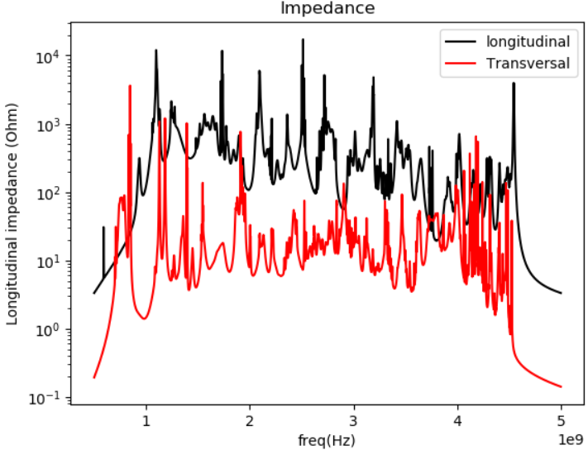
R&D-Overview continued
Superconducting RF R&D for BNL-EIC
Goals: Develop RF technology to identify unexpected challenges and to verify assumptions for the accelerator development.
This includes: - Develop of superconducting (s.c.) cavities for ERL application (strong hadron cooling),
- Electron ring storage ring cavity development,
- Development of high power (1MW), variable coupling FPC
- R&D on performance and manufacturability of SiC beam pipe absorber
- Analysis of ata from crab-cavity beam test at CERN SPS (Coll JLAB)
Results: - 5-cell high current Linac cavity developed and prototyped in industry (Cu and Nb units, vertically cold tested, calculated HOM verified
- 2-cell sc storage ring cavity developed with appropriate HOM damping which satisfies storage ring power and voltage needs and beam stability requirement
- FPC: components manufactured, test stand built for high power tests
- Si C HOM Absorber: ready for high power test in FY21
Funding: LDRD FY16-19, Base funding FY17/19
FPC components
ERL and RCS Cavity, HOM structure
FPC Test Stand

Slide 25
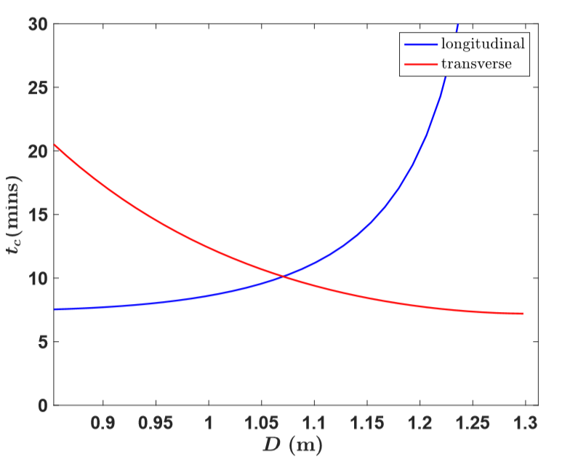
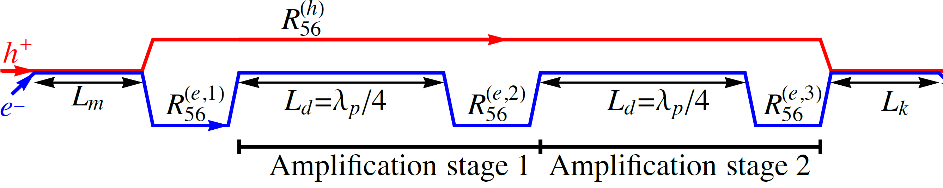
R&D- Overview continued
R&D on Advanced Hadron Cooling
Goals: a) Demonstrate coherent electron cooling in PoP experiment ➔ see Litvinenko’s presentation
b) Develop theory and simulation models for micro-bunched coherent electron cooling
Results b): theory developed for 3-D cooling of flat hadron beam by short electron bunches, theoretical model confirmed by simulation (in progress), Strawman of cooling facility developed, low energy electron beam transport optimized
Ongoing: Develop cooling model including a full 3D dynamical model of hadrons and electrons, developing solutions with ring based beam, study role of wigglers in amplification section
Funding: NP FOA funding FY18/19, BNL PD
Collaborations: SLAC, TJNAF, ANL
μ-bunched electron cooling:
Optimization of dispersion to balance transverse vs longitudinal cooling times

Slide 26
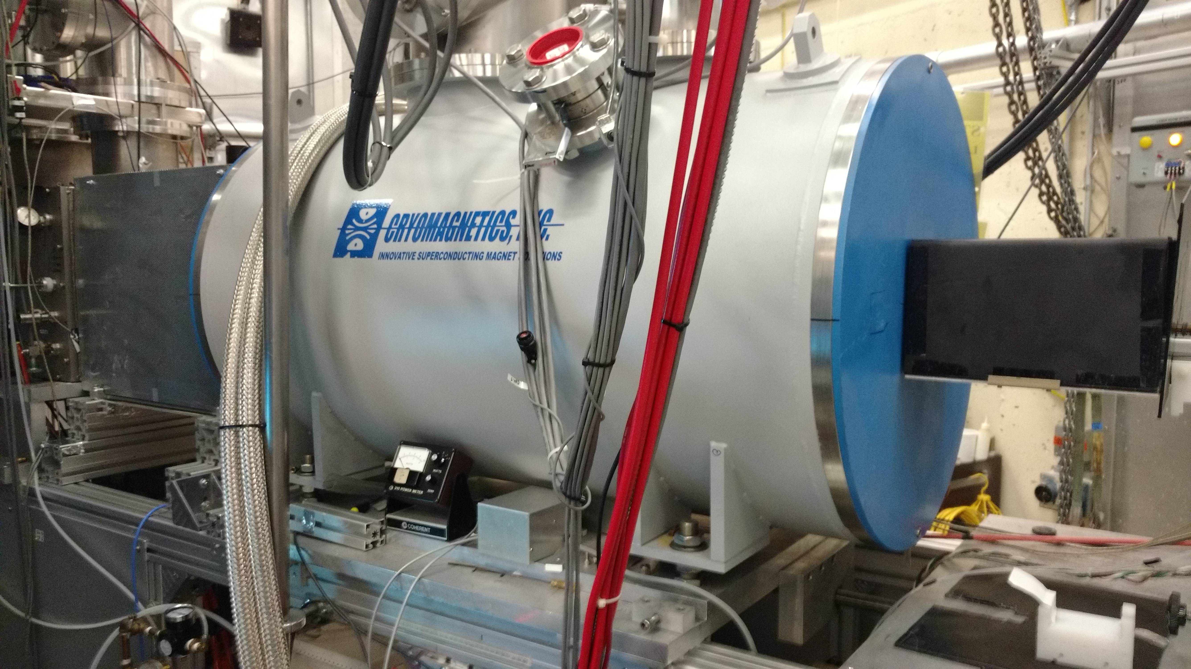

R&D- Overview continued
R&D on polarized 3He++ Source
Goals: a)Demonstrate generation of polarized 3He++
b) Develop 3He++ polarimeter (BNL medium energy group)
Results: a) Polarized 3He gas with polarization of >80% in 3T field achieved
all parts needed for integration into EBIS received or on order
b) theoretical analysis in progress
Ongoing: Insert the polarized 3He source into the EBIS ion source to generate 3He++
Funding: Base Funding FY17, Additional NP funding FY17, NP FOA FY18/19
Collaborations: MIT
Polarized gas cell
EBIS Solenoids

Slide 27
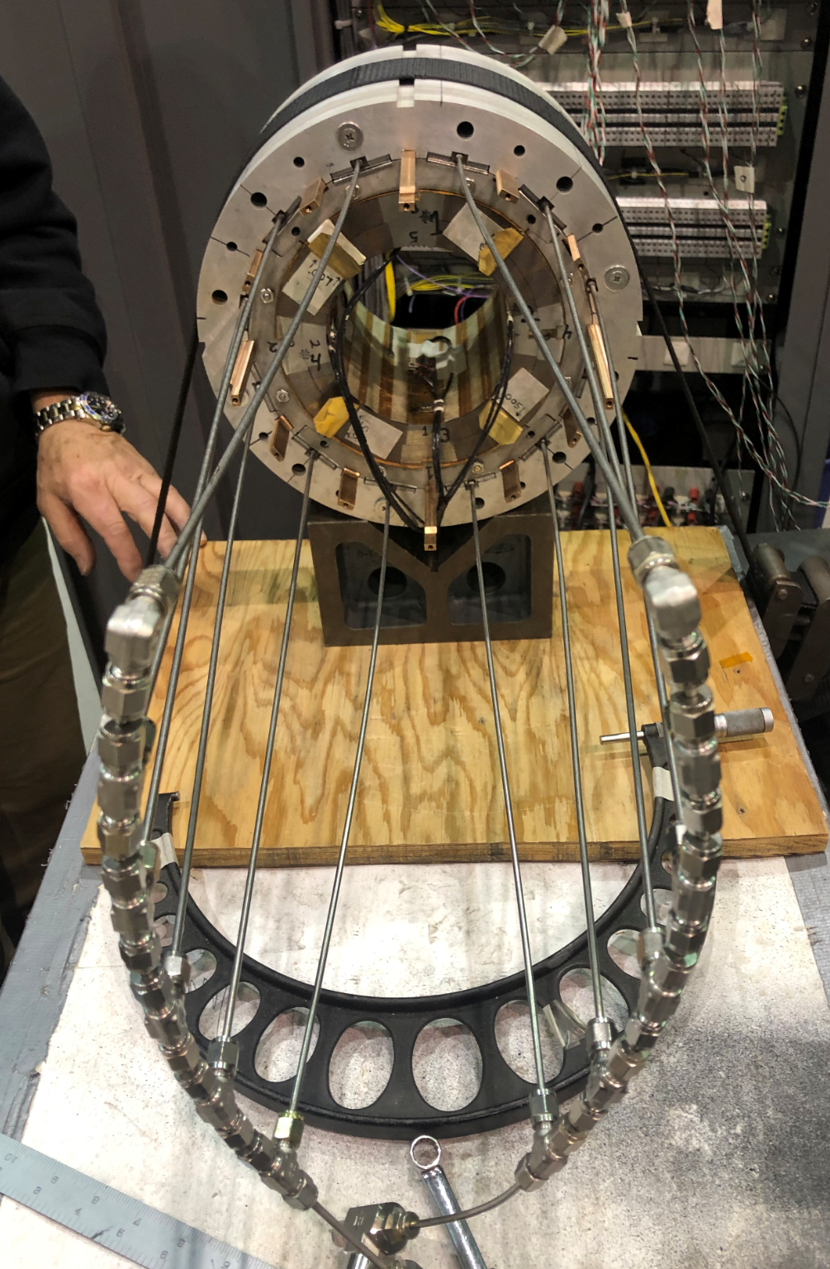
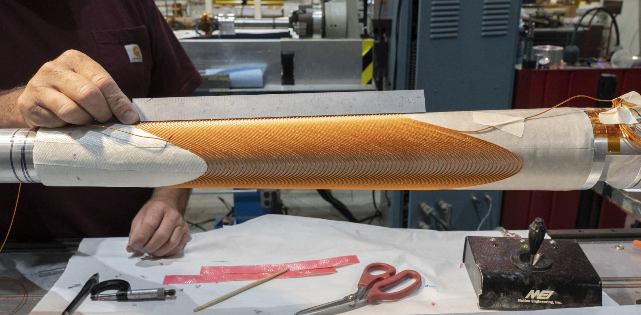
R&D- Overview continued
R&D on EIC sc NbSn IR quadrupole
Goals: Demonstrate feasibility a Nb-Sn based IR quadrupole by building a magnet using an existing coil (from LARP), explore helical direct wind and maximum capability of direct wind
Results: mechanical magnet design and cryostat complete, NbSn coil tested
Tilted direct wind coil in progress
Next step: Assembly and test
Funding: Base Funding FY17/18
Additional NP funding FY17, FY18/19 FOA, LARP
Collaborations: TJNAF, LBNL
R&D proton spin polarization in RHIC
Goals: Experimentally verify assumption on hadron polarization in JLEIC
Results: Preparations and plans complete, simulations on-going,
Next step: perform the RHIC machine experiment
Funding: Additional NP funding FY17, FY18/19 FOA
R&D on Electron Cooling with electron rings
Goals: Develop the concept of electron ring based incoherent electron cooling for eRHIC
Results: A design was developed which has sufficient cooling power to balance τ_{ibs} =10 h
Next step: Embedd into strong hadron cooling mitigation plans
Funding: FY18/19 FOA
Collaborations: TJNAF
Tilted direct wind coil
prototyping
Short Nb-Sn
Test coil

Slide 28
Summary
Comprehensive R&D efforts lay the foundation of the BNL-EIC development
Pre-conceptual layout meets or even exceeds all requirements of LRP
The pre-conceptual design based on many decades of experience of working with colliders, is mature for the present stage (pre-CD0)
It exploits existing accelerator tunnel, service buildings, superconducting accelerator rings, and hadron injector chain incl. polarized particle sources
results in cost effective implementation
Development of the electron storage ring and its injectors relies on established accelerator technology
BNL EIC parameters remain within values which have been demonstrated before
results in robust, low risk design to be implemented in a straightforward way
will be quickly commissioned
means that routine operation and physics data will emerge soon after
startup

Slide 29
BACKUP slides

Slide 30
Electron Ion Collider (EIC) Physics Questions
Nuclear Physics Community compiled an EIC WHITE PAPER^{*)} (2014/5):
How are quarks, gluons & their spins distributed in space & momentum in nucleus?
How do nucleon properties emerge from quarks and gluons and their interactions?
How do color-charged quarks, gluons & colorless jets, interact with a nuclear medium
How do confined hadronic states emerge from quarks & gluons
How do the quark-gluon interactions create nuclear binding?
How does dense nuclear environment affect the quarks-gluons correlations & interactions?
Does gluon density in nuclei saturate @ high energy
result in gluonic matter with universal properties?
*) A. Accardi et al, Eur. Phys. J. A529:268 (2016)

Slide 31
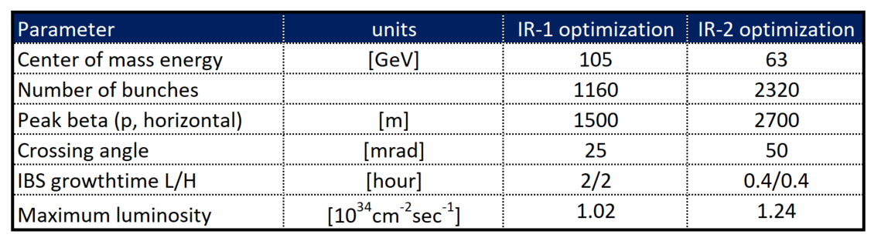
On Luminosity Optimization
Luminosity
Luminosity optimized for different center of mass energy
Going to higher bunch number increases luminosity at lower center of mass energies
Reducing number of bunches increases luminosity at higher center of mass energies
Increasing the number of bunches requires larger crossing angle,
it allows to get smaller emittance with same total beam currents
with smaller emittance, one can squeeze β harder (β_{max}~1/β*)
possible if larger IR chromaticity due to larger peak β can be tolerated
increases luminosity only if the bunches are shortened
Which requires stronger hadron cooling
Changing the optimization from larger to smaller CoM Energy
More bunches ➔ larger luminosity at lower CoM Energy, but larger crossing angle, larger peak beta, stronger cooling
105
IR-1 optimized for maximizing the discovery potential - technically less challenging
IR-2 optimized for maximizing luminosity for tomography, and nuclear structure - technically more challenging

Slide 32
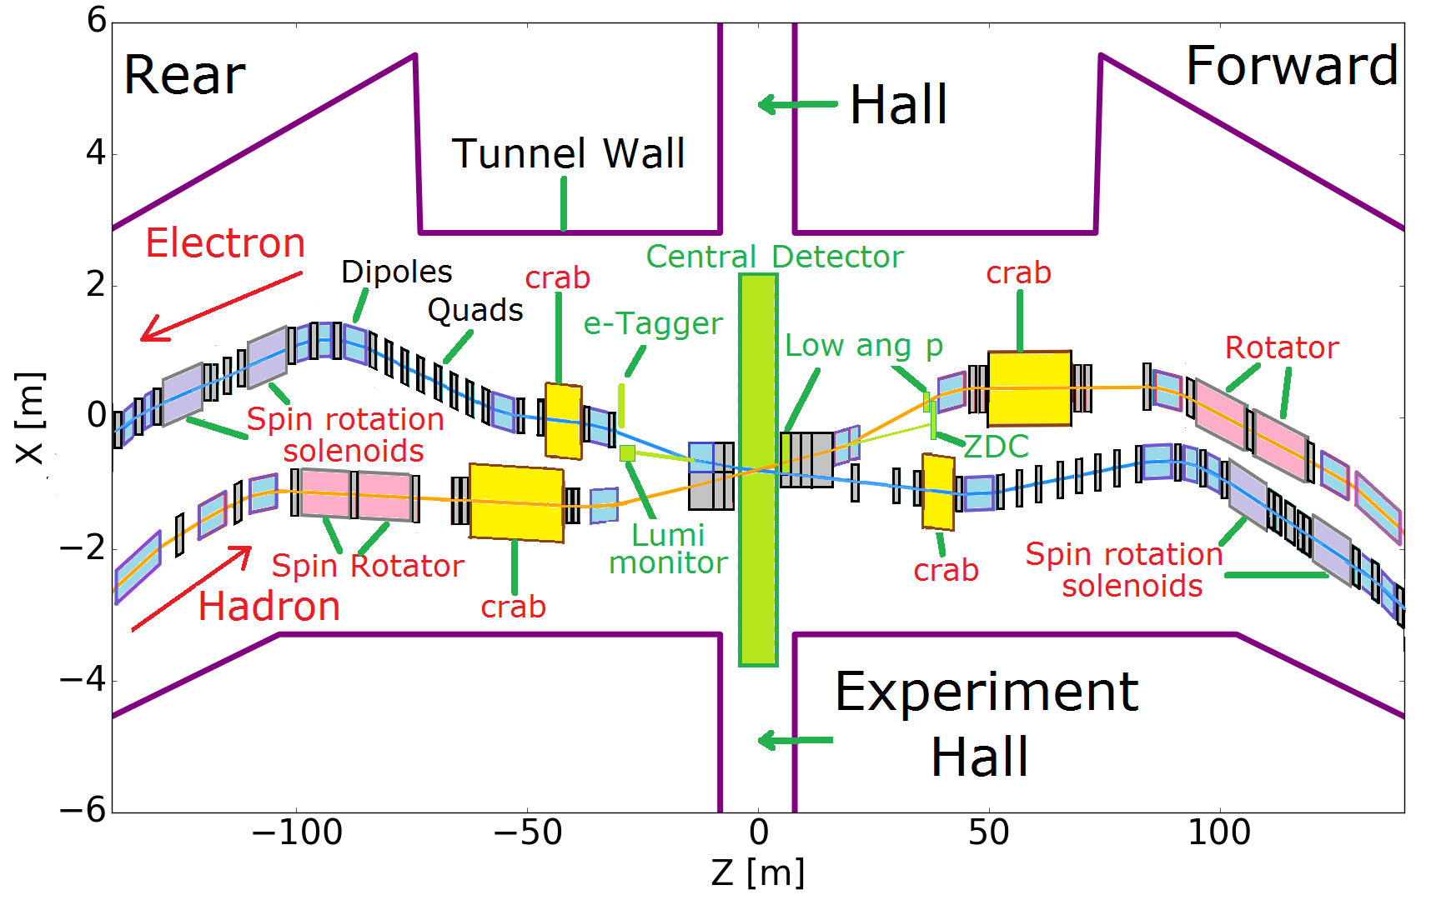
Luminosity
Full Acceptance eRHIC IR Layout
Design
All superconducting magnets
Only 5 magnets need collared Nb-Ti coils
All other magnets can be built with direct wind of Nb-Ti wire
Full acceptance e.g.
P_{t} =200 MeV/c-1.3 GeV/c
Neutrons 4 mrad
Large Aperture Dipole with instrumented gap
Modest IR chromaticity
Hadrons up to β<200m
Manageable dynamic
aperture optimization
e-Tagger
LUMI Mon.
32

Slide 33
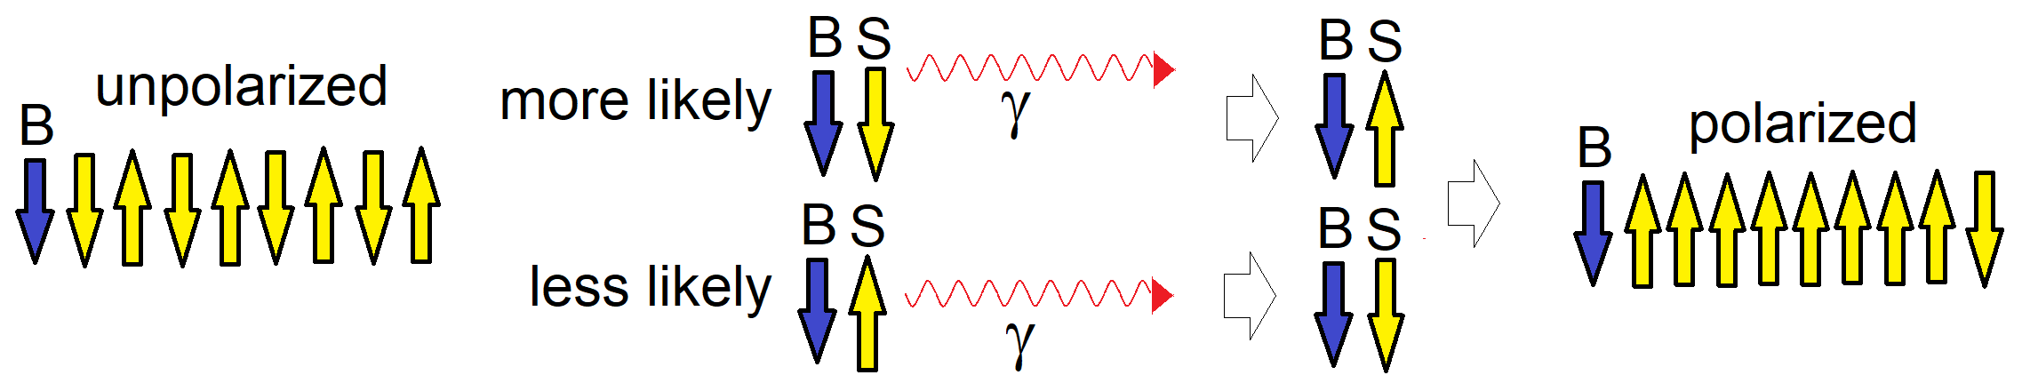
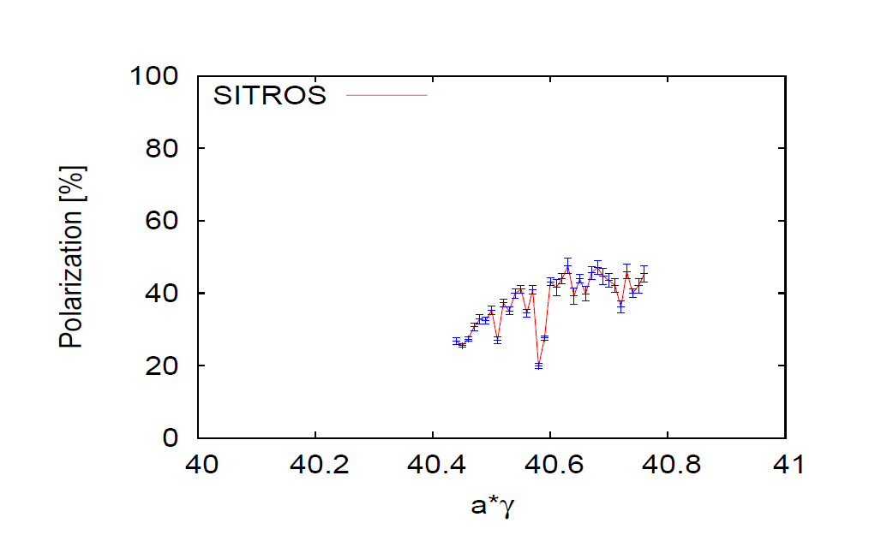
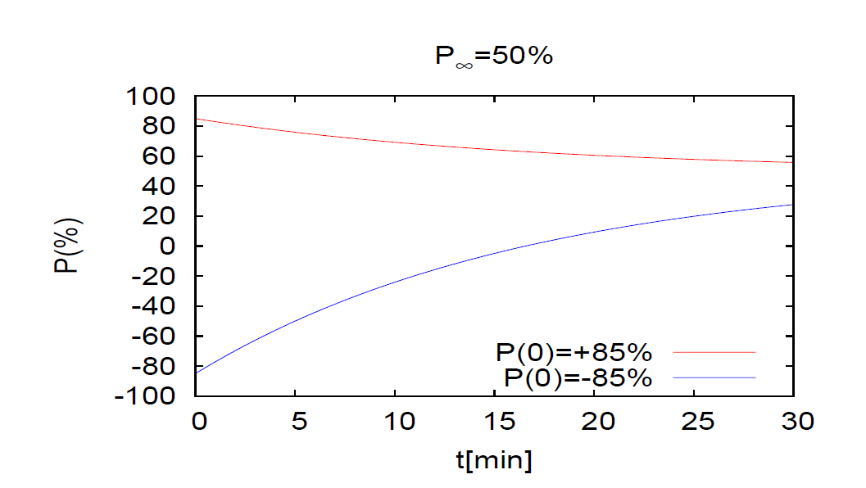

Electron Storage Ring Polarization
Polarization
Polarization in electron storage ring builds up due to “spin flips” associated emission of photons by electrons in bending magnets
The sudden changes in orbit position due to emission of photons in conjunction with lattice imperfections lead to depolarization (Derbenev-Kondratenko effect)
➔Equilibrium Polarization < 70% in real accelerators
HERA with strong beam-beam interactions P∞≈ 45%-55%
BNL-EIC with benchmarked simulations P∞≈ 50%
Any initial polarization will develop slowly to P∞
Both polarization directions realized in the same fill!
Electron Injector able to replace all bunches in 2.2 min minutes with fresh, 85% polarized bunches
With initial polarization of ± 85%
achieve average polarization of P_{av} = 80%
slow & energy dependent EIC-BNL: ~30min @18GeV
➔ Inject polarized beam
Sokolov-Ternov
Self Polarization:
B P
Refilled every 1.2 minutes
Refilled every 3.2 minutes
Re-injection
P∞= 30%
(conser-vative)
Re-injection

Slide 34
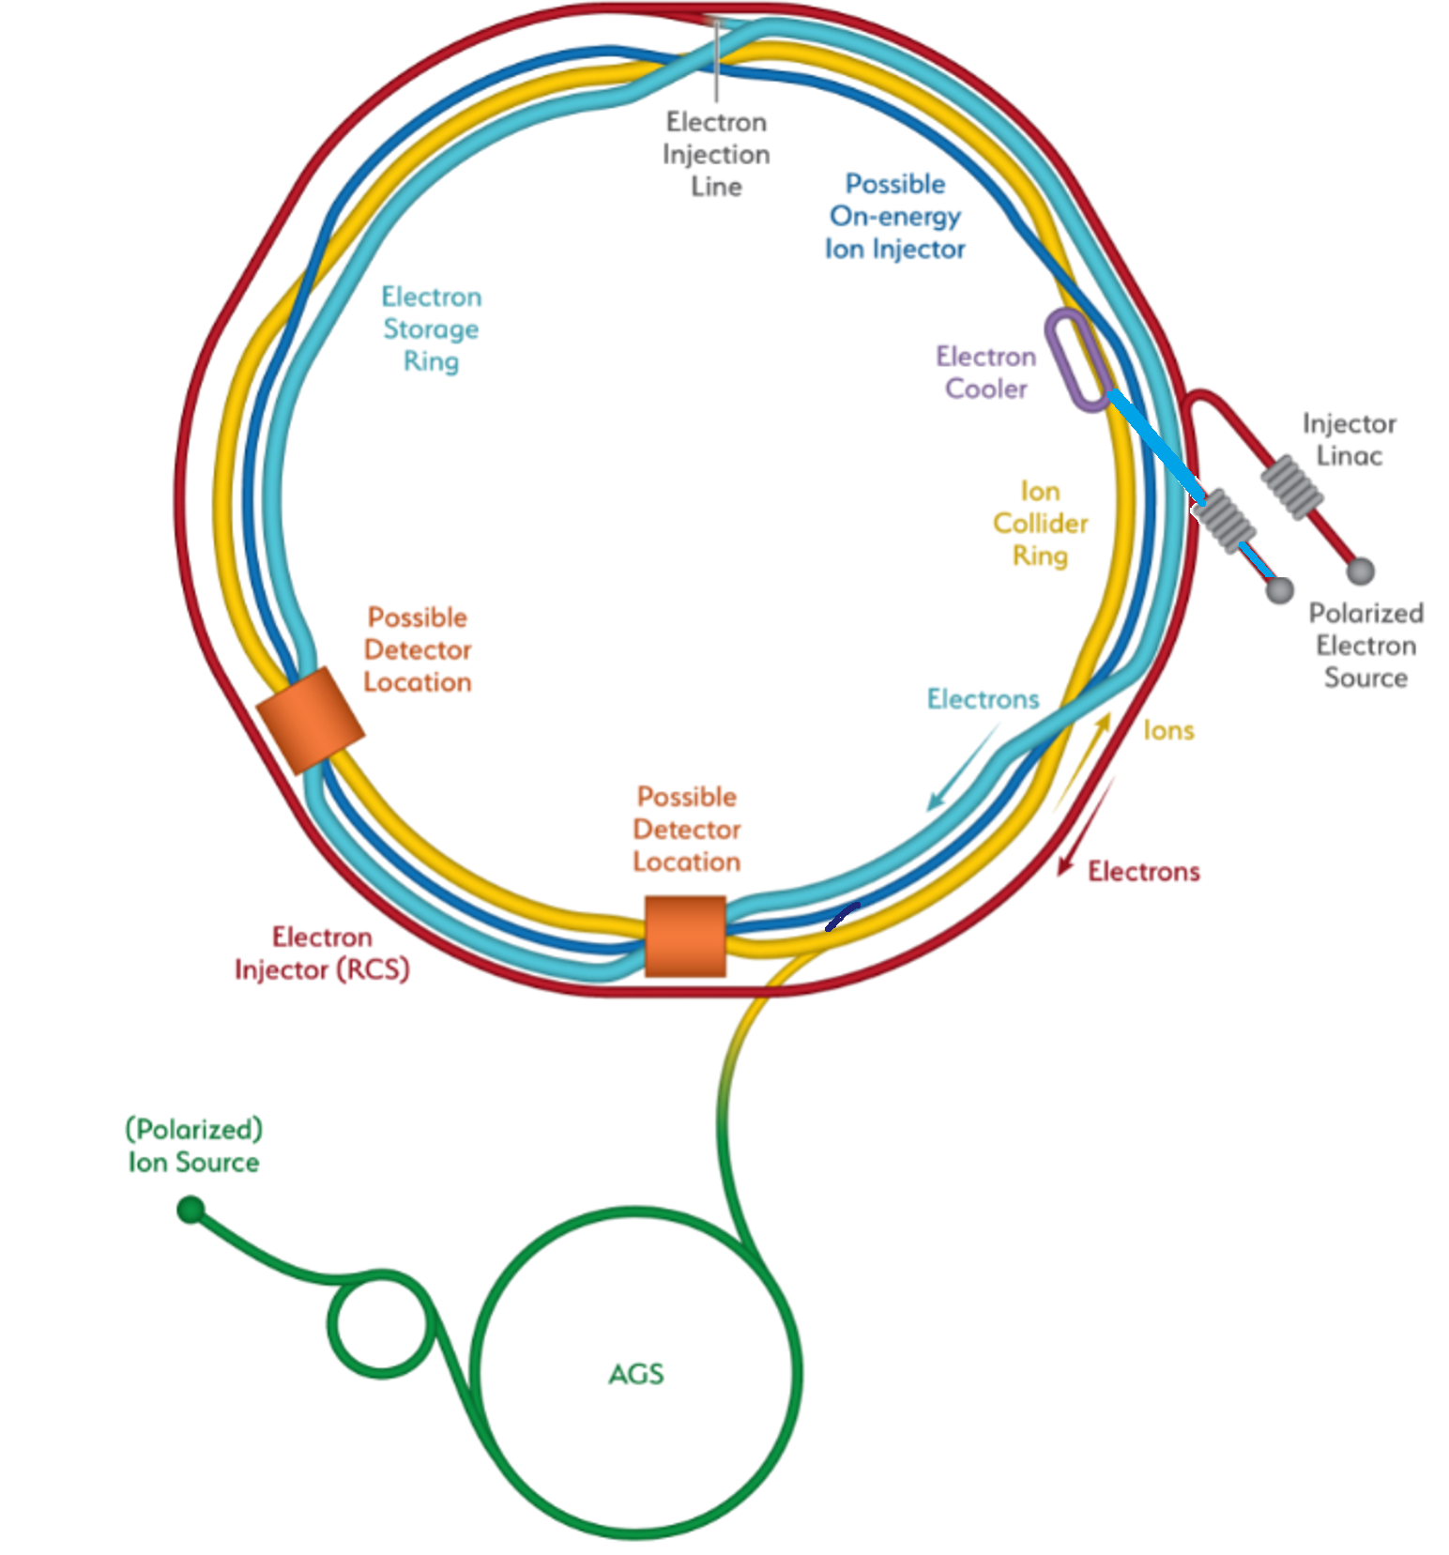
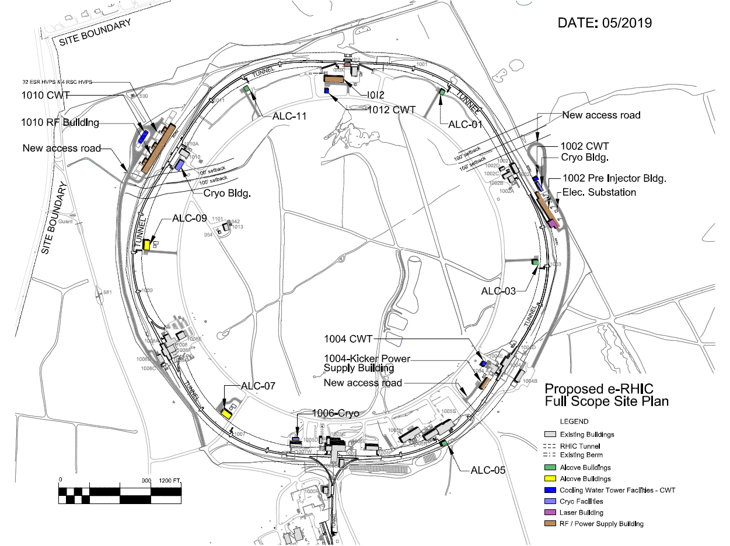
BNL-EIC Overview
Center of Mass Energy
Electrons (2.5-18) GeV
Protons (Ions) (41-275) GeV
Center of mass energies 20-140 GeV
Hadron Storage Ring
Electron Storage Ring
Electron Injector Synchrotron
Possible on-energy Hadron
injector ring
Hadron injector complex
BNL-EIC
BNL-EIC

Slide 35
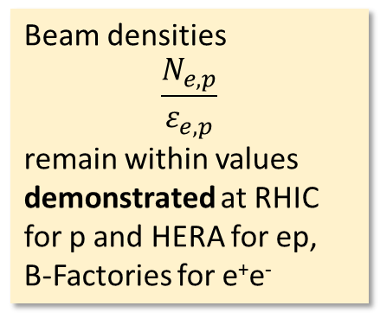
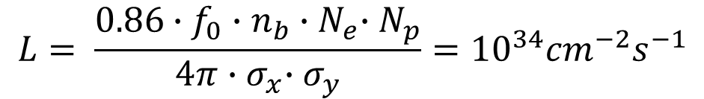
Large Luminosity
Luminosity
Demonstrated in e⁺-e⁻colliders
Demonstrated in RHIC
many particles/bunch N_{e} =1.7·10¹¹, N_{p}=7·10¹⁰
Demonstrated at B-factories
Crossing angle 25 mrad
Large beam currents
I_{e} =2.5 A
I_{p}=1 A
many bunches: n_{b} = 1160
$$L= \frac{{{0.86∙f}_{0}∙n}_{b}{∙N}_{e}∙N_{p}}{4π{∙σ}_{x}∙σ_{y}}={10}^{34}{cm}^{−2}s^{−1}$$
Beam densities
$$\frac{N_{e,p}}{ε_{e,p}}$$
remain within values demonstrated at RHIC for p and HERA for ep, B-Factories for e⁺e⁻
Small beam sizes at collision point
σ_{x} = 92μm σ_{y}= 7.7 μm
Strong focusing at IP ➔ short p-bunches , large chromatic effects➔ appropriate lattice design
small beam emittance ➔high energy hadron cooling or frequent bunch replacement)

Slide 36
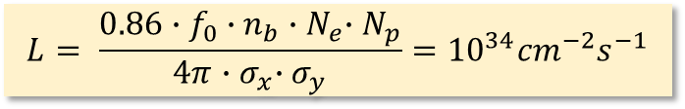
BNL EIC Luminosity
$$L= \frac{{{0.86∙f}_{0}∙n}_{b}{∙N}_{e}∙N_{p}}{4π{∙σ}_{x}∙σ_{y}}={10}^{34}{cm}^{−2}s^{−1}$$
Luminosity
BNL EIC high luminosity design is based on lessons learned from existing or previous colliders and ambitious parameters which have, however, been demonstrated for the most part on existing or previous colliders
Parameters
number of bunches n_{b}=1160
number of e/bunch N_{e}=1.7·10¹¹
number of p/bunch N_{p}=0.7·10¹¹
Horiz. beam size at IP σ_{x}=92μm
Vertic. beam size at IP σ_{y}= 8μm
Electron and protons same σ_{x,y}
Tune shift for particles in opposite beam
ζ_{x,ye}= 0.09, 0.09
ζ_{x,yp}= 0.01, 0.01
Implies
Crossing angle θ_{c}= 25mrad
I_{e}= 2.5 A
I_{p}= 0.99 A ➔ Cu, C coating
β_{xe}=42 cm β_{xp}=92 cm
β_{xy}=5 cm β_{yp}=4 cm
Strong focusing, dynamic effects appropriate lattice design
proton bunch length
σ_{sp}= 6 cm
Emittance ε_{x,yp}= 9.2/0.5 nm
ε_{yp} requires pre-cooling
maintaining ε_{x,yp} requires
Strong Hadron Cooling 0.5/hr or
Frequent on-energy injection
(existing injector) 0.5/hr
Demonstrated
KEK-B, PEP-II >2.5 A
RHIC N_{p}=2·10¹¹
B-Factories
RHIC: ε_{x,yp}= 4/4 nm
HERA, e⁺-e⁻ colliders
RHIC

Slide 37
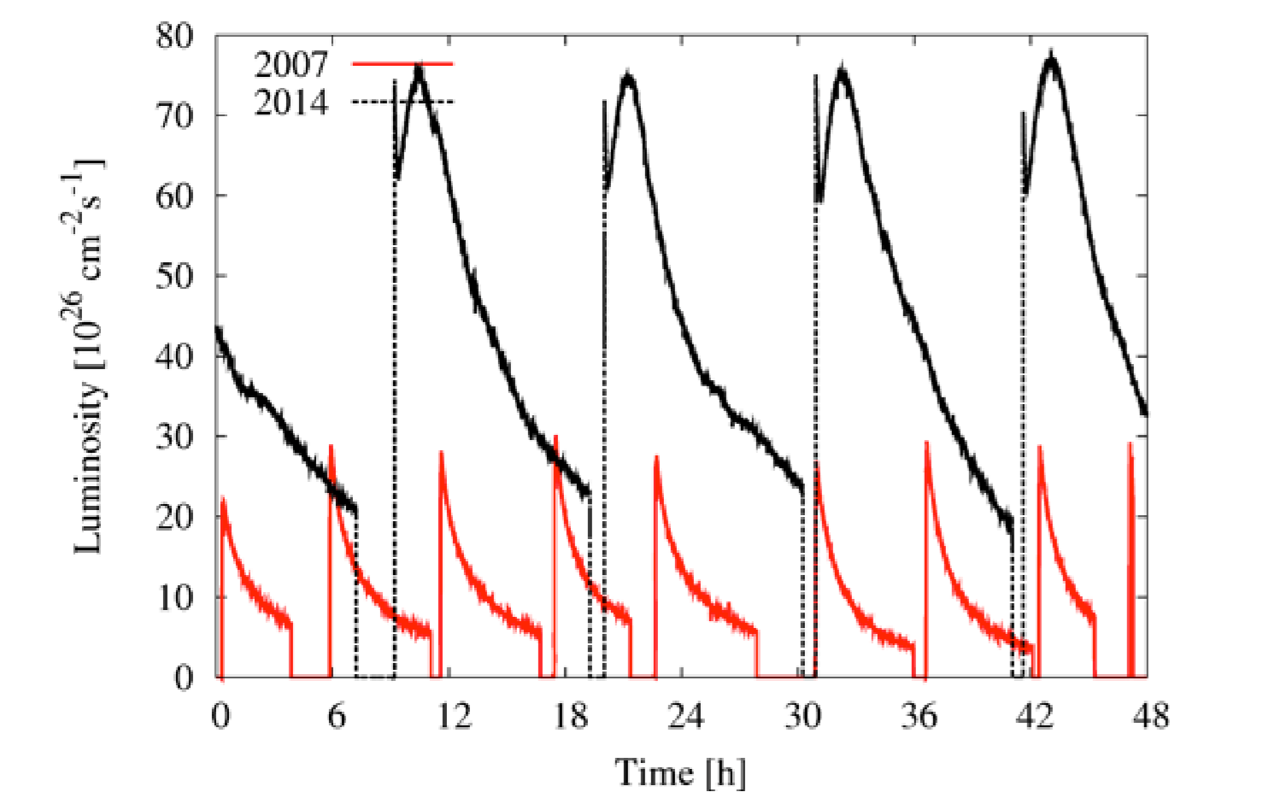
Strong Hadron Cooling and High Luminosity
Luminosity
For eA collisions, a modest upgrade of the existing stochastic cooling system will provide full cooling capability for the EIC
For high luminosity ep collisions, strong hadron cooling is desirable,
to avoid rapid decay of the luminosity caused by emittance growth
due to intrabeam scattering
BNL-EIC high-CoM energy optimization has only modest IBS growth rates of τ > 2h for highest luminosity.
BNL-EIC does not rely on cooling to operate at highest
luminosity as there is an on-energy for frequent injections
available which results in average luminosity which is still 90% of the peak luminosity.
BNL-EIC Strong Hadron Cooling is an extension of established stochastic cooling to higher bandwidth by replacing cables and amplifiers by electron beam and beam dynamical effects, called Coherent Electron Cooling
There are several amplification methods. We choose μ-bunching, a well known- , well studied- , and experimentally verified phenomenon relevant for FELs
RHIC Au-Au Luminosity enhanced by . stochastic cooling

Slide 38
High Luminosity Implementation
Luminosity
BNL EIC high luminosity design is based on lessons learned from existing or previous colliders and ambitious parameters which have, however, been demonstrated for the most part on existing or previous colliders
As BNL-EIC is a storage ring based design, large luminosity requires
Large bunch charge
Many bunches ➔ large total beam currents
➔ crossing angle collision geometry
Small beam size at collision point achieved by
·small emittance
➔ Small hadron emittance requires strong hadron cooling
(or frequent injection)
· and strong focusing at IR (small β)
➔ required short bunches ➔ need strong cooling
Beam-Beam Limit: Transverse beam density at collision point limited by the detrimental effect of the corresponding nonlinear lens

Slide 39



BNL-EIC Hadron Polarization
Polarization
The BNL-EIC will fully benefit from present RHIC polarization and near future upgrades
Measured RHIC Results with Siberian Snakes:
Proton Source Polarization 83 %
Polarization at extraction from AGS 70%
Polarization at RHIC collision energy 60%
Planned near term improvements:
AGS: Stronger snake, skew quadrupoles,
increased injection energy
➔expect 80% at extraction of AGS
RHIC: Add 2 snakes to 4 existing, no polarization loss
expect 80% in Polarization in RHIC and eRHIC
Expected results obtained from simulations which are benchmarked by RHIC operations
Polarized ³He in eRHIC with six snakes
Achieved ~85% polarization in 3He ion source
Benchmarked Simulations:
Polarization preserved with 6 snakes up to twice the design emittance
Polarized Deuterons in BNL-EIC:
Requires tune jumps in the AGS, then
benchmarked simulation show 100% Spin transparency
No polarization loss expected in the eRHIC hadron ring
Siberian Snakes

Slide 40
The EIC will answer the three fundamental questions from the National Academy of Science
How do quarks and
gluons form nucleons
and nuclei?
Requires high energy and luminosity
How does the proton
get its spin?
What is the nature of
dense gluon matter?
How does the proton
get its mass?
Requires large energy range
40

Slide 41




BNL-EIC Interaction Region
Luminosity
Crab-Cavity
Prototype
Spin Rotator
IR Vacuum design
β*_{xp} = 90 cm
β*_{yp} = 4 cm
β*_{xe} = 60 cm
β*_{ye} = 5 cm
NbTi s.c. magnets

Slide 42
Luminosity Optimization for low E_{cm}
L ~ n_{b}·N_{e}·N_{p} / σ²
Increase number of bunches from 1160 to 2320
N_{e,p} ➔ ½ N_{e,p} ; L➔ ½ L
Reduce hadron emittance to restore beam-beam tune-shift ~ N_{e}/ε_{p}
ε_{p} ➔ ½ ε_{p}; ½ L➔ L
Reduce β∗ since more room in final focus quadrupole aperture a
β_{max}~1/β* ➔ a ~ (½ ε_{p} / ½ β_{p})^{1/2}: L➔ 2·L
However:
Need to shorten hadron bunch length ➔ stronger cooling
Need to increase crossing angle ➔ stronger crab cavities
Larger β_{max} : larger IR chromaticity and reduced dynamic aperture
For electrons: Install final focus quadrupoles inside detector
Reduced acceptance for larger energies, solution preferable for low E_{cm}
More Luminosity, but need stronger cooling, parameters more extreme, works best at lower E_{cm}

Slide 43

EIC Physics Program and Luminosity Need
~1 year (10⁷ s) of BNL-EIC Running

Slide 44


Two interaction regions
Two detectors
The BNL-EIC will benefit from two large existing detector halls in IR6 and IR 8 respectively
They are fully equipped with infrastructure such as
power, water and cryogenics supplies, overhead crane, ….
44
44
IR 8 detector hall with PHENIX detector
IR 6 detector hall with STAR detector
Two IRs can be implemented in the BNL-EIC lattice and can be accommodated within the beam dynamics parameters envelope
The two IRs can be laid out identically, or could be optimized maximum luminosity at different center of mass energies.

Slide 45

The BNL ion sources and ion acceleration chain provides already today all the ions needed for EIC
Ion Species
Ions from He to U have been already generated in the Electron-Beam-Ion-Source ion source (EBIS), accelerated and collided in RHIC
EBIS can generate any ion beam from ³He to U for the BNL EIC
Existing EBIS provides the entire range of ion species from He to U in sufficient quality and quantity for the EIC
Ion Pairs
in the RHIC Complex
Zr-Zr, Ru-Ru (2018)
Au-Au (2016)
d-Au (2016)
p-Al (2015)
h-Au (2015)
p-Au (2015)
Cu-Au (2012)
U-U (2012)
Cu-Cu (2012)
D-Au (2008)
Cu-Cu (2005)
Ion-Ion Luminosity Runs in RHIC 2005-2018
Accumulated Luminosity [pb⁻¹]
Enormous
versatility!
is a unique capability!
Operation Time [weeks]

Slide 46
Polarization in the electron storage ring
Solenoid based Spin rotators ➔ longitudinal spin in collisions (arcs: vertical polarization)
High initial polarization of 85% will decay towards equilibrium polarization P∞ due to Sokolov-Ternov self polarization and Derbenev Kondratenko depolarization effects
P ∞ of 40-50% achievable (HERA experience and BNL-EIC simulations)
Time evolution of high polarization of bunches injected into the eSR at 18 GeV (worst case) RCS cycling rate = 2Hz ➔ on average, every bunch refilled in 2.2 min
B P
B P
Refilled every 1.2 minutes
Refilled every 3.2 minutes
Re-injection
P_{av}=80%
P∞= 30%
(conservative)
P_{av}=80%
Re-injections
Note: Calculation with P ∞=30% is conservative as P ∞= 50% was shown feasible

