Slide 1



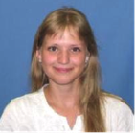

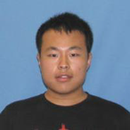

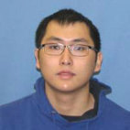

Strong Hadron Cooling and
Coherent electron Cooling
(CeC) experiment at RHIC
Vladimir N Litvinenko for CeC group
Yichao Jing, Jun Ma, Irina Petrushina, Igor Pinayev, Kai Shih, Gang Wang, Yuan Wu
Department of Physics and Astronomy, SBU
Collider-Accelerator Department, BNL
Center for Accelerator Science and Education

Slide 2
Outline
Why strong hadron cooling is needed?
CeC principle of operation and options
Theory and simulations
Workshops and Reviews
CeC experiment and its status
Conclusions
HW

Slide 3
Why strong hadron cooling is needed?
2018 NAS Assessment of U.S.-Based Electron-Ion Collider Science: The accelerator challenges are two fold: a high degree of polarization for both beams, and high luminosity.
April 2018 eRHIC pCDR review committee report:
“The major risk factors are strong hadron cooling of the hadron beams to achieve high luminosity, and the preservation of electron polarization in the electron storage ring. The Strong Hadron cooling [Coherent Electron Cooling (CeC)] is needed to reach 10³⁴/(cm²s) luminosity. Although the CeC has been demonstrated in simulations, the approved “proof of principle experiment” should have a highest priority for RHIC.”

Slide 4
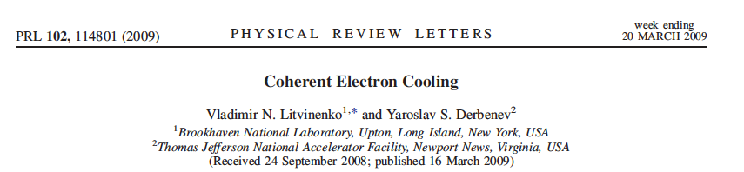
What is Coherent electron Cooling
Short answer – stochastic cooling of hadron beams with bandwidth at optical wave frequencies: 1 – 1000 THz
Longer answer
Amplification
Momentum correction
Imprint by hadrons

Slide 5
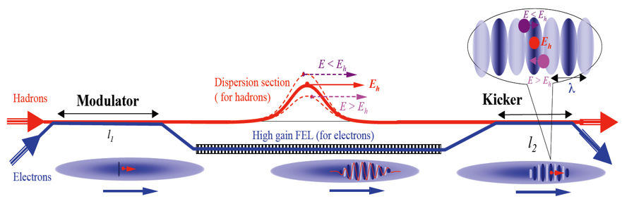
CeC schemes
Litvinenko, Derbenev, PRL 2008
High gain FEL amplifier
Possible to test
experientially
Ratner, PRL 2013
Multi- Chicane
Microbunching amplifier
Requires
beam separation/
RHIC lattice modification
Litvinenko, Wang, Kayran, Jing, Ma, 2017
Plasma-Cascade Microbunching amplifier
Plasma cascade
micro-bunching amplifier
Possible to test
experientially
Litvinenko, Cool 13
Hybrid laser-beam
amplifier
Requires
beam separation/
RHIC lattice modification

Slide 6
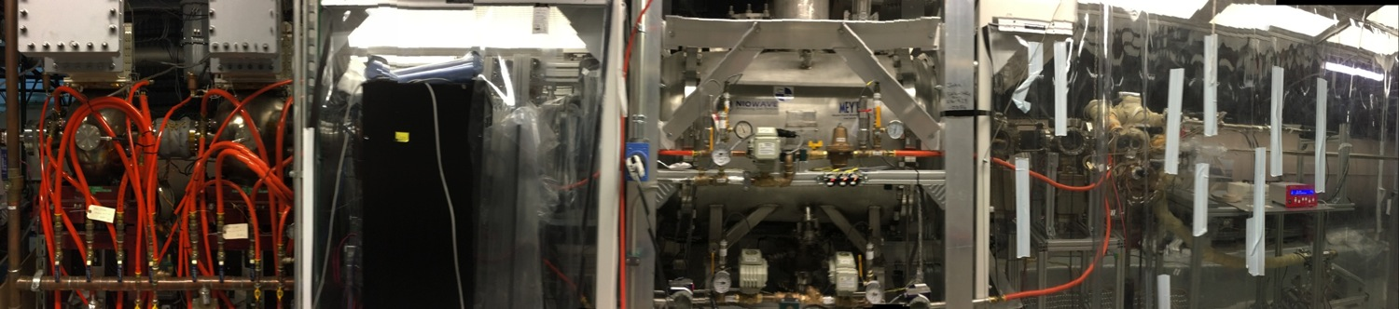
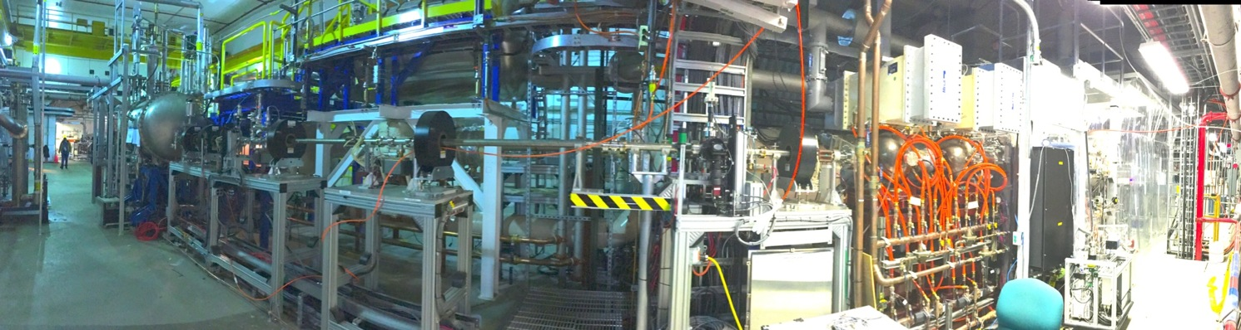
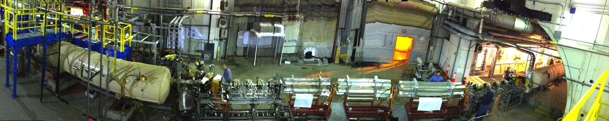
Panoramic views
500 MHz cavities
SRF gun
Laser table
LEBT
SRF linac
CeC cryo system
CeC system
RHIC DX magnet
RHIC DX magnet

Slide 7
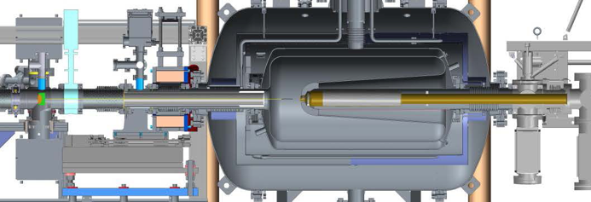
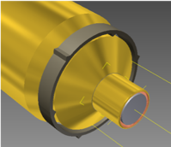
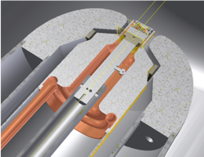
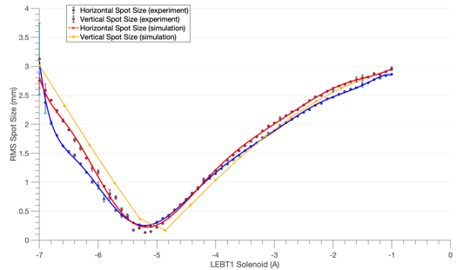
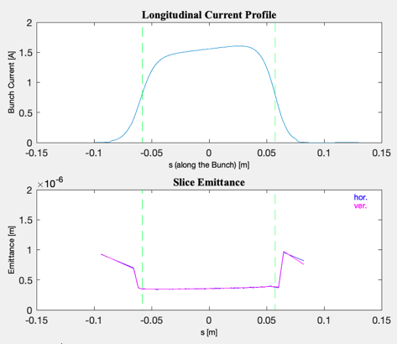
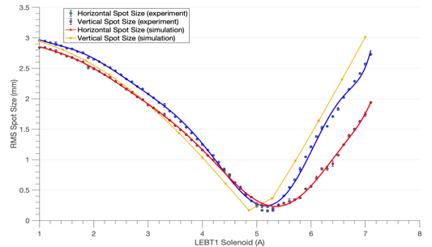
113 MHz SRF Gun
Quarter wave design
Operates at 4.2ºK
Cathode is at room temperature
Stalk is RF choke and field pick-up
Manual coarse tuners
FPC serves as fine tuner
Operational CW voltage 1.25 MV
Maximum charge 10.7 nC
Dark current < 1nA
Very low normalized emittance
  0.15 mm mrad at 100 pC
  0.35 mm mrad at 600 pC
Solenoid
FPC
Adjustable stalk position and focusing
GPT simulations
GPT simulations
vs measurements
Gun energy: 1.25 MV
Laser spot on cathode r.m.s. size: 0.8mm (3.2 mm diameter)
Bunch charge: 600 pC
Bunch length: 400 ps
Gun solenoid: 8.6 A
LEBT1 solenoid varied from -7 to -1 A (left) and 1 to 7 A (right)

Slide 8
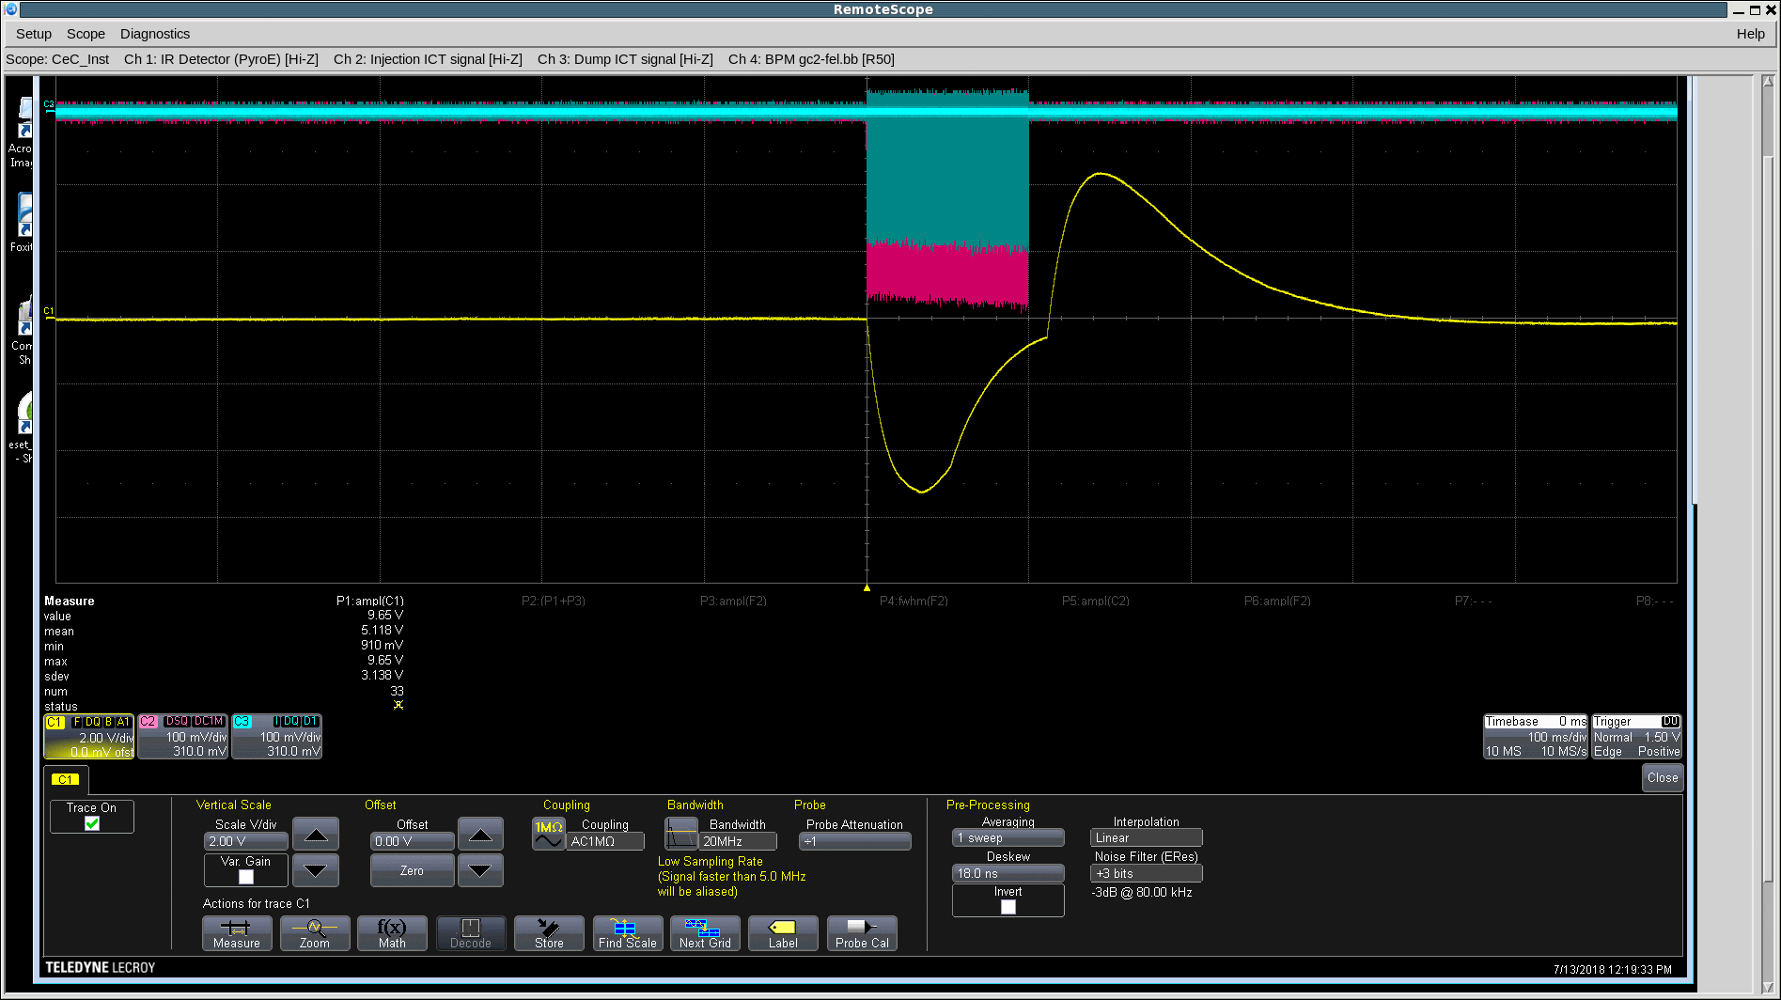
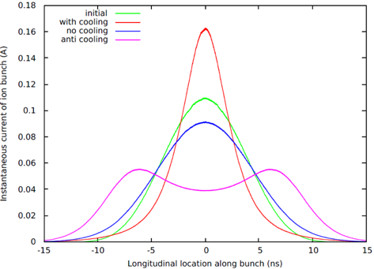
Attempt to test FEL-based CeC: Run 18
FEL lasing pulse at 31 μm: April 2018
Parameter | Design | Status | Comment
Species in RHIC | Au⁺⁷⁹, 40 GeV/u | Au⁺⁷⁹ 26.5 GeV/u | ✔ to match e-beam
Electron energy | 21.95 MeV | 14.56 MeV | Linac’s quench limit
Charge per electron bunch | 0.5-5 nC | 0.1- 10.7 nC | ✔
Peak current | 100 A | 50 -100A | ✔
Bunch duration, psec | 10-50 | 12 | ✔
Normalized beam emittance | < 5 mm mrad | 0.15 – 5 mm mrad | ✔
Energy spread, RMS | 0.1% | Core <0.1% | ✔
FEL wavelength | 13 μm | 31 μm | ✔ with new IR diagnostics
Repetition rate | 78.17 kHz | 78.17 kHz | ✔
CW beam | 80-400 μΑ | 150 μΑ | ✔
Electron bunch
train
IR detector
signal
Predicted evolution of ion bunch profile in 40 minutes

Slide 9
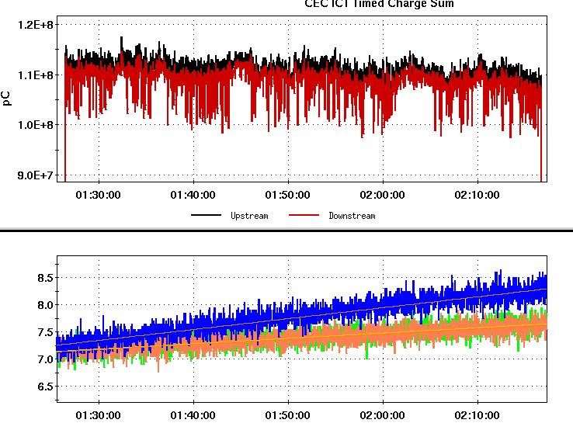
Puzzle of the CeC Run 18
Search for ion’s imprint in electron beam
and matching beam’s relativistic factors was
the first important step in CeC experiment
Interaction of ion bunch synchronized is in agreement with the measured FEL-amplified noise level
I, μA
e-beam current in μA
+/- 3 σ
120
Note Log scale
Measured
110
100
90
FWHM ion bunch length, nsec
Interacting bunch
Expected
Witness bunches
1.0
Energy detuning, %
Bottom plot: evolution of the bunch lengths for interacting (blue trace) and witness (non-interacting) bunches (orange and green traces)
Expected and measured relative change in the FEL signal with overlapping and separated beams. Measurements RMS error is 2%.
We ran out of time to demonstrate the FEL-based CeC during Run 18 with RHIC.
FEL-based CeC concept remains valid and awaiting for experimental demonstration.
Notes:
Proving expectations wrong is one of important roles played by experiment

Slide 10
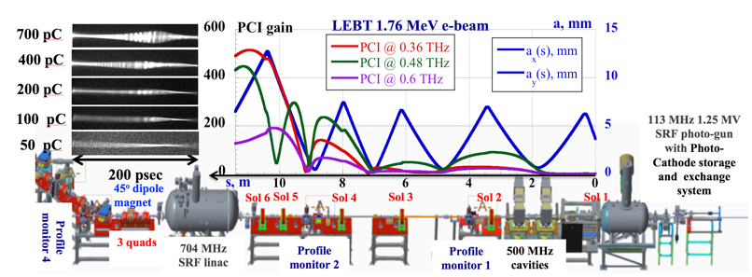
Solving the Puzzle
RHIC cryo system extended operation for LEReC mid-September and we used it to find the culprit:
THz noise in the electron beam (300-fold above the shot noise!) dwarfing the ion beam imprint.
This was not a failure of the FEL-based CeC concept, but unexpected excessive noise in the beam
(a)
Uncompressed bunch:
simulations and experiment in Sept 2018
Compressed beam simulation in CeC accelerator using Impact-T code @ NERSC
Blue line – Run 18 lattice
Red line – new lattice with suppressed PCI
20-X compression
First we showed it in simulations that we can control noise level in the electron beam and confirmed this in the experiment
during a short run in Summer 2019
(a) Measured time profiles of 1.75 MeV electron bunches with 0.45 nC to 0.7 nC; (b) Seven measured overlapping spectra and PCI spectrum simulated by SPACE (slightly elevated yellow line); (c) Clip shows a 30-psec fragment of seven measured relative density modulations.

Slide 11
Run 19: control of the noise in electron beam
Run 18 lattice and beam: 0.6 nC per bunch
Large signal of 2,500 V/A ~ 250-fold above base line. Can be seen both on scope and measured easily
Heating
Cooling
1.5 nC, 75 A peak current
Cooling
Cooling
Heating
Optimal setting
Cooling
We demonstrated that with 75 A peak current we can reduce beam noise to acceptable level. It could be as low as 6-10 times above the baseline

Slide 12
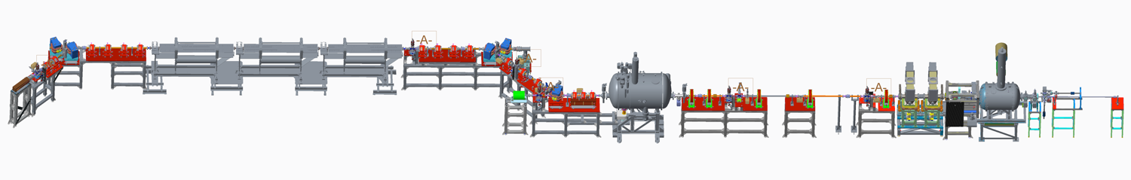
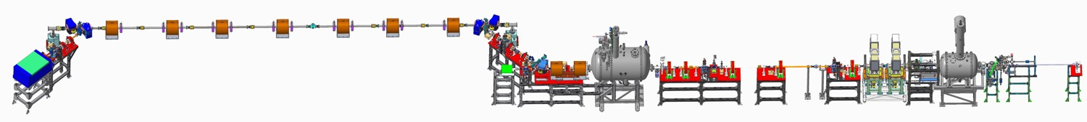
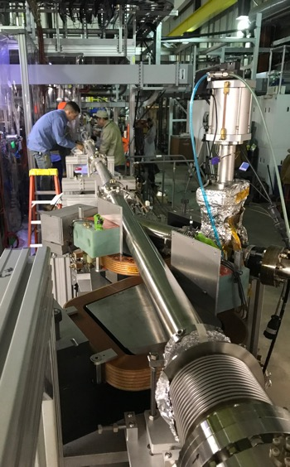
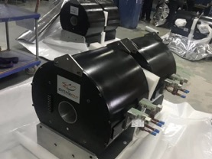
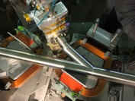
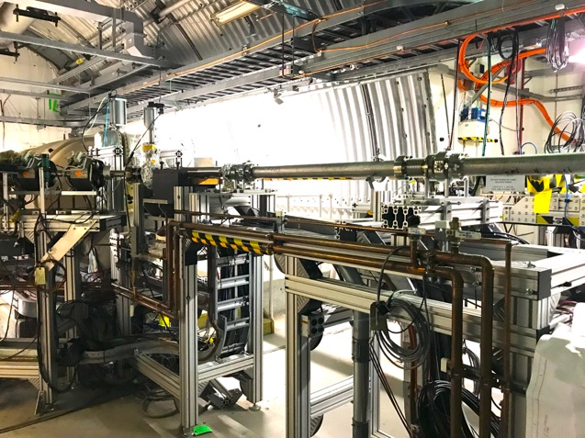
Changing CeC amplifier from FEL to PCA
Small gap in FEL wigglers is not compatible with low energy RHIC operations of the Beam Energy Scan (BES-II) program
CeC SRF accelerator
This was not a failure of the FEL-based CeC concept – the system is preserved and can be tested in the future
Kicker
Modulator
Unchanged
Unchanged
4-cell PCA
Mechanical design new CeC system is completed
We procured and commissioned new laser system with controllable pulse structure
All new vacuum with beam diagnostics are built chambers are installed
All supports are built and installed
All solenoids are designed, manufactured, delivered and undergo magnetic measurements
Assembly of the plasma-cascade based CeC will be completed this Fall

Slide 13
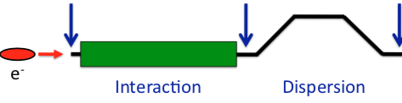
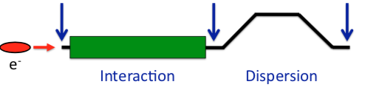
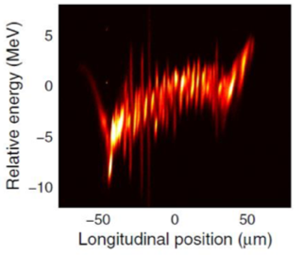
What is Plasma-Cascade Instability (PCI)?
How is it different from the previously known micro-bunching instability (MBI)?
Kick
Drift
Kick
Drift
Kick
Drift
a(s)
R₅₆=L_{b}θ²
© D. Ratner
Kick
Drift
Kick
Drift
R ₅₆ =L_{d}/γ²
Interaction
Interaction
Dispersion
Dispersion
Dispersion
MBI
PCI
Cold beam model
MBI: modulate effective mass (s-mobility) by bending beam trajectory (θ)
Modulate beam density
by changing beam radius a:
CeC
LCLS
Plasma frequency does not dependent on the shape of modulation

Slide 14
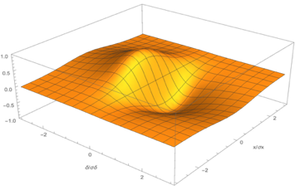
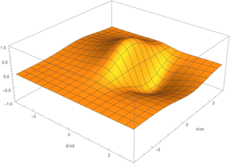
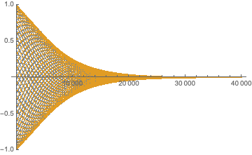
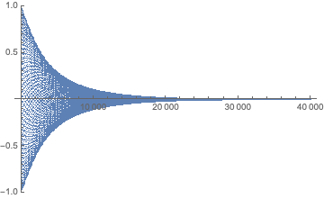
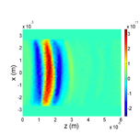
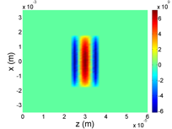
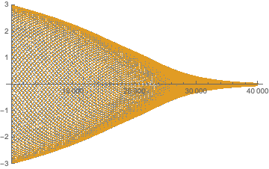
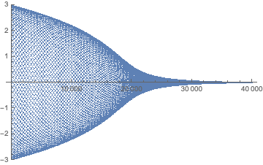
PCA-based CeC at γ=28.5
Longitudinal cooling
Kick
δ
Longitudinal and transverse cooling
Kick
δ
x/σ_{x}
δ/σ_{δ}
Δx = 0.75σ_{x}
zero energy kick at 0.4σ_{δ}
Exit of
modulator
Modulation
in the kicker
10⁹
10¹¹
⁰
^{60μm}
⁰
^{60μm}
x/σ_{x}
δ/σ_{δ}
Color map is normalized to the maximum density modulation
*SPACE is a PIC code, X. Wang et al., “Adaptive Particle-in-Cloud method for optimal solutions to Vlasov-Poisson equation,” J. Comput. Phys., 316 (2016), 682 - 699.

Slide 15
Workshop and reviews
This plan was presented to Nuclear and Particle Physics Program Advisory Committee in June 2014. In its report PAC wrote: “The PAC concurs that the demonstration of the CeC principle is a high priority task for eRHIC development. The proposed new CeC scheme should be evaluated by appropriate experts. If experts deem the approach technically promising and feasible, the PAC recommends the allocation of beam time ….”. “… we list as 4th priority for Run 20 … if ..been successful in demonstrating the imprint that the ion beam leaves on the electron beam, our second priority recommendation for Run-21 is the continuation of CeC experimentation, with 14 days of running devoted to the CeC experiment for the purpose of demonstrating coherent electron cooling”
End of July 3-day ICFA mini-workshop “Coherent Electron Cooling-Theory, Simulations and Experiment” at Stony Brook University. Four session moderated by conveners (R. Li (JLAB), Y. Hao (MSU), D. Bruhwiler (Radia-Soft) and D. Kayran (BNL) – all materials are at http://case.physics.stonybrook.edu/index.php/ICFA_workshop_CeC
  About thirty-five scientist from eight institution took part in the workshop. We had a lot of useful suggestions how to optimize the pass to demonstration experiment and developing reliable prediction for CeC. The participant strongly endorsed the need for experimental demonstration of this sophisticated and tricky technique. Important recommendation was the need to build a dedicated time-resolved diagnostic beamline

Slide 16
External review
We updated our proposal for CeC experiment at RHIC and sent in to the external review committee in August.
The proposal was reviewed by external committee of experts - S. Nagaitsev (FNAL, chair), M. Borland (ANL), I. Bazarov (Cornell U) R. Li (JLab) and D. Ratner (SLAC). The committee made a lot of excellent recommendations and critics for us to follow up. Bits of the answers to the charge questions:
Is the experiment .. technically sound and are the goals achievable? -- Yes, with some comments and reservations. … This proposal is a “high-risk/high-reward” type of an experiment… experiment is technically well motivated and there is a good likelihood that the advertised goals will be achieved…. A lot of knowledge can be gained from the CeC experiment.
Is the electron beam quality sufficient to make the experiment possible? …Yes, it appears that the emittance, energy spread, and peak current are sufficiently good for the PCI to be observed over a broad range of wavelengths. The macro-parameters of the electron beam have been already demonstrated at the level needed for the experiment. However….
Are the beam dynamics and cooling simulations sufficiently complete? … The team responded well to their lack of success in observing statistically meaningful imprint from the ion beam in the electron beam during Run 18 and came up with a number of new simulation efforts in order to explain the negative result…
Is there a good likelihood that the experiment succeeds, and should it proceed? … It is unclear whether amplification of the ion imprint will be observed… Only experiments will provide a definitive answer to this issue.

Slide 17
Proposed plan for experimental demonstration of PCA-based CeC
RHIC Run 20 – requested 8 days of dedicated RHIC time
  Commission the PCA-based microbunching CeC system
  Generate low-noise CW electron beam with required parameters
  Demonstrate plasma-cascade amplification in the CeC section
  Observe ion imprint in the electron beam and optimize it
Summer-Fall 2020 – install time-resolved diagnostic beamline

Slide 18
continued …
RHIC Run 21 - requested 14 days of dedicated time
  Commission time-resolved diagnostic beamline
  Measure and optimize electron beam parameters
  Establish interaction of electron and ion beams
  Demonstrate longitudinal cooling of ion bunch in PCA-based CeC
  Evaluate longitudinal cooling
RHIC Run 22 – request to be submitted in 2020 - we plan to ask for 14 days of dedicated time
  Reestablish operation of CeC system
  Demonstrate 3Dcooling of ion bunch in PCA-based CeC
  Evaluate PCA-based microbunching CeC

Slide 19
Milestones: minor in italic, major - bold
RHIC Run 20
  Commission the PCA-based microbunching CeC system
    Install the PCA-based microbunching CeC system at IP2
    Commission the system. Develop relaxed and strong-focusing (PCA) lattices
    Propagate electron beam with low losses to the high power beam dump
  Generate low-noise CW electron beam with required parameters
    Re-commission IR systems down stream of the first and last dipole. Commission high sensitivity cryo-cooled IR detector. Cross-calibrate detectors
    Optimize electron beam parameters from the CeC accelerator while maintaining low beam noise. Goal is 75 A peak current with normalized emittance < 3.5 mm mrad and RMS energy spread of less than 0.08% in the core (> 50% of the beam).
    Demonstrate preservation of low noise in electron beam propagating thought the dog-leg and relaxed lattice in the common section (no PCA amplification)
  Demonstrate plasma-cascade amplification in the CeC section
    Verify beam quality in the common section and at the end of the system
    Demonstrate PCA gain using strong-focusing PCA lattice and evaluate its performance (gain)
  Observe ion imprint in the electron beam and optimize it
    Use BBA to align electron and ion beams transversely. Demonstrate spatial and temporal overlap of the beams
    Observe ion beam imprint and its dependence on the relative energy detuning
Summer-Fall 2020 – install time-resolved diagnostic beamline
    Design and simulate performance of the diagnostics beamline
    Install the diagnostics beamline

Slide 20
Milestones: minor in italic, major - bold
RHIC Run 21
  Commission time-resolved diagnostic beamline – this is major milestone
  Measure and optimize electron beam parameters
    Demonstrate 1 psec resolution in the diagnostics beamline
    Measure that electron beam parameters and confirm that they are sufficient for PCA-based CeC experiment
  Establish interaction of electron and ion beams
    Re-commission PCA, observe ion beam imprint and use its to tune energy of electron beam
  Demonstrate longitudinal cooling of ion bunch in PCA-based CeC
    Observe interaction of ion and electron beam, including heating of ion bunch as function of electron bream parameter
    Demonstrated longitudinal cooling of ion bunch
  Evaluate longitudinal cooling
    Measure cooling time and other relevant parameters of PCA-based CeC as function of electron beam parameters (energy, peak current, emittance, energy spread) and PCA setting (focusing, gain)
RHIC Run 22 – there is a potential for additional millstones resulting from prior experience
  Demonstrate 3D – longitudinal and transverse - cooling of ion bunch in PCA-based CeC
    Commission control of horizontal displacement of electron beam in the kicker section
    Demonstrate tumultuous horizontal and longitudinal cooling
    Commission RHIC at γ=28,5 lattice with strong x-y coupling
    Demonstrate simultaneous horizontal, vertical and longitudinal cooling
  Evaluate PCA-based microbunching CeC
    Measure cooling times in longitudinal and transverse directions as function of electron beam parameters (energy, peak current, emittance, energy spread) and PCA setting (focusing, gain)

Slide 21
Conclusions
Our unsuccessful attempt of observing imprint during RHIC Run 18 had a very solid explanation – very high level of noise in electron beam dwarfing the ion imprint. This result has nothing to do with validity of FEL-based CeC - it was and still valid. Small aperture of CeC FEL wigglers was incompatible with aperture requirements for for low energy RHIC operation during the Beam Energy Scan (BES-II) program – the FEL-based CeC is removed and stored for future use.
Learning from our shocking experience in Run 18 we focused on finding the reason for the increased noise in the electron beam and learned controlling it and reducing to the acceptable level .
We developed new design of CeC with plasma-cascade amplifier and completed simulations of the cooling process . It is less known that FEL-based system but has significant advantages:
  Very large bandwidth (~ 25 THz for the proposed experiment, ~ 1,000 THz for eRHIC)
  Cooling of ions with any amplitudes of oscillations (e.g. full acceptance)
  Probably the best approach for future eRHIC cooler: fast cooling, low cost
We Procured all long lead components of the system using SBU NSF funds and partially install it onto RHIC IP2. The system in fully compatible with BES II and RHIC operation at any energy.
The PCA-based CeC system is undergoing installation and will be completed prior to RHIC Run 20.
We propose three year program to fully evaluate the CeC performance:
  Year 1 (Run 20) – demonstration of PCA and ion imprint
  Year 2 (Run 21) – longitudinal cooling of 26.5 GeV/u ion beam
  Year 3 (Run 22) – simultaneous transverse and longitudinal cooling
Successful experimental demonstration of PCA-based CeC will serve as a perfect starting point for design of cooler for EIC

Slide 22
HW questions
Outline the milestones, budgets and results for the past history (~10 years) of the CeC R&D – first set of slides
For the future plans:
  outline what is budget required for CeC (including the cost of operating RHIC for dedicated runs) – second set of slides
  and what are the criteria to continue effort? –
  CeC review: it is high risk/high reward experiment
  Demonstrate strong hadron technique capable of quadrupling luminosity of future EIC

Slide 23
Funding for CeC
Overall funding for CeC project is about $15M. Main sources are DoE NP AR&D program, BNL LDRD and PD awards, C-AD AR&D support, Stony Brook University NSF and DoE BES grants, and contributions from collaborating institutions: NioWave Inc (SBIR), Stony Brook University and Daresbury laboratory (UK).

Slide 24
Details

Slide 25
Details

Slide 26
Since start of DoE NP R&D DE-FOA-0000339 support we are filing quarterly reports including milestones and main concerns
The list is long and here are main events
  Preliminary CeC R&D an d prototyping was supported by BNL’s LDRD
  In FY11 CeC project started as collaboration of BNL, SBU and JLab with JLab contributing the CW SRF accelerator and the gun
  FY12 – Jlab stops collaboration – we scramble to find and fund replacement for the CW SRF accelerator and the gun
  FY12 – external CeC review support proposed plan
  FY14 – $2.1M CeC LiHe system supported by BNL PD is installed (now shared by LEReC)
  FY14 – phase I of the CeC accelerator with SRF gun is installed and commissioned – May 9 - DoE approves the SRF gun test
  FY16 – the entire CeC system is installed, DoE authorized low power test, beam is propagated through. SRF linac was contaminated.
  FY17 – SRF linac linac was taken apart, re-cleaned twice and developed quench at 13.5 MV. CeC system is fully commissioned at 14.5 MeV. New IR diagnostics is needed for FEL wavelength of 30 um.
  Run 18. New IR diagnostics is installed and commissioned. Full power beam with KPP was generated and propagated. Beams are aligned and overlapped. Attempt to observe ion imprint was unsuccessful – follow-up studies showed that it was washed out by excessive noise in electron beam. Follow-up investigations showed that it was caused by previously unknown instability.
  Run 19. In a short run we demonstrated control of the noise level and its reduction to acceptable level

Slide 27
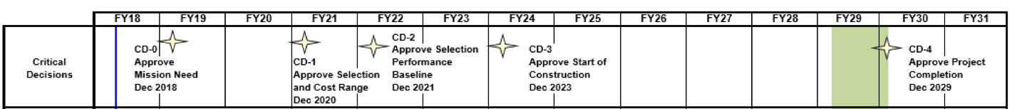
Proposed CeC plan
FY19 – install PCA equipment in the IP2 common section
– retune CeC accelerator, fix misalignments of RF cavities
FY20 – commission PCA equipment in the IP2 common section
– test PCA-based ACeC at maximum available RHIC energy
– optimize IR diagnostics for PCA
FY21 – attempt demonstration of the PCA-based ACeC at γ=28.5
FY22 – 3D cooling in PCA-based ACeC at γ=28.5
– evaluate PCA-based CeC performance
Design of eRHIC CeC
Test in CeC options
Build cost effective eRHIC CeC
Commission and Operate CeC
CeC with PCA
Beam Energy Scan
sPHENIX
eRHIC

Slide 29
Estimation of resources for FY21-FY23
CeC group – 4 1/2 scientists at 65% of the efforts, 2-3 graduate students
Estimation of resources for FY20
Engineers & technicians Total: 0.75 FTE
  Mechanical – 1 men months Laser – 0.5 men month (mostly support)
  Instrumentation – 1 men month RF – 3 men month
  Vacuum – 1.5 men month (support & cathode changes)
  Electrical – 1 men month Controls – 1 men month (support operation)
Funds: $600K for the run, 8 days of RHIC operations - $600K
New diagnostics beam-line - not costed yet, estimated at ~ $1M$, 2 FTE
Engineers & technicians Total: 0.5 FTE
  Mechanical – 0.5 men months Laser – 0.5 men month (mostly support)
  Instrumentation – 1 men month RF – 1.5 men month
  Vacuum – 1 men month (support & cathode changes)
  Electrical – 0.5 men month Controls – 1 men month (support operation)
Funds: $500K, two weeks of RHIC operation - $1.1M

Slide 30
Back-up

Slide 31

Poor laser
Last week of the Run
Recommission the CeC accelerator
Compress the beam to ~ 50 A
Propagated CW beam to HP dump
Commission IR diagnostics
Establish FEL lasing
During this run the CeC experiment was strongly supported by C-AD personnel and management.

Slide 32
Hadron cooling techniques I
There are two experimentally tested cooling techniques: RF stochastic cooling (S. van der Meer) and conventional electron cooling (G. Budker)
  The decrement of stochastic cooling is determined by its bandwidth - ~ 3 GHz in the state-of-the-art RHIC RF SC - and linear density of particles. Ion beam in RHIC with 10⁸ ions/nsec has cooling time ~ 1 hour. RHIC proton beam has ~10¹⁰ p/nsec and would have a cooling time of ~ 100 hours, insufficient to overcome IBS. Linear beam density in future EIC is at least 10-fold higher than in RHIC and the required cooling times are much shorter than the ~ 1000 hours cooling time achievable with the most advanced RF SC
  Cooling rate of conventional electron cooling does not depend on the number of cooled particles, but it cooling time is a very strong function of beam energy – cooling time grow as ~ E^{5/2}. The highest energy electron cooling demonstrated in a high average current state-of-the-art facility at FNAL is 8 GeV with cooling time ~ 1 hour. It means that with “identical” conditions cooling time will increase by ~ 7,000 times for 275 GeV proton beam in RHIC or EIC. In other words, it is about 7,000 more difficult to built an accelerator to cool 275 GeV protons that those at 8 GeV.
While there are significant efforts at Jlab and elsewhere to conceive electron cooler capable of cooling 275 GeV proton beam in EIC. Even if it is possible, it would likely be a rather monstrous and expensive system.

Slide 33
Hadron cooling techniques II
There two novel stochastic techniques promising to extend bandwidth of amplifiers to THz and PHz range, e.g. into optical range of frequencies: optical stochastic cooling, OSC, (Zolotarev, Mikhailichenko) and coherent electron cooling, CeCm (Derbenev, Litvinenko, Ratner). Both of this techniques never were tested experimentally, but two experiments one at FNAL (OSC) and one at BNL (CeC) are pursued
  OSC proposes using high-gain broad-band laser to amplify radiation generated by hadrons in high-field (~ 10T) wiggler and use it to correct energy spread of the beam in a similar high-field wiggler, e.g. it relies on radiation and absorption of photon by hadrons . This system has two main: (a) wavelength of laser amplifier is fixed and OSC can not support, for example, cooling of hadrons in EIC with energies covering 50 - 275 GeV range resulting 30-fold change of radiation wavelength from a wiggler; (b) Radiation and absorption (Compton) cross-section is inverse proportional to square of particle mass and is very small for hadrons. This is the main reason why FNAL pursues demonstrating OSC for a MeV-scale electron beam, not a GeV-scale hadron beam
  CeC is relying on various electron beam instabilities (from FEL to micro-bunching) to amplify electrostatic interaction of hadrons and electrons. This makes this technique flexible – for example, the CeC system will simply adjusts to cool hadrons within 50 - 275 GeV range. We pursuing demonstration of this technique at RHIC and to cool 26.5 GeV/u ion beam
In this presentation I will focus on CeC experiment at BNL and its promise for a strong and inexpensive cooler for future EIC

Slide 34
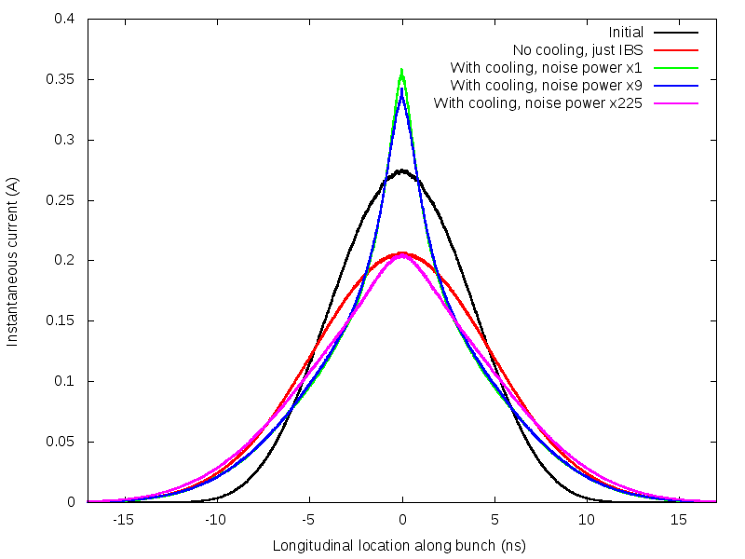
Simulated performance: full 3D treatment
Predicted evolution of the 26.5 GeV/u ion bunch profile in RHIC
Cooling will occur if electron beam noise is below 225-times the base-line (shot noise)
We demonstrated beams with noise as low as 6-times the baseline
Cooling bunches
By ideal e-beam
(t=40 mins)
By our e-beam
(t=40 mins)
Initial
Bunch (t=0)
Witness
Bunch
(t=40 mins)
By e-beam
with noise 225-fold above the baseline
(t=40 mins)
Simulated and fitted (used in simulations of the ion beam cooling) energy kick in the PCA-based CeC experiment system
Black – initial profile, red – witness (non-interacting) bunch after 40 minutes. Profiles of interacting bunches after 40-minutes in PCA-based CeC for various levels of white noise amplitude in the electron beam: green– nominal statistical shot noise (baseline), dark blue – 9 fold above the baseline, and green – 225 fold above the baseline

Slide 35
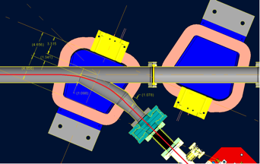
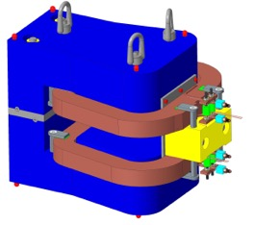
Changing CeC amplifier from FEL to PCA
Small gap in FEL wigglers is not compatible with low energy RHIC operations of the Beam Energy Scan (BES-II) program
CeC SRF accelerator
This was not a failure of the FEL-based CeC concept – the system is preserved and can be tested in the future
Unchanged
Kicker
Modulator
4-cell PCA
Unchanged

Slide 36
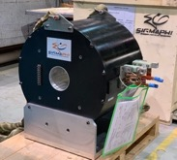
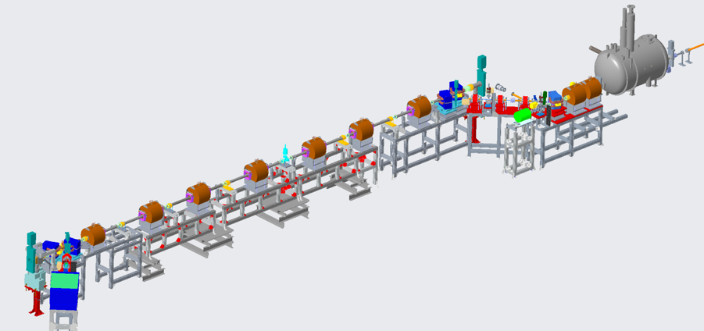
CeC with PCA: status
RHIC beam
Mechanical design new CeC system is completed
We procured and commissioned new laser system with controllable pulse structure
All new vacuum with beam diagnostics are built chambers are installed
All supports are built and installed
All solenoids are designed, manufactured, delivered and undergo magnetic measurements
Assembly of the plasma-cascade based CeC will be completed this Fall
CeC section
using Plasma-Cascade Amplifier

Slide 37
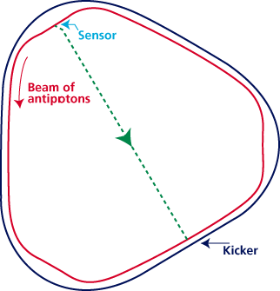
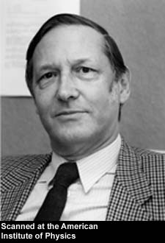
Critical conditions for the stochastic cooler
Linearity: Amplifier must be linear (no saturation) and low noise
Overlapping: Amplified signal induced by individual particle in the modulator (pick-up, sensor) must overlap with the particle in the kicker
Bandwidth: Does not matter how high is the gain of amplifier, cooling decrement per turn can not exceed 1/N_{s}, where is number of the particles in fitting inside the response time of the system: τ~ 1/Δf
Noise: Noise of the amplifier reduces attainable cooling rate beyond that limited by the amplifier bandwidth
S. van der Meer
1984 Nobel physics prize
RF stochastic cooling is reaching its limits at bandwidth ~ 10 GHz
S. van der Meer, Rev. Mod.Phys. 57, (1985) p.689
S. van der Meer, 1972, Stochastic cooling of betatron oscillations is ISR, CERN/ISR-PO/72-31
Notes:
Can it work for a bunched beam?

Slide 38



What can be tested experimentally?
RHIC Run 18
High gain FEL amplifier
with low-a_{w} wigglers
Cooling test would require significant modification of the RHIC lattice & superconducting magnets with cost exceeding $20M.
PCA amplifier
RHIC Runs 20-22
Plasma-Cascade
Amplifier
Cooling test would require significant modification of the RHIC lattice & superconducting magnets with cost exceeding $20M

Slide 39
Sensitivity studies using SPACE
Real electron beams are complex and imperfect
We are performing sensitivity studies of the PCA to various parameters of the beam as well as to the beam optics
The process is long and tedious with final goal to simulate PCA and CeC performance for measured beam parameters
We already found that PCA-based CeC required beam quality better than that sufficient for FEL-based CeC. The most stringent requirements are on the beam emittance (ε_{n} ≤ 3.5 mm mrad) and energy spread (σ_{E}/E ≤ 0.08%)
Dedicated code SPACE serves our needs very well, but we would like to have independent evaluation of PCA, for example, using VORPAL/VSIM code
Parameter
Species in RHIC | Au⁺⁷⁹ 26.5 GeV/u
Electron energy | 14.56 MeV
Charge per electron bunch | 0.6 nC - 2 nC
Peak current | 50 -100A
Normalized beam emittance (core) | < 3.5 mm mrad
RMS energy spread, (core) | Core < 0.08%
Repetition rate | 78.17 kHz
CW beam current | ~160 μΑ

Slide 40
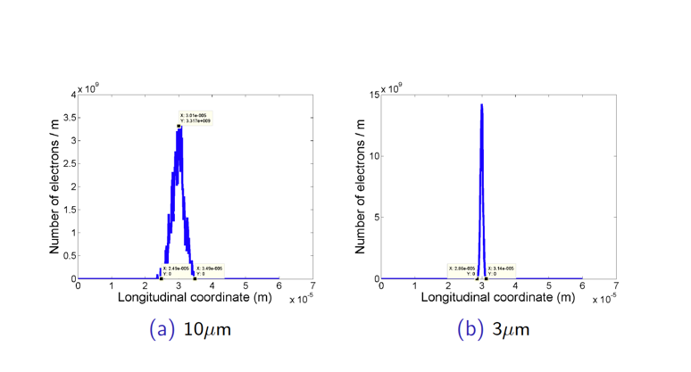
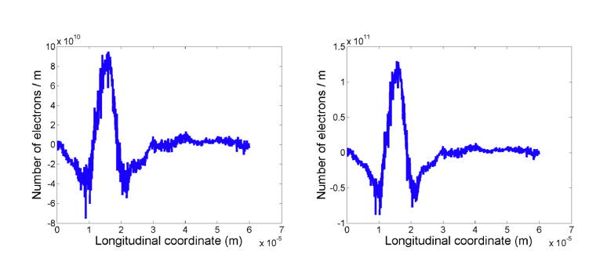
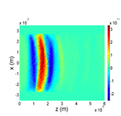
Simulating PCA at γ=28.5 using code SPACE*
Initial seed from an ion
Initial seed
from ion
Modulation
In the kicker
Signal is delayed by 15 μm because of the angular spread in PCA and rotation in solenoids.
With CeC system R₅₆ =14.8 mm, it will be compensated by 0.1% increase in the electron beam energy
*SPACE is a PIC code, X. Wang et al., “Adaptive Particle-in-Cloud method for optimal solutions to Vlasov-Poisson equation,” J. Comput. Phys., 316 (2016), 682 - 699.

Slide 41
Distribution of the decrements: linear kick
r = 0
r = 0.5
r = -0.5
r = -1
r = -1.5

Slide 42
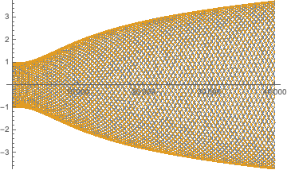
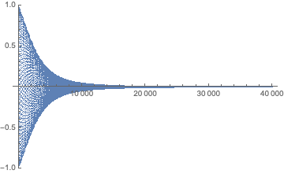
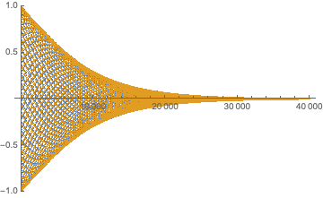
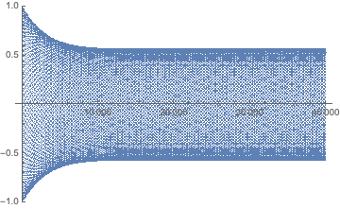
Distribution of the decrements: Real kick
Kick
Wrong sign of displacement Δx = -0.75σ_{x}
δ
δ/σ_{δ}
x/σ_{x}
Δx = 0.75σ_{x}
zero energy kick at 0.4σ_{δ}
Kick
δ
x/σ_{x}
δ/σ_{δ}
Excessive shifting of zero-kick point to δ = 0.6σ_{δ}
Kick
δ
x/σ_{x}
δ/σ_{δ}
x/σ_{x}
δ/σ_{δ}

Slide 43
How to evaluate CeC: the original recipe
Free Electron Lasers and High-energy Electron Cooling,
V. N. Litvinenko, Ya. S. Derbenev, 29th International Free Electron Laser Conference, Novosibirsk, Russia, August 27-31, 2007
Linear response of electron beam on perturbations – no saturation, superposition principle
Evaluation of hadron distribution function using Fokker-Plank equation with both damping and diffusion terms
Cooling transversely using coupling with longitudinal degrees of freedom

Slide 44
How to evaluate CeC: the original recipe
Free Electron Lasers and High-energy Electron Cooling,
V. N. Litvinenko, Ya. S. Derbenev, 29th International Free Electron Laser Conference, Novosibirsk, Russia, August 27-31, 2007
Linear response of electron beam on perturbations – no saturation, superposition principle
Evaluation of hadron distribution function using Fokker-Plank equation with both damping and diffusion terms
Cooling transversely using coupling with longitudinal degrees of freedom

Slide 45
Distribution of the decrements: a simple case
No x-y coupling
Qx-Qy resonance
Can use non-achromatic transport or transverse beam separation

Slide 46

SR radiation and IR detector sensitivity
IR power is measured by a very slow AC pyroelectric detector, which is calibrated for periodic 100 msec pulses separated by 100 msec: 2.12×10⁶ V/W
We cross-calibrated it for shorter 1.5 msec to 6.5 msec pulses (trains less then 600 bunches)
We operated CeC accelerator short 100 to 500 bunch trains repeated typically with 10 Hz and used lock-in amplified. We cross-calibrated the lock-in amplifier output for such signal to be (4±0.4).10⁵ V/W
Power reaching the insertable the 1” Cu mirror was calculated using Igor-Pro for beam in a measured magnetic field of the 45-degree dipole operated at 140 A – it was is very good agreement (within 10%) with analytical estimations
We expected that 1.4 mm x 1.4 mm metal mesh installed at he exit window has ~ 50% transparency
With 50% reaching IR detector we expected 10-15 V/A locking amplifier signal. With typical 1.5 μA beam current, we expected signal ~ 20 μV (~ 50 pW power)
This expectations are in reasonable agreement with the measured level of radiation from relaxed beam
Pyroelectric detector
The range from 0.1 to 30 THz (10 μm – 3 mm)
Response : 2.12 mV/nJ
Resolution of the system: ~0.1 nJ
Noise equivalent: 0.6 nW/Hz^{1/2}

Slide 47


Baseline (shot noise level) measurements
LogView data
MDM code
Measured signal 9.5 V/A
~ 60% of expected without losses
<cos> 10.5 V/A
<sin> 10V/A R R ~ 14.5 V/A.
The base line was measured for modestly (4-fold) compressed beam with 1.5 and 0.3 nC charges per bunch in relaxed LEBT lattice. Averaged over 4 long scans the lock-in amplifier MDM signal was 14.5 V/A with RMS error of 1.5 V/A
This value is ~ 50% level of synchrotron radiation that reaches the Cu mirror

Slide 48

What is Plasma-Cascade Amplifier
It is a parametric instability driven by variation of the plasma frequency originating from the variation of the transverse electron beam size
We do it by creating dramatic variations of plasma density using modulation of the transverse beam size
Important questions – when exponential growth occurs and how fast it is? Hence, we developed a self-consistent 3D theory and simulations*
* Plasma-Cascade micro-bunching Amplifier and Coherent electron Cooling of a Hadron Beams, V.N. Litvinenko, G. Wang, D. Kayran, Y.Jing, J. Ma, I. Pinayev, arXiv preprint arXiv:1802.08677, https://arxiv.org/pdf/1802.08677.pdf , 2018

Slide 49
PCA performance as function of beam emittance, energy spread and optics mismatch for the beam with 75 A peak current

Slide 50

Beam dynamics
We use large suit of accelerator and EM codes to simulate beam dynamics: elegant, Impact-T, GPT, ASTRA, PARMELA, MAD-X, AC3P, CST, Echo-3D, ABCI, CSR-track, SPACE, VORPAL…
We simulated wake-functions for all components of CeC accelerator and use it for final simulation. We also include CSR and space charge effects in simulations. Most detailed simulation require weeks and weeks of simulations using super-computers
We developed relatively high confidence in prediction of specific effect by specific codes: it is definitely not true that all codes can reliably simulate all aspects of beam dynamics
Favorable comparison with the experimental is the ultimate test of trust in simulations and their prediction. Our present diagnostic is very limited
We are trying to use linac and dog-leg for semi-time-resolved diagnostics, but interpretation of the results, even when possible, is very convoluted. We need a real time-resolved diagnostics beamline
Impact-T simulation of the bunch profile and normalized slice emittances at the exit of the SRF linac
Matching round-to-round beam from the exit of the SRF linac to the entrance of the PCA-based CeC with quadrupoles in the matching section and achromatic dog-leg using elegant
Simulation of the CSR effct on the beam emittance passing the e dog-leg with elegant

Slide 51







Low Energy Beam Transport Optimization
Yag 1
Yag 2
BPM 2
Final

Slide 52











Optimized Electron Beam
$$Current(A)$$
$$Current(A)$$
52.4% of total charge
x$(mm)$
$$σ_{E}(keV)$$
$$x^{′}(mrad)$$
Slice Emittance
Less than 5 mm-mrad
$$z(degree)$$
x$(mm)$
Energy spread ~ 0.023%
Projected emittance within FWHM is 3.56 mm-mrad
Energy spread ~ 0.023%
Peak current is 100 Amperes
$$α_{x}$$ | $$β_{x}$$ | $$α_{y}$$ | $$β_{y}$$
-1.94 | 1.44m | -1.91 | 1.41m
© Y.H. Wu

Slide 53





New IR diagnostics
45º dipole
magnet
Sol 6
Sol 5
Sol 4
Sol 3
Sol 2
Sol 1
3 quads
704 MHz
SRF linac
Profile monitor 2
Profile monitor 1
500 MHz cavities
1” CVD diamond window with 1.4 mm x 1.4 mm metal mesh to stop GHz radiation from getting out
Mirror actuator
2” off-axis
Parobola mirror
IR detector
Lead shielding
Added lead shielding

Slide 54




SRF linac with 15 MV/m accelerating gradient has major time-dependent effects on the 1.75 MeV electron beam.
Left: Simulated (green) and measured (red dots) energy of electron beam as function of its phase at the entrance of the SRF linac; Middle – focusing of various slices in the linac and energy of the beam in CeC accelerator (SRF linac starts at 11.75 m) ; Right – bunch compression has a kink in the fist cell of 5-cell SRF linac
Proposed a dedicated diagnostic beamline
We have most of the parts, except transverse RF cavity (either build new or re-furbish 500 MHz old cavity), profile monitors system and one beam dump. Such diagnostics with resolution ~ 1 psec could be built in one year and would allow us fine tuning and comprehensive evaluation of electron beam
Existing accelerator
YAGs
Dog-leg
Beam
dumps
Dipole
Quads
TCaV
704 MHz SRF linac
Diagnostics beamline

