Slide 1
Home work question
Outline plan for systems and infrastructure improvement to enable operability and sustainability of RHIC and injectors for the next 10 years and beyond (include where appropriate needs/opportunities/synergies of other program MIRP, NSRL, Tandem, ATF).
Specifically address the cost and benefit of updating and/or maintaining (1) cryoplant and cryo-distribution and (2) controls and machine protection.

Slide 2
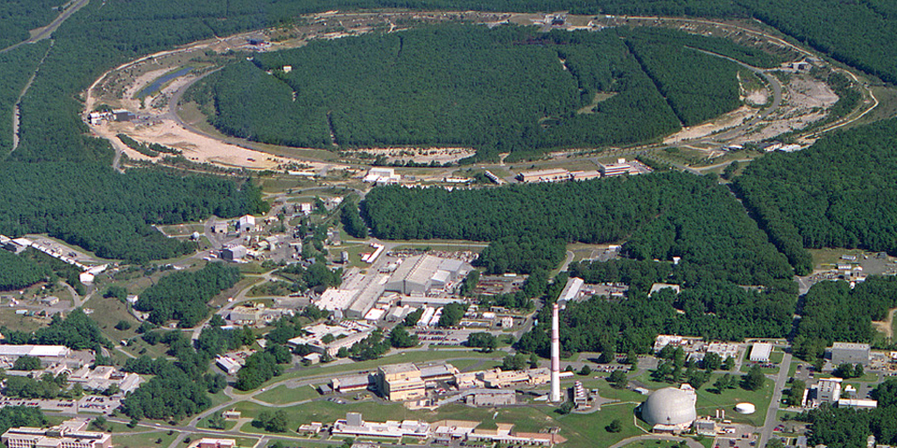
Relativistic Heavy Ion Collider (RHIC) Overview
Polarized Jet Target
Electron lenses
RHIC
Electron cooling
(s)PHENIX
RF
STAR
LINAC
Circumference : 3.8 km
Max dipole field : 3.5 T Energy : 255 GeV p : 100 GeV/nucleon Au
Species : ph to U (incl. asymmetric) Experiments : STAR (g sPHENIX)
EBIS
NSRL
Booster
SRF
BLIP
AGS
UED
TPL
Tandems
ATF
Highly flexible and only US Hadron Collider exploring the QCD phase diagram and the spin of the proton
Injectors also provide beams for unique applications: Isotope production (BLIP/TPL); Cosmic radiation simulation (NSRL); Commercial applications (Tandem)
R&D for future facilities and accelerator applications (SRF, ATF, Cooling)

Slide 3
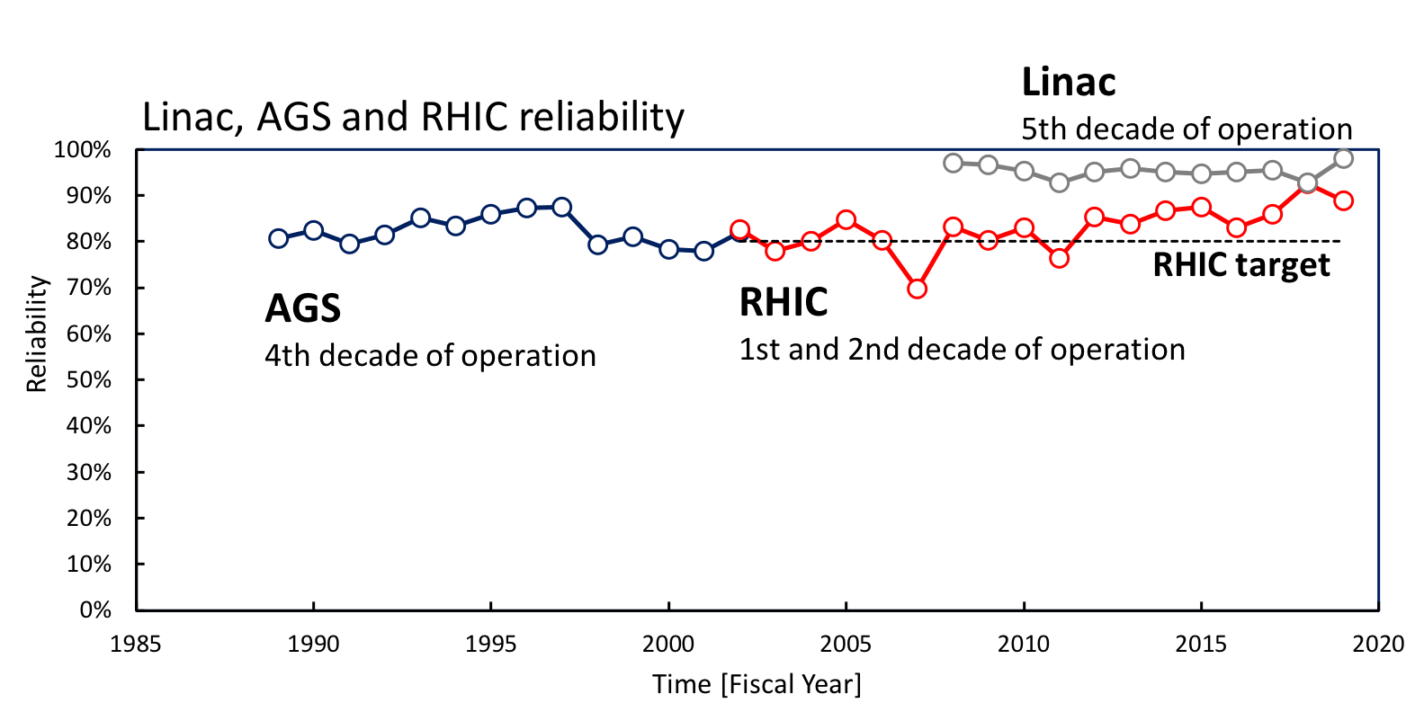
RHIC hadron complex historical reliability
Current increased 5x over last 25 y
Dramatic performance increase over 20 y Au+Au L_{avg} now 44x design (at full energy)
RHIC turned on 2000 => 19 years of operation
AGS 1960 => 59 years
Booster 1989 => 28 years
Linac 1970 => 49 years
Machine age alone not a good guide for reliability
Can maintain accelerators in good working order (almost) indefinitely

Slide 4
Upgrade planning process
In 2011 decadal upgrade plan for RHIC and injector complex, in 2018 assessment for further 25+ years
Annual re-evaluation based on:
need for performance upgrades (driven by user requests)
need for upgrades of obsolete systems
Last large planned performance upgrades for RHIC program are LEReC ($8.3M, complete 2019) and Extended EBIS ($1.8M, planned completion 2020)
Upgrades funded as Accelerator Improvement Projects (AIP), Capital Projects (CP), and Operations (smaller upgrades)
Try to extract full value of installed system before replacement
Upgrades discussed with DOE NP in annual budget briefings, S&T reviews, site visits, monthly phone calls

Slide 5
2018 Estimates for 25+ years; RHIC (6 y) and BNL EIC (19 y)
 | (all numbers in $M) | Total cost | RHIC |  |  | BNL EIC
 |  | with OH | Total | Ops | CE/AIP | Total | Ops | CE/AIP
1 | Buildings | 0.8 | 0.8 | 0.8 | 0.0 | 0.0 | 0.0 | 0.0
2 | Water Systems | 4.9 | 2.2 | 1.1 | 1.1 | 2.7 | 1.0 | 1.7
3 | Electric Power Distribution | 16.6 | 9.2 | 2.0 | 7.2 | 7.4 | 0.2 | 7.2
4 | Electrical Systems | 42.2 | 37.2 | 15.5 | 21.8 | 4.9 | 0.8 | 4.2
5 | Cryogenic Systems | 23.9 | 23.9 | 2.4 | 21.5 | 0.0 | 0.0 | 0.0
6 | Vacuum Systems | 13.3 | 7.7 | 3.0 | 4.7 | 5.7 | 0.6 | 5.0
7 | RF Systems | 11.7 | 2.3 | 0.8 | 1.5 | 9.4 | 1.4 | 8.0
8 | Instrumentation Systems | 11.2 | 9.8 | 3.2 | 6.6 | 1.4 | 1.0 | 0.4
9 | Controls Systems | 32.3 | 12.1 | 8.4 | 5.9 | 20.2 | 6.3 | 13.9
10 | Preinjector Systems | 1.2 | 1.2 | 0.6 | 0.6 | 0.0 | 0.0 | 0.0
11 | Other | 0.1 | 0.0 | 0.0 | 0.0 | 0.1 | 0.0 | 0.1
 | Total cost | 158.3 | 106.5 | 37.9 | 70.9 | 51.8 | 11.3 | 40.5
 | Annual cost | 6.3 | 17.7 | 6.3 | 11.8 | 2.7 | 0.6 | 2.1
 | Annual expected funding |  | 5.5 | 2.0 | 3.5 | 5.5 | 2.0 | 3.5
Comments:
based on expert judgement of expected system lifetimes, and expert cost estimates
approximately sorted into Ops and CE/AIP (based on funding needs)
late years probably do not fully capture upgrade needs
C-AD labor not included (historically used ~25 FTE for upgrades)
plan to delay some large items (Booster MMPS $11.5M, Booster transformers $4.8M) for as long as possible to extract full value of installation
Main conclusion: present and future complex can be maintained for 25+ years with present funding level for Ops/AIP/CE

Slide 6
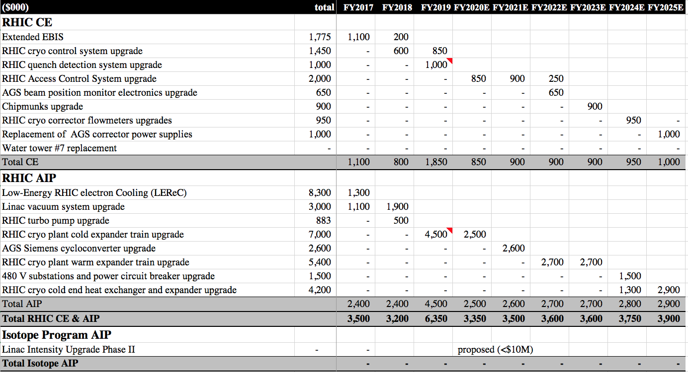
Capital and Accelerator Improvement Projects Funding (FY2017-2025)
remaining performance upgrade (until 2020)
Previous upgrades in 2 categories:
Performance upgrades
Maintenance/upgrades of technical infrastructure
New upgrades now focus on 2. category
M&S+25 FTE is approx. 0.5% of RHIC hadron complex replacement value
6
Notes:
AIP funding in place before start – DOE Financial Handbook, Chap. 24, issued May 2018 (also raises AIP max to $20M)

Slide 7
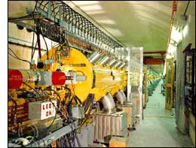
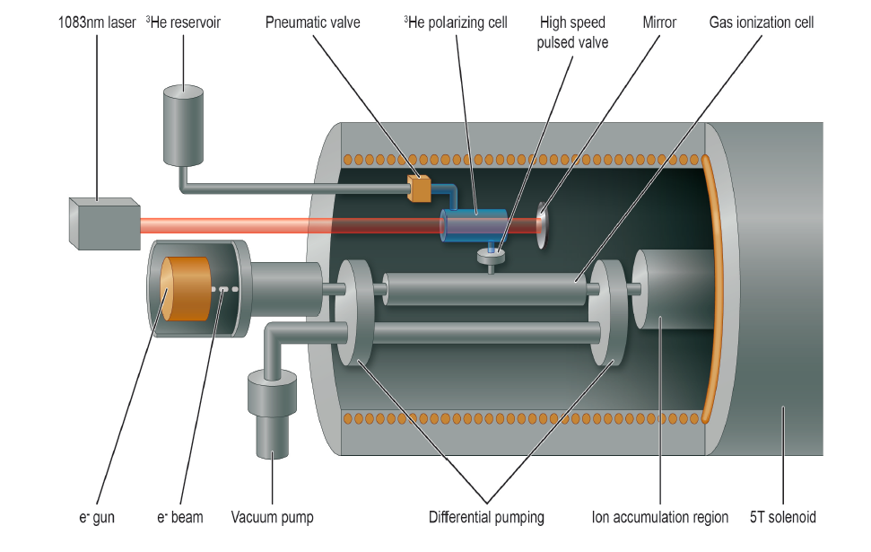
Synergies with other programs
BLIP
99.9% of all Linac accelerated protons go to BLIP (can change energy and optics pulse by pulse, at 6.67 Hz)
Planned 2x intensity upgrade for BLIP will replace all pulsed 165 quadrupole PS
NSRL
Booster costs shared by NASA (20%)
NASA also shares in cost of upgrades if there are benefits to NSRL (e.g. infrastructure upgrade for Extended EBIS since it will provide better beams from noble gases with gas cell that is also used to make polarized He-3 beam)
Tandem
Stand-alone facility for SEU/industry/NASA shielding tests, revenue covers costs
Maintain transfer line to Booster for some needs (p for NSRL, backup for EBIS, low consumption Ru-96 source, low momentum beams)

Slide 8
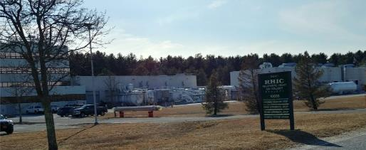
Cryo systems ($24M in estimate)
Original 4K refrigerator from Isabelle, upgraded several times
Largest items
Central He plant compressor system
2 new 2nd stage 2250 hp Helium compressors, upgrade the oil coolers on the compressor skids, and the intercoolers and aftercoolers, skid control panels
Central plant cold box system
minimum is the upgrade from oil bearing expanders to gas bearing expanders
Cryo control upgrades will allow for cryogenic operation without shift personnel, and reduce He losses (presently ~40%)

Slide 9
Cryo upgrade study: new plant vs upgrade
NEW PLANT | Equipment | Demolition | Installation | Total
New 4.5K Coldbox Carnot work = 2MW | 32 M? | 1.5 M | 3 M | 36.5M
New Compressors | 11 M | 1.1 M | 2.2 M | 14.3
Warm piping | 1.4 M | 0.6 M | 2.8 M | 4.8
 |  |  |  | 55.6 ± 5?
UPGRADE OLD PLANT | Equipment | Demolition | Installation | Total
New expanders | 12 M | 0.6 M | 2.4 M | 15 M
Heatexchangers for Compressors | 2 M | 0.2 M | 0.5 M | 2.7 M
 |  |  |  | 17.7 M

Slide 10
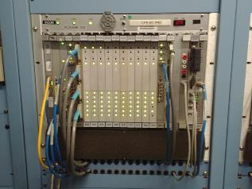
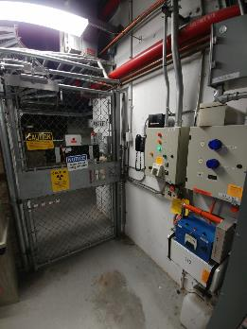
Controls ($32M in 25+ year estimate)
Largest items
VME chassis replacement ($2.1M)
could be ~$300k if only PS/fans are replace
VME module replacement ($13.5M)
VME technology may become obsolete (architecture developed in the late 1970s, but large installed base world-wide, some new platforms like ATCA/μTCA exist)
will not abandon pre-maturely to extract full value from installed base
RHIC Access Control System ($2M)
plan to do as capital project, funding FY2019-22
should last for lifetime of BNL EIC
additions for BNL EIC <$500k
Host computer, work stations, consoles etc ($2.4M)
ongoing effort, funded by operations

Slide 11
RHIC Machine/Experiment Protection upgrade
10-20 abort kicker pre-fires per year
Predominately caused by beam loss and resulting showers (no pre-fires in Ru+Ru/Zr+Zr; very small secondary beams from collisions – BFPP ~ Z⁷, EMD ~ Z², Z(Au) = 79, Z(Ru/Zr) = 44/40; very low beam losses due to stochastic cooling)
In the past some pre-fires have damaged detector components, notably in asymmetric Cu+Au and p+Au operation
Need pre-fire suppression for sPHENIX (Si detectors near beam pipe vulnerable)
Notes:
orbit bumps first installed in Run-14
bo6-qd3-ps failure on 03/18/2016 led to beam abort, quench, and damaged diode in Run-16

Slide 12
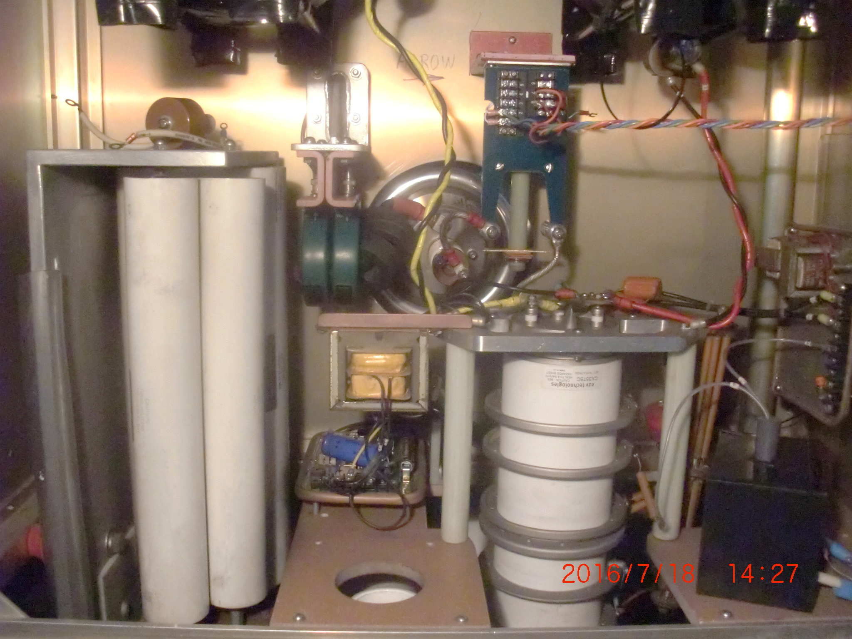
RHIC MPS upgrade Approach
Abort kicker pre-fires can be greatly reduced by moving HV switches out of tunnel, and by momentum collimation (also protects the QP diodes) => would be expensive upgrades (several $M)
More cost effective upgrade selected:
Add serial switches to RHIC abort kickers to suppress pre-fires (+6 ms delay)
Delay energy extraction from sc magnets after quench (necessity not recognized initially)
New and modified inputs to permit link detecting precursors of large losses lower BLM thresholds at store, RF systems, Orbit corrector PS (fast and slow), fast BPM readings (coherence signal from 10 Hz feedback system)
Monitor QP diode condition (measure voltage when diode becomes conductive) with sPHENIX run plan expect ~3-4x increase in distributed losses due to secondary beams from Au+Au luminosity over lifetime of RHIC
Abort kicker switches schematic
redundant mechanical relays (added)
thyratron tube
PFN
abort kicker
slow (470 turns) no pre-fires
fast (< 1 turn) pre-fires
closes 1st not synchronized
closes 2nd synchronized with abort gap

Slide 13
RHIC MPS upgrade Status
Serial switches
shortened closing time from 30 ms to 6 ms (2350 to 470 turns)
installed redundant trigger units in Blue and Yellow (prevents a failure mode observed in Run-17 test)
Blue abort kicker relays active since 05/22/19, Yellow 06/19/19
New beam permit inputs
All hardware implemented except fast corrector PS input (almost all parts in hand for installation this year)
Still need to upgrade configuration control of all inputs for use at full energy and intensity (time-dependent individual thresholds)
Expect completion in time for sPHENIX

Slide 14
Back-up material

Slide 15
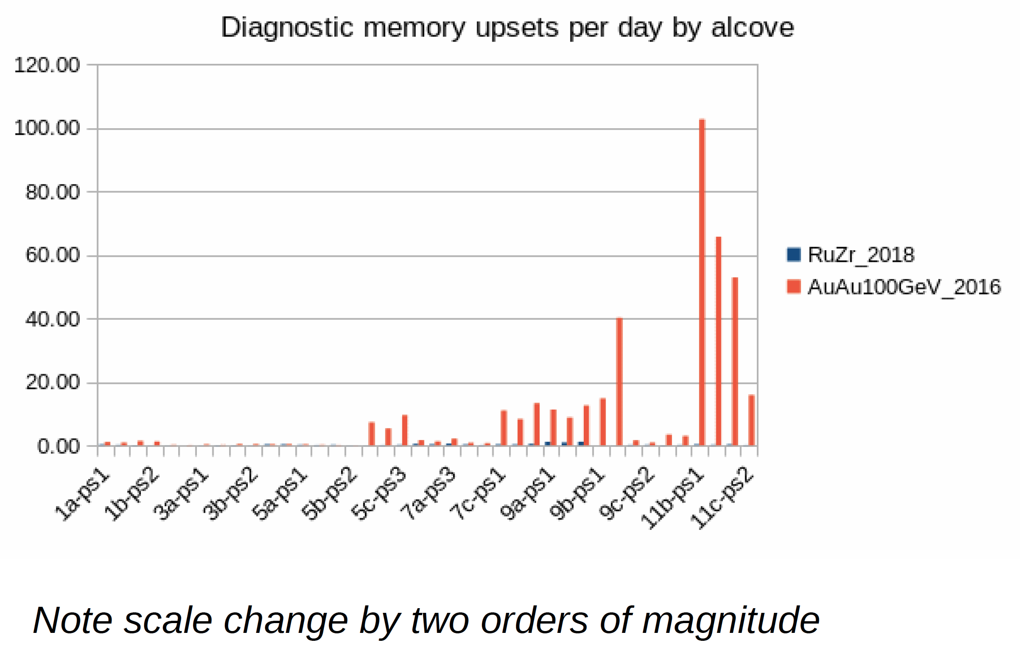
Zr+Zr / Ru+Ru is a good data point for low loss operation
Main source of losses for Au+Au (>90%) are secondary beams created in collision (σ_{tot}=218b with σ_{BFPP}=117b, σ_{EMD}=94b, σ_{nucl}=7b) BFPP = Bound-Free Pair Production – Au ion captures e⁻ EMD = Electro-Magnetic Dissociation – Au ion expels n
BFPP and EMD create large momentum deviation (1%, 0.5%) ion beams
Secondary beams from Zr+Zr/Ru+Ru collisions greatly reduced BFPP cross section ~Z⁷ => 60x reduction (Z_{Au} = 79, Z_{Ru} = 44) EMD cross section ~Z² => 3x reduction
Stochastic cooling then gives very low loss operation since it contains all other losses (IBS, beam-beam, other nonlinear)
=> had weeks with 2 and 5 failure hours (otherwise <20 h is good)
=> no abort kicker pre-fires (typically 10-20/year)
=> very few SEU

Slide 16
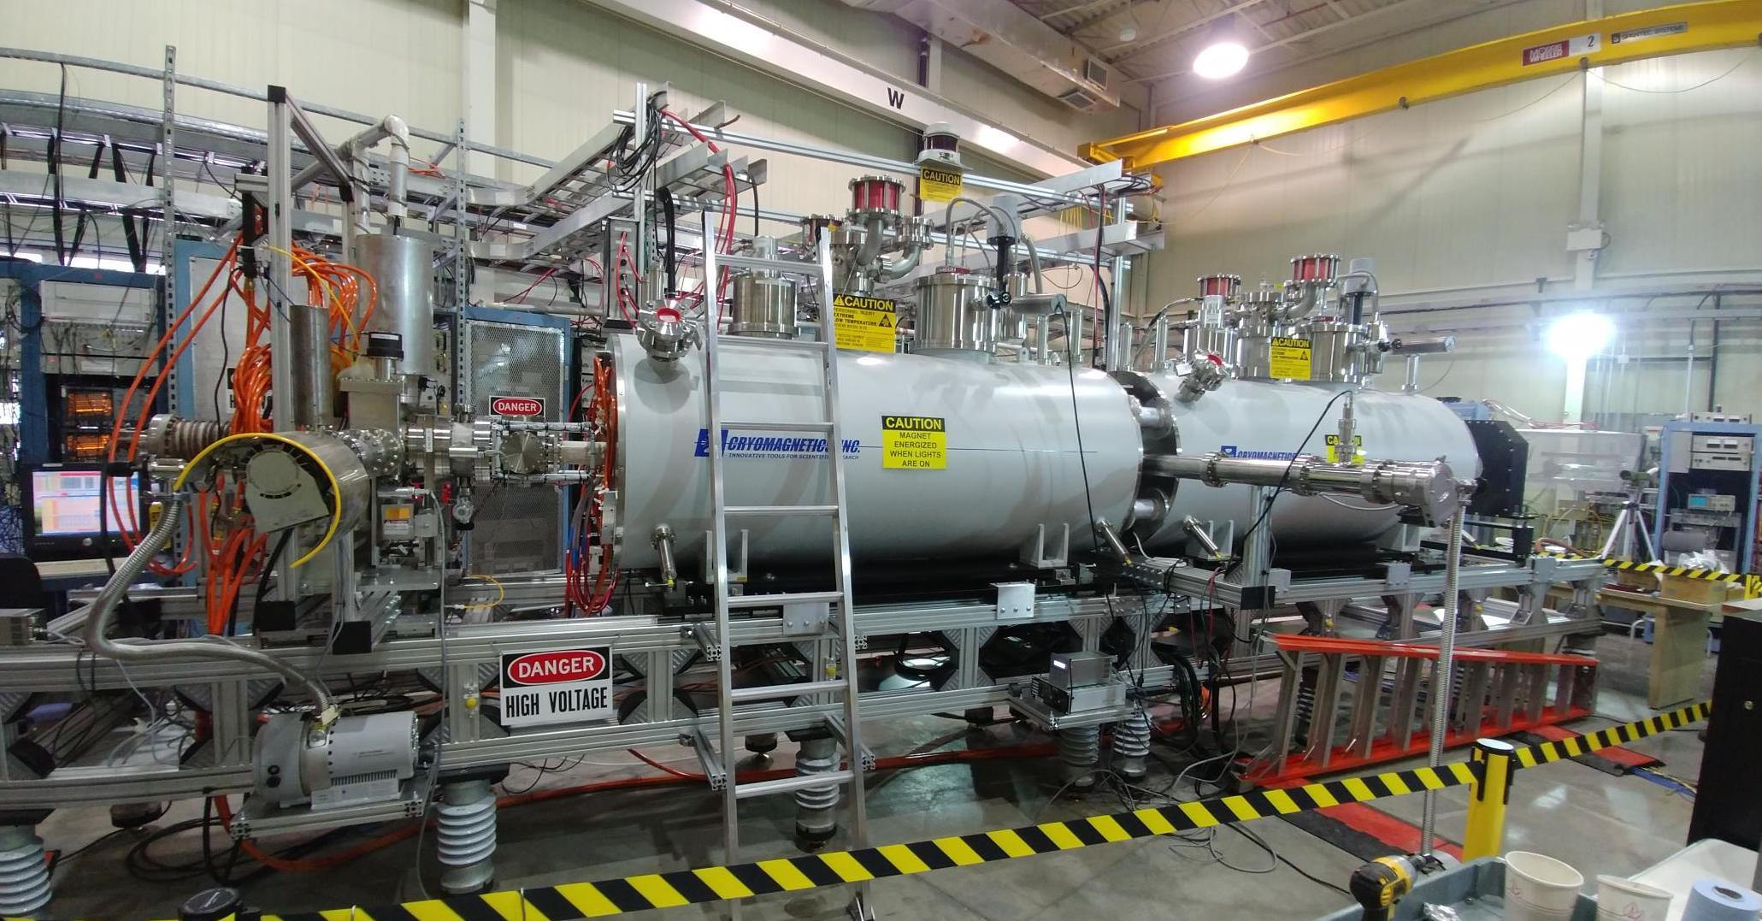
RHIC Capital Project Extended EBIS
New and reinforced spare EBIS solenoids in Test Area
transported 5 A electron beam through first (left) solenoid with smaller aperture
new system for gas elements including polarized He-3

