Slide 1
Triggering Particle Collider Experiments
Allen Mincer
New York University
July 2019

Slide 2

Examples in this talk will come from the ATLAS experiment at the LHC at CERN,
where the experiments are p-p collisions at high energies.

Slide 3
Why a trigger is necessary

Slide 4
A few definitions 1
Consider a beam of I_{incident} balls per unit time of type X with radius R_{X} incident on a target of area A.
The target is made of balls of type Y of radius R_{Y} and is very thin, so that looking at the plane of the target the particles of type Y don’t overlap.
Then a ball X will collide with ball Y if its center hits the target a distance R_{X} + R_{Y} from the center of a ball Y.
R_{X} + R_{Y}
R_{Y}
R_{X}

Slide 5
A few definitions 2
If there are N_{Y} balls of type Y in the area A, the fraction of the area A for which hitting the target would give a collision is therefore
[N_{Y}π(R_{X}+R_{Y})² ]/ A = (N/A) π(R_{X}+R_{Y})² = D π(R_{X}+R_{Y})²
Where D, the number of balls Y per unit area in the target, is equal to the density (number of particles Y per unit volume) ρ_{Y} times the target thickness t
The rate R of collisions is therefore given by
R = I_{incident} ρ_{Y} t π(R_{X}+R_{Y})²
Alternatively, one can determine π(R_{X}+R_{Y})² by measuring the rate of collisions:
π(R_{X}+R_{Y})² = R/ [ρ_{Y} t I_{incident}]
So this ratio is the cross sectional area which Y presents for a collision with X. It depends on the size of X and Y.

Slide 6
A few definitions 3
Now consider a beam of I_{incident} particles per unit time of type X incident on a target.
The target is made of particles of type Y and is very thin, so that looking down on the plane of the target the particles of type Y don’t overlap. If there are ρ_{Y} particles of type Y per unit volume, then the rate R of collisions between X and Y that give result Z is defined as the cross section σ_{XY}(Z) and is given by
Definition 1 σ_{XY}(Z) = R/ [ρ_{Y}tI_{incident}]
This is the effective area which Y presents to X to get a result of type Z.

Slide 7
Exercise
The cross section for proton proton collisions at center of momentum energy of 13 TeV is on the order of 100 mb (1b = 10⁻²⁴cm²).
Show that this means the effective proton radius is a little less than 1 fm (1 fermi = 10⁻¹⁵m)
Note that protons are not solid spheres, so this is only approximately the correct idea. But it still gives some feel for what is going on.

Slide 8
A few definitions 4
Now consider a machine which shoots bunches of particles of type X against bunches of particles of type Y so that there are N interactions per unit time giving result Z. We define the instantaneous luminosity L of the machine as
Definition 2 L * σ_{XY}(Z) = N_{XY->Z}
Note that once L is known the number of events expected from any process can be determined if we know the cross section of the process.
If we run the machine for some time, with L possibly changing, we define the integrated luminosity
Definition 3 L_{INT} = ∫L(t) dt

Slide 9
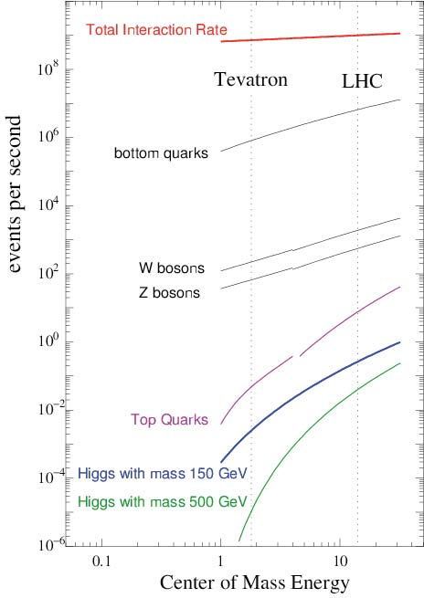
Rate =
Cross Section x Luminoisty
The plot shows the rate of two protons colliding to produce each of the particle shown. So about one in a billion LHC interactions produce a Higgs particle.

Slide 10
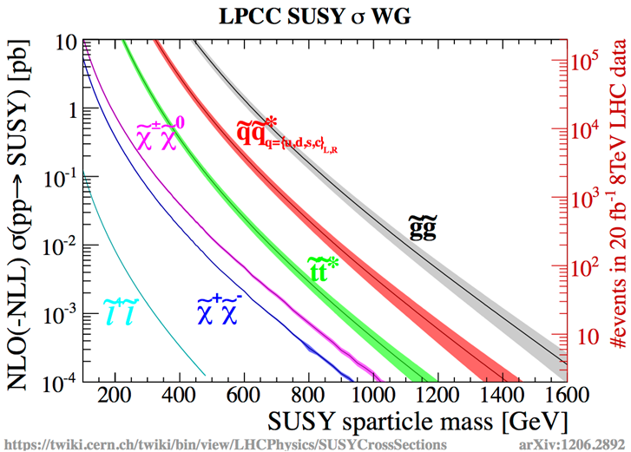
SUSY 8 TeV Cross Sections
1pb/100mb = 10⁻¹²/0.1 = 10⁻¹¹

Slide 11
Needle in Haystack
With apologies to farmers and tailors and in spirit of spherical cows:
Needle ~ 4cm long, 2/3 mm diameter, V ~ 1.4 x 10⁻⁸ m³
Haystack ~ 4m high, 5m diameter, V ~ 80 m³
Ratio = 1.4 x 10⁻⁸ m³ / 80 m³ ~ 2 x 10⁻¹⁰

Slide 12
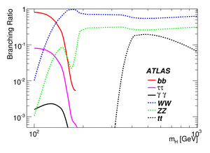
Detect new particles via signatures that have manageable background sources
Higgs decay modes
No pattern is unique to the Higgs. So we must search for an excess of a certain type of final state. Number of Higgs necessary depends on decay mode and BG rates.

Slide 13
The conclusion is that we need lots of collisions to produce and detect a new particle like H or χ

Slide 14
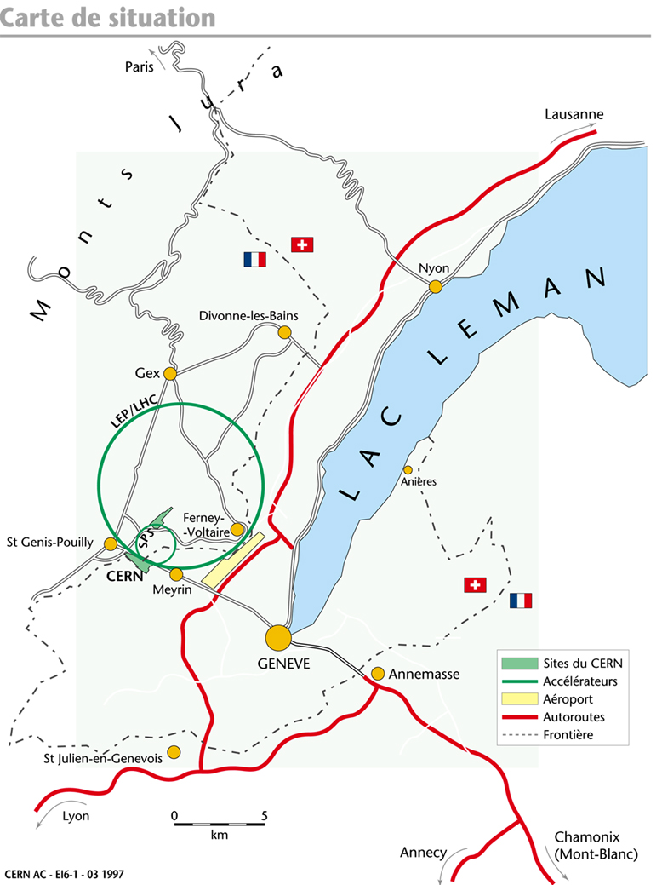
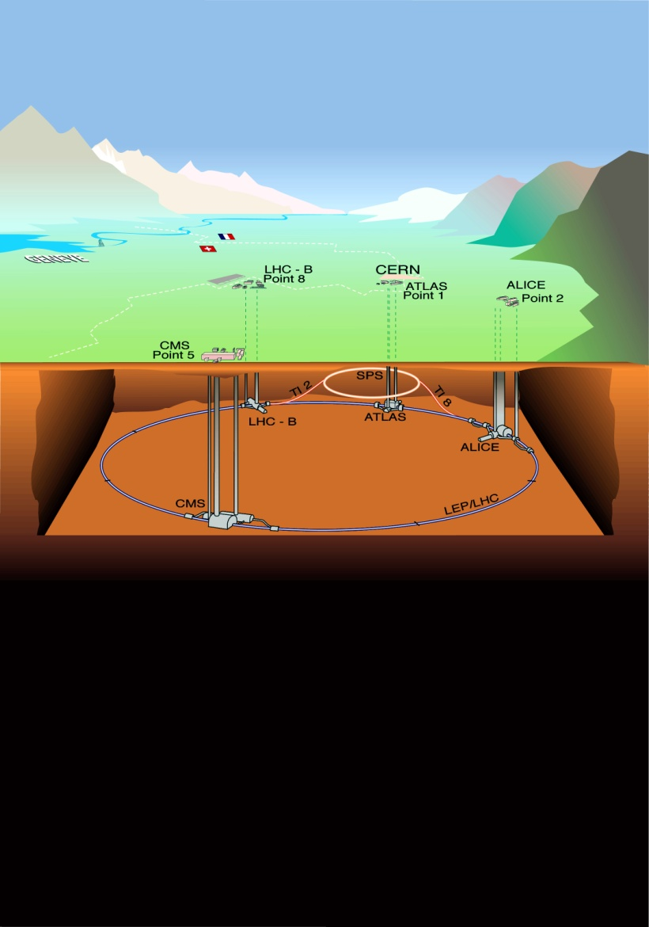
50m to 175m underground

Slide 15
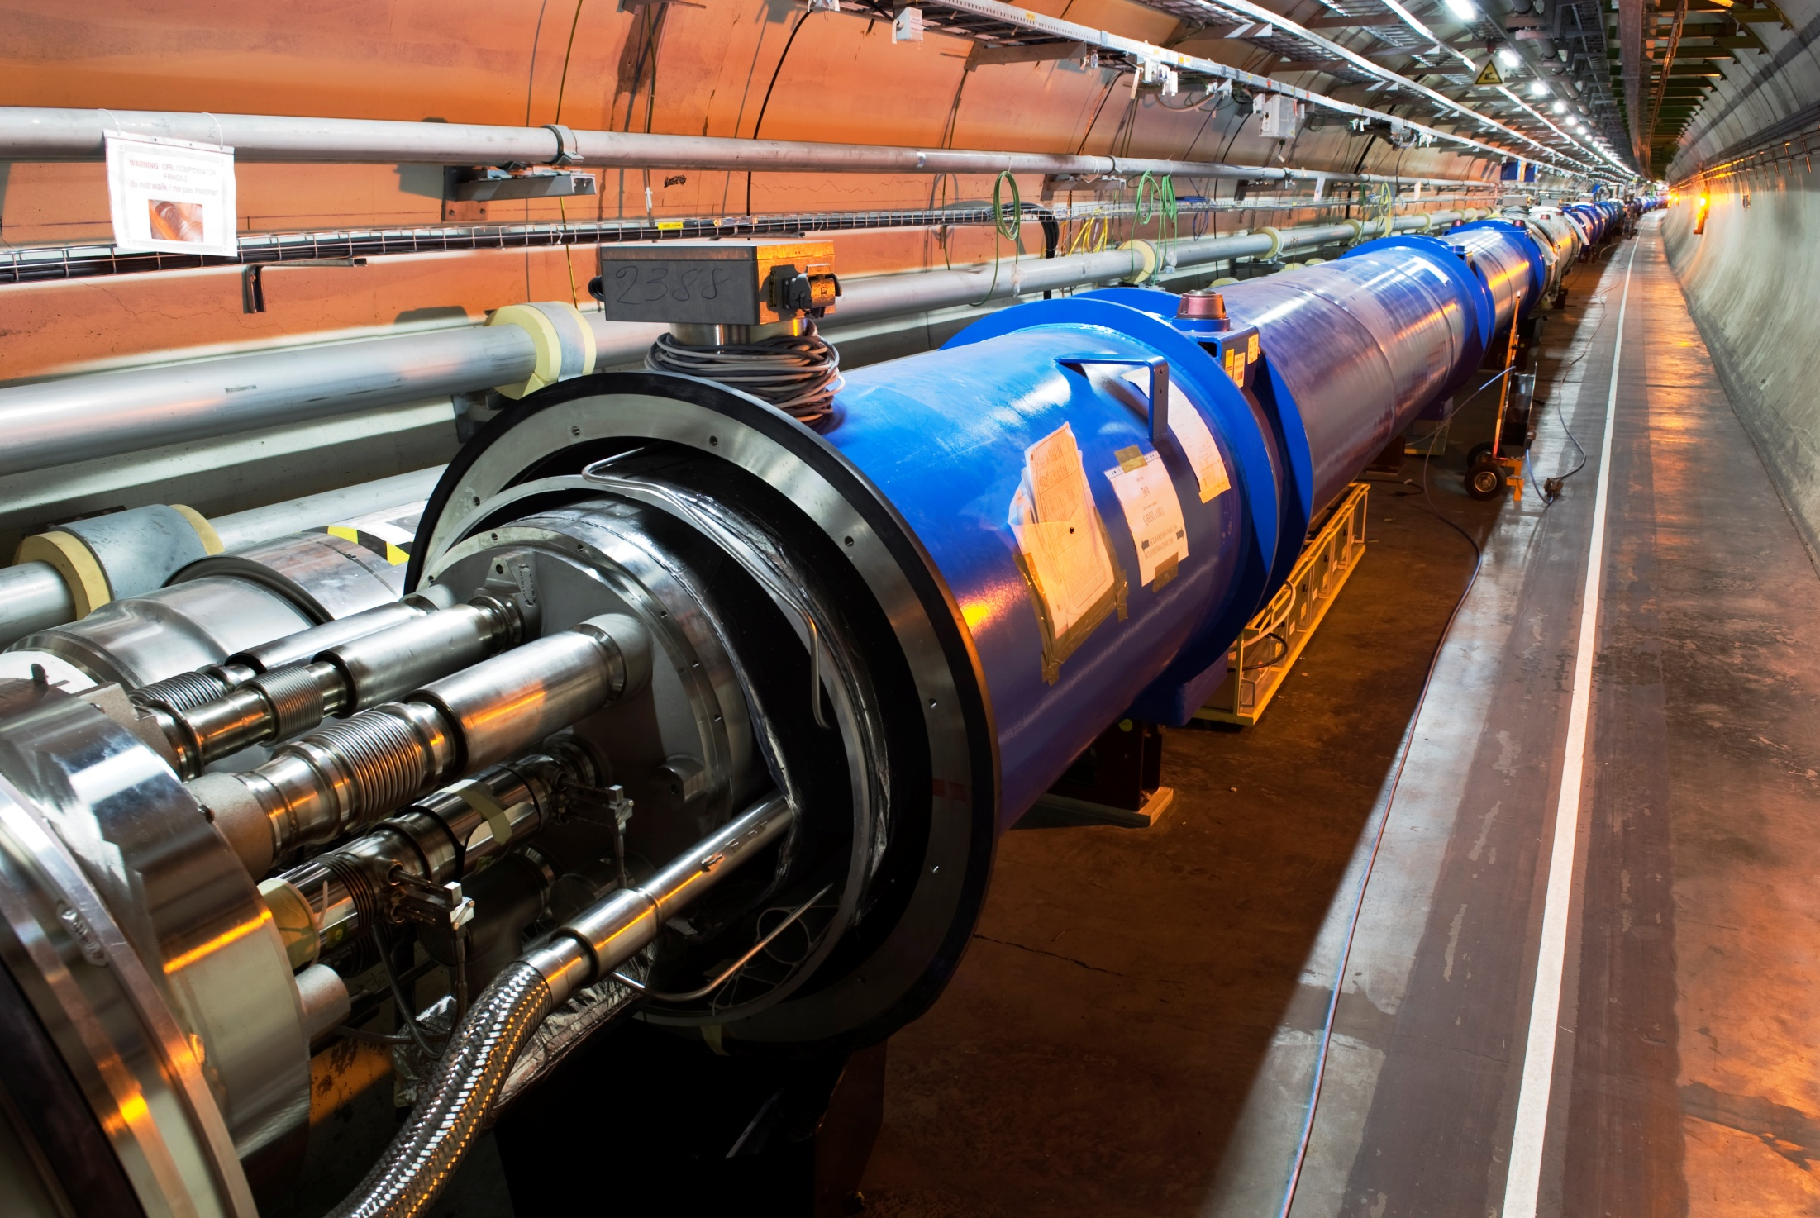
LHC
1232 15m 8.36T dipole magnets, 392 5-7m quadrupole magnets (223T/m)

Slide 16
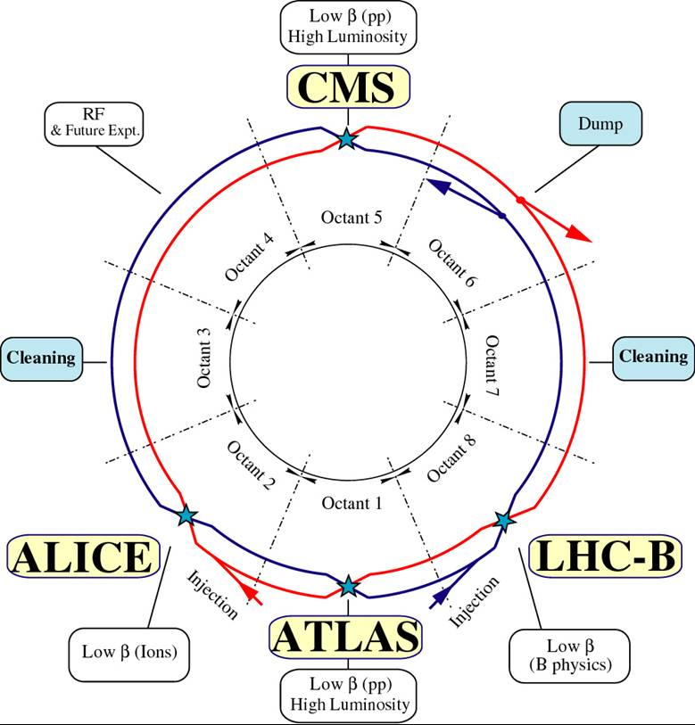

Slide 17
Now we have to detect χ once it is produced.

Slide 18
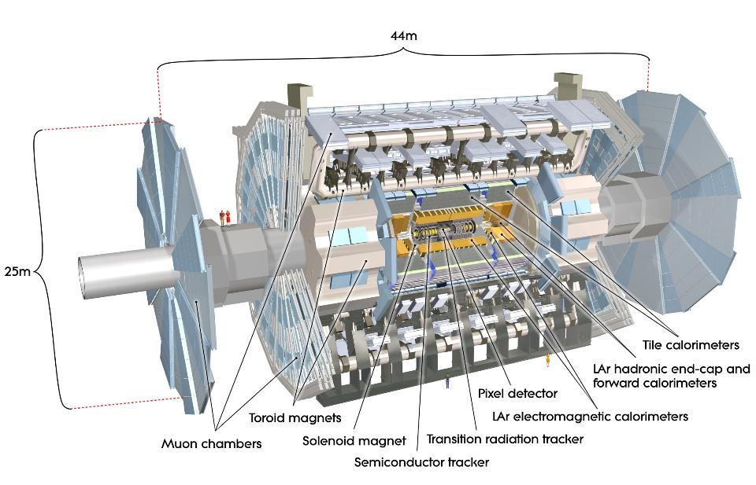

Slide 19
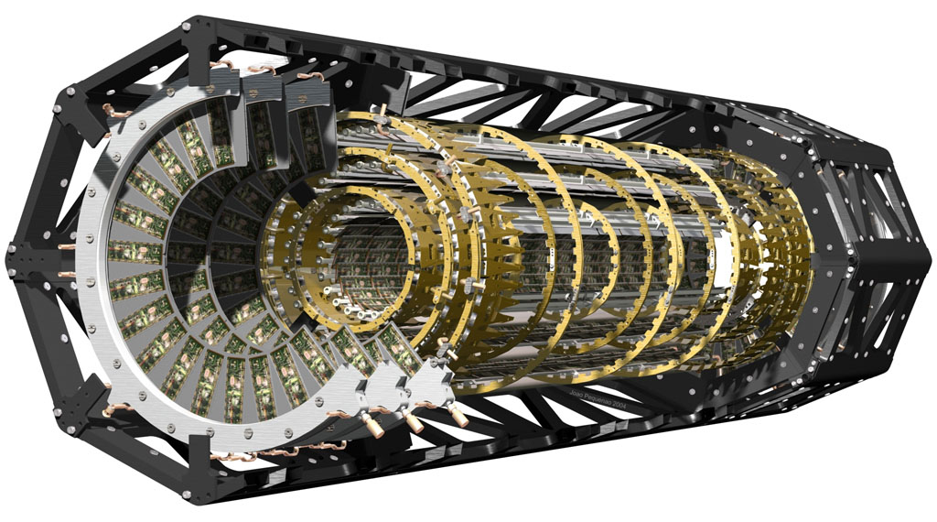
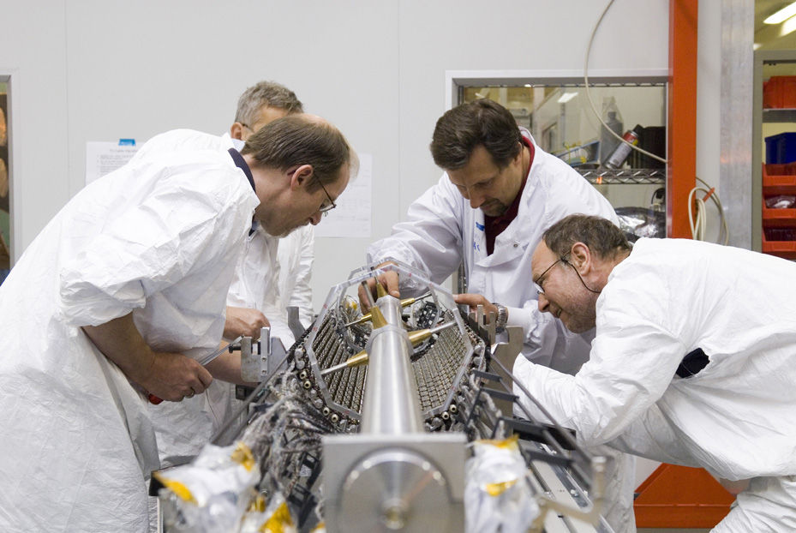
Pixel Detector
Measures position in 2T field.
9.2 x 10⁷ channels (8.0 x 10⁷ Run I)
10μm R-Φ 115μm Z (R) for barrel (disks)

Slide 20
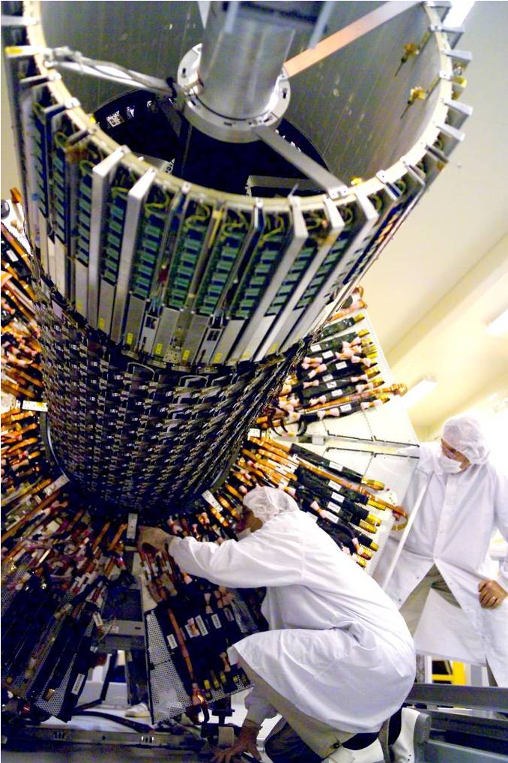
SCT: Semi-conductor Tracker
Measures position in 2T field
17μm R-Φ 580 μm Z (R) for barrel (disks)
6.3x10⁶ channels
80 μm strip pitch

Slide 21
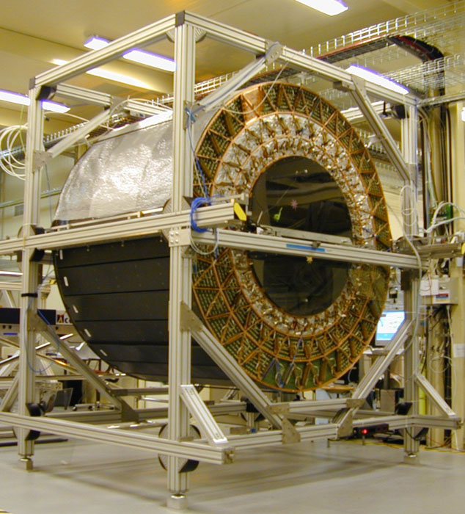
TRT: Transition-Radiation Tracker
Measure position in 2T field
351K channels
130 μm R-Φ

Slide 22
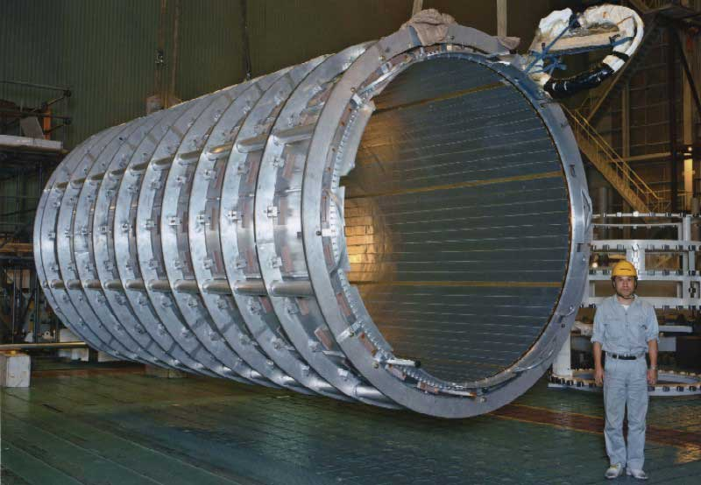
Cryostat
Superconducting, low mass, 2T Field

Slide 23
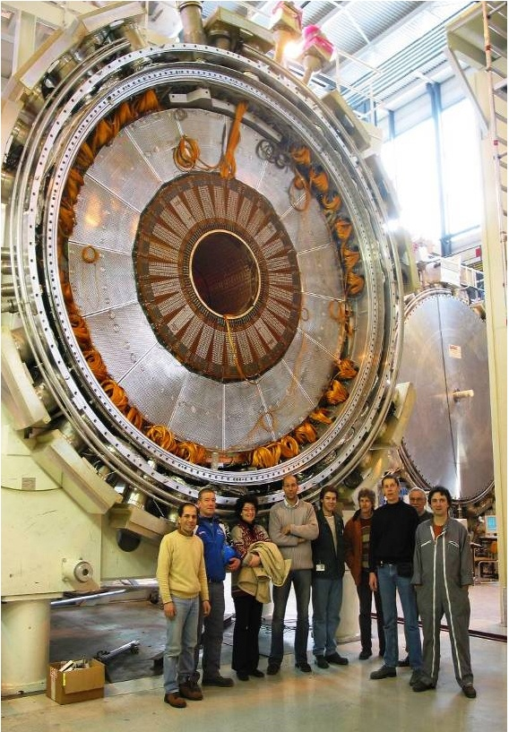
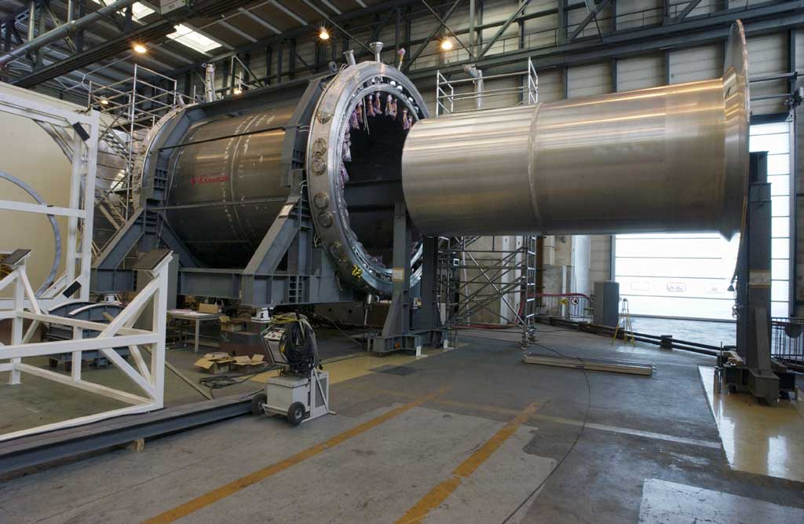
Liquid Argon Calorimeter
Measures E, Et in showers, confines e-/γ showers
170k cells
3500 forward cells
5600 hadronic endcap cells

Slide 24
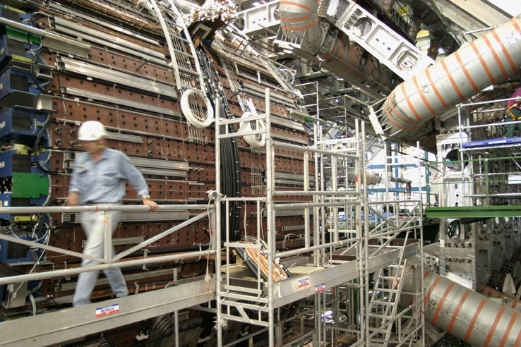
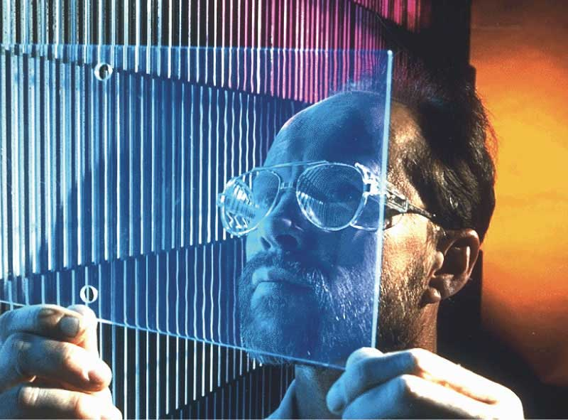
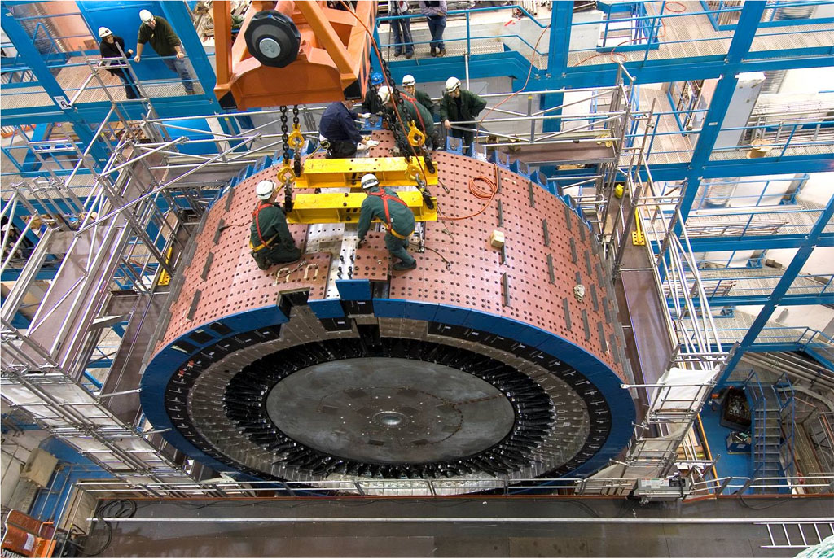
Tile Calorimeter
Measure hadronic energy
Iron/scintillating tiles, wavelength shifting fiber readout.
5200 Cells

Slide 25
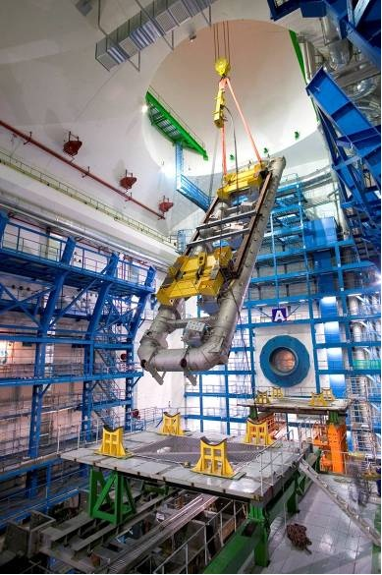
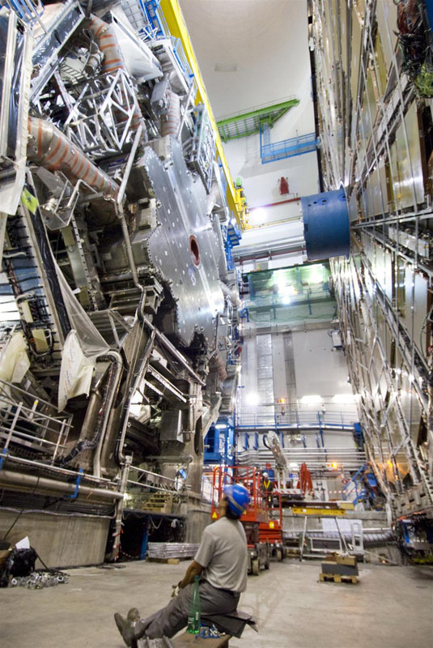
Torroid Magnets
0.5 T (1T) barrel (endcap)

Slide 26
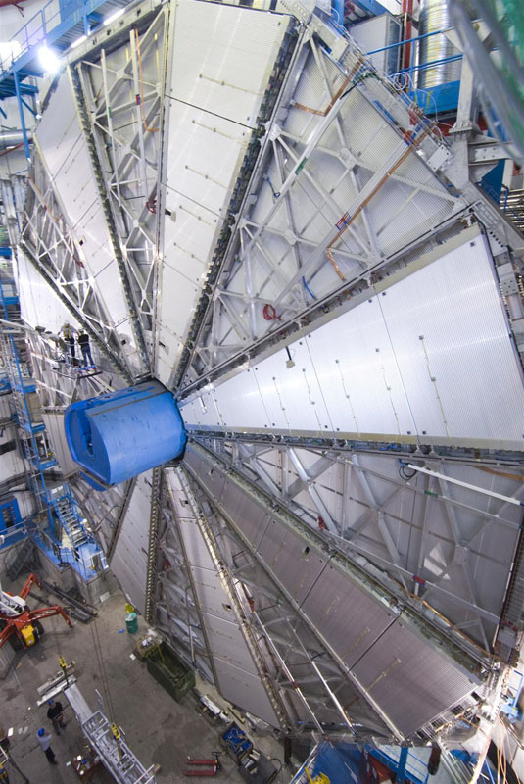
MDT
Muon System:
MDT precision
357K channels
| η | < 2.5
CSC precision
31K channels
2.0 < | η | < 2.7
RPC trigger
383K channels
| η | < 1.05
TGC trigger
318K channels
1.05 < | η | < 2.4

Slide 27
The conclusion is we need to keep and analyze a large amount of data for each collision to detect χ once it is produced.

Slide 28
Trigger Structure
TDAQ in 2016
Run II
TB/s)
TB/s)

Slide 29
How to trigger

Slide 30
Basic Trigger idea
Find a variable X such that the events you are interested in tend to have a value of X different than the events you don’t care about.
Threshold determined by distributions:
P(X|BG)
P(X|SIGNAL)
X_{T}
X

Slide 31
Choice of Variable X
P(X|BG)
P(X|SIGNAL)
X
X_{T}
Cutting on X > X_{T} in above situation throws out a lot of BG, but also a lot of signal.
Compare below:
Y_{T}
P(Y|BG)
P(Y|SIGNAL)
Y

Slide 32
Choice of Threshold
P(X|BG)
P(X|SIGNAL)
X_{T}
X
Increasing (decreasing) threshold decreases (increases) number of BG events kept, but also decreases (increases) number of signal events kept.
Threshold often determined by trigger rate, which is typically dominated by BG distribution.

Slide 33
Choice of Threshold
P(X|BG)
P(X|SIGNAL)
X_{T}
X
Note that choice of threshold may be very different than choice of analysis cuts. Other possibilities are:
For discovery, may want to maximize
N(SIGNAL)/σ(SIGNAL) ~ N(SIGNAL)/√N(BG)
For study of properties, may want to maximize
N(SIGNAL) / N(BG)

Slide 34
Choice of Algorithm
P(X|BG)
X_{T}
P(X|SIGNAL)
X
BG distribution gives allowable rate, giving threshold.
Threshold determines fraction of signal events kept.
Example:
X(Algorithm A2) defined as 2*X(Algorithm A1)
At the same threshold A2 keeps more signal events than A1
Is A2 a better algorithm?

Slide 35
Choice of Algorithm
P(X|BG)
X_{T}
P(X|SIGNAL)
X
BG distribution gives allowable rate, giving threshold.
Threshold determines fraction of signal events kept.
But this is not the only concern:
It is not sufficient to maximize the number of signal events. Must maximize the number of usable events, implying dependence on analysis method.
Analysis cuts will vary for different studies in same experiment.
Can reanalyze after data is taken, but not retrigger!
Choice of algorithm depends on metric used to define “good”

Slide 36
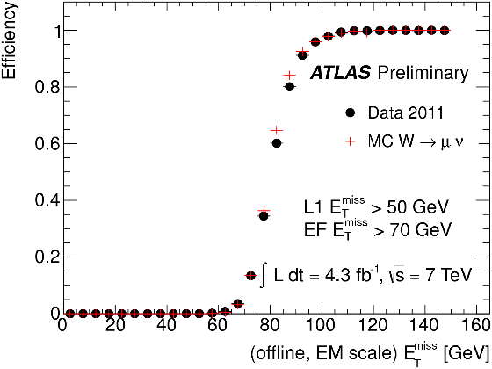
Efficiency
Efficiency = fraction of events selected by trigger
Typically a function of something, where the “something” is defined by the metric we have for “good”
X axis can be:
“True” value
(must be simulation, or you don’t need an algorithm)
Offline Value

Slide 37
Efficiency
“Good” depends on what is useful offline.
Cut here if you calculate cross sections and need to understand efficiency very well.
Cut here (or use total number) if you don’t need to understand efficiency and just care about total number of events

Slide 38
Trigger vs Offline
If x-axis is offline, why not just use offline algorithm? Efficiency curve would then be a step function.
  May not be possible
  May not be a good trigger
Example: Distribution tails:
Consider determining W mass in W →μν events, where we get P_{ν} from missing momentum. Since longitudinal momentum goes down beam pipe, can’t measure full invariant mass M² = (E_{μ}+ E_{ν})² - (P_{μ} + P_{ν} )²
Instead use transverse mass:
M_{T}² = (E_{Tμ} + E_{Tν})² - (P_{Tμ} + P_{Tν} )²
= 2E_{Tμ}E_{Tν} [ 1 – cosφ_{μν}]
Using E_{tν} ~ MET, M_{T}² ~ 2E_{Tμ}MET[ 1 – cosφ_{μν} ]
Since distribution of M_{T} depends on M, can use this to determine M.

Slide 39
Trigger vs Offline cont’d
Example cont’d:
Now trigger on MET to get sample of W events
Consider 2 algorithms triggering on MET ~ E_{Tν}
A1 gives MET to 1% except for 10⁻⁴ tail
A2 gives 0 for MET < 40 GeV, 1TeV for Met >40 GeV
Which is a better offline algorithm?
Which is a better trigger algorithm?

Slide 40
CPU and Latency Constraints
Run II
TB/s)
TB/s)

Slide 41
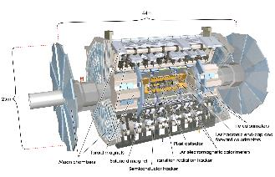
A Note About Timing
ATLAS Length: (44m /2) / c = 73 ns
ATLAS Radius: (25m/2 ) /c = 42 ns
√[(44m/2)² +(25m/2)² / c = 84 ns
Bunch crossing every 25ns means that there are additional bunch crossings while particles are still traveling through the detector from the first one

Slide 42
Multilevel Triggers
Given latency and CPU constraints, solution is a multilevel trigger:
Lowest level typically firmware. For ATLAS, latency = 100 events implies decision in 2.5μs
This is not enough time to transfer all the data from the full detector to one place and leads to Region of Interest (ROI) triggering
This is also not enough time for track finding , so originally only muon and calorimeter triggers only at Level 1. Fast Tracker in development.
Higher levels allow event building, using computer farms (40k cores for ATLAS Run II HLT)

Slide 43
Studying Efficiency
Methods to determine efficiencies include:
Tag and probe: Identify resonance decaying to two objects (eg, Z->ee) with one tight and one loose cut. Determine efficiency of tight for the loose product.
Orthogonal triggers: When event has two properties trigger one way and test other. For example, trigger W->eν with MET and select with transverse mass, then measure e efficiency.
Bootstrapping: Use events selected with lower thresholds to find efficiency for higher threshold events. Must use plateau or shape of lower threshold trigger.

Slide 44
Simulating Triggers
Claim is one can calculate cross sections etc. because one understands trigger efficiency.
Agreement with simulation means we understand what we are doing and understand backgrounds.
Still often left with small systematic simulation-data differences. Correct efficiencies, test, and hope that nothing strange is being missed.
Agreement also means that we are doing about as well as is possible.

Slide 45
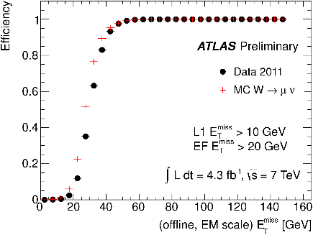
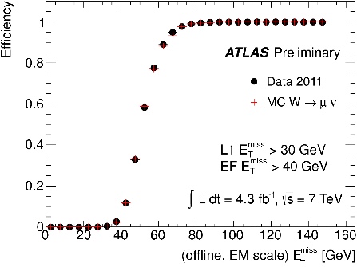
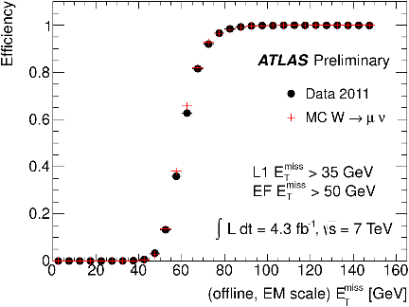
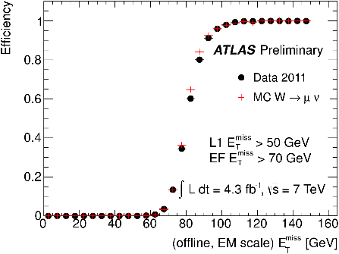
MET Efficiency 2011W-> μν events

Slide 46
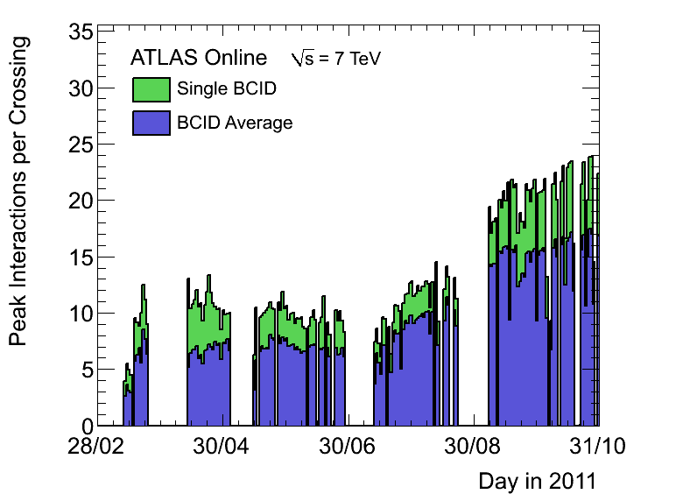
Example Challenge:
Multiple Interactions per Bunch Crossing
μ= average number of interactions per bunch crossing
Actual number in each bunch crossing is poisson distributed
μ typically ~40 – 60 in Run II

Slide 47
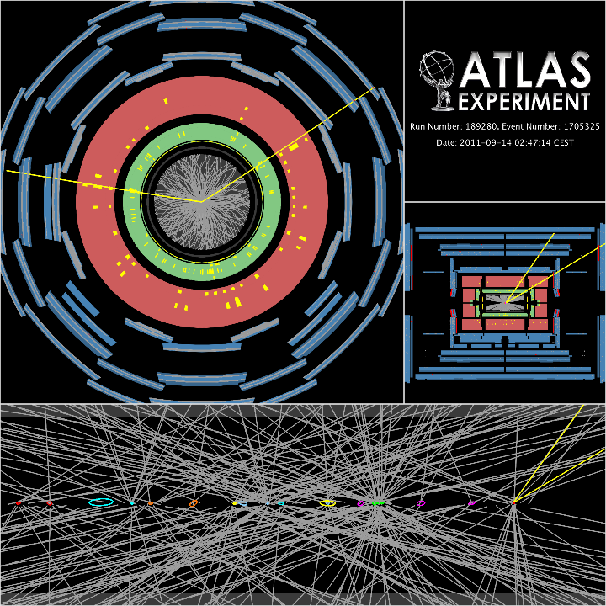
Sample High Pileup Event

Slide 48
How to Implement Software When there are Many Authors
ATLAS has robust system of checks for software changes:
  “Nightly” system
  Tags collected
  Run each night on same test sample
  Keep 7 days of results
  Development and production versions
Safeguards at Point 1
  SMK list provided by experts ahead of time
  Fixed prescales sets available for each SMK
  Division of labor in shifts

Slide 49
Building a Trigger Menu
Decide on physics priorities
Determine best physics and support triggers

Slide 50
Trigger Property Categories
Signature = main event characteristic used to select interesting events: electron, gamma, muon, tau, jets, MET, b-jets, minbias, forward
Detector used: calorimeter, muon detector, tracking
Trigger types at ATLAS:
  Standalone = uses one signature only
  Combined = uses more than 1 signature
  Unprescaled (vs. prescaled)
  Support = used to understand other triggers (in same signature or as orthogonal trigger); usually prescaled
  Calibration = used to calibrate detectors.
  Random
  Minbias
Unique rates

Slide 51
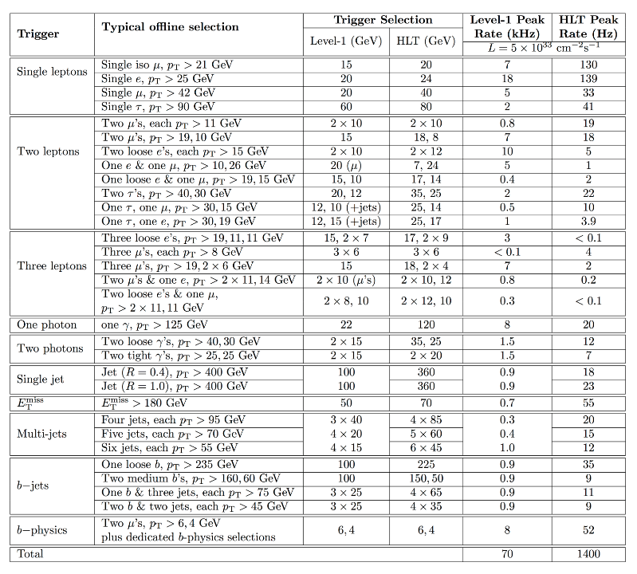

Slide 52
Building a Trigger Menu
Decide on physics priorities
Determine best physics and support triggers
Predict rates as function of luminosity and thresholds

Slide 53
Luminosity exercise
Assume:
  LHC 27 km circumference
  Guess ~2 hours to fill LHC
  Take 10¹¹ particles/bunch to start with.
  Take 40 p-p collisions per bunch crossing at the start.
  Assume bunches cross twice (ATLAS and CMS : ignore for this other interaction regions).
Determine:
  The number of collisions and protons lost per second as a function of the number of particle in the bunch.
  Estimate of luminosity as a function of time
  Estimate of how long to wait before dumping beam (note that there is beam loss for other reasons also)

Slide 54
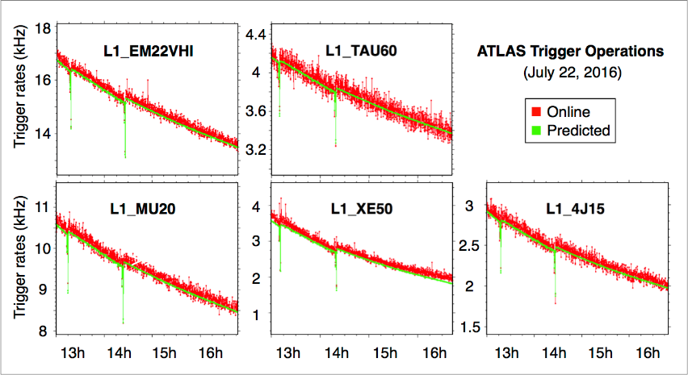
Creating Menus and Trigger Monitoring rely on
Luminosity scaled rate predictions

Slide 55
Building a Trigger Menu
Decide on physics priorities
Determine best physics and support triggers
Predict rates as a function of luminosity and thresholds
Prescaling and prescaling as a function of luminosity.

Slide 56
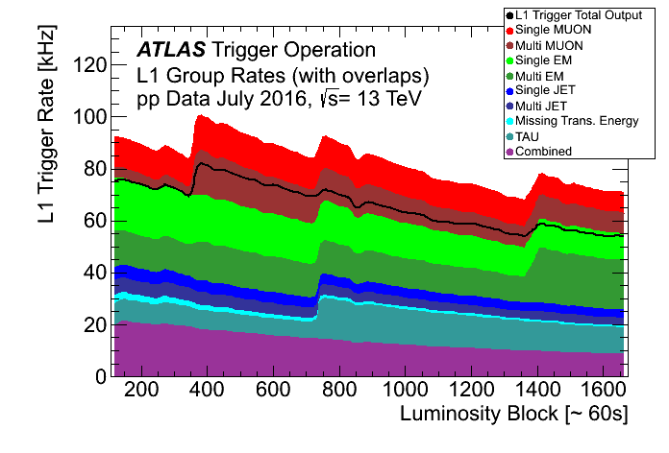

Slide 57
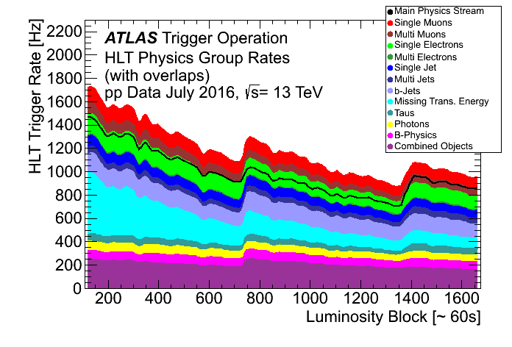

Slide 58
Building a Trigger Menu
Decide on physics priorities
Determine best physics and support triggers
Predict rates as a function of luminosity and thresholds
Prescaling and prescaling as a function of luminosity
Select thresholds based on desired triggers. Prescale where necessary if possible.

Slide 59
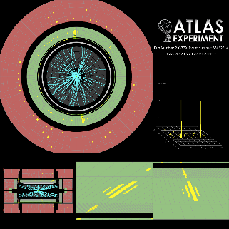
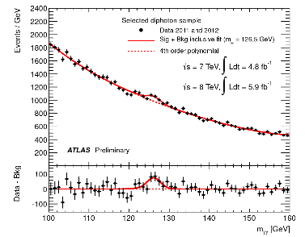
Building a Trigger Menu
Decide on physics priorities
Determine best physics and support triggers
Predict rates as a function of luminosity and thresholds
Prescaling and prescaling as a function of luminosity
Select thresholds based on desired triggers. Prescale where necessary of possible.
Collect data, analyze, and make discoveries.

