Slide 1
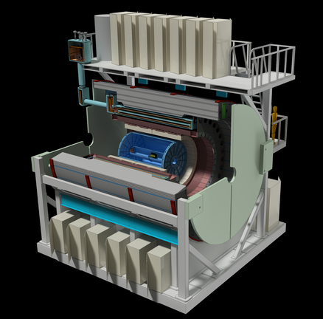
sPHENIX computing

Slide 2
sPHENIX timeline
PD 2/3

Slide 3
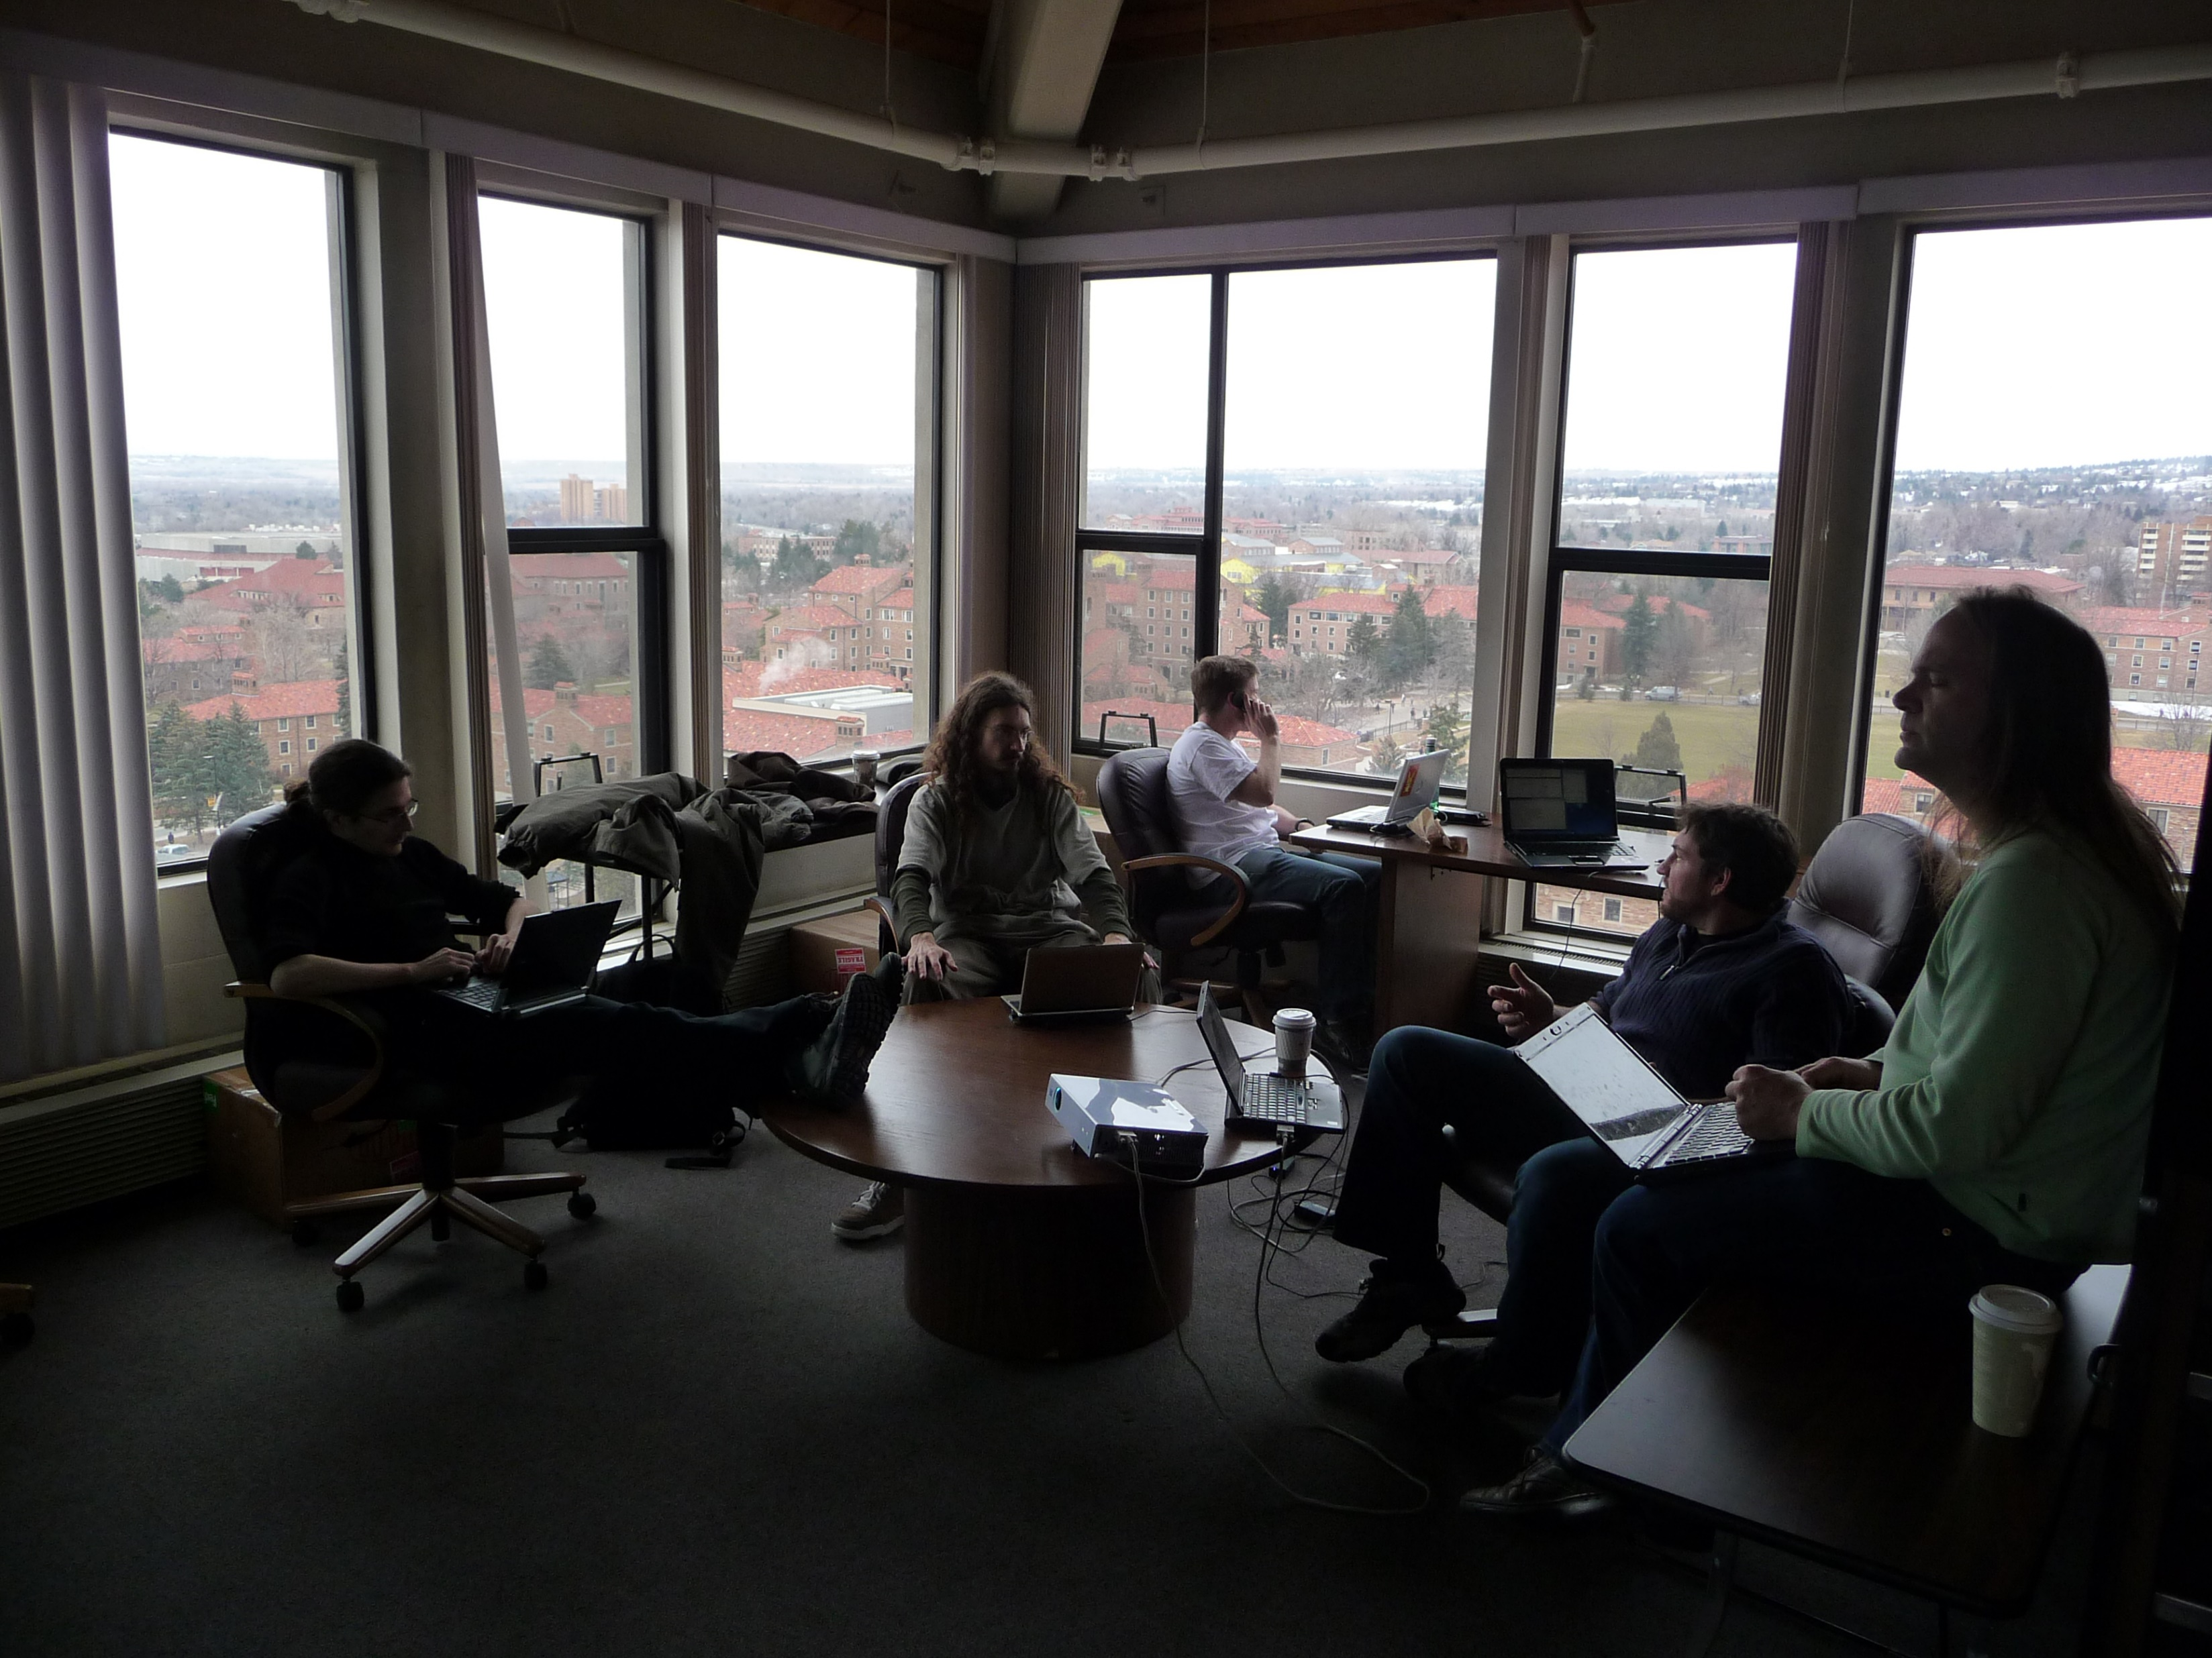
1st sPHENIX workfest, 2011 in Boulder
Computing corner:
Adding G4 to PHENIX software
(beating G4 into submission)

Slide 4
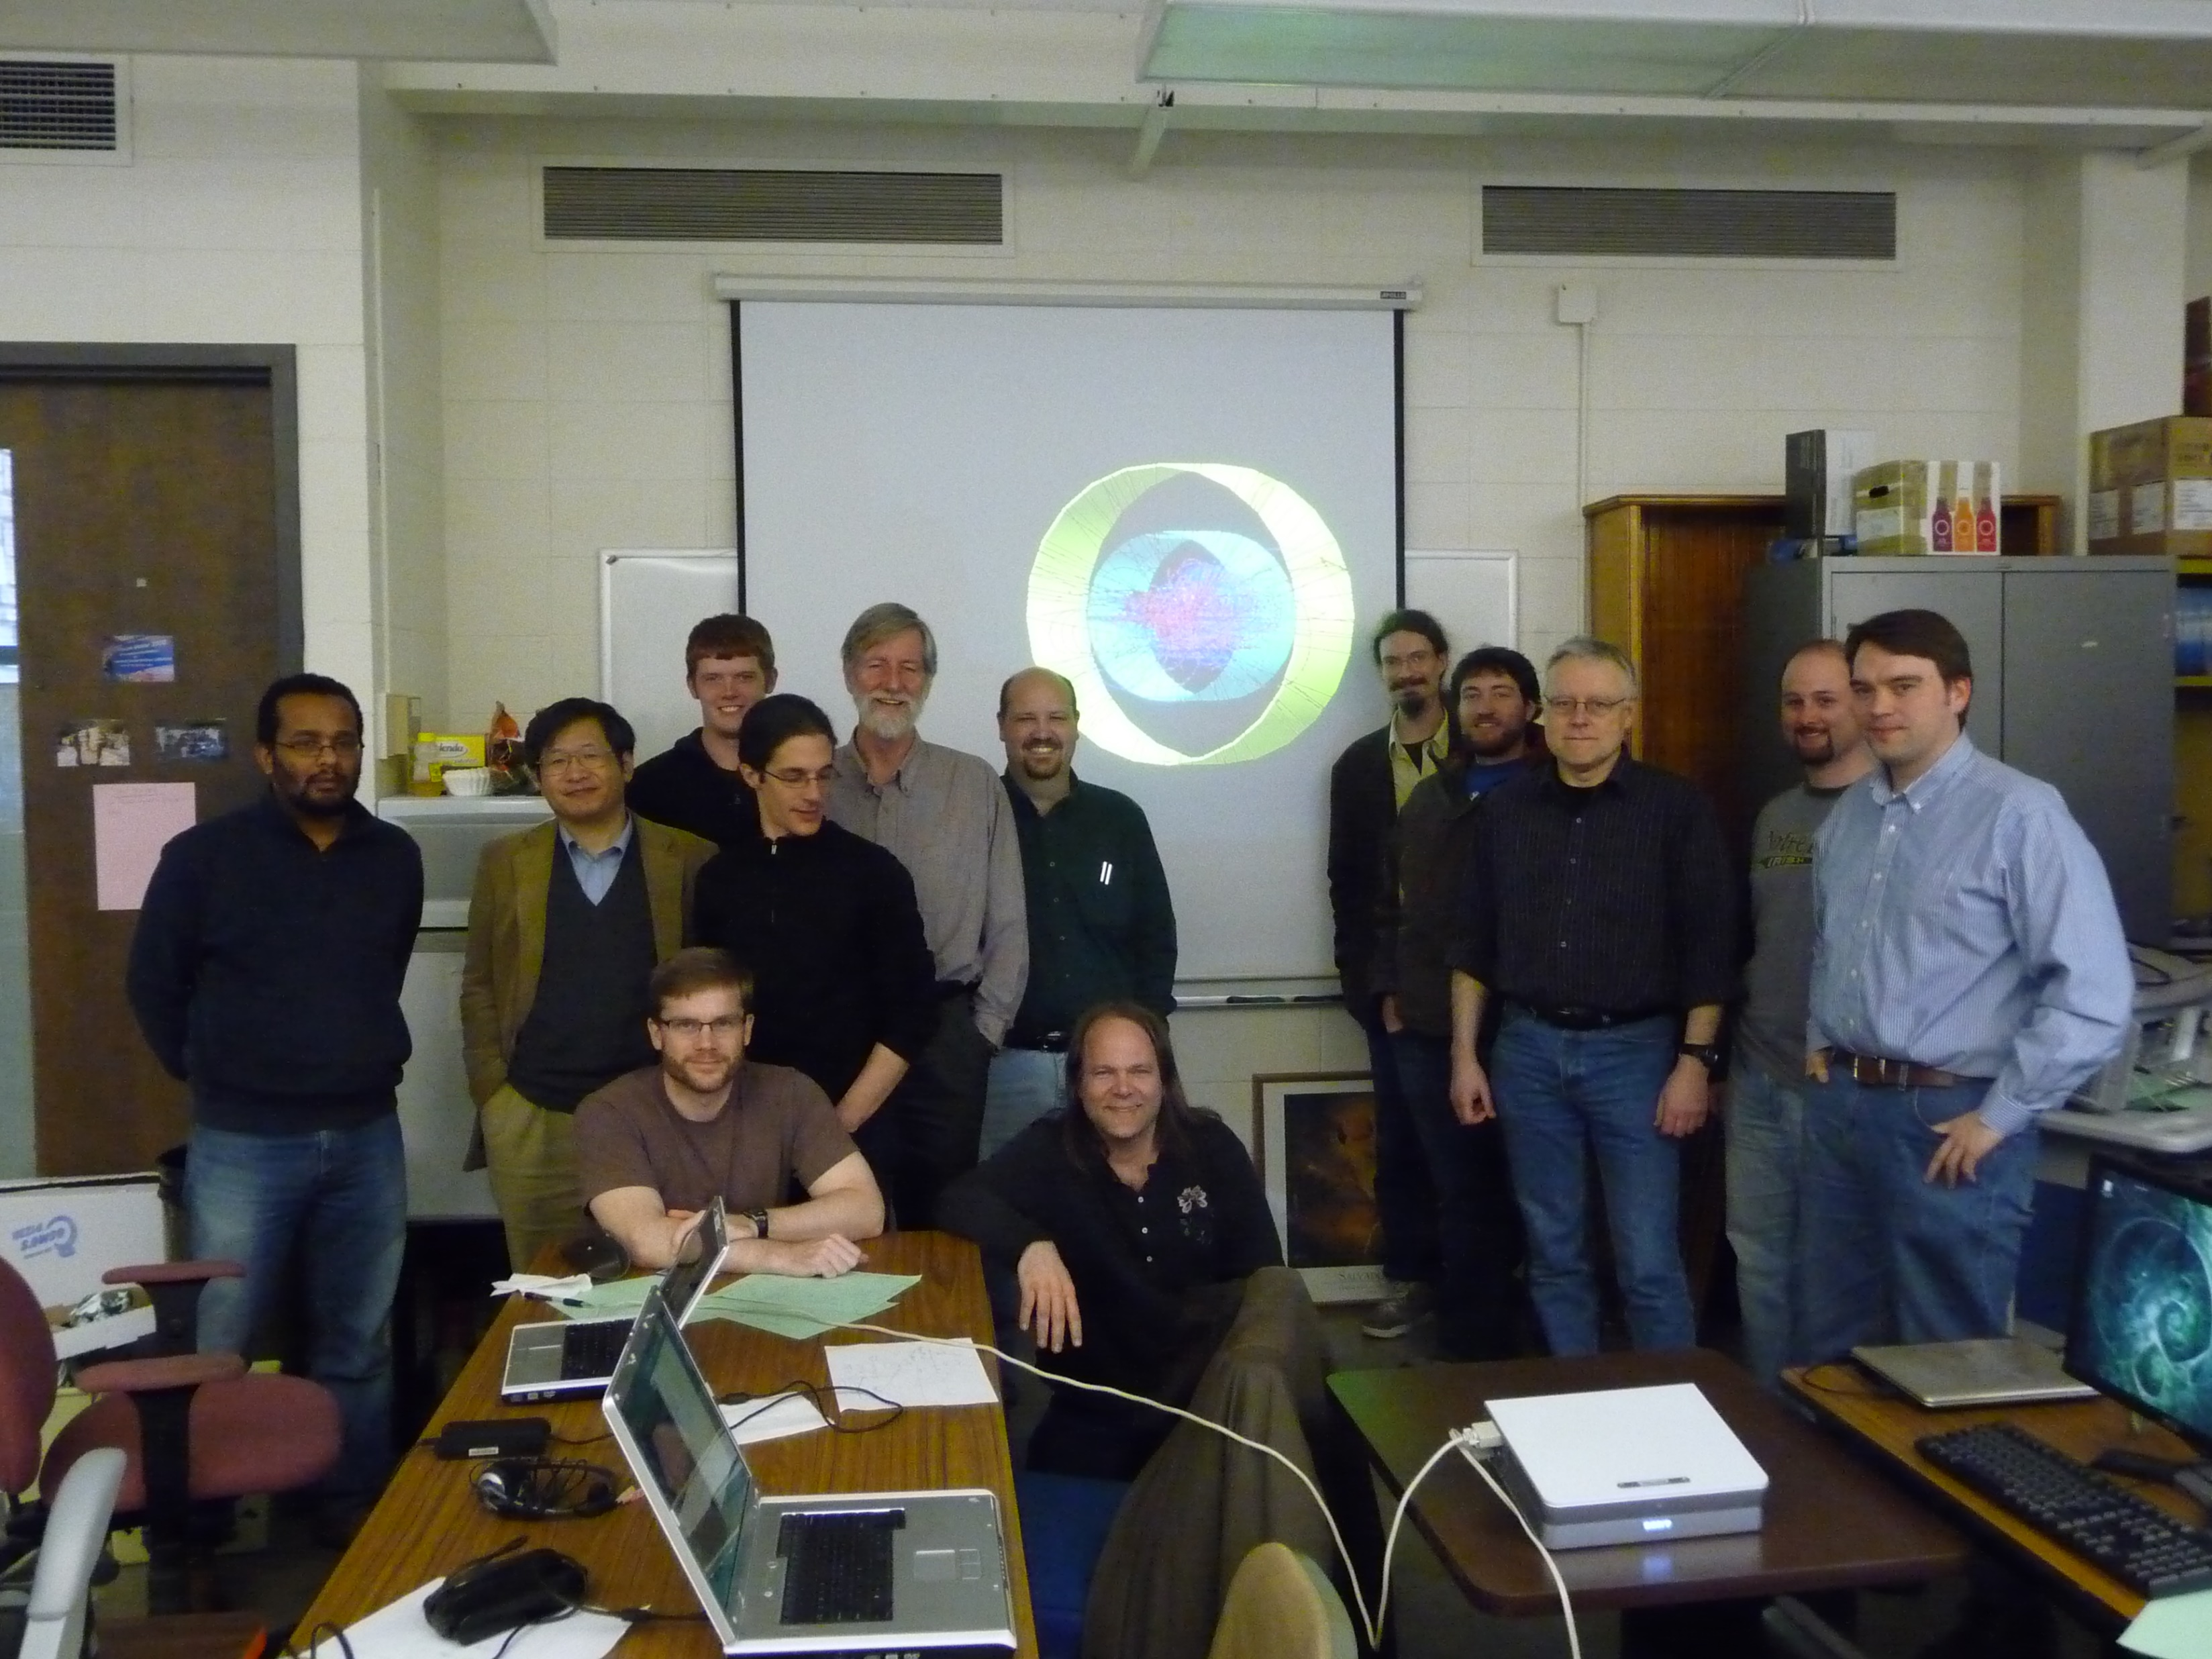
A week later
The first sPHENIX event display
(of a pythia event)

Slide 5
Fast forward to 2019, it is really happening

Slide 6
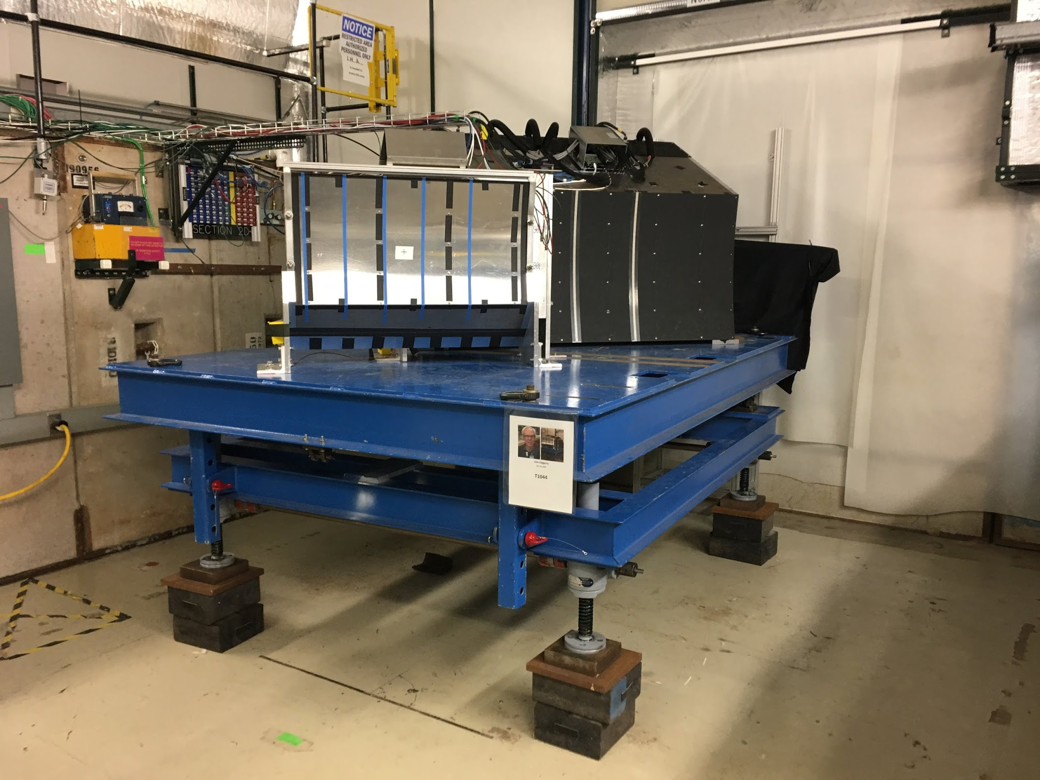
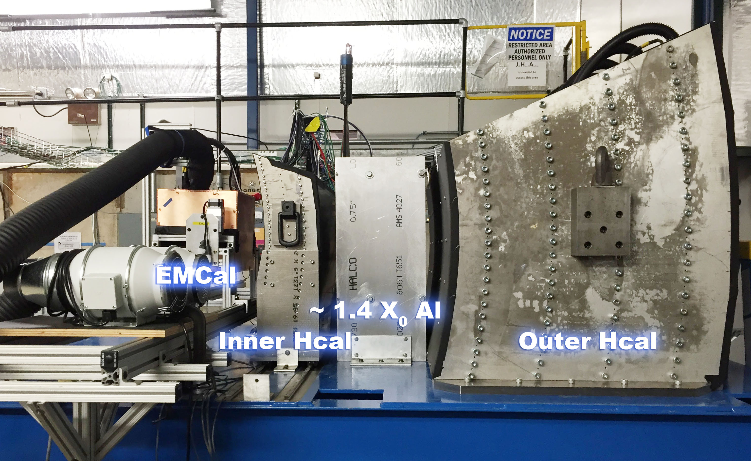
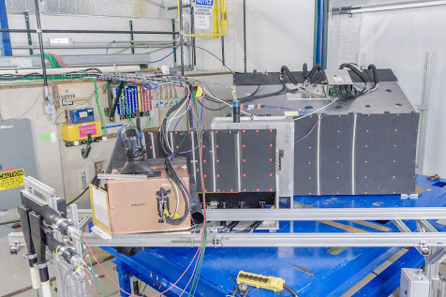
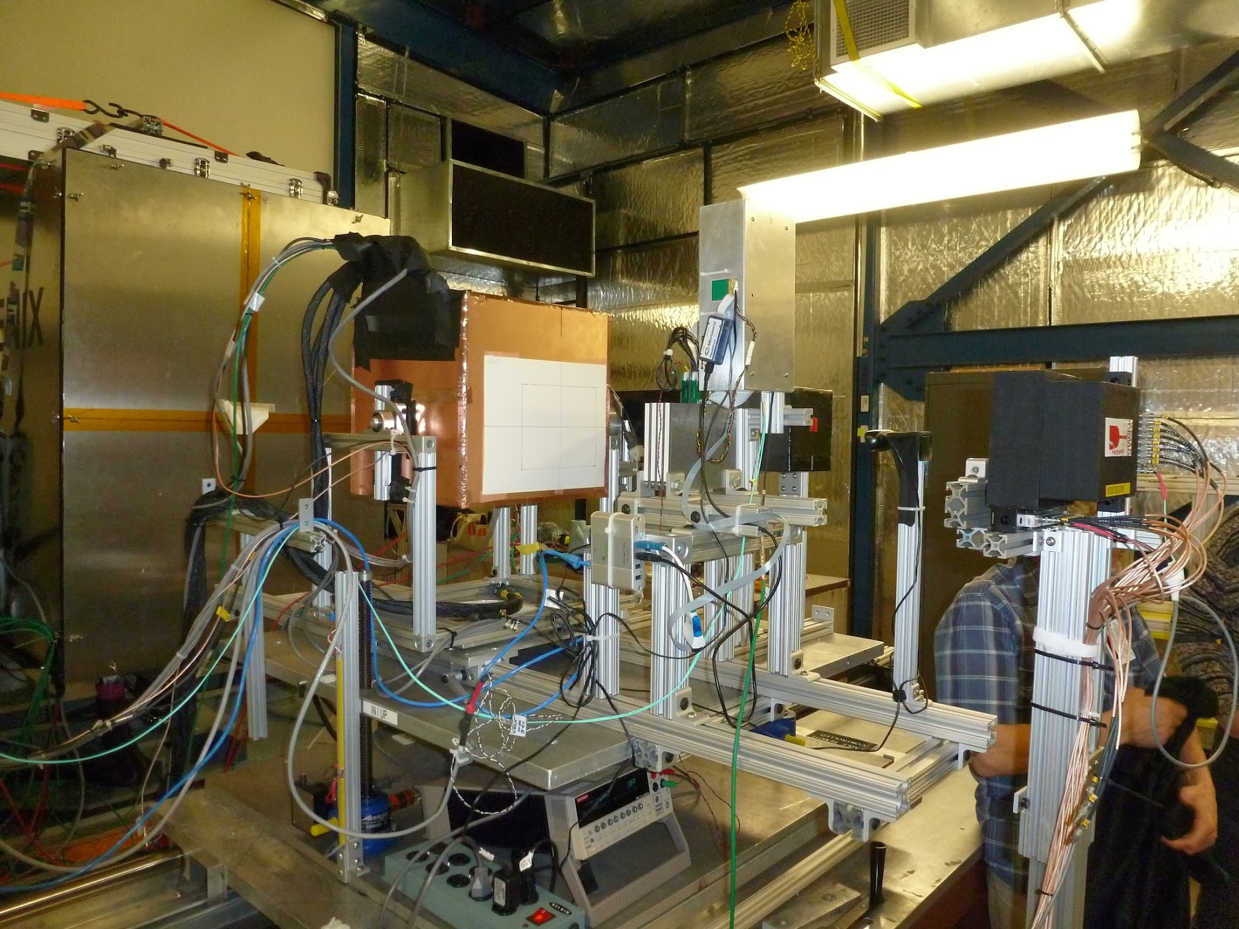
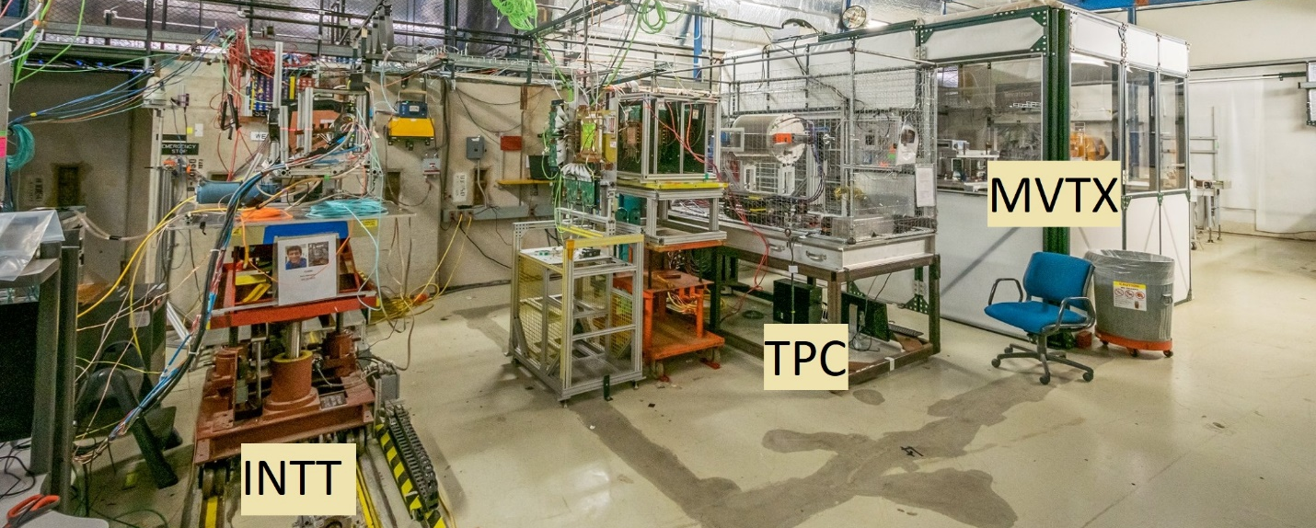
Test Beam, Test Beam and more Test Beam
2014
2016
2017
2018
Not only simulations, We also get exposed to real data written in our envisioned daq format
2019

Slide 7
Executive Summary Framework
Fun4All was developed for data reconstruction by people who used it to analyze data
  Data was coming it already
  Had to combine a zoo of subsystems each with their own ideas how to do things
  No computing group, manpower came from the collaboration
  It has been in production since 2003 (constantly updated for new needs)
  Used for raw data reconstruction, analysis, simulations (G3 runs separately), embedding
  Processed PB of data with many B of events
sPHENIX branched off in April 2015
  Major revamping – made large effort to fix all those lessons learned things
  Code checkers: cppcheck, scan, clang, coverity, valgrind, insure, 100% reproducible running
  Good – PHENIX subsystem zoo reduced to basically 2 types:
    Calorimeters (means need for clustering, use PHENIX clusterizer)
    Inner Tracking silicon+tpc (means need for tracking, based on genfit)
Fermilab E1039 (Seaquest) branched off in 2017

Slide 8
Structure of our framework Fun4All
You
Fun4AllServer
Input Managers
Node Tree(s)
Output Managers
DST
DST
Raw Data (PRDF)
Raw Data (PRDF)
Analysis Modules
HepMC/Oscar
HepMC
EIC smear
Calibrations
Histogram Manager
Empty
Root File
PostGres DB
File
That’s all there is to it, no backdoor communications – steered by ROOT macros

Slide 9
Keep it simple – Analysis Module Baseclass
You need to inherit from the SubsysReco Baseclass (offline/framework/fun4all/SubsysReco.h) which gives the methods which are called by Fun4All. If you don’t implement all of them it’s perfectly fine (the beauty of base classes)
Init(PHCompositeNode *topNode): called once when you register the module with the Fun4AllServer
InitRun(PHCompositeNode *topNode): called before the first event is analyzed and whenever data from a new run is encountered
process_event (PHCompositeNode *topNode): called for every event
ResetEvent(PHCompositeNode *topNode): called after each event is processed so you can clean up leftovers of this event in your code
EndRun(const int runnumber): called before the InitRun is called (caveat the Node tree already contains the data from the first event of the new run)
End(PHCompositeNode *topNode): Last call before we quit
If you create another node tree you can tell Fun4All to call your module
with the respective topNode when you register your modue

Slide 10
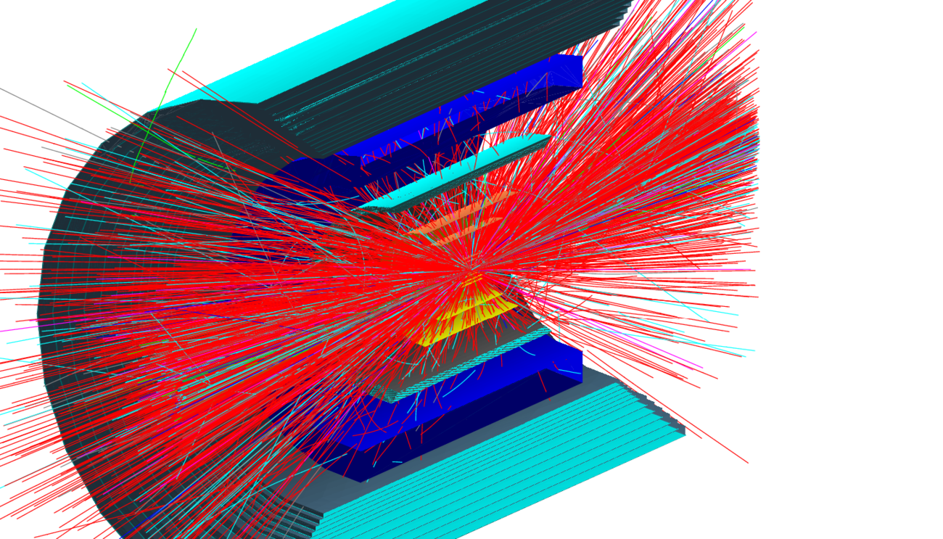
Simulations
Peripheral Au+Au @200 GeV Hijing event
Event displays are the easy part, how do we actually analyze this mess?

Slide 11
G4 program flow within Fun4All
Fun4AllServer
Geant4
Event generator (input file, single particle, pythia8)
PHG4Reco
Node tree
Interface Detector 1
Construct() → Geometry
Stepping Action (Hit extraction)
Interface Detector 2
Construct() → Geometry
Stepping Action (Hit extraction)
Digitisation
sPHENIX Raw Data
Setup
Tracking,Clustering
calls
Jet Finding, Upsilons, Photons,…
dataflow
Output Files

Slide 12
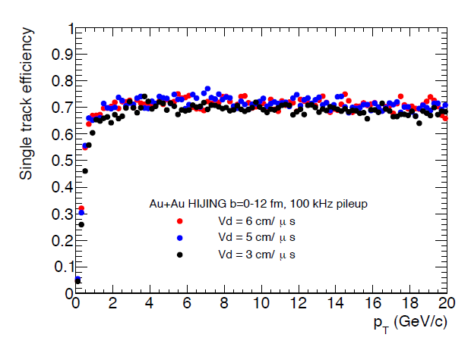
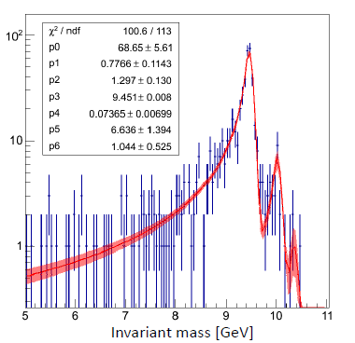
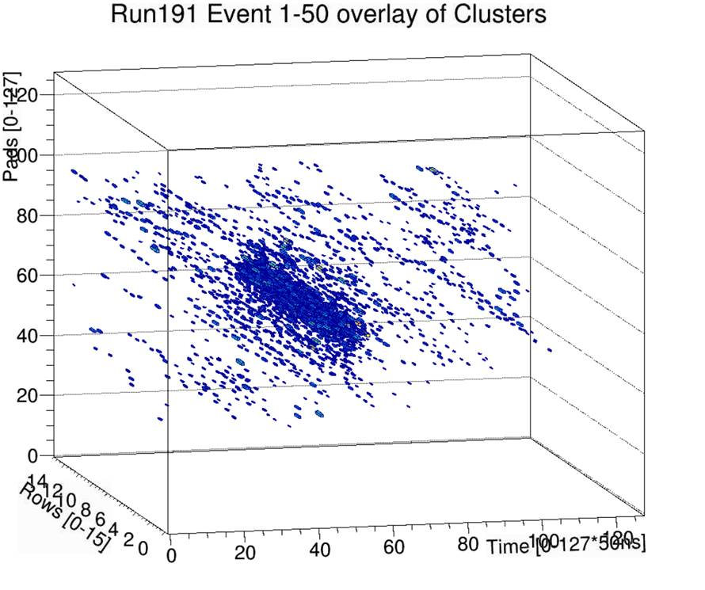
More than just pretty event displays
Tracking Efficiency
Upsilon Reconstruction
Hadronic Calorimeter Test Beam
Jet Reconstruction
EmCal Test Beam
EmCal Hadron Rejection
TPC with streaming readout

Slide 13
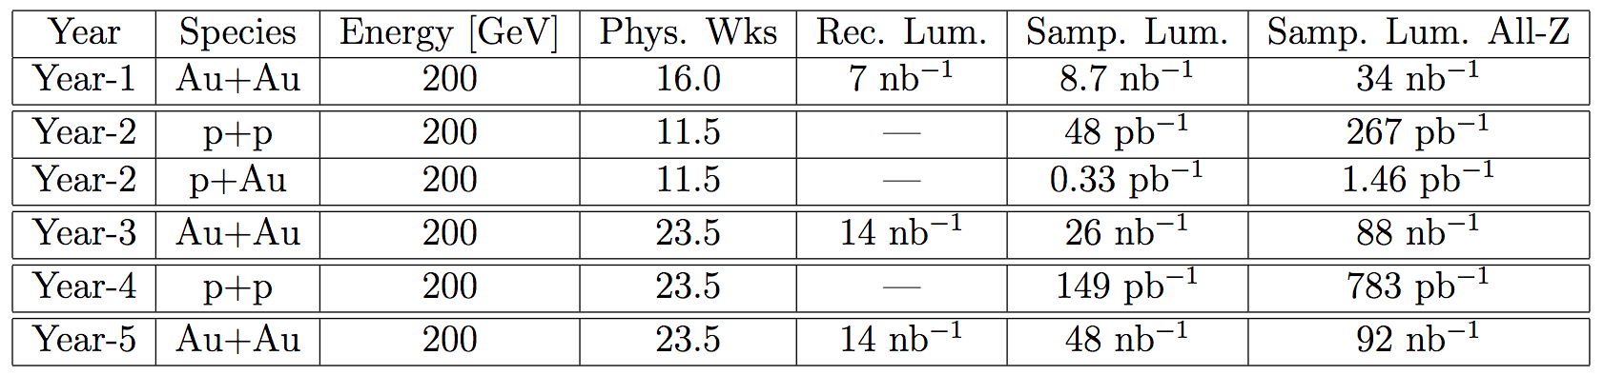
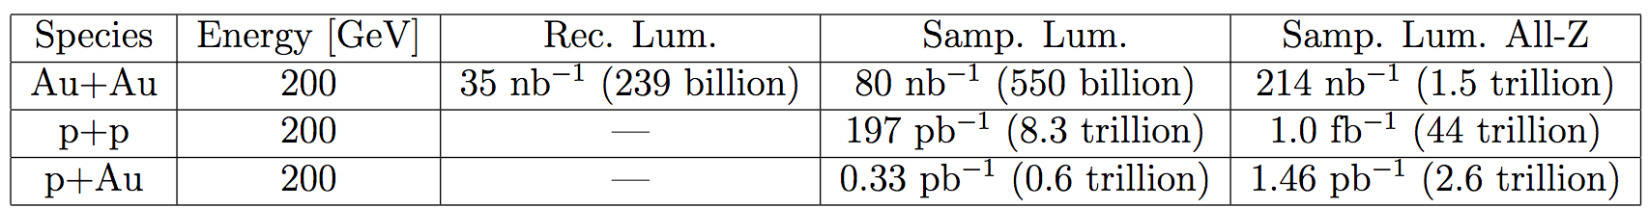
sPHENIX Run Plan
Only events in a +- 10cm vertex range have the full tracking information
Event vertex range is +- 30cm (right column)

Slide 14
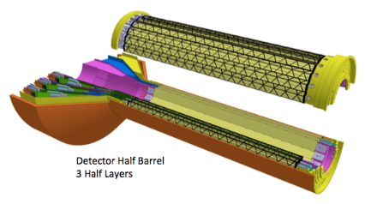
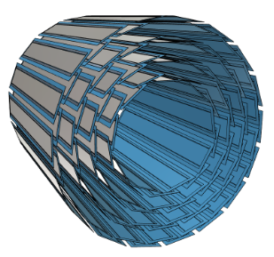
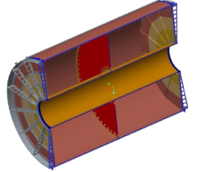
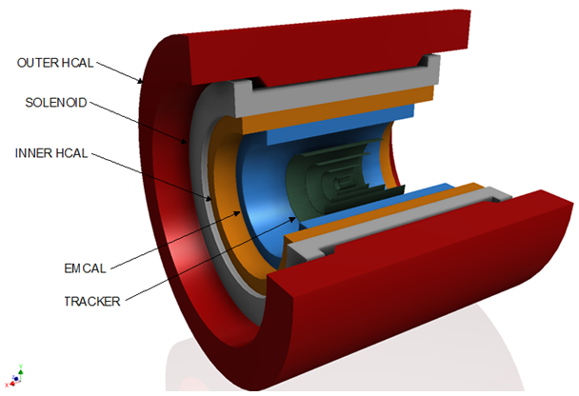
The large data producers in 200 GeV Au+Au (worst case)
Monolithic Active Pixel Sensors (MAPS) ~ 35GBit/s
Intermediate Silicon Strip Tracker (INTT) ~ 7GBit/s
Compact Time Projection Chamber (TPC) ~ 80Gbit/s
Calorimeters (primarily Emcal, hadronic cal.) ~ 8GBit/s
~ 130GBit/s
After applying RHIC x sPHENIX duty factor ~ 100GBit/s

Slide 15
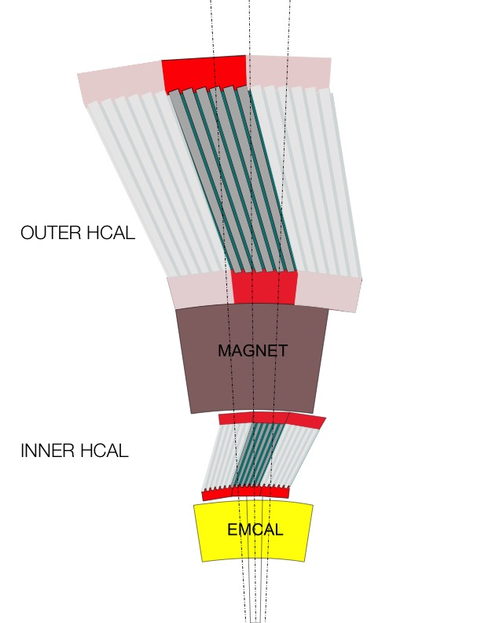
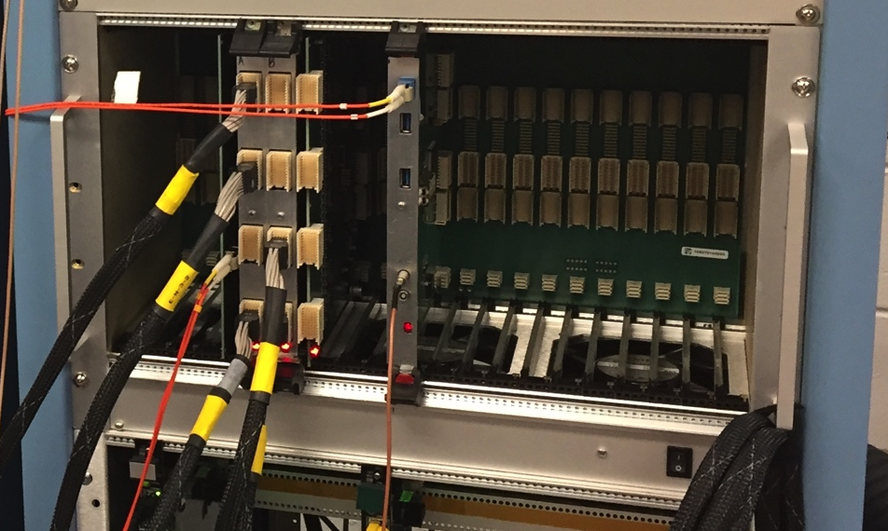
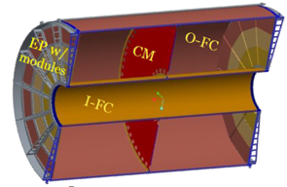
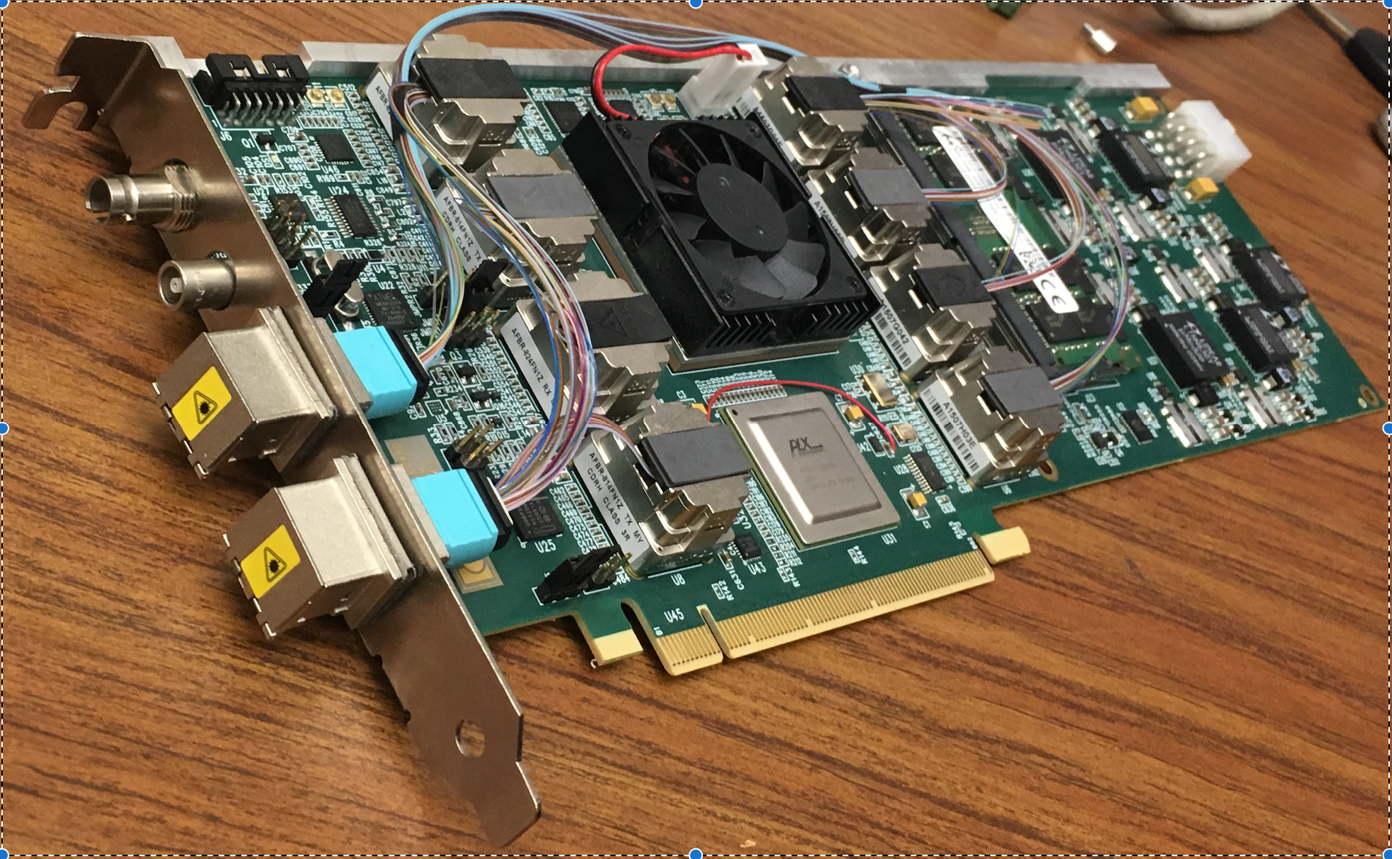
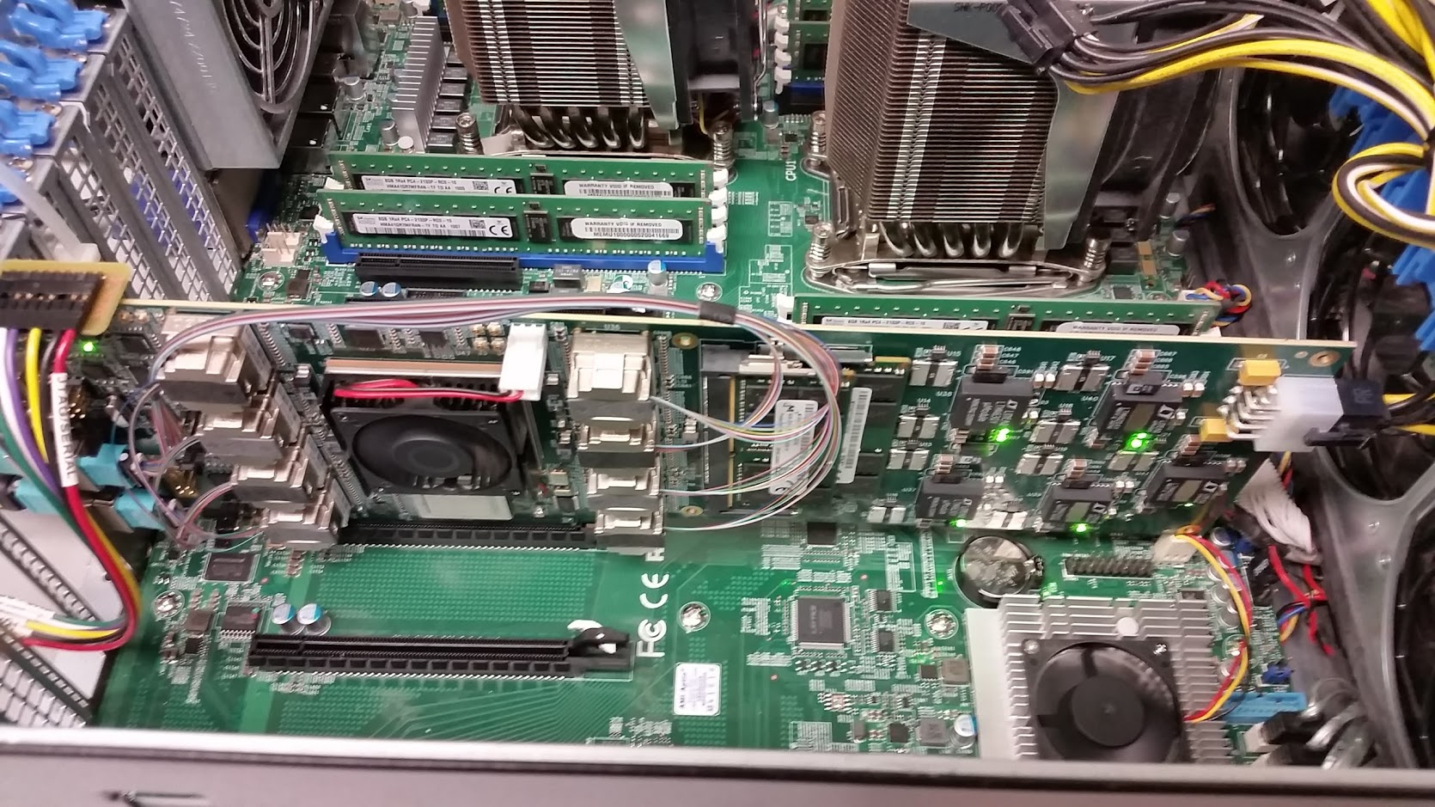
Two Classes of Front-end Hardware
The calorimeters, the INTT, and the MBD re-use the PHENIX “Data Collection Modules” (v2)
FEM
DCM
DCM2
DCM
DCM
DCM
DCM
FEM
DCM
DCM
DCM
DCM2
DCM
DCM
DCM
Triggered readout
FEM
DCM
DCM
DCM
DCM
DCM2
Calorimeters,
INTT, MBD
DCM
DCM
DCM
FEE
The TPC and the MVTX are read out through the ATLAS “FELIX” card directly into a standard PC
DCM
DCM
FELIX
PC
DCM
FEE
DCM
DCM
FELIX
PC
DCM
FEE
DCM
FELIX
PC
DCM
TPC, MVTX
DCM
Rack Room
Streaming readout
ATLAS FELIX Card
Installed in a PC

Slide 16
Event rates
The run plan is to acquire 15 kHz of collisions (subtract 1.5 weeks for rampup):
  Run 1: Au+Au: 14.5 weeks ⋅ 60% RHIC uptime ⋅ 60% sPHENIX uptime ⟶ 47 billion events, 1.7 Mbyte/event → 75PB (110Gb/s)
  Run 2 and 4: p+p, p+A: 22 weeks ⋅ 60% RHIC uptime ⋅ 80% sPHENIX uptime ⟶ 96 billion events, 1.6 Mbyte/event → 143PB
  Run 3 and 5: Au+Au: 22 weeks ⋅ 60% RHIC uptime ⋅ 80% sPHENIX uptime ⟶ 96 billion events, 1.6 Mbyte/event → 143PB
The DAQ system is designed for a sustained event rate of 15kHz
We cannot “trade” smaller event sizes for higher rates.
The new detectors (TPC, MVTX) will not have the ultimate data reduction factors until at least Year-4 (based on ALICE and others’ experience), with lzo compression in daq only minor change in data volume

Slide 17
Event building
Nothing in online requires the assembling of all events (we do not employ level2 triggers, all events selected by our level1 triggers are recorded)
Moving the event builder to the offline world makes it a lot simpler
  The offline event builder does not have to keep up with peak rates
  In offline we have many more cpus at our disposal
  Crashes can be easily debugged
  No loss of data due to event builder issues
  Subevents are ordered in raw data files
Disadvantage: Need to deal with ~60 input files in data reconstruction
Still need to build a fraction of the events for monitoring purposes
Combining triggered with streamed readout is going to be fun

Slide 18
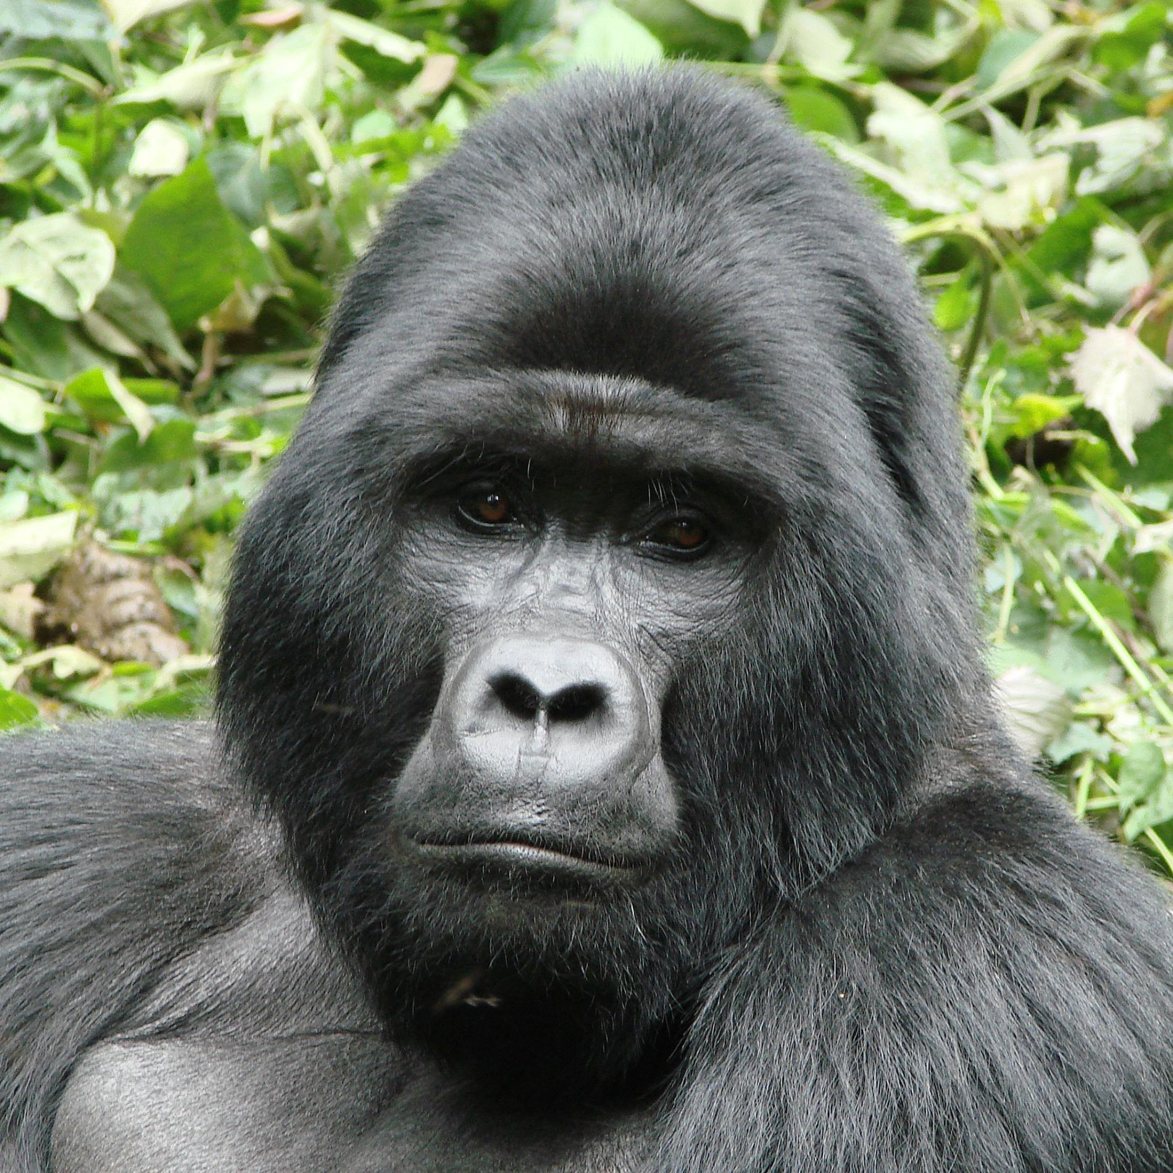
Reconstruction + analysis flow
Hpss
Buffer
boxes
110 (175)Gb/s
HPSS
disk cache
Raw
HPSS
disk cache
DST
Tape
Raw Disk cache
20PB (2 weeks)
DST Disk cache
Calibration + Q/A
Analysis
Taxi
Conditions DB
reconstruction
Current estimate: 90000 cores to keep up with incoming data: every second is 6000 cores
Raw data Disk cache size should be
sufficiently large to buffer 2 weeks
of data
Reconstructed data disk cache should
ideally keep all reconstructed output
Online monitoring

Slide 19
The Analysis Taxi, mother of all trains
User Input:
library source
root macro
output directory
Output
gpfs
15000 condor slots
@rcf
Fully automatized
Modules running over same
dataset are combined to save
resources
Provides immediate access to all
PHENIX datasets since Run3
Turnaround time typically hours
Vastly improves PHENIX
analysis productivity
Relieves users from managing
thousands of condor jobs
Keeps records for analysis “paper
trail”
Submit analysis jobs
Web signup
8PB dCache system
All datasets since Run3
available online
GateKeeper:
Compilation
Tagging
Verification

Slide 20
Towards EIC
The challenges of heavy ion event reconstruction dwarfs whatever the EIC will throw at us
sPHENIX might (will) evolve into the day 1 EIC detector by adding forward instrumentation
In any case - the central parts of the proposed EIC detectors are very similar to sPHENIX
Any improvement made to sPHENIX software will benefit the EIC program
Our software is containerized (singularity), the code in github, our libraries are in cvmfs
https://github.com/sPHENIX-Collaboration/Singularity
The OSG can provide the computing resources needed by non sPHENIX EIC users
We have some tutorials how to put together simple detectors from basic shapes:
https://github.com/sPHENIX-Collaboration/tutorials

Slide 21
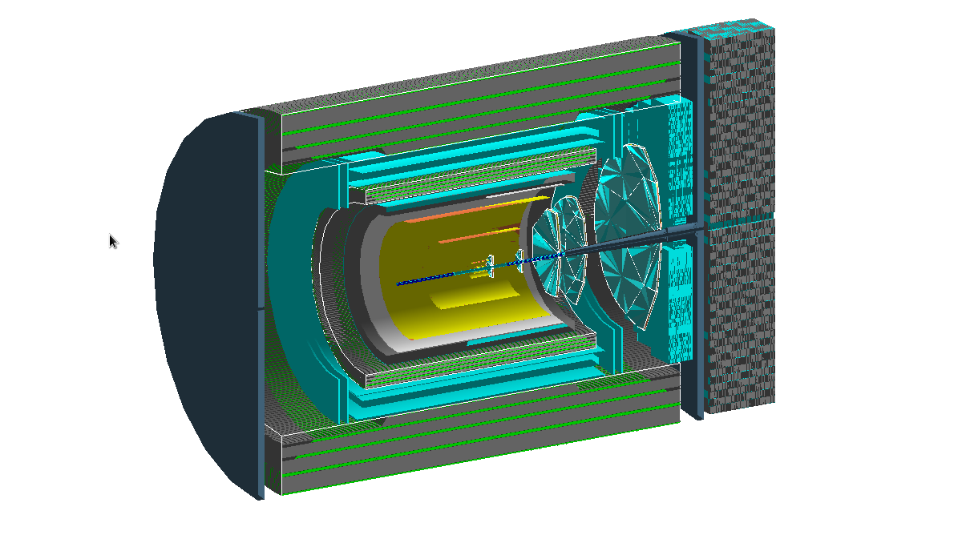
fsPHENIX – forward instrumentation for cold QCD

Slide 22
ePHENIX out of the box
Fully developed G4 model, including digitization and reconstruction

Slide 23
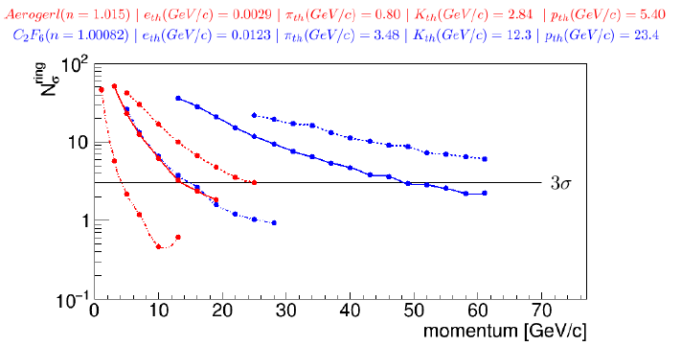
More than just pretty event displays
Tracking Efficiency
Upsilon Reconstruction
Hadronic Calorimeter Test Beam
EmCal Test Beam
Jet Reconstruction
Contains all you need to
simulate and analyze data NOW
Stonybrook is looking into the detection of leptoquarks, hopefully first results in time for the EIC users meeting July 22-26
EmCal Hadron Rejection
Rich PID

