Slide 1


EIC software
Alexander Kiselev
NPPS Group Meeting July,3 2019

Slide 2


EIC timelines
2015 NSAC (NP) Long-Range Plan:
“We recommend a high-energy high-luminosity polarized EIC as the highest priority for new facility construction.”
2018 NAS review:
“The committee finds that the science that can be addressed by an EIC is compelling, fundamental and timely.”
President’s budget request for FY2020:
Critical Decision-0, Approve Mission Need, is planned for FY2019

Slide 3
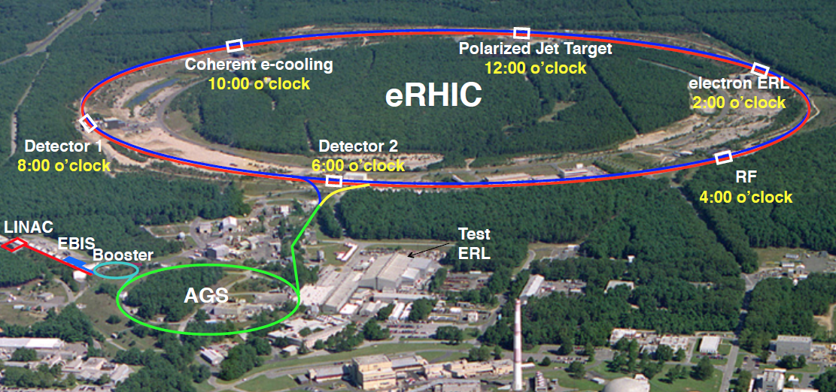
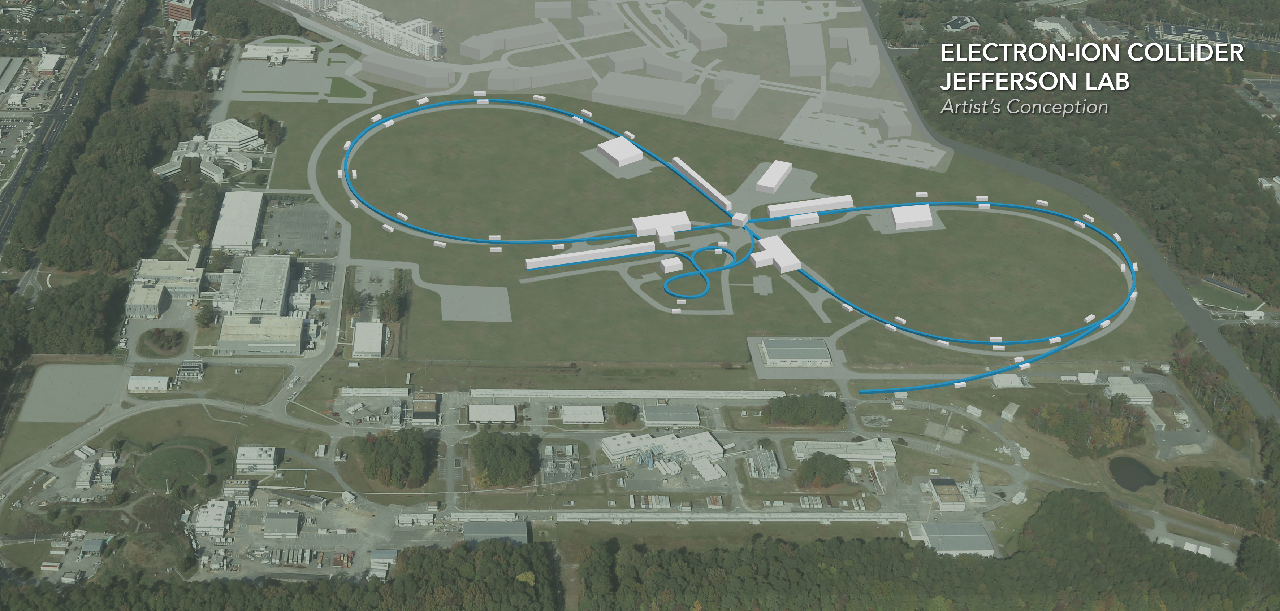
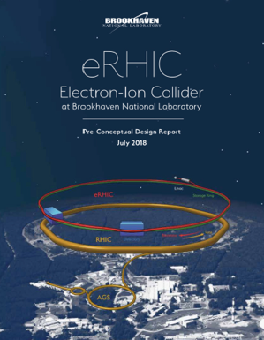
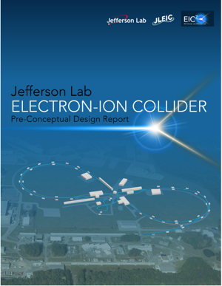
Machine requirements & EIC realization
JLEIC
Wide kinematic range: √s from ~20 to 100 GeV, upgradable to 140 GeV
Luminosity ~10³³⁻³⁴ cm⁻²s⁻¹
Polarized protons, electrons and light ions
Heavy ion beams up to U

Slide 4
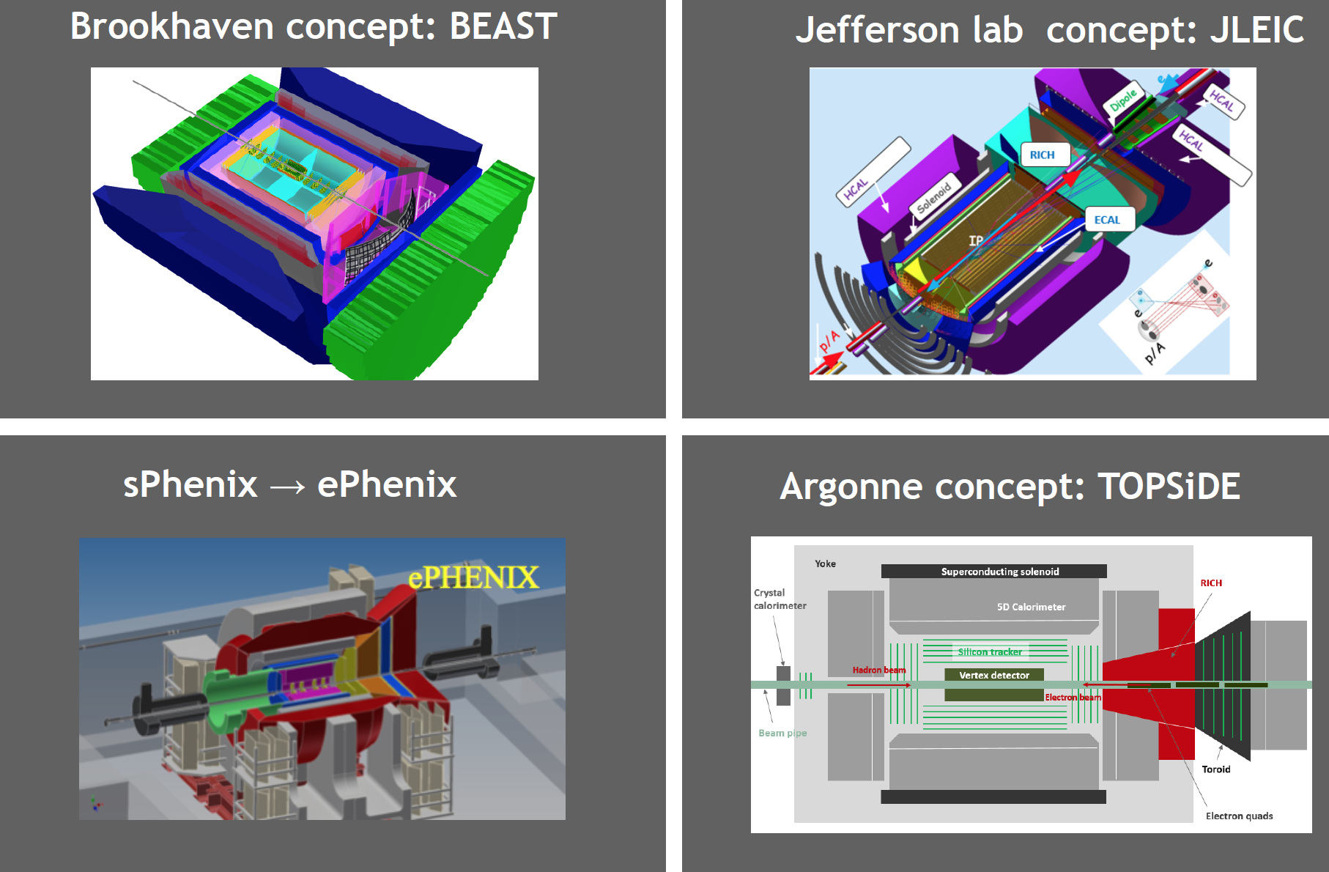
EIC detector concepts
-> software frameworks are strictly bound to the detector concepts

Slide 5
Contents of this talk
Fast simulation tool: eic-smear
Software frameworks
GEMC
fun4all
EicRoot
Argonne EIC software initiative
PID consortium GEANT4 software (one slide)
Omit all the other small custom pieces of EIC MC codes
Near-term future trend(s)

Slide 6
eic-smear
by Tom Burton (BNL TF group)

Slide 7
Overview
Overview
C++ code, runs in ROOT
Build with configure/Make or CMake
libeicsmear.so to load in ROOT
MC generator
ASCII output
Tree code:
Build ROOT tree containing events
Smearer:
Perform fast detector smearing
PYTHIA
DPMJet
Large number
of EIC Monte
Carlo generators
with standard
ASCII format
PEPSI
Milou
gmc_trans
Rapgap
LEPTO
Djangoh

Slide 8
Smearing
“Smearer” defines some element of performance
+ acceptance
  Built-in standard smearers provided with eic-smear
  Users can define own smearers using inheritance
Smearer
“Detector”
NOT a “physical detector”:
represents the overall performance in measuring a quantity.
Smearer
  Apply all smearers to an MC event
  Yield smeared event
  Optionally recalculate derived values e.g x, Q²
Smearer
Smearer
Smearer

Slide 9
How to use it
Simple “Device” smearers define σ(X) via text string
Write a ROOT script:
Smear::Detector createDetector() {
// Resolution in momentum, sigma(P).
// sigma(P) = 0.4%P + 0.3%P^2.
Smear::Device tracking(“P”, “0.004 * P + 0.003 * pow(P, 2)”);
// Add devices to a Detector.
Smear::Detector detector;
detector.AddDevice(tracking);
return detector;
}
Handles event loop, file I/O
Smear your ROOT tree:
root[0] SmearTree(createDetector(), “mc.root”, “smeared.root”);
“Standard” detector descriptions (like STAR or BeAST) exist

Slide 10
GEMC
by Maurizio Ungaro (JLab)

Slide 11
GEant4 MonteCarlo Architecture
Application independent geometry/digitization/fields: definitions stored in databases
Realistic hits treatment: electronic time window, voltage versus time signals.
Sensitive attributes assigned at run time: real calibration, survey tilts and displacements.
Plugins for generator formats (LUND, BEAGLE, easy expansion)
Plugins for output formats (TXT, CODA, JSon, easy expansion)
Realistic signal treatment allows for background rate studies, including pile-up effects
Application for detector simulations based on Geant4
Macro language for detector design
Various geometry definitions: GEMC, gdml, CAD
Data card (XML) to steer application, all Geant4 macro commands supported by design

Slide 12
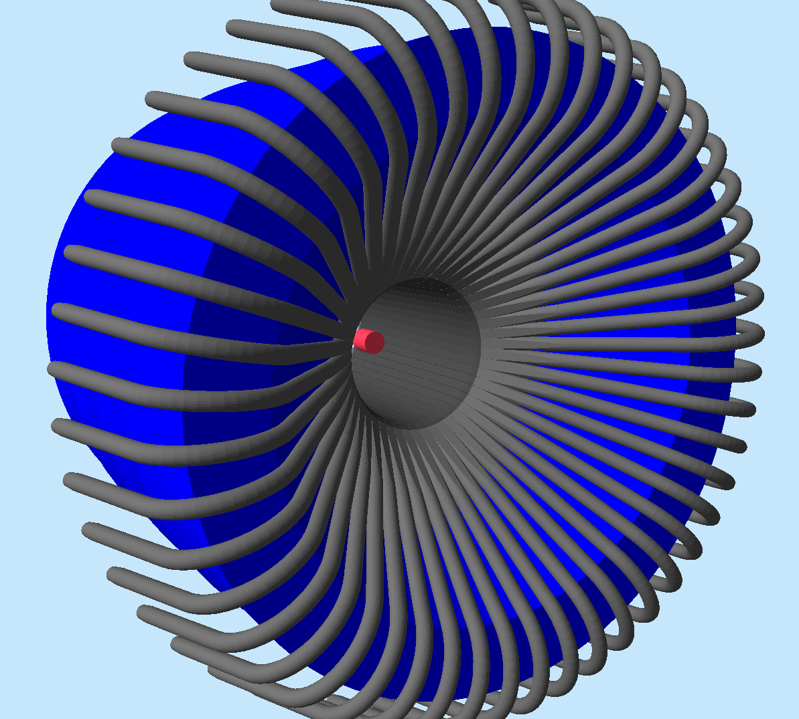
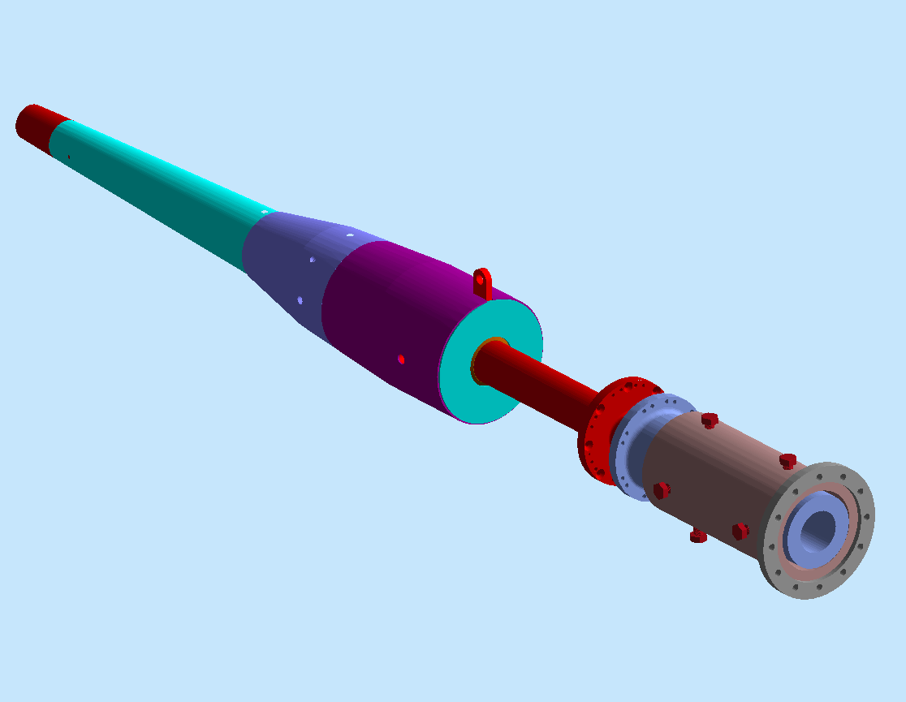
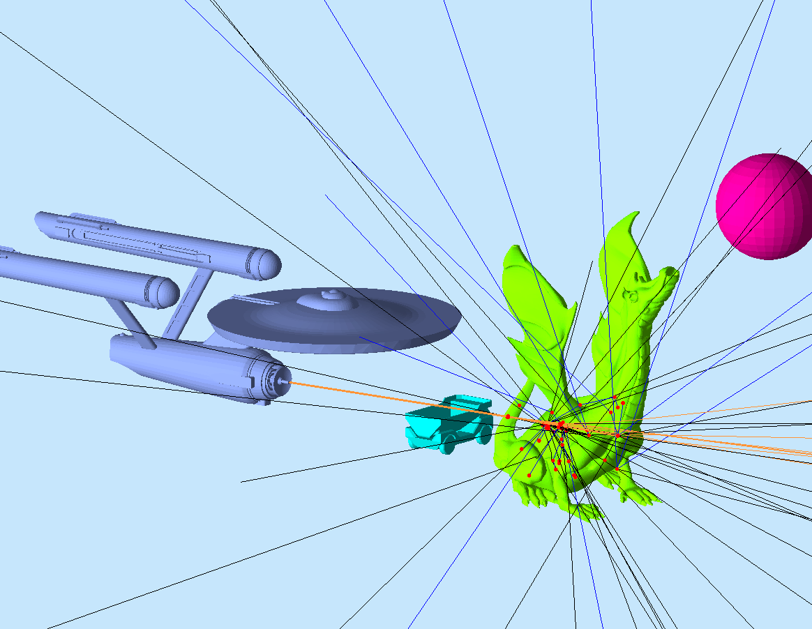
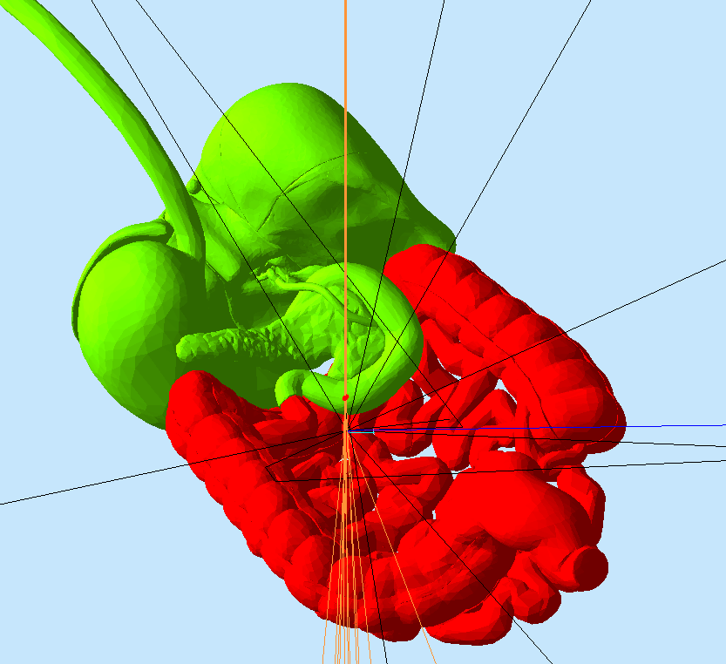
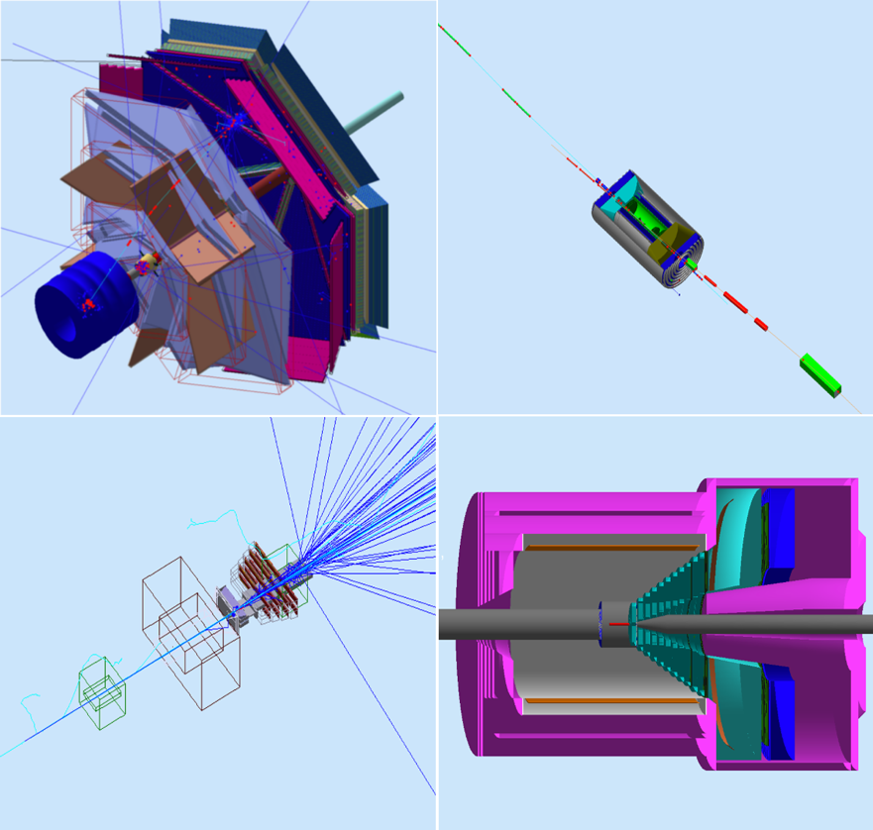
Geometry
Native
Input: Native, CAD, GDML. Arbitrary hierarchy, can be mixed and matched.
Materials, sensitivity assigned at run-time.
CAD
GDML
Experiments using the GEMC Framework: CLAS12 (Hall-B), EIC Beamline and detectors, HPS, Solid

Slide 13
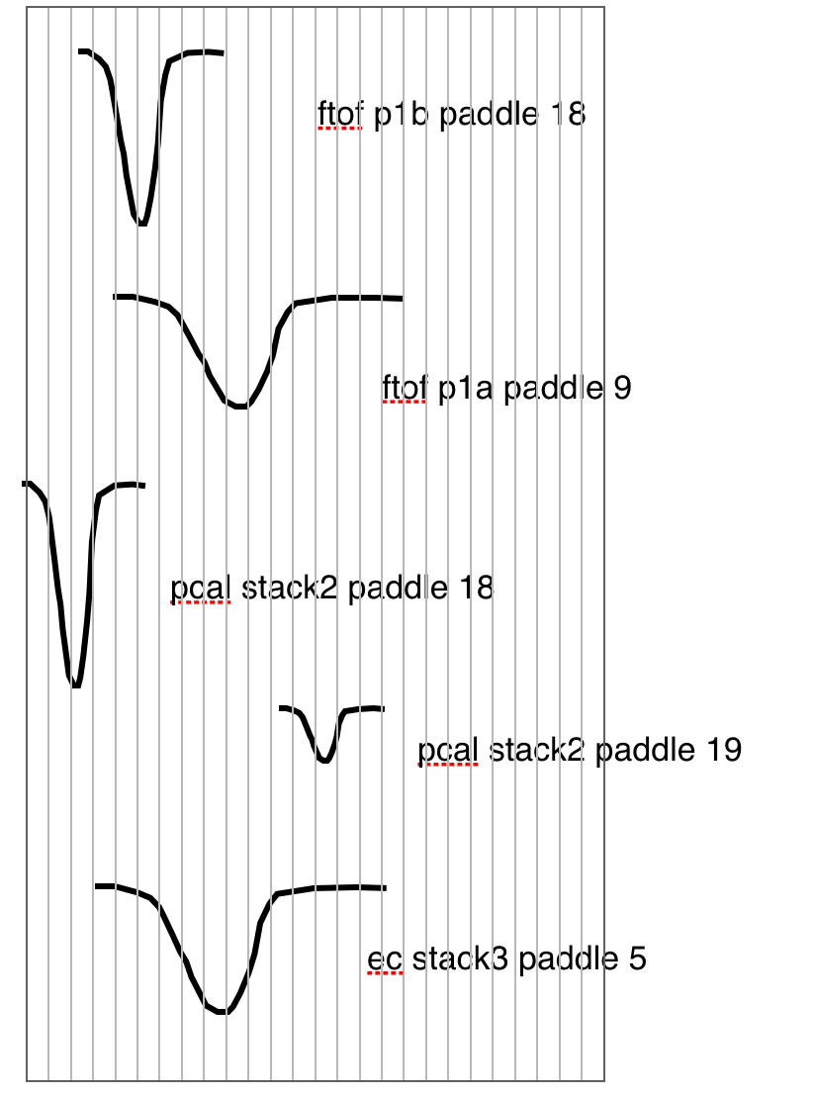
Digitization, Output
Single ADC/TDC over electronic time window.
Voltage vs time signal.
FADC output (4ns intervals or integratal mode)
Automatic true information
All g4 steps in the output
> BST
> True Step by Step infos (101, 0)
- Edep (101, 1)
- Pid (101, 2)
- positions (101, 3)
> Dgtz Step by Step infos (102, 0)
- ADCL (102, 1)
- ADCR (102, 2)
> True Integrated infos (103, 0)
- Edep (103, 1)
- Pid (103, 2)
- positions (103, 3)
> Dgtz Integrated infos (104, 0)
- ADCL (104, 1)
- ADCR (104, 2)
> Voltage as a function of time (105, 0)
- Identifier (105, 1)
- Time (105, 2)
- Voltage (105, 3)
> Trigger Bank (106, 0)
- Identifier (106, 1)
- Time (106, 2)
- Voltage (106, 3)

Slide 14
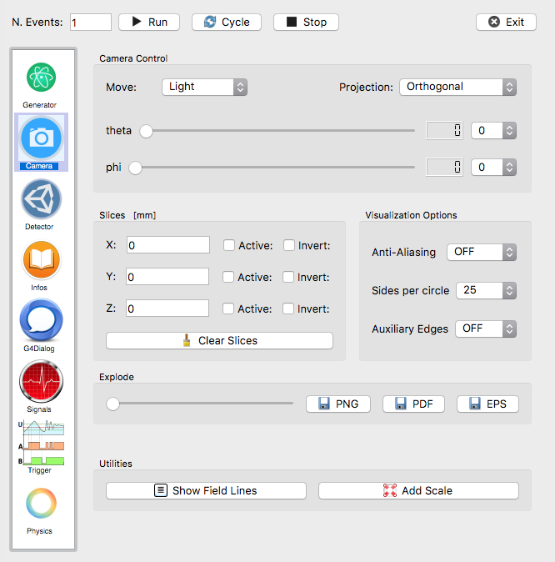
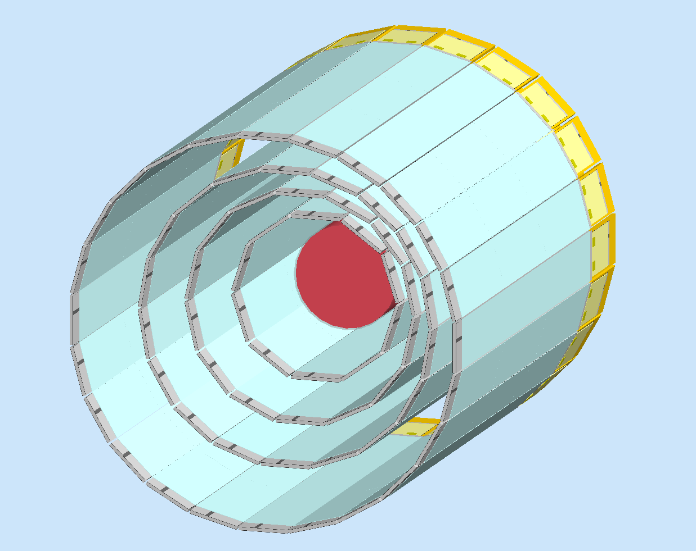
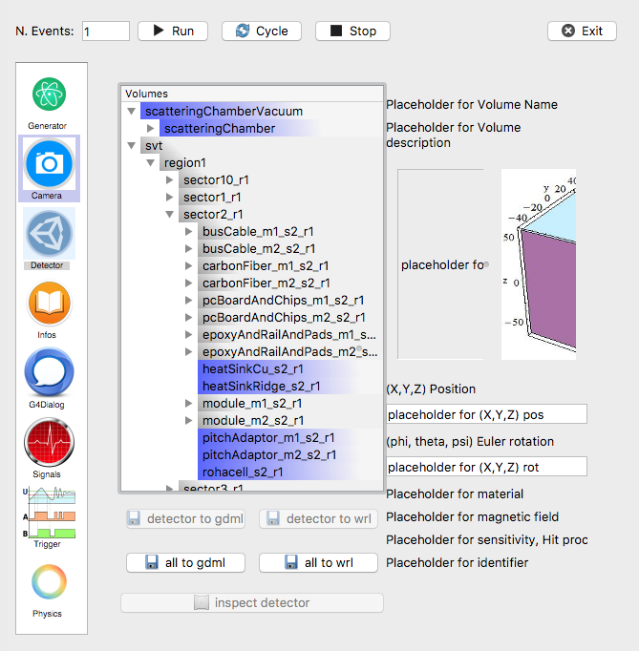
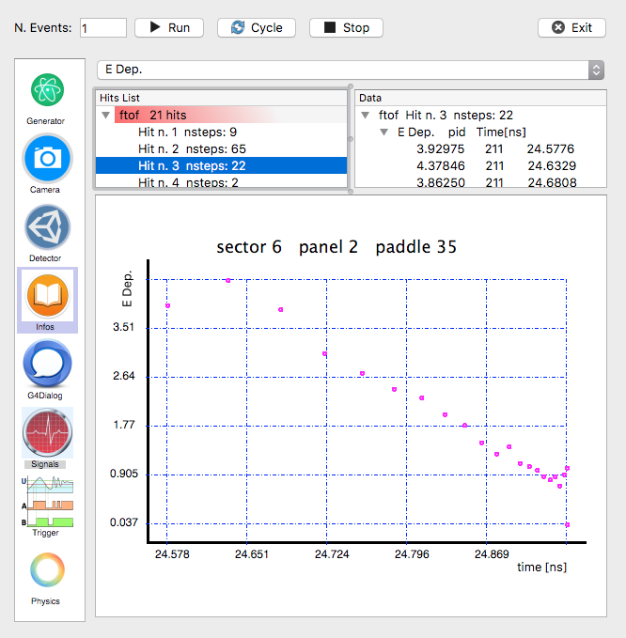
Graphical Interface
Generator
Event time window
Background beams
Camera views slices.
Axis, Scale, Show field.
Geant4 OpenGL View for the whole detector.
Can inspect and open a view on single volumes.
Graphical analysis of steps in a hit.
Can choose variable to display.
Volumes hierarchies and properties
Output to GDML

Slide 15
fun4all
by Chris Pinkenburg (BNL)
-> see the previous talk

Slide 16
EicRoot
by AK (BNL)

Slide 17
EicRoot framework building blocks
Interface to GEANT, ROOT, …
FairBase
PandaRoot
FopiRoot
“Ideal” track finder,
Interface to GenFit
…
TPC R&D stuff, …
EicRoot
CbmRoot
eic-smear
MC generated evts import
Fast smearing codes
RICH stuff
solenoid
modeling
IR design
configuration
-> basically a yet another FairRoot software clone

Slide 18
End user view
No executable (steering through ROOT macro scripts)
simulation
digitization
reconstruction
PID; assembly
-> MC points
-> Hits
-> Tracks, clusters
-> Events
ROOT files for analysis available after each step
C++ class structure is well defined at each I/O stage

Slide 19
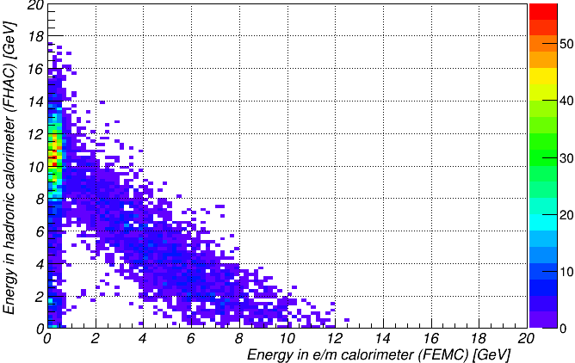

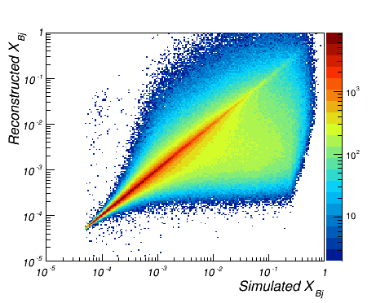
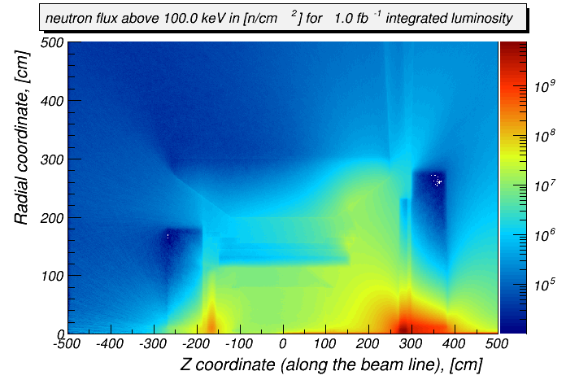
Example case studies
12 GeV pions: Hcal vs EmCal
Calorimeter design optimization
Tracker momentum
resolution
slope ~1.20
DIS electron
reconstruction
Roman Pot acceptance
Neutron fluence
100 x 10 GeV
first quad aperture & beam pipe
RP
B0

Slide 20
PID Consortium software

Slide 21
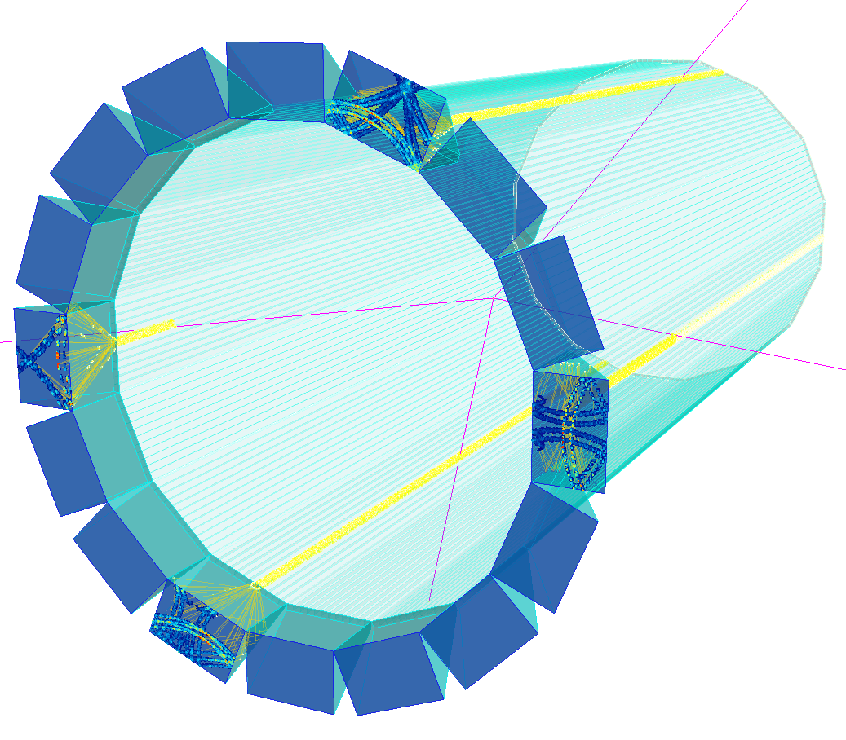
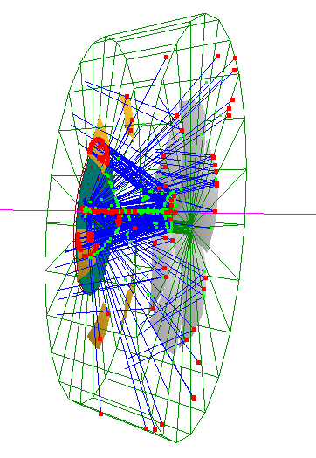
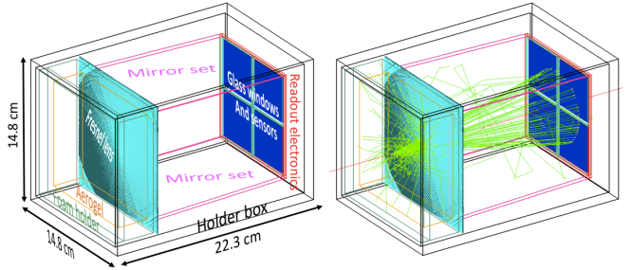
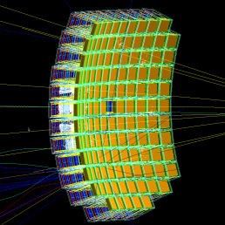
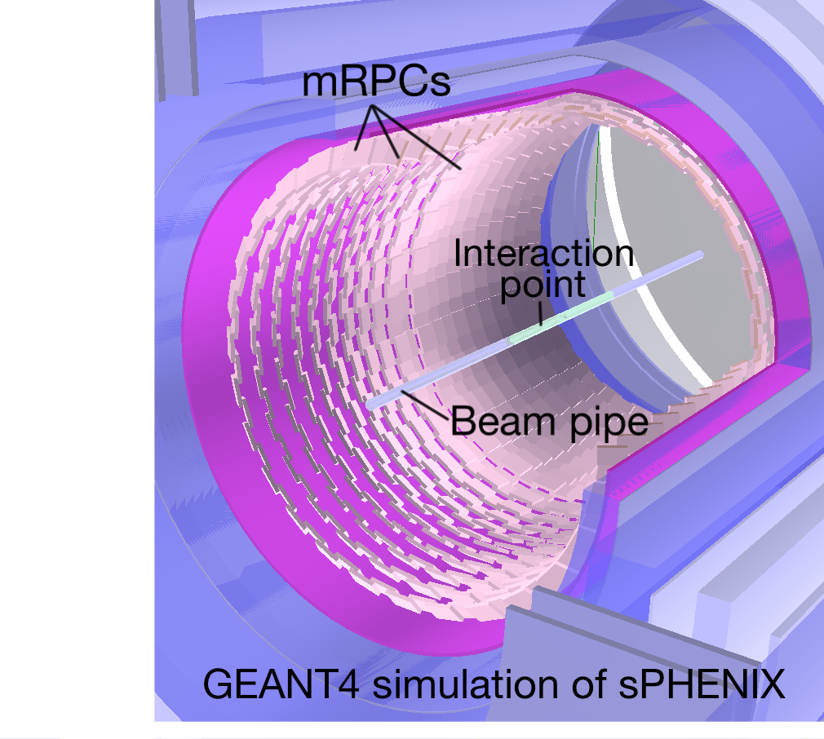
Mostly RICH & ToF applications
GEMC
DIRC
single module
for JLEIC
Dual radiator RICH
Modular RICH
All are custom GEANT4 codes
No easy way to incorporate in EicRoot

Slide 22
Argonne EIC software

Slide 23
Full simulation and reconstruction chain
Event generation
Produce the simulation input events
Detector simulation
Particle transport through detectors
Digitization
Turn energy deposits in active media into detector hits
Reconstruction of
Event vertex, charged tracks, Particle Flow Objects (PFO)
Perform analysis
Collection of benchmark analyses
Data Model

Slide 24
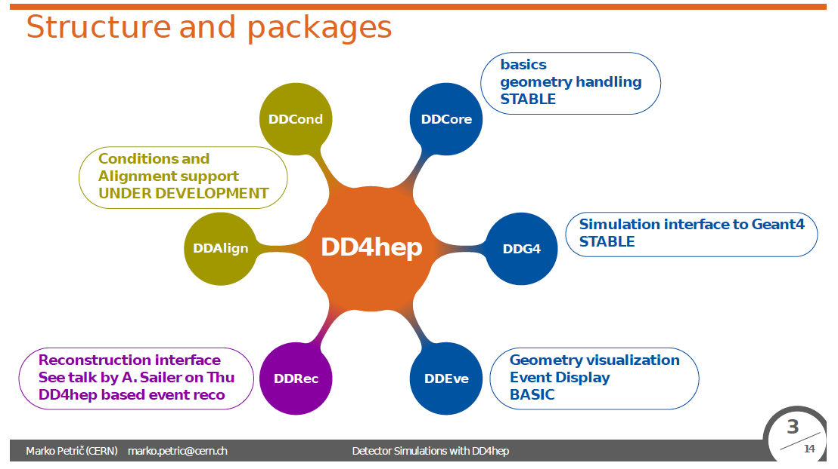
Argonne Software: Overview
Legacy chain
Adaptation of the SiD (ILC) simulation and
reconstruction software chain
Major parts
SLIC (wrapper around GEANT4)
LCSIM (digitization and event reconstruction)
slicPandora (PFA reconstruction)
Visualization with JAS4pp
Limitations
Only SiD subdetectors (e.g. no RICH)
Geometry description not centralized
Geometry constrained to be symmetric
Some parts difficult to maintain
Full chain
Available
Studies of F₂ reconstruction, timing…
Evolution chain
Evolved from the legacy chain
Geometry interface
DD4HEP
Features
Fully maintainable
Geometry obtained from single source
Geometry can be parametrized
Geometry not constrained to be symmetric
New subsystems can be easily implemented
Still working on
Realistic digitization
Generic tracking
PFA reconstruction
Visualization

Slide 25
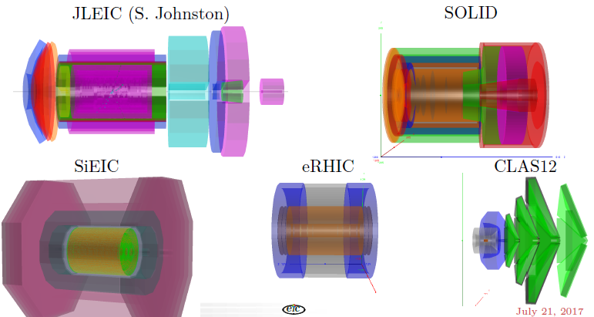
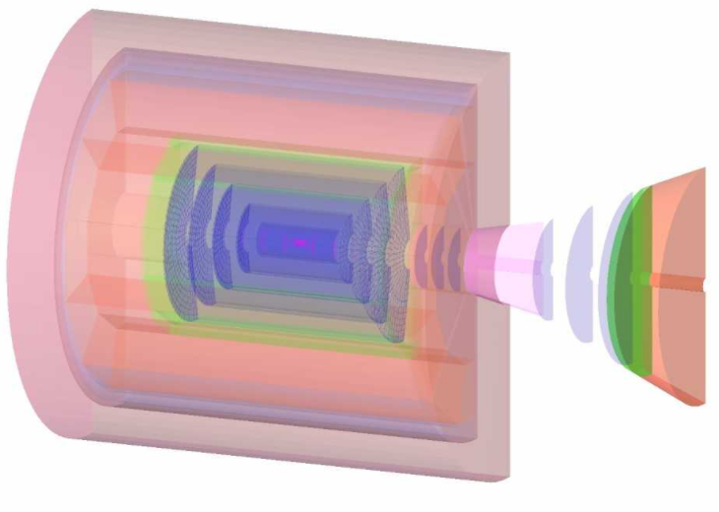
Nuclear Physics Detector Library (NPDet)
Collection of parametrized detectors which can be developed into full concepts
TOPSiDE

Slide 26
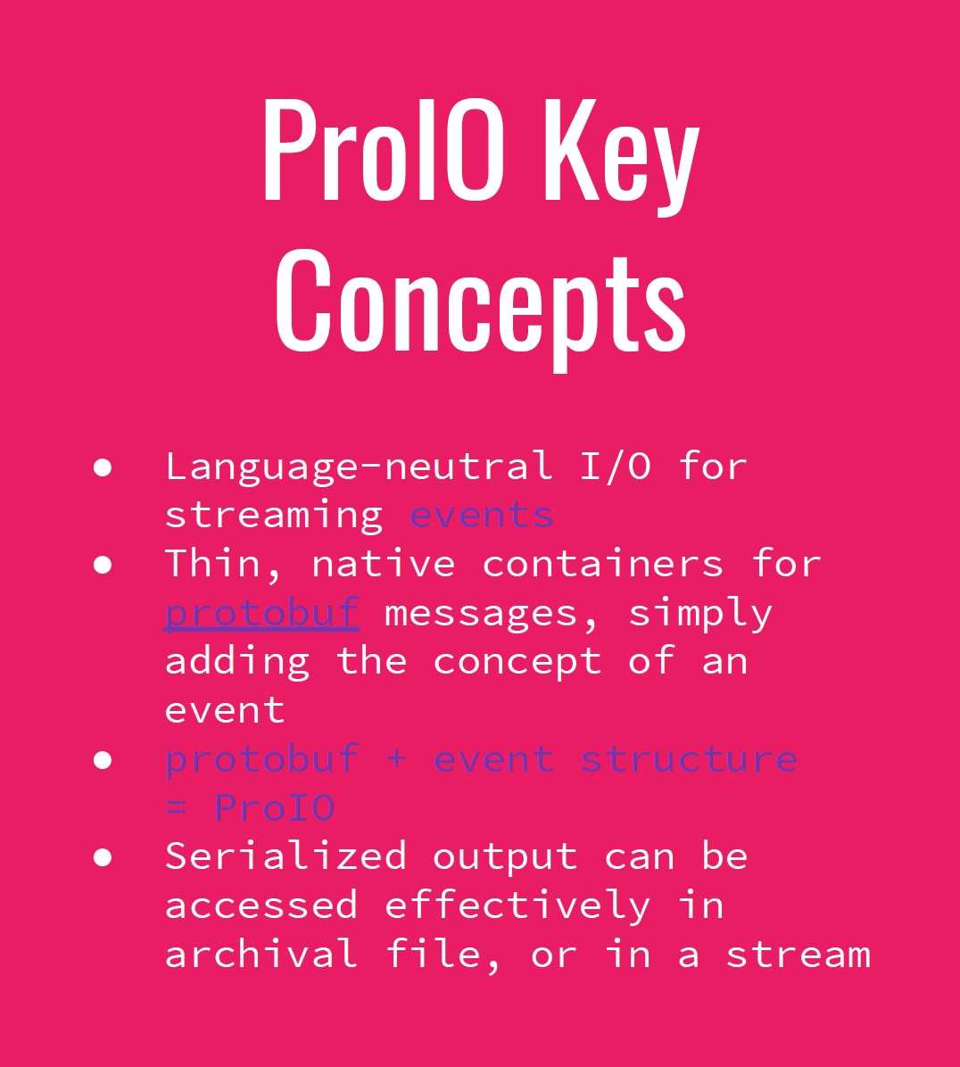
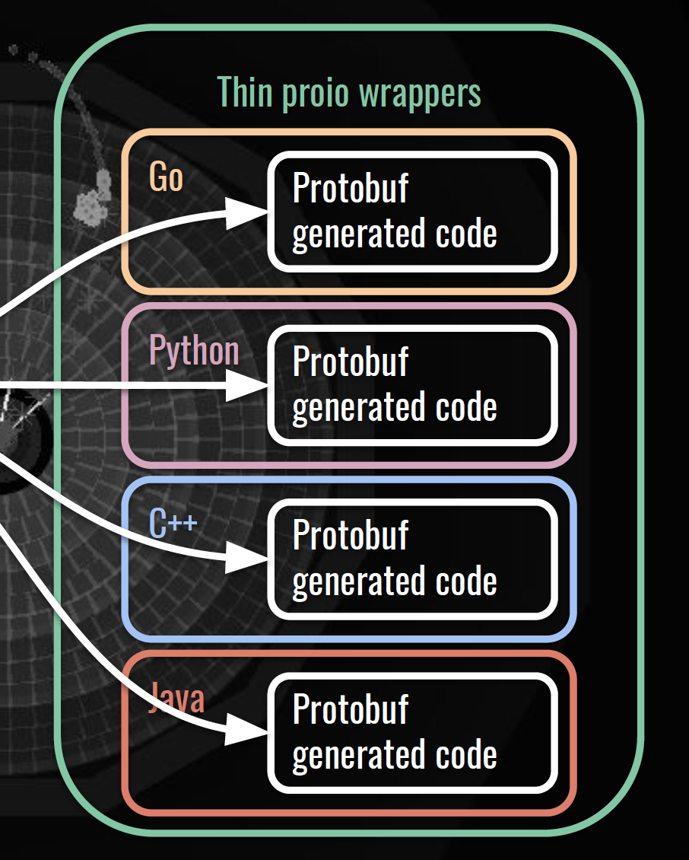
ProIO

Slide 27
Grand unification,
yet another try
by Dmitry Romanov, David Lawrence & others (JLAB)

Slide 28
Overview
Generators
Database
Generators
Database with various
MC samples
Pythia
Beagle
Herwig
…
(1)
Fast simulation
Full simulation
BNL & Jlab effort on
Fast detector prototyping
Eic smear
Geant4
Fast mode
g4e
JLEIC in Geant4
g4e = Geant 4 EIC
C++ genue GEANT4 with
JLEIC detector in it
(2)
ejana = EIC Jana
Community reference
reconstruction
Reconstruction & analysis
ejana – EIC JANA(2)
(3)
MC events
Digitized hits + magnetic field + material distribution
Reconstructed events

Slide 29
Software distribution
NO EFFORT AT ALL
Novice
Some effort
Experts
Efforts required axis
Cloud
Containers
Jlab farm
Conda
Workstation
Compilation
EJPM

Slide 30
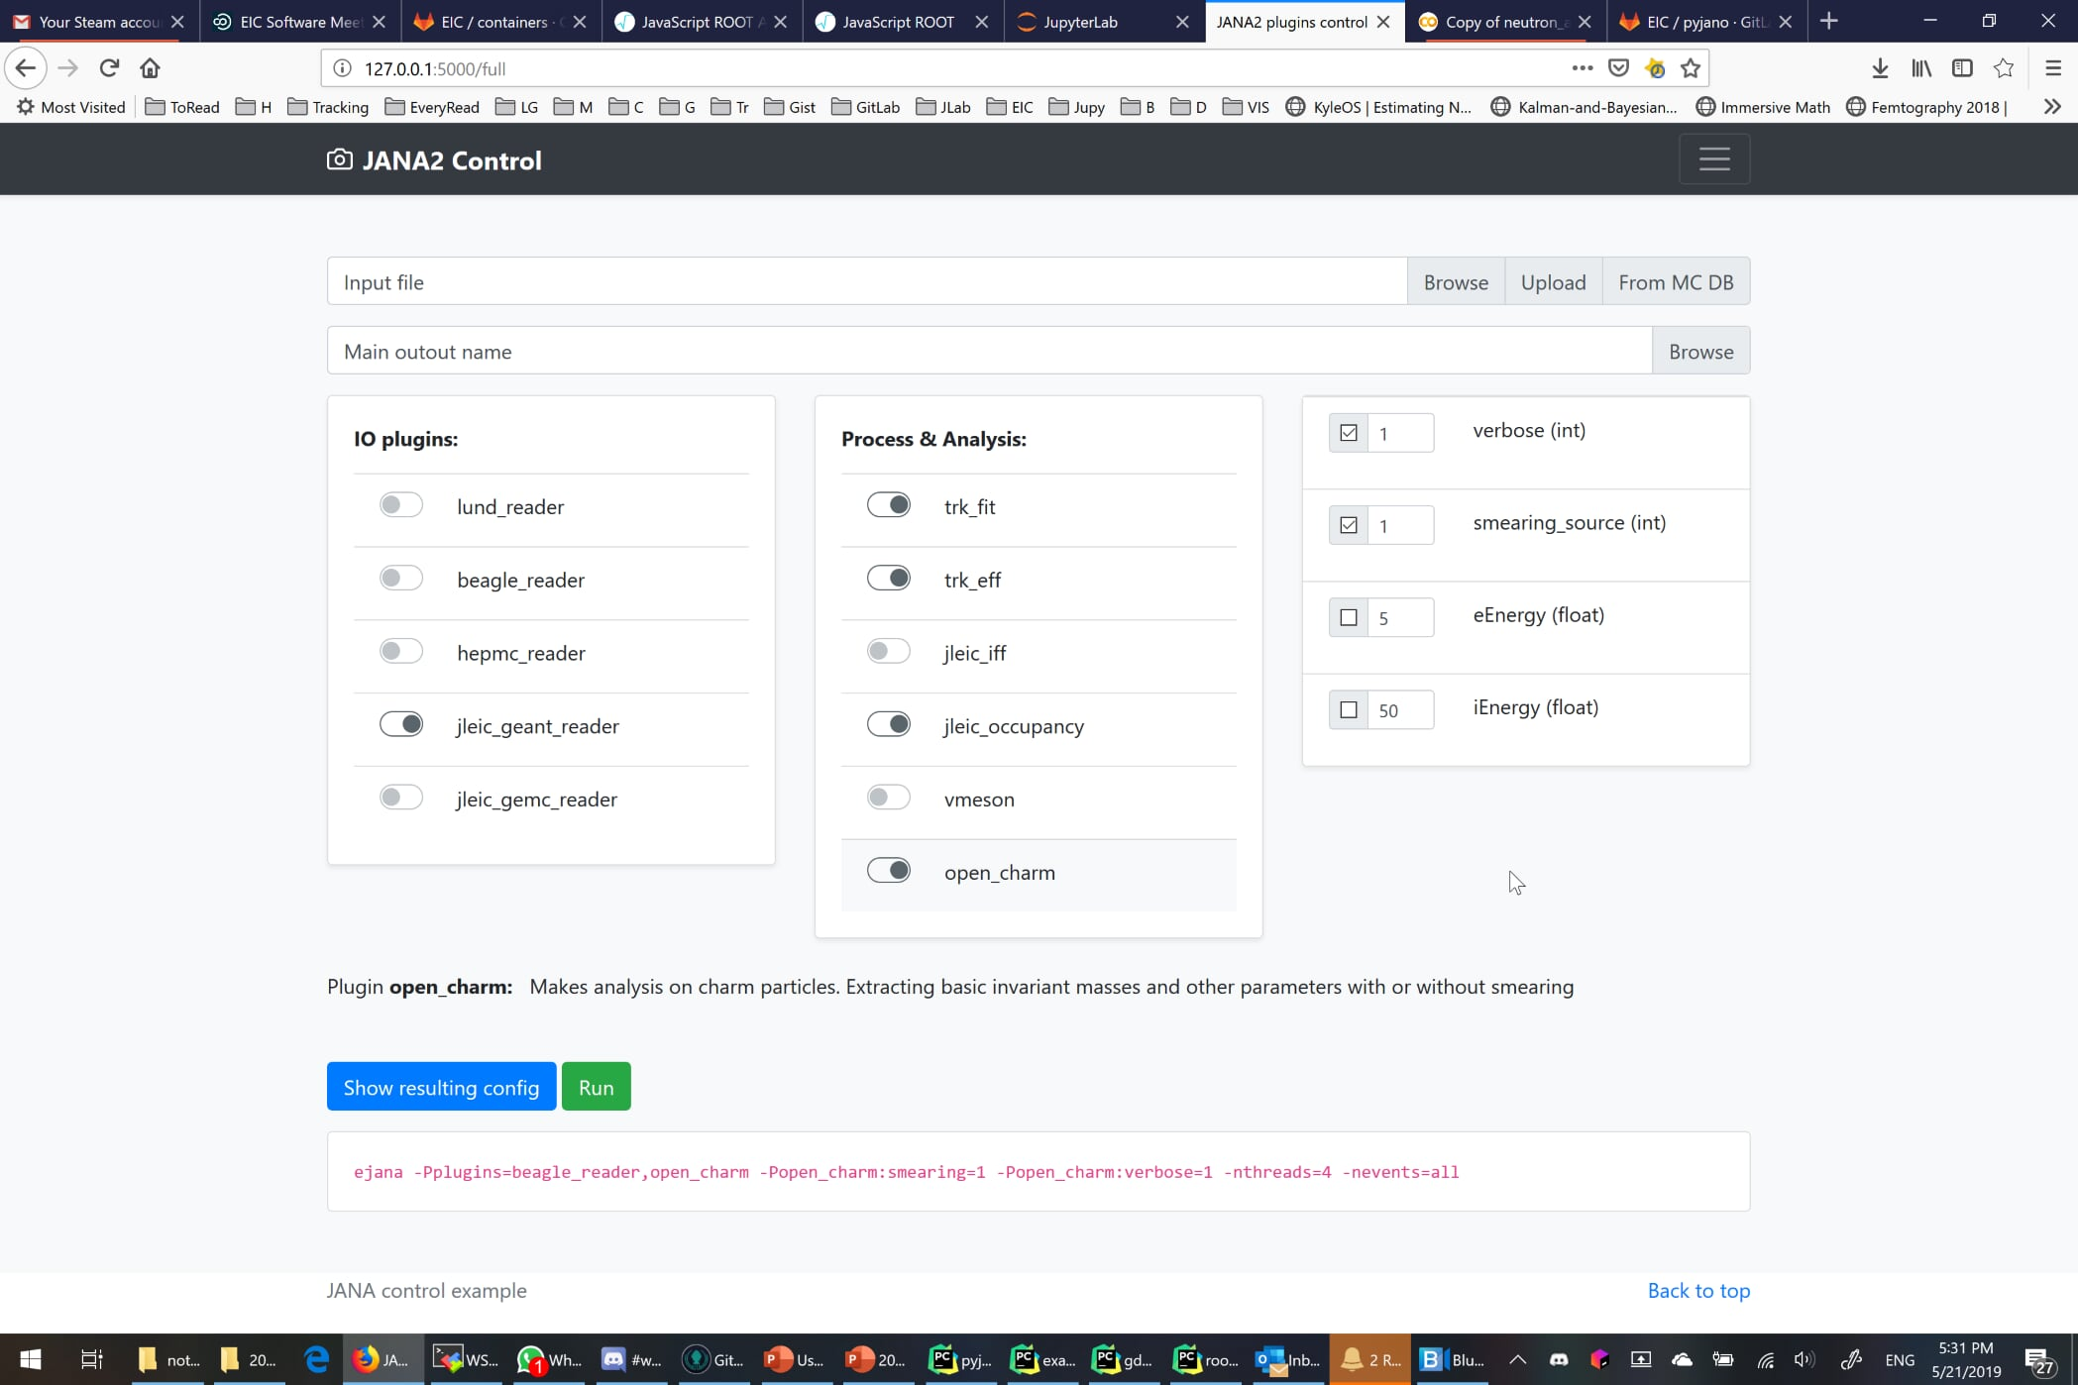
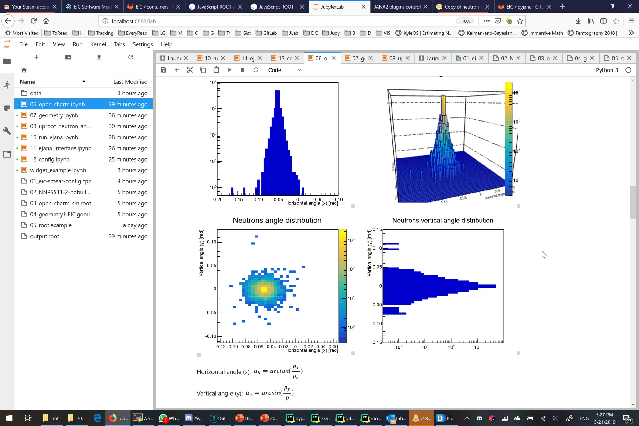
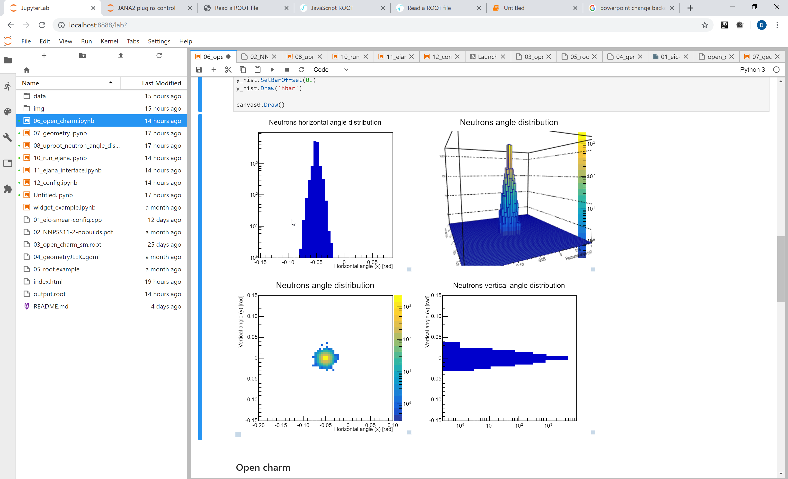
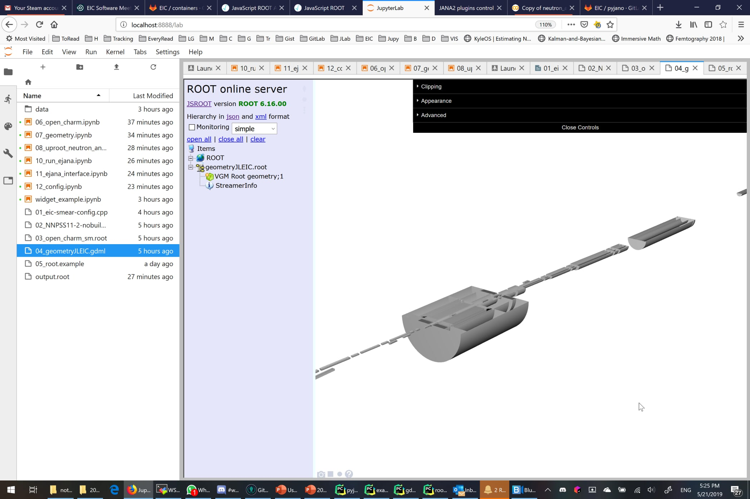
User Interface
Workflow oriented interactive environment based on Jupyter

Slide 31

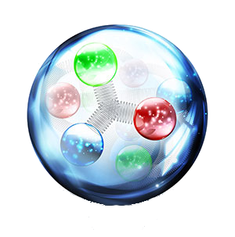
e^{JANA -} Community reference reconstruction
e^{JANA} - stands for EIC JANA
Basic reconstruction
Physics analysis
Users detector codebase integration
Reconstruction
Tracking - Genfit
Vertex finding – Rave
Physical analysis:
  ROOT C++ or
  Python data science tools
  (Jupyter, Seaborn, Pandas, etc)
Any existing C++ (or even others) code can be:
- compiled as JANA plugin
- run parallelized in eJANA
- accessed by other plugins
EIC jana

Slide 32
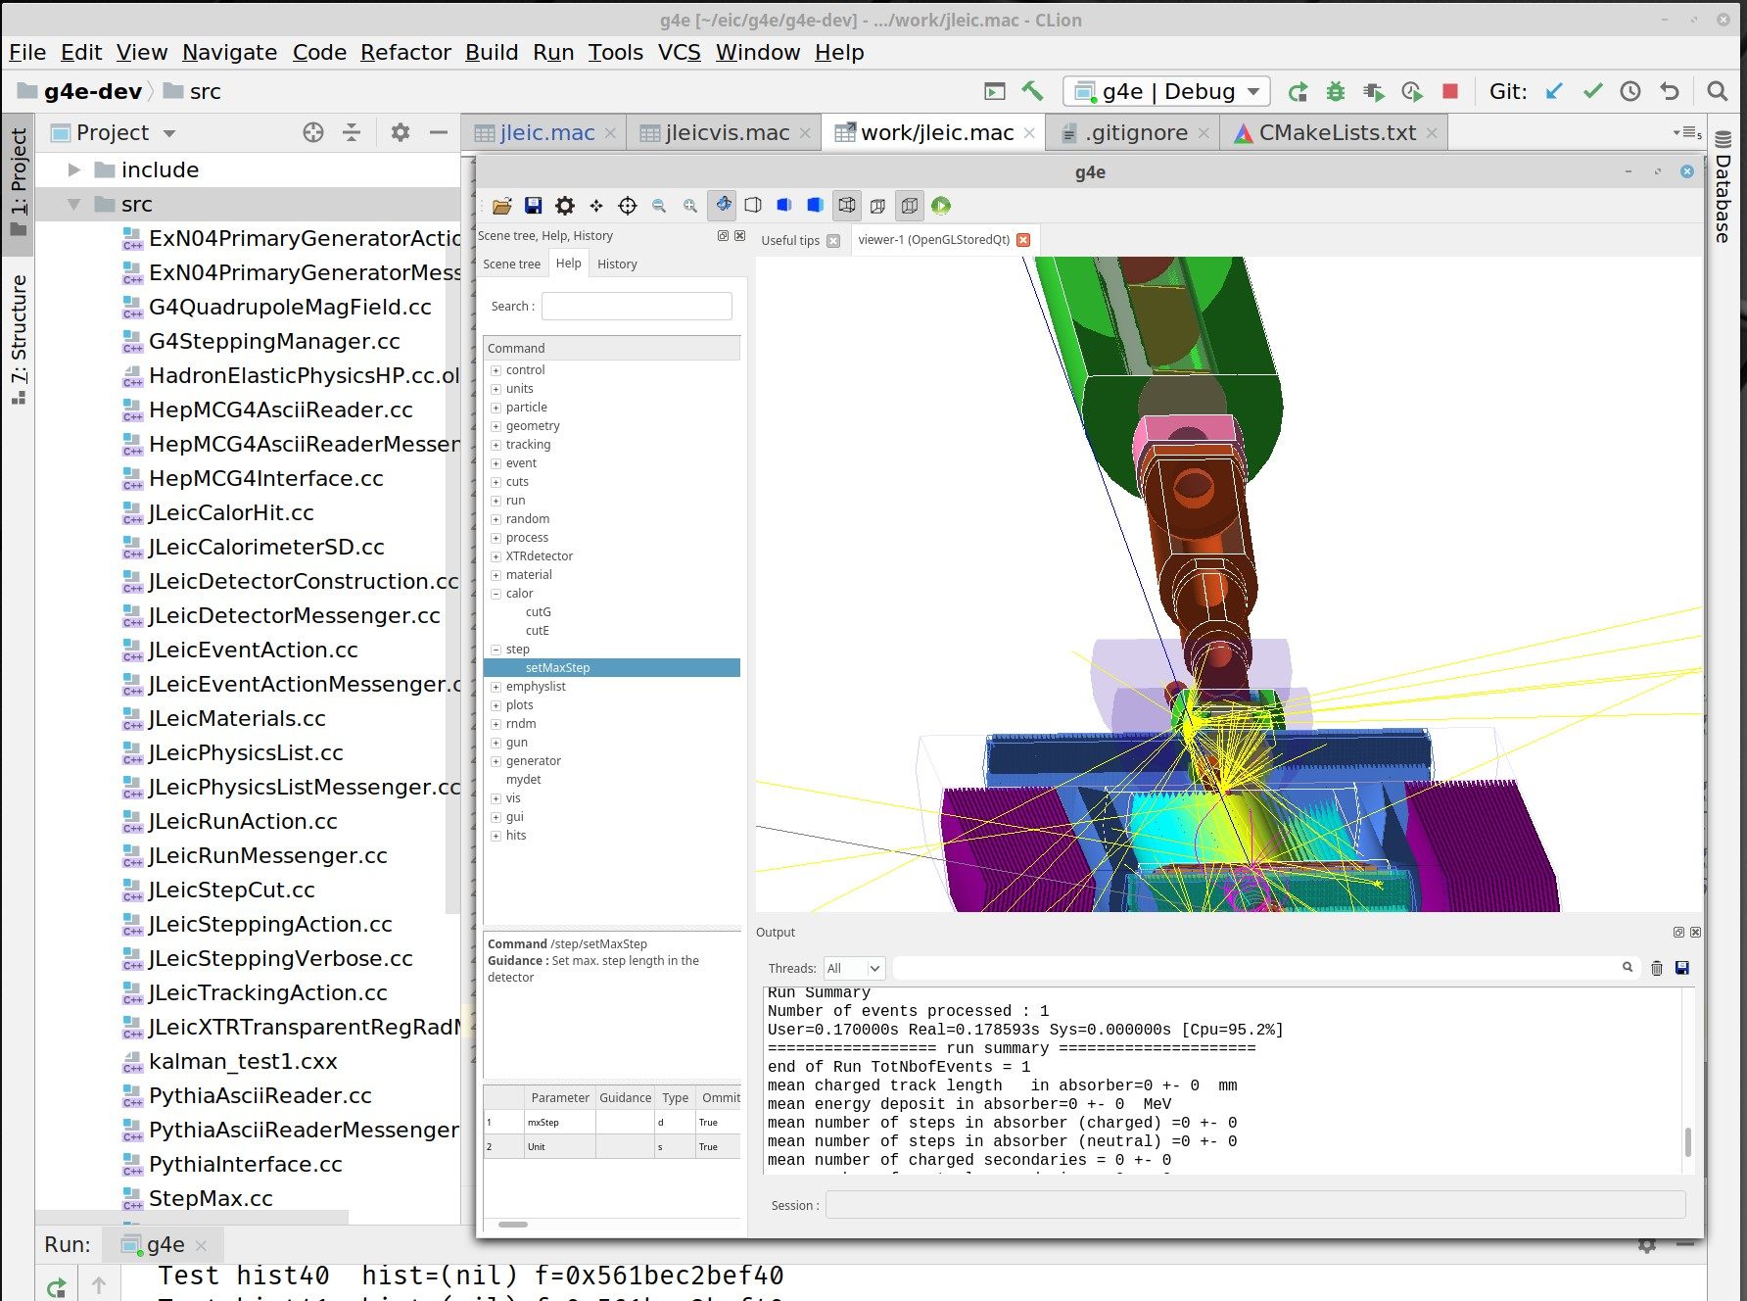
GEANT 4 EIC
The codename g4e – stands for Geant 4 EIC
Beta stage
√s 100 GeV design is implemented
Imports CAD, accelerator group data
Exports final Geometry in various formats
Plain flattened analysis ready ROOT files
For those who prefer scripting over compilation
Geant 4 python can be used

Slide 33
Backup (JANA2)

Slide 34
Overly Simplified View of JANA’s Role
C++ objects
(low level)
C++ objects
(refined)
DAQ
obj
reconstruction algorithms
obj
obj
obj
obj
obj
obj
raw data files
JANA
reconstructed data files

Slide 35
Some Goals of the JANA framework
Provide mechanism for many physicists to contribute code to the full reconstruction program
Implement multi-threading efficiently and external to contributed code
Provide common mechanisms for accessing job configuration parameters, calibration constants, etc...

Slide 36
Factory Model
FACTORY
(algorithm)
FACTORY
in stock?
NO
NO
MANUFACTURE
ORDER
in stock?
YES
STOCK
MANUFACTURE
YES
FACTORY
in stock?
NO
PRODUCT
MANUFACTURE
STOCK
YES
STOCK
Data on demand = Don’t do it unless you need it
Stock = Don’t do it twice
Conservation of CPU cycles!

Slide 37
Complete Event Reconstruction in JANA
Framework has a layer that directs object requests to the factory that completes it
HDDM File
EVIO File
ET system
Event Source
Web Service
Multiple algorithms (factories) may exist in the same program that produce the same type of data objects
JANA
Event Processor
This allows the framework to easily redirect requests to alternate algorithms specified by the user at run time
User supplied code
Fill histograms
Write DST
L3 trigger

Slide 38
Multi-threading
Each thread has a complete set of factories making it capable of completely reconstructing a single event
thread
Event Source
thread
Factories only work with other factories in the same thread eliminating the need for expensive mutex locking within the factories
Event Processor
All events are seen by all Event Processors (multiple processors can exist in a program)
thread
thread

Slide 39
JANA2 generalizes the “event” queue to allow multiple queues.
Threads are now responsiible for moving data between queues
Task Queue
parse
Task Queue
thread
analyze
Source
(file)
entangled event task
recon. evnt task
thread
recon. evnt task
thread
entangled event task
recon. evnt task
recon. evnt task
entangled event task
recon. evnt task
recon. evnt task
read
recon. evnt task
thread
Histograms/Trees
(file)

Slide 40
JANA2 arrows separate sequential and parallel tasks
CPU intensive event reconstruction will be done as a parallel arrow
Other tasks (e.g. histogram filling) can be done as a sequential arrow
Fewer locks in user code allows framework to better optimize workflow
queue
queue
...
sequential arrow
parallel arrow
sequential arrow

