Slide 1
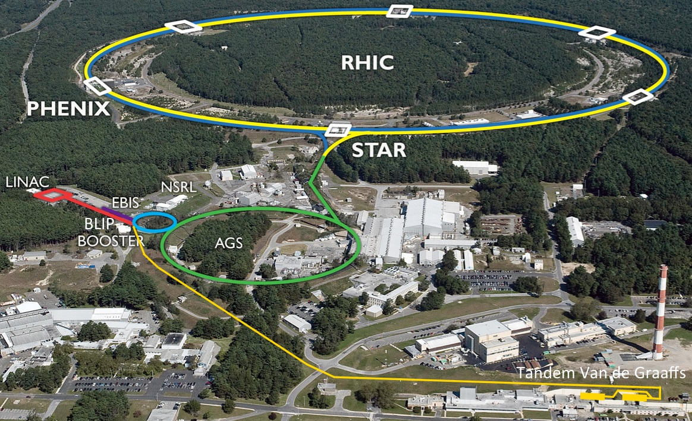
Projections for BES-II Wolfram Fischer and Chuyu Liu
31 July 2019
RHIC Retreat, BNL
Notes:
09:20, 25+10 min, 20 slides

Slide 2
Contents
Performance in Run-19 11 different modes, all with Au (single beam or colliding) Demonstration of bunched beam electron cooling
Projections for Run-19 → Beam Energy Scan II (BES-II)
Ongoing and planned upgrades Extended EBIS, Linac Vacuum and RHIC turbo pumps, Cyro control and cold expander train, AGS PS, RHIC quench detection system … progress on 25+ year plan

Slide 3
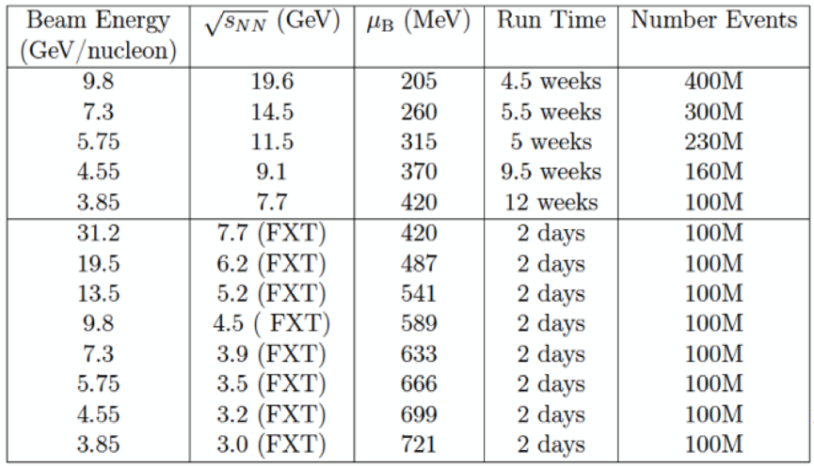
Beam Energy Scan II (BES-II) Score board
Min Full
300M
200M
150M
100M
80M
300M Run-18

Slide 4
Run-19 modes – 11 total, most flexible operation to date
Beam Energy Scan II (BES-II)
Mode 1A: LEReC cooling commissioning with ¹⁹⁷Au⁷⁹⁺ at 3.85 GeV/nucleon
Mode 1B: ¹⁹⁷Au⁷⁹⁺ on ¹⁹⁷Au⁷⁹⁺ at 9.8 GeV/nucleon particle energy
Mode 1C: ¹⁹⁷Au⁷⁹⁺ on ¹⁹⁷Au⁷⁹⁺ at 7.3 GeV/nucleon particle energy
Mode 1D: ¹⁹⁷Au⁷⁹⁺ at 7.3 GeV/nucleon particle energy on fixed target ¹⁹⁷Au foil inside STAR (3.93 GeV/nucleon COM energy)
Mode 1E: ¹⁹⁷Au⁷⁹⁺ on ¹⁹⁷Au⁷⁹⁺ at 3.85 GeV/nucleon particle energy
Mode 1F: ¹⁹⁷Au⁷⁹⁺ at 3.85 GeV/nucleon particle energy on fixed target ¹⁹⁷Au foil inside STAR (3.22 GeV/nucleon COM energy)
Mode 1G: LEReC cooling commissioning with ¹⁹⁷Au⁷⁹⁺ at 4.59 GeV/nucleon
Mode 1H: ¹⁹⁷Au⁷⁹⁺ at 4.59 GeV/nucleon particle energy on fixed target ¹⁹⁷Au foil inside STAR (3.00 GeV/nucleon COM energy)
Mode 1I: ¹⁹⁷Au⁷⁹⁺ on ¹⁹⁷Au⁷⁹⁺ at 4.59 GeV/nucleon particle energy
Mode 1J: ¹⁹⁷Au⁷⁹⁺ at 31.2 GeV/nucleon particle energy on fixed target ¹⁹⁷Au foil inside STAR (7.74 GeV/nucleon COM energy)
Mode 1K: ¹⁹⁷Au⁷⁹⁺ on ¹⁹⁷Au⁷⁹⁺ at 100 GeV/nucleon particle energy

Slide 5
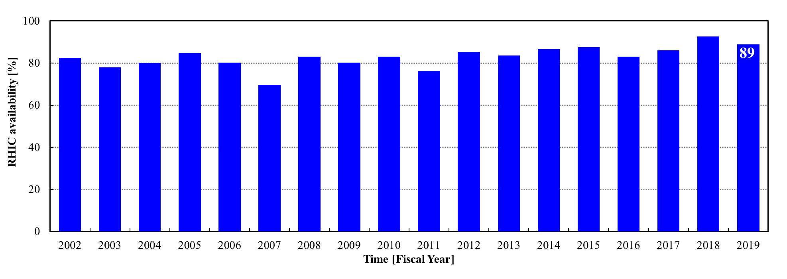
Operational efficiency availability reported to DOE
Availability = beam time / scheduled beam time (denominator excludes scheduled maintenance)
Availability goal: 80%
Typical times:
50K to 4K cool-down : 0.5 weeks
Initial set-up : 1-2 weeks
Changing species : 0.5 weeks
Beam studies (APEX): 16h / 2 weeks
Maintenance : 14h / 2 weeks
Warm-up : 0.5 weeks
=> Met availability goal now 8 years in a row (expectation will be raised next year)
Notes:
Peter Ingrassia (07/29/2018): Of the 475 Run-19 failure hours LEReC contributed 84 hours – almost 18% of the total.

Slide 6
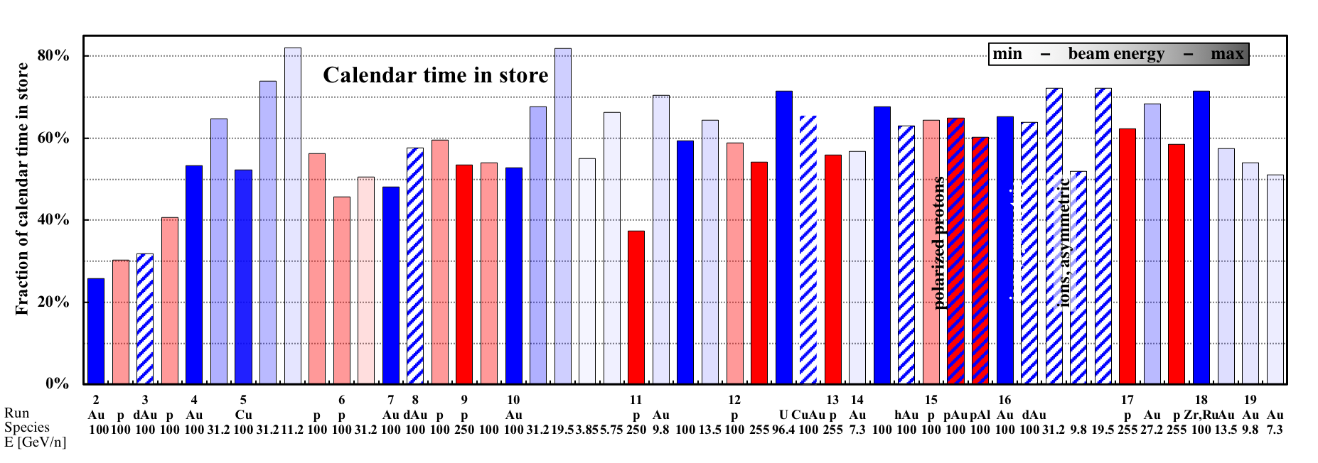
Operational efficiency setup time
Setup time: - for 1st species in run: from both rings cold to 1st physics store - for following species: from beginning of setup to 1st physics store
Run-19
7 days Au+Au 9.8 GeV
1 day for Au+Au 7.3 GeV
TRANSPARENT: low energy
BLUE: heavy ion runs
INTRANSPARENT: high energy
RED: polarized proton runs

Slide 7
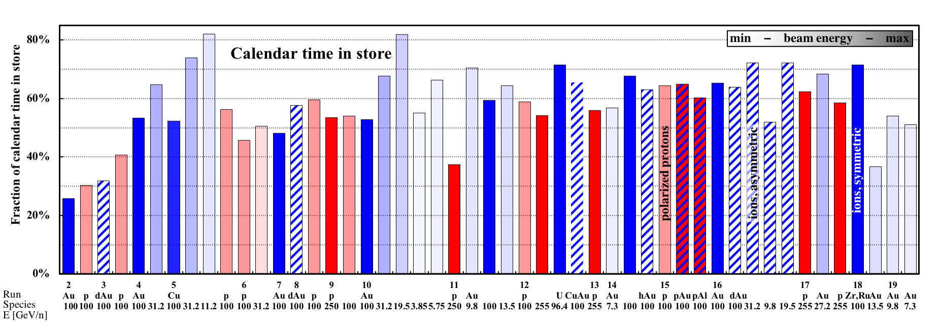
Operational efficiency store-to-store, time in store
Run-19
Time in store = store time / calendar time Goal: 60% (denominator includes scheduled maintenance, failure, setup, beam experiments)
Au+Au below goal due to frequent switches into other modes
TRANSPARENT: low energy
BLUE: heavy ion runs
INTRANSPARENT: high energy
RED: polarized proton runs

Slide 8
Operational efficiency store-to-store time, detail
BES-I
Run-10
~0.1 h
BES-II
Run-19
~0.3 h

Slide 9
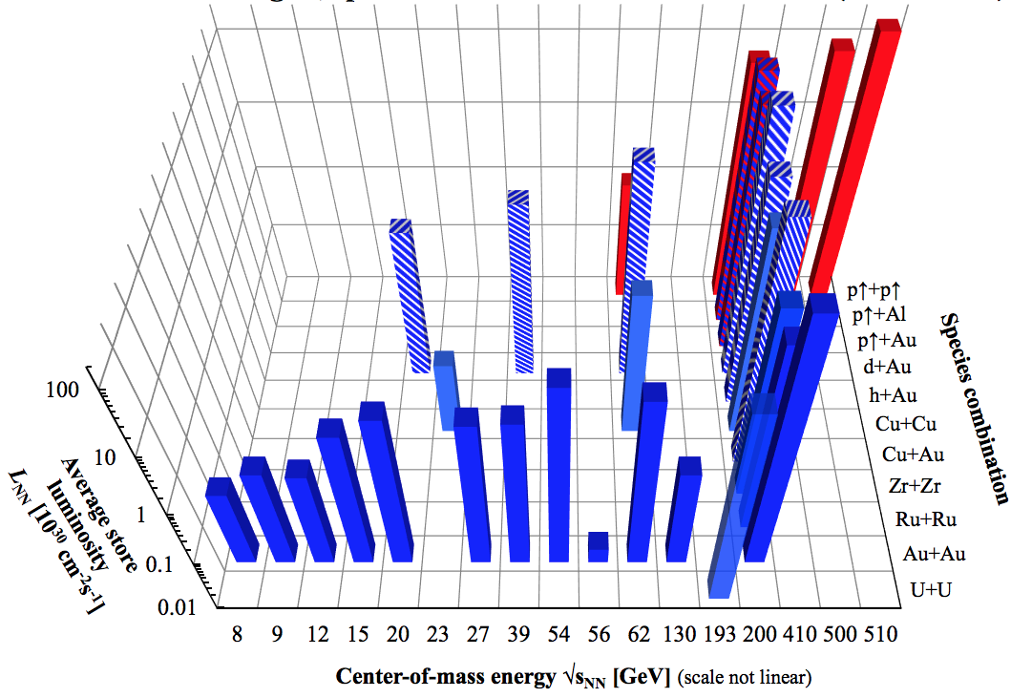
RHIC – all colliding running modes to date 2001 to 2019
2019 L_{avg} 4.0x 3.8x
2019-21 BES-II with LEReC
nominal injection energy

Slide 10
Low Energy RHIC electron Cooling (LEReC)
A. Fedotov
64 m to IP2
(not to scale)
Commissioning
Diagnostic Line 1
704 SRF
Booster Cavity
Commissioning
Diagnostic Line 2
704 MHz Cu Cavity
9 MHz Cu Cavity
2.1 GHz Cu Cavity
DC e⁻ Gun
e⁻
COOLING
in Yellow RHIC ring
e⁻
RHIC TRIPLET
RHIC DX
e⁻
COOLING
in Blue RHIC ring
LEReC Solenoids
Compensating (LF)
Matching (HF)
Merger/Transport
180° Bending Magnet
20° Bending Magnets
Beam Dump
Energies E : 1.6, 2.0 MeV Avg. current I_{avg} : 27 mA Momentum δp/p : 5×10⁻⁴
Luminosity gain : 4×
1st bunched beam electron cooler

Slide 11
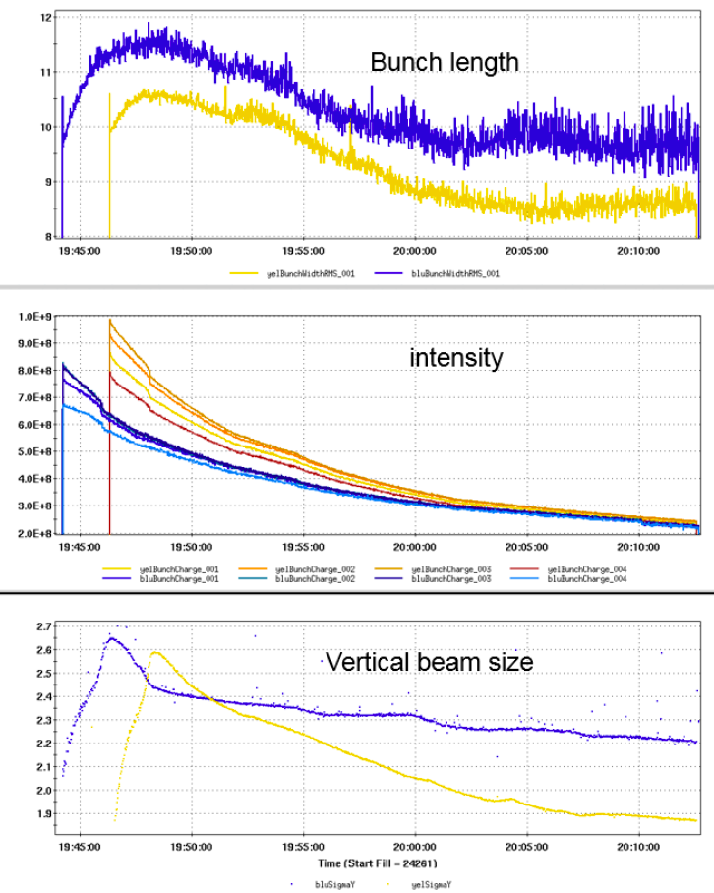
Cooled Au beams of 111x111 store, 3.85 GeV/nucleon
cooling pronounced in longitudinal plane
RMS bunch length [ns]
electron beam also
heats transversely,
cooling > heating in best cases
RMS beam size [mm]

Slide 12
LEReC accomplishments Run-19
World’s first demonstration of electron cooling with RF accelerated electron beams. New cooling approach (all previous coolers used DC beam) that opens the possibility of using this technique at high beam energies.
First “non-magnetized” electron cooling (all previous coolers used magnetization on the cathode, i.e. solenoid field).
First cooling of ion bunches in two rings using the same electron beam.
First electron cooling of colliding beams.
Electron cooling was commissioned at electron energy of 1.6 MeV (ion energy 3.85 GeV/nucleon)
Electron cooling was commissioned at electron energy of 2 MeV (ion energy of 4.58 GeV)
Electron cooling of RHIC stores with 111 ion bunches in both rings demonstrated at both 3.85 and 4.59 GeV/nucleon ion beam energies.

Slide 13
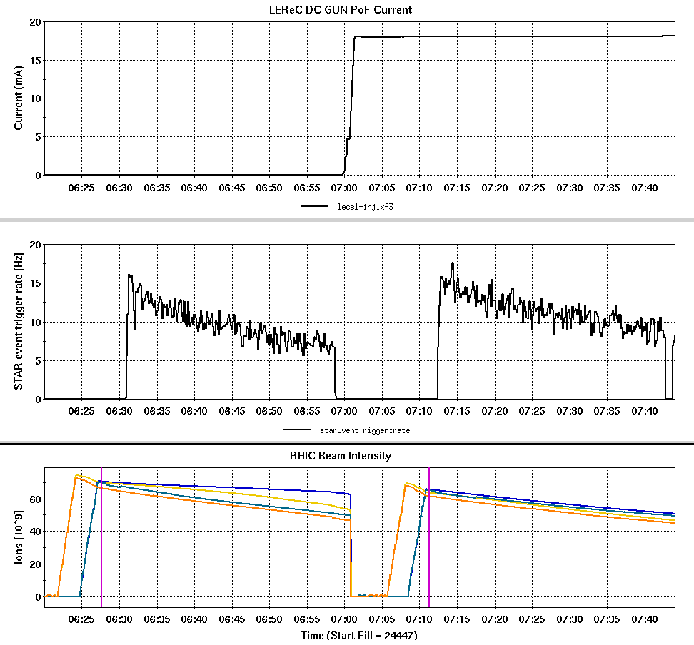
Effect of cooling at 4.59 GeV/nucleon 15-Jul-2019
NO cooling 24450
cooling 24451
STAR event integral over 28 min: +22%

Slide 14
Beam Energy Scan II (BES-II) Score board
Min Full
300M
200M
150M
100M
80M
581M Run-19
324M Run-19
3M Run-19
51M Run-19
53M Run-19
201M Run-19
300M Run-18
5M Run-19
Modes in Run-20

Slide 15
Outlook Beam Energy Scan (BES)-II, RHIC Run-19 to Run-21
↓ LEReC/BES-II plan from 2015 still holding
↓ TODAY
complete
complete
complete
complete
in progress
in progress
Plan:
2018: complete LEReC electron beam commissioning
2019: LEReC cooling commission interleaved with physics
2020: Use cooled beams at 2 (3) lowest energies
2021: contingency if event number goals not met

Slide 16
Run-20 outline MIN goals only
0.5 weeks cool-down
1 week setup
6 weeks 5.75 x 5.75 GeV/nucleon (MIN goal only)
1.5 week fixed target (up to 6 energies, interleaved)
2 weeks LEReC setup for 4.59 x 4.59 GeV/nucleon (interleaved)
10.5 weeks 4.59 x 4.59 GeV/nucleon (MIN goal only)
2 weeks LEReC setup for 3.85 x 3.85 GeV/nucleon (interleaved) CeC dedicated time (no time allocated yet)
0.5 weeks warm-up
24 weeks total (4K cryo operation)
Notes:
Assume 24 weeks for Run-20, 20 weeks in Run-21 (post LMBB adjustment, S. Pankowski 07/18/2019).
CeC request was for 8 days dedicated time at the NPP PAC in June 2019.

Slide 17
Colliding mode projections for Run-20
5.75 x 5.75 GeV/nucleon
L_{avg} improvement factor, total = 2.4x Run-10
L_{avg} improvement factor, +- 70 cm = 2.3x Run-10
bunch intensity N_{b} : 1.1 → 1.35e9
rms emittance ε_{n} : 2.5 → 2.5 μm
bunch length σ_{s} : 1.4 → 1.4 m
envelope function β* : 6.0 → 4.0 m
electron cooling : OFF
4.59 x 4.59 GeV/nucleon
L_{avg} improvement factor, total = 1.5x Run-19
L_{avg} improvement factor, +- 70 cm = 2.4x Run-19
bunch intensity N_{b} : 0.8 → 0.9e9
rms emittance ε_{n} : 1.5 → 1.6 μm
bunch length σ_{s} : 3.8 → 2.3 m (note: σ_{s} = 3.8 m for AGS 3→1 merge, 2.3 m for AGS 2→1 merge)
envelope function β* : 4.5 → 4.5 m
electron cooling : ON

Slide 18
Run-20 – some areas for possible improvements
Fill time reduction
Reduction of number of mode changes
Shortest possible bunches at space charge limit (ξ = -0.06 ?)
Fixed and reliable Au beam parameters for cooling at 4.59 GeV (requires some intensity margin)
Beam conditions that allow STAR to stay on during injection
Longer STAR beryllium beam pipe (4 m) for increased longitudinal acceptance
Full use of LEReC
→ Need to collect every ~10% improvement possible (seven 10% increases yield factor of 2, five 10% increases likely yield FULL event goals)

Slide 19
RHIC Upgrades Overview
trap length extension
Extended EBIS (CP) 2nd sc solenoid + gas cell completion for Run-20
RHIC cryo control system upgrade (CP)
RHIC quench detection (CP)
Linac vacuum system upgrade (AIP)
RHIC turbo pump upgrade (AIP)
RHIC cryo plant cold expander train upgrade (AIP)
Booster AC dipole (He-3↑)
PS: Booster sextupoles, Booster RF tuning (band III), AGS quad and sexupoles, H10/L20, BtA and LtB, RHIC IR8 tq (sPHENIX)
Siemens fire suppression system
AGS MM evaporation cooler
Vacuum lab equipment (ultrasound cleaner, oven)

Slide 20
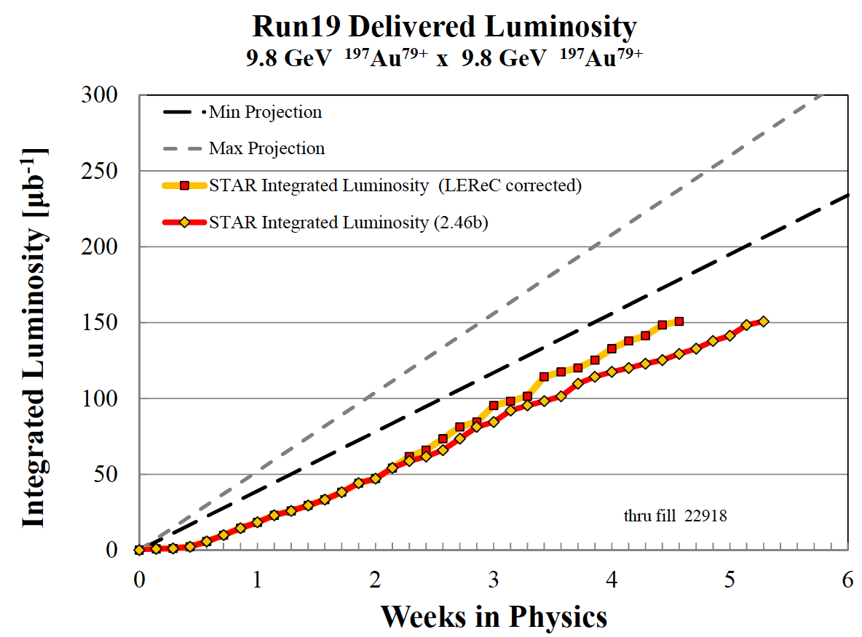
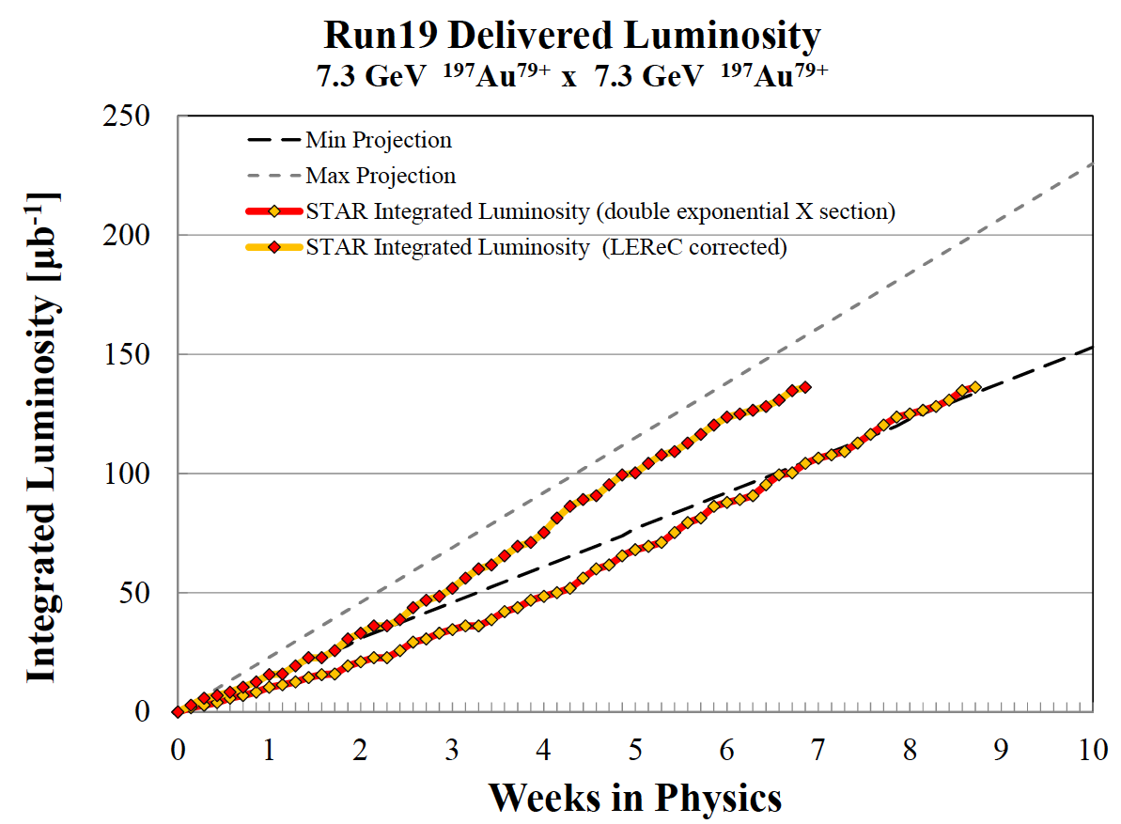
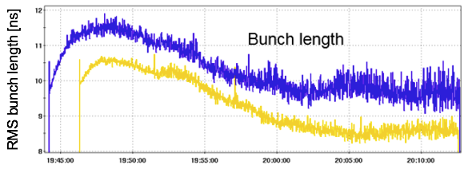
Summary
Run-19 – very successful
Met or exceeded all experimental goals, now complete: 2/5 colliding + 2/8 FXT BES-II energies
New standard for flexibility (11 modes!)
World’s 1st demonstration of cooling with RF accelerated electron beam
Run-20 – very challenging
5.75x5.75 GeV (w/o) and 4.59x4.59 GeV (w/ cooling), up to 6 FXT energies
presently project meeting only MIN event goals
need increased efficiency, and full use of electron cooling at 4.59x4.59 GeV
Upgrades
Implementation of 25+ year plan started, focus on maintaining and upgrade hadron complex (no new large performance upgrades)
Continue MPS upgrade for sPHENIX (Run-19 with relays operational)
LEReC longitudinal cooling 3.85 GeV, 111x111bunches

Slide 21
Additional material

Slide 22
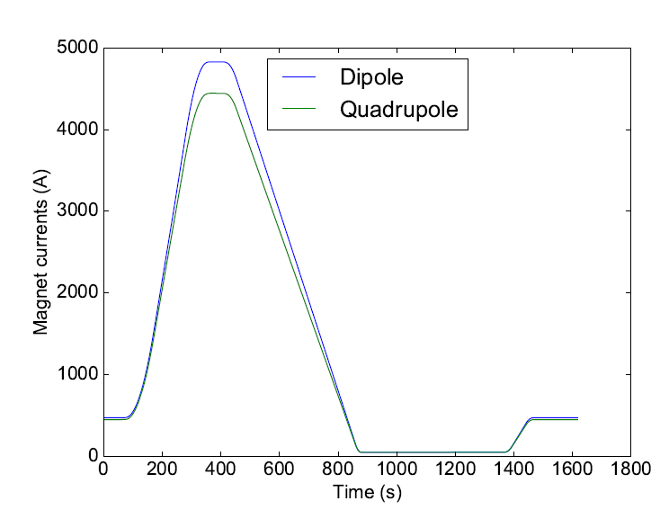
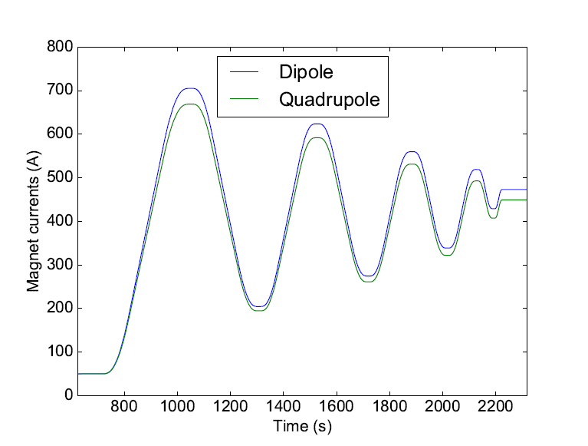
Challenge #4: persistent current in superconducting magnet
Persistent currents in superconducting magnets introduce significant field errors.
The decay of magnetic field errors causes the drifts of beam orbits, tunes and chromaticities.
from C. Liu
Regular cycle
Demagnetization cycle

Slide 23
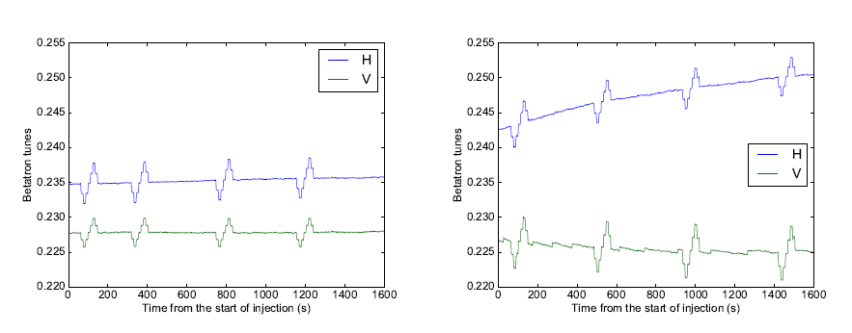
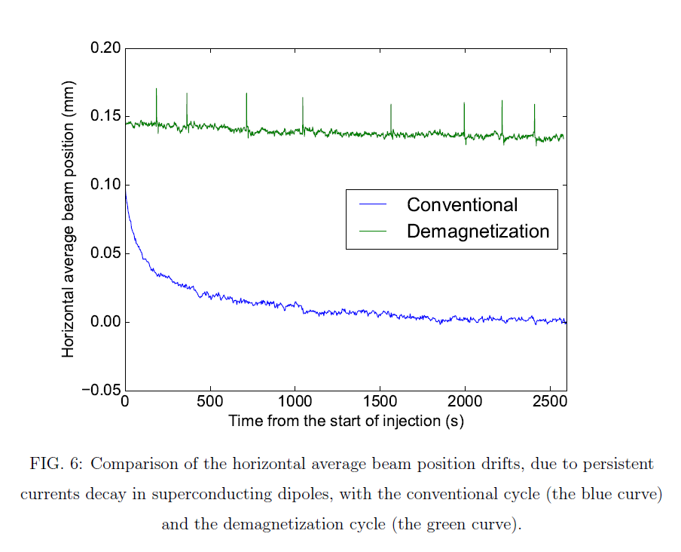
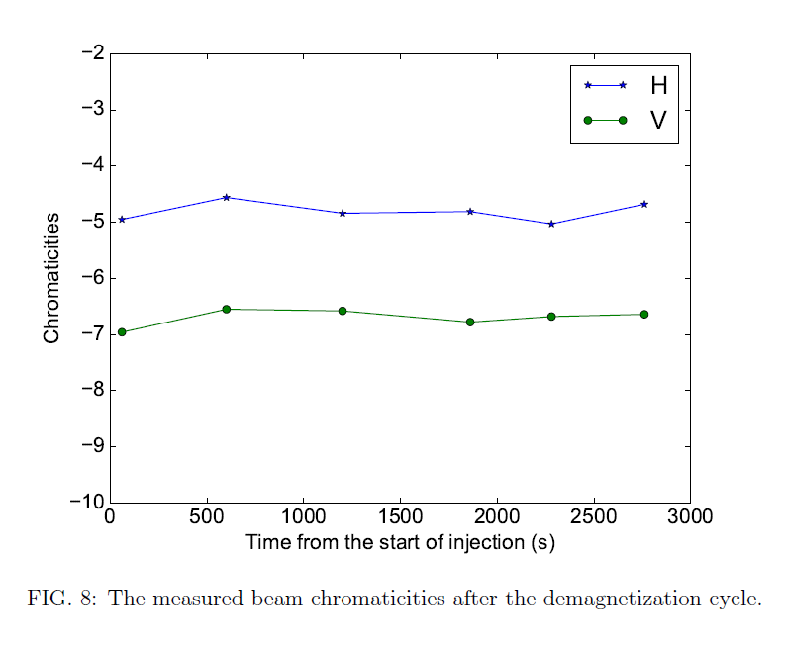
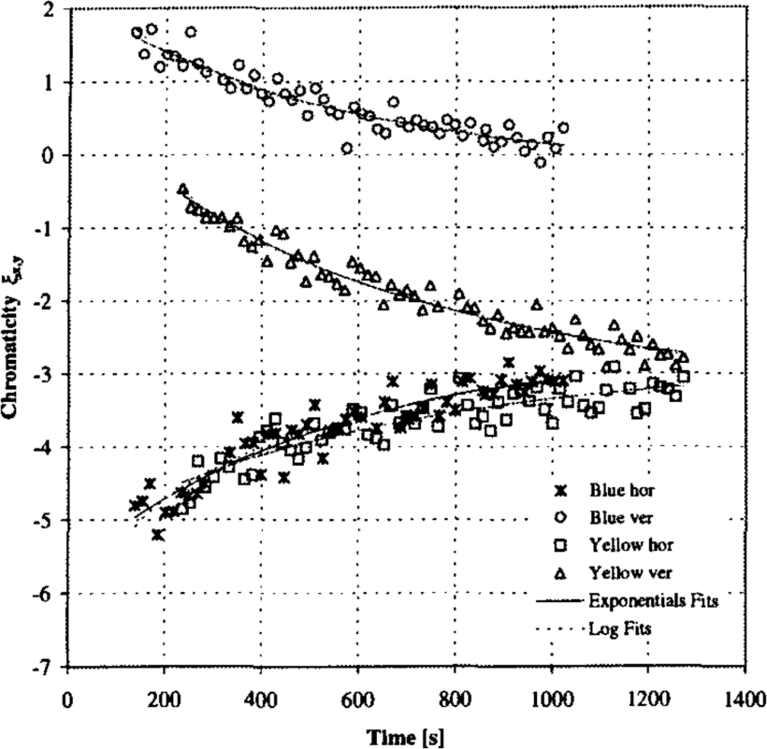
Reduction of persistent current by demagnetization cycle
from C. Liu
More stable tunes
More stable orbit
More stable chromaticity

Slide 24
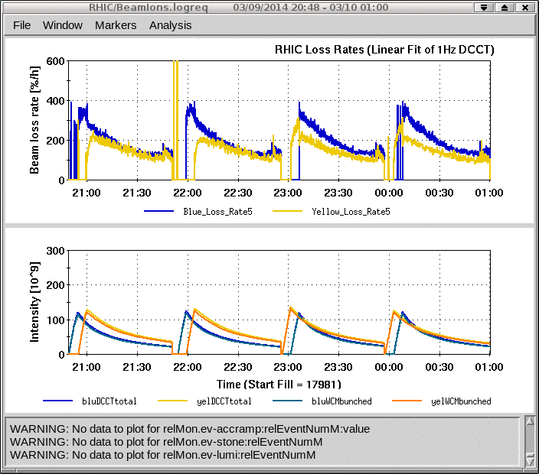
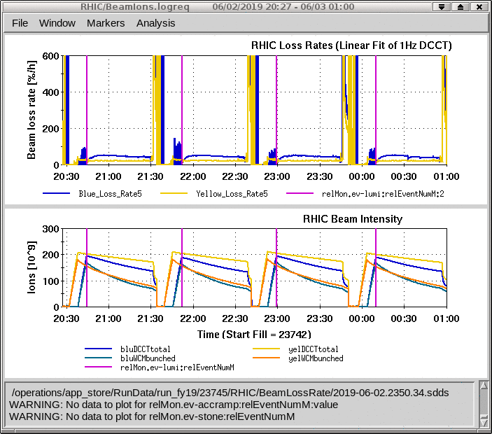
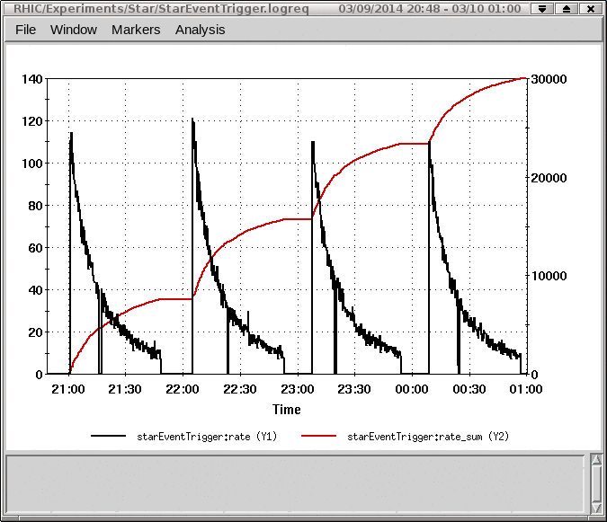
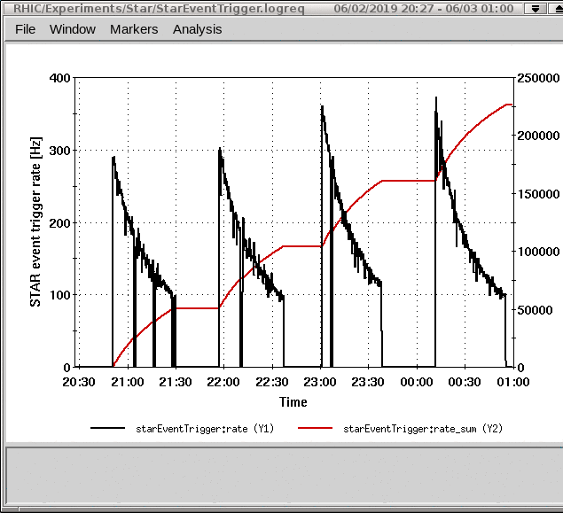
Effect of new magnetic cycle (“wiggles”), E_{b} = 7.3 GeV/nucleon
Run-14, without “wiggles” tunes <0.1, 28 MHz RF
Run-19, with “wiggles” tunes <0.1, 28 MHz RF

Slide 25
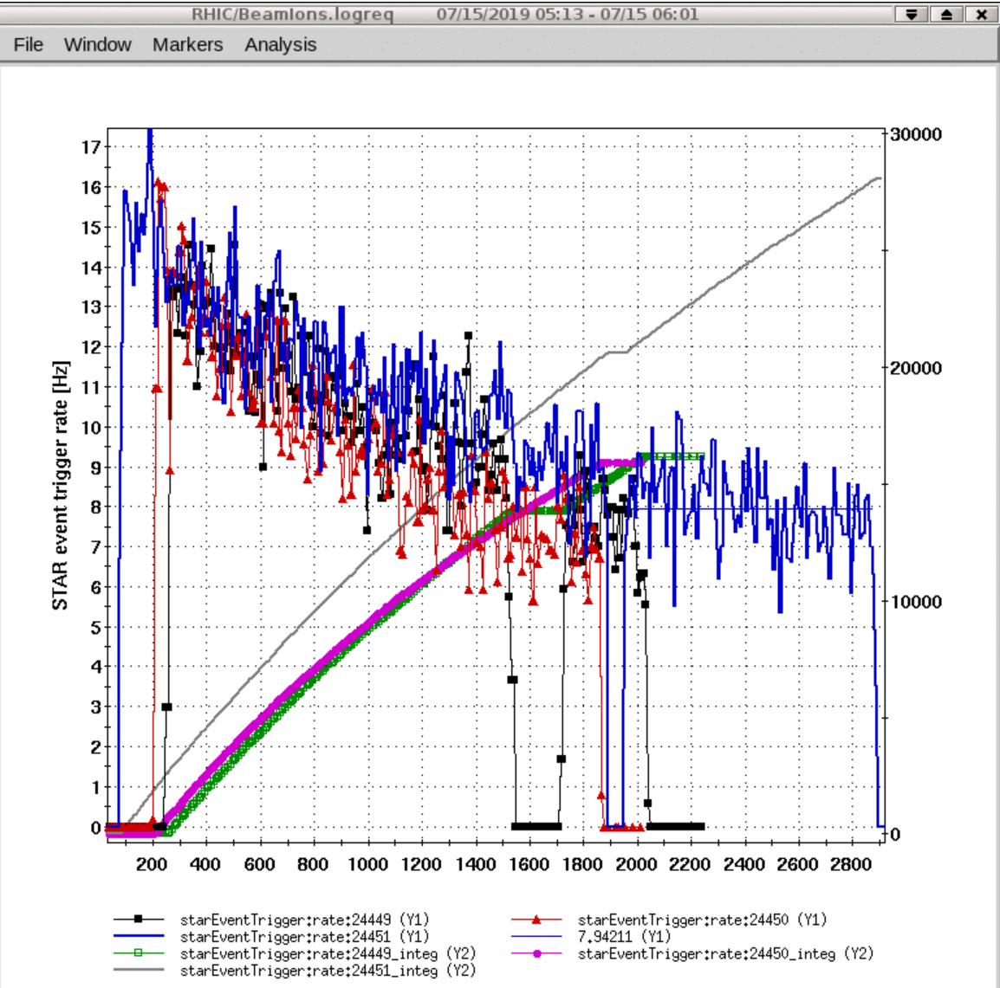
Cooling test at 4.59 GeV/nucleon
first test at 9.2GeV with cooling (not optimized yet, just a test),
we saw 10Hz average rate in cooled store. Also 20min into the store rate became constant at 8Hz which allows to have longer stores with cooling and safe time spent on refills.

Slide 26
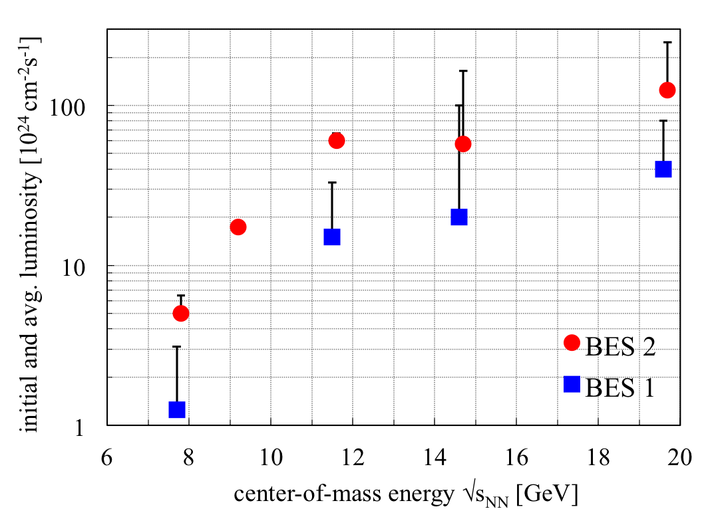
BES-II 2019/2020 BES-I and BES-II luminosities
4x increase in L_{avg} with e-cooling
3x increase in L_{avg} without e-cooling

Slide 27
LEReC Physics integration BES-II required events
RHIC Beam Energy Scan II (BES-II) for search of critical point in QCD phase diagram
center-of-mass energy √s_{NN} | GeV | 7.7 | 9.1 | 11.5 | 14.6 | 19.6
events BES-I, actual | M | 4.3 |  | 11.7 | 24 | 36
events BES-II, min goal | M | 80 | 100 | 150 | 200 | 300
events BES-II, full goal | M | 100 | 160 | 230 | 300 | 400
General strategy to maximize integrated luminosity:
Cooling at the 3(2) lowest energies (4x gain in L_{avg}), no cooling at the 2(3) highest energies (3x gain in L_{avg}) => demonstrated at √s_{NN} = 19.6 GeV in Run-16
Increase cryo-time from 22 to 28 weeks/year
Start BES-II at highest energies (machine ready w/o cooling)
Interleave cooling commissioning with physics operation
Finish BES-II at lowest energies (largest gain in L_{avg} and time)
Notes:
STAR vertex acceptance: +- 1m
STAR contacts: Zhangbu Xu (spokesperson), Bill Christie, Paul Soerensen, Daniel Cebra

