Slide 1
Injectors Performance for Run-19 and Preparation for Run-20
H. Huang, C. Gardner, V. Schoefer, K. Zeno
July 31, 2019
RHIC Retreat 2019

Slide 2
Injector Setup with Au
Injector setup started on Feb. 1st, 2 weeks before RHIC setup started.
Westinghouse was used for the whole run due to maintenance of Siemens.
L20 and F6 slow feedbacks worked very well. There is no need to adjust them constantly anymore.
On May 7, about half way through the 7.3 GeV run, the RF harmonic used for the AGS ramp was changed from h=12 to h=10 to fit more of the merged bunches into the main buckets used for acceleration. The percentage of beam spilled into neighboring buckets is reduced. RHIC intensity is also higher by ~8%.
Setup has been done for four energies with beam from EBIS source: 9.8 GeV(6->1), 7.3 GeV(6->1) , 3.85 GeV(1->1, 2->1, 3->1 and 6-1), 4.59GeV (2->1 and 3->1); for two energies with beam from Tandem: 9.8GeV (2->1), 3.85GeV( 1->1).
For next run, it is likely we need to have setup at all energies for fixed target and collision experiments: 5.75GeV, 4.59GeV, 3.85GeV, 7.3GeV, and 9.8GeV. The last three are for LEHeC and fixed target program and intensity requirement is not an issue. The first two are for collider physics program and we need to figure out how to reach the desired beam parameters.

Slide 3
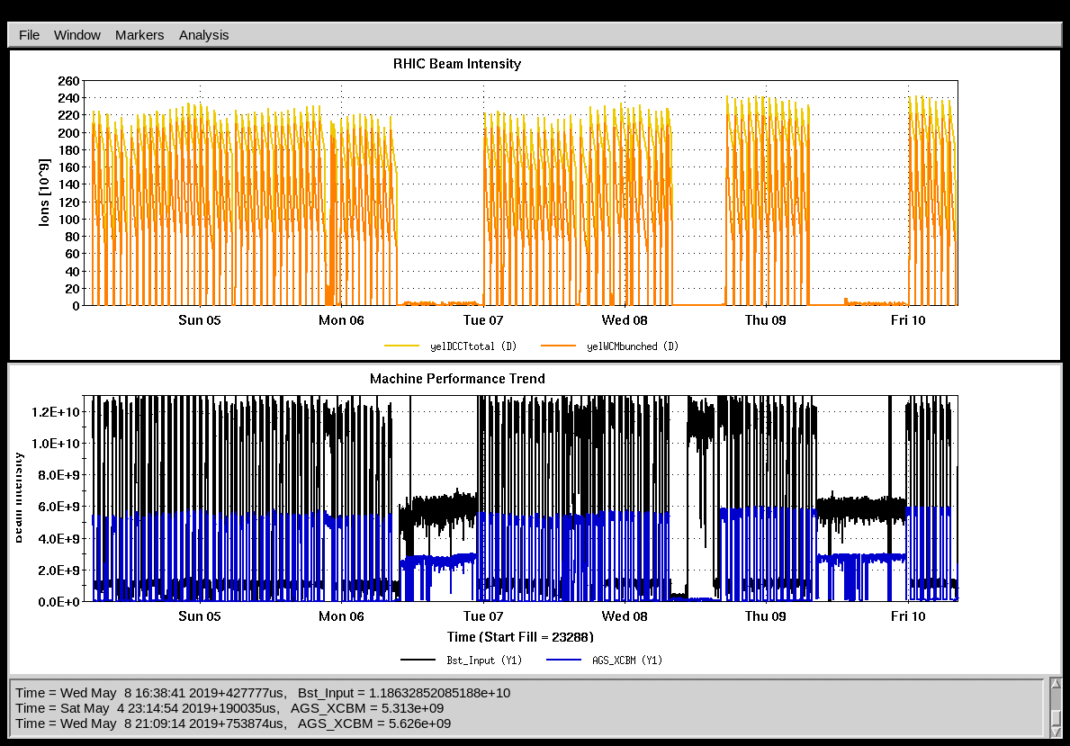
Neighboring Bunch Percentage after AGS RF Change
Change to h=10
Phase further adjusted
4%
Booster input
Neighboring Bunch Percentage
AGS intensity at extraction
2%
Booster input
AGS intensity at extraction

Slide 4
Injector Operation Issues
AGS G9 tripped many times early on. Adding filters reduced permit input noise. Eventually it was removed from the permit system.
A pair of AtR BPMs were found in wrong polarity. It is suspected that they have been that way for a long time…….
AGS MM function app was modified to prevent loading Siemens function into Westinghouse( hard coded for Westinghouse). A new version to detect which motor generator is in use has been released after the run was over.
The AGS injection field was not stable for awhile. It was fixed by reducing the down ramp speed.
In July, Booster RF cavity was switched to E6 as A6 stopped working. The bunch intensity was lower by a little less than 10%.
The frequent D5 vacuum spikes caught our attention. It started more frequently in June. It was not due to gas leak of the D5 eIPM system. Then it was found that it related to A5 kicker timing tuning or RF off at injection. Both horizontal and vertical local bumps around D5 were added on July 5. Vacuum spike disappeared afterwards.

Slide 5
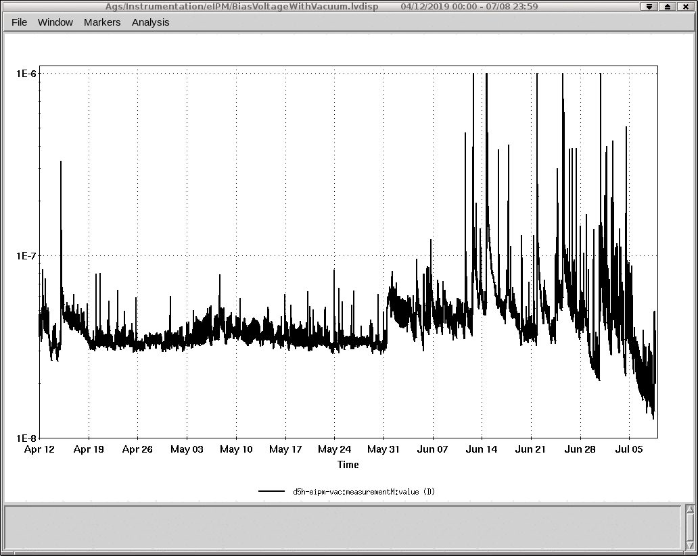
D5 Vacuum Level over Last Three Months
Bumps added
After the vertical and horizontal bumps during injection were added on July 5, the vacuum level went down.
3.85GeV run

Slide 6
Oxygen Setup in the Booster
O⁺⁵ and O⁺⁶ from EBIS: The EBIS output is close to what was estimated before: O⁺⁵ at 2.24e9/pulse, O⁺⁶ at 2.37e9/pulse (estimation was 2.4e9/pulse). The efficiency in the Booster is lower than the estimated 70%, they are 58% and 52% respectively for O⁺⁵ and O⁺⁶. Given just a few hours tuning for each, these numbers are not bad.
O⁺⁵ from tandem: With 63e9 input, the Booster late is 32e9 for 500us pulse length out of tandem. Given the AGS transmission efficiency over 80%, the AGS intensity is going to be much more than the RHIC bunch intensity limit 15e9. There is no need for bunch merge in the AGS.
Tandem will be used for oxygen operation.

Slide 7
AtR Improvements for Low Energy
U and early W line losses were noted as an intensity bottleneck (soil activation limits) in Run 10
‘Invisible’ orbit excursions between BPMs driven by survey errors and energy mismatch between beam and arcs
Realignment of U-Line quads
Addition of W line BPM: allows setting arc/trim steering separately for true flat trajectory
Loss pattern now dominated by the stripping loss, soil sample activation at previous limiting locations is lower than detectable
AtR ORM measurement
Polarity reversals in 4 BPM planes and 2 trim power supplies (mostly ancient mistakes)
Model agreement otherwise extremely good
Optics
Error dominated mostly by launch conditions. Empirical tuning of tune/chrom in the AGS at extraction time highly effective at minimizing loss
Camera upgrades (to GigE) for some AtR cameras rad hard test done. Ready for beam test?
Long bunches for low energy 9 MHz operation
Extended flattop on the G10 pulse
RHIC Injection efficiency
Optics adjustments at aperture restrictions (dump area)
Kicker resistor (pulse shape change).
Run 19 injection efficiency was 85-95% (contrast to 70-75% in Run 10)
Still have to assess how much is due to kicker change
Short stores and many (many) setups made it hard to systematically measure contribution of each individual change to ‘bottom line’

Slide 8
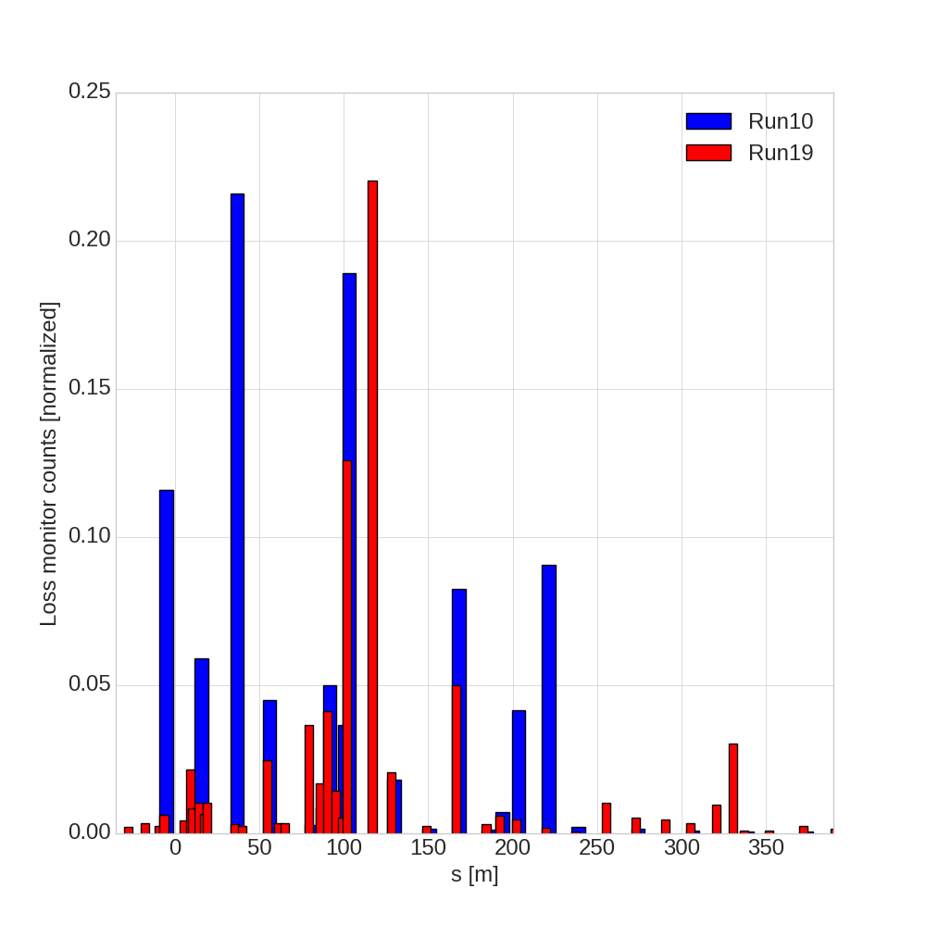
AtR Improvements for Low Energy
Loss pattern much improved BUT total loss not that different
U line loss still ~5%
W line loss now ~2% (down from 5% in Run10)
Expected stripping loss is ~2%
Soil samples for 3.85 GeV/N still out for testing, but given the 7.3 GeV/N measurements and review of the U-line shielding layout, a long 3.85 GeV/N run looks good with reasonable monitoring requirements
Recommend reviewing the alarm situation: switch from shot-to-shot alarms to hourly total limits (a la BLAM)
U/W Line Loss Patterns: 3.85 GeV/N
Au78
WD1
WP1/WD4
WP2

Slide 9
Injector Wish List
New Intensity scalers, and current transformer normalization hardware for AGS and Booster
The old hardware is unreliable.
The baseline for both the Booster and AGS transformers used for the scalers drifts. Presently, the baseline offset is adjusted locally by someone from the instrumentation group for one time in the cycle while MCR provides feedback over the phone.
The AGS transformer calibration is not stable.
A less noisy Booster input scaler for EBIS. As the signal on the scope is not as noisy, why can’t the integral of it used for Booster input be less noisy? Also, the (average) baseline for this integral drifts all the time.

Slide 10
Injector Wish List (continued)
The loss monitor window timing in the Booster loss monitor program does not work properly and the graphical display is not user friendly. A graphical display similar to the AGS counterpart would be fine. This is needed for proton operation due to heavy scraping.
Window timing and threshold settings in the AGS loss monitor program cannot be loaded from one user into any other user (active or inactive) reliably. Also, the way window timing and thresholds are set is cumbersome and unreliable (the manager often gets hung up and needs to be restarted).
A practical and reliable way to look at the AGS losses with the loss monitors in high gain.
A fast Booster wall current monitor signal available in MCR through the mux.
More ‘fast’ scopes and/or more ‘fast’ signals available on the ‘slow’ scopes. For example, have versions of the AGS and Booster wall current monitors, the kickers (F3, A5. and G10), and the HEBT xfmr (hebt.pp_xfmr) available on the ‘slow’ scopes.
A Booster rev tick or h=1 Rf drive type signal available through the mux.

Slide 11
BES-II Ion Beam Parameters
Beam Energy, GeV/n | 3.85 | 4.59 | 5.75 | 5.75 | 7.3 | 9.8
Lorentz Factor γ | 4.1 | 5 | 6.1 | 6.1 | 7.8 | 10.5
Ion Intensity, E9 | 0.6 0.8 | 0.9 | 1.3 1.35 | 1.3 1.35 | 2.1 | 2.3
AGS Intensity, E9 | 0.95 | 1.1 | 1.5 | 1.45 | 2.3 | 2.5
RF 9 MHz, kV | 160 | 160 | 160
RF 28 MHz, kV |  |  |  | 400 | 400 | 400
A_s, eV-s | 0.65 | 0.85 | 1.22 | 0.37 | 0.54 | 0.89
S_95%, eV-s¹ | 0.3 | 0.27 | 0.5 | 0.3 | 0.3 | 0.4
Full Bunch Length, ns | 55 | 55 | 50 |  | 21 | 18
¹ 95% Long. Emit. =6*rms Long. Emit.
Plan: use 9MHz for the lowest two energies. Use 28MHz for 5.75GeV.
At 5.75GeV, with 28MHz, the injection kicker pulse width is not an issue, but the bucket area is small (0.37eVs) and fitting into this bucket is a challenge.

Slide 12
AGS Late Intensities and Long. Emit.
Energy | Merge | Date | Long. Emit.¹ (eV*s/n) | Bunch Intensity | Notes
3.85 GeV | None | 4/1 | 0.14 | 0.48e9 | 6 bunches
 | 2-1 | 5/6 | 0.25 | 0.92e9 | 3 bunches
 | 2-1 | 6/12 | 0.26 | 0.95e9 | 6 bunches
 | 3-1 | 6/6 | 0.37 | 1.45e9 | 3 bunches
 | 6-1 | 5/15 | 0.61 | 2.37e9 | 2 bunches
 | 6-1 | 5/15 | 0.28 | 1.18e9 | 2 bunches, squeeze relaxed
4.59 GeV | 2-1 | 7/2 | 0.27 | 0.95e9 | 6 bunches
 | 3-1 | 7/3 | 0.41 | 1.46e9 | 3 bunches
7.30 GeV | 6-1 | 5/7 | 0.69 | 2.50e9 | 2 bunches, h=10
 | 6-1 | 4/24 | 0.55 | 2.19e9 | 2 bunches, squeeze relaxed
9.80 GeV | 6-1 | 7/8 | 0.80 | 2.66e9 | 2 bunches
 | 6-1 | 3/13 | 0.55 | 2.0e9 | 2 bunches, squeeze relaxed
Tandem
3.85 GeV | None | 3/19 | 0.15 | 1.0e9 | 3 bunches (could be up to 6)
9.80 GeV | 2-1 | 2/27 | 0.42 | 2.18e9 | 1 bunch (could be up to 3)
 | 2-1 | 3/7 | 0.38 | 1.96e9
¹ 95% Long. Emit. =6*rms Long. Emit.

Slide 13
AGS Setup Options for 4.59 GeV (0.9E9/0.27eV-s)
Energy | Merge | Date | Long. Emit.¹ (eV*s/n) | Bunch Intensity | Notes
3.85 GeV | 6-1 | 5/15 | 0.28 | 1.18e9 | 2 bunches, squeeze relaxed
4.59 GeV | 2-1 | 7/2 | 0.27 | 0.95e9 | 6 bunches
 | 3-1 | 7/3 | 0.41 | 1.46e9 | 3 bunches (possible 4)
9.8 GeV | 6-1 | 3/13 | 0.55 | 2.0e9 | 2 bunches, squeeze relaxed
Tandem
3.85 GeV | None | 3/19 | 0.15 | 1.0e9 | 3 bunches (could be up to 6)
9.80 GeV | 2-1 | 2/27 | 0.42 | 2.18e9 | 1 bunch (could be up to 3)
 | 2-1 | 3/7 | 0.38 | 1.96e9
¹ 95% Long. Emit. =6*rms Long. Emit.
Need 1.05-1.1e9 at AGS.
2-1 merge with increased EBIS output(about 15% more: 13.5e9->15.5e9. 10-15% is possible according to Deepak), we may reach 1.1e9 and 0.3eVs.
3-1 merge: the emittance could be reduced by relaxing the squeeze at the expense of intensity but it is unclear if it is enough to provide 0.27eVs while the intensity requirement would still be met.
6-1 merge will provide the required intensity and emit, but longer filling time.
Using tandem with 2-1 merge, the road to 1.1e9 and 0.3eVs is easier.
Even though the bunch intensity using Tandem without a merge was slightly lower than the requirement (1.0 vs. 1.1e9), there was little time spent optimizing the setup. Given more time, there is a good chance the intensity could be increased enough to satisfy it.

Slide 14
AGS Setup Options for 5.75 GeV (1.35E9/0.3eV-s)
Energy | Merge | Date | Long. Emit.¹ (eV*s/n) | Bunch Intensity | Notes
4.59 GeV | 2-1 | 7/2 | 0.27 | 0.95e9 | 6 bunches
 | 3-1 | 7/3 | 0.41 | 1.46e9 | 3 bunches
7.30 GeV | 6-1 | 4/24 | 0.55 | 2.19e9 | 2 bunches, squeeze relaxed
5.75 GeV | 6-1¹ | 2018 | 0.41 | 1.7e9 | 2 bunches, squeeze relaxed
9.8 GeV | 6-1 | 3/13 | 0.55 | 2.0e9 | 2 bunches, squeeze relaxed
Tandem
3.85 GeV | None | 3/19 | 0.15 | 1.0e9 | 3 bunches (could be up to 6)
9.80 GeV | 2-1 | 2/27 | 0.42 | 2.18e9 | 1 bunch (could be up to 3)
 | 2-1 | 3/7 | 0.38 | 1.96e9
¹ 95% Long. Emit. =6*rms Long. Emit.
Need 1.45-1.5e9 at AGS.
6-1 merge with further squeeze relaxing 15% more from EBIS, we may reach 1.45e9 and 0.3eVs, but need to be confirmed.
3-1 merge can not meet both parameters even with 15% more intensity.
Using tandem with 2-1 merge, the road to 1.45e9 and 0.3eVs seems easier. The filling to RHIC will be 3 bunches/super cycle. The bunch number limit comes from PPMR limit. We may be able to increase this to 4 with extension of Booster magnet cycle.

Slide 15
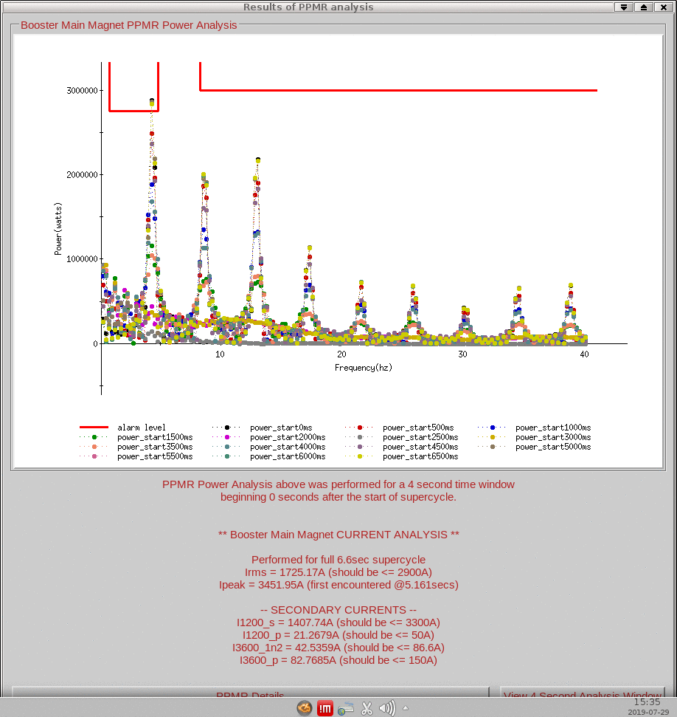
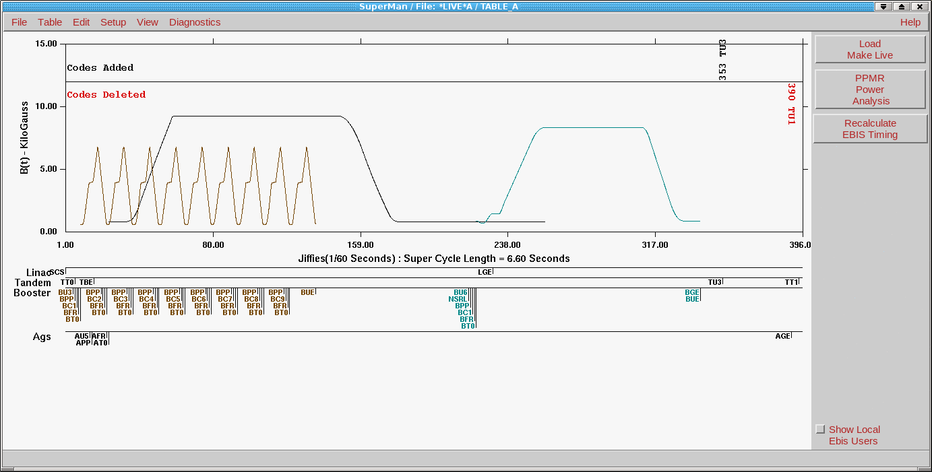
Booster MM Power Supply Upgrade ?
We can not run more than 8 current tandem cycles due to the PPMR limit set by LIPA. The Booster operation also generates noises visible in RHIC. Maybe it is time to upgrade the Booster MM power supply to a capacitor bank system similar to CERN’s PS?
PPMR limit
9 Booster cycles for tandem beam

Slide 16
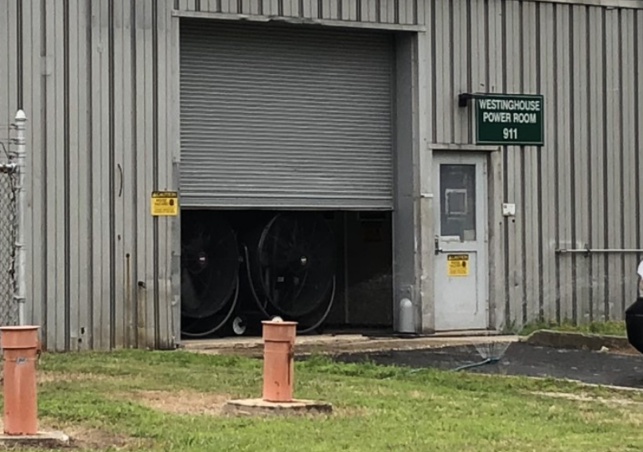
Can We Upgrade the Cooling System?
Westinghouse was cooled in last a few weeks as shown. If AC is too expensive, some upgrade of the system probably can be done. A more important one probably is Siemens.
Fans
Sprinklers

Slide 17
Summary
The frequent fills for BES II run are challenging and the two top energies are done.
A brief test with oxygen beam in the Booster showed that we could reach the required intensity easily with tandem beam.
For 7.3GeV, the RF harmonic on the AGS ramp was lowered from h=12 to 10, so that the bucket area can be larger and more beam can be put in. The percentage of beam in neighboring buckets is reduced. RHIC total intensity is higher by ~8%.
For the coming run, we need to run at all five energies, but our focus is on 4.59GeV and 5.75GeV. Next year, EBIS upgrade is not ready to deliver 40-50% more intensity yet, which make the next year a very challenging year to reach the desired intensity and emittance.
For 4.59 GeV, the desired beam parameters can be reached with 2-1 merge with 15% more EBIS output, but this is not certain.
For 5.75 GeV, the desired beam parameters may be reached with 6-1 merge and relaxed squeeze for 15% more EBIS output.
Using Tandem beam for 5.75GeV can give us faster filling time (3 bunches/cycle, maybe 4) and smaller longitudinal emittance for next run. If EBIS can not provide 15% more intensity, then tandem for 4.75GeV without merge is also a better option.
Bottomline: with the modest intensity requirements, smaller longitudinal emittance beam from tandem is very attractive for coming year’s operation.

Slide 18
Backup Slides

