Slide 1

A View From Operations
RHIC Retreat 2019

Slide 2
First Order
An improvement over the last low-energy run.
Kudos to the run coordinator: Chuyu.
Setup....some say it's still ongoing.
Hats off to our Setup Squad: trav, vhs, Al, kjm, gmarr, and grd.
Given the parameters for this run, there was a heavy workload on Operations.
Operator fatigue --- This was a real issue that was brought up by multiple people.
Operations was fully staffed.
Going forward it's essential to remain fully staffed.

Slide 3
Quick Hits
New 9 MHz cavities worked well and the overall instructions and configurations were clear.
Orbit Control this run (the resolution of the dipole corrector power supplies for RHIC were upgraded from 12 to 16 bits). This helped out immensely with the Fixed Target runs.
Feedbacks for L20 and F6 were well behaved (less drift than in previous runs).
The overall switching between energies was done quickly given the different configurations and the ongoing setup switches.
Redhat: KDE?????? (Gnome)

Slide 4
Contact During Off Hours / Pump Room
Certain call in lists have stale numbers on them.
Voicemail is either not setup or the contact's inbox is full. This exists for enough people, whereby one wonders if this is not intentional.
Specific System call in lists have people unfamiliar with that specific system and are nonplussed when contacted.
Pump Room: There exists a call in list where only the last two people ever answer/come in during off-hours (a thank you goes out to JT. Benante, and K. Kobasiuk).
Reiteration: Why is there a call in list at all if it is impossible to get a hold of the majority of the group.
Pump Room: This exact gripe has been a perpetual issue (e.g. the Operations talk from FY'17).

Slide 5
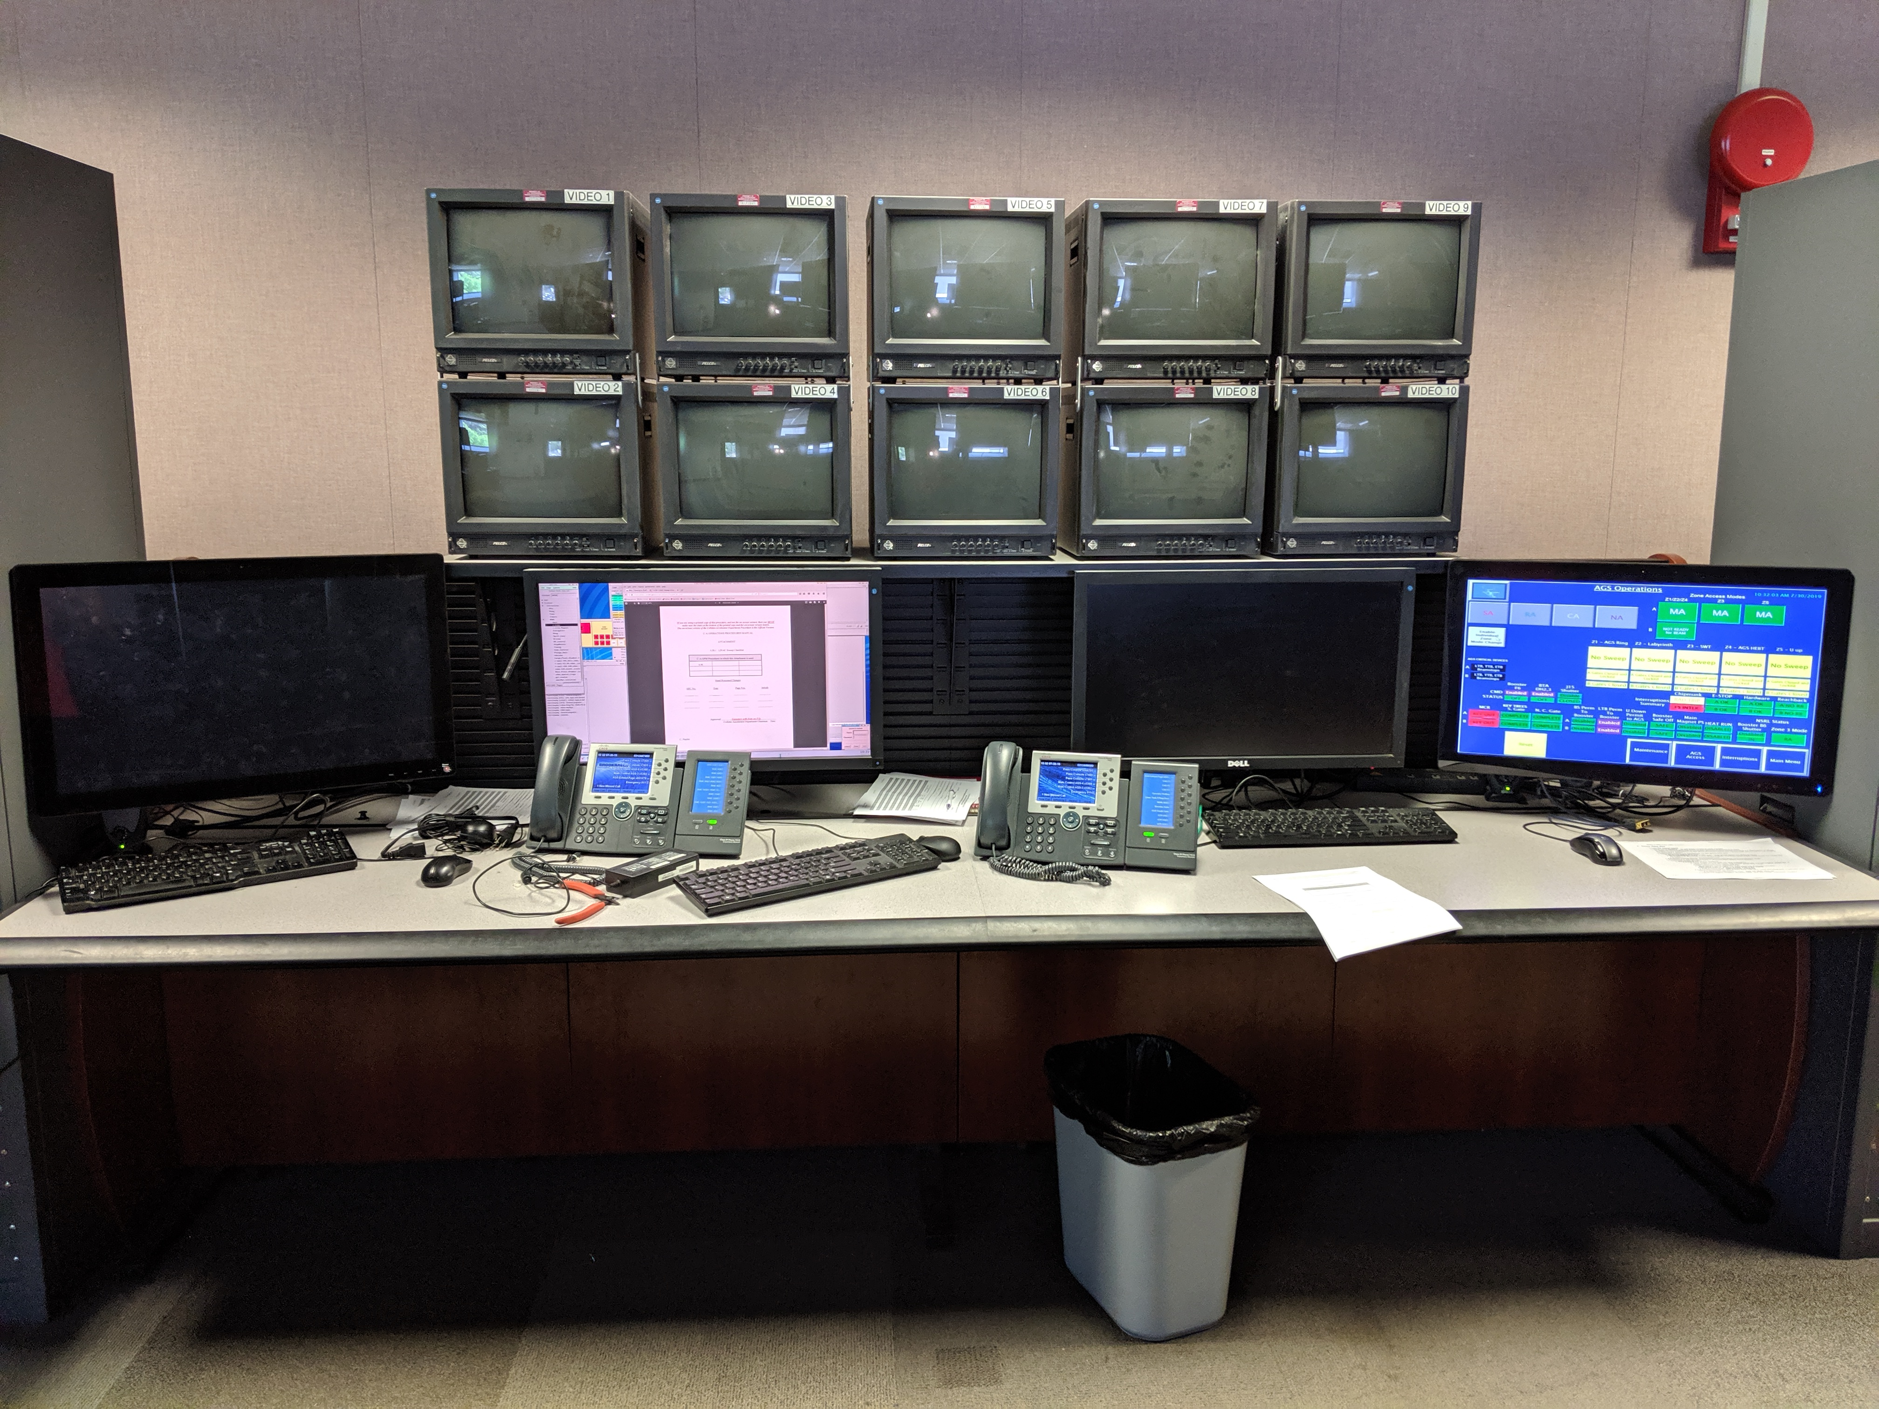
Access Controls
Sector 2 access.......
There are still concerns with how the PASS system functions for sector 2 as opposed to other RHIC zones.
One of the primary gripes: The lack of CA keys for the zone. This limitation makes it very difficult to preserve a sweep by keeping the area under CA.
On the topic of preserving sweeps....Sector 2's exterior and interior gates were the cause of numerous lost sweeps.
Overall physical PASS setup in the MCR needs to be considered.

Slide 6
F&O and A/C Issues
We need to look at how we are doing business when it comes to repairs and replacements.
There were multiple known issues where the response to the problem was, "parts are on order" for months without resolution.
This involved many cooling and A/C issues, which lead to down time and sub-optimal work arounds.
On more than one occasion, P. Sampson had to be contacted because the issue at hand was not going to be addressed in a timely manner.
If we are going to continue to work into mid-July, changes need to be made.

Slide 7
EBIS
Thumbs up for EBIS always having a few personnel available at all hours to sort through problems.
However, the frequency with which EBIS had to be contacted was quite high. This leads to two points:
1. Cross training with EBIS personnel to have a template for what Operations can and cannot reset.
  Tools in general that we can utilize to try and resolve a problem before calling off hours.
2. Does EBIS need some more dedicated time for development?

Slide 8
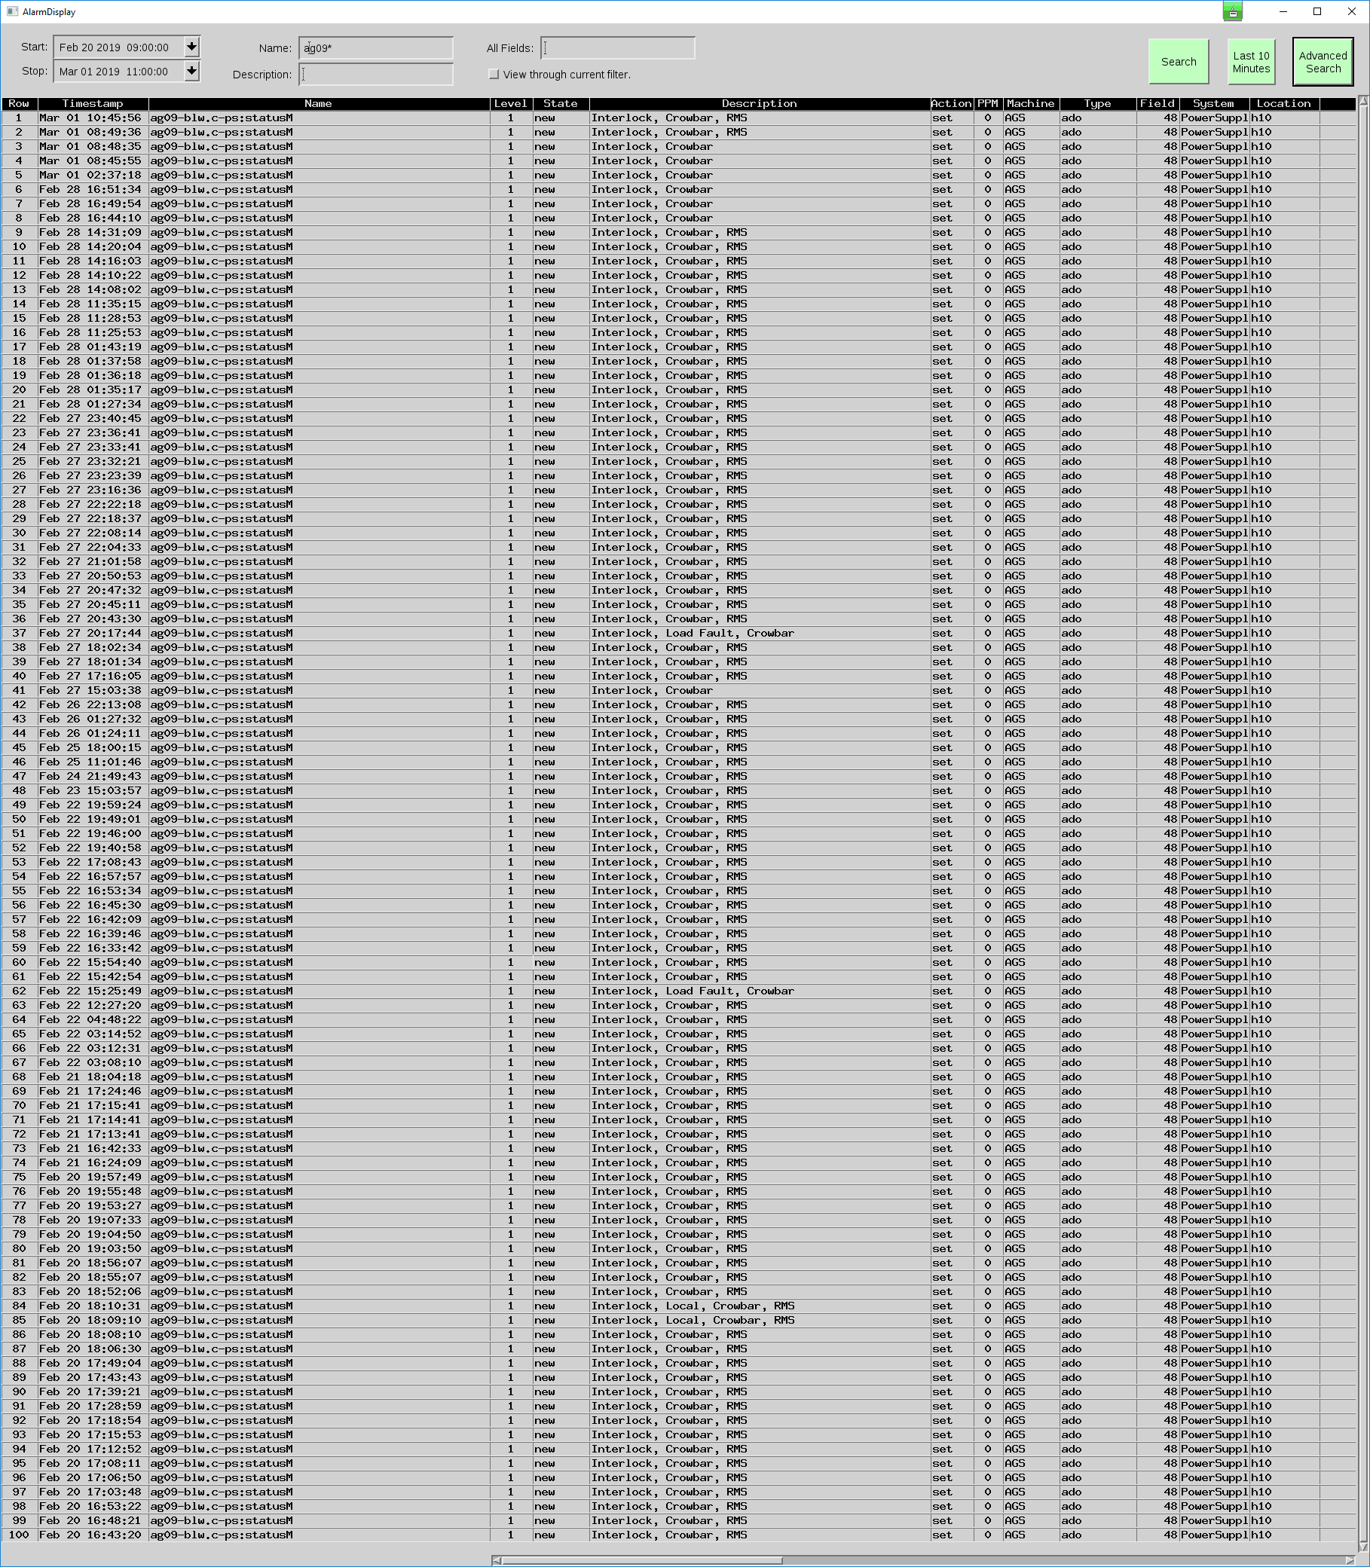
Pulsed Power:
Pictured on the right are the AGS g09 blw trips only (not the clears), so each line is an actual interruption to the program over a ten day period.
This accounted for almost 30 hours of failure.
Troubleshooting was problematic – the 'black box' that was part of the manufacturer supplied power supply was reporting an RMS fault. Machine Specialists iterated the point multiple times that this made zero sense based off when it would trip.
PP personnel reported to MCR that it was 'fixed' on multiple occasions after lowering its setpoint. However, extraction would not occur correctly at this setpoint.
PP also reported that it was 'fixed' after changing the start/stop times. However, the AGS permit would pull in this configuration with beam.

Slide 9
Pulsed Power cont.
AGS g09 blw: Ultimately, it was found that the permit pulls which were supposed to inhibit the supplies (legacy from g-2 days) were causing the fault box to trip and spit out RMS faults instead of inhibit. This feature was subsequently bypassed.
AGS h11 blw: 15 hours of severe failure, both IGBT and its drive boards were replaced. This required consultation with APS (the power supply manufacturer).
There is no plan to change the AGS extraction configuration. Given that the extraction bump power supplies were sourced from an outside manufacturer, which has complicated troubleshooting, would it be beneficial to build our own blw power supplies? This would give us full documentation and perhaps aid the program as a whole.

Slide 10
Communication/Documentation
Annual pervasive topic, but was especially poor this year.
Ever changing demands, but how these were communicated was scatter shot.
The machines were constantly changing (lattice, tune space, etc.) and the documentation of this was atrocious.
Fragmentation in how we communicate the current state of the machine/setup. Everyone has their own preferences (e-mail, phone, e-log,…....).

Slide 11
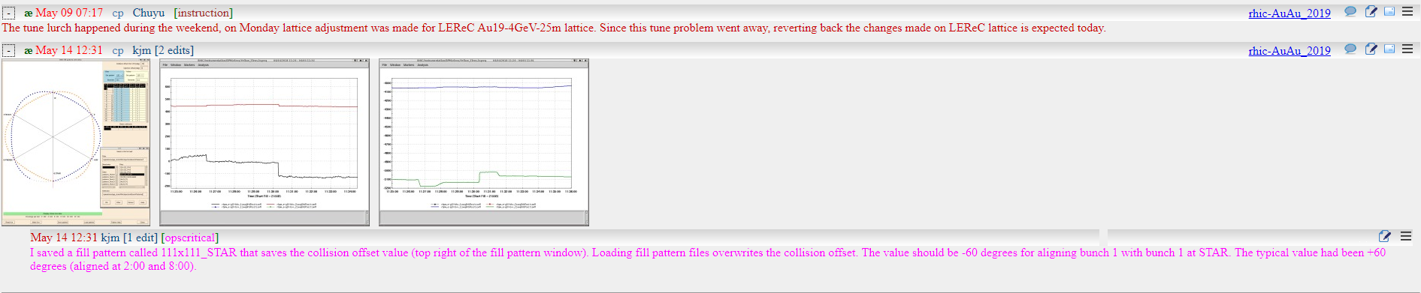
Communication/Documentation
It's essential that operators know "where we are" and "where we are going." To do this, there needs to be at least one central hub for how things get communicated (tools exist, but are not universally used).
E-log: opscritical and instruction tags***
STAR: There was a constant struggle to get their goals clearly defined so as to accommodate them.
STAR: Training? On multiple occasions STAR personnel would call with contradicting instructions/questions (this was an ongoing issue throughout the run).

Slide 12
LEReC
Cooling....Congratulations on the achievement.
Looking forward---There was a push for closer collaboration between Operations and LEReC. This still needs some work.
Having a better understanding of LEReC's needs in advance. Not every demand/desire is trivial to accomplish.
With that said, LEReC needs to understand the complexity of RHIC more. Mode switching and setup changes become smooth with repetition, but when we are constantly changing configurations our efficiency goes down.
With a better road map, Operations can be better prepared to immediately provide desired machine states for LEReC.
LEReC physical MCR location is an issue.

Slide 13
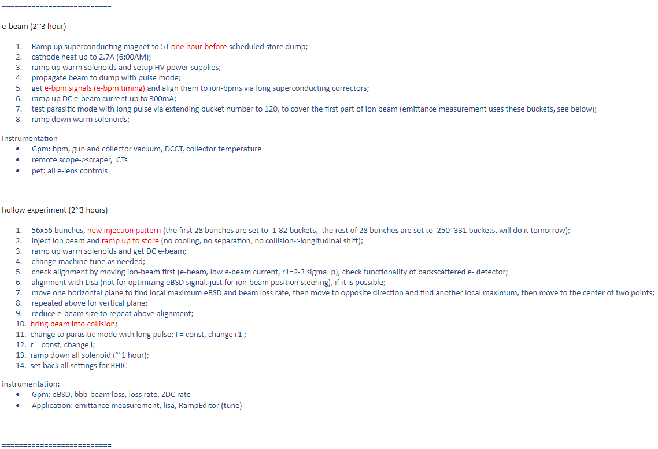
APEX and Injection Kickers
APEX----universally the question was asked of why this was held off to the end of the run.
A better outline of APEX goals and needs prior to the day of is necessary going forward (this will help us help you). For example, pictured to the right is an outline from FY'18.
Vincent's APEX showed that anything under 28 kV is directly scraping beam. This speaks nothing to the actual pulse shape and rise time at this voltage that makes for poor injected beam and likely polarization loss. Injection kickers are just way behind. Now is the time to plan ahead.

Slide 14
End of the Run.....
"This is the way the [run] ends, not with a bang but a whimper." ~ T.S. Eliot
From multiple sources: There was a general apathy within C-AD in regards to the last week and ramping in general.
This brings up the known benefit of establishing all setups at the outset of the run. This was not done in this instance...
100 GeV...It's a poor tactic to have the hardest and most complex configuration saved for last.
This is especially apropos given that the nominal configurations to accomplish the 100 GeV setup were not available (no landaus, no rebucketing, 2 mrad crossing angle, etc.).
Prefires.....
Summer months failure uptick posits the question of starting earlier in the fiscal year.

Slide 15
Alarms
The alarm system in MCR is improving, but even with increased Operator usage it remains insufficient for its intended use:
  Clear while C-A complex is running well.
  (Accurate) Warnings for leading indicators of impending failure.
  Direction towards swift resolution of failures.
Some remediation has taken place to remove alarms that were of no consequence to Operations.
Alarm filters were produced to stack any number of changing conditions where alarms were not needed, on a temporary basis.
Alarm suppression eliminated screen clutter from cases where parameters were not needed at all.
The daily hit of repetitive alarms (example, at right) is smaller, but by and large continues a glut of useless information overpowering the useful.
Alarm suppression is in lieu of remediation. It does not absolve system experts of the work they need to do on their end.
Volume is down but the sheer numbers still exceed Operators’ abilities.

Slide 16
Alarms
 | FY 2017 | FY 2018 | FY2019 (to date)
Total Parameters in Controls System | 1,936,203 | 2,093,946 | 2,161,941
Total alarm DB entries | 7,312,432 | 5,849,316 | 3,219,122
Total alarms set as new | 3,766,735 | 3,052,278 | 1,620,893
Total distinct parameters which alarmed | 27,112 | 25,317 | 19,073
Total operator actions on alarms | 18,404 | 19,821 | 39,072

Slide 17
Individuals
Recep Kuruka
Vincent Schoefer
Angelika Drees
Keith Zeno
Al Marusic
Kevin Mernick
CAS
These individuals were always available and provided countless hours of aid and instruction.

Slide 18
Singular Points of Failure
A common tune....
Still too many "mandatory" people that need to be called off-hours for things Operations should have more knowledge/control of (Al, Angelika, Keith, etc.).
A two way street: Operations can do more, but at the same time needs to work with and learn from these SPOF (and they need to be willing cede some control).
We want to help

Slide 19
The End
Discussion

