Slide 1
areaDetector Data Compression I
Mark Rivers (CARS/Univ. of Chicago)
Bruno Martins (FRIB/MSU)
Marty Kraimer (APS/ANL)

Slide 2
Data Compression Motivation
We are already in the era of “big data” with existing detectors. Eiger, Pilatus, Lambda, PCO, FLIR/Point Grey, Xspress 3, etc.
Can all produce data faster than most disk systems can handle
All exceed 1 Gbit network capacity, and some exceed 10 Gbit.
Rapidly fill up disks
Will become a more serious issue with coming upgrades
Increased count rates will allow existing detectors to run at their maximum speed
New generations of even faster detectors will be coming
Data compression can help with these issues
Must be fast and easy to use

Slide 3
Support for Compressed NDArrays
NDArray has 2 new fields to support compression
.codec field (struct Codec_t) to describe the compressor
typedef enum {
NDCODEC_NONE,
NDCODEC_JPEG,
NDCODEC_BLOSC,
NDCODEC_LZ4,
NDCODEC_BSLZ4
} NDCodecCompressor_t;
typedef struct Codec_t {
std::string name; /**< Name of the codec */
int level; /**< Compression level. */
int shuffle; /**< Shuffle type. */
int compressor; /**< Compressor type */
.compressedSize (size_t) field with compressed size if codec.name is not empty.

Slide 4
Support for Compressed NTNDArrays
pvAccess NTNDArray has always had .compressedSize and .codec fields, but never previously implemented in servers or clients
NDPluginPva now converts compressed NDArrays into compressed NTNDArrays
Compressed NTNDArrays received with pvAccess can be decompressed with NDPluginCodec or with other clients.

Slide 5
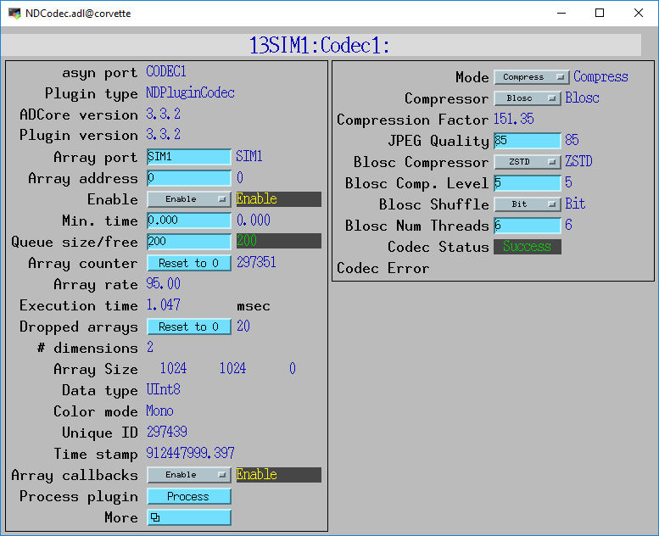
NDPluginCodec
New plugin for data compression and decompression
Written by Bruno Martins from FRIB
Mode:
Compress or Decompress
Compressor:
None
JPEG (JPEGQuality selection)
Blosc (many options, next slide)
LZ4
BSLZ4 (Bitshuffle/lz4)
CompFactor_RBV:
Actual compression ratio
CodecStatus, CodecError
JPEG is lossy, all others lossless
All codecs are now built in ADSupport as shareable libraries that can be called from Java or HDF5
Easy to add additional codecs

Slide 6
Blosc Codec Options
BloscCompressor options. Each has different compression performance and speed
BloscLZ
LZ4
LZ4HC
Snappy
Zlib
Zstd
BloscCLevel
Compression level: 0=no compression, 9=maximum compression.
Increasing execution time with increasing level.
BloscShuffle
Choices = None, Byte, Bit.
Differences in speed and compression performance.
BloscNumThreads
Number of threads used to compress each NDArray

Slide 7
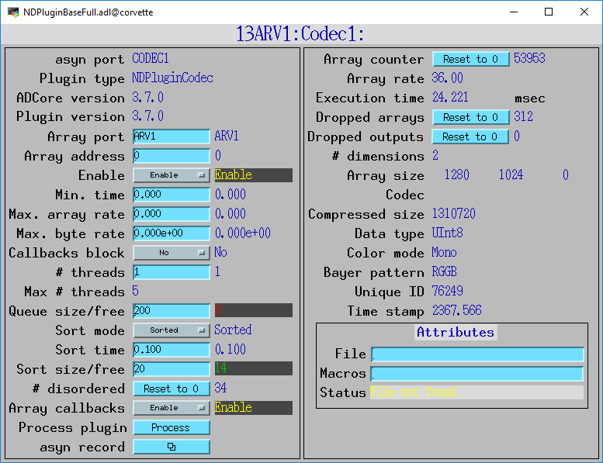
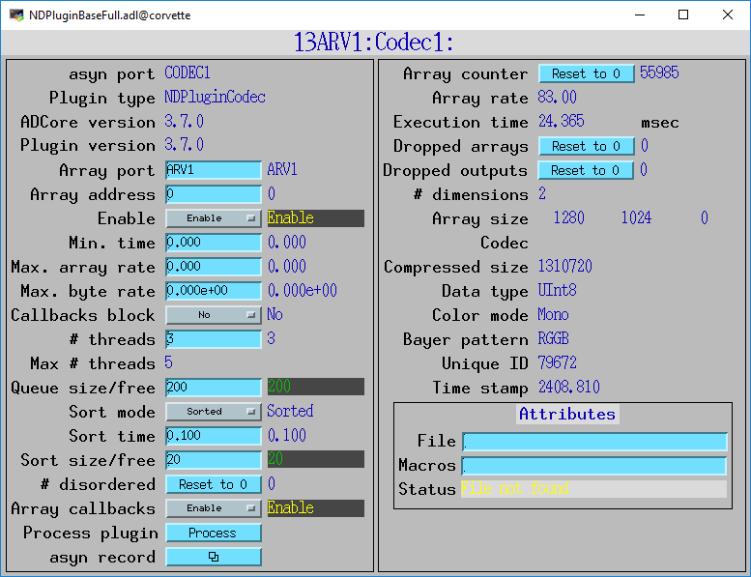
Multiple Plugin Threads
Blosc threads compress a single NDArray in parallel
Can also using multiple threads in NDPluginCodec to compress multiple NDArrays in parallel
1 thread
Execution time 24 ms
36 arrays/s
Dropping arrays
3 threads
Execution time 24 ms
83 arrays/s
No dropped arrays

Slide 8
LZ4 and BSLZ4 Codecs
These are the codecs used by the Eiger server from Dectris
They don’t use the Blosc codecs, but rather the native LZ4 and Bitshuffle/LZ4 codecs.
Dectris server can optionally use these compressions for HDF5 files saved locally on their server
Dectris server always uses one of these compressions for data streamed over the ZeroMQ socket interface to the ADEiger driver
These can now be decoded directly in ADEiger, or passed as compressed NDArrays to NDPluginCodec and other plugins
Compressed arrays can be passed directly to NDFileHDF5 to be written with newly supported direct chunk write feature. More on this later.

Slide 9
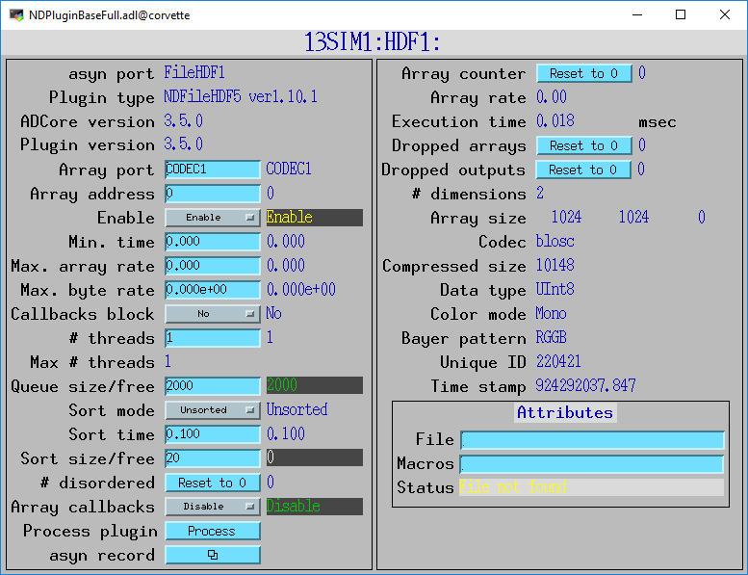
Codec Parameter Records
Codec_RBV and CompressedSize_RBV records to asynNDArrayDriver and hence to all plugins.

Slide 10
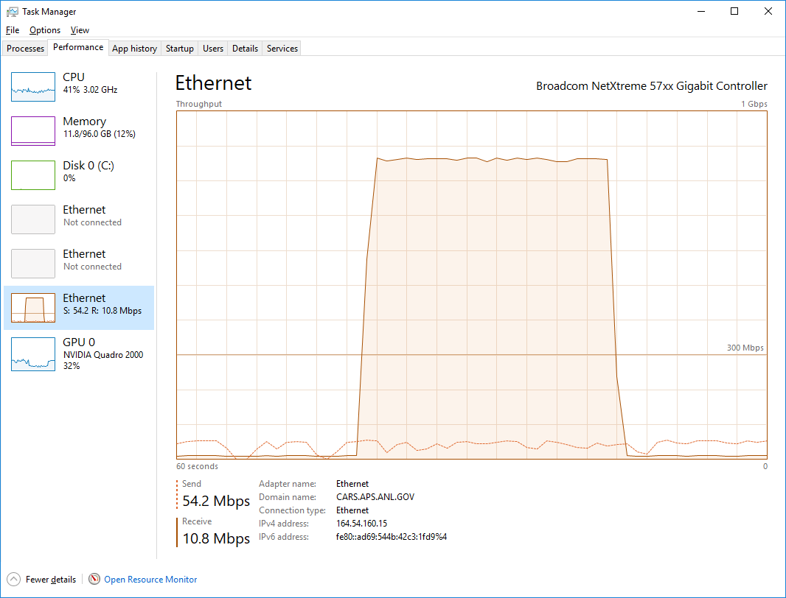
ImageJ pvAccess Viewer
Now supports displaying compressed NTNDArrays
Supports all compressions (JPEG, Blosc, LZ4, BSLZ4)
Can greatly reduce network bandwidth when the IOC and viewer are running on different machines
1 Gbps
No compression
Blosc compression
0 Gbps

Slide 11
ImageJ Decompression Implementation
Native Java versions of Blosc, LZ, Bitshuffle/LZ4 decompression are not available
Instead use C libraries built in ADSupport for these
Java calls C via a thin Java Native Access (JNA) wrapper
This same mechanism could be used to support compressed NTNDArrays in CSS/Boy or Phoebus.

Slide 12
ADEiger Changes
Now supports Bitshuffle/LZ4 on Stream interface over ZeroMQ
Previously only LZ4 was supported
New StreamDecompress bo record to enable/disable decompression. If disabled:
NDFileHDF5 can use Direct Chunk Write without ever decompressing
NDPluginPva can send to ImageJ without ever decompressing
NDPluginCodec can decompress for other plugins like NDPluginStats, etc.

Slide 13
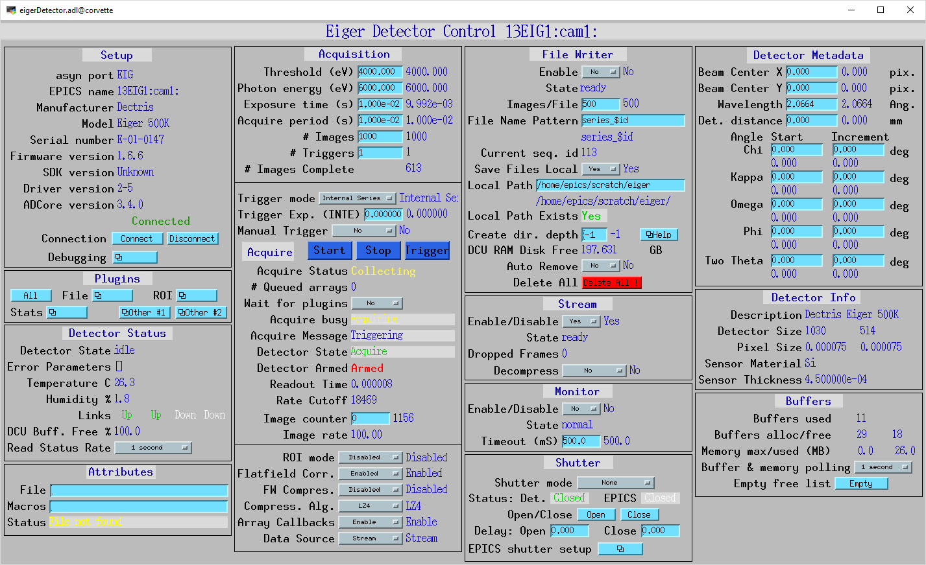
ADEiger Changes

