Slide 1

Summary of the First EPICS Documentathon
2.-6. September @ ESS

Slide 2
OUTLINE
About the event
Tasks for the group
  RRM, Website, Wikipedia, new user’s intro, setting up the structures
Documentation infrastructure overview
  More about CI for documentation in Ralph’s talk
Workflow
Website improvements
RRM update
Summary
Page 5 / 15

Slide 3
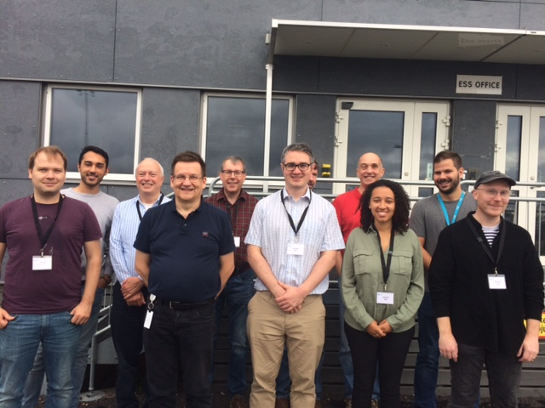
About the event
Took place at ESS in the beginning of September (2.-8. September)
12 people from different sites participated
  Diamond Light Source, ESS, ISIS, FHI (MPI), core group (Andrew, Ralph); 12 people in total
5 days of hard but rewarding work
  Writing and revising documents
  Preparing structures for documentation collection and publishing
Highly motivated group that worked well together
Page 5 / 15

Slide 4
Task list for the group
Tasks to address the most urgent documentation needs
  Update the Record Reference Manual to reflect the current status
  set up the structures to collect documentation and create a publishing process
  Website (epics-controls.org) navigation improvements
    Better balanced, easier to understand
  Write introductory material for new users,
  “doxygenization” of (C/C++) source files
  Convert release notes from html to Markdown
  Wikipedia article update
    More oriented to general public, less detail.
We worked hard, achieved a lot but could not finish everything
  Community support would be highly appreciated. It is easier now – I try to show how.
Page 5 / 15

Slide 5
Documentation infrastructure overview
Primary tools:
The epics-controls.org website (https://epics-controls.org)
  Entry point to information about EPICS
    Release notes, software downloads, index to support documentation
  After a version update this summer, the website is much more responsive than before
    Editing pages is also much easier.
  Navigation was re-organized in Documentathon
readthedocs.org documentation processing and publishing infrastructure,
linked to Github: https://github.com/epics-docs
  For hosting reference documentation that is not ideally suited for a web CMS
  Manuals, API documentation, etc. that often needs to be versioned
  Formats for readthedocs site: reStructuredText (rst) preferred.
  Markdown and a few other formats acceptable.
  Auto-generated documentation (doxygen)
Page 5 / 15

Slide 6
Documentation infrastructure overview
Publishing tools and process:
Basic process for publishing documentation on readthedocs (docs.epics-controls.org):
  Edit document using your preferred text editor
  Commit & push to appropriate project in Github
  When Github project is linked to readthedocs, it is automatically built and put to readthedocs web.
  Adding new documents to the navigation tree has to be done in the epics-docs repo (index.rst)
More about CI for documentation in Ralph’s talk
“generic” documentation should go in the epics-docs project (https://github.com/epics-docs)
  User guides, specifications, how-to documents
  Documents can however also be linked from other repositories also
Module-specific documentation is better hosted in the module repository
  To keep consistency and proper versioning
Page 5 / 15

Slide 7
Documentation infrastructure overview
https://docs.epics-controls.org
This is not complete but there are already many useful documents there.
Help in updating and adding documentation is needed!
Many old how-to’s, for instance, need updates
After a small investment in learning how the system works, it is really easy to use
  In most cases. Not perfect but pretty good.
Page 5 / 15

Slide 8
Website navigation improvements
The first attempt to epics-controls website navigation needed improvement
Users were asking for simplification and more balanced structure
  Difficult to find downloads and documentation
”Resources and Support” was split to “Software” and “Support”
The “Software” menu points to, well, software downloads of Base, Modules and Extensions
  Some updating is still needed
The “Support” menu points to documentation and training materials
  Also to introductory material for new users who want to learn about EPICS
Then there is the “community” link that points to information about EPICS users, mailing lists (tech-talk) etc.
We hope you like it - feedback is welcome
  Not everything that we planned is yet implemented.
Page 5 / 15

Slide 9
Support top page
The Support menu leads you to this page.
The “For New Users” section is brand new. Please take a look.
“Documents” will lead to the readthedocs site eventually. Not yet done, but will be done when we have sufficient material in there. The page contains a link, however.
“FAQ” items need updates in many (most?) cases. Help appreciated.
Page 5 / 15

Slide 10
Software top page
Software menu has links to
  Base
    EPICS Base releases, and downloadable packages
  Modules
    Support modules (device support, etc.)
  Extensions
    Client applications
    Language bindings
    Utilities
  Distributions
    Packages of EPICS software
Many of the module and extension links are/may be outdated
Page 5 / 15

Slide 11
Record reference manual update
Update the Record Reference Manual to reflect the current status
The process:
  Record documentation is attached to the sources, in Perl POD format
  html reference is built from the sources as a part of EPICS base build process
  Most records in Base are now formatted like this
We still have to implement a way to publish the manual on the central site
  So that not each site would have to do their own publishing
Contents still need updates in many cases
  Contact the core group (Andrew in the first place) if you would like to help
Also here the important message is: this is the process we will follow
  In case you notice something missing or wrong in the reference…
    The sources are on Launchpad…pull requests will be considered ;-)
Page 5 / 15

Slide 12
Summary
I could not cover all the work that was done – sorry for any omissions!
I find that this was a week very well spent.
We worked in good collaboration spirit, I enjoyed every minute.
We could set up processes and infrastructure for collecting and improving documentation
It is easy to use (IMHO) and open for anybody who wants to contribute
Give feedback and please help where you can!
  And last but not least:
My sincere thanks to everybody who took the time to come to this event.
This was the first but should not be the last Documentathon
  Make it a regular event? Once every year maybe?
Page 5 / 15

