Slide 1
Transition to CS Studio/Phoebus at ESS
Fredrik Söderberg, Georg Weiss
Software Engineers
European Spallation Source ERIC
2019-09-27

Slide 2
Transition to CS Studio/Phoebus at ESS
Why?
At ESS Display Builder is the preferred operator screen framework.
Display Builder based on JavaFX, BOY based on Eclipse/SWT.
Maintenance of CS Studio/Eclipse with Display Builder is… expensive.
Build system complex and error prone.
Tipping point for ESS: Java 9+.
Display Builder inside CS Studio/Eclipse has some performance issues.
CPU load for same operator display in CS Studio/Phoebus is up to 50% lower.
JavaFX widgets in an Eclipse application are rendered through SWT.
Memory footprint is (possibly) slightly smaller.
Current focus at ESS is to ensure that existing OPIs (Display Builder as well as BOY) can be run in CS Studio/Phoebus.

Slide 3
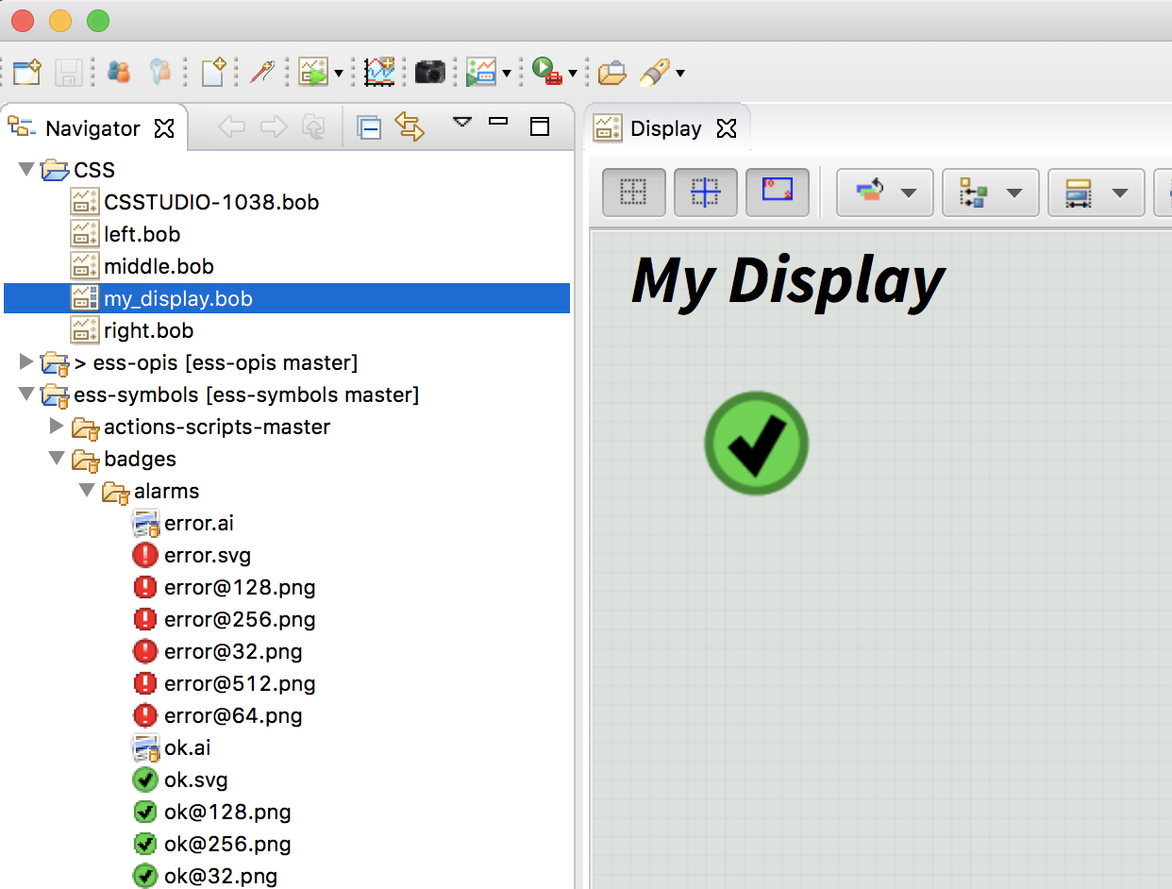
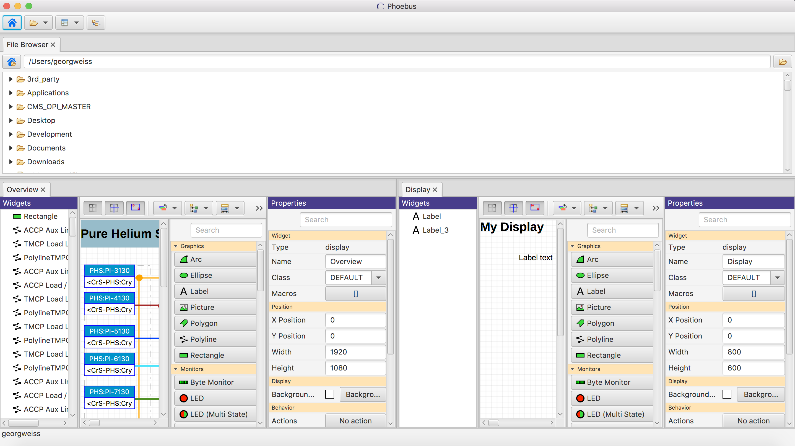
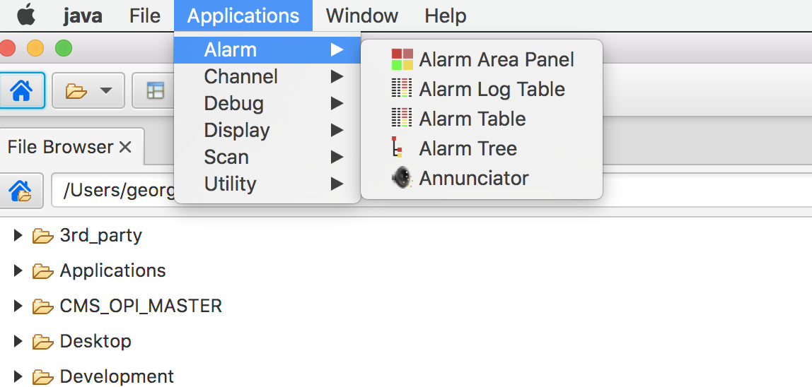
Transition to CS Studio/Phoebus at ESS
Current Eclipse – Phoebus delta
Some Eclipse concepts are unsupported or work slightly differently:
Workspaces and virtual directories – not supported.
Working sets – not supported.
Perspectives and views replaced by layouts.
Plugins – not supported, but Java SPI (Service Provider Interface) offers similar features.

Slide 4
Transition to CS Studio/Phoebus at ESS
Current Eclipse – Phoebus delta
No git integration in file browser.
Requires Java 11+
Not all tools ported.
New or changed services must be deployed:
Alarm service due to API/protocol changes (replaces BEAST)
Save-and-restore service
Some script constructs must be modified.
Help content currently incomplete.
No preferences editor.

Slide 5
Transition to CS Studio/Phoebus at ESS
OPI
CS Studio/Eclipse BOY -> CS Studio/Phoebus Display Builder
Open the existing *.opi in Display Builder , adjust, save the file as *.bob
Missing widgets
CS Studio/Eclipse Display Builder -> CS Studio/Phoebus Display Builder
Subtle differences in some of the widgets -> manually adjust some displays
Missing widgets
Scripts
Manual tweak could be required

Slide 6
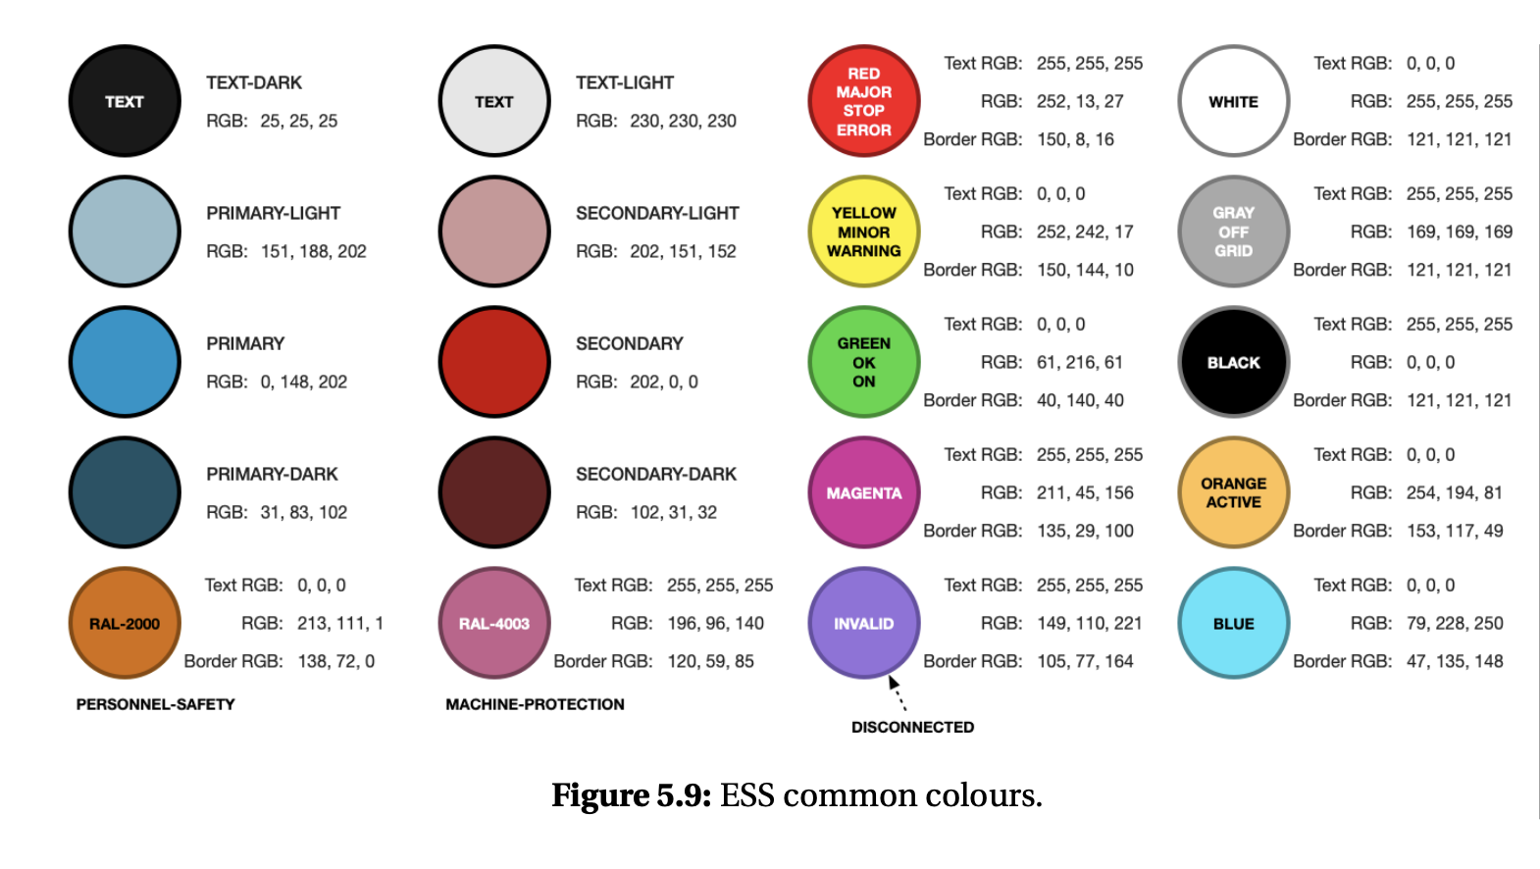
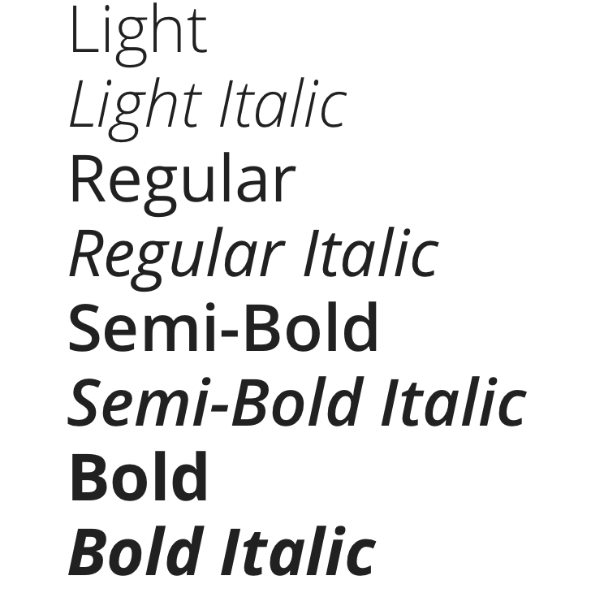
Phoebus
Collaboration
Use the same code base
Community edition
ESS Style Guide
Colors, Fonts, Classes, Splash screen.

Slide 7
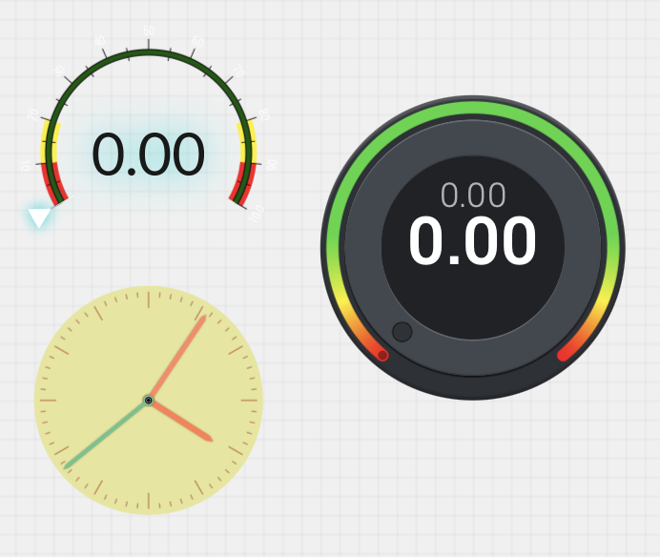
CS Studio/Phoebus Widgets
Missing widgets
Missing Widgets
Gauges
Knobs, Controlled Knobs
Clock, Digital clock
Depend on external libraries
hidden_widget_types=linear-meter,knob,gauge,clock,digital_clock
3D viewer

Slide 8
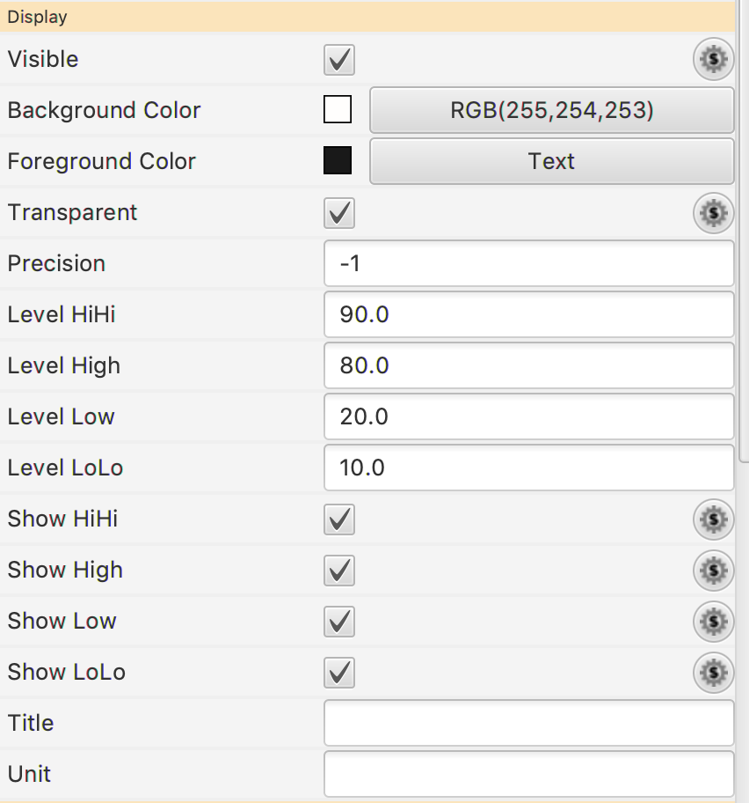
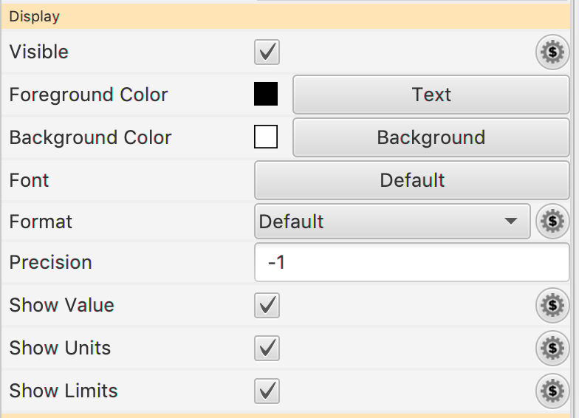
Widget Properties
CS Studio/Eclipse Widget Properties vs CS Studio/Phoebus Widget Properties
Some widgets properties are different
In general more properties to configure in CS Studio/Eclipse Display Builder

Slide 9
Conclusions
CS Studio/Phoebus considerably easier to maintain.
Initial tests indicate better performance.
Transition may require manual conversion of OPIs. Applies to both widgets and scripts.
Not all BOY widgets supported (yet).
Cooperation is key success factor.

