Slide 1
Save-and-restore in CS Studio/Phoebus
Georg Weiss
Software Engineer
European Spallation Source ERIC
2019-09-27

Slide 2
Save-and-restore in CS Studio/Phoebus
Terminology:
CS Studio/Eclipse is the “classic” CS Studio built on the Eclipse platform.
CS Studio/Phoebus is next iteration eliminating the dependency to Eclipse.
Save-and-restore port implements back-end service for persistence, and a UI face-lift.
Back-end service implemented as a Spring Boot application exposing REST endpoints to manage data (HTTP, JSON).
Data persisted in database, verified against Postgresql and Mysql. Alternative database engines or storage solutions can easily be added.

Slide 3
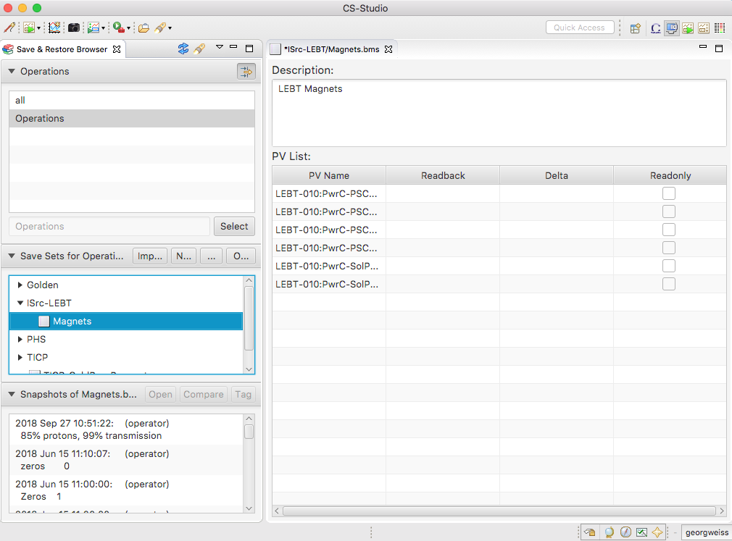
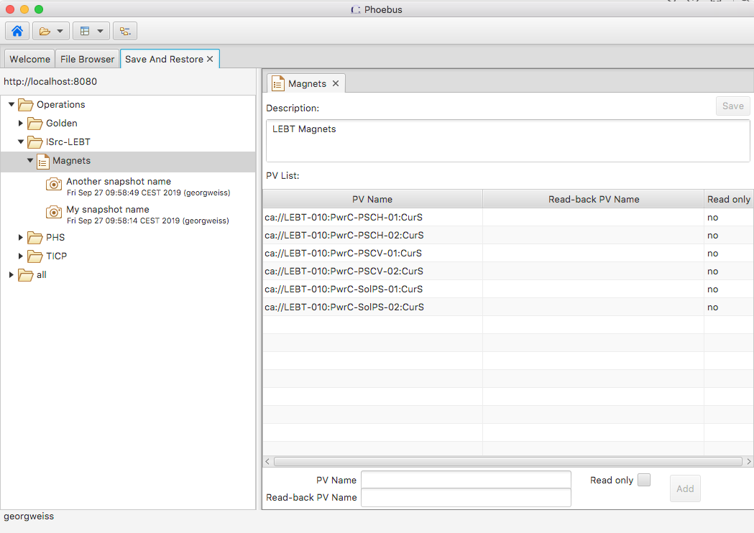
Save-and-restore in CS Studio/Phoebus
UI changes
CS Studio/Eclipse
CS Studio/Phoebus

Slide 4
Save-and-restore in CS Studio/Phoebus
Missing features
Copy-paste of folders, save sets and snapshots, including drag-n-drop.
Search for save sets or snapshots.
Save set editor, e.g. import of PV lists.
Integration with Channel Finder.
Tune and edit setpoints.
Access control.
Synchronuous restore.

