Slide 1
Building and Packaging EPICS modules with conda
Benjamin Bertrand
Speaker: Joao Paulo Martins
European Spallation Source ERIC
2019-10-05

Slide 2
Outline
EPICS at ESS
Conda
Conda EPICS module recipe
Summary

Slide 3
EPICS at ESS

Slide 4
e3
The EPICS Environment at ESS named e3 is based on the concept developed by Dirk Zimoch at PSI that allows dynamically loading of EPICS module resources
All the IOCs use the same executable from EPICS base: softIoc
Shared libraries and resources are all loaded at runtime by the require module
An IOC is started by running the iocsh.bash script and a startup command script
Notes:
The iocsh.bash script starts a softIoc and shared libraries and resources are all loaded at runtime by the require module.
The current e3 implementation includes some scripts making it easy for developers to build locally the modules they want.
It has proven to work well for development, but:
requires to recompile
Not easy to use for production

Slide 5
Conda

Slide 6

conda
Package, dependency and environment management for any language—Python, R, Ruby, Lua, Scala, Java, JavaScript, C/ C++, FORTRAN
https://conda.io/
Notes:
Conda comes from the Python data science community ot help install libraries with C/C++ dependencies.
Conda is already used in the EPICS community for pvaPy
PSI also has recipes for epics-base

Slide 7
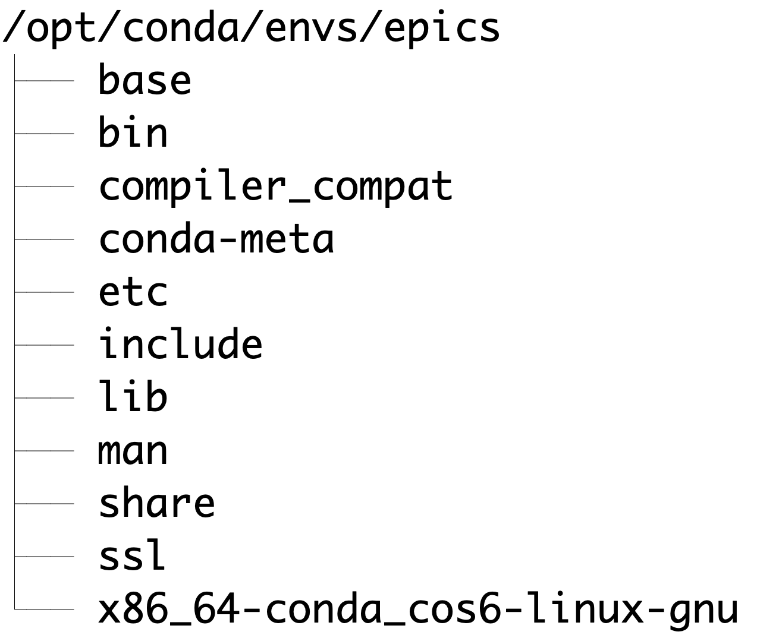
Conda concepts
A conda package is a compressed tarball file (.tar.bz2) or .conda file that contains a collection of files to be installed and some metadata
A conda channel is a repository of conda packages.
A conda environment is a directory that contains
a specific collection of conda packages.
Notes:
A conda package can include system libraries, binaries, text files…
The package filename includes the package name, version, and build string joined together by hyphen
At ESS we use our internal Jfrog Artifactory server to host conda channels
An environment can only include one version of each package. You can create several environments to work on different versions.

Slide 8
Create an environment
$ conda create -n ioc1 streamdevice recsync
The following NEW packages will be INSTALLED:
asyn conda-e3-virtual/linux-64::asyn-4.33.0-hfdbb939_0
calc conda-e3-virtual/linux-64::calc-3.7.1-h03bb814_0
epics-base conda-e3-virtual/linux-64::epics-base-7.0.3-h68659b9_1
libgcc-ng conda-e3-virtual/linux-64::libgcc-ng-9.1.0-hdf63c60_0
libstdcxx-ng conda-e3-virtual/linux-64::libstdcxx-ng-9.1.0-hdf63c60_0
libusb conda-e3-virtual/linux-64::libusb-1.0.22-hf484d3e_0
ncurses conda-e3-virtual/linux-64::ncurses-6.1-hf484d3e_1002
pcre conda-e3-virtual/linux-64::pcre-8.41-hf484d3e_1003
perl conda-e3-virtual/linux-64::perl-5.26.2-h516909a_1006
readline conda-e3-virtual/linux-64::readline-8.0-hf8c457e_0
recsync conda-e3-virtual/linux-64::recsync-1.3.0-h2943fc3_0
require conda-e3-virtual/linux-64::require-3.1.0-h2973008_0
seq conda-e3-virtual/linux-64::seq-2.2.6-h2943fc3_1
sscan conda-e3-virtual/linux-64::sscan-2.11.2-hf98a087_0
streamdevice conda-e3-virtual/linux-64::streamdevice-2.8.8-h750edfd_0
tclx conda-e3-virtual/linux-64::tclx-8.4.1-h628b354_1
tk conda-e3-virtual/linux-64::tk-8.6.9-hed695b0_1002
zlib conda-e3-virtual/linux-64::zlib-1.2.11-h516909a_1006
Notes:
Conda automatically resolves and installs all the required dependencies

Slide 9
Activate an environment
$ conda activate ioc1
$ echo $PATH
/opt/conda/envs/ioc1/base/bin/linux-x86_64:/opt/conda/envs/ioc1/bin:
/opt/conda/condabin:/usr/sbin:/usr/bin:/sbin:/bin
$ tree -L 1 /opt/conda/envs/ioc1/
/opt/conda/envs/ioc1/
├── base
├── bin
├── conda-meta
├── etc
├── include
├── lib
├── man
├── modules
├── share
└── x86_64-conda_cos6-linux-gnu
An environment is just a directory in the file system
$ tree -L 1 /opt/conda/envs/ioc1/modules/
/opt/conda/envs/ioc1/modules/
|-- asyn
|-- calc
|-- recsync
|-- require
|-- seq
|-- sscan
`-- streamdevice
Notes:
Modify the PATH
epics-base is installed under base
All modules are installed under modules

Slide 10
Activate an environment
$ env | grep EPICS
EPICS_BASE_HOST_BIN=/opt/conda/envs/ioc1/base/bin/linux-x86_64
PYEPICS_LIBCA=/opt/conda/envs/ioc1/base/lib/linux-x86_64/libca.so
EPICS_BASE_VERSION=7.0.3
EPICS_BASE=/opt/conda/envs/ioc1/base
EPICS_DRIVER_PATH=/opt/conda/envs/ioc1/modules
EPICS_HOST_ARCH=linux-x86_64
EPICS_MODULES=/opt/conda/envs/ioc1/modules
$ env | grep E3
E3_REQUIRE_NAME=require
E3_REQUIRE_INC=/opt/conda/envs/ioc1/modules/require/3.1.0/include
E3_REQUIRE_VERSION=3.1.0
E3_REQUIRE_LOCATION=/opt/conda/envs/ioc1/modules/require/3.1.0
E3_REQUIRE_LIB=/opt/conda/envs/ioc1/modules/require/3.1.0/lib
E3_REQUIRE_BIN=/opt/conda/envs/ioc1/bin
E3_REQUIRE_CONFIG=/opt/conda/envs/ioc1/modules/require/3.1.0/configure
E3_REQUIRE_DB=/opt/conda/envs/ioc1/modules/require/3.1.0/db
E3_REQUIRE_TOOLS=/opt/conda/envs/ioc1/modules/require/3.1.0/tools
E3_REQUIRE_DBD=/opt/conda/envs/ioc1/modules/require/3.1.0/dbd
Notes:
Environment variables are set by the activate.d / deactivate.d scripts in epics-base and require packages

Slide 11
Conda recipe
To create a conda package, two files are required:
meta.yaml
build.sh
https://conda.io/projects/conda-build/en/latest/resources/define-metadata.html

Slide 12
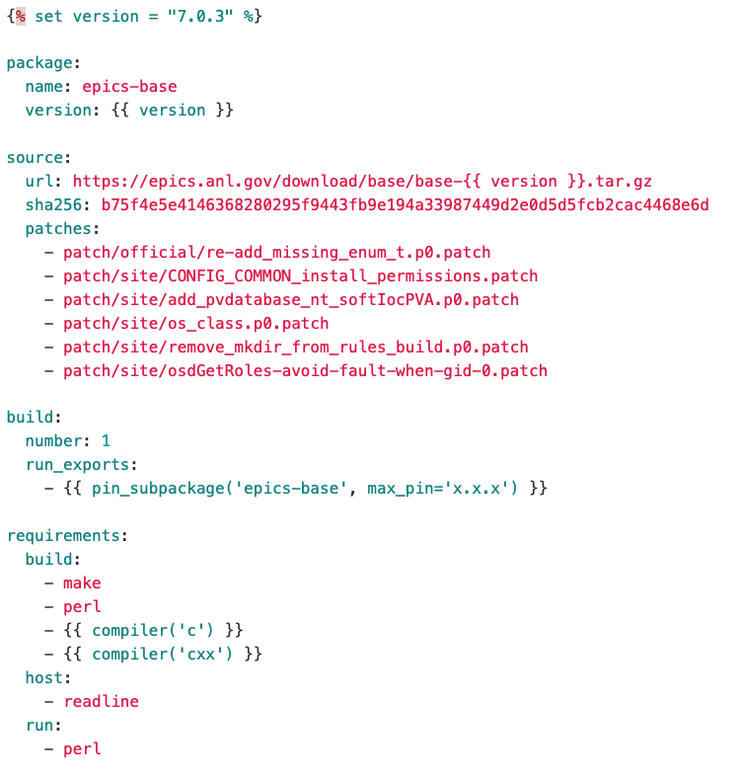
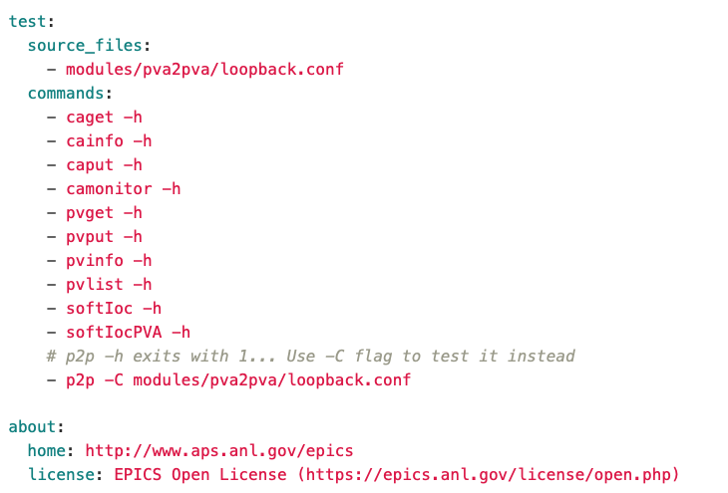
epics-base recipe: meta.yaml
Notes:
run_exports is used to impose a runtime requirement
Patches can easily be applied
Simple test are used to check the package that was built

Slide 13
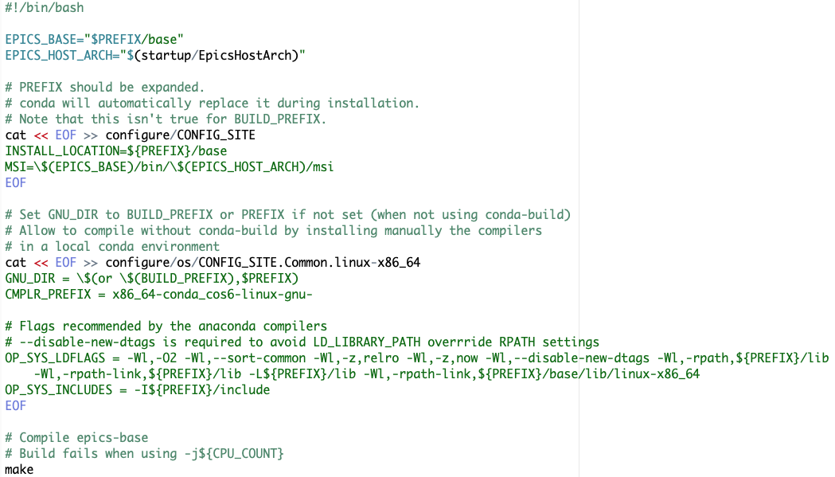
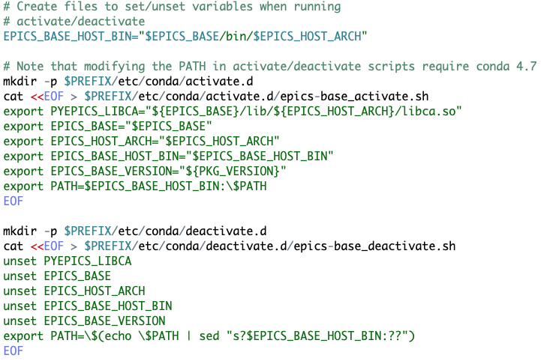
epics-base recipe: build.sh
Notes:
CMPLR_PREFIX is set to x86_64-conda_cos6-linux-gnu- to use anaconda’s compilers

Slide 14
Conda EPICS module recipe

Slide 15
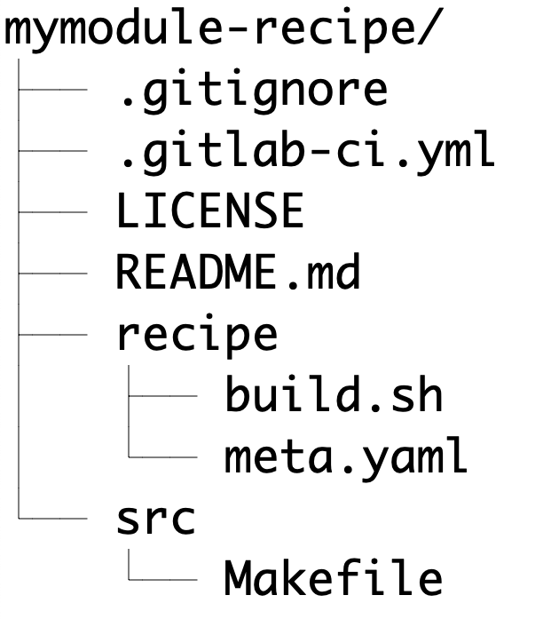
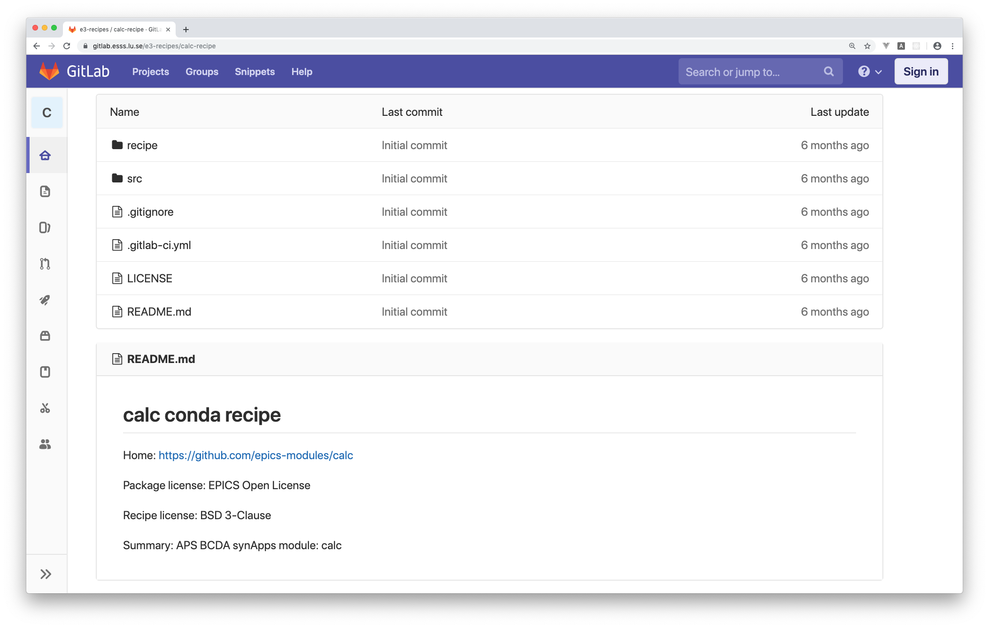
EPICS module recipe
Notes:
.gitlab-ci.yml is used to automatically build and upload the recipe to our conda channel on artifactory (using GitLab CI)

Slide 16
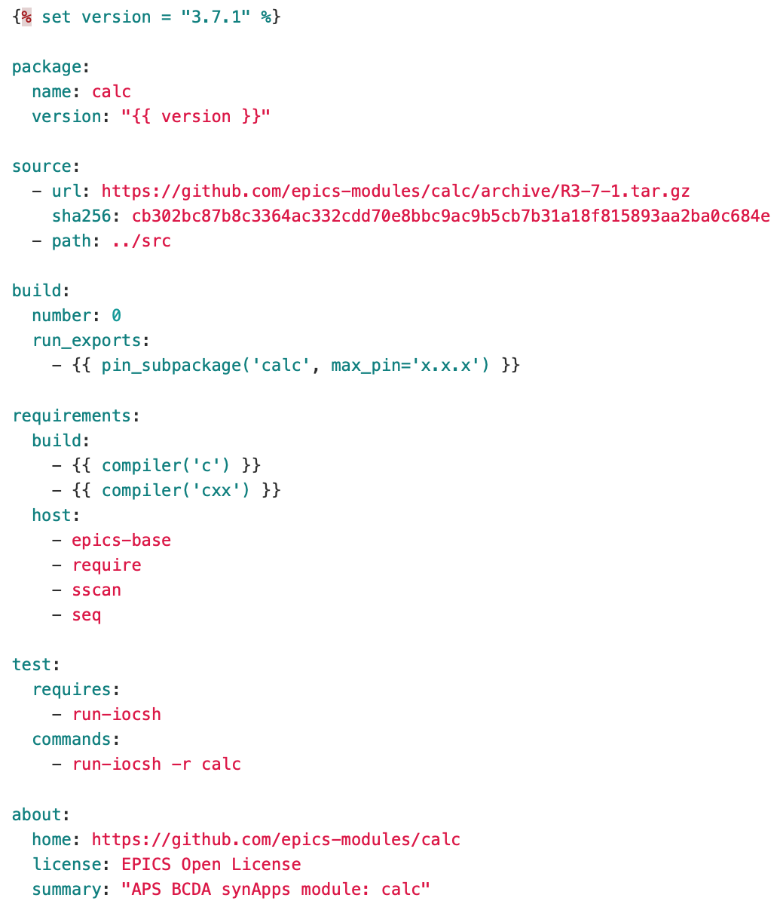
EPICS module recipe: calc meta.yaml
Notes:
All EPICS modules have a very similar meta.yaml
The source section refers to an archive of the module.
The local src directory can be used to add extra files, like a specific Makefile needed to use require.
In the build section, run_exports is used to impose the runtime dependency of packages using this module.
Version of the requirements is not in the meta.yaml but in a global conda_build_config.yaml file

Slide 17
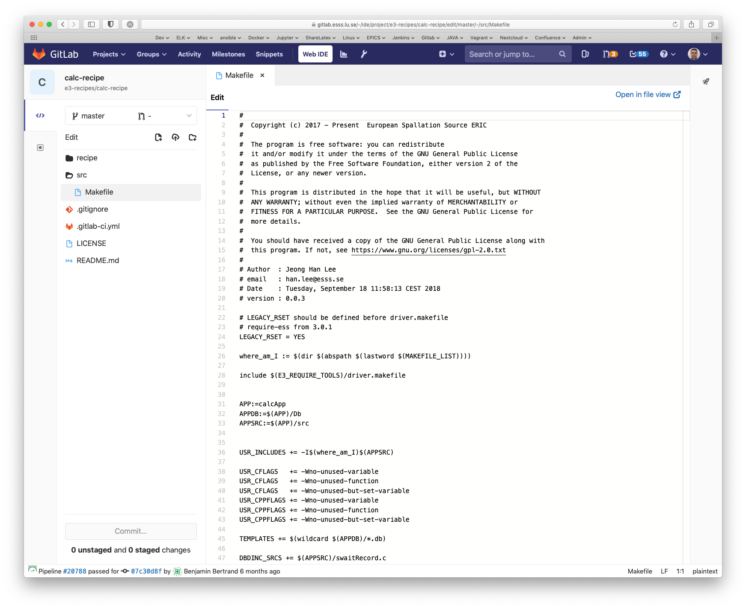
EPICS module recipe: calc Makefile
Notes:
Specific Makefile to use require
Include driver.Makefile from the require module.
calc.Makefile from https://github.com/icshwi/e3-calc

Slide 18
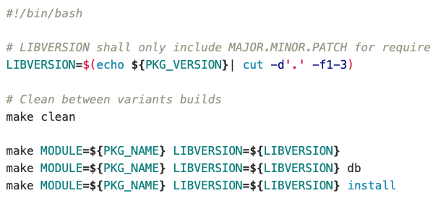
EPICS module recipe: build.sh
Notes:
All EPICS modules use the exact same build script
PKG_VERSION and PKG_NAME are env variables set by conda-build

Slide 19
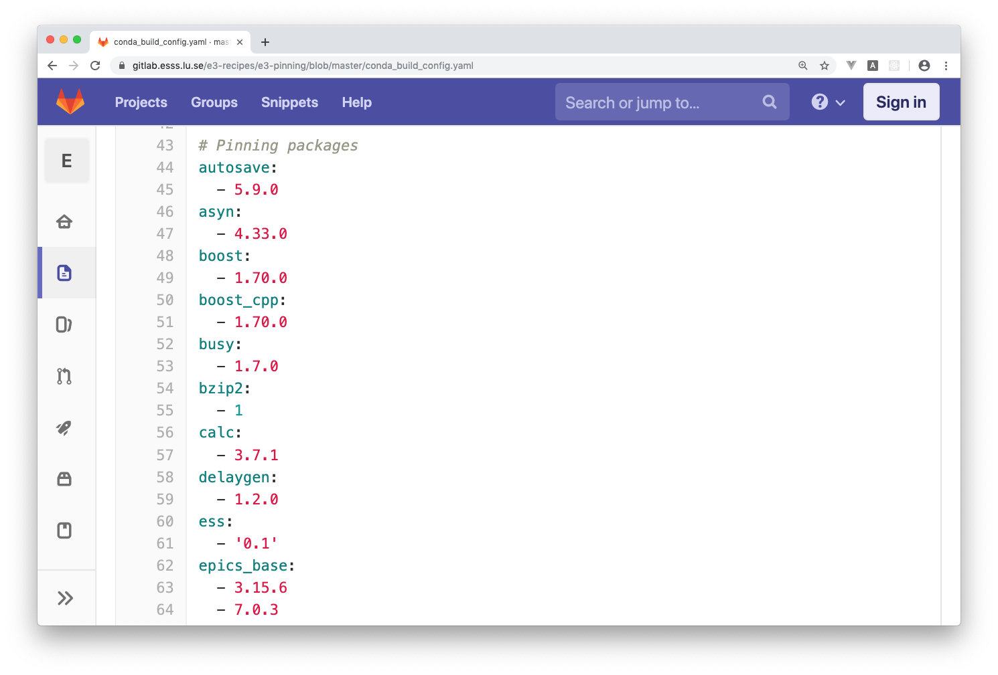
conda_build_config.yaml
Notes:
Global file to pin the version of the modules
separate the version of the requirements from the recipe (you don’t have to update the recipe itself to create a new build)
keep the versions of all dependencies centralized ensuring all packages use compatible versions
Can be overwritten locally

Slide 20
Summary
Still a proof of concept
Conda pros:
  easy to manage dependencies
  build different variants of a package
  easy to distribute and install binaries
  portable binaries can be run on any linux (x86_64) distro
  standard tool widely used in data science and even EPICS community (pyepics, pvapy)
Questions? MOPHA014 poster and paper

