Slide 1

COUNCIL
EPICS Council report 2019

Slide 2
The EPICS council - what is it?
A set of facilities demonstrably involved in the technical development of the EPICS family of software tools
Membership is granted a representative of a facility that allocates 1 man-year to EPICS development
The purpose is to optimize the use of resources available at investing facilities
The EPICS council meets by teleconference ~9 times per year and in person at least once a year

Slide 3
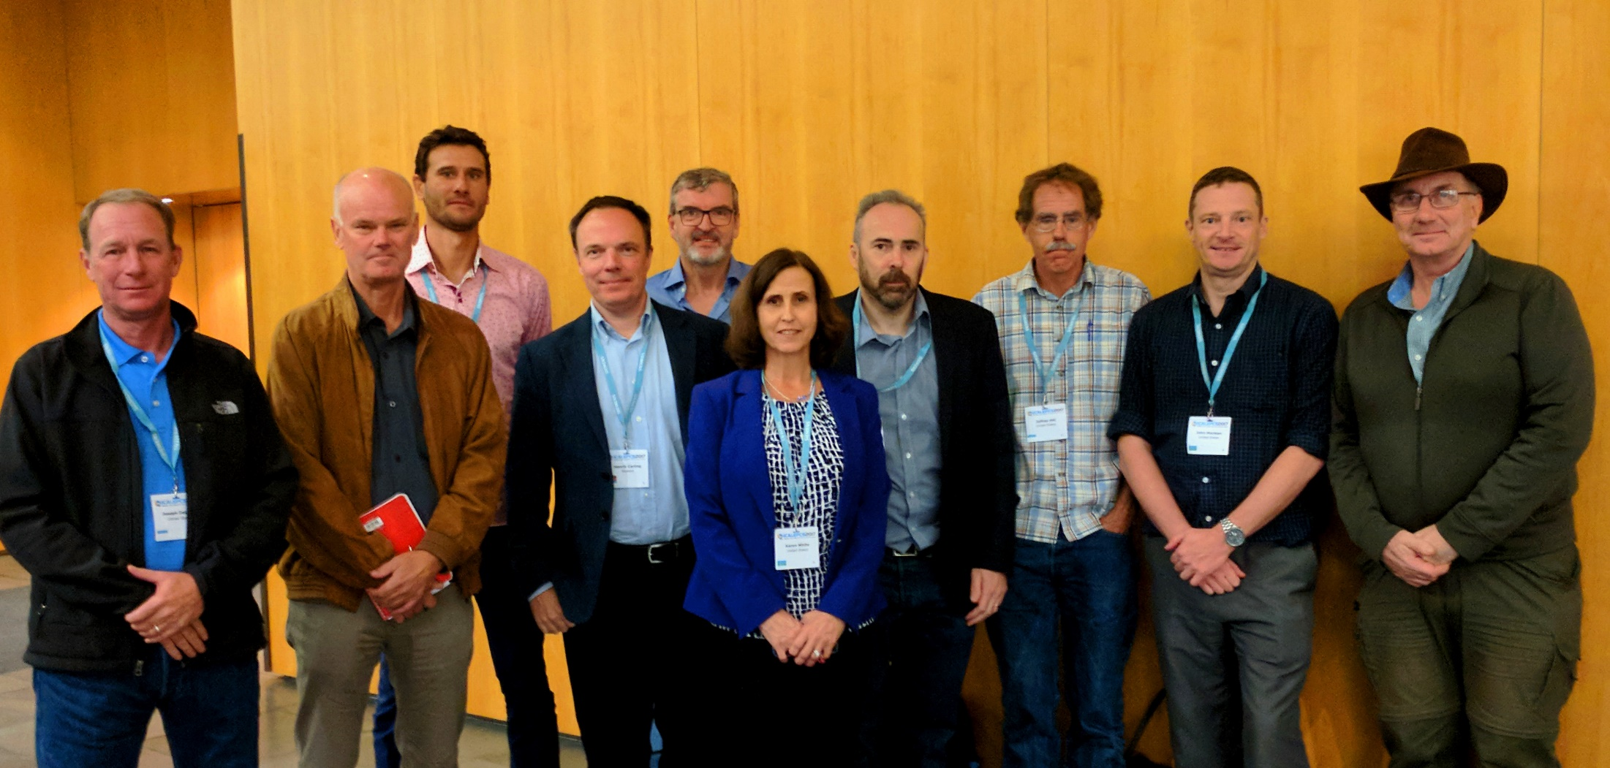
The EPICS council - who is in it?
Membership is granted a representative of a facility that allocates 1 man-year of effort towards EPICS development
Membership is reviewed each year in January
The EPICS council also relies on input from various EPICS working groups - most notably the EPICS core working group
EPICS council members at ICALEPCS 2017

Slide 4
The EPICS council - what does it do?
Develop a roadmap for future EPICS Core and Extensions development to facilitate planning for all EPICS sites.
  The roadmap is developed using technical input from the chairs of relevant working groups
Prioritize major EPICS upgrade/development projects for to guide resource allocation decisions at investing facilities
Provide support to control system managers in promoting EPICS development efforts to their organization leadership
Select semi-annual EPICS Collaboration Meeting sites and dates
Ensure that EPICS continues to be an open collaboration and that contributions are open-source

Slide 5
The EPICS council - what does it do?
The Council can
Help coordinate and optimize the use of resources
Facilitate sharing of development effort and support across projects
Develop roadmaps in collaboration with technical working groups
Encourage the growth and the long term viability of the collaboration
The Council cannot
Direct people to do things
Direct people on how to do things
Provide resources or budget

Slide 6
The EPICS council - 2019 activities?
The Council has
Made a facility assessment for the 2019 council memberships
Has held 4 council teleconferences and 2 in person meetings (including ICALEPCS 2019)
  Managed transitions of representatives and appointed new representatives
  Processed an incoming membership application (FHI, Germany)
  Identified topics to be presented at EPICS collaboration meetings
  Worked on clarifying and improving the EPICS council charter
  Worked on a model for efficiently pooling/coordinating resources
  Worked on proposals for coordinating EPICS training
  Helped start an EPICS Python working group
  Worked on improving relations to commercial EPICS suppliers
  Discussed practical activities (documentathons, codeathons etc)
  Coordinated EPICS meetings (dates, venues)
  Managed the transition of the EPICS council chair

Slide 7
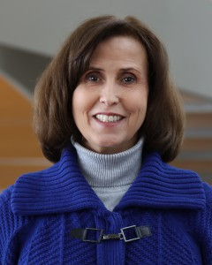
The EPICS council - new chair
The first chair of the EPICS council, elected in
2017 has now served her term
She has guided the EPICS council through the
first formative years, shaping and structuring
the work in the council and reminding us all
to complete tasks and reporting
Thank you Karen!

Slide 8

The EPICS council - new chair
Some thoughts on the way forward
  Increase transparency - efficient collaboration
  Refine charter - not only “in-house” contributions?
  Efficient collaboration with commercial partners?
  Define and clarify roadmap document
  Initiate/sponsor/support activities (-thons)
EPICS development in general
  Grow EPICS community volume2017 by 100% before 2023
    Improve documentation (newcomer, reference, clean-up)
    Improve accessibility/entry threshold
    Involve commercial players
    Engage facilities in Asia

Slide 9

Thank You for Your Attention!

