Slide 1
2.X Cryo/Infrastructure/Installation & Integration Status
Jim Mills
July 11, 2019

Slide 2
Superconducting Magnet Status
Cryo Piping RFP’s due back on July 31st. BNL to review and award contract in Augusts.
Cryo team has checked and added the spare voltage taps (VT11). Re-routed voltage taps cables to the bottom of the doghouse underneath the Valvebox instead of going through the chimneys. More reliable route and easier access.
Closed the Magnet-end doghouse and wrapped up the Valvebox-end doghouse for long-term storage.
Valve Box Extension Transport Arm in shops, due this week. The next step is to “lift” the Magnet Cryostat out of the steel box to the original yellow-frame on the floor (in Bldg. 912). Set-up for long term storage.
PS and Dump Resister now at B1008B.

Slide 3
Infrastructure and Cradle Carriage
Finalizing MOA with C-AD on roles, responsibilities and estimates for Infrastructure. Meeting weekly with C-AD management.
MVTX/INTT Engineering Workfest, July 10, 2019 – MIT/LANL/BNL -Installation/Vacuum Pipe Requirements
Tentative August 1, 2019 Final Design Review of the Cradle/Base Platform (P6 schedule - September 12-25, 2019)
2.3.1 Base Platform is 90% complete
2.3.4 Upper Platform is 60% complete
2.3.5 End Caps are 35% complete
Track Modification Brainstorming Session – June 13, 2019 (see next slide)

Slide 4
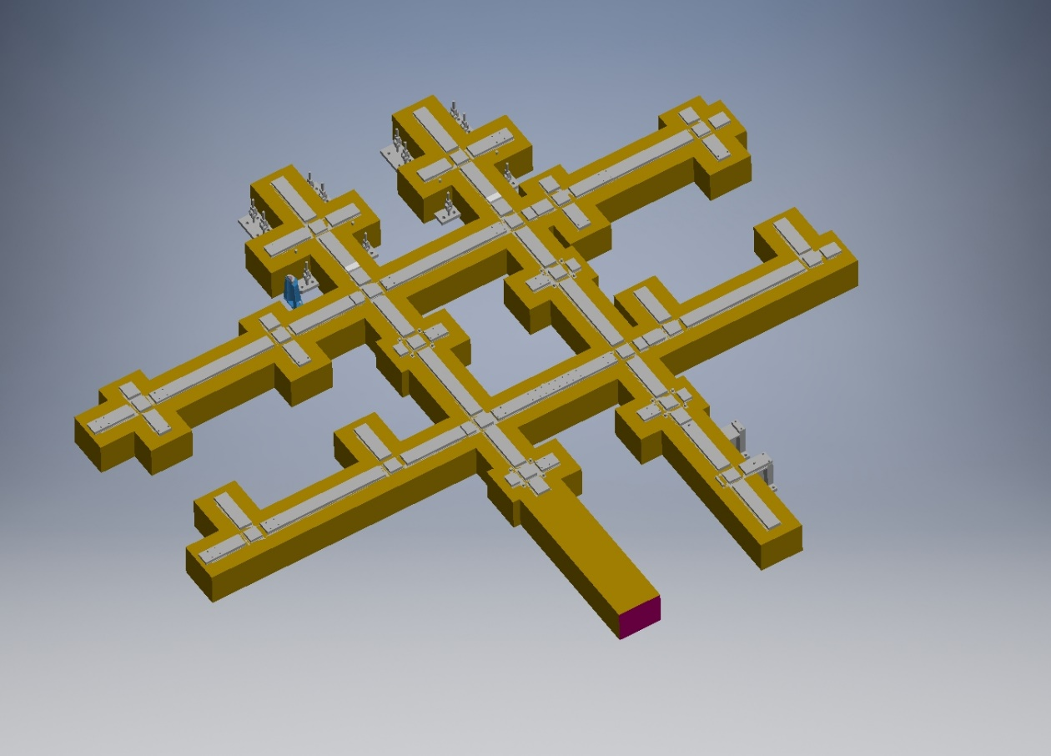
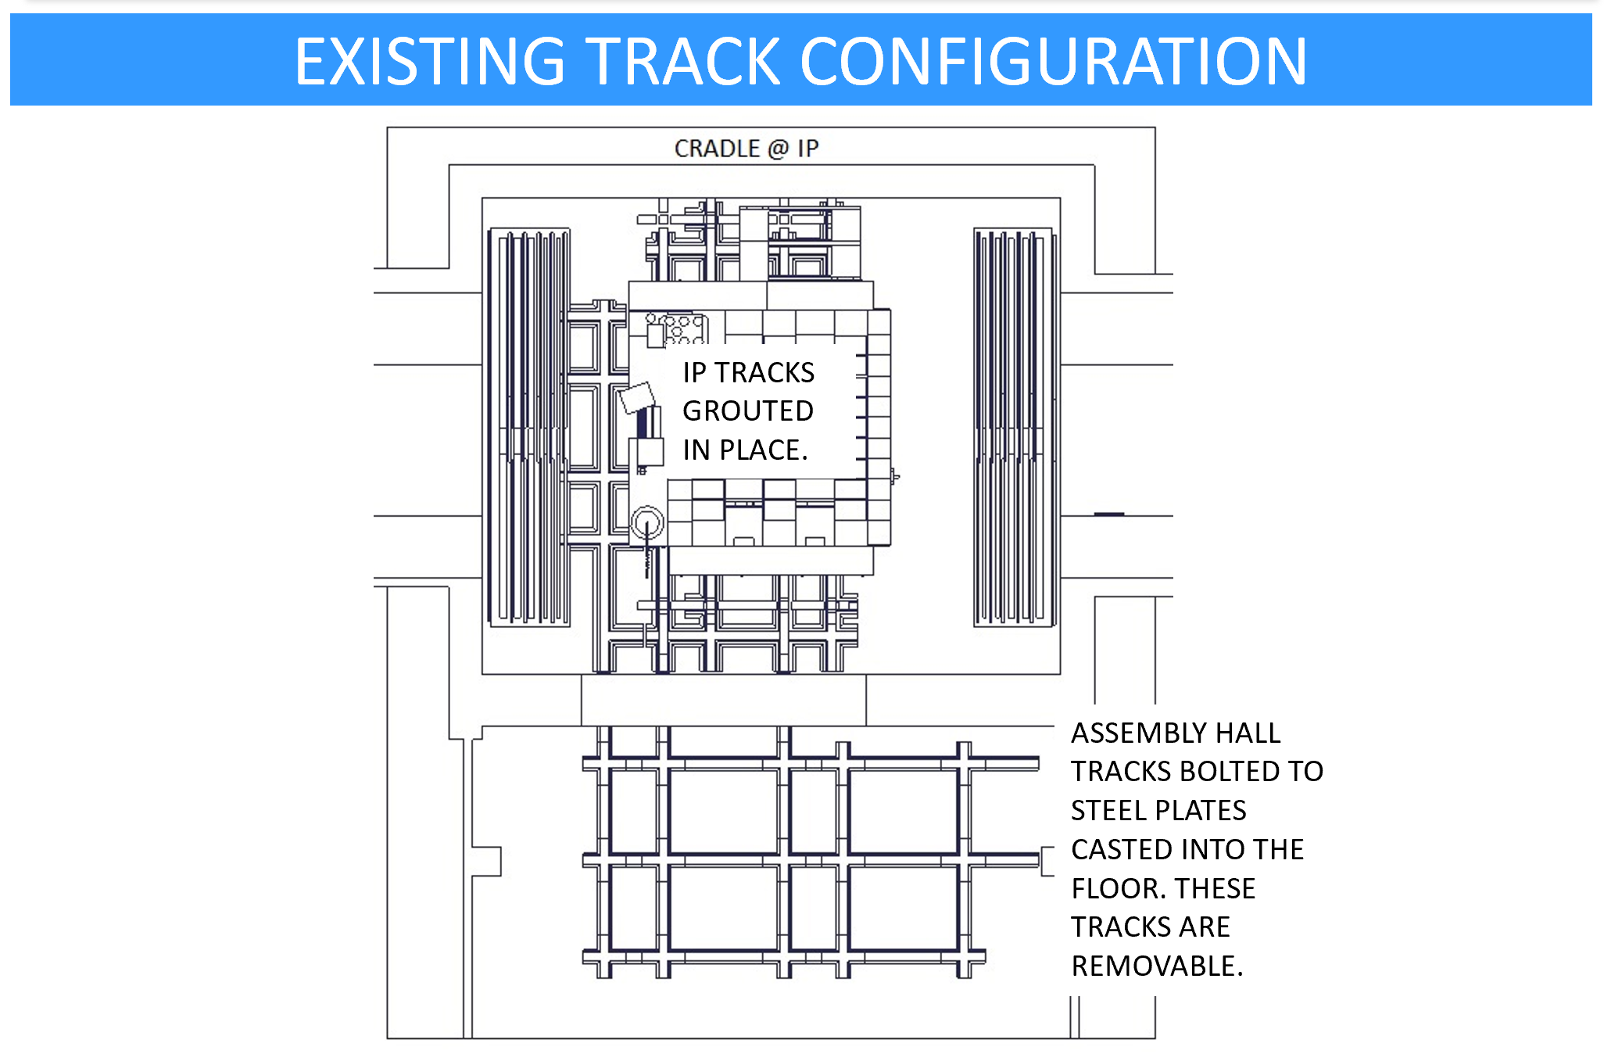
Track Modification Brainstorming Session – June 13, 2019
M. Anerella, V. Badea, S. Bellavia, C. Biggs, D. Cacace, R. Feder, C. Folz, J. Hock, C. Pearson, C. Pontieri, J. Mills, R. Ruggiero, B. Streckenbach, J. Tuozzolo
Tracks were designed to handle 450 tons @SF=3, not the 900 tons we require for sPHENIX
Consider encasing rails in concrete in order to provide additional stability and strength
Consider removing existing rails and replacing with a temporary concrete block and steel plate design

