Slide 1
PMG Topics
Status of PD review recommendations and document
Composition of advisory committee for sPHENIX TPC
Preparation for MVTX review
Infrastructure upgrade review dates
Status of MoA
  See Jim Mills’ slides

Slide 2
Recommendations from the PD-2/3 Review
There were six recommendations from the PD-2/3 review. Four Project Management and two technical.
WBS 1.01 – Project Management
There should be a dedicated ES&H Manager for the project.
  Lori Stiegler is the sPHENIX ES&H Coordinator. All BNL ES&H issues are administrated by the local ES&H managers: Peter Cirnigliaro/Lee Hammonds for CAD, Achim Franz for PO
ES&H should periodically visit universities and/or collaborators, possible look at Office of Quality Management frequency of visits.
  We have three sPHENIX detector component manufacturing locations outside of BNL: SBU, UIUC and GSU. We have had an ES&H and QA visit to SBU. We are in the process of scheduling a visit to UIUC. We will schedule a visit to GSU once there is significant activity to observe.
The committee recommends PD2/3 after a clean up, review and status of the project schedule, cost estimate and risk register.
  We have statused the schedule and cost estimate. The schedule, integrated budget and budget profile remain unchanged from the budget and schedule presented at the PD-2/3 review. Will update the risk registry starting next week.

Slide 3
Recommendation from the PD-2/3 Review
WBS 1.03 EMCal - Risk
Re-evaluate the contingency associated with large procurements such as the W powder, in view of the recent cost increase in this material and possible pending tariff situation. Once the above is satisfactorily completed, to the satisfaction of the sPHENIX Project Director and reported to the Review Committee, the EMCal can proceed to PD-2/3.
  This will be part of the Risk Registry update starting next week. We expect this process will be a straight forward because we have these risks already in the spreadsheet we just need to reexamine the risks assigned. We have >$300k in unassigned bottom-up contingency that we can apply to these risks if necessary.

Slide 4
Recommendations of the PD-2/3 Review
WBS 1.02 - TPC technical
The review committee recommends PD-2 for the TPC. Before PD-3, however, the TPC group needs to establish credible production readiness. The review committee is convinced that the TPC Team is very capable; is very close to proving production readiness and that an appropriate focus in the coming weeks could see it done. To this end, we recommend that this be accomplished using their first set of pre-production chambers to simultaneously study the actual IBF, energy resolution and discharge stability for their proposed gas mixture as a function of possible operating point settings for the full range of GEM voltages and transfer fields. This is to be done with the front mesh in place (if that continues as a design option) to confirm that an operating point exists that meets all sPHENIX requirements with their proposed gas mixture. Once the above is completed to the satisfaction of the sPHENIX Project Director and reported to the Review Committee, the TPC can proceed to PD-3.
  The TPC team believes that the measurements to prove we have a good working point have been made both at the Yale test set-up and FNAL test beam. The results will be written up by the end of July

Slide 5
Recommendations of the PD-2/3 Review
WBS 1.02.05 TPC FEE technical
As indicated in last year’s review, all components on the TPC FEE board need to be radiation-qualified; this has been largely achieved but some tests remain. Demonstrate the performance of (two) full TPC FEE boards with SAMPA V4 ASICs versus dose up to a TID of at least 100 kRad. Once available, repeat this demonstration using full TPC FEE boards with SAMPA V5 ASICs. The Committee then recommends proceeding to PD- 2/3.
  Preparations are underway for the test. The tests to rad-qualify the TPC Fee board with the SAMPA chip will take place at the IO ⁶⁰ Co test facility within the next two weeks.

Slide 6
Make-up of the TPC Advisory Team
Based on consultation with Tom Hemmick and Klaus Dehmelt, the proposed advisory team is:
Dick Majka Yale/ALICE/STAR
Harry Appelschauser CERN/ALICE
Ties Behnke DESY/ILD
Either
Ken Read ORNL/UTK/ALICE or
Tonko Ljubicic BNL/STAR

Slide 7
Preparation for the MVT Review
The MVTX Review is July 29-30 at BNL
  1st day is plenary talks
  2nd day is homework answers, report writing, closeout
Proposed Agenda will be available by Monday July 15
Documents posted by July 22 (PMP, CDR, Risk Registry)
Talks posted by July 25

Slide 8
Review Committee
Electronics, Integration, Si Performance
Dave Lynn - dlynn@bnl.gov Si Performance
Andrei Nomerotski (BNL) – anomerotski@bnl.gov - Si Performance, Integration
Sergio Rescia - rescia@bnl.gov Electronics, Integration
Mechanics, Management, Cost & Schedule, Risks
Bill Wahl (BNL) - bwahl@bnl.gov Mechanical, Cost & Schedule, Risks
Flemming Videbaek - videbaek@bnl.gov Management, Cost & Schedule, Risks

Slide 9
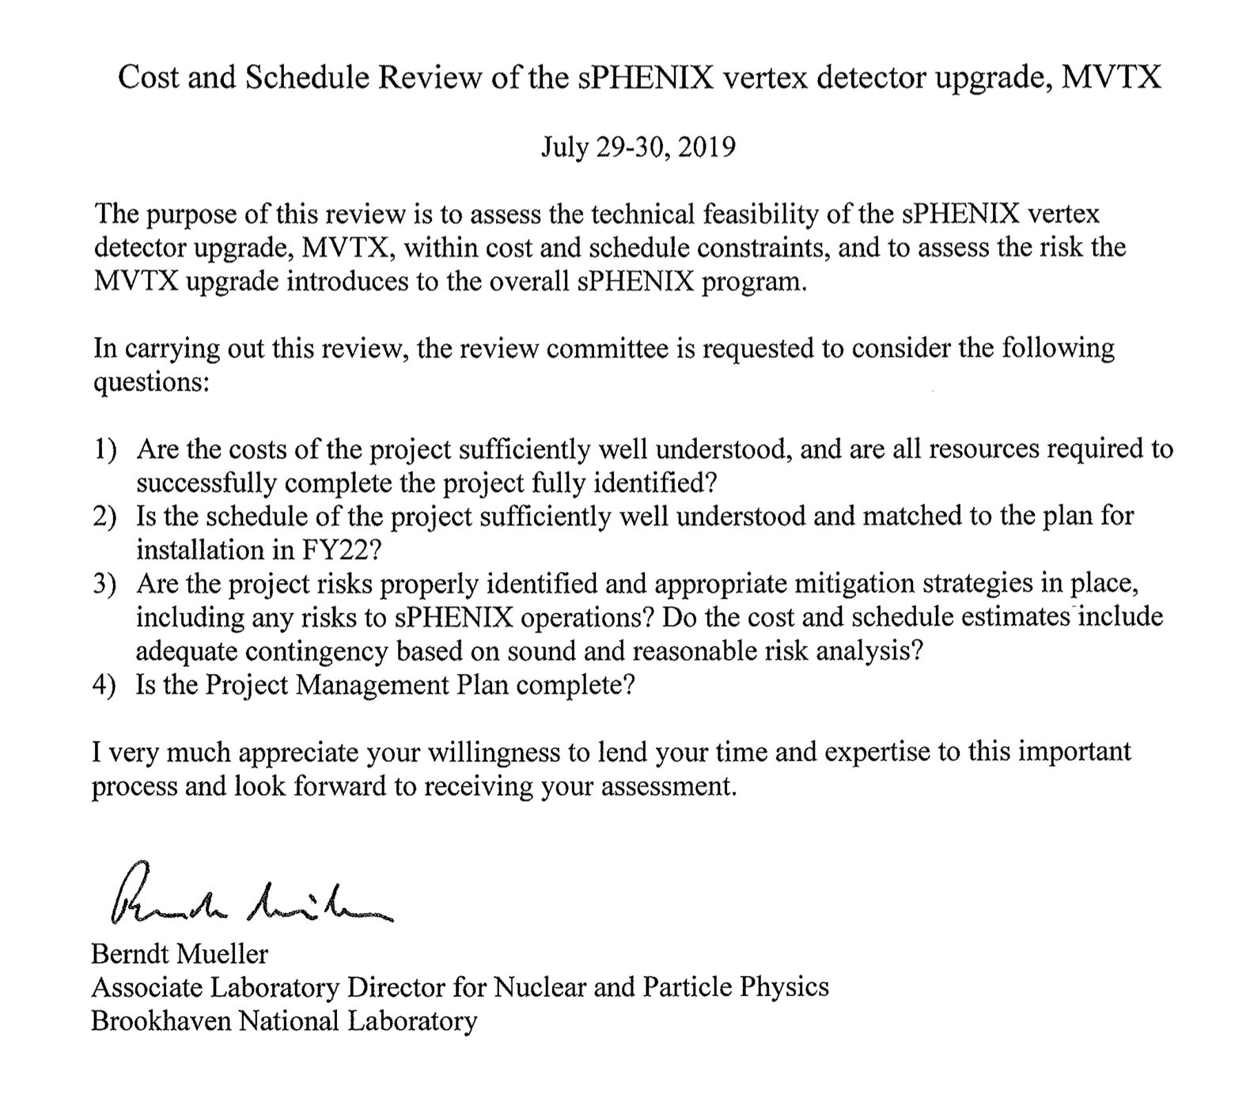
Charge

Slide 10
Review Dates for Infrastructure and Facility Upgrade
I’ve polled the engineers and they would like a review date of mid-October
Carriage Cradle FDR early August
Award of cryo contract early to mid August
Prepare documentation for Carriage/Cradle RFQ Throughout September
By mid October we will have an accurate knowledge of the cost and schedule of both the cryo and carriage/cradle. At that point we’ll be able to fix the baseline cost and schedule, and begin EV reporting.

Slide 11
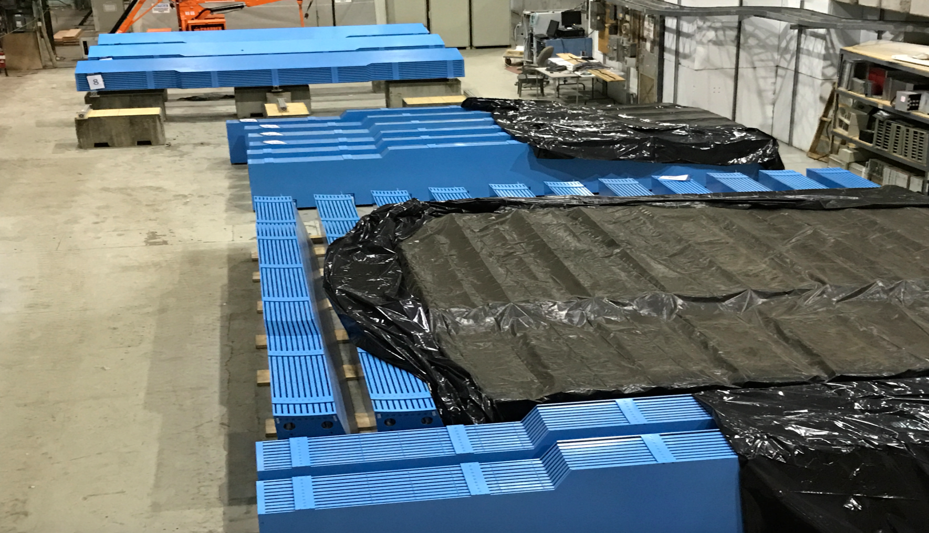
31/32 Barrel Magnet Steel Sectors at BNL
Order will be completed by tomorrow!

