Slide 1
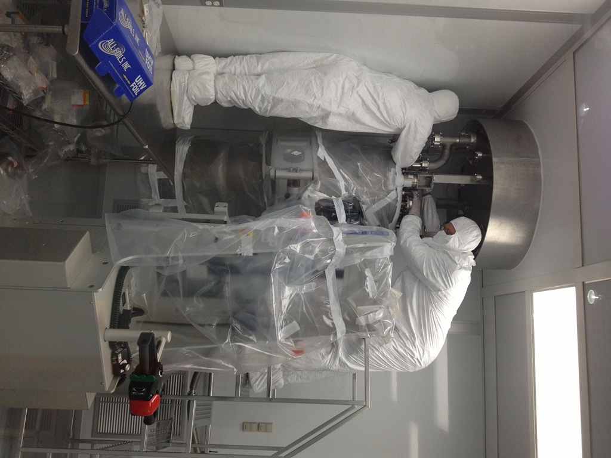
56 MHz SRF cavity
Sergey Belomestnykh
Collider-Accelerator Department, BNL
July 26, 2013
RHIC Retreat
BNL• July 25-26, 2013

Slide 2
Acknowledgement
In this talk I present work of a large number of people from different groups across the department.
Just listing everybody involved would take several slides.
So this slide is an acknowledgement of everybody’s contributions and efforts to make this complex and sophisticated project successful.

Slide 3
Outline
56 MHz design
Cavity & cryomodule
HOM couplers
Fundamental mode damper
Quench detection with IR sensors
Frequency tuner
Cavity fabrication, processing & testing
Installation in RHIC tunnel
Milestones
Cryogenics
RF system
MPS
Summary

Slide 4
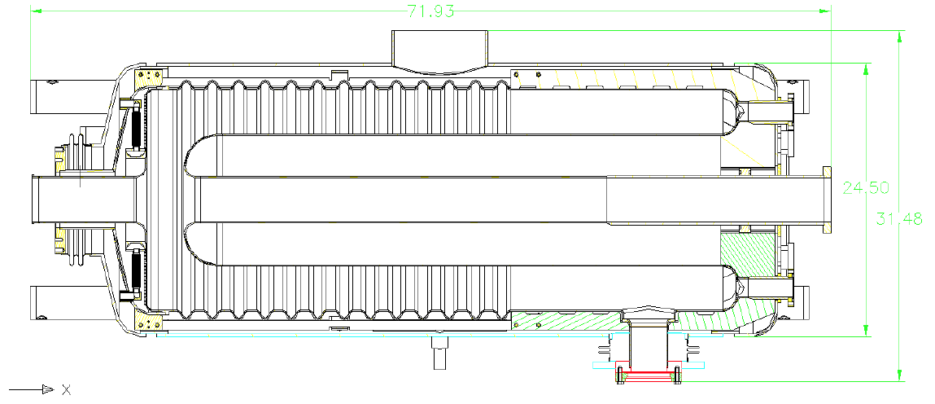
56 MHz cavity
V_{acc} | 2.0 MV
Stored energy | 140 J
R/Q | 80.5 Ohm
Geometry factor | 33.5 Ohm
Operating temperature | 4.4 K
Q₀ at low fields (assuming R_{res} = 10 nOhm) | 3.0×10⁹
Q₀ at 2 MV | 2.4×10⁹
P_{cav} at 2 MV | 20.7 W
Q_{L} | 4×10⁷
Available RF power | 1 kW
Coarse tuning range | 25.5 kHz
Coarse tuning speed | 3.7 kHz/s
Tuning sensitivity (stepper motor) | 17 kHz/mm
Fine tuning range | 60 Hz
Tuning sensitivity (piezo) | 0.06 Hz/V
LF detuning at 2 MV | -132 Hz
Frequency sensitivity to He bath pressure | 0.282 Hz/mbar
Peak detuning due to microphonic noise | 1 Hz
The purpose of this Quarter Wave Resonator (QWR) is to provide a larger RF bucket (5 times larger than that of 197 MHz cavities) for ions, which should result in higher luminosity of RHIC by: direct adiabatic capture from 28 MHz system, better preservation of longitudinal emittance, elimination beam spillage in satellite buckets, improving luminosity by allowing shorter beta function at the IP.
This is a “storage” cavity, that is it does not have large tuning range to follow the large frequency change during acceleration from injection energy to energy of experiment and is turned on only after that for re-bucketing.
One 56 MHz cavity will serve both RHIC rings. It will be the first superconducting RF system in RHIC.

Slide 5
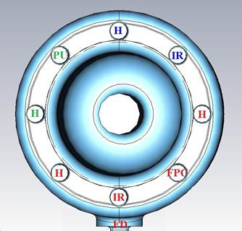
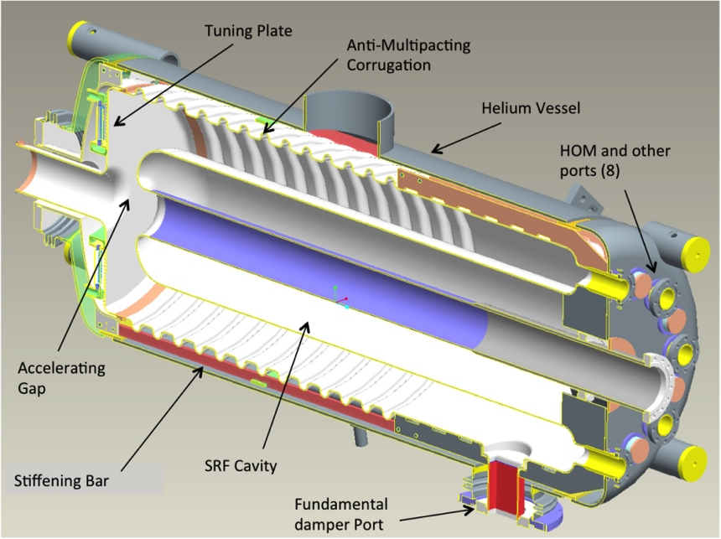
Cavity design
The cavity is mechanically rigid: its first mechanical mode frequency is 98.5 Hz.
The cavity is designed to be multipacting-free.
High degree of higher order mode (HOM) damping is provided by four dampers asymmetrically placed at the “short” end of the cavity.
Fundamental mode Damper (FD) reduces the cavity fundamental mode Q to ~300 during beam injection and acceleration.
The cavity shape was optimized so that at 2.0 MV we get E_{pk} = 35.3 MV/m, B_{pk} = 83.9 mT, power dissipation ~20 W.
These numbers are below what was already achieved at other labs in cavities with similar geometries.
The cavity is tuned to 720th harmonic of the RHIC revolution frequency.
It is a beam driven cavity. However, there will be a 1 kW RF amplifier. The amplifier will serve to: achieve required amplitude and phase stability and provide conditioning capability.
At the energy of experiment, first the fundamental damper will be withdrawn and then the cavity frequency will be tuned (approaching from below the beam harmonic) to achieve the operating voltage of 2.0 MV.
A piezo tuner will be employed to compensate any fast frequency changes.

Slide 6
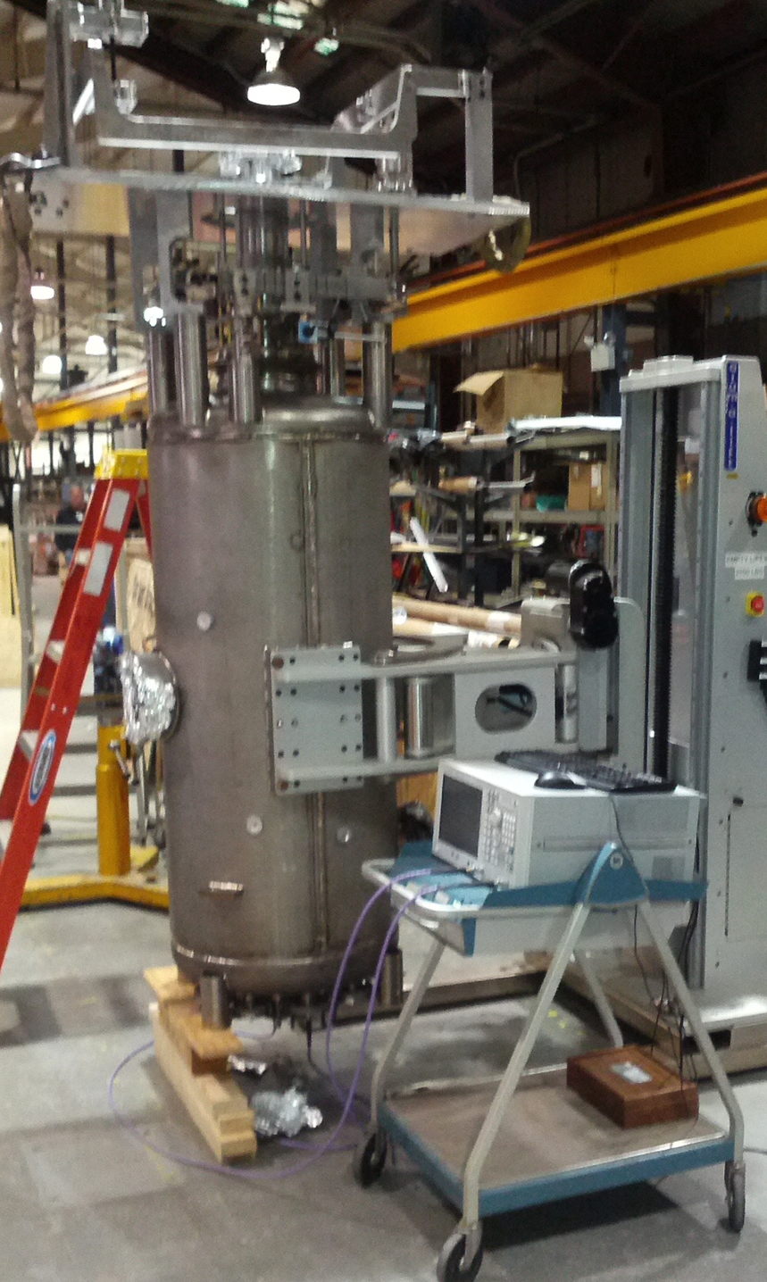
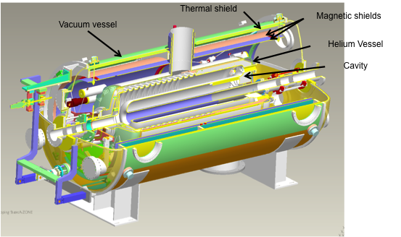
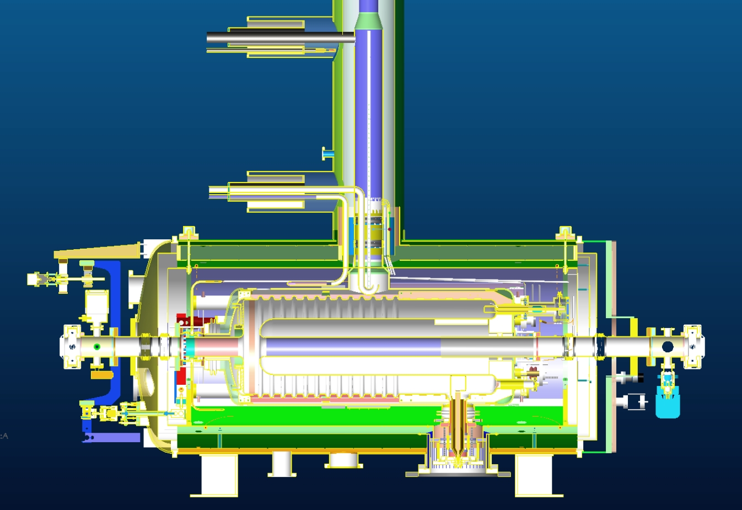
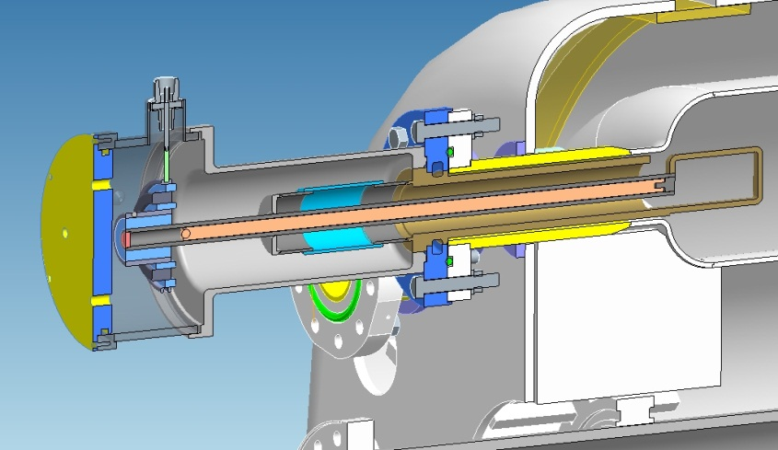
Cryomodule design

Slide 7
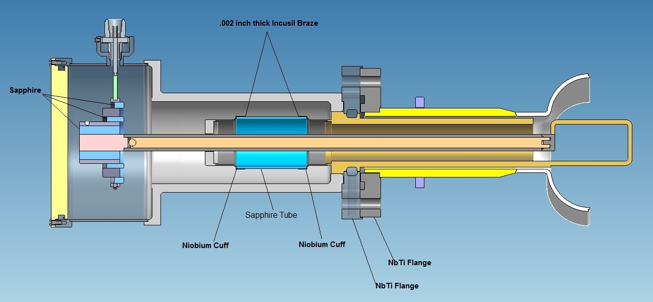
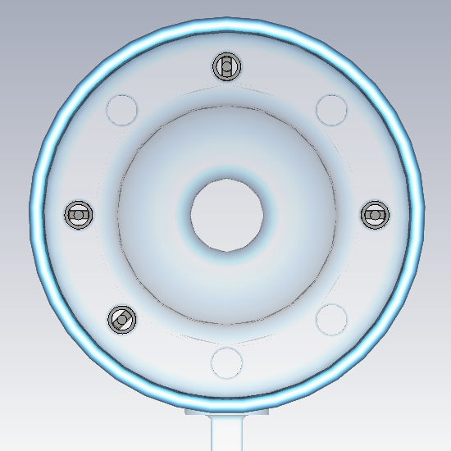
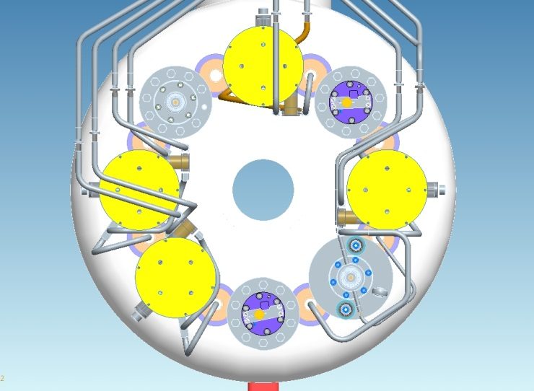
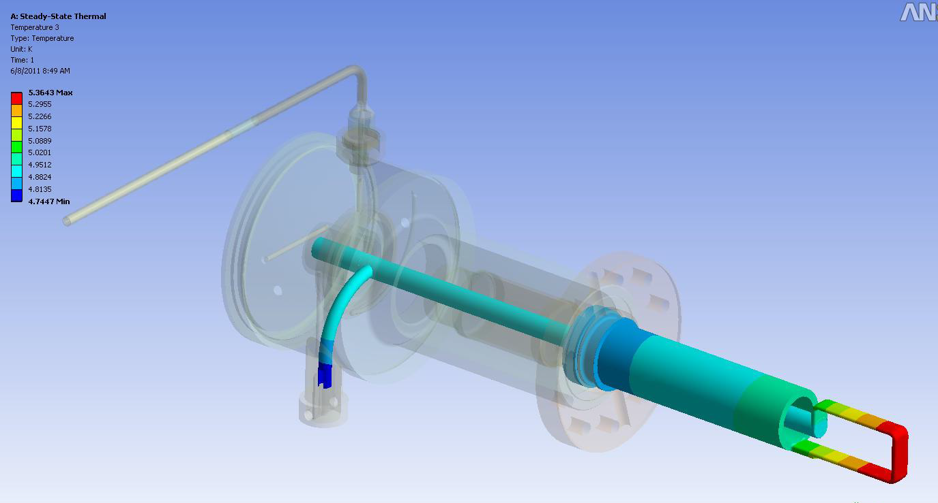
HOM coupler = coupling loop + filter
Optimization of damping for all HOM modes up to 1 GHz, resulted in 4 HOM couplers.
The couplers are inserted in an asymmetric configuration, which ensures that all modes are damped adequately.
The NbTi flange will be cooled with helium.
A high RRR copper rod inside the center conductor improves cooling of the loop. It is LHe-cooled.

Slide 8
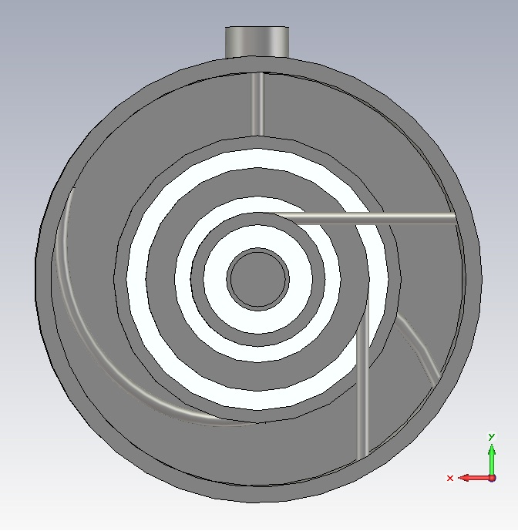
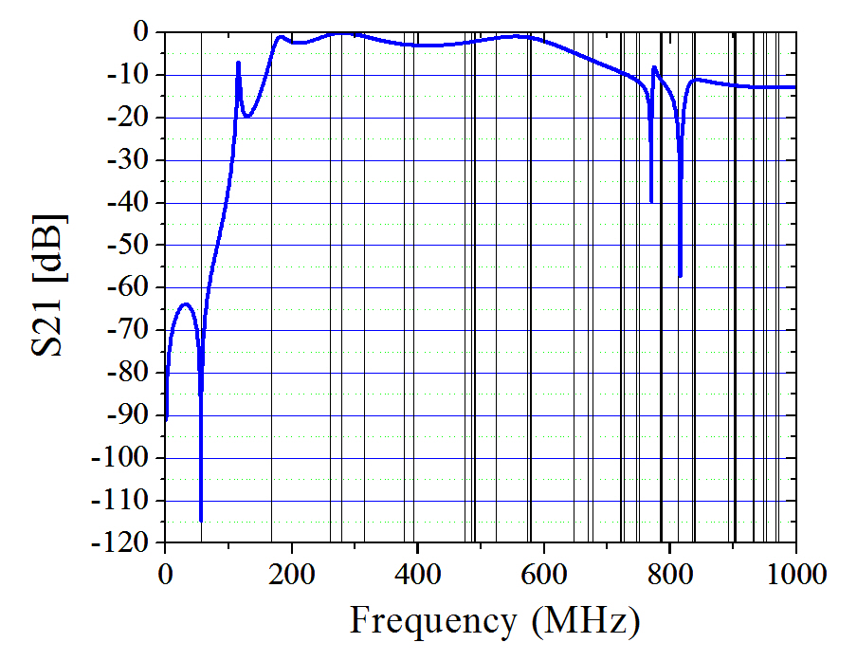
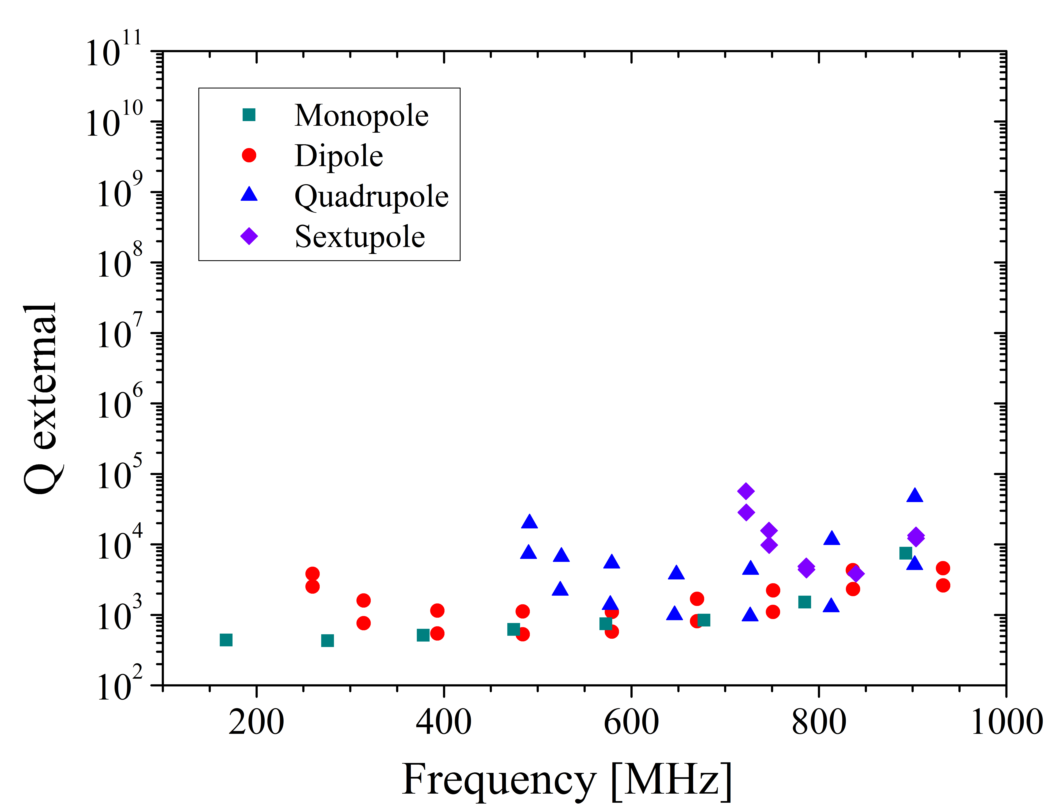
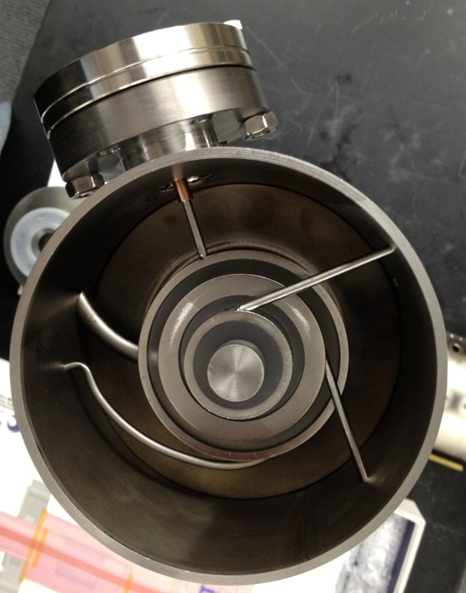
HOM filter
output
L3
L4
C1
A Chebyshev-type filter provides -110 dB attenuation at 56.3 MHz, which limits the output power of the fundamental mode to less than 1 mW.
The total power of the HOM modes excited by the beam in the 56 MHz SRF cavity is ~1.1 W during operation, both rings are included. With the filter installed, the HOM total power output is ~0.33 W/damper.
Prototype coupler is being fabricated at JLab, production units are on order from Niowave.
C2
L1
C3
L2

Slide 9
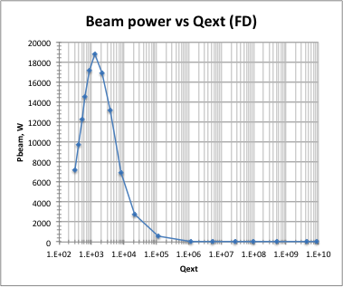
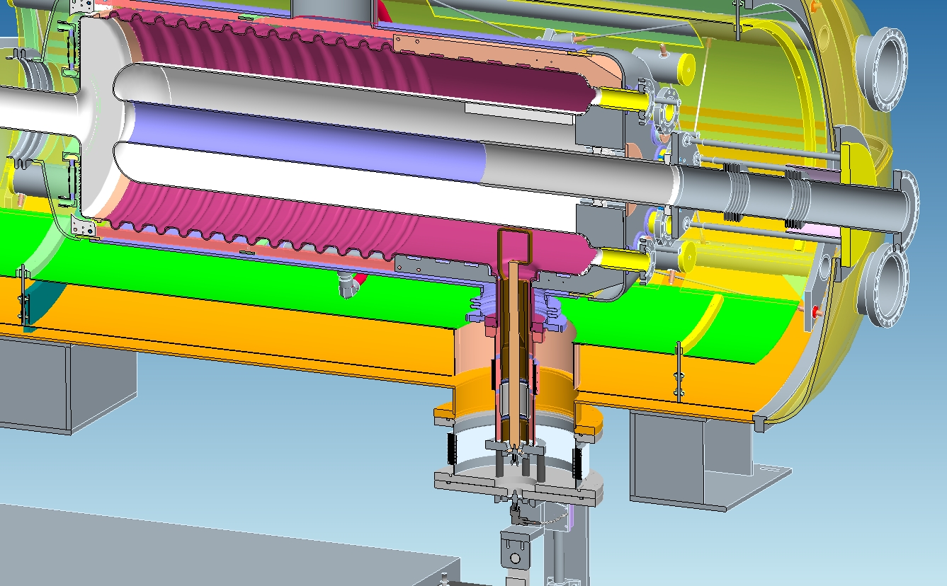
Fundamental mode Damper
FD is a unique component of the 56 MHz cavity. It will be inserted during the acceleration and retracted at store.
Heavy damping (Q_{load} = 300) makes the cavity “invisible” (= low impedance) to the beam during acceleration, therefore no large frequency tuning range is needed. It is moved between two positions by a stepper motors outside of the cryostat.
At a total beam current of 0.6 A, RF power extracted via FD is ~7 kW in fully inserted position. During motion the power will peak at about 19 kW and then quickly decrease to a very low value.
FD, fundamental power coupler and RF pick-up probe are fabricated by MPF.

Slide 10
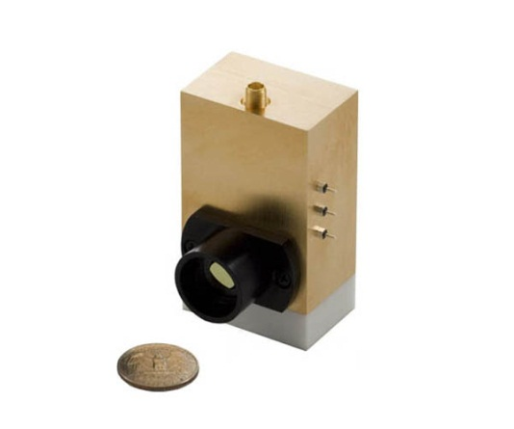
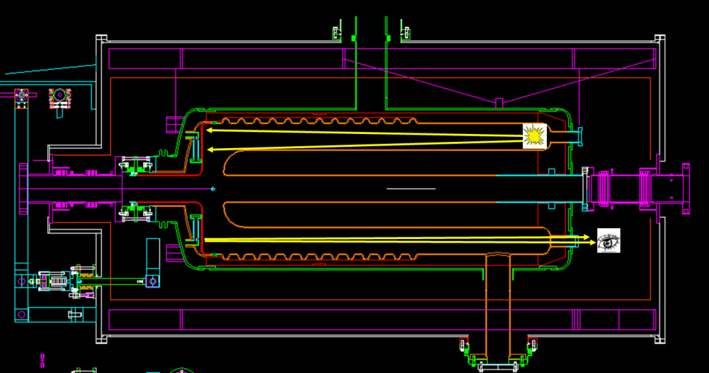
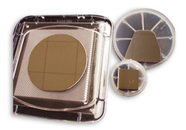
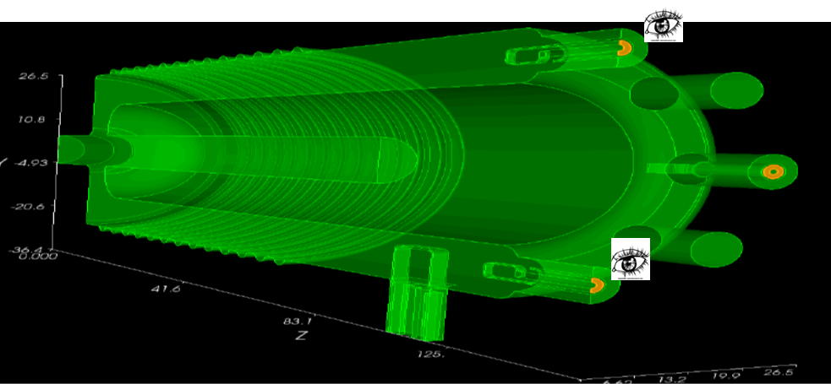
IR sensors for quench detection
MCT
(HgCdTe)
InSb
Purpose: detect thermal radiation from a quench event on the HOM dampers.
Sensors look into the cavity from end ports and detect IR radiation reflected from the hotspot
Nb highly reflective at IR wavelengths
Two units on 2 end ports. Each unit includes, mounted on a ZnSe window:
a detector, HgCdTe or InSb
a pulsable thermal source for testing: test one by flashing the source on the other

Slide 11
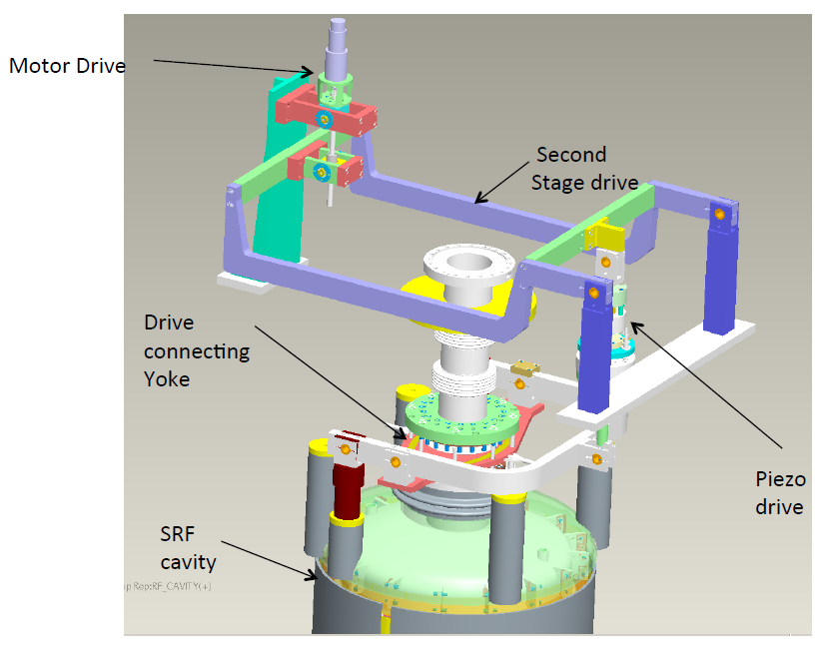
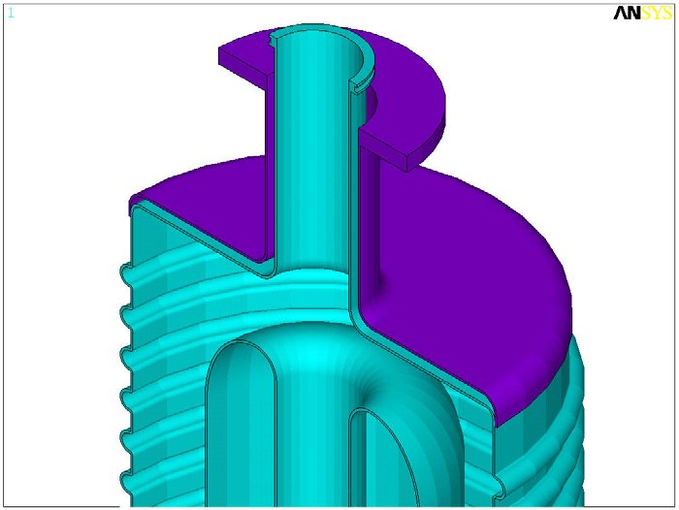
Frequency tuner
Mechanical tuning of the RF cavity resonance frequency will be achieved by physically pushing or pulling the upper part of the SRF cavity (tuning plate) to change the gap.
A tuning mechanism mounted on the helium vessel will provide both fast and slow tuning for the SRF cavity to change its fundamental resonance frequency.
The tuner plate is an internal structure of the RF cavity vessel. A crown head is welded over the tuner plate to take helium pressure. The tuner plate is free from helium and vacuum pressure.
Total leverage ratio is 24.88.

Slide 12
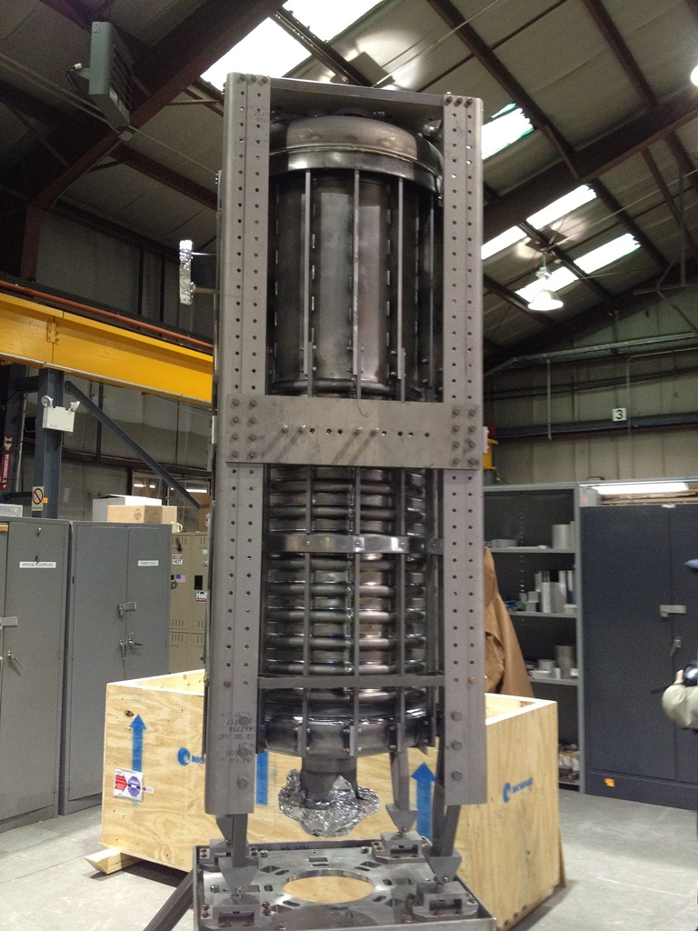
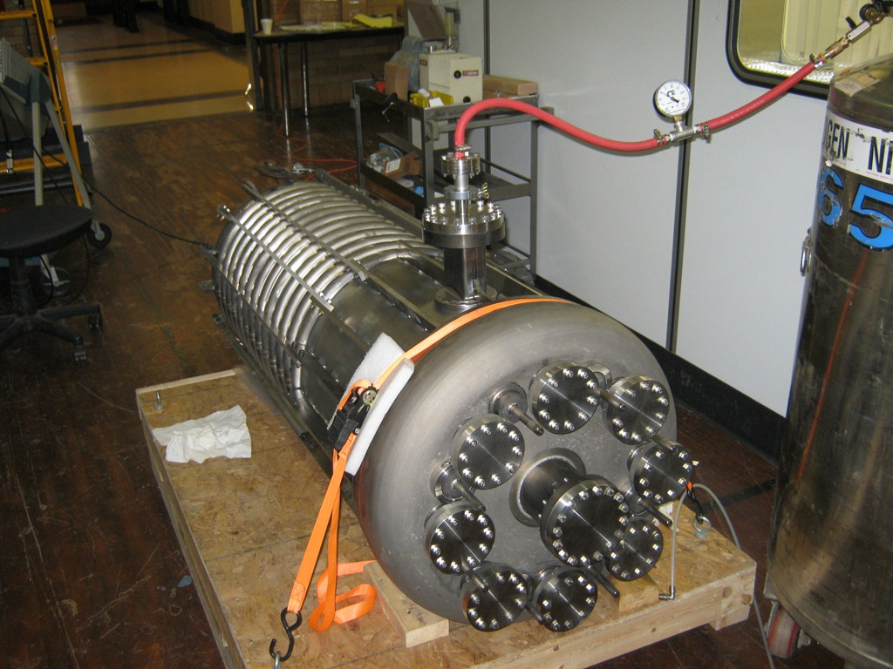
Cavity fabrication
Cavity arrived at BNL (no helium vessel yet)
Cavity and helium vessel were fabricated at Niowave.
Cavity pressure test at Niowave

Slide 13
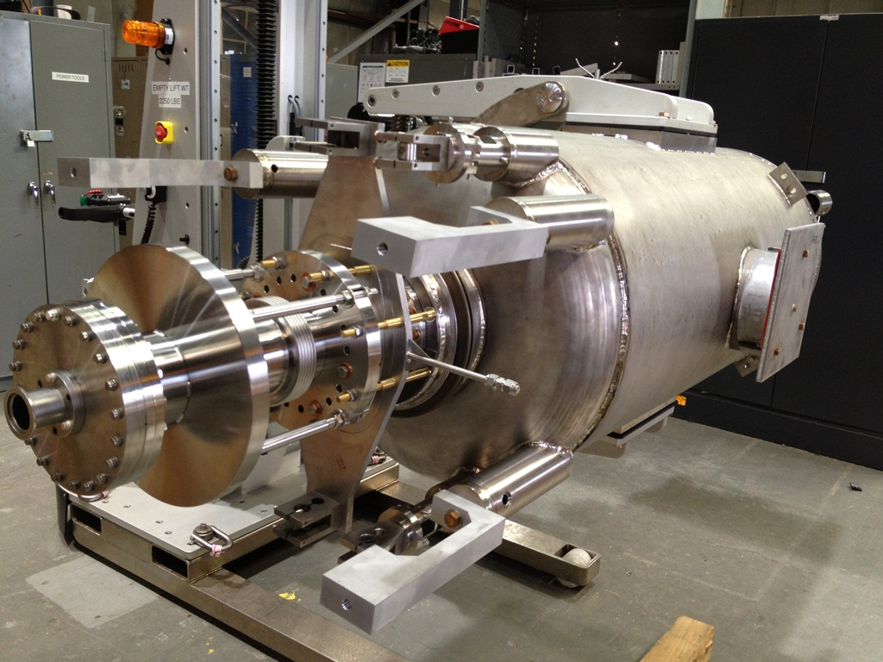
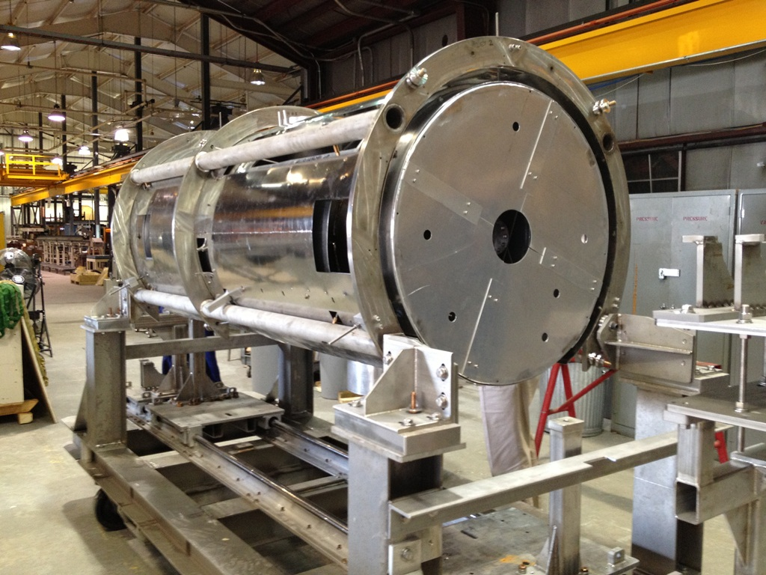
Mock-up assemblies in 905

Slide 14
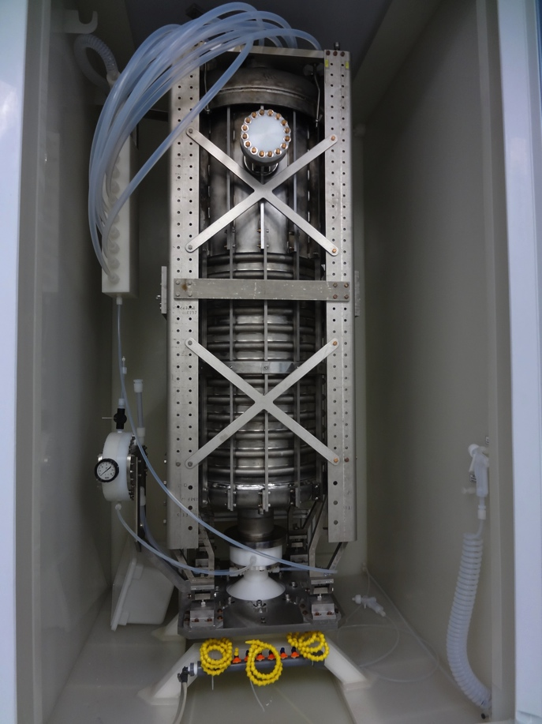
Cavity processing
Cavity in BCP cabinet at AES
To achieve good performance, preparation of the SRF cavities involves several important steps:
The cavity surface must be free of manufacturing defects. About 150 μm of material is etched out by Buffered Chemical Polishing (BCP) process to remove the damaged layer.
Vacuum baking at 600°C for 10 hours is performed for hydrogen removal.
Light BCP (~20 μm) to prepare fresh cavity surface.
Any residual particulate contamination is removed by High Pressure water Rinsing (HPR).
All subsequent cavity preparations are done in Class 100 or better clean room environment to facilitate particulate-free assembly until the cavity vacuum volume is closed up.
After the cavity is processed, its performance is tested in a vertical cryostat.
For BCP and HPR, we have a joint BNL/AES facility at AES.
At C-AD, we have SRF VTF facility in building 912, which includes a 800°C vacuum oven, Mezzanine clean room (Class 100 and Class 10,000 areas), and large and small Vertical Test Facilities (LVTF and SVTF) coupled to a dedicated ERL/VTF refrigeration system.
Cavity in Class 100 cleanroom at BNL

Slide 15
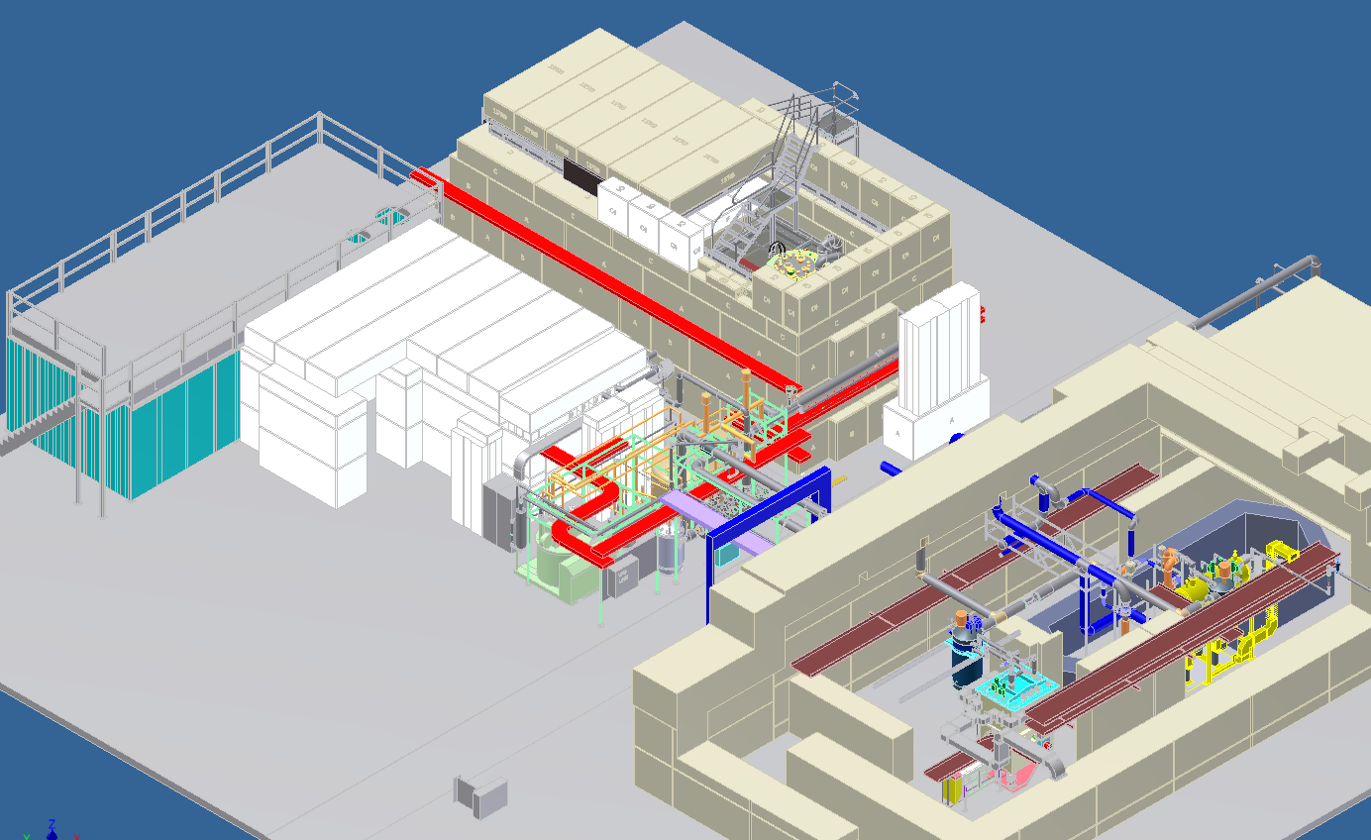
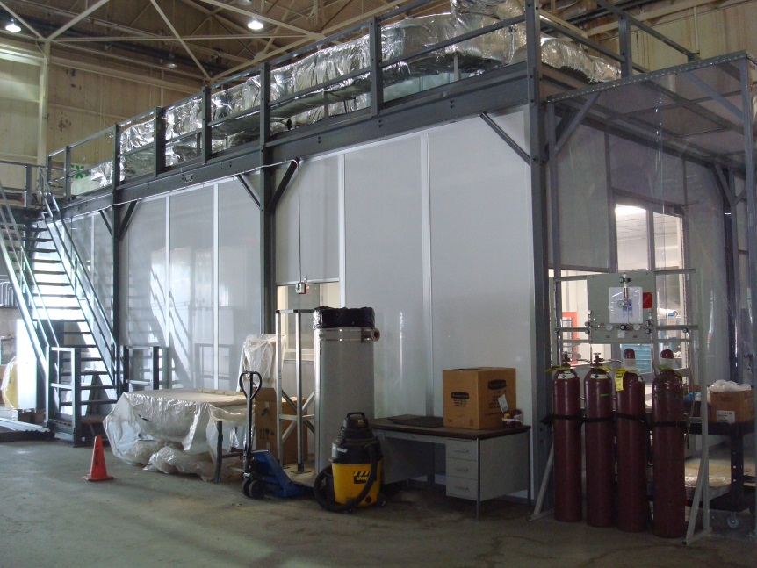
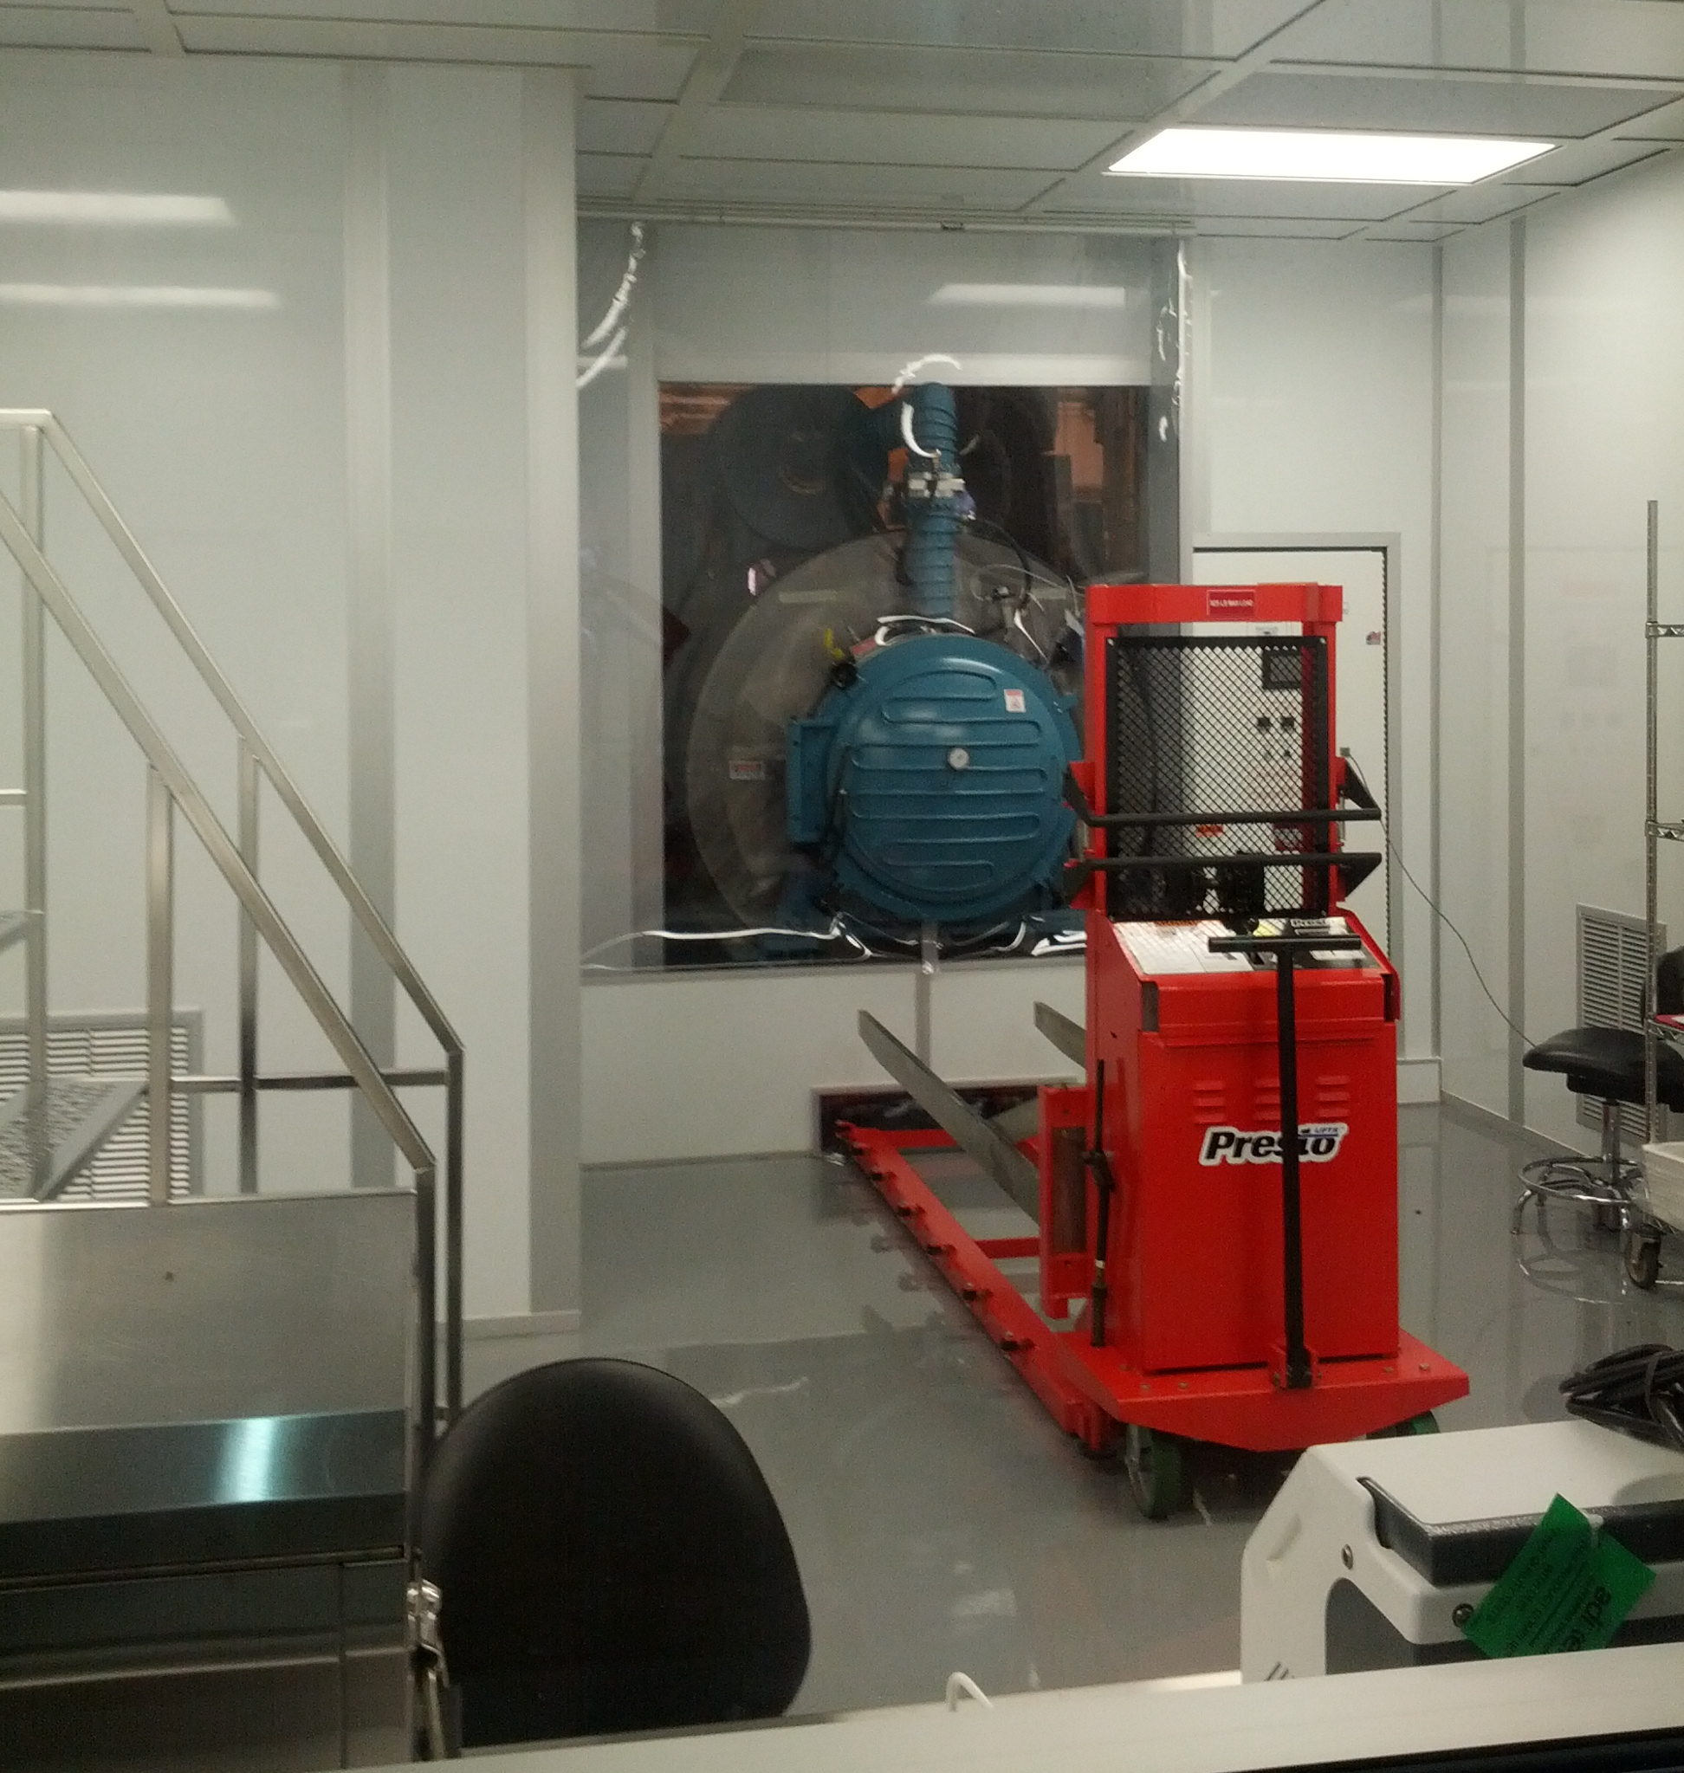
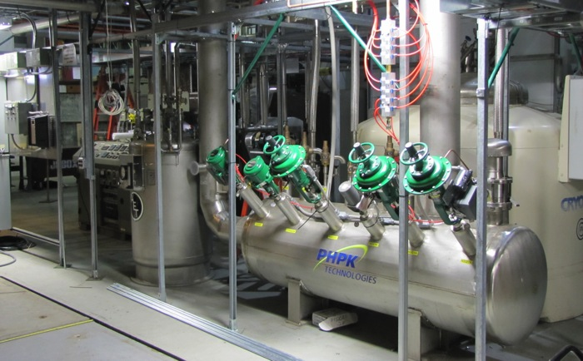
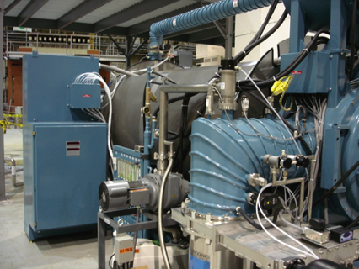
SRF facilities in building 912
Large Vertical Test Facility
Mezzanine clean room
ERL
Mezzanine clean room
Small VTF
ERL / VTF cryogenic system
ERL/VTF cryogenics
800°C vacuum oven for cavity baking

Slide 16
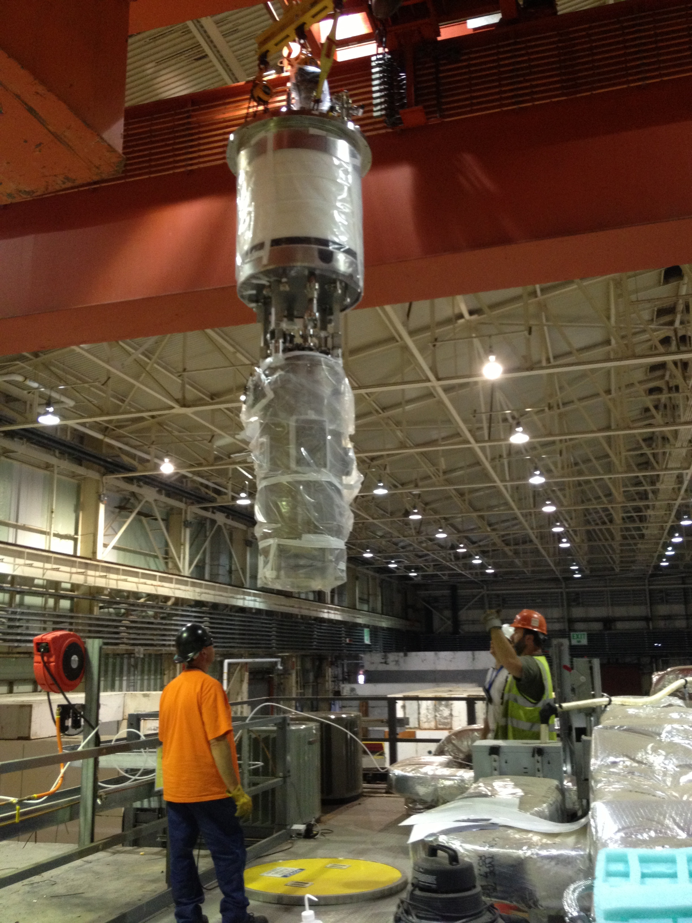
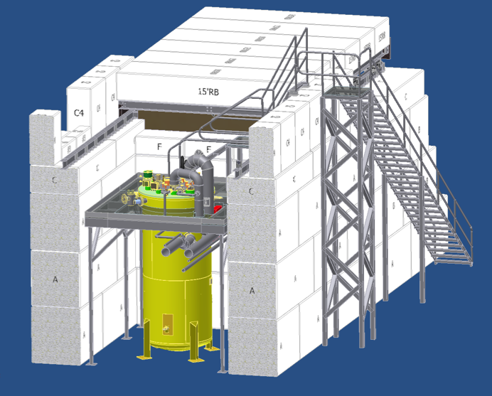
LVTF setup
VTF dewar top plate
Fundamental Damper port
Chimney

Slide 17
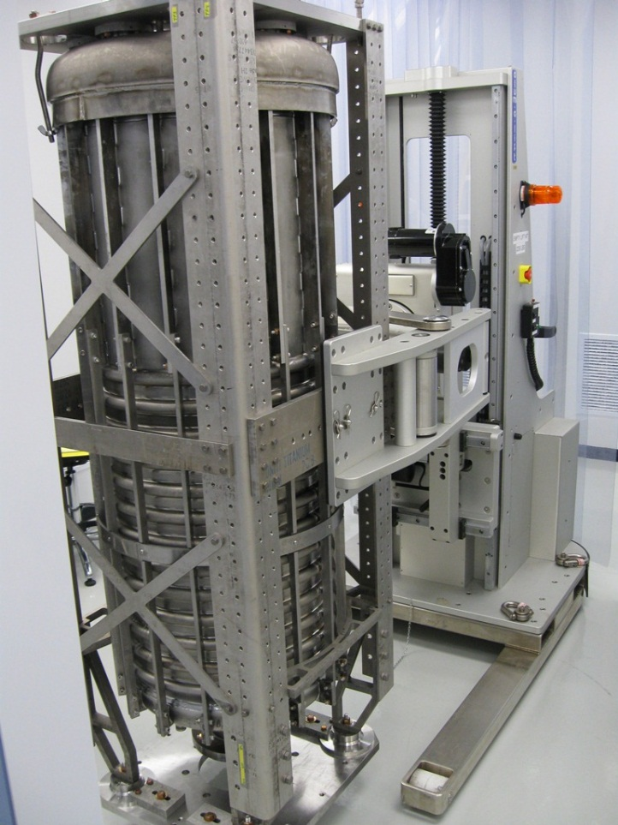
56 MHz project milestones (accomplished)
Feb 2012 Cavity received from manufacturer (Niowave)
Mar-May 2012 Heavy BCP etching removing 150 µm (BNL/AES)
Jun 2012 High temp bake @ 600°C (BNL)
Jul-Sep 2012 Helium vessel welding (Niowave)
Dec 2012 Light BCP etching removing 20 µm (BNL/AES)
Dec 2012 High power water rinse (BNL/AES)
Jan 2013 Sealed in clean room under vacuum, ready to assemble for testing (AES)
Jul 2013 Cavity assembly to the LVTF top plate in the Mezzanine cleanroom is complete, the insert is in LVTF for testing
Jul 2013 Vertical testing is in progress

Slide 18
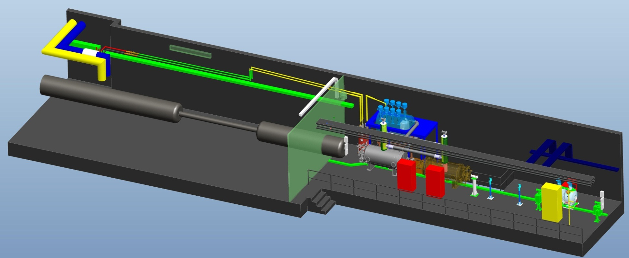
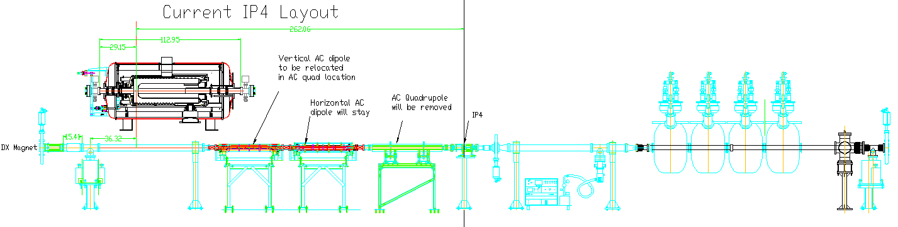
Installation in RHIC
56 MHz cavity will be installed in the IP4 area
Quiet Helium Source
D0
DX
56 MHz Cavity Cryostat
Future 56 MHz Cavity

Slide 19
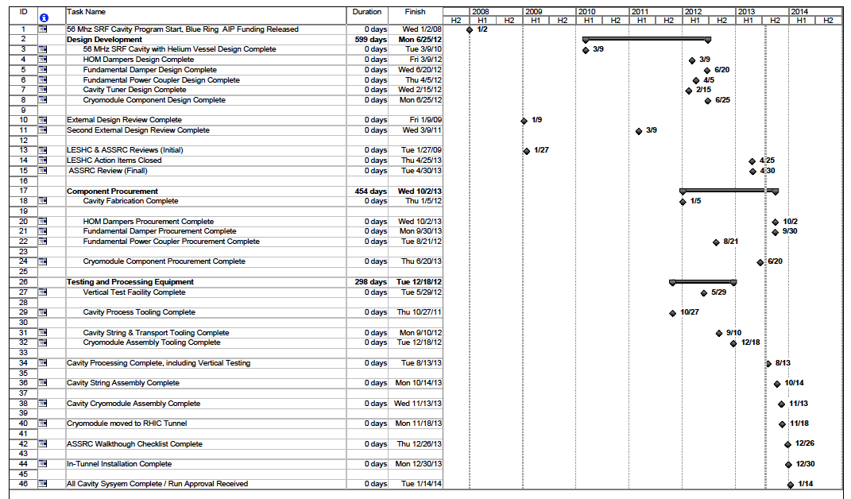
56 MHz project schedule

Slide 20
56 MHz project milestones
Aug 8, 2013 Cavity processing, including VTF testing, is complete
Sep 30, 2013 FD procurement is complete
Oct 2, 2013 HOM coupler procurement is complete
Oct 14, 2013 Cavity string assembly is compete
Nov 13, 2013 Cryomodule assembly is complete
Nov 18, 2013 Cryomodule moved to RHIC tunnel
Dec 26, 2013 ASSRC walkthrough checklist is complete
Jan 14, 2014 All systems are complete / Run approval is received

Slide 21
IP4 Layout (vacuum system components)

Slide 22
Cryogenic system at IP4
Condenser/Boiler
Condenses the boil-off vapor
Condenser/Boiler design heat load is 200 W
Heat transfer surface area 39.5 m² (condenser) & 33 m² (boiler)
Condenser side is operated at 4.4 K and 1.2 bar
Boiler side is operated at 4.3 K and 1.09 bar
Condenser Load Heater
A 50 W load heater is mounted in the helium bath to balance the effect of dynamic heat load to maintain a constant heat load on condenser side, and therefore a constant pressure.
HOM Cooling Loop
Each HOM is cooled by a helium siphon loop – liquid helium enters HOM and outgoing tube is heated to induce helium flow and remove the heat generated within the HOM.
RHIC – [R] Vapor Return
RHIC Interface
Phase Separator
RHIC [S]
4.8K LHe
Quiet Helium Source
[Condenser System]
[WR] RHIC
Warm Return
56MHz SCRF Cavity
Heater
Helium Compressor

Slide 23
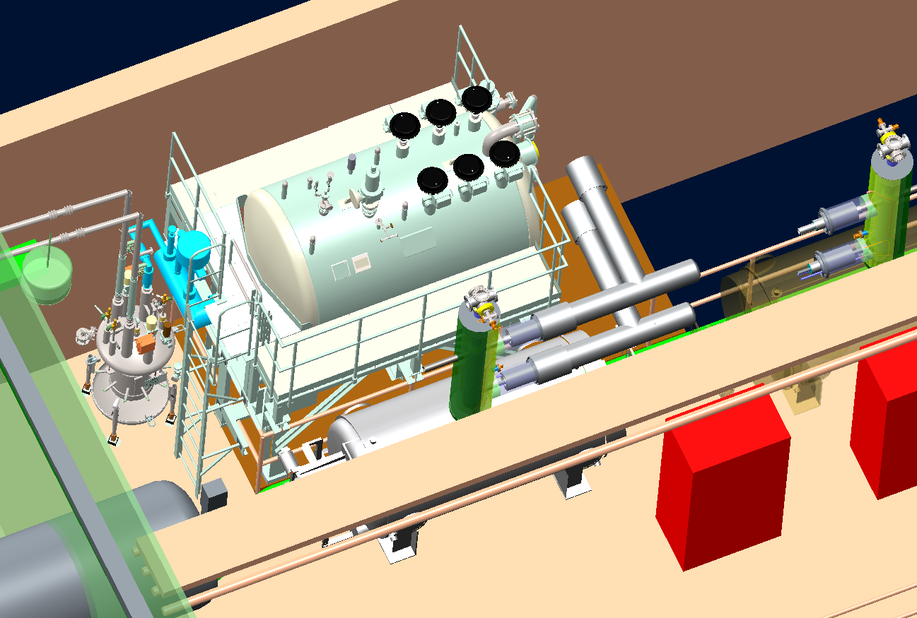
Cryogenic system layout
Quiet Helium Source
Phase Separator
Cryoduct
56MHz SCRF Cavity

Slide 24
Cryogenic system schedule
Item | Status
Helium Compressor | In house
QHS (Condenser Cryostat) and piping | To be delivered before Oct 2013
Warm Piping | In progress – to be complete before Dec 2013
Final cavity connections and final I/O check out | Before Start of RHIC Run – Jan 2014

Slide 25
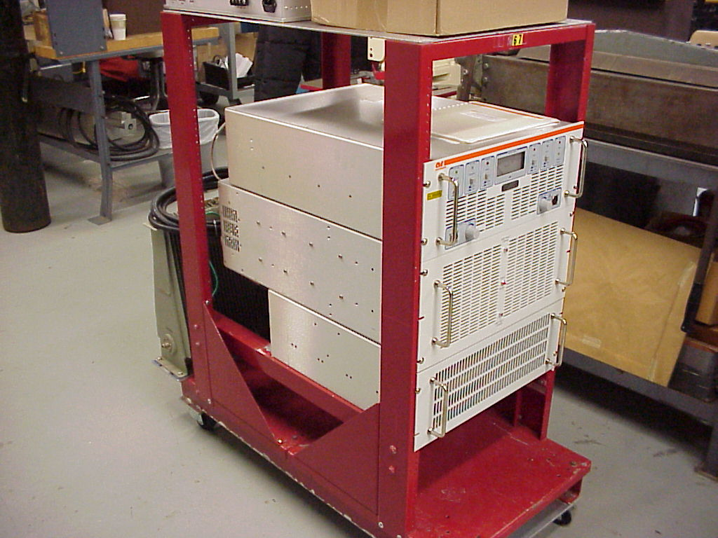
RF system
The 56 MHz SRF cavity is a beam driven cavity. RF system needs power only to fight microphonics detuning (1 Hz peak):
0.63 kW
However, the power coming back from the cavity to RF amplifier is
1.88 kW
1 kW RF power amplifier was purchased from AR. Its initial testing was OK, but it failed recently during re-testing and is back at the vendor for repairs.
A spare amplifier is on order from TOMCO

Slide 26
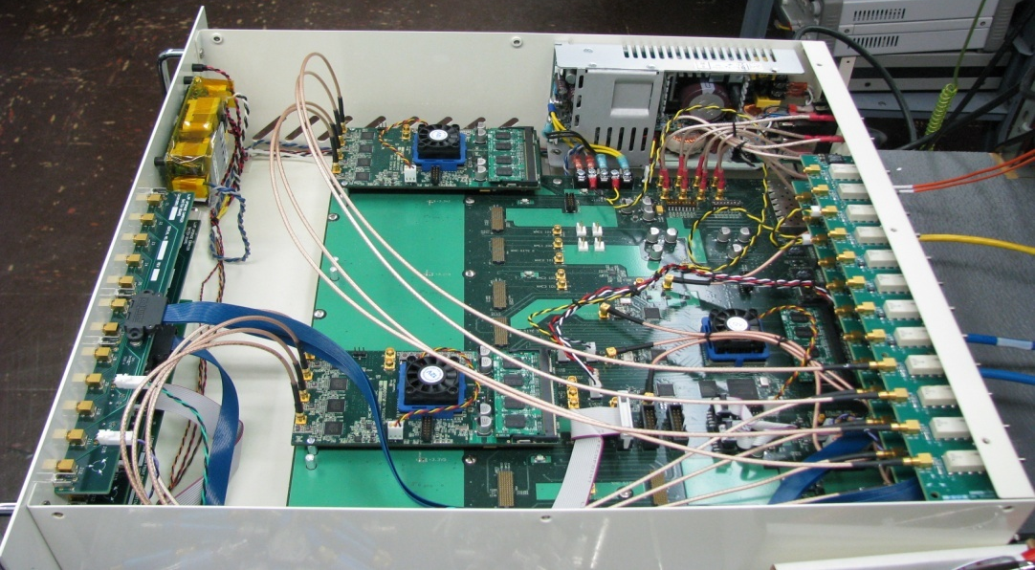
LLRF control requirements
Cavity field control objectives
Amplitude and phase: 1E-4 rms (“AC” variation only, absolute “DC” voltage and phase determined by beam and cavity detuning).
Adiabatic turn on under control of state machine slowly pushing cavity frequency toward beam frequency, via stepper tuner.
“Slow” feedback via piezo tuner for control of cavity impedance to maintain nominal 2.0 MV on the gap.
“Fast” feedback via LLRF drive and 1kW PA to compensate microphonic detuning, i.e. “AC” variations about the nominal 2.0 MV setpoint within a few hundred Hz modulation bandwidth.
Cavity and machine protection.
56 MHz system is a variant of the recently developed generic LLRF Controller, currently being used at EBIS, AGS, RHIC and ERL.

Slide 27
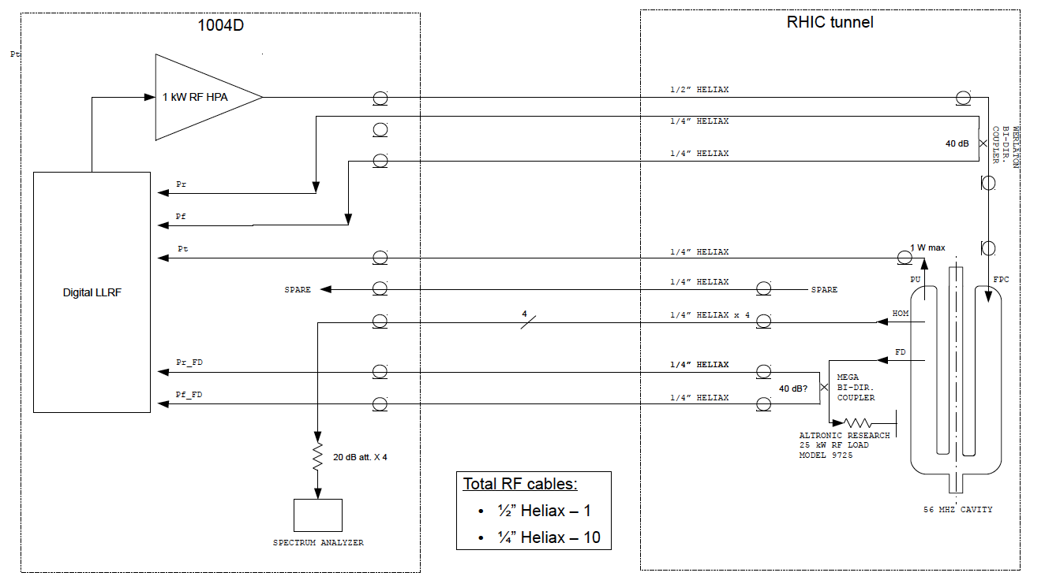
RF connections

Slide 28
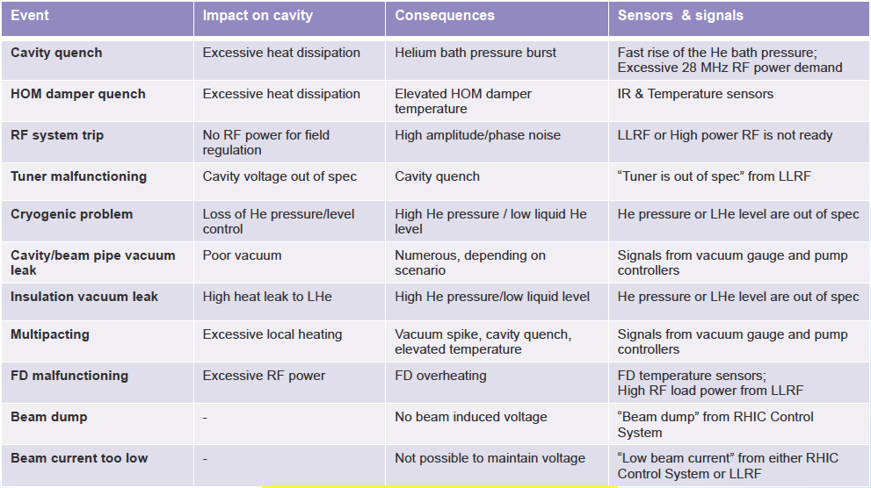
Off-normal events, consequences and actions

Slide 29
Machine protection system

Slide 30
Summary
56 MHz cavity fabrication and processing is complete
Vertical test of the cavity is in progress
Cryostat fabrication is progressing well, many components are fabricated and dry-fitted
The most critical components for the project at the moment are HOM couplers and FD
Current schedule allows installation for Run-14 and everybody is working hard to make this happen
Summary

Slide 31
Backup slides

Slide 32
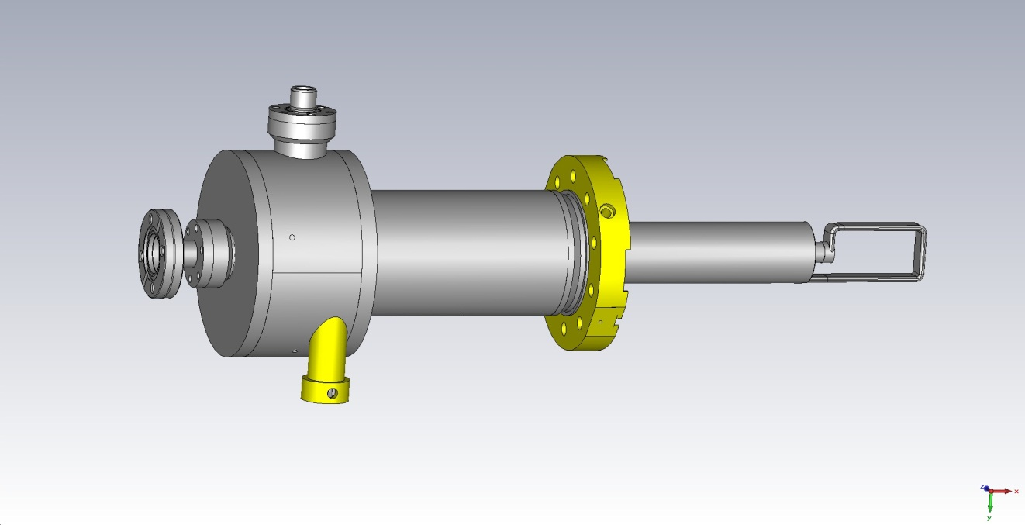
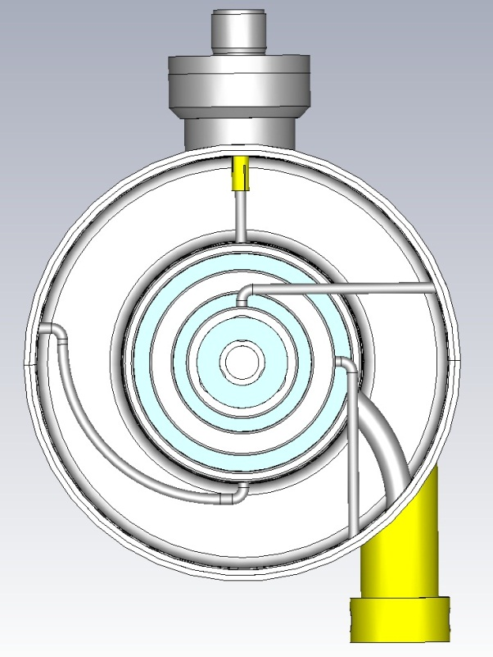
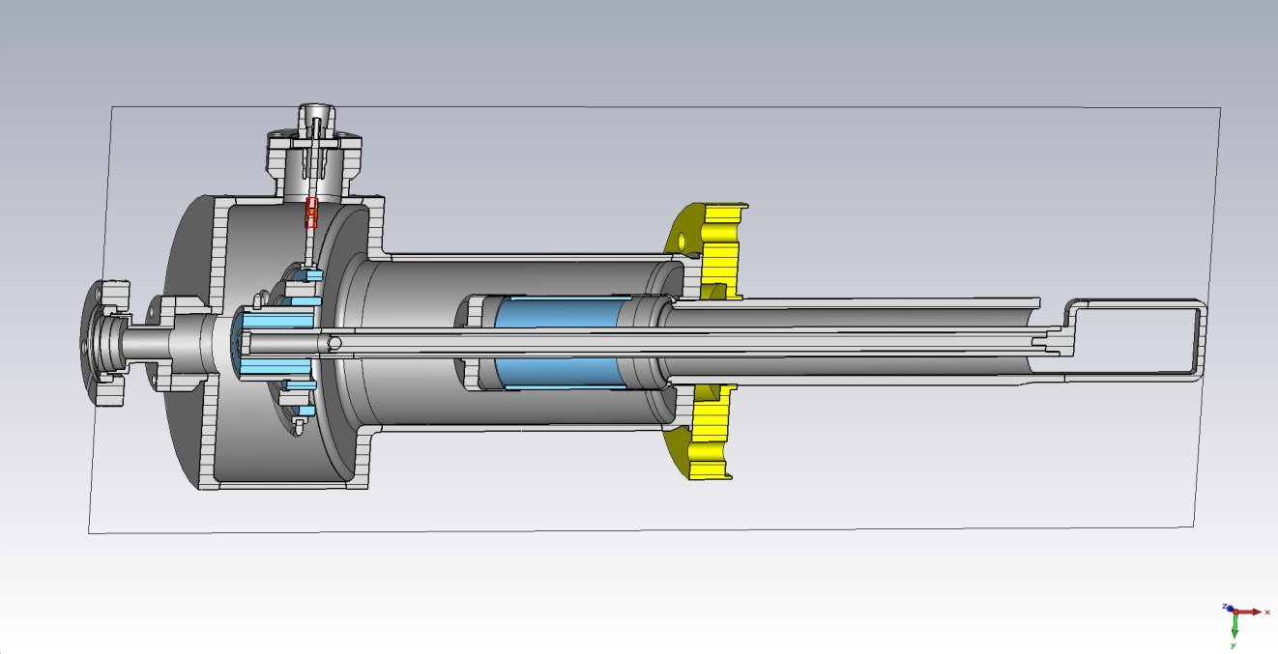
HOM couplers
The final version is remodeled from the Niowave wave version. Dimensions changed in some components, but maintained same high performance.
Prototype will be fabricated in Jlab.
Reuse some of the components from Niowave.

Slide 33
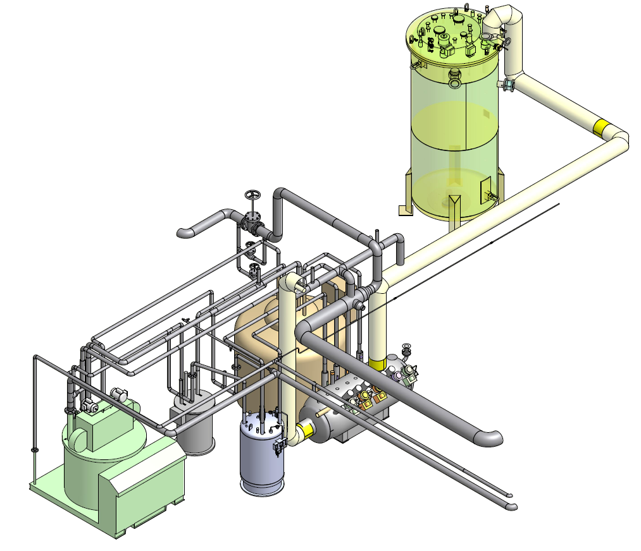
ERL/VTF cryogenic system
360 W 4 K refrigerator.
A liquid ring pump is used to reach 2 K operation, capable of handling a 100 watt heat load.
1000 gallon LHe storage dewar.
38,000 gallon warm helium gas storage tank.
VTD
He dewar
Wet expander
1660 plant
Valvebox
Subcooler

Slide 34
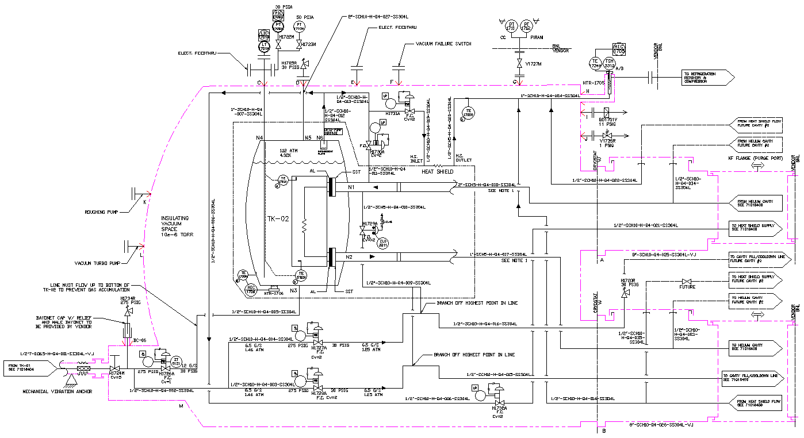
QHS P&ID – Interface review
Condenser
Boiler Vessel
Vapor Return
Liquid Supply

Slide 35
56 MHz SRF Cavity Cryomodule P&ID

Slide 36
Small helium compressor location

Slide 37
Generic LLRF controller
56 MHz system is a variant of the recently developed generic LLRF Controller, currently being commissioned at both RHIC and the EBIS injector for RHIC.
Two major components from which any Controller is configured:
“Controller” = “Carrier Board” + “Daughter Modules”
A LLRF Controller is a stand-alone configurable, modular, hardware / software platform, the basic building block from which a complete LLRF system is built up.
Carrier Board
Stand alone control system interface, daughter host platform, communication hub, timing, data acquisition management, power …
Daughter Module
Provide system specific functionality (ADCs, DACs, DSP, etc.) and signal processing horsepower.

Slide 38
1 kW RF power amplifier (AR)
SPECIFICATIONS
Model KAA5040M16
RATED POWER OUTPUT..............................................1000 Watts
INPUT FOR RATED OUTPUT ........................................1.0 mW maximum
POWER OUTPUT @ 1dB COMPRESSION....................1000 Watts minimum @ 56 MHz, ± 5 MHz
FLATNESS.....................................................................± 2.0 dB maximum unleveled, ± 0.5 dB leveled
FREQUENCY RESPONSE.............................................56 MHz +/- 5 MHz instantaneously
GAIN ..............................................................................60 dB minimum
GAIN ADJUSTMENT RANGE.........................................30 dB typical
INPUT IMPEDANCE.......................................................50 Ohm nominal
OUTPUT IMPEDANCE...................................................50 Ohm nominal
MISMATCH TOLERANCE ..............................................infinite
PROTECTION................................................................VSWR, over-temperature, overdrive, Integrated 1000W
circulator
MODULATION CAPABILITY...........................................Will faithfully reproduce AM, FM, or pulse modulation
appearing on the input signal
HARMONIC DISTORTION .............................................-46 dBc to -10 dBc (-25 dBc min @ 56 MHz, ±5 MHz)
SPURIOUS OUTPUTS...................................................–70 dBc maximum

Slide 39
1 kW RF power amplifier (TOMCO)

