Slide 1
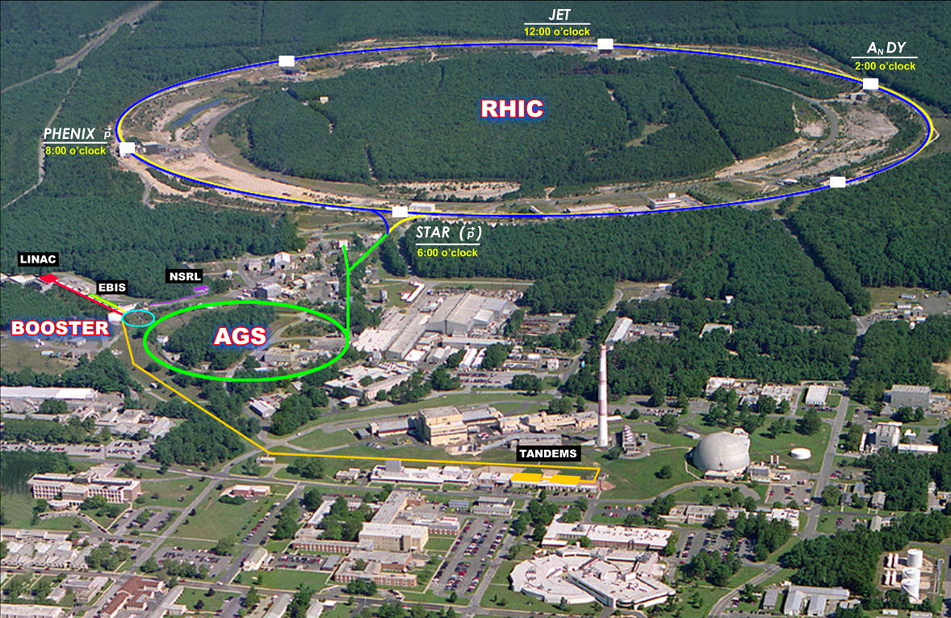
Outlook on Run-14 and beyond Wolfram Fischer
31 July 2013
RHIC Retreat, BNL
Notes:
25 July 2013, 09:10, 15 min (incl. questions)

Slide 2
Contents
Physics outlook
Recent performance, limits
PAC recommendations for Run-14 and Run-15
Upgrades
Projections for Run-13 and Run-14

Slide 3
B. Mueller

Slide 4
B. Mueller

Slide 5
B. Mueller

Slide 6
B. Mueller

Slide 7
B. Mueller

Slide 8
B. Mueller

Slide 9
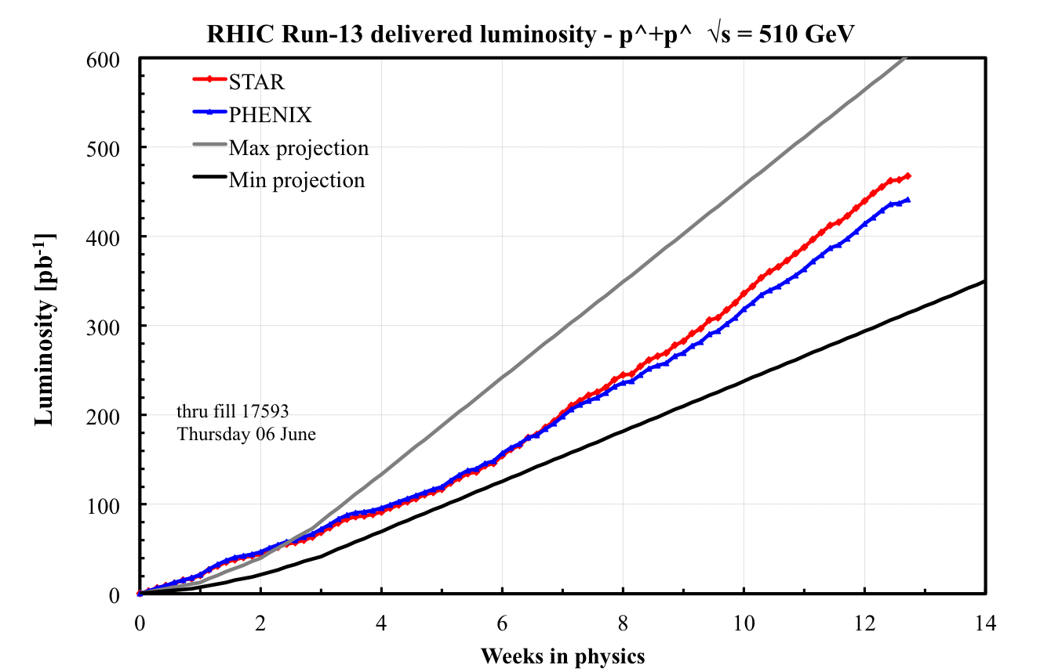
Run-13 luminosity
Best weeks
(50 pb⁻¹/week) close to max projected (56 pb⁻¹/week)
New: OPPIS, AGS survey, upgrade 9 MHz, upgrade pC, new STAR Be pipe, e-lens lattice tested, e-lens hardware commissioning, longitudinal damper injection and ramp, …

Slide 10
Run-13 polarization (preliminary)
Transverse emittance reduction after optimization of AGS transition crossing
50%
H-jet measured polarization (average over intensity, time, run)
H-jet measures intensity-averaged P
LP² and LP⁴ are luminosity-averaged
Luminosity-averaged values are higher than intensity-averaged values
 | Run-12 | Run-13
Blue | 50.3% | 49.8%
Yellow | 53.5% | 53.2%

Slide 11
V. Ranjbar

Slide 12
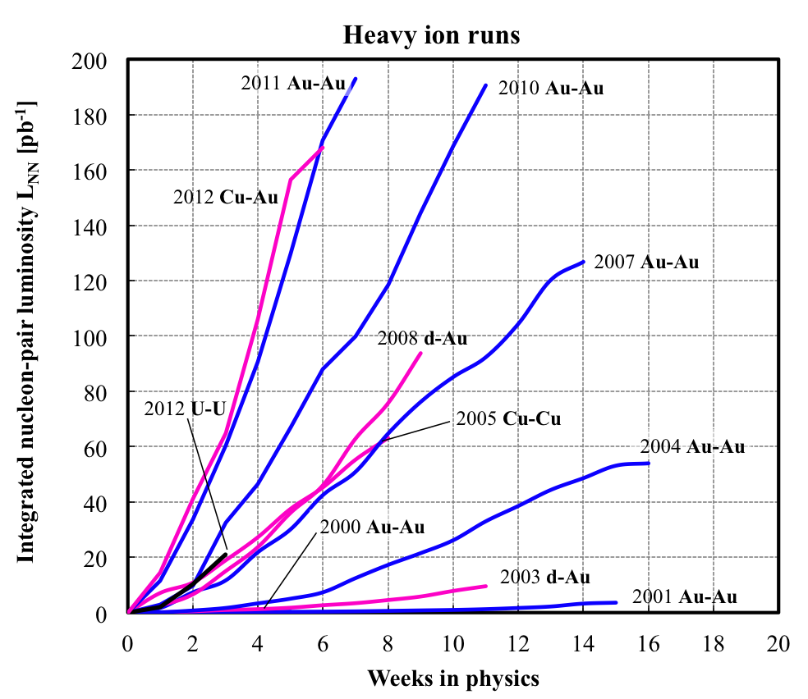
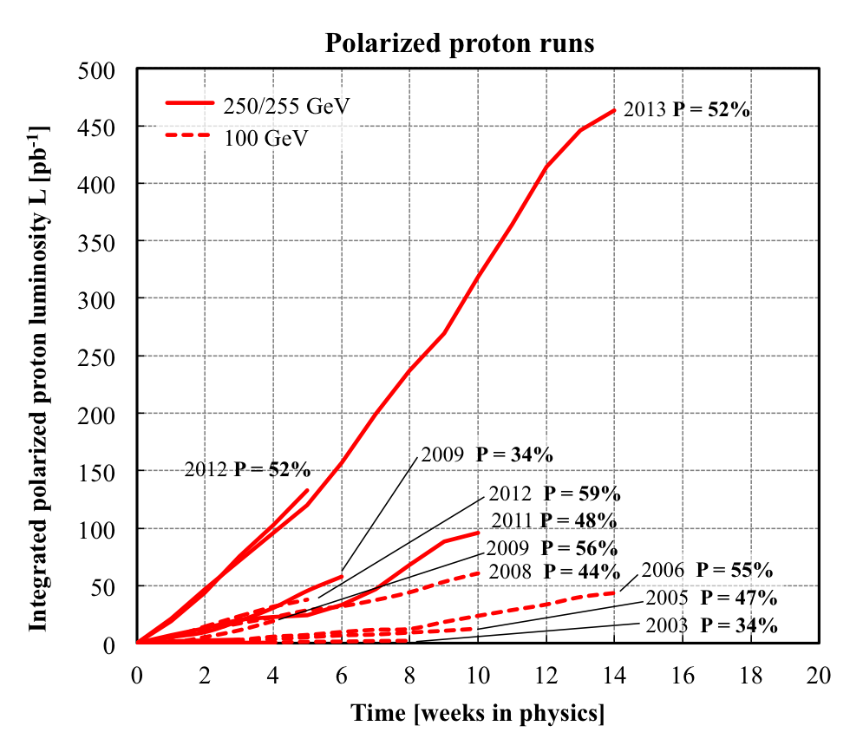
Delivered Integrated Luminosity and Polarization
Nucleon-pair luminosity: luminosity calculated with nucleons of nuclei treated independently; allows comparison of luminosities of different species; appropriate quantity for comparison runs.

Slide 13
Performance measure: setup time
Setup time: - for 1st species in run: from both rings cold to 1st physics store - for following species: from beginning of setup to 1st physics store
Setup time [d]
Example: Setup of 250/255 GeV polarized proton operation as 1st species most demanding operating mode Gain of 2 weeks in setup from 2009 to 2013 savings of ~$1M (incremental operating cost ~$0.5M/week) major upgrade: beam based feedbacks (orbit, tune, coupling)
TRANSPARENT: low energy
BLUE: heavy ion runs
INTRANSPARENT: high energy
RED: polarized proton runs
Notes:
----- Meeting Notes (7/24/13 10:42) -----
go to 40 days on scale

Slide 14
Store-to-store time, time in store
TRANSPARENT: low energy
BLUE: heavy ion runs
INTRANSPARENT: high energy
RED: polarized proton runs
Time in store = store time / calendar time (denominator includes scheduled maintenance, failure, setup, beam experiments)
Time in store goal: 60%
Notes:
----- Meeting Notes (7/24/13 10:42) -----
Fermi and CERN data

Slide 15
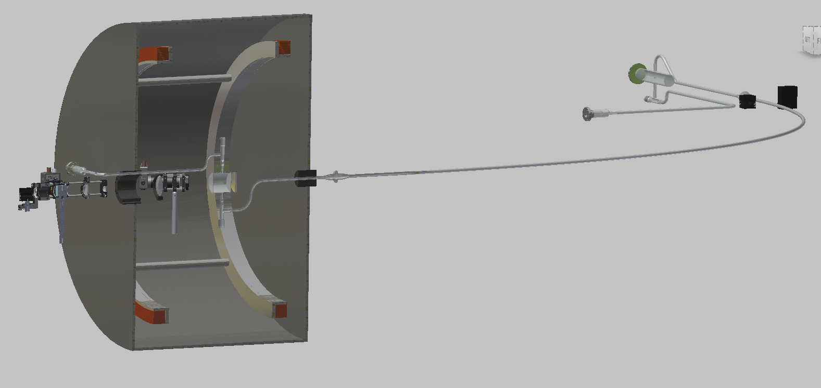
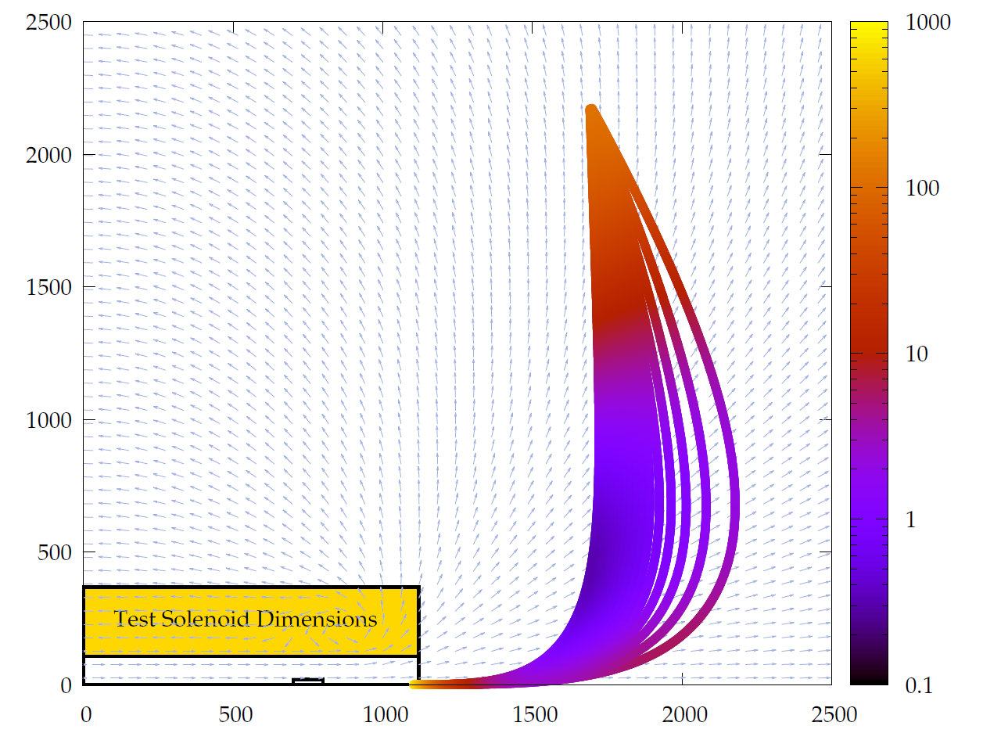
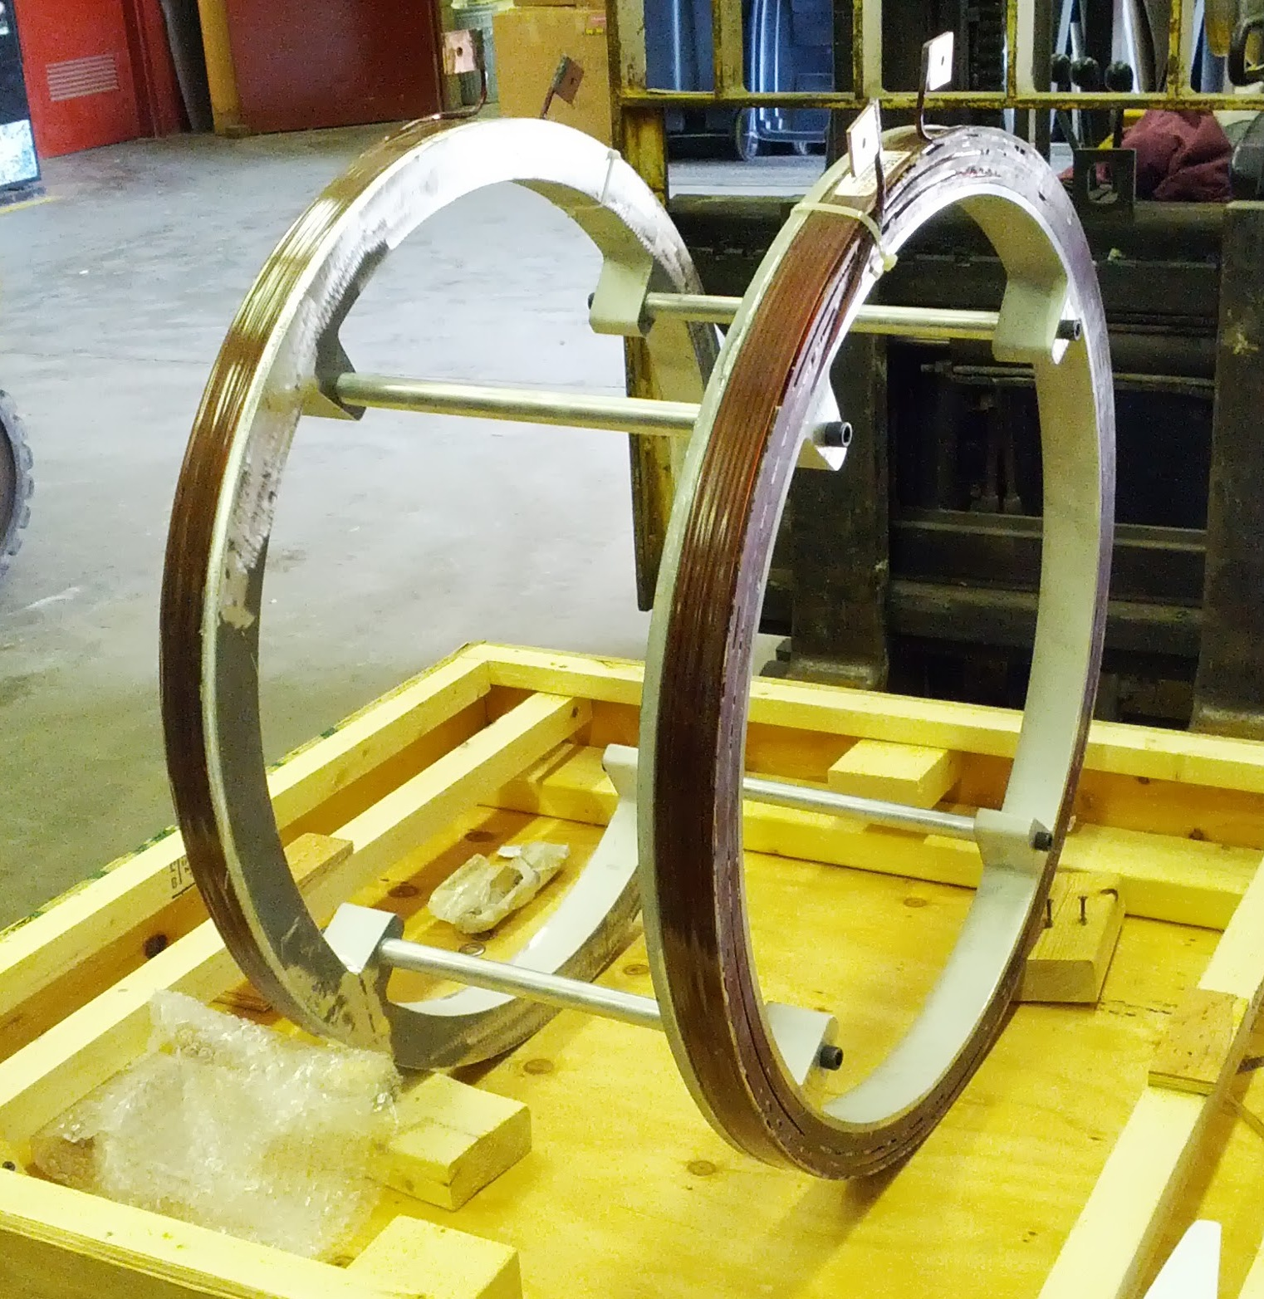
Run-13 test: He-3 acceleration in AGS
H. Huang et al.
Polarized He-3 source under development at MIT (R. Milner, J. Maxwell, C. Epstein)
Accelerated unpolarized He-3 nuclei (helions) in AGS: 3.3x more intensity at AGS extraction than 2012 4x10¹⁰/bunch in reach at AGS extraction [EBIS intensity increase from 3.4 to 3.9x10¹⁰; 2 bunch merges in Booster, can do 2 more merges in AGS; better Booster injection field regulation; for polarization preservation have demonstrated: vertical tune at Booster injection of 4.09, AGS tune of 8.97]
2013: test of transfer depolarization of ³Heh into EBIS (spare) magnet
CAD of new polarizer and test transfer line
Transfer path simulation
New Helmholtz pair

Slide 16
Recommendation of the Program Advisory Committee
11-12 June 2013

Slide 17
RHIC luminosity and polarization goals
parameter |  | unit | achieved |  | goals
Au-Au operation |  |  | 2011 |  | ≥ 2014 3D stochastic cooling + 56 MHz SRF
energy | GeV/nucleon |  | 100 |  | 100
no colliding bunches | … |  | 111 |  | 111
bunch intensity | 10⁹ |  | 1.3 |  | ≥ 1.1
avg. luminosity | 10²⁶ cm⁻²s⁻¹ |  | 30 |  | 40
p↑-p↑ operation |  |  | 2013 |  | ≥ 2014 source + e-lenses
energy | GeV |  | 100 | 255 | 100 | 255
no colliding bunches | … |  | 107 | 111 | – 107 –
bunch intensity | 10¹¹ |  | 1.6 | 1.85 | 1.8 | 2.5
avg. luminosity | 10³⁰ cm⁻²s⁻¹ |  | 33 | 135 | 60 | 300
avg. polarization* | % |  | 59 | 53 | 62 | 56
*Intensity and time-averaged polarization as measured by the H-jet. Luminosity-averaged polarizations, relevant in single-spin colliding beam experiments, are higher. For example, for intensity-averaged P = 48% and R_{x} = R_{y} = 0.2 (255 GeV, 2013), the luminosity-averaged polarization is P = 53%.

Slide 18
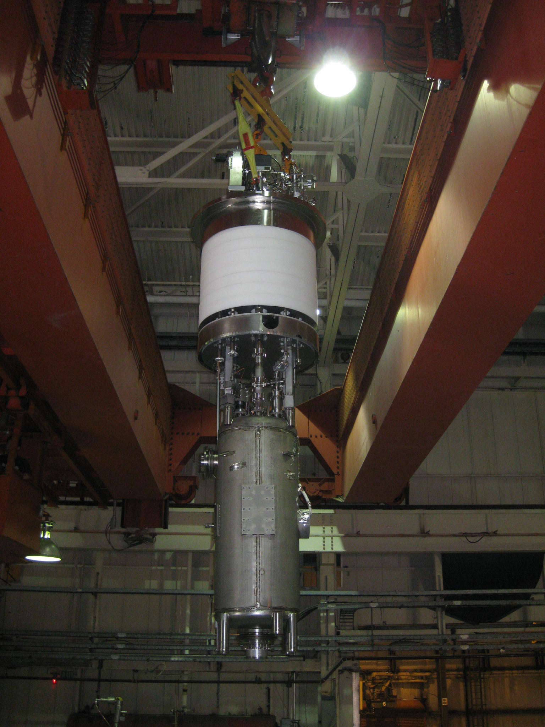
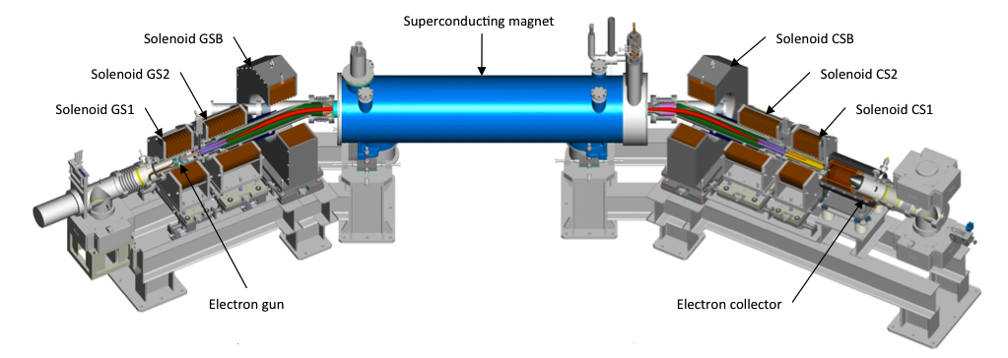
Current and future large performance upgrades
Cavity moved into vertical test facility
56 MHz SRF (heavy ions, high energy) provides more longitudinal focusing against IBS 30-50% luminosity increase depending on vertex cut plan installation in 2013
Electron lenses (polarized protons) addresses beam-beam limit 2x luminosity increase hardware/e-beam commissioning under way hadron beam commissioning in Run-14
Electron cooling (heavy ions, low energy) based on bunched beam cooling using SRF 10x luminosity increase for Beam Energy Scan II (in search of critical point in QCD phase diagram) plan for operation in 2018

Slide 19
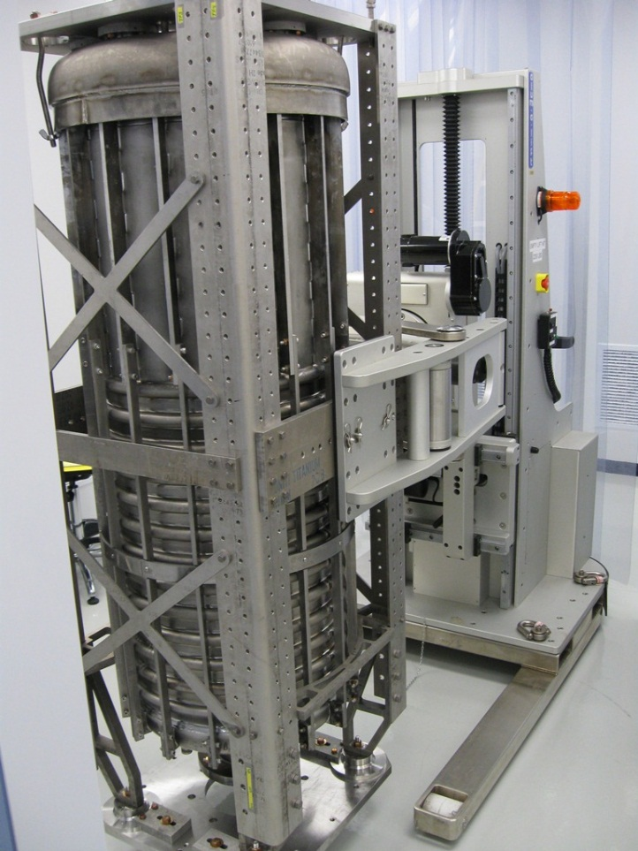
56 MHz project milestones
Feb 2012 Cavity received from manufacturer (Niowave)
Mar-May 2012 Heavy BCP etching removing 150 µm (BNL/AES)
Jun 2012 High temp bake @ 600°C (BNL)
Jul-Sep 2012 Helium vessel welding (Niowave)
Dec 2012 Light BCP etching removing 20 µm (BNL/AES)
Dec 2012 High power water rinse (BNL/AES)
Jan 2013 Sealed in clean room under vacuum, ready to assemble for testing (AES)
Jul 2013 Cavity assembly to the LVTF top plate in the Mezzanine cleanroom is complete, the insert is in LVTF for testing
Jul 2013 Vertical testing is in progress
Aug 8, 2013 Cavity processing, including VTF testing, is complete
Sep 30, 2013 FD procurement is complete
Oct 2, 2013 HOM coupler procurement is complete (critical path item)
Oct 14, 2013 Cavity string assembly is compete
Nov 13, 2013 Cryomodule assembly is complete
Nov 18, 2013 Cryomodule moved to RHIC tunnel
Dec 26, 2013 ASSRC walkthrough checklist is complete
Jan 14, 2014 All systems are complete / Run approval is received

Slide 20
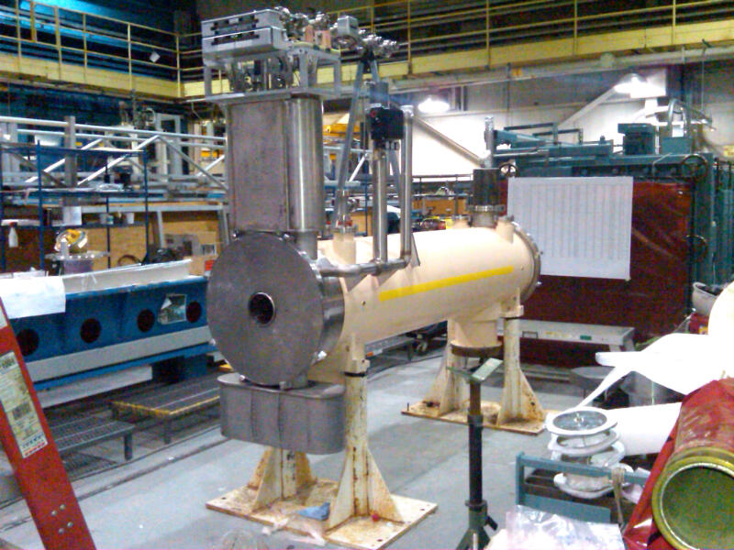
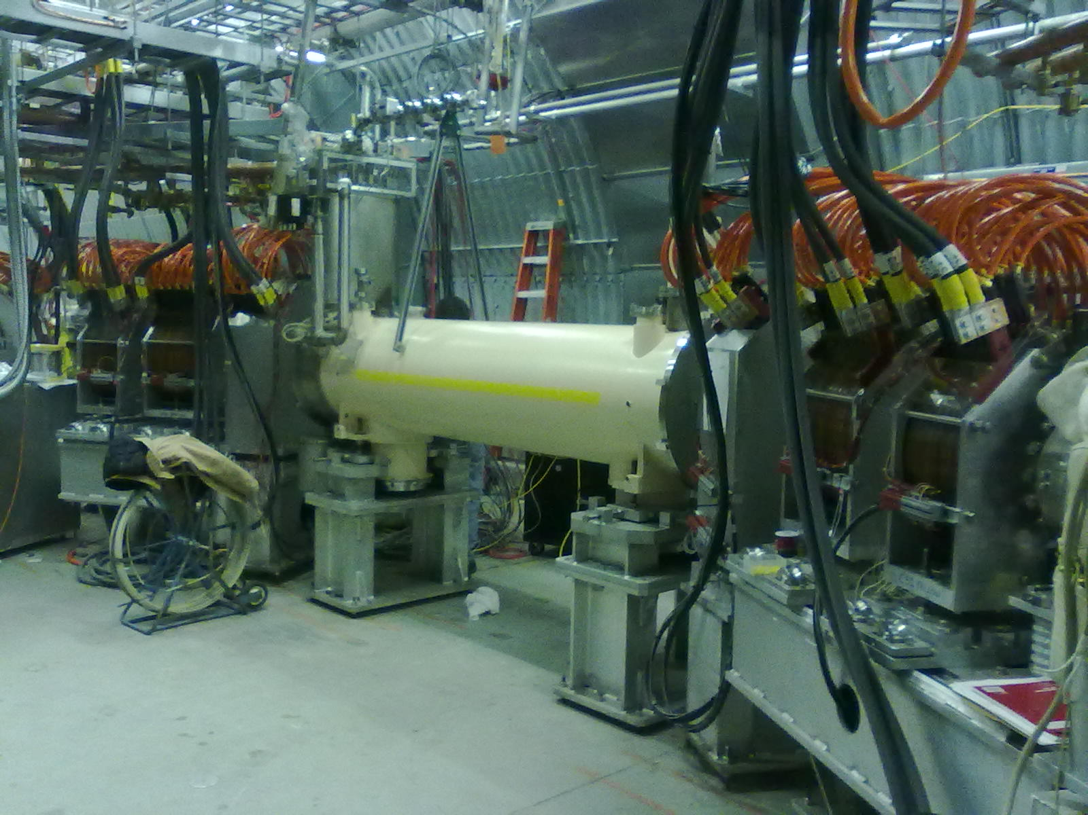
Status e-lenses
SC solenoid #1 completed on 01/09/13, #2 on 02/20/13 both solenoids tested horizontally ≥ 5 T (≥ 6 T in vertical test)
Blue lens with EBIS spare solenoid: e-beam commissioning completed Yellow lens with SC solenoid #1: hardware commissioning under way New e-lens lattice tested (needs modification), new single bunch p diagnostics
Complete installation in summer 2013, beam commissioning in Run-14
SC solenoid #1 in SMD
Yellow e-lens in RHIC tunnel
Notes:
2nd collector?

Slide 21
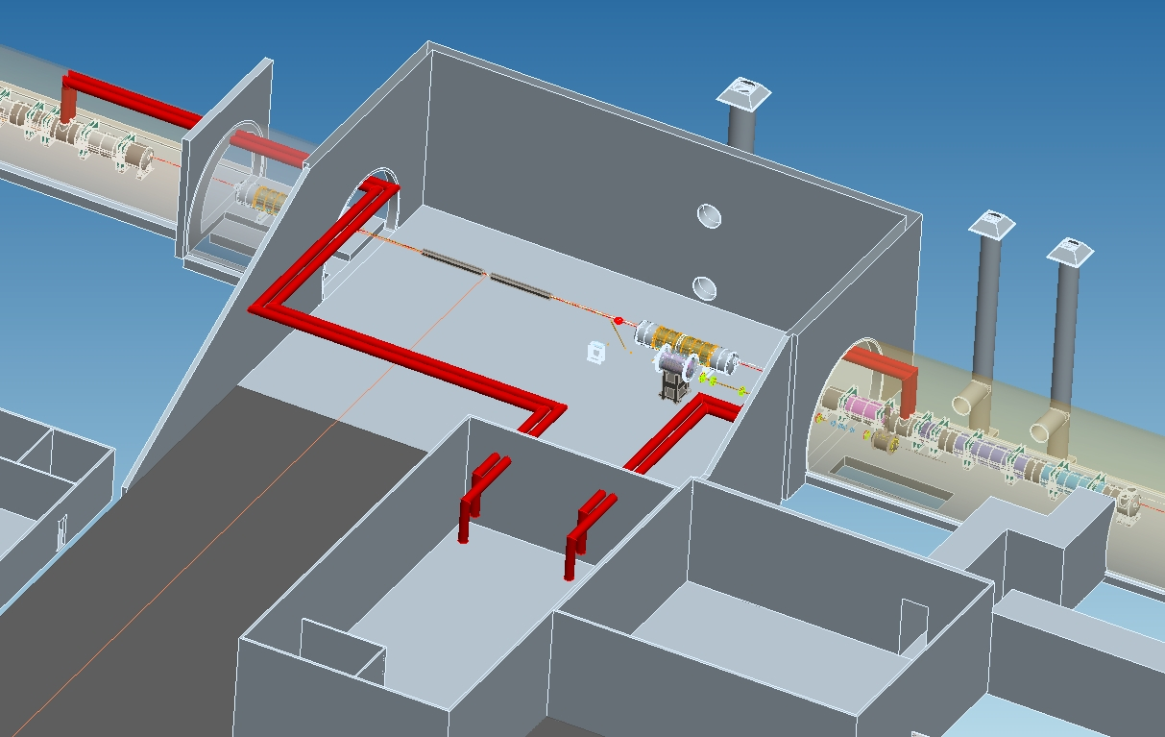
Further upgrades: e-cooling for Au-Au √s_{NN} = 7.7 − 20 GeV
A. Fedotov, V. Litvinenko et al.
Major design choices made
Accelerator Physics Design review: 13-14 August 2013
Largest performance upgrade in near-future
Start commissioning in Run-18
LEReC injector
(close to cryo and cooling sections)
IR2

Slide 22
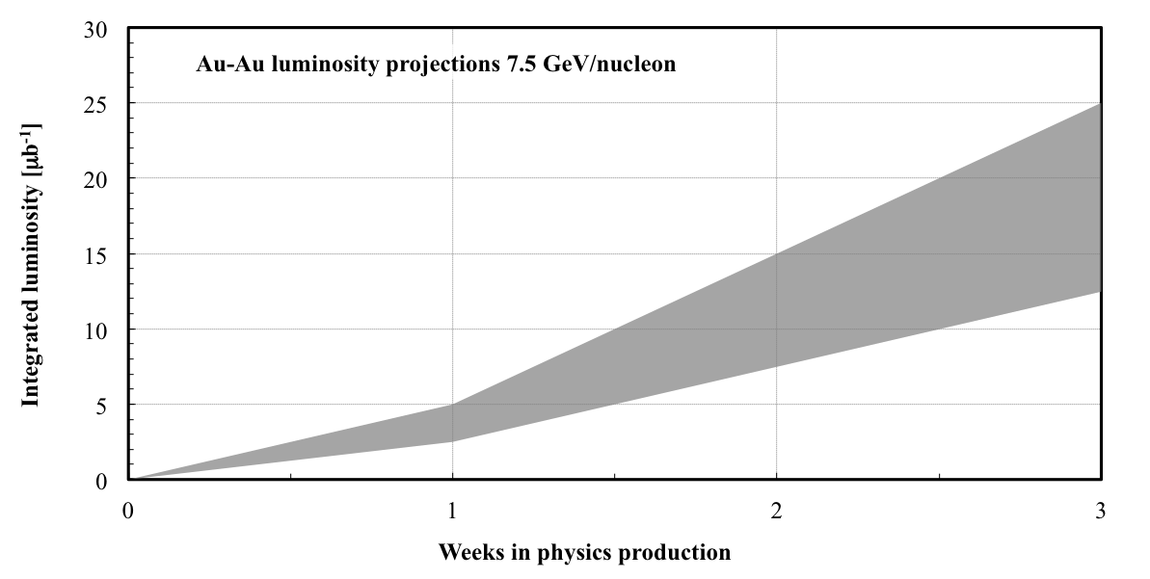
7.3 GeV/nucleon Au+Au projection for Run-14
Scaled from operation at 5.75 (Run-10) and 9.8 GeV/nucleon (Run-11)
AGS extraction close to (and below) transition energy Store times ~30 min, frequent refills require good loss control in AtR

Slide 23
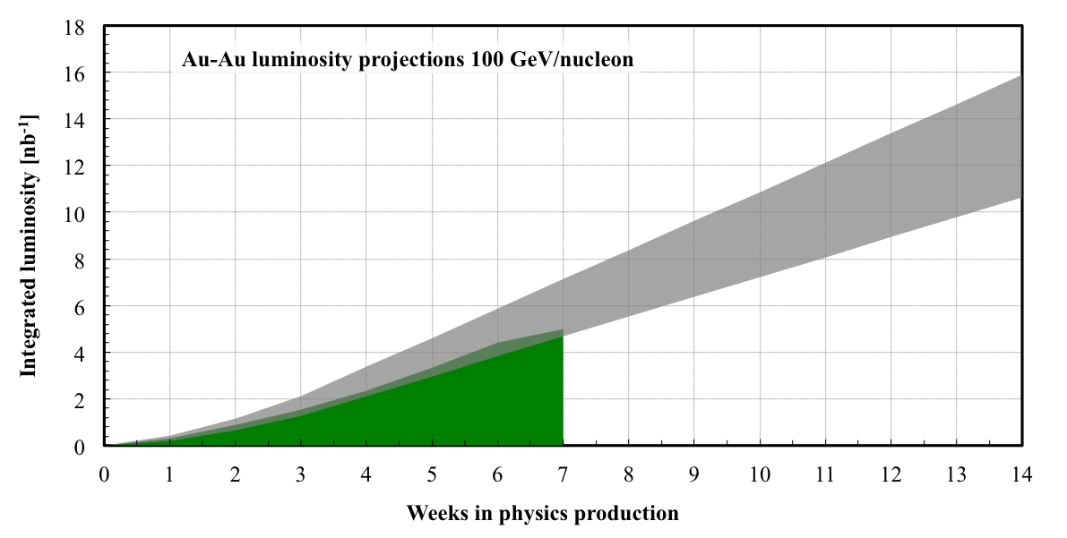
100 GeV/nucleon Au+Au projection for Run-14
Run-11
Improvements compared to Run-11: 3D cooling, new longitudinal pick-up and kicker for stochastic cooling, higher bunch intensity (long proton run with high intensity provided scrubbing – expect higher instability threshold at transition), 56 MHz SRF commissioning

Slide 24
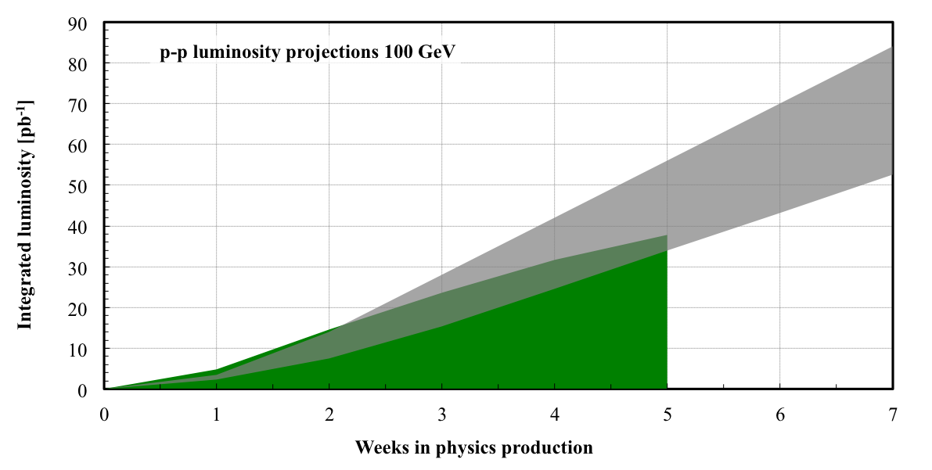
100 GeV ph+ph projection for Run-15
Run-11
Improvements compared to Run-11: OPPIS performance, e-lenses

Slide 25
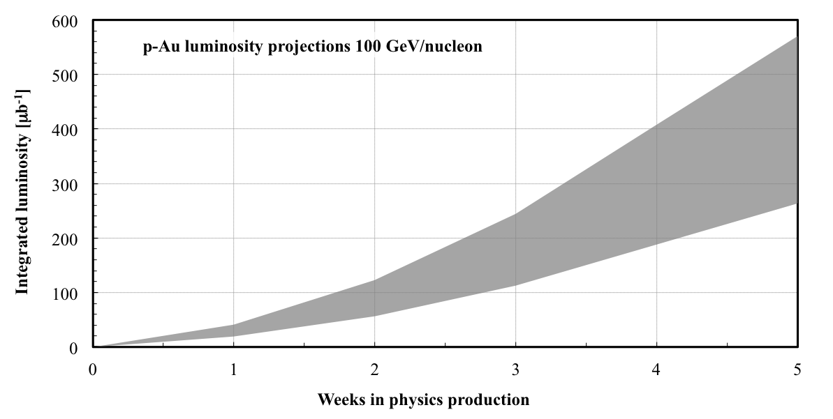
100 GeV/nucleon ph+Au projection for Run-15
DX (beam splitting dipoles next to experiments) and ZDC move needed

Slide 26
Preparation for Run-15: asymmetric ph-Au operation
maintains same f_{rev} for both beams
Lorentz factor γ
collision ph+Au
107.4
injection ph
store Au (close to γ_{tr})
acceleration ph, Au
injection Au
25.4
10.5
acceleration Au (cross transition)
time
Note: now tolerate ion beam instabilities at transition to obtain higher intensity (can be cooled down again), not possible with p+Au since have smaller aperture available

Slide 27
Summary
Very successful Run-13 new records for L_{peak}, L_{avg}, P_{avg}, almost 0.5 fb⁻¹/experiment increased ³He intensity in AGS 3.3x (g 0.4x10¹¹ with 2 more merges)
Run-14 Au+Au 7.3 GeV/nucleon [ 3 wks] (AGS extraction close to γ_{tr}) Au+Au 100 GeV/nucleon [14 wks] (3D cooling, maximization of bunch intensity, minimization of non-luminous losses, 56 MHz SRF commissioning) possibly d+Au or ³He+Au preparation for p-Au (DX move, shielding modification)
Run-15:
ph+ph 100 GeV (source + injectors + electron lenses) ph+Au 100 GeV/nucleon (DX move) ph+Si(Al), ph+Cu, d+Au, ³He+Au (setup time)

