Slide 1

Longitudinal Instability and
Bunch-by-bunch Damper
Kevin Mernick
July 25, 2013
RHIC Retreat
*stay tuned at the end of our program for a short preview of coming bunch-by-bunch damper attractions

Slide 2

Background
Proton bunches at nominal intensity are unstable with just the 9 MHz RF system
There are multiple modes of instabilities – dipole mode, quad mode, dancing bunches (multiple higher order modes)
The existing RF system damped coherent dipole mode oscillations, but does not have the bandwidth to damp incoherent bunch-by-bunch oscillations
Landau cavities keep the other modes mostly under control
We built the damper specifically to address the incoherent bunch-by-bunch dipole oscillations

Slide 3

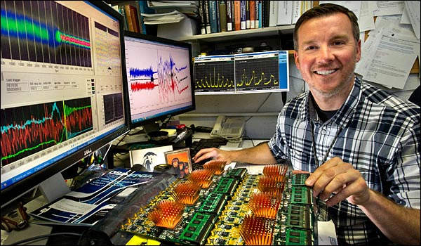
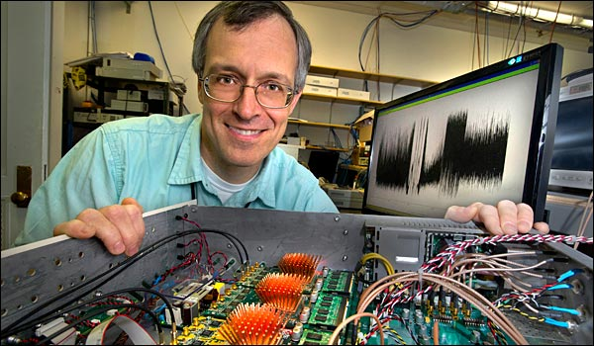
Damper System Overview
The damper is built around the LLRF platform
Bunch-by-bunch phase measurements come from the existing bunch-to-bucket phase detector and are processed in the “system controller” DSP (4 o’clock)
The kicker waveform is synthesized with custom DAC (“arb”) firmware with bucket-by-bucket amplitude modulation capability (2 o’clock)
The RF master clock and Update Link (with the bunch-by-bunch corrections) are broadcast to 2 o’clock on fiber optics
The DAC waveform is amplified with 500W QEIs driving 2m stripline pairs
This gives a maximum kick of about 100 V per turn

Slide 4
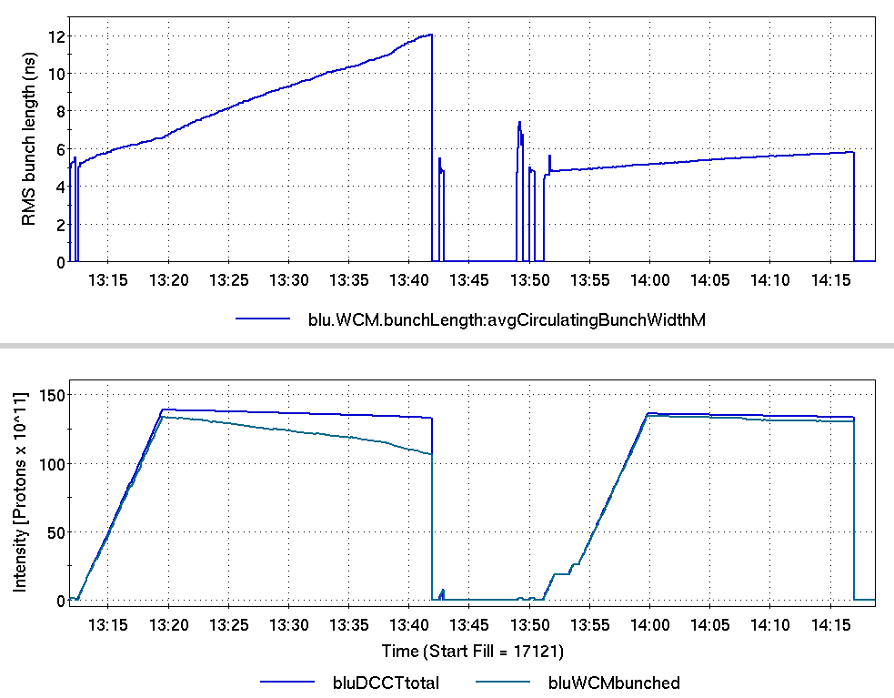
Damper Results
damper off
damper on
Commissioning in blue went well

Slide 5
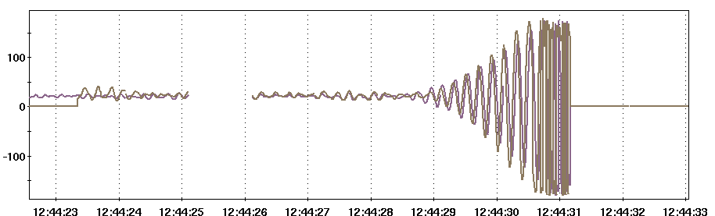
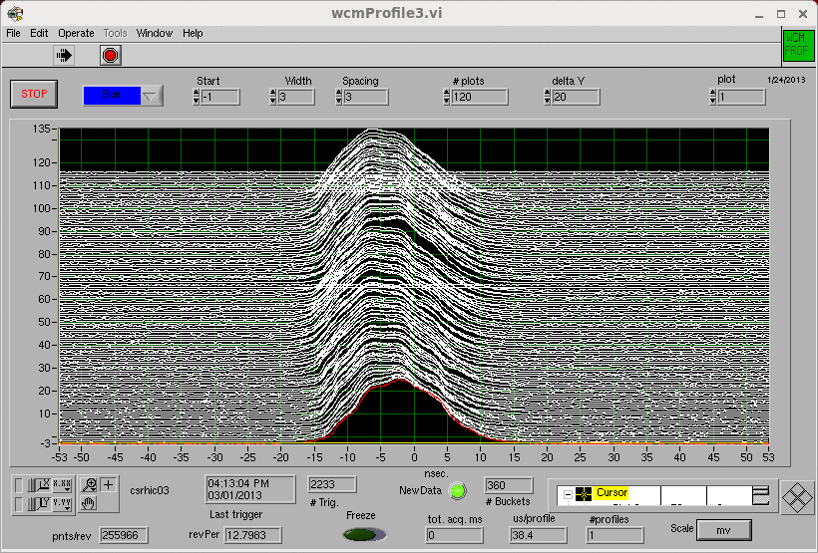
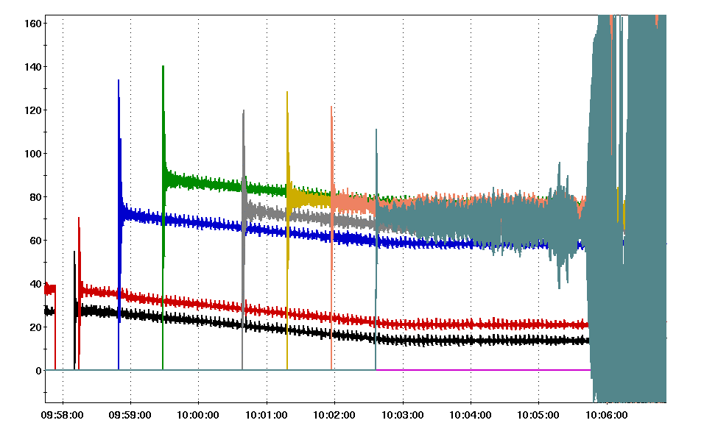
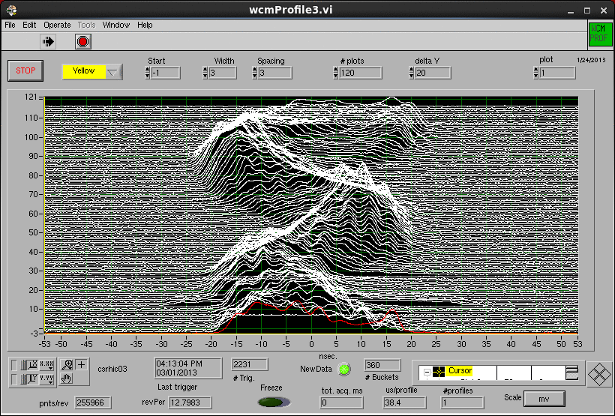
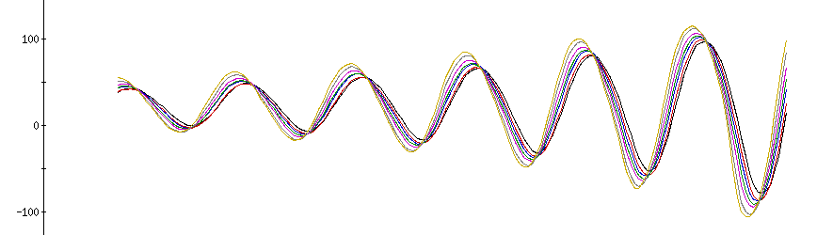
Damper Results
Xxx
Yyy
Zzz
Yellow was a little more difficult

Slide 6
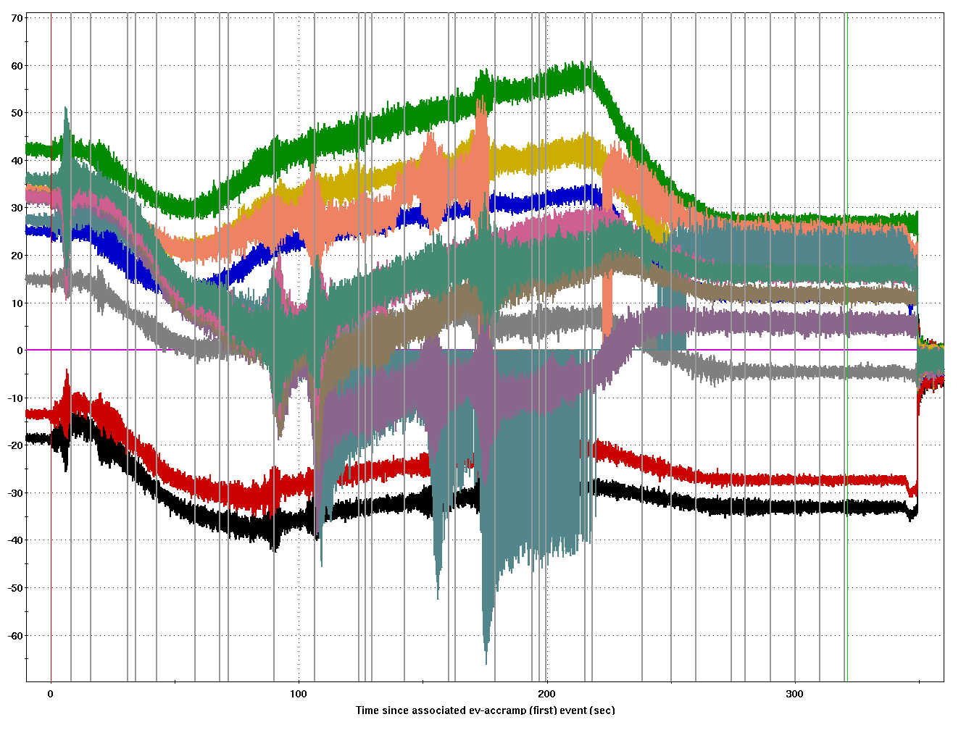
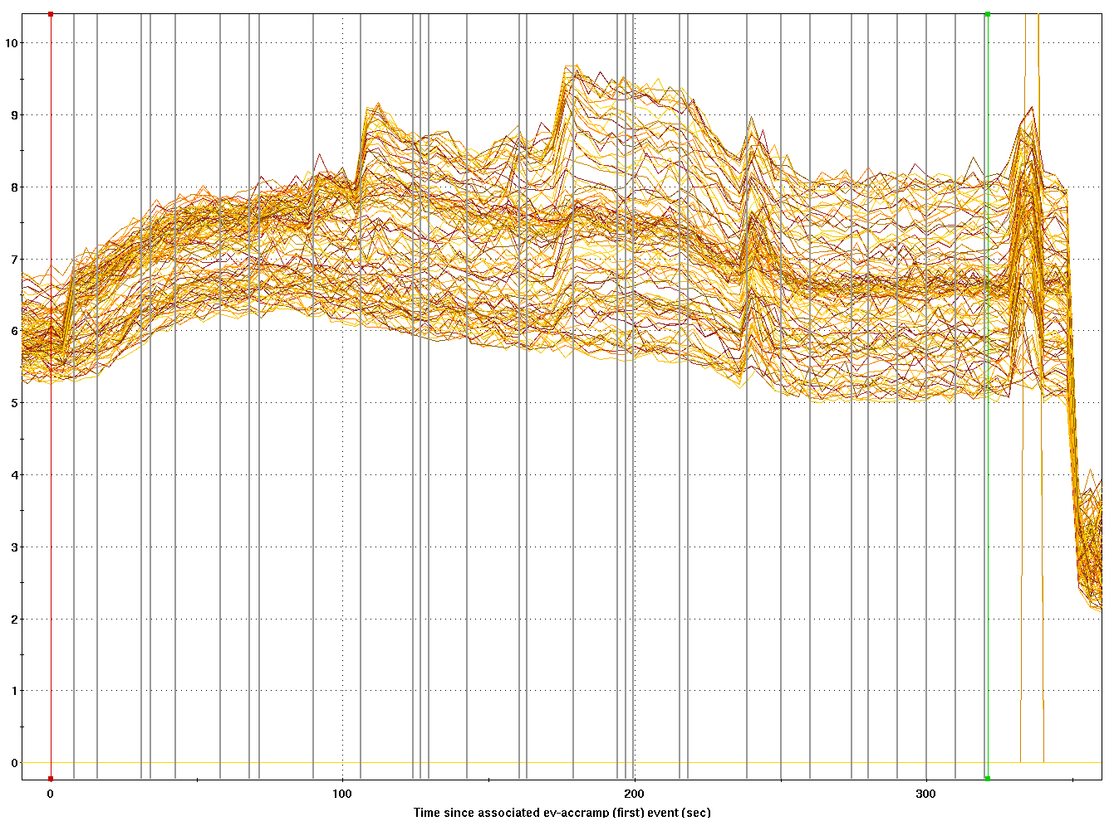
Damper Results
The damper was used operationally at injection starting from March 7
Changed filter response to allow running with higher gains – this allowed us to get the system running
40 MHz degrees
ns
bunch length
bunch phase
But there were problems on the ramp

Slide 7
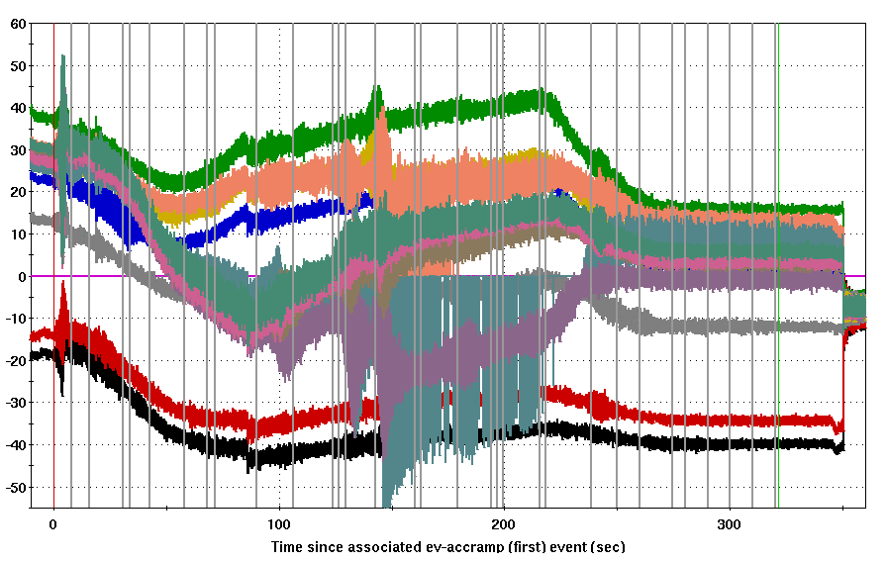
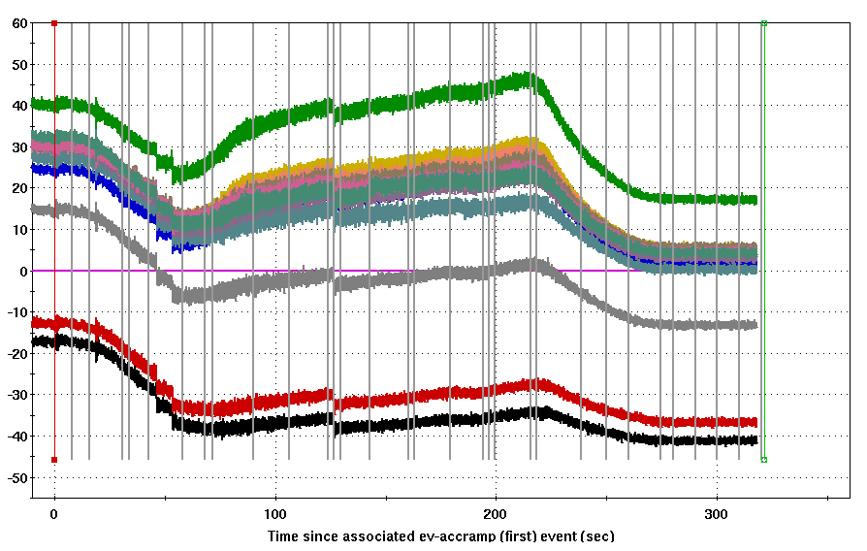
Damper Results
The damper was used operationally on ramps starting from April 18
This only required a short period of time to setup delay compensation and worked the first try
bunch length
bunch phase
without damper
bunch phase with damper

Slide 8
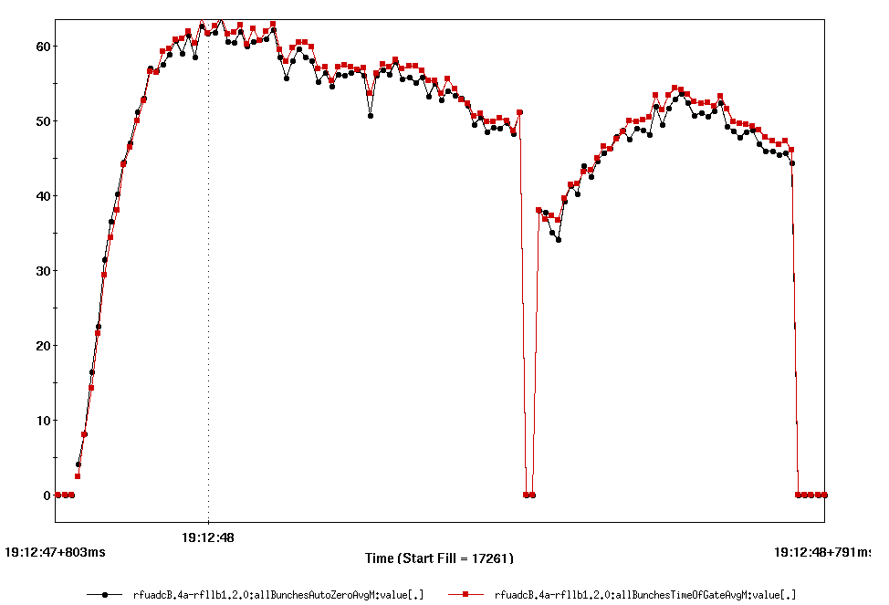
Periodic Transient Beam Loading
The beam driven response of the RF cavities are affected by the fill pattern – they see a transient from the abort gap (or any other empty buckets) that is periodic at the revolution frequency
This means that different bunches see a different RF voltage (amplitude and phase)
40 MHz degrees
bunch phase

Slide 9
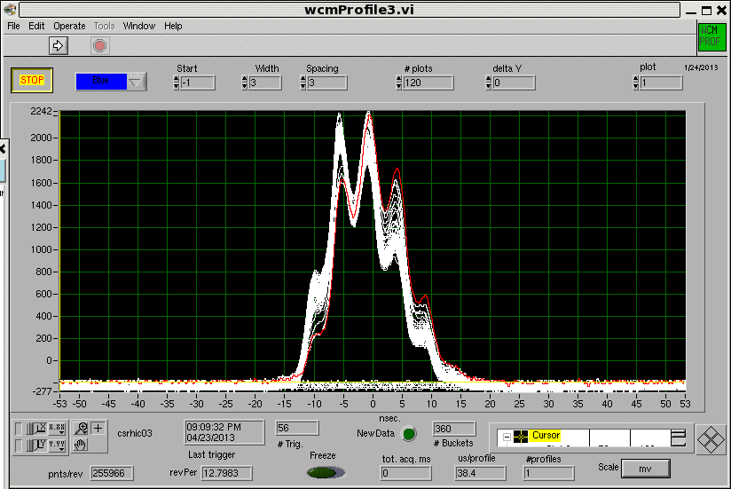
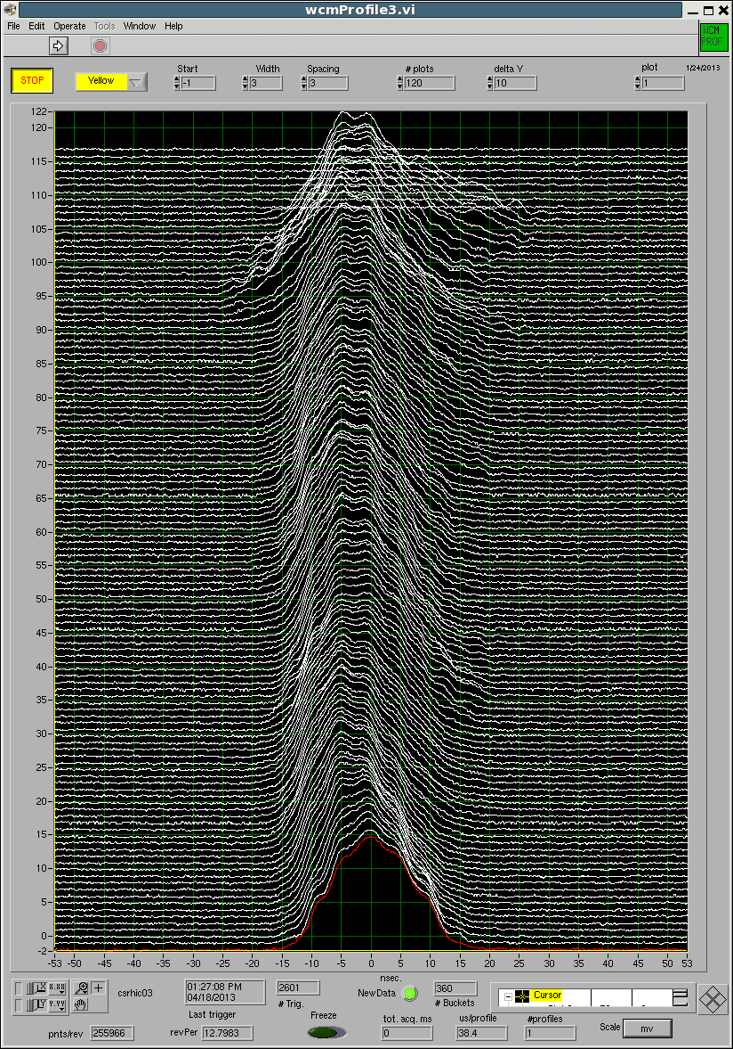
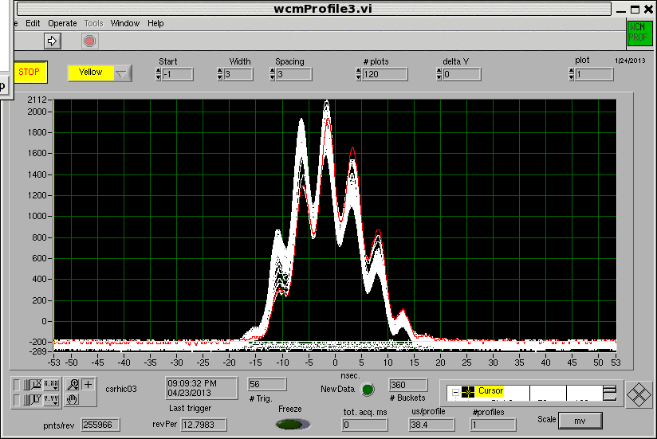
Periodic Transient Beam Loading

Slide 10
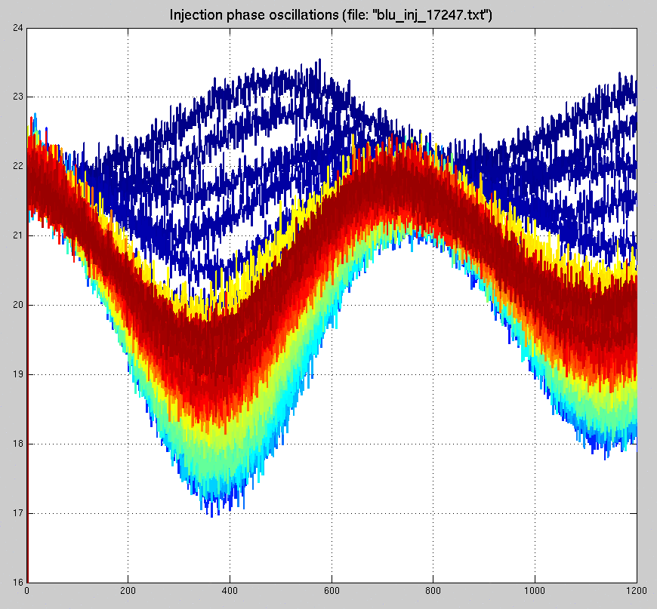
Periodic Transient Beam Loading
This is an issue because it makes injection matching difficult – tuning up bunch 1 doesn’t optimize all the bunches
This shows injection oscillations for all bunches in a fill
The early bunches are better matched than the ones in the middle to end of the train in this case

Slide 11
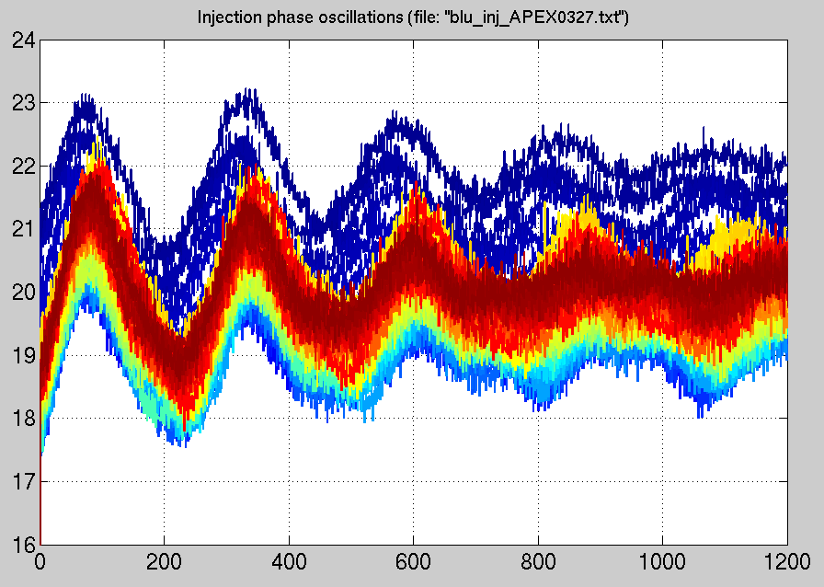
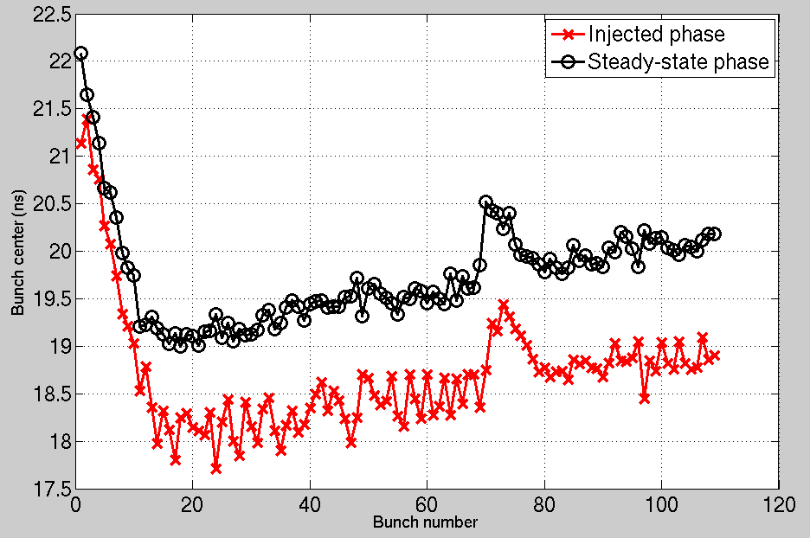
PTBL Compensation (part 1)
To compensate for the injection error, we adjusted the ATR synchro phase target based on the measured phase of previous bunches to try to match the new bunch to the phase of the transient
This keeps the injection phase error more or less constant over the course of a fill
A further improvement would be to correct that error as well (essentially giving an automatic “Apply P” correction on every shot)

Slide 12
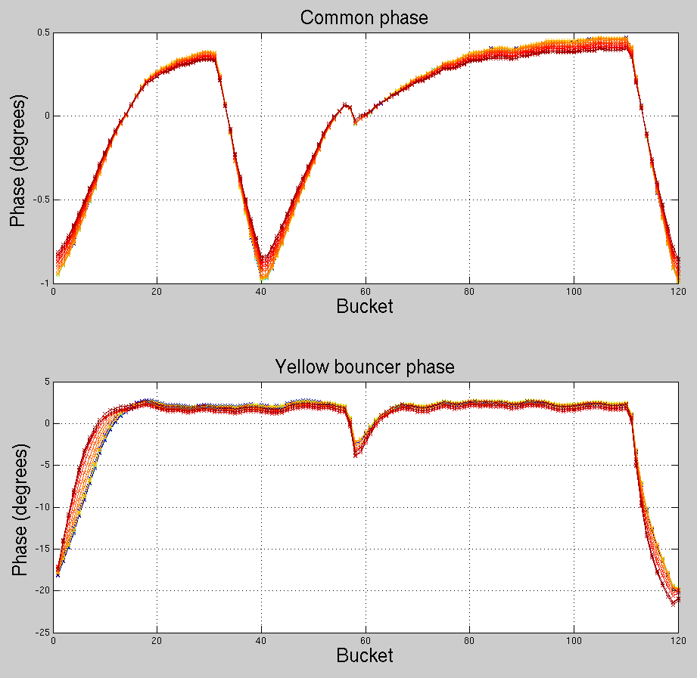
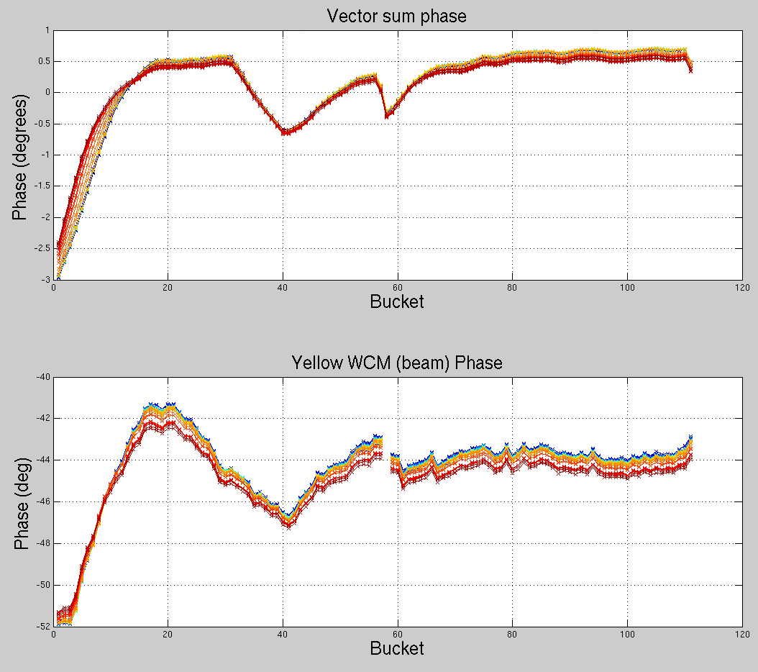
Measuring Transient Beam Loading
The “bucket-by-bucket” phase detector was developed during the run
Vector sum here is the combination of the 9 MHz common and bouncer cavities – it only accounts for about 1/3 of beam phase

Slide 13
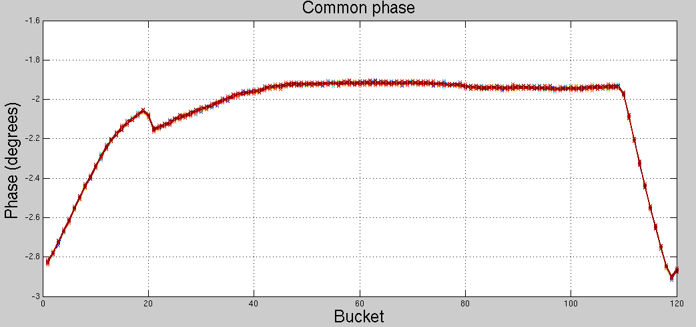
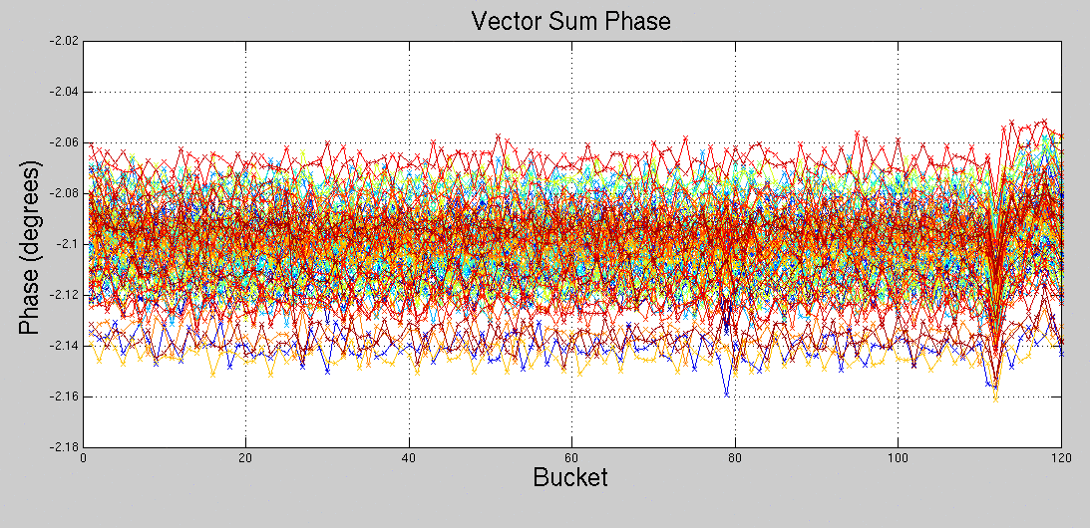
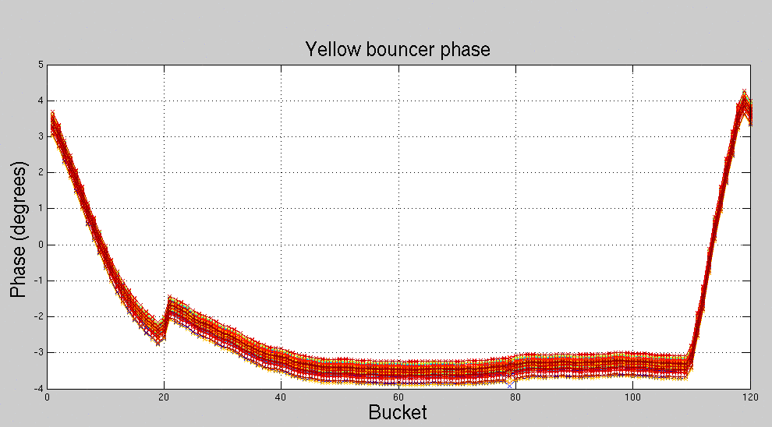
PTBL Compensation (part 2)
Once we had the bucket-by-bucket cavity phase measurements, we could attempt to flatten the transient with feedback
0.1°
This only fixed about 1/3 of the beam phase
Ran well with low intensity (~1.2e11), but had problems at higher intensities (~1.8e11)
But useful to learn about possible future progress

Slide 14
Longitudinal Instability Summary
We built the damper specifically to address the incoherent bunch-by-bunch dipole oscillations and it works for this
In the early part of the run, we had some bunch-by-bunch dipole mode instabilities, but once we settled on good settings for the damper, we didn’t see those again
We still need enough Landau voltage to prevent bunch shape oscillations
The yellow instability threshold is clearly lower than blue, but we couldn’t really figure out why – broadband impedance measurements for both rings give essentially the same answer
We attempted to quantitatively determine instability thresholds for both rings – with the damper on and Landaus off, the yellow “threshold” is between 1e11 and 1.25e11 and blue is between 1.5e11 and 1.75e11

Slide 15
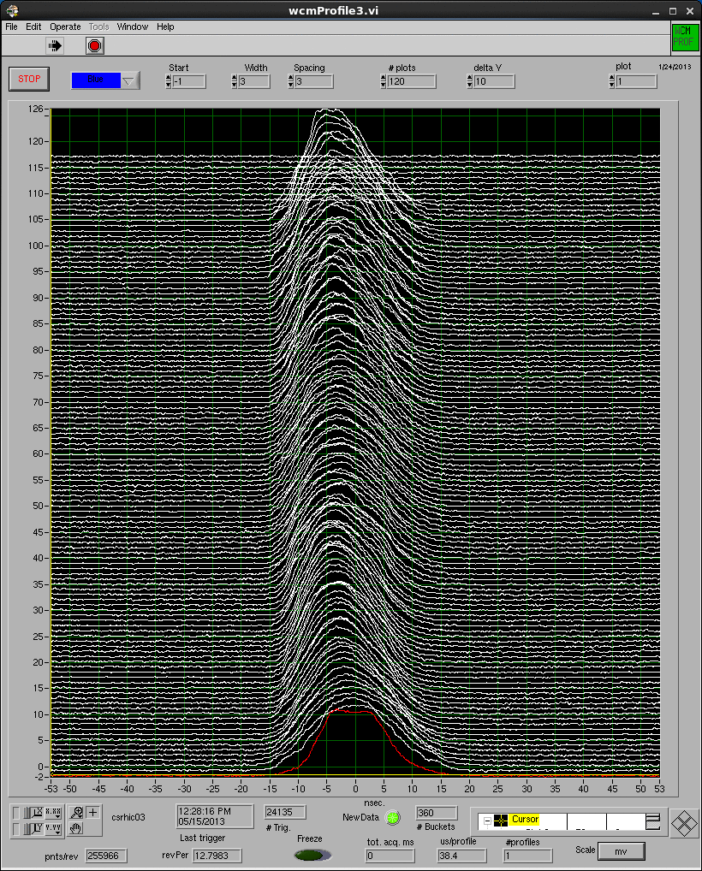
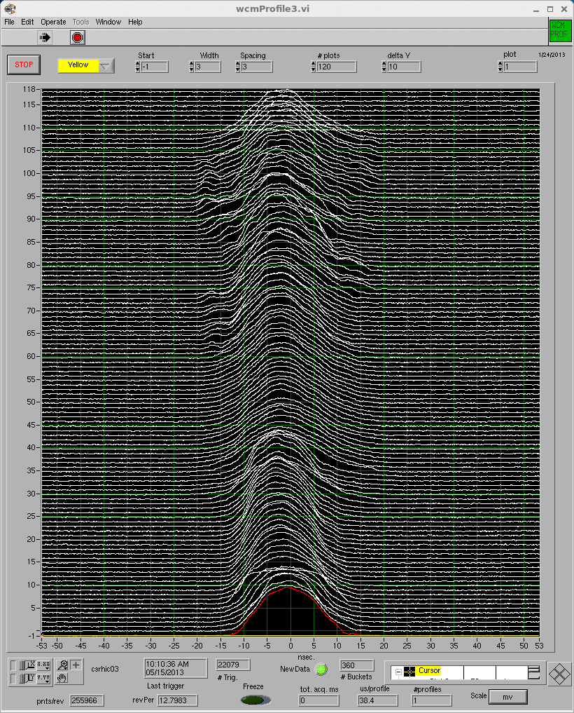
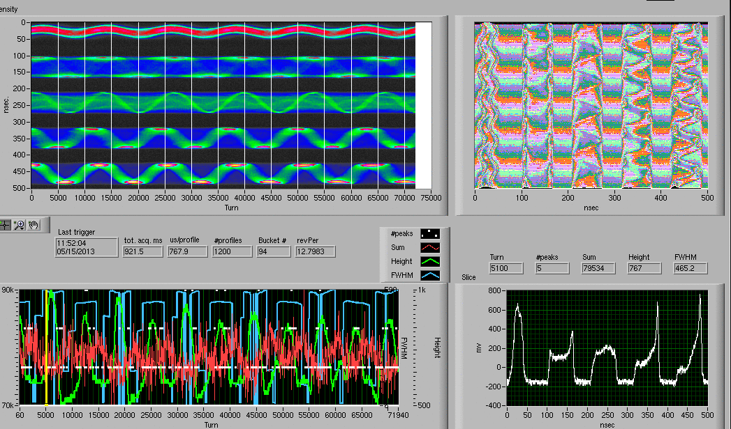
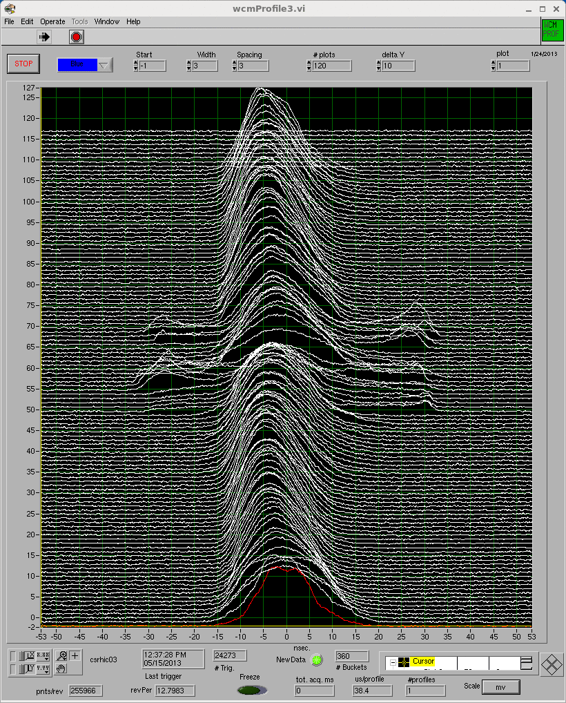
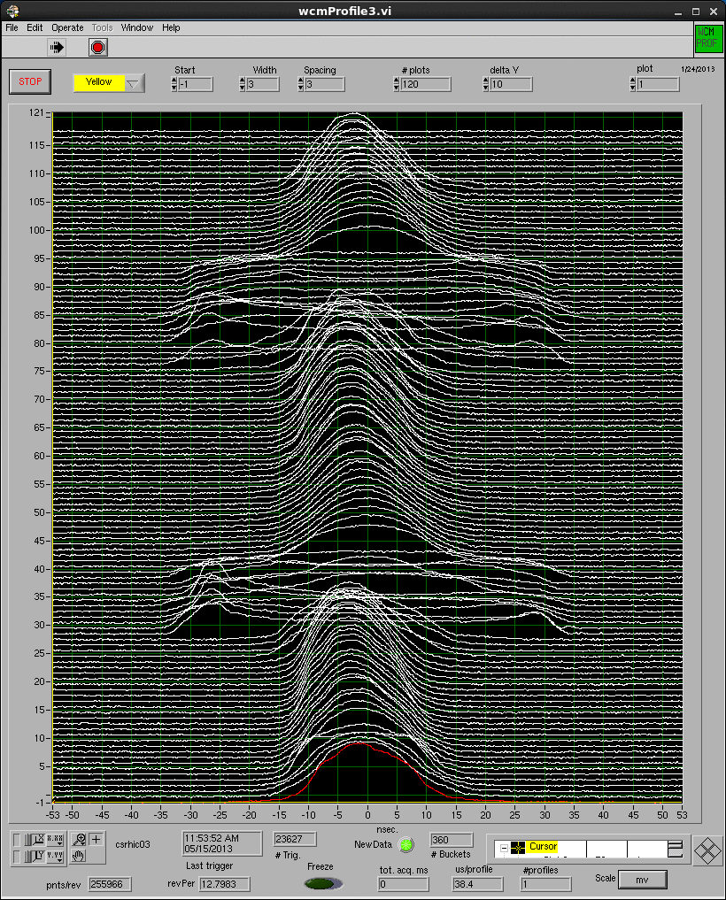
Longitudinal Instability Summary
above instability threshold
below instability threshold
but probably not what we want for a physics store

Slide 16
From the people who brought you Longitudinal Bunch-by-bunch Damping
We are working on designing and building a transverse bunch-by-bunch damper now
The motivation for building this now is to damp the transverse mode coupling instability which may be excited when running high-intensity proton beams with the E-Lens, but it will also be beneficial at injection and on the ramp
The hardware will be very similar to the longitudinal damper
We plan to use existing arc BPMs for the pickups – the signals from the selected BPMs will be split at the cryostat, similar to the way the “RF BPMs” are shared by the RHIC orbit system and the LLRF system
The BPM signal processing and damper processing will all be handled using the LLRF platform
The kickers will be dual-plane 2 meter 50 Ω striplines – we are working on simplifying the existing design to be able to build more – driven by broadband (100 kHz – 30 MHz) RF power amplifiers

Slide 17
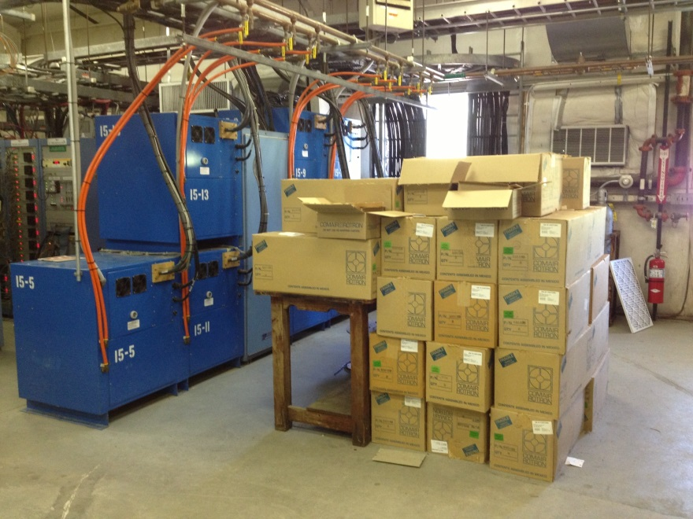
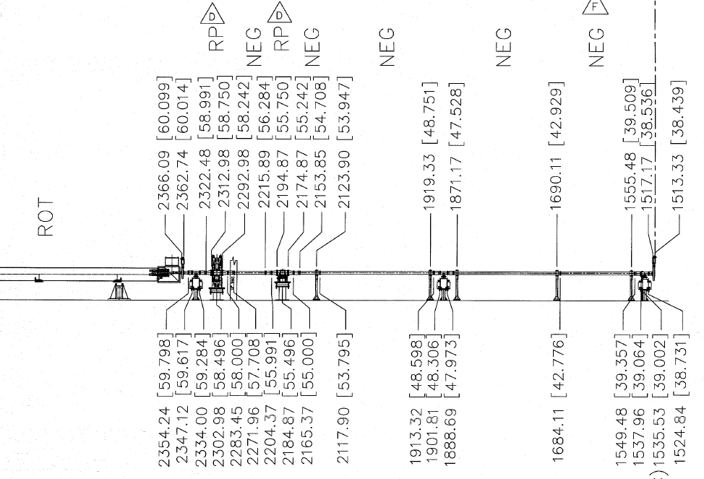
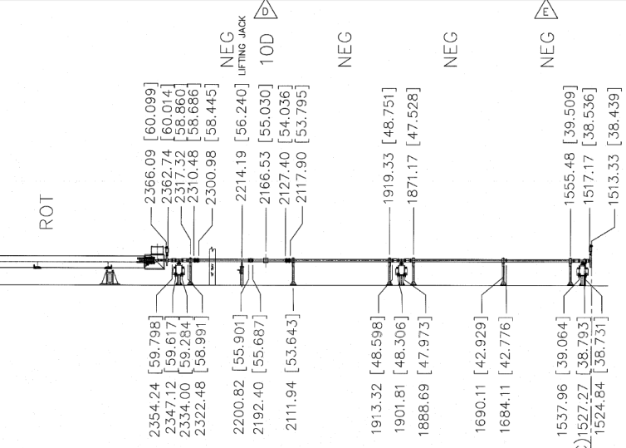
Transverse Bunch-by-bunch Damper
The plan is to install the new kickers in the sector 5 warm bore – we need 4 meters of beam line in each ring
The electronics will go in the 1005E service building
Yellow
Blue

