Slide 1
Stochastic Cooling: Upgrades
Mike Brennan
RHIC Retreat, July 2013

Slide 2
OUTLINE
Longitudinal Kickers
  Reliability
  New features, less is more
Longitudinal Pickups
  Keyhole design
  Results from proton beam tests
Microwave links
Operations Software
Schedule, Status
Still dream’n

Slide 3
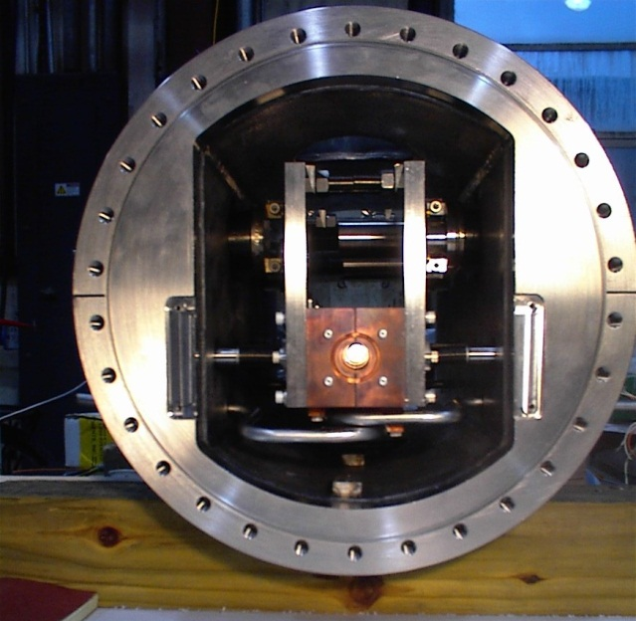
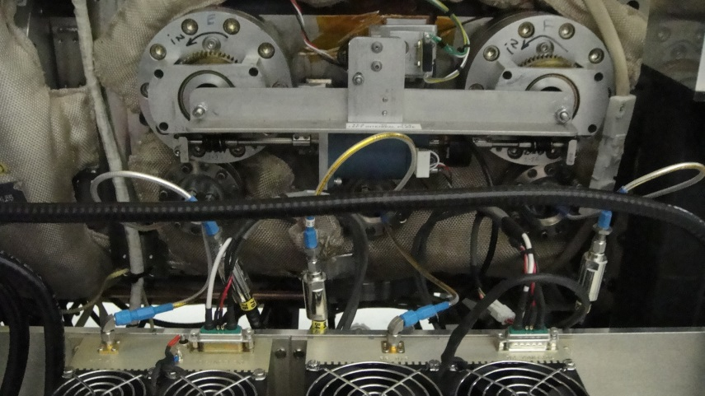
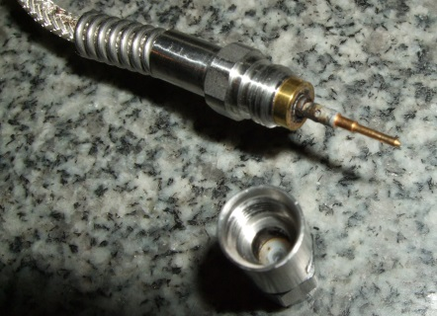
Motivation
Reliability of kickers
  Longitudinal kickers are made from retrofitted kicker tanks from Tevatron
  Problems have occurred
    Motion mechanism
      Stuck bearings in vacuum
      Stepper motors/encoders (“slip detected” error)
      Reproducibility of cavity resonant frequencies
    Vacuum leaks
      Water cooling line, and bellows
      Rf vacuum feedthrus
      Thermocouple vacuum feedthrus
    Coax cable over heating
    Power amplifier failures

Slide 4
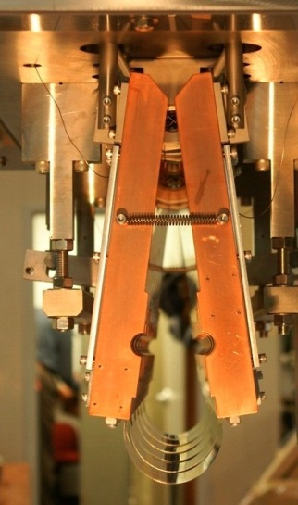
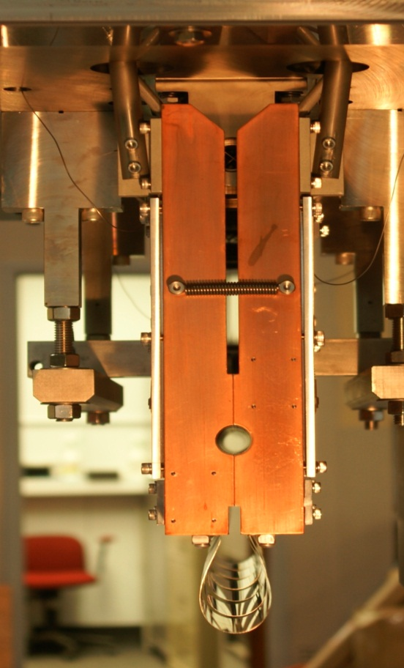
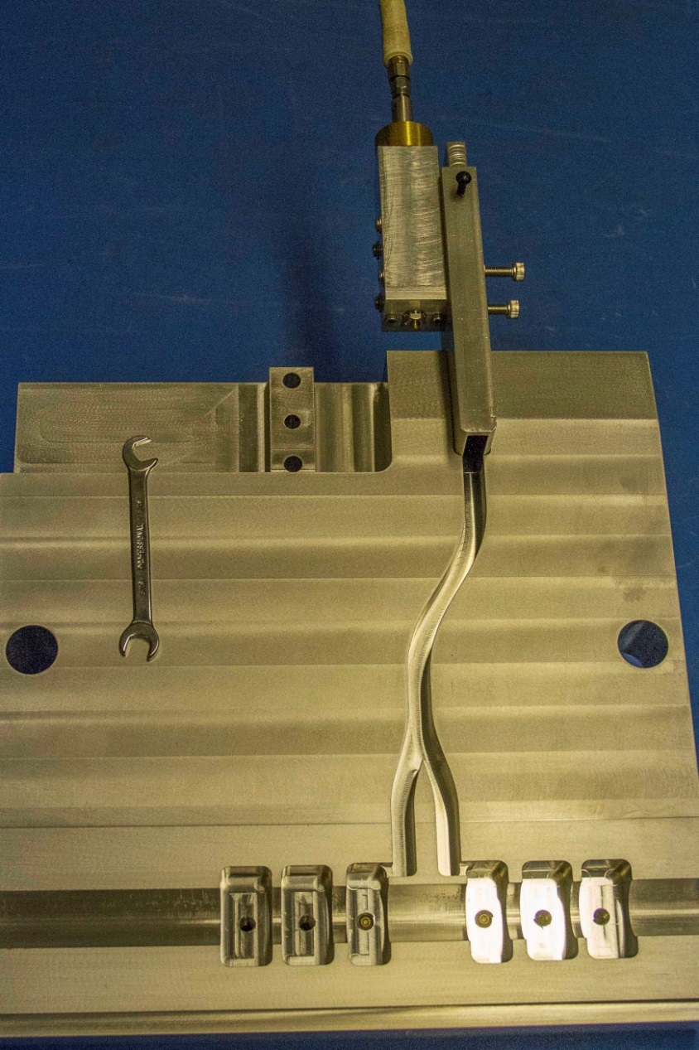
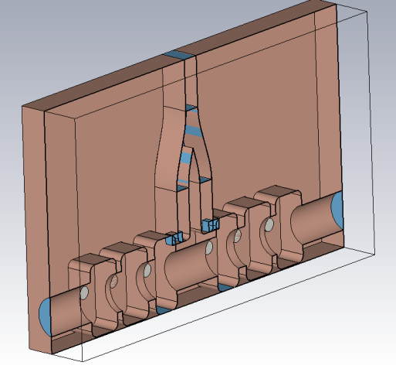

Six-Cell Cavity Kickers
6-cell cavities, higher R/Q (don’t have to shoehorn into Tevatron tanks)
No bearings in vacuum
  Scissors type motion for opening cavities
    Used for vertical and horizontal kickers
    Binary motion mechanism (open or closed)
  Flexi-hinge (no sliding surfaces)
  No springs (more below)
Waveguide power feeds (no coax cables in vacuum)
Use all existing power amplifiers and low-level electronics
MicroWaveStudio model of 6-cell cavity, split on the symmetry plane

Slide 5
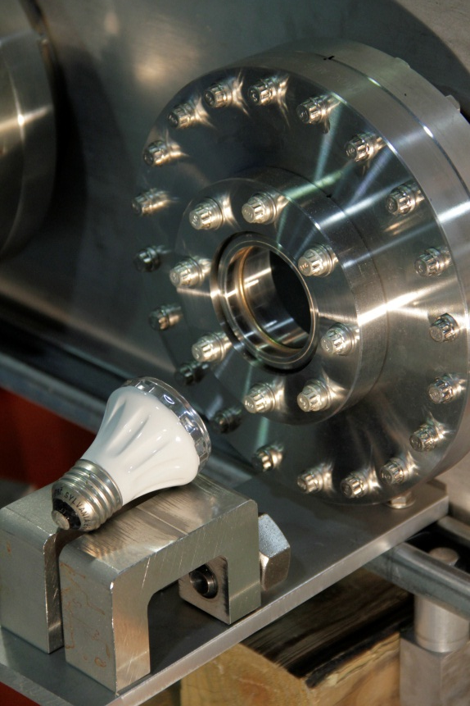
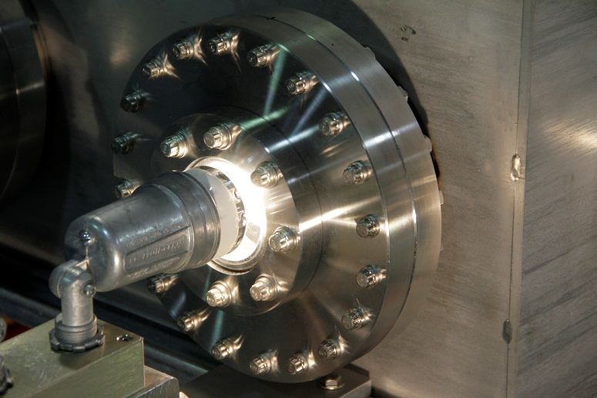
Temperature Control of Kickers
Controlled heating for temperature stabilization (frequency reproducibility)
  Operating at 20-30 C above ambient
  Heat source is heat lamps (60 Watt Halogen spotlight)
  Via glass windows
  Eliminates water pipes and vacuum bellows
  No dissimilar metals in cavity structure (bi-metal shape distortions)
    Frequency is sensitive at 0.001 inch = 1 Bandwidth

Slide 6
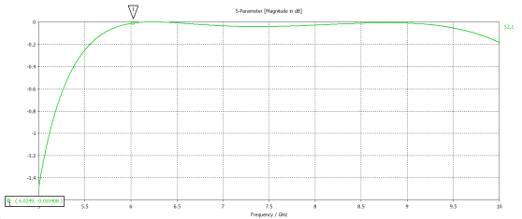
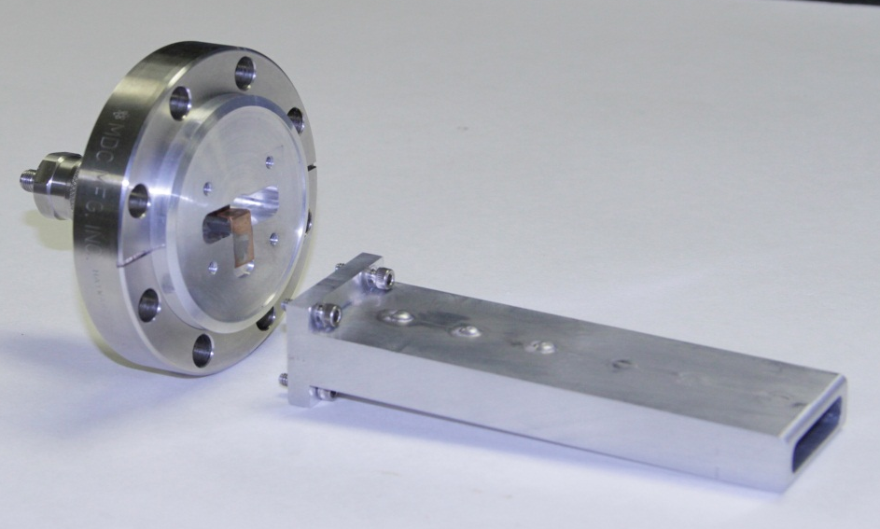
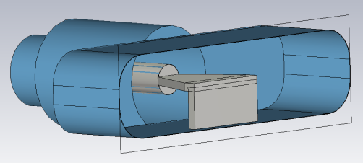
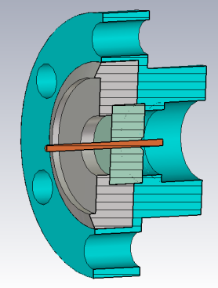
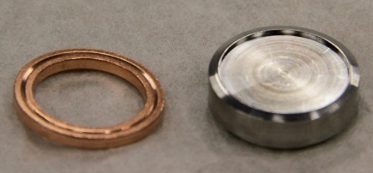
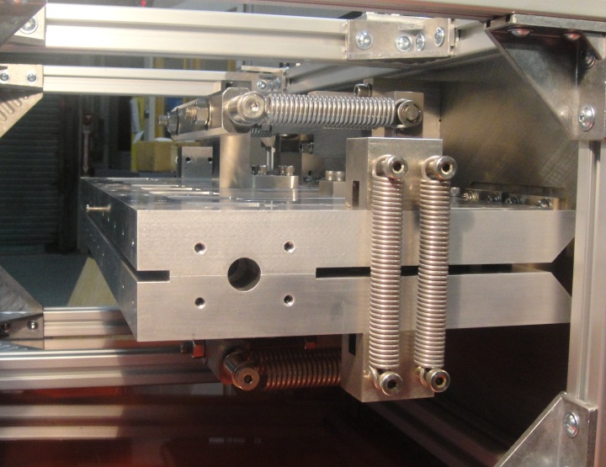
S21 > -0.1 dB
Power feeds via waveguides
  No coax cables in vacuum
    No Teflon
    Eliminates outgassing load from cables
    Cables get hot (80 C)
  Waveguide-to-coax transition is integrated into conflat flange
    N connector (not SMA)
    Brazed Al2O3 (can be baked at high temperature)
    Choke joint means no metal to metal contact
Honest weights, no springs
MWS model
Horizontal kickers, need springs

Slide 7
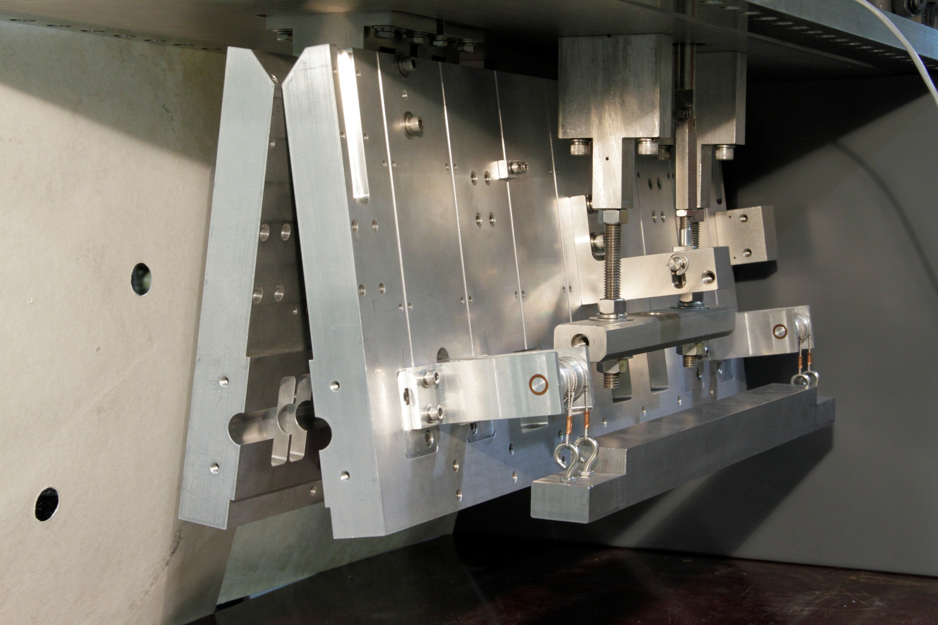

Slide 9
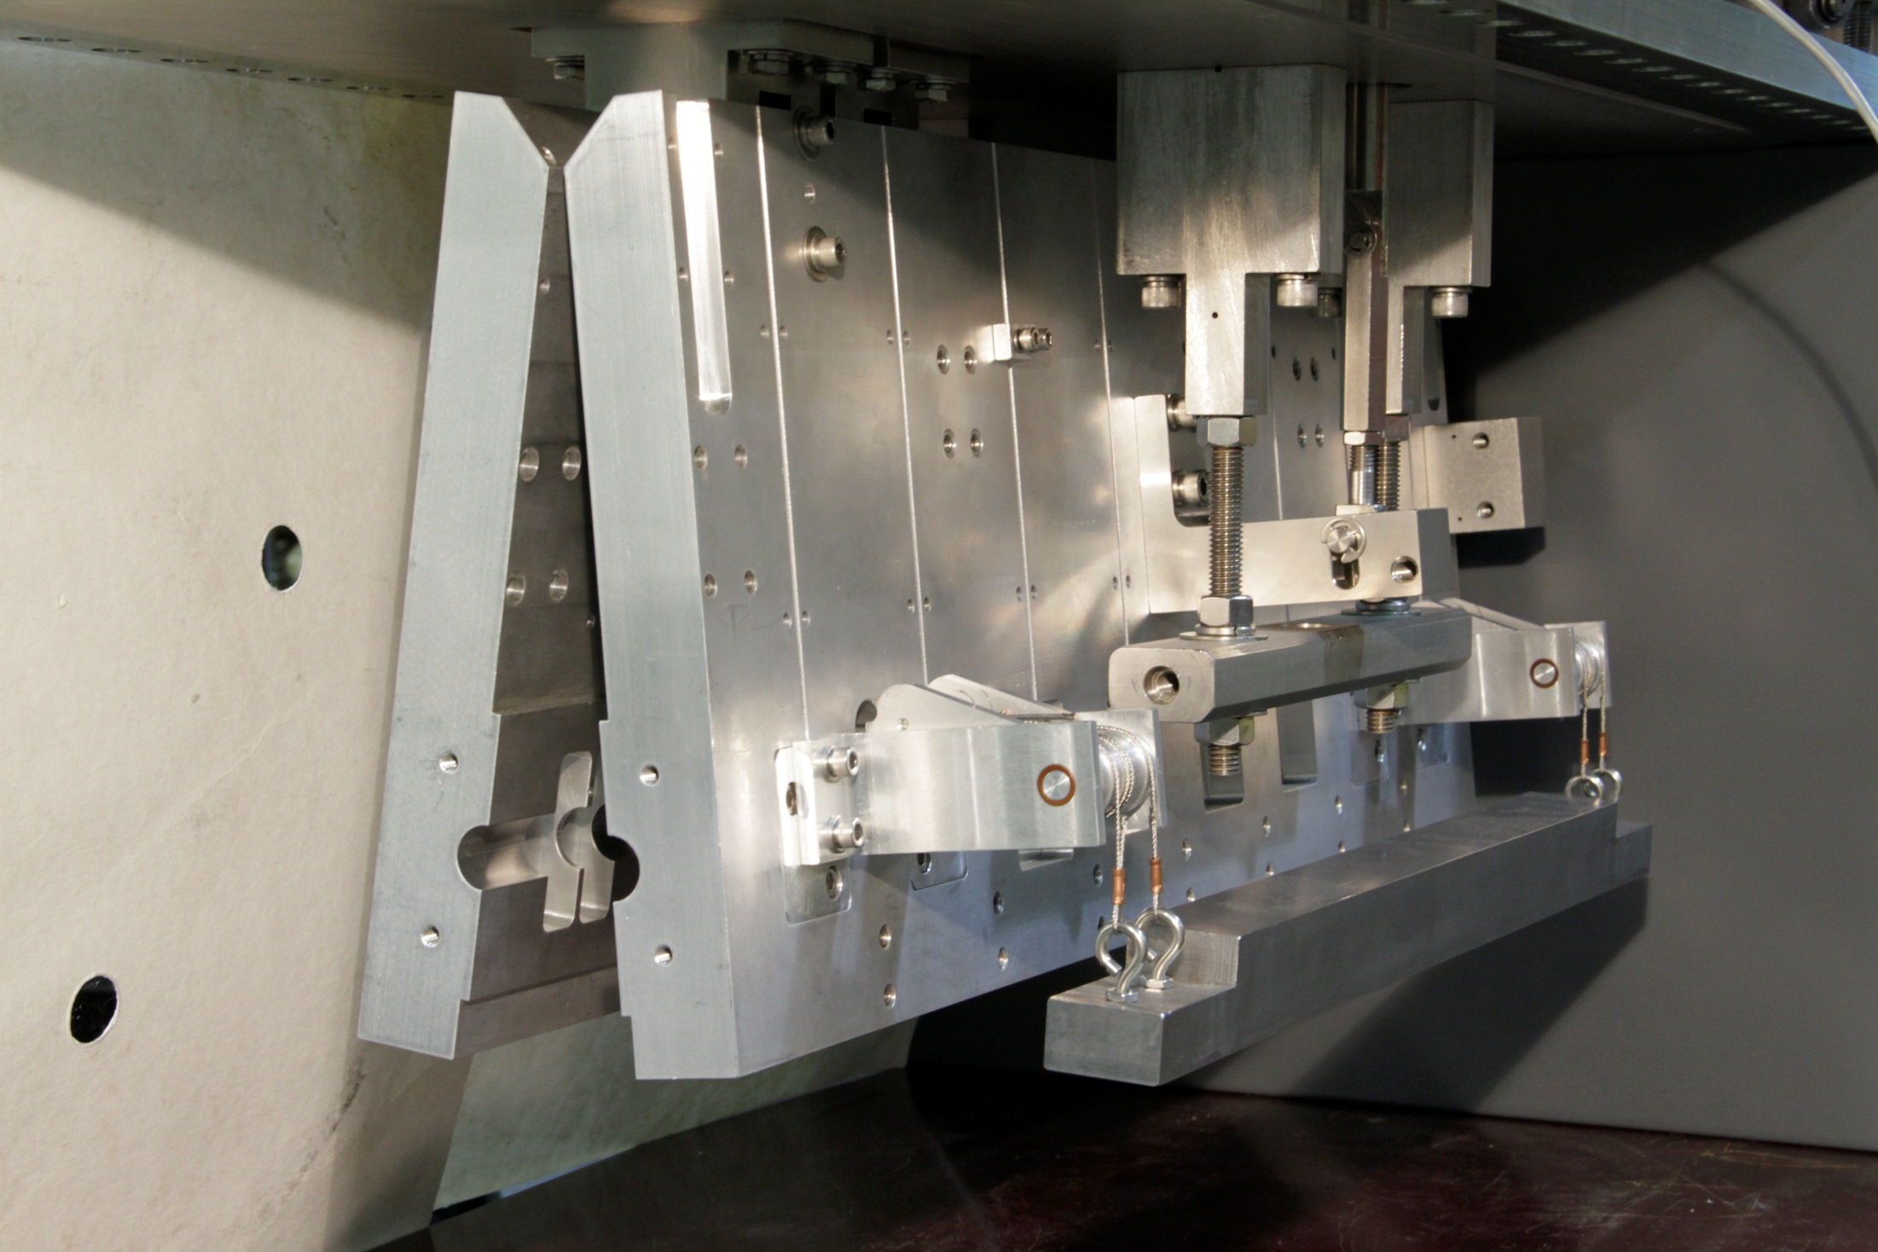

Slide 10
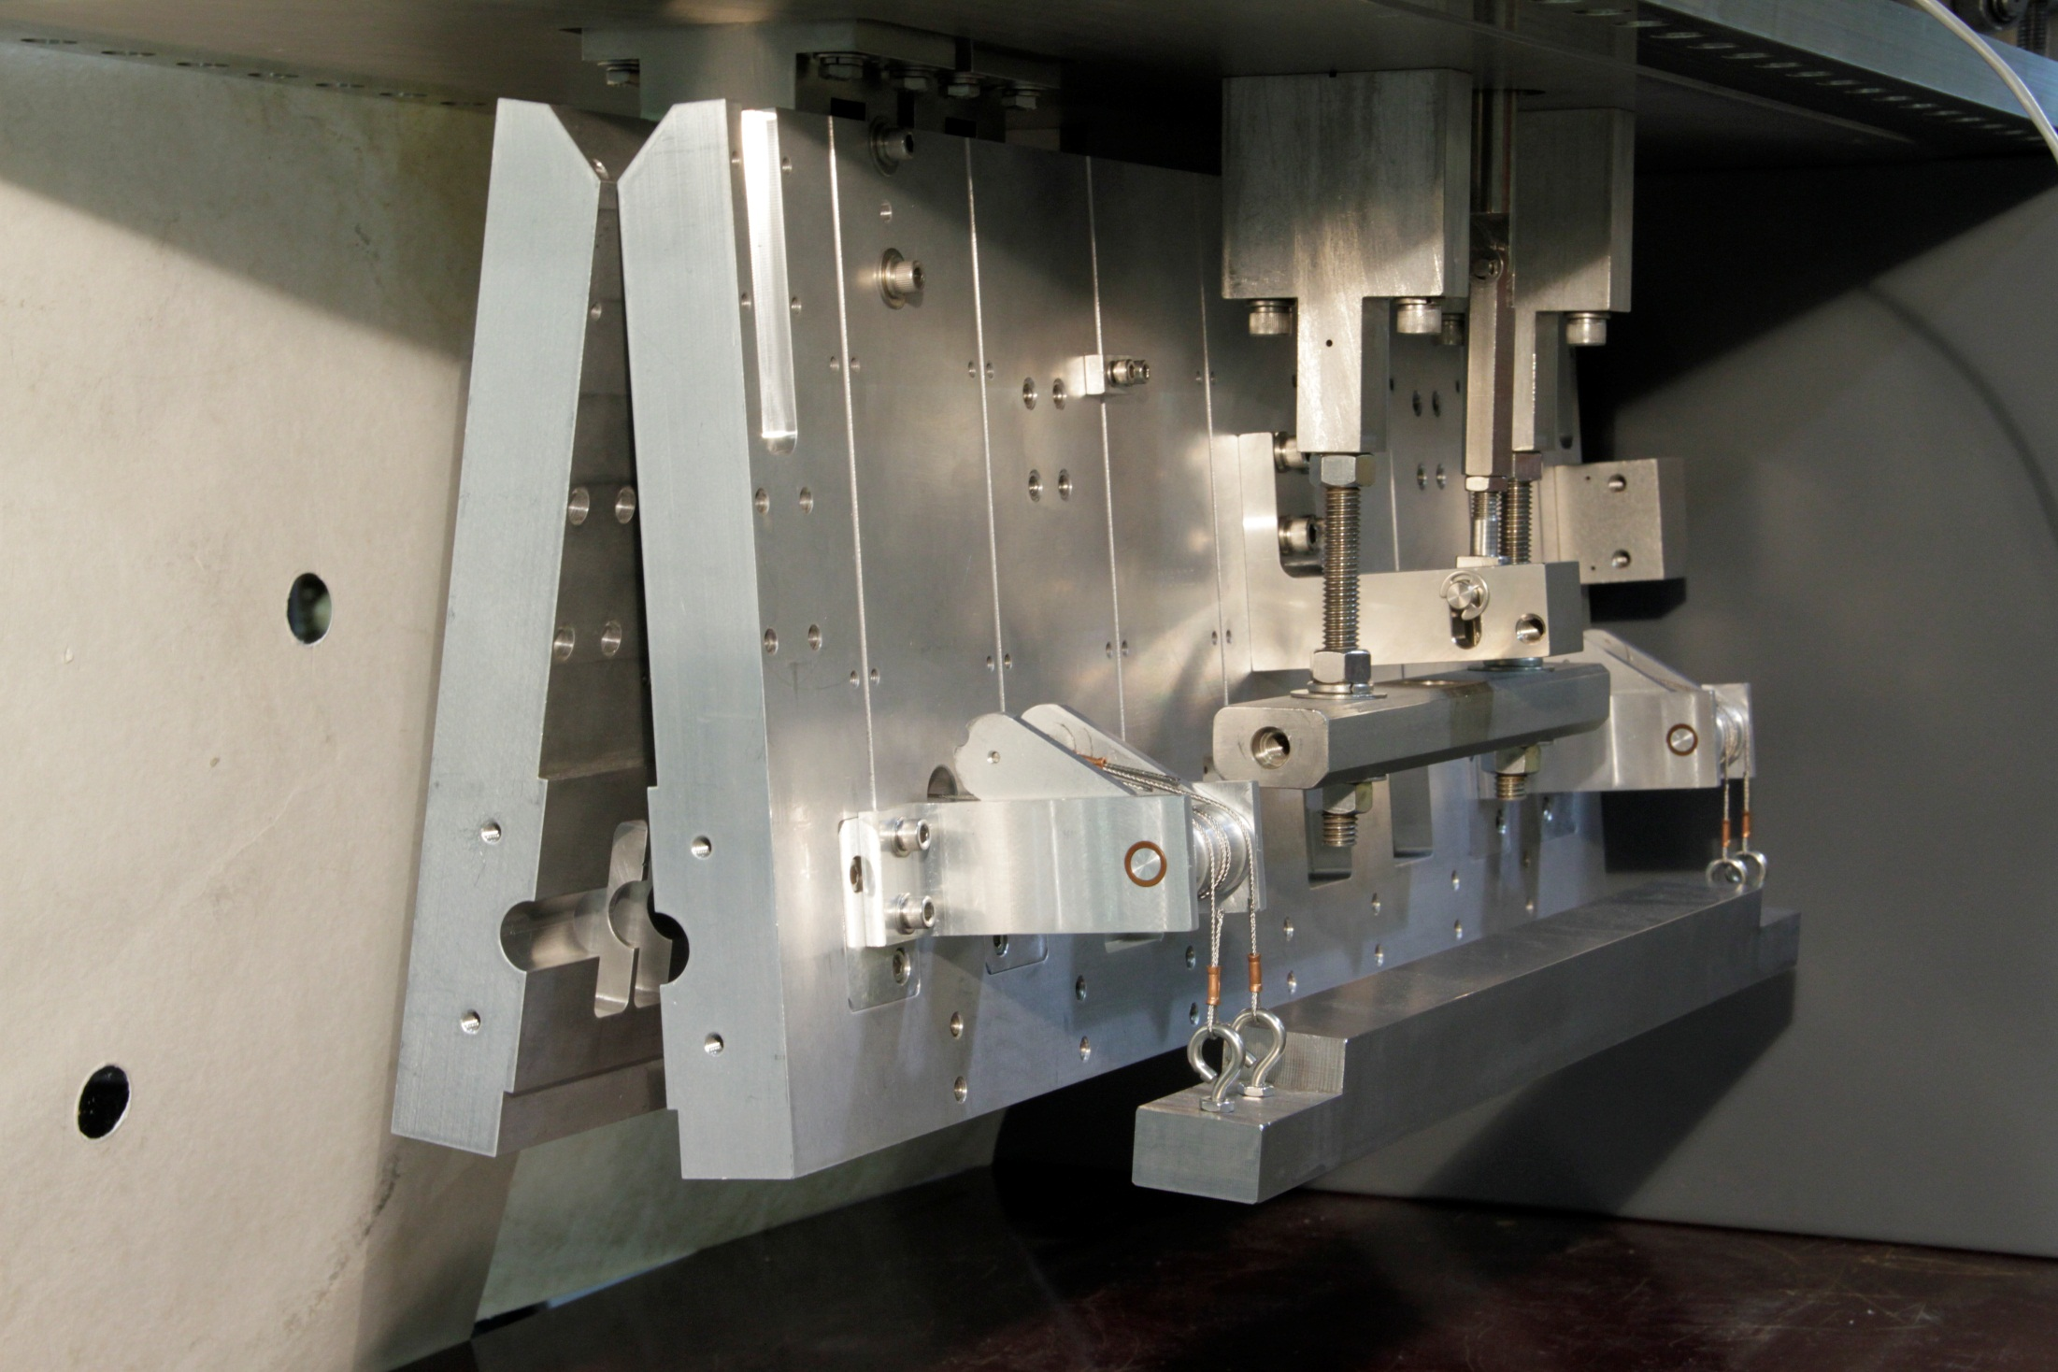

Slide 11
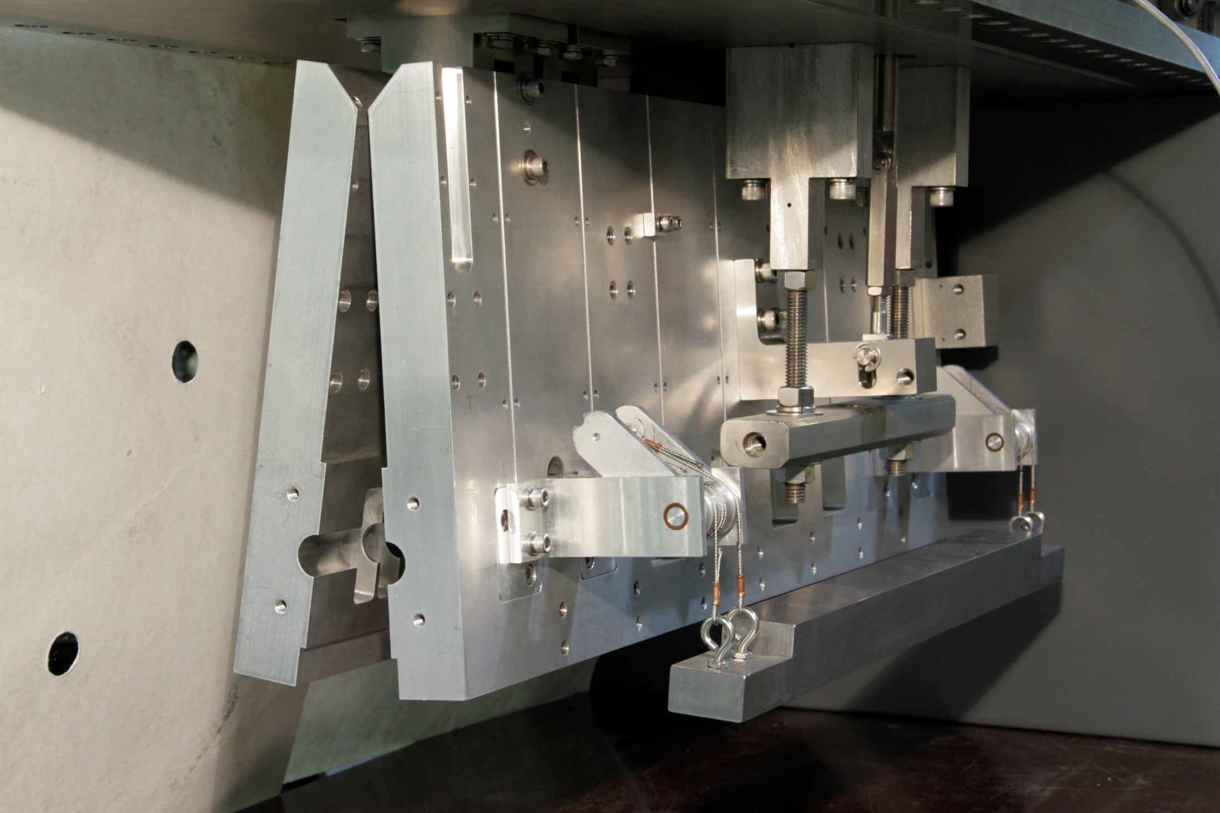

Slide 12
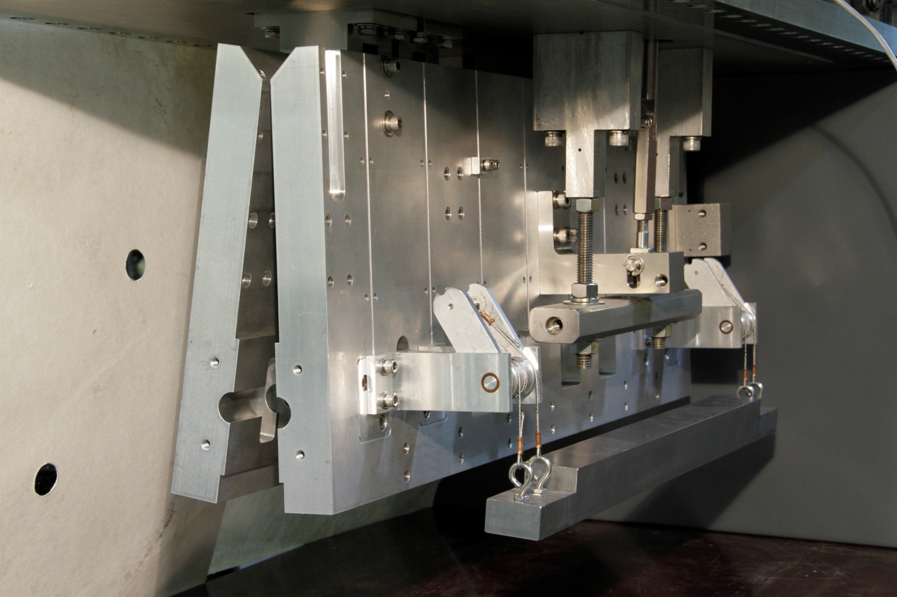

Slide 13
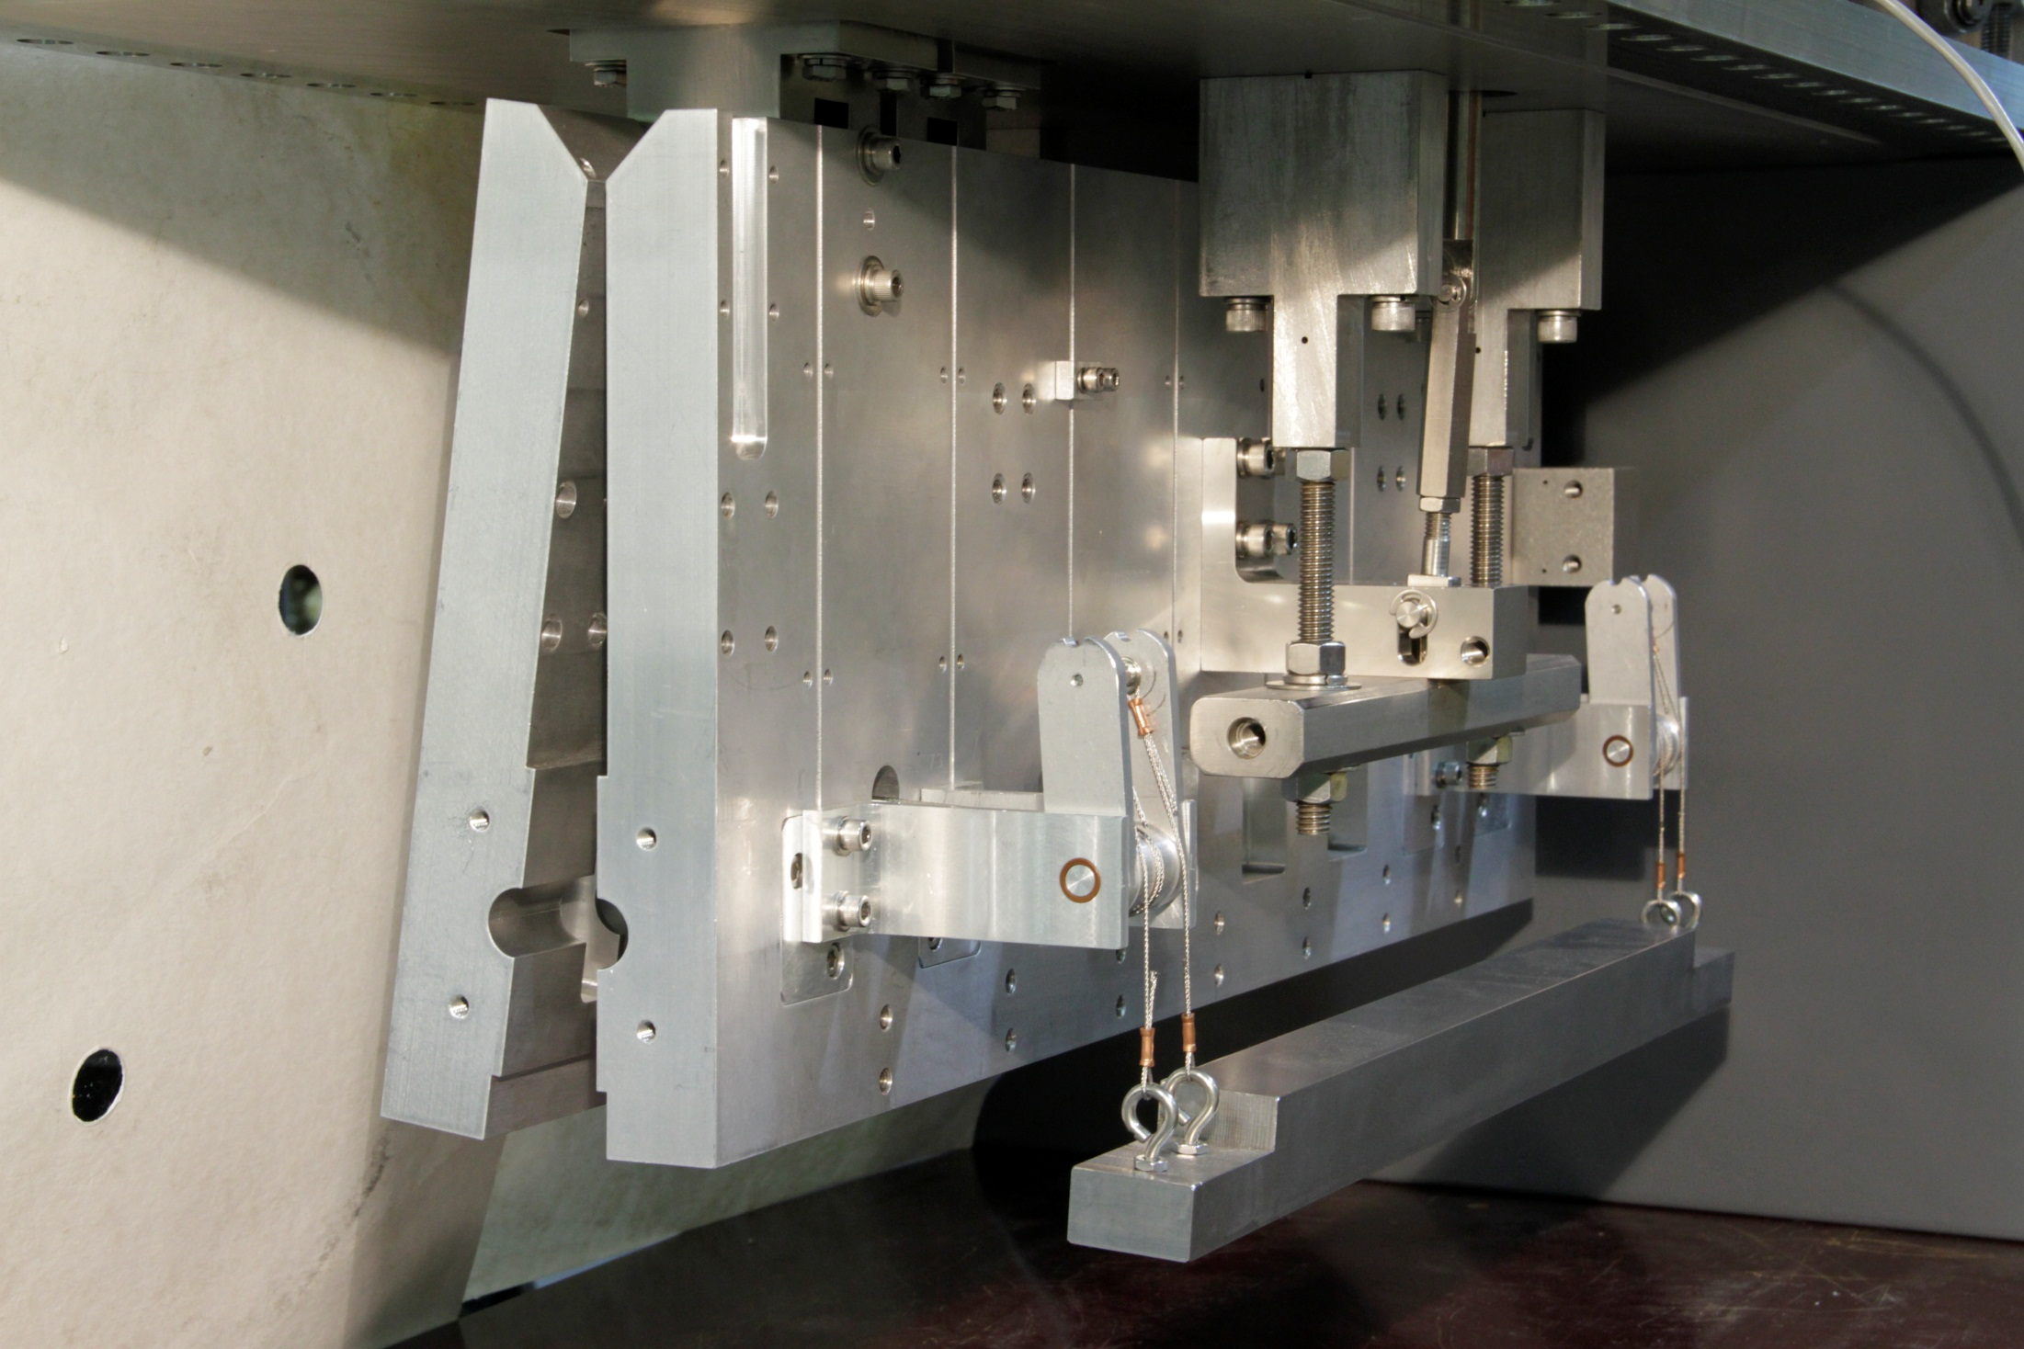

Slide 14
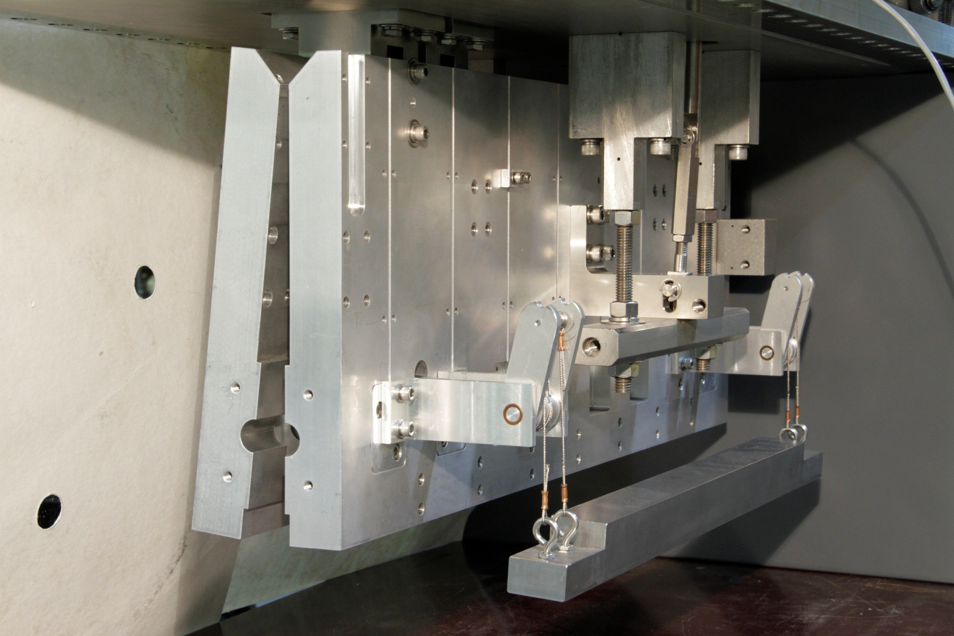

Slide 15
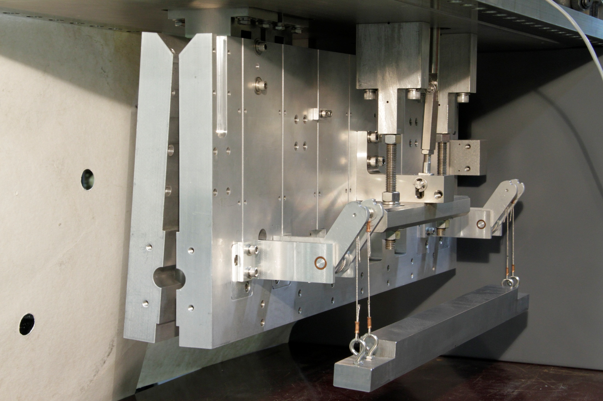

Slide 16
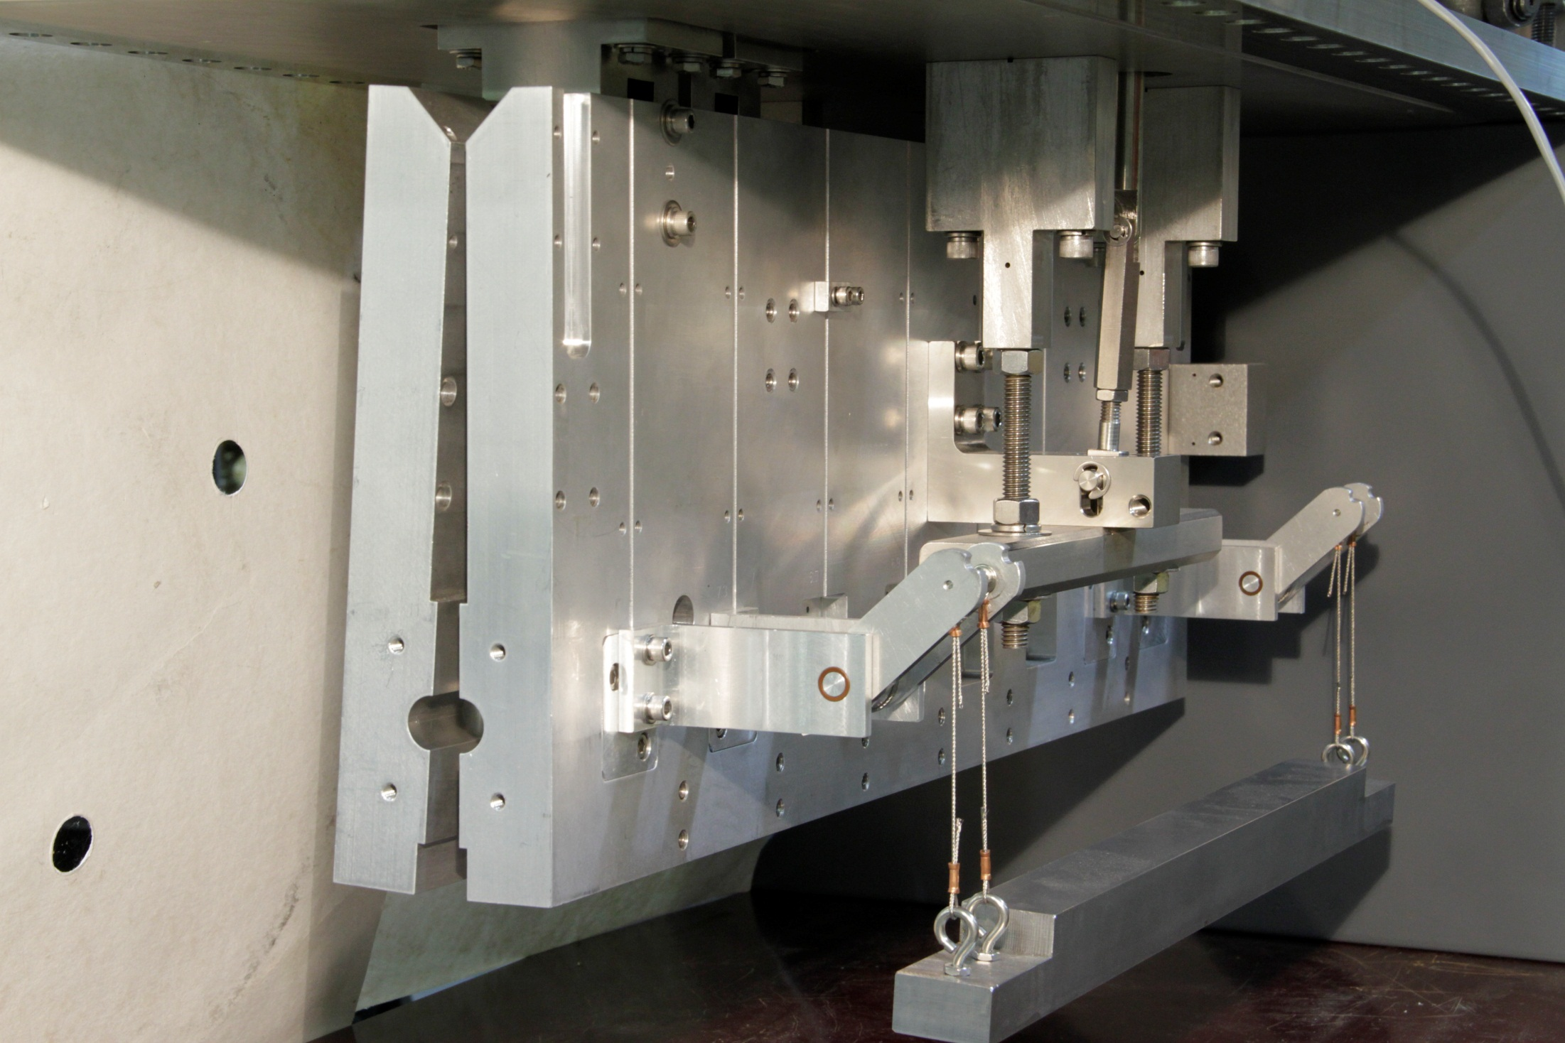

Slide 17


Slide 18
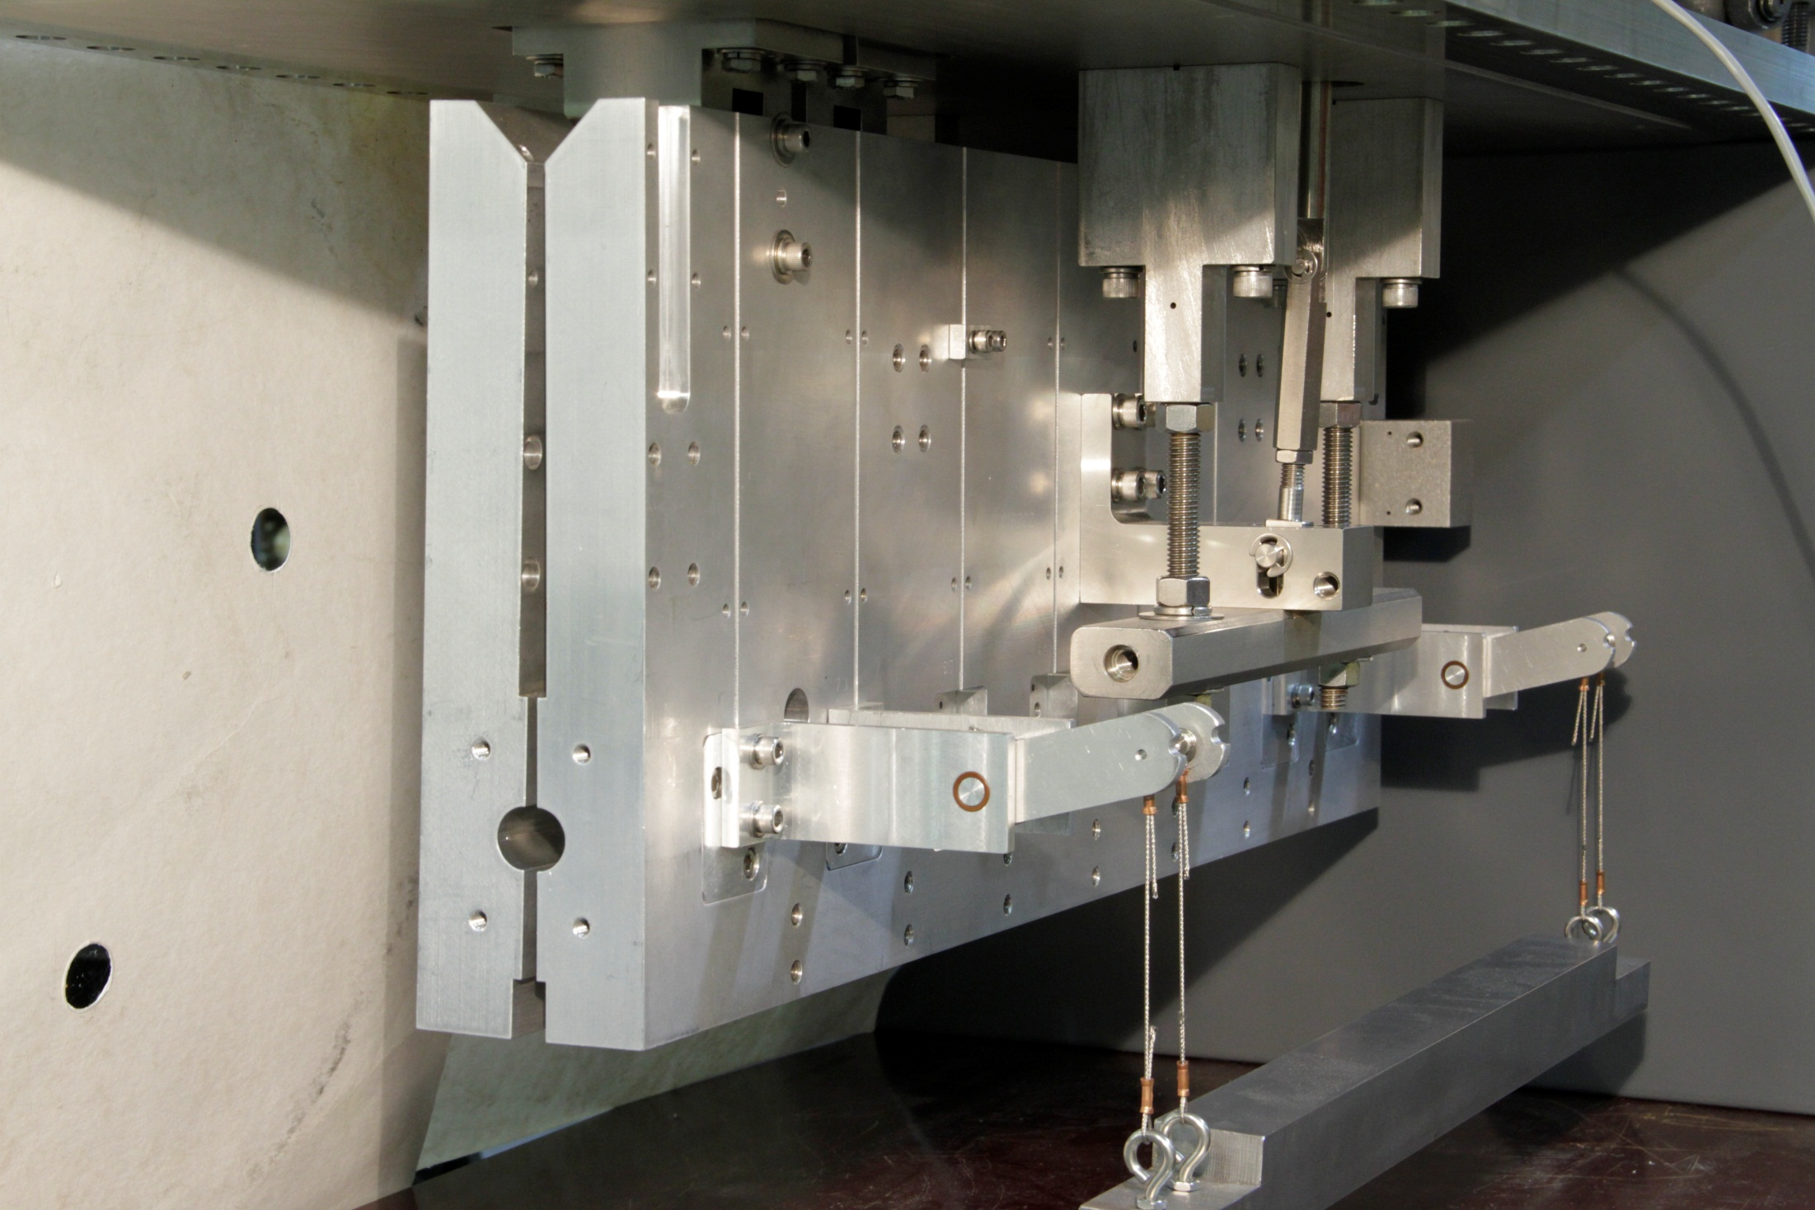

Slide 19


Slide 20
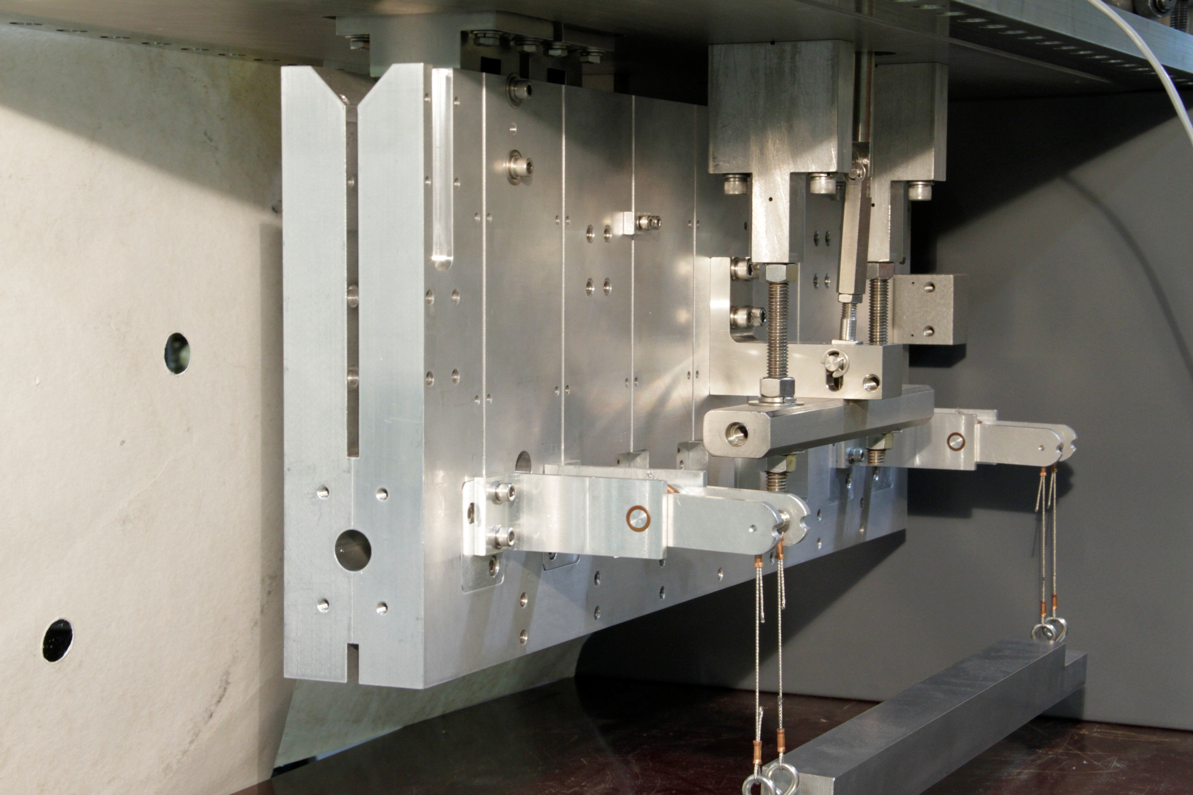
Beam

Slide 21
Beam

Slide 22
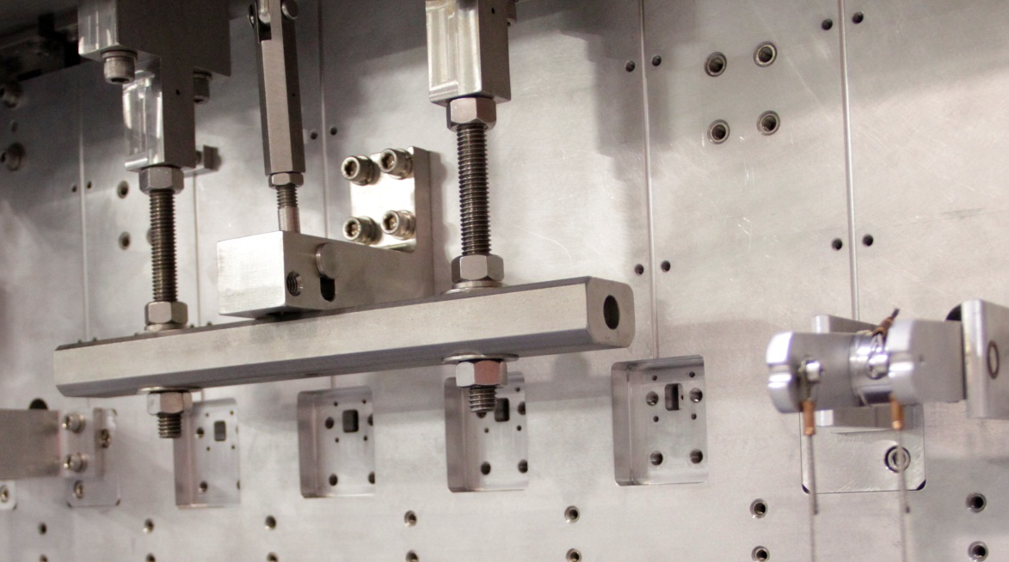
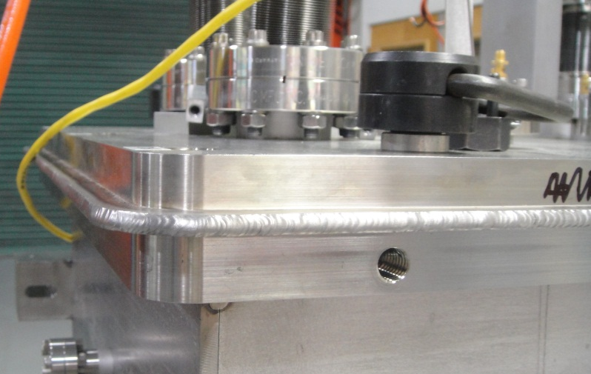
Details
Binary motion actuators (open or closed only)
  Alignment of kicker aperture to beam axis is determined by hard stop
  Not by stepper motor set point
Welded tank top flange (used on transverse kickers)
  No metal O-ring seal on square tank
Linkage goes slack

Slide 23
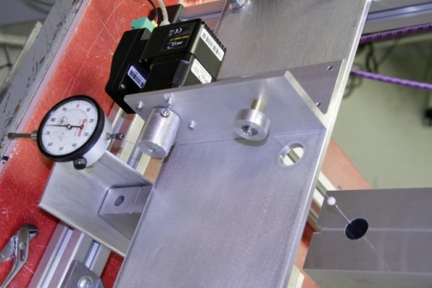
Status of kicker production
Bead pulls for frequency and bandwidth tuning have begun (tank 1, 6-7 GHz)
Vacuum vessels are arriving now
Weights design to replace springs in closing mechanism has been exercised > 2000 times in vacuum
Cavities for tank 2 (7-8 GHz) due to arrive next week
Kickers will be installed during shutdown of 2013 for FY14 Heavy Ion run
6-cell bead pull, R/Q = 230 Ohm

Slide 24
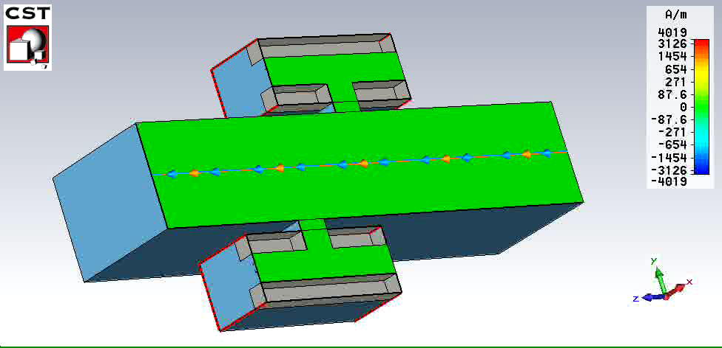
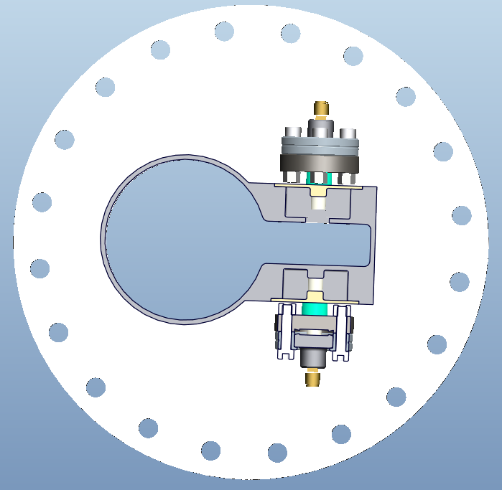
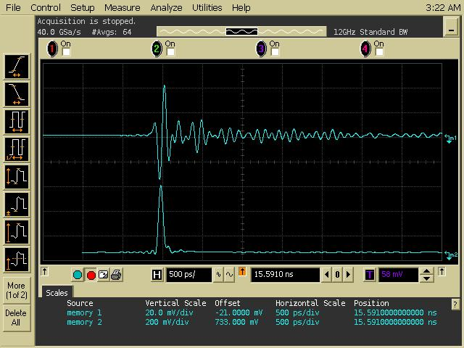
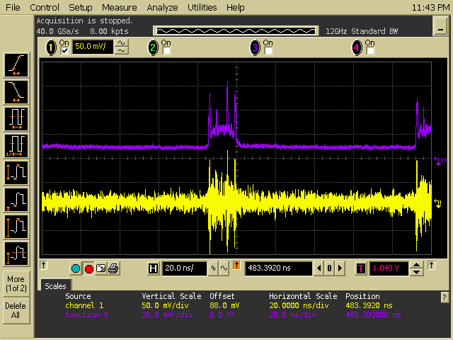
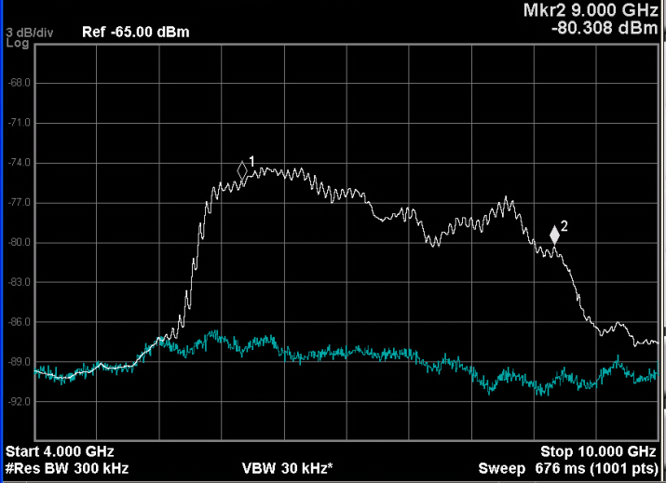
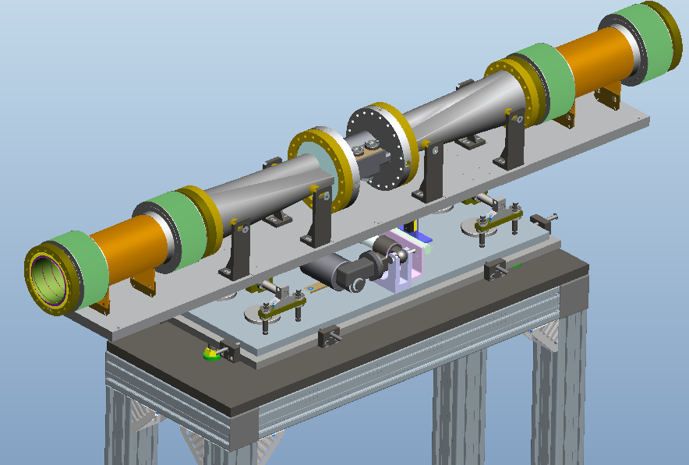
Keyhole Pickup
Keyhole shape
Smooth frequency response
Wire test of pickup.
50 ps risetime pulse, 500 ps/div
Beam test of pickup.
protons, 20ns/div
Shape transition
Bellows
Spectrum from wire test.
Markers at 6 and 9 GHz, 3 dB/div

Slide 25
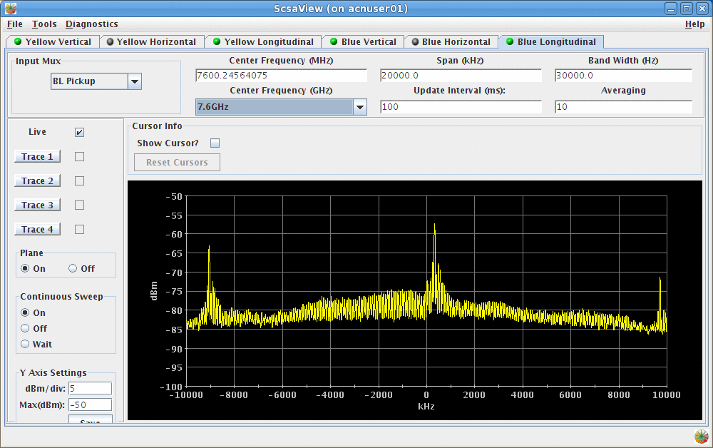
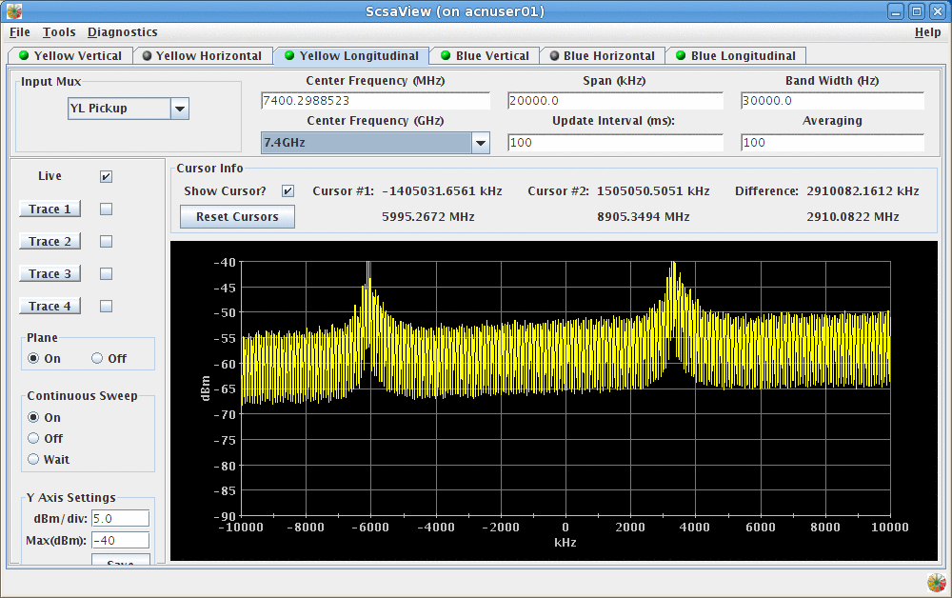
Beam Test (protons): Frequency response
Frequency response varies from one bunch frequency line to the next (9.38 MHz)
Old pickup, Blue
Frequency response is constant from one bunch frequency line to the next (9.38 MHz)
New pickup, Yellow
Power spectrum from pickup. Fine structure is revolution frequency lines.
7.5 GHz. Span= 20 MHz, 5 dB/div

Slide 26
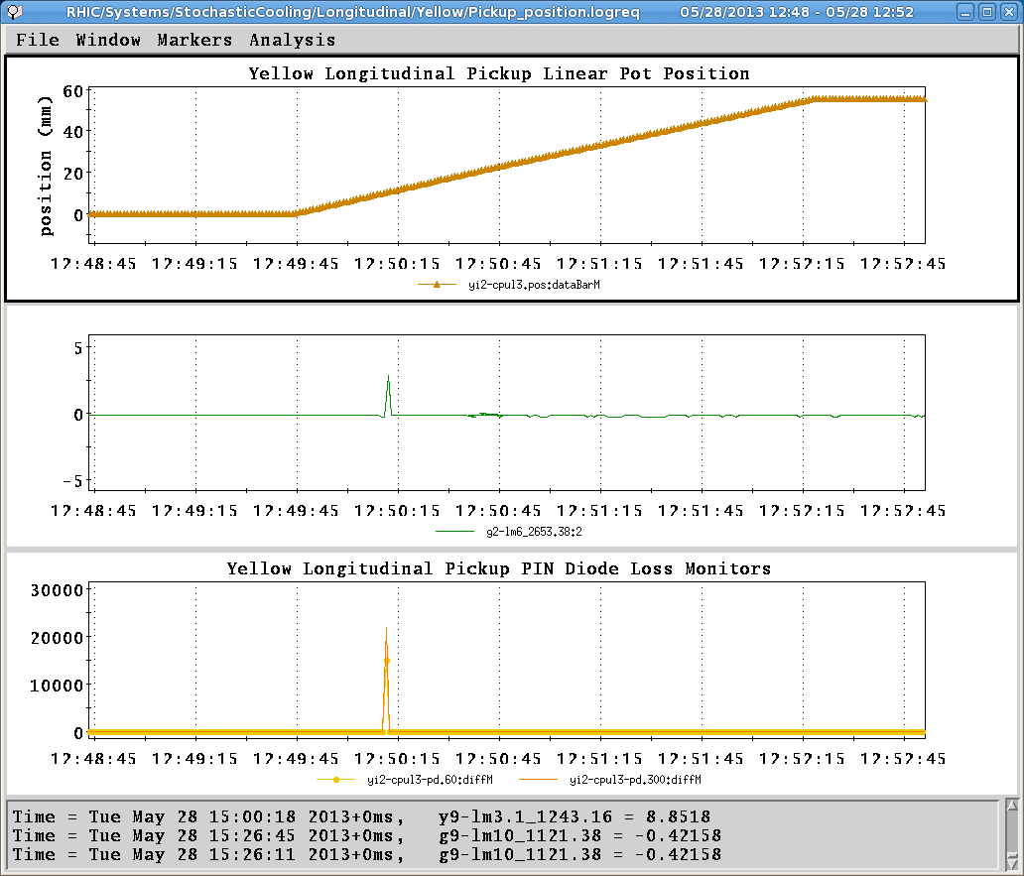
UFOs as the pickup moves
When the pickup moves it appears that some flakes from the bellows shields drop into the beam.
Tests are underway with the Blue pickup before it is installed to see if this behavior continues after many cycles.
The blue pickup has executed ~2000 cycles and we have collected flakes on glass slides.
Next we’ll test if flakes continue.
If yes then further analysis is required.
Pickup position
BLM at s = 2653m
PIN diodes at pickup

Slide 27
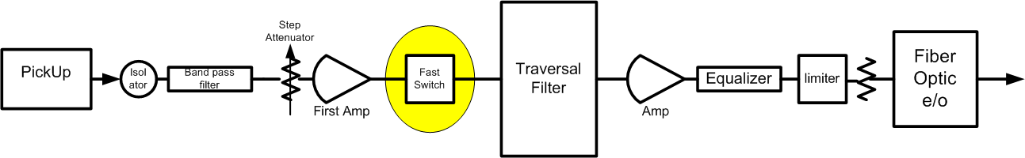
Pickup signal processing improvements
Better signal subtraction for transverse pickups
  180 degree hybrids, (Fermilab and BNL (Sal Polizzo))
  Colby trombones for cable length compensation (Fermilab)
Fast switch (5 -25 ns) after first amplifier will gate out noise
  Signal to noise ratio improvement
  Hopefully this will facilitate better use of the signal suppression effect to optimize the system transfer function (BTF)
  Controls are supplying modified V124 timing modules to trigger the switches (bunch pattern and bunch-by-bunch gating)
Noise floor is determined here

Slide 28
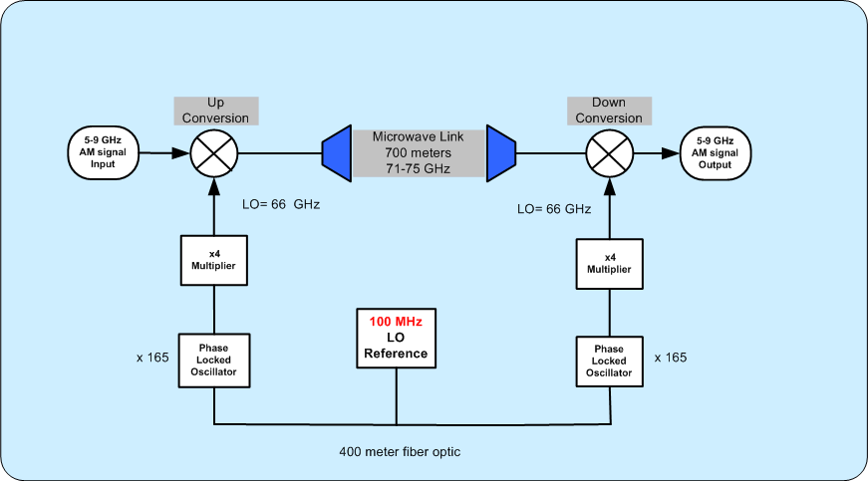
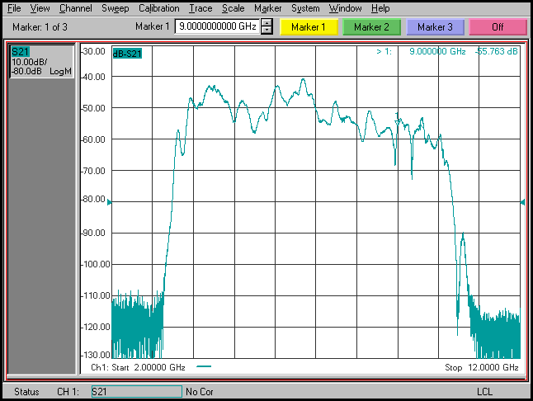
Microwave Link
The receiver and transmitter are coupled via a common Local Oscillator. The LO is used to heterodyne our signals from 6-9 GHz to the carrier frequency of 72 to 75 GHz
The coupling between the two LOs happens at 100 MHz. The phase noise of the 100 MHz clock is a weak link in the system.
We will upgrade this coupling signal from 100 MHz to 16 GHz. The 16 GHz signal will be delivered using our standard Fiber Optic components.
The main benefit will be eliminating Intermodulation distortion in the longitudinal pickup-to-kicker signal
It will also make the job of the pilot tone feedback easier
It will enable us to put the signal band (6-9 GHz) in the good part of link passband
6-9 GHz
Pilot tone frequencies

Slide 29
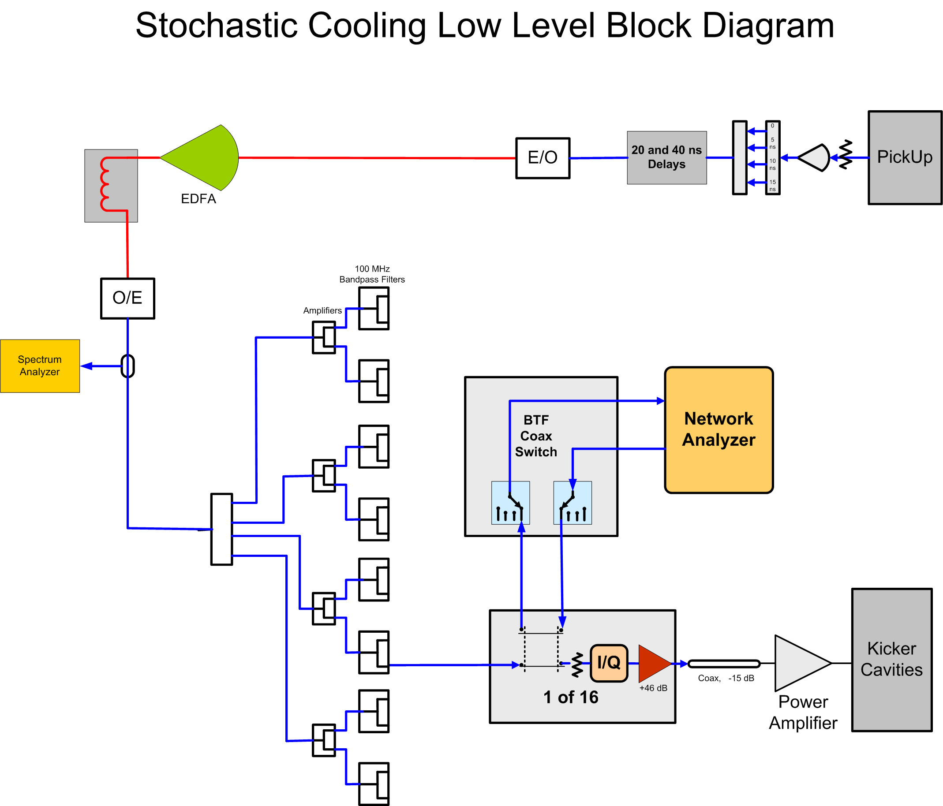
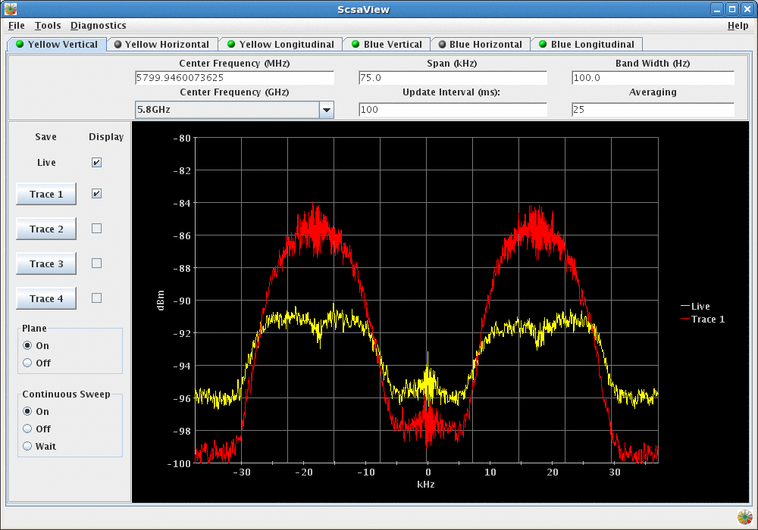
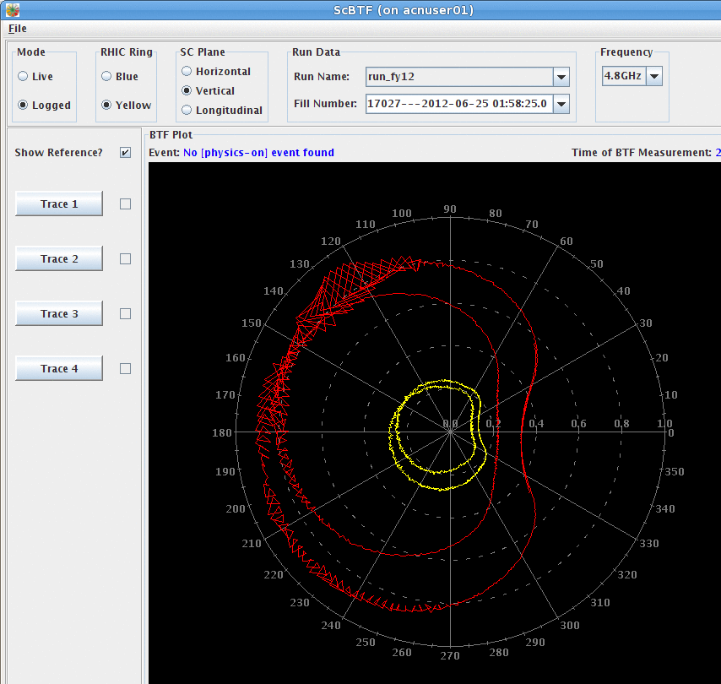
Operating Software
Phase out LabView Interface with the Network Analyzer
BTF in MCR without Remote Desktop
Better organization of logged of BTF results (how do parameters evolve)
(maybe) Better reference BTFs by sampling all the revolution lines within the cavity bandwidth to evaluate signal suppression
BTF application, not Remote Desktop
Spectrum showing signal suppression

Slide 30
Ideas for New Software Capabilities
Use parasitic monitoring of signal suppression to “continuously” optimize system parameters.
  Phase drifts from ambient temperature changes
  Changes in kicker cavity resonant frequencies
  Changes in beam response function with cooling
Compensate for effect of signal suppression from adjacent cavities during open-loop BTF measurements (becomes more significant as cooling proceeds)

Slide 31
Status
Yellow keyhole pickup was installed and operated during the proton run FY13
Blue keyhole pickup will be installed this shutdown
Kicker production is underway. First vacuum tanks have arrived. First set of cavities have been built and are being tuned. RF vacuum feedthrus are on hand. Small components, hinges, brackets, etc. are now coming from the shops.
Fast switches for the pickups are on order. Control electronics are being designed
Microwave link LO upgrade is in progress. Most parts are on hand. We’ll do a test with one link next month (using spare parts if needed)
Software work is “ramping up”

Slide 32
Possible next upgrade
For the pA program the number of ions will be greater than 1.7e9/bunch. We’ll want more bandwidth to keep the same cooling rate
  Add one more kicker at ~20 GHz, 15 % bandwidth
  Cooling rate doubles because of good mixing factor (x2), and same bandwidth (3 GHz)
  One plane, vertical (betatron coupling)
  One ring (with light ions)
  Keyhole pickup concept can be used for transverse pickup
  Schottky band overlap is not a problem for betatron cooling
  TWTs are available at 20 GHz (power supplies from Fermilab?)
  Possibilities for peak power reduction (necessary for cost control)
    Q= 10 resonant kicker
    Chirp kicker drive, compress with dispersion of a waveguide
  Kicker possibilities
    Corragated waveguide, slot coulped waveguide, dielectric loaded waveguide

Slide 33
Summary
We are on track for installing upgraded pickups and kickers for the longitudinal cooling system, for the FY14 Heavy Ion run
The pickup has been successfully tested with beam. UFOs are a concern.
The new kickers will replace the original Fermi tank kickers for improved reliability.
Possibilities are envisioned for further improvements to the stochastic cooling system

