Slide 1
Summary RHIC Retreat Session III Operations, Reliability, Instrumentation, Controls…. Dilemma 10 talks –> 10 summary slides -- or 100?
Contributors -- P. Ingrassia, D. Bruno, K. Smith, J. Morris, R. Hulsart, A. Marusic, G. Marr, S. Perez, C. Montag, P. Sampson

Slide 2
Run13 Availability… RHIC Retreat July 26, 2013
P. Ingrassia

Slide 5
Wolfram observes no improvement in Store to Store Times Run09 thru Run13 – A work in progress

Slide 6
RHIC PS System 7/26/13
What did we do to improve the reliability for Run 13
Improvements made during Run 13
What will we do to improve the reliability for Run 14
New Projects

Slide 7
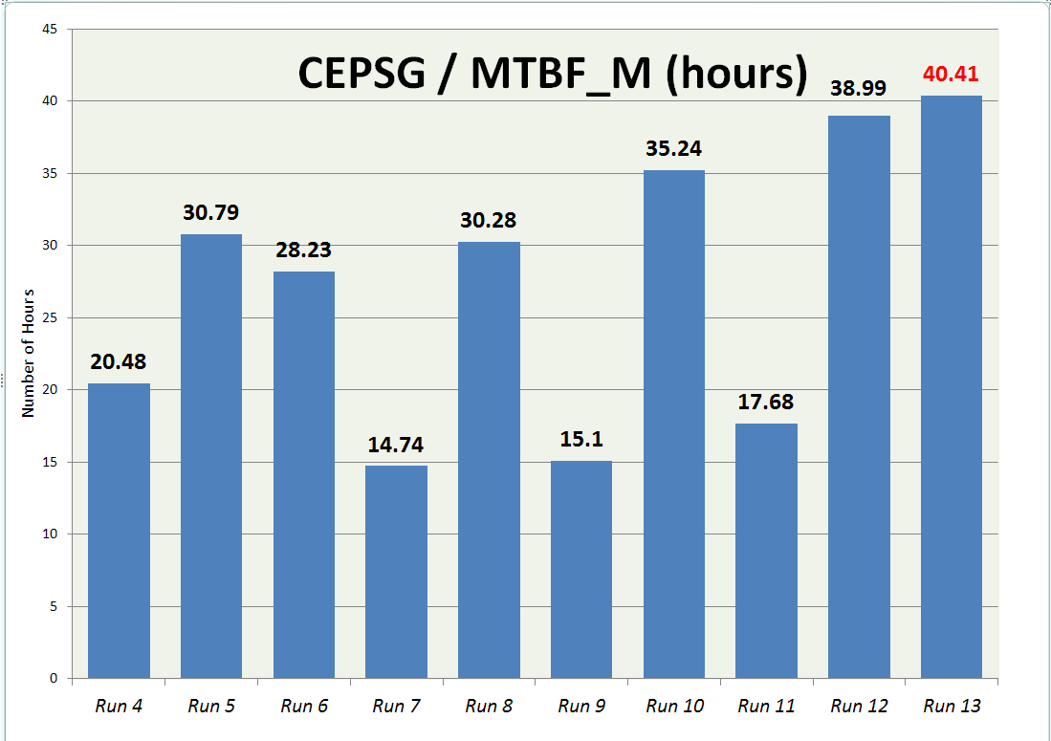
Notes:
Inconsistent- not now- Run 12 and 13 are 2 back to back good years!
After Run 7, 8 Supplies sent to Algen.
After Run 9 no Suncrafts pulled out
After Run 11 all Suncrafts pulled out
Ater Run 12 we did not pull out all o the Suncrafts, only some for repairs, and a few or upgrades

Slide 8
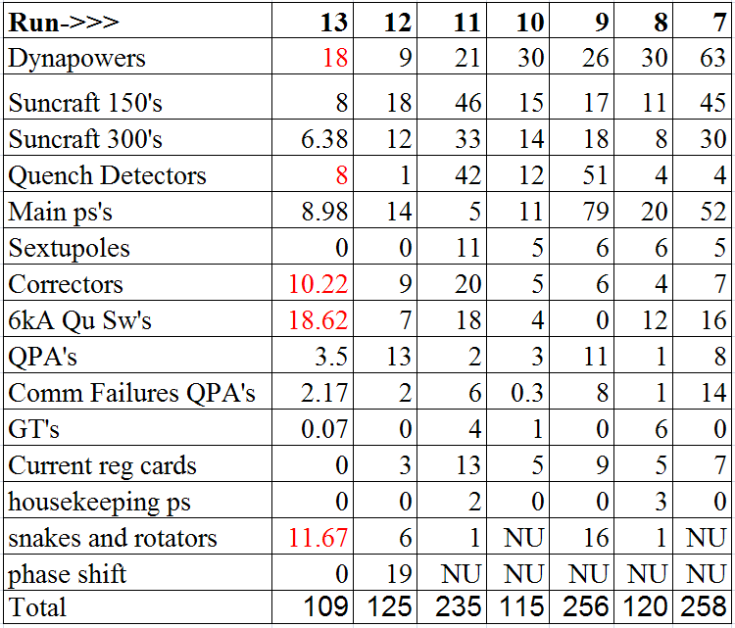
Down Time in Hours Runs 13-7
Notes:
Y dh0 coupling problem not shown here, should be under qd, maybe additional 2.5 hrs
Dynapowers
Crowbar of b8-dh0 and bi9-qf7 took a lot of time actually misdiagnosed as a QPA crowbar fault for awhile
Diagnosing b8-dh0 was the majority of the downtime. Probably about 9-12 hours due to these problems.
2. We also had a problem with the bi4-qf7 ac input current causing a breaker to trip which we replaced
3. Bo6-qd3 has a problem with the 4-20mA qd readback to the qd
4. SCR OT of yo9-dh0 because of bad connection on SCR klixon. This took awhile to diagnose and fix
150A problems list here
4 ps’s swapped out, should have been only 3 swapped out because one had a bad fiber optic interface card. 12.58 hrs should probably be around 9 hrs
Yo8-tq6 s/n 65 should not have been pulled out. It had a fiber optic card problem. This was swapped out the second time then the problem was figured out, also ESI jumper missing from spare.
Yi6-tq4 s/n 88 wouldn’t run negative awaiting troubleshooting still as of 7/15/13
Yi6-tq4 s/n 110 voltage jumped up, still looking at, right now went through oven possible hkps problem. Could not reproduce problem.
Bo7-tq4 s/n 29 no positive current output at all, found all positive fuses blown, cheap fuses, replaced with double resistors and good fuses, done and spare, waiting to hear from Tom for more info. This was running at 140A, all fuses blown.
300 problems list here
B4-q89 could not make operating current s/n 16,installed UCI board, back into b4-q89 slot. Converter board problem with both converter boards, repaired both, replaced fuses with stamped fuses.
Quench Detectors-TIME SHOWN AS ZER0 BUT AGS COLD SNAKE QD HAD A LOT OF DOWNTIME-NOT PART OF RHIC
AGS cold snake connection in bucket to ADC card caused about 7 hours of down time
RHIC 9a fec had to be re-mounted so it would talk to the qd fec server, slow logs were not working: ASK GREGG IF THIS CAUSED DOWNTIME
We did not count ydh0 coupling problem which was probably 8 min running yellow quench recovery each time x 20 times=160min about 2.6HRS
Al has an idea to mount the qd fec’s differently? Do this during summer 2013
Main PS’s
DCCT problem Al had and then we tried to replace it- NEED SIGN that says kill control power before replacing dcct
Start up had main ps regulators problem but I don’t know I it counted towards downtime
Correctors (run 13 replaced 7, run 12 =8, run 11=17, run 10,9=5, run 8=2, run 7=4, run 6=6, run 5=10)
7 correctors swapped out for Run 13. Found nothing wrong with 3 on the bench, 2 hard failures, 2 were the leaky capacitor
Bo2-th4, ovetemp fault, intermittent. Nothing found on bench.
Bo10-octd swapped on a maintenance day 3/8/13 because of voltage and current spikes. RK said nothing found on bench. Ran in oven or 4 days.
Bo10-th16-ps on maint day 4/3/13, RK replaced FET board
Bi5-th15 by CAS and Tom on a non-main day. 4/19/13 Friday evening~6pm, DCOC, found that same cap blown and eating away at pc board
Bi8-qs3 by CAS and Gregg on a non maintenance day Monday, 4/22/13 ~3am, found blown bus fuse, replaced and runs fine.
Swapped yi7-sxs3-ps on 5/8/13 maintenance day because it failed the day before.-found leaky cap, same one as cap on bi5-th15 this run. Rich said a batch of serial numbers are grouped together that have this problem.
Bi9-th19-ps swapped out on maint day 5/22, nothing found wrong on the bench, slated for oven
6KA quench switch-always Y9DQPSW-right next to open 1010A door
Shorted capacitor the first time (PFN Low voltage fault on Y9DQPSW)
The second time the problem went away after moving wires around. Insulation rating only 600V on some of these wires. We should clean this up with better wires. (PFN Low voltage fault on Y9DQPSW)
We added portable air conditioner, humidity and wires only rated for 600V?
QPA’s
Really only the bi9-tq4-qp crowbar fault which was a bad relay on the SCR driver card
Snakes & Rotators
During the start up there was one that could not make full voltage
4 P-10’s swapped out. Found one hard failure, one intermittent, 2 others fine on bench, could have been connection problems.
Will check d connectors over summer and possibly replace one with a sorenson.
Crosstalk Problem not listed here

Slide 9
New Projects during 2012 Shutdown
E-lens (majority of time)
Wiring up the trailer for the Superconducting magnets and PS System
Testing in 902A
Getting quench detector built, installed, tested (big learning curve)
Blue ps signal wiring should be done end of July
Need blue Vtap cables and corrector dc cables pulled
QD Vtaps see beam injected, dumped and other warm magnets being ramped

Slide 10
Improvements made during 2012 shutdown
Phase Shift ps’s (also majority of time)
Installed new fiber for qd current readback
QD crosstalk problem when one channel left open
Workmanship issues with original phase shift ps installed
ground in d connector
Installed new ps’s. Sorensons instead of P-10’s.
P-10’s obsolete and hi-pot issues, ac connection problems EMI filter
Using ps iso amp for Vsetpoint, less connections
Added 2 more phase shift ps’s
Timing Resolver operational
Model 7 QPA’s
De-sensitized fuse fault, no more faults in run 13
Correctors - 1240 fans to replace
554 total fans replaced in 277 ps’s (over many years)
Notes:
From Run 12 These are old phase shift ps problems
Phase Shift PS Problem Summary from Run 12
Analog current readback to QD would pick up beam noise. Installed fiber optic transmitter and receiver (Charlie)
Problem with fiber damaged after pull and connections installed
Possible problem with Power Ten ps, A spare P-10 spare had a blown fuse. 3 P-10’s swapped out. One had ac stud problem, one spare had blown fuses, one ok.
Possible crosstalk in QD because one input left open, shorted unused inputs.
Possible 4-20mA qd card problem, swapped out, card ok on bench
Possible problem with isolation amplifier chassis, not tested on bench yet.
Yellow QD problem with new operating mode and RTDL signal. Larry fixed this. Had to reset FEC
Ground in d connector for yellow phase shift ps

Slide 11
Improvements made during 2012 shutdown
Snake and rotator ps work
Searched and repair bad ac connections on the EMI filters
VODH work- (some testing done during run 13)
Completed and ready to go on our end
Suncraft upgrades (not many done)
Soft start mod (still evaluating)
Parallel current sharing resistors for FET’s
Install stamped fuses
PC board consolidation
Main Power Supplies Output Circuit Compartment SCR current sharing
Reworked SCR assemblies
Now only the main quad OCC’s left to do

Slide 12
New Projects/Improvements During Run 13
Three 100A kepcos installed for y2-q89-ps (Suncraft replacement)
Ran very well for about last 2 months of run 13
Tested 2-50A kepcos in a tq slot during Run 12
New pc board for Suncraft 300A b4-q89-ps
Consolidated 3 boards into one, run 12 installed in a 150A
Eliminated many problem connections
E-lens (took majority of time)
Tested the yellow superconducting magnet during run and after run was over.
Crosstalk problem, need more time to investigate, cannot de-sensitize qd because signal is too large. May go away when ps is on at current.

Slide 13
Improvements/Work for Run 14
Dynapowers (gate=8hrs startup, iso amp 9 hrs during run)
Replace capacitor on gate drive boards (start up delay)
Replace op amps on iso amp board (run downtime)
Design new 3 channel iso amp board (run downtime)
Correctors (7 replaced Run 13) (caps 4 hrs during run)
2 Electrolytic caps fail run 13. 2 run 12. 3 run 11.
1 FET brd, 1 blown bus fuse
3 cannot be reproduced, waiting on oven
4 swapped out on maintenance days
1240 corrector fans. Fan replacement project continues
QD:
Fix Y DH0 coupling problem when blue goes down (3 hrs during run)
Win XP going away when? We have visual basic programs that don’t run well under WIN 7
Switch MS Access database over? Testing.
Al wants to make a changes to QD, no more FTP

Slide 14
Improvements/Work for Run 14
Power ten ps’s for snakes/rotators (11 hrs during run)
Running snakes, rots on shorts at operating currents for LIPA switching problem, adding line reactors, EMI filter, Surge suppression
Order Sorenson as P-10 replacement
E-lens-work in trailer to finish and then more testing
New Kepco ps’s
Purchasing new kepco ps’s to replace bipolar q89’s
New 3u control chassis and cards to build
DCCT’s to be purchased
3 or 4 may be ready for run 14
APS H-bridge – Should be ready 10/2013

Slide 15
Improvements/Work for Run 14
QD (cont’d)- need more time, no change from run 13
New card to compare sextupole 3 coils vs 3 coils
Possibly eliminate R algorithm for temp compensation
To Eliminate sextupole training
Suncraft 150’s and 300’s (3 150’s swapped and 1 300’s)
(14 hrs during run)
Fix 2 150A ps’s from Run 13 first
Soft start mod
Parallel Resistors for FETs
Install stamped fuses
Install consolidated pc board in 10 more Suncrafts

Slide 16
Improvements/Work for Run 14
Investigating new QPA fans to eliminate QPA fan warnings (0.42hrs during run)
Controls Programs-need controls help
Qdtune for checking V taps needs work
Improvements to QLI analysis program needed
Phase shift ps’s incorrectly picked out at 10A
Quenching Q4,5, 6 should not come up as ps fault
Other QLI’s to be corrected, see list
We need to give Controls feedback on snake rotator pgm
ODH Vacuum Switch Monitoring System – operational Run 14
Bruker (sextupoles) and dynapower(200 & 300)fan replacement
RHIC ps repairs, maintenance list from Run 12
Building more IR ps current regulator cards, eliminates relays
Node Card
New node card being developed

Slide 17
Improvements/Work for Run 14
Mains
HPDS
DCCT work
OCC SCR rework blue quad
New Regulator New combined PLL and Firing Boards New Backplane Incorporates Control System
6kA UPS work-network cards different
Test QPA crowbar circuits
Spares
Need to order spare dynapower ps SCR’s
Need to order 6kA quench switch spare parts
Need to check for other critical spares
Air Conditioning – Ductwork?

Slide 18
Focus-reminder
E-lens
New Kepcos and APS H-bridge
Ydh0 crosstalk
Y9 quench switch
Dyn 3 channel iso amp board/Gate Drives
P-10 problems
Corrector fans
Maintenance/repairs/crowbar testing

Slide 20
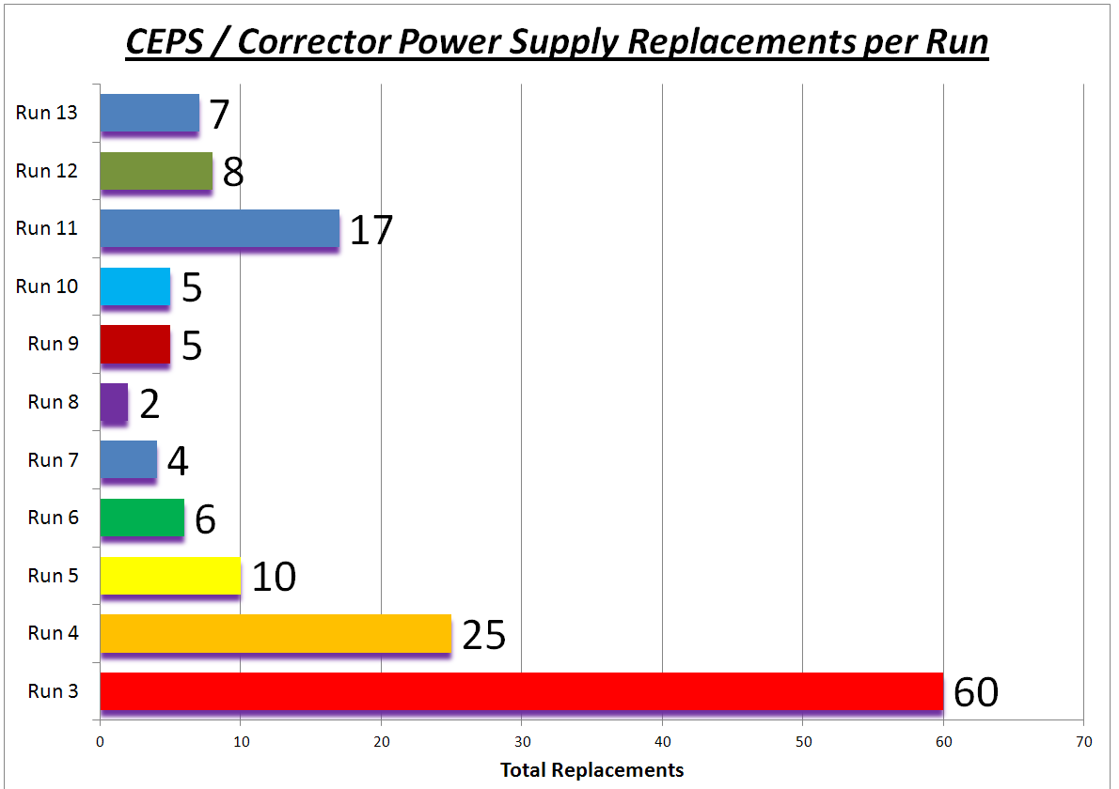

Slide 21
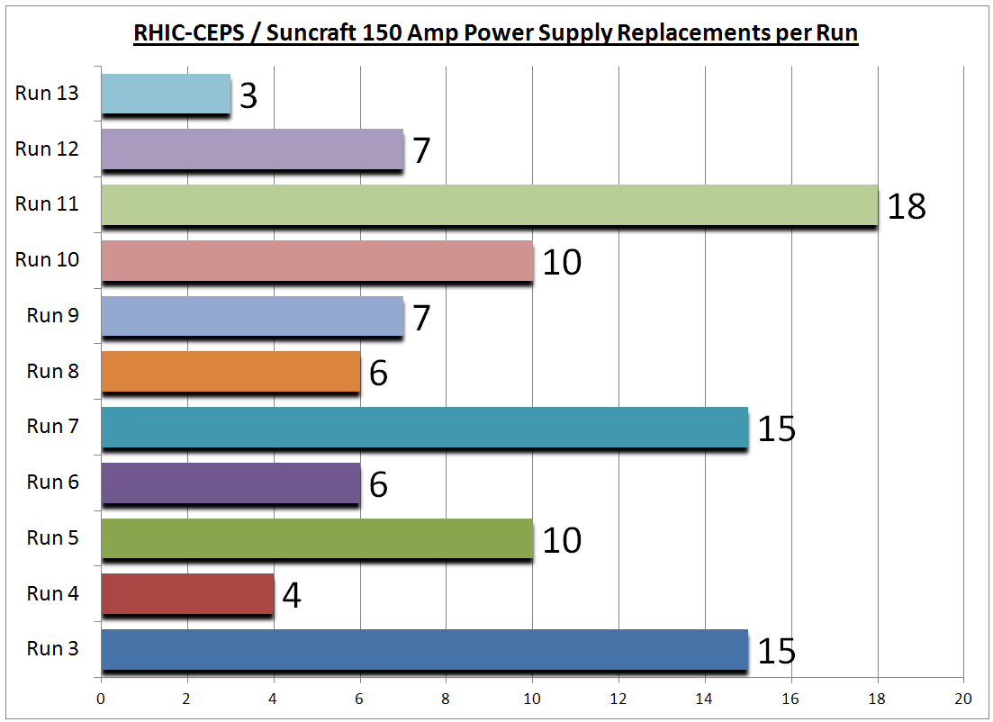

Slide 22
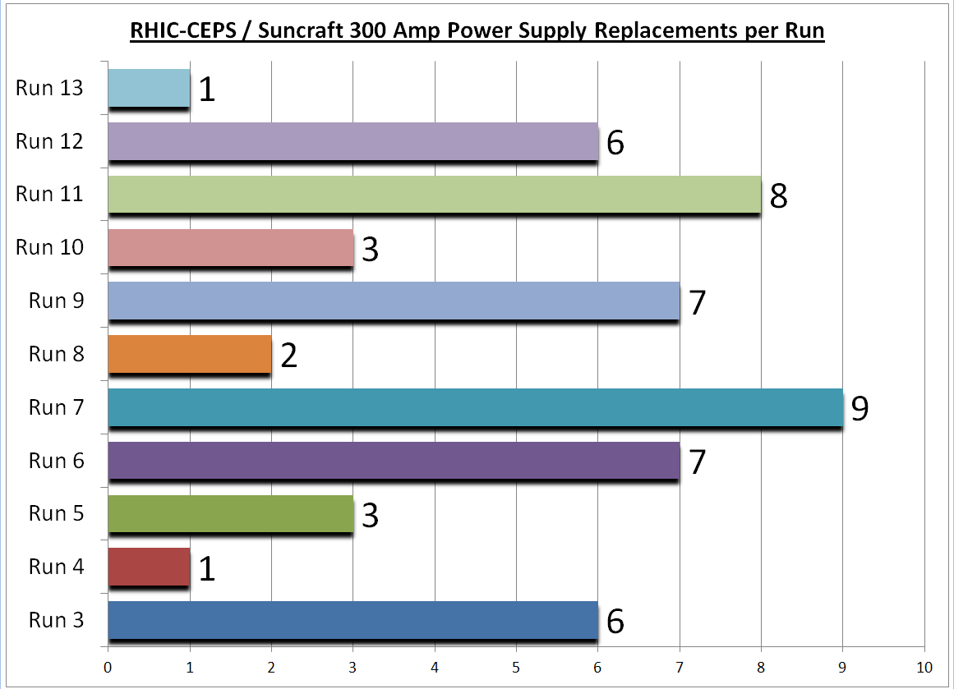

Slide 23
RF System Reliability and Developments Run13 Retreat
K. Smith
RF – The Giving Group
July 26, 2013

Slide 24
RF System Performance: Total Severe Failure Hours
2013 2012 2011 2010 2009 2008 2007
pp pp/U/Au-CU pp/Au Au pp d-Au/pp Au
Booster 6 9 10 4 10 4 1
AGS 13 10 13 19 13 6 17
RHIC 41 20 75 61 73 41 35
Total 60 39 98 84 96 51 52
HL 49 29 47 35 46 43 21
LL 11 10 51 35 50 8 31
Selected Notables
04/16 8.8 hrs Equipment Failure Replacement of BA2 Power Amplifier
05/05 6.9 hrs Equipment Failure YA1 Tuner Mechanical Failure (sheared bolt)
05/09 3.0 hrs Human Error BA1 incorrect reset procedure
05/14 2.3 hrs Equipment Failure BTA analog synchro controller flaky power connection
03/23 0.7 hrs Human Error Bouncer tuners railing due to voltage change
03/25 0.4 hrs Human Error Unanticipated sign flip in rebucket re-phasing tweak
RHIC HLRF
BA2 failures and YA1 tuner failure account for much of the Run13 spike.
RHIC & AGS LLRF
Minimal upgrade and development growing pains Run 13 & Run 12 vs Run 11.

Slide 25
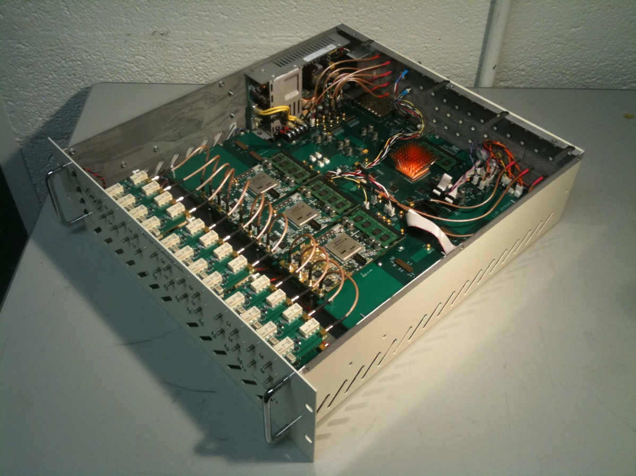
AGS LLRF System Upgrade for Run 13
Replacement of the 20 year old system with a new system based on the ubiquitous LLRF Upgrade Platform.
Hardware installed was a total of eight 3U LLRF Controllers.
5 Cavity Controllers, 2 System Controllers, 1 Update Link Master
Hardware replaced included:
25+ NIM crates with 130+ NIM modules
1 VME crate
10+ assorted custom chassis and commercial instruments (filters, signal generators, etc.)
Operational LLRF Upgrade Platform Applications
RHIC LLRF System
RHIC Bunch by Bunch Longitudinal Dampers & PTBLC-LMNOP…
RHIC Spin Flipper System
AGS LLRF System
EBIS LLRF System
ERL LLRF System
Applications in the pipeline
Booster LLRF Upgrade
EBIS LLRF system upgrade
RHIC LLRF system expansion / update
RHIC 56MHz
RHIC Cec PoP
iRCMS
RHIC Bunch by Bunch Transverse Damper
Actual LLRF Platform Chassis
Simulated Platform User, Professional Paid Actor

Slide 26
AGS LLRF System Upgrade for Run 13
New Functionality and System Benefits
True PPM system finally.
No more secret knob turning in Bldg. 929.
Independent LLRF drive generation for each cavity.
Each cavity is independently controlled in terms of frequency, amplitude, phase throughout the cycle.
Improved flexibility and configurability in the system setup.
No more need to jury rig hardware and cabling to support complex operational requirements.
Digital IQ (Amplitude & Phase) feedback for stable, precise, wide dynamic range control.
Improved stability and robustness for each cavity and the overall vector sum of cavity voltages.
Particularly important for the ion merge setups.
Digital closed loop main tuning (cavity resonance) and feedback (PA grid) transformer tuning.
Improved tuning control reduces required drive power, extending service life of PA components and reducing potential for cavity trips within the acceleration cycle.
Old open loop tuning of the feedback transformer in the direct RF feedback loop has long been the Achilles heel of the AGS HLRF system.
Much less spurious tripping due to overloads induced by open tuning errors.
HLRF modifications to feedback transformer bias windings to take advantage of new tuning.
Digital beam control feedback loops
MCR’s discomfort with radius auto zeroing noted and summarily dismissed.
Fully digital ATR synchro loop control
Utilizes an ac coupled phase loop and eliminates need for the (noisy) radial input in old system.
No more S/H glitch, smooth ramp to target frequency, completely flexible setup, very stable.

Slide 27
AGS LLRF System Upgrade for Run 13
Other System Upgrade Benefits
Direct synthesis of Beam Locked RF and Rev Ticks.
Much improved cavity protection.
All control parameters accessible through control system (i.e. no more knobs, switches …).
Also means they are cacheable and archiveable.
Tremendous amout of system data available through GPM / Loggers.
Great eyes into the system (if you know where to look).
Pretty much any internal system parameter is available at high rate (1 kHz std, 10kHz, 100kHz).
Remote access allows for faster support, on or off hours.
Common hardware means fewer yet more readily available spares.
Only four different pieces of major hardware used to build the system
Easier to develop, maintain and operate multiple systems distributed across multiple machines when they are based on a common platform with maximum commonality of components (hardware, firmware, and software).
A note about the “AGS LLRF Fix” and the transverse emittance.
Much to my dismay, I appear to have provided Vincent with a red herring on this one - sort of.
KLZ redisambiguated my notoriously poor memory yesterday after VHS’ presentation.
From early in the run there had been a persistent AGS longitudinal injection matching problem.
Fixed on 04/15. This fix induced the “transition” problem, which was then fixed on 04/16.
Presumably then, the injection fix is the actual fix as opposed to the “transition” fix.

Slide 28
RHIC LLRF & HLRF System Developments for Run 13
LLRF Development focused on two main efforts (covered in K. Mernick’s talk):
Bunch by Bunch Longitudinal Damper
Increase the threshold for intensity related longitudinal instability.
Periodic Transient Beam Loading Compensation
Longitudinal emittance preservation.
Bucket by bucket IQ demodulator IP development will have many offshoot applications.
Measure amplitude and phase of any desired frequency component of a signal on a bucket by bucket basis every turn.
A lot of phenomenal real time development work by F. Severino and G. Narayan.
And don’t let KM’s modesty fool you – key in all areas of development.
HLRF Upgrades
New RF measurement and Interface chassis for all RHIC RF Systems
Provide required signal conditioning between HLRF and LLRF.
Enhanced system diagnostics reduce downtime.
Recabled the RF control room to support integration of the LLRF and HLRF Measurement chassis.
Installed sliding short on the 9MHz common cavity.
Designed and installed application specific directional couplers on all 9MHz systems.
Installed new landau cavities for h=2580.
Retuned fundamental and higher order mode dampers to support new frequency (201.6 MHz).
Decoupled landau PASS logic from the 28MHz systems.
Refurbished the QEI amplifiers used for the BBB damper striplines.
Freebies from our friends at SNS.

Slide 29
Booster LLRF Upgrade for Run 14
Existing Booster LLRF essentially identical to the old AGS LLRF.
Upgrading for all the same reasons to realize all the same benefits.
See the AGS LLRF Upgrade presentation from Retreat 2012.
Alas, we are presently in a severe pinch for hardware.
Classic example of how hard it is to get things done.
Large hardware order web req entered 03/27/2013, for 06/28/2013 delivery.
Covers much more than Booster hardware needs.
Purchase order dispatched 07/09/2013. T. Hayes wins bet.
Expect first articles around 08/19/2013, then production hardware around mid September.
Production hardware will still need configuration and testing prior to any installation.
Still trying to maintain a very aggressive Booster upgrade schedule.
Hopeful to have main System Controller and Band II Cavity Controllers operational for NSRL startup in late September.
Dependent only on existing hardware, cannibalizing some development systems.
Means our remaining development hardware systems are the spares for everything.
New hardware coming in alleviates that problem eventually.
Minimum necessary system was tested for proof of principle at the end of NSRL 2013B.
Entire system upgrade must be completed for RHIC Run 14 startup.
Leverages off prior experience upgrading AGS LLRF in particular.

Slide 30
AGS LLRF Upgrades for Run 14
Thought that was done already? Right …
See the AGS LLRF Upgrade presentation from Retreat 2012.
As it usually does, the plan changed and became far more aggressive.
A Stage III goal became a Stage I goal, making the plan even more aggressive.
Basically this meant implementing the full Cavity Controller functionality for Run 13 startup.
IQ feedback control for cavity amplitude and phase regulation.
Closed loop control of the main cavity tuning.
Closed control of tuning for the feedback transformer.
Closed loop tuning of the feedback transformer was really the driver in this decision.
As often happens, a very aggressive plan led to compromises.
The system architecture was modified and consolidated due to lack of available hardware.
Two cavities per Cavity Controller chassis.
Cavity Controller FEC is overloaded with serving data.
One chassis takes down two cavities in the event of failure or maintenance.
AGS Update Link Master development was compromised by lack of resources.
The non-expert human machine interface was given little priority.
We need to find a way to address this. It is an ongoing issue across all LLRF systems.
So, work remains for the AGS LLRF
Highest priority is decompromising the AGS Update Link Master.
Also need harmonic jump machinery, L10 control (done-ish), some PPM work …
Likely to split Cavity Controllers following Run 14.

Slide 31
RHIC HLRF & LLRF for Run 14
RHIC LLRF has a number of open issues to address
Still in the process of identifying priorities for Run 14.
Setup of IQ feedback and cavity protection for the 28MHz and 197MHz systems.
Address tuning control for the new landau cavities.
LLRF control of the landau pre to post gammaT.
Address tuning control for the 28MHz systems with new ferrite tuners.
Continuation of transient beam loading compensation - bucket by bucket measurement and modulation.
Also related to this development are the “real” BTB Phase Detector and Radial BPM Processor firmware for RHIC, AGS and Booster.
Some new development always materializes. Always …
And oh yeah, a new 56MHz SRF common cavity. Woot!

Slide 32
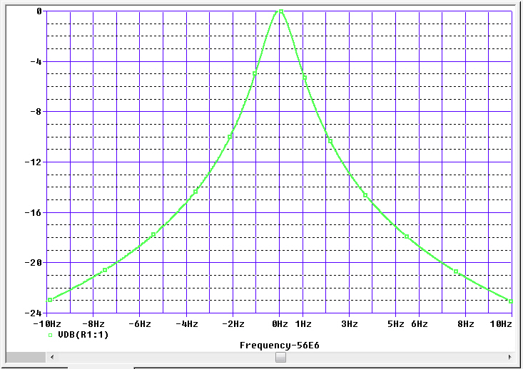
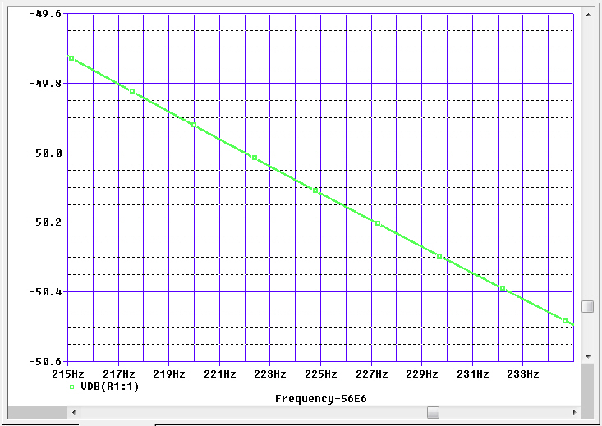
RHIC HLRF & LLRF for Run 14
New 56MHz “Passive” SRF Bunch Compression Common Cavity for RHIC
A beam driven cavity. Details upcoming in S. Belomestnykh presentation.
Operate cavity with resonance detuned $∆f$ well below beam rev line at 56MHz (h=720).
Beam induced voltage used to adiabatically compress bunch length. No rebucketing gymnastic.
$\left|\text{V}\text{cav}\right|$= I_{h=720}*$\left|Zcav\right|$_{h=720}, I_{h=720} = 0.5A (110x110 1.25E9/bunch) and $\left|Zcav\right|f0$ = 1.6E9 ohm.
Piezo and stepper tuners control $∆f$ to adiabatically increase and then maintain voltage at desired setpoint, compensating for slow beam current decay.
But, need something like 1E-4 $∆V/V$ stability at 2*f_{sync} to prevent emittance growth.
LLRF modulates 1kw power amplifier to compensate ambient microphonic noise, $±∆fm$.
Think triplet vibration. Cavity detunes about 16Hz/um of deformation.
Other control issues to consider and contend with.
$\left|Zcav\right|=\frac{R}{\sqrt{1+j\frac{∆f}{BW\text{½} }}}$ $\left|Zcav\right|=\frac{\left(R/Q\right)∗f0}{2∗∆f0}$*$\left(1−\frac{∆fm}{∆f0}\right)$
Recast where $∆f$ = $∆f0$ + $∆fm$ >> $BW\text{½}$
$⇒ ⇒ ⇒$
LEFT PLOT:
Loaded Q = 4E7, so 3dB half bandwidth is about 0.7Hz, which would typically make me cry.
RIGHT PLOT:
But, we are detuned very far ($∆f0$ about -225 Hz) so that microphonic effects are ameliorated relative to normal on resonance operation of very high Q cavities.

Slide 33
Control System
Reliability and Developments
RHIC Retreat
July 26, 2013
John T. Morris

Slide 34
Controls Run13 Downtime Categories – hours and occurrences
Control System Reliability and Developments RHIC Retreat 2013
Notes:
Comparison with run12
Run12 – 10 events > 1hr, MTTR = 2.0
Run13 – 23 events > 1 hr, MTTR = 2.5

Slide 35
Resets
Fec Resets for Failures
Server/Manager Restart Statistics
Reasons for server starts not logged
291 unique servers started during run
Half of these started 3 times or less
21 servers started more than 20 times including: polarBiasManAGS, AgsLossMan & Permit Monitor, RefManxxx, RampManager, wfgManager
Some problems (e.g. 10a PLC comm) found and fixed
Mysteries (e.g. inj timing) remain
Control System Reliability and Developments RHIC Retreat 2013

Slide 36
Reliability of Performance
What has your experience been when working at Control System consoles? Consider responsiveness, reliability of behavior and any other factors that affect your ability to work productively...
Some file system performance problems addressed during run
work on system performance continues during shutdown
Low ratings for MCR – especially 4-head displays
More data would be nice – especially for “Other C-AD Locations”
Control System Reliability and Developments RHIC Retreat 2013

Slide 37
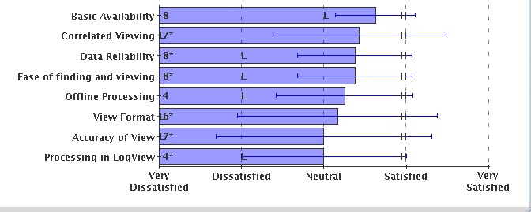
Reliability of Data Access
What's your experience in trying to access data to analyze accelerator performance? We ask you to rate seven different aspects of data access…
Overall results not too bad but…
Some negative ratings (& comments) in many categories.
No big surprises – data retrieval and analysis tools are (always) a work in progress.
Partnership with others in the department can help.
Control System Reliability and Developments RHIC Retreat 2013

Slide 38
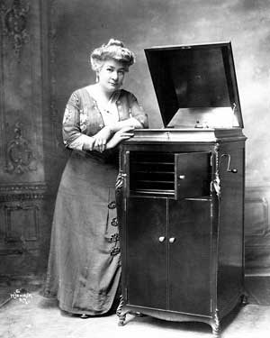
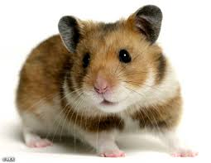
File System
To provide more consistent performance
Reorganization of op directories and NAS config (summer maintenance)
Adjustments in backup procedures
Expect purchase for FY15
Database Server
To avoid bottlenecks
Databases divided over multiple servers (free servers used where appropriate)
Configuration error corrected
License upgrade for primary server?
SUN/Solaris license is a dead end
Move to Linux 64-bit
Enhance performance, failover
Evaluating options now
Control System Reliability and Developments RHIC Retreat 2013

Slide 39
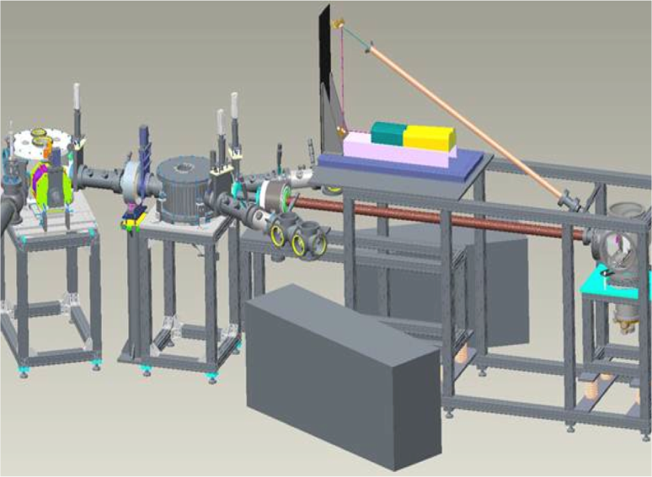
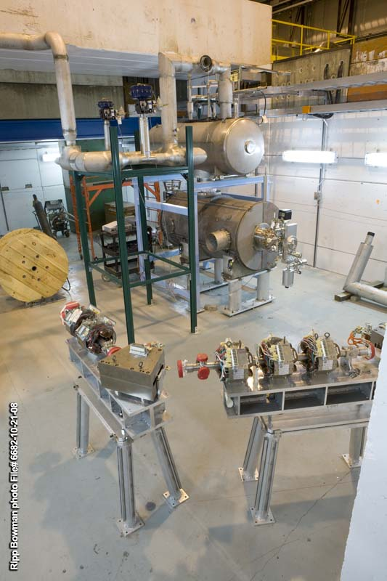
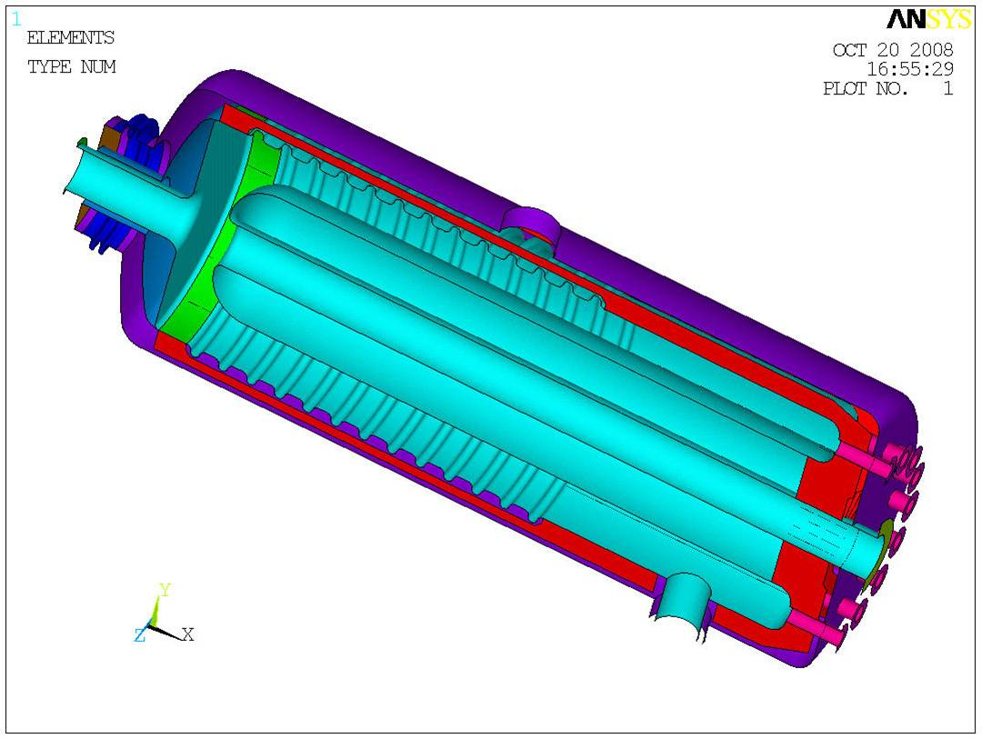
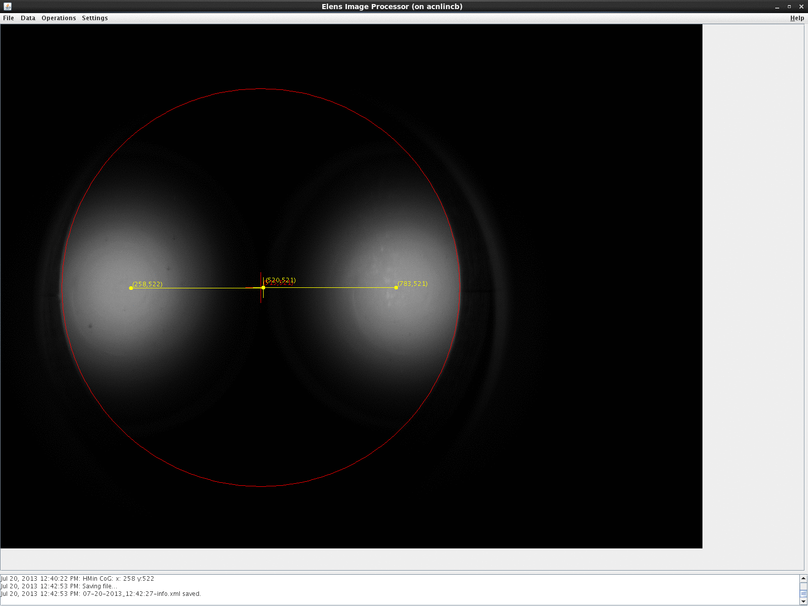
High priority: provide basic controls for…
EBIS Laser Ion Source
56MHz Cavity
ERL
Elens
CeC
EBIS Laser Ion Source
ERL components
56MHz Cavity
Elens image
Control System Reliability and Developments RHIC Retreat 2013

Slide 40
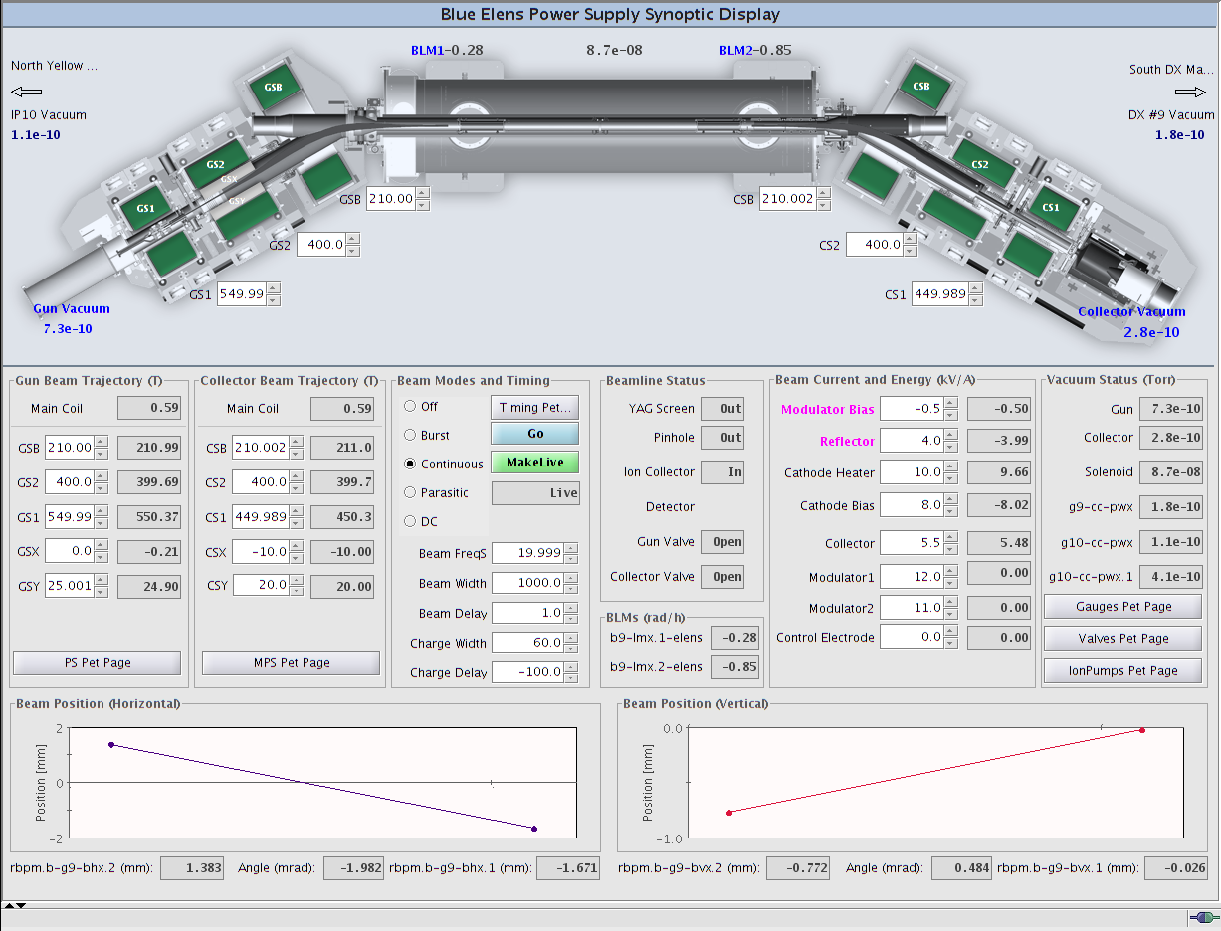
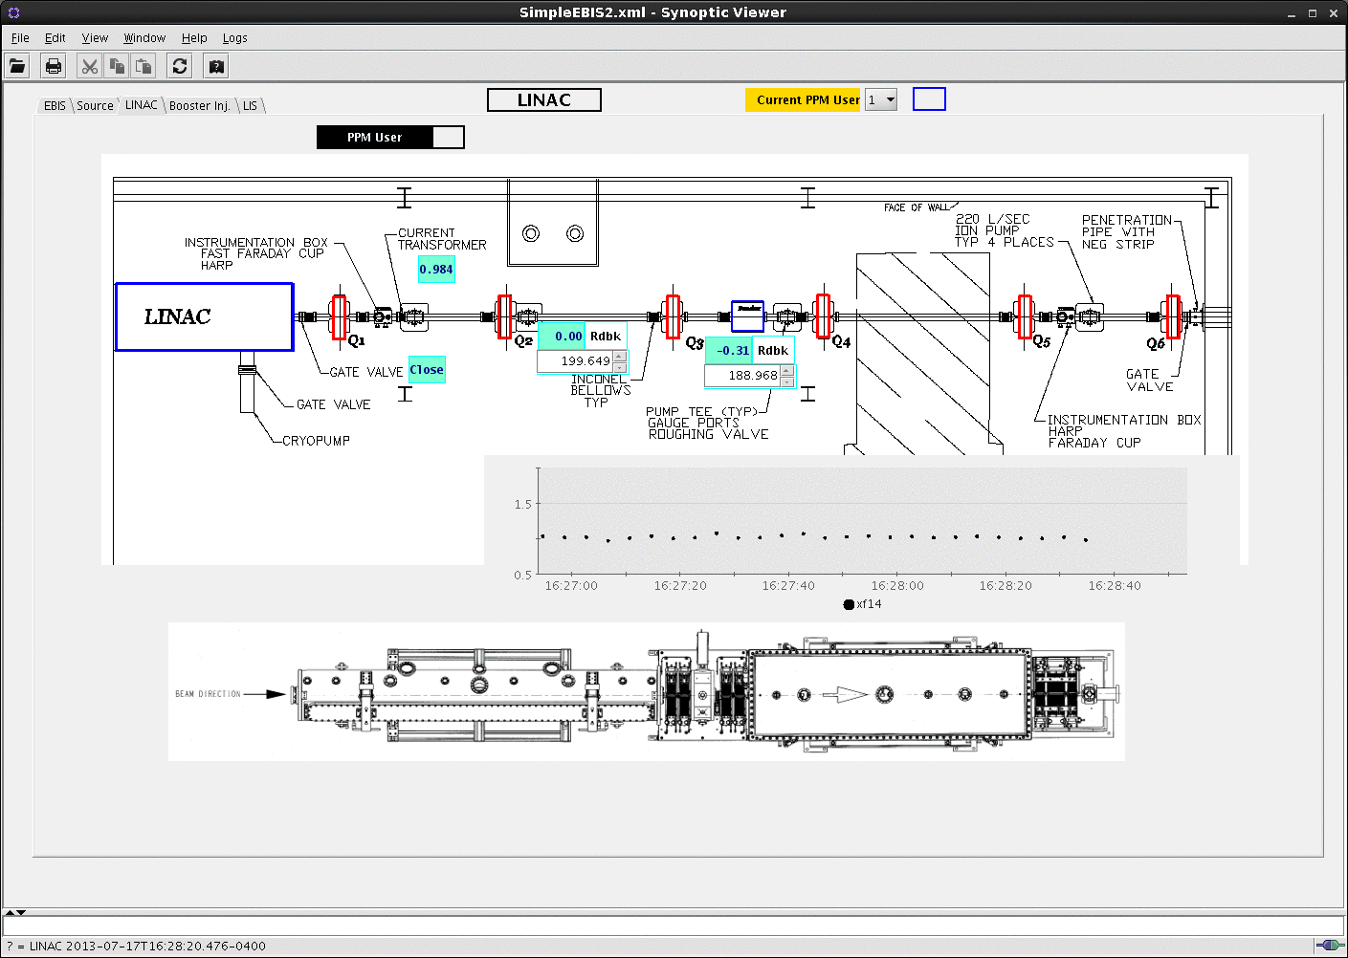
Synoptic Displays
Needed
Experience
Critical feedback
Synoptic – “characterized by comprehensiveness or breadth of view”
Control System Reliability and Developments RHIC Retreat 2013

Slide 41
Instrumentation System Developments in RHIC Run-13
RHIC Retreat - July 26, 2013
By
Rob Hulsart

Slide 42
Systems Overview
AGS e-IPM
Travelling Wave Schottky Pickup
RHIC WCM Architecture Upgrade / DCCT
Bunch By Bunch Loss / Luminosity Monitors
W-Dump Injection Timing
RHIC BPMs
Existing IFE Enhancements
Future Upgrade Prototypes (BBB Dump BPM)

Slide 43
AGS Horizontal eIPM R. Connolly, T. Curcio, C. Dawson, J. Fite, H. Huang, S. Jao, D. Lehn, W. Meng, R. Michnoff, M. Minty, P. Sampson, T. Summers, S. Tepikian, C. Trabocchi
Motivation
The existing AGS IPMs are ion-collecting IPMs. The measurements are susceptible to instrumental - space charge induced - broadening of the measured profiles (as evidenced by comparison of RF on and RF off measurements).
A RHIC-style electron-collecting IPM (for horizontal profiling) was installed during run-13 and partially commissioned. A second IPM (for vertical profiling) is being fabricated for run-14. The new IPMs will allow for:
- turn-by-turn measurements at injection (for injection matching)
- measurements during acceleration

Slide 44
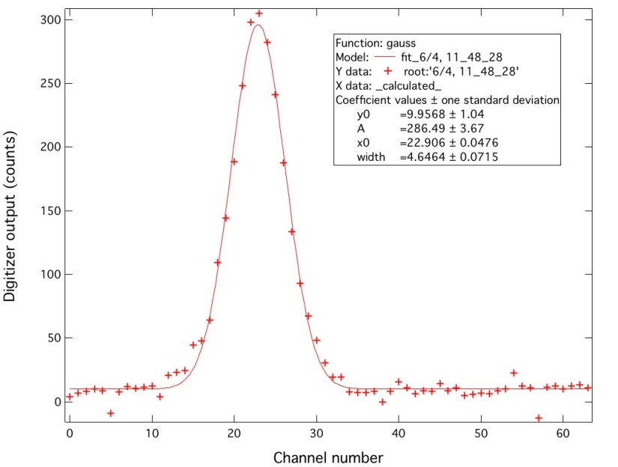
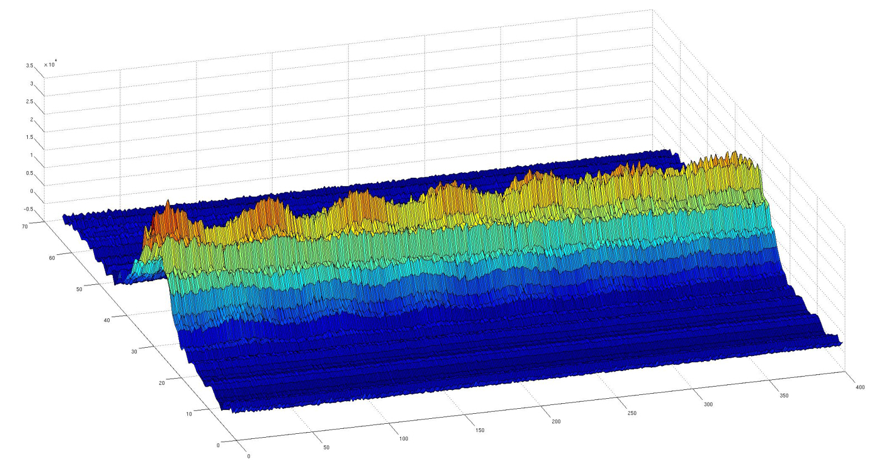
Profile measured at 425ms after t₀.
Channel offsets are subtracted and channel gain
variations are corrected in channels 1-30.
sigma = 1.741 ± 0.027 mm (1.5%).
Turn-by-turn measurements
Each profile is average over
100 acquisitions each with
1000 turns (subset shown
here)
offline data alignment and figure generation courtesy of Sean Dai and Reid Smith
channel number
(~ 34 mm full scale)
turn number
(turns 300-700)

Slide 45
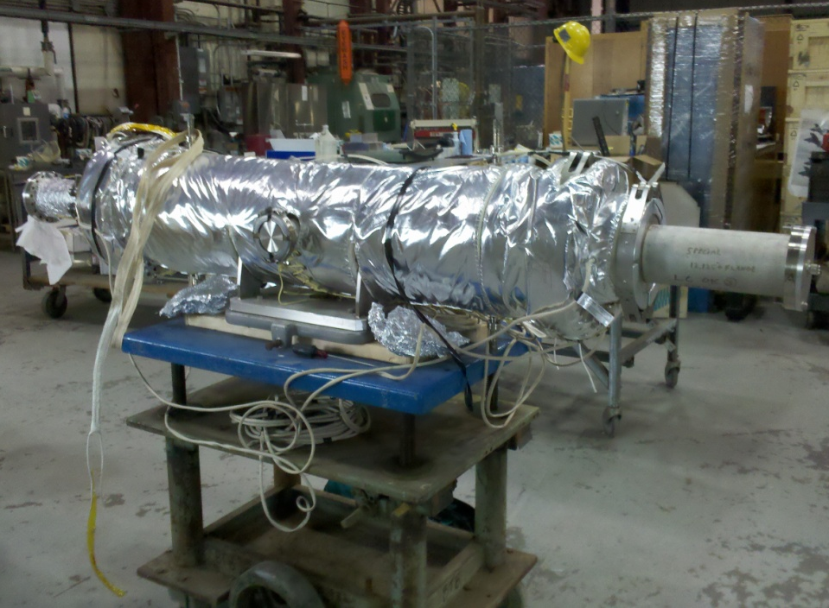
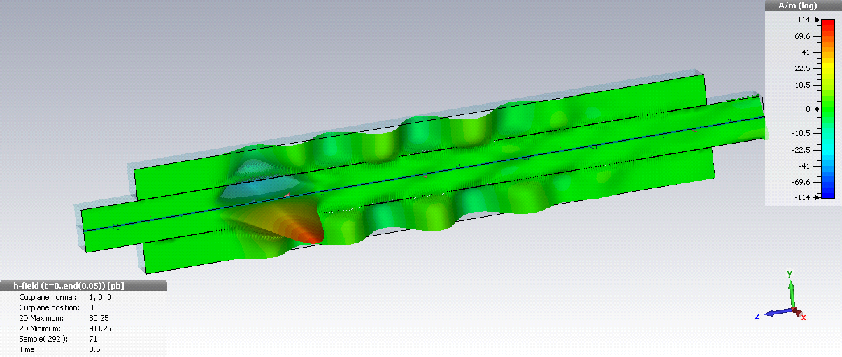
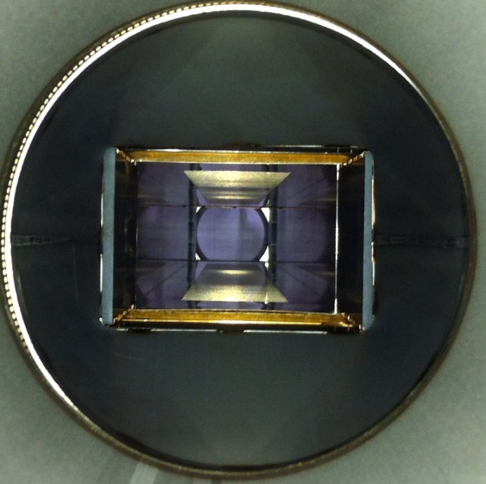
Travelling Wave Schottky Pickup
The travelling wave pickup was built at CERN based on a design from Fermilab as part of LARP collaboration
Measures Schottky signal around 1.7 GHz with ~100 MHz bandwidth – unlike other Schottky pickups in RHIC, it has high enough bandwidth to allow gating the signal to measure bunch-by-bunch
It was previously installed in RHIC in IR10, but was removed a few years ago to make room for e-lens
Installed in blue sector 2 near the end of last shutdown, cables and electronics installed during the run.
Pickup Tank (in 919B last summer)
Beam pipe is center waveguide, couples to top and bottom waveguides through slots
pickup internals
X component of magnetic field
from CST Particle Studio
By K. Mernick

Slide 46
WCM Architecture Upgrade (A. Marusic, C. Degen, K. Mernick)
Serves as Reference for RHIC Timing Setup
System Components Removed:
PC for Oscilloscope Communications
Two CDEV Managers
LabView Server ‘wcmServer’
Database for Settings
Accompanied by Numerous Improvements
Simpler Pet Pages
Better Log Files
Increase Acquisition Rate from 4s to 1s

Slide 47
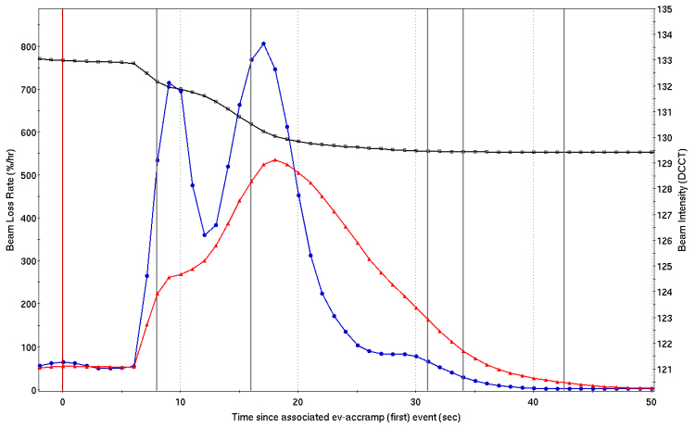
RHIC DCCT data processing
Data processing to remove off-time measurements used in signal averaging
(main cause: internal calibration process that interrupted data delivery)
Sampling rate increased from 1 to 10 Hz
New algorithm (Nick Kling) for beam loss rates developed:
Beam losses more
precisely measured
Time of losses also
more precise
Beam intensity from DCCT
Beam Loss Rate (%/hr)
Old algorithm
New algorithm
Time after ACCRAMP (s)

Slide 48
Bunch By Bunch Loss Monitors (P. Cerniglia, A. Drees, R. Hulsart, R. Michnoff)
Modified ML-510 Hardware (10Hz Feedback)
Inputs Added for Beam Sync and PIN Diode Signals
RF Clock is Extracted from Beam Sync
Used to Correlate Pulses from PIN Diode with RF Buckets
Revolution Event Decoded from Beam Sync
Used to Align Turns and Bucket 1
“Bunch-by-Bunch Loss Monitor”, R. Hulsart et al – RHIC Monday meeting 05/06/13
http://www.cadops.bnl.gov/Instrumentation/InstWiki/images/BBB_Loss_Monitor_MondayMeeting_5_6_13.pdf

Slide 49
BBB Luminosity Monitor (P. Cerniglia, A. Drees, R. Hulsart, R. Michnoff, M. Minty)
3rd Hardware Channel Added to Loss Monitor Electronics
Coincidence Signal from PHENIX
A Spare Cable was Available Between 1008C and the 1008B
A Separate Counting Block was Added to Firmware
Correlate this signal with the RF Clock
RF Clock Already in the FPGA from Loss Monitor Block
Similar to PIN Diode Signal for Loss Monitor

Slide 50
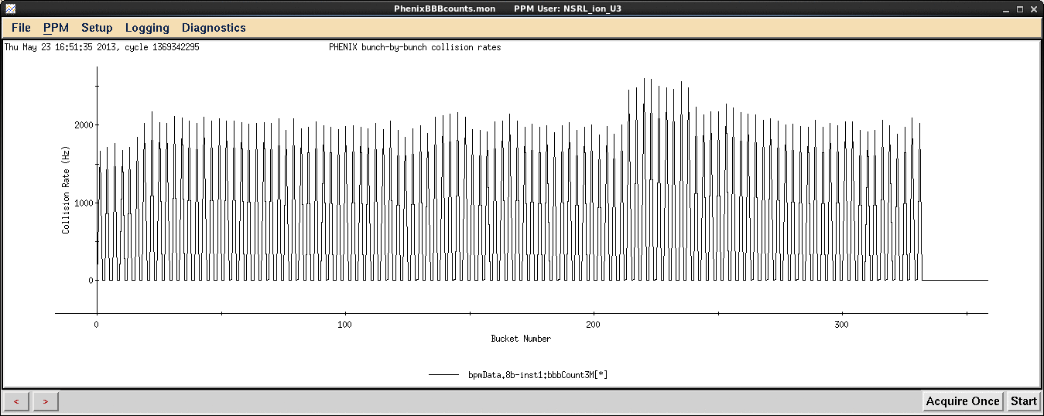
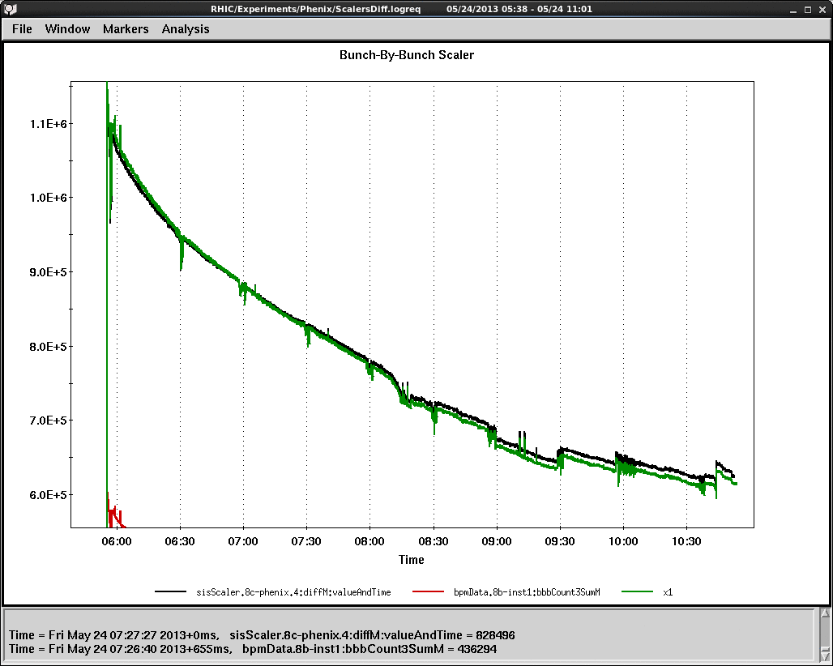
PHENIX Bunch-by-Bunch Collision Rates
Collision Rate (Hz)
Bucket Number
Integrated Bunch-by-Bunch Collision Rates (green)

Slide 51
RHIC Injection Timing from W Dump (P. Cerniglia, R. Hulsart, G. Marr, R. Michnoff, R. Schoenfeld, T. Shrey)
Initially Requested by Operations to Improve Startup
Modified ATR BPM Electronics for wbh7
Generate Pulse When Beam is Detected by Self Trigger Circuit
Convert to Fiber and Send to 5E and 7W
Fanout and TTL-Fiber VME Cards Installed in 1000P
Covert Back to TTL At Each Injection Support Bldg.
Display Pulse on Injection Kicker Timing Scopes
Kicker Timing Can Be Verified with Beam at W-Dump

Slide 52
RHIC BPM IFE Enhancements (P. Cerniglia, R. Hulsart, A. Marusic, R. Michnoff, M. Minty)
Expanded TBT Dataset Size
1024, 2048 and 4096 Turns Selectable via ADO
Beneficial to Beam Optics Studies with AC Dipole
Abort Trigged Post Mortem TBT Data
4096 Turns Prior to Trigger Delivered from Circular Buffer via Existing TBT Record
Million Turn Features Merged into ADO
LabView VI No Longer Needed
Data Can be Accessed via GPM/LogView
Supports Spin Flipper Effort

Slide 53
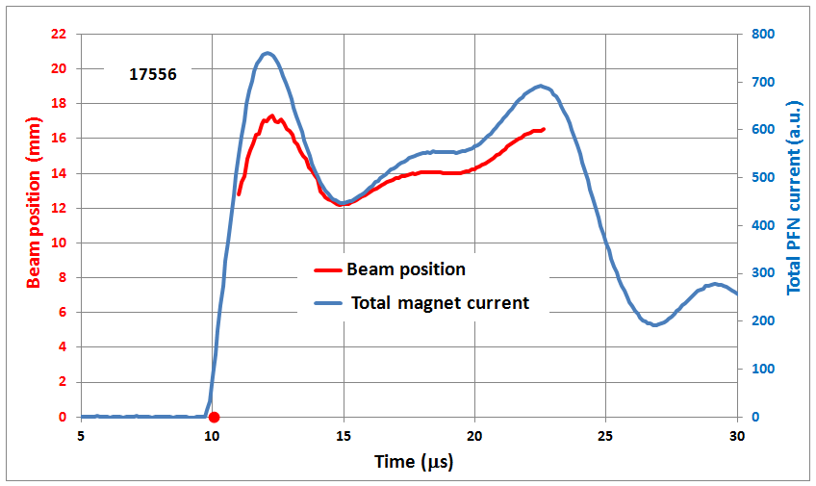
RHIC Beam Aborts : Bunch by Bunch Position (bo10-bh3.1 Blue Dump BPM)
Position (microns)
Bunch Number

Slide 54
Future BPM Upgrade Plans
Developing VME Board in House
Subset of Components on Xilinx Development Board
Same 400MSPS A/D Converters on Prototype
Makes Use of Existing VME Infrastructure for Power/Cooling
Entirely Uses Ethernet for Digital Communications
Many Different Analog Front-End Options
Versions for Hadrons/Electrons
Faster A/D Converters
Better Signal Processing Techniques
Intregration with Existing 10Hz Feedback System

Slide 55
Other Work Completed Run-13
WCM – Repair of Blue & Yellow
New R-SC Longitudinal PU in Sector 2
Replace R-IPM MCP’s
R-CNI Polarimeter Target Cameras / RF Grids
CeC House (1002A) Infrastructure
Gated Switches for R-BBQ
C15 Polarimeter Modify Pre-Amps
F5 Vertical Jump Target House Electronics
J7 Plunging Stripping Foil Motor Drive

Slide 56
RHIC Run­13: Triumphs, Challenges and Disappointments
A. Marusic
2013 RHIC Retreat

Slide 57
Ideal startup:
● Unchanged timing, using kickers to inject (ATR and STAR beam pipe problems made setup of blue ring harder, achieving yellow circulating beam was very easy).
● Ramping to any energy as soon as possible using old ramps. This could have been the best run ever by far.
Less than Ideal startup:
Wrong wire­up configuration of phase­shifter PS.
Not clear role of phase­shifter PS.
Problems related to beta squeeze during store ramp:
● Quench detector tables,
● Shifted time.
Problem with feed­forward of tunes due to different parameterization of quad strengths.
RampDesigner incident.
New main dipole PS regulator.
Failure of yellow main dipole DCCT.
Problems with global coupling.
Run13 Improvements
Control of feedbacks moved from tape to wfgman.
Setup of instrumentation improved, only IPM hard to setup.
Store orbit corrections and collision rates:
● do not capture b4, b5 BPMs.
● do not use dependent / inconsistent BPMs in orbit correction.
● correct orbit at IP using b1 or dx BPMs.
● pay more attention to selecting goal orbits.

Slide 58
Main PS DCCTs
This picture shows the difference between primary and redundant DCCTs of RHIC main dipole and quad PS at injection during Run 13.
The large changes happened on:
Mar­22­2013: Carl wiggled the cable on the back of the DCCT.
Apr­03­2013: Don changed yellow dipole DCCT head electronics.
Apr­11­2013: Main PS crash button was pressed.
Yellow dipole DCCT also failed during Run 12 (causing QLI), but at that time we did not know that. Malfunction of DCCT caused tune and beam radius instability during e­lens part of the run.

Slide 59
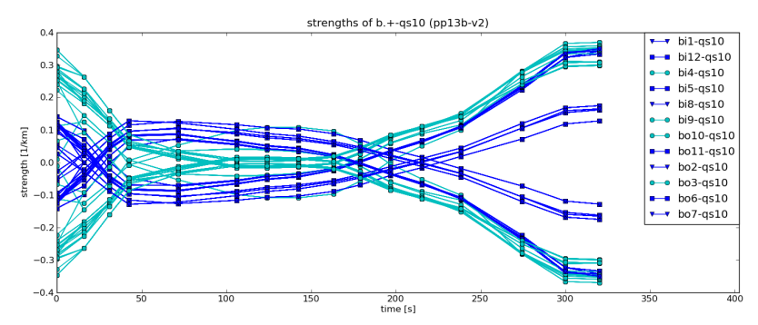
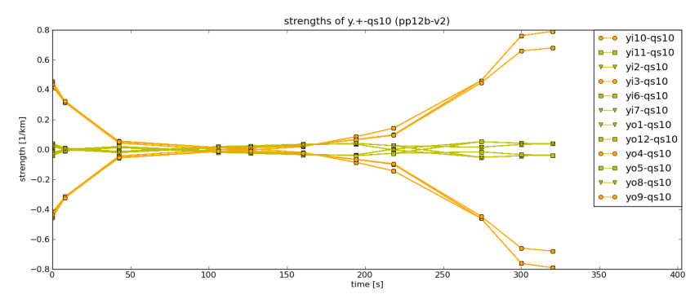
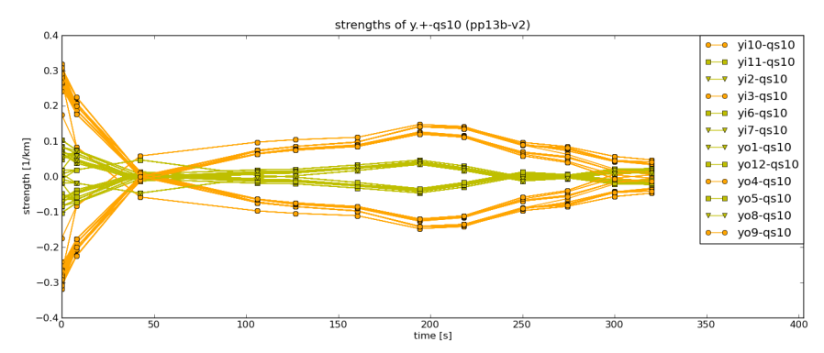
Global coupling 1
The next 4 pictures compare the global skew quad settings of pp12b­v2 and pp13b­v2 ramps for blue and yellow rings.
The different local skew quad settings in those ramps led to the reduction of global skew quad strengths.
Surprised- Global skew quad strengths in pp13b­v2 ramp show increase when bi8­qs3 PS was replaced.

Slide 60
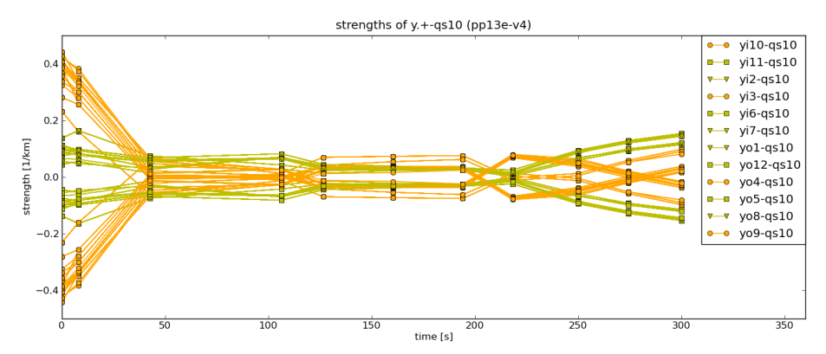
Global coupling 2
The 2 pictures show that global skew quad settings in the blue ring in pp13e­v4 ramp were abnormally large (best R12 to worst R13). For pp13e­v4 ramp skew quad magnets had to be paired into families differently due to different range of goal tunes: in pp13e­v4 ramp integer part of horizontal and vertical tunes in blue ring were 27 and 29 respectively, while for other ramps integer part of horizontal and vertical tunes were 28 and 29 respectively.

Slide 61
Store orbit corrections 1
In the figure (right) the blue line is the measured horizontal orbit at IP8, the green line is the calculated orbit, the purple lines indicate the positions of dipole correctors, the labels show the positions of BPMs and yellow bars mark the BPMs which are excluded from the correction. Calculated orbits are the orbits calculated from the strengths obtained by applying SVD correction algorithm to the measured orbits. At locations where calculated and measured positions are equal, SVD correction, if applied, would correct the orbit. At locations where calculated and measured positions are not equal, SVD correction can not correct the orbit. This picture shows that positions of b7/b8, b3/b4 and b3/b4/b5 BPMs are dependent.

Slide 62
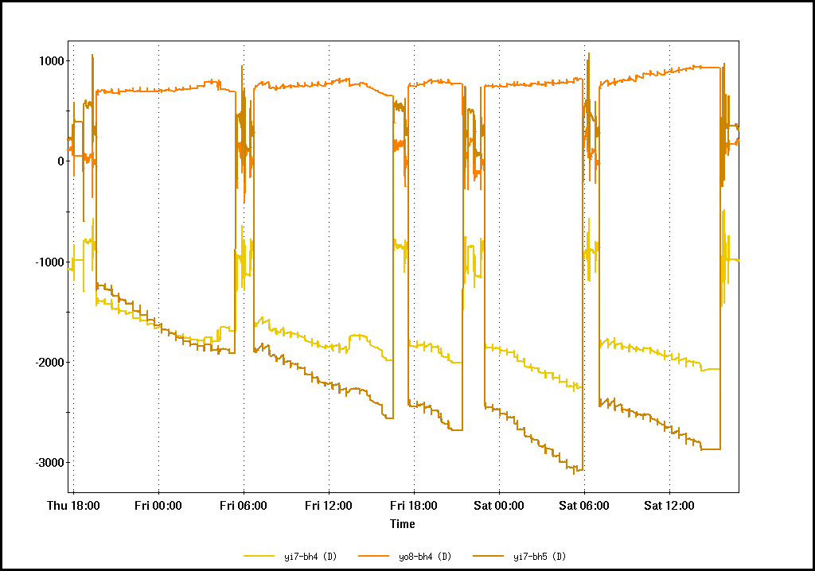
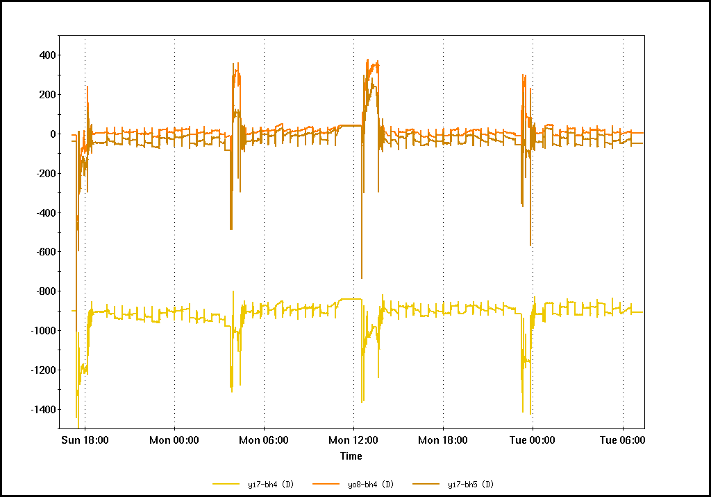
Store orbit corrections 2
The first picture shows what happens if dependent BPMs are used in orbit correction: the achieved positions are combinations of the desired positions at those BPMs (resulting in the drift of the positions by ~1mm during single store) and what happens if they are excluded, i.e. beam positions at those BPMs become stable (vary by ~100 um). b4 BPMs are near rotators and in order to keep orbit through rotators constant, we must control orbit at b4.
Another problem during the run was that some goal orbits were too different from previous goal orbits.
For the next run we should ensure that goal orbits are more similar.

Slide 63
Store orbit corrections 3
During early part of Run 13, beam positions at all BPMs between dipole correctors used for collision optimizations were “captured”, i.e. they were used as goal positions for subsequent orbit corrections. That was a mistake. Only b1/dx BPMs on both sides of IP should have been used (because only orbits between those BPMs affect collision rates). By using other correctors, beam positions at b4/b5 BPMs can be changed without affecting collision rates.
For the next run:
All dependent BPMs should be excluded from corrections (if dependent BPMs are used, their positions should be made consistent).
Goal positions for b4 and b5 BPMs at IP6 and IP8 should be 0. After this is done, currents in rotators and snakes should be adjusted.

Slide 64
Ramp Design Infrastructure problems
Present Ramp design infrastructure – old
Code not updated in a decade.

Slide 65
Ramp Design Infrastructure problems
Image shows how a ramp is constructed.
Misses demands on power supplies imposed by feedbacks
During commissioning it was realized optics used in ramp design did not incorporate E-lens phase shifter supplies – doomed to fail
AL HAS A PLAN!

Slide 66
Startup Run Coordination: Summary & Improvement
Gregory Marr
RHIC Operations Specialist

Slide 67
Overview
This run, Operations took the lead role during the Start-up period, and was responsible for providing a machine with sufficient colliding beam at store to begin the physics program.
Despite delays, we provided Physics on schedule.

Slide 68
The “Wet Run”
Pros:
Allowed setup of systems using configurations already known to be good.
Helps separate common problems from new lattice issues.
Allowed beam ramps and store setup earlier.
Beam development was able to advance beyond injection energy even though PS work was not complete.

Slide 69
The “Wet Run”
Cons:
Still requires PS checkout, high and low current, shutoff tests, captured key tests, etc. as prerequisite.
In the long run, only useful if it does not extend the amount of PS group effort & time required.

Slide 70
Improving Communication
Support groups and operations need to relay information well during startup.
It would be nice if everybody read each other’s elogs, but it’s not going to happen.
Example: RMMPS voltage glitches. Noted 2/18, discovered in beam operation 2/25.
Make daily plan more rigid
As noted in previous review, daily plan changed too frequently. Keep daily plan static, and update adjustments to the shift plan as they arise.

Slide 71
Injector preparation
Effort continues to complete as many tasks as possible prior to RHIC being beam-ready.
Next run, injection kicker timing setup can be checked with beam to W-dump and W-line BPM signal
Start-up is the time to push the limits, e.g. intensity.
Doesn’t mean that should be the starting point for Physics (RHIC parameters included).

Slide 72
Other recurring themes
AP shifts
We did not require AP coverage (in the MCR) during startup.
Run Coordinator, Scheduling Physicist role
Was it better for the Coordinator that they were not dumped into the fray immediately?
Ramp preparation
Going from a lattice design to a usable ramp is still fraught with problems that are not sorted out before we start losing beam time.

Slide 73
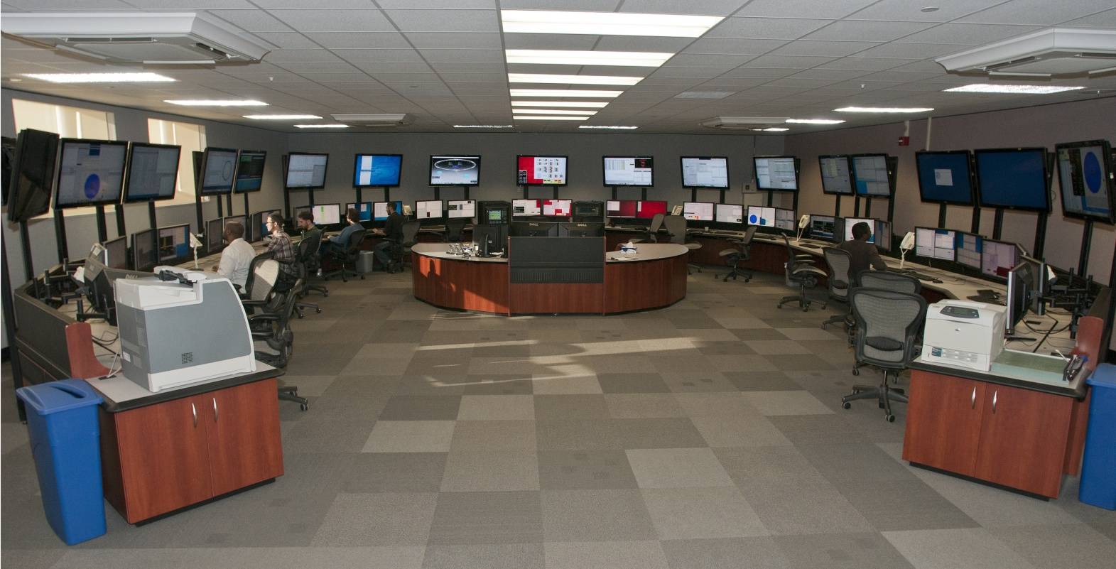
View from Operations - RHIC Run 13
Reid
Will
Reid
Brian
X
X
X
X
Caitlin
X
Shawn
Rocco
Iris
Jordan
?
Tasha
?
Chris
?
LOA
?
?

Slide 74
Technical Improvements
AGS Main Magnet’s BLW monitor patch panel should be connected to a multiplexer to allow and provide signals for diagnostics
RF group needs to make their system more easily accessible to operations
PET pages buried deep in PET tree locations that are not intuitive
Logged data in logview is hard to find and not descriptively named
Consider having and operations liaison work with RF liaison to make system more transparent
Consider giving priority to making this improvement
Ultimately may free up RF personnel to do other tasks

Slide 75
Tech Improvements Cont.
IR angle creep/orbit feedback
Would like a scope signal of the raw AGS radial average and beam phase error signal the RF uses for diagnostic purposes
Currently only a temporary solution to this issue and ideally would like higher resolution

Slide 76
Scheduling
Schedule was organized and well thought out for the day once stable running conditions were achieved in mid to late April.
More efficiently develop a formula for injection for operations that details the expectations and criteria for beam parameters to optimize physics stores. Frequent changes make it difficult for the operator to figure out their role and goal and leads to disorganization. (outline machine performance goals for operators to meet – pfi)

Slide 77
Morale
Scheduled lunch and healthy breaks would contribute to better performance and health
Machine Specialists in combination with OC’s and Operators have decades of combined experience
Take at word when stating that system is broken
Operator burn-out due to insufficient operators on top of an already demanding 24/7 rotating shift schedule

Slide 78
Personnel Shortage
Operators were pulled from other teams to make-up for the shortage
During the day shift this IS helpful and also does not interfere with that individuals recovery from nights and circadian rhythm
Despite this additional strain – we were still precariously close to forced operations shut-down due to not fulfilling the requirements set forth in OPM 2.5.2 (staffing requirements)

Slide 79
Personnel Shortage Cont.
Ultimately - In the absence of fully-staffed teams, under-staffed teams need to remain under-staffed when working evenings and overnights, rather than pulling a member from another team into their shift
organization as a whole will suffer and it will create a greater negative impact than just having a smaller team doing the job
Higher operator error
Higher operator turnover
Unscheduled days and off days are extremely necessary to recover from the constant rapid cycling operator schedules undergo – they are not optional
Biological processes need time to adjust

Slide 80
RHIC Abort System a.k.a. Waste Management
C. Montag, A. Drees

Slide 81
Problems and Challenges
• Many quenches with the increased proton intensity during Run-13, almost exclusively in Yellow
• Increasing Au intensity in conjunction with stochastic cooling exceeds the safety limit for thermal stress on the exit window - not covered here

Slide 82
The First “Mystery Quench”
Measured abort kicker currents:
April 24: All kicker traces appear normal, no pre-fire
What’s going on???

Slide 83
Three Weeks Earlier
April 3: All kicker traces appear normal, no quench, but kicker amplitude minimum is significantly higher

Slide 84
The Band-Aid
Re-tuned one module (blue trace) to raise the minimum
More modules were treated this way during the course of the run
Could eventually result in cracking the window (see problems and challenges above)

Slide 85
Minimum Kick vs. Time
After each re-tuning, the minimum slowly slides down
Quenches happen at higher and higher minima

Slide 86
Bunch-by-Bunch Dump BPM Signals
Black trace: Fill 17536
Blue trace: Fill 17555
In spite of tuning after Fill 17536, resulting in higher current in the minimum, the beam receives a smaller kick

Slide 87
Minimum Kick (Bunch Position) vs. Kicker Current
Modules were re-tuned two times - hence, three groups of data The second tuning, which resuletd in twice as much current increase than the first, increased the minimum kick only marginally
Something is wrong with the kicker magnets!

Slide 88
Kicker Waveforms Several Days After the End of the Run
After reverting the tuning modifications, kicker waveform (blue trace) has recovered
Kicker magnets have cooled down

Slide 89
What Can We Do?
Install thermocouples in one kicker module to monitor temperature during next run
Re-build the beam dump (replace carbon with steel in strategic locations) to be less sensitive to kicker amplitude. Simulations are underway.
Modify kickers to reduce beam-induced heating – under study
Summary and Outlook
Beam induced heating of the kickers affects their impedance, resulting in a reduced kick
Kickers have to be modified for the next proton run (Run-15)
Beam dump will be modified during shutdown 2014 to be less sensitive to kick strength by replacing carbon with steel to prevent dumped particles from being scattered back into the beam pipe
Stainless steel exit window will be replaced with titanium in 2014 to allow higher Au intensities.

Slide 90
Run 13: Maintenance, Reliability and Scheduling
P. Sampson

Slide 91
Run 13 Maintenance Days:
Continued alternate weeks opposite to APEX.
Usual Heavy work load (100+ individual jobs executed in ~12 hour period).
Extensive installation, commissioning and testing.
Energy and other changes.
Access times minimized.
No Bake outs!
Few major extended Maintenance days.
PP running = Long stores, allowing injector maintenance and repair as well as Beam development.
Booster maintenance scheduled with consideration for NSRL/NRO.

Slide 92
Maintenance Day Duration - Drivers
Nominally 8 hours.
Determined by committee of OPS, ES&F and Experimental representatives at the weekly Scheduling Meeting.
Once the longest job is determined, other work to fill in available timeslots.
Outside forces into play: LIPA, weather, Karma?
Failure prevention into play: Siemens Motor Rotor.
Performance consideration: OPPIS Maintenance.
Necessary, vacuum pump down: Polarimeter foil replacement, jet target etc.

Slide 93
PWS Run13 Maintenance Priorities
Date | Maintenance Duration [h] | Comments
 |  | PRIOR TO START OF PHYSICS
2/06/2013 | 14.2 | no comments
2/20/2013 | 13.32 | RHIC PS work
2/28/2013 | 9.67 | RHIC MMPS Regulator swap
3/08/2013 | 14.17 | STAR Pixel detector install
 |  | AFTER START OF PHYSICS
3/20/2013 | 10.85 | RHIC CNI polarimeter targets replace
4/03/2013 | 15.92 | Siemens Retaining Ring Painted
4/17/2013 | 13.13 | RHIC Phase Shifter PS Polarity Change
5/08/2013 | 15.92 | STAR Pixel detector install
5/22/2013 | 10.38 | "standard maintenance"

Slide 94
“Extended” Maintenance Days.
LIPA outages (March 8, 15, 20).
March 8th snowstorm!
Extended stores.
e-lens work to fill the gaps.
Siemens paint, yellow DCCT issues (April 5).
Insulating paint necessary for Siemens Motor Rotor.
DCCT work caused glitches, issues contacting expert, undone by RPSG personnel
e-lens phase shifter polarity change April 17.
STAR Pixel detector, OPPIS, JET and RF issues (May 8).

Slide 95
Machine Performance
Failure Hours:
Continued reduction in system failure.
Increased access to and resilience against infrastructure failure shows measurable results (AC systems).
Maintenance:
Time to Physics minimized.
Quick return to nominal running conditions.
Energy changeover preparation pays.
Bottom line:
Transition to and recovery from maintenance periods continues to be smooth for the most part.
Continued improvement to the CAD work review and feedback process will help to reduce preventable future delays.

Slide 96
Improvements:
Through continued improvement to the process of:
Request ➔Review ➔Approval ➔Execution ➔Closeout ➔Post Mortem, improvements in execution and efficiency are evident and there has been a reduction in preventable errors.
Continue to improve communication with F&O, ES&F and others.
Continue with improvements to infrastructure.
AC, Power/UPS, Lighting….
Continue to add remote reset, diagnosis.
Continue to make systems more robust and able to run through some fault conditions.

Slide 97
Conclusions:
Affects of improvements in the way we do business, including better communication and planning have shown measurable results.
As systems are installed and upgraded, careful planning, scheduling and communications are key to a good start up and run.
Careful planning and execution during all phases of accelerator operation has proven to be of overall benefit to the performance of the complex.
Continued improvement to infrastructure promises to keep showing positive results.
The improvements are only possible through the continued cooperation of all of the players involved.

Slide 98
Haiku for departing Operator Zimmer (SLAC) – by VHS
Self-polarizing.
Really? Self-polarizing?
I mean, why bother?
LINACS are one way.
Synchrotrons make better friends,
Always one more turn
Left coast fights the Man,
Shouts, “FREE ELECTRON LASER!”
What’s he locked up for?

