Slide 1
Implementation at Brookhaven National Lab
Brandon Weindorf

Slide 2
What is Rocket.Chat?
Free, open source software that is designed to augment email as a means of communication and data sharing
Designed to maximize collaboration among team members
More secure than other services such as Slack
Once implemented at BNL, users will be able to communicate efficiently with one another and easily, yet securely share results with the team

Slide 3
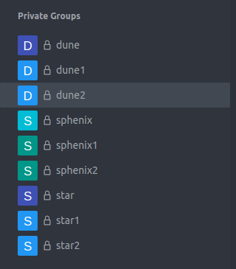
Base Configuration
Private (closed) Chat Groups
Direct Messaging
Sharing of virtually anything
Data
Documents
Messages
Images
Notes:
https://www.youtube.com/watch?v=T2v29gK8fP4

Slide 4
Custom Additions
Authenticate with SDCC KeyCloak
Automatic Creation of Collaboration-Wide Chat Groups
Automatically join users to the appropriate Collaboration-Wide Chat Group
Ability to Request Access to other Private Chats
Collaboration-Wide Chat Groups
Subgroups of Collaboration-Wide Chat Groups
Ability for Owner/Moderator to
Accept a requestee
Deny a requestee
Ban a requestee
Centralized Administration Page for Subgroups of Experiments:
Add
Delete
Edit Owner/Moderator

Slide 5
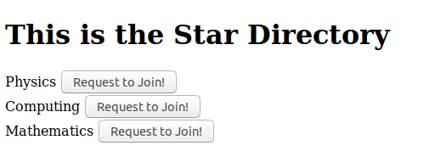
How it Works:
Joins Experiment Group Chat
Directory for Experiment Subgroups
In SDCC Experiment Database?
LINK
Yes
In addition:
Periodically, each user will get a link to their respective directory so that they can see any new groups that may have formed
LINK
No
General Directory
Deny
Accept
User is not allowed into private chat
Example Directory for Star
Accept
User joins Experiment Subgroup
Access Request goes to Private Chat Owner
Deny
User is prohibited from joining Experiment Subgroup

Slide 6
Future Work
Integrate authorization with PHP
Within the next week:
Test with SDCC staff for feedback and debugging
Beta test with experiments
Make adjustments from feedback

Slide 7
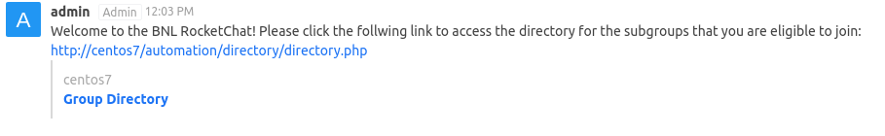
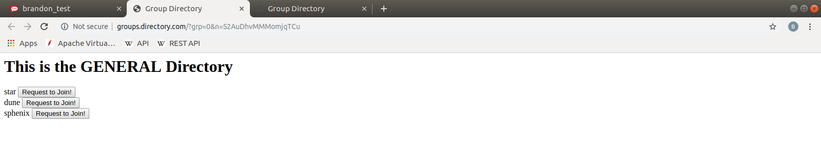
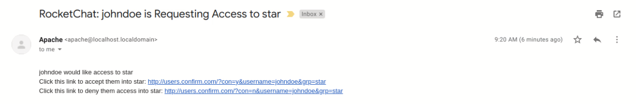
DEMO

Slide 8
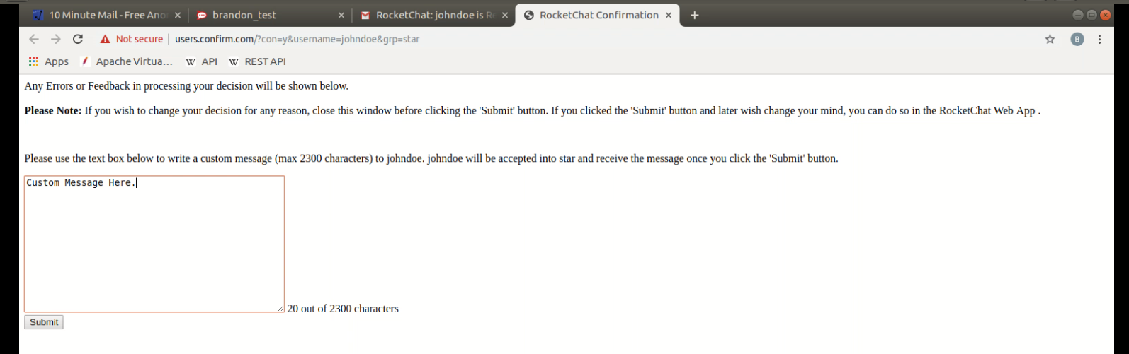
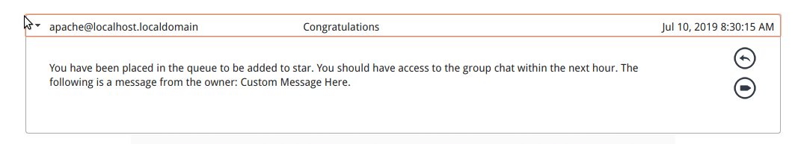
DEMO

