Slide 1
Physics Requirements for Zero-Degree Electromagnetic and Hadronic Calorimetry:
Spectator Tagging in light systems and Impact Parameter Tagging in heavy systems
Charles Hyde
Old Dominion University
Joint CFNS & RBRC Workshop :
Physics and Detector Requirements at Zero-Degree of Colliders
(24-26 September 2019)

Slide 2
Physics Near Zero Degrees
Spectator/Fragment tagging in light nuclei.
DVES on heavy nuclei: (≥ C)
  The challenge of true exclusivity
Target Fragmentation in DIS
  Flavor/p_{T} correlations with current fragmentation region
  Baryon multiplicity as impact parameter tag
Fission Fragments in both photo- and electro-production
  Search for exotic nuclei?

Slide 3

HaDRONIC Calorimetry: I. Light Systems
D(e,e’p_{S})X
  Proton tracking determines p_{T} , $α=A\frac{p^{+}}{P_{A}^{+}}$
  Probe neutron structure function for nearly on-shell neutron
  Probe EMC effect in the deuteron with strongly off-shell neutron
D(e,e’n_{S})X
  Calibrate “nearly on-shell neutron” with “nearly on-shell proton”

Slide 4
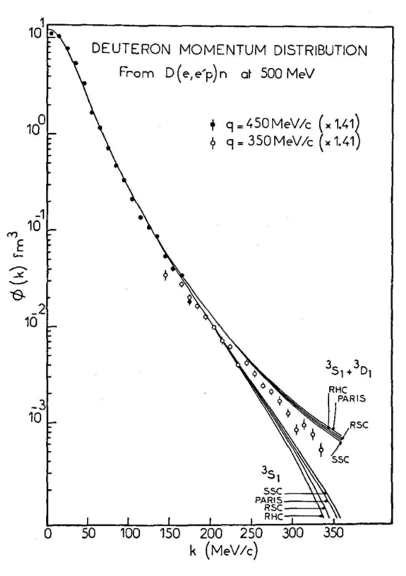

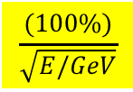
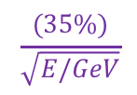
D(e,e’n_{S})X ≈ p_{bound}(e,e’)X
200 GeV/c D ➔ 100 GeV/c spectator neutron
Hadronic Calorimeter at 45 m (JLEIC)
Impact point resolution 1.5 cm rms:
  $\frac{δp_{T}}{p}=0.33$ mrad ➔ 𝛿p_{T} = 33 MeV
  Equivalent to rms beam spread
If energy Resolution $\frac{δE}{E}=\frac{(35\%)}{\sqrt{E/GeV}}$
  $α=A\frac{p_{n}^{+}}{P_{A}^{+}} ≈ {\left[1+\frac{p_{n}}{M_{N}}\right]}_{Deuteron Rest−Frame}$
  $δα=$ $\frac{δE}{E}=3.5\%$ ➔ 𝛿p_{n}^{D-rest} ≈ 35 MeV/c
  If $\frac{(100\%)}{\sqrt{E/GeV}}$ ➔ 𝛿p_{n}^{D-rest} ≈ 100 MeV/c
$$\frac{(35\%)}{\sqrt{E/GeV}}$$
$$\frac{(100\%)}{\sqrt{E/GeV}}$$

Slide 5
Hadronic Calorimetry II: Evaporation
Evaporation neutrons
  Thermal Distribution T ~ 10MeV (Nuclear Rest frame)
  95% within in angular cone 3mrad
  HCal must separate shower profiles separated by ~7 cm to count neutrons.
See also talks by M. Baker, F. Hauenstein

Slide 6

Far-Forward Hadronic
Calorimeter: Technology
ZEUS: Depleted Uranium: $\frac{(35\%)}{\sqrt{E/GeV}}$
High Segmentation e.g. FeSci sampling (longitudinal and transverse)
  $\frac{(50\%)}{\sqrt{E/GeV}}$
  < 1 cm transverse spatial resolution
  Require 50cm lateral size beyond active area.
    Wrap around Dipole 3? Wedge into space at 50 m between D & Q?
      Some resolution-loss on beam side may be inevitable
$$\frac{(35\%)}{\sqrt{E/GeV}}$$

Slide 7
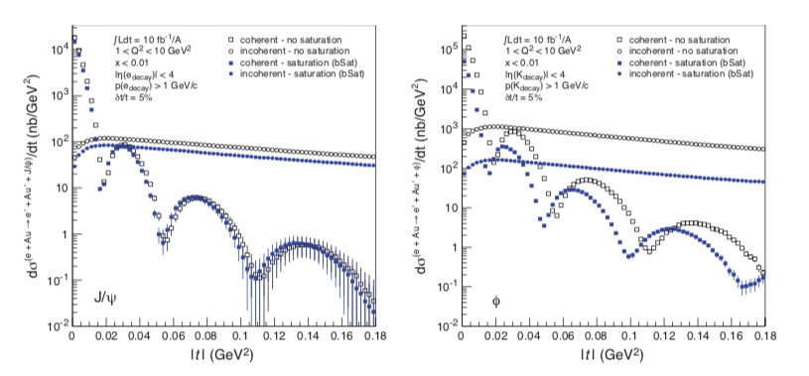
Far-Forward EM Calorimetry & Gluon Saturation
DVES as a signature for saturation
Veto Incoherent by nuclear break-up
What about Nuclear Bound states?
Based on elastic ^{A}Z(e,e) ^{A}Z and inelastic ^{A}Z(e,e’) ^{A}Z* data:
  Expect even first diffractive minimum to be washed out by excitation diffraction: ^{A}Z(e,e’ V) ^{A}Z*_{bound}
  VETO DECAY GAMMAs!

Slide 8
Forward EM CalorimeTRY
Proposed signature for gluon saturation:
  Comparison of low-x deep virtual exclusive J/Psi vs phi production.
  Both are sensitive to gluon density, but with different spatial averaging: 𝜙-production sensitive to saturation at larger x_{B} then J/Psi
Signature is a shift in the diffractive minima
  Inelastic production to bound excited states will wash-out the sharp diffractive minima and obscure the saturation signal
Solution is to detect the gamma-decays to veto bound-state excitation

Slide 9
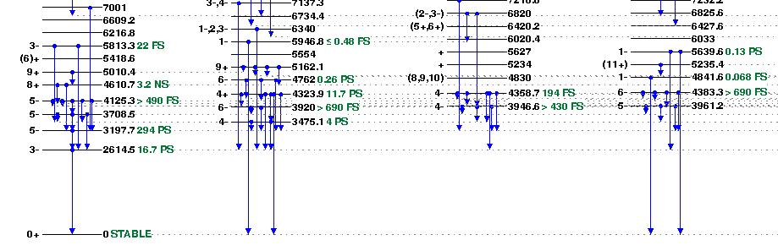
Gamma-Ray veto
²⁰⁸Pb
Requires doubly magic nucleus, e.g. ²⁰⁸Pb
  Every gamma-cascade of ²⁰⁸Pb has least one photon above 2.6 MeV (in nuclear rest-frame).
  Compare to Au, gamma decay chains with energies < 0.2 MeV

Slide 10
ForwARD 𝛾 BOOST/
ACCEPTANCE
JLEIC: P_{A} = Z (200 GeV/c),
  E_{A} / M_{A} ∼ 80
  50% of (2.6 MeV) photons
  are emitted in forward
  hemisphere of rest frame
  with detector energy from 220 MeV to 440 MeV
    50% of photons are in angular cone ± 1/80 = 12.5 mrad.
    ±10 mrad aperture would capture 42% of decay photons
    ±5 mrad aperture would capture only 15% of decay photons

Slide 11
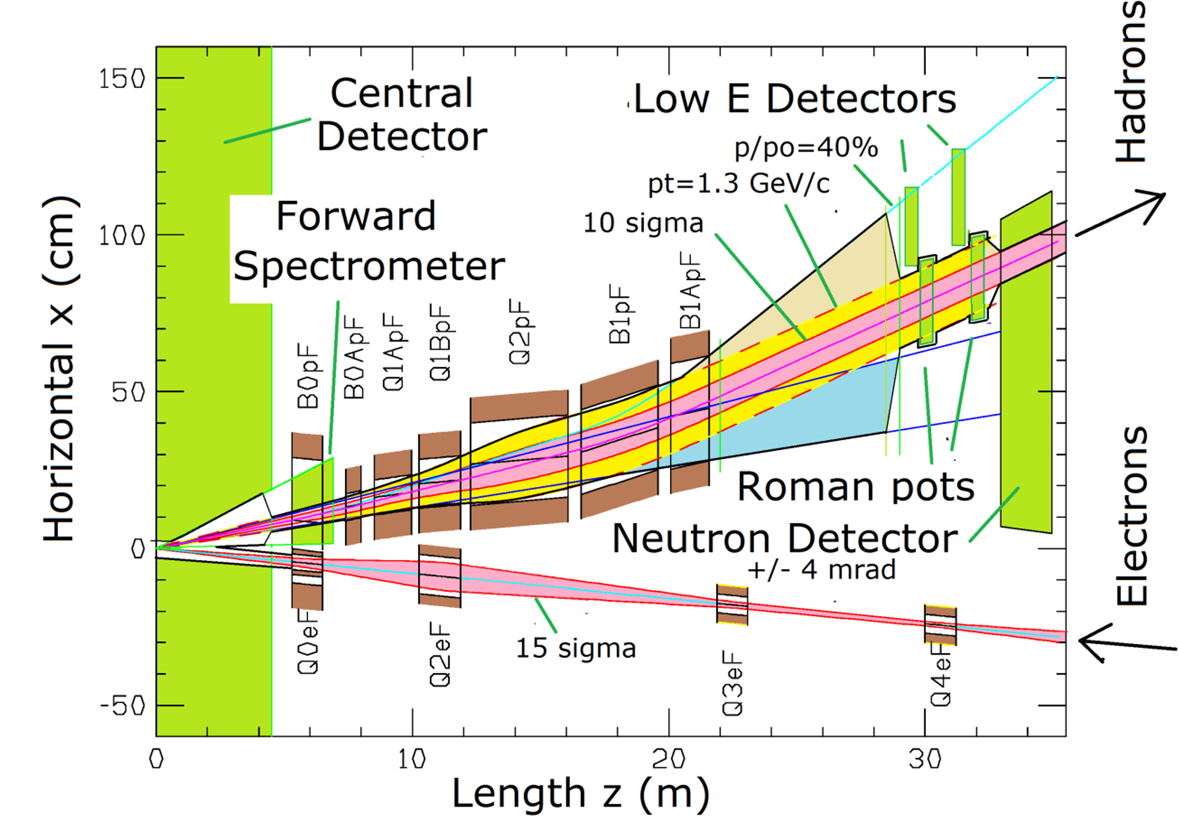
ForwARD BOOST/ACCEPTANCE
eRHIC: P_{A} = Z (275 GeV/c),
  E_{A} / M_{A} ∼ 116
  50% of photons are in
  angular cone ± 8.5 mrad.
    At least one photon ≥ 300 MeV (if detected)
    ±4 mrad aperture captures 18% of decay photons

Slide 12

Far-Forward EM Calorimetry
PbWO₄
  X₀ = 8.9 mm, r_{M} = 2.2 cm, 𝜏=25 nsec
  5% resolution at 300 MeV (https://arxiv.org/pdf/hep-ex/9907047.pdf)
LYSO:
  X₀ = 11.4 mm, r_{M} = 2.1 cm, 𝜏=40 nsec
  SuperB prototype:
  NIM A 718 (2013) 10
  2.6% @ 300 MeV
Both tolerant to fluence from 100 fb^{–1} at IP ≤ 10¹³ neutron/cm²

Slide 13
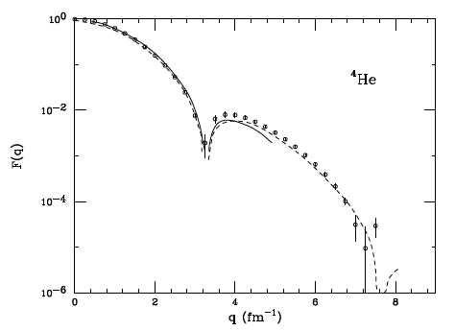
Quark-Gluon Imaging of ⁴He
0.4 GeV/c 0.8 GeV/c 1.2 GeV/c 1.6 GeV/c
Highest Central Density of any nucleus
  J=0, I=0
  H_{g}(ξ, t |Q²), H_{u}(ξ, t |Q²) = H_{d}(ξ, t |Q²)
Elastic Charge Form Factor

Slide 14
⁴He DVES : 𝛾, 𝝆⁰, 𝜙, 𝜔, J/𝛹
0.4 0.8 1.2 1.6 GeV
Diffractive minimum @ |Δ| ≈ 0.64 GeV/c
⁴He Beam: 400 GeV/c
  σ(p) ≈ 0.6∙10^{–4} p = 240 MeV/c
  σ(p⟘) ≈ 0.3∙10^{–4} p = 120 MeV/c
  0° recoil nucleus detectable for
    x_{A} = x_{Bj} /A > 0.01 (Dispersion = 1m) → x_{Bj} >0.04,
    Raw resolution σ (Δ⟘) ≈ 120 MeV/c (improvable via over-complete kinematics)

Slide 15
Conclusions
There is no separation between the accelerator and the detector
The Interaction Region and Detector design process is a series of negotiations and re-negotiations.
We can design and build an accelerator, interaction region and detector that fulfills our science ambitions.

Slide 16
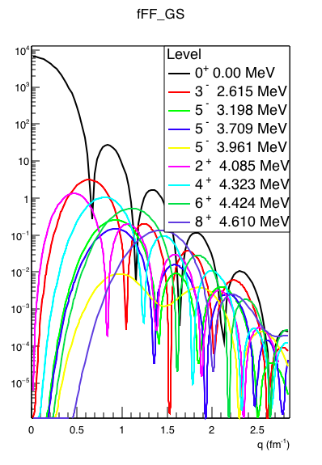
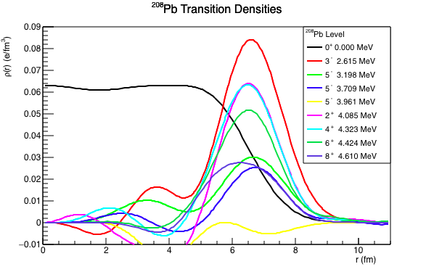
Elastic vs Inelastic scattering
Fourier-Bessel expansion of inleastic electron scattering from
  J. Heisenberg et al, Phys Rev C v25 (1982) p.2292
Inelastic (e,e’) scattering on Pb to bound excited states.
Deep Virtual excitation will not be identical,
but will be similar

