Slide 1
Current Status of AMPX
Dorothea Wiarda
Andrew Holcomb
Friederike Bostelmann
CSEWG
Brookhaven
November, 2019

Slide 2
Overview
GNDS and AMPX
SCALE Libraries
AMPX training

Slide 3
Reminder: ENDF Access in AMPX
Employing the “onion” principle
Operational for almost all codes that read ENDF data (except PURM, which is used to create unresolved probability tables) for ENDF-formatted files
KinematicReaction
Yield (TAB1)
KinematicBlock
S(α,β)
KalbachMann
Y12
ENDF
Data
Evaporation Spectrum

Slide 4
Operational ”Hand-coded” GNDS classes
As reported last CSEWG:
We have code to read GNDS files and process 1-D data (includes resonance parameters) and covariance data.
With this code we can compare the results from ENDF formatted and GNDS formatted files.
In order to support kinematic data a lot more coding is needed.

Slide 5
Since GNDS is now defined by JSON…
Write code that translates JSON files to C++ low level classes.
This worked well (again for 1-D and covariance data):
  Some low-level data containers (XY-1D and array) are not generated by the JSON translator.
Kinematic data needs to make sure that data containers with the same name have different name spaces:
    Example: Tag name “Energy” is used for energy of a nuclide level and for energy distribution.
  Documentation generation code has solved this problem, but not yet implemented in AMPX

Slide 6
AMPX classes generated from JSON are not an API
The classes generated from JSON follow exactly the description in the manual.
There is a lot of code needed to put the data into the AMPX in-memory structure. Of course we can reuse most of the code from the “hand-coded” GNDS.
For testing we ran the same comparison between GNDS and ENDF formatted files from ENDF/B-VIII.0
The classes are not yet merged into the main branch, but because it is easier to track GNDS specifications, these are the ones we will use going forward.

Slide 7
SCALE Libraries
Beginning with SCALE -6.3b3 SCALE contains ENDF/B-VIII.0 based libraries.
ENDF/B-VII.0 based libraries have been removed
(Libraries from previous release still work with the current SCALE release).
Exception: All covariance libraries are still available.
ENDF/B-VIII.0 CE libraries are distributed in new HDF5 format.

Slide 8
Libraries available with SCALE
Updated ENDF/B-VII.1 MG libraries:
  Updated probability tables (normalization issue)
  Added incident gamma and gamma production data
Updated ENDF/B-VII.1 CE libraries:
  Updated probability tables (normalization issue)
All ENDF/B-VIII.0 libraries are coupled libraries
  252 neutron 47 gamma group library as the main transport library
  56 neutron 19 gamma group library
  200 neutron 47 gamma group library mainly for shielding
  27 neutron 19 gamma group library
All libraries contain homogenous f-factors, the 252n and 56n libraries also contain heterogeneous f-factors for selected nuclides.

Slide 9
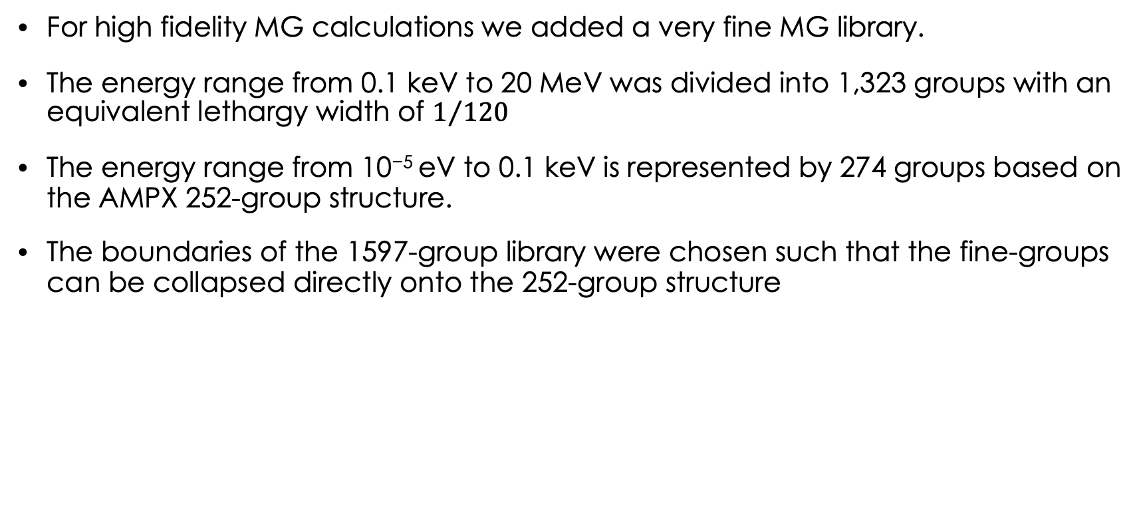
1597-group MG library
For high fidelity MG calculations we added a very fine MG library.
The energy range from 0.1 keV to 20 MeV was divided into 1,323 groups with an equivalent lethargy width of $1/{120}$
The energy range from 10⁻⁵ eV to 0.1 keV is represented by 274 groups based on the AMPX 252-group structure.
The boundaries of the 1597-group library were chosen such that the fine-groups can be collapsed directly onto the 252-group structure

Slide 10
Memory requirement
Unfortunately, SCALE loads the ENTIRE library first, and then selects the nuclides actually needed. This is a side effect of the change to an in-memory structure for MG loading.
The plot below is for a simple model, memory requirement will grow with more complex modules.
GB
22.39^ #
| #
| @#
| @@#
| @@@#
| @@@#
| @@@@#
| @@@@@@#
| :@ @@@@#
| :@ @@@@#
| @:@ @@@@#
| @@:@ @@@@#
| @@@:@ @@@@#
| @@@:@ @@@@#
| @@@@@:@ @@@@#
| @@@ @@@:@ @@@@#
| :@ @ @@@:@ @@@@#
| :@ @ @@@:@ @@@@# :::::::@@:@@@:@
| @@:@ @ @@@:@ @@@@# : ::::::::::::::::::::::::::::::: :: ::@@:@@@:@
| :@ :@ @ @@@:@ @@@@#:::::::: ::: : ::: :: :::: : ::: : ::: :: ::@@:@@@:@
0 +----------------------------------------------------------------------->Time
Some older SCALE modules do not allow more than 999 groups.

Slide 11
Memory requirement cont.
We updated SCALE to:
  Initially Only load the header information
  Fully only load the nuclides needed.
This allows to run simple problems
More changes are needed to not duplicate unshielded information for more complex problems.
GB
4.024^ ##
| # :: :::
| @@@# : ::::: :
| ::@:@ @# : : : : :
| @@: @:@ @# : : : : :
| @@ :@:@ : @:@ @# : : : : :
| ::::::::::@ :::::@:@ : @:@ @# : : : : :
| @@: :: : : :@ ::::: ::@:@ : @:@ @# : : : : :
| :::@ : :: : : :@ ::::: ::: ::@:@ : @:@ @# : : : : :
| @ ::: :@ : :: : : :@ ::: : : ::: ::@:@ : @:@ @# : : : : :
| @ :::: : :@ : :: : : :@ @@@::: : : ::: ::@:@ : @:@ @# : : : : :
| @ :::::: : :@ : :: : : :@ @@ ::: : : ::: ::@:@ : @:@ @# : : : : :
| ::@::: :::: : :@ : :: : : :@ @@ ::: : : ::: ::@:@ : @:@ @# : : : : :
| ::::@: : :::: : :@ : :: : : :@ @@ ::: : : ::: ::@:@ : @:@ @# : : : : :
| : ::@: : :::: : :@ : :: : : :@ @@ ::: : : ::: ::@:@ : @:@ @# : : : : :
| @: ::@: : :::: : :@ : :: : : :@ @@ ::: : : ::: ::@:@ : @:@ @# : : : : :
| @: ::@: : :::: : :@ : :: : : :@ @@ ::: : : ::: ::@:@ : @:@ @# : : : : :
| @: ::@: : :::: : :@ : :: : : :@ @@ ::: : : ::: ::@:@ : @:@ @# : : : : :
| @: ::@: : :::: : :@ : :: : : :@ @@ ::: : : ::: ::@:@ : @:@ @# : : : : :
| @: ::@: : :::: : :@ : :: : : :@ @@ ::: : : ::: ::@:@ : @:@ @# : : : : :
0 +----------------------------------------------------------------------->Time

Slide 12
AMPX training
We developed an AMPX training course
  Hands-on exercises
  Theory
The week long course was given in Oak Ridge and at NRC head quarters
A 2-hour course gives an overview on how to generate libraries with AMPX.

Slide 13
Summary
Added additional GNDS functionality to AMPX which we intend to share with SAMMY
Generated new ENDF/B-VIII.0 libraries for SCALE
Prepared and presented AMPX training
This work was supported by the Nuclear Criticality Safety Program, funded and managed by the National Nuclear Security Administration for the Department of Energy.

