Slide 1
Current Status of SAMMY
Dorothea Wiarda
Goran Arbanas
Andrew Holcomb
Marco Pigni
CSEWG
Brookhaven
November, 2019

Slide 2
Overview
Sammy infrastructure
Use of container array in SAMMY
Connection between SAMMY and AMPX code
Brune transformation
Future plans

Slide 3
Sammy modernization goals
SAMMY is used to analyze experimental data mainly in the resolved range to generate evaluated data files for use in transport codes.
The code base in SAMMY is still mostly F77, i.e. fixed line length and almost no use of modules.
SAMMY is used in production environments, so during the modernization its functionality cannot be lost. That means we can not simply rewrite it from scratch.
Modernization is needed to allow us to add new features (for example new and improved algorithms in the resolved range).
SAMMY has a large suite of regression tests that can be run and whose outputs can be checked automatically. During the modernization process, we will not change the results of these regression tests, except if errors in the original coding are found and corrected.

Slide 4
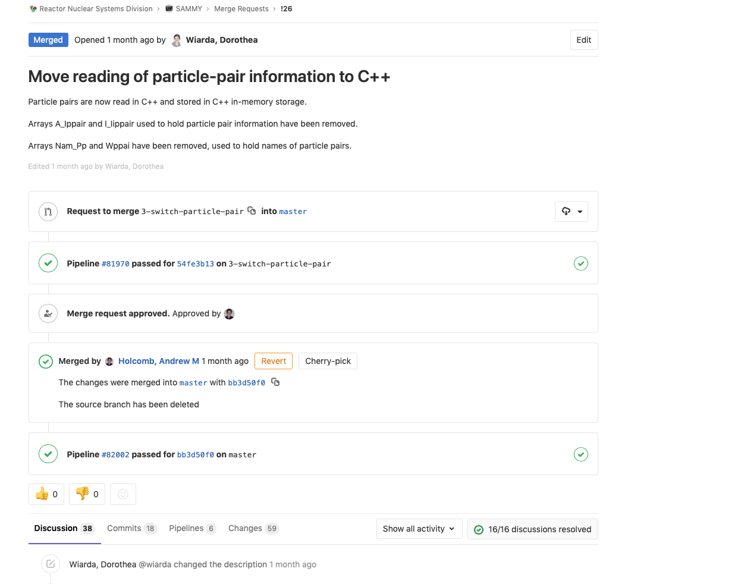
Source code repository
SAMMY was migrated to ORNL git-lab repository, sharing the same ”eco-system” as SCALE and AMPX.
This allows to set up automatic Pipelines that run the SAMMY regression tests on demand.
Merge request can be easily reviewed and will not be merged unless the Pipeline is successfully executed.
Discussions including modifications on the merge request can be easily monitored and are preserved.
This code development environment makes developers and related staff members promptly aware of changes to SAMMY.

Slide 5
Container array
SAMMY memory handler
Advantage:
One memory allocation, little churn.
Only way before the advent of allocate
Disadvantage:
Hard to debug using tools like Valgrind.
Memory manager does work the operating system and compiler can do
Array is fixed and needs to be dimensioned for largest desired problems.
SAMMY already needs to index container array from (-n, n) to accommodate indexing into a large array.

Slide 6
Replace container array – simple strategy
Instead of calling SAMMY memory manager, call allocate and deallocate for the desired array.
Do a global replace for the array using the new name (previously passed as an index into the container array).
Recompile
Run tests
Lots of failed tests.

Slide 7
Container array failures examples
A
B
Array B is inadvertently dimensioned to start before the end of array A.
Array A is zeroed (but not used) beyond its bound -> Array B is now corrupted.
Array space is erroneously reused for a new array, corrupting data that are still used in other parts of the code.
Once the arrays are allocated using the allocate function, Valgrind can find the problem and we can fix it. This is labor intensive.
We found a couple of examples were results are changed due to the above mentioned failures. We will rebase the test cases and report the differences in the release notes.
Some way for SAMMY to mitigate the problem with container arrays is the use of temporary files, which we want to minimize.

Slide 8
Data management
During SCALE modernization we had great success with keeping data in C++ and letting Fortran access the data.
Calculations can then be done either in C++ or Fortran.
AMPX has C++ classes for resonance parameters, which are filled from ENDF, and used to reconstruct cross section data
MLBW
ENDF
Resonance parameters
and
Covariance matrix
SLBW and MLBW parameter are stored in the same class with a flag indicating which formalism to use
Resonance parameters for Reich-Moore for LRF=3 are initially stored in a different class, but are converted to a LRF=7 class before calculation
If derivatives are desired, all formalisms (except URR) are converted to LRF=7
All resonance parameter classes can contain a covariance matrix. If converting to a different formalism, the covariance matrix is re-organized accordingly
Reich-Moore LRF=3
Reich-Moore LRF=7
Adler-Adler
URR –
SLBW only

Slide 9
Strategy: Share code with AMPX
Since AMPX already has classes to access resonance parameters, it would be advantageous to use the same classes in SAMMY.
Currently, AMPX uses SAMRML (stripped-down version of SAMMY) for some calculations. However, we would like to link AMPX use to the full and modernized version of SAMMY.
Advantage: Improvements in the resonance formalism implemented in SAMMY are immediately available to the processing code.
To achieve that, SAMMY internally links to AMPX, which is in a different repository. Developers will have to check out AMPX and SAMMY to build. This will ensure that we do not duplicate code. For internal developers this is not a problem, since they contribute to SCALE and SAMMY.
For official distribution with RSICC, the shared code will be distributed with SAMMY. External users will not need to have access to SCALE if using the RSICC distribution for SAMMY.

Slide 10
Access to the AMPX code
We added Fortran access to the R-Matrix container classes in AMPX (with the help of CIX, a SCALE tool to help in this process).
Since SAMMY needs additional information and has a different order internally we provided C++ wrapper classes, that:
Give access to the R-Matrix classes by references to the spin group, resonance etc.
Add extra information: Is the parameter varied or pup’ed, index into the covariance matrix
Add Fortran access to these wrapper classes.
Start changing SAMMY to use these classes instead of the current Fortran data structures.
Added benefit:
Legacy SAMMY had only 8 characters to name parameters. C++ (and modern Fortran) can use more descriptive names
Related parameters can be bundled together:
Instead of passing an array for resonance energies, an array for gamma width and an array for other width, we now pass one object containing all resonance data.

Slide 11
Progress on implementation
SAMMY uses C++ data for almost all resonance parameters (currently still working on finishing access to the channel parameters.)
All resonance parameters are read from the input or parameter file using C++.
Therefore SAMMY no longer needs to scan the resonance parameter data to get dimension, allocate the correct array size and read the data again.
Work started to do the same for writing the output files.
Once all resonance data are accessed from C++, we will switch to use the ENDF reading and writing routines from AMPX. This will also give us access to GNDS functionality.

Slide 12
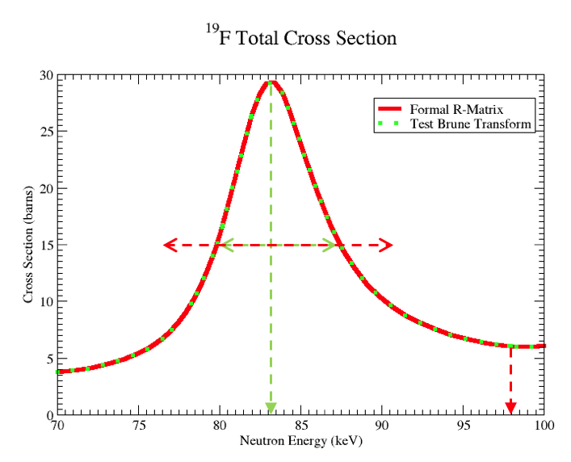
Transformation to Brune basis
In contrast to the “formal” parameterization (for which the resonance energy E_{r} is affected by a shift factor), the Brune basis representation provides resonance parameters that have a more intuitive meaning since their values can be visually related to corresponding measured values.
A code to transform between ”formal” to “Brune” and vice versa was developed and added to the repository. The input and output is an ENDF file with the resonance parameters.
During the conversion from the formal R-Matrix parameters to the Brune R-Matrix parameters, several non-linear eigenvalue solves must be performed; we use the method of successive linear approximations, which is easy to implement and robust for our purposes.

Slide 13
Future plans
Convert all container array access to Fortran allocate (or use C++ storage)
Finish the conversion to use C++ storage for all resonance parameters
We have an initial C++ implementation of the cross section reconstruction from R-Matrix parameters, used in AMPX. We will update this code, add reconstruction of angular data and derivatives and will use it in AMPX and SAMMY.
Once this is done, we can start to add new features to the R-Matrix algorithm, like complex channel radii or relativistic effects.
Modularize SAMMY to separate cross section reconstruction, experimental effect etc. from the Bayes fitting routines.
This work was supported by the Nuclear Criticality Safety Program, funded and managed by the National Nuclear Security Administration for the Department of Energy.

