Slide 1
arXiv 5 Nov. 2019, under review Nuclear Data Sheets
CSWEG 2019, BNL, Upton, NY, November 4-6 2019

Slide 2
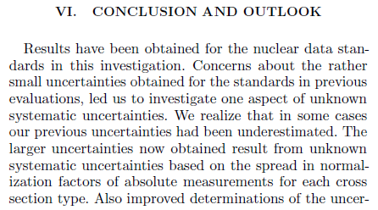
Deficiencies in ND evaluations:
USU in Neutron Data Standards
A.D. Carlson et al, Nucl. Data Sheets 148 (2018) 143-188
Evaluation of the Neutron Data Standards

Slide 3
Deficiencies in ND evaluations:
USU in Neutron Data Standards
¹H(n,n) : 0.34%
⁶Li(n,t) : 0.5 %
¹⁹⁷Au(n,γ) : 1.7 %
²³⁸U(n,γ) : 1.7-2.4 %
²³⁵U(n,f) : 1.2 %
valid for all actinides measured with fission chambers
C(n,n) : 0.8%
¹⁰B(n,α) : 0.5 %
²⁵²Cf(s.f.) ν_{tot} : 0.4%
valid for all actinides
RC & D. Neudecker
arXiv 1908.00272 (2019)

Slide 4
USU definition and statistical model
Statistical model to estimate USU uncertainties
μ – mean value
ε_{i} – counting statistics
η_{i} – systematic errors
δ_{i} – USU

Slide 5
Before identifying USU
Assess INPUT values, uncertainties & correlations
Identification and removal of outliers

Slide 6
What is not USU?
²³⁵U(n,f)
20keV-1MeV
Poenitz GLSQ eval.
(1970)
Evolution of measured ²³⁵U(n,f) with time
THIS IS NOT USU !

Slide 7
What is not USU?
Some targets contained water !
THIS IS NOT USU !

Slide 8
Deficiencies in ND evaluations
Too small evaluated uncertainties, δ<1% (*)
arXiv IRDFF-II: A new neutron …
Why δ<1% are too small? Expert judgement !!
(*) Disclaimer: There are also people worried about too large uncertainties – also expert judgement

Slide 9
Clues pointing to the need of USU

Slide 10
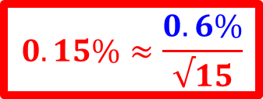
²⁵²Cf(sf) nubar measurements, USU?
111 | Boldeman | 1977 | 3.7549
116 | Spencer | 1982 | 3.7831
121 | Hopkins | 1963 | 3.7767
125 | Asplund | 1963 | 3.7910
127 | White | 1968 | 3.8194
128 | Axton | 1985 | 3.7547
129 | COLV/AXT | 1966 | 3.7299
130 | COLV/ULL | 1965 | 3.7405
138 | Alek-Rov | 1981 | 3.7618
139 | Smith | 1984 | 3.7678
140 | Edwards | 1982 | 3.7641
141 | Boz-nesh | 1977 | 3.7475
142 | DeVolpi | 1972 | 3.7507
143 | Zhang | 1981 | 3.7534
144 | Spiegel | 1981 | 3.7828
N=15
All measurements:
3.765 +/-0.023 (0.6%)
GMA value (GLSQ):
3.764 +/-0.005 (0.13%)
Indep. Exp. !
$$0.15\%≈\frac{0.6\%}{√15}$$
USU nubar: 0.4% (0.6%)

Slide 11

USU in ²⁵²Cf(s.f.)?
Indep. Exp. !
$$0.15\%≈\frac{0.6\%}{√15}$$

Slide 12
USU in ²⁵²Cf(s.f.)
Std 2009:
0.13%
(too small)
Std 2017:
0.42%
(slightly large?)
PUB upper:
0.38%
PUB min. real.:
0.23%

Slide 13
Deficiencies in benchmark evaluations:
USU in benchmarks (too small uncert.?)
HEU

Slide 14
Summary and conclusions
USU definition given
First action : UQ based on recognized uncertainties
Second … : Outlier removal
Third: estimate USU (if any) following clues
Examples given of what is not USU
USU estimates:
USU~200 pcm for HMF benchmarks (sph. vs cyl.)
Important ²⁵²Cf(s.f.) nubar (ν) to be reevaluated:
Expected Δν from 0.23% up to 0.38% (PUBs)
Std 2009 (/B-VII)=0.13%; Std 2017 (/B-VIII)=0.42%

