Slide 1
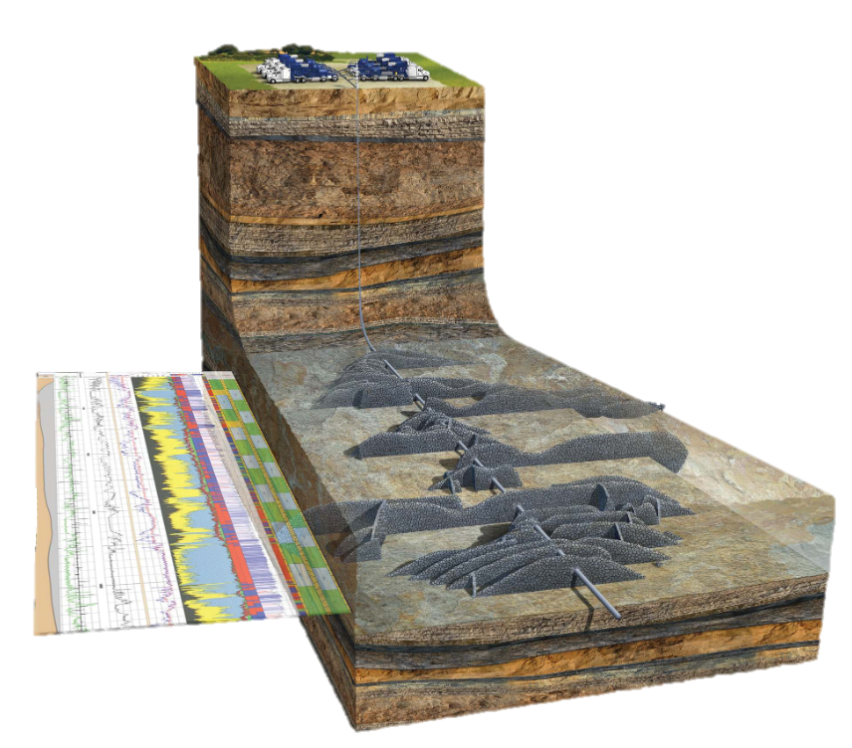
Impact of the ENDF/B-VIII.0 Library on Modeling Nuclear Tools for Oil Exploration
Marie-Laure Mauborgne, R. J. Radtke, Fabien Haranger
Schlumberger
MMauborgne@slb.com

Slide 2

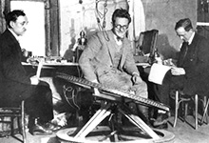
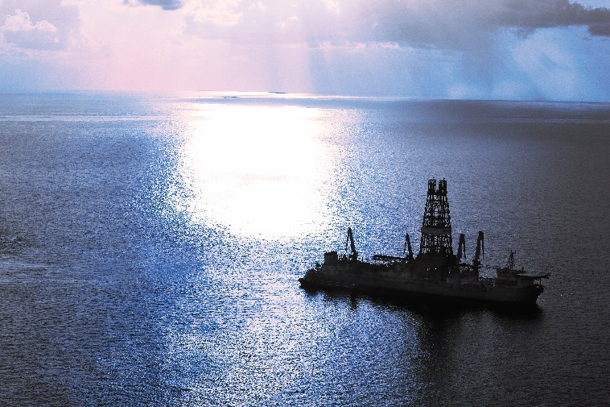

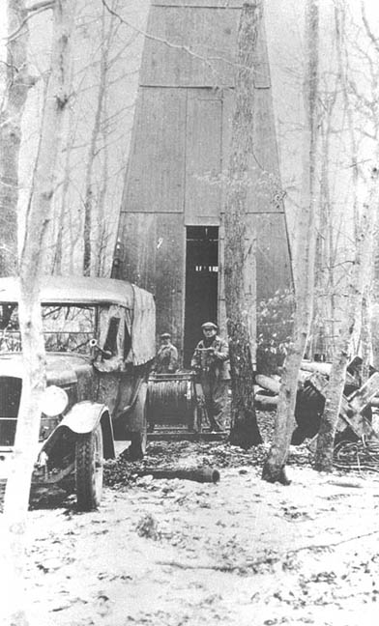
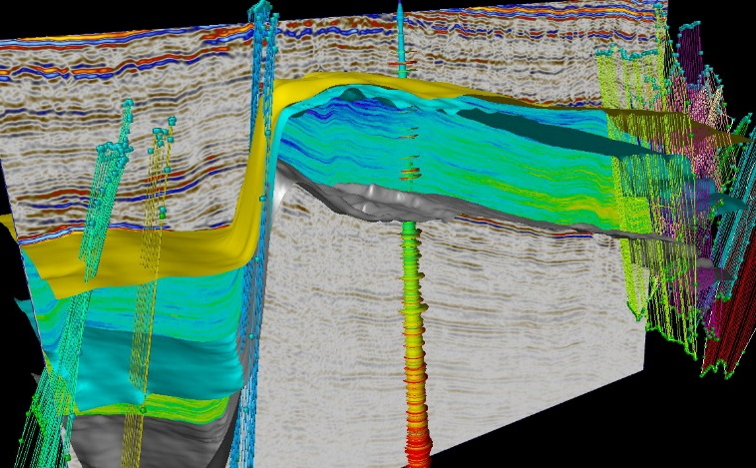
What is Schlumberger?
Founded in 1927 by a physicist and an engineer to conduct geophysical measurements of rock formations
Now:
  100,000 employees, >140 nationalities working in >85 countries
  125 research and engineering centers world-wide

Slide 3
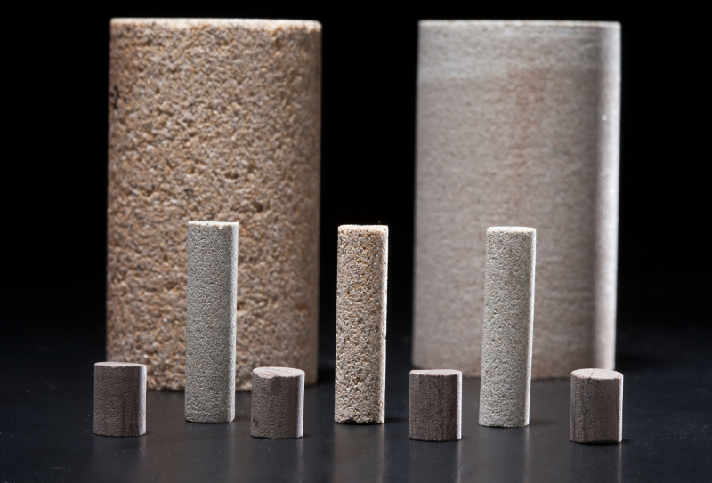
What are Rocks Made of?
Rock = Matrix + Pores
Typical matrix materials:
  In the reservoir —
  sandstone (SiO₂), limestone (CaCO₃), dolomite (CaMg(CO₃)₂)
  Everywhere else —
  “shale” (e.g. aluminosilicates)
Typical pore fluids
  Salt water (NaCl brine)
  Hydrocarbon (oil or gas, C_{n}H_{m})
Notes:
Very high overview of geology

Slide 4
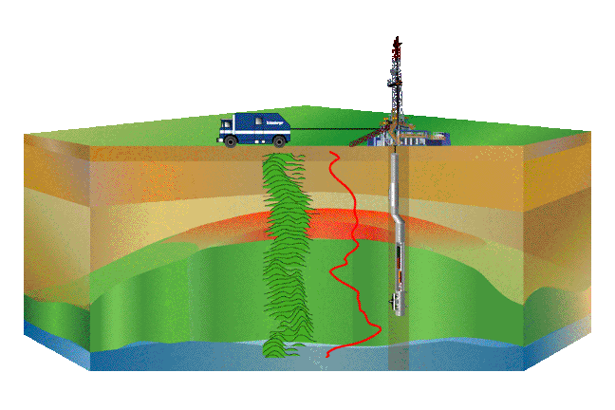
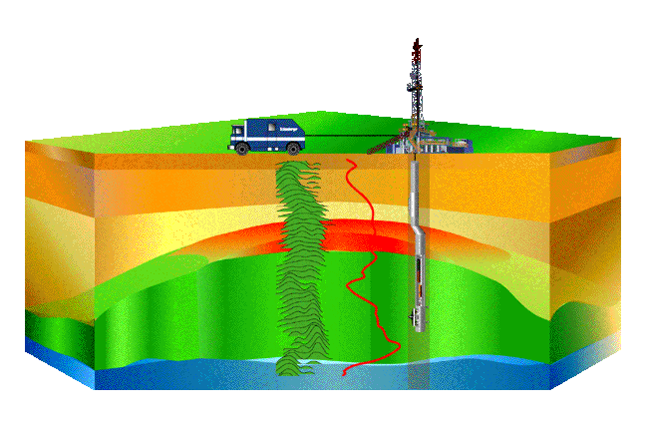
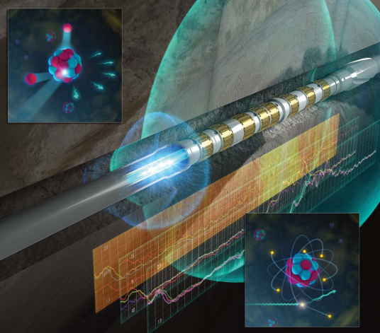
What Do we Do?
We are developing tools to answer basic questions of oil exploration:
  Where are the hydrocarbons?
  What kind (oil or gas)?
  How much can be extracted?
Use nuclear physics to measure:
  Natural radioactivity
  Rock density
  Hydrogen index / Porosity
  Rock matrix and pore fluid composition
  Hole diameter
  …
Notes:
Formation evaluation + Other physics

Slide 5
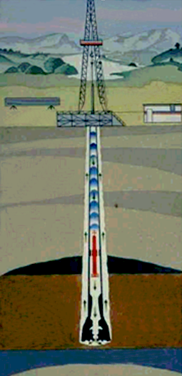
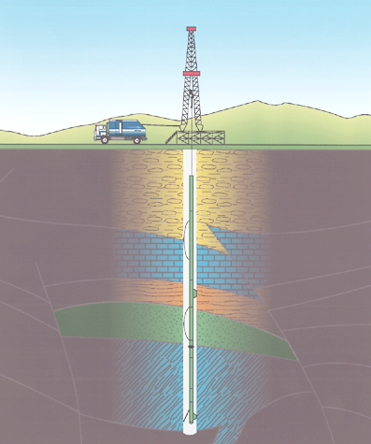
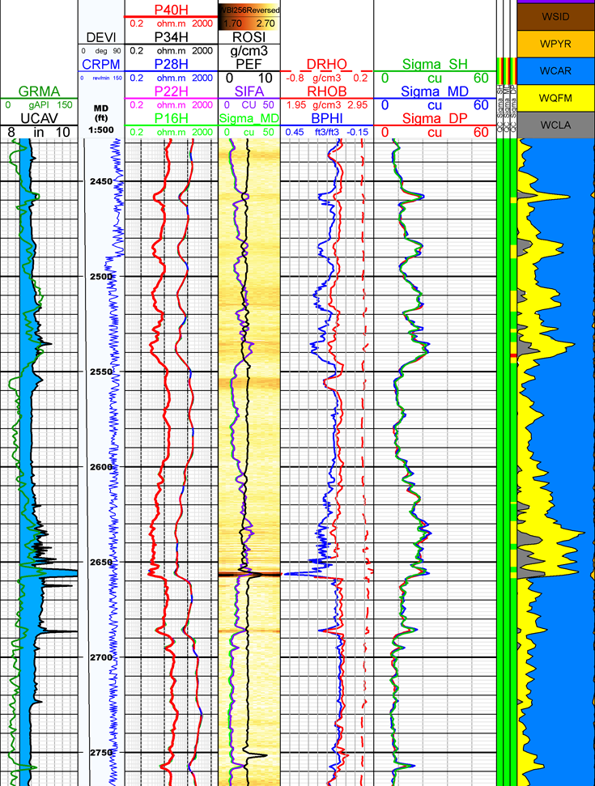
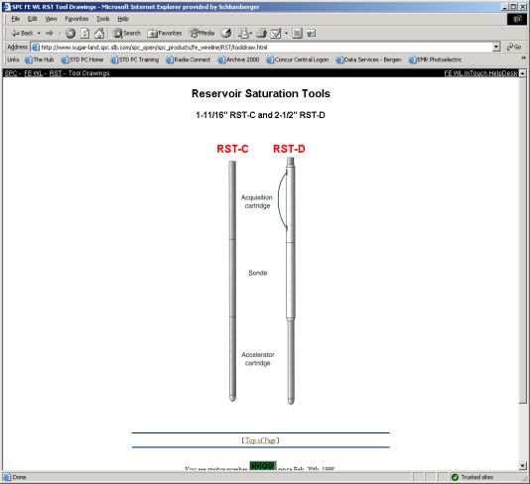

How Do we Do it?
Various measurements
Measurements can be acquired:
  After drilling the hole, with a tool deployed on a cable which provides power and communication (Wireline)
  While drilling the hole (Logging while drilling (LWD))
Data are recorded as a function of depth (log)
Depth

Slide 6
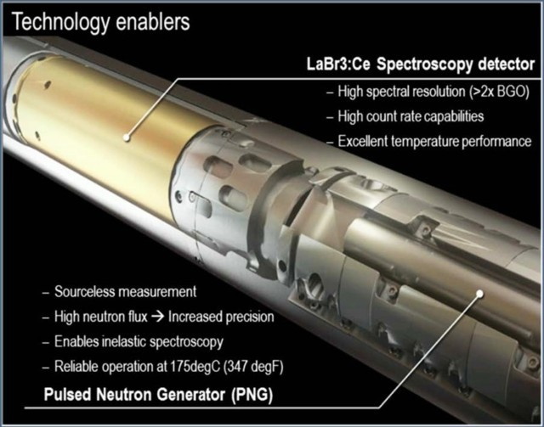
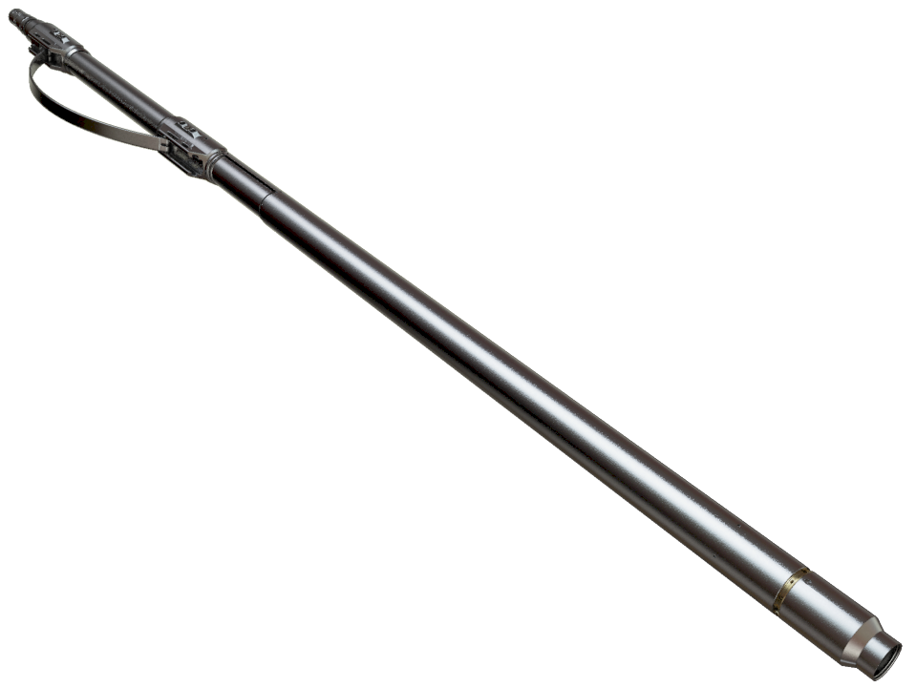
Spectroscopy Tool for Wireline
  Diameter: 4½ in – 11.5 cm
  Length: 9 ft – 3 m
  Mass: 300 lbm – 130 kg
  175°C, 20 kpsi rating – 1350 atm
  Uses LaBr₃:Ce spectroscopy detector
  Pulsed Neutron Generator 3.6 x 10⁸ neutron/s nominal
  First (in the industry) in situ measurement of
  Total Organic Carbon (TOC)
Notes:
Count rate > 10Mcps

Slide 7
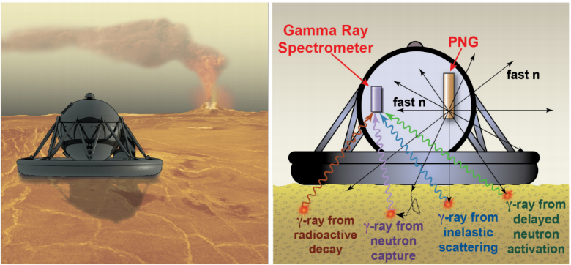
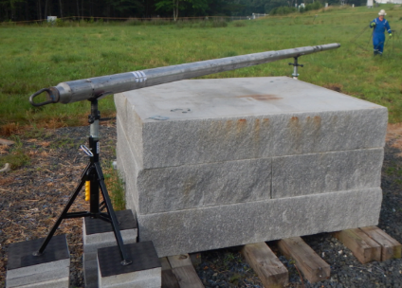
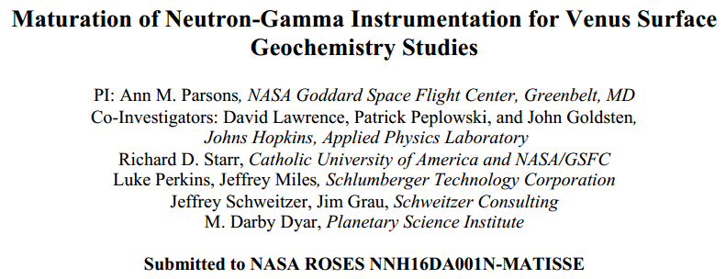
Recent SLB-NASA Engagements - BECA
Spectroscopy on Venus Lander to analyze its crust and look for water
Venus surface: P = 92 atm; T = 462ºC
  Operational lifetime: 2-4 h max.
  First test done at NASA Goddard Space Flight Center with an actual tool.
  Very good results with only minor modifications of the tool
Notes:
Bulk Elemental Composition Analyzer
IEEE 2016

Slide 8
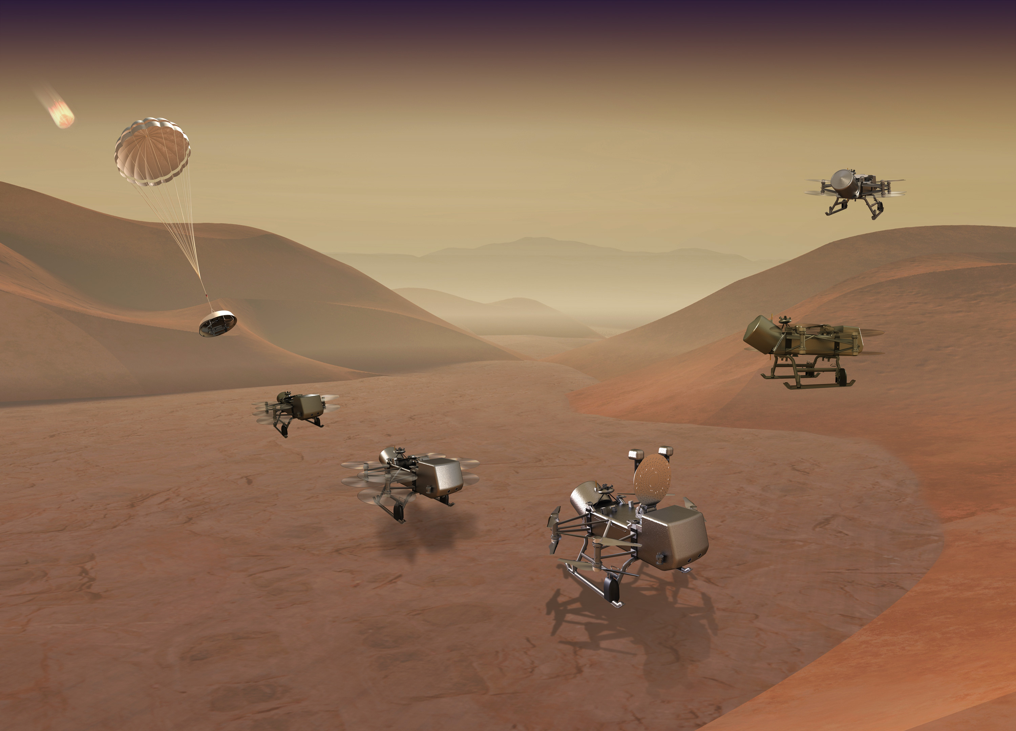
Recent SLB Space Engagements - DragonFly
In collaboration with Johns Hopkins Applied Physics Laboratory
Explore Titan (Satune’s largest moon) with an instrumented, radioisotope-powered dual-quadcopter
Provide pulse neutron generator and expertise on gamma ray spectroscopy to analyze the composition of the shallow sub-surface

Slide 9
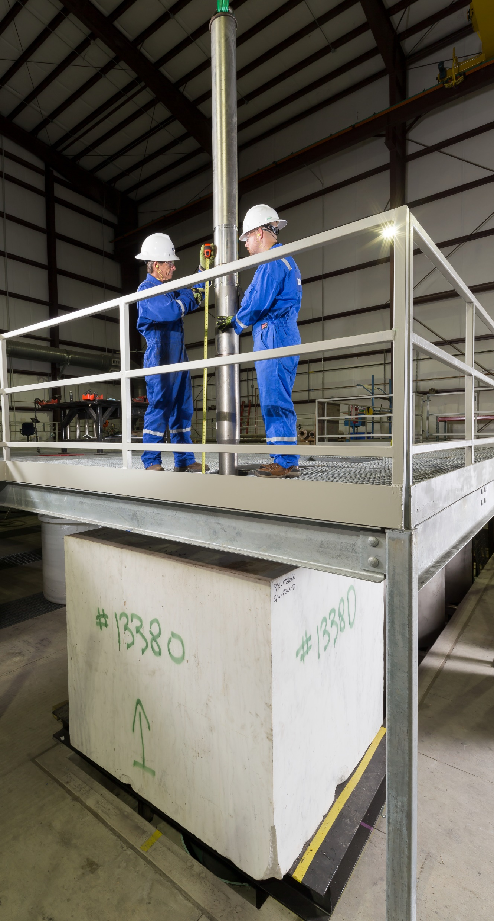
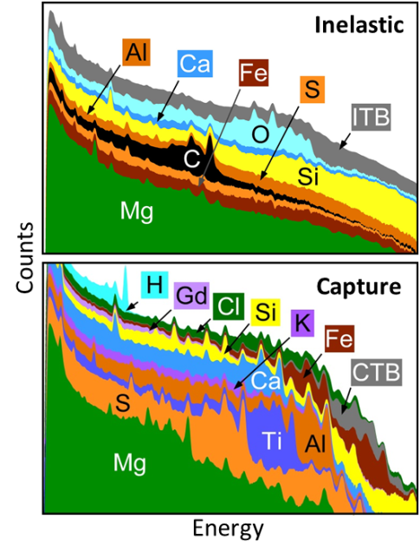
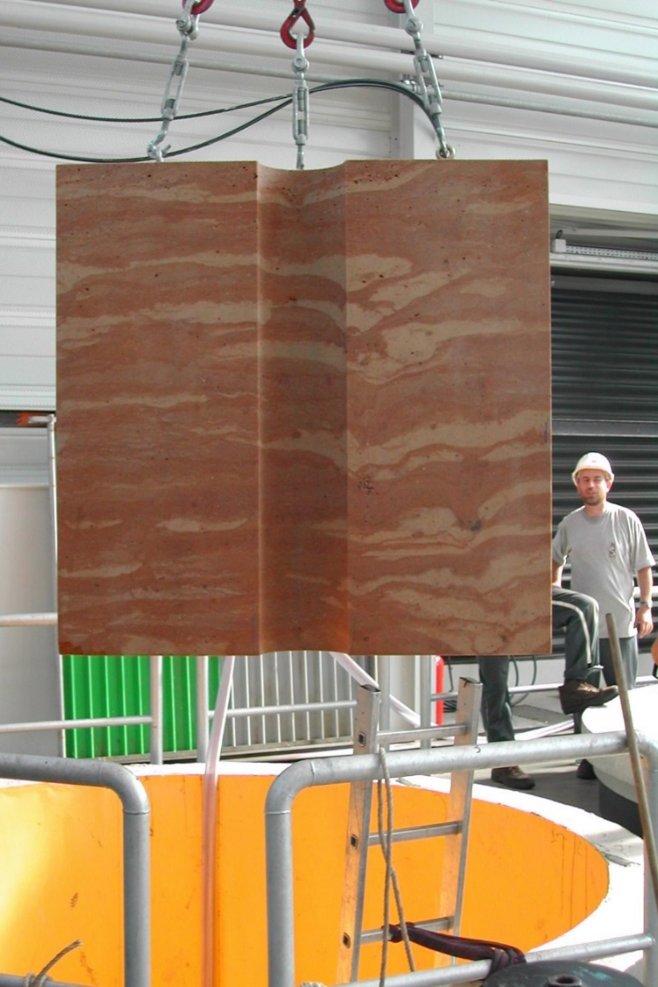
From Measurements to Elemental Standards
Focus on
  Si, Ca, Mg, Al, Fe, K, S, Na to identify rock matrix
  H, C, O, Cl to identify pore fluid
Extract the spectral signatures of the different elements
  Acquiring high-precision spectra in variety of environments
  Combining measured spectra to isolate specific contributions
  Guiding this process through modeling
High-quality elemental standards enable accurate spectral analysis, from which all tool answers are derived:
elemental weight fractions, mineralogy, and total organic carbon

Slide 10
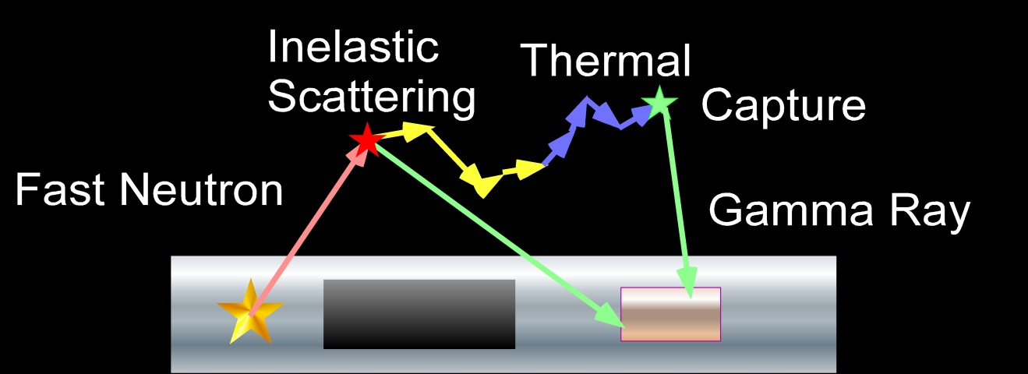
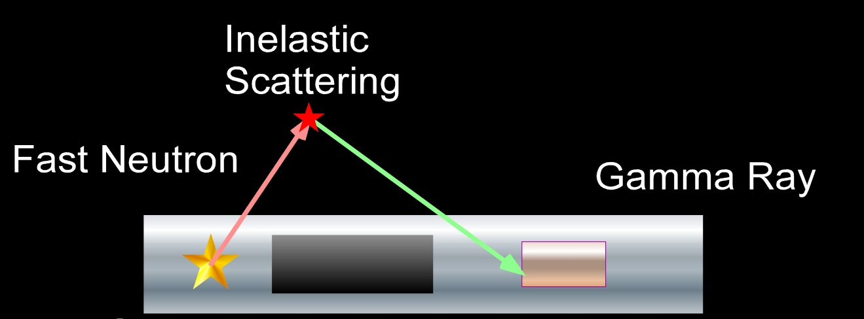
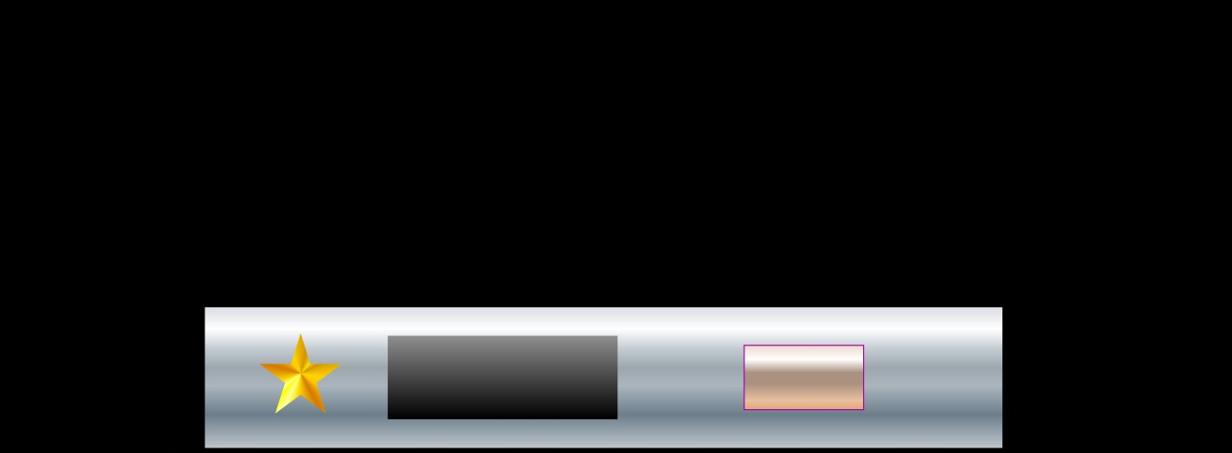
Principles of Spectroscopy Measurement
Spectral Acquisition
Geochemical
Logging Tool
  Inelastic
  Capture
Shielding
Pulsed
Neutron
Source
Gamma Ray
Detector

Slide 11


Principles of Spectroscopy Measurement
Spectral Acquisition
Spectral Stripping
  Inelastic
  Capture
  Elemental yields
Notes:
Point out “new” elements in spectra

Slide 12
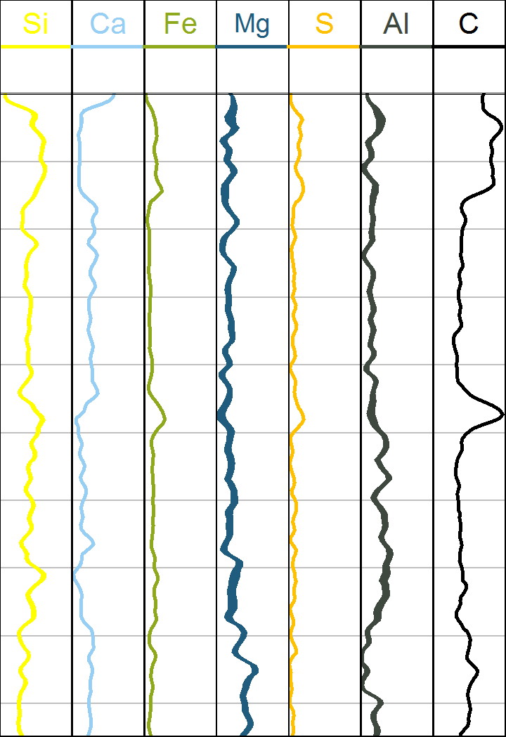
Principles of Spectroscopy Measurement
Spectral Acquisition
Spectral Stripping
Composition
  Inelastic
  Capture
  Elemental yields
  Elemental weight fractions
Notes:
Robust results using more elements (full closure)

Slide 13

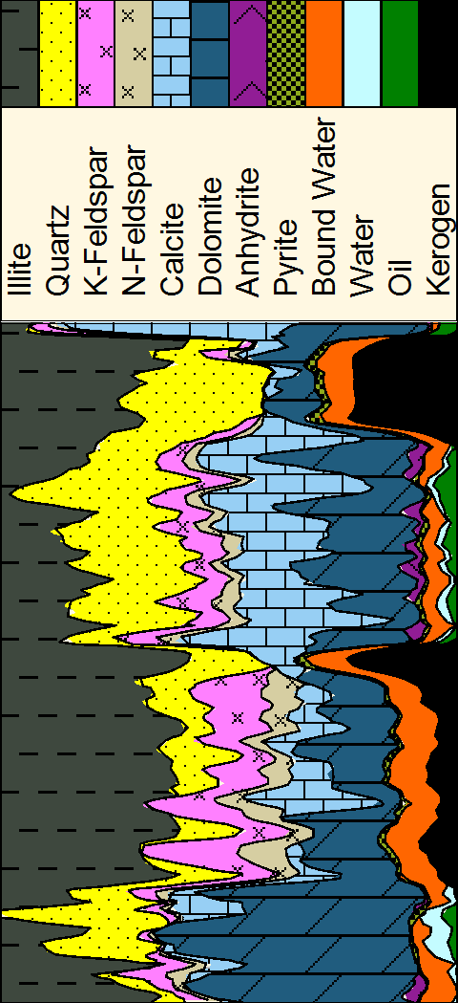
Principles of Spectroscopy Measurement
Spectral Acquisition
Spectral Stripping
Composition
Mineralogy
  Inelastic
  Capture
  Elemental yields
  Elemental weight fractions
  Lithology
  Pore Fluid

Slide 14
Why Do We Need Cross Sections?
Nuclear modeling is fundamental to well logging tool development
  Explore design choices quickly
  Balance mechanics, electronics and physics without costly experimentation
  Complement and extend characterization measurements
Accurate modeling relies on accurate cross sections
  Adequate for gamma rays and neutrons transport
  Improvement needed for neutron-induced gamma rays
For spectroscopy, better cross sections would
  Improve standards derivation and interpretation algorithms
  May allow elemental standards directly from modeling

Slide 15
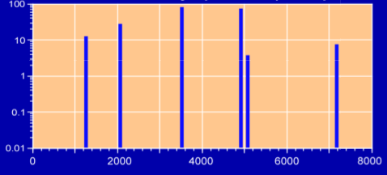
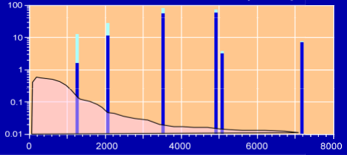
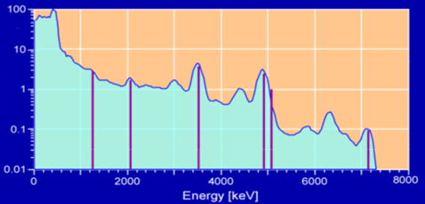
How Do We Model the Standards?
Use a detailed model of tool geometry
  Construct the secondary gamma ray source produced by neutrons from the pulsed neutron generator (PNG)
  Transport the gamma rays back to the detector (mainly through scattering)
  Apply a detector-specific response map computed by modeling to represent detector response
Use a customized version of MCNP to separate contributions from different elements

Slide 16
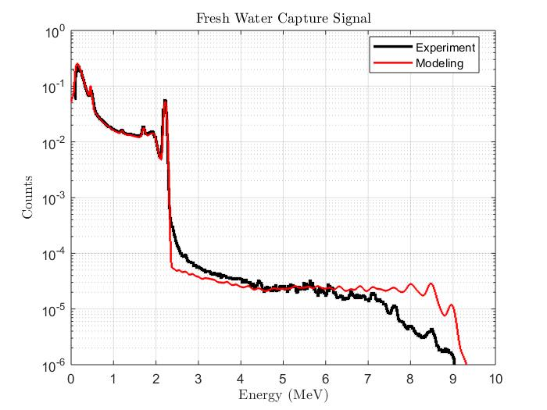
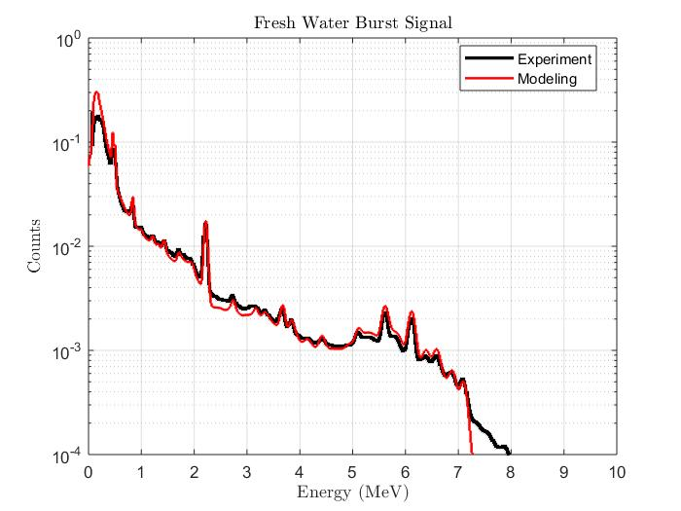
How Accurate Is Our Modeling?
Compare modeling and experiment in the simplest environment: Water
Separate spectra acquired after the PNG is turned off (mainly capture reactions) and during the PNG burst (mainly inelastic reactions)
Hydrogen peak
Background from the tool
Electronic threshold
Oxygen and escape peaks

Slide 17
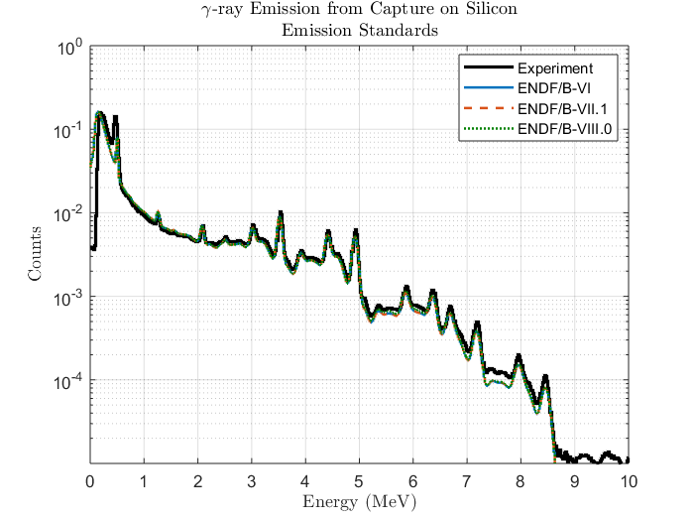
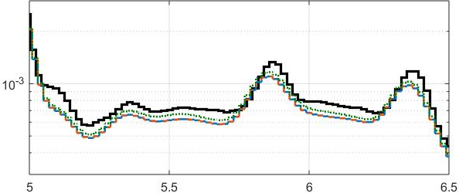
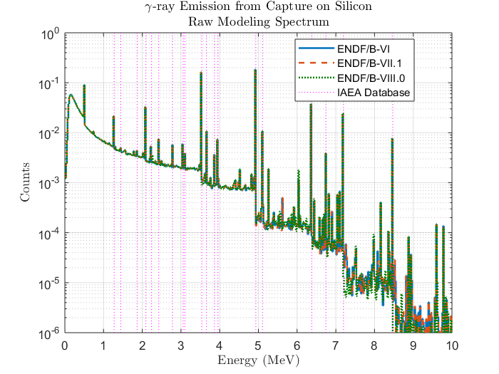
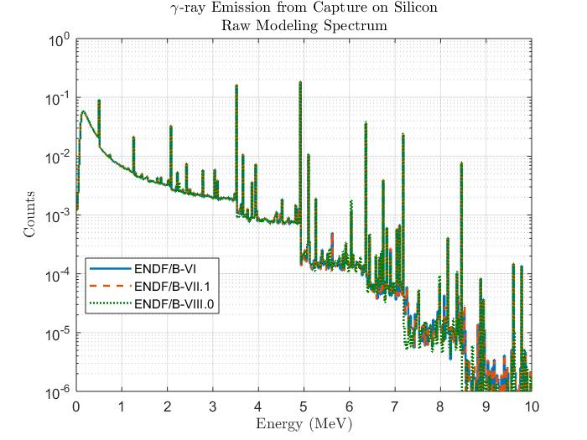
Silicon Capture
Very good reproduction of the silicon capture spectrum
Use of natural compound in ENDF/B-VI, Si-28 afterward
Slightly improved with ENDF/B-VIII.0 between 5 and 6.5 MeV
Look at modeling response without the detector response
Only plot main lines from IEAE capture handbook above 1 MeV
Different versions of ENDF are very similar

Slide 18
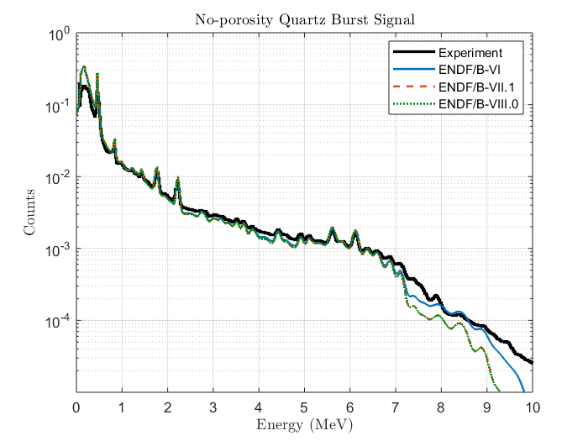
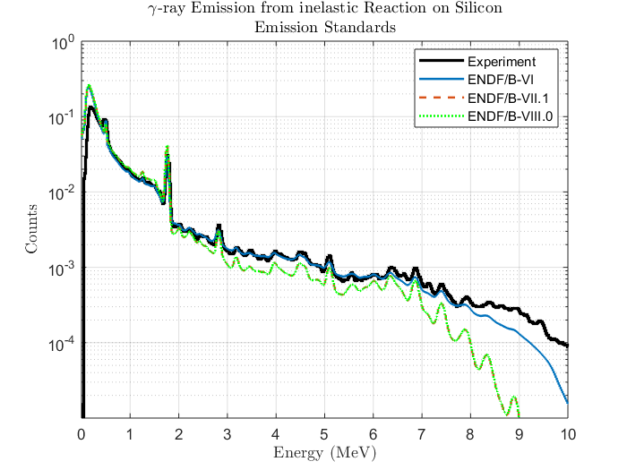
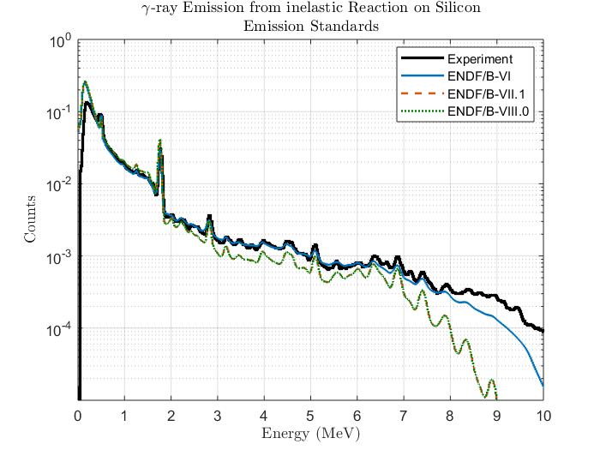
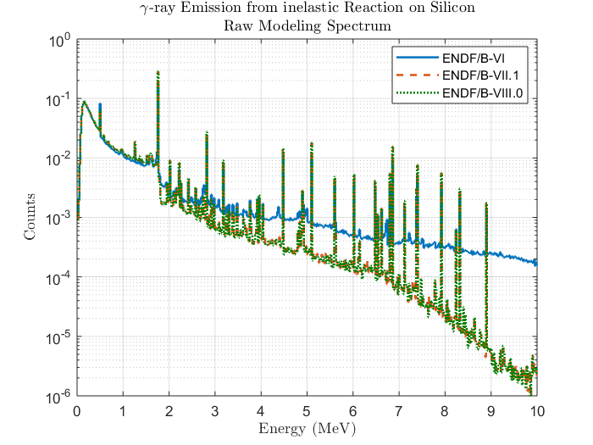
Silicon Inelastic
Use of natural compound in ENDF/B-VI, Si-28 afterward
Modeling benchmark is poorer for inelastic
Totally different response between ENDF/B-VI and newer releases
ENDF/B-VI in better agreement with our experimental results above 7MeV

Slide 19
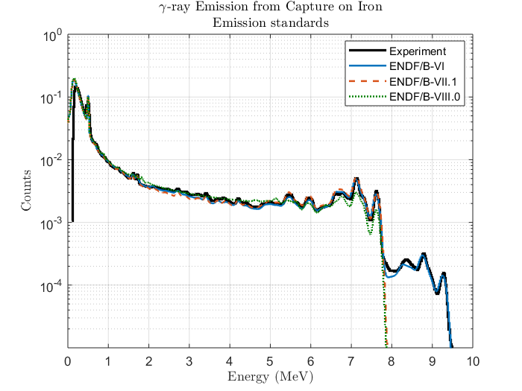
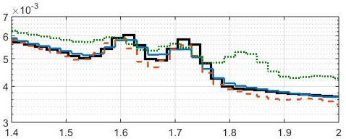
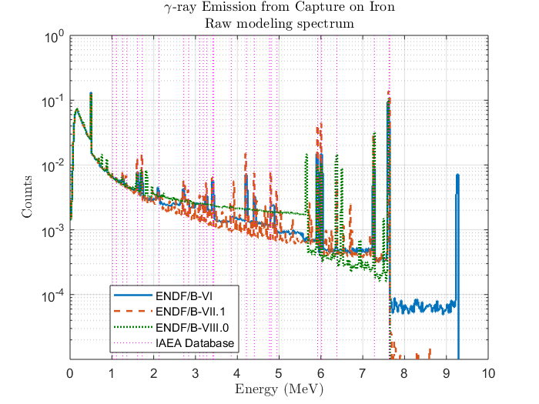
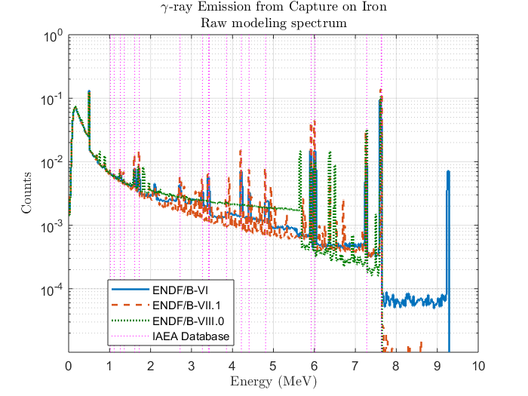
Iron Capture
Iron has been reevaluated through the CIELO collaboration
  Focus on (n, γ) cross section
  Not on secondary gamma energy spectrum
  Total count rate is of secondary interest to us
Use of Fe-56 cross sections
ENDF/B-VII.1 has the best match with experimental data and IAEA capture gamma-ray emission lines
ENDF/B-VIII.0 introduces new lines not seen experimentally or in the literature

Slide 20
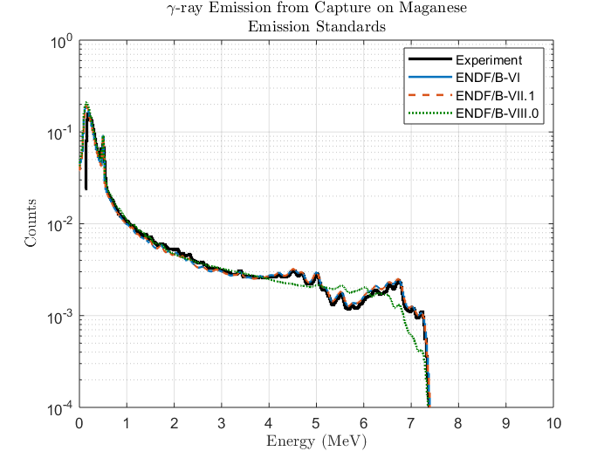
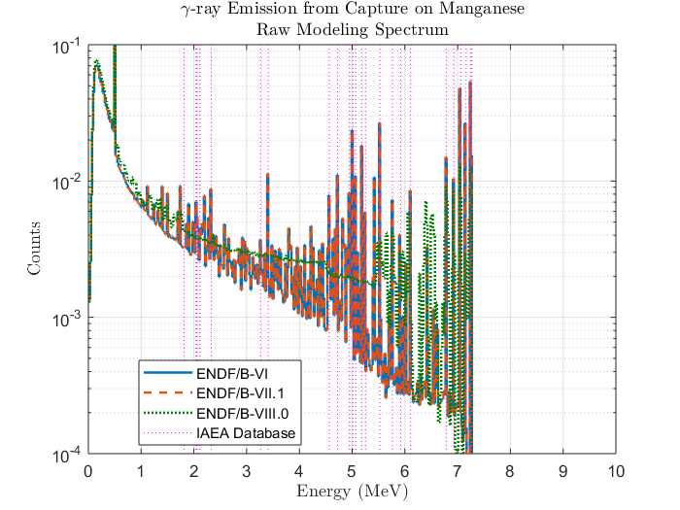
Manganese Capture
Only one isotope found in natural manganese
Significantly worse in ENDF/B-VIII.0
ENDF/B-VI and ENDF/B-VII.1 in better agreement with our experimental results and IAEA capture gamma-ray emission lines

Slide 21
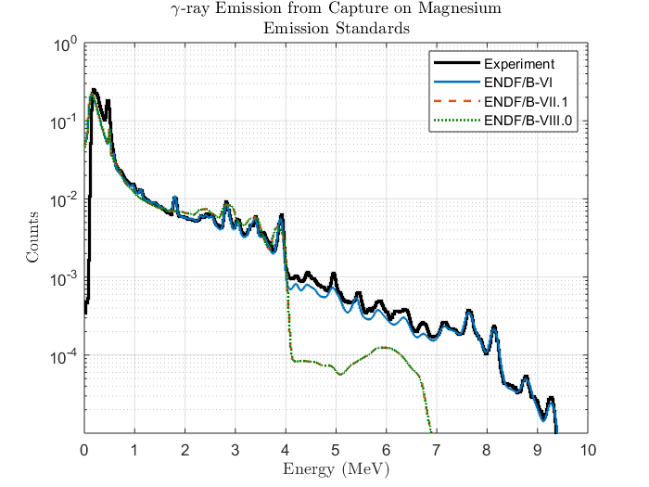
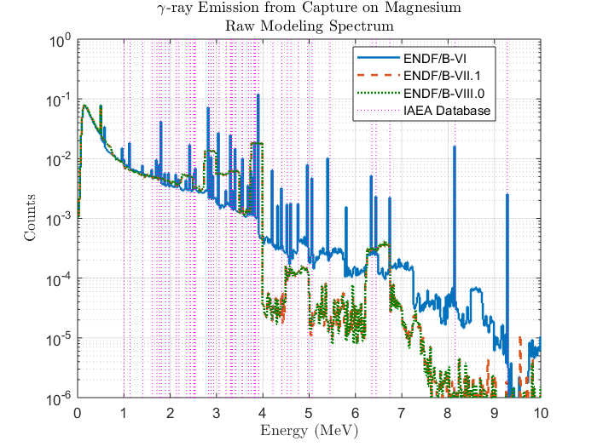
Magnesium Capture
Natural compound in ENDF/B-VI, break into isotopes afterward
Significantly worse in ENDF/BVII.1 and ENDF/B-VIII.0
Gamma ray emission energy are very coarse
ENDF/B-VI is just much better for capture!

Slide 22
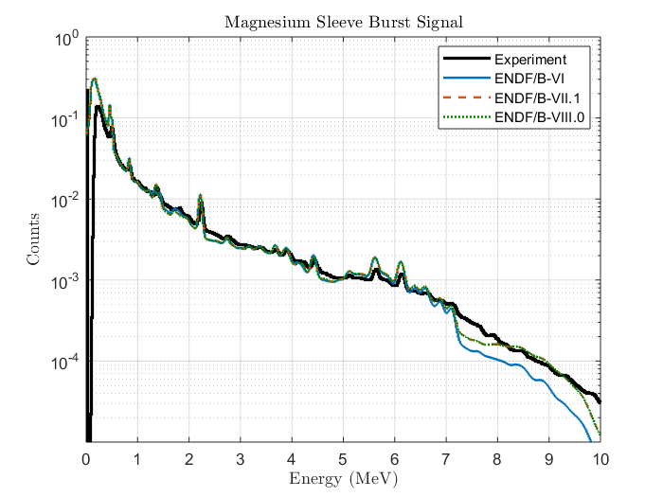
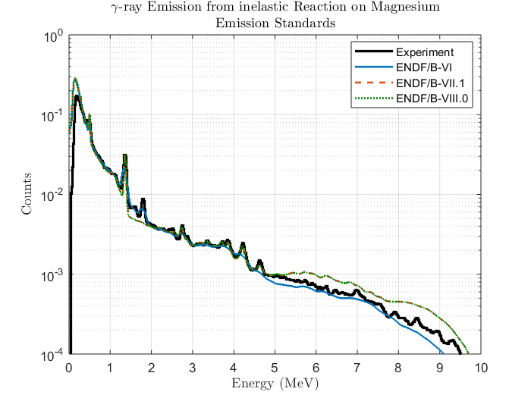

Magnesium Inelastic
Natural compound in ENDF/B-VI, break into isotopes afterward
Poorer benchmark compared to capture
Gamma ray emission energies are much finer
One line at ~1.8 MeV seems to be missing
Difficult choice, but the 1.8 MeV line is very distinctive
ENDF/B-VI is better for capture

Slide 23
Summary
Recommendations for capture gamma ray spectra in the table
For inelastic reaction, benchmark is generally poor
Changes in emission spectrum are relatively small
Experimental results may not be accurate enough to choose one vs another
Element | ENDF-B/VI | ENDF/B-VII.1 | ENDF/B-VIII.0
Hydrogen | ✓ | ✓ | ✓
Silicon | ✓ | ✓ | ✓
Calcium | ✓ | ? | ?
Iron | ✓ | ✓ | ?
Manganese | ✓ | ✓ | ?
Magnesium | ✓ | ? | ?
Titanium | ✓ | ✓ | ?
Sodium | ✓ | ✓ | ✓
Chlorine | ✓ | ✓ | ✓
Aluminum | ✓ | ✓ | ✓
? Questionable reproduction of direct measurement
✓ Good reproduction of direct measurement

Slide 24
Conclusion
The Oilfield industry focuses more and more on secondary gamma ray measurements
It is critical to have accurate gamma ray energy lines and related emission cross sections
In the last two major releases of ENDF/B, we have seen more degradation than improvement concerning this specific topic

