Slide 1
⁹Be(γ,n) Evaluation
Jason Thompson
Presented at CSEWG 2019

Slide 2
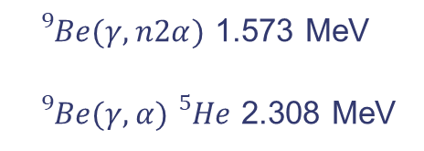
Current ⁹Be(γ,x) Evaluation
${}_{}^{9}{Be}\left(γ,n_{0}\right){}_{}^{8}{Be}$ 1.665 MeV
${}_{}^{9}{Be}\left(γ,n_{1}\right){{}_{}^{8}{Be}}^{∗}$ 4.695 MeV
${}_{}^{9}{Be}(γ,n2α)$ 1.573 MeV
${}_{}^{9}{Be}(γ,α){}_{}^{5}{He}$ 2.308 MeV
Notes:
The “current” evaluation is dated Dec 1998. It goes up to 30 MeV, with many channels opening up around 20 MeV, but for this work going to focus on the low energy region up to a few MeV. In this range, there are few resonances which roughly correspond to known energy levels in Be9 from ENSDF. The first two peaks correspond to first two excited states, while the next two excited states are both near 3 MeV and contribute to this third peak. The last bulge at the edge of the plot is actually two more resonances on top of the low energy side of a cluster dipole resonance.
There’s four reaction channels open in this energy range. (gamma,n1) at towards the high end of our sensitive region so I’m actually going to ignore it and all higher excitation states for here. The (gamma,alpha) channel opens up around 2.3 MeV, (gamma,n) at 1.665, and the (gamma,n2alpha) below that at 1.573. If you set up an experiment simply to count reaction products, you can’t tell these reactions apart because Be8 decays into two alpha particles, and He5 decays into a free neutron and an alpha particle, both at the sub picosecond timescale. This evaluation lumps all three of these reactions into the (g,n2a) channel.

Slide 3
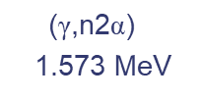

Cross Section Between the (γ,n2α) and (γ,n) Thresholds
$$\text{(}\text{γ}\text{,}\text{n}\text{2}\text{α}\text{)}$$
1.573 MeV
$$\text{(}\text{γ}\text{,}\text{n}\text{)}$$
1.665 MeV
At 1.576 MeV
9.18 μb from evaluation
0.40±0.18 μb from Fujishiro et al.,
Canadian J. of Phys., 6, p1579 (1983)
At 1.63 MeV
180 μb from evaluation
0.093±16 μb from Utsunomiya et al.
Rev C 92, 064323 (2015)
Notes:
The first thing we noticed was some suspect behavior between the first two reaction thresholds. This shape It looks like the last evaluated point above the (g,n) threshold is non-zero, and rather than setting the cross section to zero between the (g,n) threshold, it was set to zero at the photodisintegration threshold. I’d expect that the cross section should go more or less to zero at the (g,n) threshold based on the shape of the curve.
There’s been at least two cross section measurement between the two thresholds. The evaluation overpredicts the first one just about the breakup reaction threshold by more than a factor of 20, and the second misses the, low precision measurement by 11 standard deviations.
Logic and experiment agree in this case, and this shape is not physical.

Slide 4
New Data
Notes:
There is a lot of interest in Be8 for astrophysics, specifically when modeling helium burning and nucleosynthesis in the low mass range. The new measurements were performed after the evaluation was constructed using a laser Compton scattering method to generate nearly monoenergetic photons.
As you can see, the lowest energy resonance hits a lot of the data, but the doesn’t reproduce the deep dip above 2 MeV. Only one measurement reports a resonance around 2.6 MeV, and the two datasets that extend to the third peak (which is supposed to be two close resonances) differ significantly. Above 4 MeV, there’s two resonances laying on top of a broad cluster dipole resonance. I tried to fit these two resonance and the CDR to hopefully catch some of their low energy effects, but our proprietary models are not sensitive enough for us to recommend any modifications to the evaluation above about 4 MeV.

Slide 5
New Evaluation
Notes:
Here is the evaluation we’ve been working on. We used a Breit Wigner formalism to describe the six resonances and a Lorentzian for the CDR. We still need to improve how we sticking everything together above 4 MeV.
Some other things to note is that the shape of the first resonance is very sensitive to the resonances energy relative to the neutron separation energy. An additional measure of the third/fourth resonance would help to reduce us to understand the discrepancy between the two measurements.
We also still don’t have a clear method of assigning strengths to each of the three different reactions. Work with the (He3,p) reaction on Li7 indicated that the second resonance decays primarily via alpha emission. Some older mass evaluations (AME03) put this resonance slightly below the (g,a) threshold, while the newest one (AME2016) put it just above the threshold.

Slide 6
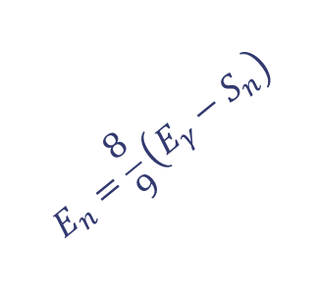
Average Neutron Energy
Utsunomiya, Phys. Rev. C 92, 064323 (2015).
$$E_{n}=\frac{8}{9}\left(E_{γ}−S_{n}\right)$$
Notes:
Utsunomiya also reported average secondary energies for some of the lowest energy points. The first batch of points which were taken over the first resonance all fall closely on the 8/9 line which is what you would get from a pure 2-body (g,n) reaction, so we can assign most of the total cross section from this resonance to the (g,n) reaction. The three higher points deviate from the 8/9ths line indicating that an other reaction are making non-trival contributions to the total cross section.

Slide 7
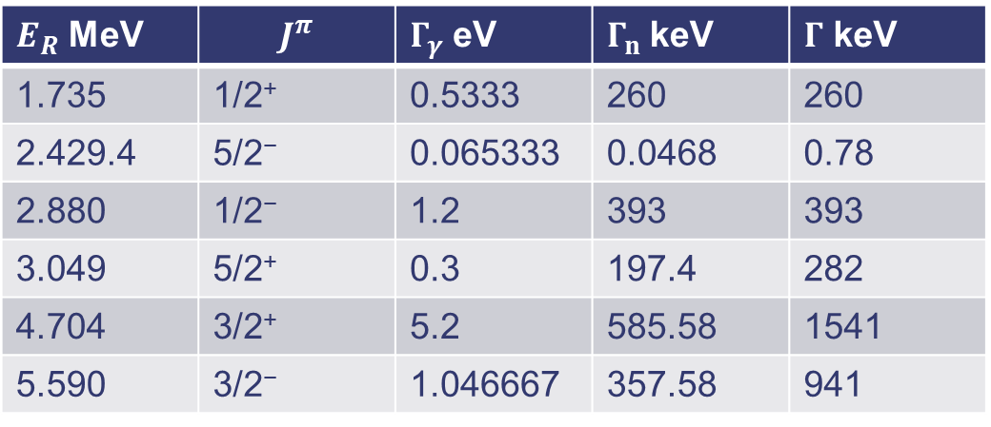
Multilevel Breit Wigner Parameters
$E_{R}$ MeV | $$J^{π}$$ | $Γ_{γ}$ eV | $Γ_{n}$ keV | $Γ$ keV
1.735 | 1/2⁺ | 0.5333 | 260 | 260
2.429.4 | 5/2⁻ | 0.065333 | 0.0468 | 0.78
2.880 | 1/2⁻ | 1.2 | 393 | 393
3.049 | 5/2⁺ | 0.3 | 197.4 | 282
4.704 | 3/2⁺ | 5.2 | 585.58 | 1541
5.590 | 3/2⁻ | 1.046667 | 357.58 | 941
Notes:
These are the resonance parameters we’ve assigned. We’re evaluating the total cross section as a (g,n) reaction (using Gamma instead of Gamma_n), and assigned MT=50 Gamma_n over Gamma fraction of the total cross, with the remaining assigned to MT=29. We assigned an isotropic two-body distribution to the (g,n) reaction and retained the original File 6 data for the disintegration reaction. We are clearly missing some physics with this method, but it at least we see an improvement in the agreement between the total cross section and experimental data, and hopefully and improvement in secondary energy near the first resonance.

Slide 8
Conclusions
NNL has a new ⁹Be(γ,x) evaluation base on the multilevel Breit-Wigner formalism
We plan to provide this evaluation (preprocessed into a MF=3 format) to the NNDC later this year or early next
This evaluation does a better job of matching the low cross section between resonances (~2-3 MeV)
The second resonance is significantly more narrow than the ENDF/B-VIII.0 evaluation
Secondary angle/energy measurement at low energy would help distinguish between reactions and simple specify the secondary distributions
Notes:
NNL has a new Be-9 photoneutron evaluation, which we plan on submitted to the NNDC probably beginning of next year once we have time to finalize our checks, polish the file up (update the header information), and make sure it processes through NJOY. This evaluation better predicts the dips between the two major structures around 1.7 and 3.0 MeV, and better represents the very narrow resonance at 2.4 MeV.
We’re not putting this on any must have list of experiments, but this work would have benefited from detailed angular or energy distributions to help distinguish between reaction types, or just to know the secondary emission angle and energy distributions.

