Slide 1
Energy-dependent Bias between ENDF/B-VII.1 and ENDF/B-VIII.0 for LCT Benchmarks
B.J. Marshall
CSEWG
Brookhaven National Laboratory
November 4, 2019

Slide 2
Purpose
Present the process I went through to identify an energy-dependent bias in LCT benchmarks in the ORNL VALID suite
Sometimes people ask me how I find these things, and this one has a clear process
I do not believe specific, in-depth knowledge of the benchmarks is required
It sure is helpful though

Slide 3
Steps to find the bias
Start with C/E plot for all 140 LCT experiments for both ENDF/B-VII.1 and ENDF/B-VIII
CE only
Note variation in differences
Identify shared trait for some cases
Plot C/E versus EALF
Plot change in C/E versus EALF

Slide 4
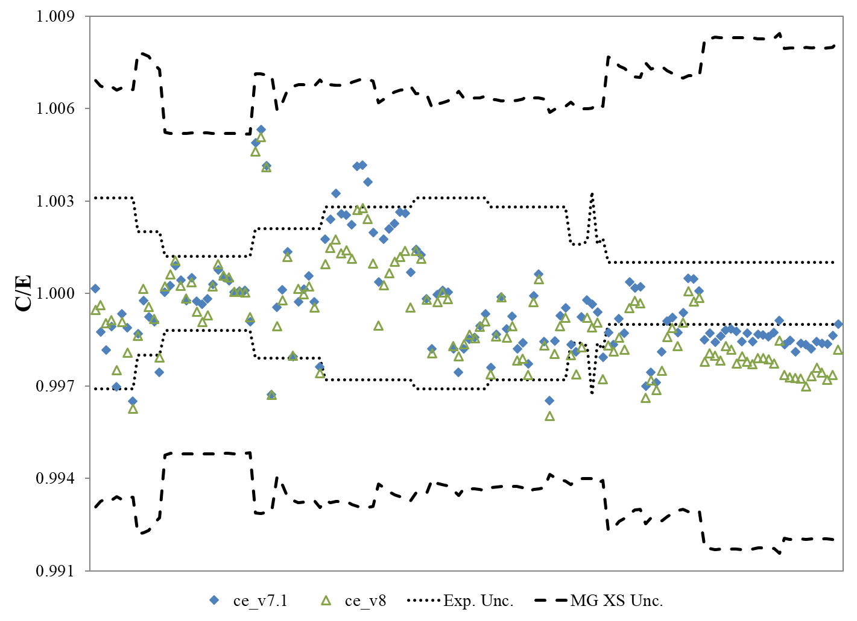
All LCT C/E values, CE E7.1 and E8

Slide 5
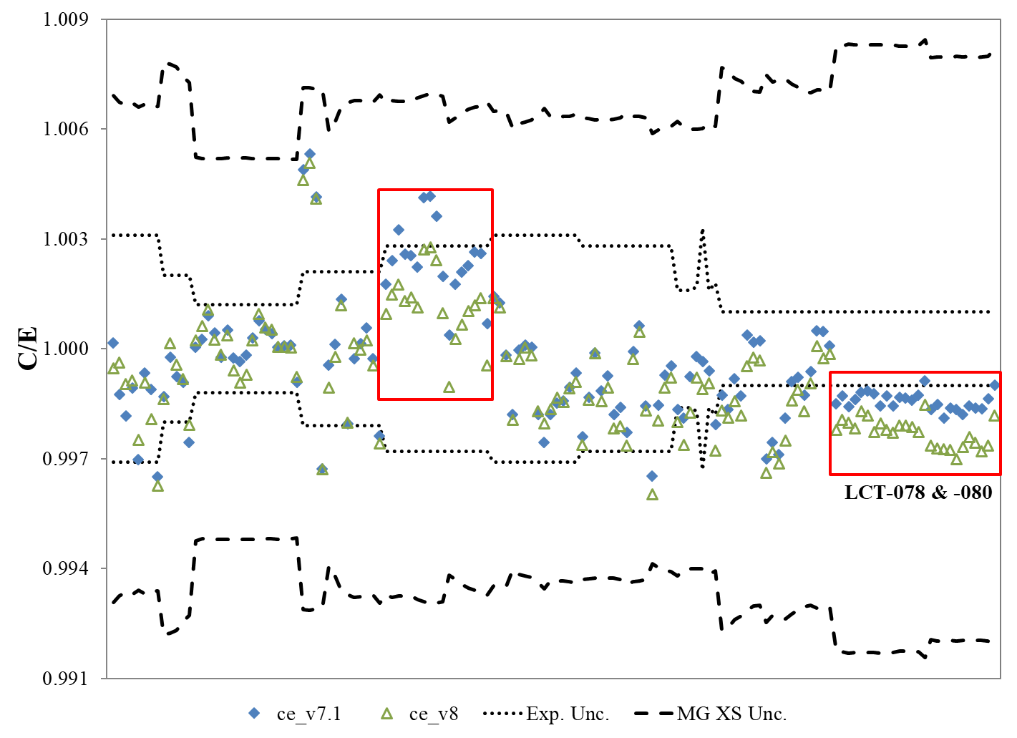
Now with regions of interest…

Slide 6
So what’s in that other box
Turns out it’s LCT-010 cases 14 through 30
LCT-010 uses two different pitches
2.54 cm for cases 1 – 13
1.892 cm for cases 14 – 30
Well that’s interesting…
LCT-078 and -080 are also relatively tight pitch
Dryer lattice → harder spectrum → bigger difference?

Slide 7
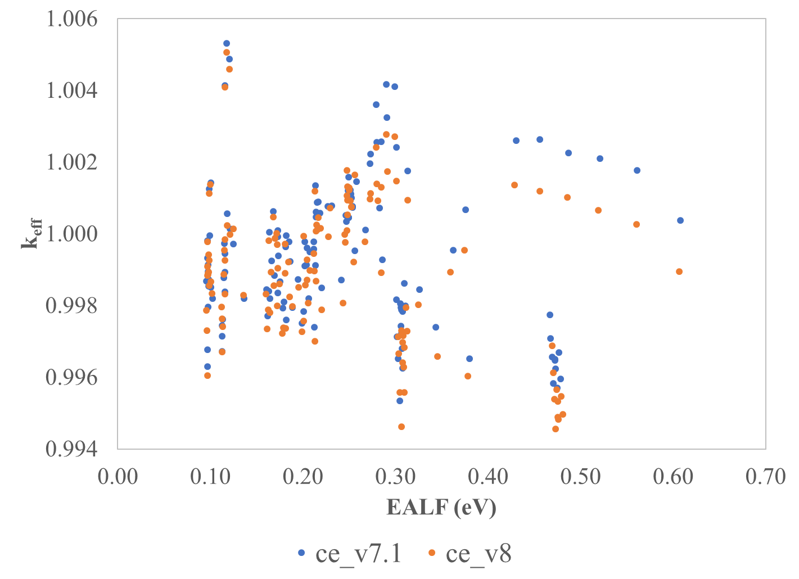
All C/E values vs EALF

Slide 8
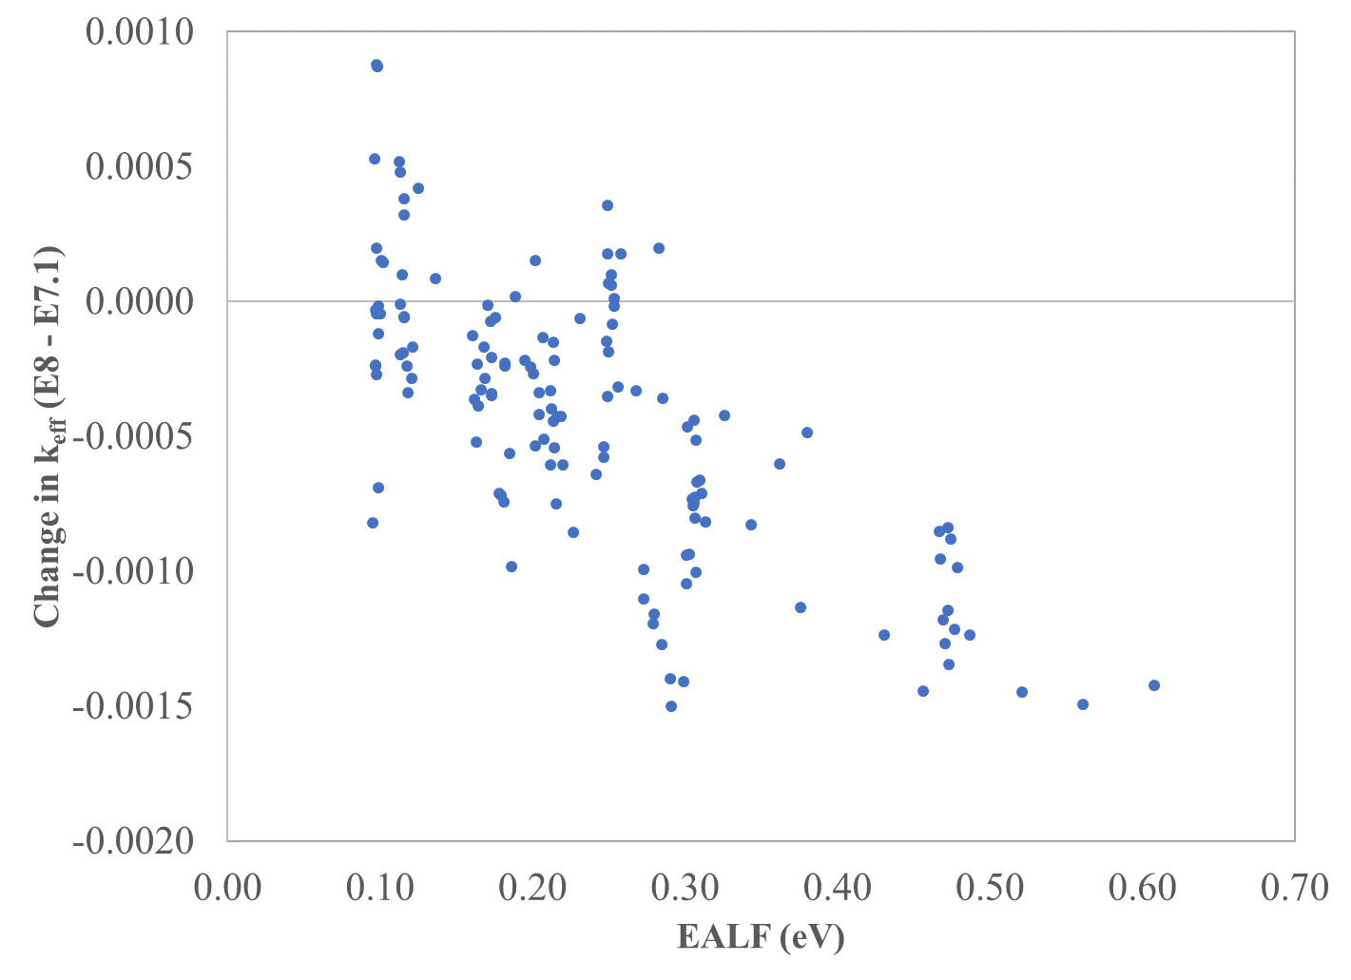
Difference in k_{eff} versus EALF

Slide 9
A trend!
There appears to be a fairly strong trend (as these things go) with larger magnitude bias with increasing neutron energy
More negative is more wrong. The average for ENDF/B-VIII.0 is lower (larger magnitude negative bias) than ENDF/B-VII.1
Initial investigations indicate several isotopes contribute to the bias
²³⁵U, ²³⁸U, and ¹⁶O in different, sometimes canceling, changes
More information in the future when it is available and digested

Slide 10
Questions?
This work was supported by the Nuclear Criticality Safety Program, funded and managed by the National Nuclear Security Administration for the Department of Energy.

