Slide 1
Isotope Production Charged-Particle cross section templates
Lee Bernstein
Nuclear Science Division
Lawrence Berkeley National Laboratory
Department of Nuclear Engineering
University of California - Berkeley
Andrew S. Voyles
13 June 2018 – Program Review for NSSC2 – TA1
Notes:
Emerging trends for next-generation (targeted & personalized) nuclear medicine:
Targeted alpha therapy (5-10 MeV)
40-80 μm range → single cell
Targeted Auger therapy (20 eV – 1 keV)
1 nm – 2 μm → cellular nucleus
Theranostic medicine
Simultaneous imaging and therapy

Slide 2
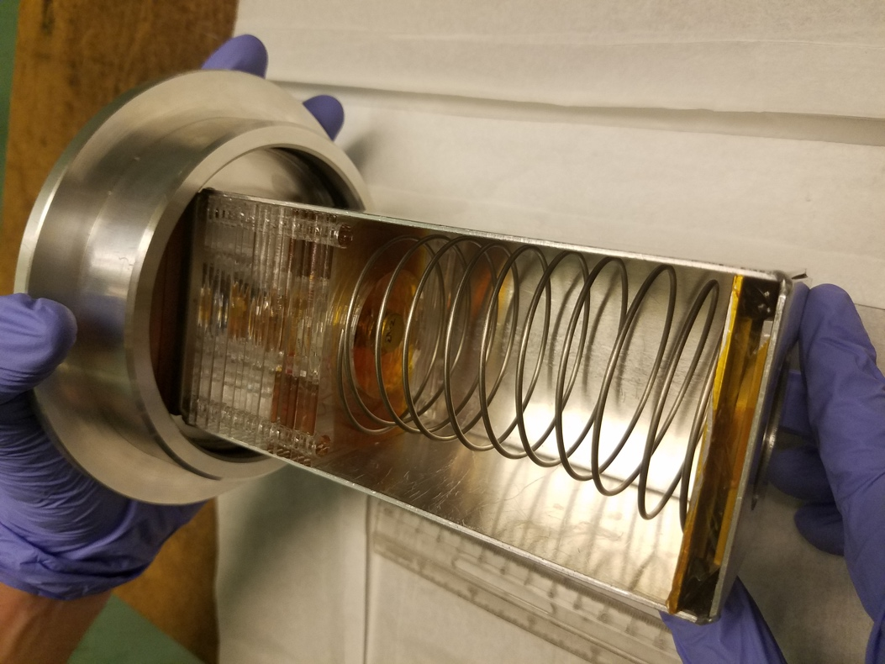
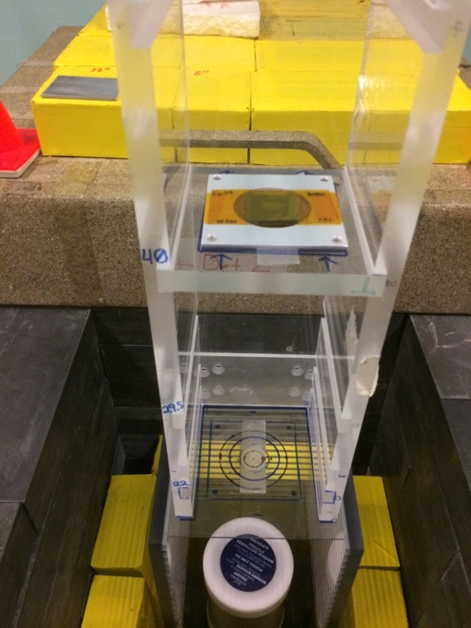
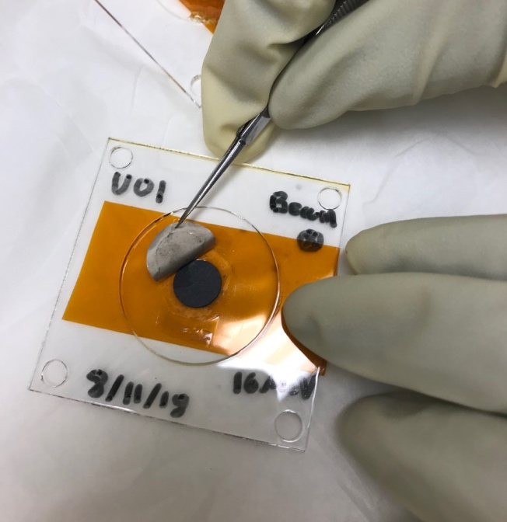
Angle-integrated charged-particle cross sections over a range of energies can be rapidly measured using the stacked target technique
Monitor
Foils
Al
Degraders
Monitor
Foils
Stacked Target Holder
Beam
Foil of Interest
Pencil or
overfill beams
HPGe
Assay
Energy and Flux from Activation
Foil Variance Minimization
Monitor Foils
Al Degraders
Monitor Foils
Beam
Foil of Interest
The beam energy and current throughout the stack is determined by minimizing the variance between the measured and modeled activity in the monitor foils [3]
Notes:
Beam current and energy measured using activation monitors and beam-current integrators. High current (≤1500 W) and modest beam energies allow for very short irradiations and quick sample extraction facilitating the measurement of activities with t-1/2 ≥ 10 min.

Slide 3
Uncertainties
$$\frac{dσ}{dE_{p}}=\frac{\# of activation products}{\# of beam particles}= \frac{{\left(ρr\right)}_{target}σIΔt}{IΔt}$$
✗
Activation + decay measurements covered separately (see A.M. Lewis)
Introduces a dependence on E at each foil location
Current integrator is only used as a “sanity check” on the first foil
$$\frac{dσ}{dE_{p}}=\frac{\# of activation products}{\# of beam particles}= \frac{{\left(ρr\right)}_{target}σ(E)IΔt}{{\left(ρr\right)}_{monitor}{σ(E)}_{monitor}IΔt}$$
The monitor foil activation is used to determine the flux at each position in the stack, correcting for flux depletion and allowing for determination of the beam energy through out the stack by adjusting the Al degrader density using a variance minimization procedure*
Energy
Fluence
*S.A. Graves et al., NIM B386 (2016) 44–53
https://doi.org/10.1016/j.nimb.2016.09.018

Slide 4
The vast majority of (p,x) cross section measurements have been for E < 25 MeV* despite the fact that regional isotope production facilities run at 100-200 MeV
The DOE Isotope Program has recognized this and initiated a Tri-lab effort to measure important (p,x) cross sections from threshold to 200 MeV
*A global pre-equilibrium analysis from 7 to 200 MeV based on the optical model potential A.J. Koning and M.C. Duijvestijn. Nuclear Physics A 744 p. 15–76 (2004). https://doi.org/10.1016/j.nuclphysa.2004.08.013
Notes:
Emphasis on the last sentence

Slide 5
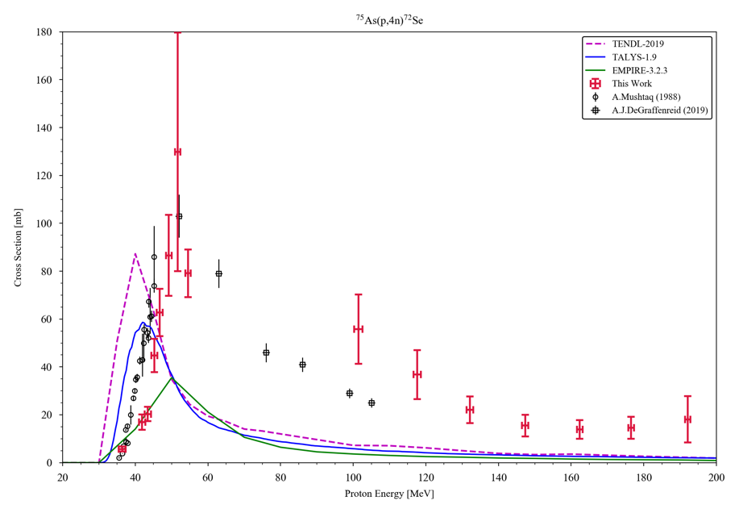
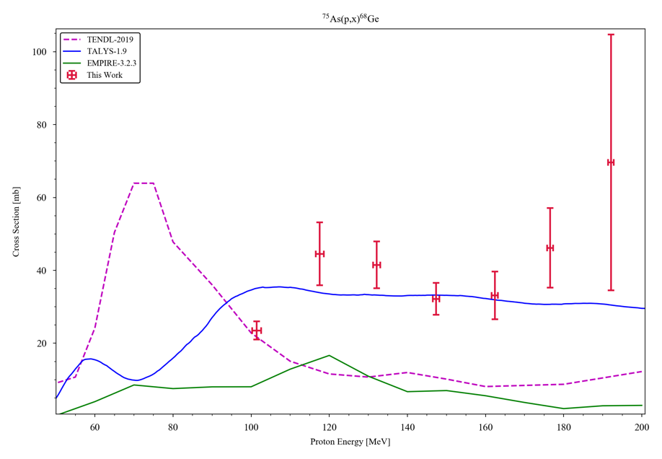
Our first joint effort with LANL-IPF and BNL-BLIP has centered on ⁷⁵As(p,x) with an emphasis on ⁶⁸Ge and ⁷²Se production (Morgan Fox)
⁷⁵As(p,4n)⁷²Se
⁷⁵As(p,x)⁶⁸Ge
The next reactions on the list are from protons on Sb
Notes:
Emphasis on the last sentence

