Slide 1
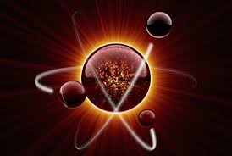
The 2019 Editions of the
ICSBEP and IRPhEP Handbooks
John D. Bess
Idaho National Laboratory
This presentation was prepared at Idaho National Laboratory for the U.S.
Department of Energy under Contract Number (DE-AC07-05ID14517)

Slide 2
Summary
ICSBEP Handbook available Sep 2019
IRPhEP Handbook available Dec 2019
Key benchmarks of interest to nuclear data:
  LCT099 – Ti cross section
  LCT103 – U7Mo (~20% ²³⁵U) plates
  KRITZ-LWR-RESR-004 – Rod lattices 20 – 250 ºC
  MSRE-MSR-RESR-001 – Molten salt & graphite
  TREAT-FUND-RESR-002 – Graphite & hydrogen sensitivity in fuel
See additional slide-pairs for slight additional information as desired

Slide 3
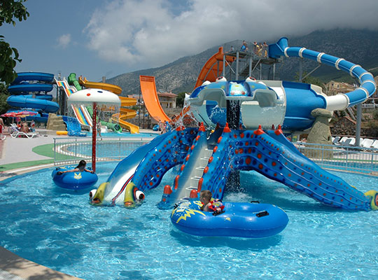
Extra Slides

Slide 4
International Handbook of Evaluated Criticality Safety Benchmark Experiments
September 2019 Edition
22 Contributing Countries
~70,000 Pages
577 Evaluations
  4,973 Critical, Near-Critical, or Subcritical Configurations
  45 Criticality-Alarm-Placement/Shielding Configurations
  237 Configurations with Fundamental Physics Measurements
  838 Unacceptable Experiment Configurations
http://icsbep.inl.gov/
https://www.oecd-nea.org/science/wpncs/icsbep/

Slide 5
International Handbook of Evaluated Reactor Physics Benchmark Experiments
2019 Edition
21 Participating Countries
56 Reactor Facilities
Data from 166 Experimental Series
  162 Approved Benchmarks
  4 DRAFT Benchmarks
Available ~Dec 2019
http://irphep.inl.gov/
http://www.oecd-nea.org/science/wprs/irphe/
Notes:
It is available, free of charge, to OECD NEA member countries via the weblinks.

Slide 6
New Approved Evaluation 1:
LEU-COMP-THERM-99
Sandia National Lab
  UO₂ fuel in water
  4.31 wt.% U-235
  17 critical configurations
  Ti and/or Al sleeves around fuel
Results
  Calculations with various modern codes/libraries within 1𝝈 to 2𝝈.

Slide 7
Titanium
Improvements
ENDF/B-VII.0
Results
  Calculations with various modern codes/libraries within 1𝝈 to 2𝝈.
Ti
ENDF/B-VII.1

Slide 8
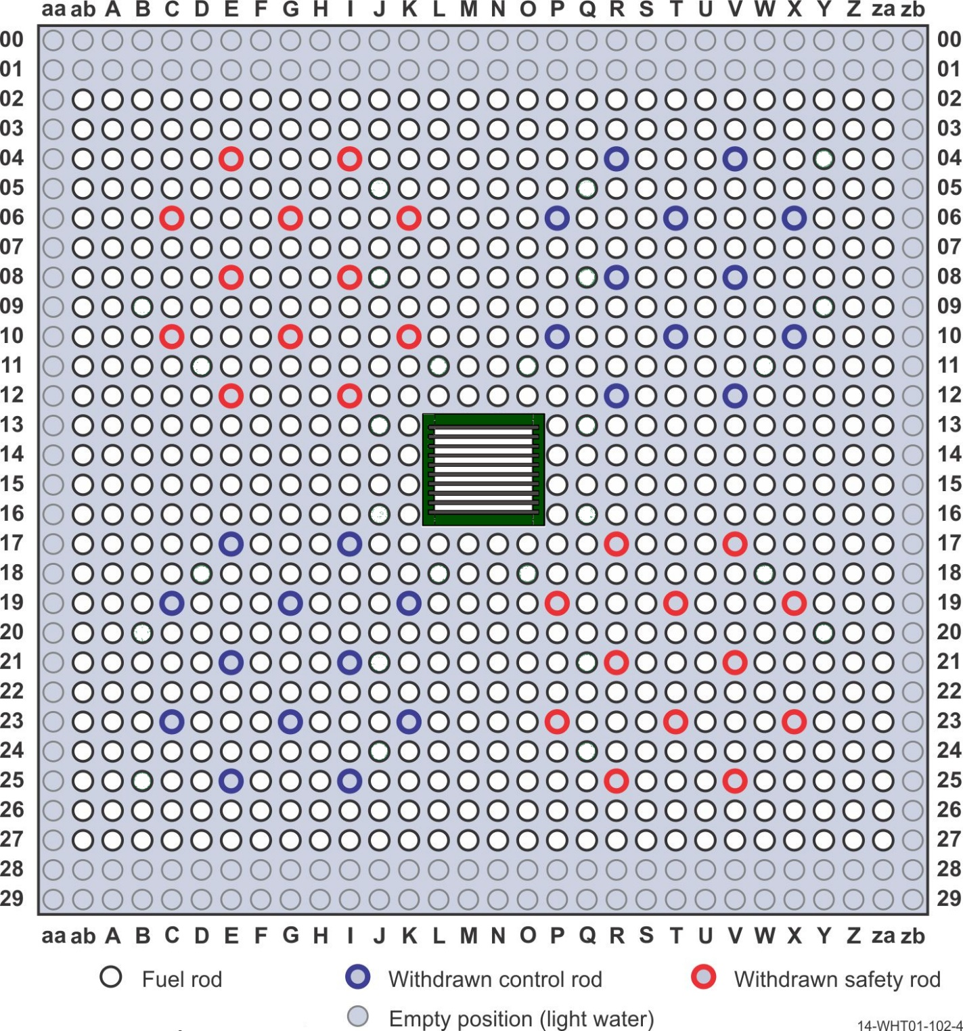
New Approved Evaluation 2:
LEU-COMP-THERM-103
MB-01 Reactor
  IPEN (Brazil)
  LWR w/ UO₂ rods (4.346 wt.% ²³⁵U)
  U7Mo (19.80 wt.% ²³⁵U) plates in core center
Part of an extensive series of benchmarks for this reactor facility

Slide 9
Results
Evaluated
  3 critical configurations
  MCNP5.1 w/ ENDF/B-VII.0 results within 1σ-2σ

Slide 10
New Approved Evaluation 3:
LEU-COMP-THERM-104
Studsvik KRITZ-1
  Sweden
  Various LWR lattices with T = 20 to 250 ºC
  Zr-2-clad UO₂ (1.35 wt.% ²³⁵U)
  Marviken Boiling Heavy Water Reactor (BHWR) fuel

Slide 11
Example Results
Evaluated
  Criticality
  Reactivity Worth
  Reactivity
  Coefficients
Criticality
  MCNP6 and ENDF/B-VIII.0
    Within 0.5 %
  SCALE 6.2.3 and ENDF/B-VII.1
    Within 0.7 %
  MONK 11A DEV and ENDF/B-VII.1
    Within 0.7 %

Slide 12
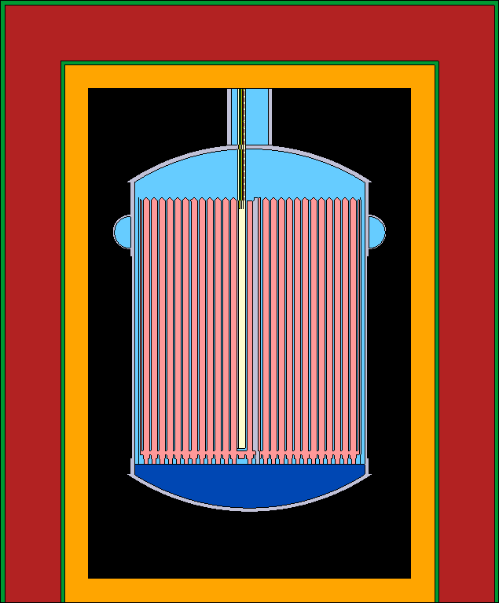
New Approved Evaluation 4:
MSRE-MSR-RESR-001
Molten Salt Reactor Experiment – ORNL
  U.C. Berkeley & ORNL (US)
  62.5LiF-31.6BeF₂-5.1ZrF₄-0.8UF₄
  1.408 wt.% ²³⁵U
  Graphite moderated
First MSR benchmark in IRPhEP Handbook
DOE-NE NEUP MS-NE-1

Slide 13
New Approved Evaluation 4:
MSRE-MSR-RESR-001
Evaluated
  Criticality
Most sensitive uncertainties
  Graphite density
  Li-6 enrichment
  Fuel salt density
Sensitive to graphite thermal scattering law data
Unknown if missing significant data biasing the model

Slide 14
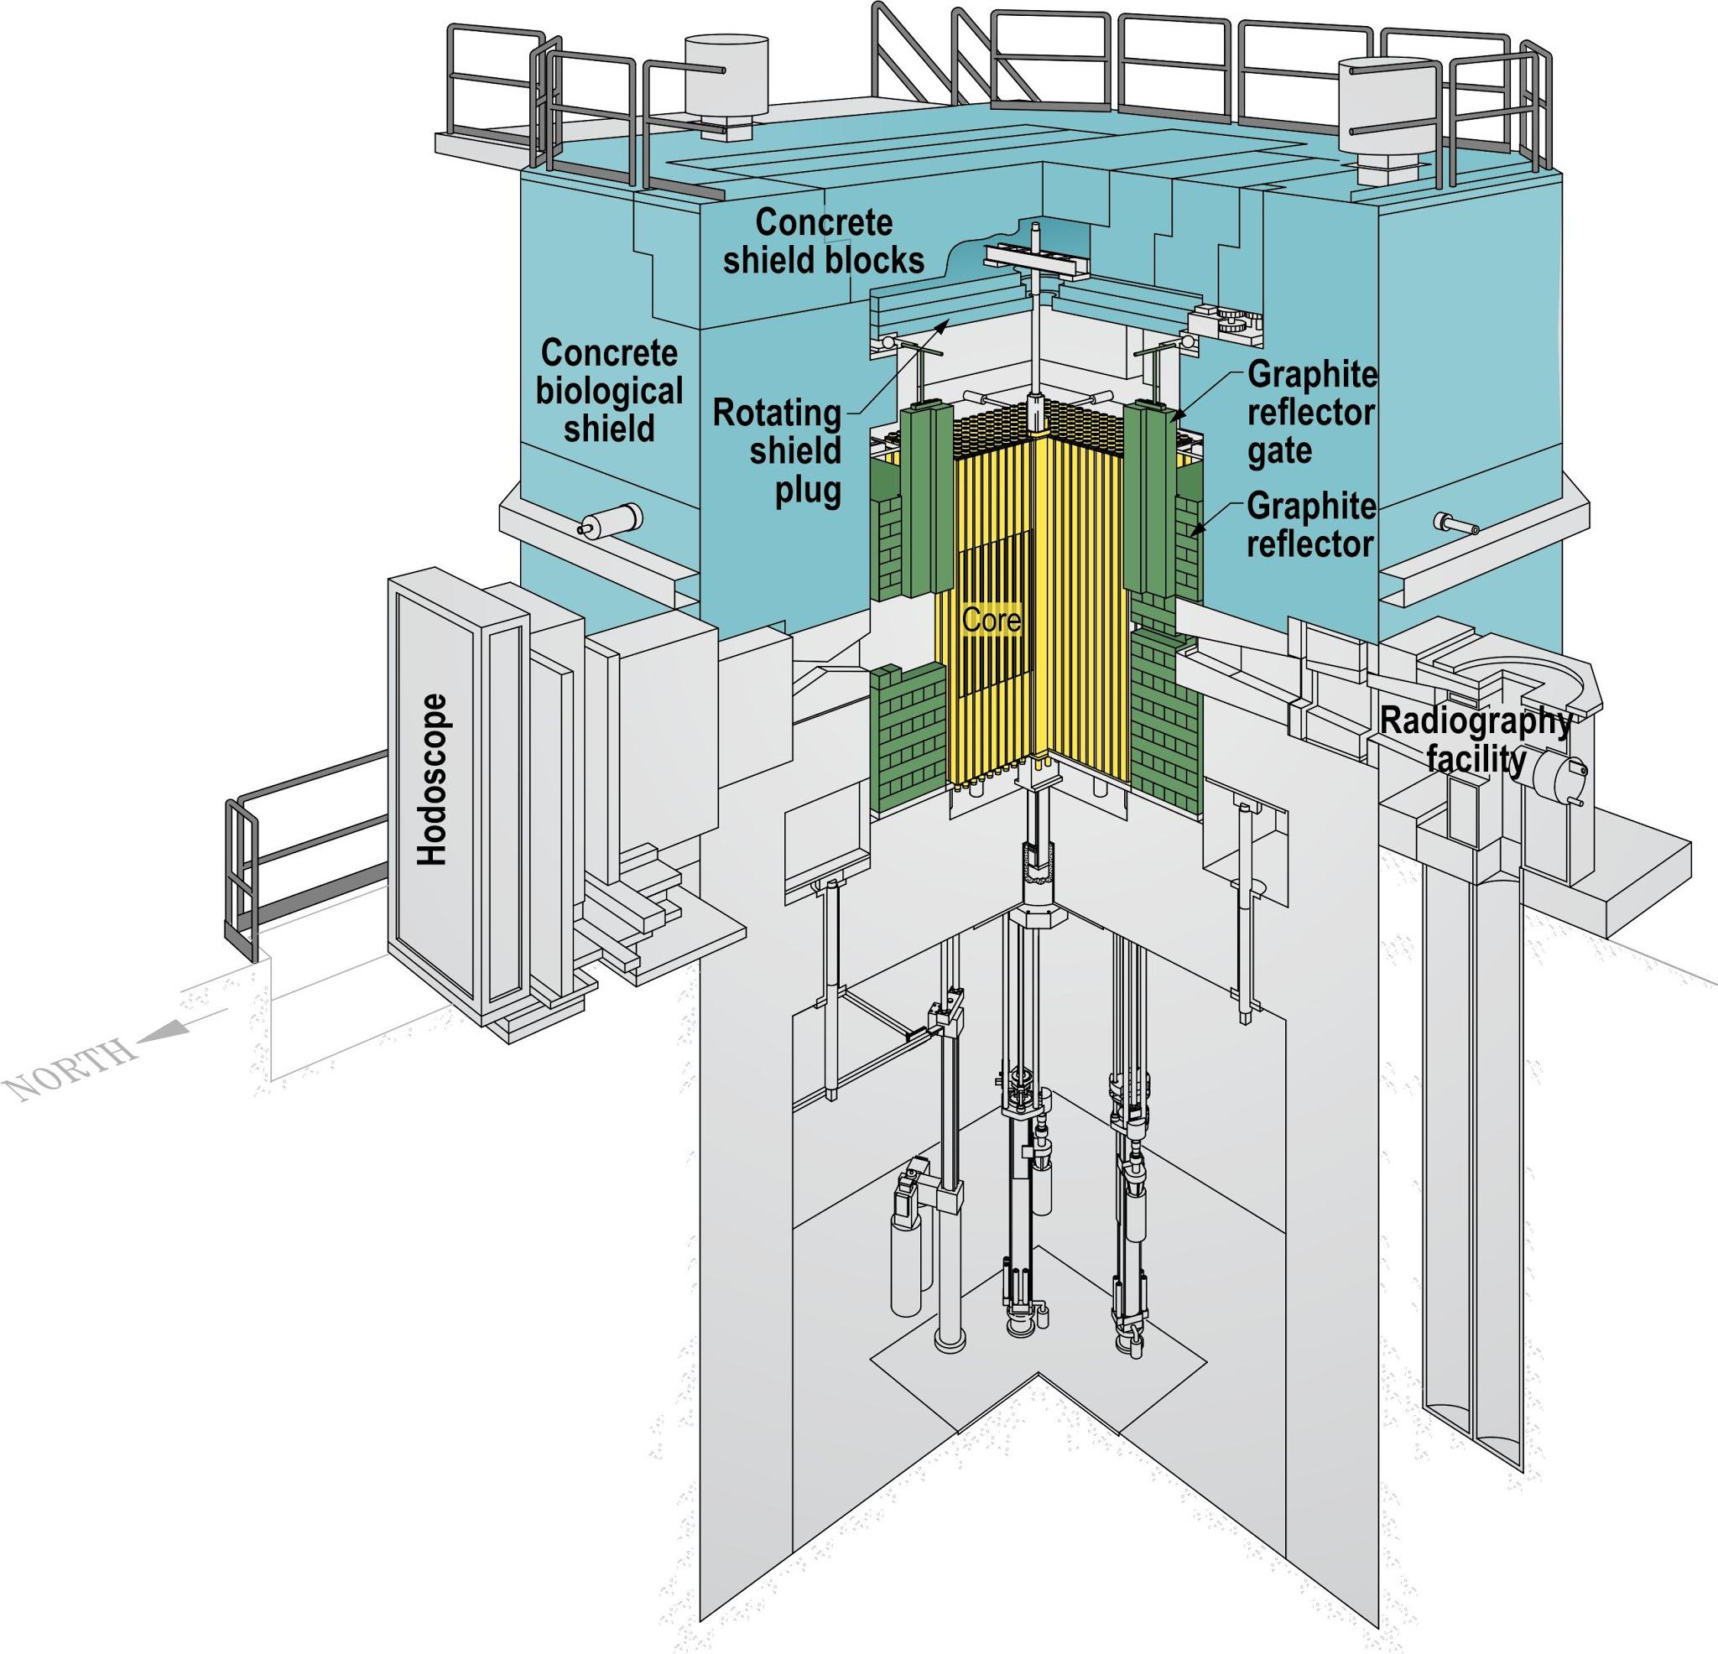
New Approved Evaluation 5:
TREAT-FUND-RESR-002
Transient Reactor Test Facility – INL
  U. Michigan (US)
  M8CAL Series
  Dilute HEU in graphite
  CP-2 graphite reflected
  Relevant to current TREAT core configurations
DOE-NE IRP

Slide 15
New Approved Evaluation 5:
TREAT-FUND-RESR-002
Evaluated
  Criticality
  Serpent w/ ENDF/B-VII.1 results within 1σ
  Large uncertainties in graphite boron and hydrogen content
Also sensitive to thermal scattering law data for graphite

