Slide 1
CSEWG Validation – Contribution from the IAEA
- Code validation for ACE
- Analysis of LCT benchmarks
- Temperature coefficient
- Iron evaluations
- Chromium evaluations
- ICSBEP/SINBAD
Andrej Trkov
International Atomic Energy Agency, Vienna, Austria

Slide 2
Scope
Report from the code-validation exercise for ACE libraries
Analysis of ICSBEP LEU-COMP-THERM benchmarks
Impact of U-235 on the temperature coefficient.
Iron evaluations
Chromium evaluations
News from ICSBEP/SINBAD

Slide 3
Code validation for generating ACE files
Background:
  IAEA Member States expressed desire to have a processing code independent of NJOY
  IAEA initiated an activity to develop a module for generating ACE files as a supplement to PREPRO → ACEMAKER
  Other codes with ACE capability were developed/announced
  In the meantime, NJOY became “open source”

Slide 4
Code validation for generating ACE files
Nine (9) codes have the capability to generate ACE files for neutrons above the thermal energy range
  NJOY – USA
  FUDGE - USA
  GRUCON – Russia
  FRENDY – Japan
  ACEMAKER/PREPRO – IAEA
  NECP-Atlas – China
  RULER – China
  GAIA – France
  GALILEE- France

Slide 5
No. ICSBEP Label Short name Common name
--------------------------------------------------------
1 HEU-MET-FAST-001 hmf001 Godiva
2 HEU-MET-FAST-002 hmf002-002 Topsy-002
3 HEU-MET-FAST-003 hmf003-001 Topsy-U_2.0in
4 HEU-MET-FAST-003 hmf003-002 Topsy-U_3.0in
5 HEU-MET-FAST-003 hmf003-003 Topsy-U_4.0in
6 HEU-MET-FAST-003 hmf003-010 Topsy-W_4.5in
7 HEU-MET-FAST-003 hmf003-011 Topsy-W_6.5in
8 HEU-MET-FAST-014 hmf014 VNIIEF-CTF-DU
9 HEU-MET-FAST-032 hmf032-001 COMET-TU1_3.93in
10 HEU-MET-FAST-032 hmf032-002 COMET-TU1_3.52in
11 HEU-MET-FAST-032 hmf032-003 COMET-TU1_1.742in
12 HEU-MET-FAST-032 hmf032-004 COMET-TU1-0.683in
13 IEU-COMP-FAST-004 icf004 ZPR-3/12
14 IEU-MET-FAST-007 imf007 Big_Ten(s)
15 IEU-MET-FAST-007 imf007d Big_Ten(detailed)
16 IEU-MET-FAST-010 imf010 ZPR-6/9(U9)
17 IEU-MET-FAST-012 imf012 ZPR-3/41
18 IEU-MET-FAST-013 imf013 ZPR-9/1
19 IEU-MET-FAST-014 imf014-002 ZPR-9/2
20 IEU-MET-FAST-022 imf022-001 FR0_3X-S
21 IEU-MET-FAST-022 imf022-002 FR0_5-S
22 IEU-MET-FAST-022 imf022-003 FR0_6A-S
23 IEU-MET-FAST-022 imf022-004 FR0_7-S
24 IEU-MET-FAST-022 imf022-005 FR0_8-S
25 IEU-MET-FAST-022 imf022-006 FR0_9-S
26 IEU-MET-FAST-022 imf022-007 FR0_10-S
27 MIX-MISC-FAST-001 mif001-001 BFS-35-1
28 MIX-MISC-FAST-001 mif001-002 BFS-35-2
29 MIX-MISC-FAST-001 mif001-003 BFS-35-3
30 MIX-MISC-FAST-001 mif001-009 BFS-31-4
31 MIX-MISC-FAST-001 mif001-010 BFS-31-5
32 MIX-MISC-FAST-001 mif001-011 BFS-42

Slide 6
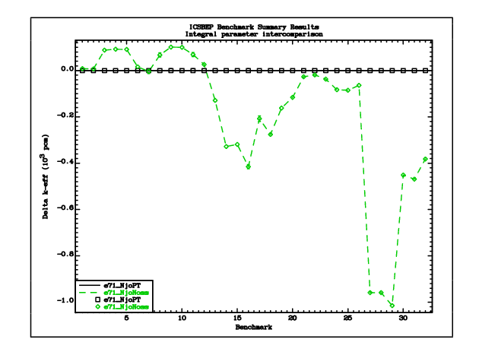
Importance of Self-Shielding

Slide 7
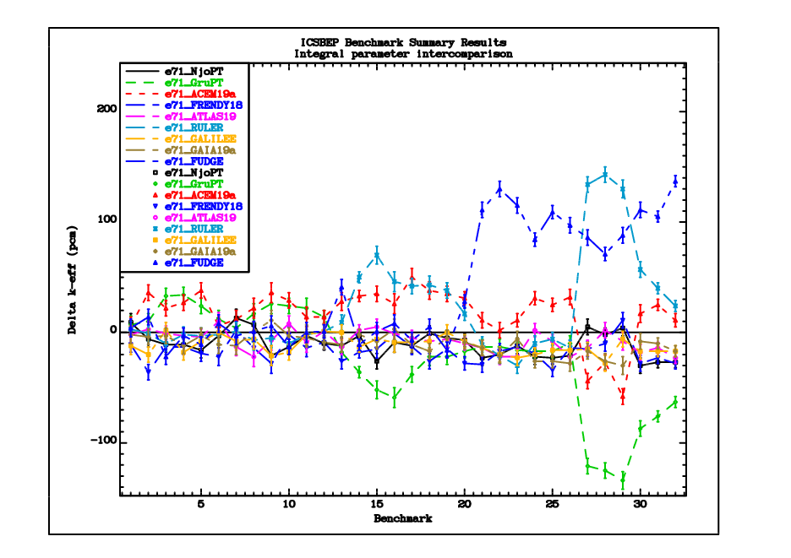

Slide 8
Conclusions on ACE Library Validation
Without self-shielding, all codes are capable of generating ACE files that produce results within 20 pcm (~10 pcm convergence criterion in MCNP)
With self-shielding included in the calculations, the preliminary results are within 100 pcm

Slide 9
ICSBEP LEU-COMP-THERM
ICSBEP-2018 contains 97 benchmarks, most of them include several cases
At the IAEA, the computational models are available for 338 cases (input models obtained from the Handbook, Skip Kahler or otherwise)
Some of the benchmarks show huge discrepancies, which can hardly be attributed to nuclear data
“e80” performance is similar to “e71”, except for LCT078, LCT080 and LCT096, where “e80” is distinctly worse (see cumulative χ²/DoF plot)

Slide 10
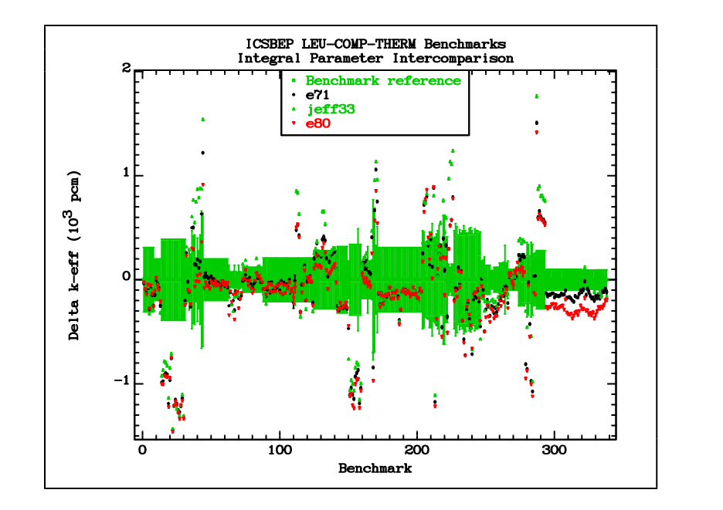

Slide 11
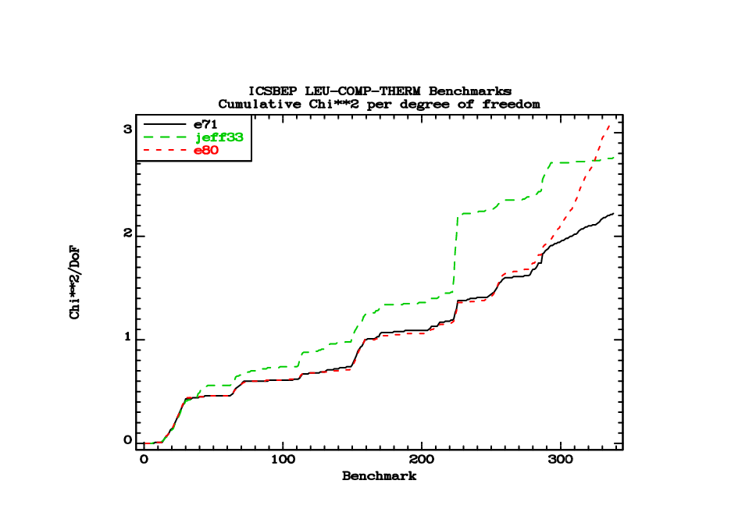

Slide 12
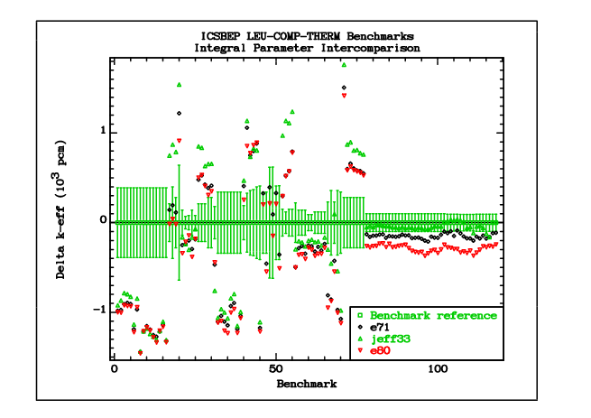
2-sigma outliers only
PNL-1.64cm pitch (LCT003,12)

Slide 13
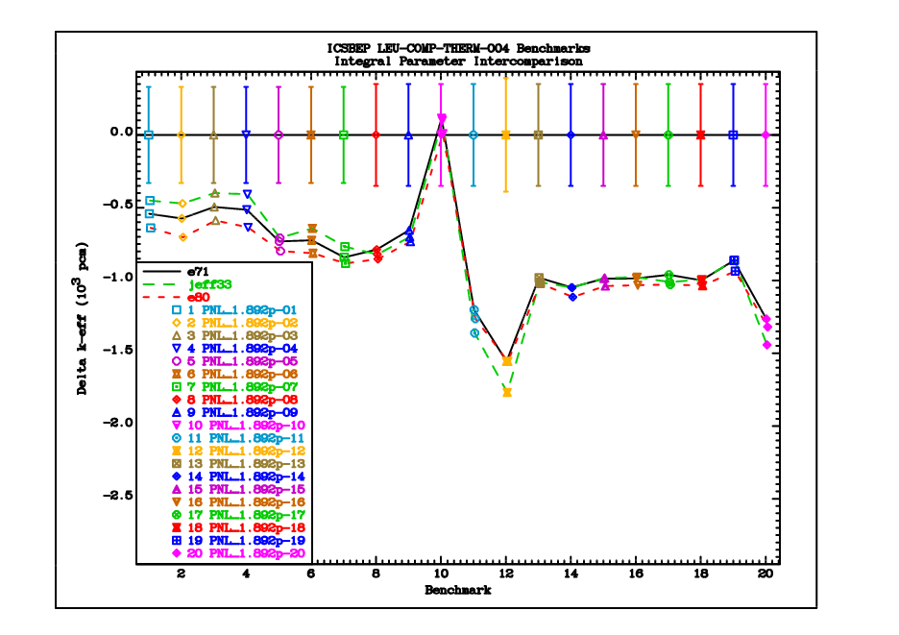
LCT004 Case-10 with NO Gd impurity is
the only one that agrees with the
measured k_eff

Slide 14
ICSBEP LEU-COMP-THERM - Rejected
LEU-COMP-THERM-003 (PNL_1.64p) ^{(*)}
LEU-COMP-THERM-004 (PNL_1.89p) ^{(*)}
LEU-COMP-THERM-009 (PNL_2.54p not an outlier - correlated with LCT010)
LEU-COMP-THERM-010 (PNL_2.54p_Pb-1)
LEU-COMP-THERM-012 (PNL_1.64p, correlation with LCT003?) ^{(*)}
LEU-COMP-THERM-022 (RRC-KI-0.70p_hx)
LEU-COMP-THERM-024 (RRC-KI-0.62p_hx)
LEU-COMP-THERM-025 (RRC-KI-0.80p_sq)
LEU-COMP-THERM-027 (Valduc-Pb)
LEU-COMP-THERM-042 (Fuel clusters, SS reflector, not an outlier)
LEU-COMP-THERM-052 (Valduc hx Gd)
LEU-COMP-THERM-064 (VVER_1.27p)
Temperature-dependent cases
The remainder comprises 207 cases
(*) Gd impurity is mentioned, which might not be there?

Slide 15
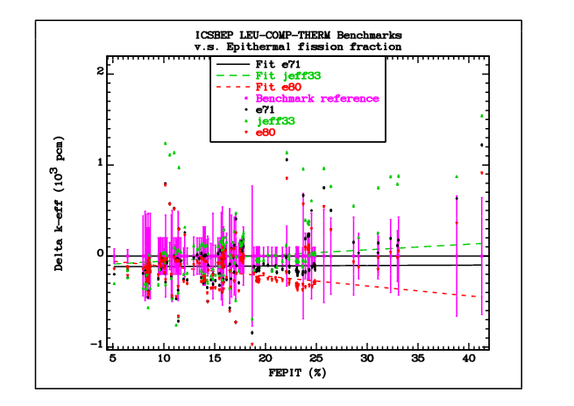

Slide 16
ICSBEP LEU-COMP-THERM-078, 080, 096
Why are “e80” results lower than “e71”?
  Processing: swap U-235,238 in “e71” with “e80b4” processed with ACEMAKER → no effect → neither processing nor U data are responsible for the difference
  TSL at room temperature: Swap “e80” tsl into “e71” library → slight increase in reactivity → TSL is not responsible for the large difference
  O-16:
    Swap O-16 from “e80” into “e71” → performance is degraded
    Swap O-16 from “e71” into “e80” → performance is restored (see “e80_O16”)
    Swapping O-16 from JEFF-3.3 instead of “e71” makes no difference.
    Swap elastic cross section below 0.3 MeV from “e71” into “e80” helps only in cases with softer spectra (see “e80_O16a” on next slide)
    Proof that O-16 is the reason for the degraded performance!
    The problem is not limited to the cross sections in the low-energy range, although soft-spectrum assemblies are affected slightly more

Slide 17
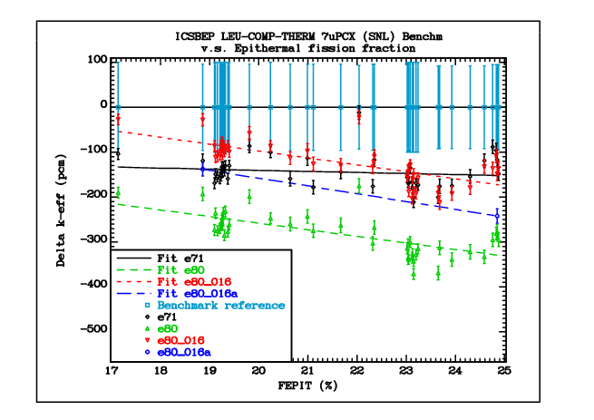

Slide 18
DICE sensitivities on k_eff for LCT096 cases 1, 19
Case | Nuclide | Reaction | Thermal | Epithermal | Fast | Total
LEU-COMP-THERM-096-019 | H1 | capture | -0.1369 | -0.0054 | 0.0000 | -0.1423
LEU-COMP-THERM-096-001 | H1 | capture | -0.0744 | -0.0048 | 0.0000 | -0.0792
LEU-COMP-THERM-096-001 | O16 | elastic | -0.0014 | 0.0206 | 0.0734 | 0.0926
LEU-COMP-THERM-096-001 | H1 | elastic | -0.0199 | 0.2774 | 0.2018 | 0.4593
LEU-COMP-THERM-096-019 | H1 | elastic | -0.0610 | 0.2199 | 0.2065 | 0.3654
LEU-COMP-THERM-096-019 | O16 | elastic | -0.0036 | 0.0192 | 0.0692 | 0.0848
LEU-COMP-THERM-096-001 | Al27 | elastic | -0.0005 | 0.0035 | 0.0140 | 0.0170
LEU-COMP-THERM-096-019 | Al27 | elastic | -0.0003 | 0.0027 | 0.0111 | 0.0135

Slide 19
HEU-SOL-THERM O-16 impact on ATLF
Flat dependence on ATLF of HST was one of the constraints for ENDF/B-VIII.0
Swapping O-16 from ENDF/B-VII.1 increases the reactivity bias and increases the gradient slightly, but not excessively

Slide 20
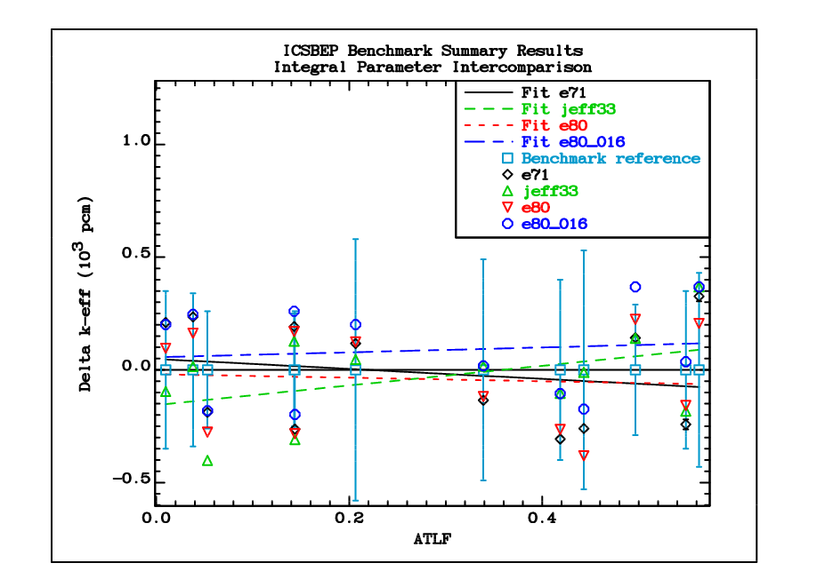

Slide 21
Coefficients of the polynomial fit
Parameter Library Coefficients
k-eff e71 4.83E+1 -2.21E+2
k-eff jeff33 -1.56E+2 4.35E+2
k-eff e80 -1.95E+1 -7.68E+1
k-eff e80_O16 5.59E+1 1.09E+2

Slide 22
Temperature Coefficient due to U-235
Oscar Cabellos showed a potentially alarming plot of a reactivity decrease with increasing enrichment using ENDF/B-VIII.0 data for the Mosteller pin-cell benchmark (~600 pcm at 5% enr.)
The plot shows there is a difference between “e80” and “e71”, but it does not say which one is less wrong.
Candidate benchmarks for temperature coefficient:
  HCT016: IGR-graphite up to T=600 deg.C
  LCT026: IPPE-MATR (water) up to T=~231 deg.C
  There are more benchmarks in ICSBEP with lower span of T
  KRITZ (KRITZ-1 = LEU-COMP-THERM-104, to be included in the next release of ICSBEP)

Slide 23
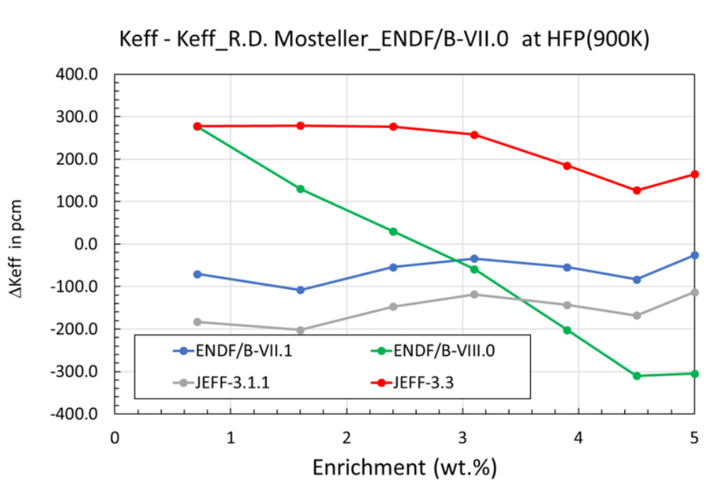

Slide 24
Slide by Y. Danon at the 2018 INDEN Meeting

Slide 25
Temperature coefficient (Cont.)
HCT016:
  Need ACE files at high temperature, ACE Fast and TSL have different temperature grids
  Ambiguity about which graphite TSL to use
KRITZ:
  WIMS-D (1D/buckling) quick test (contributed by O. Cabellos) does not show any degraded performance of ENDF/B-VIII.0
  KRITZ-1 will be in ICSBEP LEU-COMP-THERM-104, but not in 2019 edition (private communication with Dennis Mennerdahl shows no clear indication of ENDF/B-VIII.0 deficiency).

Slide 26
Temperature coefficient (Cont.)
LCT026:
  Light water array up to ~200 deg.C (=~480 K)
  “e80” calculation done at 293.6K and 600 K
  K_eff interpolated as 1/sqrt(T)
  Flat prediction of reactivity with “e71” and “e80”
There is no observable difference with respect to temperature effects between “e71” and “e80” in this benchmark

Slide 27
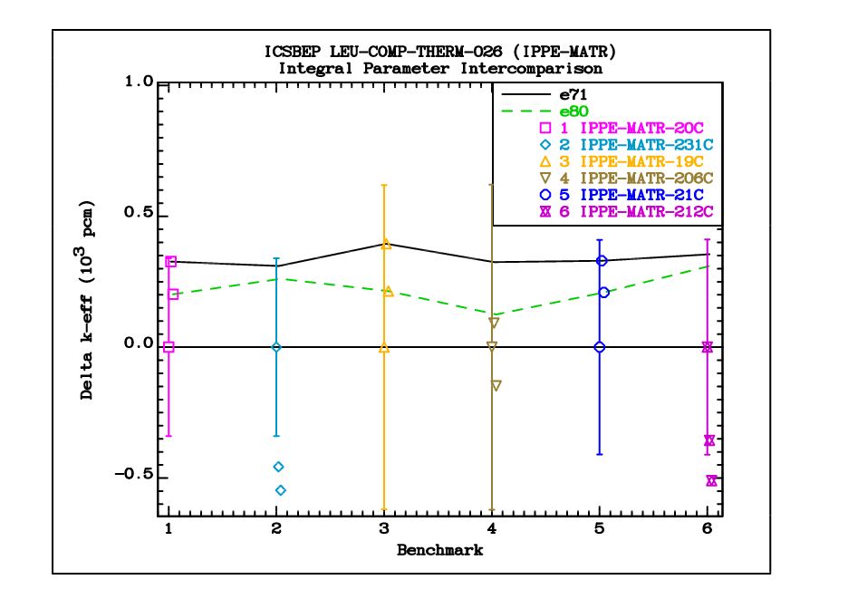

Slide 28
Iron cross sections
CIELO=ENDF/B-VIII.0 evaluation
Inelastic cross sections from Geel by Negret
Leakage spectra from thick spheres with ²⁵²Cf source are under-predicted by up to 40% from 2 MeV to 6 MeV (shown by Simakov just before the release of ENDF/B-VIII.0)
Patch to the Fe-56 is available that
  Shows good performance in leakage spectra from thick spheres
  Removes some deficiencies (e.g. near 300 keV)
New resonance evaluation is needed (some progress was made with L. Leal, including direct capture contribution)

Slide 29
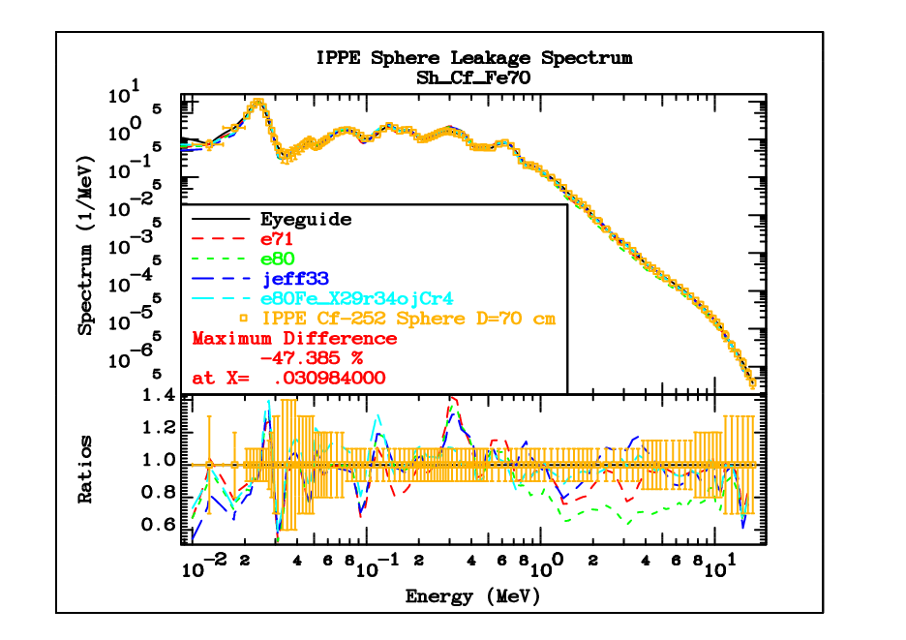

Slide 30
Chromium cross sections
There is a problem with the ~5 keV resonances in ^{50,53}Cr
Raw measurements from ORNL/JRC and RPI agree in shape, but differ strongly after multiple scattering corrections
ZPR-6/10 benchmark is highly sensitive to Cr cross sections near 5 keV
New measurement is needed to resolve the discrepancy in measured data? (e.g. Lead-Slowing-Down measurement)

Slide 31
News from ICSBEP (from J. Bess)
ICSBEP Handbook available Sep 2019
IRPhEP Handbook available Dec 2019
Key benchmarks of interest to nuclear data:
  LCT099 – Ti cross section
  LCT103 – U7Mo (~20% ²³⁵U) plates
  KRITZ-LWR-RESR-004 – Rod lattices 20 – 250 ºC
  MSRE-MSR-RESR-001 – Molten salt & graphite
  TREAT-FUND-RESR-002 – Graphite & hydrogen sensitivity in fuel
See additional slide-pairs on the CSEWG 2019 web site for more information

Slide 32
Conclusions
Code validation for ACE was successful (9 codes)
LEU-COMP-THERM-078, 080, 096 benchmarks show sensitivity to oxygen data
Lower elastic cross sections below 0.3 MeV in “e80” are only partly responsible for the negative bias in reactivity
Higher absorption cross sections in “e80” (e.g. the alpha-emission) most probably affect assemblies with harder spectra
Before re-tuning ENDF/B-VIII it is essential to sort out the oxygen cross sections in the MeV energy region

Slide 33
Conclusions (Cont.)
Strong decrease of reactivity at higher temperatures as a function of enrichment with ENDF/B-VIII.0 data shown by O. Cabellos was alarming
  Preliminary analysis of LCT026 benchmark (up to 231 deg.C) does not show any degraded performance of ENDF/B-VIII.0
  More data testing is needed.
Patched to ⁵⁶Fe were made,
  new resonance evaluation is warranted
Problems with ^{50,53}Cr resonance remain,
  new measurement is needed to resolve contradicting measurements
New release of ICSBEP and IRPhE handbooks

