Slide 1
Validation of H-H₂O at Elevated Temperatures using Diffusion Experiments
Mike Zerkle
Jesse Holmes
Cross Section Evaluation Working Group
Brookhaven National Laboratory
November 4-6, 2019

Slide 2
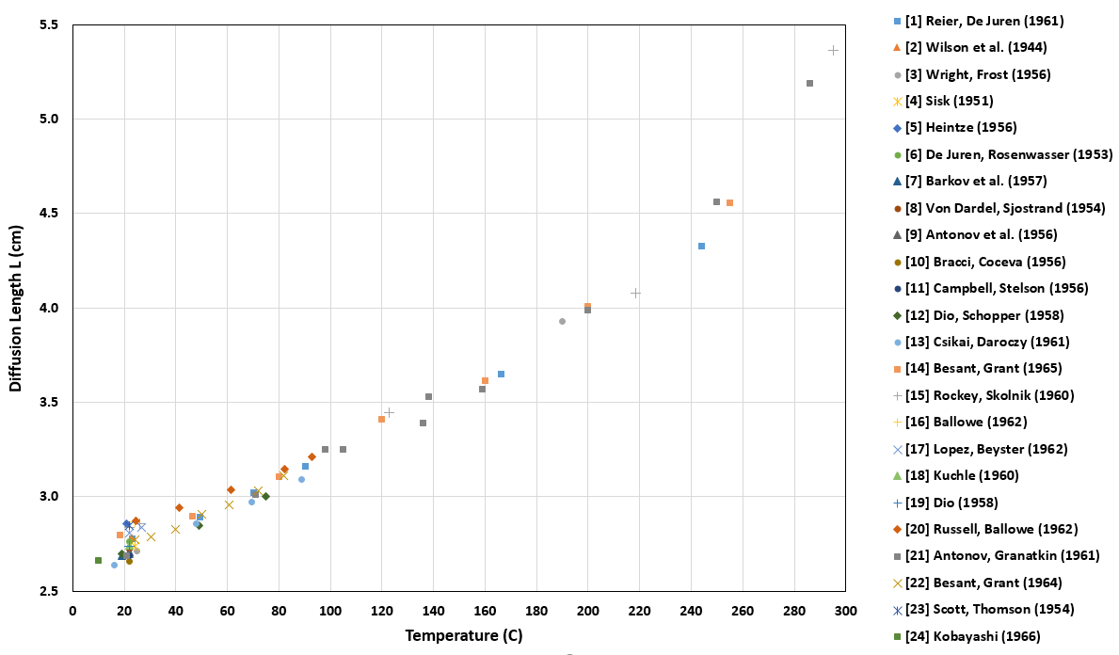
Compilation of Historical Thermal Neutron Diffusion Length (L) Measurements for Water
These experimental results are a based on either the pulsed-neutron die-away (PNDA) method or the static relaxation length method.
Both methods (in theory) should give the same result for L.
Quoted uncertainties are approximately the widths of the markers and are not shown.

Slide 3
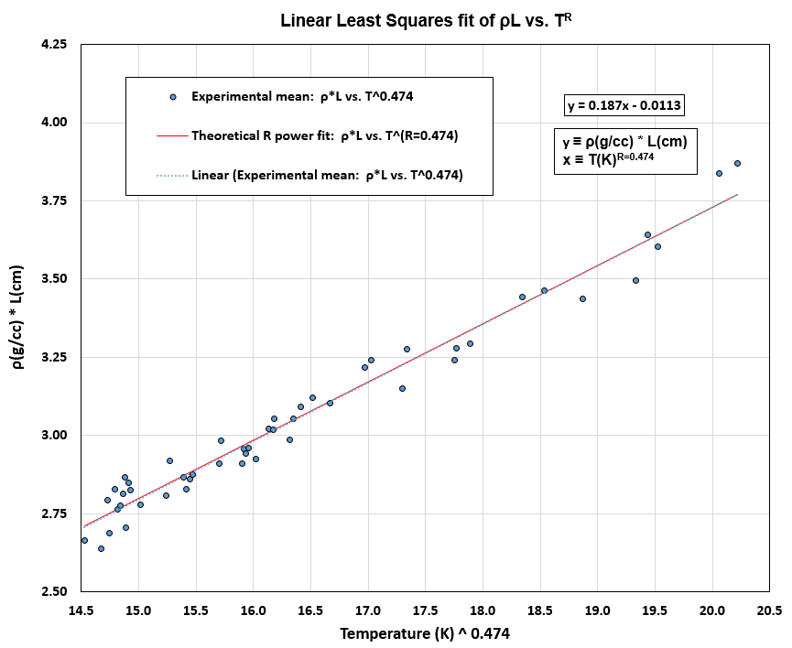
Linear and Power Fit Based on 24 Publications
LINEAR FIT
The parameter R was iteratively adjusted in T^{R} so that the theoretical ρL=T^{R} curve matched the linear best fit of experimental data plotted as ρL=T^{R}. The best solution for R is 0.474.
The experimental scatter greatly exceeds that which would be consistent with quoted uncertainties alone.
However, fitting over data from 24 different publications likely greatly reduces any net methods bias in the fit.

Slide 4
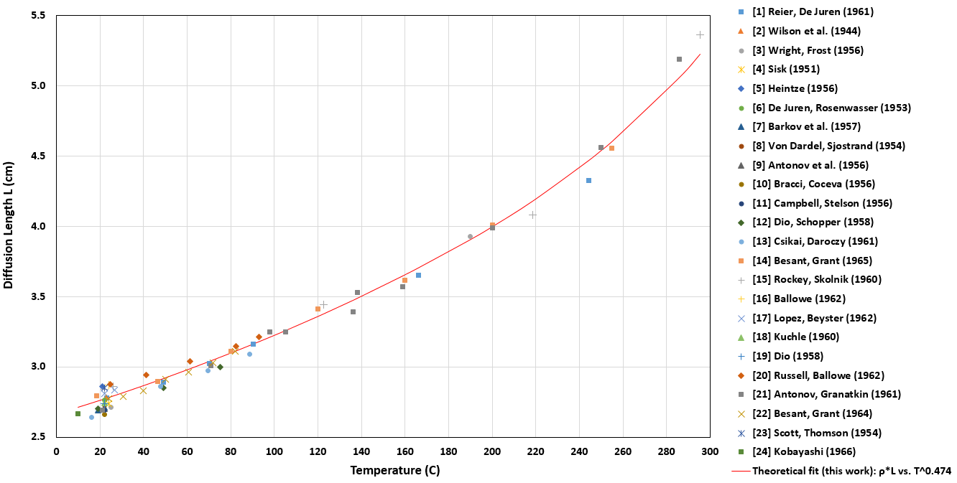
Experimental Data Compared to Power Fit
Theoretical fit for ρL=T(K)^{0.474} with curve
“pinned” at 22 C based on the weighted mean
of diffusion length measurements from 11
different publications (L = 2.770 cm).

Slide 5
Calculating L with MC21 PNDA Simulations
PNDA flux decay: $φ\left(r,t\right)=φ0 {(r)e}^{−αt}$; fundamental eigenvalue α computed with MC21 simulations
$α = vΣa+vDB_{g}^{2} –{CB}_{g}^{4}+O(B_{g}^{6})≈a_{0}+D_{0}x+Cx^{2}$ for $x=B_{g}^{2}$
$L≈\sqrt{\frac{D_{0}}{2a_{0}}\left(1+\sqrt{1+\frac{4a_{0}C}{D_{0}^{2}}}\right)}≈\sqrt{\frac{D_{0}}{a_{0}}+\frac{C}{D_{0}}}≈\sqrt{\frac{D}{Σa}}$
Geometric buckling for spheres: ${B_{g}^{2}=\left(\frac{π}{r+z}\right)}^{2}$.
$z$ is approximately proportional to $λ_{tr}$ and is computed at 22 C by Sjostrand (1977) for water spheres (with corrections for small geometries).
$λ_{tr}$ is approximately proportional to $D$, and $L≈\sqrt{\frac{D}{Σa}}$.
The ratio of L at an arbitrary temperature to L at 22 C can be computed from the previously given fit.
The expected $D$, $λ_{tr}$, and $z$ for any temperature can now be computed (accounting for density change), allowing $B_{g}^{2}$ to be determined for water spheres of arbitrary radii and temperature.
Finally, calculated $α$ can be plotted vs. $B_{g}^{2}$ for many water spheres of varying radii, and then L can be computed by solving for the coefficients $a_{0}$, $D_{0}$, and $C$ with a quadratic fit.

Slide 6
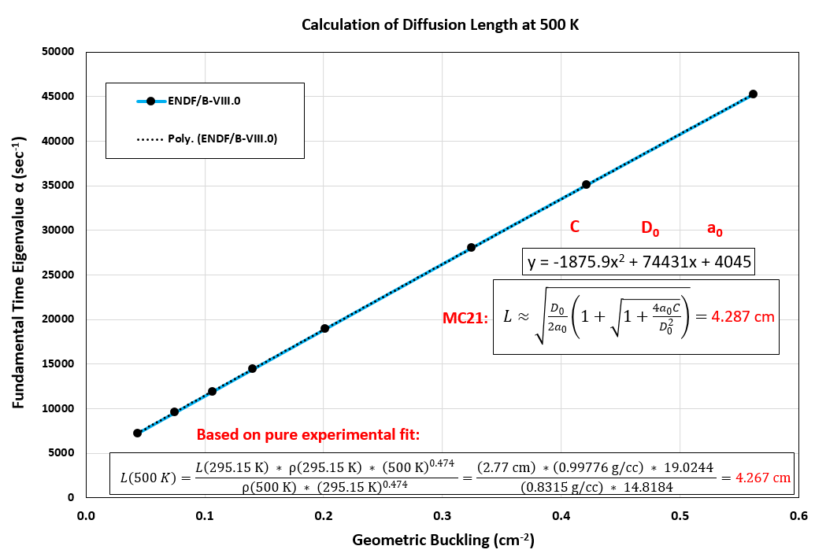
500 K MC21 Calculation Compared to Prediction by Pure Experimental Fit
Difference between MC21 result and pure experimental fit result for 500 K is 0.5%.
The uncertainty in MC21-calculated L due to ENDF uncertainty in σ_{a}(¹H) is 0.9%.

Slide 7
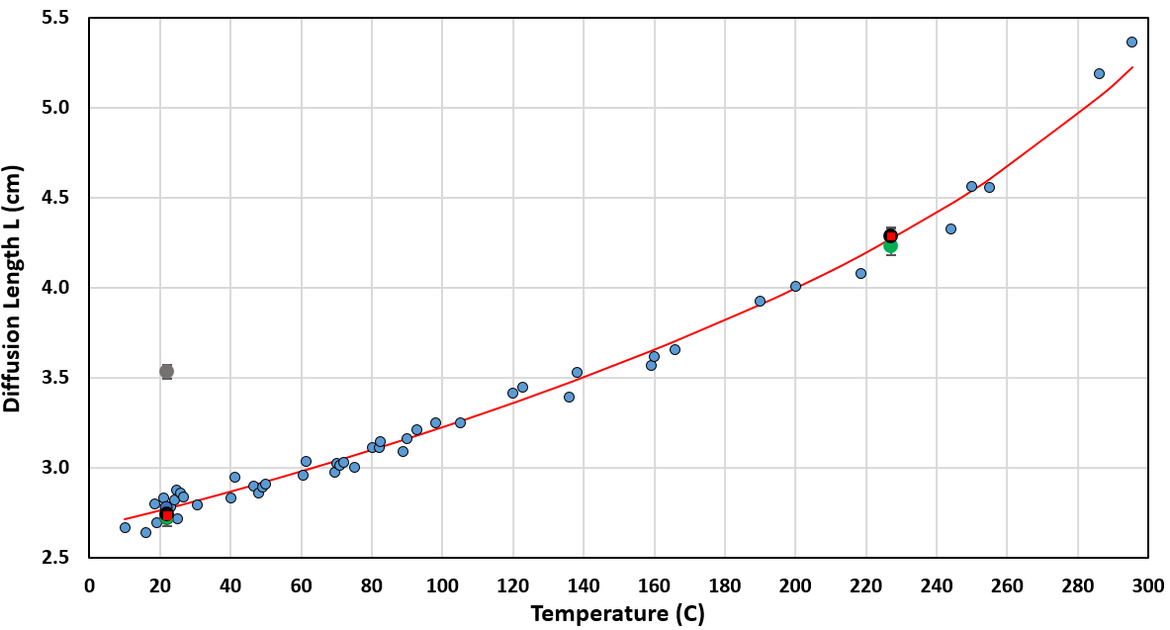
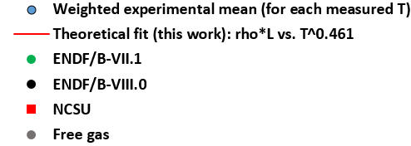
Room Temperature and 500 K Results for Several H-H₂O TSL Evaluations
T (C) | TSL evaluation | L (cm) | % diff. from exper.
22 | EXPERIMENTAL FIT | 2.770
22 | ENDF/B-VII.1 | 2.714 | -2.0
22 | ENDF/B-VIII.0 | 2.738 | -1.2
22 | NCSU | 2.735 | -1.3
22 | FREE GAS | 3.532 | 27.5
227 | EXPERIMENTAL FIT | 4.267
227 | ENDF/B-VII.1 | 4.232 | -0.8
227 | ENDF/B-VIII.0 | 4.287 | 0.5
227 | NCSU | 4.283 | 0.4
T^0.474

