Slide 1
Evolution of the ICSBEP and the Need for Modern Benchmarks and Experiments
Presented at the
2019 Cross Section Evaluation Working Group
November 4-6, 2019
Catherine Percher
Soon Kim
David Heinrichs

Slide 2
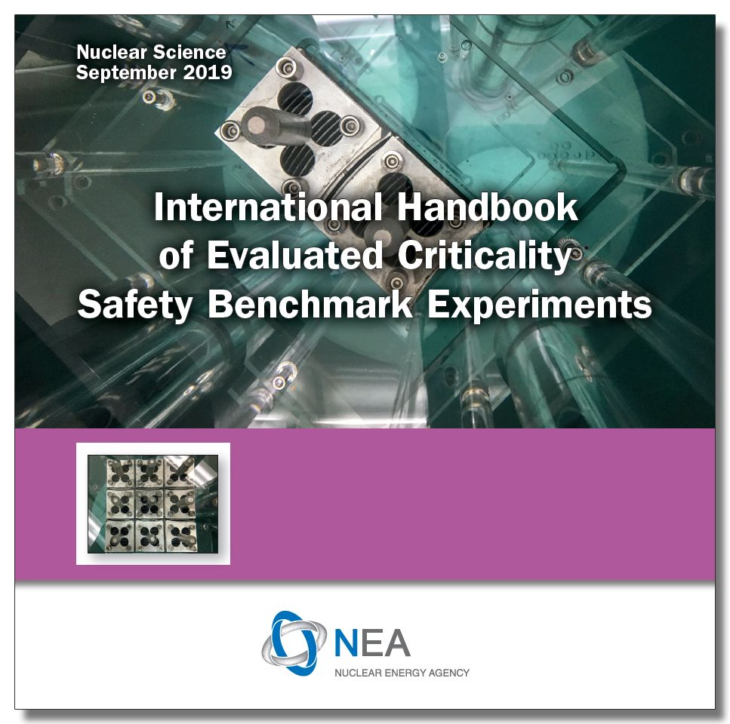
International Criticality Safety Benchmark Evaluation Project
1992- Criticality Safety Benchmark Evaluation Project (CSBEP)
Founded by DOE Defense Programs to provide standardized benchmarks for criticality safety validation
1995- CSBEP became ICSBEP
Official activity of the Organization for Economic Cooperation and Development’s (OECD) Nuclear Energy Agency
4973 critical, near-critical, and subcritical configurations
748 Plutonium configurations
589 are thermal plutonium solution cases
116 fast metal cases
1426 HEU configurations
886 are thermal uranium solution cases
424 fast metal cases

Slide 3
Critical Benchmarks and Sources of Uncertainty
Critical Experiments- Controlled assemblies of nuclear material designed to just achieve the critical point (or slightly lower/higher)
Critical Benchmarks- Computer simulations of the real critical experiment
Uncertainties
Experimental: How certain are the experimenters of the k_{eff} reported?
Uncertainty in measurement technique, reproducibility measurements, etc
Usually small contribution
Benchmark Model Uncertainties: How certain are the evaluators of the benchmark model k_{eff}? Model vs. Reality
Uncertainties from mass (are all masses or densities well known?), dimensions (were all parts measured? How do they fit together?), and composition (what are the constituents of all parts, including impurities?)
Usually majority contribution

Slide 4
Not All Benchmarks are Created Equal
Criticality safety validation driving force behind evaluations
Most experiments evaluated decades later by non-experimentalists
ICSBEP expectations have evolved over time
Earlier evaluated benchmarks tend to be more brief
Many evaluated benchmarks are missing major sources of uncertainties
Computer power was limited, more reliance on simplified geometries
Example: PU-MET-FAST-001 (Jezebel) Section | Revision 2 pages (2007) | Revision 4 pages (2016) | Increase
1 (Experimental Data) | 6 | 33 | x5
2 (Experiment and Uncertainty Evaluation) | < 1 | 40 | x40
3 (Benchmark Model) | 3 | 46 | x15
4 (Sample Calculations) | 1 | 8 | x8
Appendix (Supporting Documentation) | 5 | 46 | x9

Slide 5
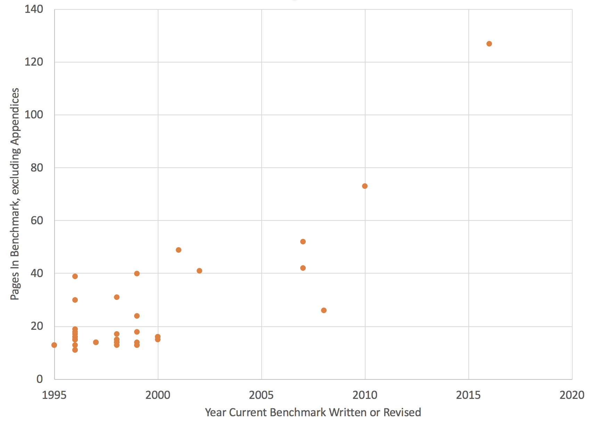
Total Page Count for Fast Pu Metal Cases over Time (excluding appendices- sample inputs, etc)

Slide 6
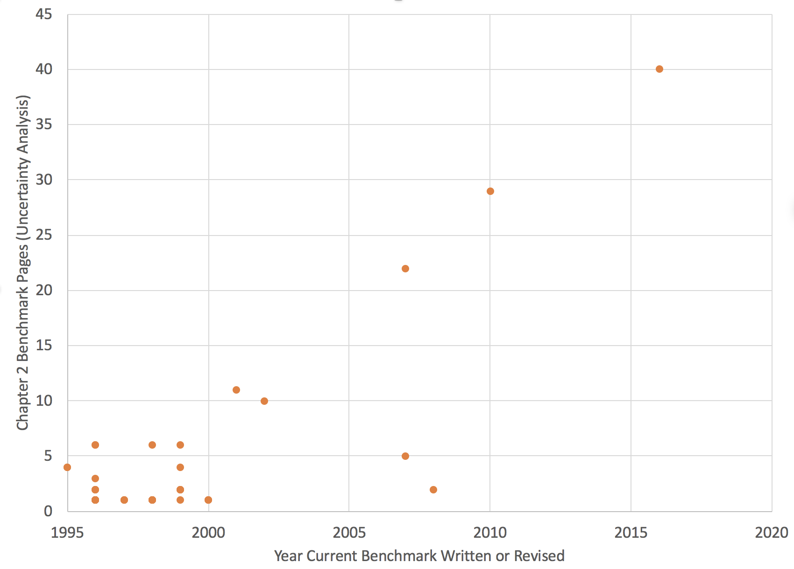
Uncertainty Analysis for Fast Pu Metal Cases over Time (Length of Section 2)

Slide 7
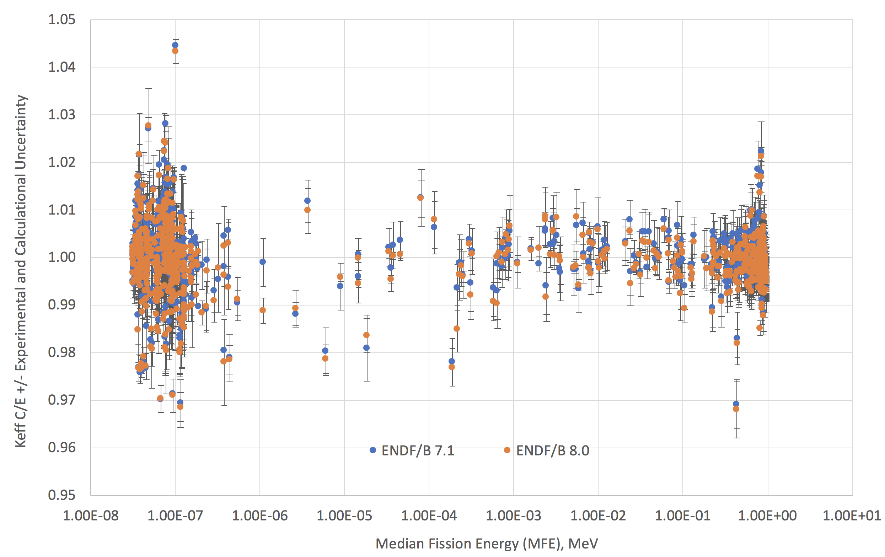
ICSBEP HEU Benchmarks Overview
Thermal
886 Cases
7% Spread
116 Intermediate/Mixed
3% Spread
Fast
424 Cases
4% Spread

Slide 8
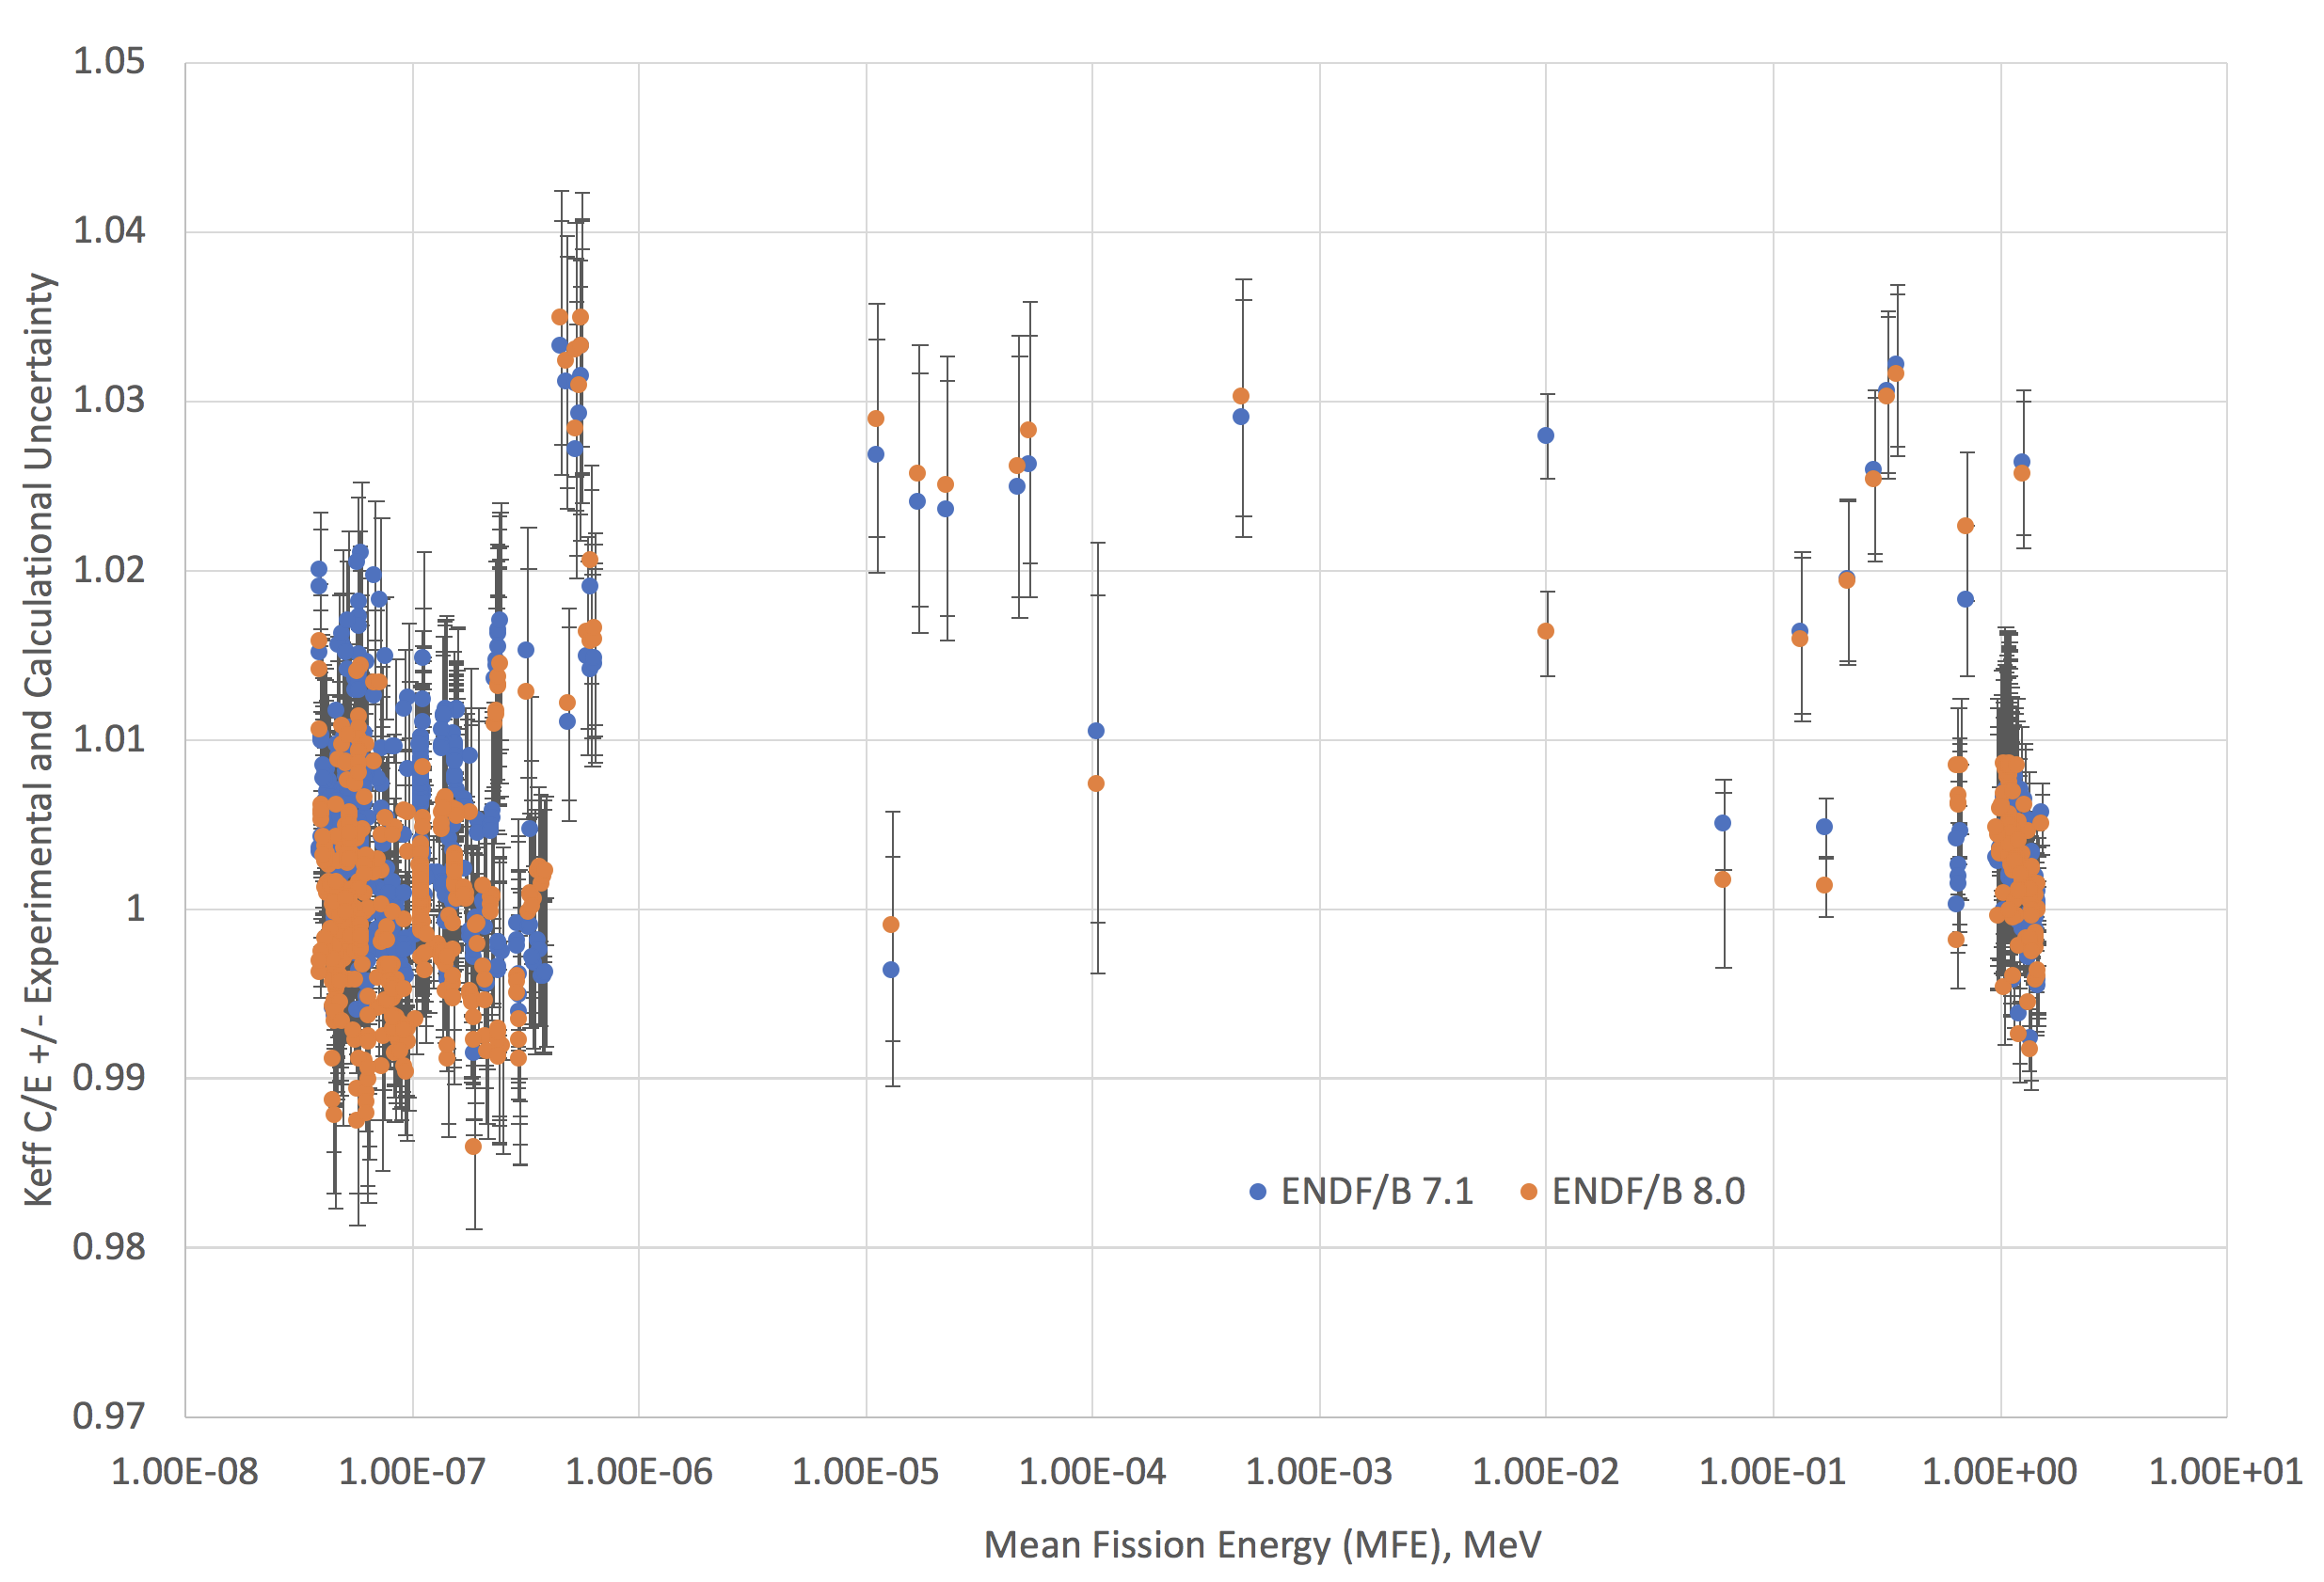
ICSBEP Pu Benchmarks Overview
Thermal
589 Cases
3% Spread
43 Intermediate/Mixed
4% Spread- Very Sparse Coverage
Fast
116 Cases
2% Spread

Slide 9
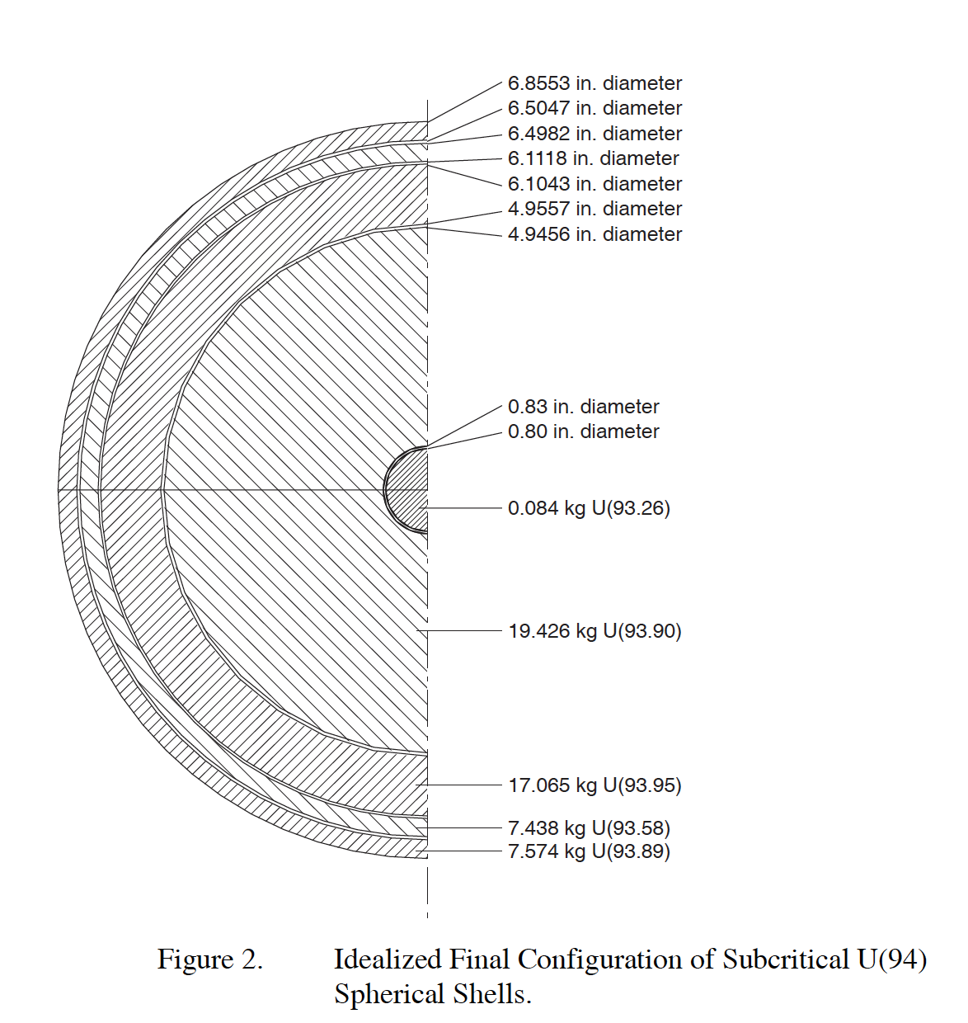
HMF-001, “Godiva”
Benchmark is subcritical shell experiments completed to inform Lady Godiva design
“Uncertainties” are only experimental- from extrapolation to idealized critical sphere from subcritical shells
Shell radii were not well known!
Missing MAJOR Uncertainties:
Uranium Mass
Dimensions of shells
Uranium composition
100 pcm uncertainty is likely not right

Slide 10
ZPR/ZPPR Examples
Many examples of ZPR/ZPPR benchmarks, very complicated honeycomb drawer configurations comprising thousands of fissile, diluent, and reflector plates
Benchmarks use nominal plate sizes with simplified geometries (smeared densities, no streaming paths)
No analysis of dimensional uncertainties
Modeled as 0.125” by 2” by 3”
Modeled as 0.117” by 1.993” by 3.002”
PANN Plate From PU-MET-INTER-004
PANN Plate From PU-MET-MIX-002

Slide 11
ICSBEP- September 2019 Edition
Even with 748 Plutonium configurations, only fast and thermal regimes are well represented
589 are thermal plutonium solution configurations, 530 cases are >80% thermal
116 fast metal cases, 82 are >80% fast
Only 35 have intermediate fission fractions > 30%
4 modern BFS configurations (Russia, IPPE)
1 k_{inf} measurement (UK, small sample reactivity measurement)
3 Zero Power Reactor (ZPR) configurations (USA, Argonne Reactor Mock-ups)
27 are plutonium oxide polystyrene compacts (USA, Hanford Poly Block experiments)

Slide 12
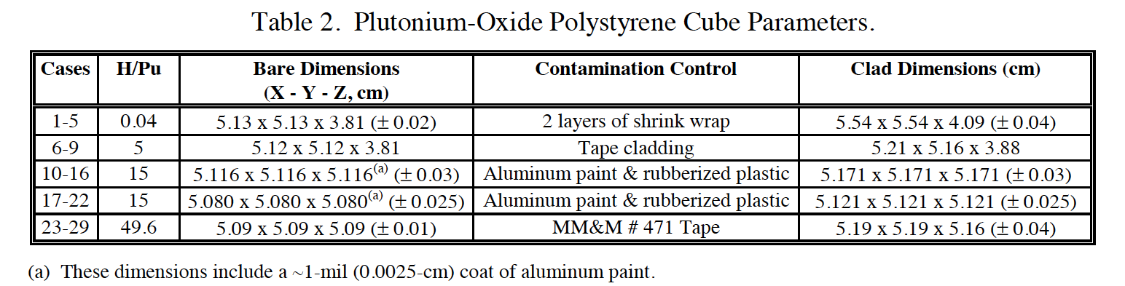
Majority of Intermediate/Mixed Cases are Suspect
Pu-Comp-Mixed-001 and -002, Unreflected and Plexiglass-Reflected Slabs of Polystyrene-Moderated Plutonium Oxide
34 cases, 1960’s experiments evaluated in 1999
Only loose Pu oxide benchmarks- considered important for criticality safety
These benchmarks calculate very poorly (C/E values of 1.02-1.04)
Likely due to unquantified uncertainties- tape around boxes, compact densities, heterogeneity, thermal expansion, loss of hydrogen due to radiolysis

Slide 13
What Does This Mean for Nuclear Data Users?
Use caution when relying on a benchmark to inform nuclear data- Read the evaluation and use your judgement
New OECD Working Party for Nuclear Criticality Safety (WPNCS) Subgroup 8- Preservation of Expert Knowledge and Judgement Applied to Criticality Benchmarks
New Subgroup approved in Sept 2019
Capture historical and tribal knowledge of benchmark issues
Ultimate goal to “grade” ICSBEP benchmarks, similar to past efforts related to differential measurements
Will Wieselquist (ORNL), Chair
Will help identify candidates for re-evaluation
Prioritize and complete new, modern experiments that can undergo full uncertainty and correlation assessment

Slide 14
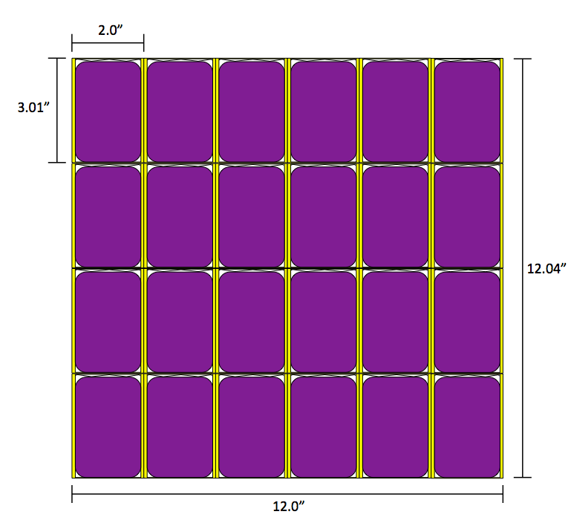
New Experiment Design at LLNL: The TEX Project
Produce new critical benchmarks to address the nuclear data and validation needs for criticality safety
Concept is to provide three test bed assemblies, using plutonium, HEU, and ²³³U fissile materials that can be easily modified to include test materials of interest
The first 10 plutonium TEX assemblies were completed in FY18:
Five baseline experiments, covering thermal, intermediate and fast fission energy regimes and five similar experiments that include tantalum, a material used in plutonium pyroprocessing that is of interest to the criticality safety community

Slide 15
TEX-Pu Baseline Experiment Characteristics
Experiment Number | Thickness of PE Plates (cm) | Thermal Fission Fraction (<0.625 eV) | Intermediate Fission Fraction (0.625 eV- 100 KeV) | Fast Fission Fraction (>100 KeV)
1 | 0 (no PE) | 0.09 | 0.18 | 0.73
2 | 0.159 | 0.14 | 0.38 | 0.48
3 | 0.476 | 0.28 | 0.43 | 0.29
4 | 1.111 | 0.50 | 0.32 | 0.18
5 | 2.540 | 0.66 | 0.21 | 0.13

Slide 16
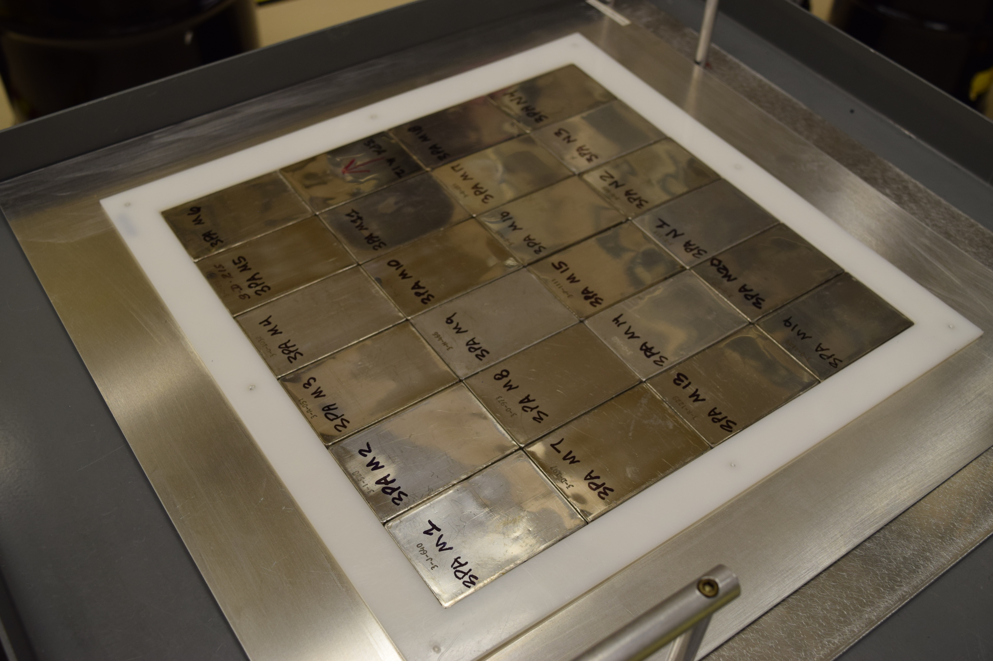
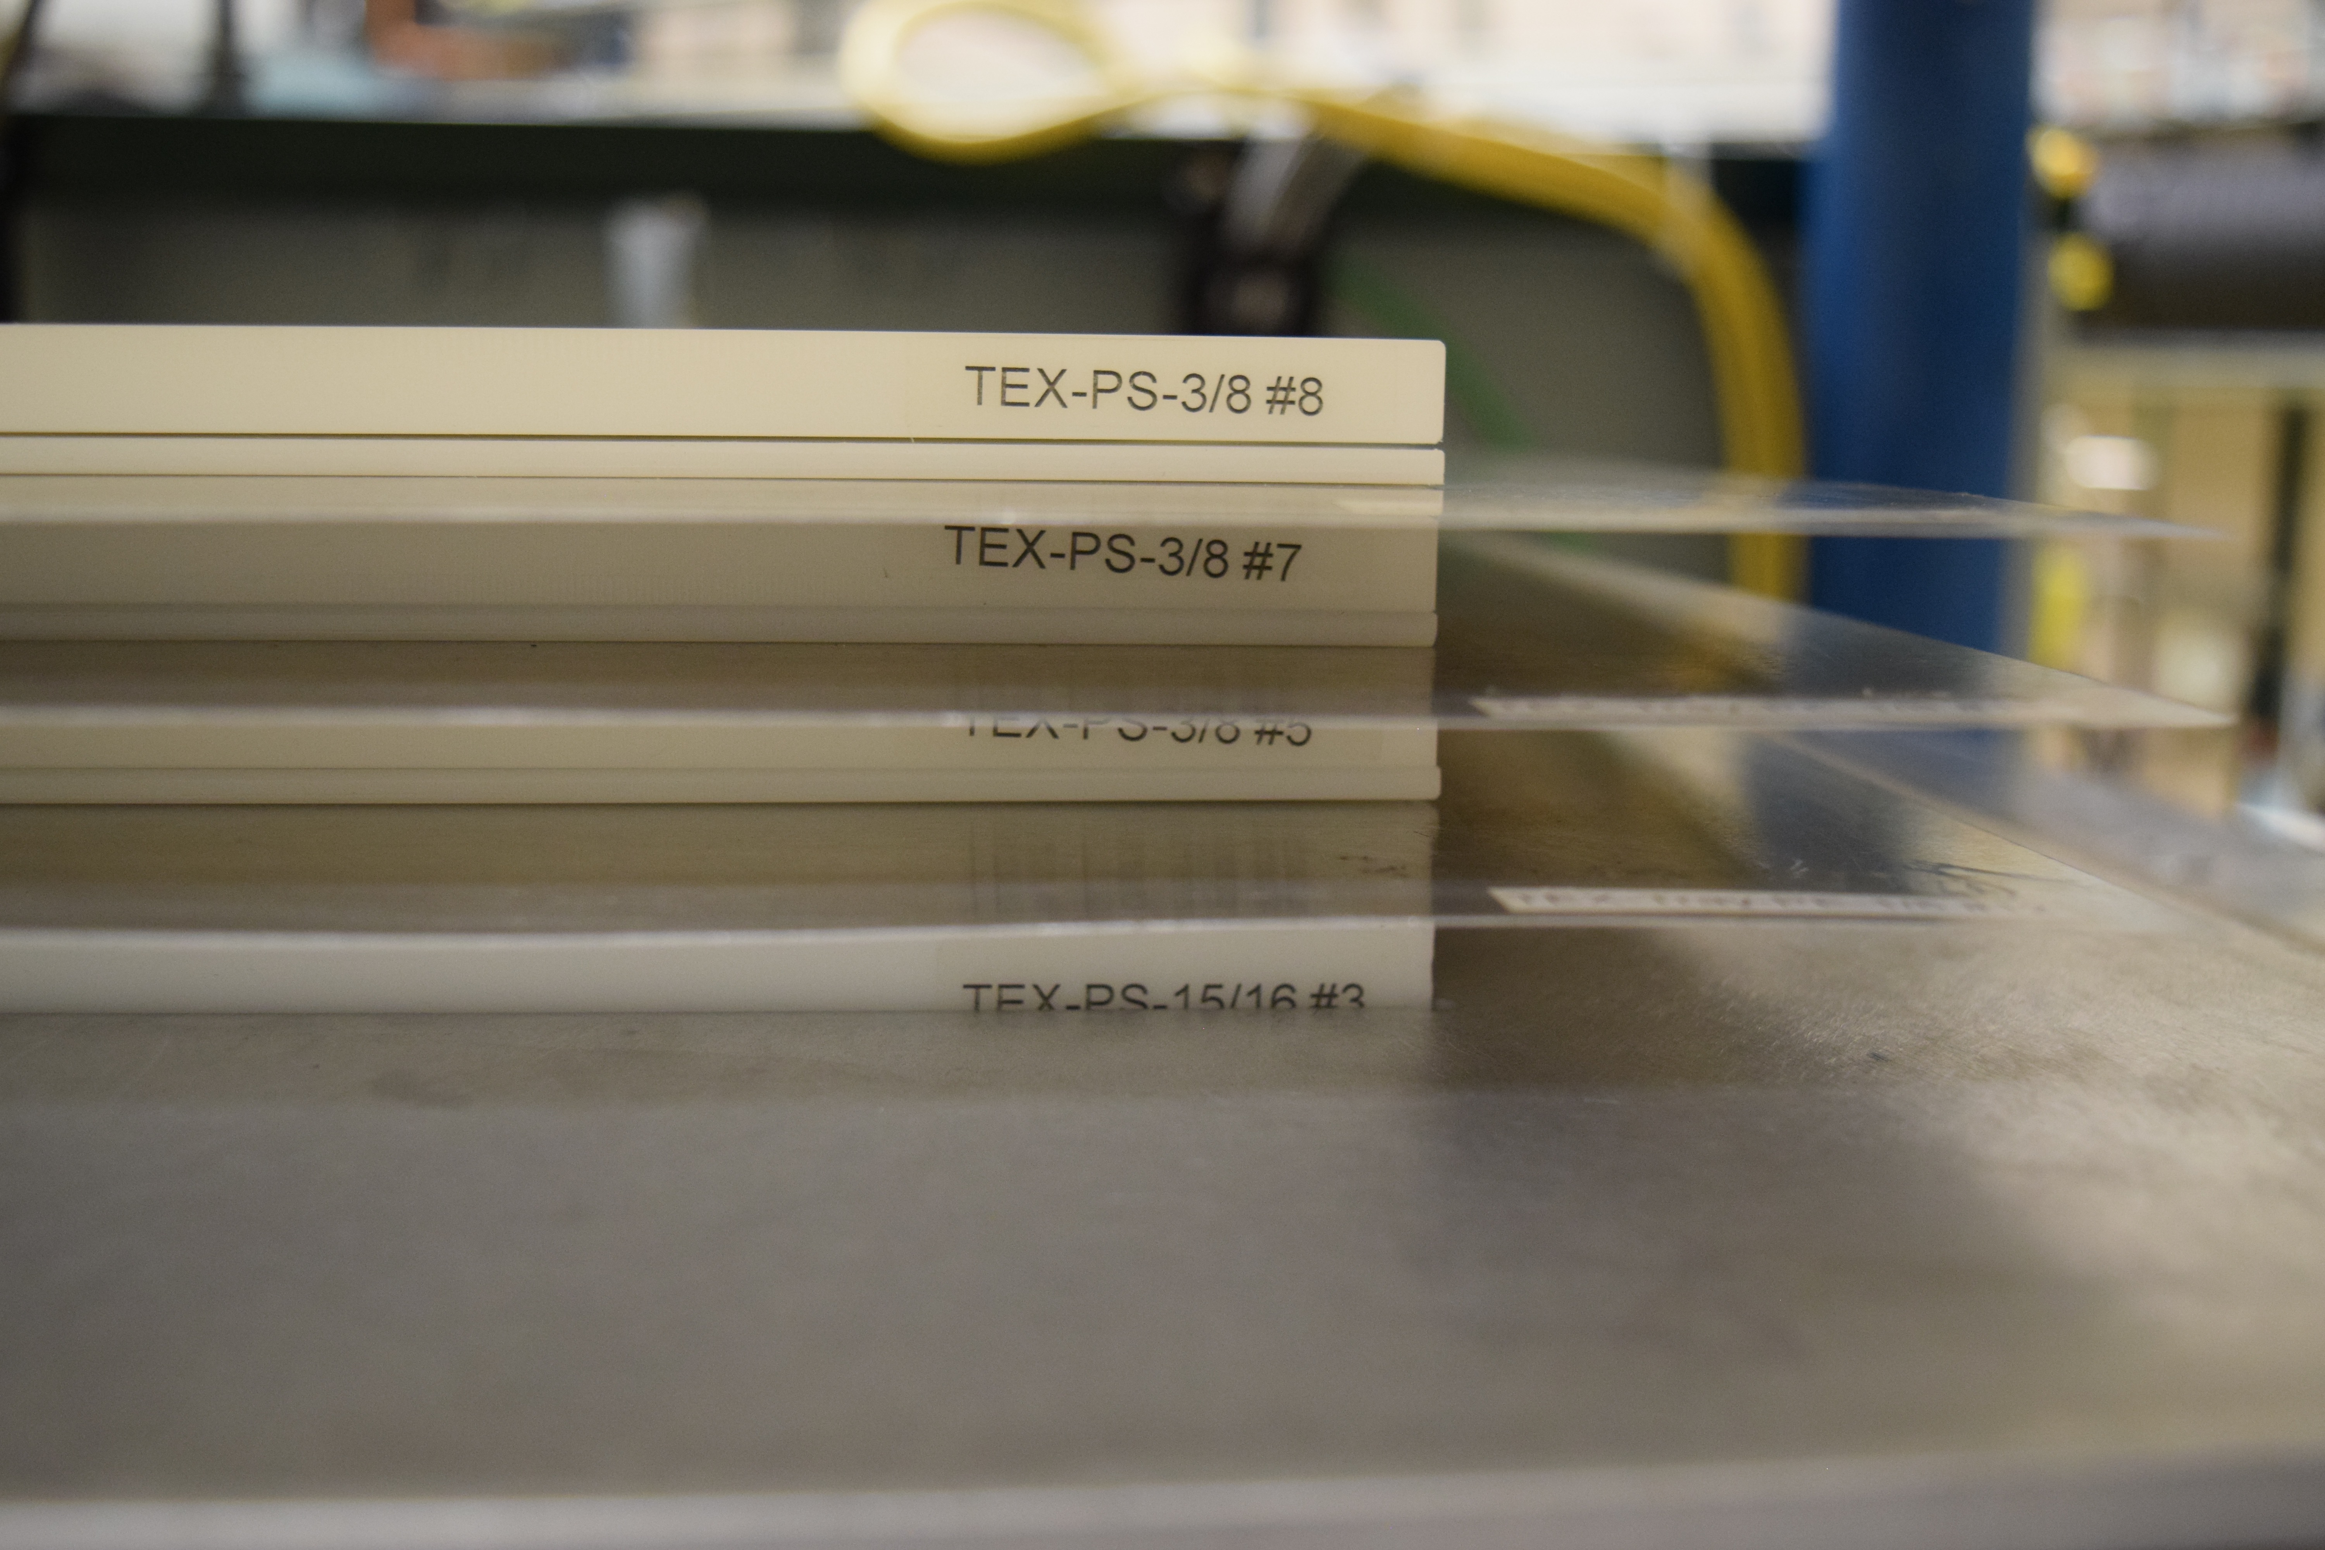
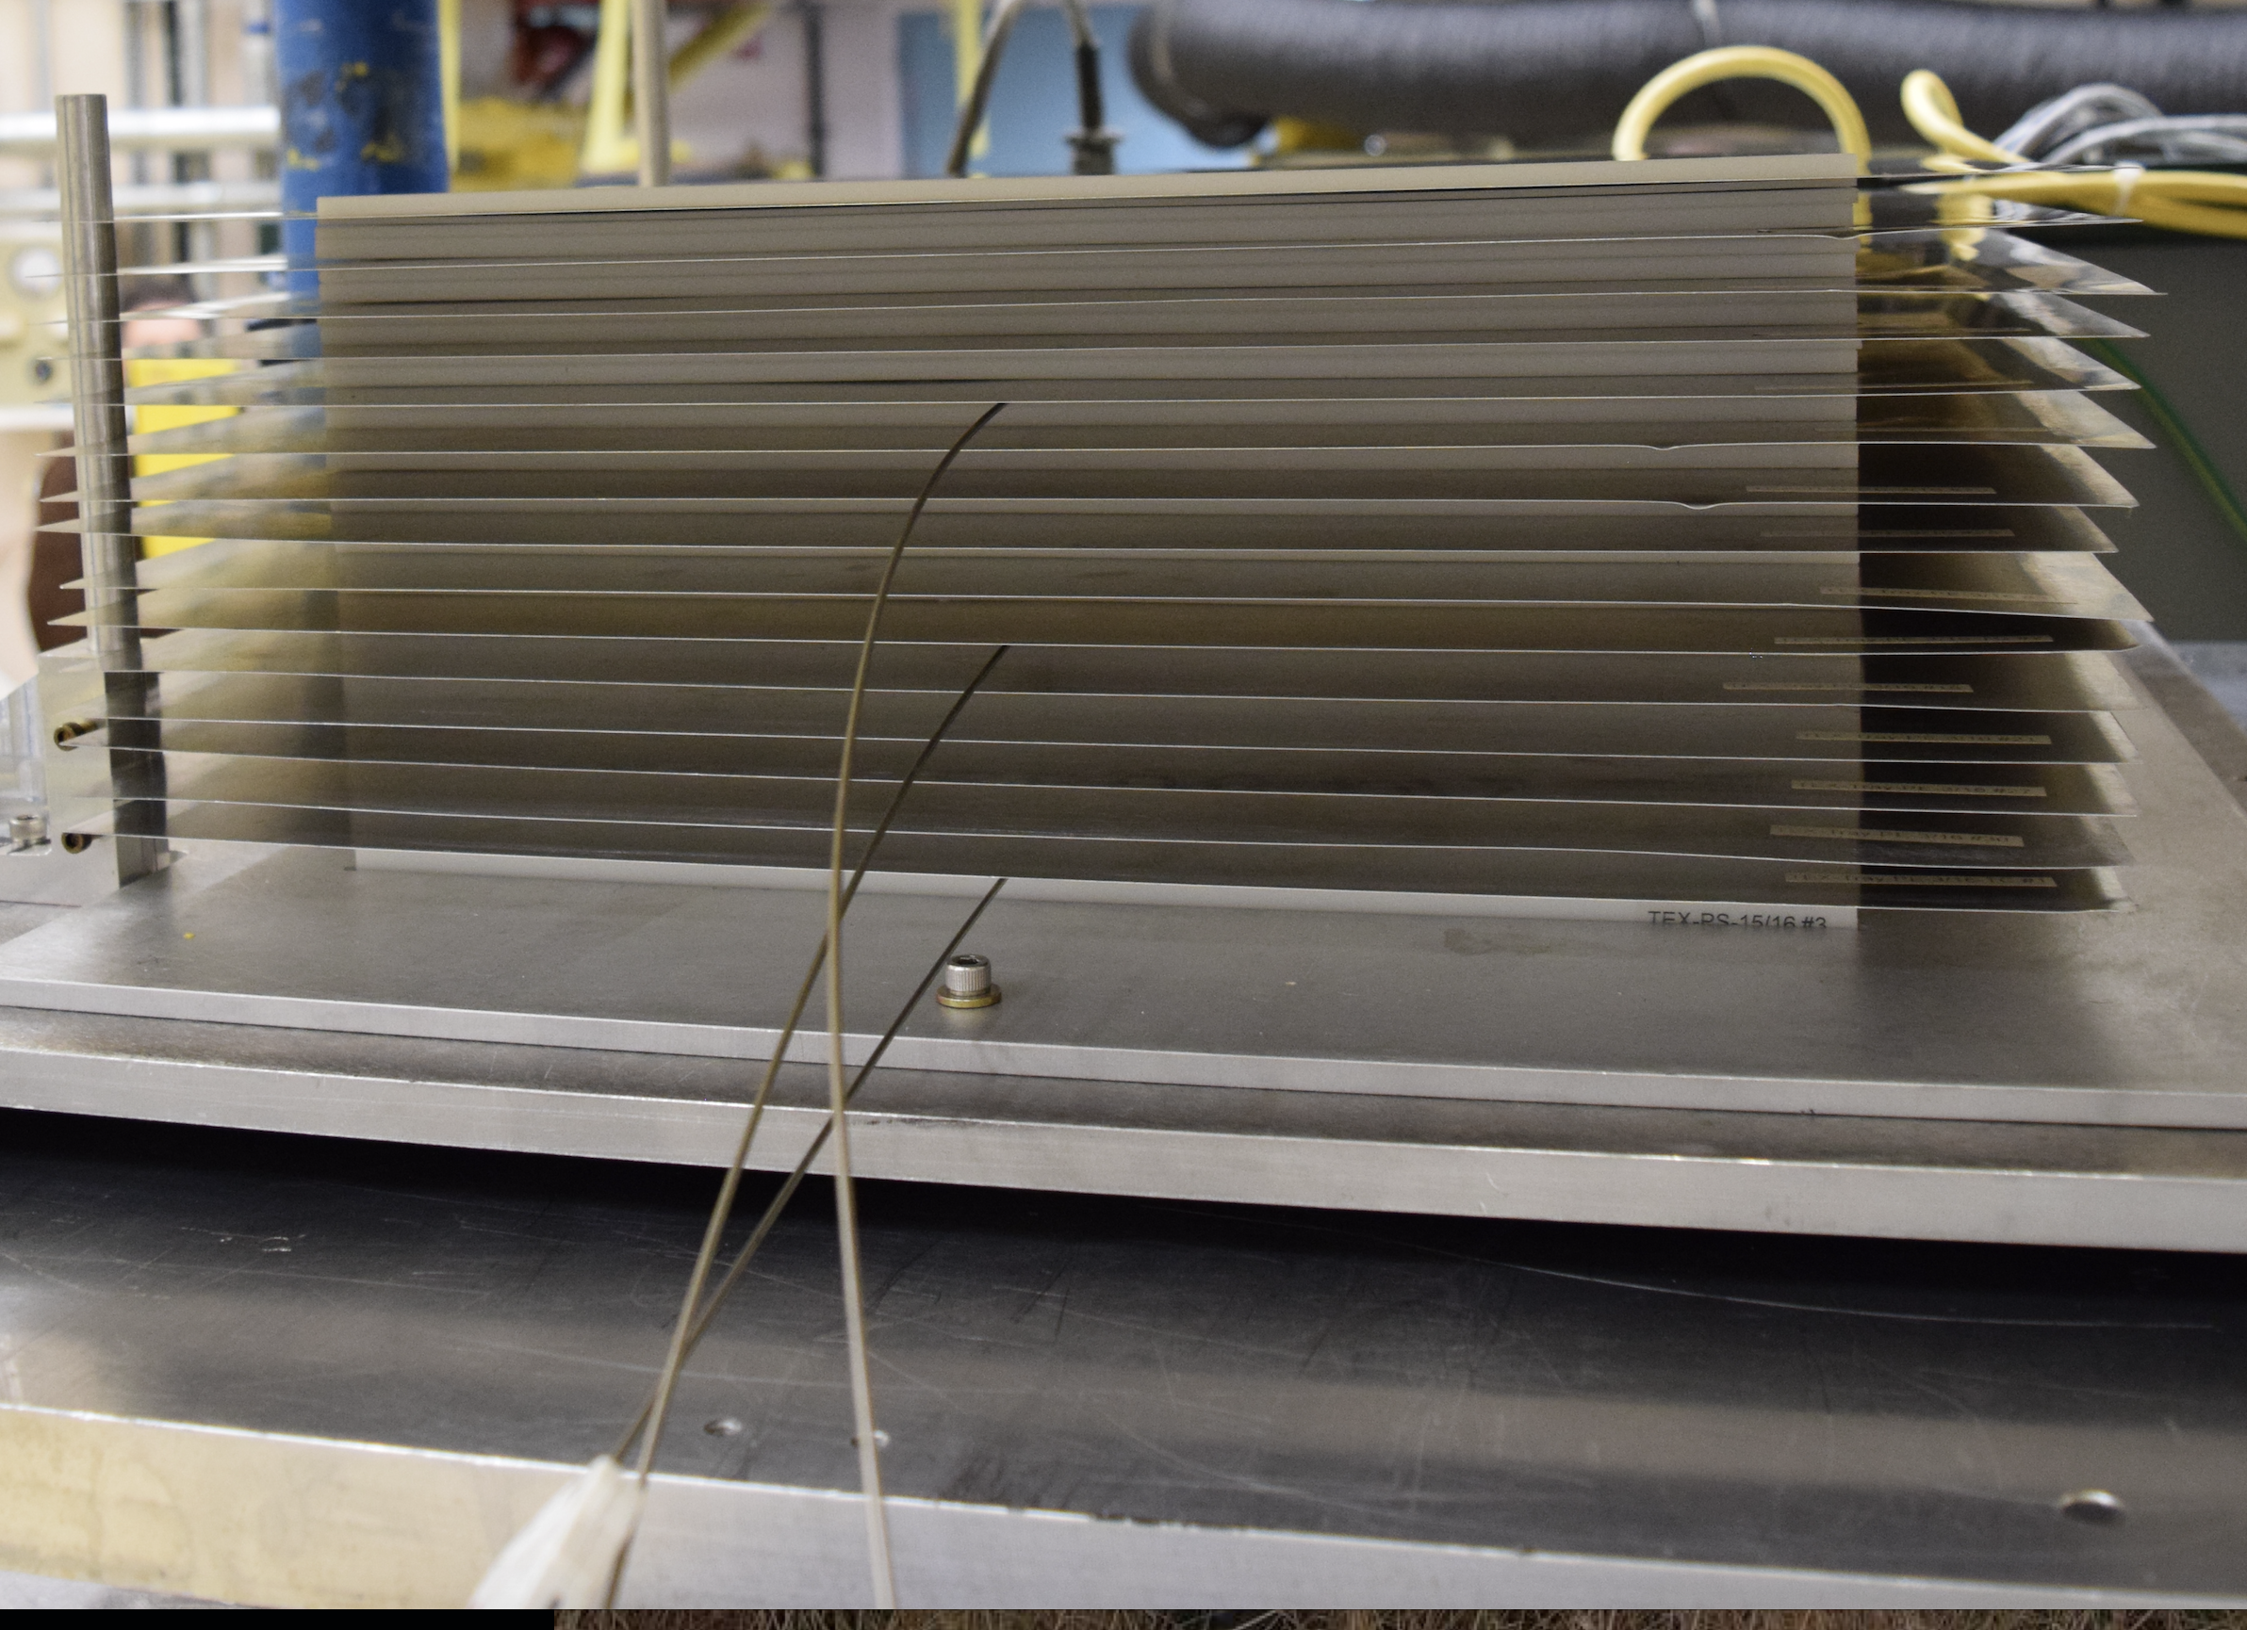
Experiment Photos

Slide 17
TEX-Pu Experimental Results (Colored Markers) Overlaid on Existing ICSBEP Pu Benchmarks
3
4
2
1
5

Slide 18
TEX-Pu Conclusions
Large differences seen in ENDF/B-VII.1 versus ENDF/B-VIII.0, on the order of 0.5% in k_{eff}
ENDF/B-VII.1: All cases calculate within 2σ
ENDF/B-VIII.0: Cases 3 (most intermediate) and 5 (thermal) outside of 2σ
Baseline cases generally calculate well- worst was most intermediate case (Experiment 3) which was 1.0% high with ENDF/B-VIII.0- much better prediction than current benchmarks
Benchmark work is ongoing, but experimental uncertainties are currently evaluated to be 0.00180-0.00280 (in k_{eff})
Expected to be included in 2020 Version of ICSBEP Handbook as PU-MET-MIX-002- HEU and U233 TEX in coming years

Slide 19
Acknowledgements
This work was funded by the United States Department of Energy’s Nuclear Criticality Safety Program (NA-511).
The experiments were a joint effort by Lawrence Livermore National Laboratory and Los Alamos National Laboratory and were completed at National Critical Experiments Research Center (NCERC).
Institut de Radioprotection et de Sûreté Nucléaire (IRSN) provided design and review assistance for the TEX experiments.

Slide 20
Disclaimer
This document was prepared as an account of work sponsored by an agency of the United States government. Neither the United States government nor Lawrence Livermore National Security, LLC, nor any of their employees makes any warranty, expressed or implied, or assumes any legal liability or responsibility for the accuracy, completeness, or usefulness of any information, apparatus, product, or process disclosed, or represents that its use would not infringe privately owned rights. Reference herein to any specific commercial product, process, or service by trade name, trademark, manufacturer, or otherwise does not necessarily constitute or imply its endorsement, recommendation, or favoring by the United States government or Lawrence Livermore National Security, LLC. The views and opinions of authors expressed herein do not necessarily state or reflect those of the United States government or Lawrence Livermore National Security, LLC, and shall not be used for advertising or product endorsement purposes.

