Slide 1
Cumulative Fission Yield Correlations
G. Fabricante, R. Lorek, A. Mattera, E.A. McCutchan, A.A. Sonzogni, M. Vorabbi, S. Zhu
National Nuclear Data Center

Slide 2
Cumulative fission yields
In a reactor, the fission products form a decay network satisfying
dN_{i} / dt = -λ_{i} N_{i} + r IFY_{i} + Σ λ_{k} p_{ki} N_{k},
Decay probability from k to I product
ln(2)/T_{1/2i}
Fission rate
Independent fission yield
Under equilibrium, that is dN_{i} / dt = 0, then
N_{i}= r CFY_{i} / λ_{i}

Slide 3
Fission as a tool to study weak interactions
It was realized early on that the large antineutrino flux generated by a nuclear reactor, > 10²⁰/second, could be used to detect antineutrinos
Detection of the Free Neutrino: a Confirmation
C.L. Cowan, F. Reines, F.B. Harrison, H.W. Kruse, A.D. McGuire, Science 124, 3212 (1956).
LANL team working at the Savannah River Site
25 years after first postulated by Pauli
Antineutrinos are produced in the β-minus decay of neutron rich fission products

Slide 4
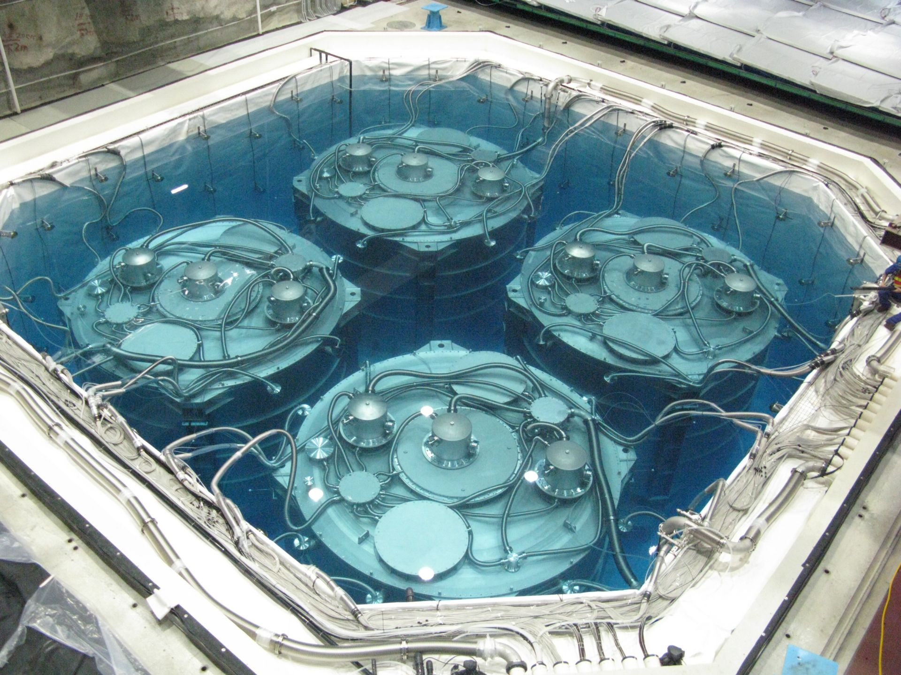
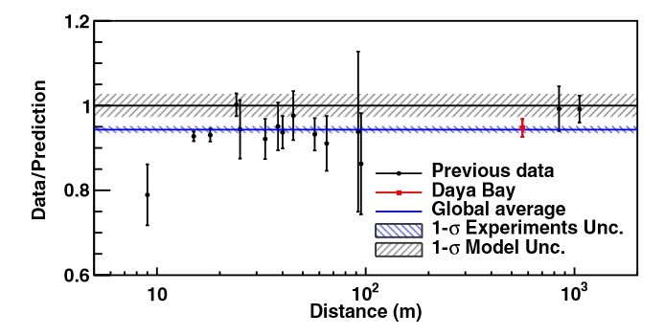
Reactor Antineutrino Anomaly
Since 2011 we learned that we are missing about 6% of electron antineutrinos near the reactor (model dependent)
F.P. An et al, PRL 116, 061801 (2016).

Slide 5
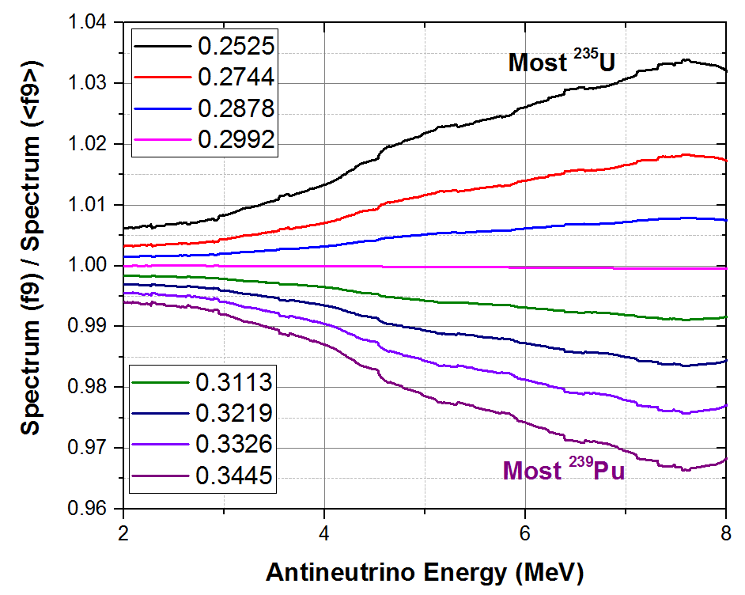
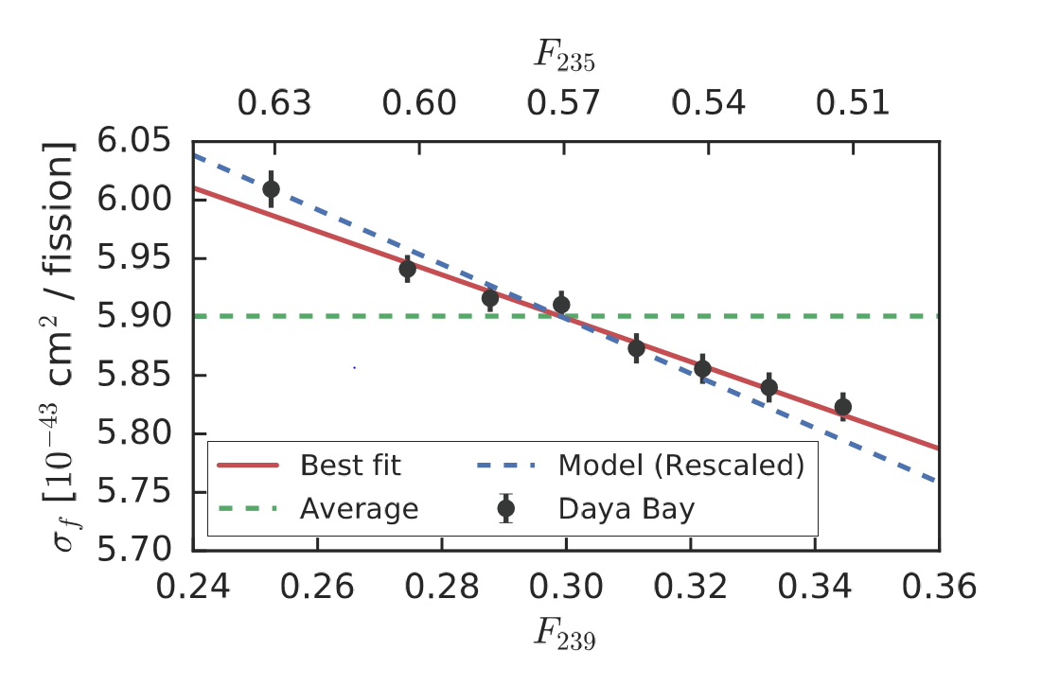
IBD Antineutrino Yield measurements
0.2% precision points!!!!
Daya Bay, F.P. An et al, PRL 118, 251801 (2017).
Nucleus | Daya Bay Yield | Δ | H-M Yield | Δ
²³⁵U | 6.17 | 2.8% | 6.69 | 2.2%
²³⁹Pu | 4.27 | 6.1% | 4.36 | 4.4%
Yields in 10⁻⁴³ cm²/fission units
²³⁹Pu DB value agrees with Huber-Mueller value, ²³⁵U does not, therefore no sterile neutrinos

Slide 6
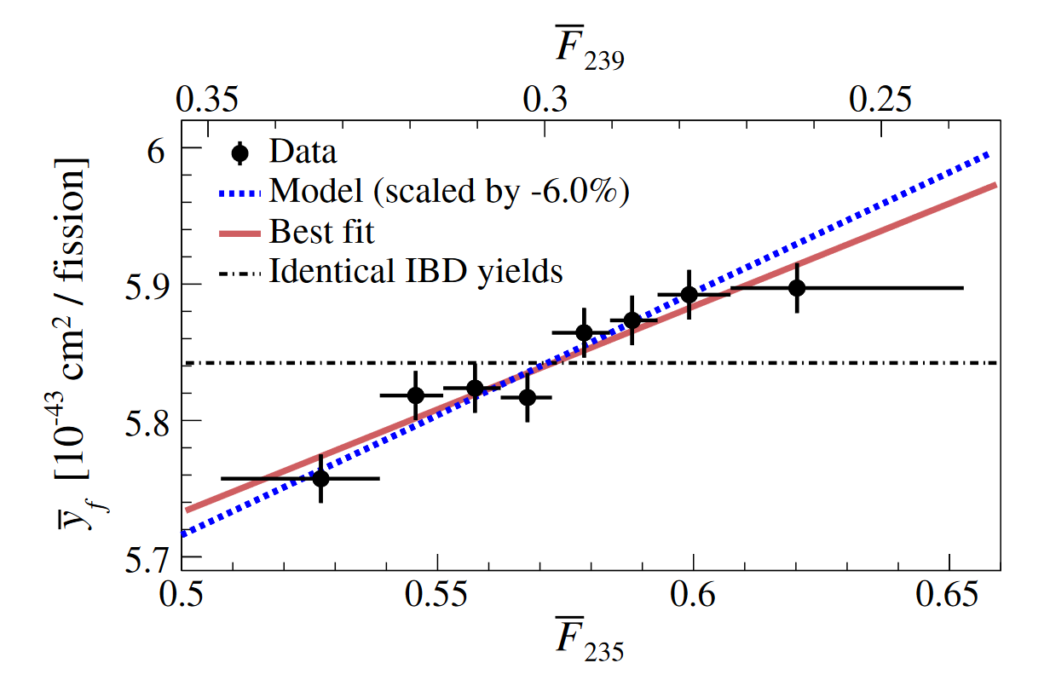
IBD Antineutrino Yield measurements
RENO results
G. Bak et al, PRL 122, 232501 (2019).
Nucleus | RENO Yield | Δ | Daya Bay Yield | Δ | H-M Yield | Δ
²³⁵U | 6.15 | 3.1% | 6.17 | 2.8% | 6.69 | 2.2%
²³⁹Pu | 4.18 | 6.2% | 4.27 | 6.1% | 4.36 | 4.4%
RENO contradicts Daya Bay, sterile neutrinos back in the market
Can we use our databases to shed some light?

Slide 7
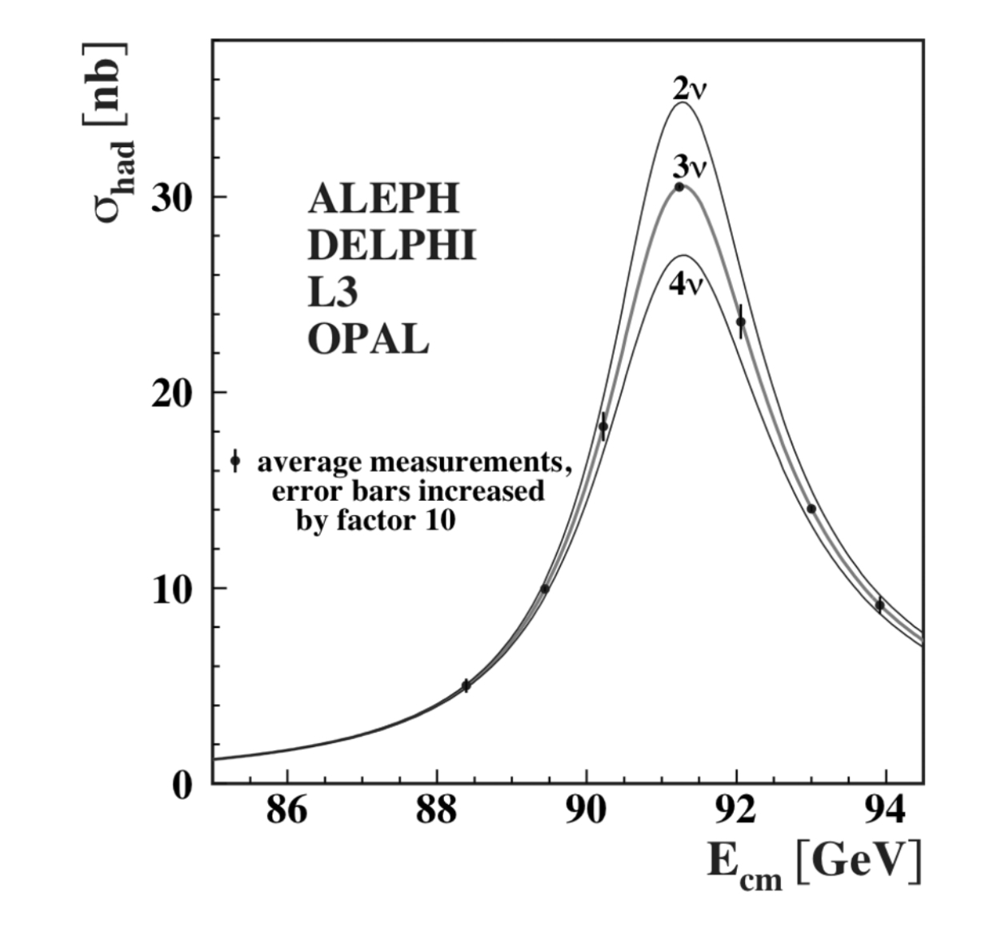
Sterile antineutrinos?
Production cross section for the Z boson,a resonance, is only compatible with 3 active neutrino families.

Slide 8
Summation Method
Using nuclear databases, the IBD antineutrino yield under equilibrium conditions can be calculated as
where Ci is the cumulative fission yield and Si(E) the antineutrino spectrum for the fission products. The uncertainty can be calculated as
Nucleus | Summation Yield | Sum. Δyield
²³⁵U | 6.37 | 1.76%
²³⁸U | 9.69 | 2.04%
²³⁹Pu | 4.39 | 2.08%
²⁴¹Pu | 6.25 | 2.36%
We use the ENDF/B-VIII.0 decay data and JEFF-3.3 yields
Uncertainties are unrealistically low

Slide 9
Summation Method
Uncertainties can be calculated as
Unfortunately, the fission yield databases don’t contain any correlation data.
The GEF¹ code will be used to obtain Y(Z,A) correlations, which will be converted to Y(Z,A,FPS) correlations, and then using decay data, we will obtain Cor(Ci,Cj)
¹ "General Description of Fission Observables: GEF Model Code", K.-H. Schmidt, B. Jurado, C. Amouroux, C. Schmitt, Nucl. Data Sheets 131, 107 (2016).

Slide 10
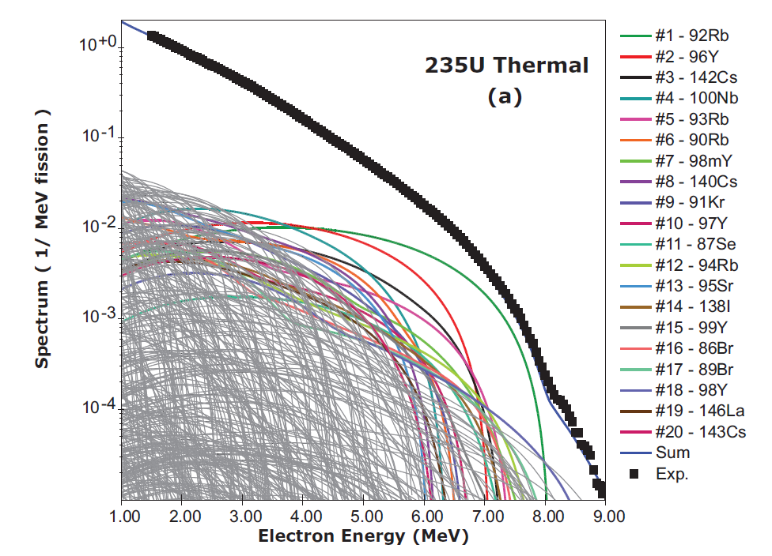
Summation Method
Some examples of correlations will be given for the most important contributors to the IBD antineutrino spectrum:
⁹²Rb,
⁹⁶Y,
and so on

Slide 11
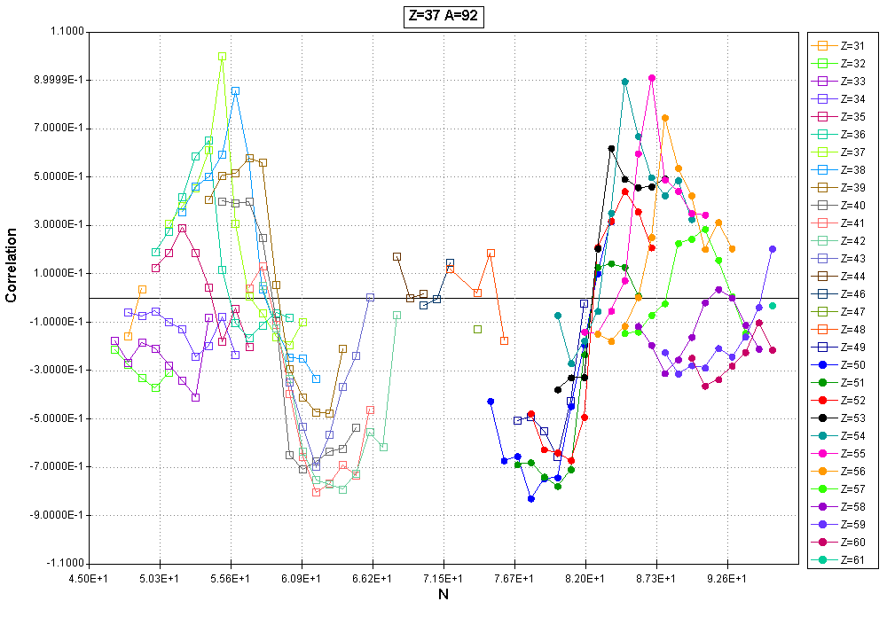
Summation Method
Independent fission yield correlations for ⁹²Rb in ²³⁵U(n,f).
The largest correlations will be for nearby nuclides as well as for nuclides with Z=92-37 and A=236-92-2.
Positive correlations among nuclides in the same fission mode: symmetric, asymmetric (S1), very asymmetric (S2).
Negative correlations among different fission modes.

Slide 12
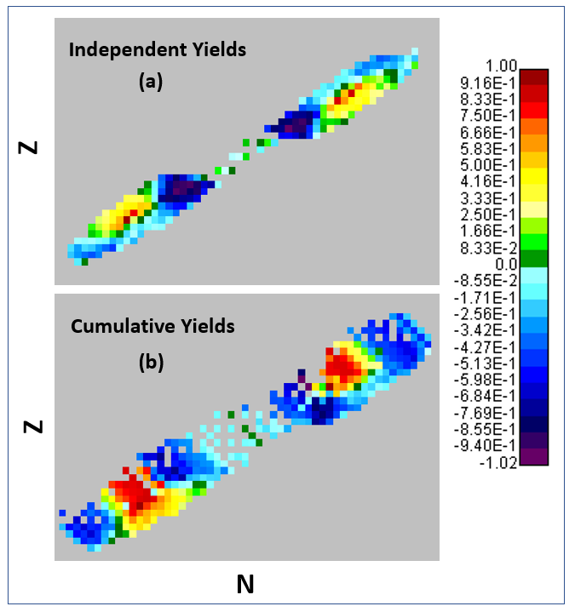
Summation Method
Using ENDF/B-VIII.0 decay data, we can calculate cumulative yield correlations:
C_{i} = I_{i} + Σ b_{ik} I_{k} , where b_{ik} are decay probabilities and I_{k} are independent yields.
For instance, C(⁹²Rb) = I(⁹²Rb)+I(⁹²Kr)+0.0195 x I(⁹³Kr)+0.67 x I(⁹²Br) + 0.68 x I(⁹³Br)

Slide 13
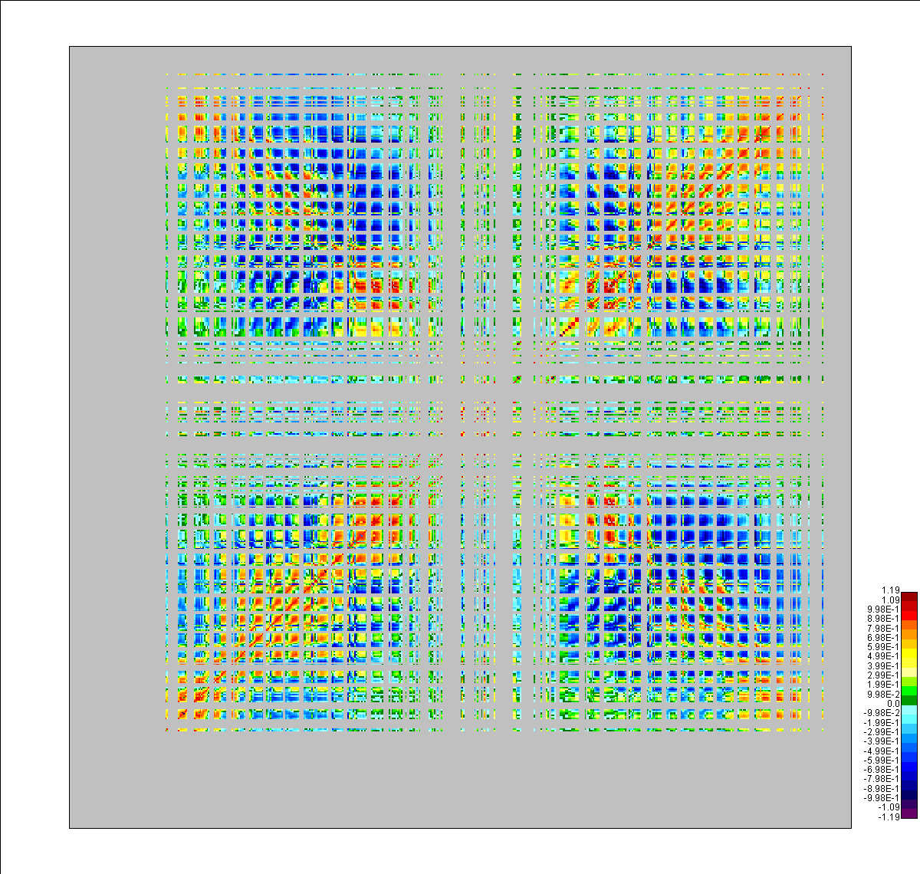
Summation Method
CFY correlation matrix for fission products that contribute to the IBD antineutrino yield.
The grey areas are due to statistics issues for very low fission yield values in JEFF-3.3
Preliminary

Slide 14
Summation Method
Yield results (10⁻⁴³ cm²) using ENDF/B-VIII.0 decay data, JEFF-3.3 yields and GEF IFY correlations.
Nucleus | Summation Yield | Sum. ΔYield | Sum. Δyield No Corrs.
²³⁵U | 6.37 | 2.58% | 1.76%
²³⁸U | 9.69 | 2.89% | 2.04%
²³⁹Pu | 4.39 | 3.01% | 2.08%
²⁴¹Pu | 6.25 | 4.07% | 2.36%
Conclusion: summation calculations must include the correlations among Cumulative Fission Yields!

Slide 15
Summation Method
We can use the same technique for other delayed radiation types, for instance delayed neutron multiplicity per fission, AKA delayed nu-bar
Nucleus | Summation | ΔSum. | ΔSum. No Corrs. | ENDF/B-VIII.0
²³⁵U | 1.567E-2 | 6.67% | 5.45% | 1.585E-2
²³⁸U | 4.01E-2 | 5.92% | 4.03% | 4.4E-2
²³⁹Pu | 6.767E-3 | 6.31% | 6.77% | 6.45E-3
²⁴¹Pu | 1.454E-2 | 5.21% | 4.43% | 1.62E-2
Correlation effects seem to be stronger in IBD antineutrino yields than in delayed nu-bars. Do we understand that?

Slide 16
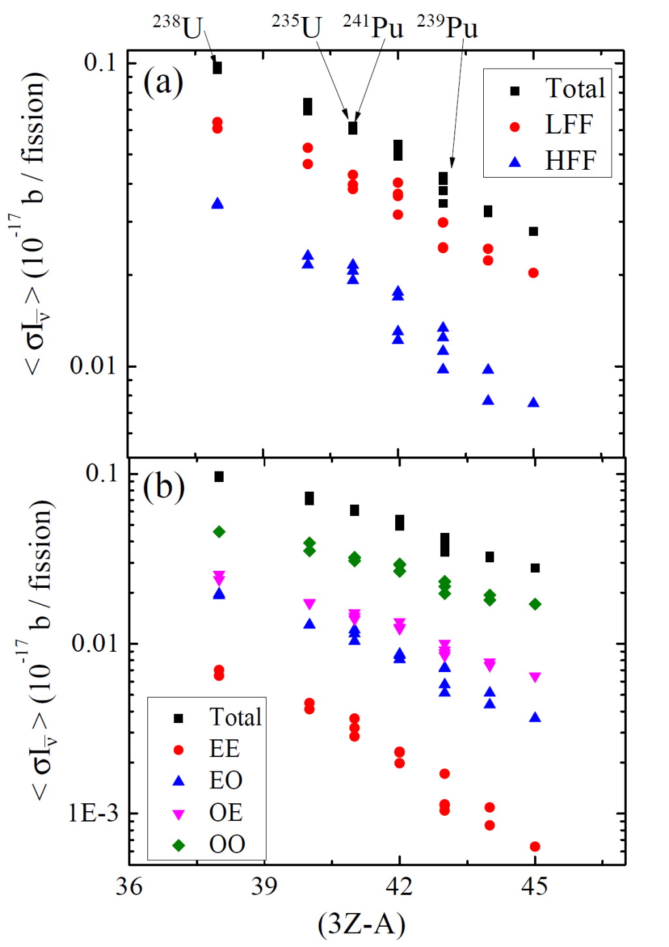
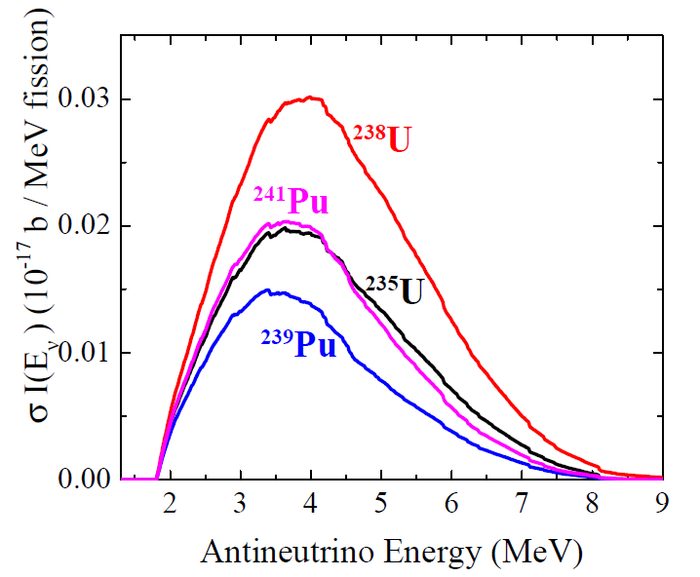
Systematics for all fissioning systems
3Z-A

Slide 17
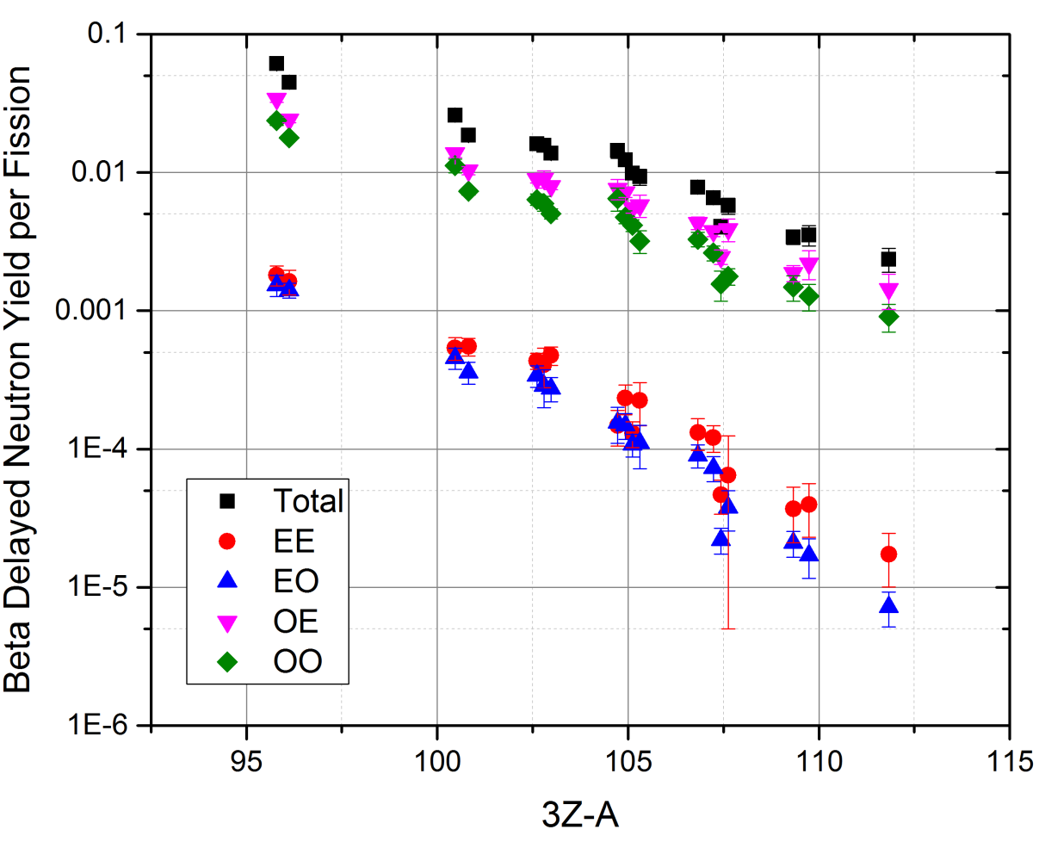
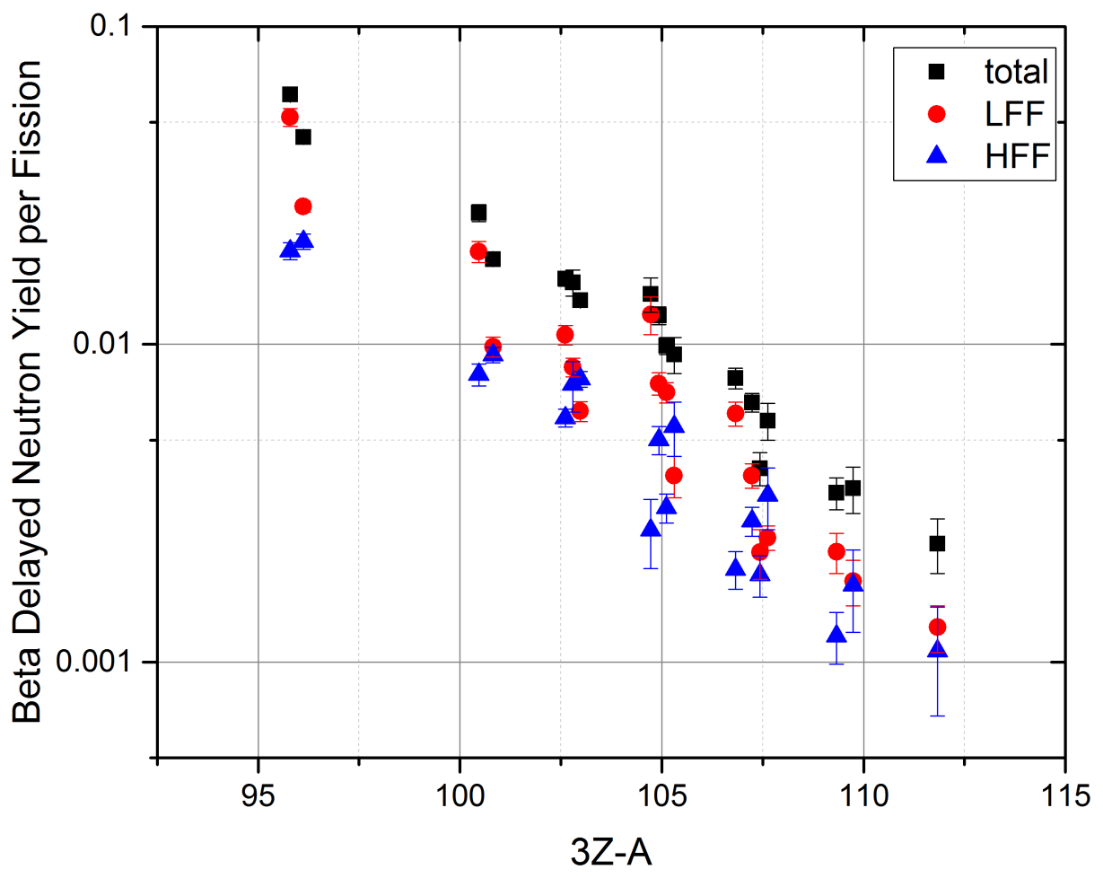
Delayed nu-bar vs (3Z-A)
More selectivity in IBD antineutrino yield than in delayed nu-bars

Slide 18
Another Summation Calculation
E_{i}: Energy converted into heat in the reactor following fission, used to calculate a nuclear reactor’s antineutrino spectrum:
Target | E_{i}(Kopeikin 2004) | %Δ | E_{i}(Ma 2013) | %Δ
²³⁵U | 201.92+-0.46 | 0.22% | 202.36+-0.26 | 0.12%
²³⁸U | 205.52+-0.96 | 0.47% | 205.99+-0.52 | 0.25%
²³⁹Pu | 209.99+-0.60 | 0.29% | 211.12+-0.34 | 0.16%
²⁴¹Pu | 213.60+-0.65 | 0.30% | 214.26+-0.33 | 0.15%
E_{i}s are derived using nuclear data. Uncertainties seem unreasonably low.

Slide 19
Another Summation Calculation
E_{i} is calculated as
Summation!
M: mass excess
C: cumulative fission yield for the most stable fission product
N_{p}: prompt neutron multiplicity
E_{νi}: energy carried away by the antineutrinos
Will briefly discuss Σ CM next

Slide 20
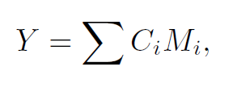
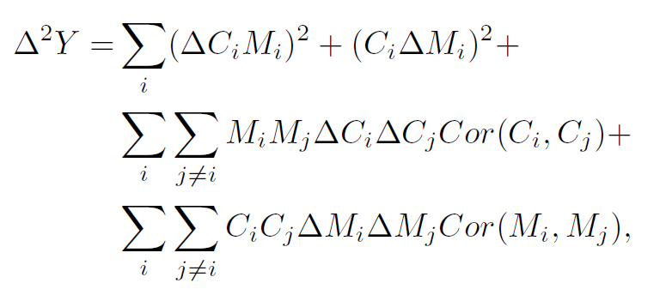
Another Summation Calculation
You will need strong anticorrelations to bring down diagonal uncertainties by a factor of 10!
Target | Y (MeV) | ΔY (MeV) no CFY cors.
²³⁵U | -173.27 | 0.73
²³⁸U | -173.06 | 2.11
²³⁹Pu | -173.56 | 2.41
²⁴¹Pu | -173.57 | 3.29

Slide 21
Summation Calculations
Kopeikin came up with a clever way to obtain uncertainties, from mass conservation:
M_{t} + 1 = Σ C_{i} A_{i} + nu-bar
Then perform an uncorrelated Monte Carlo simulation varying C_{i}s assuming a Gaussian shape, and keep those events that give nu-bar within its known, low uncertainties.
Target | ΔY (MeV) JEFF-3.3 | ΔY (MeV) ENDF/B-VIII.0 | ΔY (MeV) Kopeikin 04 (E&R) | ΔY (MeV) Ma 13 (JEFF-3.1)
²³⁵U | 0.076 | 0.927 | 0.050 | 0.062
²³⁸U | 0.298 | 0.593 | 0.100 | 0.058
²³⁹Pu | 0.115 | 0.416 | 0.070 | 0.060
²⁴¹Pu | 0.240 | 0.409 | 0.100 | 0.070

Slide 22
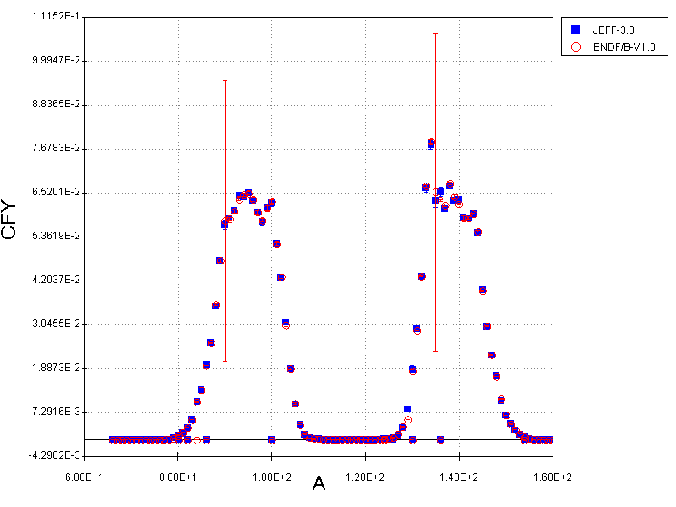
Reason for disagreement between Kopeiking and ENDF/B-VIII.0
Large uncertainties for ⁹⁰Zr and ¹³⁵Cs

Slide 23
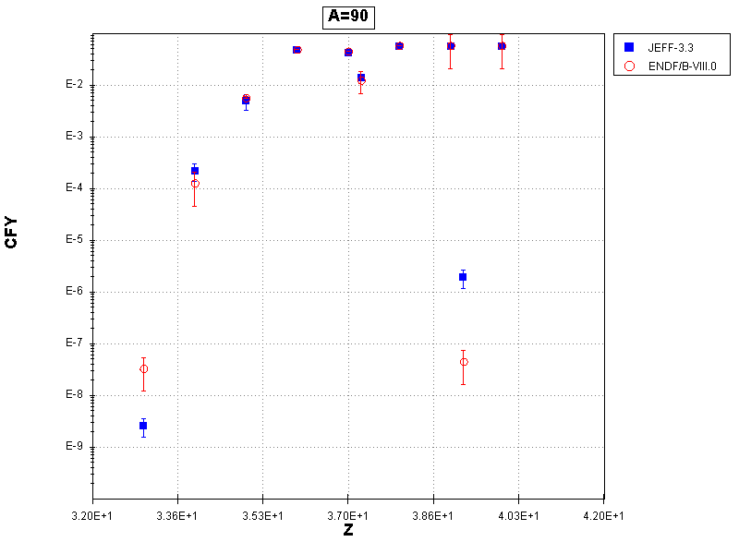
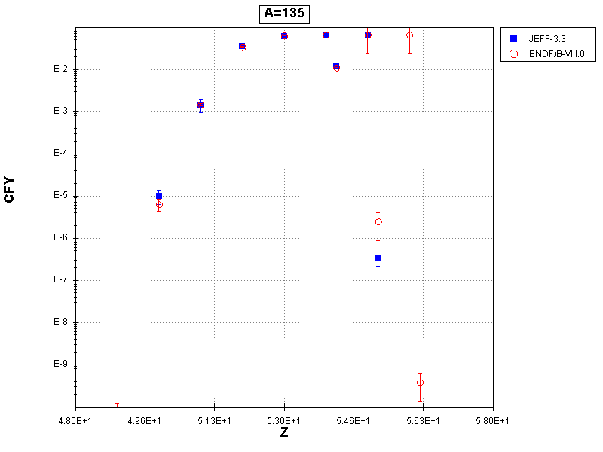
Reason for disagreement between Kopeiking and ENDF/B-VIII.0
Isomeric ratios uncertainties were not propagated well
Issue appears in ENDF/B-VI.8, was absent in ENDF/B-V.2

Slide 24
Propagating IR uncertainties properly
Target | ΔY (MeV) JEFF-3.3 | ΔY (MeV) ENDF/B-VIII.0 | ΔY (MeV) ENDF/B-VIII.0 Corrected | ΔY (MeV) Kopeikin 04 (E&R) | ΔY (MeV) Ma 13 (JEFF-3.1)
²³⁵U | 0.076 | 0.927 | 0.040 | 0.050 | 0.062
²³⁸U | 0.298 | 0.593 | 0.082 | 0.100 | 0.058
²³⁹Pu | 0.115 | 0.416 | 0.116 | 0.070 | 0.060
²⁴¹Pu | 0.240 | 0.409 | 0.101 | 0.100 | 0.070
Is it possible that CFY and ΔCFY in ENDF/B-V.2 were adjusted to the nu-bar uncertainties?
This Monte Carlo method also yields correlation matrices, which should never be taken as true fission yield correlation matrices!

Slide 25
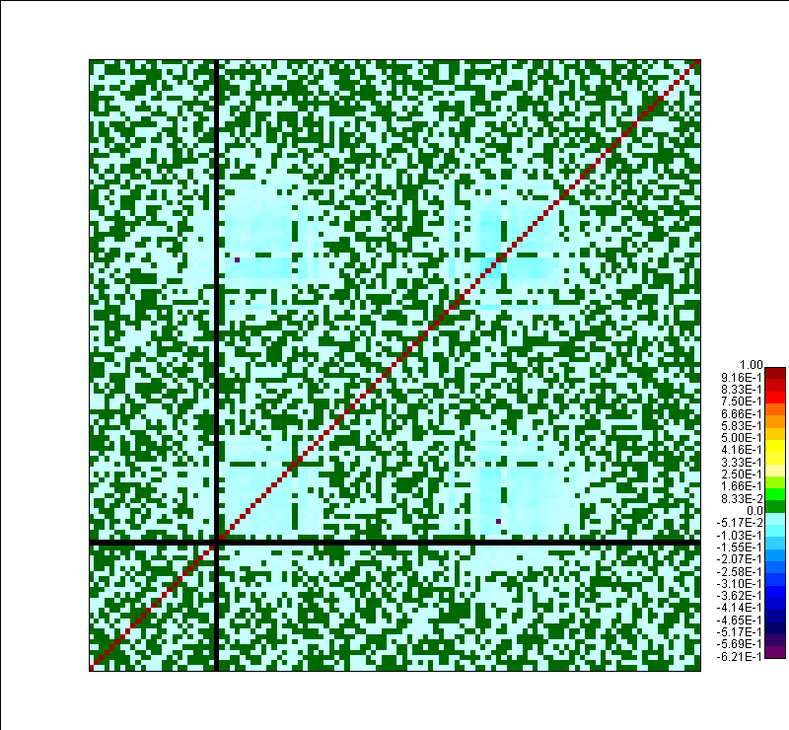

Slide 26
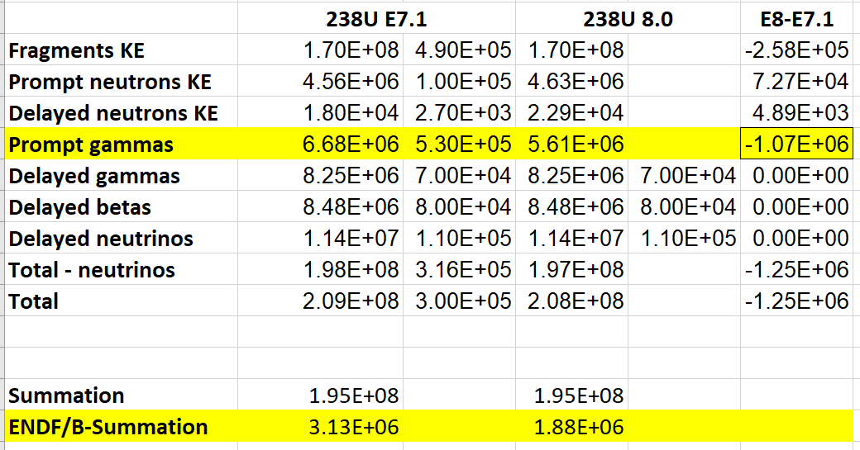
Spin-off
Energy values in Mf=1 Mt=458 for ²³⁸U
The 1.07 MeV reduction in prompt gamma energy has improved the agreement with the summation calculation

Slide 27
Conclusions
We introduced fission yield correlation matrices in summation calculations.
We observe sensible changes in the uncertainties if these matrices are included.
Only low-fidelity, best model based correlations could be developed for ENDF/B-VIII.0 (also perhaps for JEFF-3.3) as correlations induced by the experimental data used to obtain the library are not available.
These correlations should be thoroughly tested in uncertainty calculations.

