Slide 1
NSR & EXFOR Compilations
Boris Pritychenko
National Nuclear Data Center, BNL, Upton, NY 11973

Slide 2
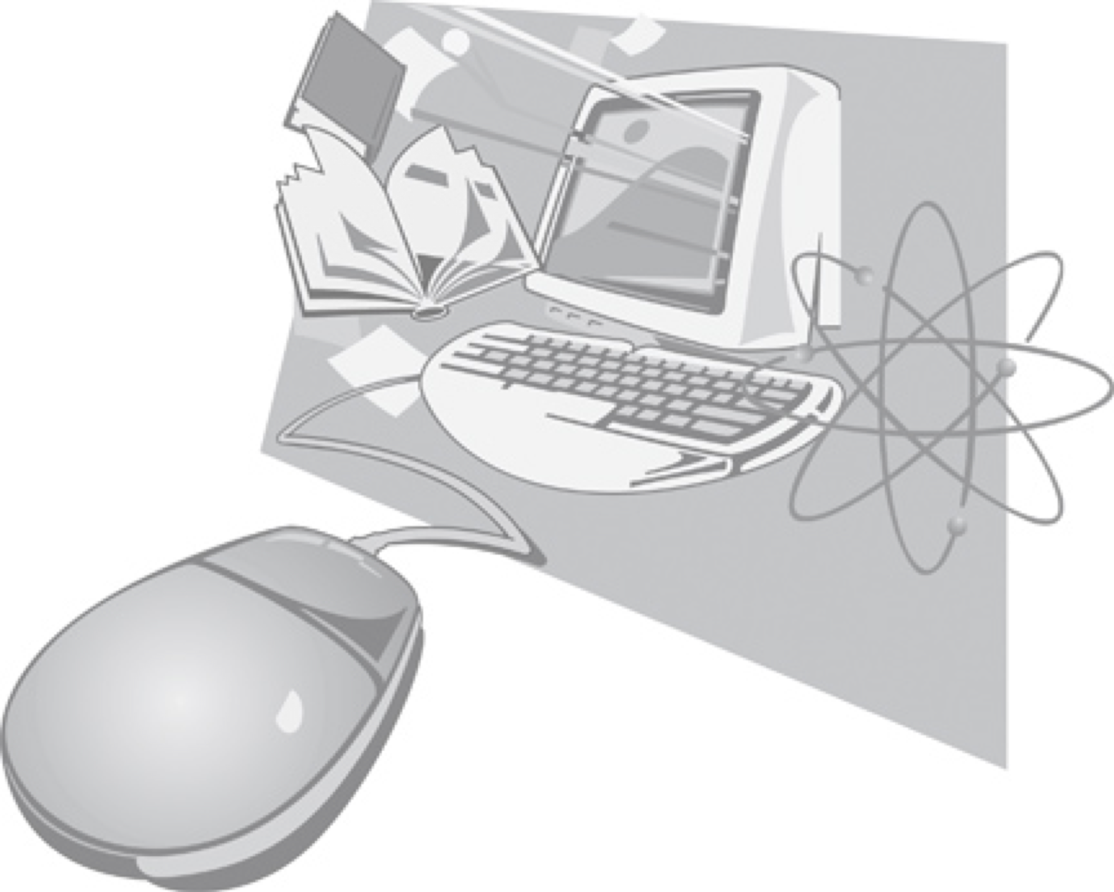
Compilation Databases
There are three major and two minor compilation databases at NNDC: NSR, EXFOR, XUNDL and B(E2)↑, ββ-decay.
In this presentation, we will concentrate on NSR and EXFOR databases:
Nuclear Science References (NSR): all low- and intermediate-energy references for a broad use, not just nuclear structure and decay as before 90ies.
Experimental Nuclear Reaction Data (EXFOR): all low- and intermediate-energy reaction data sets for neutron-, charged- and photo-induced reactions, not just neutron-induced as before 80ies.
The compilation scope and quality controls for NSR and EXFOR database have evolved over the many years of operation. These facts plus lack of advanced computer tools in the past are responsible for missing references and data sets.

Slide 3
NSR Compilations
Nuclear Science References compilation creates a foundation for nuclear structure, decay and reaction data efforts and impacts research activities.
FY 2019 NSR team: 1.5 NNDC (B. Pritychenko, J. Totans), 2 contractors (B. Singh, E. Betak), 1 Berkeley collaborator (J. Batchelder) and 1 IAEA collaborator (V. Zerkin).
Our goal is provide the coverage for current publications; we are also proactively recovering previously missed references.
One of our major requirement is speed, prompt creation of entries and quality keywords for ENSDF: NSR is always up-to-date (it is updated 2-3 times a week).
NSR Quality Assurance: Manager + Users + Evaluators + Compilers inputs. We do not have a bug database, we just fix bugs immediately.
Direct communication with Phys. Rev. C: ~10% of authors submit keywords to NSR.

Slide 4
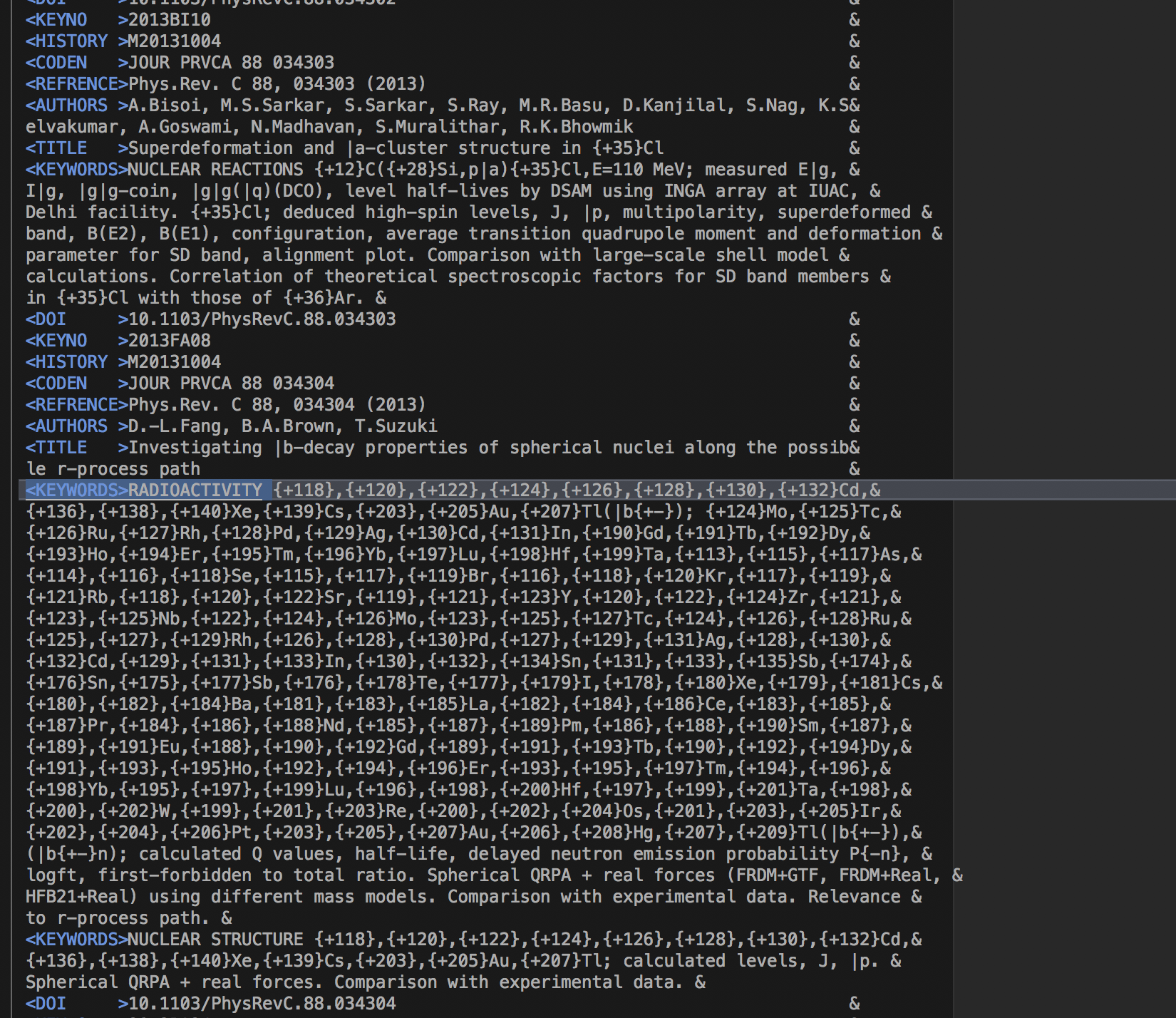
FY 2019 NSR Statistics
NSR References:
3,337 new article entries.
265 modified (corrected) article entries.
1,632 keyworded article abstracts (September 30, 2019) =>
1,703 (November 5, 2019), takes time to prepare the keywords.
NSR Dictionaries updates:
1,000 new authors
12 new journals
160 new reactions
689 new nuclides
16 new decays
NSR Database updates: 129 in FY 2019.
NSR Web retrievals: 316,494, or 64 references/retrieval.
Total number of retrieved references was 20,335,439.

Slide 5
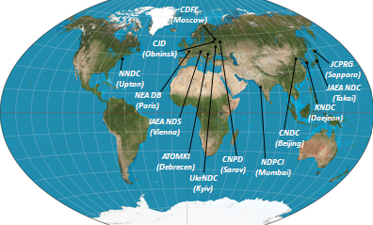
EXFOR Effort in the U.S. and Canada
Nuclear Reaction Data Centers (NRDC) is responsible for EXFOR compilations worldwide, NNDC is responsible for the Area #1 (USA & Canada).
EXFOR Team: B. Pritychenko, S. Hlavac, O. Schwerer, O. Gritzay and V. Zerkin (IAEA).
NNDC: Overall database and contracts management, website support, compilation and correction of missing and older references.
Bratislava: Mainly new references compilation.
Kyiv: Fission yields compilation.
Vienna: Overall quality assurance and transmission handling.
IAEA: Web and database software development.
Smooth operation based on efforts of BNL stuff, contractors and collaborators.
Contractors (S. Hlavac, O. Gritzay and O. Schwerer) are essential for the overall success of the NNDC EXFOR effort.

Slide 6
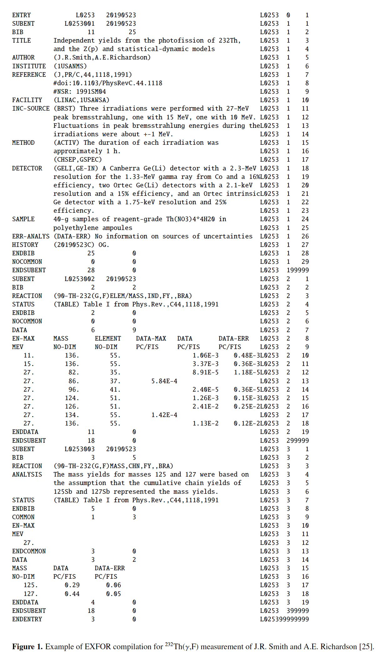
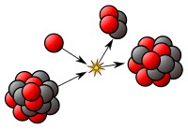
Area #1 EXFOR Statistics
New entries: 63 + 62 (BNL) = 125.
Corrected entries: 174 + 46 (BNL) = 220.
26 Preliminary and 28 final data transmissions (Preliminary transmissions go through the NRDC network quality assurance system, after implemented corrections final transmission are loaded into the database).
EXFOR database was updated 30 times.
EXFOR Web retrievals in FY2019: 40,391.
More compilation details in the IAEA system based on calendar years: http://www-nds.iaea.org/exfor-master/x4compil/.
Fission yields compilation project is underway.

Slide 7
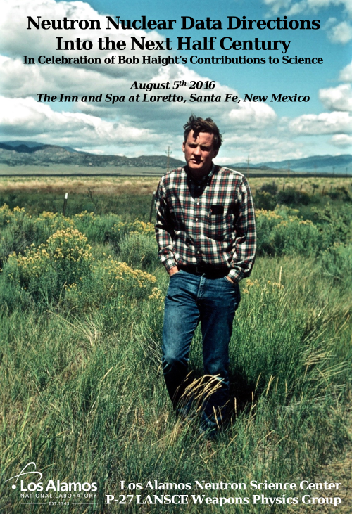
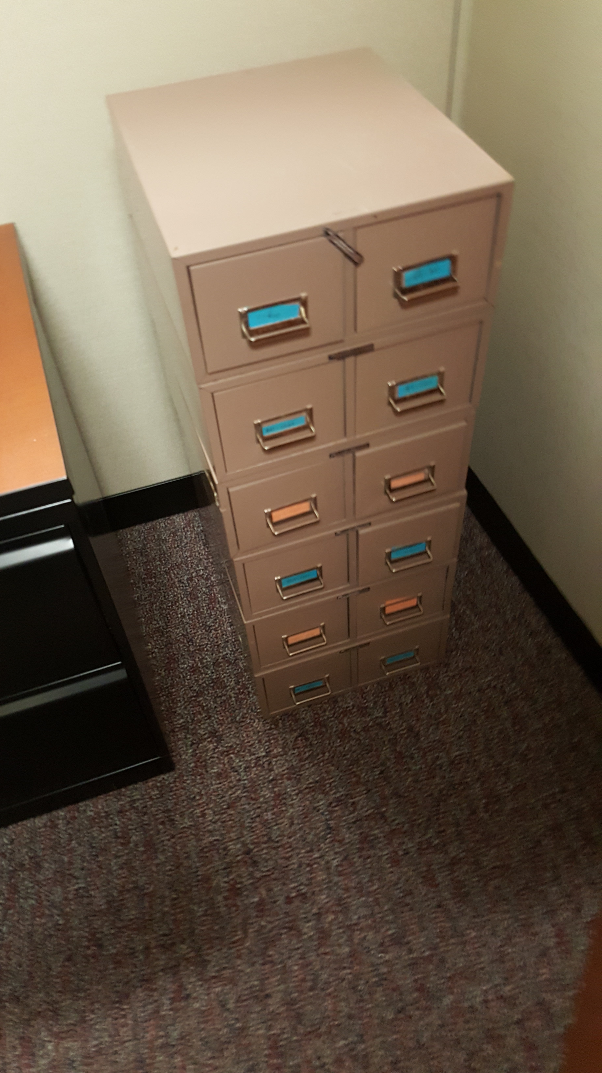
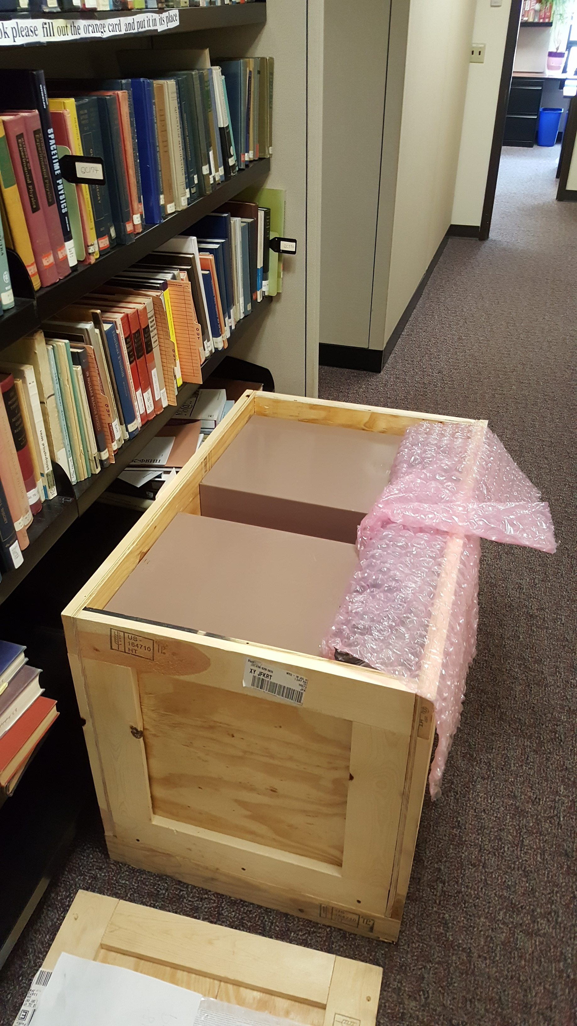
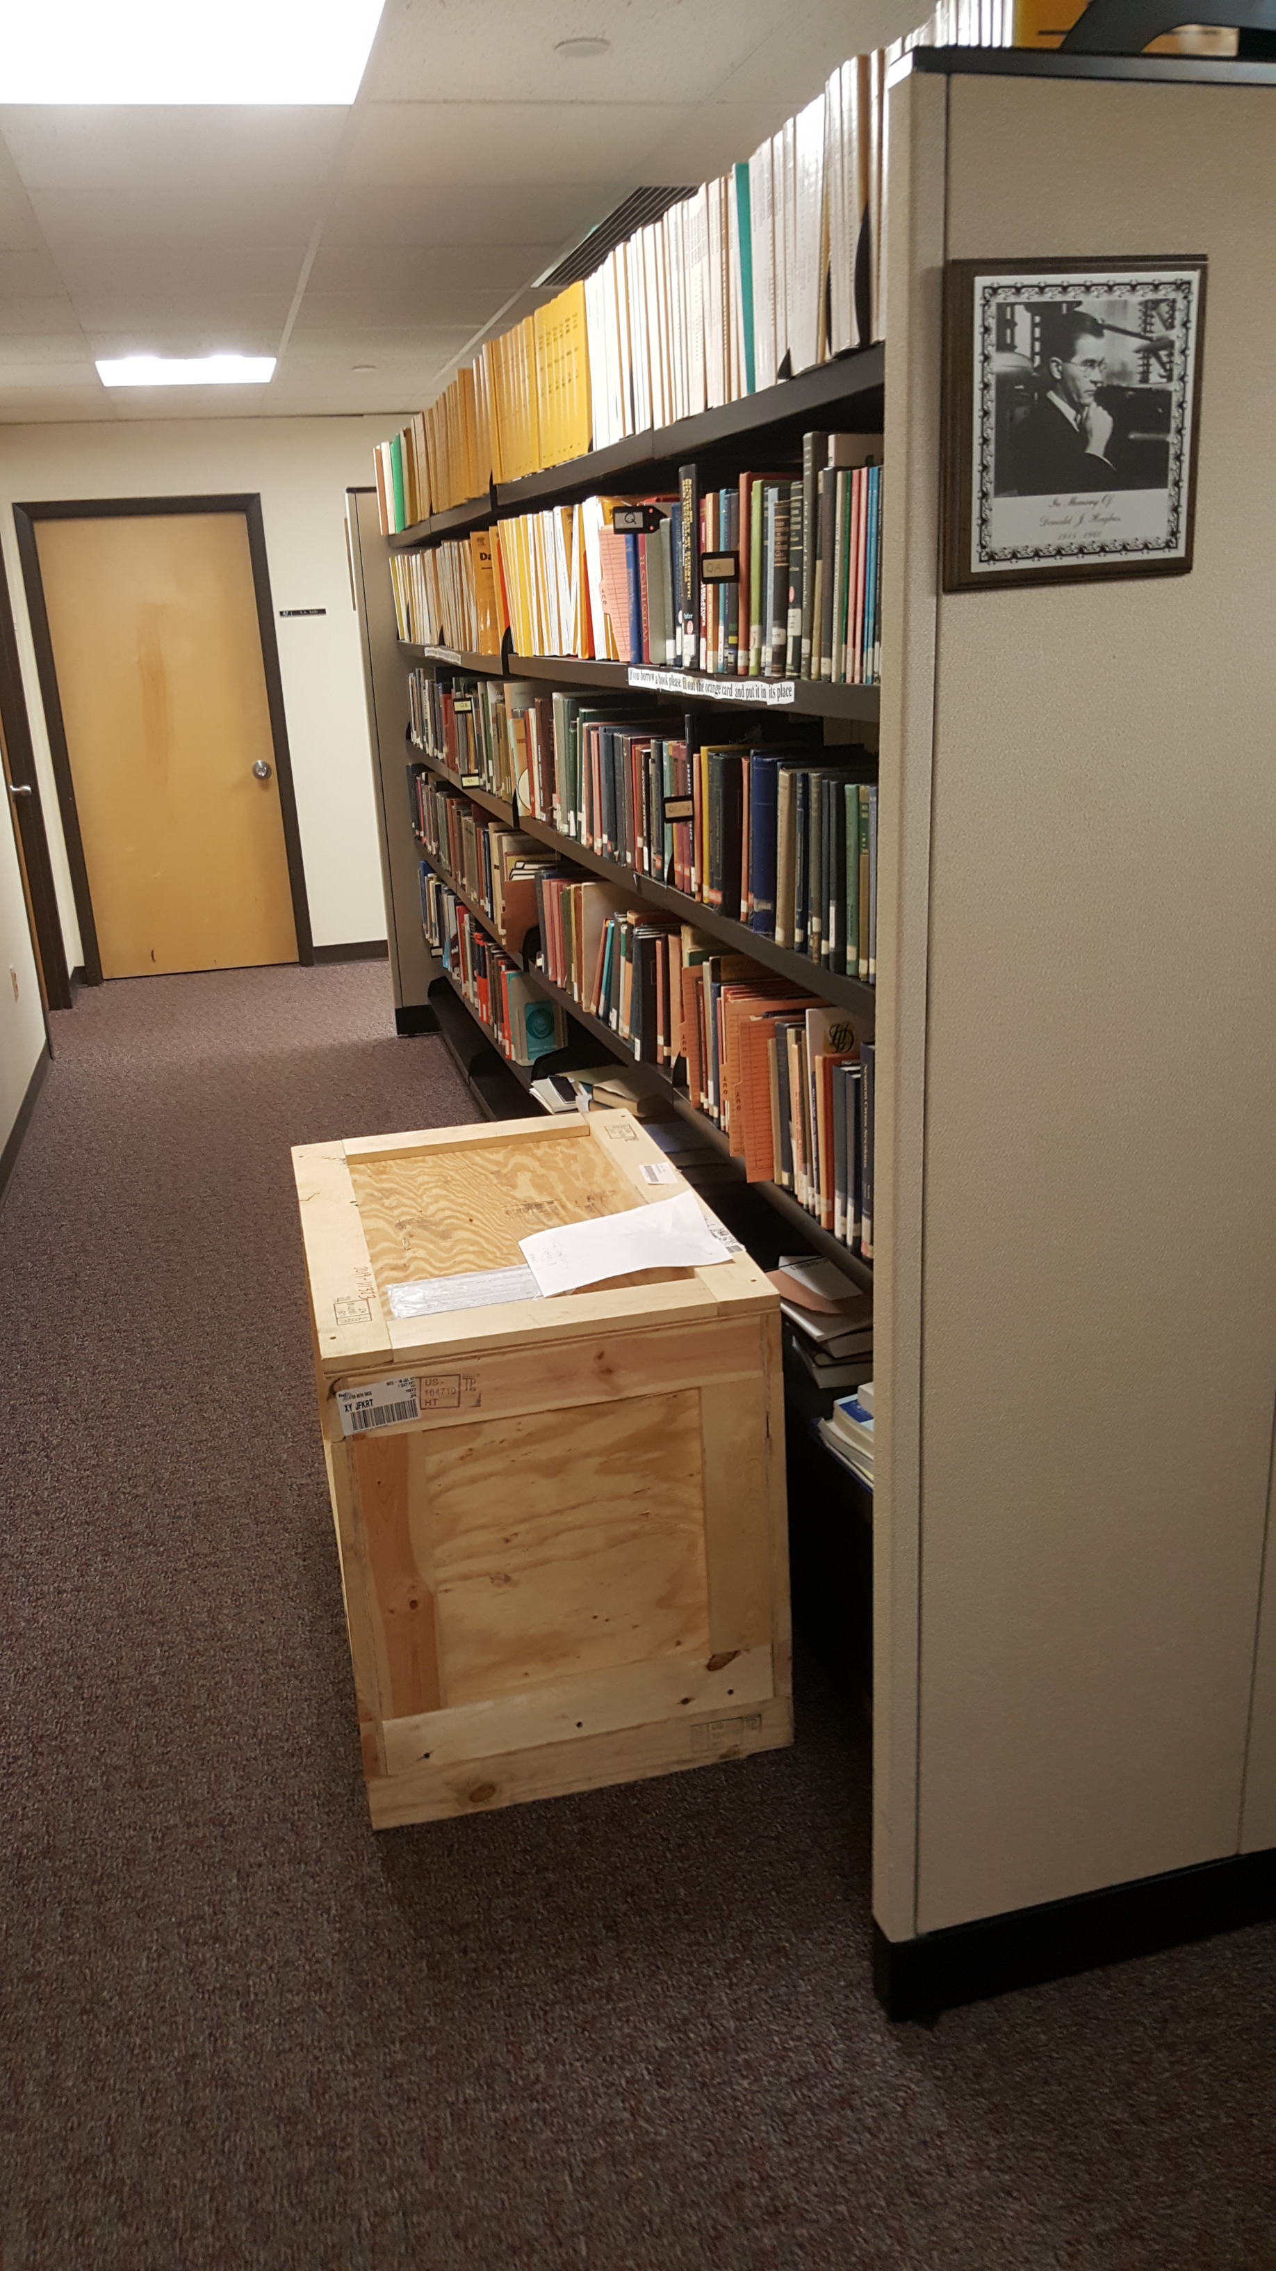
Missing Data Collection I
NNDC: Donald Hughes library.
July 30, 2019: Crate from South West.
Los Alamos collection of microfiches will be processed by NNDC librarian J. Totans.
More valuable contents than raiders of the lost ark of the covenant.
A typical cost of one-week measurement is $1 M: LBNL charges $2,500 per hour or $420 K per week to IBM for cyclotron beam time.

Slide 8
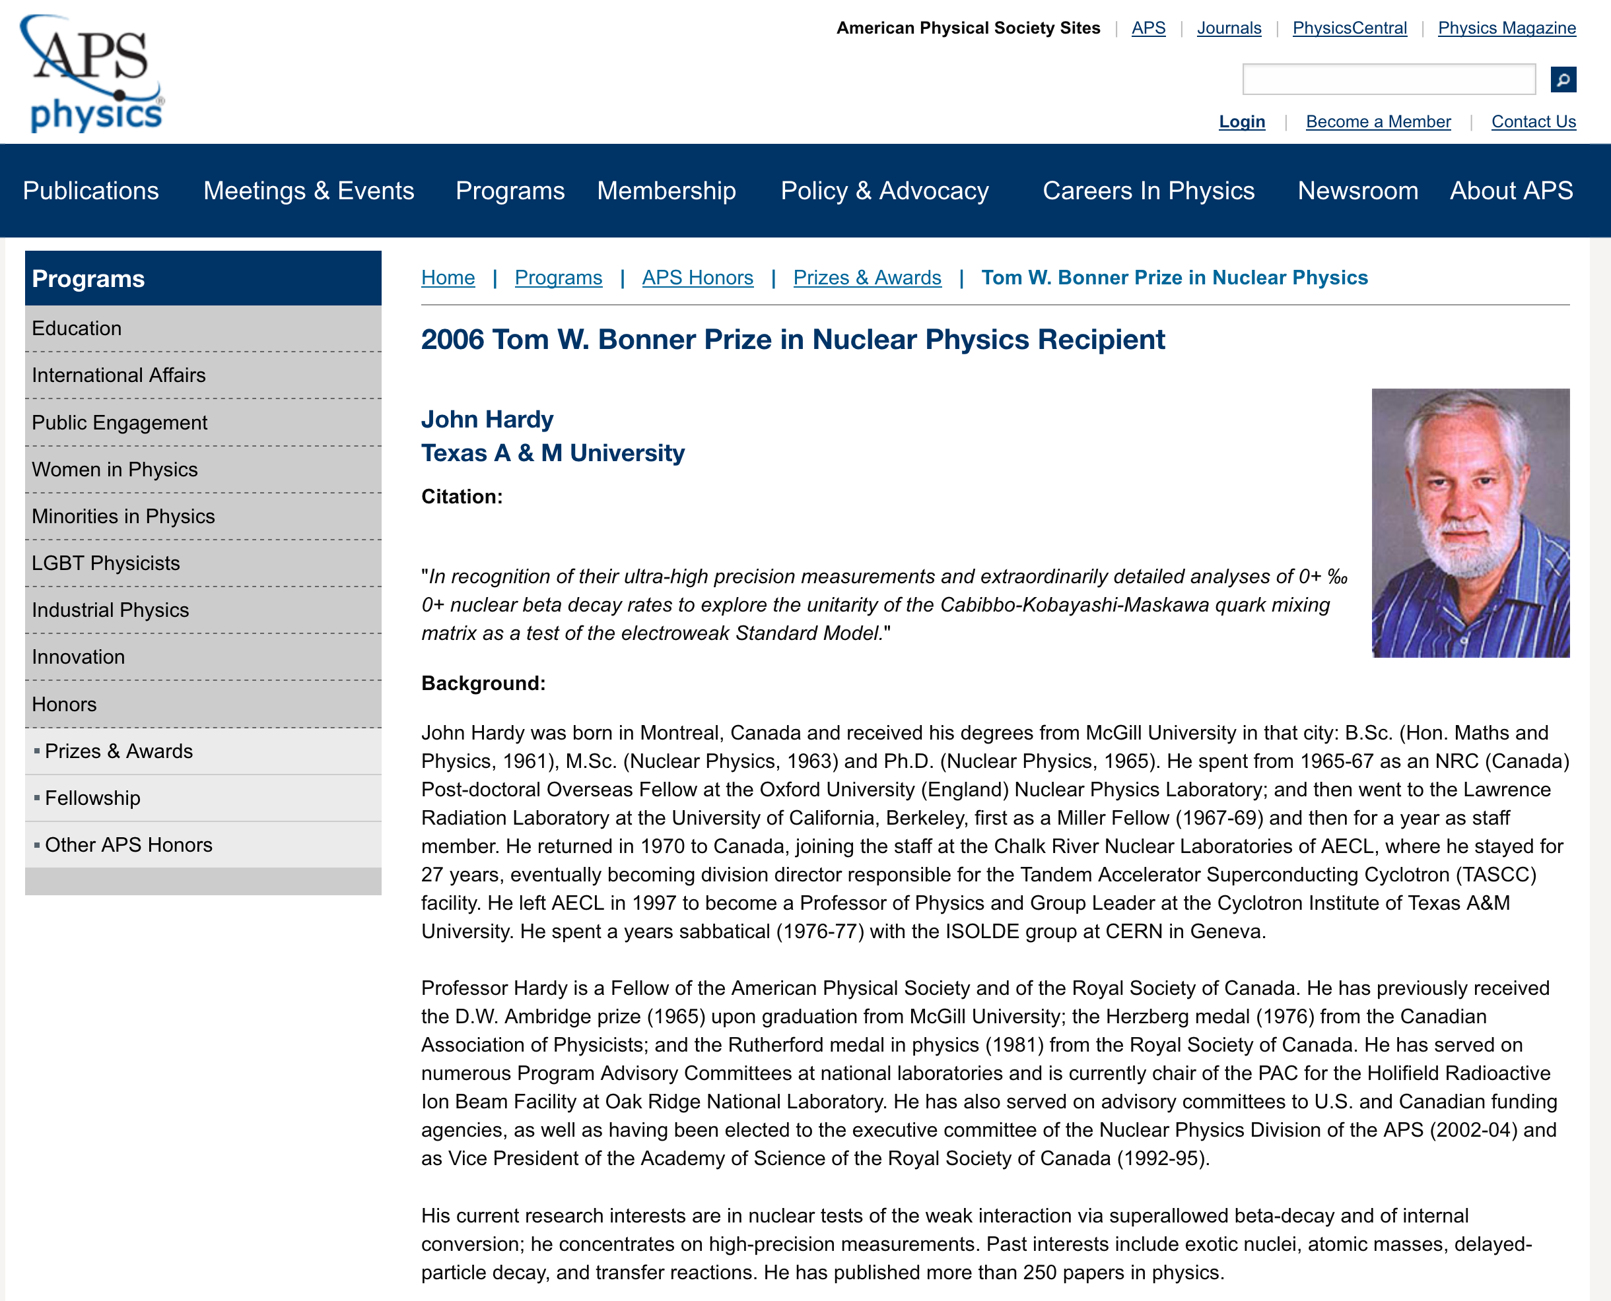
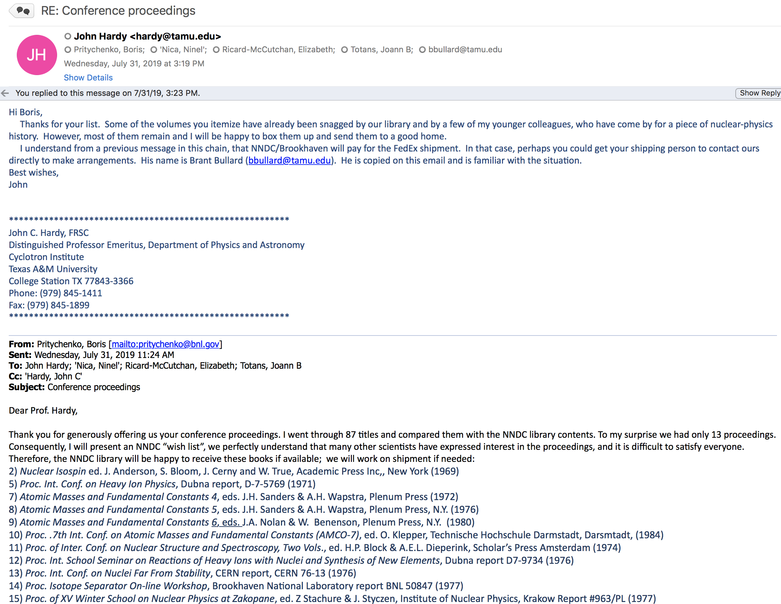
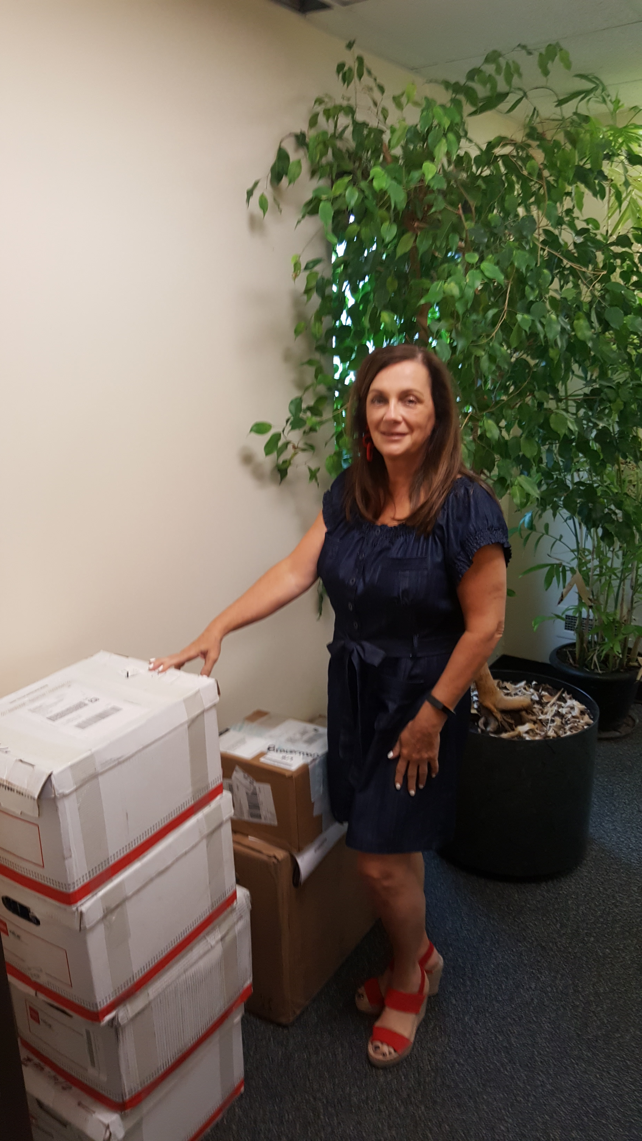
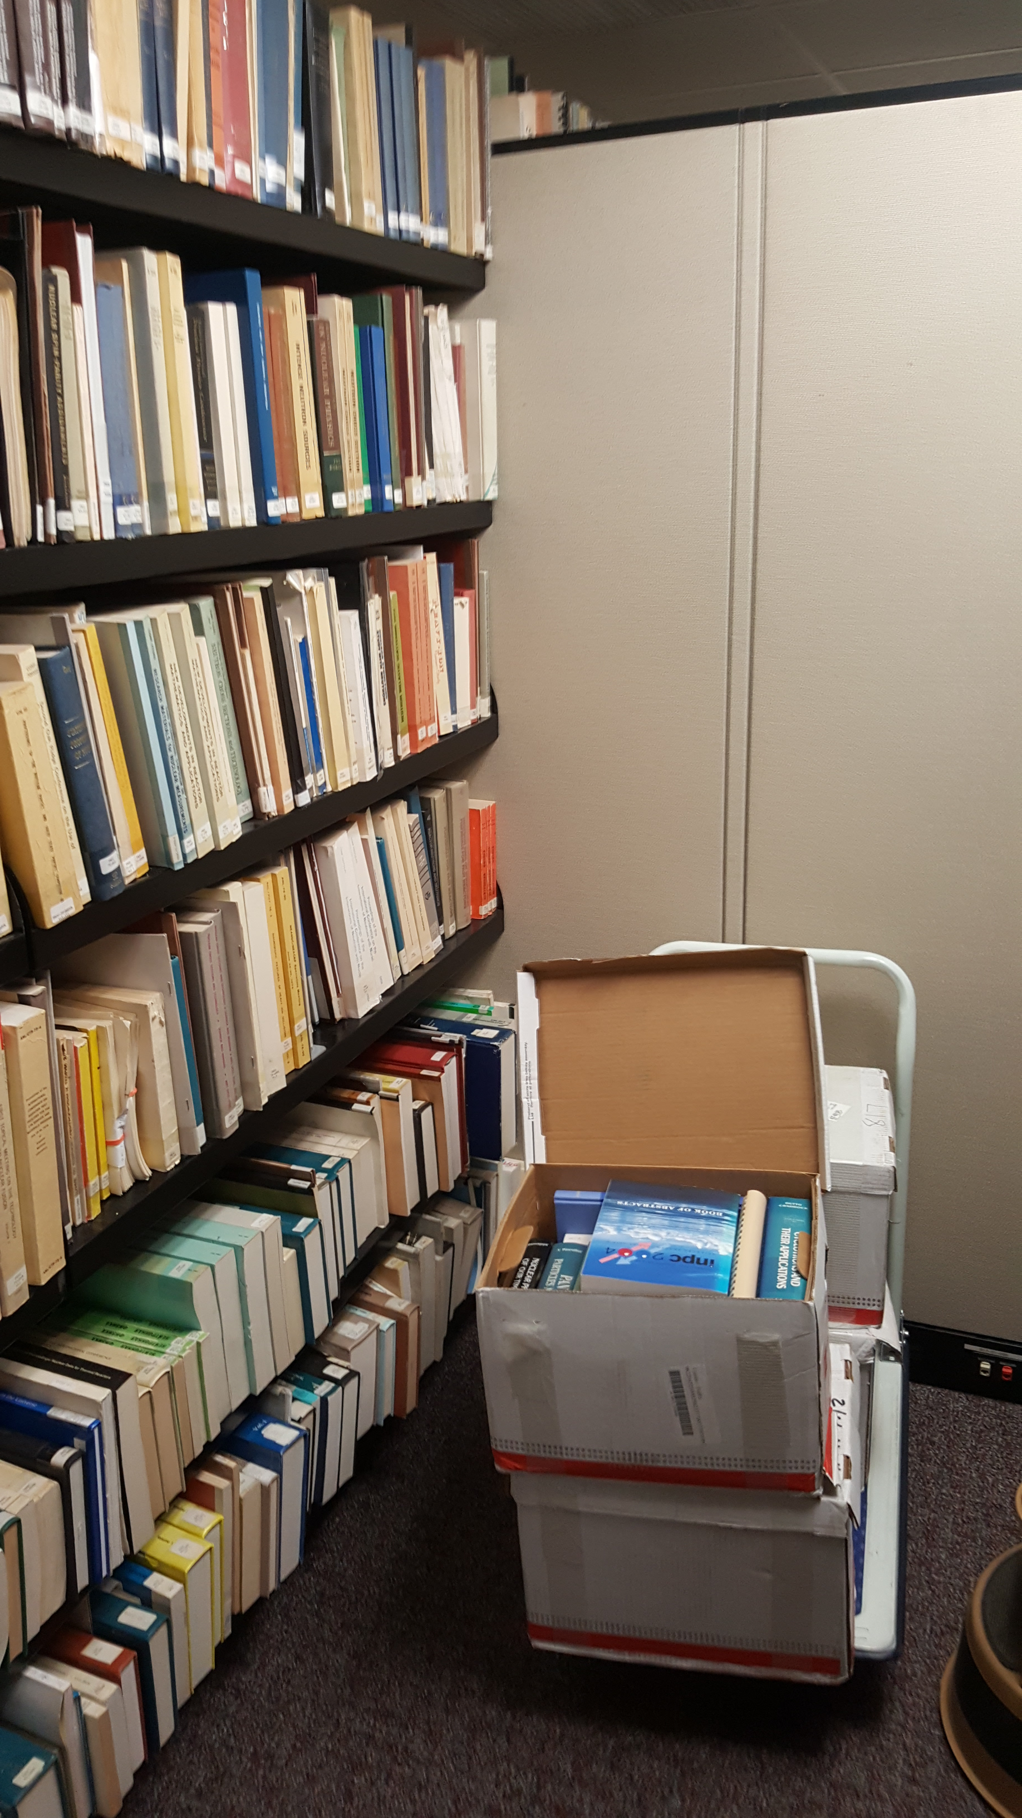
Missing Data Collection II
NNDC: Donald Hughes library.
August 13, 2019: FedEx from Texas.

Slide 9
Takeaways
NSR & EXFOR projects are in a good shape, and we collaborate with the IAEA on these projects.
We will continue compilation support for nuclear structure and reaction research, evaluations, and theory.
We add new and previously missing references & experiments to NSR & EXFOR databases:
R. Height: Los Alamos Laboratory microfiches.
J. Hardy: Texas A&M University proceedings.

