Slide 1


LBNL/UCB Site Report
USNDP Meeting
8 November 2019
Lee Bernstein
Nuclear Science Division
Lawrence Berkeley National Laboratory
Department of Nuclear Engineering
University of California - Berkeley
Andrew S. Voyles
13 June 2018 – Program Review for NSSC2 – TA1
Notes:
Emerging trends for next-generation (targeted & personalized) nuclear medicine:
Targeted alpha therapy (5-10 MeV)
40-80 μm range → single cell
Targeted Auger therapy (20 eV – 1 keV)
1 nm – 2 μm → cellular nucleus
Theranostic medicine
Simultaneous imaging and therapy

Slide 2
FY19 Personnel & FTE Breakdown
Name | Position | USNDP Activity | USNDP % | Other support
L.A. Bernstein | Staff | Coord, Measure., (n,n’γ) | 85% | NA-22, UC, Isotopes
M.S. Basunia | Staff | ENSDF, XUNDL | 95% | Isotopes
A.M. Hurst | Staff (UC) | (n,γ), (n,n’γ) | 40% | NA-22
J.C. Batchelder | Staff (UC) | β-p evaluation, ENSDF | 75% | Isotope Program
A.S. Voyles | PD → RE | Reac. measure., comp. | 25% | Isotope Program
J.A. Brown | Staff (UC) | ²³⁸U(n,n’γ), (n,f) yields | 80% | DOE-NE/NA-22
J.T. Morrell | GS | (n,x) Isotope Production | 0% | Isotope Program
A. Lewis | GS | Reaction eval. (n,n’γ) | 0% | Rickover fellow
J. Matheny | GS | Gamma-Xray Database | 0% | DTRA-PNNL
E.F. Matthews | GS | Fission modeling | 10% | NSSC fellow
I. Kolaja | UG | (n,n’γ) | 10% | UC
M. Fox | GS | 75As(p,x) to 200 MeV | 0% | Isotope Program
R.B. Firestone | Ret. | (n,n’γ), (n,γ), RSF-CRP | 23%
J. Tuli | Ret. | ENSDF | 35%
USNDP Fraction≈33%
(GS limited to 50%)

Slide 3
Structure Compilation/Evaluation
Nuclides/Mass chain (submitted): total 37 nuclides
  A = 186 (14 nuclides) – Batchelder, Hurst, and Basunia
  A = 229 (11 nuclides) – Tuli and Browne
  A = 233 (11 nuclides) – Tuli, Browne, and Singh
  A = 218 (1 nuclide of 11) – Singh et. al. (ICTP, IAEA)
XUNDL:
  6 datasets from 5 papers (Basunia)
Mass chain review: 2
  A = 50 – Basunia, A = 218 (Tuli)
NSR (Batchelder):
  174 articles (training) 30 articles (post training)
β-p horizontal evaluation close to publication (Batch)

Slide 4
Publications (15+2 accepted) (#6 on hidden)
2019Tu06: Nucl. Data Sheets 157, 260 (2019) J.K. Tuli and E. Browne, Nuclear Data Sheets for A=82. doi: 10.1016/j.nds.2019.04.002
2018Ba41: Nucl. Data Sheets 153, 1 (2018) C.M. Baglin, E.A.McCutchan, S. Basunia, E. Browne, Nuclear Data Sheets for A=170 doi: 10.1016/j.nds.2018.11.001
NSDD report: INDC(NDS)-0783, 2019, J.K. Tuli, A. Nichols, E. McCutchan, & P. Dimitriou
2019Hu07: Phys. Rev. C 99, 024310 (2019); A.M.Hurst, A.Sweet, B.L.Goldblum, R.B.Firestone, M.S.Basunia, L.A.Bernstein, Zs.Revay, L.Szentmiklosi, T.Belgya, J.E.Escher, I.Harsanyi, M.Krticka, B.W.Sleaford, J.Vujic; Radiative-capture cross sections for the ¹³⁹La (n,γ) reaction using thermal neutrons and structural properties of ¹⁴⁰La. doi: 10.1103/PhysRevC.99.024310
2019Ba16: Phys.Rev. C 99, 044612 (2019); J.C.Batchelder, S.-A.Chong, J.Morrell, M.A.Unzueta, P.Adams, J.D.Bauer, T.Bailey, T.A.Becker, L.A.Bernstein, M.Fratoni, A.M.Hurst, J.James, A.M.Lewis, E.F.Matthews, M.Negus, D.Rutte, K.Song, K.Van Bibber, M.Wallace, C.S.Waltz; Possible evidence of nonstatistical properties in the 35Cl (n, p) 35S cross section doi: 10.1103/PhysRevC.99.044612

Slide 5
Publications (15+2 accepted) (#6 on hidden)
2018Ga34: Phys.Rev.Lett. 121, 222501 (2018); J.M.Gates, G.K.Pang, J.L.Pore, K.E.Gregorich, J.T.Kwarsick, G.Savard, N.E.Esker, M.Kireeff Covo, M.J.Mogannam, J.C.Batchelder, D.L.Bleuel, R.M.Clark, H.L.Crawford, P.Fallon, K.K.Hubbard, A.M.Hurst, I.T.Kolaja, A.O.Macchiavelli, C.Morse, R.Orford, L.Phair, M.A.Stoyer; First Direct Measurements of Superheavy-Element Mass Numbers. doi: 10.1103/PhysRevLett.121.222501
2019Le12: Eur. Phys.J. A 55, 141 (2019); A.M.Lewis, L.A.Bernstein, T.Kawano, D.Neudecker; Ratio method for estimating uncertainty in calculated gamma cascades. doi: 10.1140/epja/i2019-12826-y
2019Ze03: Phys. Rev. C 100, 024305 (2019); F.Zeiser, G.M.Tveten, G.Potel, A.C.Larsen, M.Guttormsen, T.A.Laplace, S.Siem, D.L.Bleuel, B.L.Goldblum, L.A.Bernstein, F.L.Bello Garrote, L.Crespo Campo, T.K.Eriksen, A.Gorgen, K.Hadynska-Klek, V.W.Ingeberg, J.E.Midtbo, E.Sahin, T.Tornyi, A.Voinov, M.Wiedeking, J.Wilson; Restricted spin-range correction in the Oslo method: The example of nuclear level density and γ-ray strength function from ²³⁹Pu (d, pγ)²⁴⁰Pu. doi: 10.1103/PhysRevC.100.024305

Slide 6
Publications (15+2 accepted) (#6 on hidden)
2018Tr07: Phys.Rev. C 98, 034309 (2018) J.L.Tracy, J.A.Winger, B.C.Rasco, U.Silwal, D.P.Siwakoti, K.P.Rykaczewski, R.Grzywacz, J.C.Batchelder, C.R.Bingham, N.T.Brewer, L.Cartegni, A.A.Ciemny, A.Fijalkowska, C.J.Gross, C.Jost, M.Karny, K.Kolos, A.Korgul, W.Krolas, Y.Liu, M.Madurga, C.Mazzocchi, A.J.Mendez, K.Miernik, D.Miller, S.Padgett, S.V.Paulauskas, D.W.Stracener, M.Wolinska-Cichocka, M.M.Rajabali, E.F.Zganjar Updated beta-decay measurement of neutron-rich 74C http://10.1103/PhysRevC.98.034309
Science Advances 11 Sep 2019: Vol. 5, no. 9, eaaw5526; Daniel Rutte, Jonathan Morrell, Liqiang Qi, Mauricio Ayllon, Paul R. Renne, Karl van Bibber, Jonathan Wilson, Tim A. Becker, Jon Batchelder, Lee Bernstein, Mathieu Lebois, Jay James, Su-Ann Chong, Will Heriot, Max Wallace, Angel Marcial, Charles Johnson, Graham Woolley, Parker Adams, Howard Mattis; Boutique Neutrons Advance 40Ar/39Ar-geochronology.
Annu. Rev. Nucl. Part. Sci. 2019.69:109-136. Lee A Bernstein, David A Brown, Arjan J Koning, Bradley T Rearden, Catherine E Romano, Alejandro A Sonzogni, Andrew S Voyles, Walid Younes; Our Future Nuclear Data Needs.

Slide 7
Publications (15+2 accepted) (#6 on hidden)
Nuclear Inst. and Methods in Physics Research A. Available online 21 January 2019; James E. Bevins, Z. Sweger, N. Munshi, B.L. Goldblum, J.A. Brown, D.L.Bleuel, L.A.Bernstein, R.N. Slaybaugh; Performance evaluation of an energy tuning assembly for neutron spectral shaping. https://doi.org/10.1016/j.nima.2019.01.049
Nuclear Inst, and Methods in Physics Research A 922, 1 April 2019, Pages 36-46.; Jackson Van Dyke, LA Bernstein, Ramona Vogt; Parameter optimization and uncertainty analysis of FREYA for spontaneous fission. https://doi.org/10.1016/j.nima.2019.01.001
Measurement, Vol. 127, October 2018, Pages 580-587; M.Kireeff-Covo, R.A. Albright, B.F. Ninemire, M.B. Johnson, A. Hodgkinson, T. Loew, J.Y. Benitez, D.S. Todd, D.Z. Xie, T. Perry, L. Phair, L.A. Bernstein, J. Bevins, J.A. Brown, B.L. Goldblum, M. Harasty, K.P. Harrig, T.A. Laplace, S.B. Cronin; The 88-Inch Cyclotron: A one-stop facility for electronics radiation and detector testing. https://doi.org/10.1016/j.measurement.2017.10.018.

Slide 8
Publications (15+2 accepted) (#6 on hidden)
Neutron Spectroscopy for pulsed beams with frame overlap using a double time-of-flight technique. K.P. Harrig, B.L. Goldblum, J.A. Brown, D.L. Bleuel, L.A. Bernstein, J. Bevins, M. Harasty, T.A. Laplace, E.F.Matthews. Nuclear Inst. and Methods in Physics, A 877 359–366 (2018). https://doi.org/10.1016/j.nima.2017.09.051
Accepted for Publication:
Accepted for publication (9/3/19) Nuclear Inst. and Methods in Phys. Res. A; James M Mitrania, Drew P Higginson, Zack T Draper, Jonathan Morrell, Lee A Bernstein, Elliot L Claveau, Christopher M Cooper, Eleanor G Forbes, Ray P Golingo, Brian A Nelson, Andrea E Schmidt, Anton D Stepanov, Tobin R Weber, Yue Zhang, Harry S McLean, Uri Shumlak; Measurements of temporally- and spatially-resolved neutron production in a sheared-ow stabilized Z-pinch.
Accepted for publication EPJ-A – Hadrons and Nuclei; Jonathan T. Morrell, Andrew S. Voyles, M.S. Basunia, Jon C. Batchelder, Eric F. Matthews, and Lee A. Bernstein. Measurement of 139La(p,x) Cross Sections from 35{60 MeV by Stacked-Target Activation.

Slide 9
Submitted Publications (3)
"Recommended Values for Beta-Delayed Proton and Alpha Emission"
J. C. Batchelder, submitted to Atomic Data and Nuclear Data Tables – Final referee review
Resolution of a discrepancy in the γ-ray emission probability from the β decay of ¹³⁷Ce^{g} Submitted to PRC (with referees). M.S. Basunia, J.T. Morrell, M.S. Uddin, A.S. Voyles, C.D. Nesaraja, L.A. Bernstein, E. Browne, M.J. Martin, and S.M. Qaim.
Proton-induced reactions on Fe, Cu, & Ti from threshold to 55 MeV. Andrew S. Voyles, Amanda M. Lewis, Jonathan T. Morrell, M. Shamsuzzoha Basunia, Lee A. Bernstein, Jonathan W. Engle, Stephen A. Graves, Eric F. Matthews. Submitted to PRC (with referees)

Slide 10
Invited Talks (6)
“ENSDF: Structure via particle spectroscopy and a few tips for evaluation” - M. S. Basunia, Joint ICTP-IAEA Workshop on Nuclear Structure and Decay Data: Experiment, Theory and Evaluation, Trieste, Italy, Oct 15 – 26, 2018.
"Improving the double-differential 238U(n,n'gamma) cross section using neutron-gamma coincidences" – L.A. Bernstein, Workshop on Applied Nuclear Data Activities. Washington, DC. January 22 - 24, 2019. http://nucleardata.berkeley.edu/wanda
"Nuclear Data Activities in Support of Isotope Production" – L.A. Bernstein, Isotope Program Strategy Meeting, Bethesda, MD. April 8-10, 2019.
"Developing a National Nuclear Data Plan for National Security" – L.A. Bernstein, Director's Review of the Office of National and Homeland Security, LBNL. May 8, 2019.
"The Bay Area Nuclear Data Group" – L.A. Bernstein, 7th Workshop on Nuclear Level Density and Gamma Strength. Oslo, Norway. May 27 - 31, 2019
“Berkeley Nuclear Database Projects” – A.M. Hurst, Exotic Beam Summer School 2019, Oak Ridge National Laboratory, Oak Ridge, Tennessee, USA, June 24-29, 2019.

Slide 11
Coordination/Community Service (8)
Committee/conference/workshop leadership activities:
6th Compound Nuclear Reactions Workshop – September 22-27, 2018, Berkeley CA – Co-organizer. – L.A. Bernstein – Member of the Organizing Committee
Workshop for Applied Nuclear Data Activities – January 22-24, 2019, Washington, DC – L.A. Bernstein – Lead Organizer
Nuclear Structure 2020 – Member of the local organizing committee – L.A. Bernstein

Slide 12
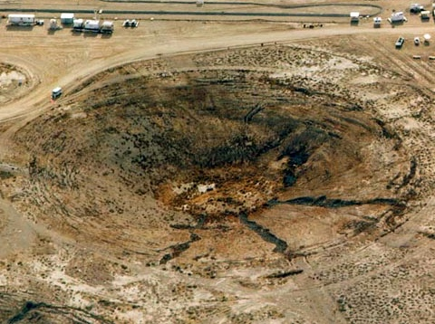

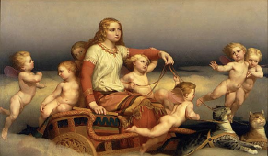
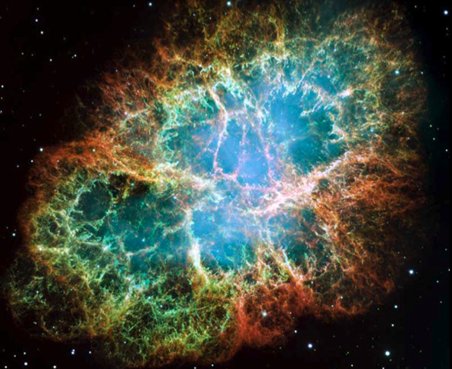
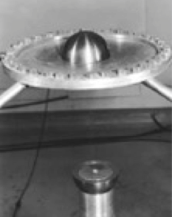
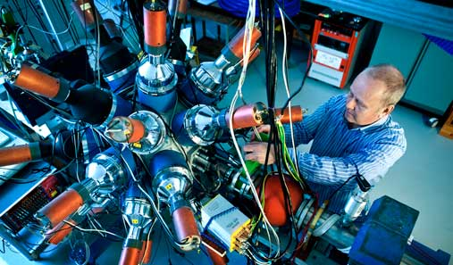
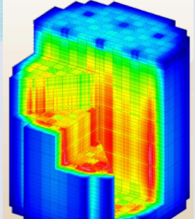
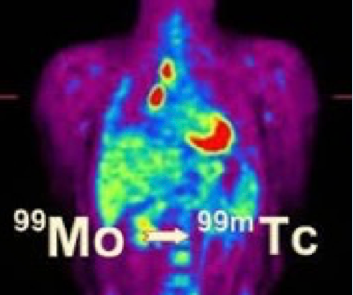
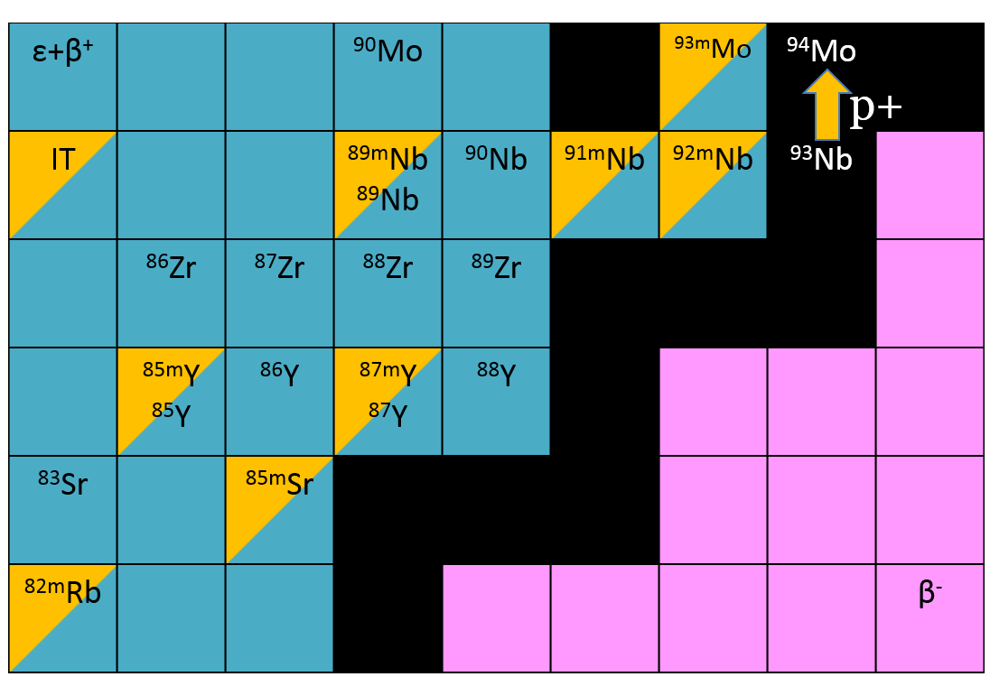
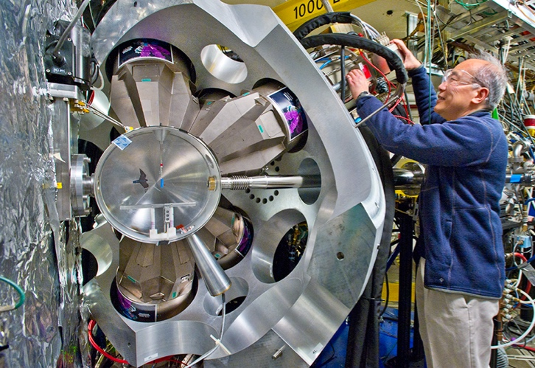
Much of our group’s work is directed at addressing nuclear data needs that cross the “structure-reactions divide”
FIER & FREYA codes (Matthews)
FREYA event generator (Jackson/Vogt)
Stewardship Science
Nonproliferation
Astrophysics
Radiative Strengths Geochronology
Criticality
Baghdad Atlas (Hurst, Lewis)
Nuclear Data
Nb, La, As(p,x)
(Voyles, Morrell, Fox)
³⁵Cl(n,p)
(Batchelder)
Isotope Program
Energy
ENSDF/XUNDL
γ-X database
(Basunia, Hurst, Batchelder, Tuli, and Browne)
Nuclear Science
Notes:
Emphasis on the last sentence

Slide 13
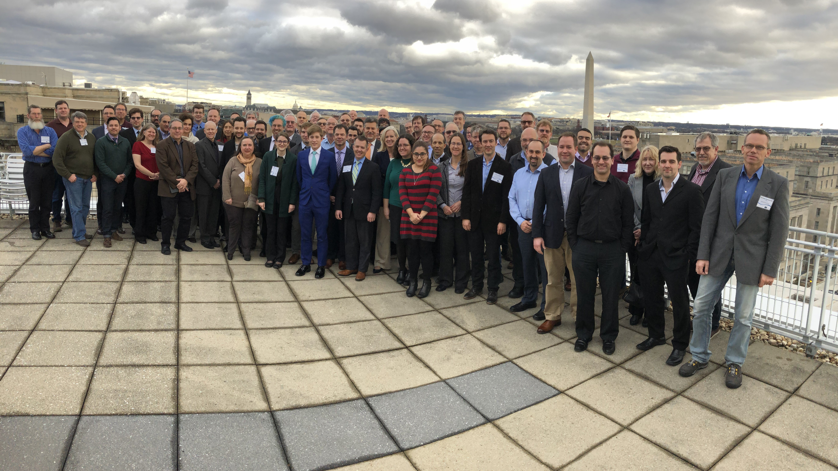
Noteworthy Event – WANDA 2019
The WANDA 2019 workshop at George Washington University in January 2019.
DOE Nuclear Energy, Isotope program and several NNSA offices needed guidance to plan nuclear data activities in FY20 forward.
A whitepaper was produced* and the input was used to provide guidance for the most recent Nuclear Data Interagency Working Group FOA (https://nucleardata.berkeley.edu/wanda/docs/WANDA_2019_Final_Report_040119.pdf)
We will support WANDA 2020 (Lead Organizer – Cathy Romano)
Workshop for Applied Nuclear Data Activities (WANDA)
January 22-24, 2019
George Washington University
Topics covered: Nuclear Energy, Isotope Production, Materials Damage Cross Sections, Safeguards and Atomic/XRF data
139 attendees from 48 labs, institutions and companies
Notes:
Emphasis on the last sentence

Slide 14
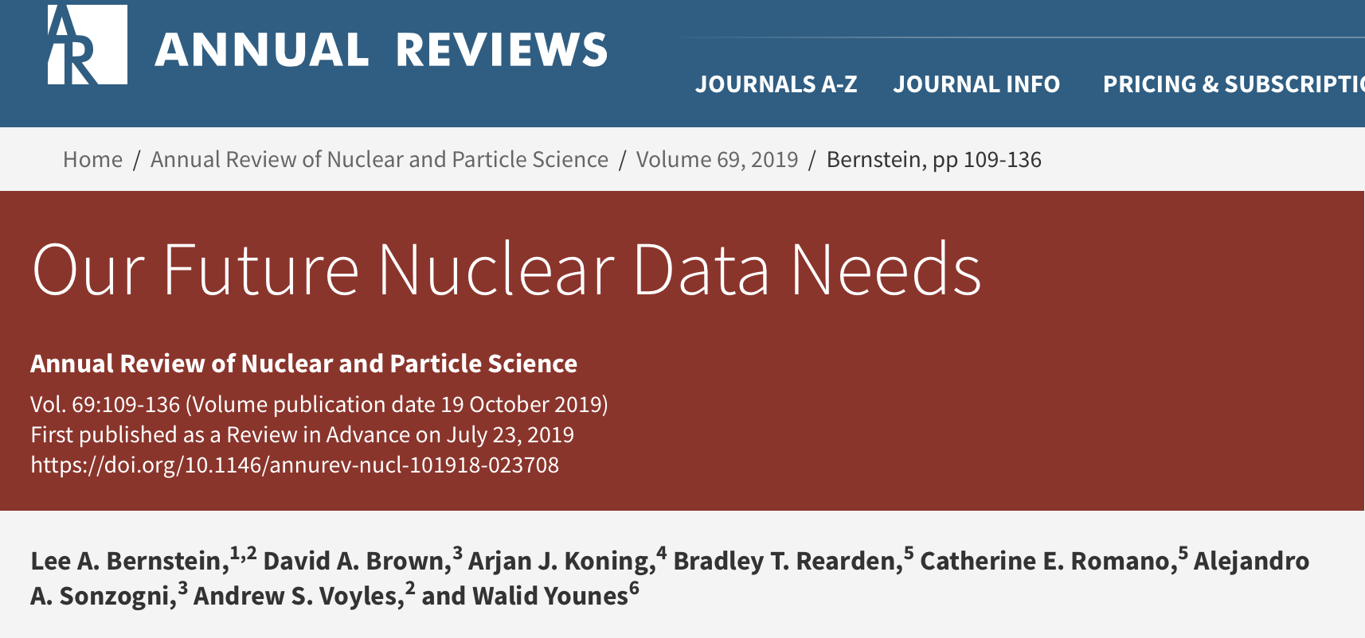
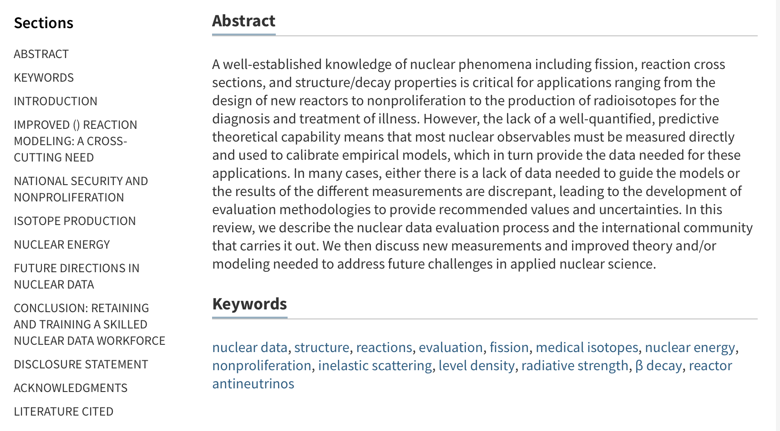
Noteworthy Papers – Our Future Nuclear Data Needs
We were invited to submit a review article to the 69th edition of the Annual Review of Nuclear and Particle Science.
The article serves as am intro to the compilation → evaluation → dissemination process and the major databases and lists high-priority needs in reaction modeling, national security/nonproliferation isotope production and nuclear energy.
Coauthors include Dave, Alejandro and Andrew
Notes:
Emphasis on the last sentence

Slide 15
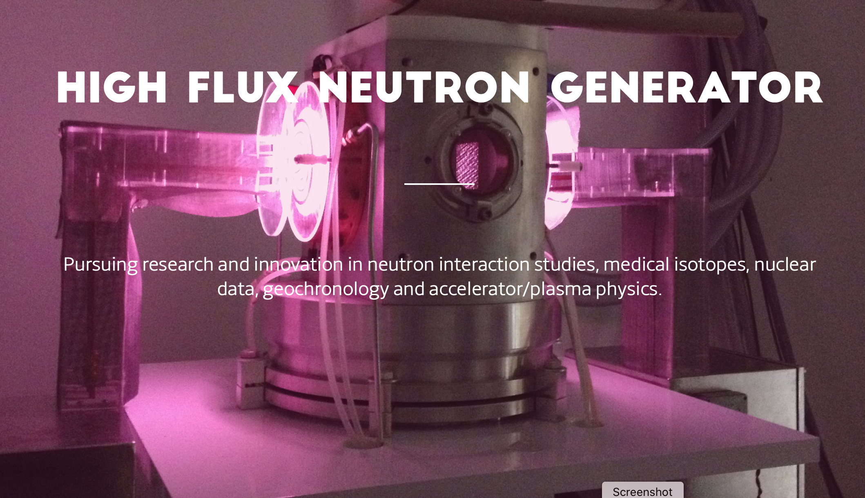
Noteworthy Papers – Science Advances and PRC
We measured the ³⁹K(n,p)⁴⁰Ar cross section at LICORNE and the HFNG
³⁹Ar from ³⁹K(n,p) is measured relative to ⁴⁰Ar via noble gas mass spectrometry
Notes:
Emphasis on the last sentence

Slide 16
Geochronology: K-Ar Dating Method
Rocks
We have some rocks. We want to know how old they are.
At formation, an initial fixed quantity of potassium is trapped in each rock.
Electron Capture Decay of ⁴⁰K to ⁴⁰Ar: half life of 1.2 billion years.
By measuring ⁴⁰K content versus ⁴⁰Ar content, can determine age of rock sample.
³⁹K
⁴⁰K
t_{1/2}=1.2 Gyr
⁴⁰Ar
Measure K Content
Determine Age
Measure Ar Content

Slide 17
Geochronology: ⁴⁰Ar/³⁹Ar Variant
Rocks
Enter nuclear physics: the ³⁹K(n,p)³⁹Ar reaction.
Neutron irradiation of K-containing samples will produce ³⁹Ar.
Comparison of measurement of two Ar isotopes determines age.
³⁹K
³⁹K(n,p)³⁹Ar
³⁹Ar
⁴⁰K
t_{1/2}=1.2 Gyr
⁴⁰Ar
Measure K Cotent
Determine Age
Measure Ar Content

Slide 18
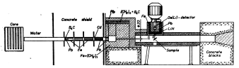
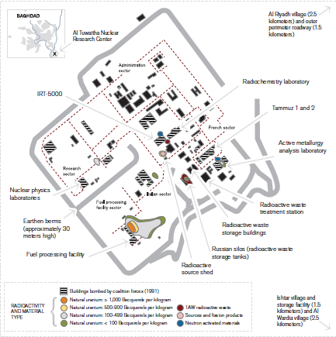
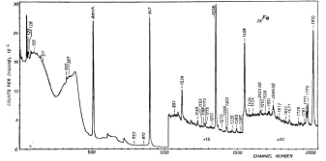
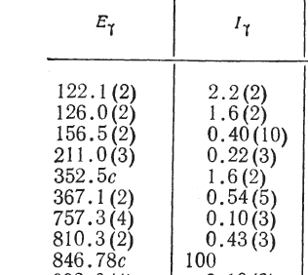
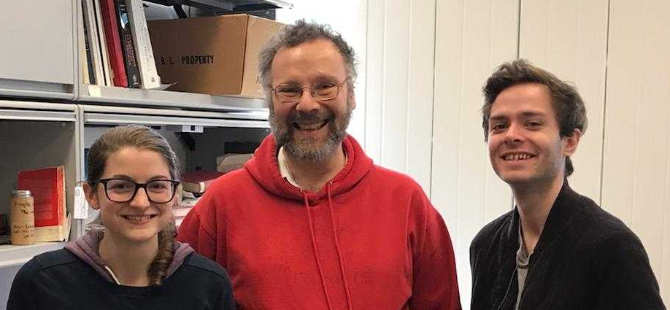
Noteworthy Project: The Baghdad Atlas
Baghdad Nuclear Research Facility (Al-Tuwaitha)
IRT-5000
Amanda Lewis
Ian Kolaja
Excellent Documentation and Consistent Measurements
Notes:
And now I’m going to use a couple of Lee’s slides to describe a data set that we are working on turning to a new benchmark with sensitivities to inelastic scattering gammas.

Slide 19
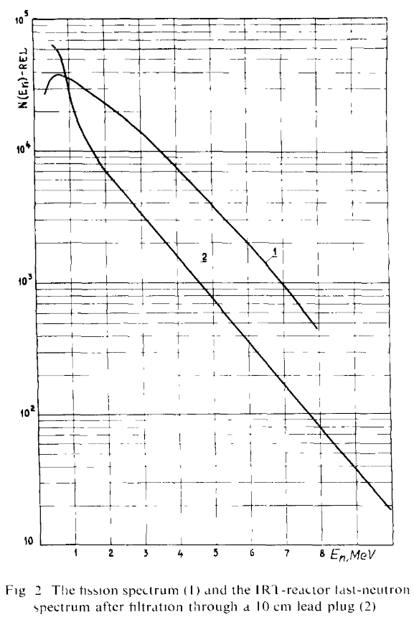
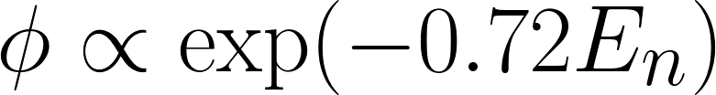
The flux shape is a large source of uncertainty in the modeling, and the available information is not specific enough
The flux was measured using threshold reactions and fit to an exponential
No data points were shown, and there was no uncertainty given on the fit parameter 0.72
The flux was therefore re-fit using information on the best known of the isotopes, ⁵⁶Fe
We convolved this flux with ENDF cross sections and the result didn’t fit the data at all ☹
Ahmed, M. R., et. al NIM 117(1974)
6
Notes:
Another source of uncertainty in the use of the benchmarks is in the modeling. In this case, the ATLAS values are integrated over the neutron spectrum at the Baghdad reactor, so it is critical to have a good understanding of that spectrum shape.
In a 1974 paper describing measurements at the reactor, an exponential

Slide 20
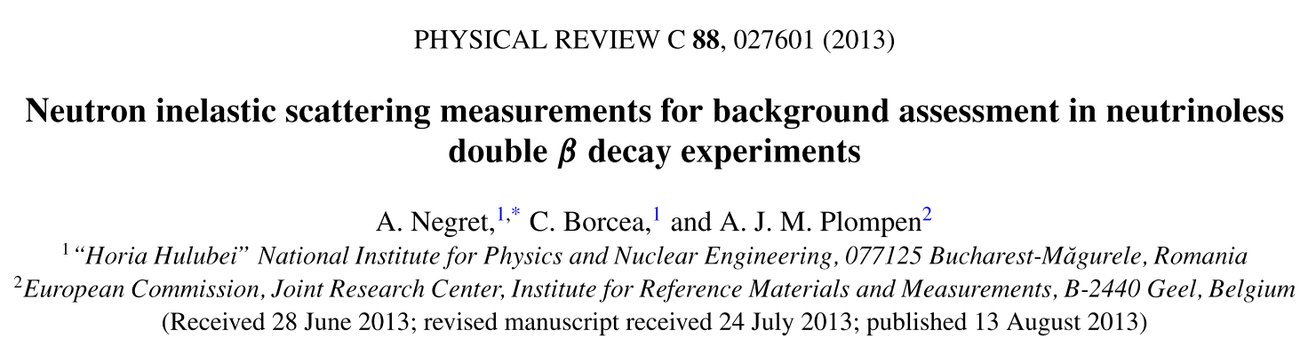
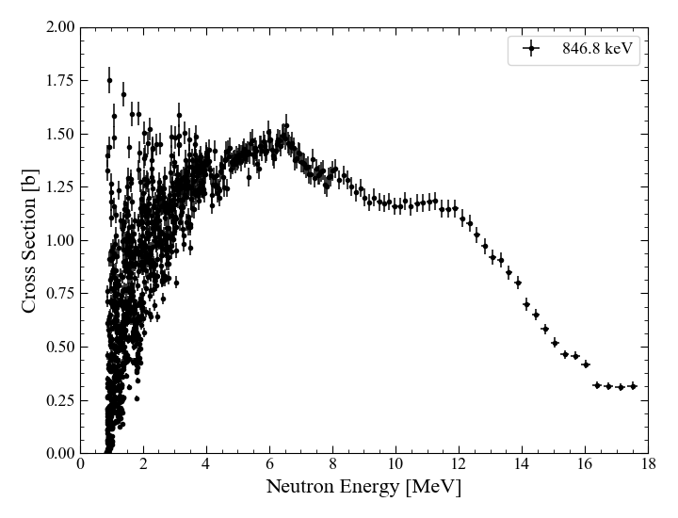
We used partial γ-ray cross section data for ⁵⁶Fe inelastic scattering from Negret, et al, was used to fit the Atlas reactor flux
Data for 20 gammas in EXFOR
The partial cross sections were integrated over reactor spectrum, and the ratios over the 847 were calculated for comparison with the ATLAS values
7

Slide 21
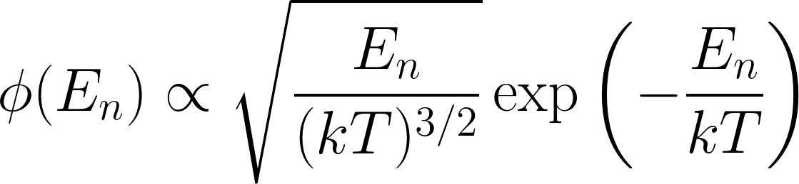
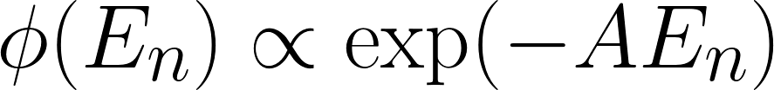
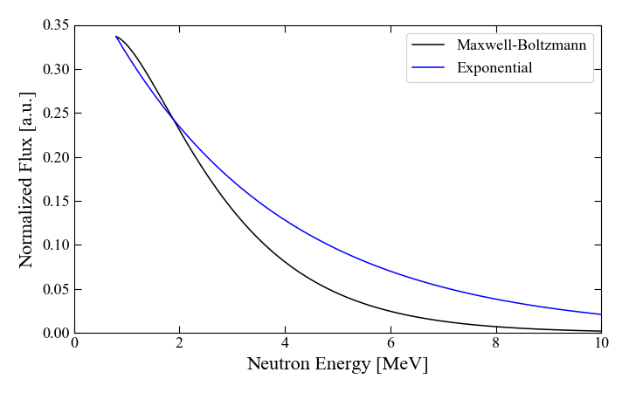
Both the exponential form and a Maxwell-Boltzmann were tested, and the MB was found to fit better
Exponential
  Initially fit by threshold reactions
Maxwell-Boltzmann
  Physically reasonable for reactor
8
Notes:
Exponential falls off much faster, is a softer spectrum than the MB – lower ratios

Slide 22
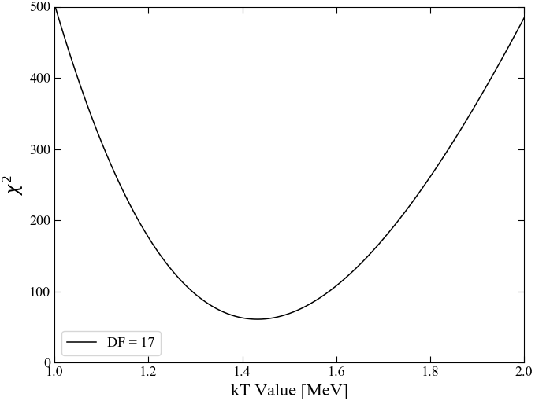

The best fit was found using chi-sq minimization
We found this very “validating” since the standard used for fast reactors is a MB with kT=1.42
kT_{opt} = 1.44
χ² = 60.5
11

Slide 23
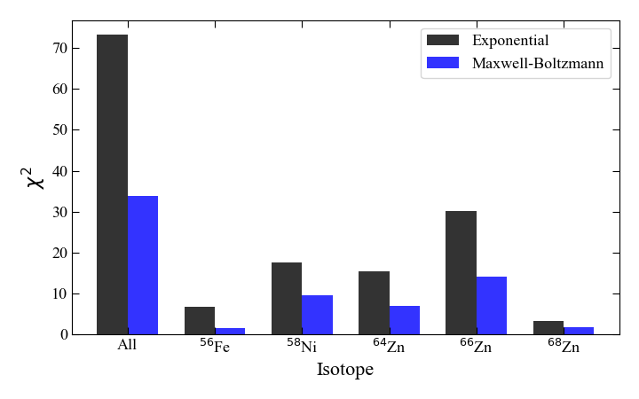
Validation of the MB flux shape was seen with improved TALYS calculations for several isotopes as well
Introduction ATLAS Flux Fitting Validation Future Work
13
Notes:
One example of this is the check that we did on the MB flux shape, where the ratios for several other f-p shell nuclei were calculated with Talys and compared to the ATLAS values. The new MB shape uniformly improved the ratios for all of the nuclei

Slide 24
Benchmarking of the models involved in the partial gamma cross section calculations – ⁶⁶Zn
Gamma cascades involve incoming angular momentum, level density, gamma strength functions, transition from continuum to discrete levels, and structure data of the discrete states
Level Energy [keV] | J^{π} | ATLAS Ratio | Talys Ratio
1039 | 2+ | 98.4456 | 99.7802
1872 | 2+ | 29.361 | 26.439
2372 | 0+ | 2.59067 | 3.89443
2451 | 4+ | 4.83592 | 5.83202
2703 | (3) | 1.5544 | 6.02295
Comparing the Atlas to model predictions will provide insight into both nuclear structure and reaction dynamics
Introduction ATLAS Flux Fitting Validation Future Work
14
Notes:
Now that we trust the flux shape, we can start treating this like a benchmark and testing the modeling of codes like TALYS.

Slide 25
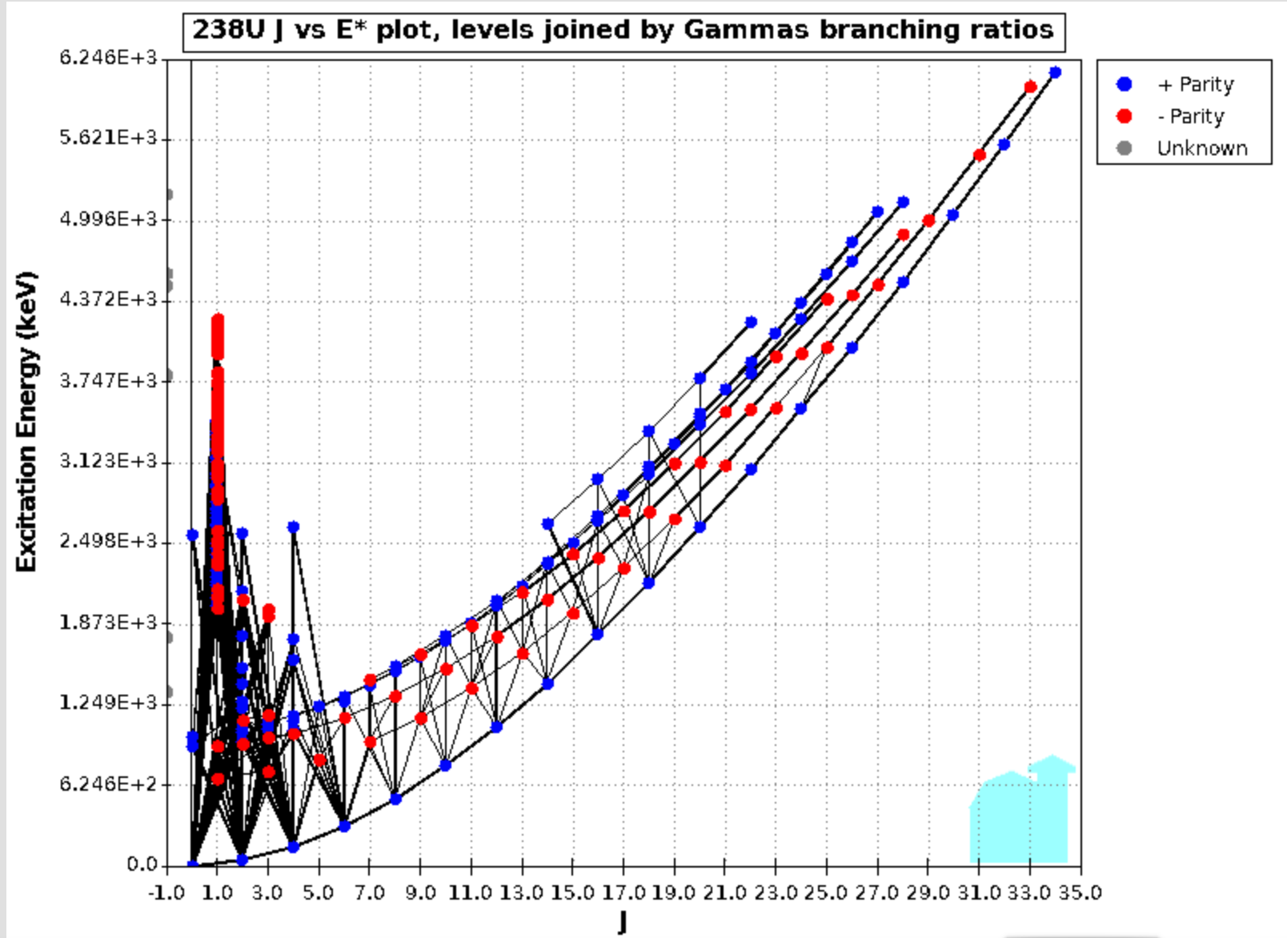
Tools that we are developing for a γ-X database with PNLL will allow us to compare (n,n’γ) from the Baghdad Atlas to ENDF
ENSDF Branching
Ratio Data
ENDF MT 50-91 (n,n’-L*) Data
We can use the γ-X database project γ−γ coincidence scripts to convert the (n,n’-L*) calculated using a model (e.g., EMPIRE, Talys, CoH etc.) to a given (n,n’γ) observed in the Atlas
Improved (n,n’γ) is now an emerging top priority for DNN and others
Notes:
25

Slide 26
Proposals
Nuclear Data Interagency Working Group | Funding | Period
²³⁸U(p,xn) & ²³⁵U(d,xn) ²³⁵⁻²³⁷Np Nuclear Reaction Cross Sections Relevant to the Production of ^{236g}Np (Lead PI: M. Fassbender) (IP) | $225k ($75k/yr) | 6/18-5/21
Improving the double-differential ²³⁸U(n,n’γ) cross section using neutron-gamma coincidences (NE+NP) | $600k ($200k/yr) | 11/18-10/21
Energy Dependent Fission Product Yields (NA-22) (Lead PI: A. Tonchev) | $600k ($200k/yr) | 11/18-10/21
DOE - Isotope Program | Funding | Period
Simultaneous Radionuclide Prod. using (d,2n) and Secondary (n,p) Reactions | $382k | 6/18-5/20
Measurement of charged particle-induced nuclear reaction cross sections important to the Isotope Program at LBNL, LANL, & BNL (Joint Program) | $380k* | 10/18-9/18*
Novel Methods for Th-229 Production through Fast Neutron Irradiation of Th-230 and Charged Particle Irradiation of Th-230 and Th-232 | $227k | 9/19-8/21
PNNL | Funding | Period
Positron-emitting analogs of ²²⁵Ac (Lead PI: B. Pierson) | $450k | 8/19-8/21
7 proposals submitted in FY19 (3 NDIAWG, 2 NEUP, 1 UC, 1 Norwegian Research Council
*renewable up to 3 more years

Slide 27
Planning/Future
WANDA will be an annual workshop
  We will provide support, but Cathy is leading
  Who will lead 2021? New Lab+Program led NDWG plan
Measurements activities
  Growing isotope production program
  New staff needed. Search underway.
Our evaluation work includes new database development
  The Baghdad Atlas as an (n,n’) validation database
  A Gamma+X-ray coincidence database (PNNL led)
  ChENDF?
We continue to train and recruit students into the field
  One candidate who worked on the Baghdad Atlas Kaixin Song, is now a student at NC State
  You’ve seen how great Amanda, Eric (Jon and Andrew) are :-)

