Slide 1
Status Report of MSU data center for FY19
Jun Chen
2019 USNDP meeting
November 2019, BNL

Slide 2
MSU nuclear data center
Independently funded by DOE in FY19
budget cycle (1 year): 12/15/2018 to 12/14/2019
awarded in 01/2019
FY20 renewal underway
recommendation received from DOE on 10/25/2019
expected to be awarded in 12/2019
Data personnel: 1.0 FTE (since 12/2014)
Primary responsibilities:
ENSDF evaluation (A=31-44)
XUNDL compilation
Code development

Slide 3
ENSDF evaluation at MSU
Current Responsibility: A=31-44
currently all are up-to-date (10-year update cycle)
the oldest one was updated in 2011
Completed in FY19:
* in collaboration with Balraj
Plan for FY20
A=194 (14 nuclides) and A=64 (13 nuclides), in collaboration with Balraj
A=xxx (to be determined)
A | #of nuclides | #of datasets | #of lines | #of Adopted Levels | #of Adopted Gammas
A=123 | 15 | 85 | 20,599 | 1255 | 1762
A=190* | 13 | 71 | 16,918 | 829 | 1332
A=149* | 17 | 101 | 26,175 | 1462 | 2393

Slide 4
XUNDL compilation at MSU
Commitment: one paper/week
Completed in FY19:
152 data sets from 54 papers
including 7 PRC-XUNDL data review
Goal for FY20:
~80 data sets from ~50 papers
Student involvements
trained top MSU undergraduates (recruited by Prof. H. Iwasaki) for XUNDL compilation:
2018: Amani Ahnuar
current: Pranjal Dangwal, Dave Lempke (both from Honors College in MSU)

Slide 5
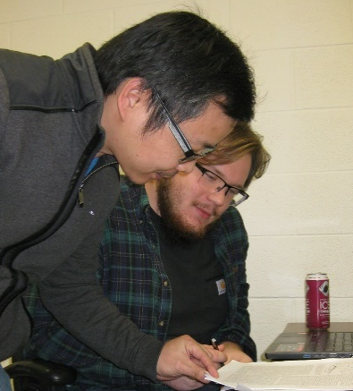
XUNDL compilation at MSU
Commitment: one paper/week
Completed in FY19:
152 data sets from 54 papers
including 7 PRC-XUNDL data review
Goal for FY20:
~80 data sets from ~50 papers
Student involvements
trained top MSU undergraduates (recruited by Prof. H. Iwasaki) for XUNDL compilation:
2018: Amani Ahnuar
current: Pranjal Dangwal, Dave Lempke (both from Honors College in MSU)
Amani
Dave
Pranjal

Slide 6
Code developments at MSU
ConsistencyCheck
Check data consistency among datasets, e.g., JPI, MULT, XREF, T1/2, etc.
Group levels and gammas to assist in preparing Adopted dataset
Average EG, RI, T1/2 and generate averaging comments in ENSDF
Other functions: setting up evaluation folders, sorting, merging/splitting datasets, etc.
Java-RULER
written in Java with all functions as in the old Fortran version
Solve issues with error propagations of large and asymmetric uncertainties
KeynumberCheck
Check all NSR keynumbers in datasets for format errors, irrelevant or nonexistent keynumbers (mostly due to mistyping)
Excel2ENSDF
A Java version of the Python codes xls2ens and ens2xls combined, with easier usage
Convert a tabulated Excel table to an ENSDF file, and vice versa
Also useful for multiplying a factor or adding a constant (or both) to all values of a record in an ENSDF file, e.g., adding S(n) to E(n)

Slide 7
List of Java codes developed/maintained at MSU
Name | Functions | Note | Last Update
ConsistencyCheck | check data consistency among ENSDF datasets, group levels and gammas, and average values from different datasets (with user selections), and more | considered as replacement of PANDORA with more functions; useful for preparing Adopted dataset | October 22, 2019
Excel2ENSDF | convert BETWEEN an Excel file (formatted data) and an ENSDF file; perform simple operations on column data in Excel, such as multiplying a factor or adding a constant (or both) to all values of a record, e.g., adding S(n) to E(n) | extensively used in XUNDL compilation and useful for extracting tabulated data from ENSDF | October 11, 2019
Java-RULER | calculate gamma-ray transition strengths in ENSDF file with proper error propagations of large/asymmetric uncertainties | solved a long-standing uncertainty calculating issue in the old FORTRAN code | June 6, 2019
KeynumberCheck | check all NSR key-numbers in ENSDF datasets for format errors, irrelevant or nonexistent key-numbers (mostly due to mistyping) by searching in an input list of key-numbers or in the NSR database directly. | useful to catch incorrect, irrelevant or non-existent key-numbers for the final check of an ENSDF evaluation | September 13, 2019
Java-NDS | generate LaTeX and PDF outputs from ENSDF file(s) for Nuclear Data Sheets and web-display of ENSDF and XUNDL databases on NNDC retrieval webpages | started at McMaster by Balraj and his students | October 21, 2019

Slide 8
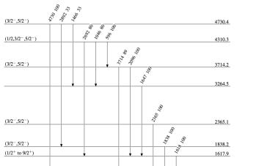
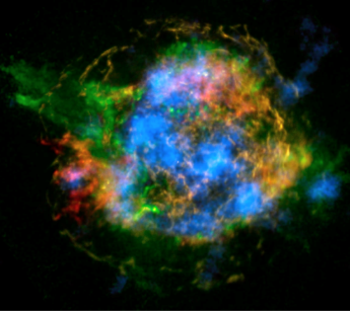
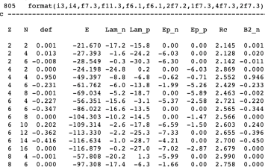
Proposed Expanded FRIB Nuclear Data Effort Addresses Data Needs in the FRIB Era
Addresses the diverse nuclear data needs in the FRIB area
Takes full advantage of synergies between data efforts in nuclear structure, reactions, astrophysics, and theory
Maximizes scientific impact and enables discoveries
Aligned with conclusions from 2016 Data Workshop at Low Energy Community Meeting
Complements existing efforts, integrated with NNDC
Takes advantage of leverage opportunities at MSU
0.5 FTE Nuclear Structure Evaluation
Another nuclear structure data evaluator at MSU to ensure the proper and timely compilation (XUNDL) and subsequent evaluation (ENSDF) of FRIB data
0.5 FTE Nuclear Astrophysics Evaluation
Makes nuclear data usable in astrophysics
Focus on reaction rate data evaluation
Connects structure data, reaction data, theory data and theory tools
Leverage opportunity with NSF Networks JINA-CEE and IReNA (community connection, field wide standards, ensure impact)
0.5 FTE Nuclear Theory
Provide a theoretical counterpart to ENDSF, fully integrated with NNDC
Theory data evaluation, curation, and dissemination
Structure
Astrophysics
Theory

Slide 9
Plans of MSU nuclear data program
propose to add 3 data FTEs
(funds: 0.5 MSU + 0.5 USNDP for each FTE)
ENSDF&XUNDL (1 FTE):
To ensure the proper and timely compilation (XUNDL) and subsequent evaluation (ENSDF) of FRIB data.
To help solve manpower shortage in ENSDF evaluation
Nuclear Astrophysics Data (1 FTE):
To build on and expand JINA-CEE Reaclib infrastructure
To provide a natural connection of structure and reaction efforts to USNDP
Nuclear Theory Database (1 FTE):
To provide a theoretical counterpart to ENDSF, fully integrated with NNDC
To interface theoretical database with ENDSF to be able to directly compare theory with experiment

