Slide 1
Neutron- and photon-induced cross-section measurements at TUNL
Dr. Krishichayan
TUNL & Duke University

Slide 2




Who are we?
TUNL/Duke
Krishichayan
S. Finch
C.R. Howell
W. Tornow
M. Ahmed
R.V.F. Janssen
LANL
M. Gooden
T. Bredeweg
M. Fowler
G. Rusev
D. Vieira,
J. Wilhelmy
LLNL
Jack Silano
A. Tonchev
M. Stoyer
ANL
David Rostch
Jerry Nolen
Jeongseog Song
Robin Kruijff

Slide 3
What motivates us?
Stockpile Stewardship applications
  Excitation functions: (n,γ), (n,el), (n,inel), (n,2n)
  Nuclear forensics
  Remote detection of SNM
Basic and applied nuclear physics
  Nuclear astrophysics
  Fission process
  Nuclear structure and reaction
Practical applications
  Advanced nuclear reactor design
  Dosimeter technique
  Determination of weapon yields
  Medical Isotope production
Neutrinoless double-beta decay
  Background estimates in 0νββ searches
Education of students, including Undergraduates

Slide 4
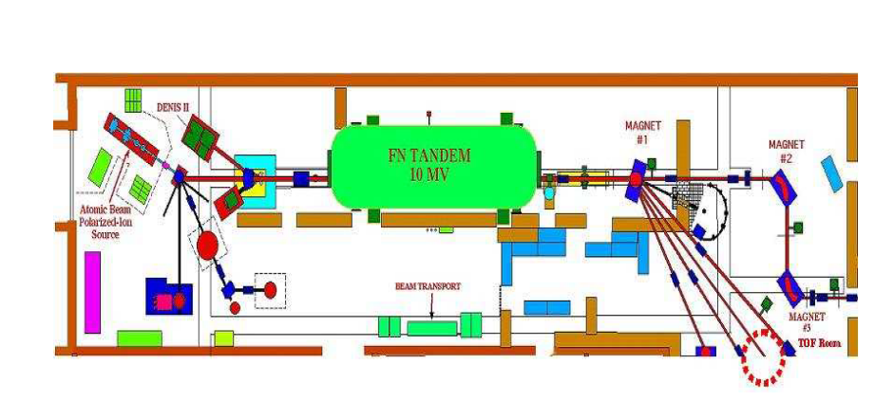
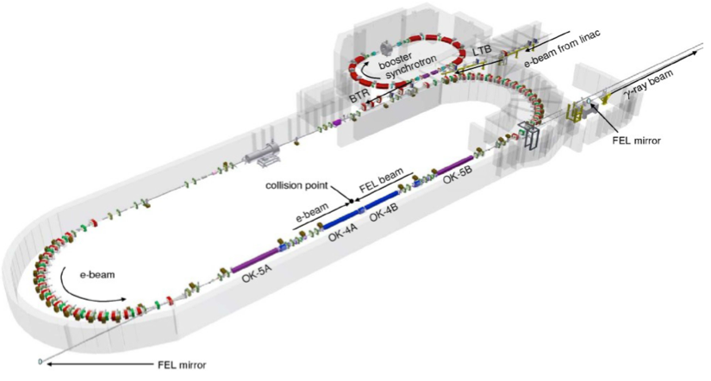
Tools we use
10 MV tandem
(mono-energetic neutrons)
HIγS
(mono-energetic photon beam)

Slide 5
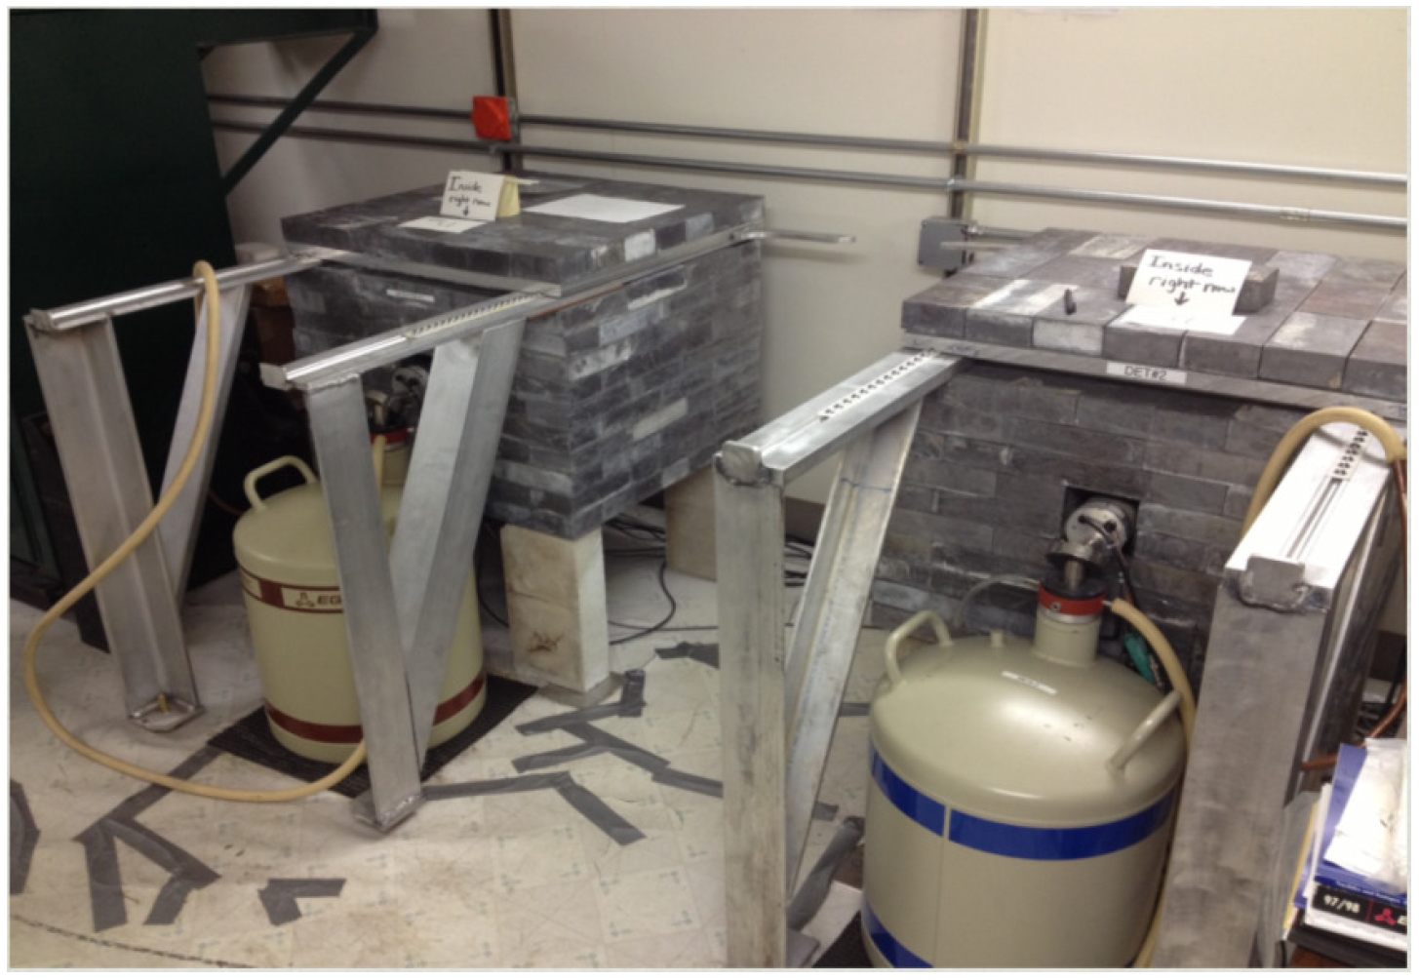
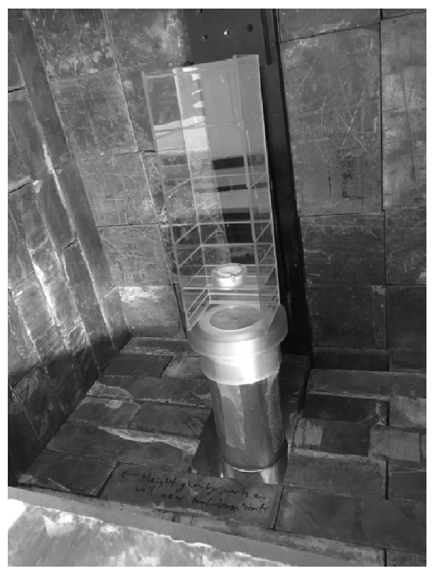
low-background counting facility
γ-ray counting done with Shielded HPGe detectors (TEN stations)
using the GENIE DAQ system, with enabled pile-up rejection.
Detectors are being kept cold for years and years!

Slide 6
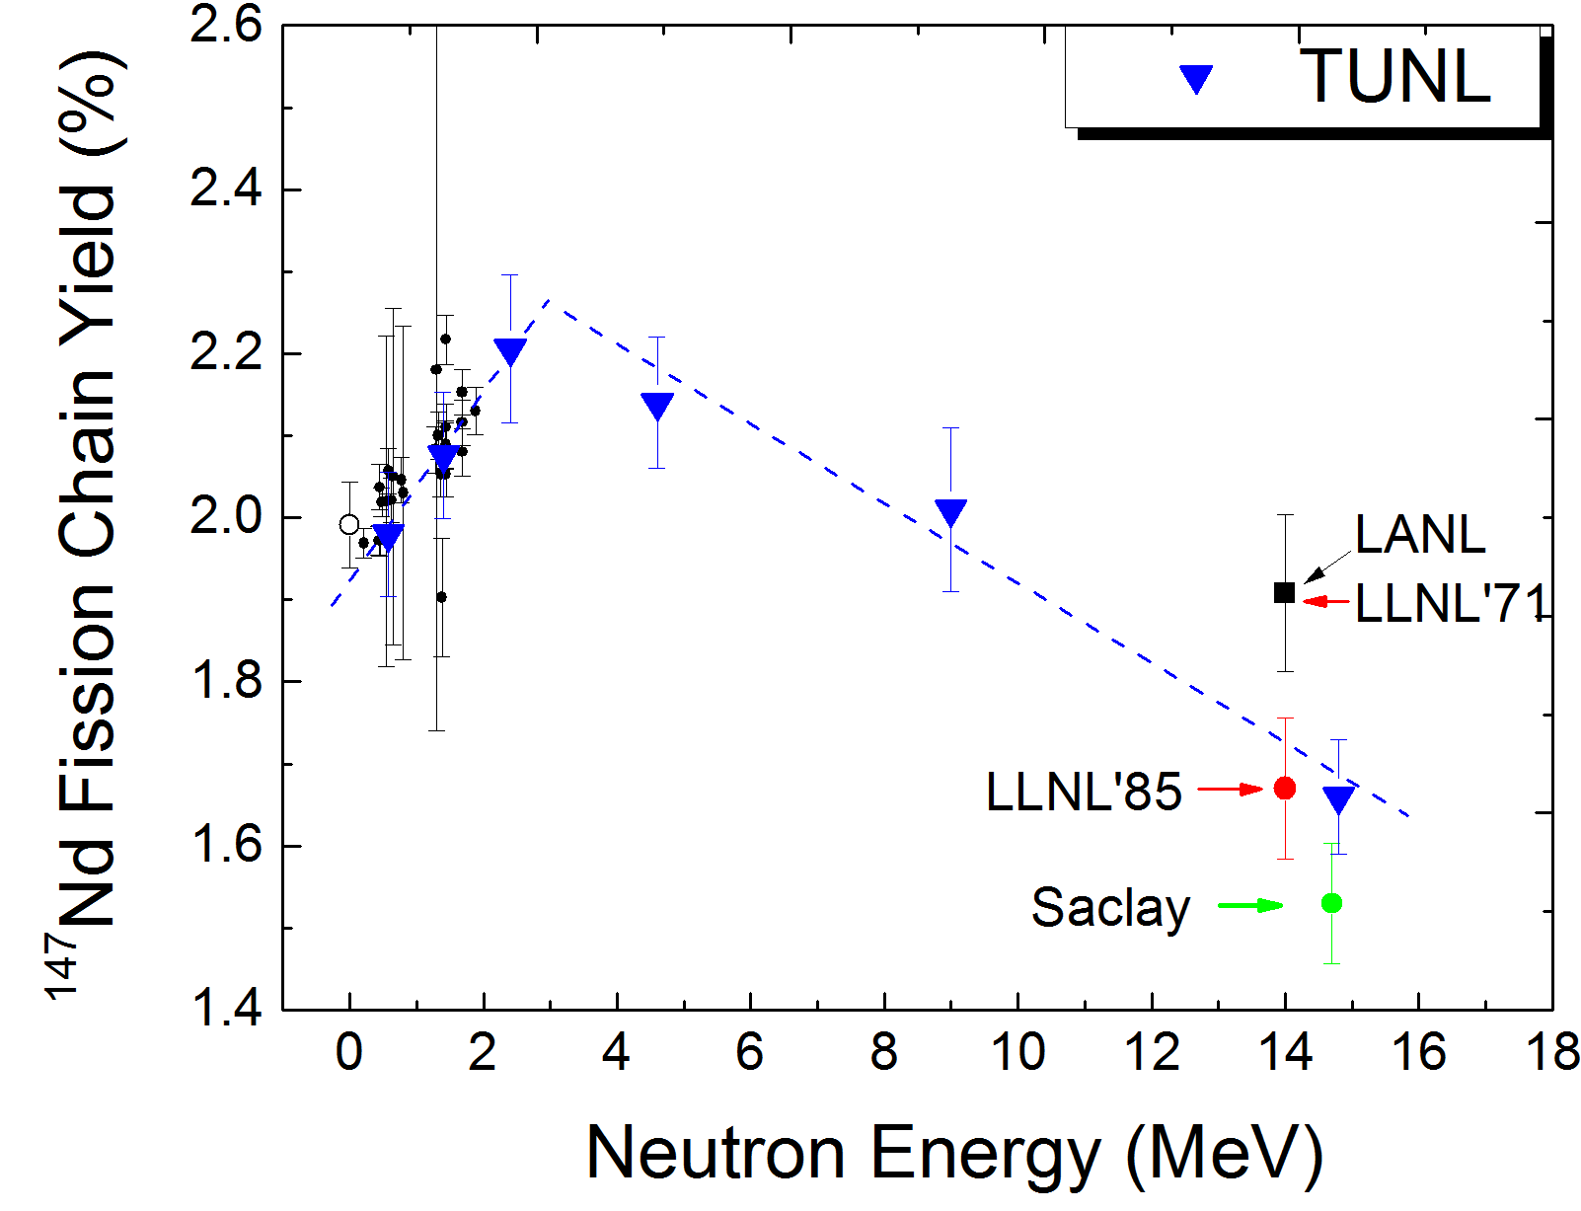
FPY measurements at TANDEM
TUNL-LANL-LLNL joint collaboration
Measure the energy dependence of selected high-yield fission products using monoenergetic neutron beams.
²³⁹Pu(n,f)
Goal is to provide an accurate, systematic investigation of the neutron energy dependence of several cumulative FPYs in the thermal to 15 MeV energy range.
M. Gooden et al.,
Nuclear Data Sheet 131, 319 (2016)

Slide 7
FPY measurements at HIγS
The photon-induced FPY measurements provide us a unique opportunity to explore the effect of the incoming probes on the FPY, photons versus neutrons.
Well understood electromagnetic probe offers some principal advantages over hadron-based reactions
  absence of a binding energy and Coulomb barrier
  unlike reactions with neutrons and charged particles, over a wide photon energy range practically the same angular momentum (1ħ or/and with much smaller probability also 2ħ) is transferred to the nucleus
A program has been initiated at TUNL to carry out systematic comparisons of the FPYs from neutron and photon induced fission of “big three” actinides (²³⁵U, ²³⁸U, and ²³⁹Pu).
For both (n,f) and (γ,f) reactions, the incident beam is mono-energetic, both measurements cover approximately same range of excitation energies, the same isotopes will be tracked in the FPY measurements, and the same counting detection system will be used.

Slide 8
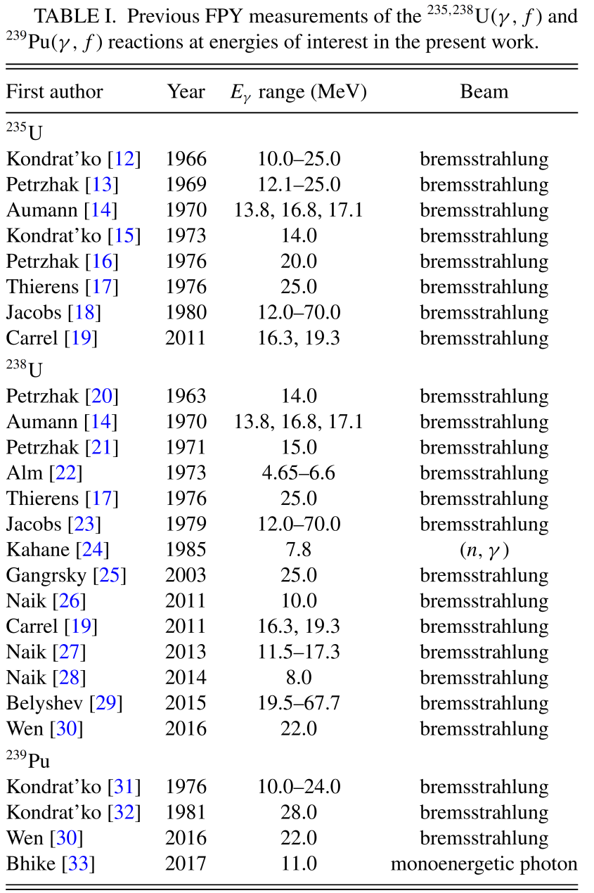
Previous FPY measurements

Slide 9
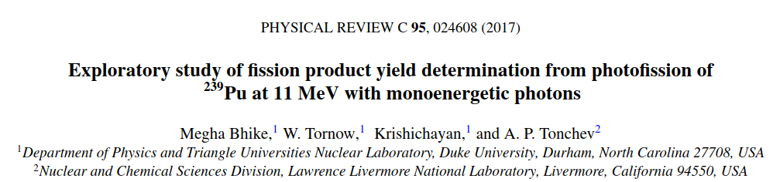
Exploratory study on Photo-fission
Short activation run (8 hours)
²³⁹Pu @ 11.0 MeV
¹⁹⁷Au: monitor foil to measure the gamma flux

Slide 10
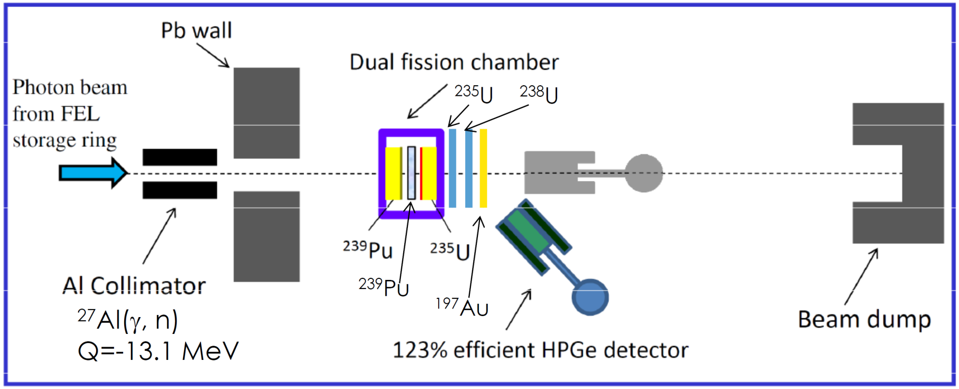
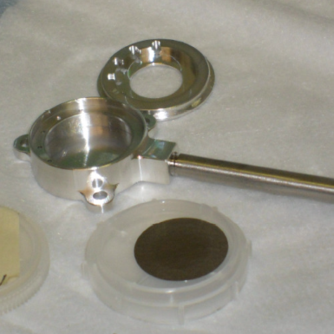
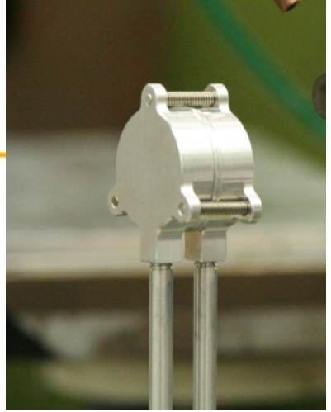
FPY measurements at HIγS using fission chamber
A dual fission chamber provides the rate of fission events
Samples irradiated for ~ 3 days using
circularly polarized 13 MeV photon beams

Slide 11
γ-FPY @ 13 MeV

Slide 12
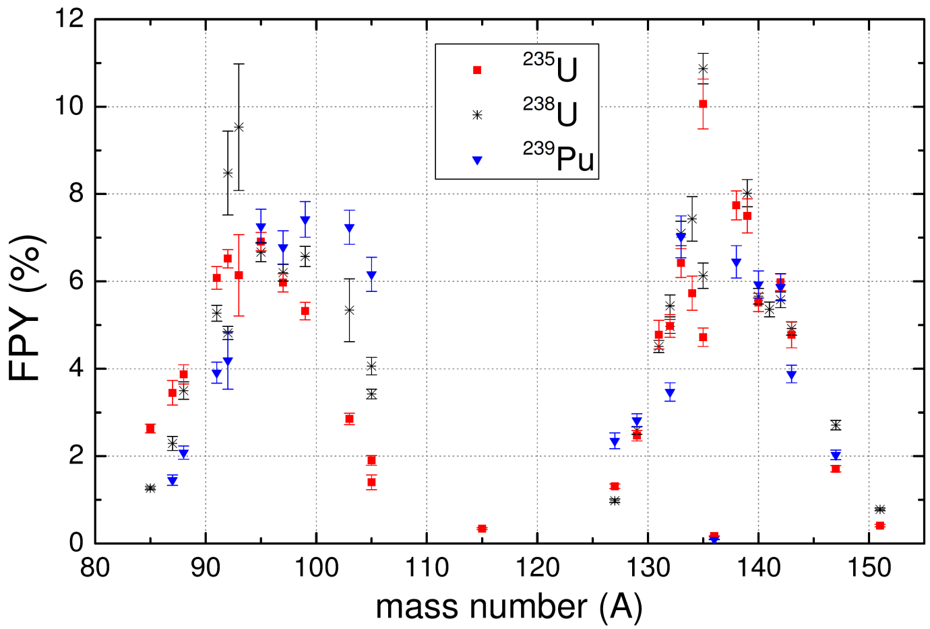
γ-FPY @ 13 MeV results

Slide 13
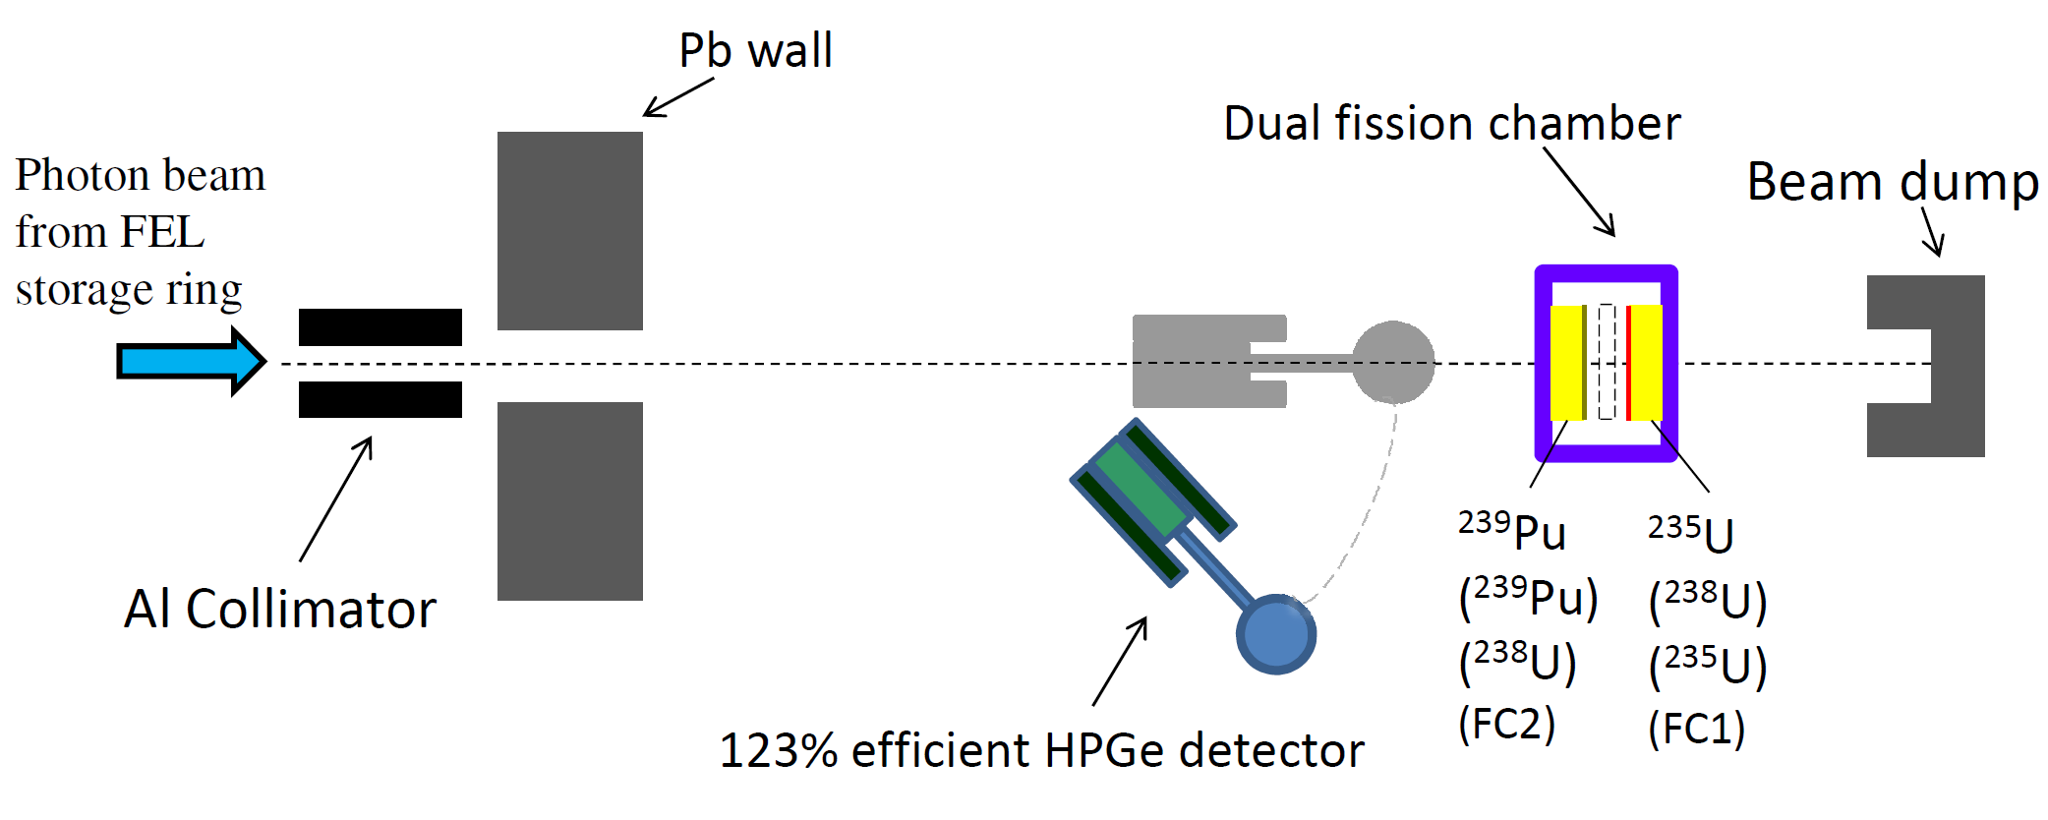
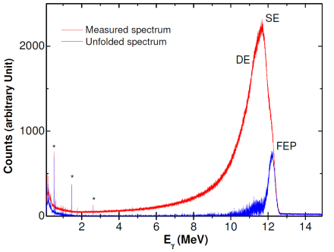
Photo-fission
CS ratio measurements
Took advantage of fission chambers
Technical paper

Slide 14
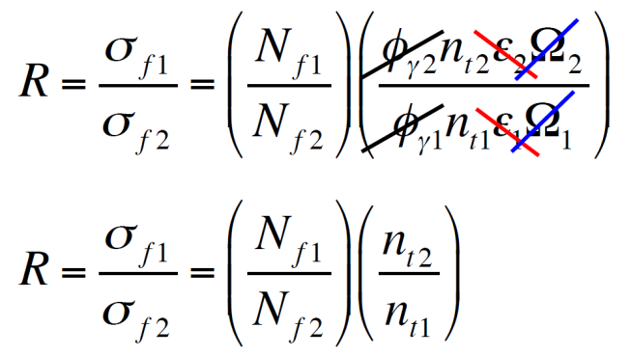
Photo-fission
CS ratio measurements
Very useful measurements for data evaluation

Slide 15
FPY measurements: moving up the decay chain

Slide 16
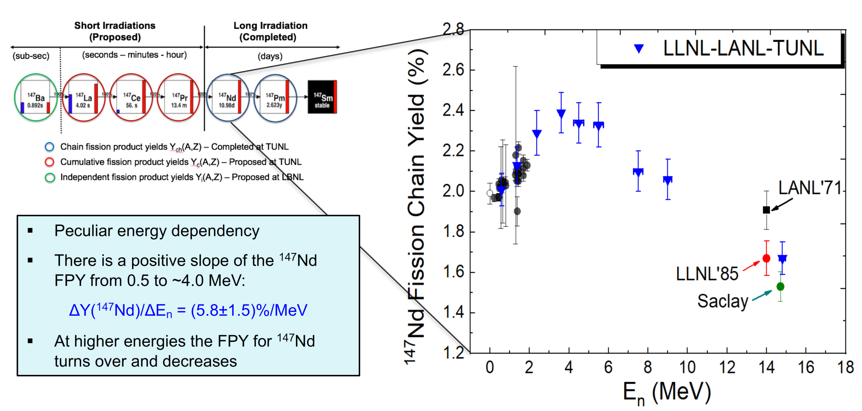
Long lived (T_{1/2} ~ days)

Slide 17
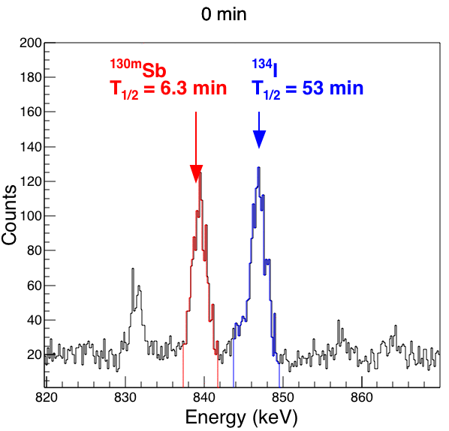
Short lived (T_{1/2} ~ minute to hour)
Expose to neutron/photon beam for 1-2 hr, begin counting immediately after (<5 min) and count continuously for 3-4 days
Reduce activity from long lived FPs, halving background

Slide 18
Short lived (T_{1/2} ~ minute to hour)

Slide 19
Short lived (T_{1/2} ~ minute to hour)

Slide 20
Very Short lived (T_{1/2} ~ seconds)

Slide 21
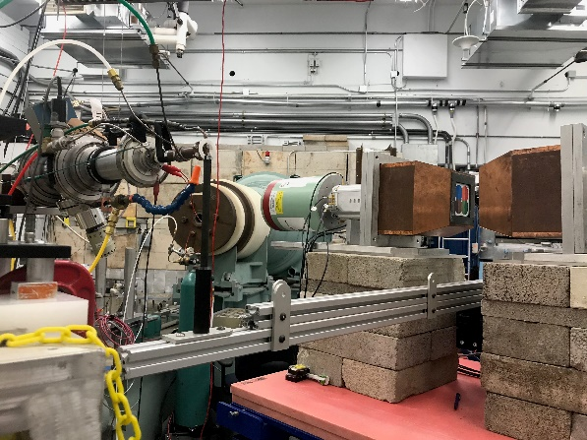
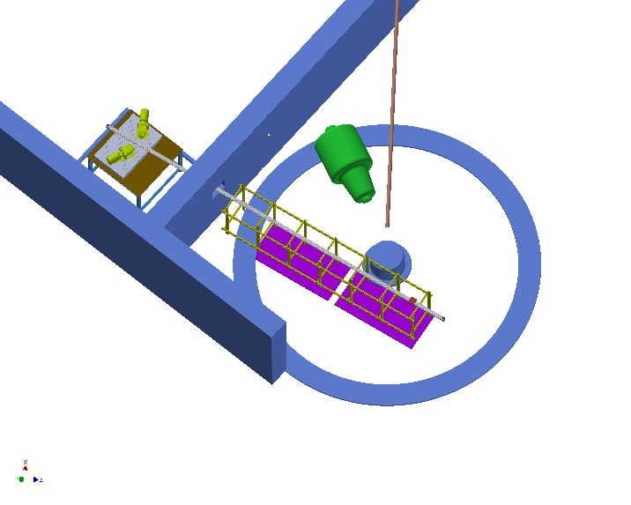
RABITTS
Goal: measure fission product yields for
²³⁵U, ²³⁸U, and ²³⁹Pu
Fission product T_{1/2} from <1 s to 100 s
Investigate dependence on neutron energy
Construction began December 2018
RApid
Belt-driven
Irradiated
Target
Transfer
System
Fully automated system
Moves between irradiation and counting positions
1 m track with 0.4 s transfer time
10 m track with 1 s transfer time
User set irradiation, transfer, and counting time
Servomotor controls sample position
Repeatability to ±33 µm
Soft acceleration and deceleration
Data acquisition system
Digital DAQ time stamps events to < µs precision

Slide 22
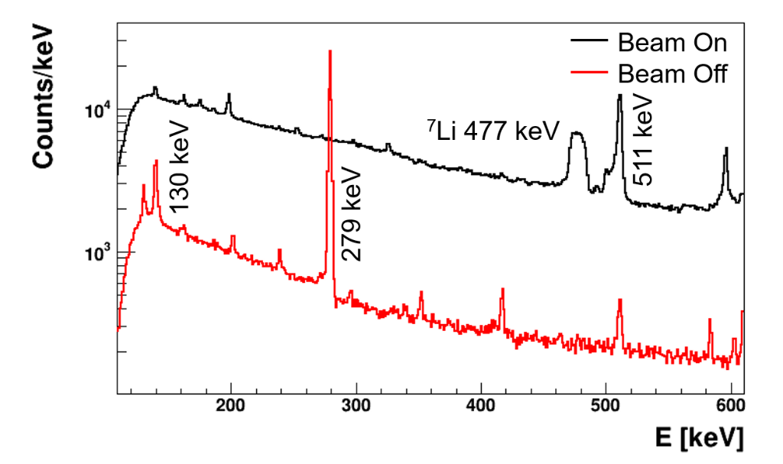
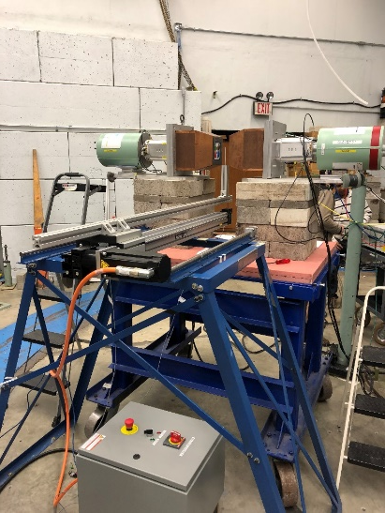
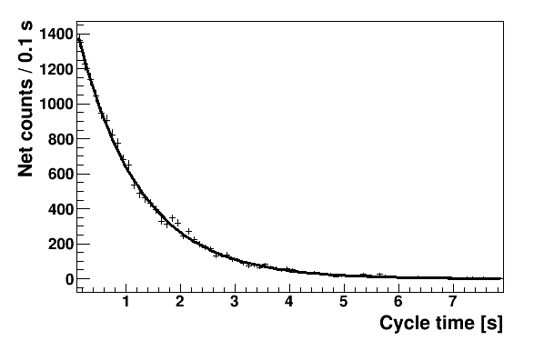
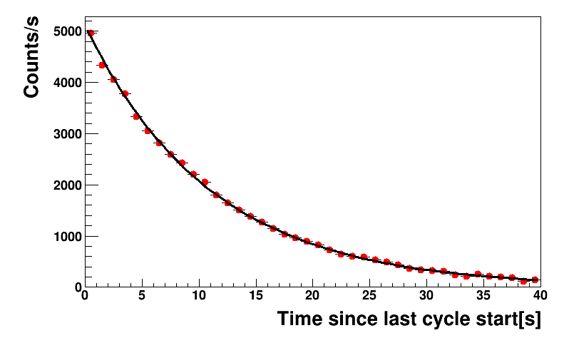
Benchmarking of RABITTS
¹⁹⁷Au(n,n’)^{197m}Au
7.73 s isomer
E_{n} = 2.0 MeV
515 mg Au sample
60 m experiment time
⁹⁰Zr(n,n’)^{90m}Zr
      0.809 s isomer
      E_{n} = 5.0 MeV
      197 mg ^{nat}Zr sample
      153 m experiment time
⁹⁰Zr(n,n’)^{90m}Zr
E_{γ} = 2318.9 keV
T_{1/2} (prelim) = 787 ± 8 ms
T_{1/2} (NNDC) = 809 ± 2 ms
¹⁹⁷Au(n,n’)^{197m}Au
E_{γ} = 279.0 keV
T_{1/2} (prelim) = 7.75 ± 0.09 s
T_{1/2} (NNDC) = 7.73 ± 0.06 s
σ(n,n’)_{prelim} = 507 ± 32 mb
σ (n,n’)_{NNDC} = 510 ± 42 mb

Slide 23
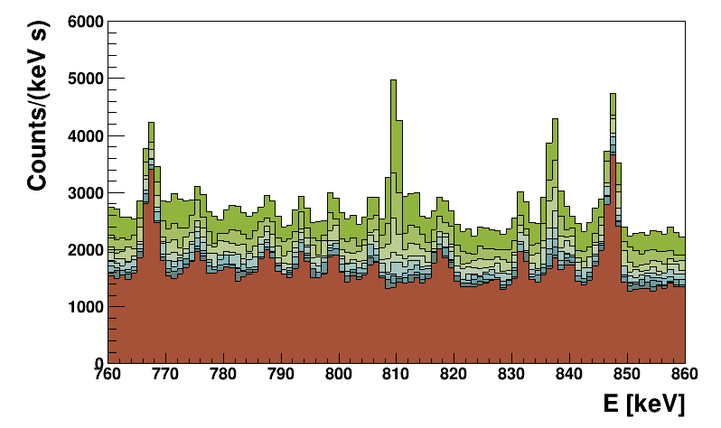
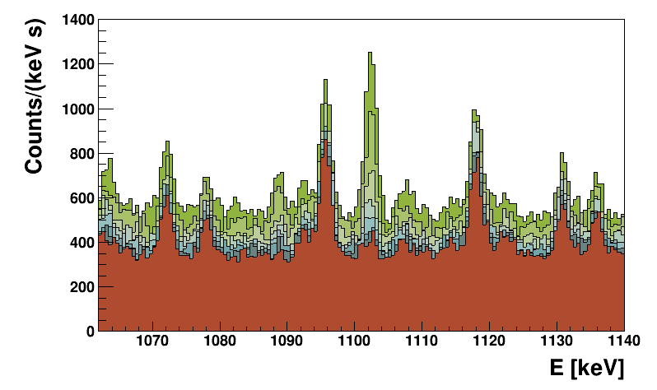
Very Short lived fission products
Applications:
Advance fundamental understanding of the fission process
Benchmark microscopic fission models
Stockpile science
Nuclear energy
Nuclear forensics
Antineutrino anomaly
Data on ²³⁵U, ²³⁸U, and ²³⁹Pu
3 s irradiation time, 9 s counting time
6 hours beam on target
⁹⁶Sr
E_{γ} = 809.4 keV
T_{1/2} = 1.07 s
^{97m}Y
E_{γ} = 1103.1 keV
T_{1/2} = 1.17 s
γ-ray intensity in 1 s intervals after irradiation

Slide 24
Cross section measurements of photonuclear reaction pathways towards promising medical radioisotopes*
Radioisotopes play important roles in numerous areas ranging from medical treatments to national security and basic research.
Develop methodologies for the determination of photonuclear cross sections over multiple energies in a single irradiation and simultaneously determine the feasibility of electron linear accelerator production of certain in-demand radioisotopes.
Use of HIγS facility at TUNL and LEAF at ANL.
Cross section data for the production of high priority medical radioisotopes such as ⁴⁷Sc, ⁶⁷Cu, ⁷⁷As, and ¹⁸⁶Re, simultaneously.
*TUNL-ANL Collaboration, partially funded by US DOE Isotope program

Slide 25
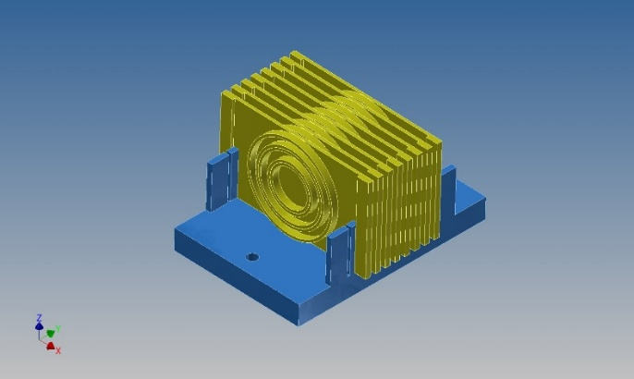
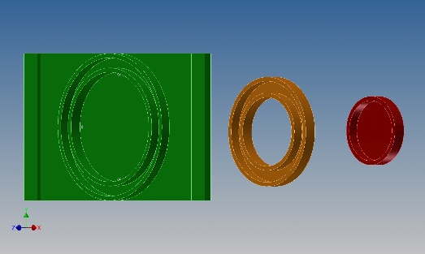
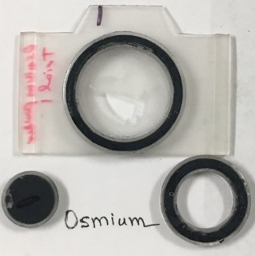
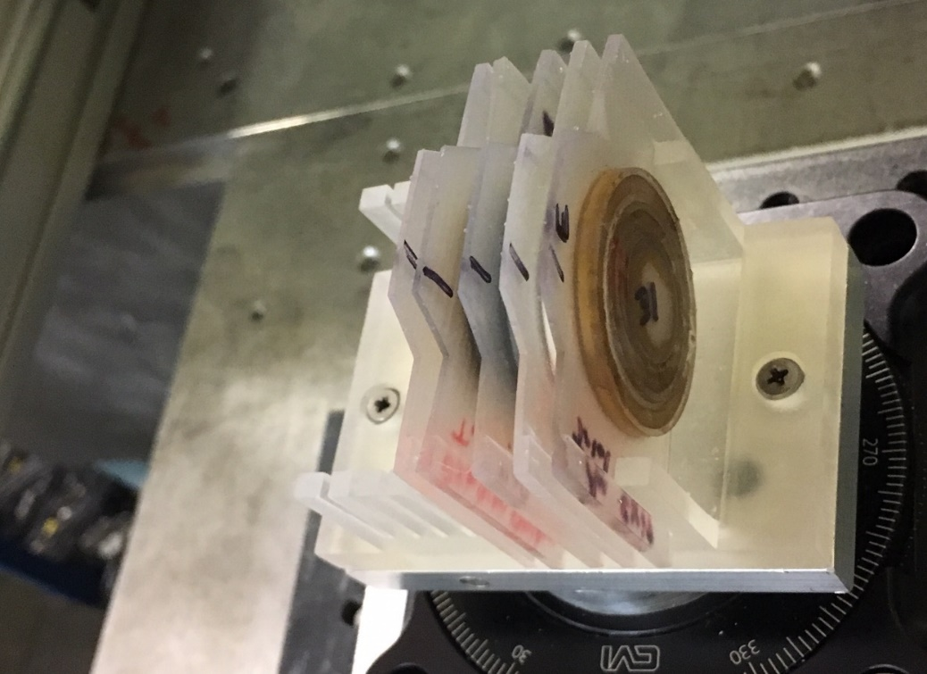
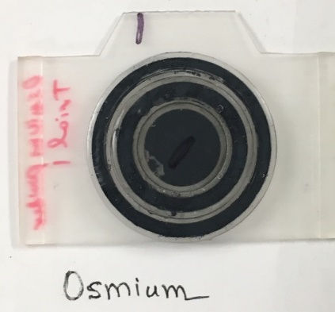
Targets used:
(Au, TiO2, Zn, Os, and Pt)
Photon

Slide 26
Beam alignment
By using Tungsten (W) rod, beam was
aligned within ~ 0.5 mm offset

Slide 27
Collimator configuration and imaging
Develop methodologies for the determination of photonuclear cross sections over multiple energies in a single irradiation

Slide 28
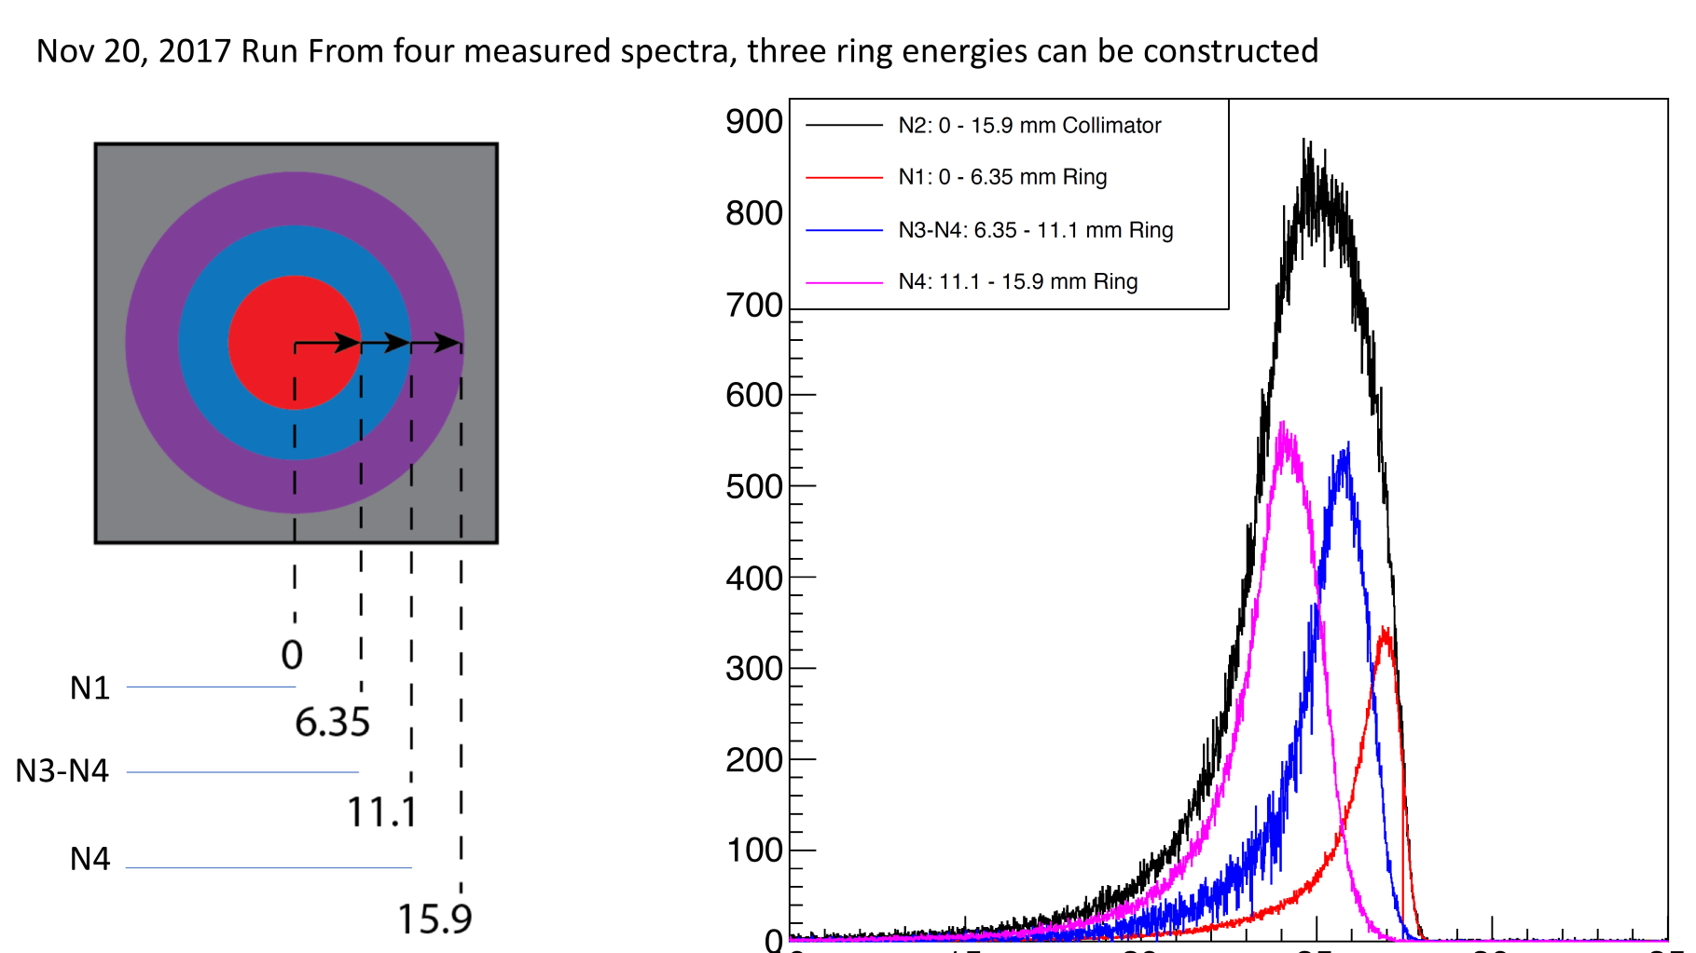
Radial dependence of gamma-ray beam flux and gamma-ray beam energy

Slide 29
Typical spectra: ¹⁹⁷Au(γ,x) and ^{nat}Ti(γ,x)

Slide 30
Cross section measurement: ¹⁹⁷Au(γ,n)¹⁹⁶Au
HIγS

Slide 31
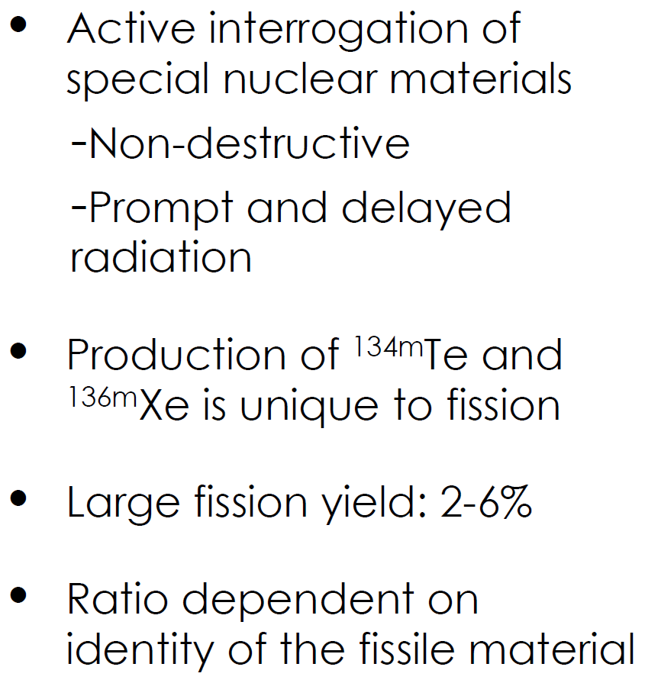
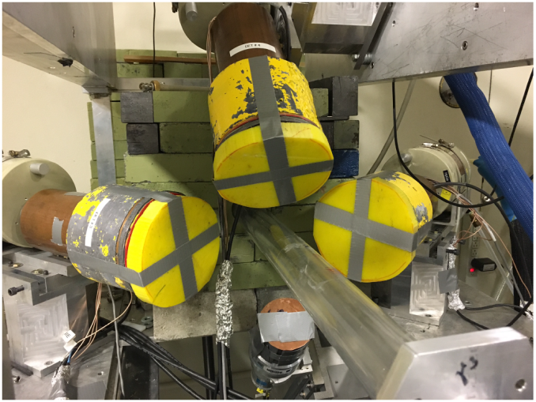
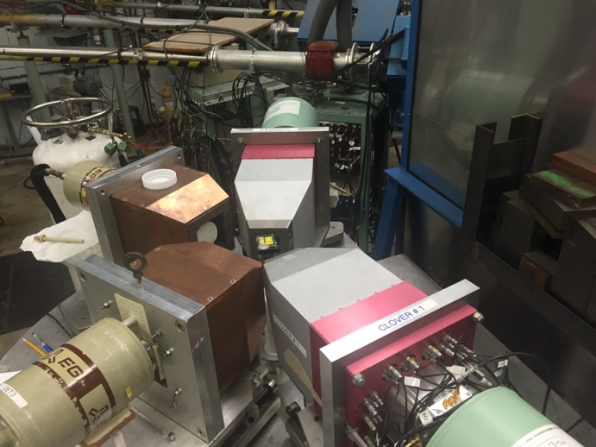
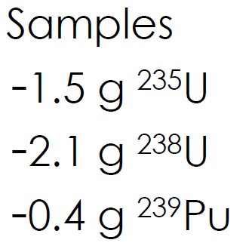
Fission isomers: tool for Nuclear forensic
TANDEM
(n-beam)
HIγS
(γ-beam)

Slide 32
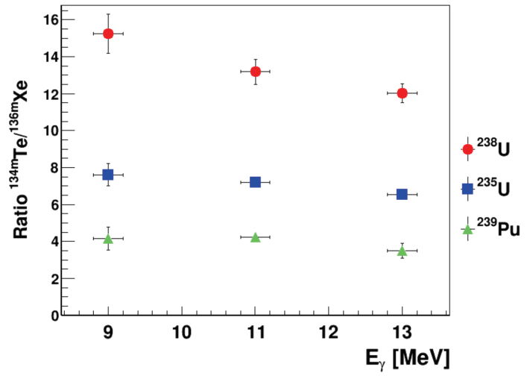
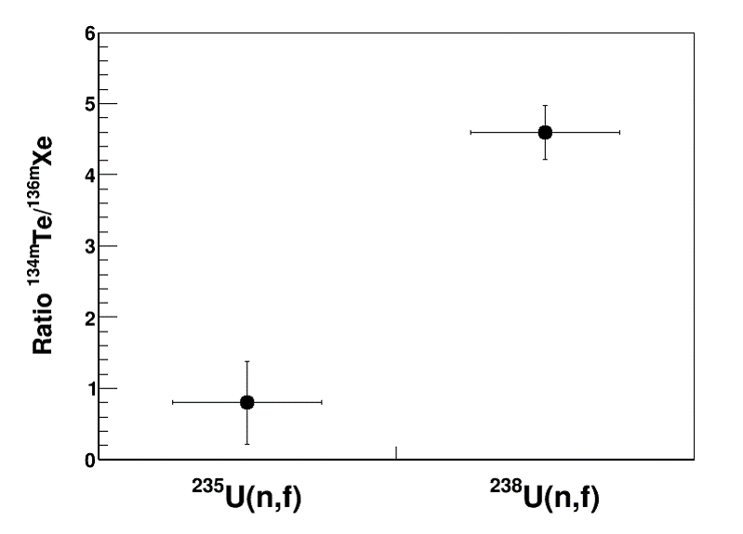
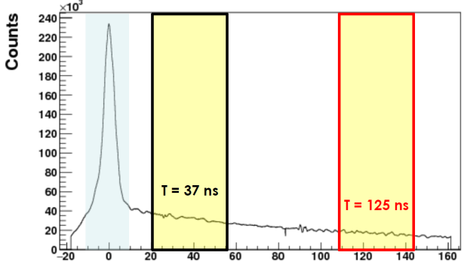
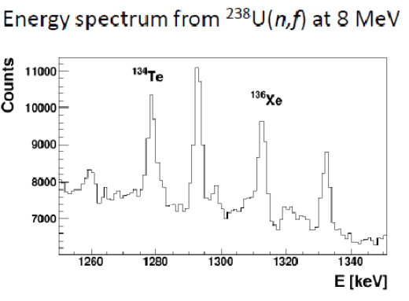
Fission isomers: tool for Nuclear forensic
γ-beam
n-beam
E_{n} = 8.0 MeV
T_{1/2}
^{134m}Te : 164.1ns
^{136m}Xe: 2.95 μs
Manuscript under preparation

Slide 33
¹¹⁵In(γ,γ’)^{115m}In

Slide 34
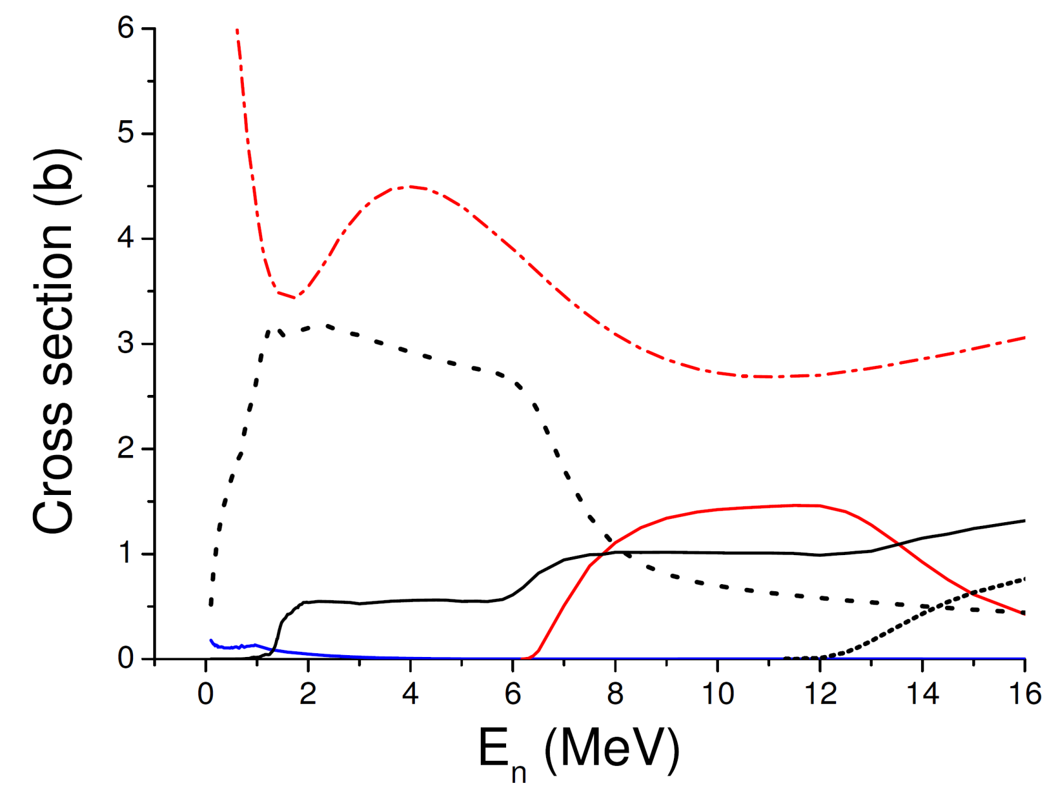
Neutron-induced reactions on ²³⁸U
n,elastic (total)
n,inelastic (total)
(n,2n)
(n,f)
(n,γ)
(n,3n)

Slide 35
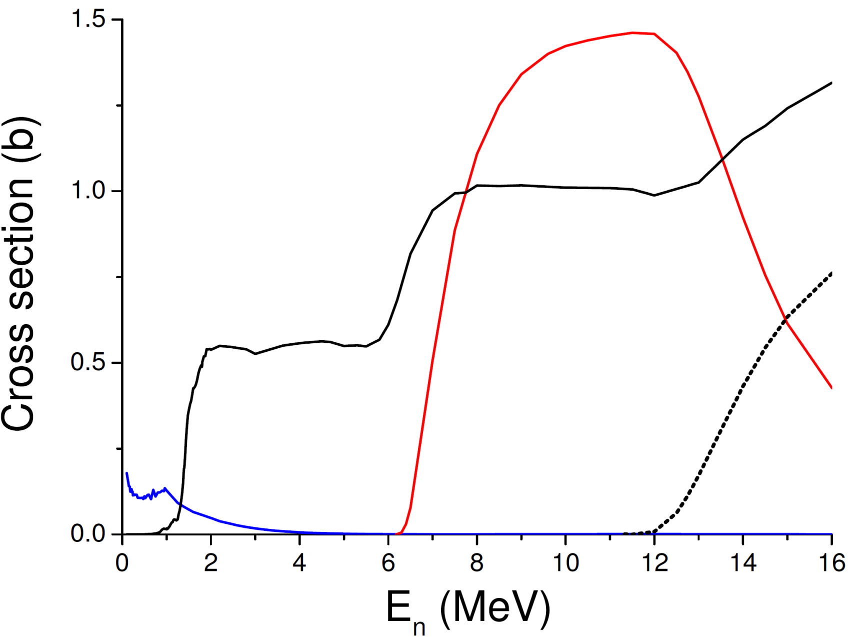
²³⁸U(n,x) CS measurements at TUNL
FPY data
Gooden et.al., NDS 131, 319 (2016)
Stockpile stewardship
(n,f)
Nuclear forensic
(n,2n)
Krishichayan et al.,
PRC 96, 044623 (2017)
Advanced/breed reactors
Nuclear astrophysics
(n,γ)
On-going

Slide 36
²³⁸U(n,γ)²³⁹U
High priority
Nuclear Energy Agency
CIELO
(Collaborative International Evaluated Library Organization)
The radiative capture cross section for ²³⁸U has been extensively studied but there still exists inconsistency in the existing experimental data.
The recent demands require better data sets with lowest possible uncertainties.
Goal of the present work is to provide an accurate and self-consistent set of high-quality cross-section data
for the ²³⁸U(n,γ) from 0.3 to 3.0 MeV.

Slide 37
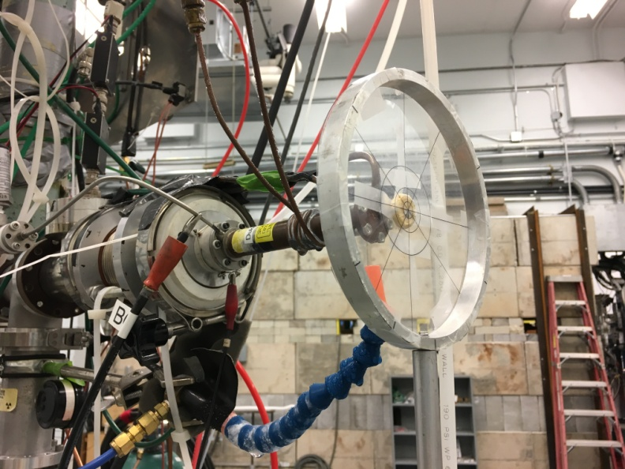
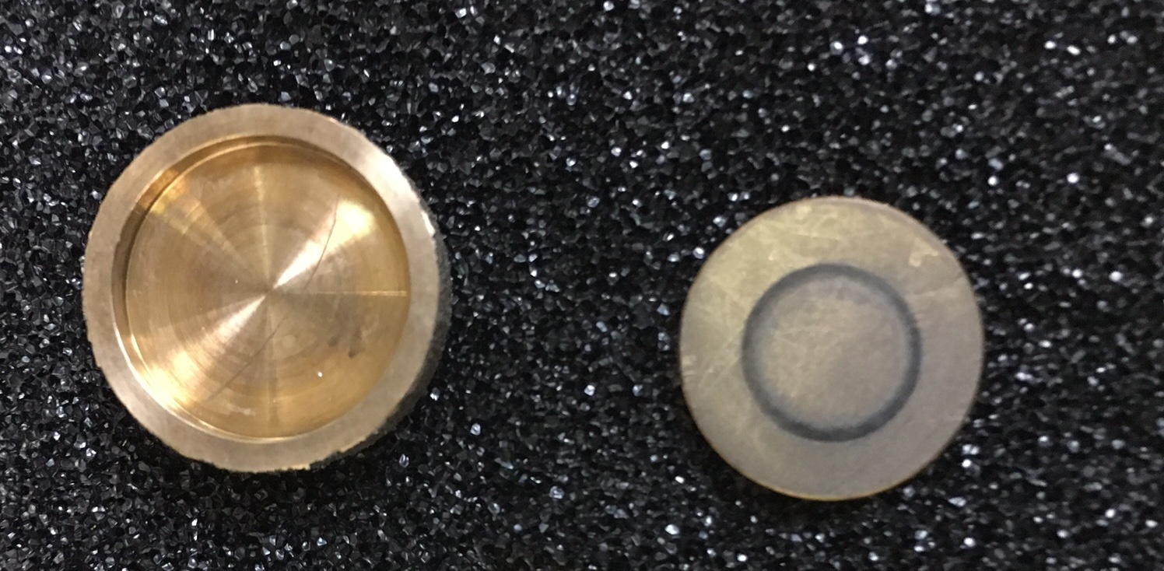
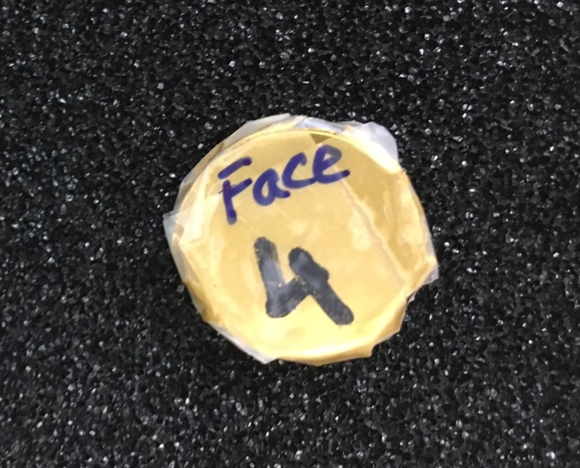
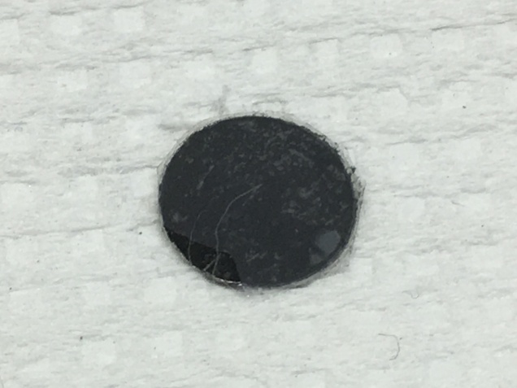
²³⁸U(n,γ)
Great challenge to estimate and/or reject thermal neutron capture cross section (comparatively large cross section).
Use of a custom designed pill-box made of the ²³⁸U material itself.
Pill-box
Pill-box
²³⁸U

Slide 38
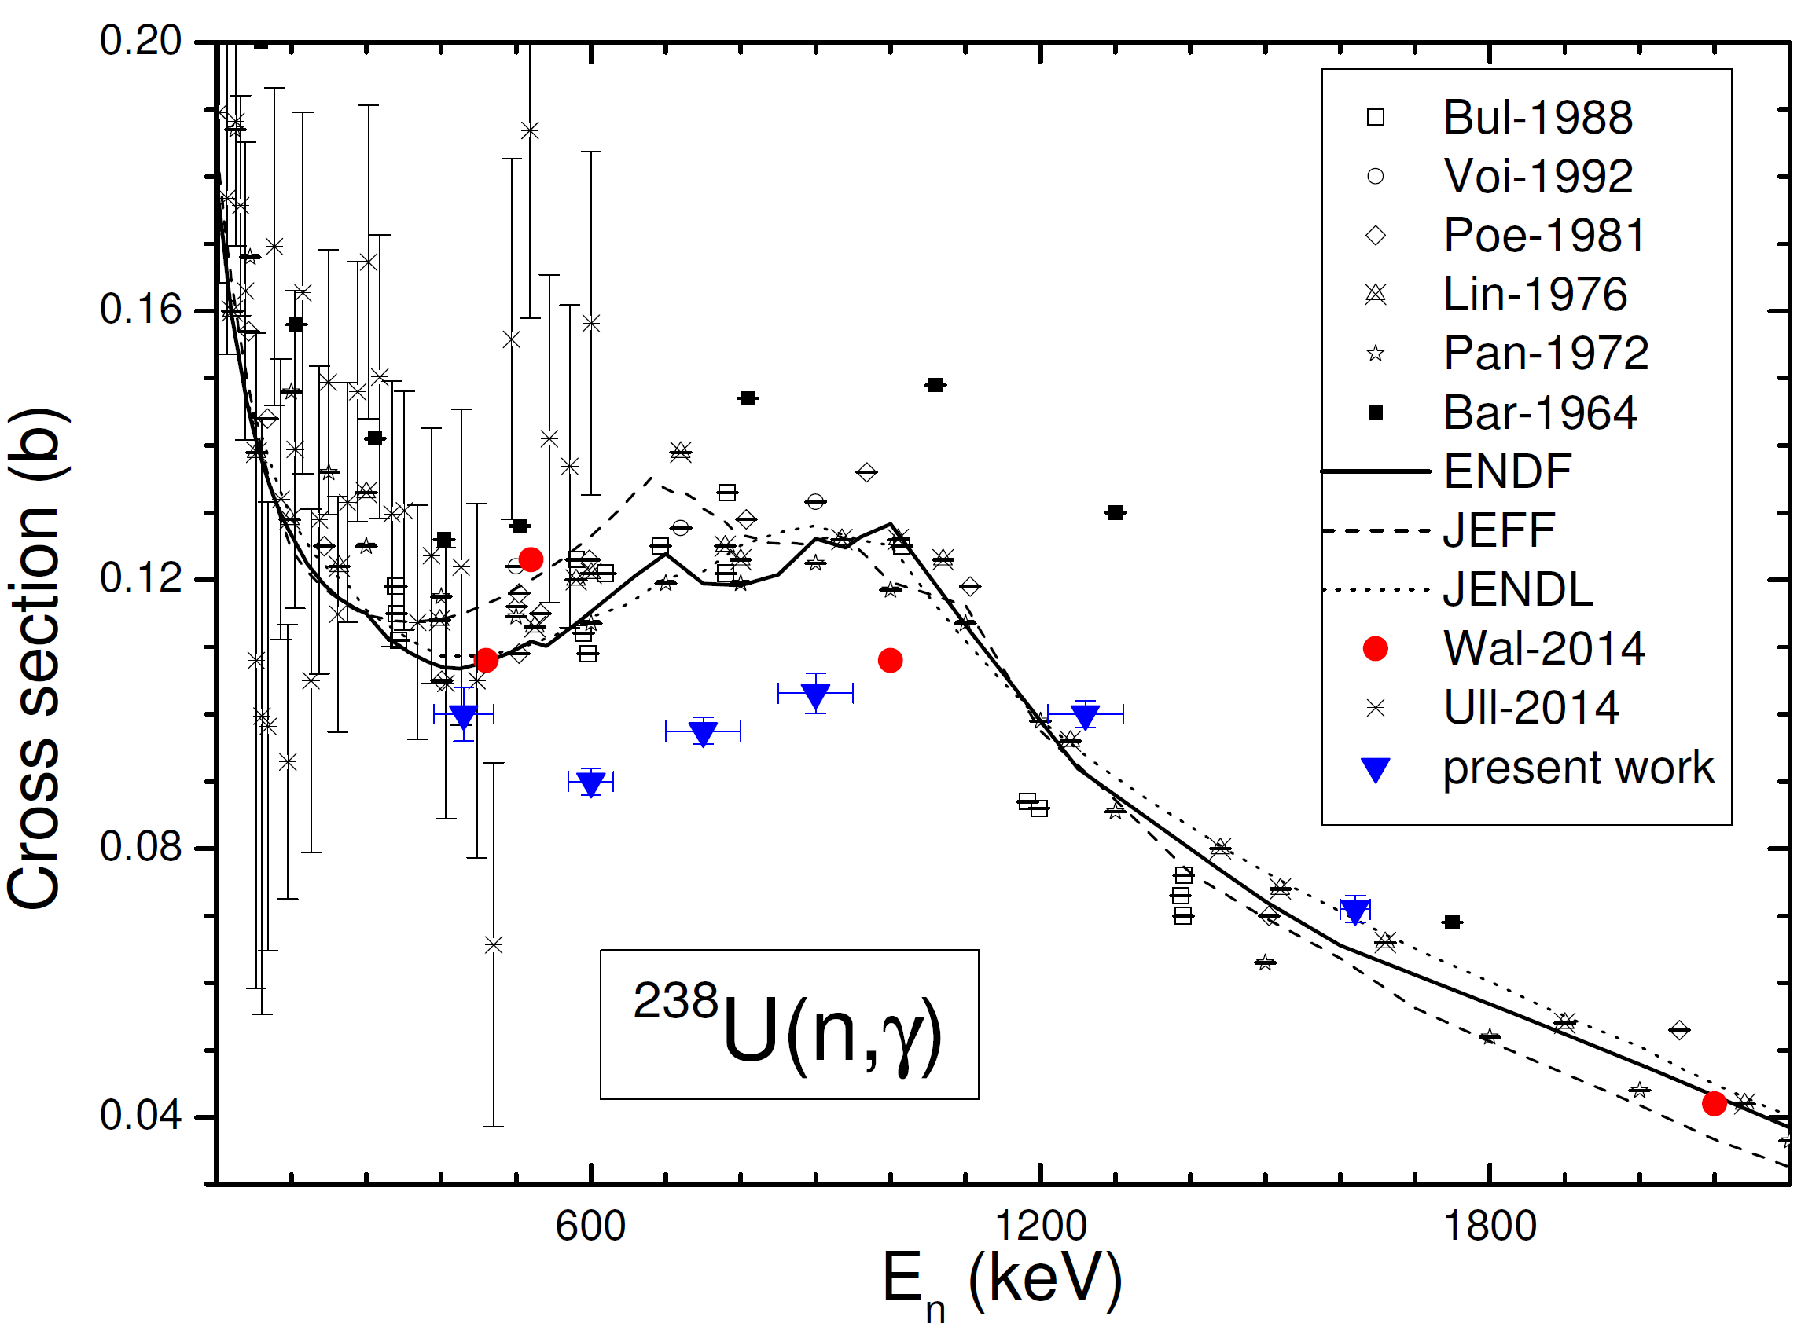
²³⁸U(n,γ)
Preliminary result
Future plan includes to carry out ²³⁸U(n,γ) CS
measurements at several other energies

Slide 39
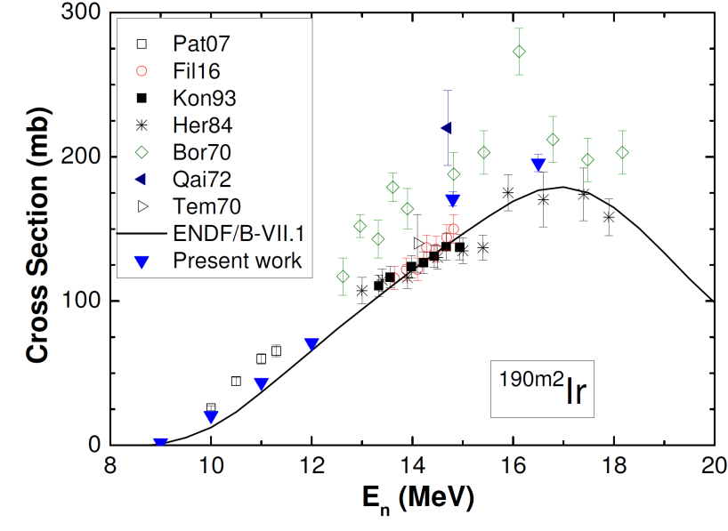
^{191,193}Ir(n,2n)^{190,192}Ir
REU project work
Material for constructing activation detector
Medical uses
¹⁹¹Ir(n,2n)^{190m}Ir

Slide 40
Thank You !

