Slide 1
Current status of EXFOR (Area #1)
Boris Pritychenko
National Nuclear Data Center, BNL, Upton, NY 11973

Slide 2
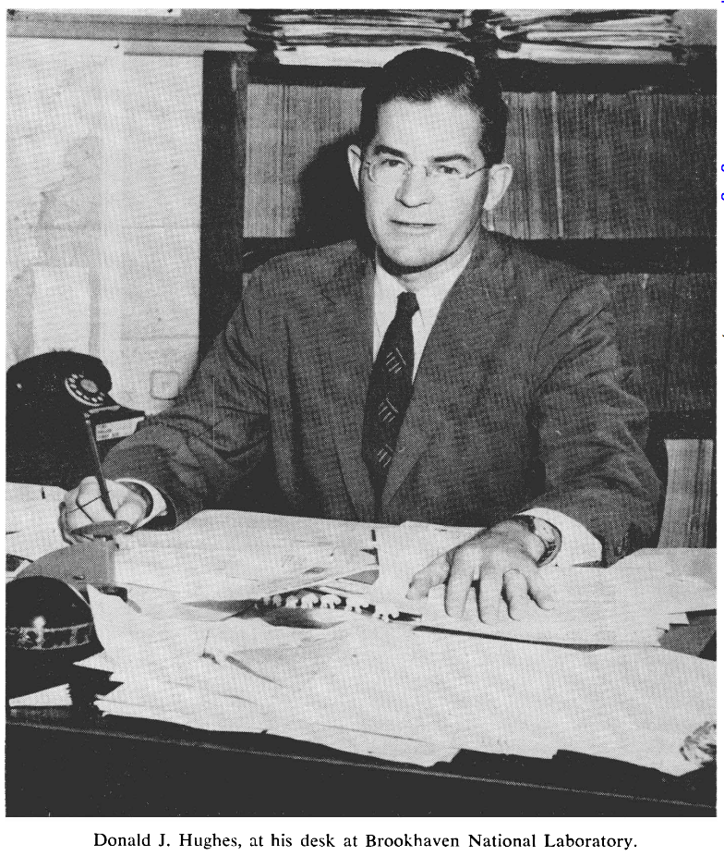
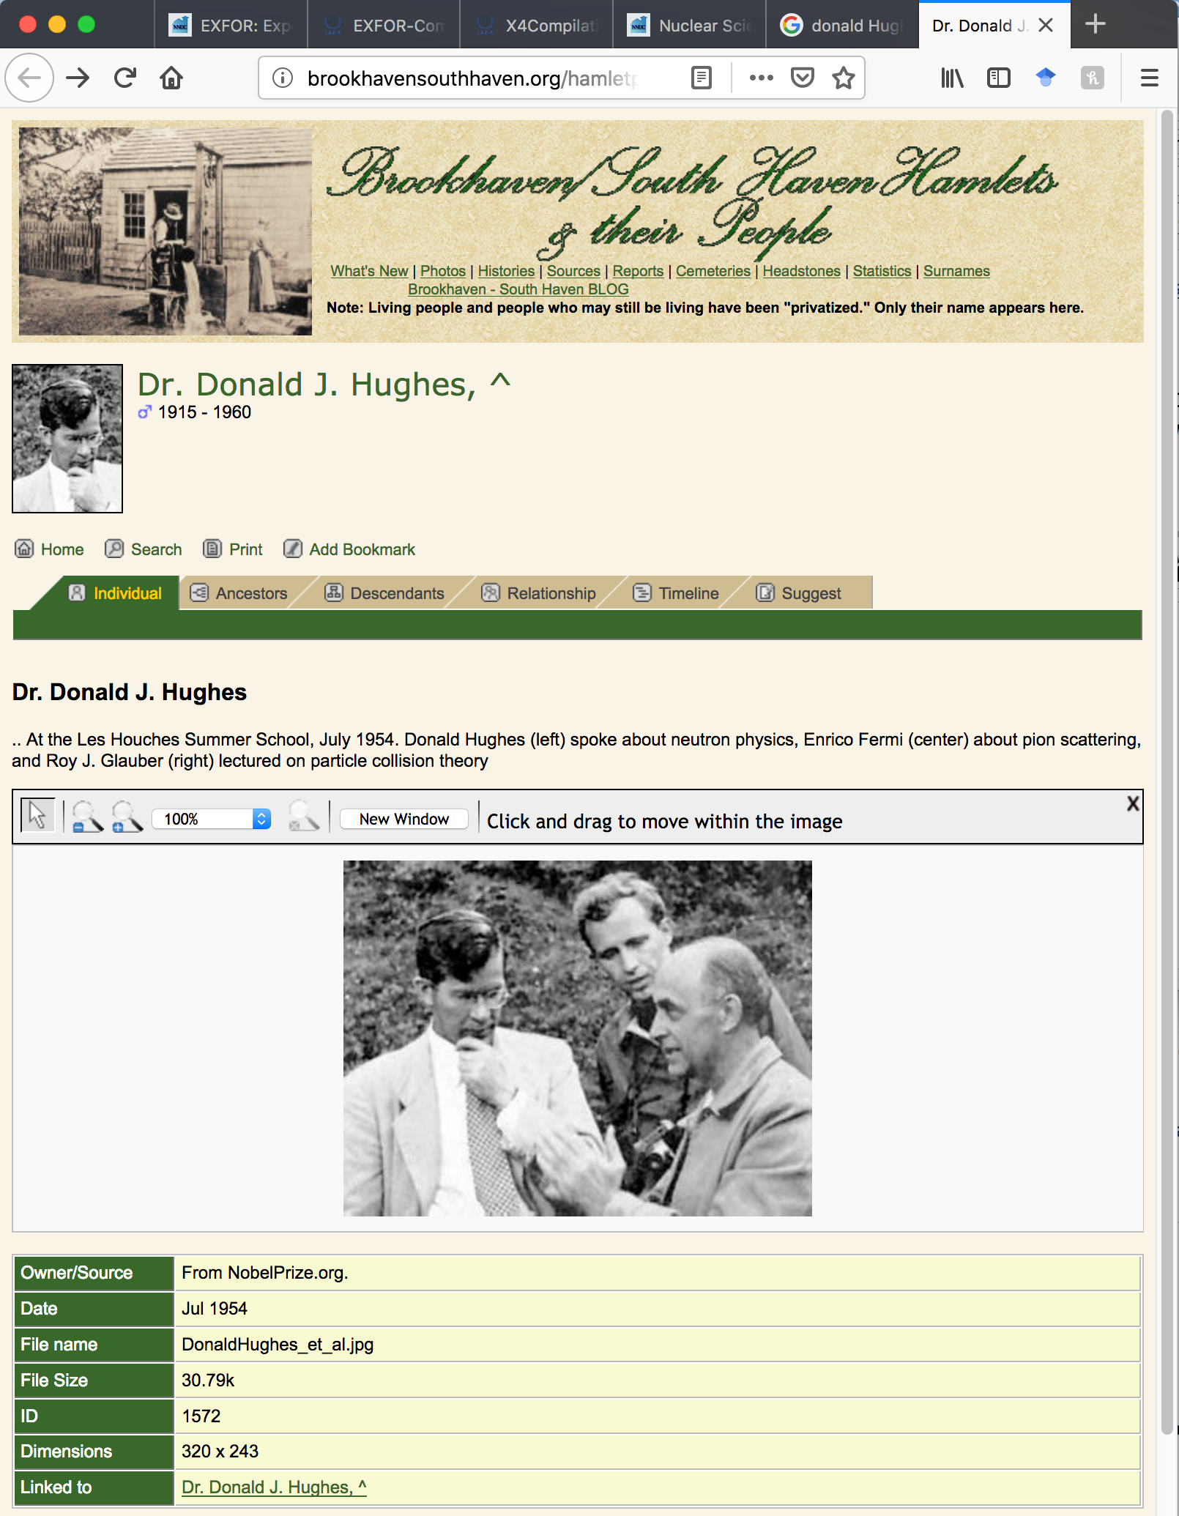
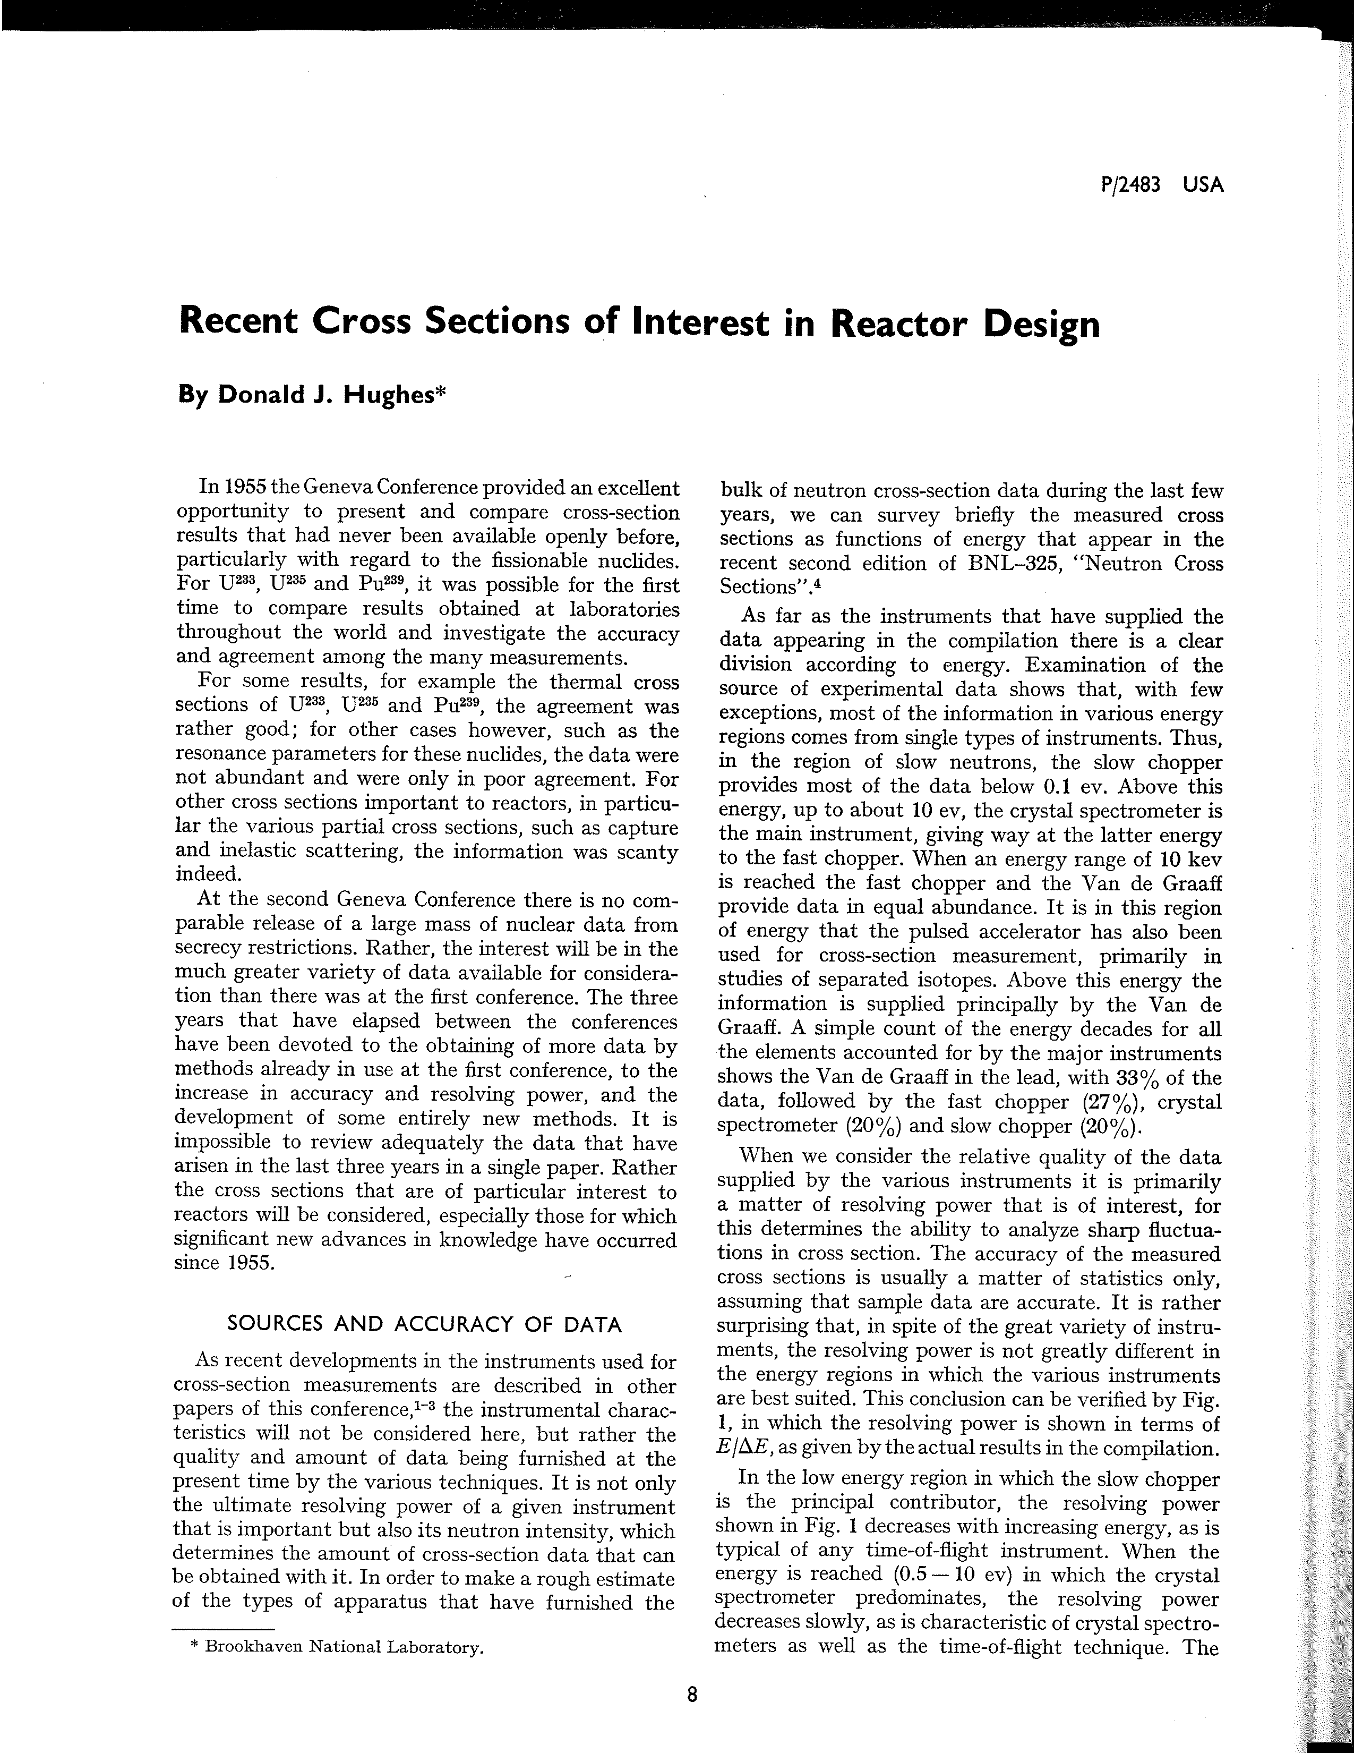
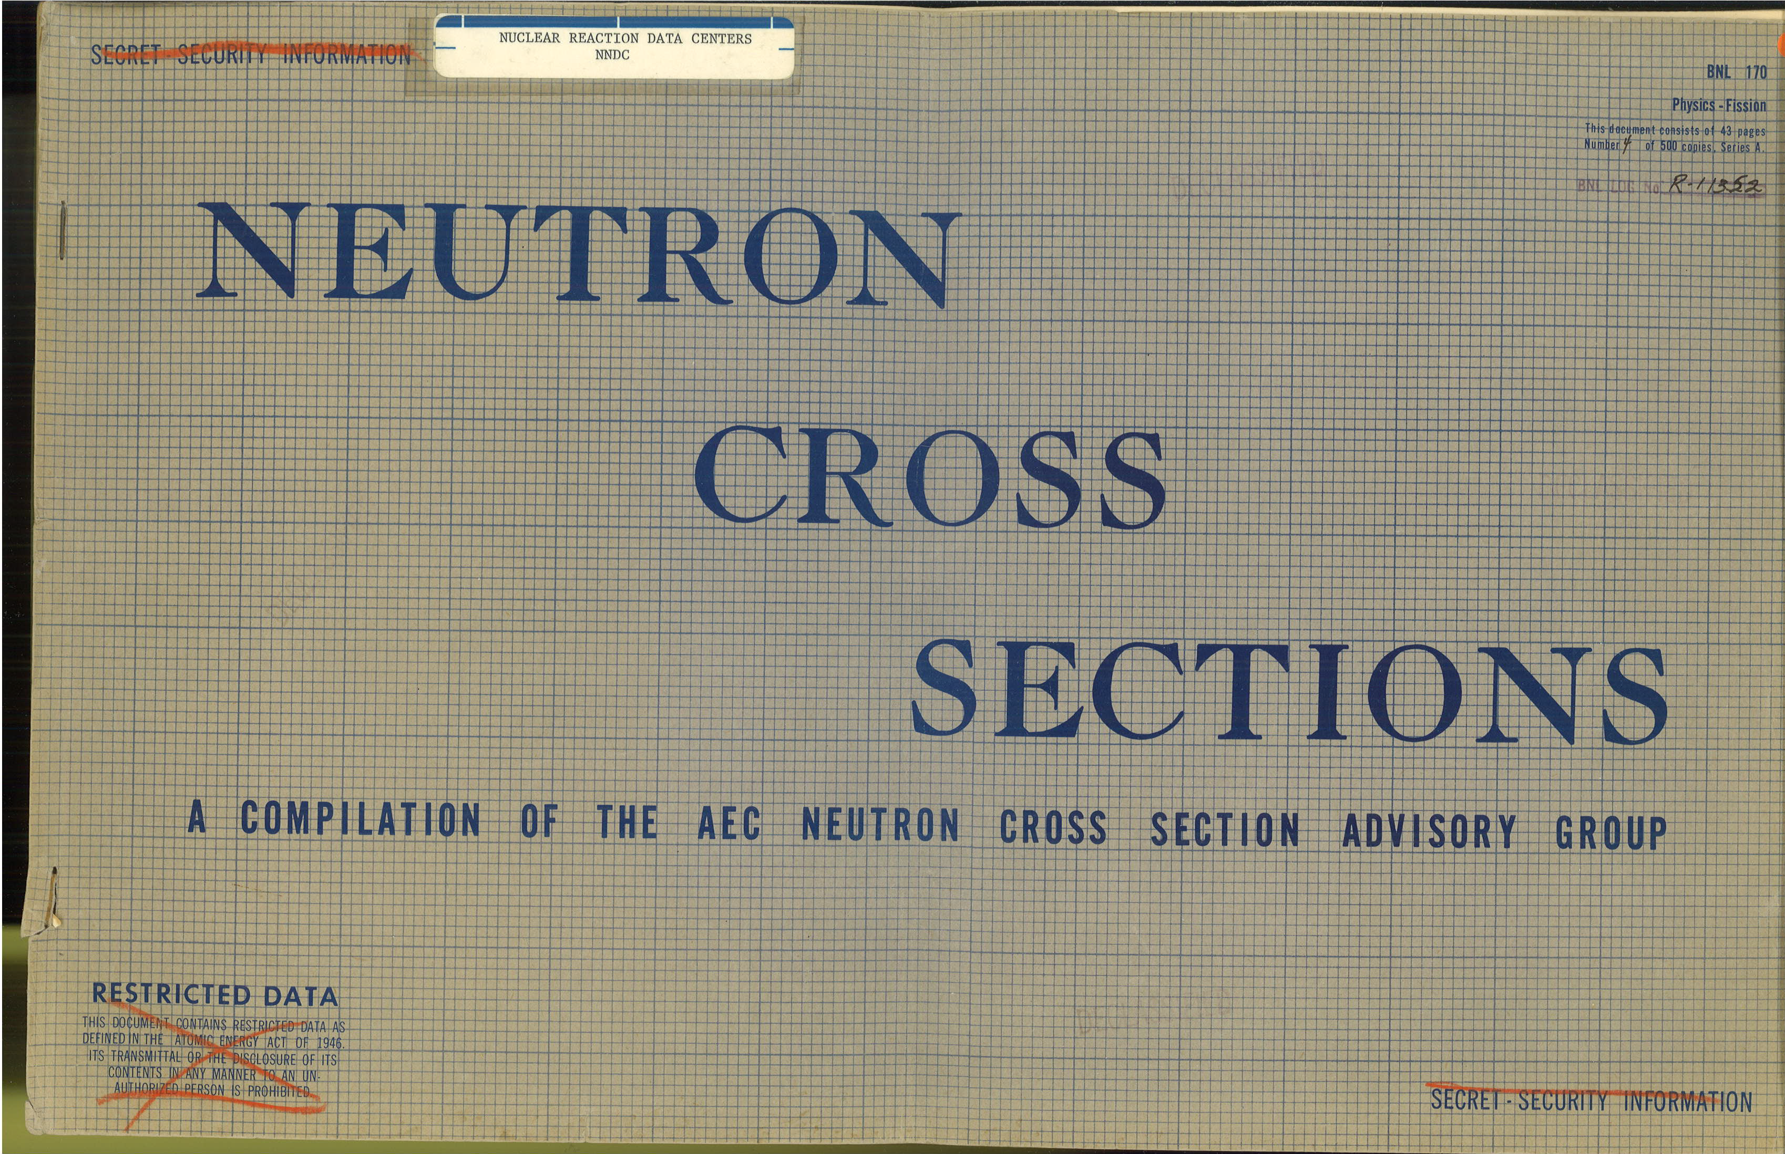
Nuclear Reaction Data Compilations
Experimental neutron reaction data compilations have been pioneered at Brookhaven National Laboratory.
Donald J. Hughes (1915-1960) compiled data since 1950.
BNL-170 was published in 1952; it is a precursor of BNL-325.
Second UN International Conference on Peaceful Uses of Atomic Energy, Geneva, 1958.
SCISRS (Sigma Center Information and Retrieval System) at BNL (1964) was a precursor of EXFOR.
Other data centers were created in Vienna, Austria (NDS-IAEA), Paris, France (NEA-Databank) and Obninsk, USSR (IPPE) in 1963-1964.
Around 1970 four neutron data centers agreed on the data interchange format (EXFOR). The four centers could store data locally in its formats. The Nuclear Data Centres Reaction (NRDC) network was later formed under the auspices of the IAEA

Slide 3
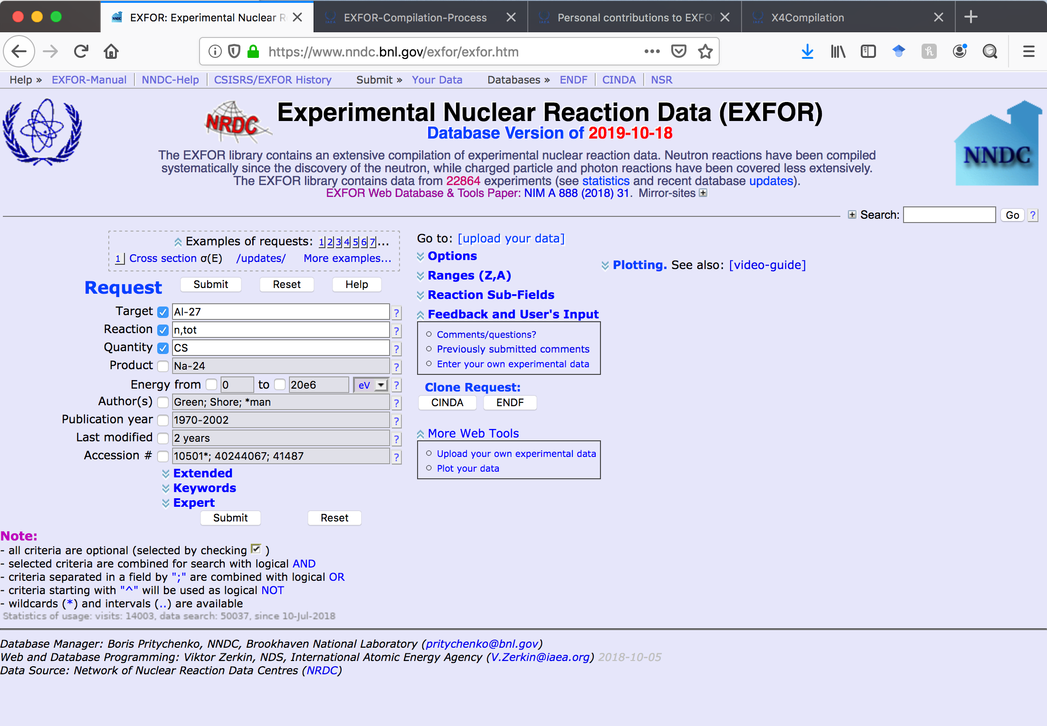
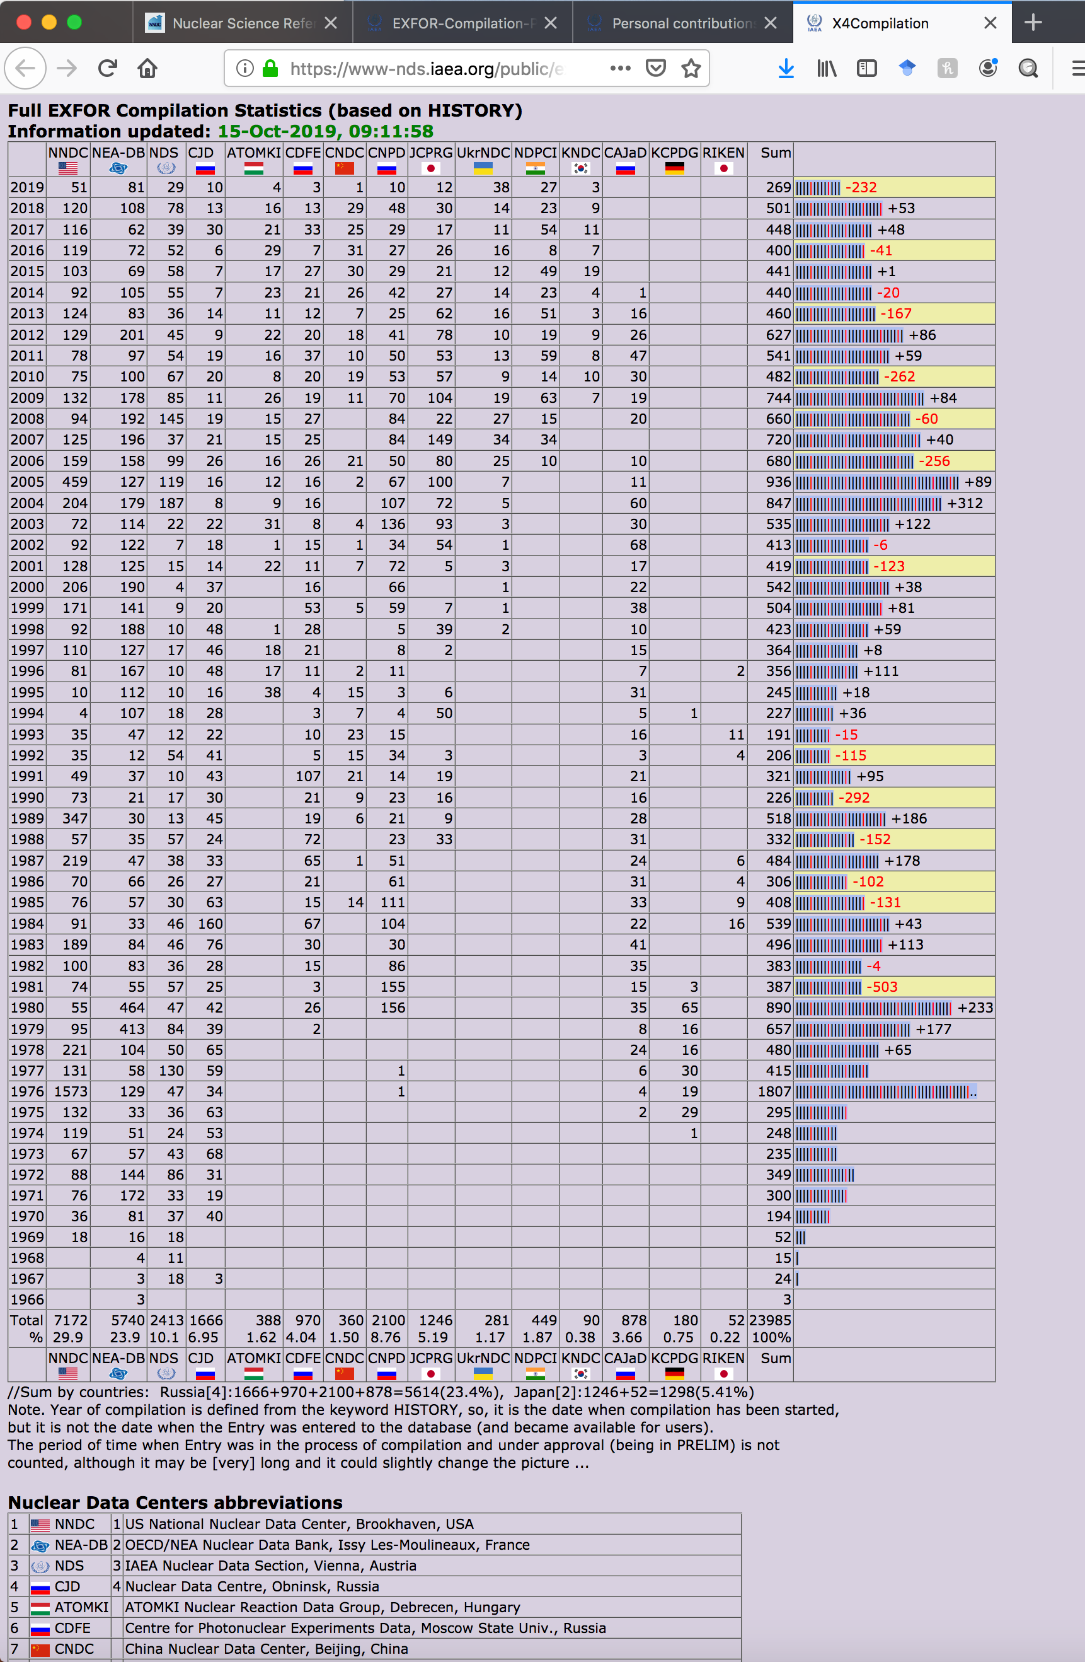
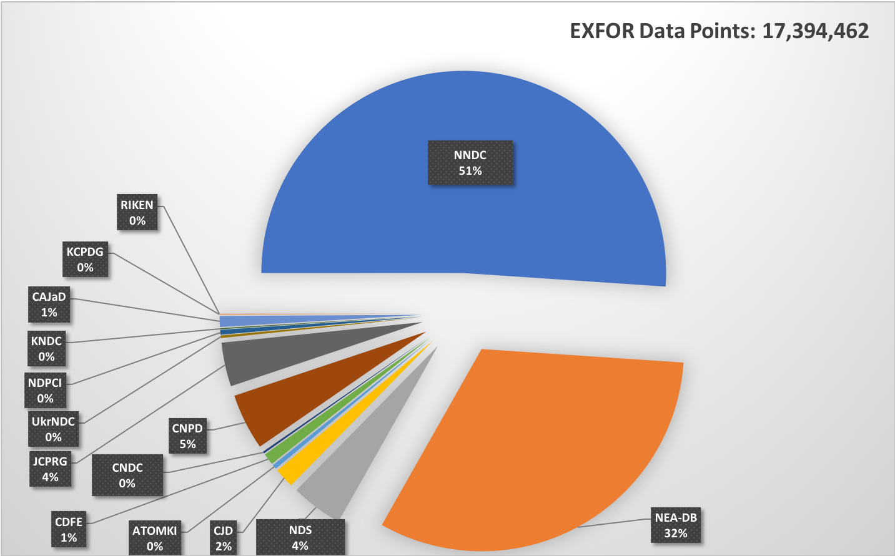
What is EXFOR???
The EXchange FORmat (EXFOR) experimental nuclear reaction database and format for low- and intermediate-energy physics
22,864 experimental works
175,078 reaction data tables
Total and differential cross sections, resonance parameters, fission yields, thick-target and product yields, multiplicities, ….
Originally neutron-induced reactions, charged particles and photons were added later.
All compilations go through a strict quality assurance process.
Available at https://www.nndc.bnl.gov/exfor and https://www-nds.iaea.org/exfor.
EXFOR statistics, the IAEA official count of compilations: https://www-nds.iaea.org/public/exfor/x4compil/exfor_input.htm.
Data compilations were started in United States, centers split data geographically. Therefore National Nuclear Data Center (NNDC) has the largest individual contribution to the EXFOR library followed by NEA-Databank (Paris), NDS-IAEA (Vienna) and others.

Slide 4
Area #1 EXFOR Statistics
New entries: 63 + 62 (BNL) = 125.
Corrected entries: 174 + 46 (BNL) = 220.
26 Preliminary and 28 final data transmissions (Preliminary transmissions go through the NRDC network quality assurance system, after implemented corrections final transmission are loaded into the database).
EXFOR database was updated 30 times.
EXFOR Web retrievals in FY2019: 40,391.
More compilation details in the IAEA system based on calendar years: http://www-nds.iaea.org/exfor-master/x4compil/.
Fission yields compilation project is underway.
Team effort: B. Pritychenko (Project Manager), S. Hlavac, O. Schwerer, O. Gritzay (Contractors),
V. Zerkin (IAEA, Web and database developer).

Slide 5
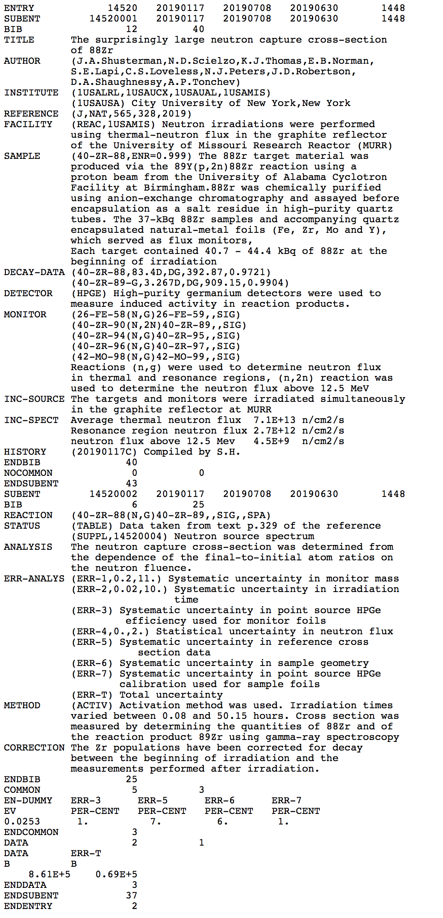
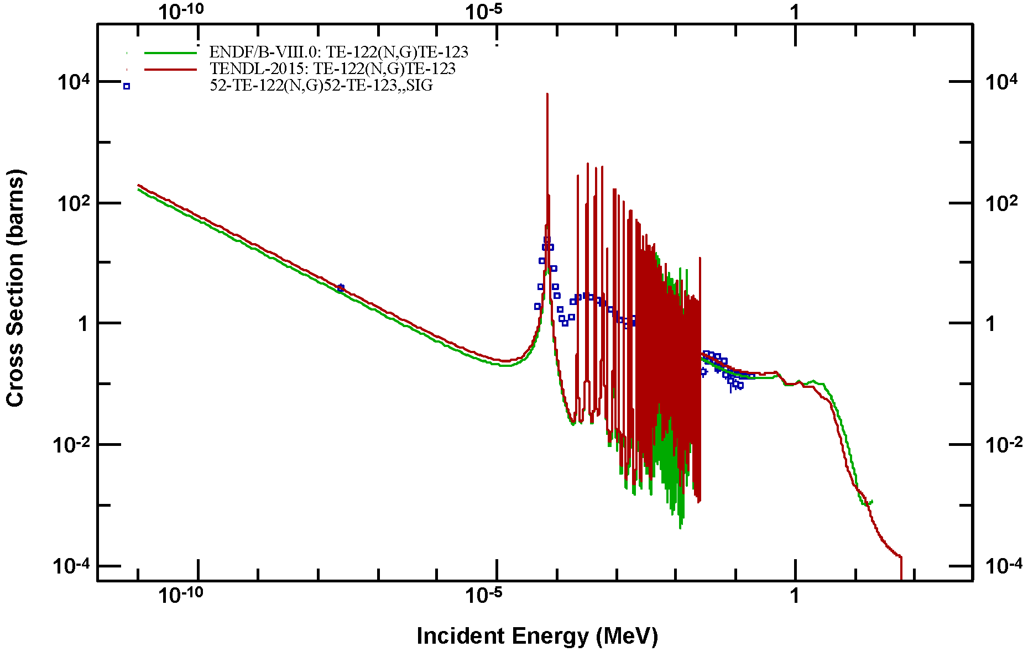
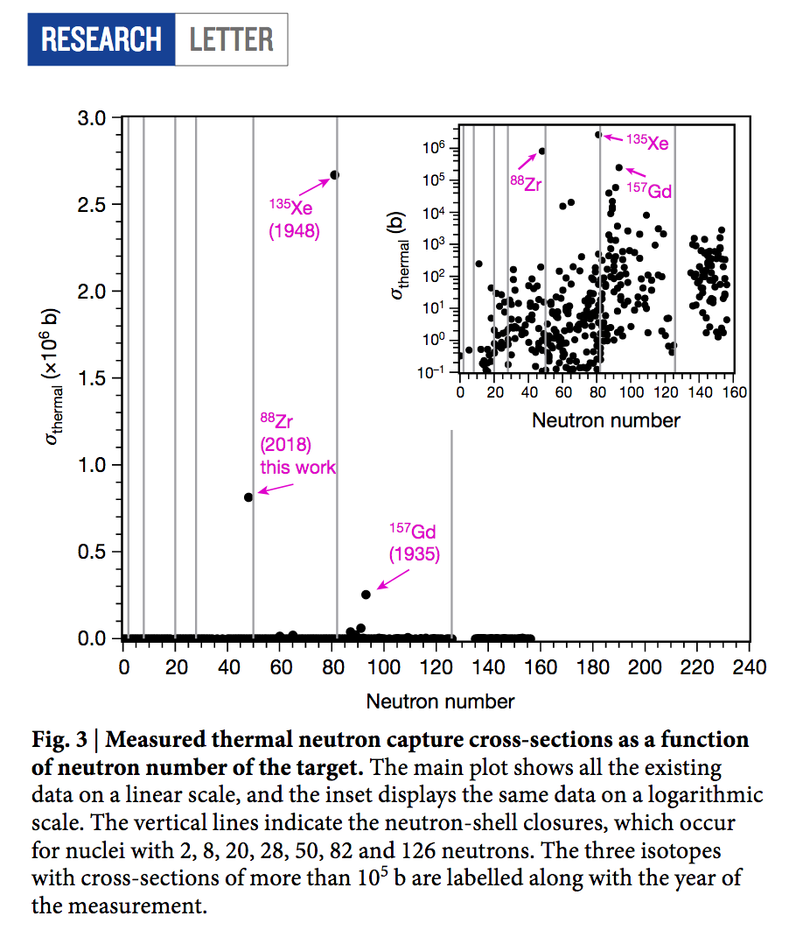
EXFOR: ENDF validation
ENDF is a core nuclear reaction database containing evaluated (recommended) cross sections, spectra, angular distributions, fission product yields, thermal neutron scattering, and photo-atomic and other data, with an emphasis on neutron-induced reactions.
ENDF library evaluations are based on theoretical calculations normalized to experimental data with an exception of neutron resonance region, where priority is given to experimental data.
Importance of microscopic validation: Experimental ⁸⁸Zr(n,γ) thermal cross section is (8.61± 0.69) x10⁵ barns [1] compared with theoretically predicted 10 barns [2].
[1] J.A. Shusterman, et al., “The surprisingly large neutron capture
cross-section of ⁸⁸Zr,” Nature 565, 328 (2019).
[2] A.J. Koning, D. Rochman, “Modern nuclear data evaluation with the
TALYS code system,” Nucl. Data Sheets 113, 2841–2934 (2012).
EXFOR compilation of ⁸⁸Zr(n,γ) Nature article.

Slide 6
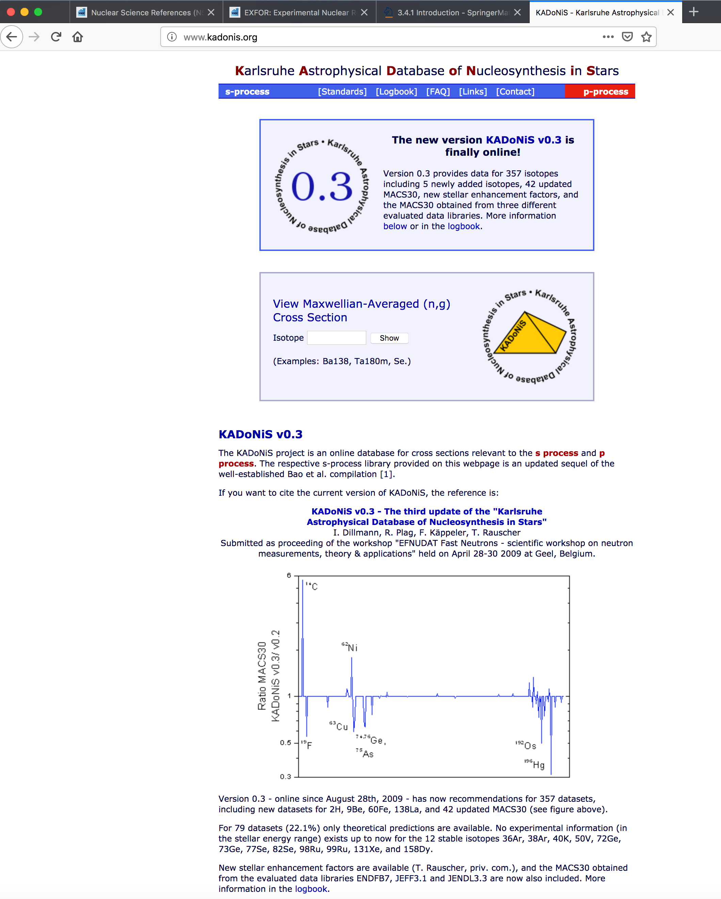
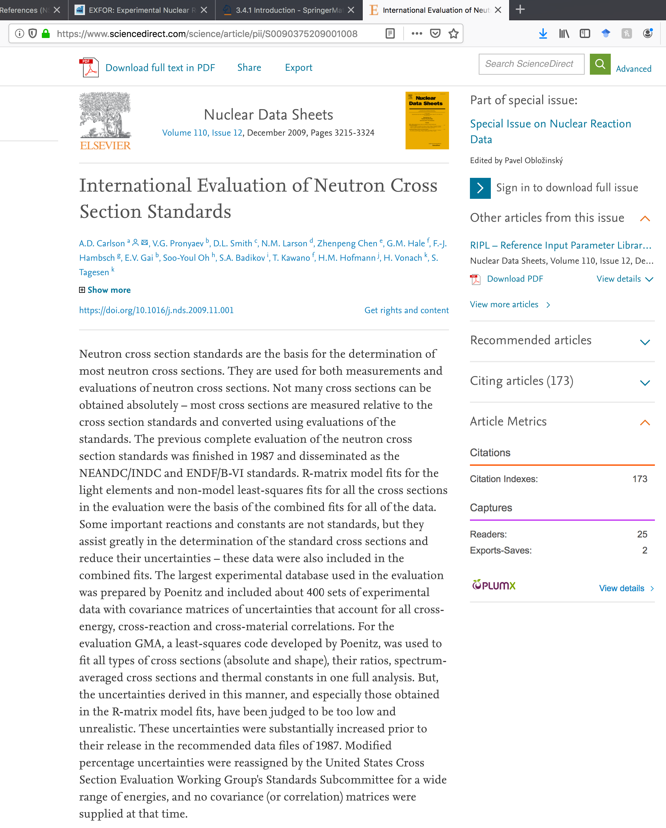
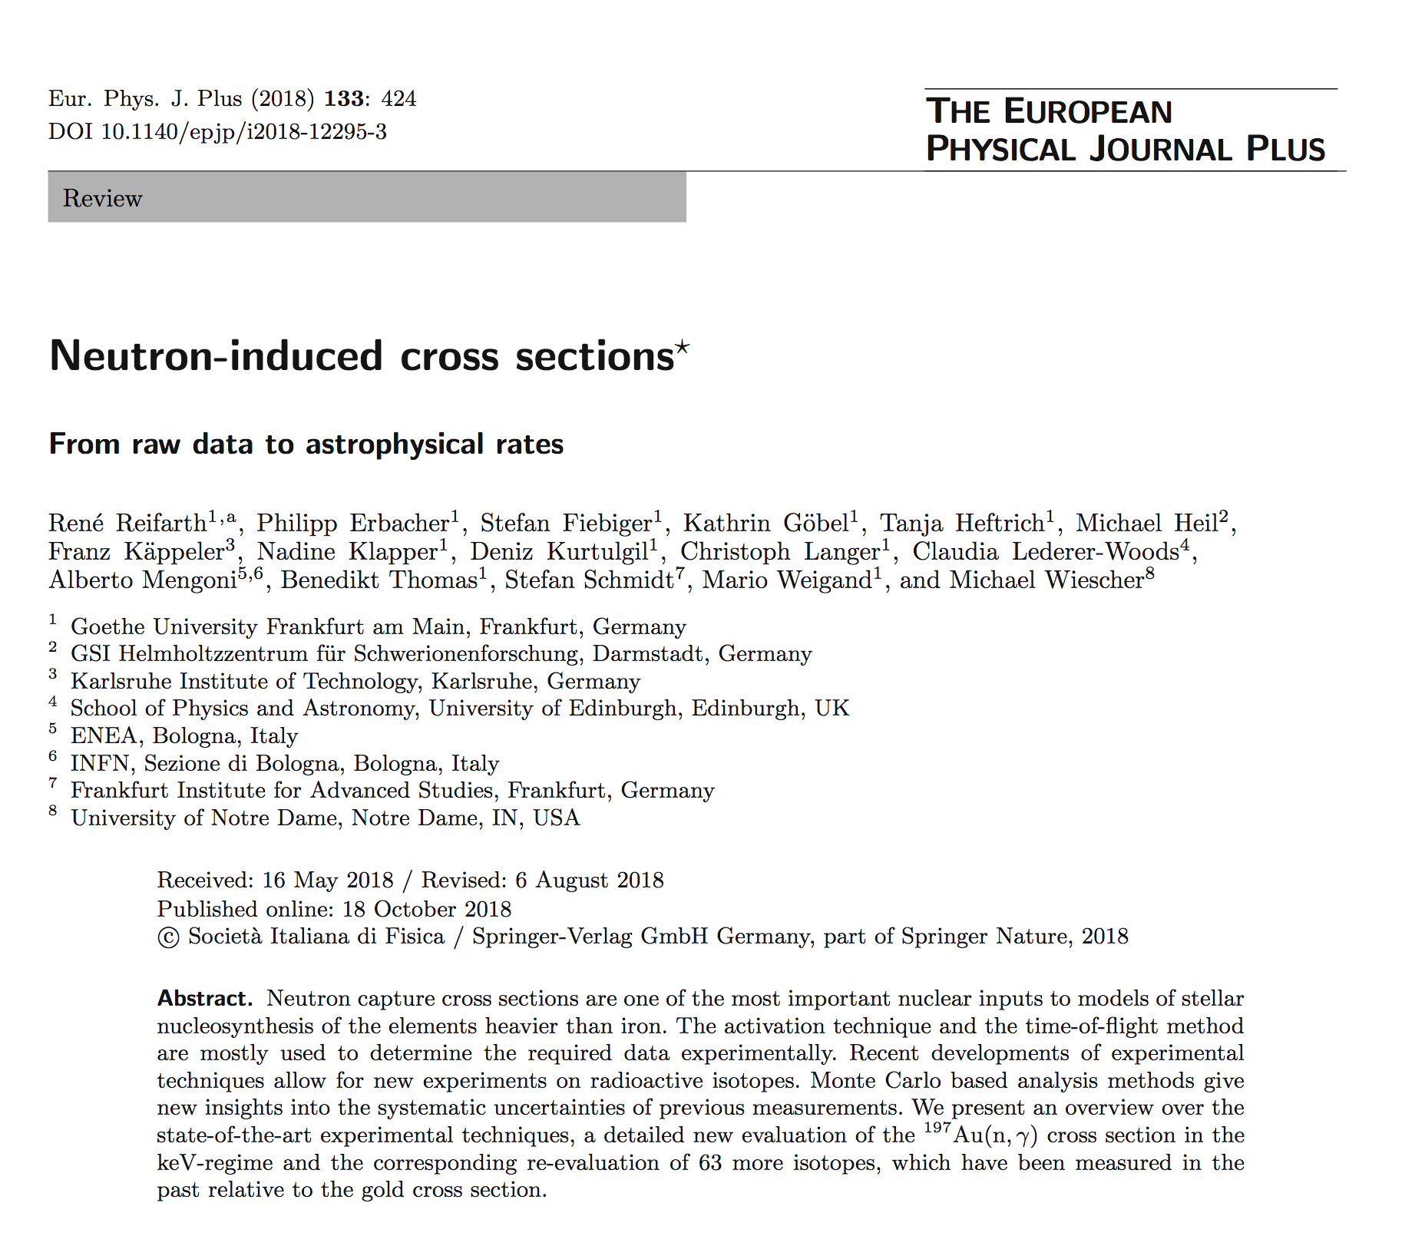
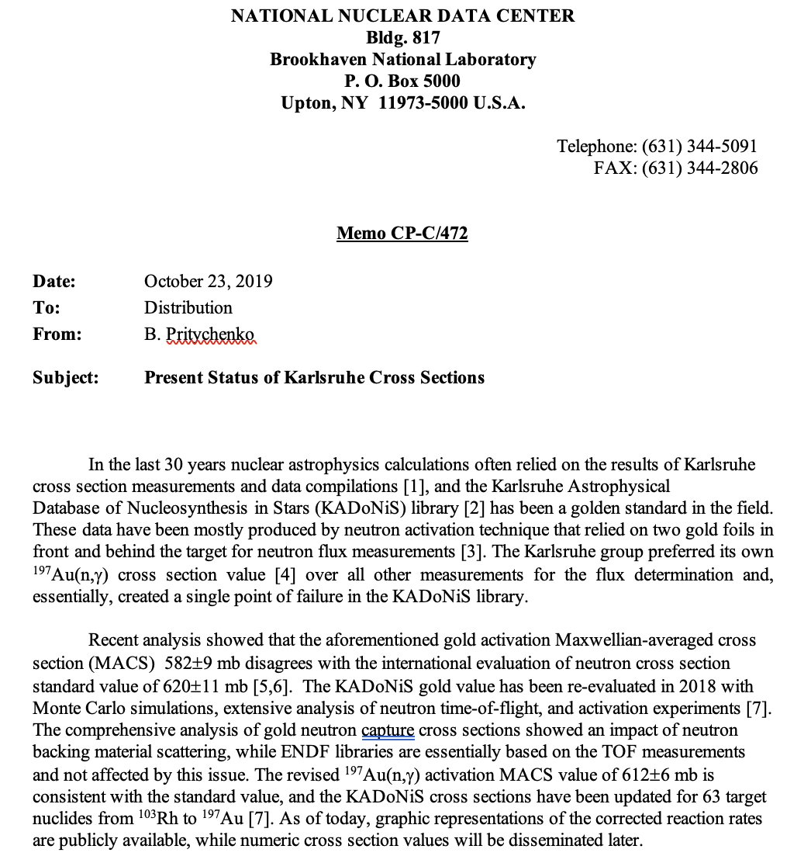
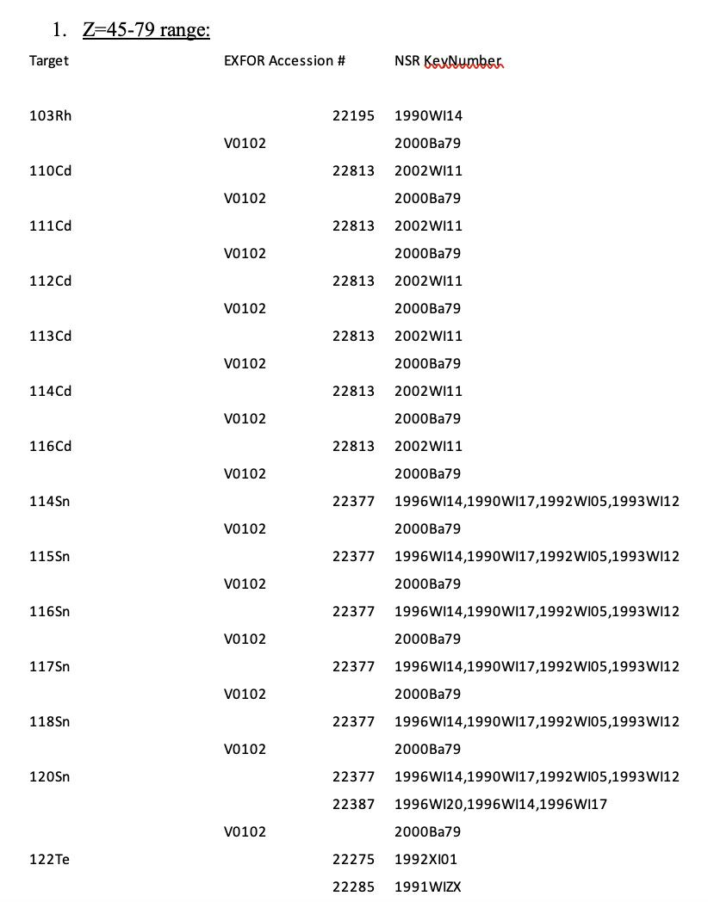
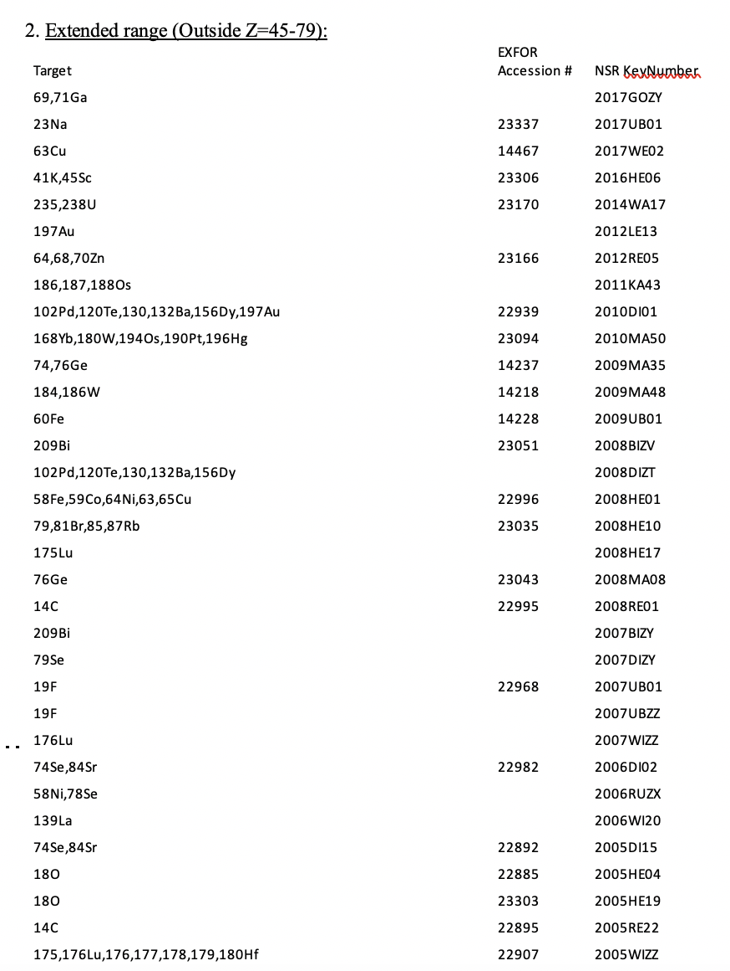
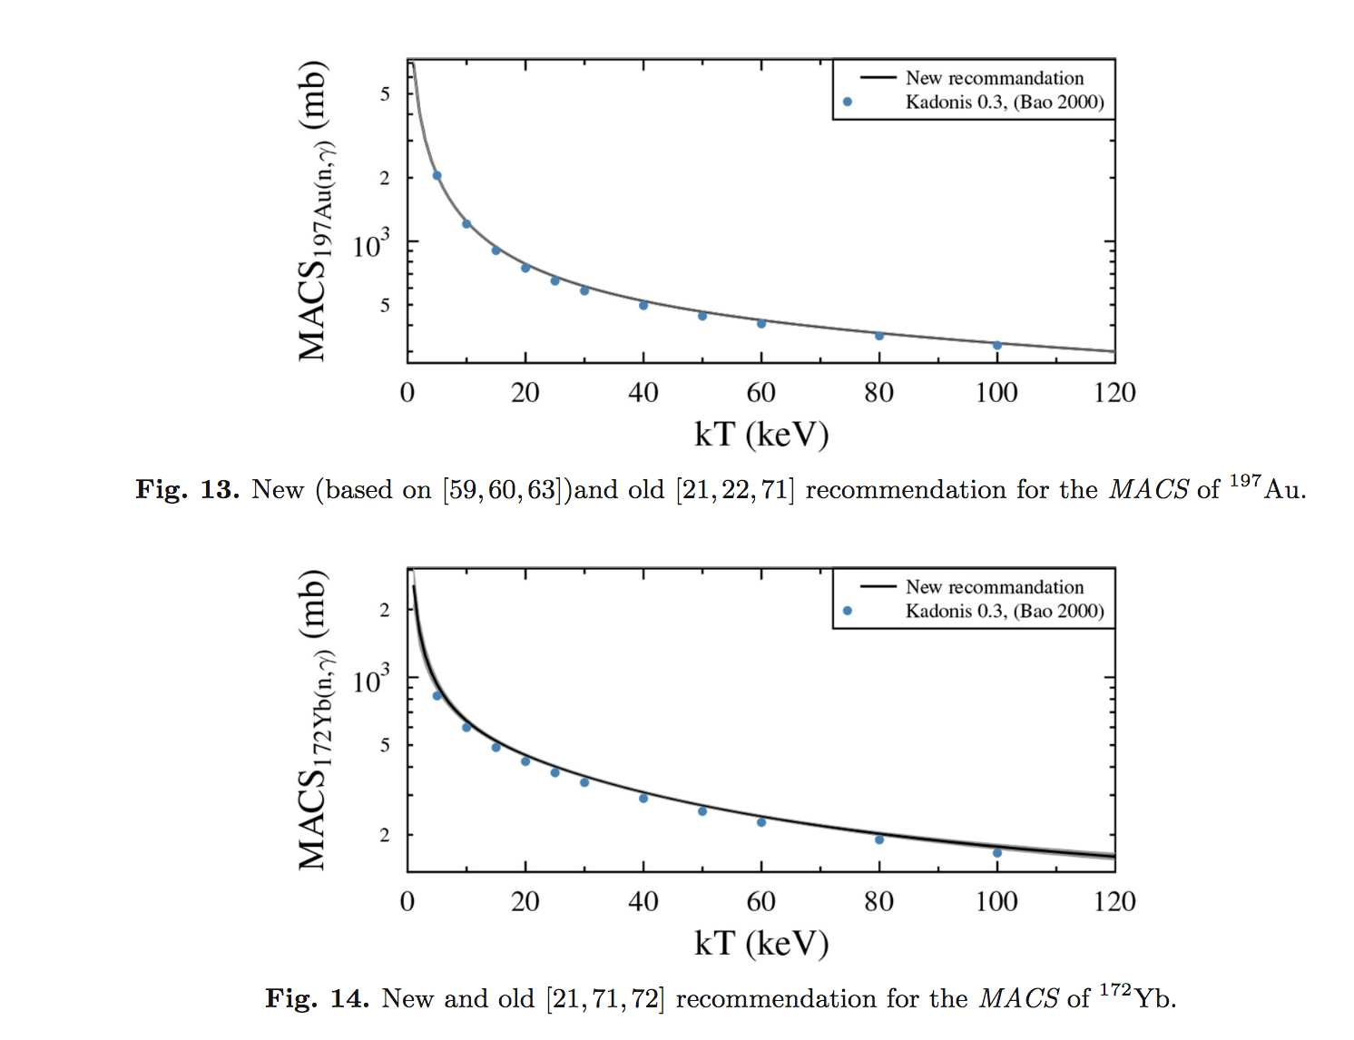
Re-analysis of KADoNiS Library
KADoNiS (Karlsruhe Astrophysical Database of Nucleosynthesis in Stars) has been extensively used in stellar nucleosynthesis calculations, and its cross sections are normalized (biased) to a ¹⁹⁷Au(n,γ) activation measurement of W. Ratynski, F. Kaeppeler, Phys. Rev. C 37, 595 (1988).
The activation Maxwellian-averaged cross section (MACS) 30 keV value of 582±9 mb disagrees with the International Evaluation of Neutron Cross Section Standards value of 620±11 mb.
The revised ¹⁹⁷Au(n,γ) activation MACS value of 612±6 mb is consistent with the ENDF value, and the KADoNiS cross sections have been updated for 63 target nuclides from ¹⁰³Rh to ¹⁹⁷Au.
Karlsruhe group publications for 1988-2018 have been re-examined at NNDC using NSR and EXFOR databases: Gold cross section was used in the Z=6-92 range, well beyond the Reinfarth et al. range of Z=45-79.
Findings are summarized in the NRDC memo CP-C/472, October 23, 2019.
We expect that Karlsruhe group will publish corrigendum where cross section values will be corrected, so we can update EXFOR.

Slide 7
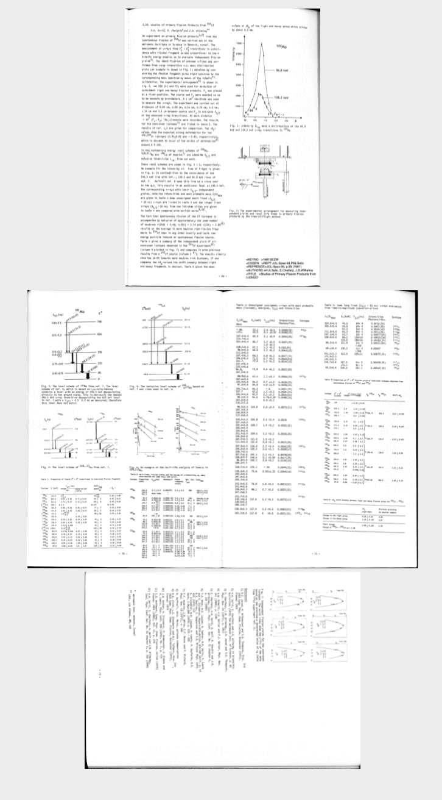
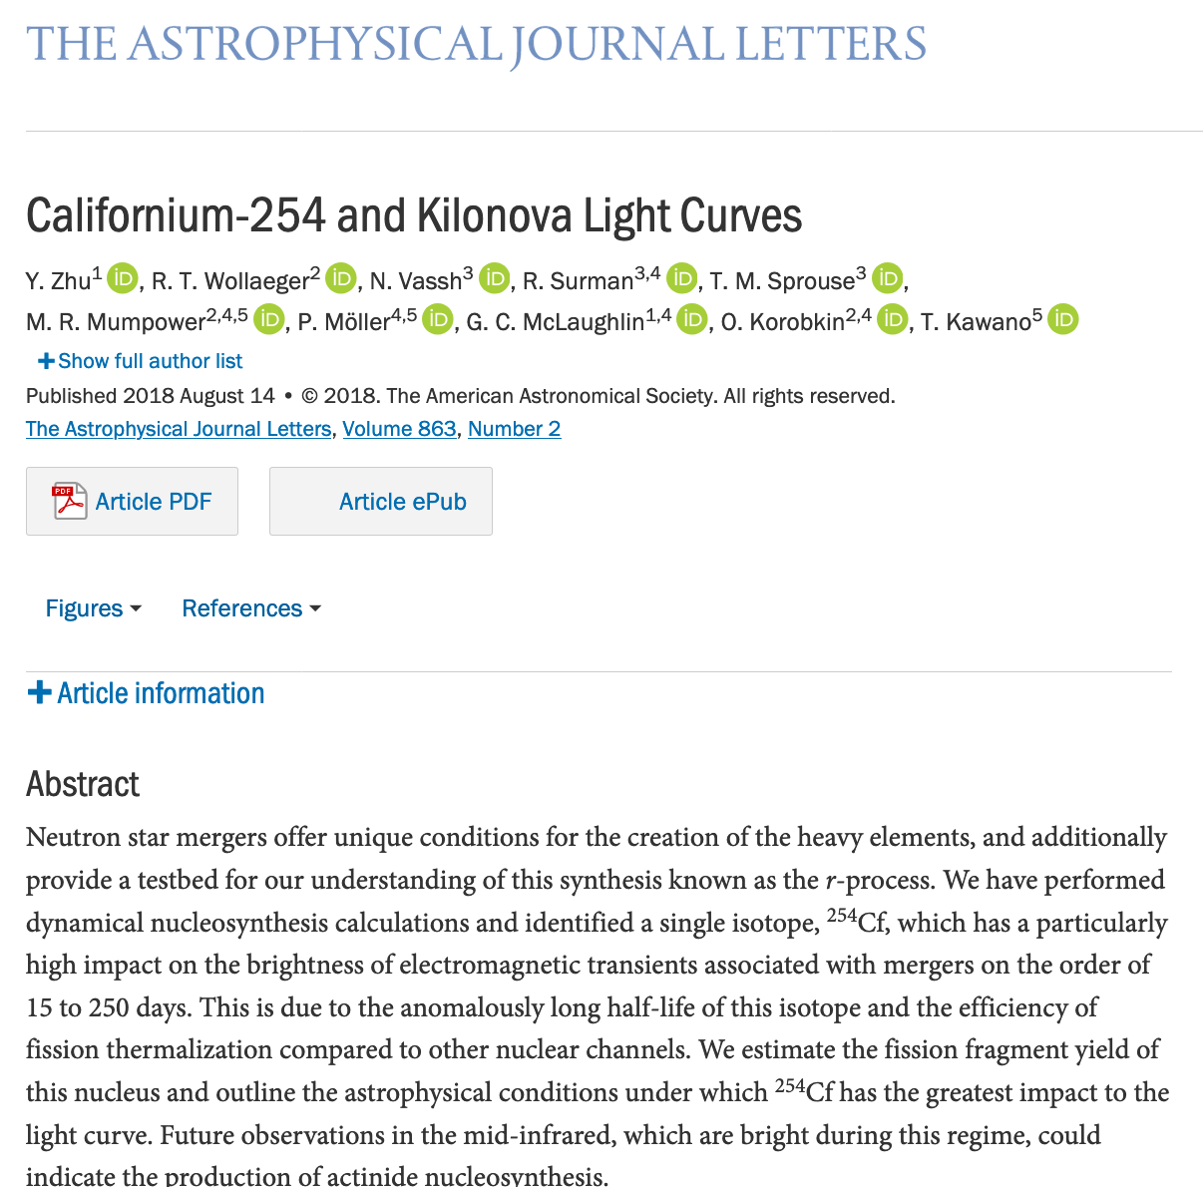
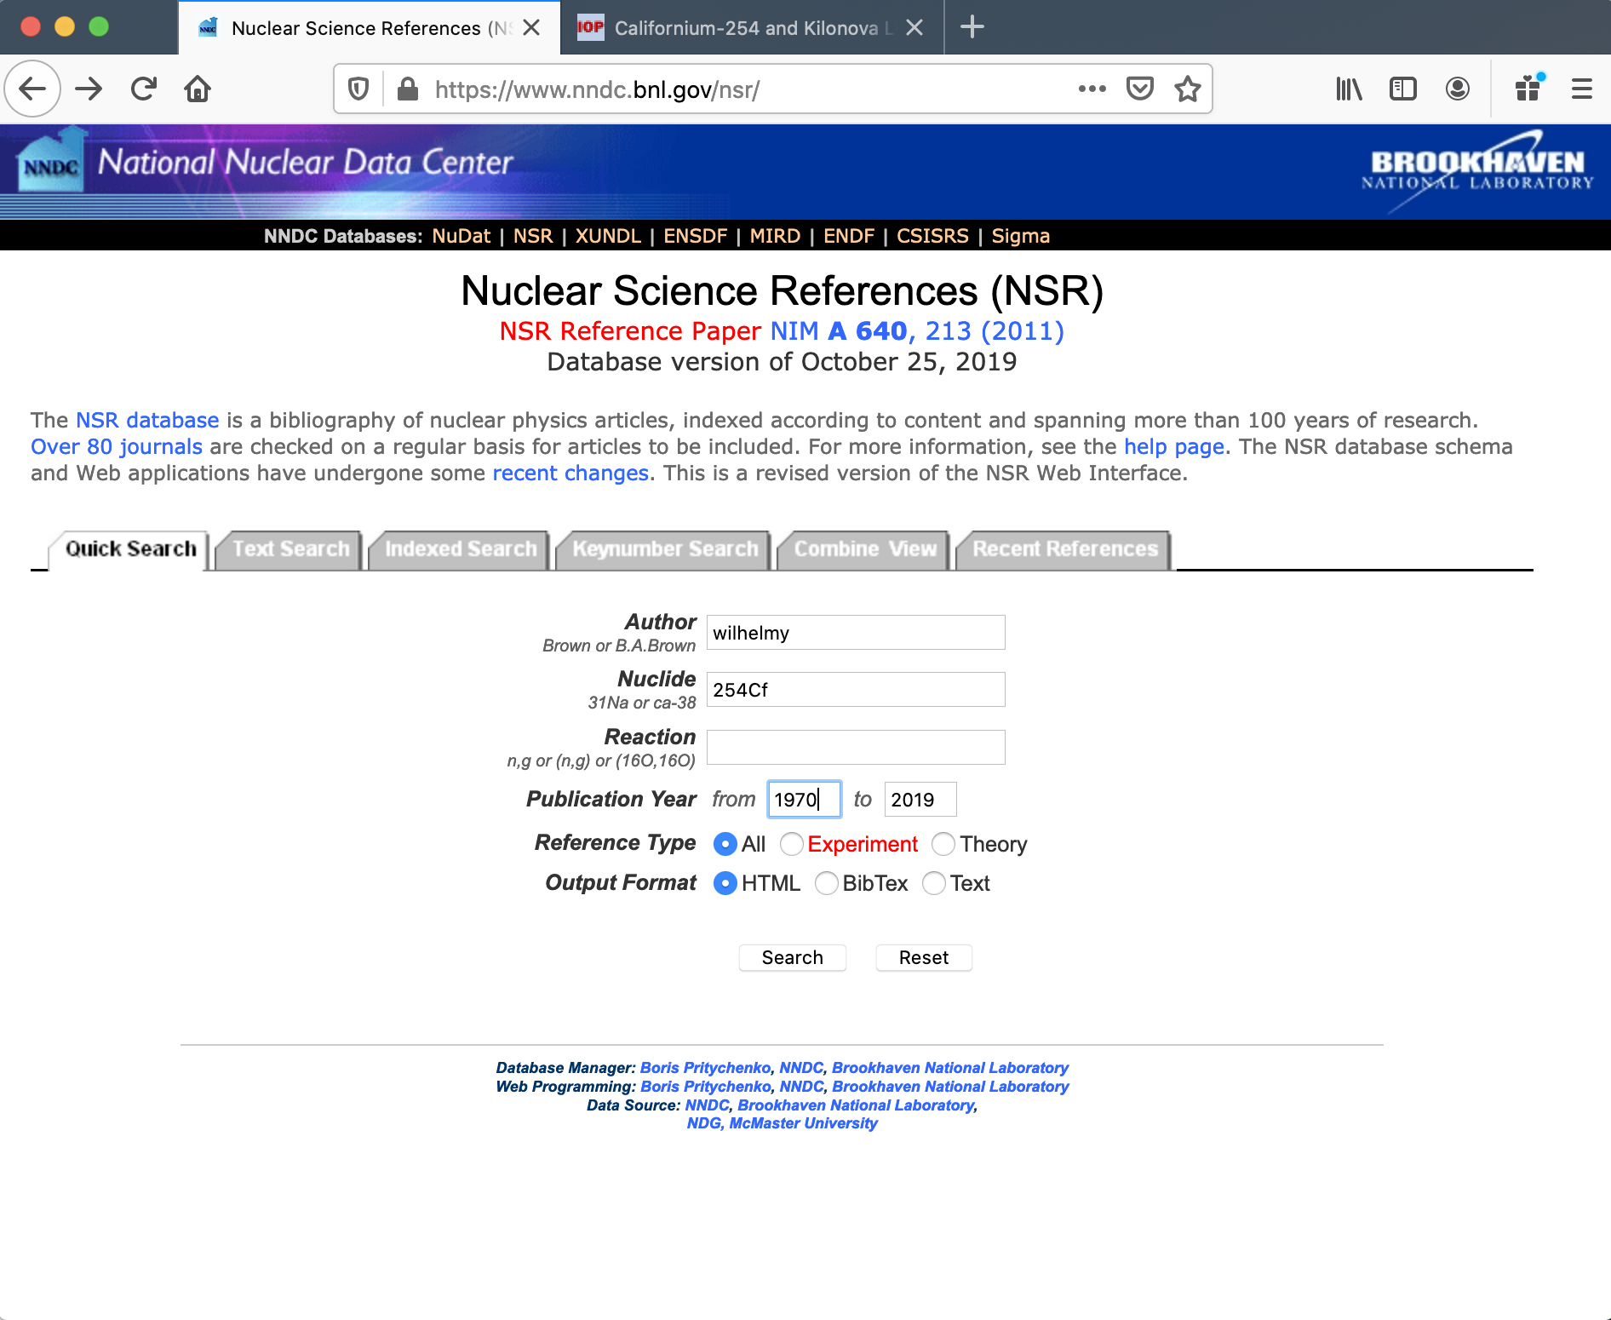
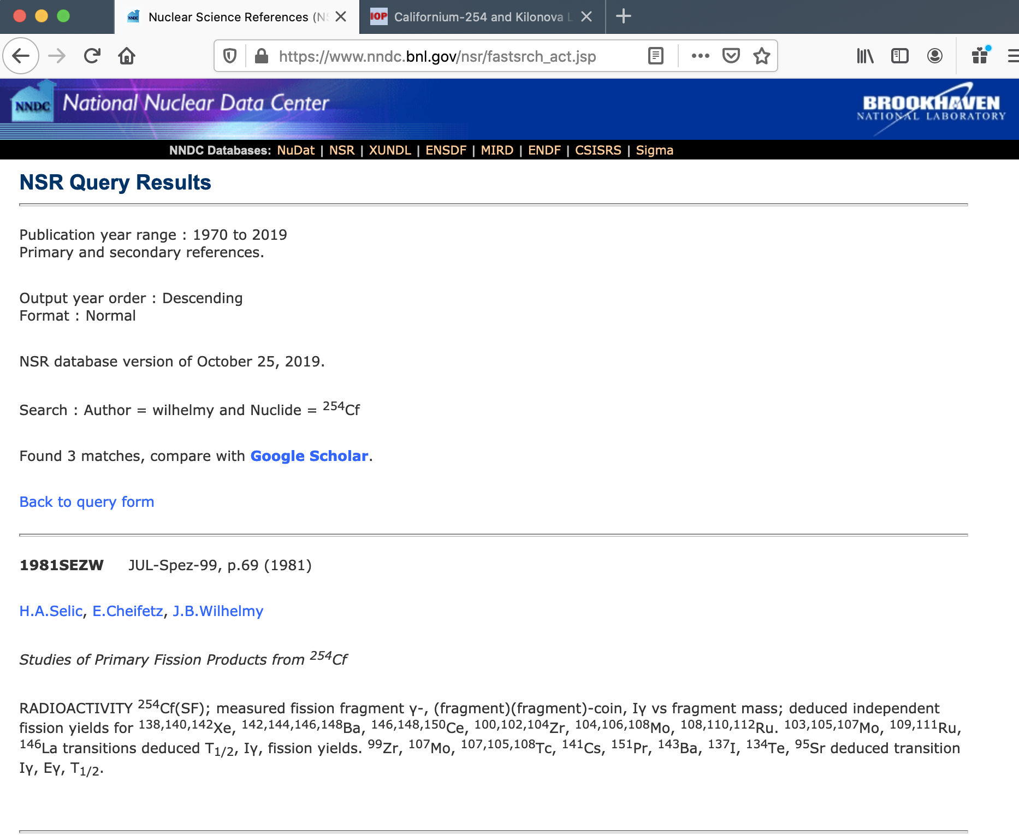
²⁵⁴Cf Spontaneous Fission
Strong interest in astrophysics community for modeling neutron stars merger events (GW170817).
Fission yields of ²⁵⁴Cf were calculated at Los Alamos because we did not have any experimental data: EXFOR DB does not have any ²⁵⁴Cf(SF).
At the Santa Fe FY workshop J. Wilhelmy argued that they have done such measurements in the 70s and calculations could be benchmarked against real results.
I conducted a simple NSR database search for author Wilhelmy and nucleus ²⁵⁴Cf that resulted in two conference papers and one lab report.
The PDF files were passed to J. Wilhelmy and R. Surman, and the tabulated data will be compiled into EXFOR at NNDC.
Nuclear astrophysicists should use NSR database.

Slide 8
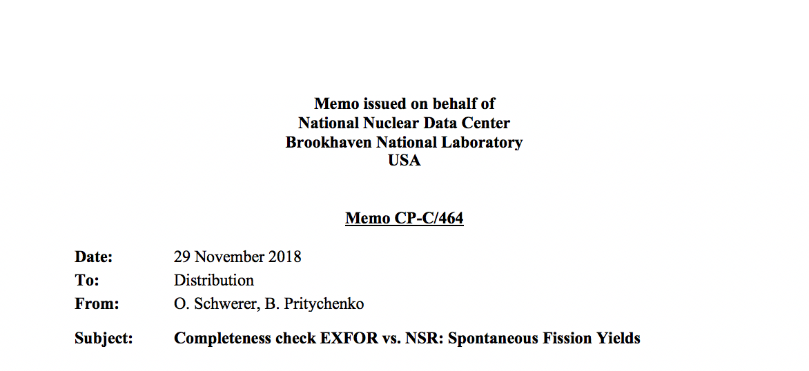
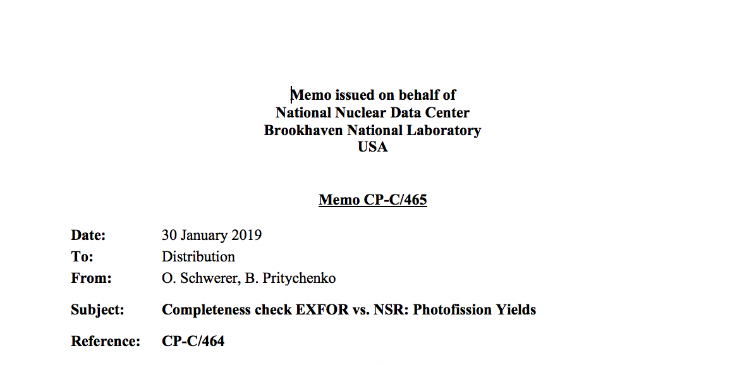
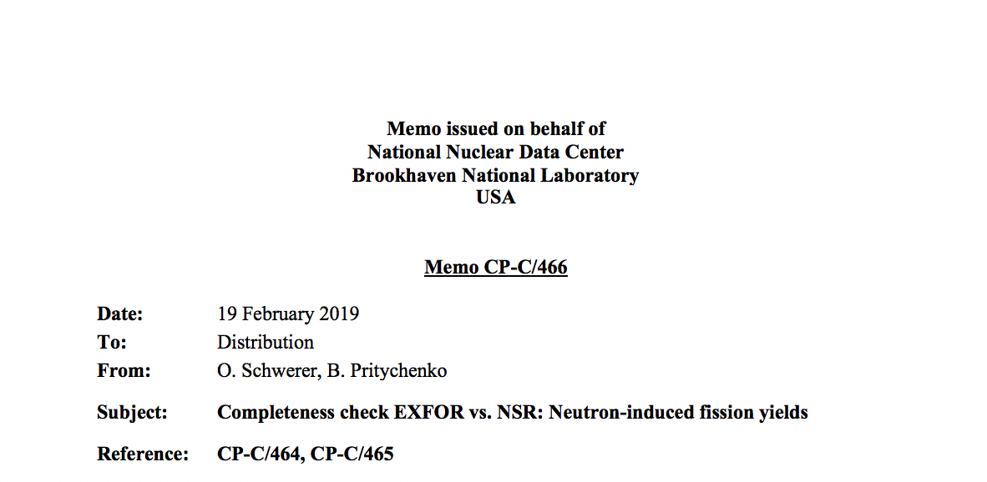
FY Compilation Project
NNDC is responsible for completeness of EXFOR compilations.
We produced three NRDC memos on NSR database analysis: CP-C/464 (Spontaneous fission), CP-C/465 (photo fission), and CR-C/466 (Neutron-induced fission).
Surprisingly fission yields are not complete in EXFOR (missing data publications):
Spontaneous fission: 49 + 28 (#2) + 16 (#3) + 21(#4) = 114
Photo fission: 8 + 32 (#2) + 7 (#3) + 41 (#4) = 88
Neutron-induced fission: 35 + 124 (#2) + 26 (#3) + 49 (#4) = 234
Volume of work in the Area #1:
Spontaneous fission: 49
Photo fission: 8
Neutron-induced fission: 35
Dr. Olena Gritzay is hired by NNDC to work on fission yields compilations in the Area #1. First compilations are already produced.

Slide 9
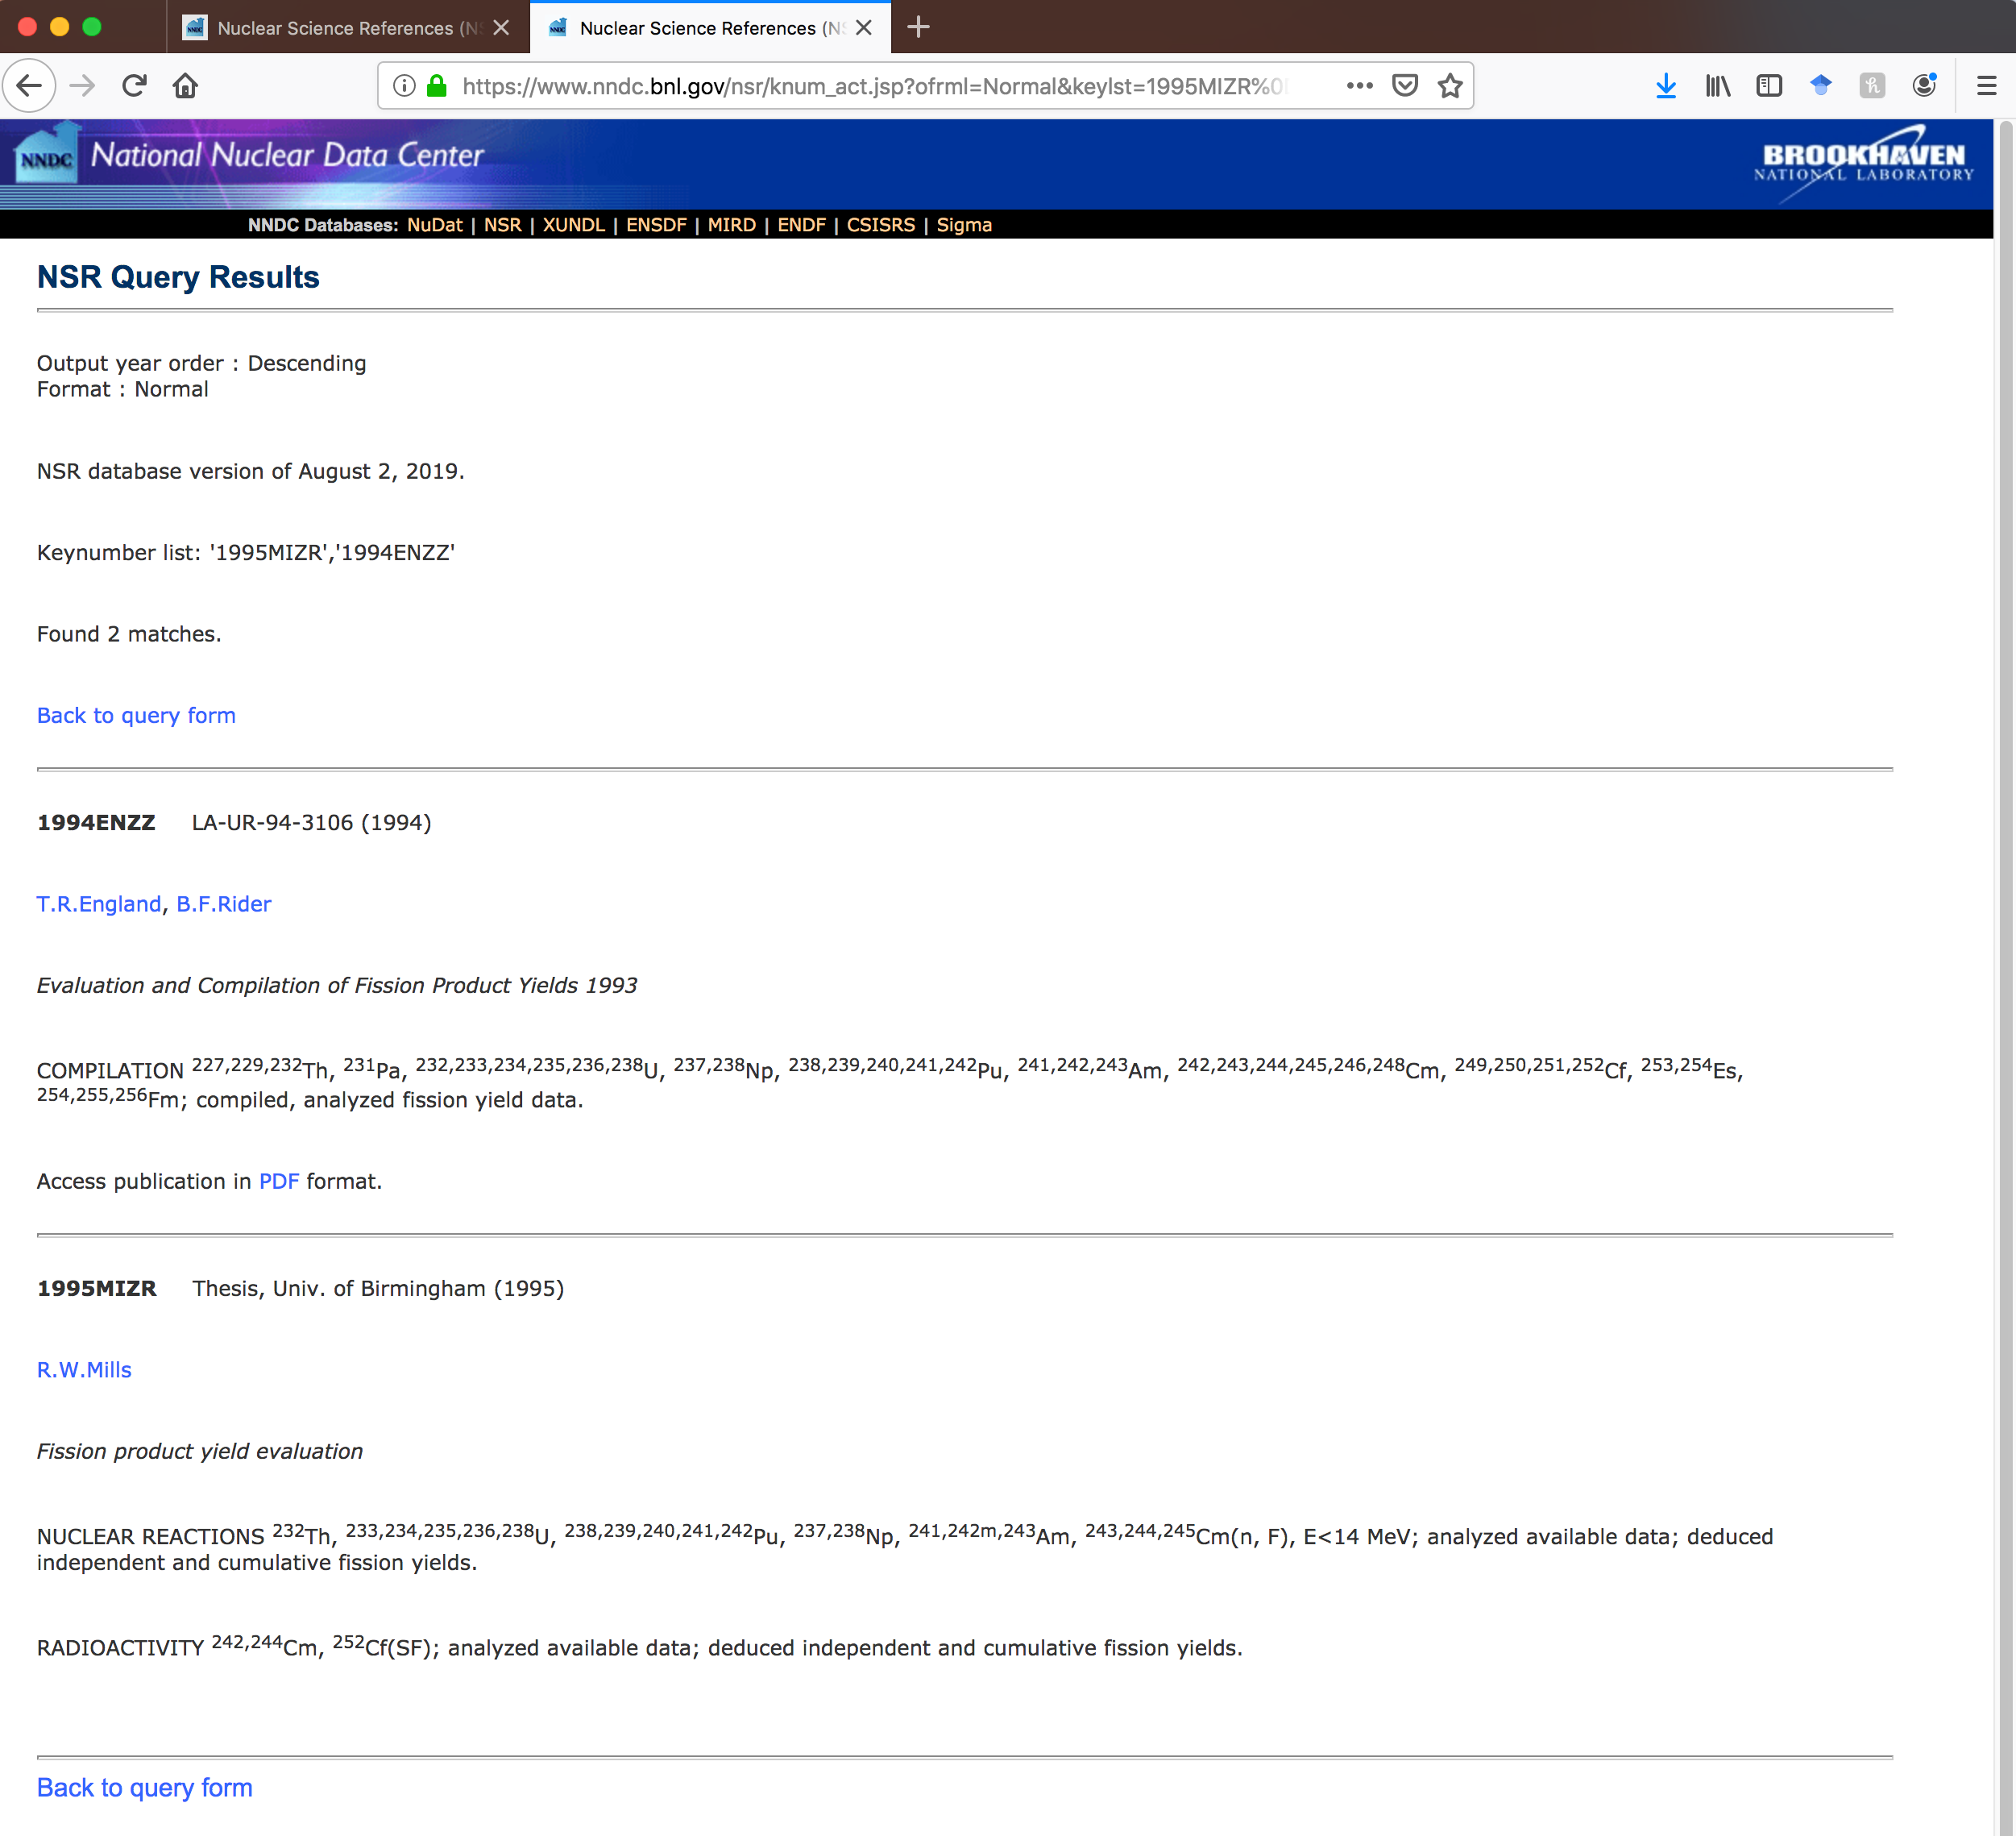
Current Status of FY Compilations at NNDC
Dr. Olena Gritzay is working on NRDC Memos CP-C/464, CP-C/465 and CP-C/466.
As of September 26, 2019:
New X4 Entries: 18 neutron- and 6 photo-induced fission
Revised X4 Entries: 41 neutron-induced fission
More missing data are expected for Area #1 from the IAEA effort on verifying bibliography of Mills, England & Rider works. More details in the next presentation of Shin Okumura.
NNDC has been compiling all Mills, England & Rider into NSR databases and collecting PDF files, special thanks to J. Totans.
Expected time of completion of FY compilations: Fall 2020

Slide 10
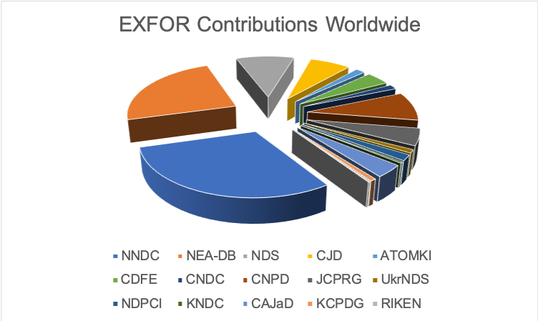
Takeaways
NNDC EXFOR compilation effort is complex and well-organized.
NSR database is a very valuable resource for reaction physicists, please consider it in your work.
Missing FY articles have been identified and compilation is in progress.

Slide 11
The International Atomic Energy Agency: (https://www.iaea.org/about/mission)
is an independent intergovernmental, science and technology-based organization, in the United Nations family, that serves as the global focal point for nuclear cooperation;
assists its Member States, in the context of social and economic goals, in planning for and using nuclear science and technology for various peaceful purposes, including the generation of electricity, and facilitates the transfer of such technology and knowledge in a sustainable manner to developing Member States;
develops nuclear safety standards and, based on these standards, promotes the achievement and maintenance of high levels of safety in applications of nuclear energy, as well as the protection of human health and the environment against ionizing radiation;
verifies through its inspection system that States comply with their commitments, under the Non-Proliferation Treaty and other non-proliferation agreements, to use nuclear material and facilities only for peaceful purposes.

Slide 12
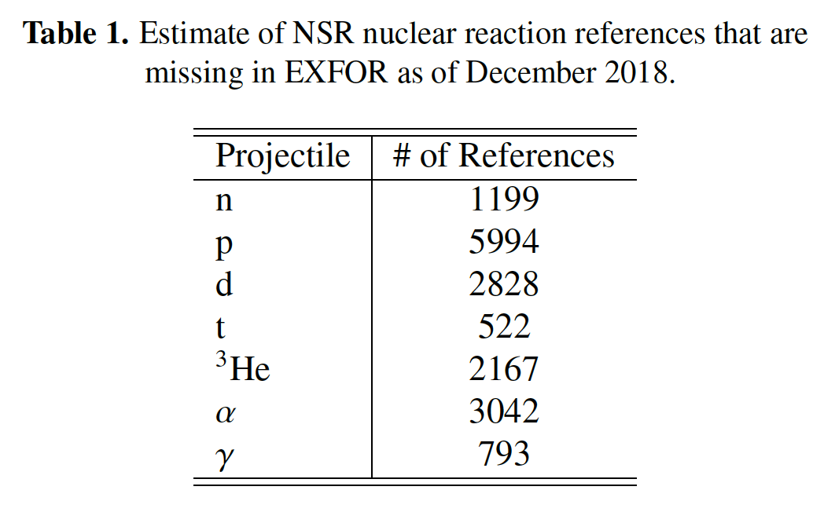
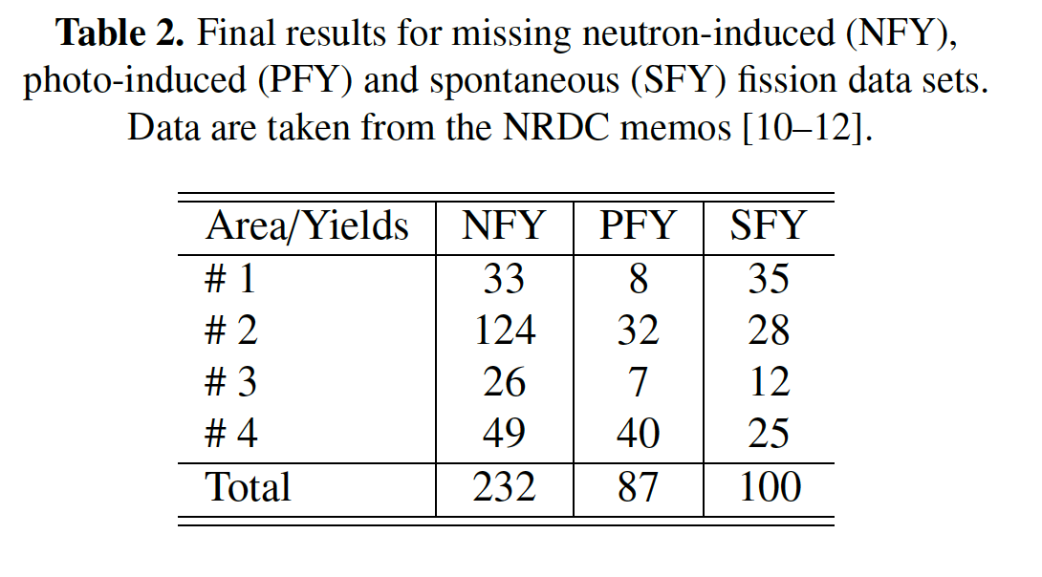
Missing Data Estimates
Big acknowledgements to F. Kaeppeler for pointing out this issue, Trento 2007.
The analysis of missing data in Tables 1 - 2 shows that the NSR estimate is reasonable.
The accurate accounting for missing info on B, C, N, O,F and Ne projectiles, spontaneous fission and the different NSR database scope and keywording style at ORNL would raise the projected size of the EXFOR library from the current 22,000 to approximately 40,000 experimental works.
We have to recover the missing data sets.

Slide 13
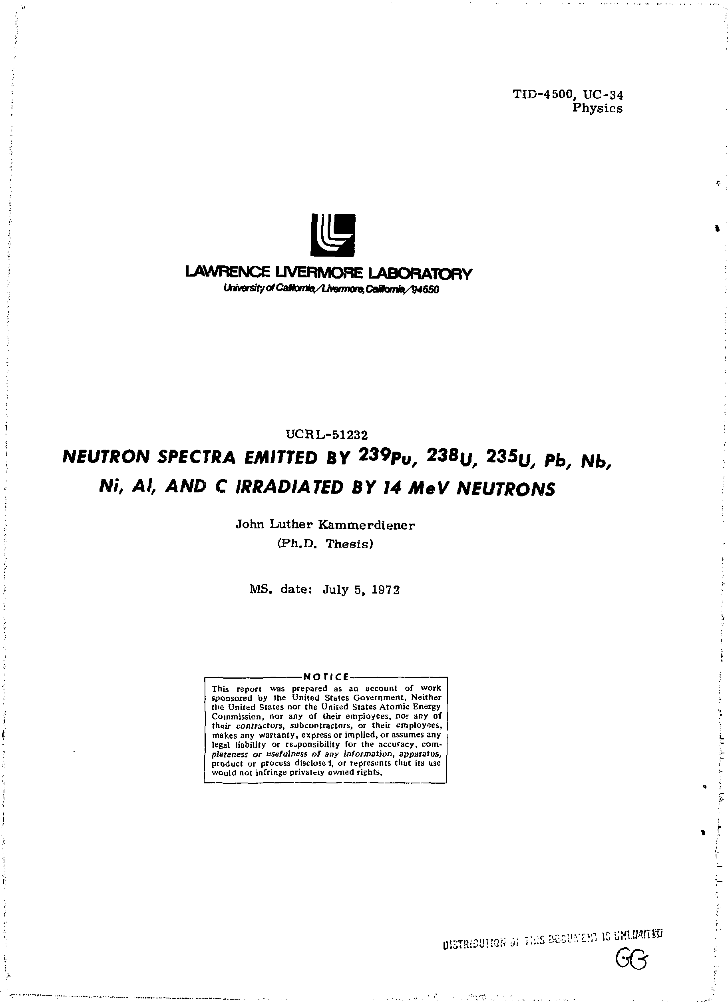
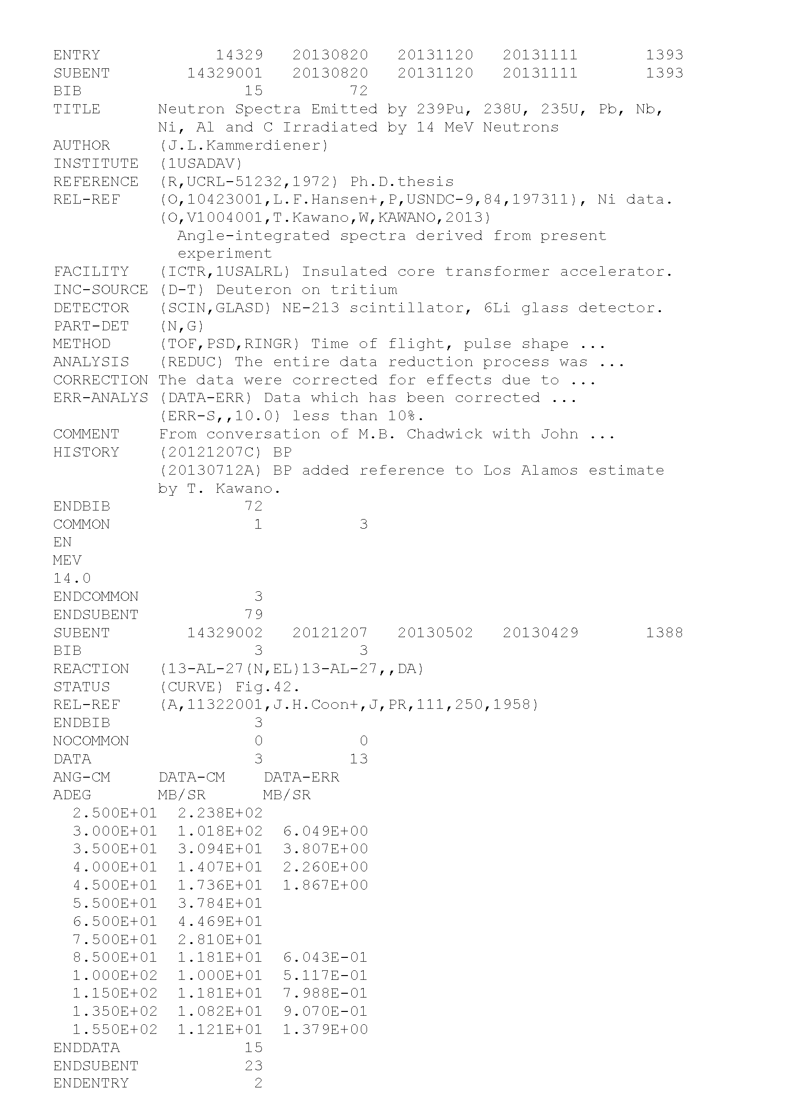
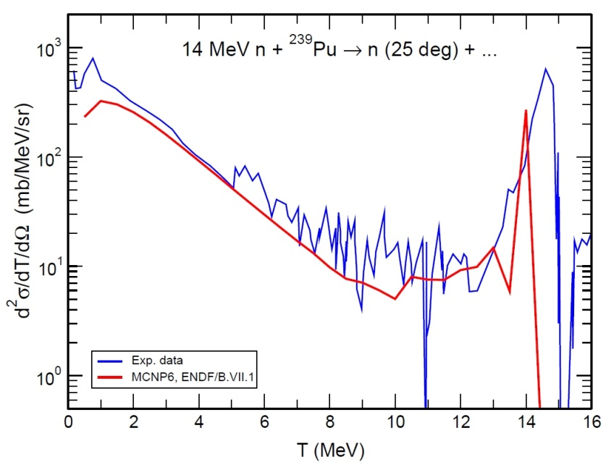
Example of Data Recovery (Nuclear Archeology)
New measurements are expensive: cyclotron beam cost of $2,500 an hour or $420 K for a week. Addition of target, electronics and personnel expenses results in $1 M price tag.
Therefore it is cost effective to recover results from the previous measurements.
The Ph.D. thesis of J.L. Kammerdiener was compiled by NNDC as EXFOR entry #14329 41 years since its defense at UC Davis.
The thesis contains unique and time- and cost-expensive measurements with: ²³⁹Pu, ²³⁸U, ²³⁵U, Pb, Nb, Ni, Al and C targets.
A new measurement with multiple targets would require lengthy approval and may result in a few million dollars of additional expenses.
Thesis and associated graphic data were reanalyzed and digitized at NNDC and used in MCNP calculations at LANL.
Tools: EXFOR editor & Java plot digitizer.
These techniques could be applied for recovery of other experimental data.

Slide 14
NRDC Memos

