Slide 1
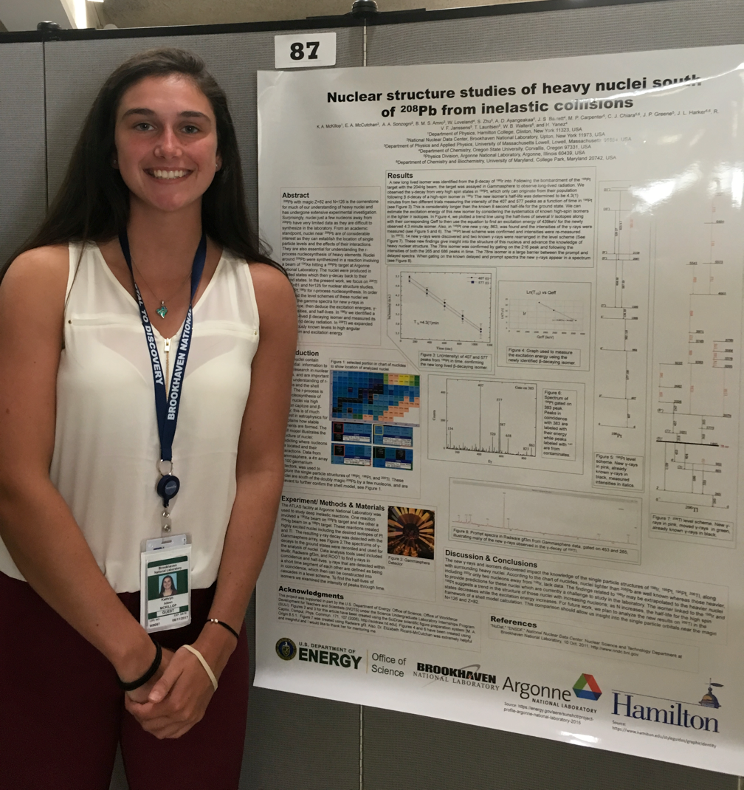
Measurements of Branching Ratios in ²³⁸U
K. McKillop, E. McCutchan, S. Zhu, A.A. Sonzogni
National Nuclear Data Center
Brookhaven National Laboratory, NY USA

Slide 2
Motivation
Improving the double-differential ²³⁸U(n,n’γ) cross section using neutron-gamma coincidences
Collaborative Proposal to the U.S. Department of Energy, Office of Science, Nuclear Physics FOA call: LAB 17-1763
Nuclear Data Interagency Working Group/ Research Program
Collaboration between LBNL, BNL, LANL, LLNL
P.G. Young et al., Nucl. Data Sheets 108, 2589 (2007)

Slide 3
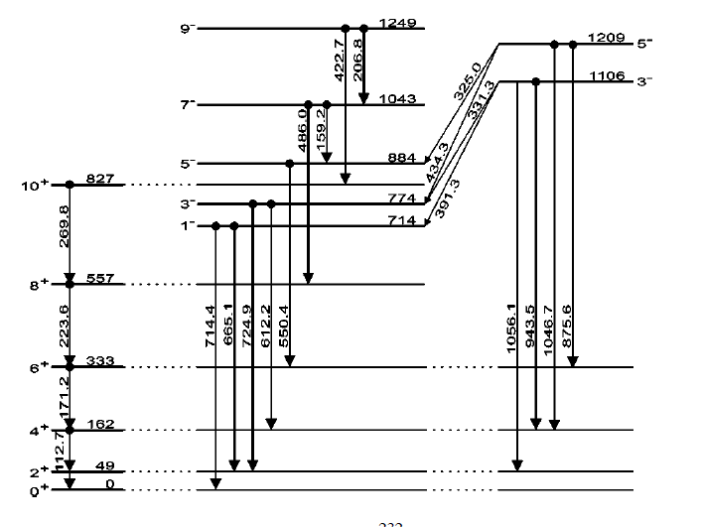
Motivation
Merger of nuclear structure and nuclear reaction physics
Branching ratios essential to determine cross section from off-yrast states

Slide 4
Isn’t ²³⁸U well studied?
By Coulomb Excitation: 10+ measurements
D. Ward et al., Nucl. Phys. A 600, 88 (1996)

Slide 5
Isn’t ²³⁸U well studied?
Only a handful of intensities reported
E. Browne, J.K. Tuli, Nucl. Data Sheets 127, 191 (2015)

Slide 6
Isn’t ²³⁸U well studied?
550 gamma transitions
single Ge detector
By n,n’γ: 8+ measurements
2- branching | Reference
0.80 (24) | 1978De41
0.50(17) | 1984BlZS
0.36 | 2014Go06
0.52(6) | Coulex

Slide 7
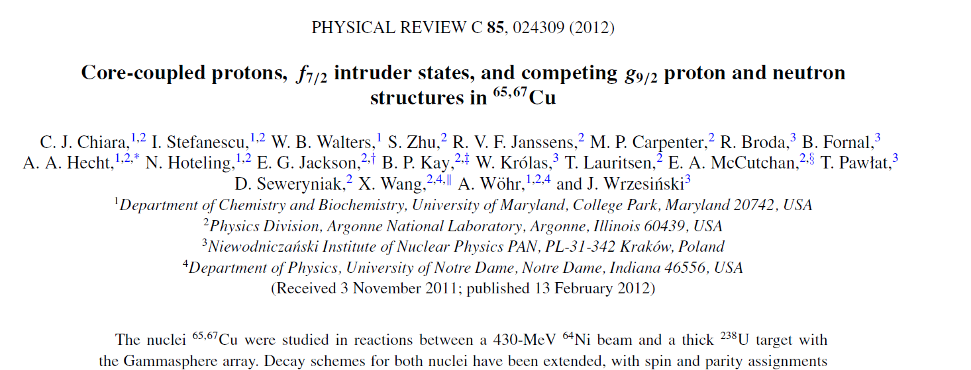
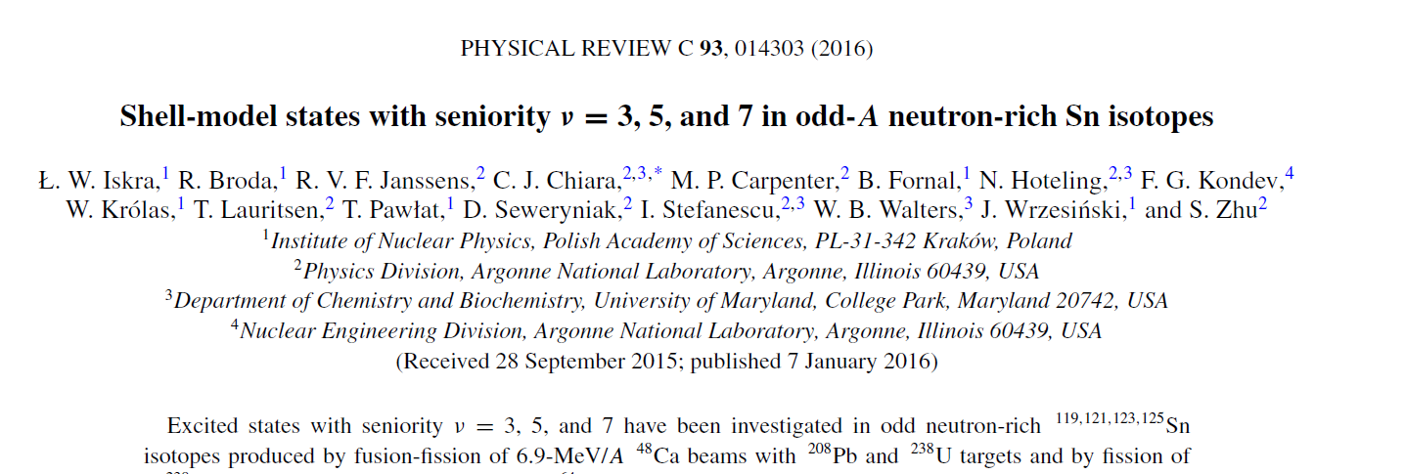
Wealth of Existing Data
In nuclear structure experiments, ²³⁸U frequently used as a target for deep inelastic reactions

Slide 8
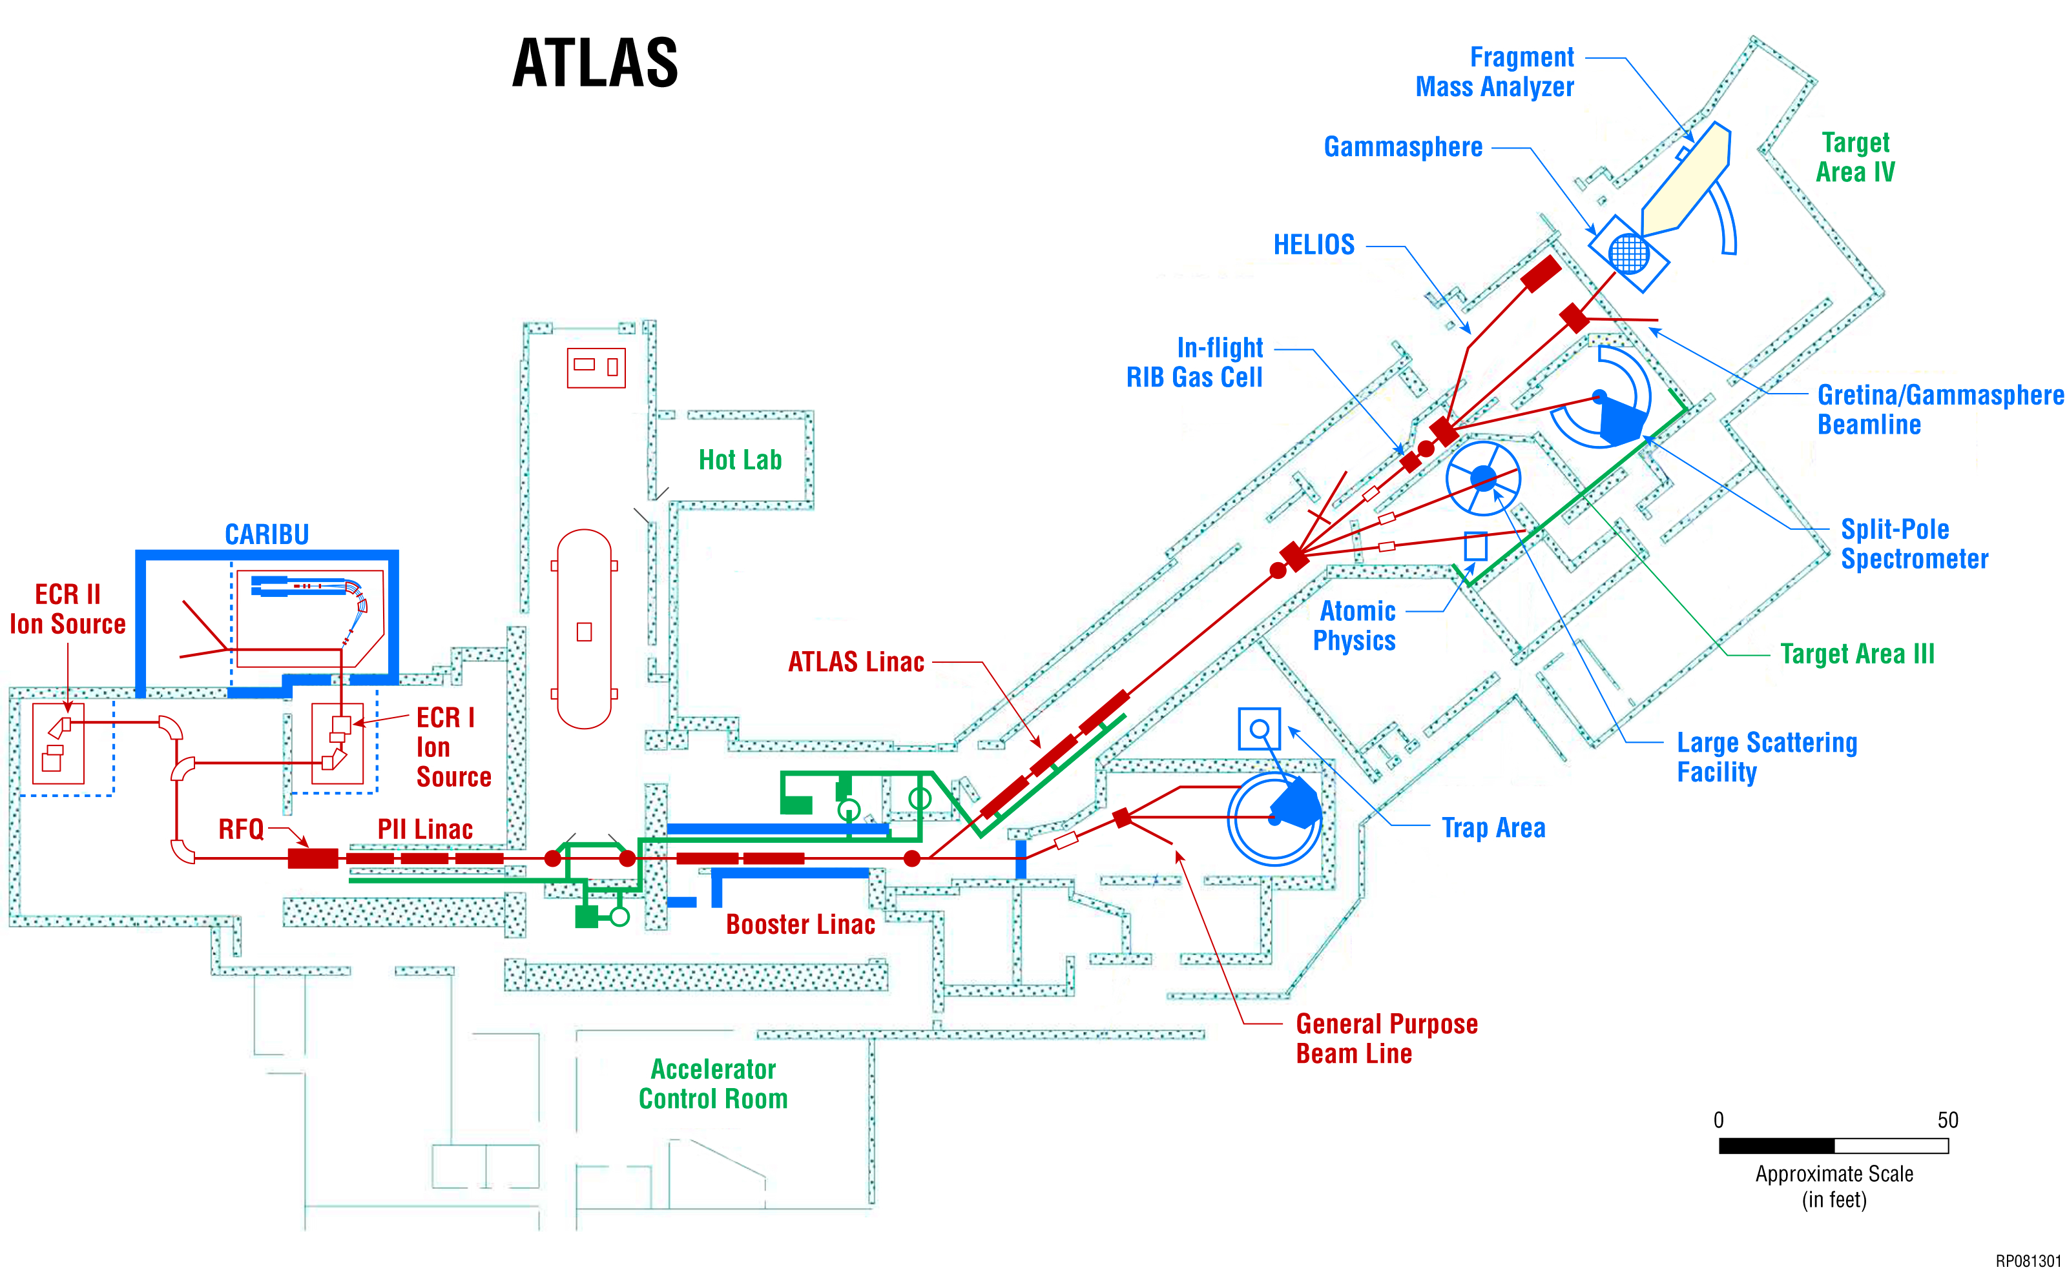
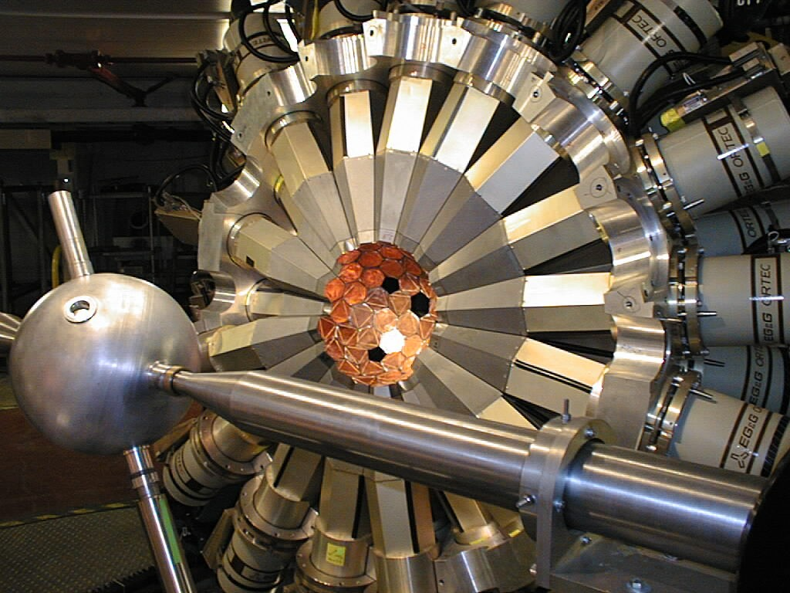
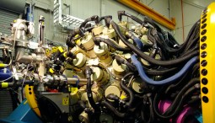
Gammasphere at Argonne National Lab
100 HPGe detectors
Compton-suppressed
High coincidence efficiency

Slide 9
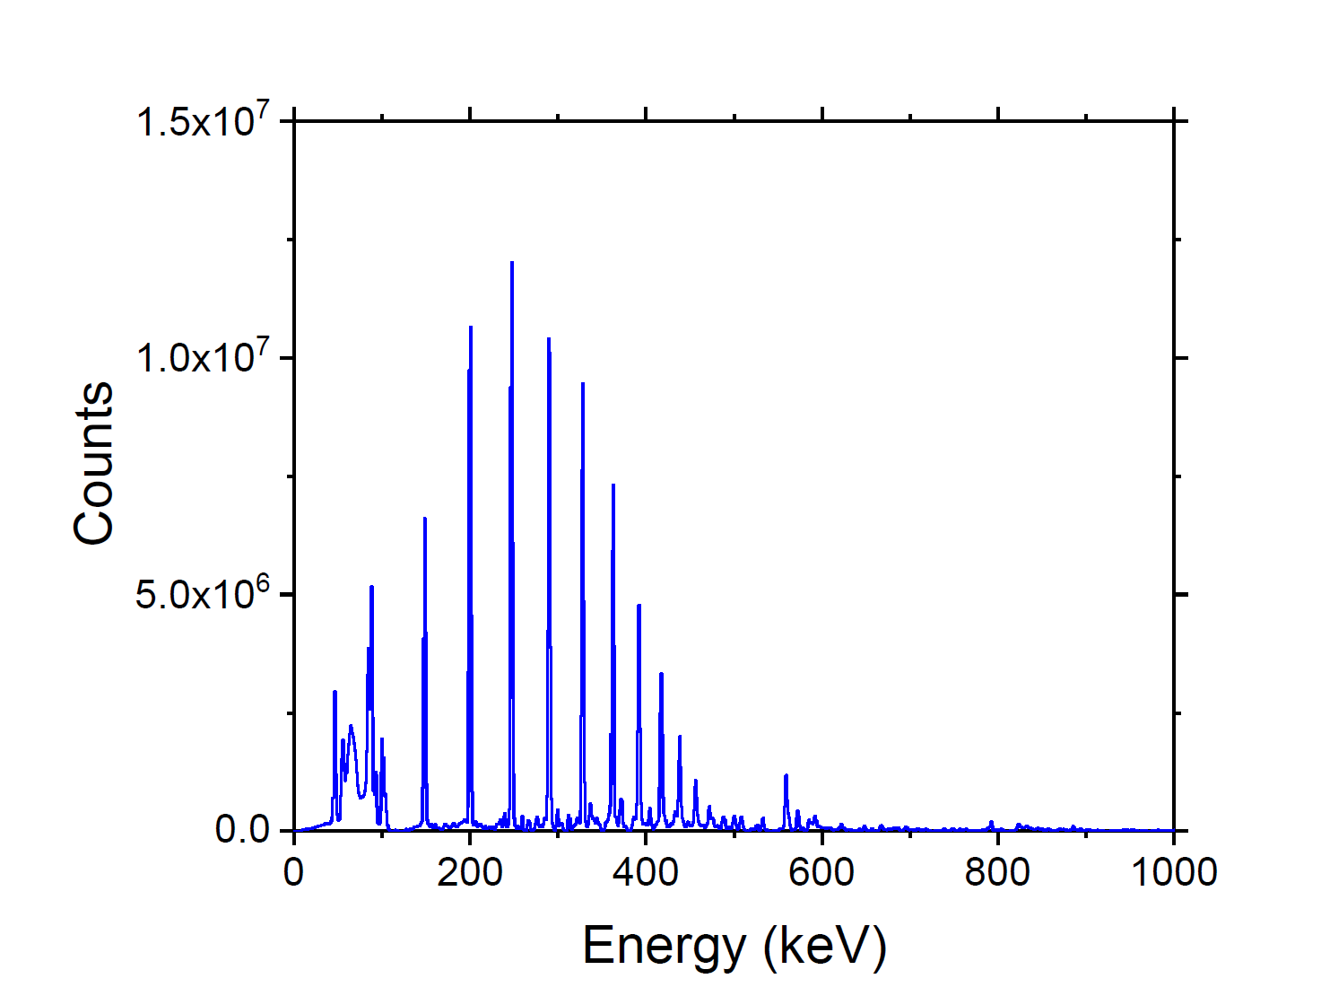
Example Dataset
Projection
Beam: ²⁰⁷Pb, E= 1400 MeV
Target: 48 mg/cm² ²³⁸U
>99% enrichment
Analysis with Cube data
γγγ

Slide 10
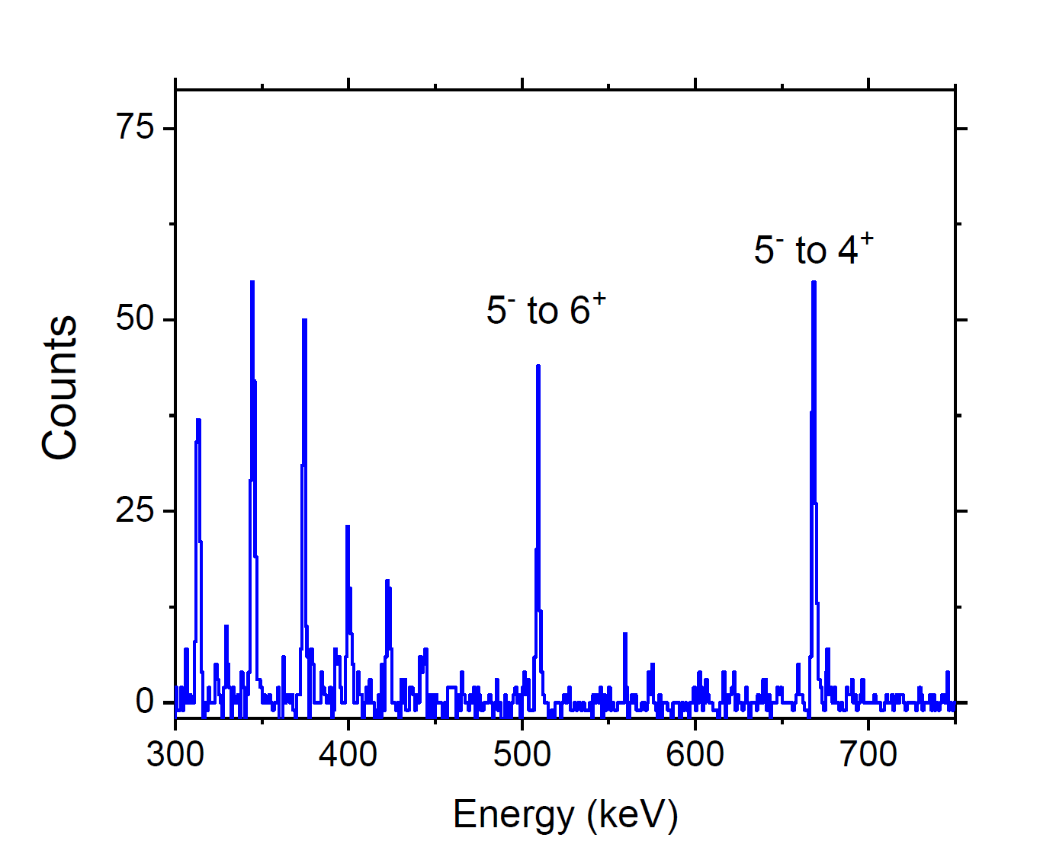
Branching from first 5-

Slide 11
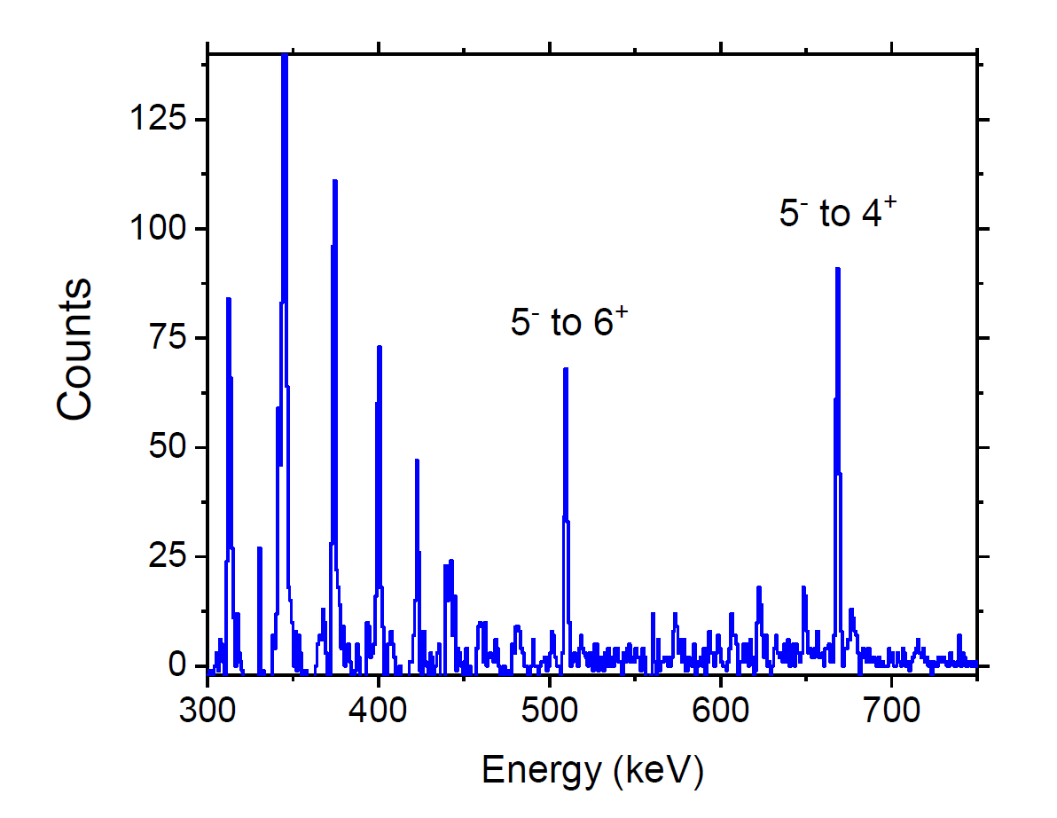
Branching from first 5-

Slide 12
Preliminary Results
Branching ratios for 22 levels in ²³⁸U
Cross checks between different beams
Also will analyze neutron transfer, ²³⁷U, ²³⁶U

