Slide 1


A New Gamma+X-ray Coincidence Catabase
Lee Bernstein for Aaron Hurst and Bruce Pierson
Nuclear Science Division
Lawrence Berkeley National Laboratory
Department of Nuclear Engineering
University of California - Berkeley
Andrew S. Voyles
13 June 2018 – Program Review for NSSC2 – TA1
Notes:
Emerging trends for next-generation (targeted & personalized) nuclear medicine:
Targeted alpha therapy (5-10 MeV)
40-80 μm range → single cell
Targeted Auger therapy (20 eV – 1 keV)
1 nm – 2 μm → cellular nucleus
Theranostic medicine
Simultaneous imaging and therapy

Slide 2
Overview
PNNL (PI Bruce Pierson) is leading an effort to develop a high-efficiency, high-resolution spectrometer for nuclear forensics applications.
The detector is designed to facilitate the identification of radionuclides in a sample via observation of γ-rays and coincident X-rays following α- β- and IT-decay
  X-rays could come from either internal conversion or electron capture (followed by cascade).
  X-ray down to ≈20 keV of interest
The LBNL/UC component of the project is to develop a coincident γ-X database.
The methods we have developed are being benchmarked against earlier work by PNNL.

Slide 3
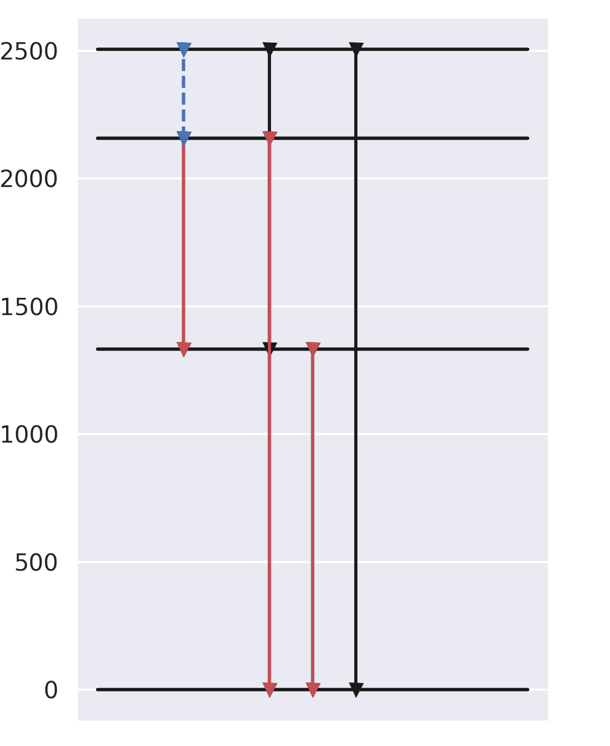
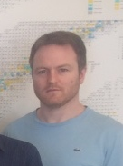
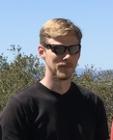
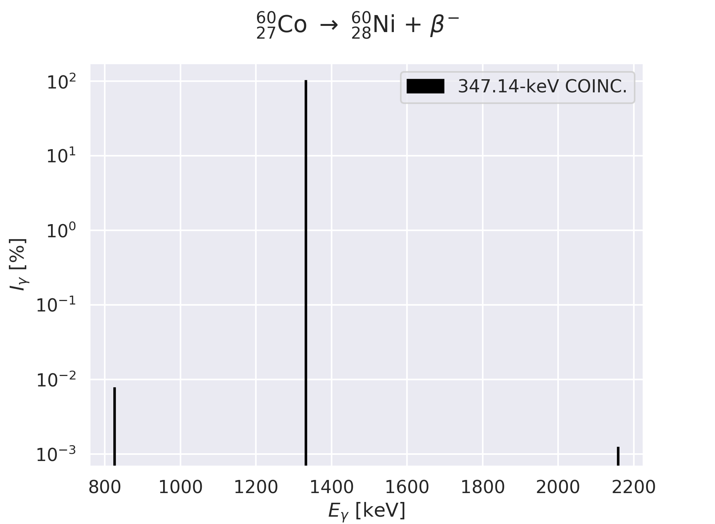
The first step is to build a γ−γ coincident database and use it to obtain gated intensity plots
Jason Matheny
Aaron Hurst
Example: ⁶⁰Co β⁻
γ-gate: 347.14 keV
γγ: 826.1; 1332.5; 2158.6
Coincident-decay lookup library for fission products with T₁> 1 h.
γ, β, α, X-ray coincidence for forensics with energy and intensity information
Locally-built and installed SQLite database.
Flexible approach allowing users to query, manipulate, and visualize data.
Jupyter Notebook interface.
⁶⁰Ni
The data comes from the ENSDF2XML* parser created by Aaron Hurst
*https://www.osti.gov/servlets/purl/1332135
Notes:
3

Slide 4
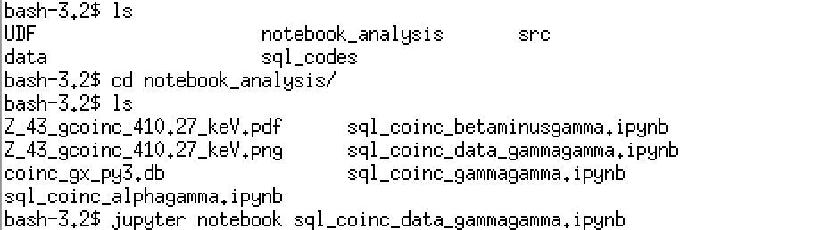
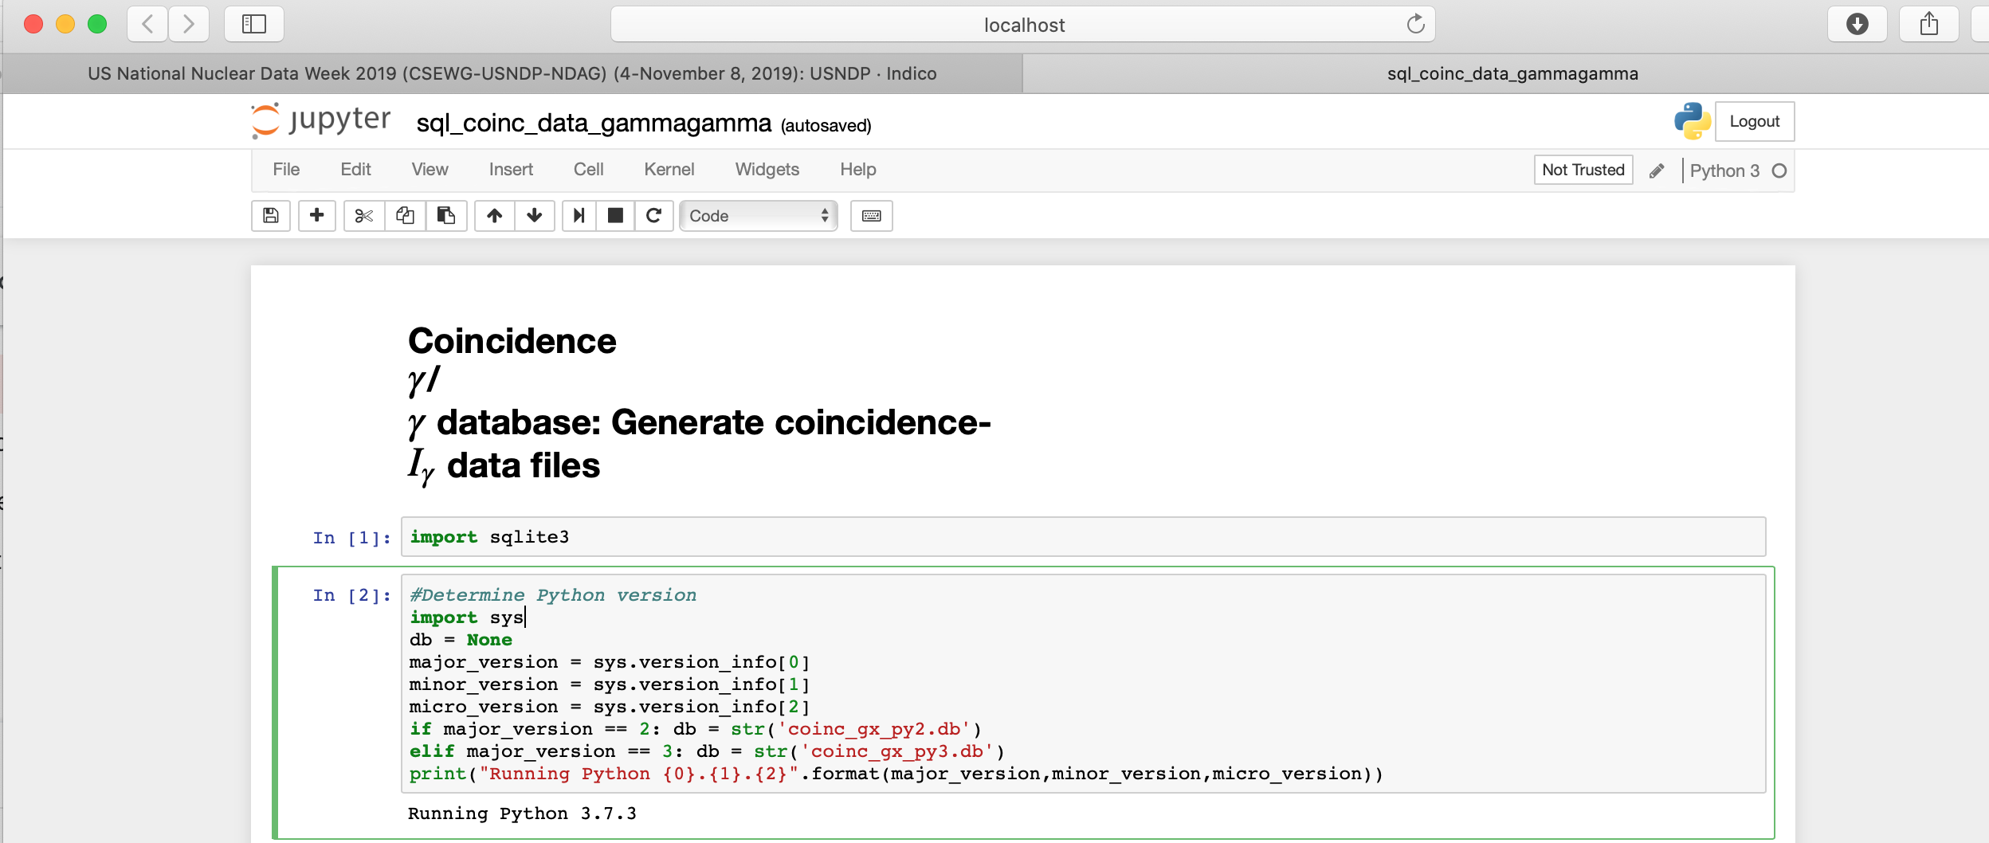
Jupyter Notebook allows us to document our analysis and inspect it step-by-step.
Notes:
Step 6 is where we draw the level scheme
4

Slide 5
Let’s look at the Notebook…
Notes:
Step 6 is where we draw the level scheme
5

Slide 6
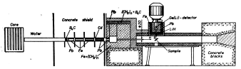
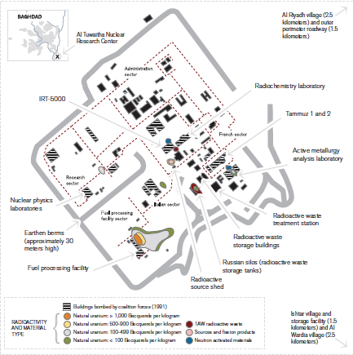
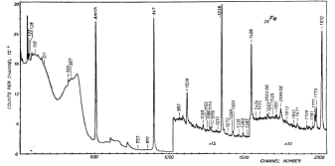
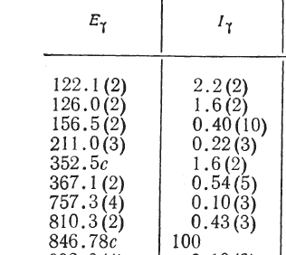
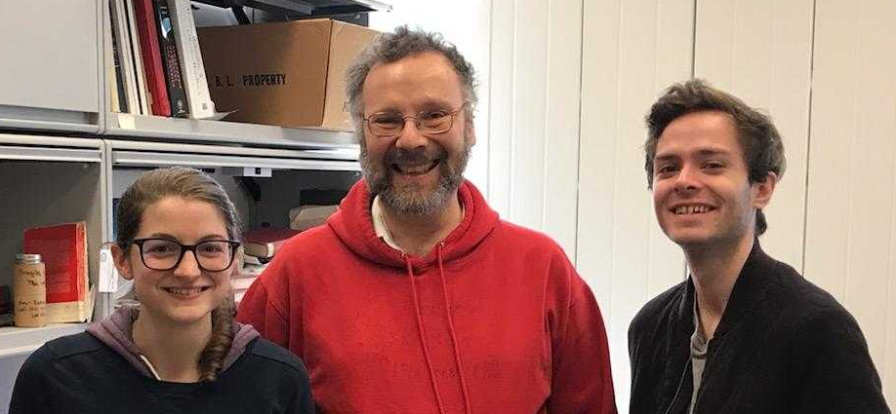
The γ-X database enables the use of the Baghdad Atlas as a Benchmark (n,n’)
Baghdad Nuclear Research Facility (Al-Tuwaitha)
IRT-5000
Excellent Documentation and Consistent Measurements
Notes:
And now I’m going to use a couple of Lee’s slides to describe a data set that we are working on turning to a new benchmark with sensitivities to inelastic scattering gammas.

Slide 7
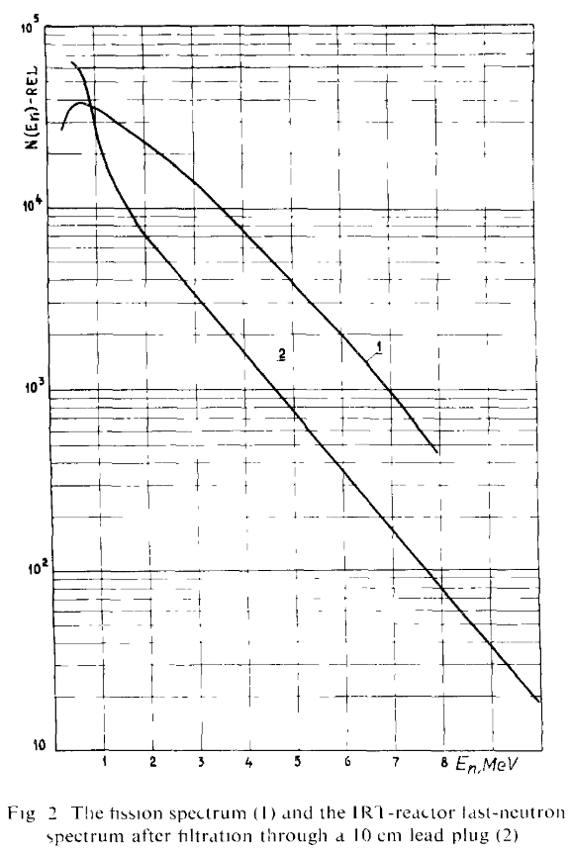
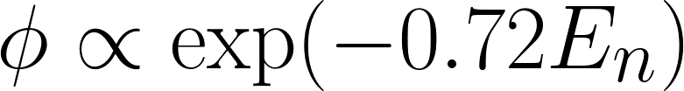
The flux shape is a large source of uncertainty in the modeling, and the available information is not specific enough
The flux was measured using threshold reactions and fit to an exponential
No data points were shown, and there was no uncertainty given on the fit parameter 0.72
The flux was therefore re-fit using information on the best known of the isotopes, ⁵⁶Fe
We convolved this flux with ENDF cross sections and the result didn’t fit the data at all ☹
Ahmed, M. R., et. al NIM 117(1974)
6
Notes:
Another source of uncertainty in the use of the benchmarks is in the modeling. In this case, the ATLAS values are integrated over the neutron spectrum at the Baghdad reactor, so it is critical to have a good understanding of that spectrum shape.
In a 1974 paper describing measurements at the reactor, an exponential

Slide 8
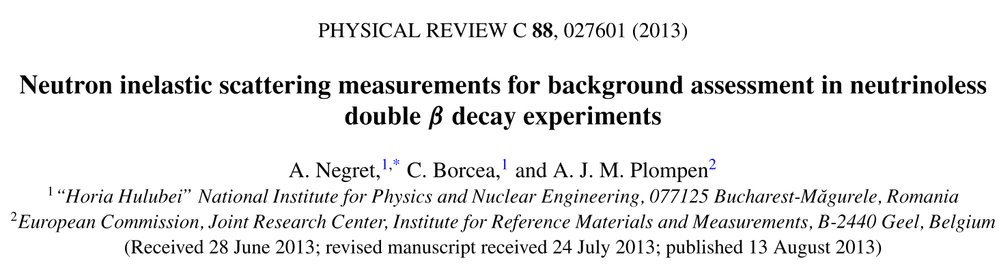
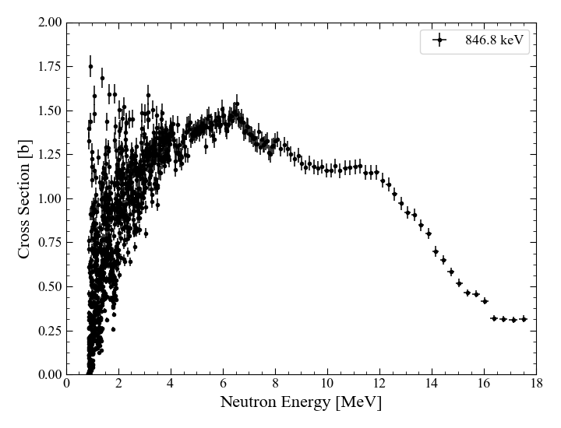
Partial gamma data for ⁵⁶Fe inelastic scattering from Negret, et al, was used to fit the reactor flux
Data for 20 gammas in EXFOR
The partial cross sections were integrated over reactor spectrum, and the ratios over the 847 were calculated for comparison with the ATLAS values
7

Slide 9
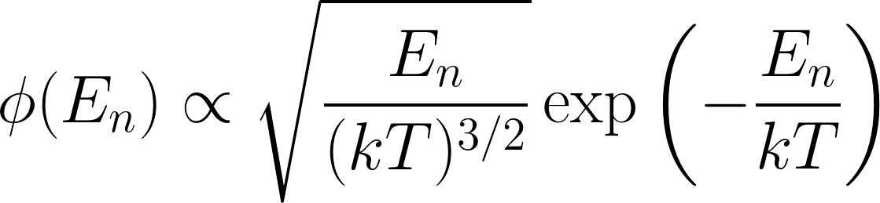
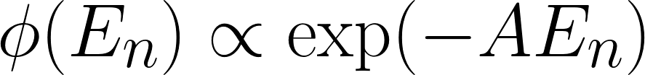
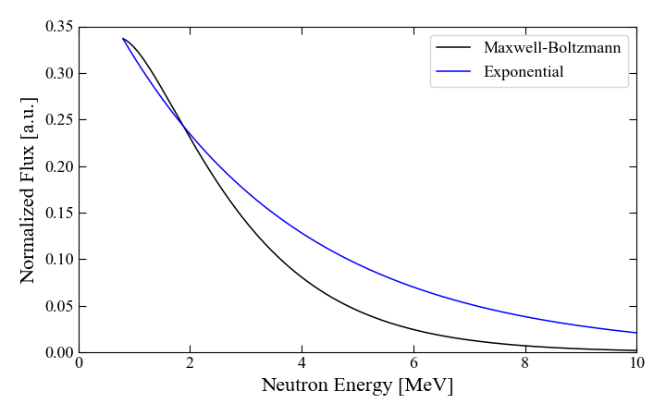
Both the exponential form and a Maxwell-Boltzmann were tested, and the MB was found to fit better
Exponential
  Initially fit by threshold reactions
Maxwell-Boltzmann
  Physically reasonable for reactor
8
Notes:
Exponential falls off much faster, is a softer spectrum than the MB – lower ratios

Slide 10
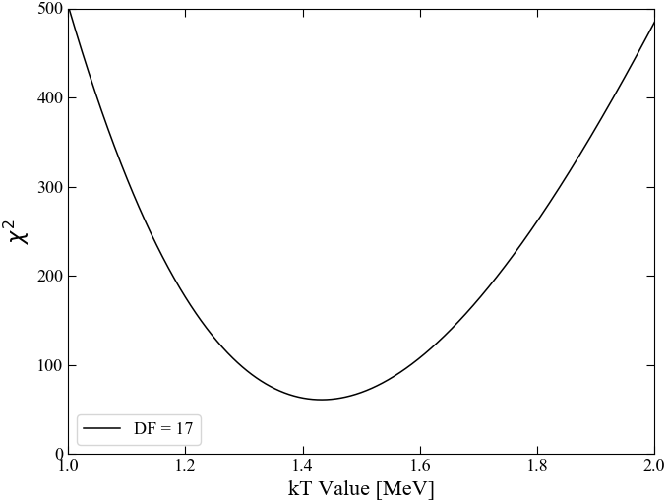

A Maxwell-Botzmann flux distribution was found to produce the best fit to the GELINA data
We found this very “validating” since the standard used for fast reactors is a MB with kT=1.42
kT_{opt} = 1.44
χ² = 60.5

Slide 11
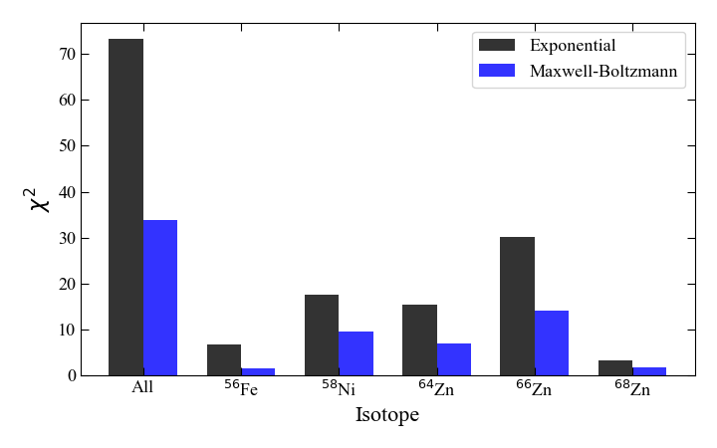
Validation of the MB flux shape was seen with improved TALYS calculations for neighboring isotopes
13
Notes:
One example of this is the check that we did on the MB flux shape, where the ratios for several other f-p shell nuclei were calculated with Talys and compared to the ATLAS values. The new MB shape uniformly improved the ratios for all of the nuclei

Slide 12
Benchmarking of the models involved in the partial gamma cross section calculations – ⁶⁶Zn
Gamma cascades involve incoming angular momentum, level density, gamma strength functions, transition from continuum to discrete levels, and structure data of the discrete states
Level Energy [keV] | J^{π} | ATLAS Ratio | Talys Ratio
1039 | 2+ | 98.4456 | 99.7802
1872 | 2+ | 29.361 | 26.439
2372 | 0+ | 2.59067 | 3.89443
2451 | 4+ | 4.83592 | 5.83202
2703 | (3) | 1.5544 | 6.02295
Comparing the Atlas to model predictions will provide insight into both nuclear structure and reaction dynamics
14
Notes:
Now that we trust the flux shape, we can start treating this like a benchmark and testing the modeling of codes like TALYS.

Slide 13
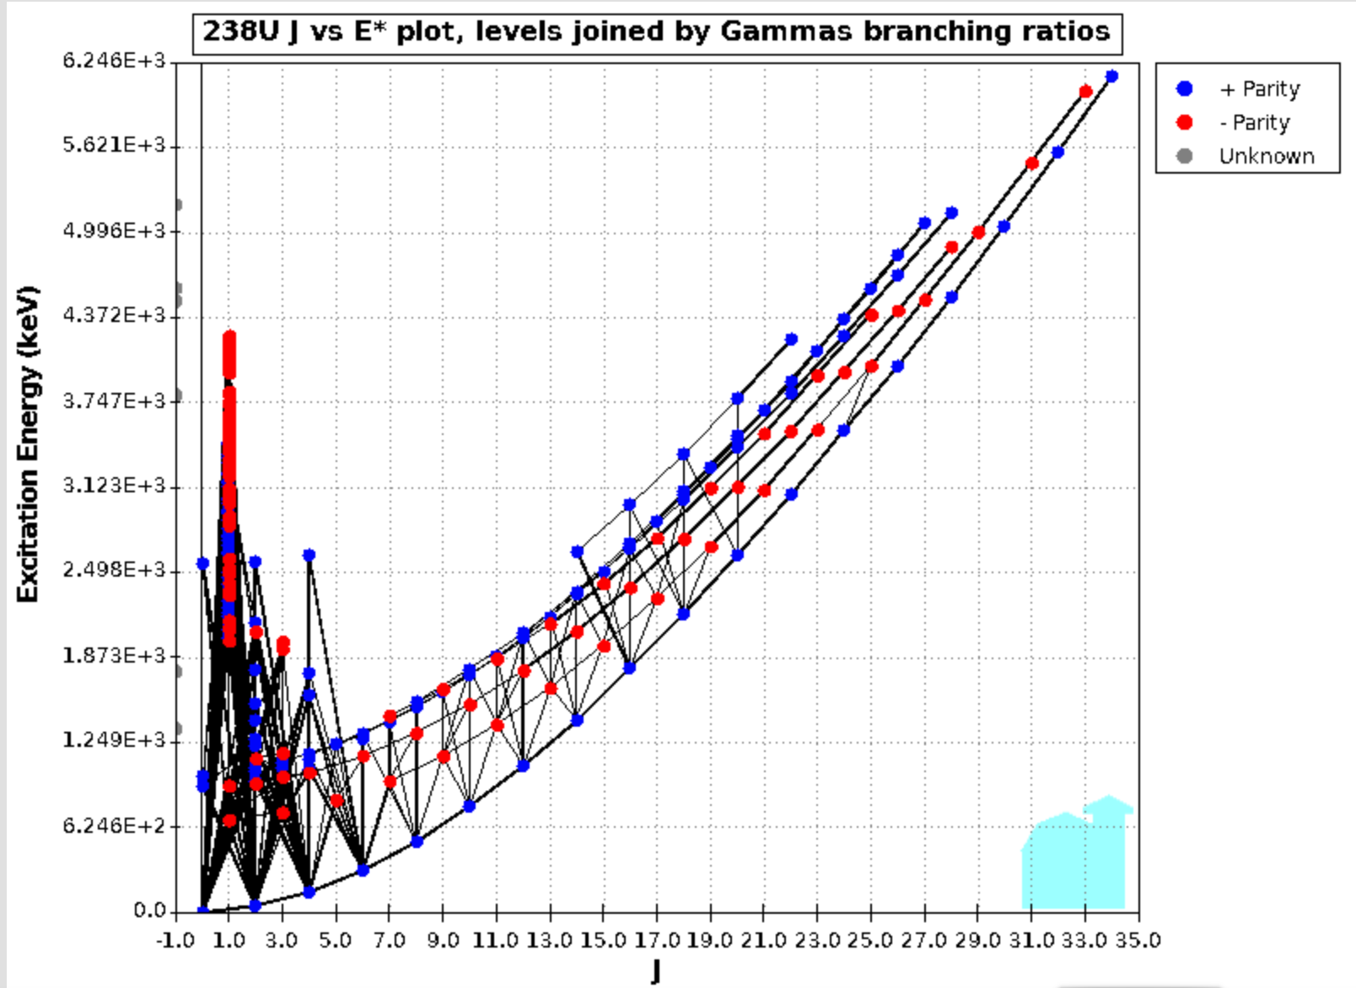
The tools being developed for the γ-X-ray database will help us turn the Baghdad Atlas into a validation database for (n,n’γ)
ENSDF Branching
Ratio Data
ENDF MT 50-91 (n,n’-L*) Data
We can use the γ-X database project γ−γ coincidence scripts to convert the (n,n’-L*) calculated using a model (e.g., EMPIRE, Talys, CoH etc.) to a given (n,n’γ) observed in the Atlas
Improved (n,n’γ) is now an emerging top priority for DNN and others
Notes:
13

