Slide 1
The Need for Gamma Spectroscopy Remeasurements of ²²⁶Ra Decay
S. Zhu and E. A. McCutchan
National Nuclear Data Center
US National Nuclear Data Week 2019
November 4–8, 2019;
Brookhaven National Laboratory
Upton, New York

Slide 2
²²⁶Ra Decay Chain
²²⁶Ra: Discovered in 1898 by Curies

Slide 3
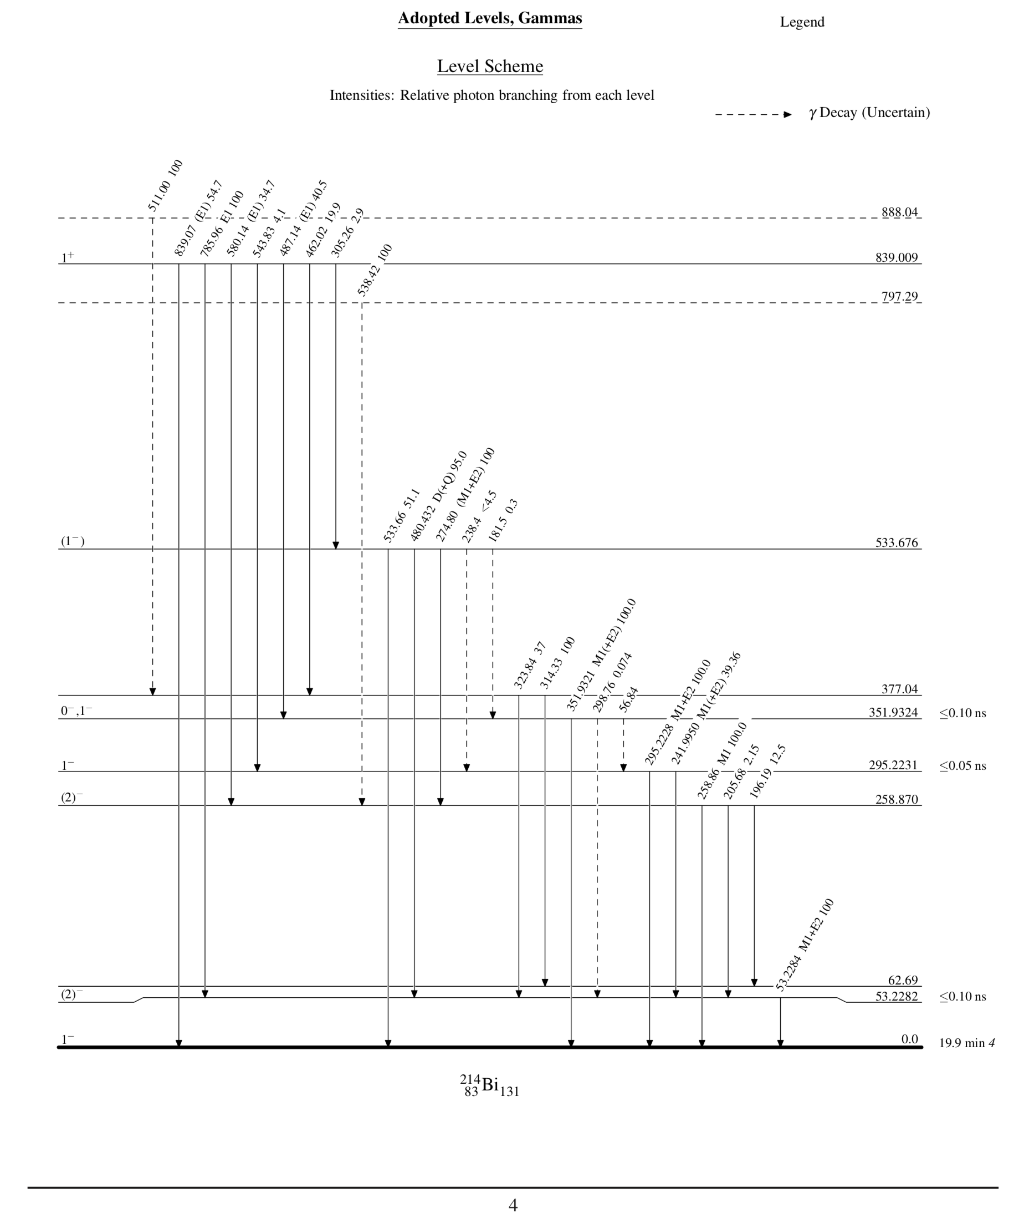
Current Status of ²¹⁴Bi Level Structure
Assignment of J^{π}: 3 out of 10 levels
Latest coincidence measurements:
γγ: Two HPGe, 1991
Latest measurements for J^{π}:
γγ(θ): Four HPGe, 1991
Ice: Si, 1991;
magnetic: 1957

Slide 4
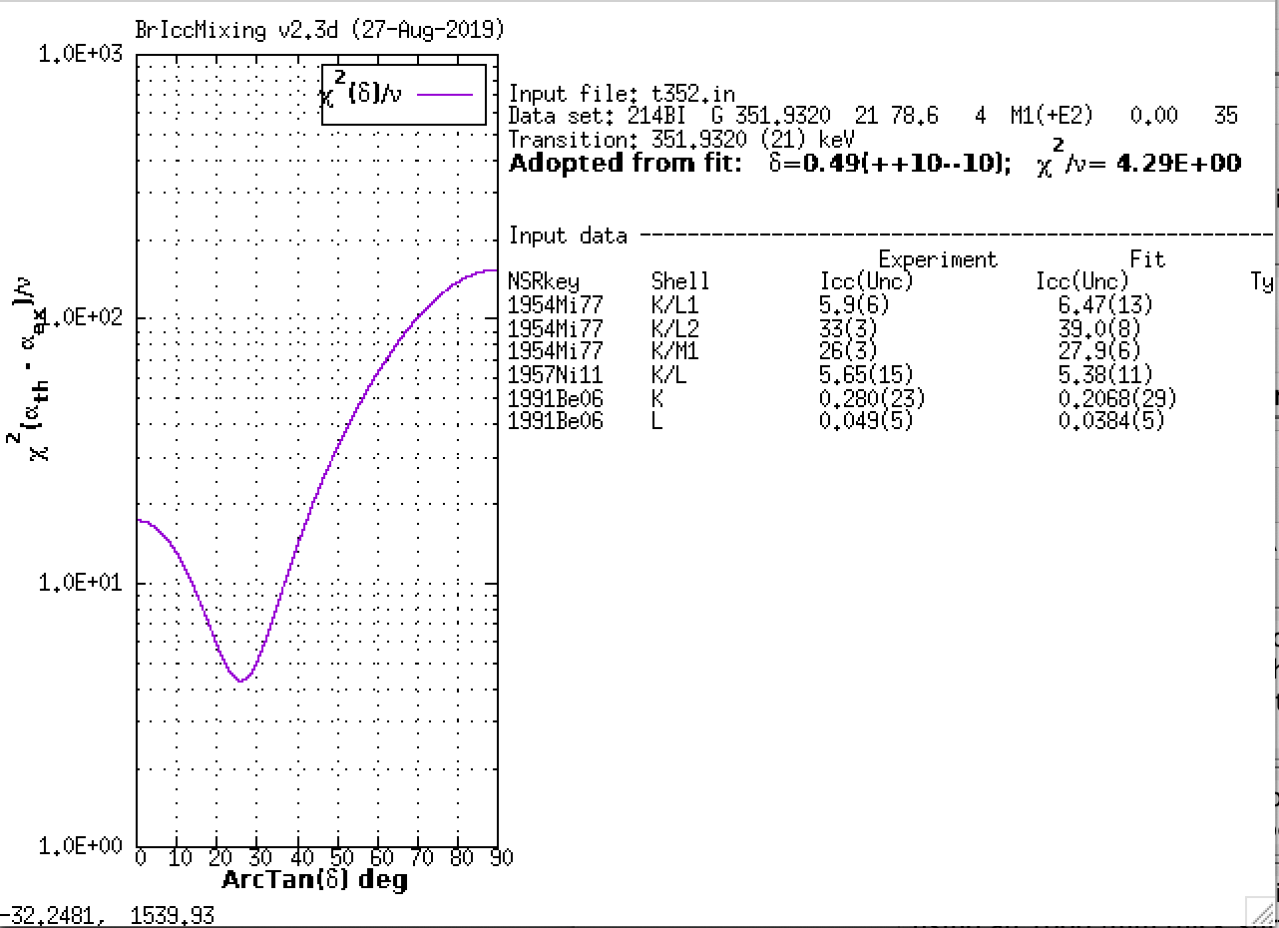
Mixing Ratio Calculations

Slide 5
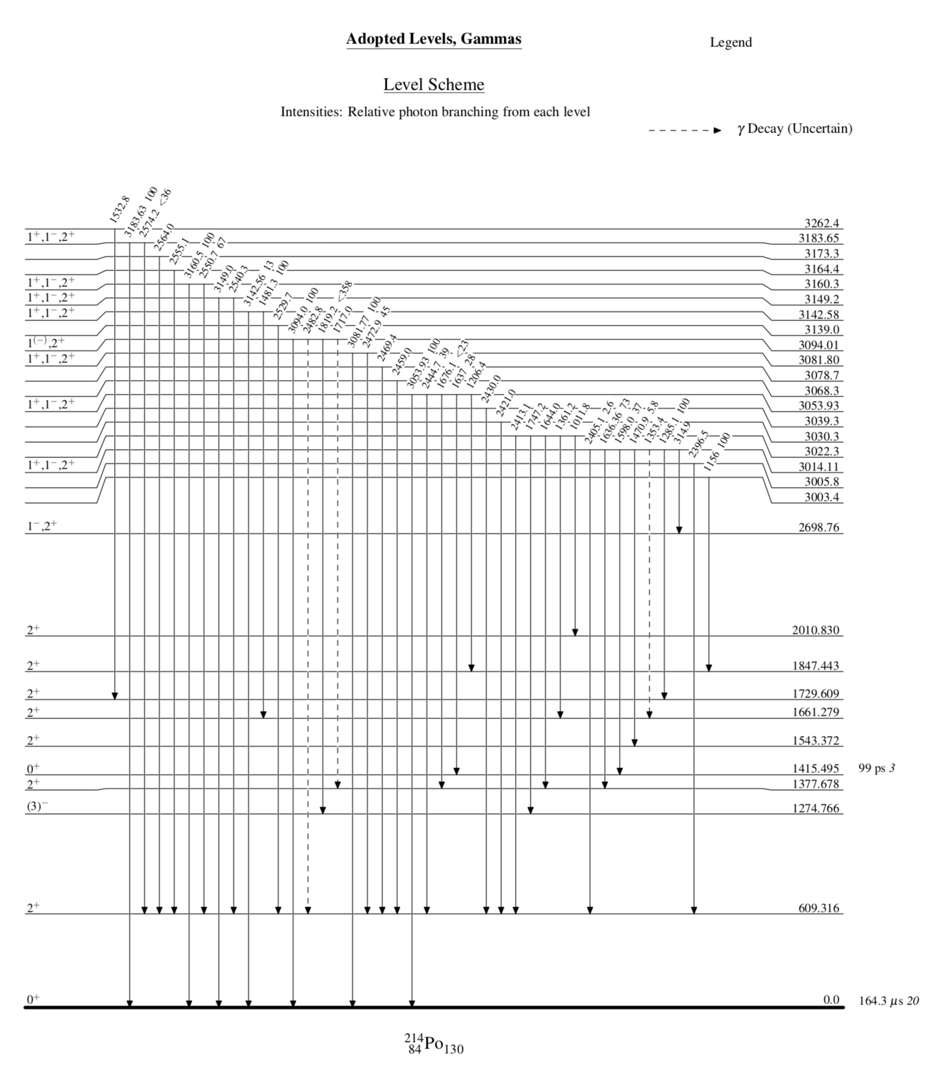
Current Status of ²¹⁴Po Level Structure
Assignment of J^{π}: 17 out of 81 levels
Latest coincidence measurements:
γγ: Two HPGe, 1990
Latest measurements for J^{π}:
γγ(θ): Two HPGe, 1989
Ice: magnetic: 1960

Slide 6
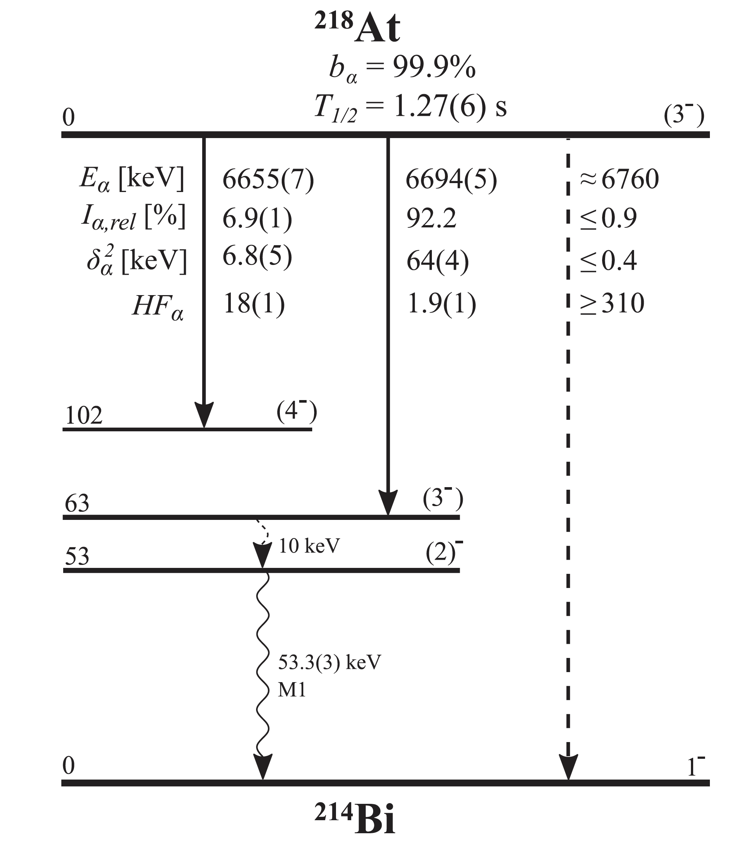
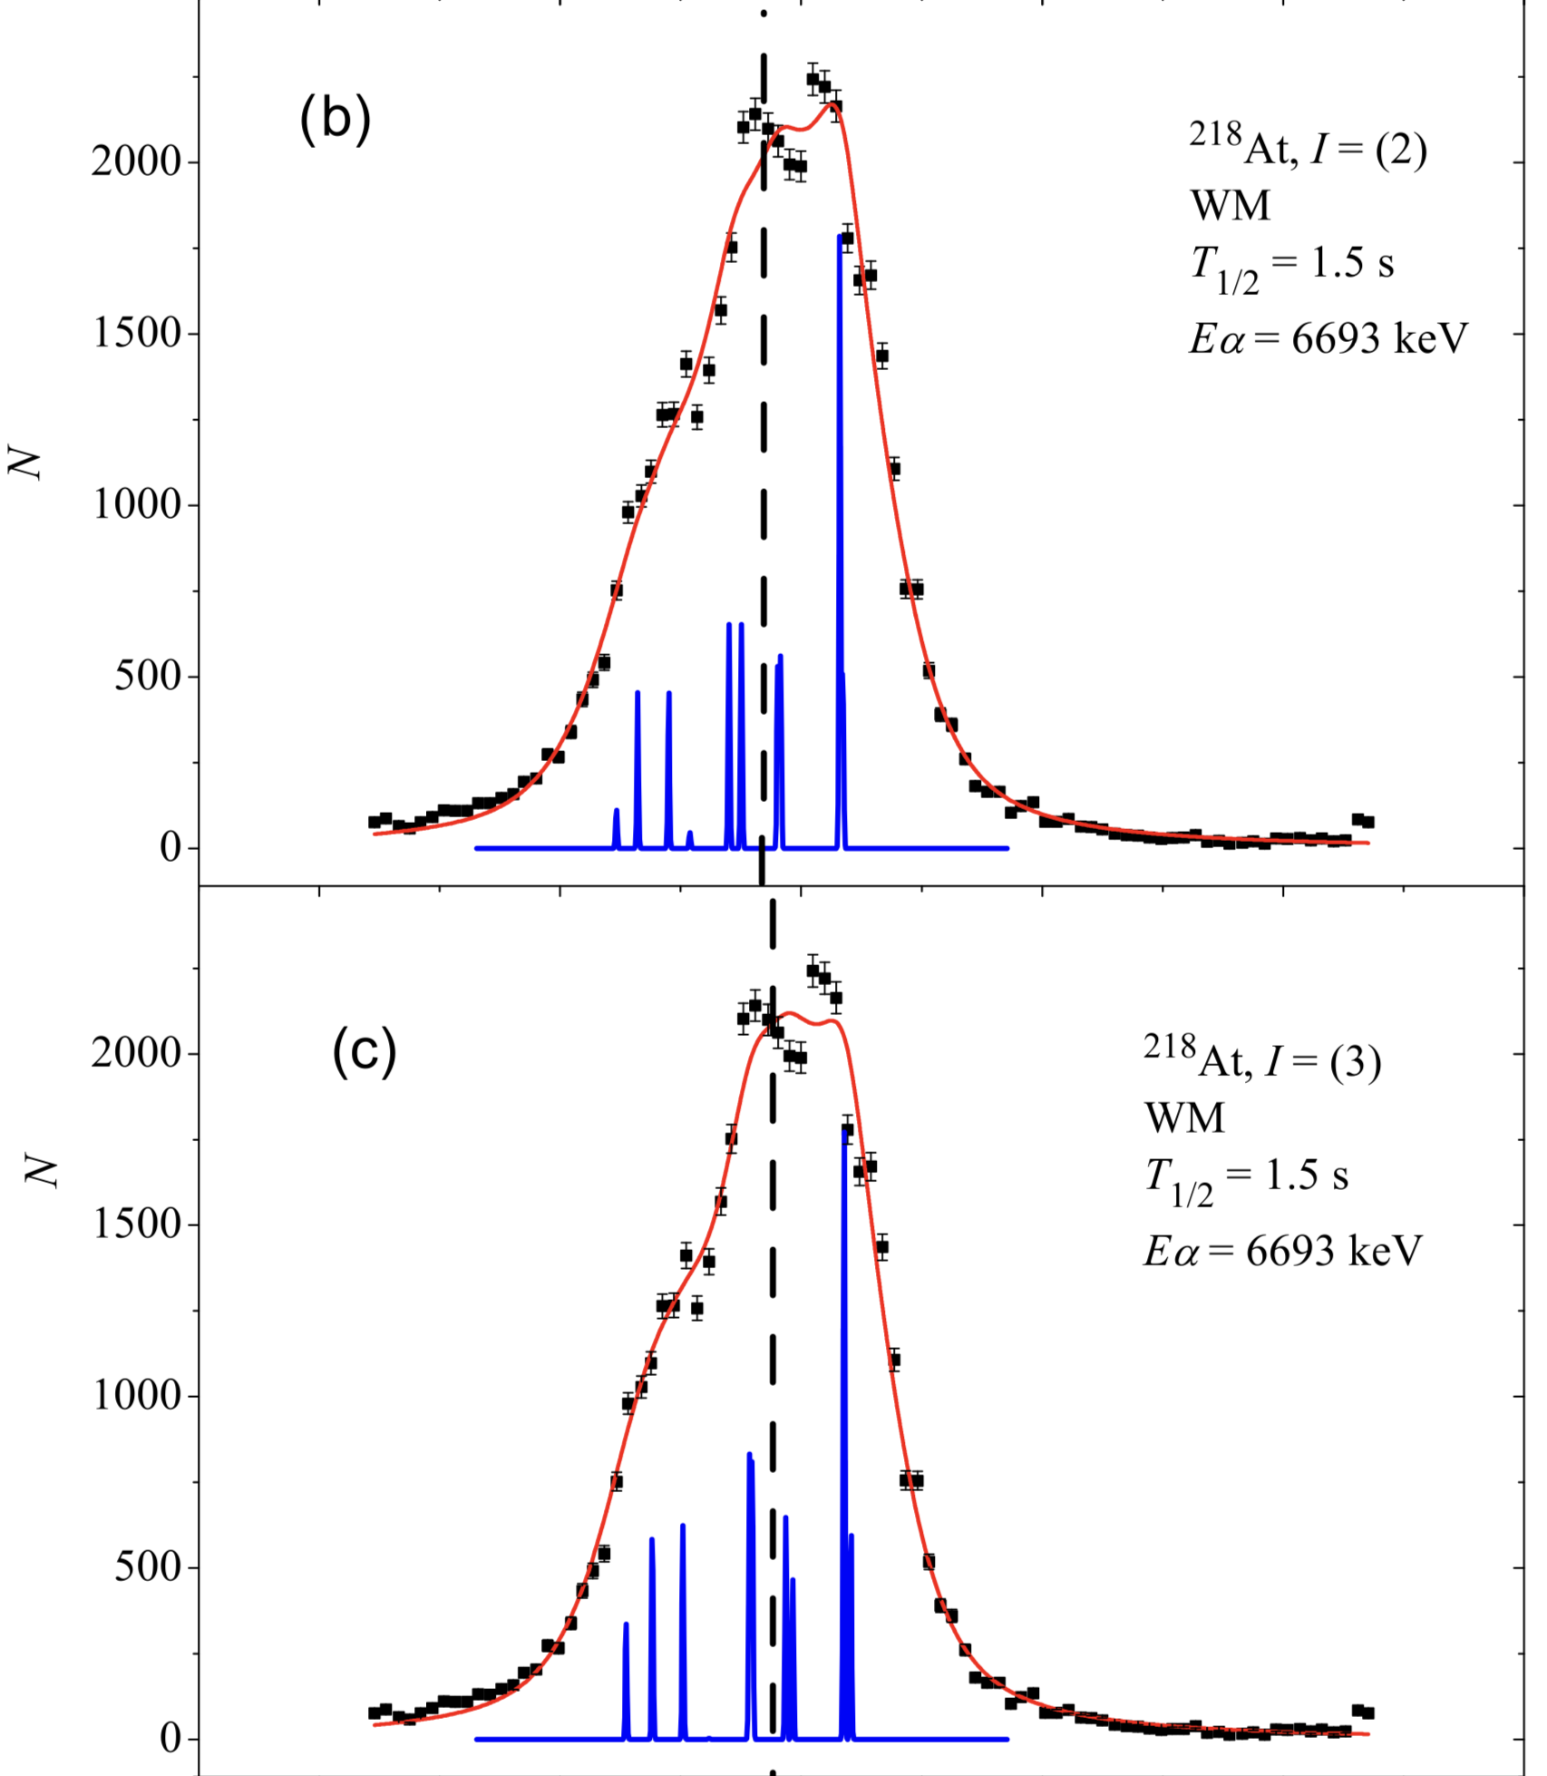
Ground State J^{π} of ²¹⁸At
From NUBASE2017 J^{π}=1⁻

Slide 7
Nuclear Structure of Neutron-rich Nuclei above ²⁰⁸Pb
Realistic Effective Interactions
νg_{9/2}, νi_{11/2}, πh_{9/2}, πf_{7/2}
The structures of ²¹⁴Bi and ²¹⁴Po are relevant in developing the effective interactions in this region.
The firm assignment of J^{π} in ²¹⁴Bi and ²¹⁴Po will provide solid ground for systematic extension to more exotic nuclei.

Slide 8
GRETINA Detector Array
The GRETINA array 12x4 detectors;
Tracks γ-ray interaction points ;
γ rays first-hit position resolution: 2mm;
Efficiency: about 10% tracked (at 1132 keV);
Peak-to-total: 0.52 (tracked);
Energy resolution:
2.6 keV @ 1332 keV central contacts
2.5 keV @ 1332 keV segments

Slide 9
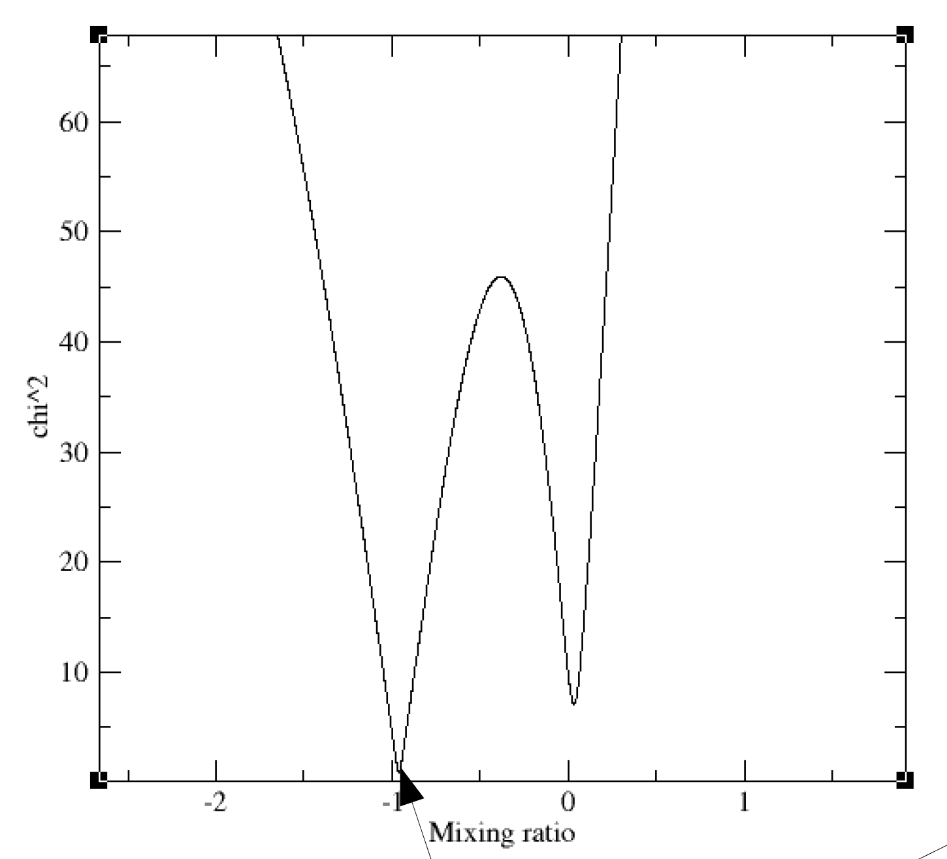
Angular Correlation Measurements with GRETINA
13/2⁺
1064
M4+E5
5/2⁻
570
E2
1/2⁻
²⁰⁷Pb
a₂=0.202(2); a₄=-0.025(2)
δ=−0.960
Courtesy of: Torben Lauritsen (ANL)
δ=0.02 (ENSDF)

Slide 10
γ−ray linear polarization measurements in GRETINA
γ₂:polarized with respect to γ₁
$$\overset{⃑}{n}2\text{:}\text{Scatering} \text{direction} \text{in} \text{HPGe}$$
$$\overset{⃑}{n}2$$
Coordinate System
$$\overset{⃑}{n}1$$
$$\overset{⃑}{n}1$$
$\overset{⃑}{Z}$=$\overset{⃑}{n}1$
source
θ
$\overset{⃑}{Y}$=$\overset{⃑}{n}0×\overset{⃑}{n}$₁
γ₂
$\overset{⃑}{X}$=$\overset{⃑}{Y}×\overset{⃑}{Z}$
$$\overset{⃑}{n}0$$
$Azimuth angle(\overset{⃑}{n}0×\overset{⃑}{n}$₁)in X,Y,Z system
γ₁
γ${ =tan}^{−1}{(Y/X)}$
-180$°<$ γ $<$180$°$
$w\left(θ,γ\right)=w\left(θ\right)+Pcos\left(2γ\right)$w’($θ)$
w$\left(θ\right) =a0+a2P2\left(cosθ\right)+a4P4⁡(cosθ)$
w’$\left(θ\right) =A2\left(L1L1^{′}IiI\right)ℜ2\left(L2L2^{′}IfI\right)P22\left(\cos{θ}\right)+(A4\left(L1L1^{′}IiI\right)ℜ4\left(L2L2^{′}IfI\right)P42\left(cosθ\right)$
P (E): Positive; P (M): Negative
Courtesy of: Torben Lauritsen (ANL)

Slide 11
Polarization Measurements of ²⁰⁷Bi Source
13/2⁺
1064
M4+E5
5/2⁻
570
E2
1/2⁻
P = +0.266
²⁰⁷Pb
P = -0.372
γ₁: 1064 keV; γ₂: 570 keV (E2)
γ₁: 570 keV; γ₂: 1064 keV (M4)
Courtesy of: Torben Lauritsen (ANL)

Slide 12
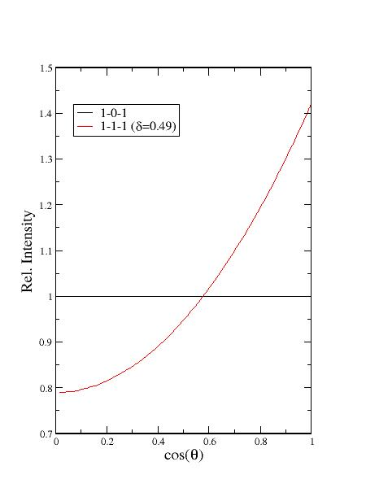
Angular Correlation Measurements for ²¹⁴Bi
Angular correlation:
γ487 - γ352

Slide 13
Summary
The properties of decay gamma rays in ²²⁶Ra need to be remeasured;
GRETINA is a powerful device in establishing the level scheme of ²¹⁴Bi and ²¹⁴Po;
Measurements using GRETINA in collaboration with Dr. Dirk Weisshaar at the NSCL, MSU will be carried out in winter break.

