Slide 1
Status Report of MSU data center for FY19
Jun Chen
2019 USNDP meeting
November 2019, BNL

Slide 2
MSU nuclear data center
Independently funded by DOE in FY19
budget cycle (1 year): 12/15/2018 to 12/14/2019
awarded in 01/2019
FY20 renewal underway
recommendation received from DOE on 10/25/2019
expected to be awarded in 12/2019
Data personnel: 1.0 FTE (since 12/2014)
Primary responsibilities:
ENSDF evaluation (A=31-44)
XUNDL compilation
Code development

Slide 3
ENSDF evaluation at MSU
Current Responsibility: A=31-44
currently all are up-to-date (10-year update cycle)
the oldest one was updated in 2011
Completed in FY19:
* in collaboration with Balraj
Plan for FY20
A=194 (14 nuclides) and A=64 (13 nuclides), in collaboration with Balraj
A=xxx (to be determined)
A | #of nuclides | #of datasets | #of lines | #of Adopted Levels | #of Adopted Gammas
A=123 | 15 | 85 | 20,599 | 1255 | 1762
A=190* | 13 | 71 | 16,918 | 829 | 1332
A=149* | 17 | 101 | 26,175 | 1462 | 2393

Slide 4
XUNDL compilation at MSU
Commitment: one paper/week
Completed in FY19:
152 data sets from 54 papers
including 7 PRC-XUNDL data review
Goal for FY20:
~80 data sets from ~50 papers
Student involvements
trained top MSU undergraduates (recruited by Prof. H. Iwasaki) for XUNDL compilation:
2018: Amani Ahnuar
current: Pranjal Dangwal, Dave Lempke (both from Honors College in MSU)

Slide 5
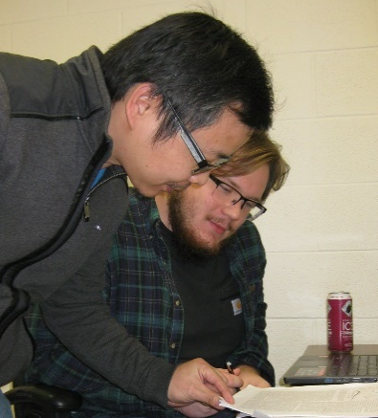
XUNDL compilation at MSU
Commitment: one paper/week
Completed in FY19:
152 data sets from 54 papers
including 7 PRC-XUNDL data review
Goal for FY20:
~80 data sets from ~50 papers
Student involvements
trained top MSU undergraduates (recruited by Prof. H. Iwasaki) for XUNDL compilation:
2018: Amani Ahnuar
current: Pranjal Dangwal, Dave Lempke (both from Honors College in MSU)
Amani
Dave
Pranjal

Slide 6
Code developments at MSU
ConsistencyCheck
Check data consistency among datasets, e.g., JPI, MULT, XREF, T1/2, etc.
Group levels and gammas to assist in preparing Adopted dataset
Average EG, RI, T1/2 and generate averaging comments in ENSDF
Other functions: setting up evaluation folders, sorting, merging/splitting datasets, etc.
Java-RULER
written in Java with all functions as in the old Fortran version
Solve issues with error propagations of large and asymmetric uncertainties
KeynumberCheck
Check all NSR keynumbers in datasets for format errors, irrelevant or nonexistent keynumbers (mostly due to mistyping)
Excel2ENSDF
A Java version of the Python codes xls2ens and ens2xls combined, with easier usage
Convert a tabulated Excel table to an ENSDF file, and vice versa
Also useful for multiplying a factor or adding a constant (or both) to all values of a record in an ENSDF file, e.g., adding S(n) to E(n)

Slide 7
List of Java codes developed/maintained at MSU
Name | Functions | Note | Last Update
ConsistencyCheck | check data consistency among ENSDF datasets, group levels and gammas, and average values from different datasets (with user selections), and more | considered as replacement of PANDORA with more functions; useful for preparing Adopted dataset | October 22, 2019
Excel2ENSDF | convert BETWEEN an Excel file (formatted data) and an ENSDF file; perform simple operations on column data in Excel, such as multiplying a factor or adding a constant (or both) to all values of a record, e.g., adding S(n) to E(n) | extensively used in XUNDL compilation and useful for extracting tabulated data from ENSDF | October 11, 2019
Java-RULER | calculate gamma-ray transition strengths in ENSDF file with proper error propagations of large/asymmetric uncertainties | solved a long-standing uncertainty calculating issue in the old FORTRAN code | June 6, 2019
KeynumberCheck | check all NSR key-numbers in ENSDF datasets for format errors, irrelevant or nonexistent key-numbers (mostly due to mistyping) by searching in an input list of key-numbers or in the NSR database directly. | useful to catch incorrect, irrelevant or non-existent key-numbers for the final check of an ENSDF evaluation | September 13, 2019
Java-NDS | generate LaTeX and PDF outputs from ENSDF file(s) for Nuclear Data Sheets and web-display of ENSDF and XUNDL databases on NNDC retrieval webpages | started at McMaster by Balraj and his students | November 7, 2019

Slide 8
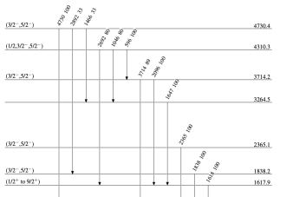
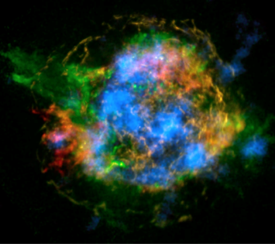
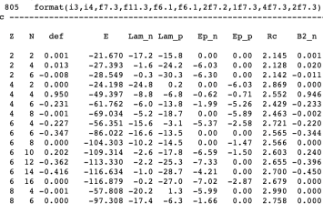
Proposed Expanded FRIB Nuclear Data Effort Addresses Data Needs in the FRIB Era
Addresses the diverse nuclear data needs in the FRIB area
Takes full advantage of synergies between data efforts in nuclear structure, reactions, astrophysics, and theory
Maximizes scientific impact and enables discoveries
Aligned with conclusions from 2016 Data Workshop at Low Energy Community Meeting
Complements existing efforts, integrated with NNDC
Takes advantage of leverage opportunities at MSU
0.5 FTE Nuclear Structure Evaluation
Another nuclear structure data evaluator at MSU to ensure the proper and timely compilation (XUNDL) and subsequent evaluation (ENSDF) of FRIB data
0.5 FTE Nuclear Astrophysics Evaluation
Makes nuclear data usable in astrophysics
Focus on reaction rate data evaluation
Connects structure data, reaction data, theory data and theory tools
Leverage opportunity with NSF Networks JINA-CEE and IReNA (community connection, field wide standards, ensure impact)
0.5 FTE Nuclear Theory
Provide a theoretical counterpart to ENDSF, fully integrated with NNDC
Theory data evaluation, curation, and dissemination
Structure
Astrophysics
Theory

Slide 9
ENSDF ConsistencyCheck code
Jun Chen
2019 USNDP meeting
November 2019, BNL

Slide 10
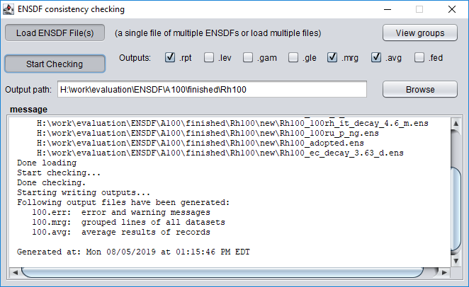
ConsistencyCheck: user interface
check data consistency among ENSDF datasets, group levels and gammas, and average values from different datasets (& additional functions)

Slide 11
ConsistencyCheck: usage and outputs
The usage is simple:
load an ENSDF file containing all datasets to be checked
or
load multiple single-dataset files at one time
(drag and release files into the message window to load files)
select files, drag & drop
(no changes made to input files)
Output files: (e.g., for A=73)
73.err: error reports
73.mrg: grouped lines of all datasets
73.avg: average results of records(T_{1/2},E_{ϒ},I_{ϒ})
73.adp: adopted dataset based on auto-grouping
73.fed: list of feeding gammas to each level
73.wrn: warning reports
73.lev: tabulated level information
73.gam: gammas grouped by gamma energy
73.gle: gammas grouped by level energy

Slide 12
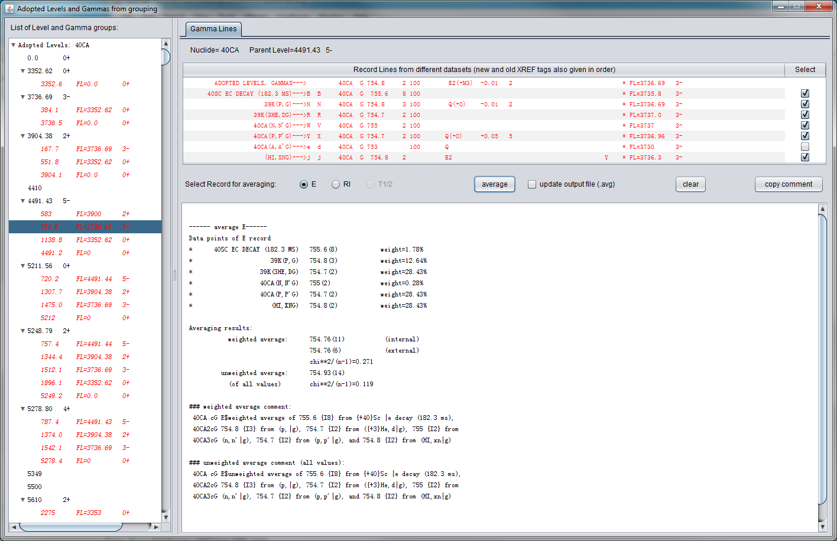
ConsistencyCheck: customized averaging
select datasets for averaging
select gamma
results
automatically generated averaging comment for copy and paste into dataset

Slide 13
ConsistencyCheck output:
averaging report (.avg)
can select entries to average in GUI
.avg
output file
averaging results
weighted comments (for selected entries)
weighted
comments
(for all entries)
for copy and paste
unweighted comments

Slide 14
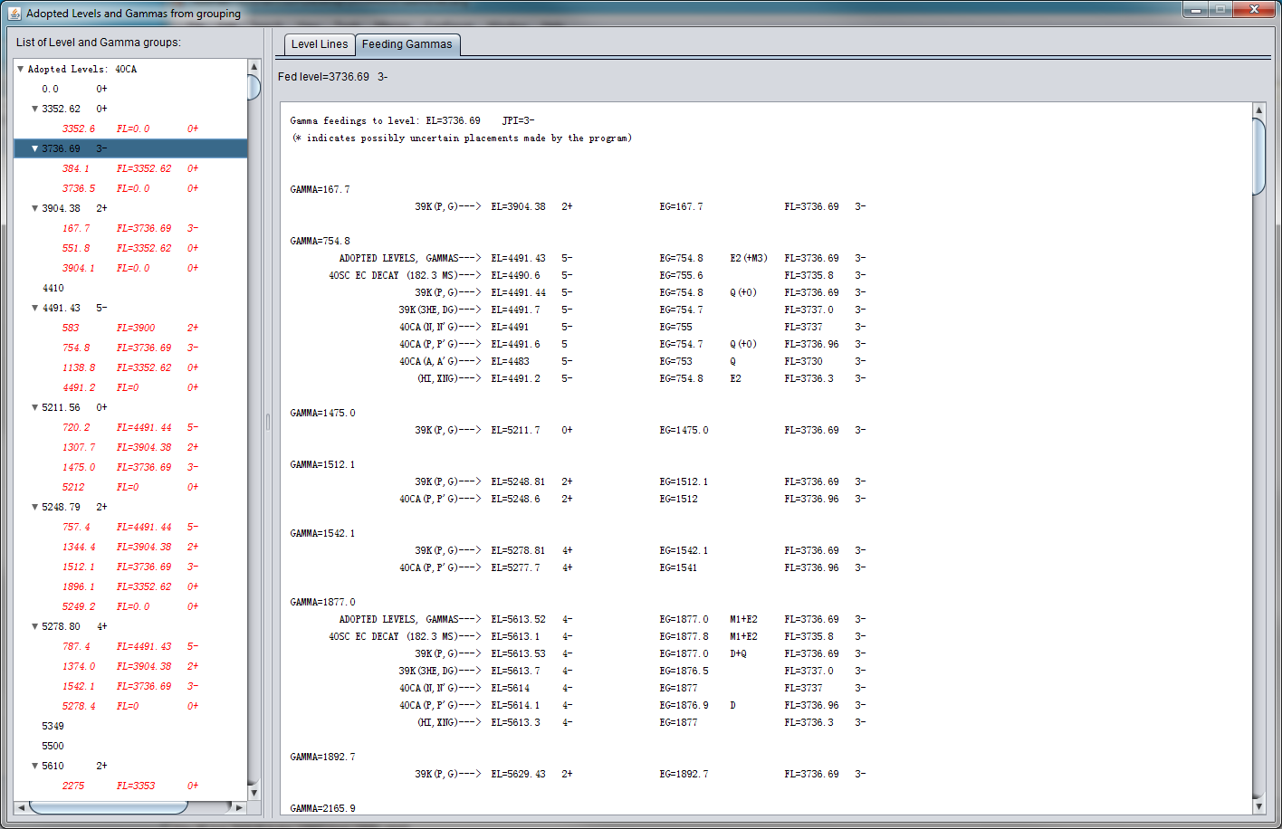
ConsistenchCheck: list of feeding Gammas
Dataset
DSID
Initial level
Feeding Gammas
select level
also in
.fed
output file

Slide 15
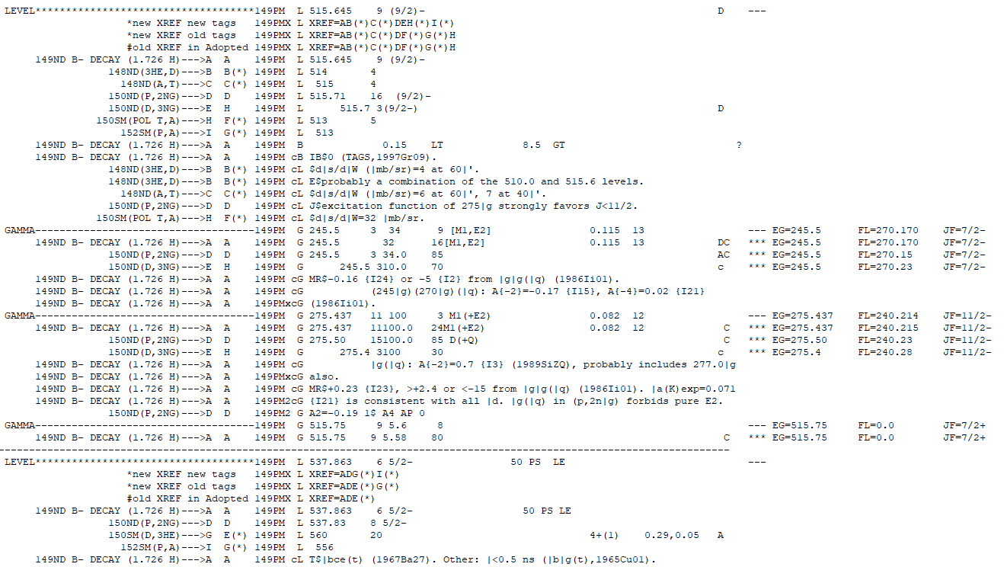
ConsistencyCheck output:
grouped entries (.mrg)
all records and comments of the same property from different datasets at a glance
New XREF after dataset sorting & Original XREF
.mrg
output file
ENSDF record and comment lines of a same gamma from different datasets
DSID & XREF tag
final levels

Slide 16
ConsistencyCheck output:
grouped entries (.mrg)
summary table for statistics of levels and gammas from all datasets
.mrg
output file

Slide 17
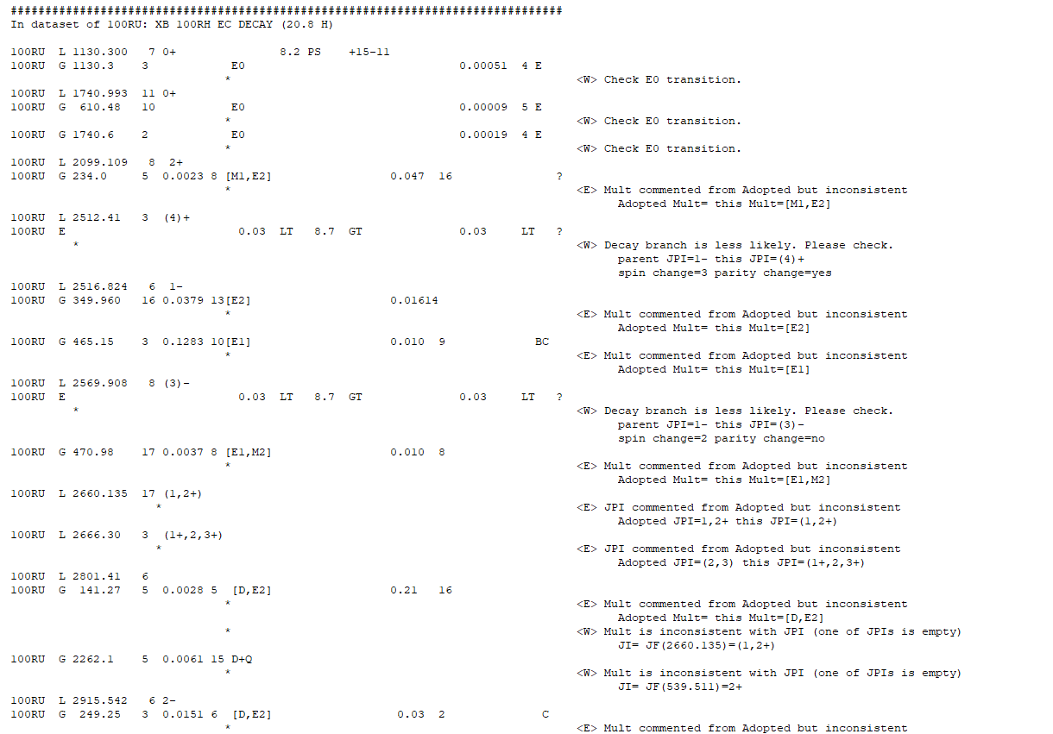
ConsistencyCheck output:
error report (.err)
.err
output file
error and warning messages

Slide 18
ConsistencyCheck: checklist
This program performs the following checks:
(1-7 from suggestions at Duke workshop in August 2019)
1. check consistency for adopted values in comments, as quoted from Adopted dataset
2. check consistency between uncertainties in alpha-decay HF and IA records of g.s.
3. check if flag=1U is missing for log ft~8.5, ∆J=2, ∆π=yes
check if records of mass and moment in Adopted datasets are updated
check if L-transfers in transfer reactions (when target JPI is given for non even-even) is consistent with Adopted JPIs
check consistency for JPI of band-head quoted in band title
check consistency for ∆J of in-band transitions: must be same for BAND otherwise SEQ

Slide 19
ConsistencyCheck: checklist (cont.)
8. check consistency of gamma-ray multipolarity with change of spin and parity between parent and daughter levels
9. check consistency of log ft value with change of spin and parity between parent and daughter levels for beta/EC decay dataset
If 3.6<log ft<5.9, then, Ji-1<=Jf<=Ji+1, no parity change
If 3.6<log ft<6.4, then, transition can’t be 0⁺ ---> 0⁺
If log ft>=8.5 and 1U, then, Jf=Ji+/-2, with parity change
10. check consistency of HF value with change of spin and parity between parent and daughter levels for alpha decay dataset:
If mass=odd and HF<4, then, Jf=Ji, no parity change
If Jf=0 or Ji=0, then, parity change=(-1)^(Jf-Ji), with +1 for no change and -1 for change
11. check consistency of spin-parity values in Adopted Levels with those in individual datasets if there is any comment stating that they are from Adopted Levels
12. check consistency of information in parent record in decay dataset with the Adopted data for the parent nuclide, like, JPI, T1/2, Q-value

Slide 20
ConsistencyCheck: checklist (cont.)
13. check BXLW values in continuation records with RUL values for Adopted Level, Gammas dataset
14. check if any level from individual datasets is missing in Adopted Levels dataset or if its XREF tag is missing in the “XREF=” field of the corresponding Adopted Level
15. check if the “XREF=” field of an Adopted level has any wrong XREF tag.
16. check 0 to 0 transition, parity-change=yes should not happen
17. check if Ig is normalized to strongest=100 (PN=6) in Adopted Gammas, and that should not normalized to gamma flagged by ?, *, &
18. check decay branch with DJ>2 or (DJ==2 and parity change=no), less likely
19. check if any gamma is missing in Adopted Gammas
20. check if T1/2 as quoted from Adopted is consistent
21. check if MULT and MR as quoted from Adopted is consistent
22. check if BXLW is missing in Adopted Gammas when T1/2, Ig, MUL are available
23. check MULT=E0, flagging that CC should be from experimental data
24. check MS flag in column 78-79 for level record with T1/2>=100 ns

Slide 21
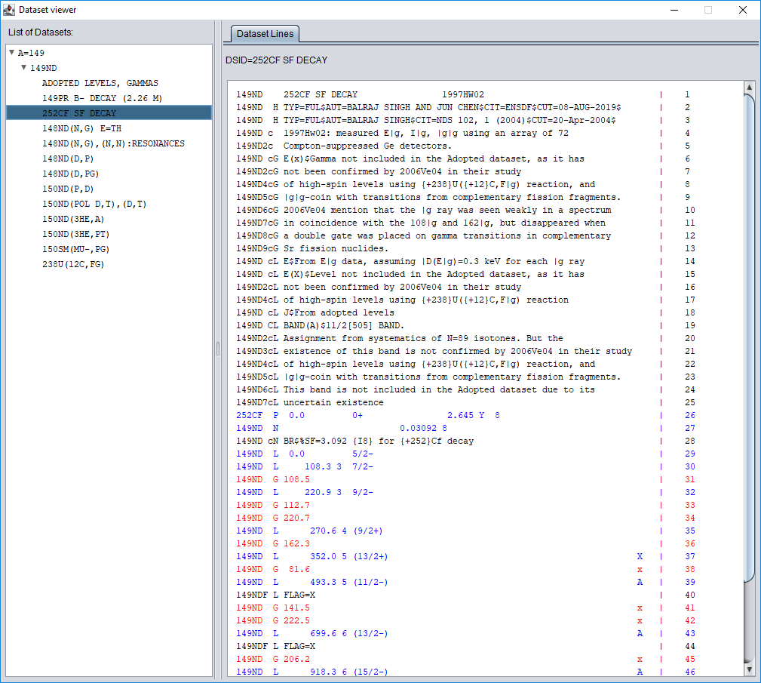
ConsistencyCheck: dataset viewer
quick switch among datasets
line number for quick locating
different color for “L” and “G” lines for easy reading and quick finding
more features to be implemented
(text not editable)

Slide 22
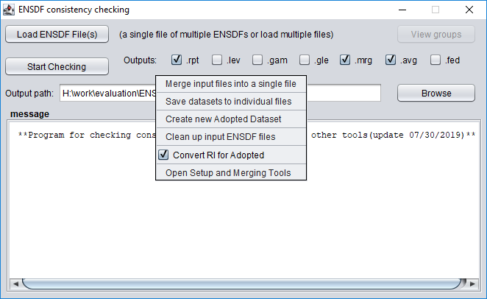
ConsistencyCheck: other functions
Right-click on blank area above for this pop-up menu

Slide 23
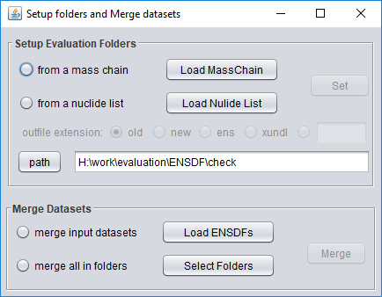
ConsistencyCheck: other functions (cont.)
create a default evaluation folders
automatically sort and merge all files in all “new” folders into a single file
An example structure of evaluation folders created from an input mass-chain file, with each dataset saved to an individual ENSDF file named by DSID

Slide 24
ConsistencyCheck: other functions (cont.)
Sort and Merge all input ENSDF files into a single file

Slide 25
ConsistencyCheck: other functions (cont.)
Save each dataset in input ENSDF files to an individual file by the name of its DSID

Slide 26
ConsistencyCheck: other functions (cont.)
Create a simple Adopted dataset based on automatic grouping of all available datasets, with
a new XREF summary table
average values for E(level), T1/2, E(gamma), I(gamma) fields, where available
automatically generated averaging comments
automatically selected best value for other fields

Slide 27
ConsistencyCheck: other functions (cont.)
Clean up input ENSDF files:
fixing line-length=80
converting upper-case "C" comments to lower-case "c" comments.
outputs are written into new files labelled by "CLEANED" in file names

Slide 28
ConsistencyCheck: other functions (cont.)
checked by default to convert relative RI in all datasets to PN=6 intensities for Adopted dataset.
uncheck it for averaging original RI values

